Slide 1
CEOS SIT-41
WGCV Land Product Validation (LPV) Subgroup Land Cover and Change Map Accuracy Assessment and Area Estimation Good Practices Protocol
[for endorsement]
Alexandra (Sasha)
Tyukavina,
University of Maryland
Agenda Item #7.3
CEOS SIT-41 2026
Irvine, California, USA
14-16 April 2026

Slide 2
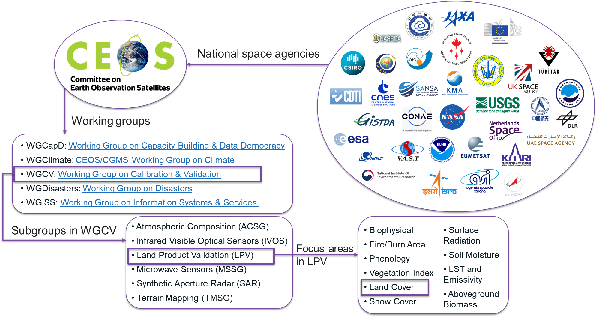

CEOS WGCV LPV Land Cover focus area
Evapotranspiration
GPP/NPP

Slide 3
Land cover map accuracy
“A map that is lacking an accuracy assessment is just a prototype or an untested hypothesis and should not be used as a source of information.”
Executive Summary, Land Cover and Change Map Accuracy Assessment and Area Estimation Good Practices Protocol, Tyukavina et al. (2025)

Slide 4
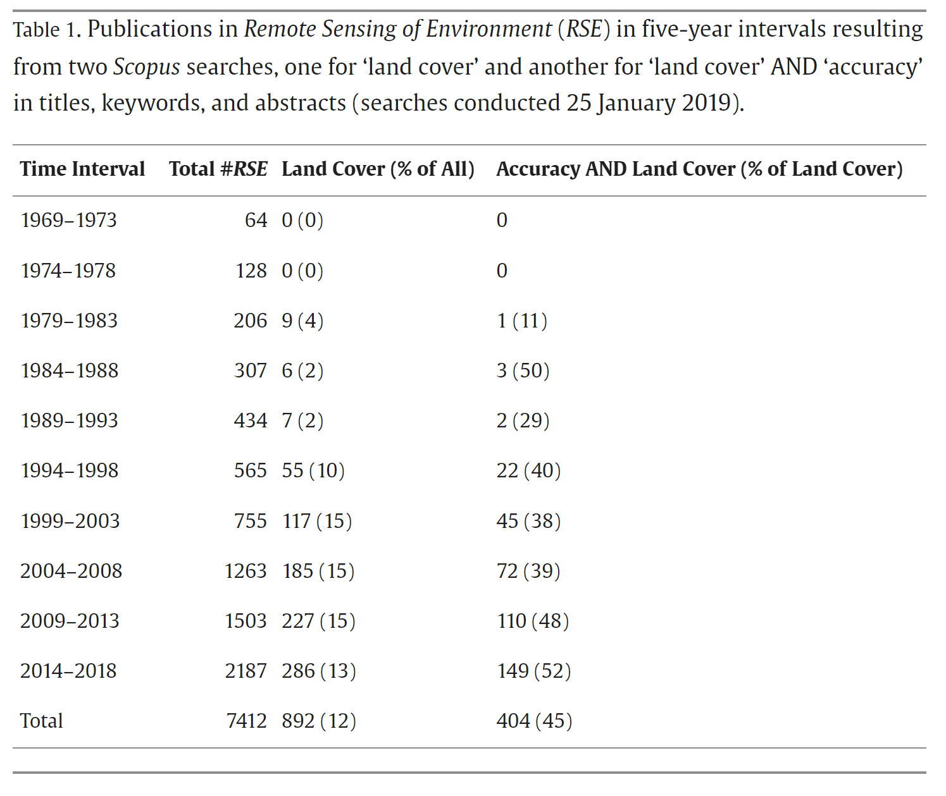
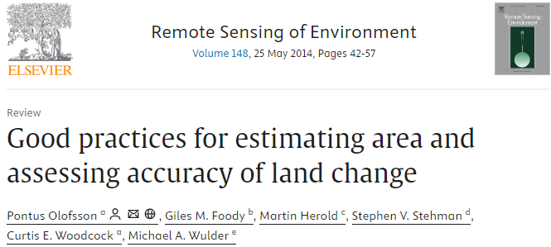
Accuracy assessment in land cover studies
“From 1994 to 2008 approximately 40% of all land cover articles also had ‘accuracy’ as a keyword and this percent increased to about 50% for the past decade, 2009–2018, providing some evidence that accuracy has become more prominently emphasized in land cover studies.” Stehman & Foody, 2019
But,
Accuracy assessment methods are very much an area of ongoing research
and
Even if map accuracy is reported, accuracy assessment is often superficial, methodology not well described, reference data are not shared, etc.
From Stehman, S. V., & Foody, G. M. (2019). Key issues in rigorous accuracy assessment of land cover products. Remote Sensing of Environment, 231, 111199.
Cited >3,500 times!

Slide 5
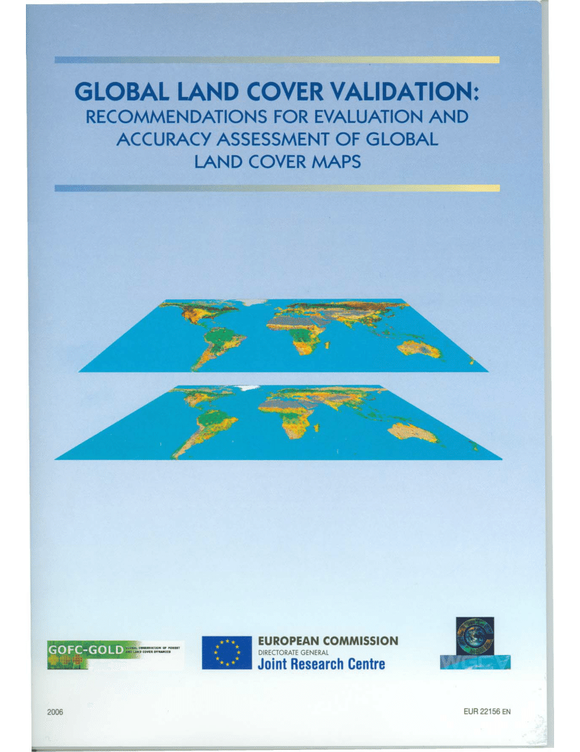
Land cover validation guidelines update
Goal – to update Strahler et al. (2006) guidelines to reflect:
new literature on land cover map validation published in the last ~20 yrs, including sample-based area estimation for reporting;
existing and new sources of reference data (previous guidelines were published in the pre-free Landsat and pre-Sentinel era);
examples of existing global- and continental-scale validation efforts.
+ to emphasize recommendation from Strahler et al. (2006) that map accuracy assessment should be taken seriously, planned ahead, and significant resources (at least 30% of the budget) need to be allocated towards validation (the latter is important to be communicated to research funders!)
+ to clarify frequently misinterpreted aspects of accuracy assessment methodology and encourage correct implementation
Strahler, A., Boschetti, L., Foody, G., Friedl, M., Hansen, M., Herold, M., Mayaux, P., Morisette, J., Stehman, S., Woodcock, C. (2006) Global land cover validation: Recommendations for evaluation and accuracy assessment of global land cover maps. European Communities, Luxembourg 51, no. 4,1-60.

Slide 6
























Working group: expert community effort
35 land cover mapping and validation experts from 18 institutions from 9 countries
Editorial team
Alexandra (Sasha) Tyukavina
U. Maryland, USA
Sophie Bontemps
UC Louvain, Belgium
Nandika Tsendbazar
Wageningen U.,
Netherlands
Stephen Stehman
SUNY ESF, USA
Giles Foody
U. of Nottingham, UK
Anna Komarova
U. Maryland, USA
Jaime Nickeson, NASA GSFC, USA
CEOS LPV Land Cover Focus Area Co-leads,
Land cover mapping experts
Recognized thought leaders in statistical map validation methods, with 30+ years of publications on the topic
Science communication/document readability leads

Slide 7
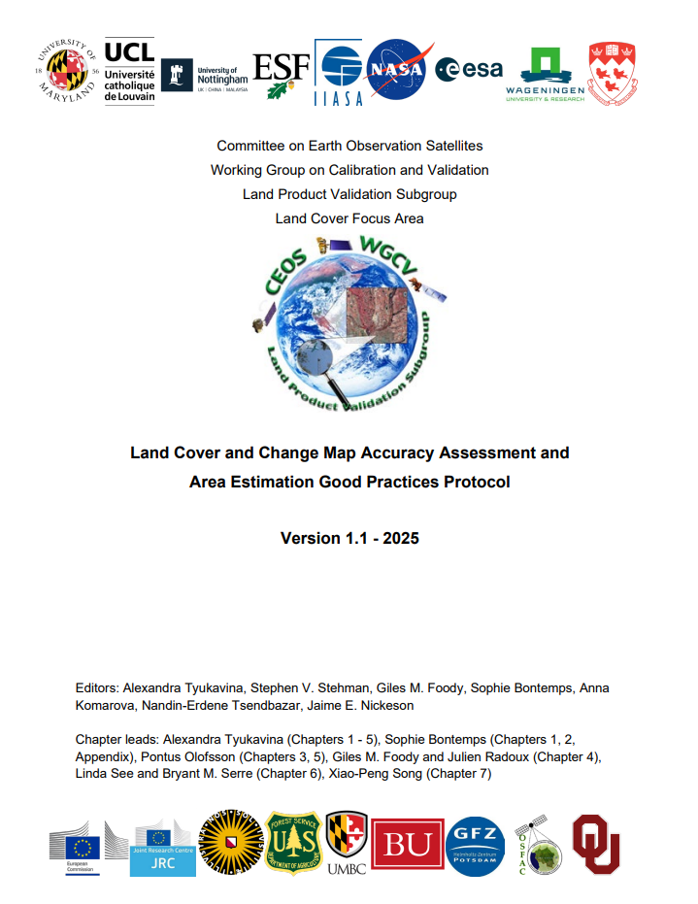
Work timeline: it took 3 years!
October 2022 - initial call for contributions via CEOS LPV LC email listserv;
2023 - Q1-Q3 2024 - collecting contributions, editing the first draft to harmonize terminology, reaching consensus on good practice recommendations;
August 30, 2024 - Version 0.1 sent out for community review via CEOS LPV LC listserv;
End of October, 2024 - received comments from 12 reviewers from 11 organizations from 7 countries;
Overwhelmingly positive and constructive reviewer feedback;
September 15, 2025 - reviewers’ comments addressed, Version 1.0 published on the CEOS LPV website;
November 2025 - Version 1.1 incorporating minor feedback from and endorsed by CEOS WGCV.
https://doi.org/10.5067/doc/ceoswgcv/lpv/lc.001

Slide 8
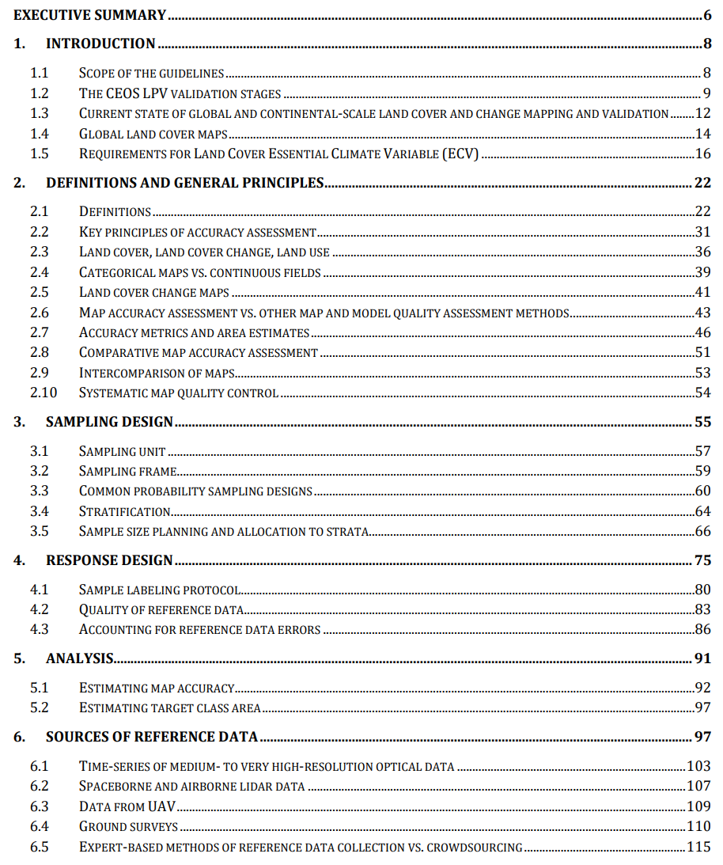
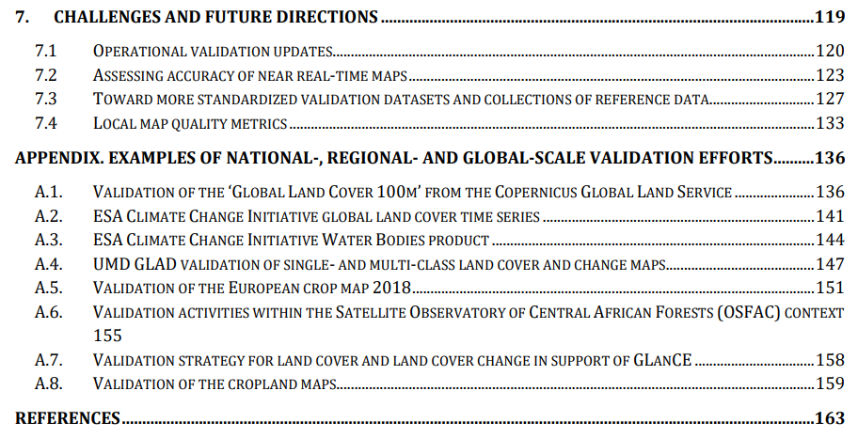
Contents of the updated protocol
New compared to Strahler et al. (2006), forward-
looking
‘Definitions’ - recommended by reviewers
Formulating
Key Principles and defining Map Accuracy Assessment vs. other QA methods
Following the structure of Olofsson et al. (2014) and Stehman & Foody (2019) to present key elements of design-based accuracy assessment
Core accuracy assessment recommendations
New compared to Strahler et al. (2006)

Slide 9
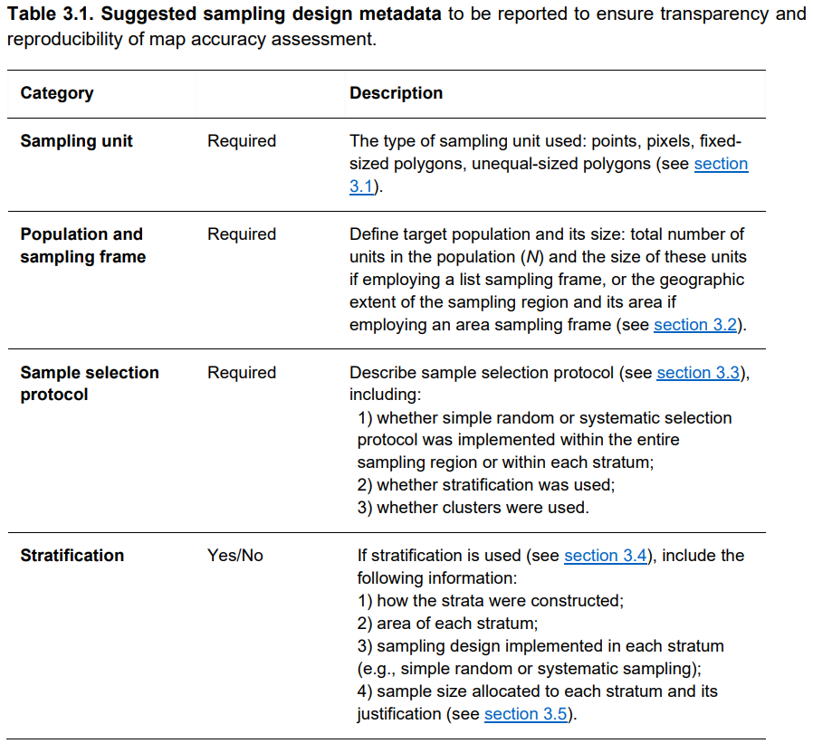
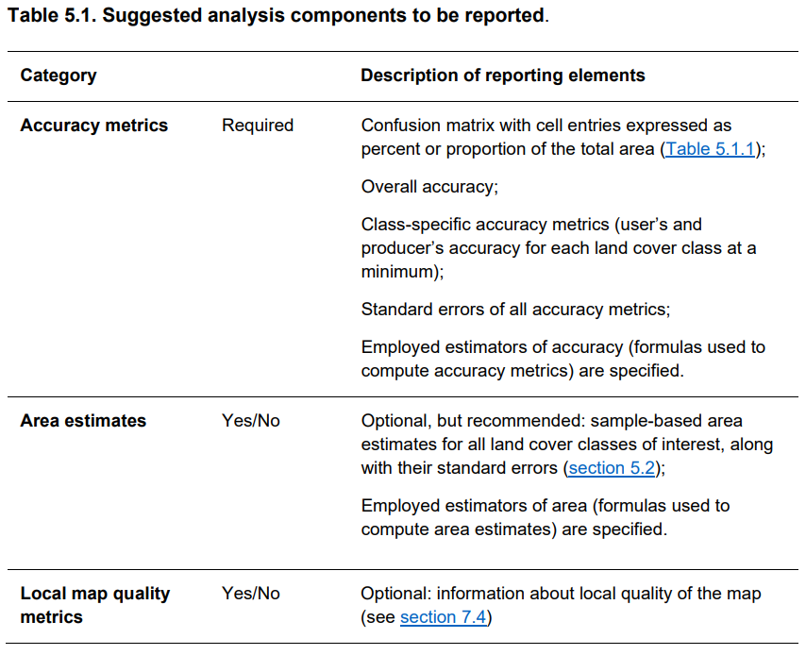
Standardized accuracy reporting
Tables with metadata reporting recommendations by category
(sampling design, response design, analysis)

Slide 10
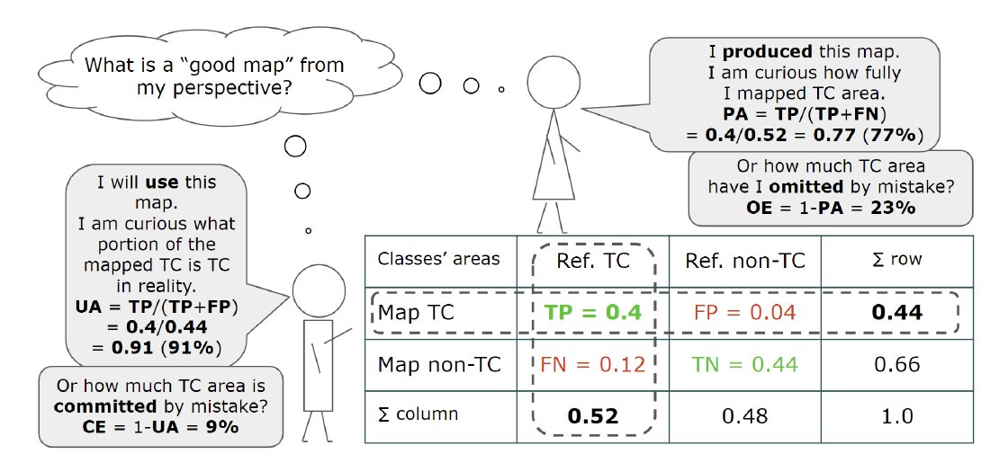
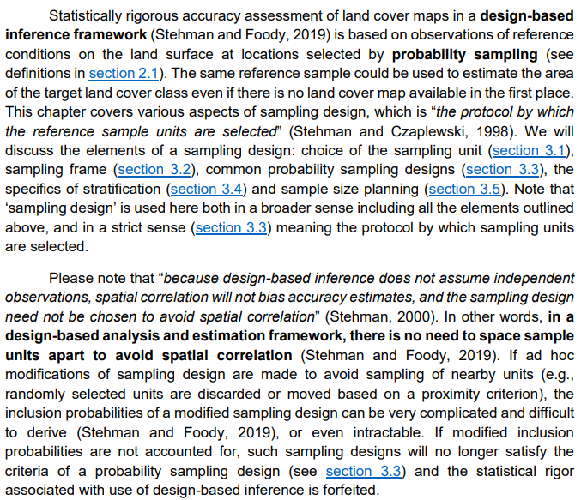
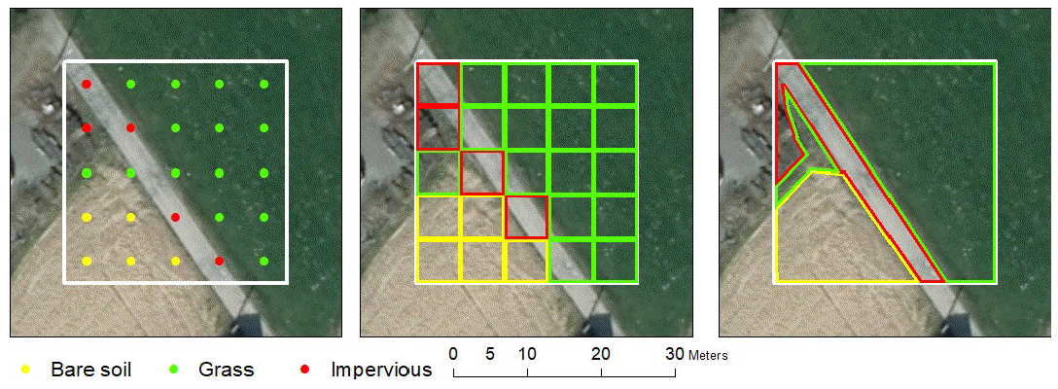
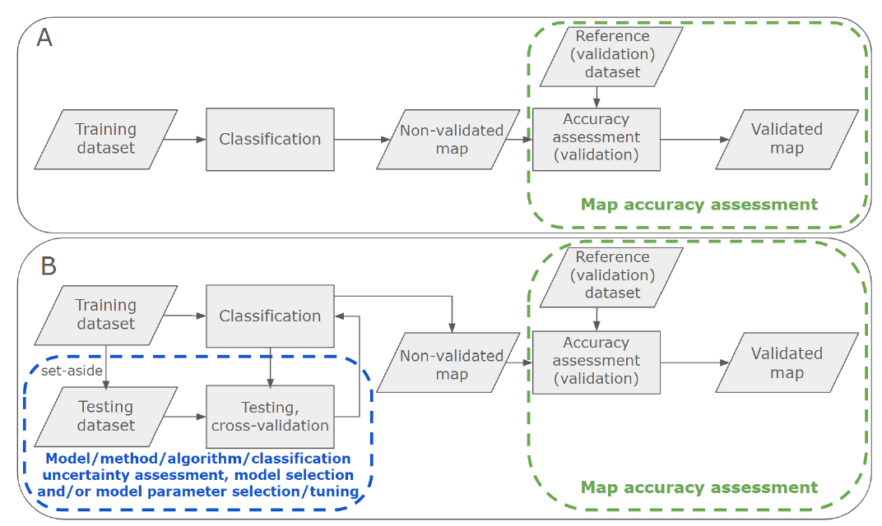
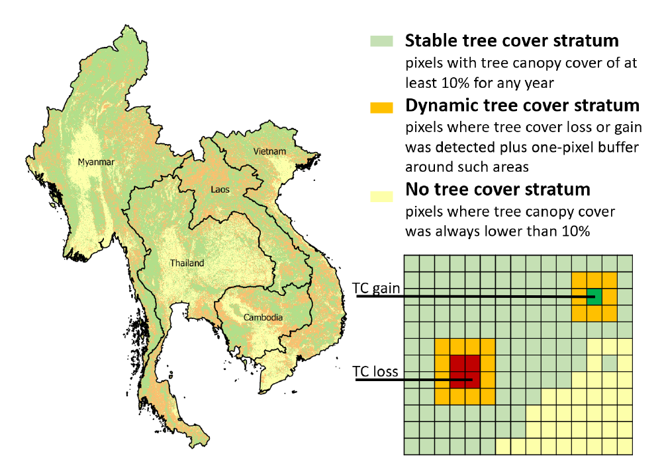
Focus on document readability
Schematic diagrams (visual summaries) of material
Text highlights to emphasize
main messages
Figures with
real-life examples of discussed concepts
Internal document navigation
(to figures, tables and sections mentioned in the text)
via hyperlinks

Slide 11
Call for CEOS SIT endorsement
We respectfully ask SIT to:
endorse Version 1.1 of the Land Cover Validation Protocol without amendments;
encourage adoption of the updated guidelines by the land cover mapping branches of national space agencies as a standard for newly published maps;
publicize the new Land Cover Protocol via official CEOS and member agency channels.
Thank you for your consideration!

