Slide 1
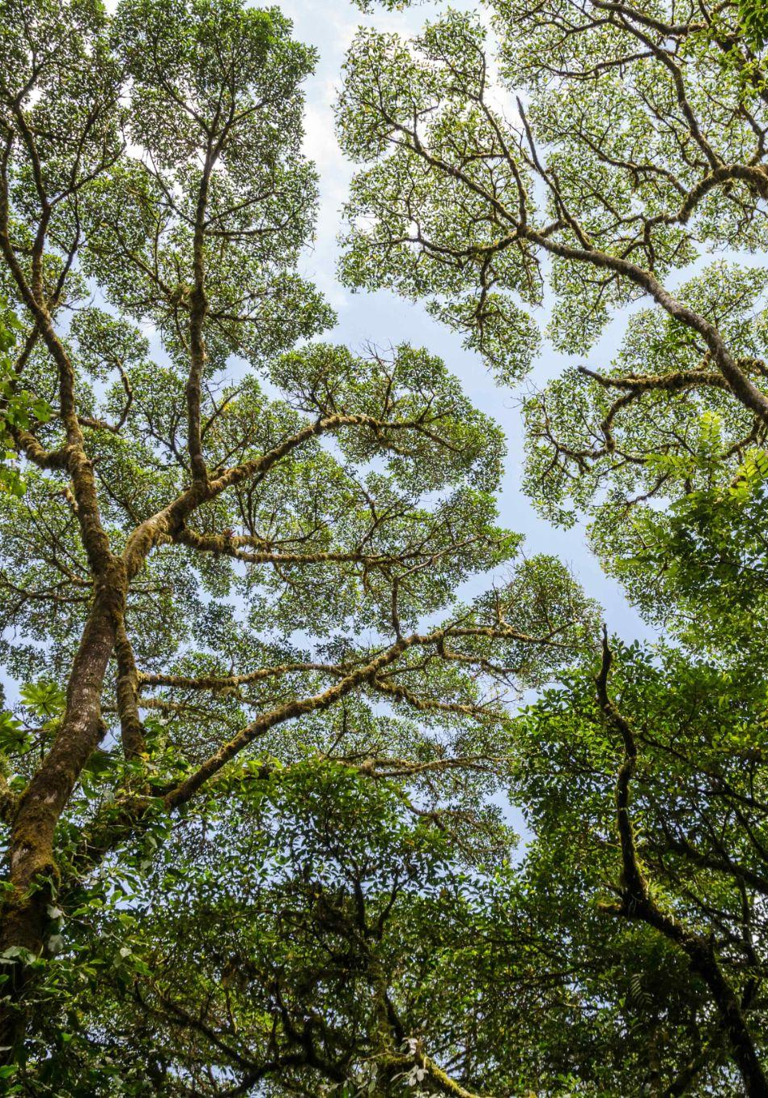
CEOS AFOLU Roadmap
LSI-VC Forests and Biomass Subgroup
Clement Albergel, ESA
Neha Hunka, ESA
Takeo Tadono, JAXA
…And many more!
Agenda Item #7.4
CEOS SIT-41 2026
Irvine, California, USA
14-16 April 2026

Slide 2

Presentation Overview
CEOS AFOLU Roadmap Background
AFOLU Roadmap Recommendations Actions
Stocktaking CEOS Agency Contributions and Activities
Future Plans
Requests of CEOS Principals

Slide 3
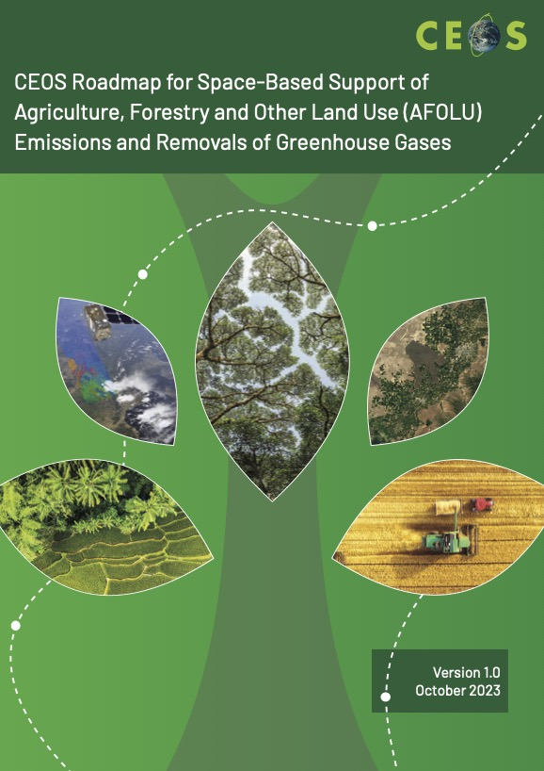
CEOS AFOLU Roadmap
Objective: Provide a framework for long-term (+15 years) coordination of CEOS agency observing programmes in support of the needs of society for Agriculture, Forestry and Other Land Use (AFOLU)-related information
Endorsed by CEOS Plenary in 2023
Subsequently a series of actions were developed and documented here – endorsed at SIT-40 in April 2025
Roadmap is implemented and overseen by the LSI-VC Forests and Biomass Subgroup
Co-Leads:
Takeo Tadono (JAXA)
Neha Hunka (ESA)
Clement Albergel (ESA)
Two key ongoing activities:
Recruiting additional CEOS Agencies to contribute and document contributions to CEOS AFOLU efforts (covered on later slides)

Slide 4
CEOS AFOLU Roadmap
0: Ensure countries have access to satellite data from CEOS Agencies to report to UNFCCC following IPCC guidance
1: Ensure continuity and long-term backward compatibility of CEOS missions providing activity data and emission factors
2: Improve use of Earth observation data and derived products in UNFCCC reporting and IPCC Guidelines
3: Enable dialogue between inventory practitioners and the CEOS community
4: Support efforts to reconcile bottom-up, top-down, and inventory estimates of GHG emissions and removals
5: Systematically target activities to support IPCC Land Cover classes
6: Work with other data providers incl. commercial partners to maximise coverage to support national GHG inventories
7: Ensure consistency of CEOS AFOLU and GHG Roadmaps to support an integrated national GHG inventory system
8: Develop and maintain the CEOS AFOLU Roadmap action list

Slide 5





CEOS-ARD Directly Supporting AFOLU Goals
0: Ensure countries have access to satellite data from CEOS Agencies to report to UNFCCC following IPCC guidance
0.2: Ensure all relevant data are accessible through web portals plus physical media where necessary. Promote wider adoption of CEOS-ARD, within and beyond CEOS

Slide 6
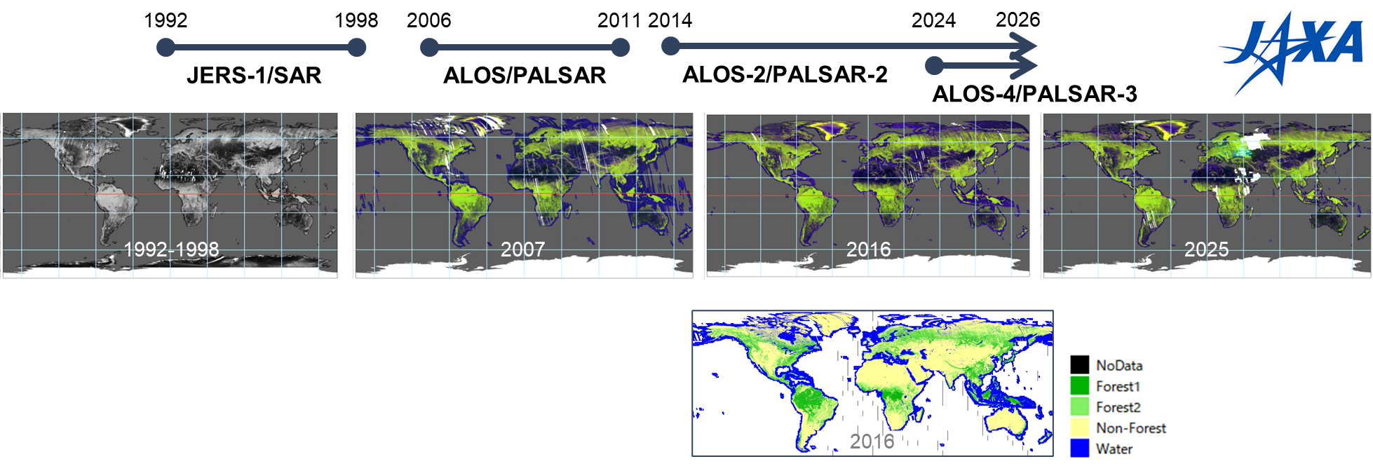
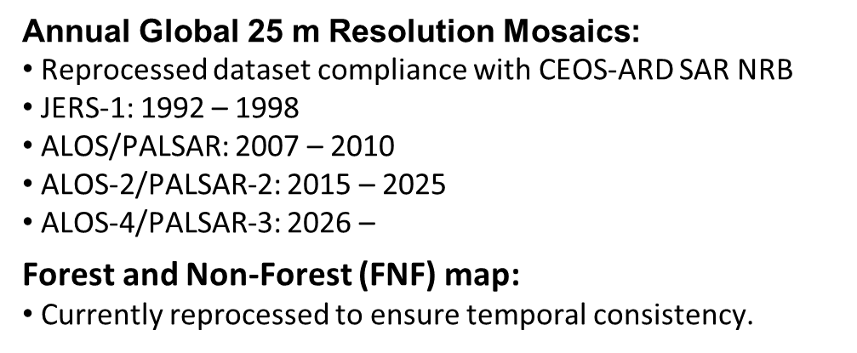


L-band SAR Annual Global Mosaics and Forest/Non-Forest maps
“For our Global Mangrove Watch (GMW) data workflow where we process thousands of images, the CEOS-ARD standard used for the JERS-1/ALOS/ALOS-2 SAR data from JAXA has simplified our processing chains with data now provided as GeoTIFFs and with standardised metadata. The specified pre-processing, including geometric rectification and radiometric terrain correction, has also been a significant help and reduced our internal data processing effort.”
Dr Pete Bunting,
Global Mangrove Watch Product Lead,
Aberystwyth University, UK
0: Ensure countries have access to satellite data from CEOS Agencies to report to UNFCCC following IPCC guidance
0.1: Ensure data policies remain open and free and that all relevant satellite Level 1b data are available to Parties as needed.

Slide 7

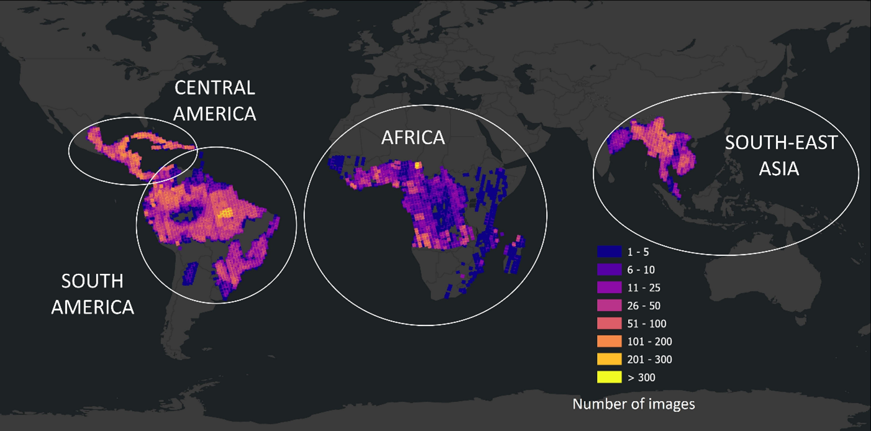

Radarsat-2 Tropical Forests Dataset
Free access to processed RADARSAT-2 data over tropical forests archive datasets for science and research.
CSA in collaboration with Natural Resources Canada’s Canada Centre for Mapping and Earth Observation (CCMEO) and MDA Space.
High-resolution C-band Synthetic Aperture Radar (SAR) data available through the Earth Observation Data Management System (EODMS) platform, spans over a decade – from 2014 to 2024.
24-day revisit over four main regions: Africa, Central and South America and South-East Asia with Indonesia and additional areas expected to be available in 2026
0: Ensure countries have access to satellite data from CEOS Agencies to report to UNFCCC following IPCC guidance
0.1: Ensure data policies remain open and free and that all relevant satellite Level 1b data are available to Parties as needed.

Slide 8
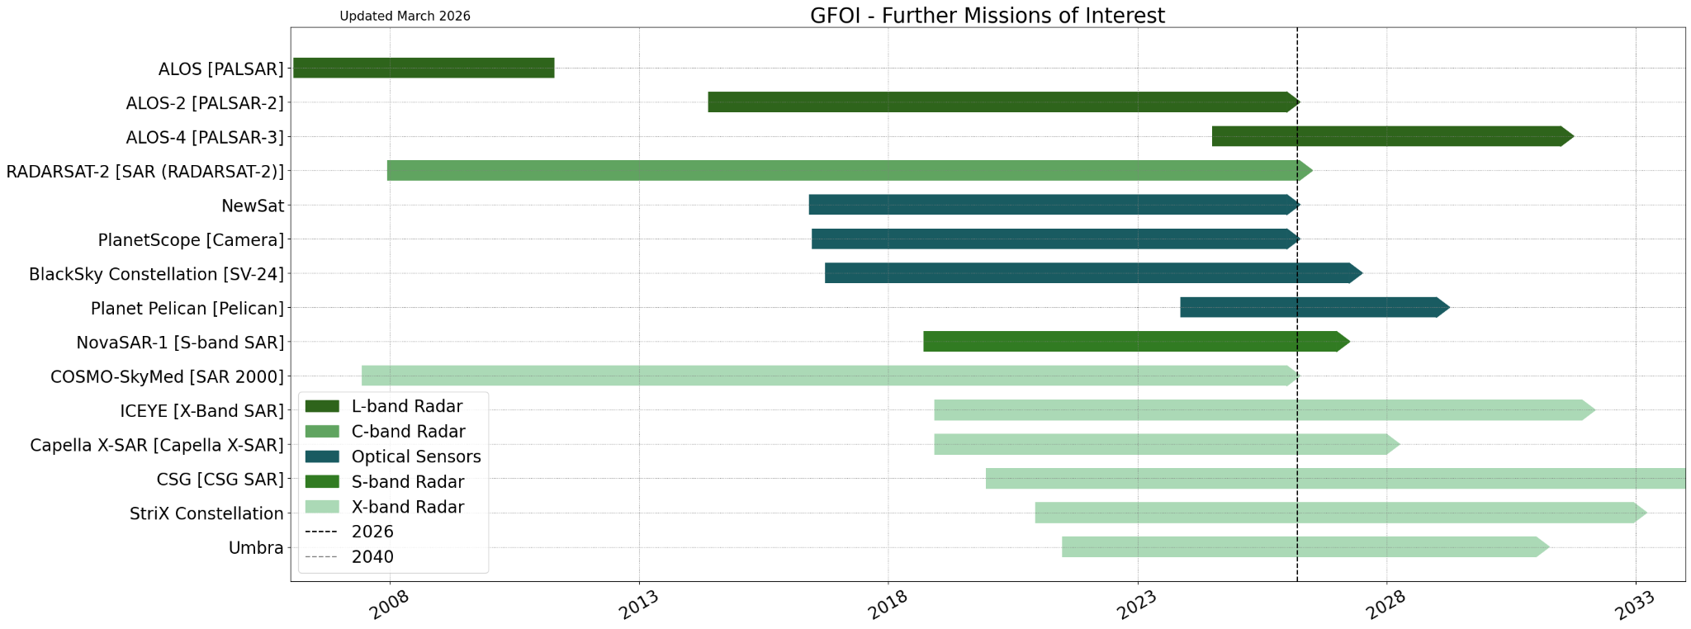
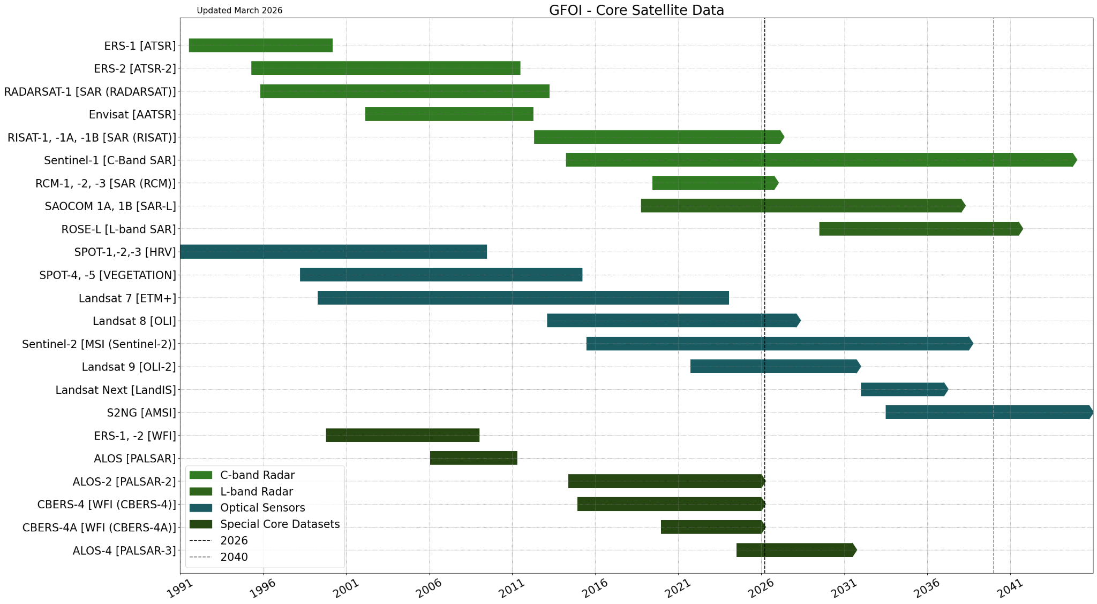
GFOI Core Satellite Data Continuity
Propose to maintain these on a future CEOS AFOLU Portal (see later slides) for ongoing visibility
Timelines powered by the CEOS MIM Database
1: Ensure continuity and long-term backward compatibility of CEOS missions providing activity data and emission factors
1.1: Track CEOS agency data continuity provision for the key AFOLU measurement groups and report outlook to SIT meetings for gaps, overlaps and interoperability actions. Provide guidance as needed to new missions (and related Mission Advisory Groups/Science teams).

Slide 9
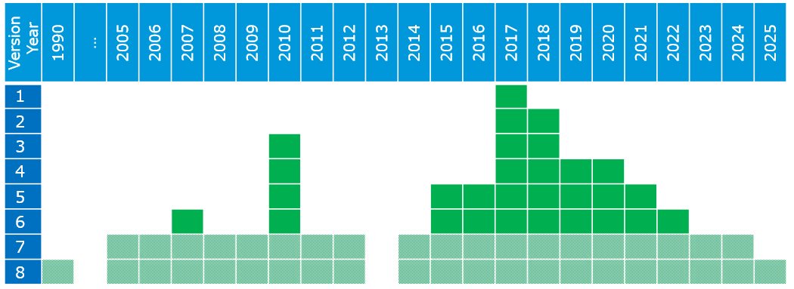
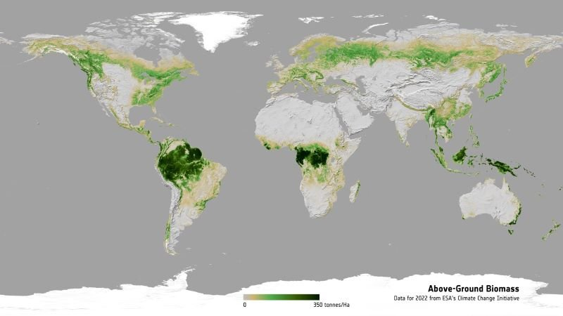



CCI Biomass
The current release of the CCI BIOMASS data products (v7) consists of global maps of AGB for each of the years 2005-2012 and 2015-2024, together with per-pixel standard deviation with a pixel size of 1 ha, i.e., for a 100 m x 100 m large area.
Software tool to compute the AGB change product (including SD and quality flag) based on comparisons of estimates between any 2 years
Nine additional years released in v7! Before 2015, ALOS PALSAR and Envisat ASAR are used, then ALOS-2 PALSAR-2 & Sentinel-1. Close collaboration and special processing by
V8 tested ERS-1/2, JERS-1 (backward compatibility) and new sensors BIOMASS, NISAR
This work (along with several other ESA projects) also provides a major contribution to recommendation 3 (see extra slides)
1: Ensure continuity and long-term backward compatibility of CEOS missions providing activity data and emission factors
1.2: Explore harmonization and integration activities that generate temporal continuity and provide complete and consistent spatial coverage of Activity Data and biomass estimates.

Slide 10
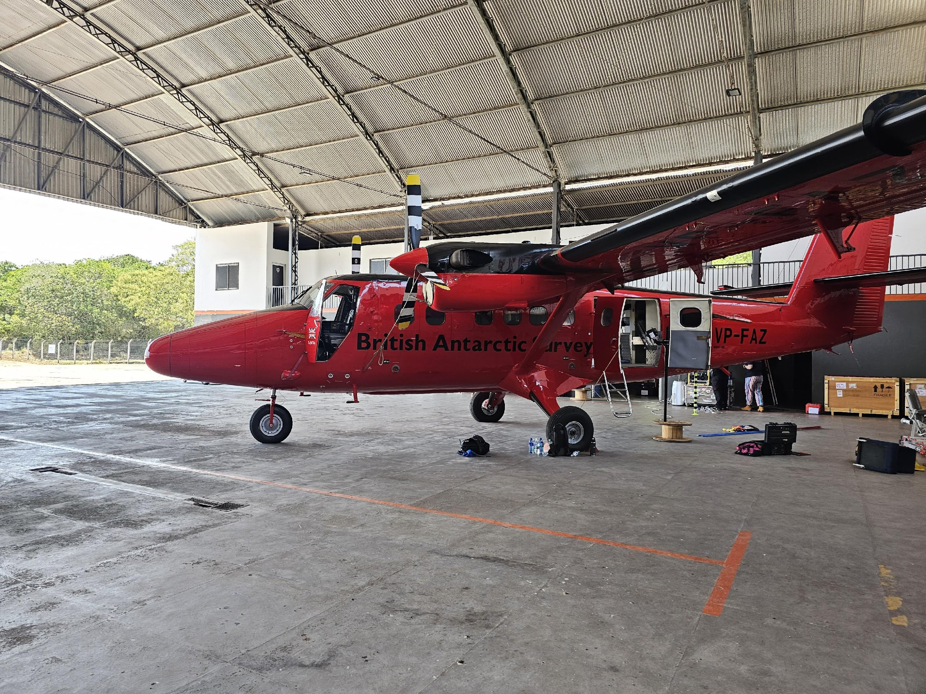


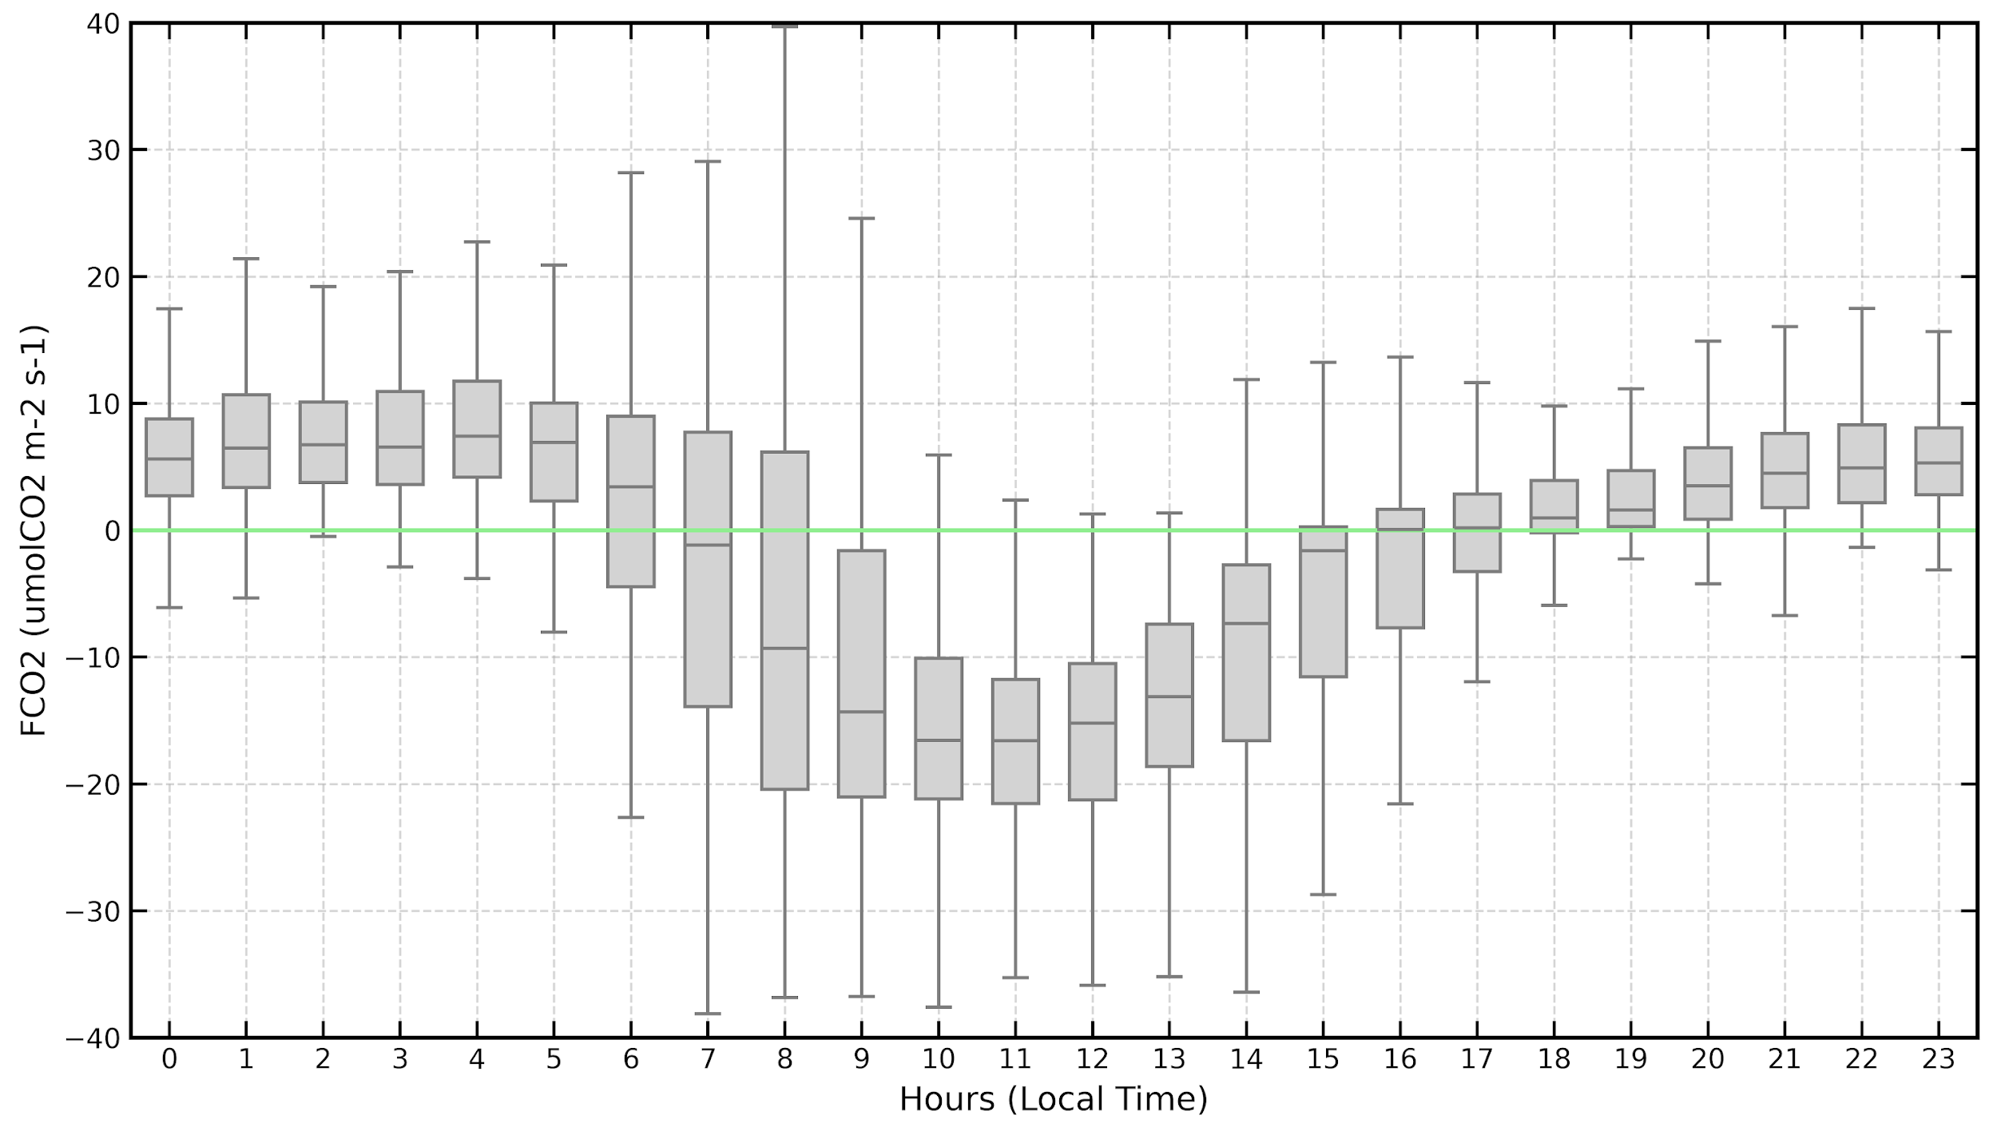
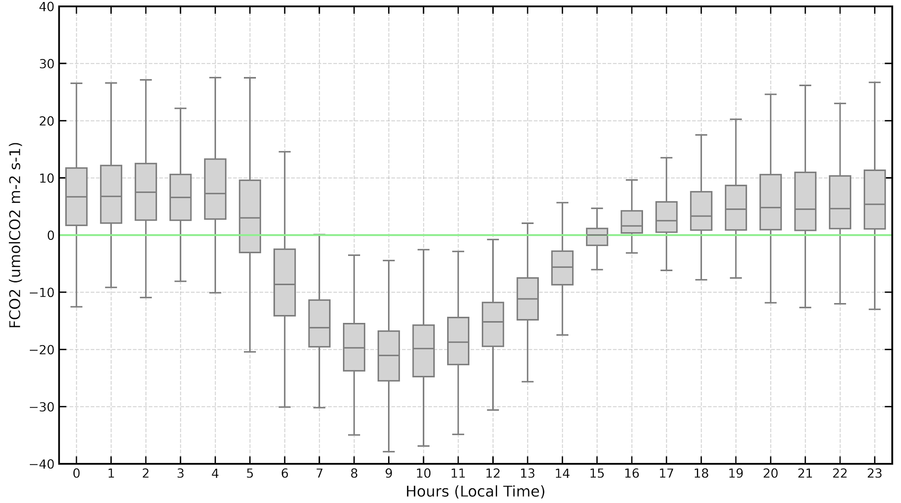
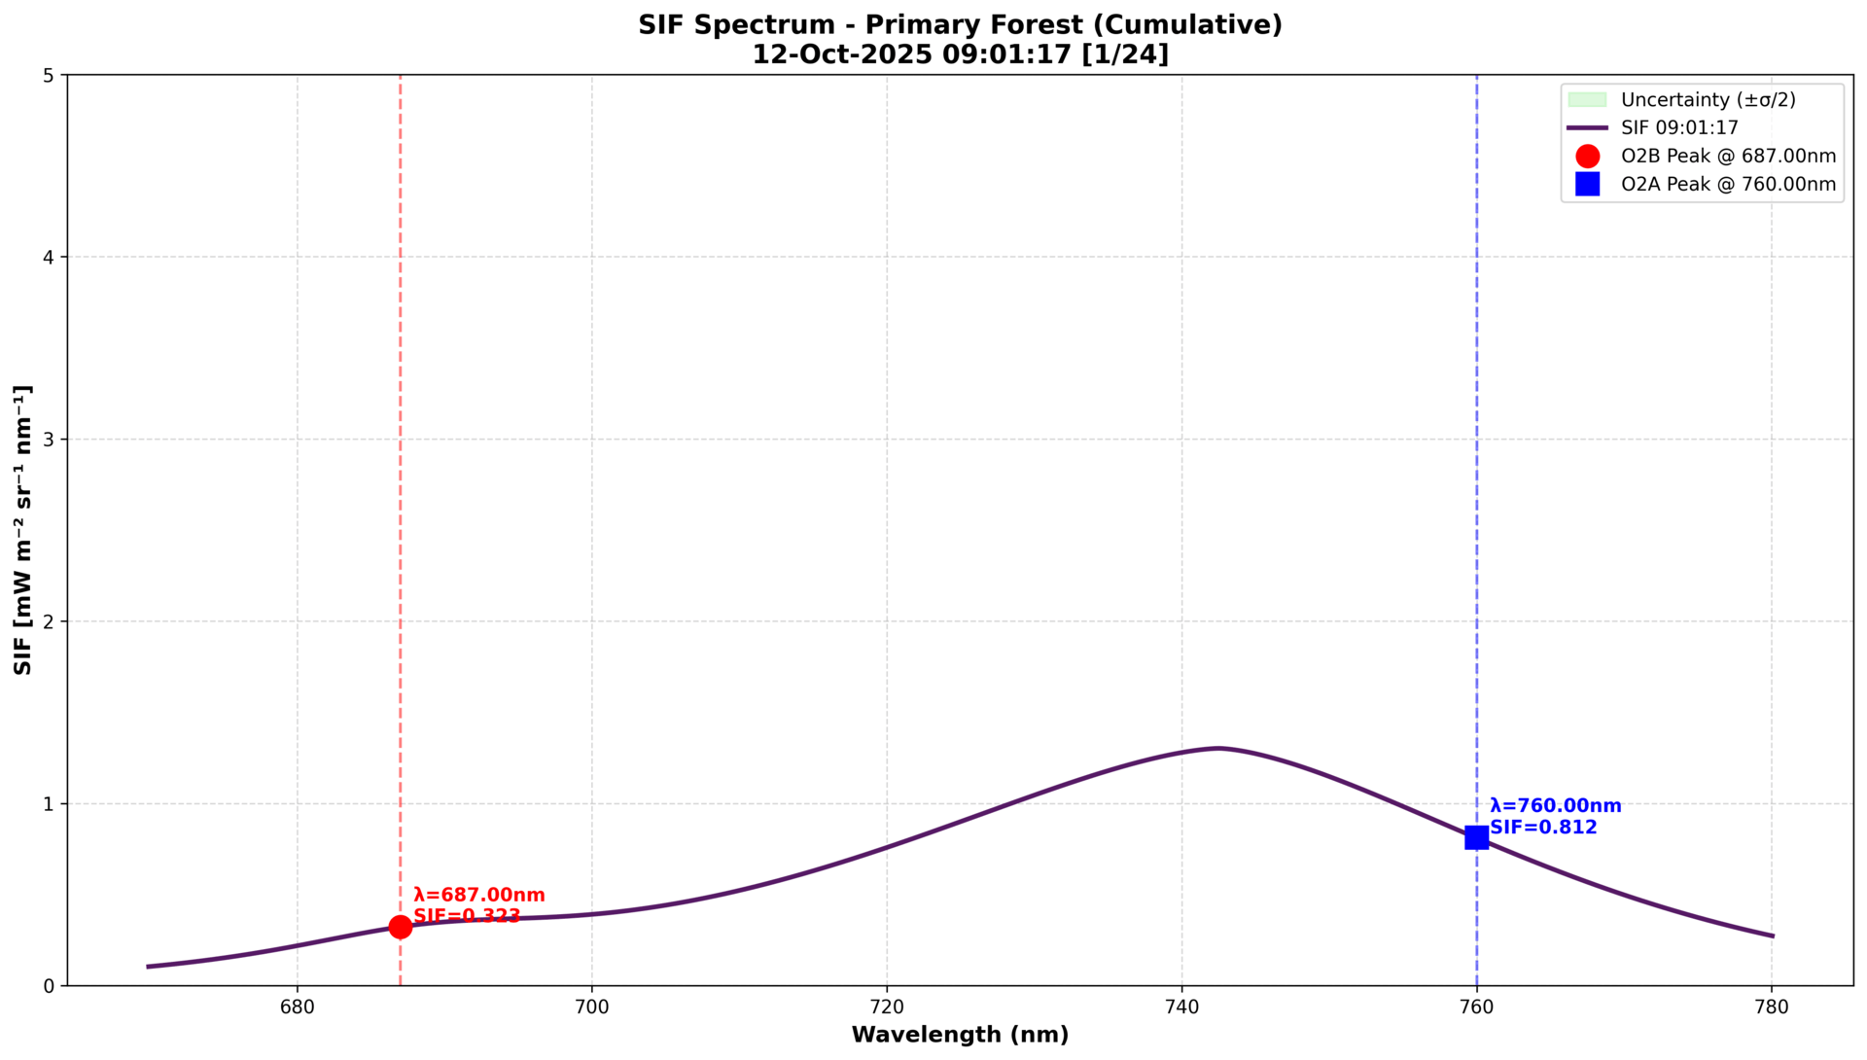
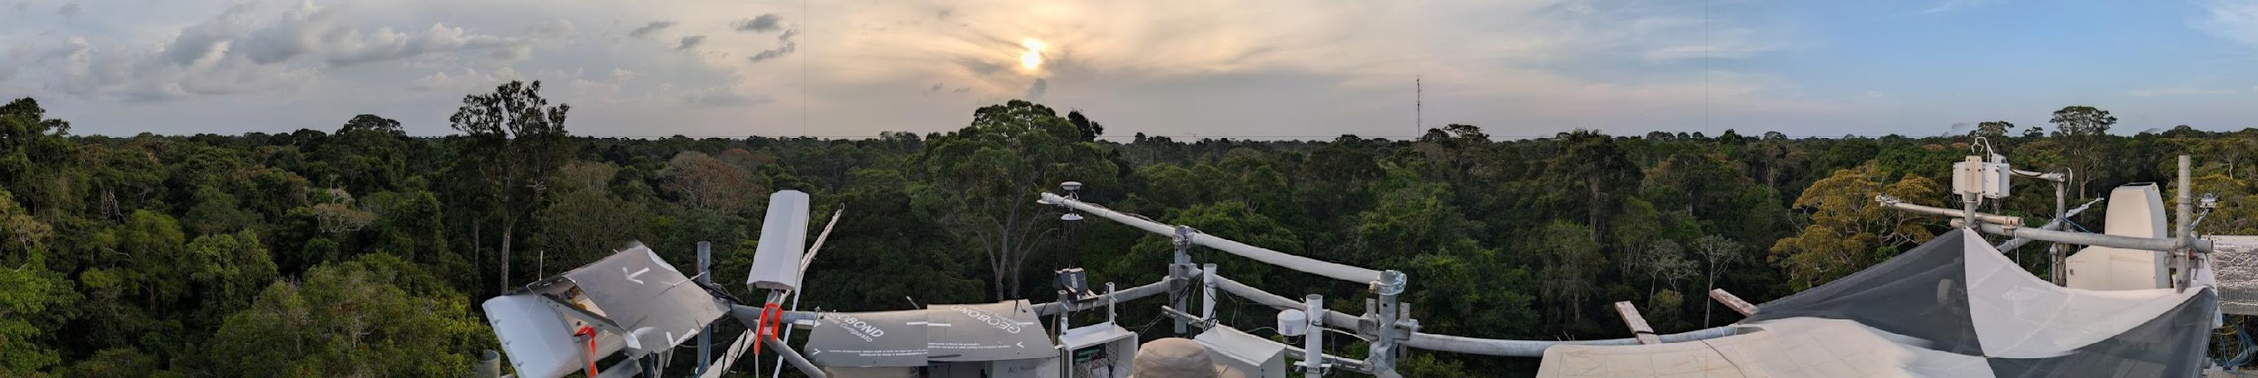
ESA-INPE Campaign
Instrument | Parameter(s) Derived
EC Systems | NEE (CO₂, CH₄, H₂O fluxes)
FloX (Fluorescence Box) | SIF, NDVI, canopy reflectance
EM27-SUN FTIR | Total column XCO₂, XCH₄, XCO
L-Band radiometer (PoLRa) | VOD, soil moisture
GNSS | Veg. Optical Depth
Thermal Radiometers | Brightness Temperature & LST
Pandora Spectrometer | Atmospheric column (NO₂, O₃ etc)
Meteorological Stations | T, RH, pressure, wind, PAR, radiation
Purple air sensors | Particulate matter
Primary Forest
Secondary Forest
FloX
(top) Net Ecosystem exchange FCO2 patterns from primary and secondary forests
(left) Solar induced fluorescence diurnal cycle from primary forest tower FloX box
Tower O2A SIF @761 nm [13:29 UTC]
1.46 ± 0.33 mWm-2nm-1sr-1
Airborne O2A SIF @761 nm [13:29 UTC]
1.71 ± 0.82 mWm-2nm-1sr-1
Primary Forest Site – 12 Oct 2025
Tower SIF spectra from 9 to 20 UTC (6am – 5pm local time; every 30’)
3: Enable dialogue between inventory practitioners and the CEOS community
3.2: Undertake dedicated country demonstrations / field campaigns for better ground/space data integration

Slide 11
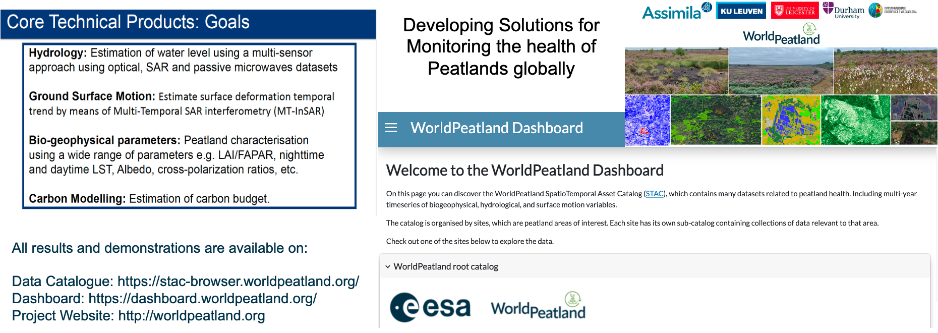
ESA WorldPeatlands
Peatlands, as high carbon ecosystems, are a priority for development of EO applications
3: Enable dialogue between inventory practitioners and the CEOS community
3.3: Support NFI teams and review experts accessing independent estimates derived from satellite EO in the context of the Enhanced Transparency Framework

Slide 12
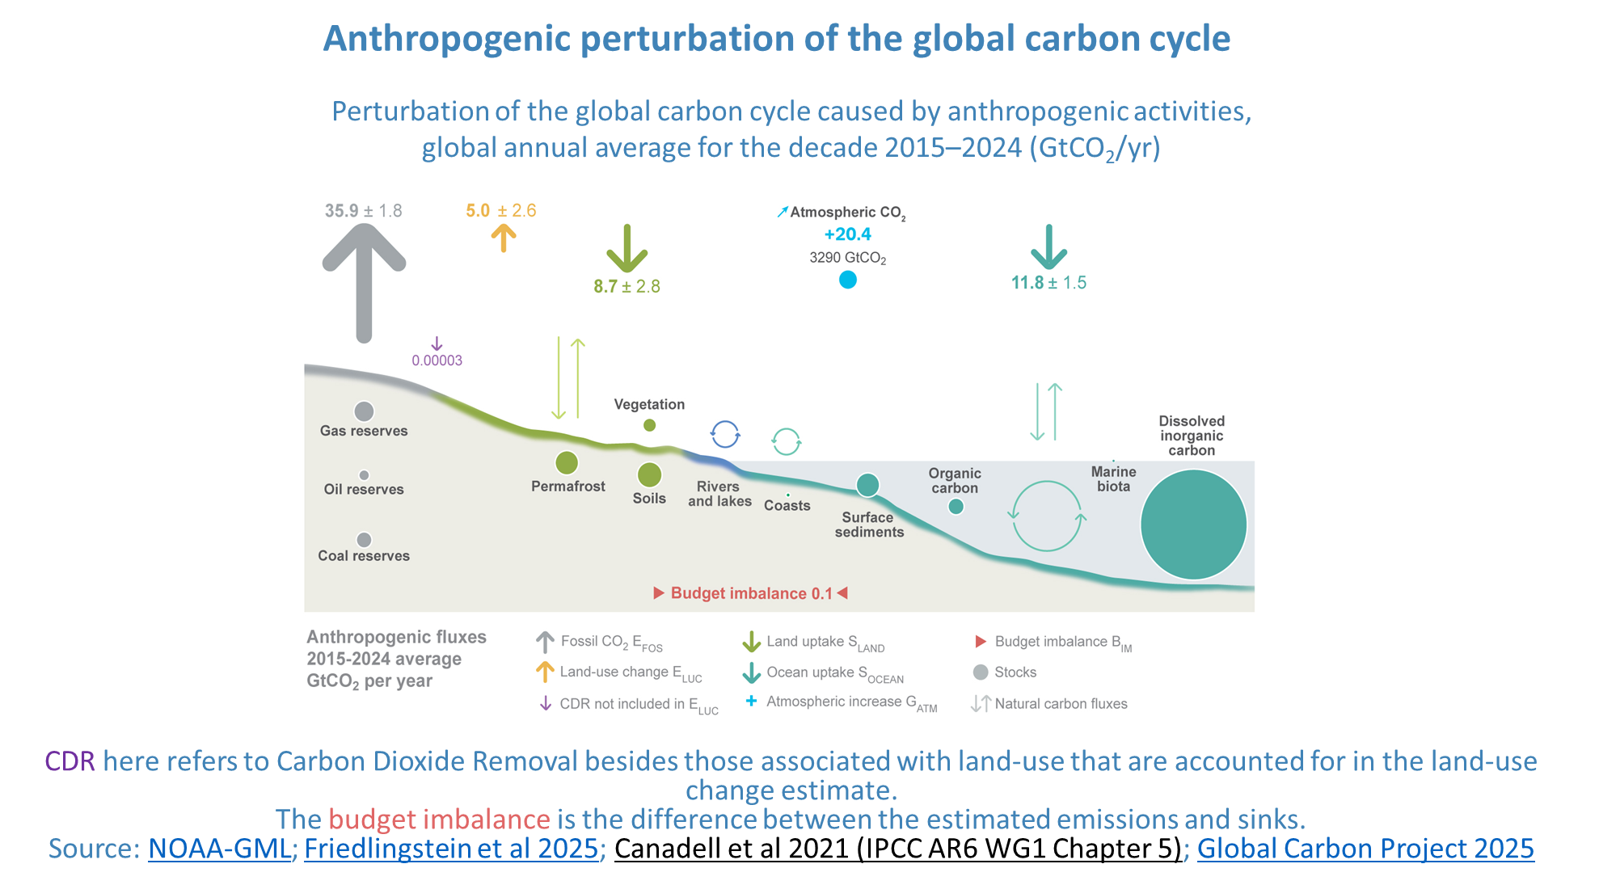


Global Carbon Project & RECCAP-2
CO2 but also CH4, N2O, H2, black carbon, carbon monoxide
Harness satellite based ECV for reducing the uncertainty on the emissions and sinks of CO2, and CH4 over key land regions, and attributing them to anthropogenic and global change drivers.
keep a global perspective by developing a global framework to make EO-based estimates of bottom-up and top-down CO2, and CH4 fluxes comparable with national inventories.
Open dialogue with several NGHGI agencies through workshops (recommendations 3 & 7)
4: Support efforts to reconcile bottom-up, top-down, and inventory estimates of GHG emissions and removals
4.1: Develop guidance and datasets to support the consistent comparison and assessment of bottom-up and top-down methodologies with national GHG inventories.

Slide 13
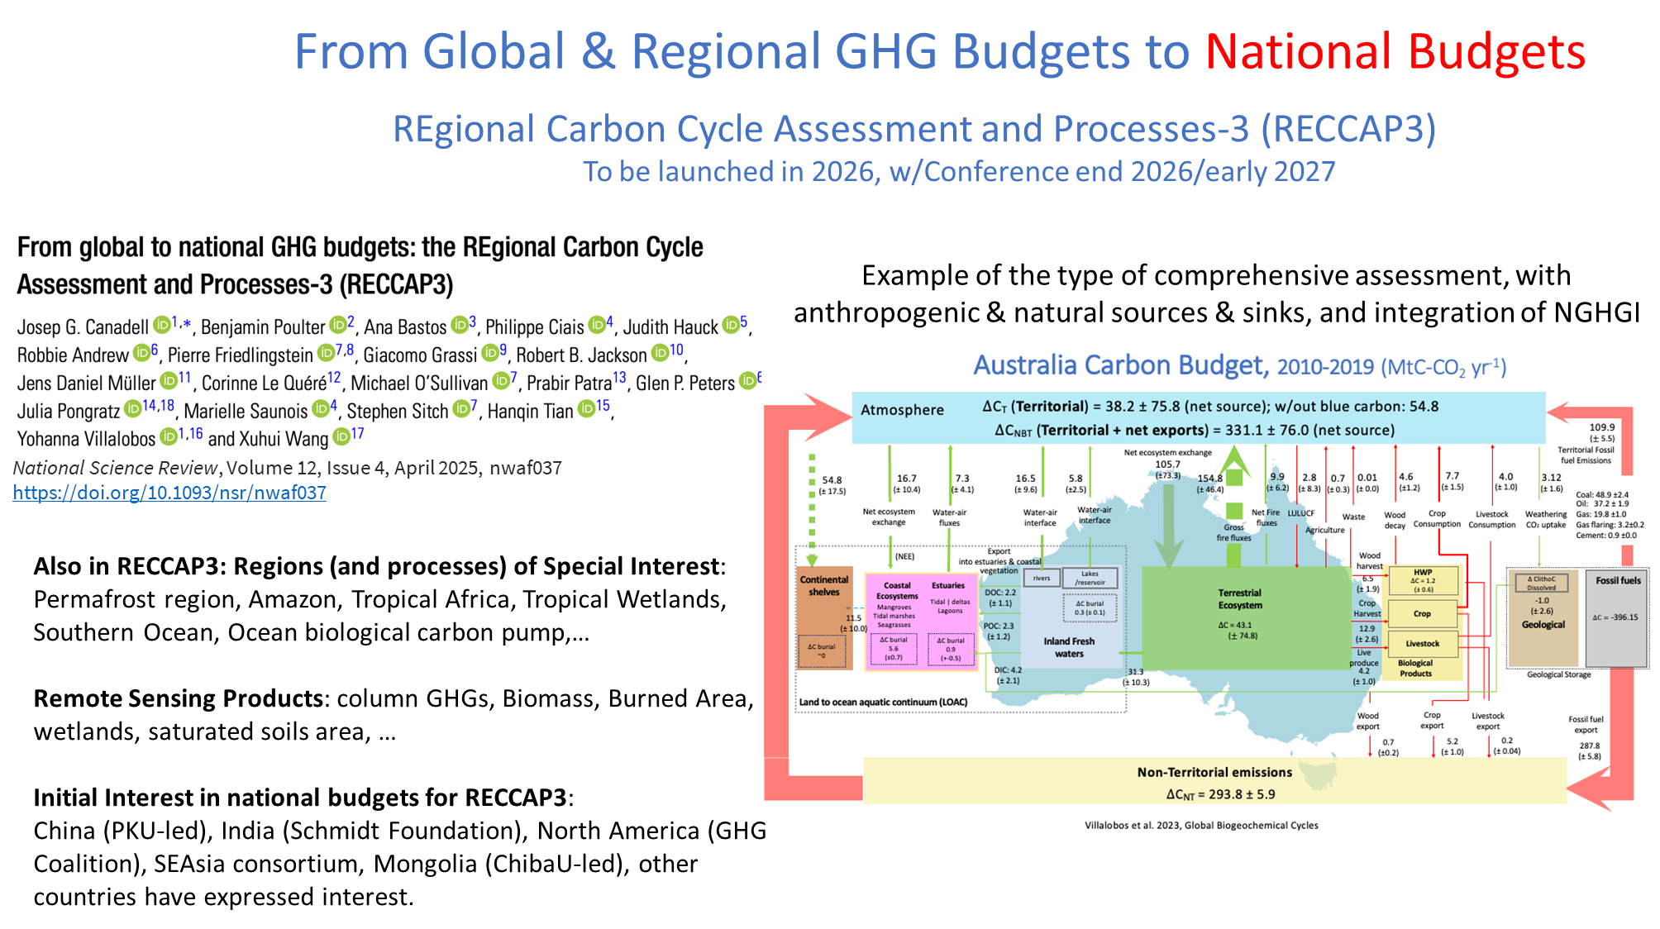
4: Support efforts to reconcile bottom-up, top-down, and inventory estimates of GHG emissions and removals
4.1: Develop guidance and datasets to support the consistent comparison and assessment of bottom-up and top-down methodologies with national GHG inventories.

Slide 14

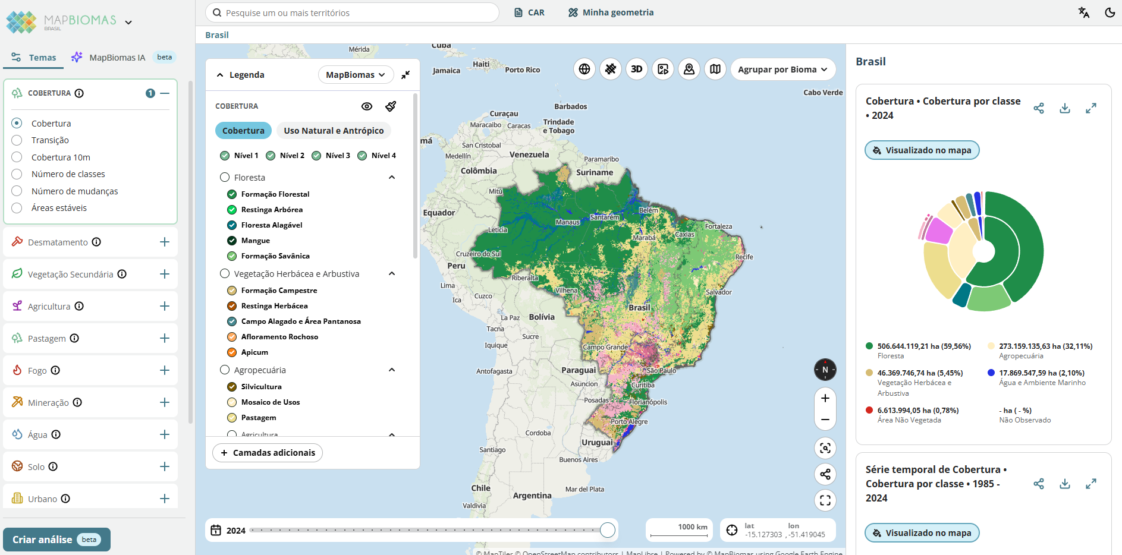
MapBiomas
A global, multi-institutional network formed by universities, NGOs, and technology companies
It provides annual up-to-date and detailed spatial databases on land use/land cover and changes and their impacts.
Launched 2015 in Brazil, MapBiomas is now active in 14 countries across South America and Indonesia.
(Also ESA WorldCover, CCI Land Cover …etc)
5: Systematically target activities to support IPCC Land Cover classes
5.1: Provide demonstration studies (nationally/regionally but also globally) that illustrate and demonstrate capacity to generate IPCC classes through amalgamation of mapped FAO LCCS classes, given the latter can be mapped directly from Earth observation data or reconstructed from existing land cover products.

Slide 15

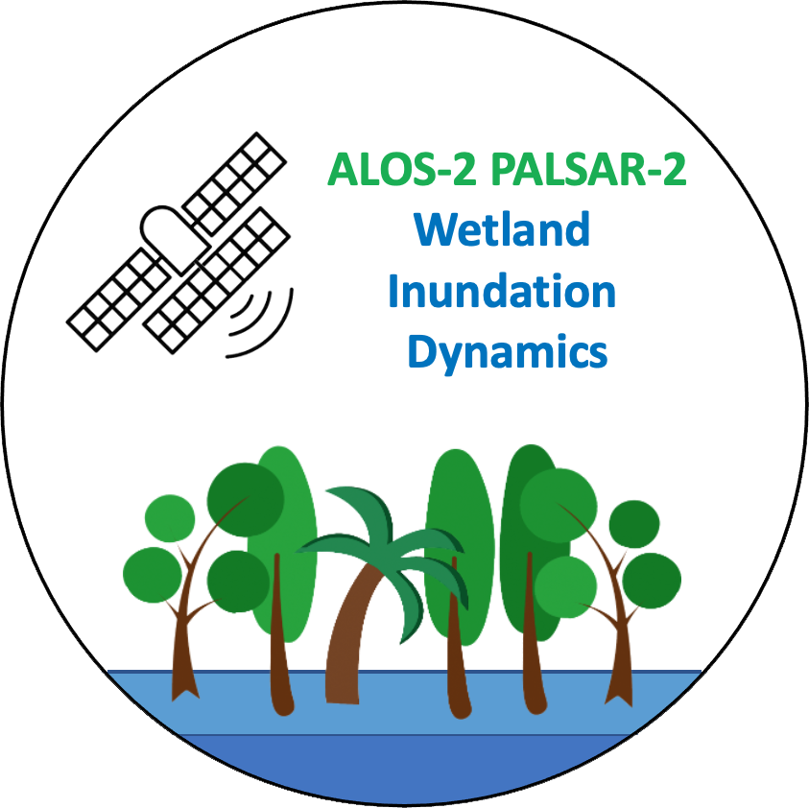



Actions 5.3/ 5.4/ 5.5: Wetlands
❖ Action 5.3: Consider best practice for including Blue Carbon Ecosystems (BCEs) in national inventories
GFOI/MGD: Blue Carbon Guidance for REDD+ reporting published in 2025
Global Mangrove Watch (JAXA) – 1985-2025 annual time-series for release in 2026
Coastal Blue Carbon Project (ESA) – seagrass, saltmarshes, mangroves
❖ Action 5.4(a): Explore the development of new CEOS initiatives on wetlands mapping and monitoring
LSI-VC “EO & Wetlands” theme initiated
GEO-Wetlands in GEO Work Programme. Led by Ramsar, Wetlands Int’l, ESA and JAXA
Wetland Inundation Dynamics mapping (JAXA) - Tropical wetland temporal dynamics
❖ Action 5.4(b): Ensure that CEOS missions consider wetlands amongst their mission goals
Wetlands science objectives in ALOS-2, ALOS-4, NISAR, ROSE-L, CHIME, LSTM (others?...)
❖ Action 5.5: Establish closer collaboration with the Ramsar Convention
JAXA & ESA long-term Ramsar STRP Observer Organisations
EO Side Event and GEO-Wetlands exhibition at Ramsar COP15
EO in the 2025-2028 Ramsar STRP Work Plan (Task 2.2: “Advancing the development and use of technology, especially through an initiative on Earth observation, for dynamic wetland mapping and inventory, assessment and conservation”.
5: Systematically target activities to support IPCC Land Cover classes

Slide 16
And many more…
Name | Agency | Type
Rangeland and Pasture Productivity | CSIRO | Dataset
Biomass P-band SAR maps | ESA | Dataset
NISAR biomass maps | NASA | Dataset
Radarsat-2 Tropical Forest (R2TF) | CSA | Dataset
TanDEM-X DEM change maps | DLR | Dataset
MapBiomas | INPE | Dataset
JERS-1, ALOS & ALOS-2 CEOS-ARD | JAXA | Dataset
Global Mangrove Watch | JAXA | Dataset
ALOS-2 Tropical Wetland Inundation maps | JAXA | Dataset
JAXA Biomass Cambodia | JAXA | Capacity Building
GEO-Wetlands | JAXA, ESA | Activity/Project
GEDI biomass | NASA | Dataset
ESA-NASA MAAP | ESA, NASA | Tool, Analysis platform
GEO-TREES | GEO | Reference data
CarbonARA | ESA, INPE | Activity/Project
CCI Biomass | ESA | Activity/Project
WorldForest | ESA | Activity/Project
WorldCover | ESA | Dataset
RECCAP 2 | ESA | Activity/Project
RAMONA | ESA | Activity/Project
EO4MRV | ESA | Activity/Conference
GFOI R&D | ESA | Activity/Project
TerraClass | INPE | Activity/Project
LULUCF data hub | EC | Data platform
… | … | …
Impossible to demonstrate the breadth and depth of agency AFOLU activities in a 15 minute presentation
There are 48 actions!
And many agency activities and contributions
We ask Principals to reflect on how their activities link to each of the action areas and provide information and contacts
Seek to establish a better catalogue of activities

Slide 17
2026 Goal: CEOS AFOLU Portal
Objective: Provide a public-facing means to stocktake and present CEOS Agency contributions to the AFOLU Roadmap
Breadth of CEOS Agency contributions to AFOLU Roadmap not well documented to date
To facilitate identification of collaboration opportunities, gaps, opportunities
Communicate CEOS Agency work and achievements for AFOLU
Show progress on implementation of the AFOLU Roadmap
Need: CEOS Agency POCs for LSI-VC F&B Group and Contributions

Slide 18
Thank you!
Clement Albergel, ESA
Neha Hunka, ESA
Takeo Tadono, JAXA
Agenda Item #7.4
CEOS SIT-41 2026
Irvine, California, USA
14-16 April 2026

Slide 19
Extra slides/detail

Slide 20
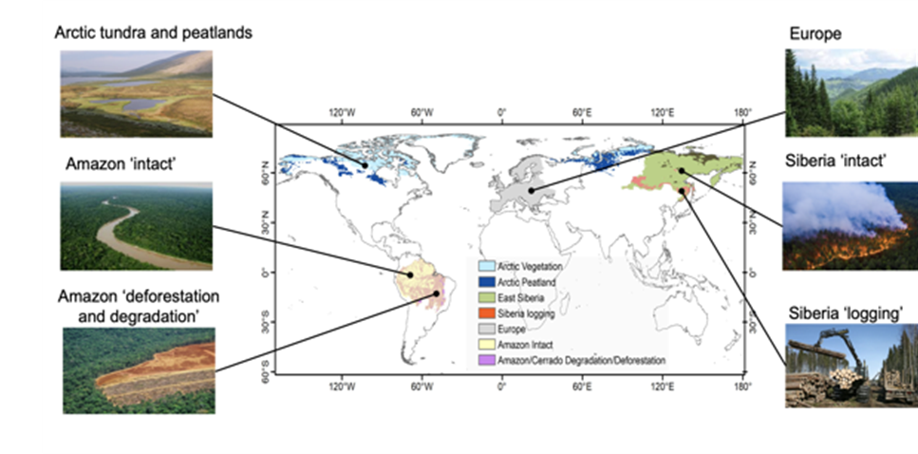
4.1 / 7.1: Engagement with GCP & RECCAP-2
Harness satellite based ECV for reducing the uncertainty on the emissions and sinks of CO₂, and CH₄ over key land regions, and attributing them to anthropogenic and global change drivers.
The project proposes to integrate bottom-up and top-down methods and compare their results with inventories for case study land regions that are of key importance for global budgets and where uncertainties on current CO₂, and CH₄ fluxes remain very large: Europe, Siberia, Amazon and Arctic.
The project also keeps a global perspective by developing a global framework to make EO-based estimates of bottom-up and top-down CO₂, and CH₄ fluxes comparable with national inventories.
4: Support efforts to reconcile bottom-up, top-down, and inventory estimates of GHG emissions and removals
4.1: Develop guidance and datasets to support the consistent comparison and assessment of bottom-up and top-down methodologies with national GHG inventories.

Slide 21
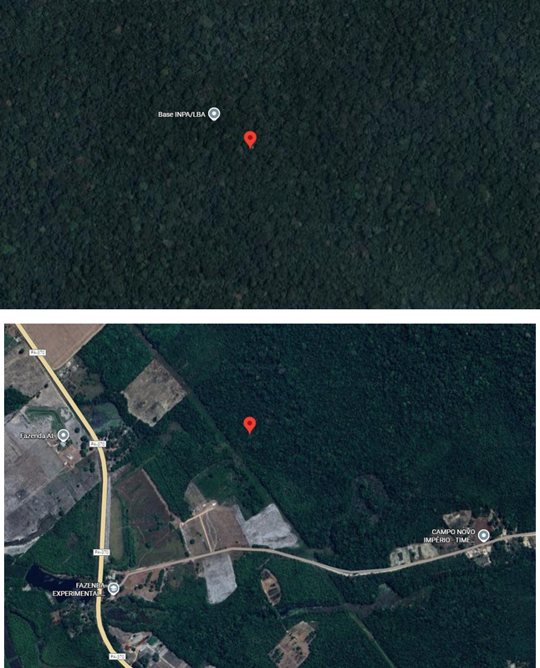

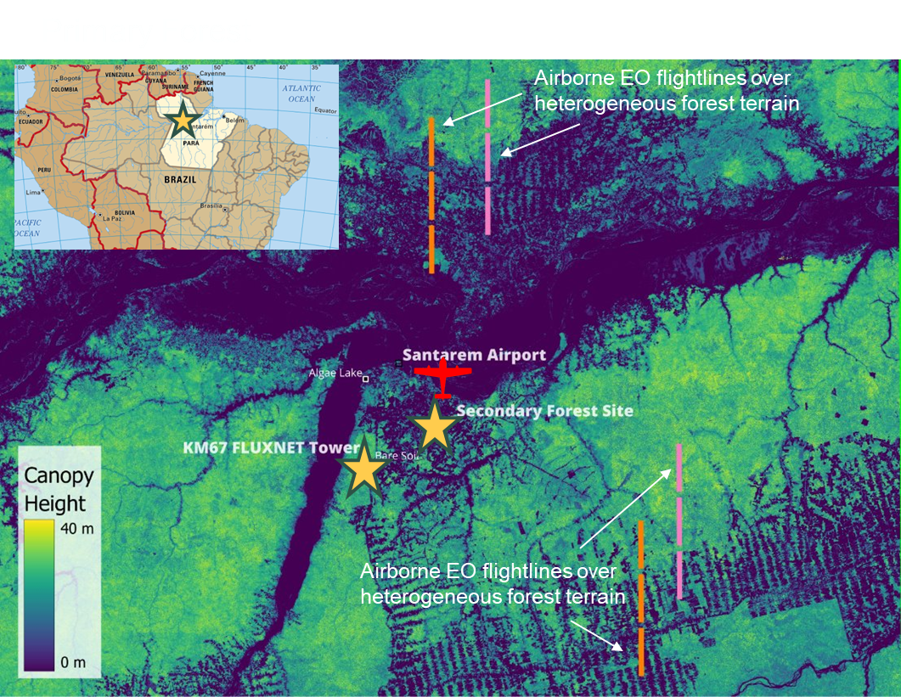

Action 3.2/6.1: ESA-INPE Campaign
Location of primary & secondary towers
3: Enable dialogue between inventory practitioners and the CEOS community
3.2: Undertake dedicated country demonstrations / field campaigns for better ground/space data integration

Slide 22
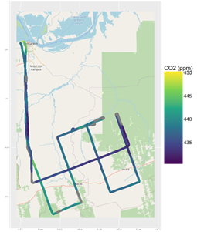

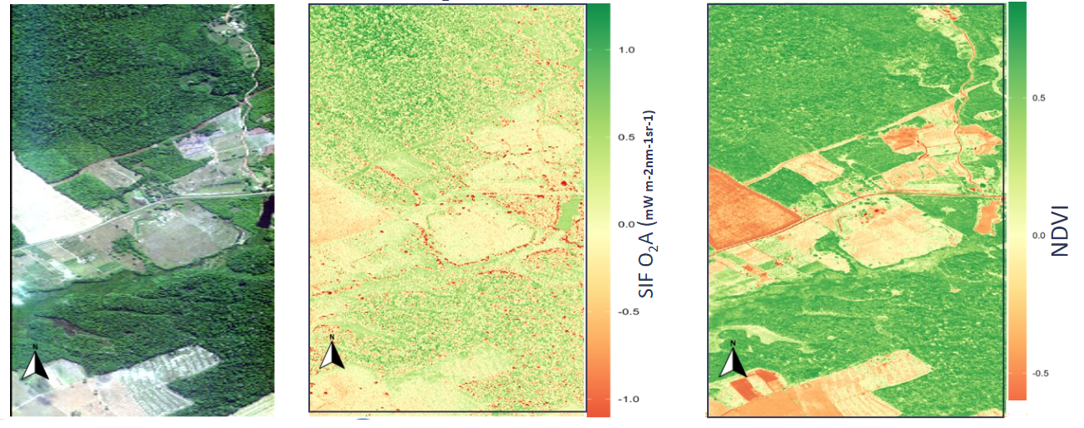
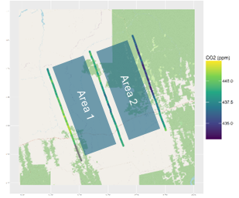
Action 3.2/6.1: ESA-INPE Campaign
Airborne landscape scale GHG fluxes
Solar Induced Fluorescence
Airborne CO₂
Mixing Ratio
Landscape Scale GHG Fluxes
Area 1: +2374 mg m⁻² h⁻¹
Area 2: +4070 mg m⁻² h⁻¹
Solar Induced Fluoresence :
Tower O₂A SIF @761 nm [13:29 UTC] 1.46 ± 0.33 mWm⁻²nm⁻¹sr⁻¹
Airborne O₂A SIF @761 nm [13:29 UTC] 1.71 ± 0.82 mWm⁻²nm⁻¹sr⁻¹
3: Enable dialogue between inventory practitioners and the CEOS community
3.2: Undertake dedicated country demonstrations / field campaigns for better ground/space data integration
Notes:
Landscape scale GHG Fluxes
Airborne CO₂ mixing ratios assessed during ~ 3 - 4 hr flights show clear contrasts over different land-covers, centred on early-afternoon time when fluxes should change relatively slowly.
Decrease in CO₂ downwind of primary forest, consistent with net carbon uptake, while over disturbed and secondary forest CO₂ mixing ratios increase downwind, potentially consistent with net CO₂ emission (tbc).
Very early CO₂ flux estimates suggest positive net fluxes (2374 and 4070 mg m⁻² h⁻¹) over the disturbed and secondary forest respectively, demonstrating the capability to resolve landscape-driven carbon dynamics.
SIF Solar induced fluorescence (SIF) O₂A and NDVI maps retrieved from AisaIBIS and AisaFENIX1K airborne EO over contrasting land-cover types
Preliminary comparison of continuous tower (FLoX) and airborne (IBIS) SIF retrievals show consistency.

Slide 23
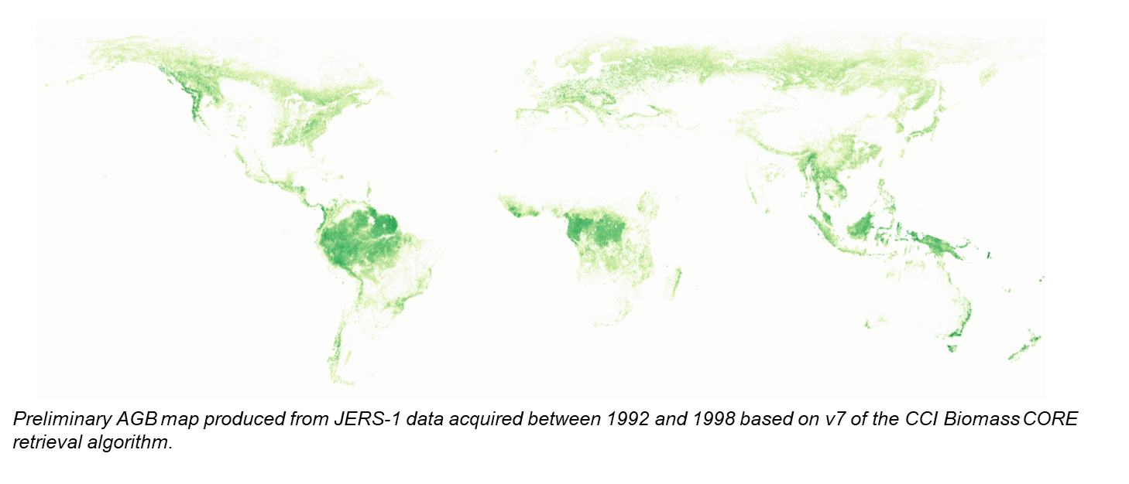
Recommendations 0 / 1 : CCI Biomass
1: Ensure continuity and long-term backward compatibility of CEOS missions providing activity data and emission factors
1.2: Explore harmonization and integration activities that generate temporal continuity and provide complete and consistent spatial coverage of Activity Data and biomass estimates.

Slide 24
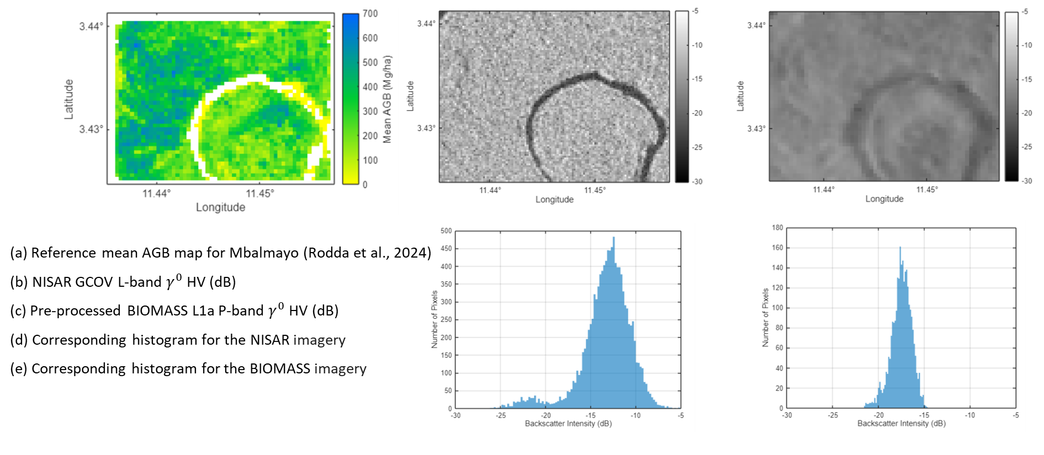
Recommendations 0 / 1 : CCI Biomass
1: Ensure continuity and long-term backward compatibility of CEOS missions providing activity data and emission factors
1.2: Explore harmonization and integration activities that generate temporal continuity and provide complete and consistent spatial coverage of Activity Data and biomass estimates.

Slide 25
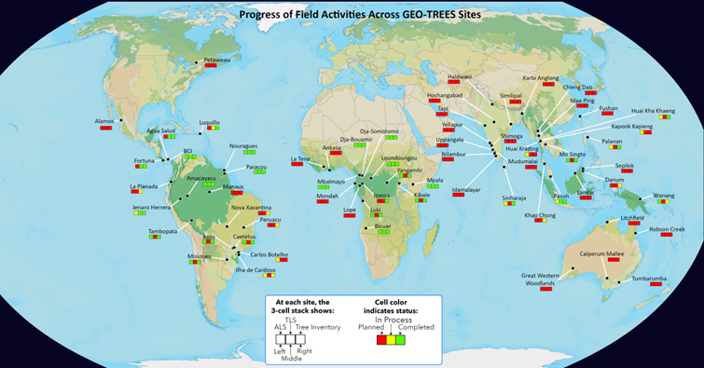
Action 2.5 - GEOTREES
Action 2.5 : Biomass harmonisation group to work with GEO-TREES to implement validation of CEOS biomass products with GEO-TREES data.
Data acquisition has been started for 38 sites
(of which 10 sites are complete)
Integration of national sites
(India, Australia, Canada) is ongoing
Geo-Trees technical workshops
on Terrestrial Laser Scanning,
Chiang Mai, Nov 2025
on Data Processing Pipeline
Harmonisation, Panama, March 2026
Awarding 6 research grants to GT site researchers in March 2026

Slide 26
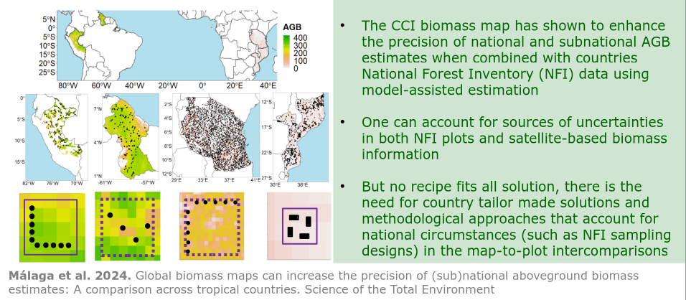
Action 2.6 / 2.8 / 3.1 R&D efforts on informed uptake of space-based biomass products

Slide 27
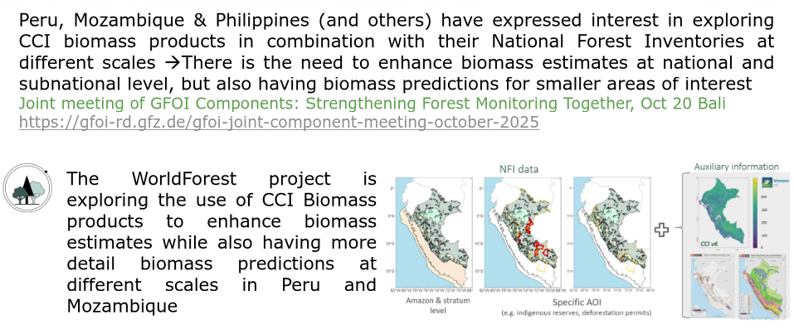
Action 2.6 / 2.8 / 3.1 R&D efforts on informed uptake of space-based biomass products

Slide 28
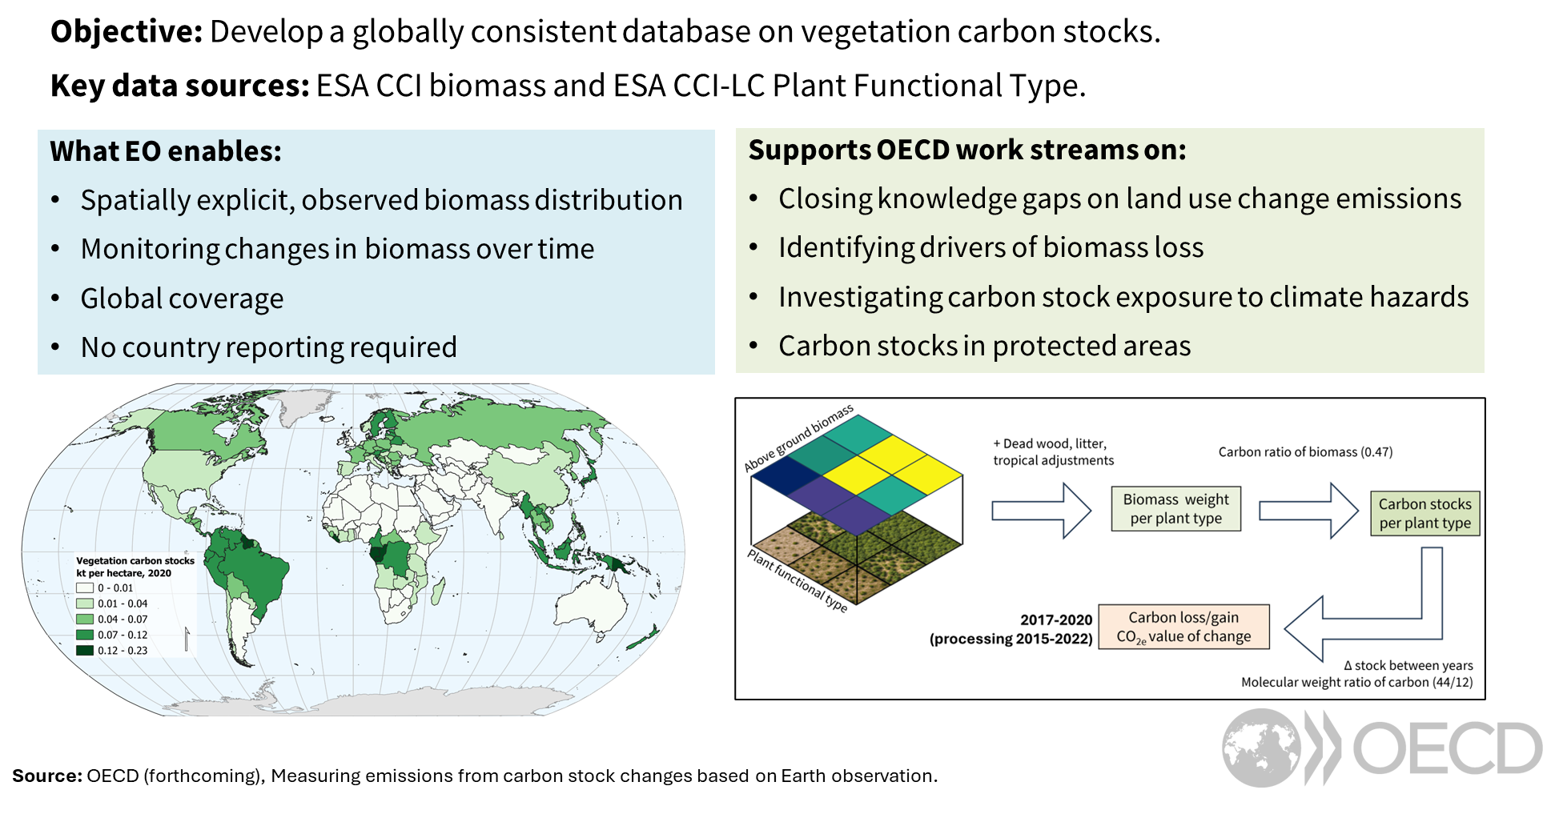
Action 2.6 / 2.8 / 3.1 R&D efforts on informed uptake of space-based biomass products - OECD exploring EO’s potential to monitor carbon stock

Slide 29
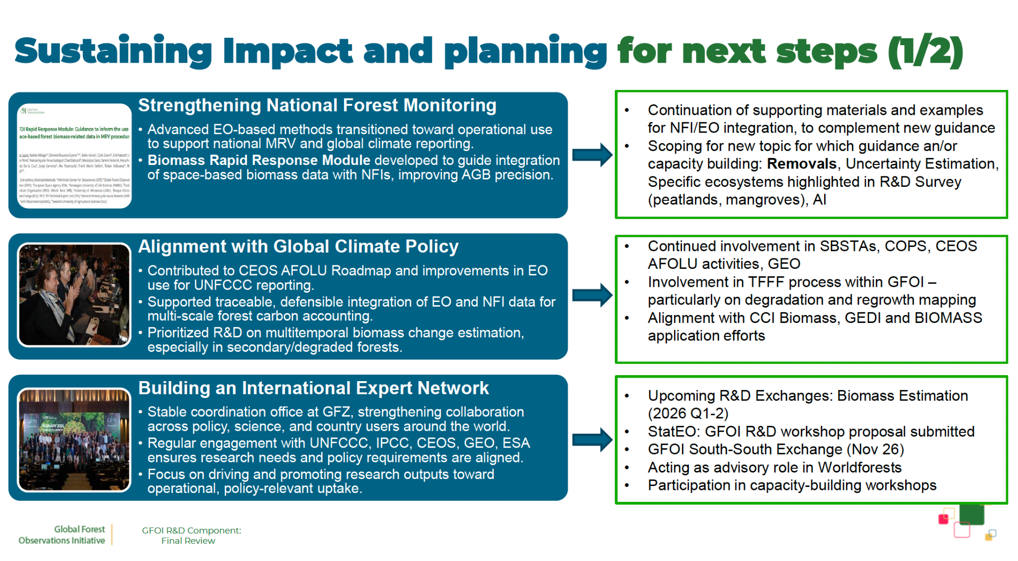
Action 2.6 / 2.8 / 3.1 R&D efforts on informed uptake of space-based biomass products - ESA support to GFOI R&D

Slide 30
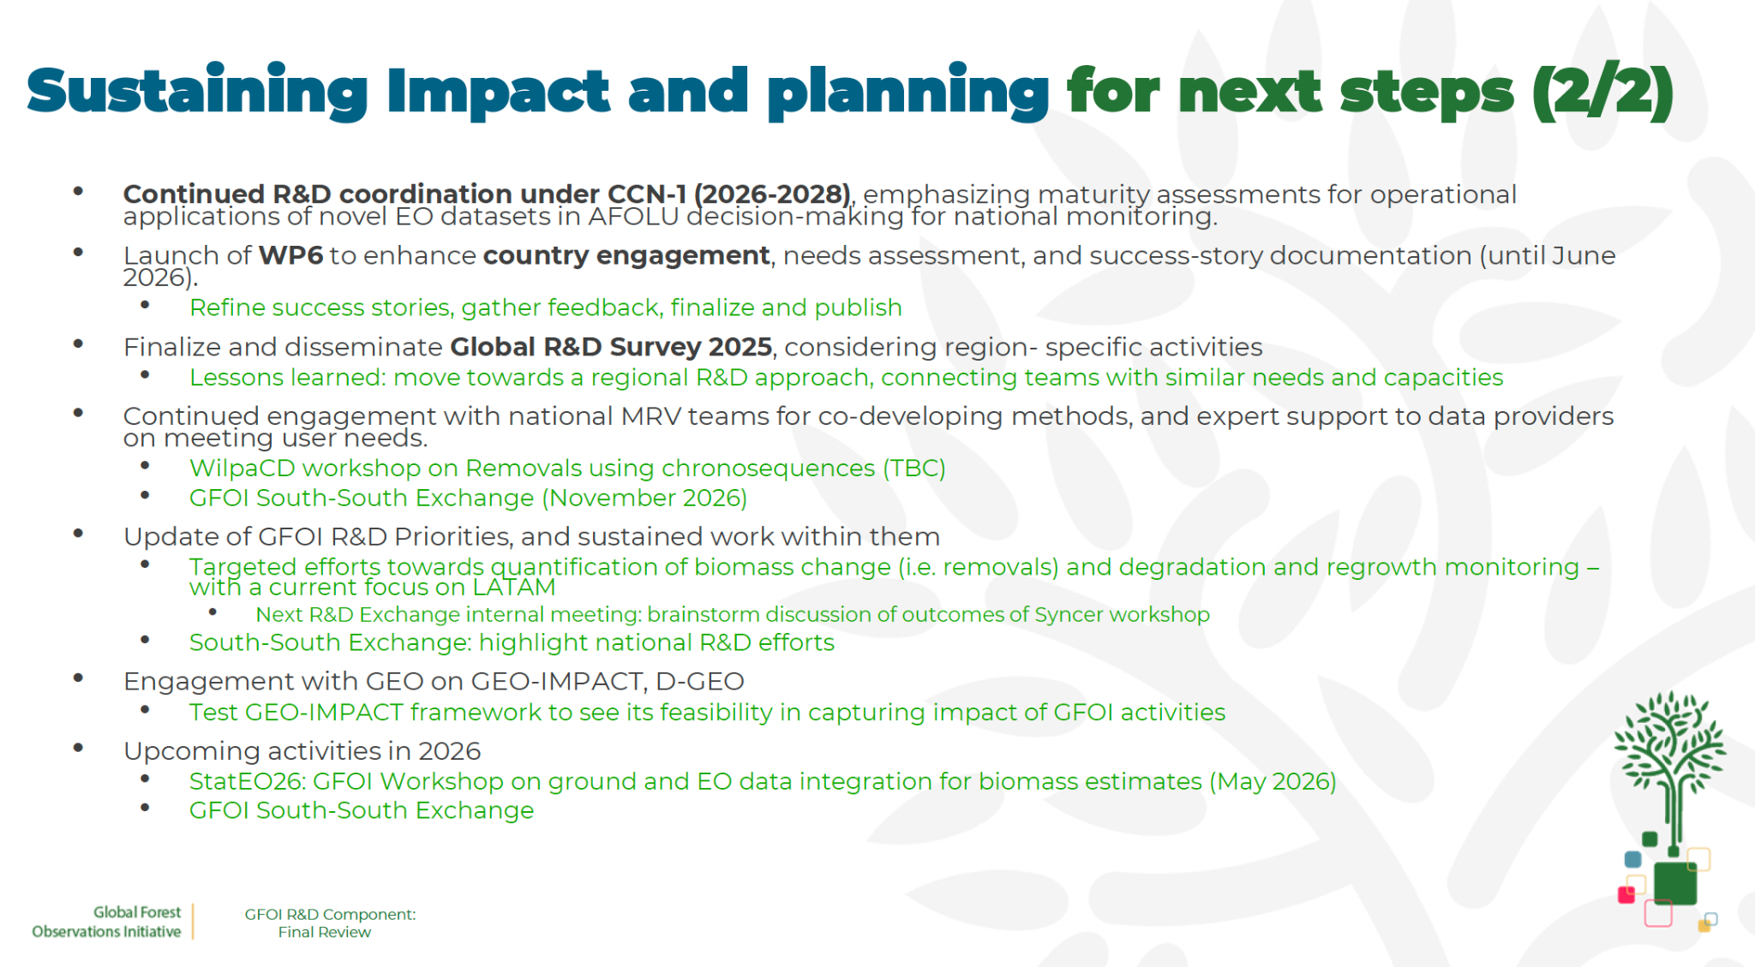
Action 2.6 / 2.8 / 3.1 R&D efforts on informed uptake of space-based biomass products - ESA support to GFOI R&D

Slide 31
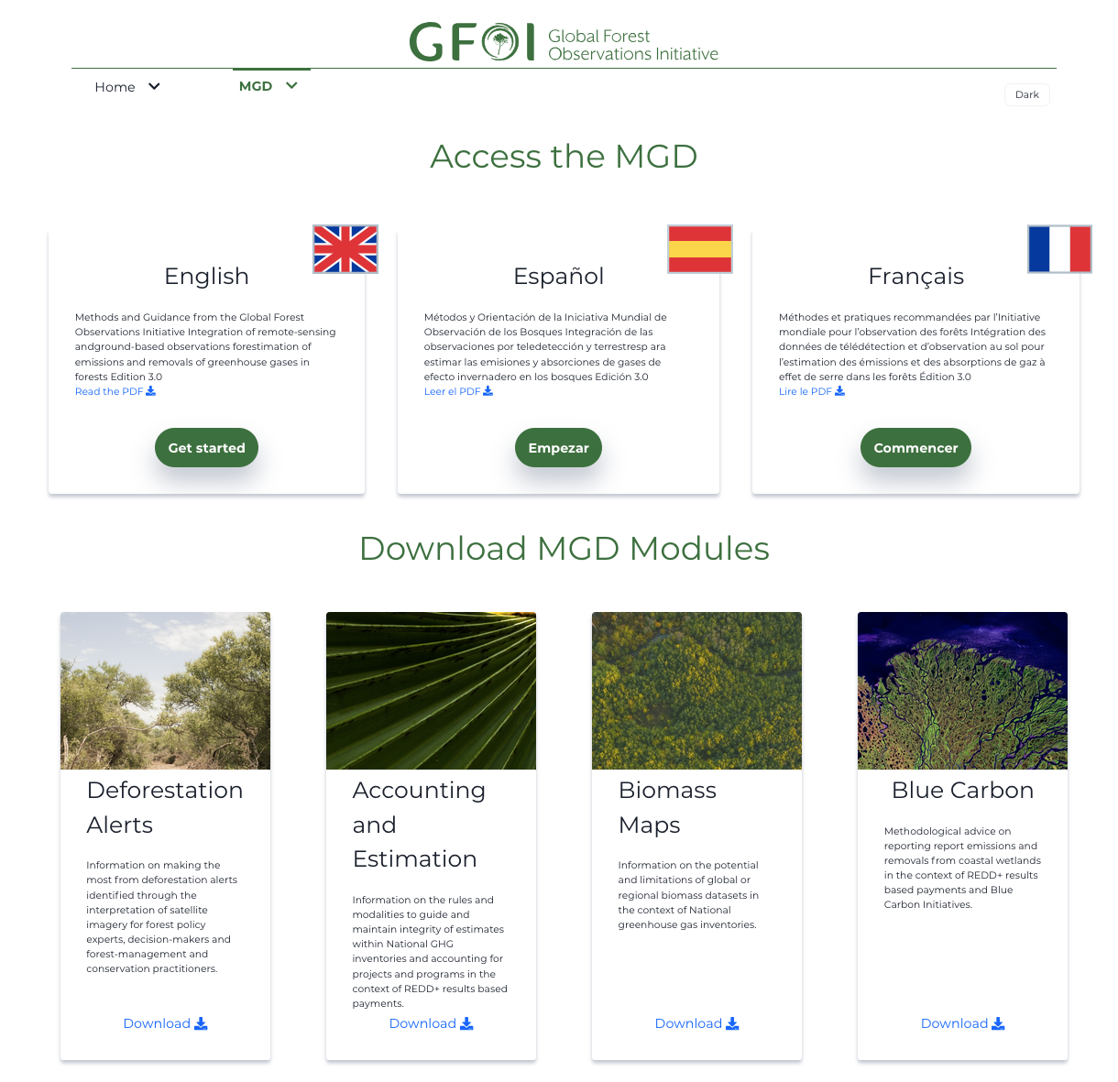
Action 2.6 / 2.8 / 3.1 Guidance efforts on informed uptake of space-based biomass products - JAXA support to GFOI MGD
JAXA support to the GFOI Methods & Guidance Document (MGD) Advisory Group.
Guidance Documents released in 2025:
The use of space-based forest biomass-related data in MRV procedures
Advice on the inclusion of Blue Carbon in Greenhouse Gas Inventories and relationship with REDD+ reporting

Slide 32
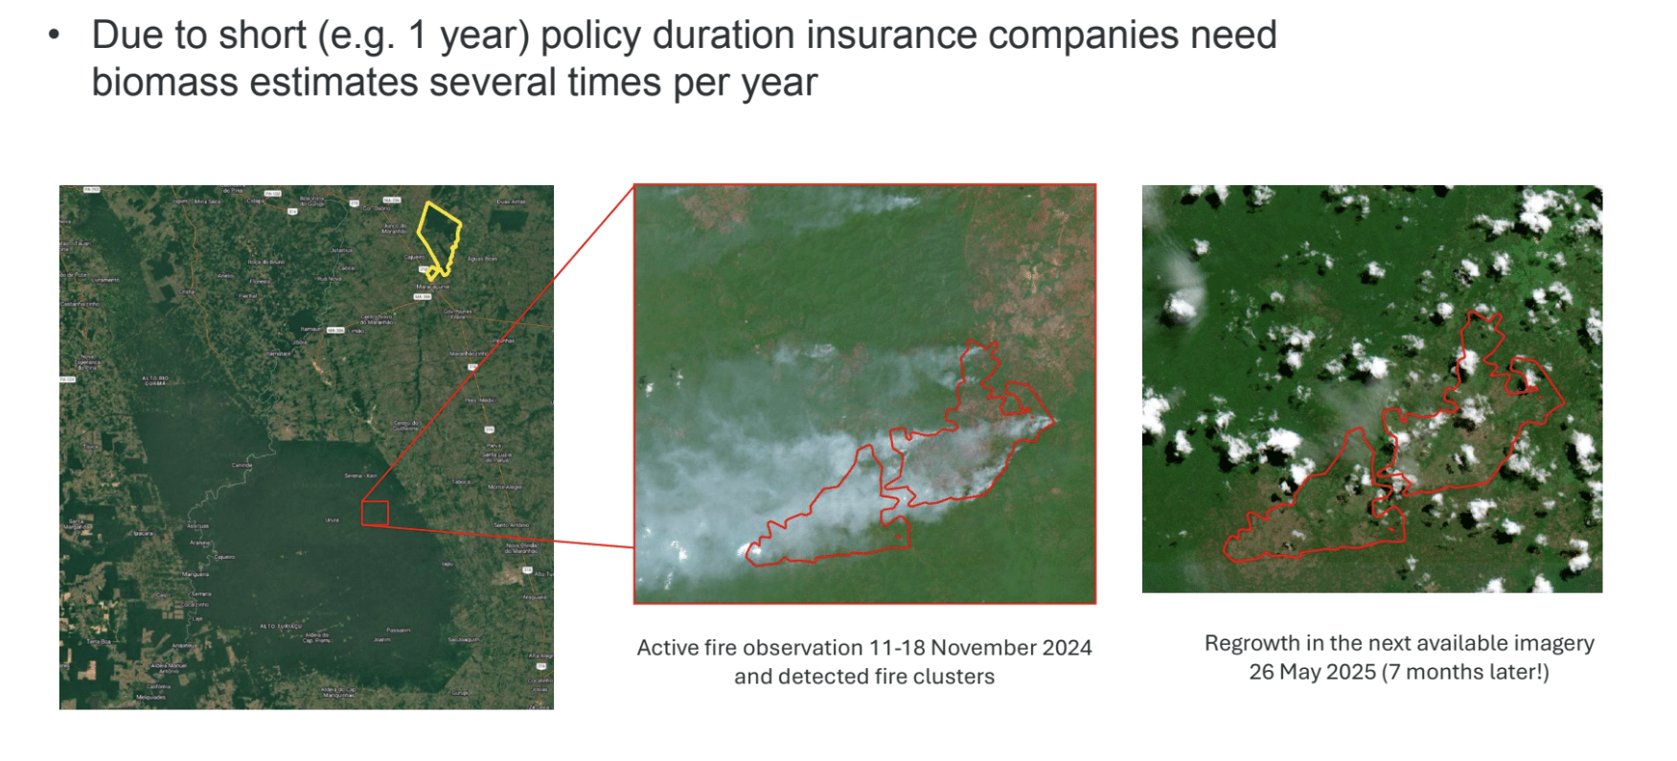
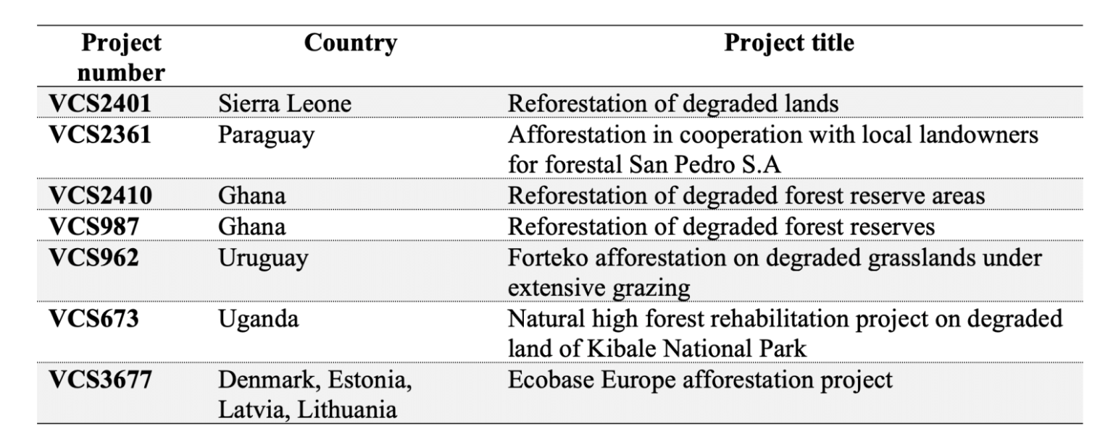


Action 2.d ESA CarbonEYE Project
ESA’s CarbonEYE project brings forest carbon / biomass maps to the carbon markets

Slide 33
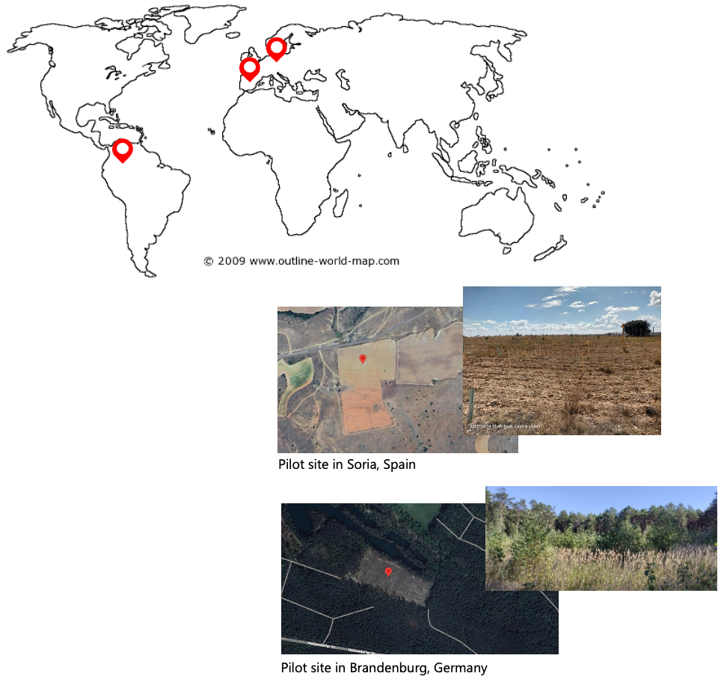
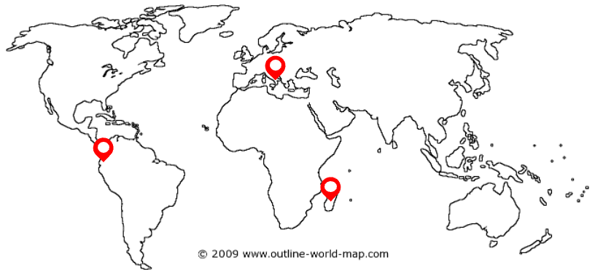
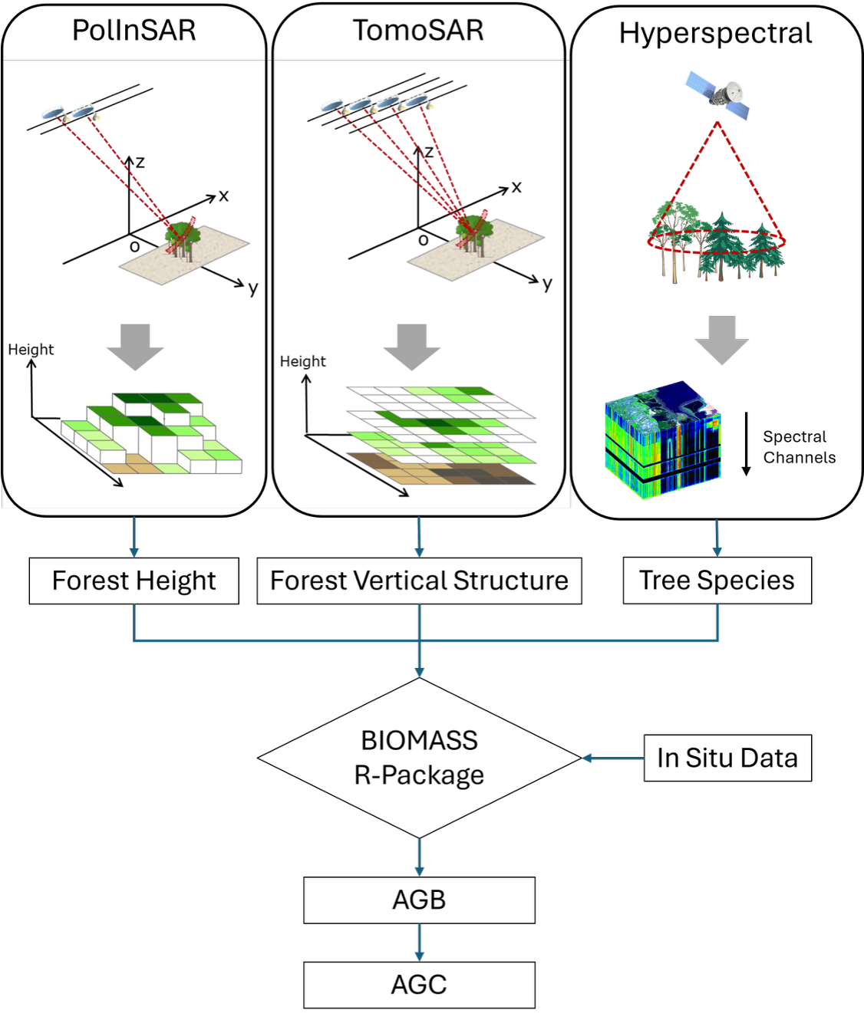
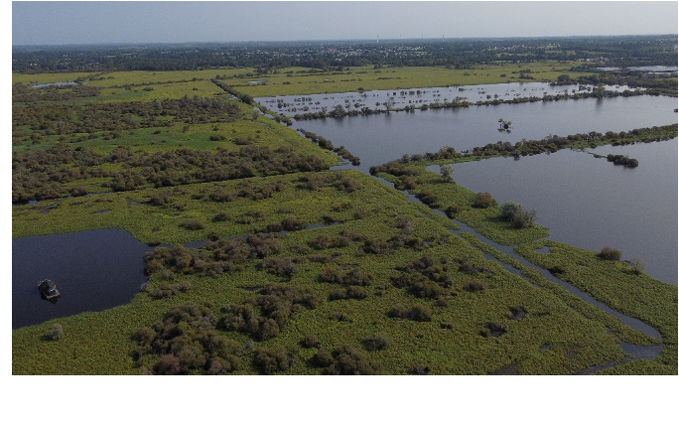
Action 2.d Earth Observation in support of Carbon Markets
Planting of trees on degraded land
Soil Carbon in Mineral Soils and Agroforestry
Rewetting of Peatlands

Slide 34
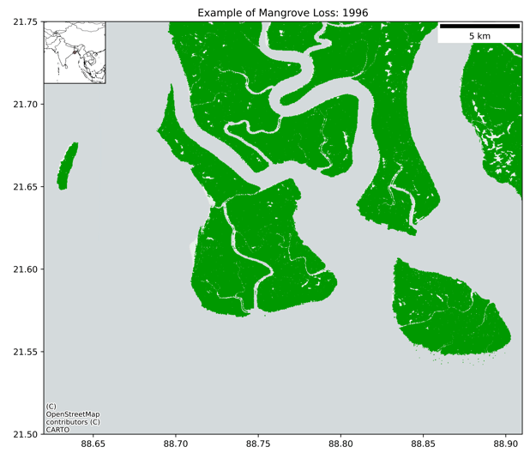

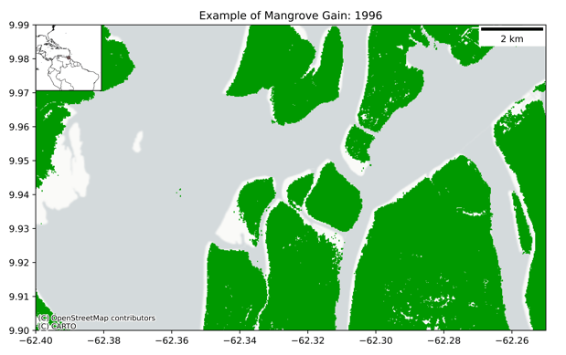
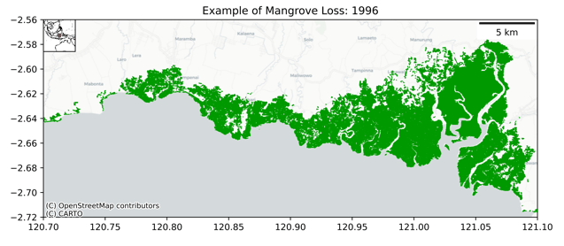

GFOI Core Satellite Data Continuity
5: Systematically target activities to support IPCC Land Cover classes
5.3: Review and consolidate current approaches to characterising, mapping and monitoring Blue Carbon Ecosystems.
5.4: Explore development of new CEOS initiatives on wetlands mapping and monitoring … Highlight the uptake of the Global Mangrove Watch
5.5: Establish closer collaboration with the Ramsar Convention Secretariat and Scientific and Technical Review Panel (STRP).
Global Mangrove Watch
The Global Mangrove Watch – A consistent global dataset of mangrove extent and changes over 4 decades (1985–2025) generated from a combination of optical (Landsat, S-2) and SAR (JERS-1, ALOS, ALOS-2) data.
Activity Data: Annual layers of mangrove gains and mangrove losses.
Non-anthropogenic losses: Erosion
Gains:
Sedimentation
Anthropogenic losses: Land conversion

Slide 35
CEOS-ARD Directly Supporting AFOLU Goals
“For our Global Mangrove Watch (GMW) data workflow where we process thousands of images, the CEOS-ARD standard used for the JERS-1/ALOS/ALOS-2 SAR data from JAXA has simplified our processing chains with data now provided as GeoTIFFs and with standardised metadata. The specified pre-processing, including geometric rectification and radiometric terrain correction, has also been a significant help and reduced our internal data processing effort.”
Dr Pete Bunting, Global Mangrove Watch Product Lead, Aberystwyth University, UK
0: Ensure countries have access to satellite data from CEOS Agencies to report to UNFCCC following IPCC guidance
0.2: Ensure all relevant data are accessible through web portals plus physical media where necessary. Promote wider adoption of CEOS-ARD, within and beyond CEOS

Slide 36
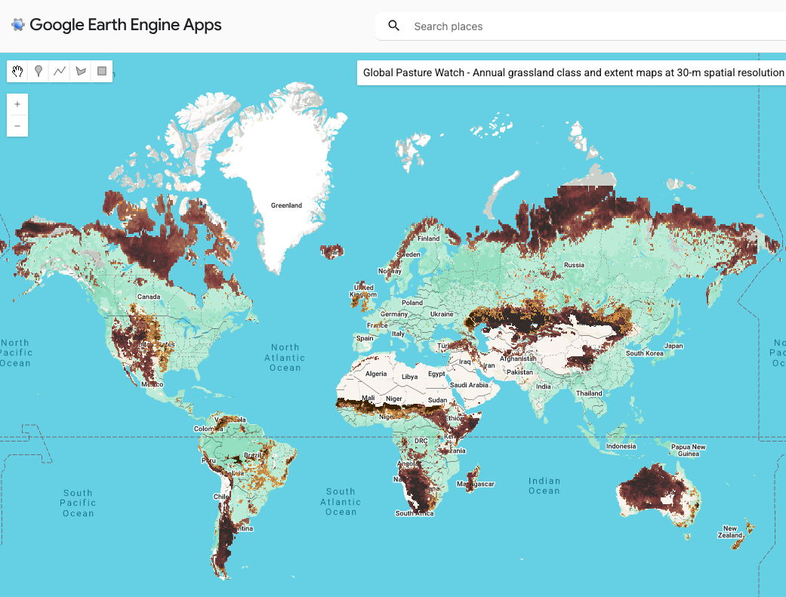
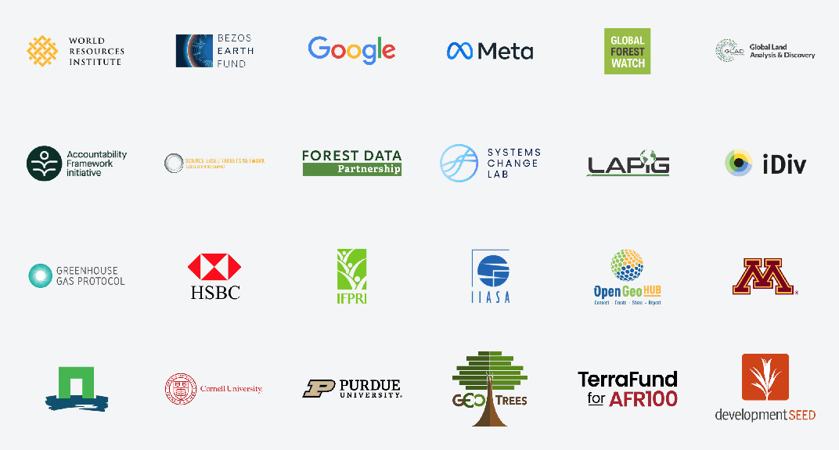

Recommendation 5: Systematically target activities to support IPCC Land Cover classes. Actions 5.6: Rangelands
❖ Action 5.6: Improve rangeland mapping including via better classification of grasslands and rangeland (Continental, Africa) & linkage with other organisations
Global Pasture Watch (World Resources Inst.):
Annual grassland class and extent maps at 30-m spatial resolution (2000—2024)
Part of Land & Carbon Lab consortium

