Slide 1
CEOS SIT-41
April 2026
Expanding Geostationary Atmospheric Composition Satellite Constellation: Towards Global Coverage
Emma Knowland &
Ali Omar, NASA
Session 7.5
CEOS SIT-41 2026
Irvine, California, USA
14-16 April 2026

Slide 2
Expanding Geostationary Atmospheric Composition Satellite Constellation: Towards Global Coverage
GENESIS
In 2024, CEOS AC-VC commissioned a new White Paper
The initial goal was to complement GEMS, TEMPO, and Sentinel-4 with global air quality and greenhouse gas observations
A dedicated team has been meeting bi-weekly to draft the document
The initial plan was presented at the October 2025 CEOS SIT Meeting
Following this meeting, the scope was reduced to focus exclusively on air quality
A finalized White Paper will be ready for the 2026 SIT Fall meeting for review by the Principals.

Slide 3
Study Co-Authors
Ali Omar, Emma Knowland, Jonathan Hickman, Barry Lefer, NASA
Shobha Kondragunta*, Owen Cooper, NOAA
Pieternel Levelt*, UCAR/NCAR, KNMI, TU Delft
Shima Shams, Helen Worden, James Hannigan, UCAR/NCAR
Arlindo DaSilva, NASA Emeritus
Sheldon Drobot, Dennis Nicks, BAE
Raid M Suleiman, Xiong Liu, CfA | Harvard & Smithsonian
Omar Emam, Intopass, UK
Ray Nassar, Chris Sioris, ECCC
Dominika Czyzewska, EUMETSAT
Ben Veihelmann, ESA, the Netherlands
Paulo Artaxo, University of Sao Paulo, Brazil
Betsy Farris, University of Colorado, Boulder
Sara Basart, WMO, Geneva
Ana Andries, Surrey University, UK
Jun Wang, University of Iowa
Dylan Millet, University of Minnesota, Twin Cities
*White Paper Co-Leads

Slide 4
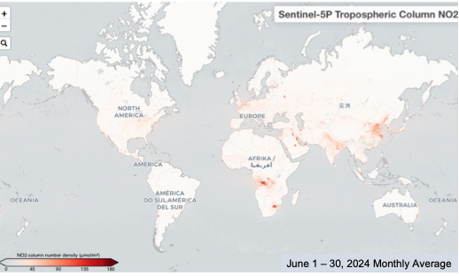
The Challenge – Addressing the Gap in Observations
Human activities drive rapid atmospheric changes.
The fast pace of change requires hourly observations.
These shifts directly impact air quality and human health.
Accurate measurements are vital to guide actions and evaluate the success of current strategies
Tropospheric Nitrogen dioxide (NO₂ ) column concentration retrieved by Sentinel 5P for the month of June 2024. High column densities ( denoted by bright red colors ) over the South Africa are associated with high power plant and industrial emissions in the region. Elevated column densities over south equatorial Africa are associated with dry season biomass burning activity

Slide 5
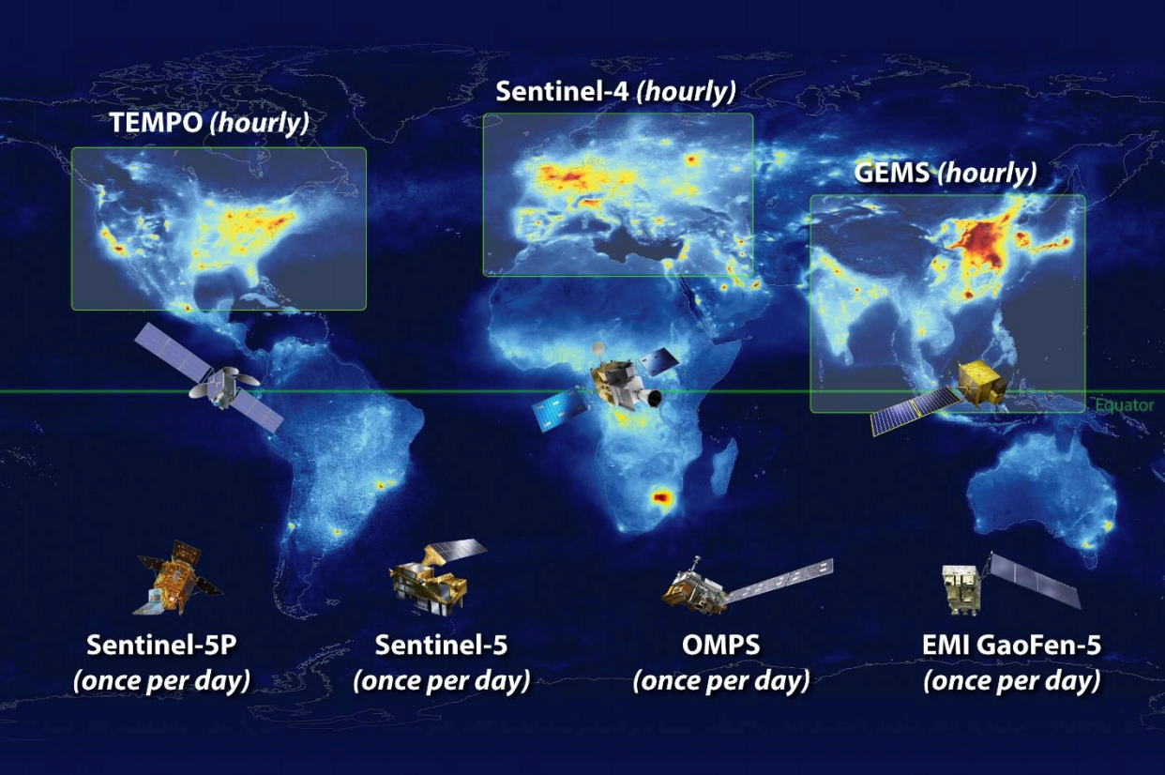
The Current Landscape
  The CEOS Atmospheric Composition Virtual Constellation (AC-VC) partners provide valuable data
  Gaps remain in observing diurnal cycles, rapidly changing events, and specific pollutants in the SH and populated NH regions
  Polar-orbiting satellites offer global coverage, but limited temporal resolution

Slide 6
Closing the Gap: The Global Geostationary Satellite Solution
  Five new geostationary satellites identified to cover the gaps
  Continuous, wide-area coverage over currently undermonitored regions
  Complementing and enhancing existing constellation
  Significant ownership and participation at the regional level to build capacity
  Leverage the Analysis Ready Data (ARD) concepts for Geo
Geo-ISC
MEASMA
Geo-N
Geo-SA
Geo-AUS
Geo-S
The benefits of investing in geostationary atmospheric composition monitoring extend far beyond the science. By improving our ability to predict and respond to environmental challenges, we can realize significant economic savings in areas such as healthcare, agriculture, and resource management.

Slide 7
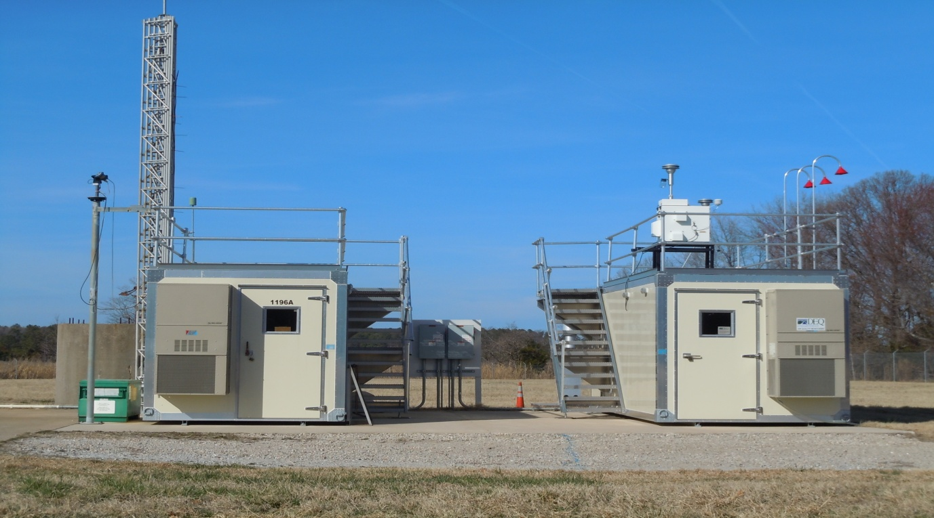
Strengthening Ground-Based Measurements for Calibration/Validation
Leverage existing ground-based networks (e.g., AERONET, Pandonia, NDACC).
Establish strategically located collection of instruments at relevant sites
Focus on comprehensive instrumentation and local capacity building.
Engage diaspora scientists to reach local institutions (e.g., AMS Townhall Jan 2025) in developing countries
Credit: Ali Omar
  The disparity in atmospheric composition ground-based measurements around the globe creates an issue, as unmonitored regions are often disproportionately impacted by pollution but lack the resources to monitor and mitigate the impacts effectively.

Slide 8
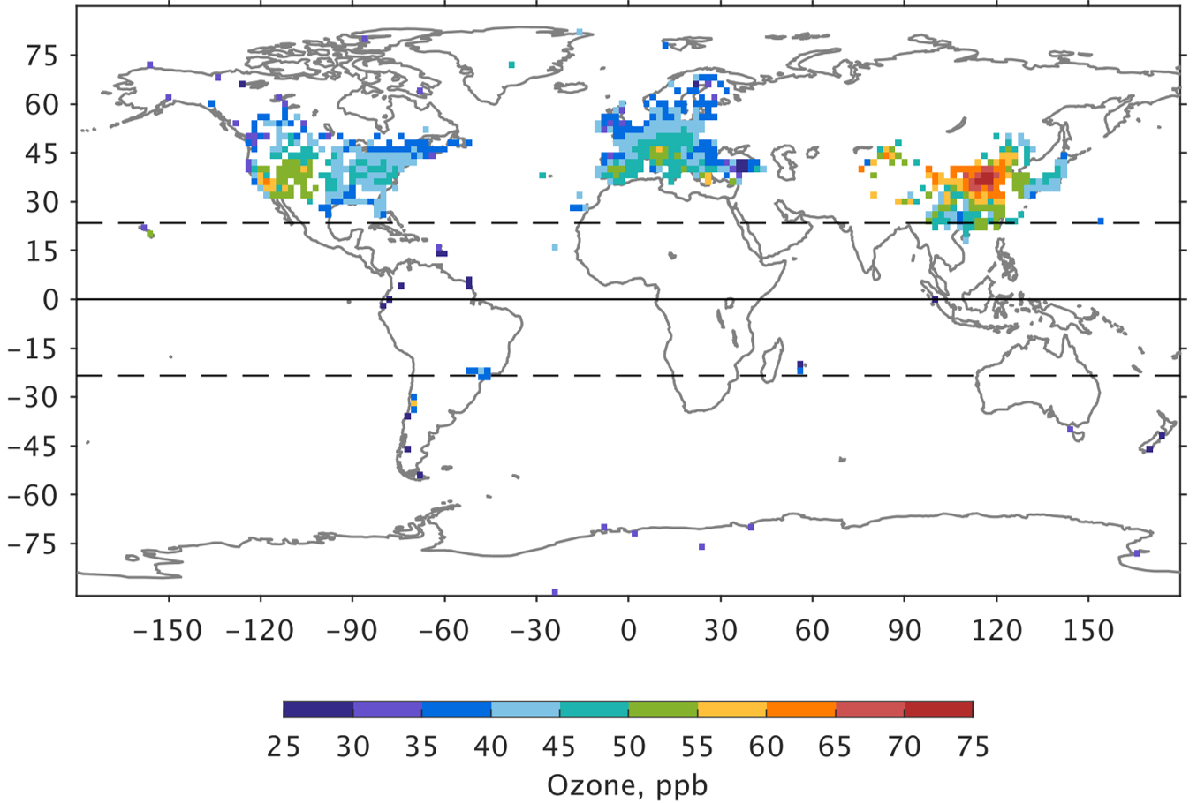
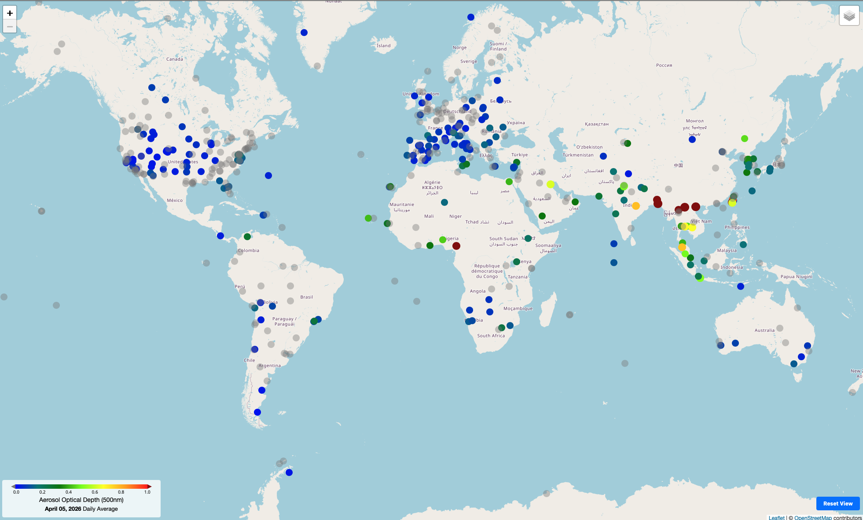
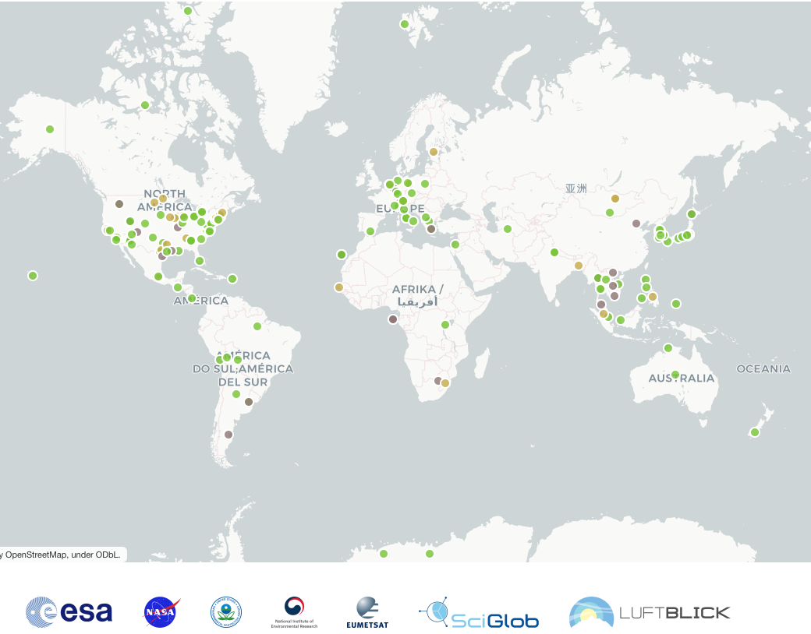
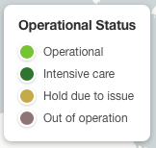

Ground Stations for Monitoring Ozone, Nitrogen dioxide, and Particulate Matter
All available surface ozone (O₃) observations from the Tropospheric Ozone Assessment Report (TOAR). Note that Ozone monitors exist in Australia but are not yet in the open-access TOAR-II database (Szopa et al., 2026)
Pandonia Global Network (PGN) – Trace gases NO₂, O₃, HCHO, etc
AERONET – Optical Depth (proxy for PM)
TOAR-II
AERONET
Strengths
Uniform and standardized
Algorithms /data processing
Instrument operating routines
Quality control
Real-time data processing
Data archiving
PANDONIA
Geostationary observations will provide data in regions not covered by ground networks

Slide 9
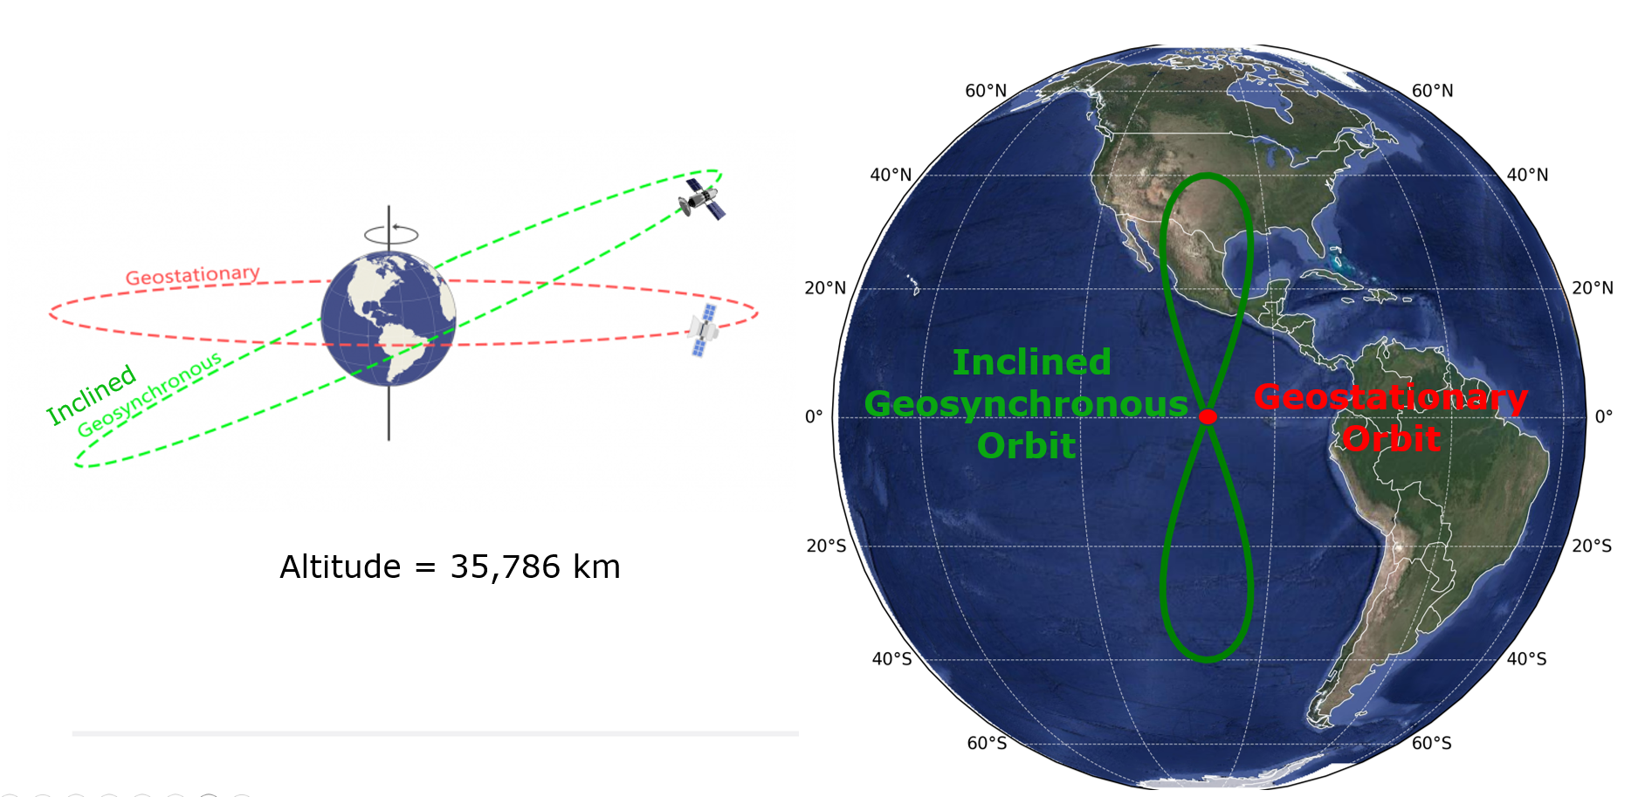
Inclined Geosynchronous Orbits (IGOs)
ECCC has proposed the use of Inclined Geosynchronous Orbits (IGOs) to observe under monitored regions at high northern latitudes

Slide 10
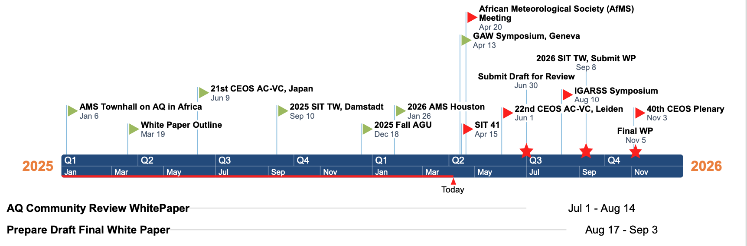
Schedule
Major Milestone/Deliverable

Slide 11
Decisions, outcomes, or actions sought
  • Update the SIT on current status and strategic objectives of the Expanding Geostationary Atmospheric Composition Satellite Constellation: Towards Global Coverage white paper.
  • Highlight the urgent, global need for improved atmospheric composition monitoring capabilities.
  • Emphasize the vital importance of deploying geostationary satellites to complement existing polar-orbiting systems.
  • Solicit volunteer subject matter experts and reviewers to author and review sections of the white paper
  End goal – Gain SIT endorsement of the White Paper (Oct 2026)
  Join our team if you want to participate as author or reviewer
  Write to: ali.h.omar@nasa.gov

Slide 12
Backup slides

Slide 13
Outline of White Paper and this Presentation
01
THE CHALLENGE
02
CURRENT LANDSCAPE
Observation Gap
Limitations of existing observations
03
CLOSING THE GAP
04
Air Quality GAPS
Geostationary Solution
The case for Geo Observations
05
COMMERCIAL DATA
06
GROUND TRUTH
Opportunities and Limitations
Strengthening ground-based monitoring in undermonitored regions
07
SYNEGISTIC BENEFITS
08
A CALL TO ACTION
Integrated Observations plus Modeling
Case for improved atmos. composition observations

