Slide 1
CEOS SIT-41
April 2026
WGCapD & EOTEC DevNet
Yasha Moz, NASA
Agenda Item #7.6
CEOS SIT-41 2026
Irvine, California, USA
14-16 April 2026

Slide 2
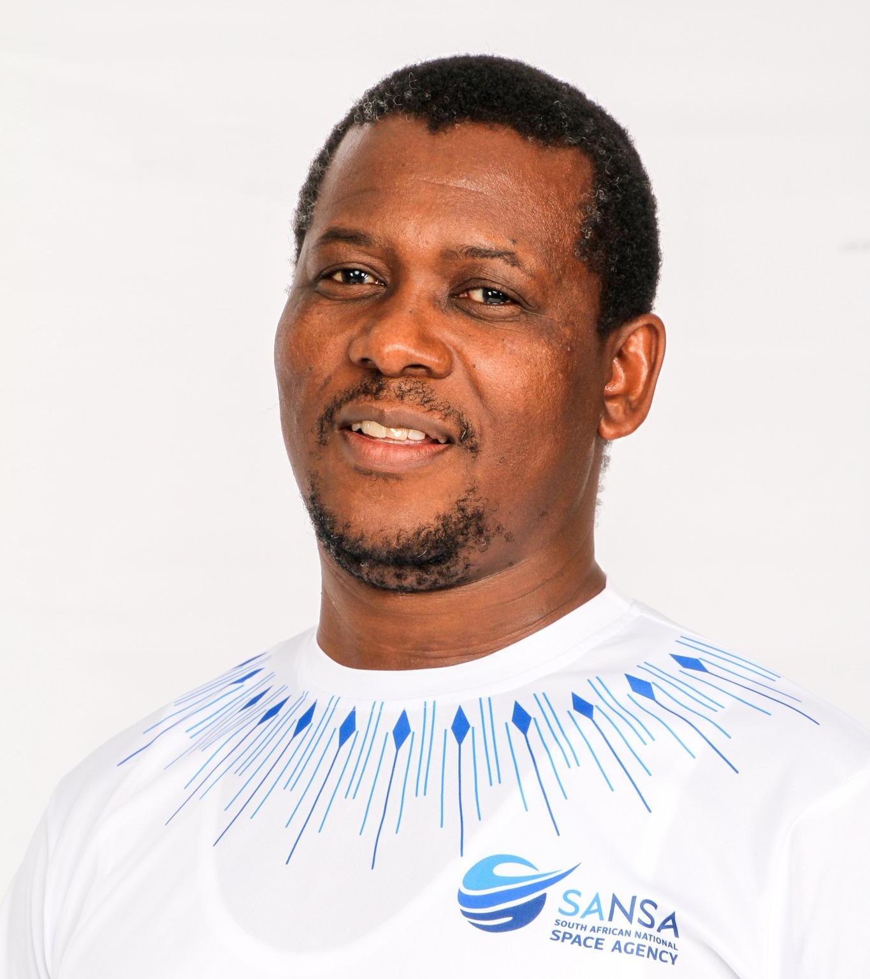
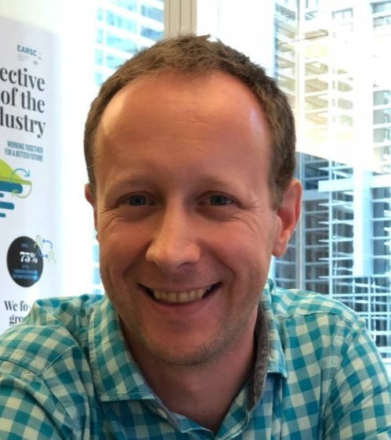

WGCapD Leadership
Dan Matsapola (SANSA) WGCapD Chair 2024/25 stayed on for an additional year in 2026 to support transition
Christoph Aubrecht (ESA) WGCapD Vice Chair 2026 to serve as Chair 2027/28
A WGCapD Vice Chair for 2027/28 needs to be identified, for nomination and approval at the Plenary in Nov’26

Slide 3
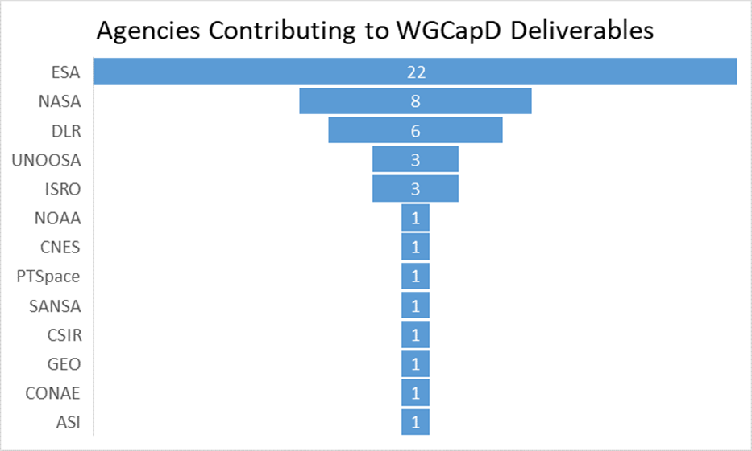
Work Plan Contributions
WGCapD member agencies are currently working to execute 16 deliverables
13 deliverables were closed since the last SIT-TW
Examples include:
Copernicus User Uptake in Africa (DLR, UNSPIDER, NASA)
Hyperspectral Remote Sensing Training (ESA, DLR, ASI, NASA)
Polarimetric SAR Training Course (ESA, ISRO)
PUMAS training on the joint utility of Sentinel-1 and SAOCOM-1 (ESA, CONAE)
Guidance for Conducting Needs Assessments for Capacity Building (NASA, UNOOSA)
UN/UNU-INWEH/CEOS Training on Resilience and Humanitarian Aid (ASI, CNES, DLR, ESA, UNOOSA)
Notes:
After closing out 13 deliverables since last year’s SIT-TW, WGCapD member agencies are currently working to execute 16 deliverables. UNI-INWEH stands for United Nations University Institute for Water Environment and Health

Slide 4
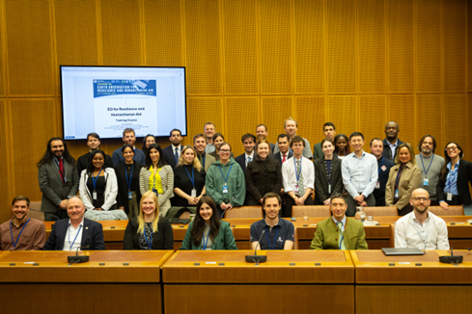
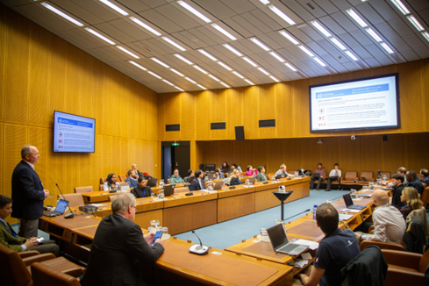
CB-26-01: UN/UNU-INWEH/CEOS Training on Resilience and Humanitarian Aid
Objective: build and expand EO capacity in UN entities
Venue: United Nations in Vienna + Online, 23-27 March 2026
Contributing CEOS members: ASI, CNES, DLR, ESA, UNOOSA
In-kind contribution from all members (e.g. speakers, venue, coffee breaks), no exchange of funds
Special thanks to Dave Borges, Libby and Harvey for the great CEOS Social Media Coverage!
Training content:
Day 1: Introductory Day (open to Embassies in Vienna)
Day 2: VHR Optical and Machine Learning
Day 3: Synthetic Aperture Radar
Day 4: Hyperspectral
Day 5: Medium-resolution – use of different data sources
Format:
Mix of 50% theoretical / 50% practical
Maximum capacity 30 persons (in person and online) to keep practical sessions manageable
Certified by United Nations University and UNOOSA

Slide 5
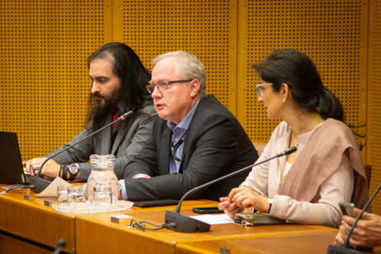
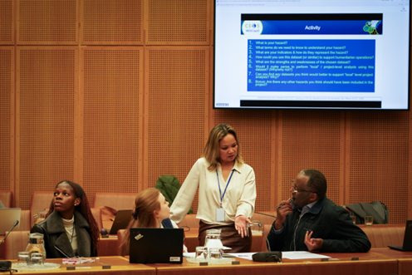
CB-26-01: UN/UNU-INWEH/CEOS Training on Resilience and Humanitarian Aid
17 Organizations took part:
Food and Agriculture Organization (FAO), United Nations Office on Drugs and Crime (UNODC), United Nations Development Coordination Office (UNDCS/RCS), United Nations Environment Programme (UNEP), United Nations Office for Project Services (UNOPS), World Meteorological Organization (WMO), UN Economic Commission for Africa (UNECA), United Nations Industrial Development Organization (UNIDO), International Atomic Energy Agency (IAEA), United Nations Office for the Coordination of Humanitarian Affairs (OCHA), United Nations Institute for Disarmament Research (UNIDIR), UN Interim Force in Lebanon (UNIFIL), Office of the United Nations High Commissioner for Human Rights (OHCHR), Economic and Social Commission for Asia and the Pacific (UNESCAP), UN Office of Counter-Terrorism (UNOCT), United Nations Office for Outer Space Affairs (UNOOSA), World Bank. 23 Embassies attended Day 1:
Algeria, Argentina, Australia, Austria, Brazil, Chile, China, Colombia, Cote D’Ivoire, Ecuador, El Salvador, Israel, Italy, Iraq, Japan, Kenya, Malta, Panama, Peru, Slovakia, Spain, Sri Lanka, Türkiye.

Slide 6
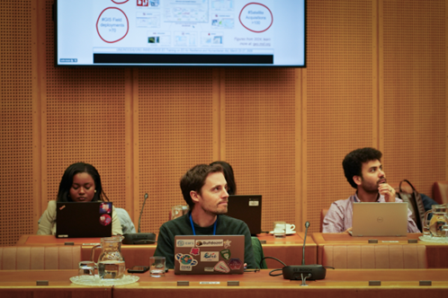
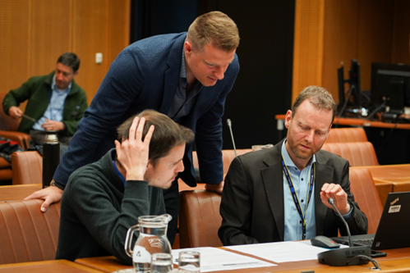
CB-26-01: UN/UNU-INWEH/CEOS Training on Resilience and Humanitarian Aid
Positive points:
Strong satisfaction with the training (mean overall rating 4.73/5)
Participants recognized the high-quality lecturers and the clarity of explanations were praised across nearly all responses
Relevance and usefulness of EO content for their own work
Diversity of the topics
Improvements:
Need more time for practical sessions.
Installing software in the UN IT environments is a challenge
Increase pre-training materials
Requests:
New editions of the training were demanded (e.g. annual basis)
Demand for deeper technical modules, including hyperspectral, SAR and multi-sensor analysis.
Main takeaway - it was amazing!

Slide 7
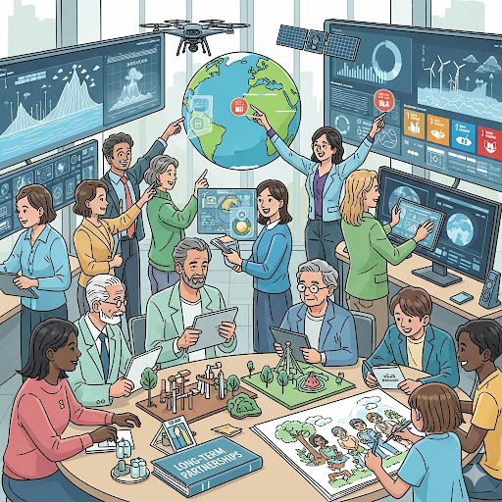
Update on WGCapD Priorities
Shift from one-time joint trainings or webinars to sustained long-term collaborations
Addressing capacity building beyond training
Focus on capacity building of underrepresented communities
South Africa & Australia collaboration on CEOS In Schools webinars on monitoring fires & water quality from space
Promoting cross-cutting deliverables that involve more than just two agencies
Engaging more CEOS members who are not yet involved in WGCapD
New deliverable with AfSA and outreach to PhilSA
Prioritize capacity development of decision- and policy-makers for greater impact
Incorporate new AI tools and best practices to support capacity building efforts
Strengthen collaborations with Working Groups on Disasters, Climate, WGISS, and others

Slide 8
Working Group Engagements
WG Climate
Form a joint WGClimate-WGCapD coordination team to address capacity building in the climate domain
Explore ways to support UNFCCC’s Capacity Building Portal
Prioritize skills transfer, enabling local stakeholders to develop and maintain tools/service and create commercial opportunities
WG Disasters
Collaboration on capacity building for New Pilots
Drought Pilot initiative proposed by CONAE and co-lead by ASI
Biodiversity pilot through the new Biodiversity VC
The Humanitarian and Resilience training had strong DRM components and linked well to WG Disasters
Plans to jointly identify capacity building needs
WGCapD member agencies will be encouraged to submit deliverables in the climate/disasters domains
Continue/resume joint efforts to collect existing capacity building materials and identify any gaps
Notes:
After closing out 13 deliverables since last year’s SIT-TW, WGCapD member agencies are currently working to execute 16 deliverables.

Slide 9
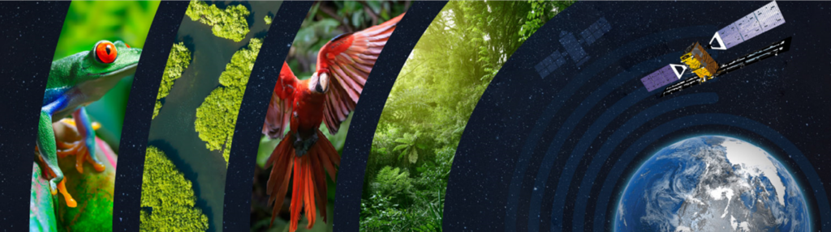
Additional Engagements
Biodiversity VC
First connection established with the new Biodiversity VC
Clear needs for capacity building activities and agreement to coordinate (e.g. ESA and NASA active in both WGCapD and Biodiversity VC)
Indigenous Communities
Link established to GEO Indigenous Alliance with clear needs identified
Contribution to recent GEO Indigenous Summit
Links not only to capacity building but also to the data democracy element of WGCapD
Notes:
After closing out 13 deliverables since last year’s SIT-TW, WGCapD member agencies are currently working to execute 16 deliverables.

Slide 10
EOTEC DevNet: 5 Years of Extending WGCapD Reach
🌟2026🌟
2,280+ people involved
Quarterly CoP meetings with 50-70% repeat attendance
Collecting, organizing, sharing training resources via website, trackers and social media
Endorsed by CEOS SIT-36
Founding partners committed
First regional CoP task team meetings
First regional CoP Flood WG meetings
First regional CoP Drought WG meetings
March 2021
June 2021
April 2022
April 2025
Notes:
Very happy that EOTEC is marking its 5th year this year.
This slide gives you a sense of the timeline.
The idea came from WGCapD. A handful of people including Senthil Kumar of ISRO and Nancy Searby of NASA build the partnership with the global partners you see here.
CEOS - Committee on Earth Observation Satellites
UNOOSA - United Nations Office for Outer Space Affairs
GEO - Group on Earth Observations
WMO - World Meteorological Organization (Training and Education)
WMO-CGMS Vlab
We have accomplished a lot. Today we have more than 2000 people involved in the network (through meeting attendance, social media, or newsletter distribution.)
Vibrant regional and thematic CoPs; we have hosted meetings for 940+ participants with 50–70% repeat attendance.

Slide 11
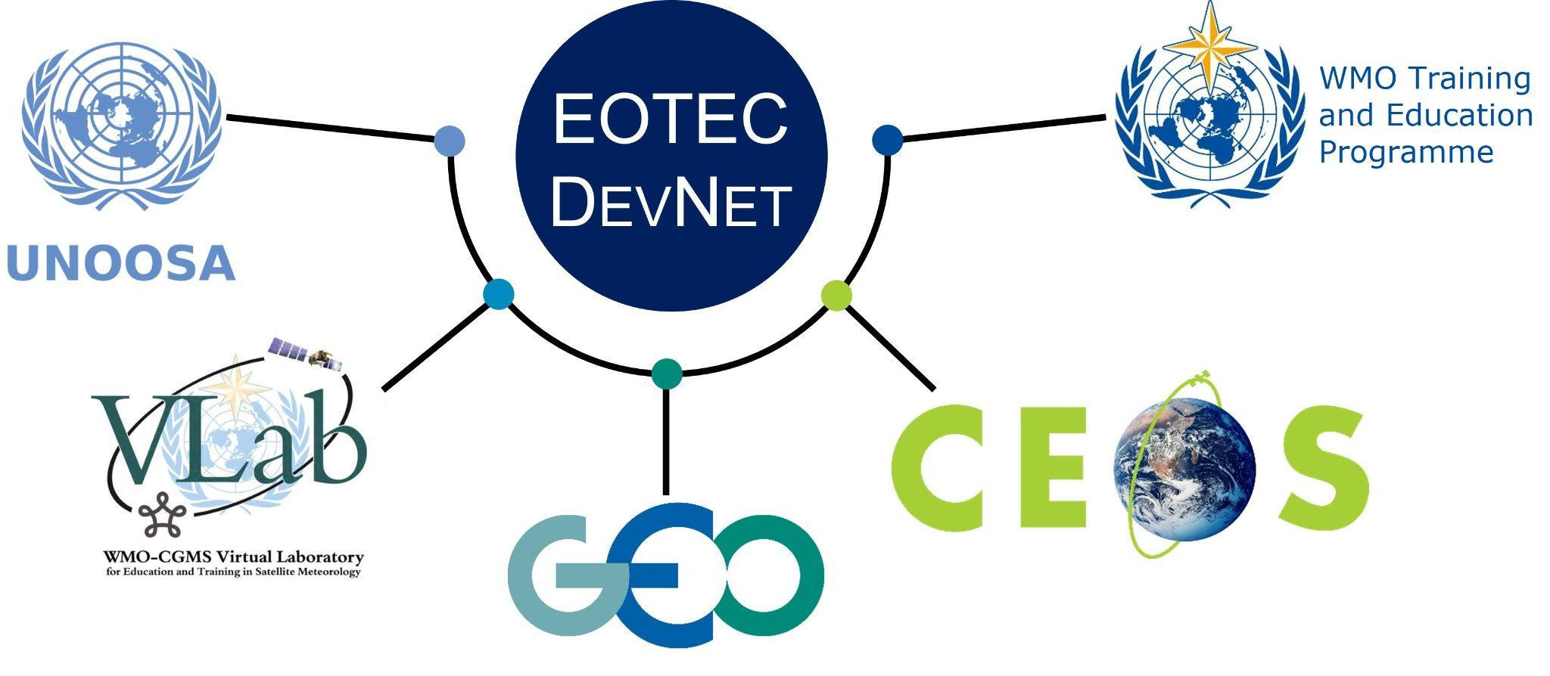
5 Global Networks
Facilitating exchanges across the networks
Quarterly meetings of the Global Task Teams
Integration in each others’ workplanning:
WMO Integrated Drought Management Programme (IDMP) annual meeting action items include collaboration with EOTEC on Drought Trackers
EOTEC is included in VLab long-term strategy
Active participation in WMO CONECT and UN Space4Water initiatives
Relentless promotion of training resources and opportunities across the networks via CEOS Training Calendar and social media
Notes:
Very happy that EOTEC is marking its 5th year this year.
This slide gives you a sense of the timeline.
The idea came from WGCapD. A handful of people including Senthil Kumar of ISRO and Nancy Searby of NASA build the partnership with the global partners you see here.
CEOS - Committee on Earth Observation Satellites
UNOOSA - United Nations Office for Outer Space Affairs
GEO - Group on Earth Observations
WMO - World Meteorological Organization (Training and Education)
WMO-CGMS Vlab
We have accomplished a lot. Today we have more than 2000 people involved in the network (through meeting attendance, social media, or newsletter distribution.)
Vibrant regional and thematic CoPs; we have hosted meetings for 940+ participants with 50–70% repeat attendance.

Slide 12
5 Communication Channels
www.eotecdev.net
Social media: LinkedIn, X/Twitter, and YouTube
Newsletter
Communications platform and region-specific messaging apps
Distribution through partner channels
Sample statistics | 2023 | 2024 | 2025 | Annual change (%)
People engaged in the network | 600 | 1,350 | 2,017 | +49%
LinkedIn followers | 123 | 1,154 | 2,113 | +76%
X followers | 276 | 401 | 499 | +11%
Views/website post | 4,111 | 12,646 | 17,699 | +40%
Notes:
Very happy that EOTEC is marking its 5th year this year.
This slide gives you a sense of the timeline.
The idea came from WGCapD. A handful of people including Senthil Kumar of ISRO and Nancy Searby of NASA build the partnership with the global partners you see here.
CEOS - Committee on Earth Observation Satellites
UNOOSA - United Nations Office for Outer Space Affairs
GEO - Group on Earth Observations
WMO - World Meteorological Organization (Training and Education)
WMO-CGMS Vlab
We have accomplished a lot. Today we have more than 2000 people involved in the network (through meeting attendance, social media, or newsletter distribution.)
Vibrant regional and thematic CoPs; we have hosted meetings for 940+ participants with 50–70% repeat attendance.

Slide 13
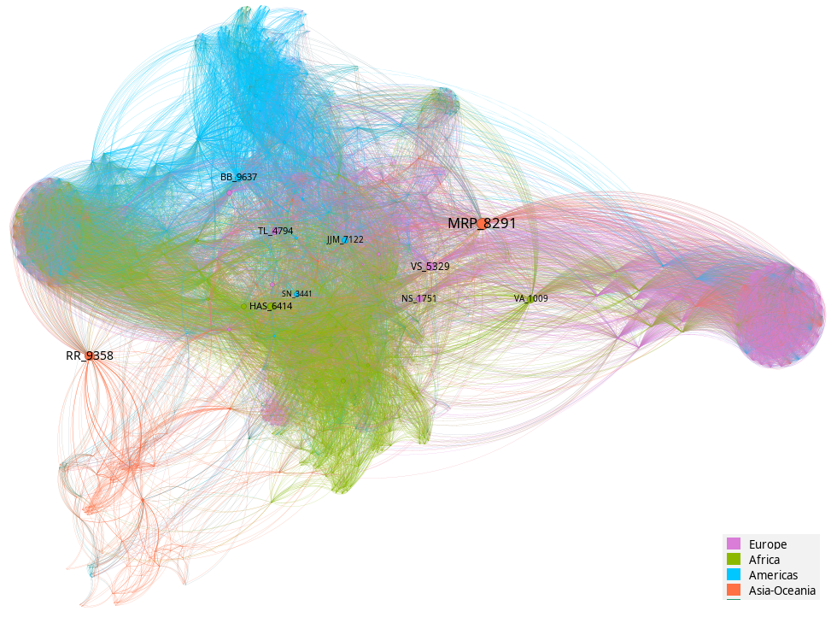
5 Insights from Social Network Analysis
A Truly Global "Network of Networks": EOTEC DevNet has successfully engaged 2,017 individuals from 609 organizations across 120 countries, with all five founding partner networks actively represented.
Resilient, Non-Hierarchical Structure: The network has a low centralization score (0.30), meaning coordination does not rely on a single leader; instead, leadership is distributed, making the network highly resilient to the loss of any single actor.
"Small-World" Communication Efficiency: With an average path length of 2.3, information typically requires only two "handshakes" to reach almost any participant, allowing for extremely rapid dissemination of knowledge across the global community.
Diverse Global Brokerage: Unlike many international initiatives, key structural "bridges" (participants who connect isolated clusters) are not heavily concentrated but are distributed across regions.
Strong Regional Integration: The network features a dense core where African and European participants are heavily interwoven, while the Americas and Asia-Oceania operate as cohesive regional "lobes" connected via key brokers.
Bipartite network projected to a one-mode network. Node size is proportional to betweenness score. Node color shows each participant’s region of affiliation.

Slide 14
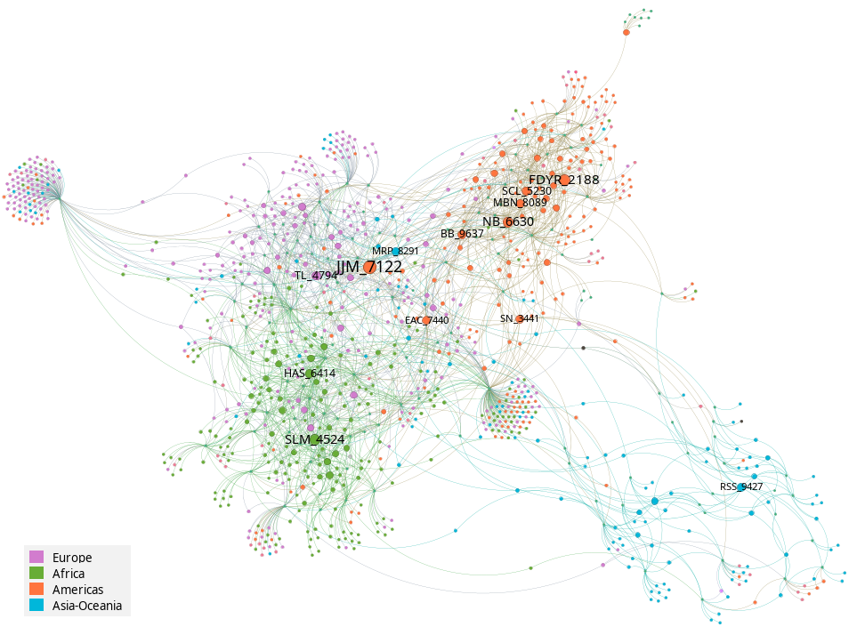
5 Recommendations for Management
Engage "Structural Bridges" for New Initiatives: When launching new projects, prioritize early engagement with identified high-betweenness participants to prevent "knowledge silos" and ensure cross-regional buy-in.
Utilize the Core as a Broadcasting Cohort: Rather than relying only on formal leaders, treat the high-closeness "dense core" as a distributed team of broadcasters to ensure information saturates the network through multiple parallel pathways.
Adopt Tiered Communication Strategies: To maximize efficiency, focus on a "Strategic Communications Core" of 15–20 key connectors; the network’s 2.3-step efficiency will naturally cascade information to the remaining participants.
Promote Inter-Agency Data Sharing: Integrating activity data between CEOS, GEO, WMO, and others with EOTEC DevNet’s will provide a morecomplete "network-of-networks" view and further reduce duplication of effort.
Targeted Outreach to Missing Stakeholders: Use the interactive dashboard to guide recruitment from under-represented groups, i.e. Small Island Developing States, development finance institutions, and major national data providers.
Bipartite network showing participant–meeting attendance, with participant nodes colored by continent of affiliation and sized by meeting attendance frequency.

Slide 15
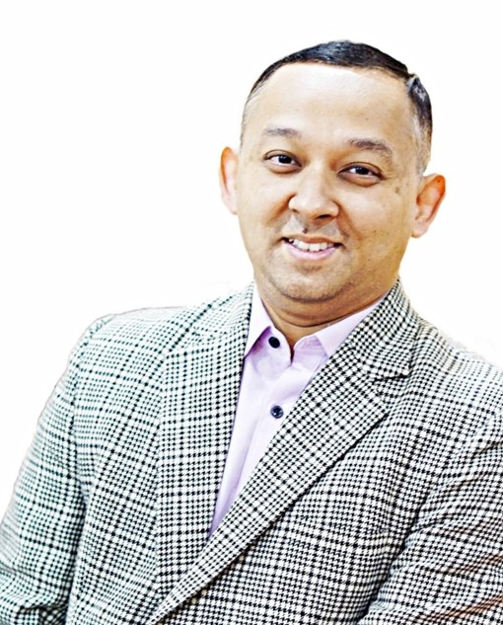
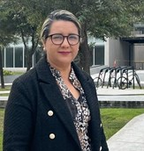
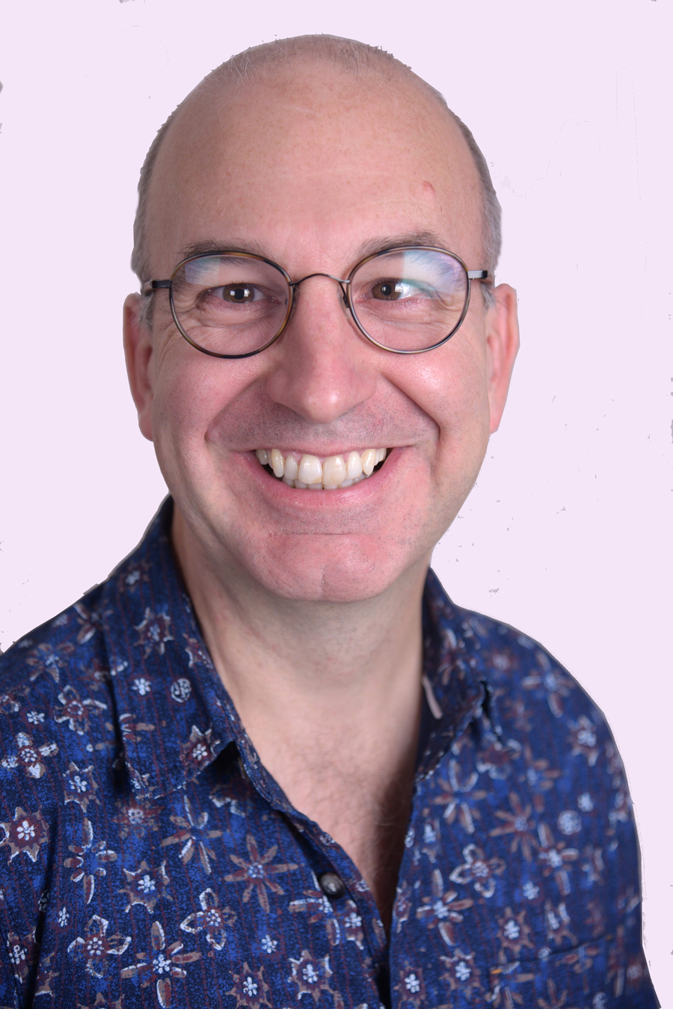
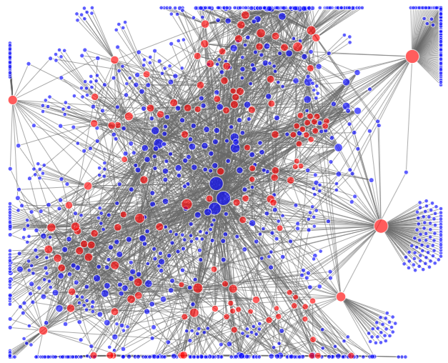
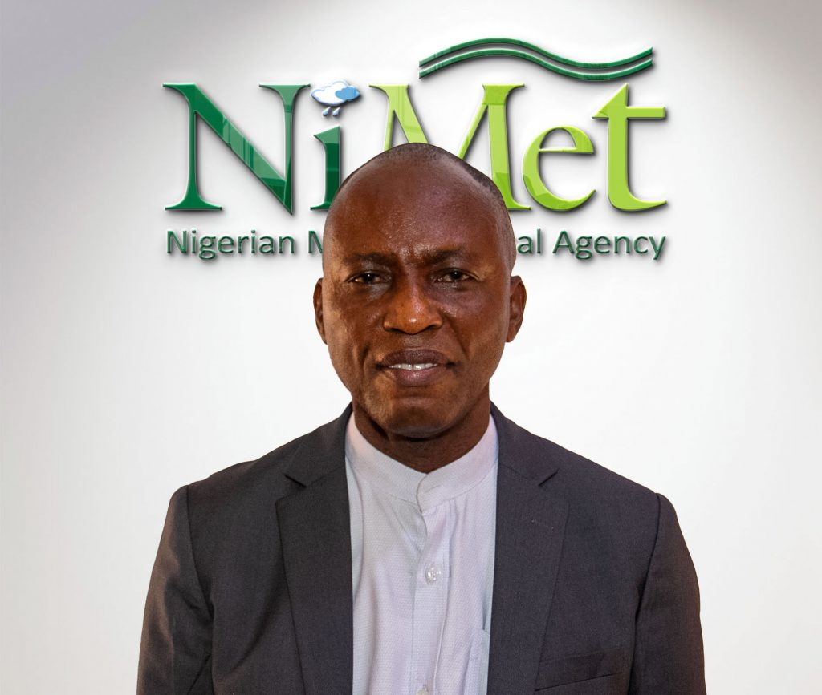
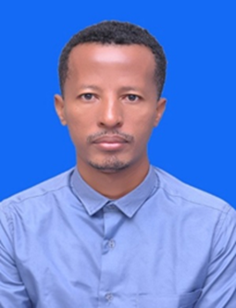
5 Committed Regional Leads
Rishiraj Dutta, ADPC
Asia Oceania
Fabiola D. Yépez Rincón, SELPER Americas
Mark Higgins, EUMETSAT
Europe
Effiom Oku, NiMet Africa
Terefe Hanchiso, Wolkite University Africa
Notes:
Very happy that EOTEC is marking its 5th year this year.
This slide gives you a sense of the timeline.
The idea came from WGCapD. A handful of people including Senthil Kumar of ISRO and Nancy Searby of NASA build the partnership with the global partners you see here.
CEOS - Committee on Earth Observation Satellites
UNOOSA - United Nations Office for Outer Space Affairs
GEO - Group on Earth Observations
WMO - World Meteorological Organization (Training and Education)
WMO-CGMS Vlab
We have accomplished a lot. Today we have more than 2000 people involved in the network (through meeting attendance, social media, or newsletter distribution.)
Vibrant regional and thematic CoPs; we have hosted meetings for 940+ participants with 50–70% repeat attendance.

Slide 16
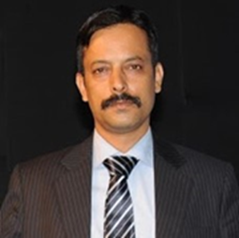
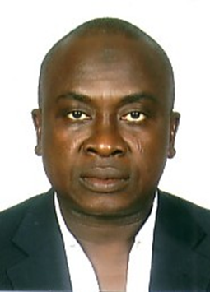
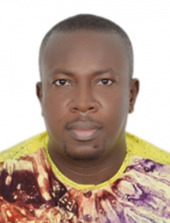
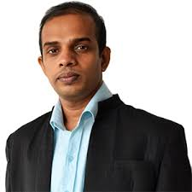
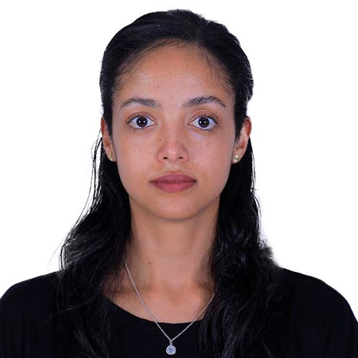
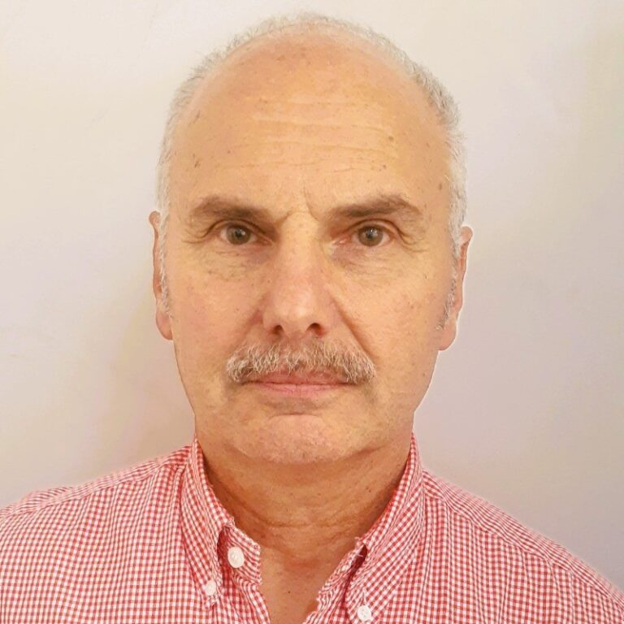
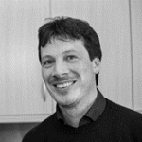
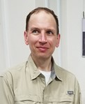
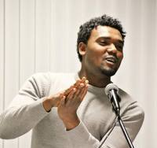
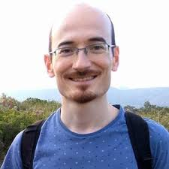
More Committed Leads…
Flood and Drought Working Groups
Target group: Technical + capacity development leaders from space + met agencies, national governments, researchers, regional science centers, NGOs
Goal: Knowledge sharing, identification of capacity gaps and collaboration on tools/guidance
FLOOD WG LEADS
DROUGHT WG LEADS
Ganiy Agbaje
GMES & Africa
Jean Danumah
CURAT, Abidjan
Susantha Jayasinghe
ADPC
Ethiopia Bisrat Zeleke
Florida International U., USA
CM Bhatt
IIRS/CSTEEAP
Álvaro Germán Soldano, CONAE
Luca Brocca
National Research Council of Italy
William Straka III
U of Wisc, CIMSS
Zemede Mulushewa Nigatu
Hawassa University, Ethiopia
Jaime Gaona García
National Research Council of Italy (CNR-IRPI)
Notes:
The Flood and Drought Working Groups present a good opportunity for collaboration and alignment with WG Disasters.
The Flood Working Groups are quite well established. The drought working were launched in 2023 and started meeting regularly last year,
The pictures are of the leads for each regional group - they come from those regions. And each one has been there since the start.

Slide 17
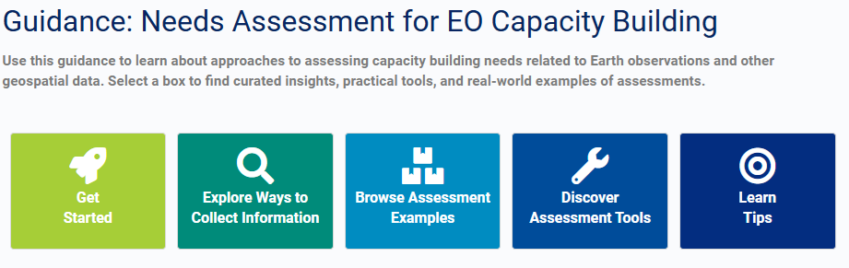
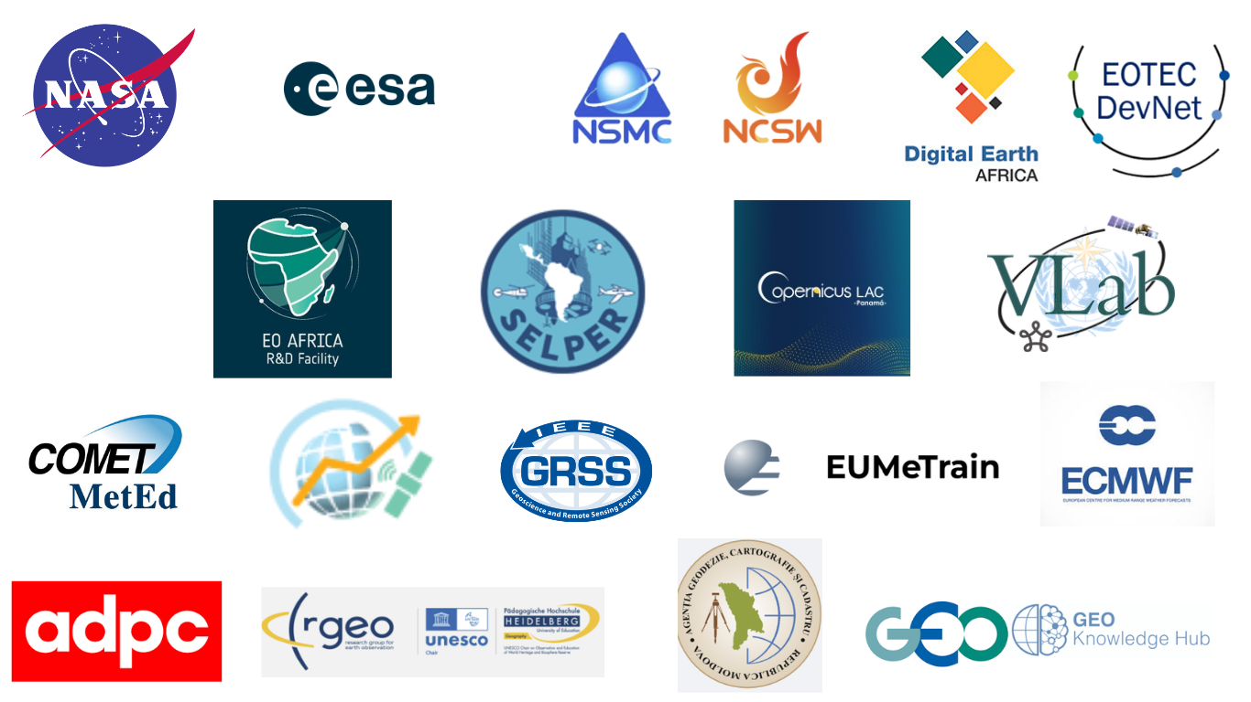
5 EOTEC DevNet Contributions
Places to Find Trainings
Needs Assessment Guidance
Flood & Drought Trackers
Thanks to CEOS SEO
Annual EO Providers Roundtables
Vibrant Community of Practice
50-70% of participants come back for more
Notes:
Very happy that EOTEC is marking its 5th year this year.
This slide gives you a sense of the timeline.
The idea came from WGCapD. A handful of people including Senthil Kumar of ISRO and Nancy Searby of NASA build the partnership with the global partners you see here.
CEOS - Committee on Earth Observation Satellites
UNOOSA - United Nations Office for Outer Space Affairs
GEO - Group on Earth Observations
WMO - World Meteorological Organization (Training and Education)
WMO-CGMS Vlab
We have accomplished a lot. Today we have more than 2000 people involved in the network (through meeting attendance, social media, or newsletter distribution.)
Vibrant regional and thematic CoPs; we have hosted meetings for 940+ participants with 50–70% repeat attendance.

Slide 18
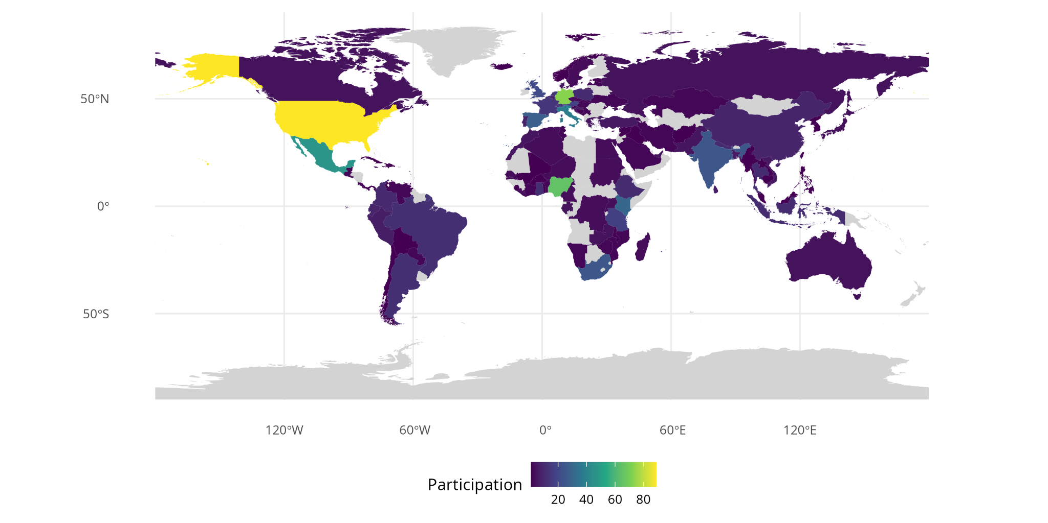
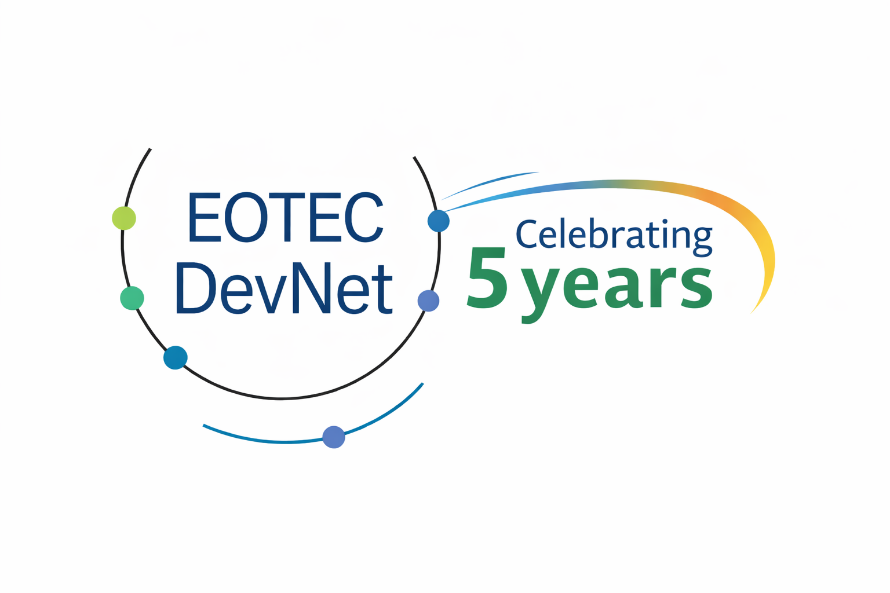
5 Goals for the Next 5 Years
Grow community by 5x
Close integration with WGCapD in supporting other CEOS working groups, i.e. in discoverability of data/tools/trainings
Implement EOTEC DevNet 2026-2027 strategy shared at SIT-TW in 2025
Expand network analysis to additional EO Capacity Building partners
Engagement of partner networks in support of CEOS SIT Chair Priorities on water hazards and data for community resilience
Notes:
Very happy that EOTEC is marking its 5th year this year.
This slide gives you a sense of the timeline.
The idea came from WGCapD. A handful of people including Senthil Kumar of ISRO and Nancy Searby of NASA build the partnership with the global partners you see here.
CEOS - Committee on Earth Observation Satellites
UNOOSA - United Nations Office for Outer Space Affairs
GEO - Group on Earth Observations
WMO - World Meteorological Organization (Training and Education)
WMO-CGMS Vlab
We have accomplished a lot. Today we have more than 2000 people involved in the network (through meeting attendance, social media, or newsletter distribution.)
Vibrant regional and thematic CoPs; we have hosted meetings for 940+ participants with 50–70% repeat attendance.

