Slide 1
CEOS SIT-41
Closing remarks
Dr. Julie Robinson
SIT Chair Team, NASA
Agenda Item 8.3
CEOS SIT-41 2026
Irvine, California, USA
14-16 April 2026

Slide 2
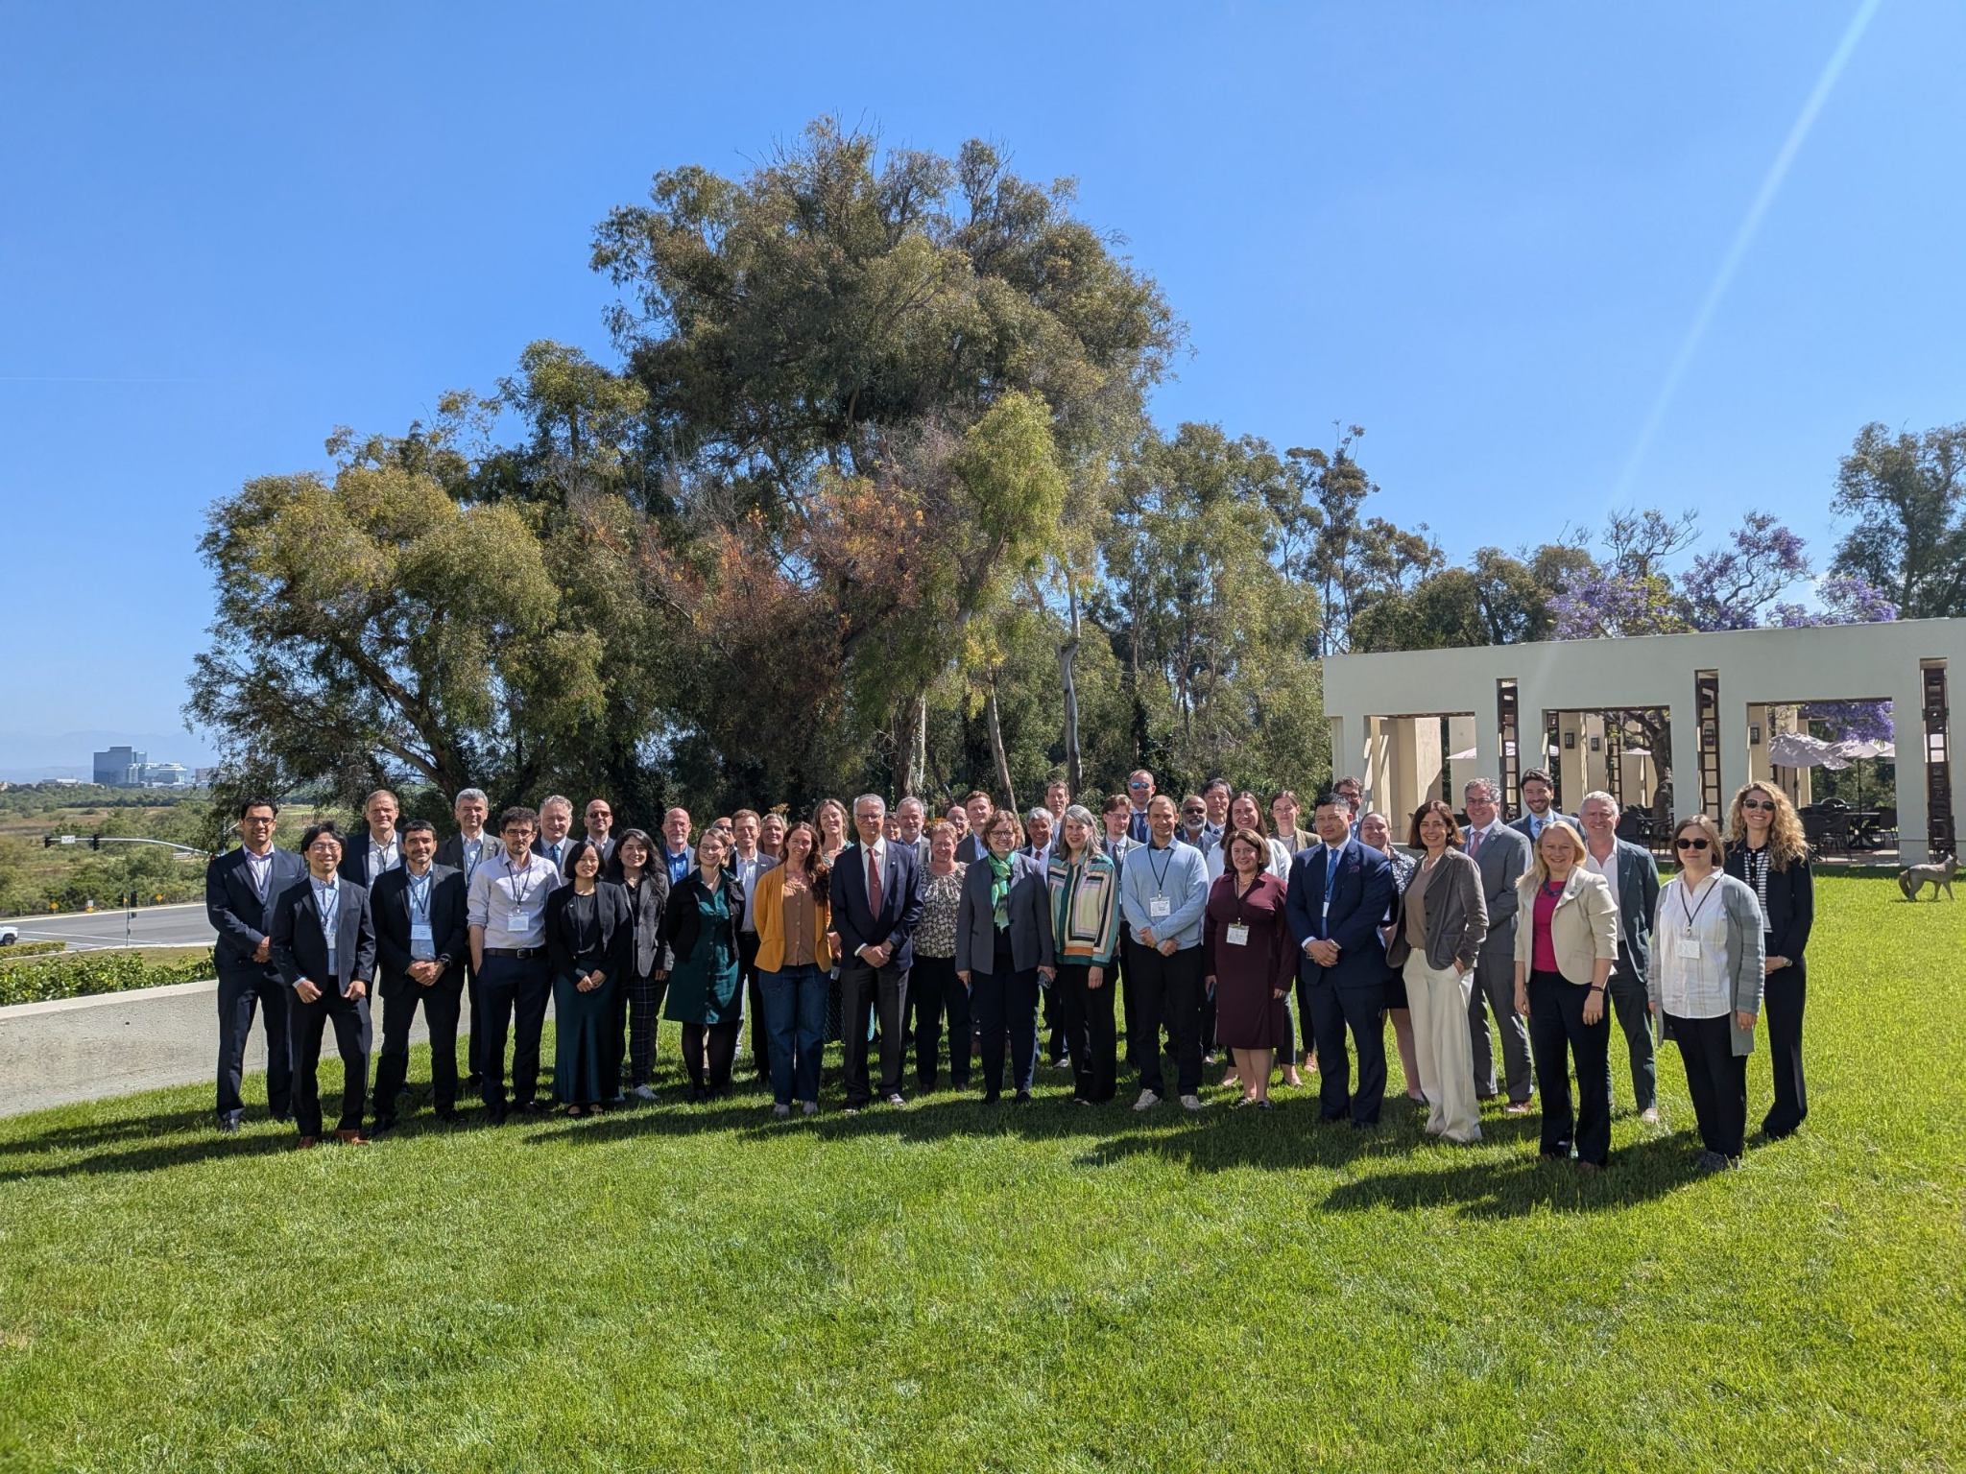
Thank you!
Notes:
Replace with group photo

Slide 3
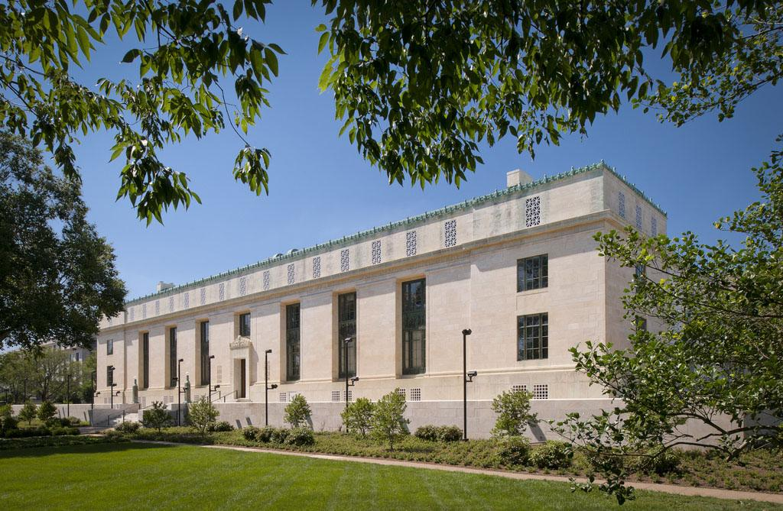
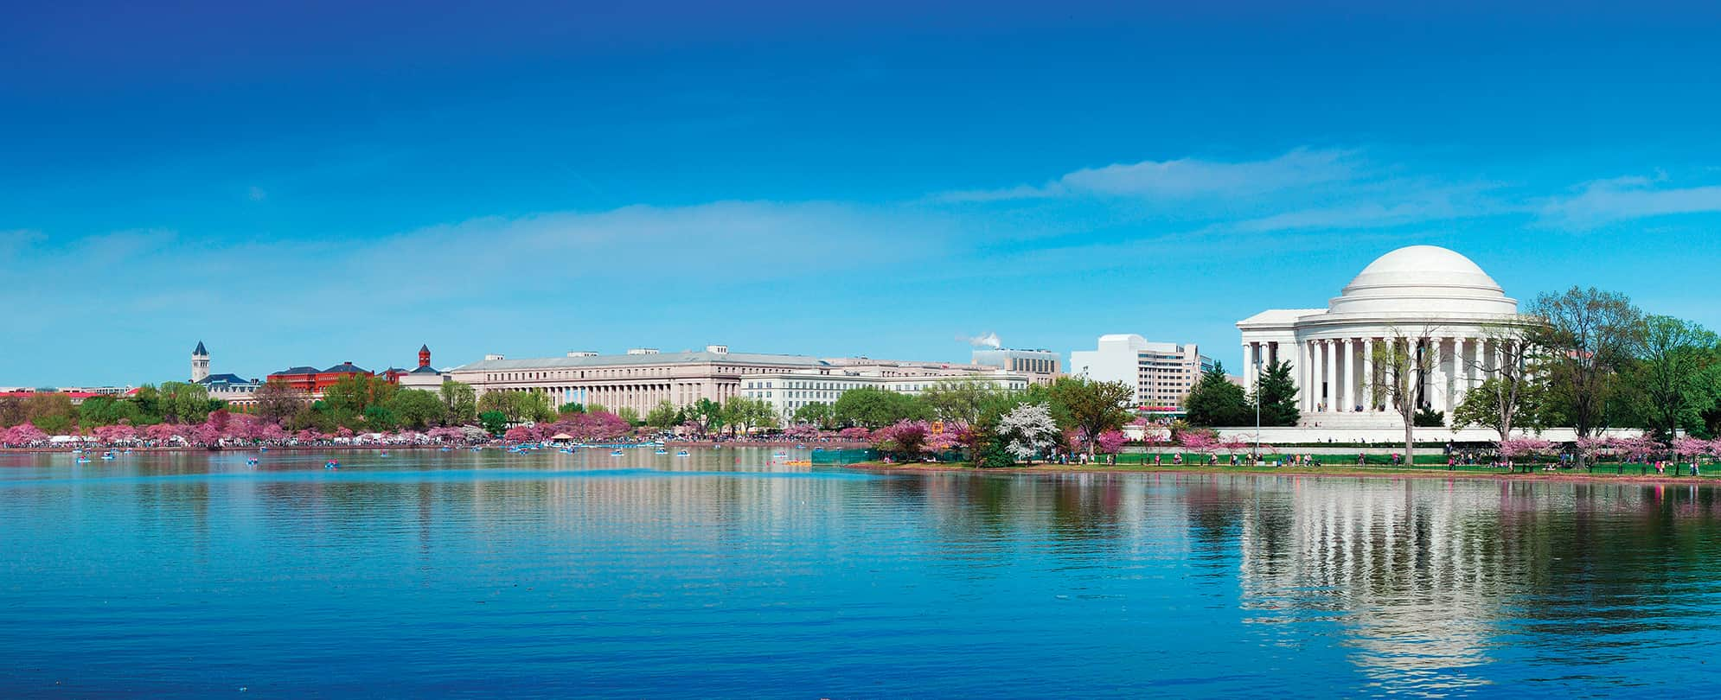
Plans for the 2026 SIT Technical Workshop
8-10 September 2026
National Academies of Sciences, Engineering, and Medicine (NASEM)
National Academy of Sciences Building, Washington, DC
Logistics Package coming soon!
Contact nasa-sit-chair-2026-27@googlegroups.com for more information

Slide 4
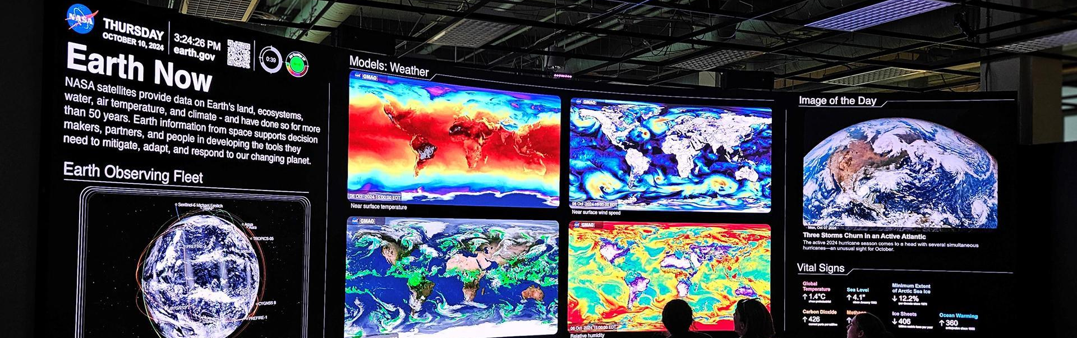
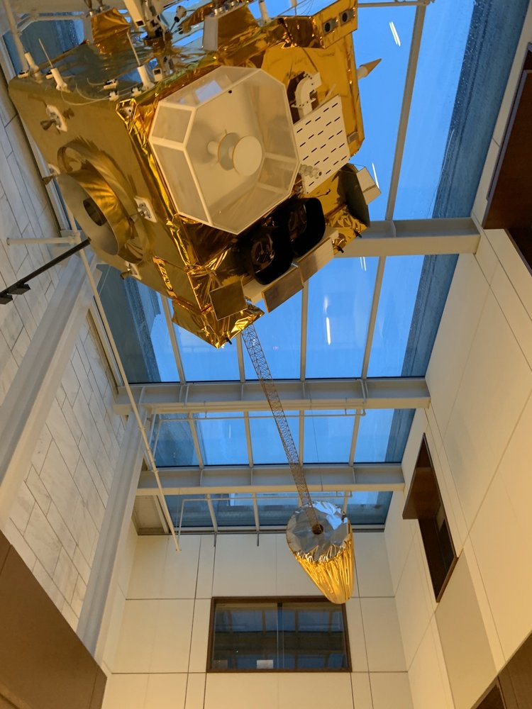

Week at a Glance
Tuesday, 8 September
Side Meetings
Welcome reception
NEW! Tour of the Earth Information Center (EIC) at the Smithsonian Museum of Natural History (details tbc)
Wednesday, 9 September
SIT Technical Workshop Day 1
Dinner at the National Academy of Sciences
Thursday, 10 September
SIT Technical Workshop Day 2
Friday (tbc): Water Quality Workshop #2
Notes:
Highlight the EIC tour!

Slide 5
3-6 November 2026
Hobart (Nipaluna), Australia
2026 CEOS Plenary
Credit: USGS/NASA Landsat 8

Slide 6
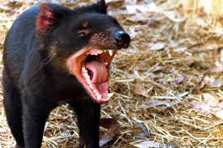
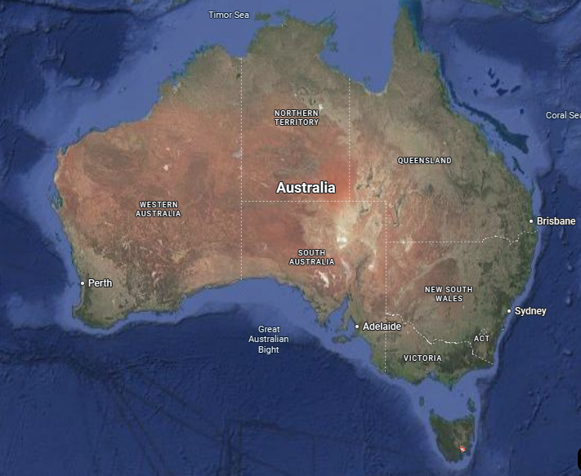
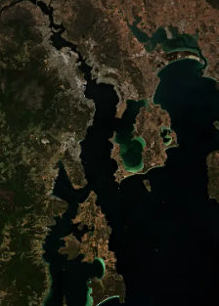
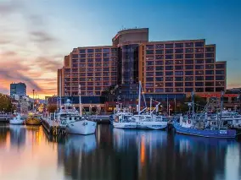
40th CEOS Plenary
3-6 November 2026
Hobart, Australia
Antarctica
Venue: Hotel Grand Chancellor
Credit: European Union Sentinel-2

Slide 7
Venue
Hotel Grand Chancellor, Hobart, Australia.
Accommodation available at the venue and surrounding area.
Please consider booking flights and hotel - information shared on the invitation.
Please reach out to us for more information on ceos-chair-2026-cdt@googlegroups.com
Notes:
Accommodation is available at the venue, additionally there is plenty of accommodation near by.

Slide 8
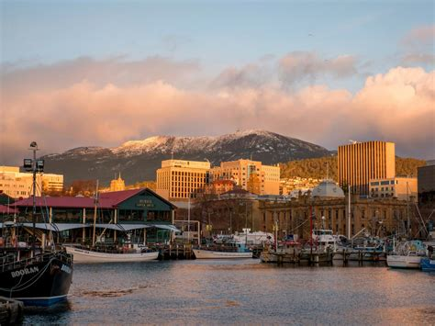
Week-at-a-glance
Tuesday, 3rd November:
  Side Meetings
  Welcome Reception at the Tasmanian Museum and Art Gallery
Wednesday, 4th November:
  CEOS Plenary Day 1
Thursday, 5th November:
  CEOS Plenary Day 2
Friday, 6th November:
  Antarctic Plenary Experience at the Australian Antarctic Division
Australia’s national EO conference (‘Advancing Earth Observation Forum’) will take place in Hobart the following week 9-12 November
Notes:
Welcome reception at the Tasmanian Museum and Art Gallery - where your journey to Antarctica starts, and access to the Islands to Ice exhibit for self guided tours on bringing the wonders of the Southern Ocean and Antarctica region to the shores of Tasmania.
Antarctic Plenary experience - technical tour at the Australian Antarctic Division providing an opportunity to deepen the CEOS community connections with polar issues through in person engagement with leading experts with lived experience.

Slide 9
Thank you

