Slide 1
CEOS SIT-41
NOSA 2027 CEOS Chair Priorities Preview
Christian Hauglie-
Hanssen, NOSA
Agenda Item 8.1
CEOS SIT-41
Irvine, CA, USA
16 April 2026

Slide 2
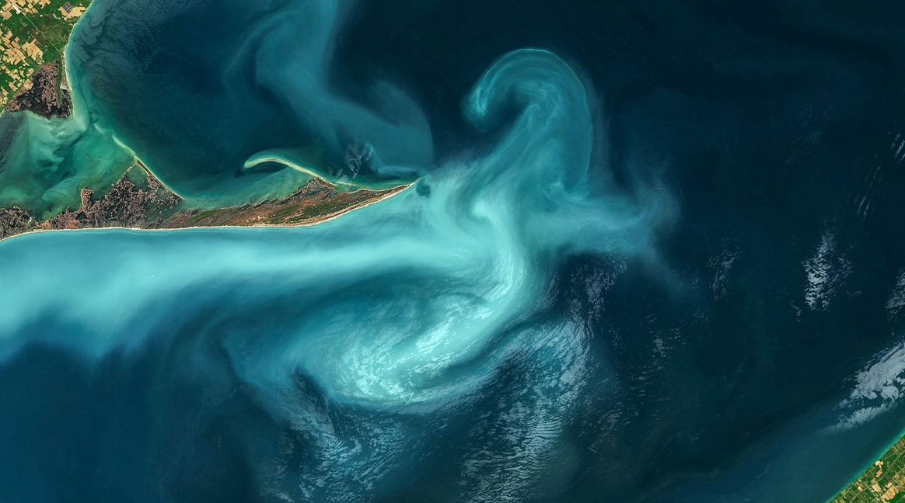

CEOS Chair Priorities in 2027
True Blue (Ocean and Polar)
    Focus on trustworthy and analysis ready data over the oceans and the rapidly changing polar regions
    Link to NASA CEOS SIT initiative: Water Planet – Seeing Earth's Water from Space
    True Green (Tropical Rain Forest)
    Trustworthy and analysis ready data over rain forests
Link to CEOS initiatives on Analysis Ready Data (ARD), Biodiversity-VC and Global Forest Observation Inititive (GFOI).
True Future
Continuity of CEOS Youth Engagement Programme
Foto: Nansen Environmental and Remote Sensing Centre
Photo: Getty Images-iStockphoto

Slide 3
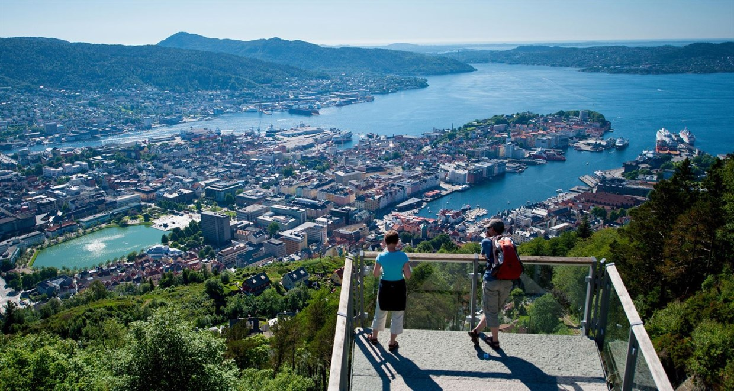

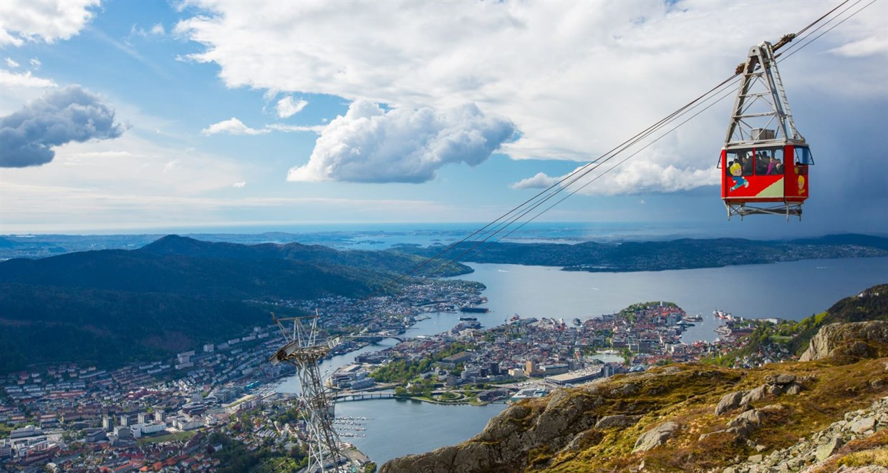
CEOS Plenary 2027
Save the date!
CEOS Plenary in Bergen, Norway
1 - 5 November 2027
Fløyen. Foto: Sverre Hjørnevik
Bryggen i Bergen. Foto: Visit Bergen - Girish Chouhan
Ulriken. Foto: Visit Bergen / Espen Haagensen

