Slide 1

Status of CH₄ Inventory Development Activities from
NASA Carbon Monitoring System
Presenting: John Worden
©2021 California Institute of Technology. Government sponsorship acknowledged

Slide 2
Testing and Updating Emissions Using Atmospheric Concentration Data
We quantify fluxes by projecting emission inventories through a forward model (usually a chemical transport model) and then “inverting” this relationship. However interpreting the results of this inversion can be challenging:
A priori inventories used with top-down inversions are typically out-dated leading to poor inversion outcomes (e.g., Maasakkers et al. ERL 2016 Scarpelli et al. 2020)
Limited and varying sensitivity to underlying fluxes because of measurement sampling and because methane and CO2 are long-live trace gases
varying spatial resolution → choice of prior affects fluxes → correlated uncertainties makes it challenging to interpret results because remote sources can influence interpretation of locally observed emissions
Transport and chemistry errors impart errors in the model which to date are still poorly characterized
Lack of knowledge about the atmospheric (OH) and surface (Chlorine) sinks imparts a 10% plus error
Transport error can inflate regional estimates of emissions in an unknown manner, especially in tropics and high latitudes (Jiang et al. JGR 2013; Schuh et al., 2019 GBC 2019)
Solutions:
Test inventories at large scales and regions where transport error less important
Hi-resolution measurements over point sources
New algorithms which better account for varying spatial resolution, correlated uncertainties, different priors

Slide 3
NASA CMS funds efforts to update wetland models (and corresponding inventories) for use in top-down inversions
Wetlands remain the most uncertain component of the global methane budget
Updates from WETCHARTS (Bloom et al. 2017) and the Global Carbon Project (Poulter et al. 2017) indicate uncertainties of 10 to 25% for the global total but 50% or more for regional emissions.
But wait!
A recent paper by Rosentrater et al. (2021) suggest that other aquatic sources (rivers/lakes) add another 50 to 100 Tg CH4/yr
Top down (shown later) completely disagree with these estimates suggesting a major issue to be resolved by the scientific community

Slide 4
NASA CMS funded bottom-up fossil emissions (based on reports to UNFCC, Scarpelli et al. 2020) increases emissions in E. Europe and Russia but reduces fossil emissions elsewhere. Global total approximately the same at ~100 Tg CH4/yr.
Confounding factors: Prior emissions and top-down estimates are both ~100 Tg CH4/ yr whereas surface isotope information suggest values that are ~20 to 60% higher (Schweitzke et al. 2016)
P
Wolf et al. (2017) updated livestock emissions using emission factors reported to UNFSCCC + global livestock numbers.
Critical need: All other emission sources (agriculture, biofuels, waste, geo-sources) make up another 25 to 30% of global methane emissions should be poked at and tested

Slide 5

Using GOSAT satellite observations of atmospheric methane
to evaluate the US EPA National Greenhouse Gas Inventory
Maasakkers, J.D., D.J. Jacob, et al., Atmos. Chem. Phys., 21, 4339-4356, 2021. DOI: 10.5194/acp-21-4339-2021
GOSAT methane data for 2010-2015
Significance: Satellite observations can now be used to monitor and improve national methane emission inventories including attribution to different sectors
Science question: Can we better quantify US methane emissions in service to national climate policy?
Gridded version of US EPA methane inventory
for use as ‘prior’ in inversions of atmospheric data
inversion
‘posterior’ emissions
Key result: Emissions from oil/gas production are 90% higher (oil) and 50% higher (gas) than in EPA 2020 inventory report
Construct gridded version of EPA inventory
Use it as prior estimate in inversion of GOSAT satellite data
Show that GOSAT – Modeled CH4 is improved using updated inventory

Slide 6
NASA Aircraft data used to quantify partitioning of California methane budget and inform decision making
(Duren et al. Nature 2019)
Landfills are the largest sector (41%) followed by dairies (26%) and fossil fuels (26%)
Notably, large emissions from East Los Angeles landfill were observed and reported → landfill operator used this information to change their waste management practices and reduce emissions (Cusworth et al. ERL 2020)

Slide 7
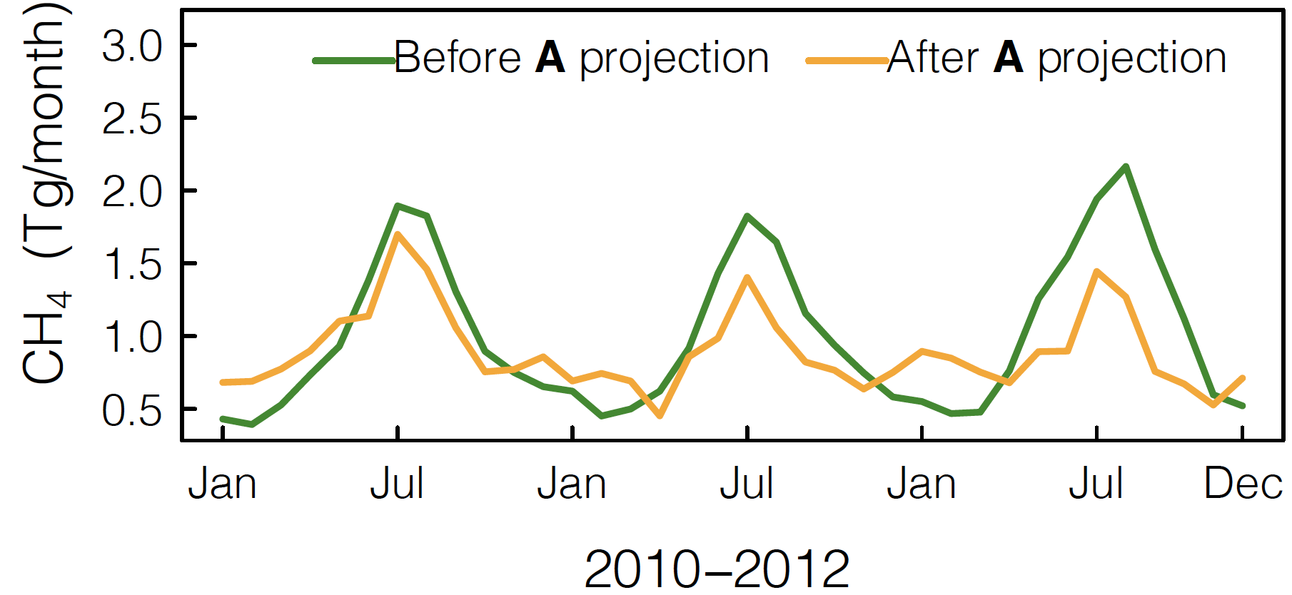
GOSAT based fluxes used to test ensemble of wetland models by projecting models through “Flux Observation Operator”
Top Models can then be used as improved a priori for next top-down methane flux estimate
(Ma et al. AGU Advances in revision)
Accounts for a priori, spatial resolution, and correlated uncertainties of GOSAT inversion by applying averaging kernel matrix from flux inversion
Total wetland emissions are : 117-189, 5th-95th percentile) Tg CH₄ yr⁻¹
Best models show ”low” climate sensitivity Q10 = 1

Slide 8
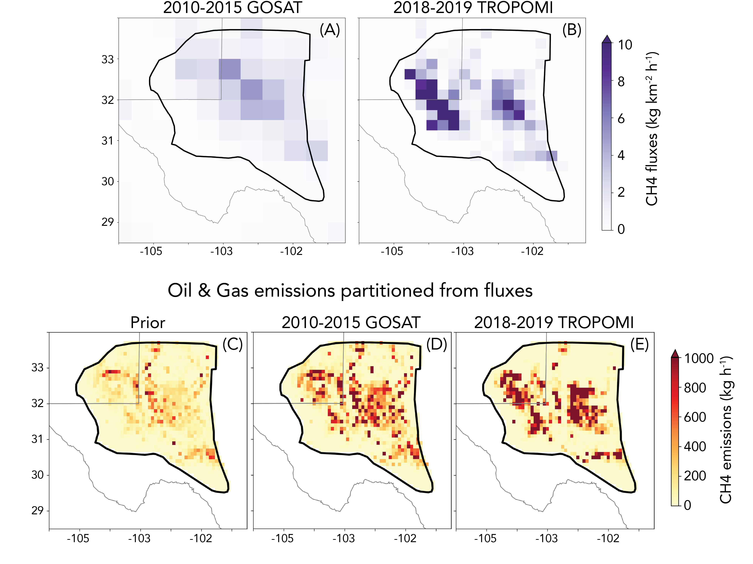
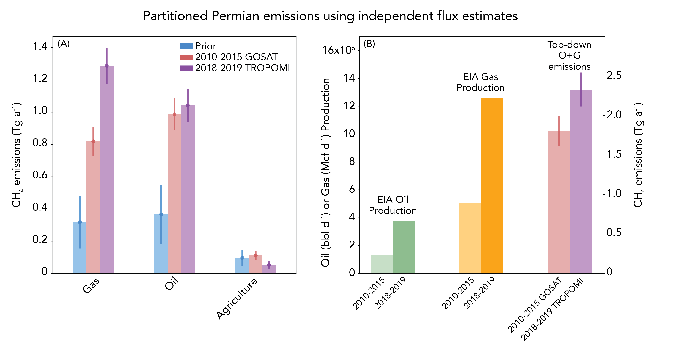
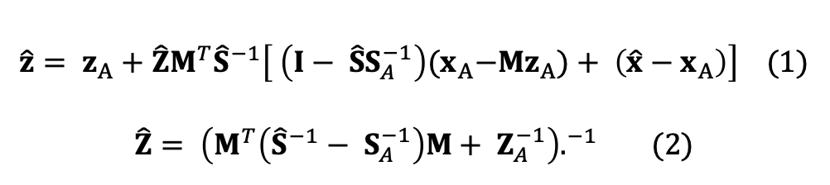
GOSAT and TROPOMI fluxes used for evaluating Permian basin emissions and robustly attributing observed increase to gas emissions, consistent with activity data.
Key algorithm: Project both fluxes back to common prior and covariance using flux averaging kernel and posterior covariance
(Cusworth et al. submitted)
Fluxes from GOSAT and TROPOMI have very different spatial resolution and uncertainties
Project both GOSAT and TROPOMI fluxes back to common emissions a priori (z_{A})and prior Covariance (Z_{A})
$$\hat{z}= z_{A}+\hat{Z}M^{T}{\hat{S}}^{−1}\left[ \left(I− {\hat{S}S}_{A}^{−1}\right){(x}_{A}−Mz_{A})+ \left(\hat{x}−x_{A}\right)\right] (1)$$
$$\hat{Z}= {\left(M^{T}\left({\hat{S}}^{−1}− S_{A}^{−1}\right)M+ Z_{A}^{−1}\right).}^{−1} (2)$$

Slide 9
Inventories and their posterior uncertainties (based on measurement error and flux spatial resolution) can also be calculated at arbitrary spatial resolution using this same approach
Ingredients needed: Emission covariance and inventory at desired resolution, posterior covariance, prior, and constraint matrix needed from flux inversion
Global total posterior uncertainties “small” for each sector but do not include uncertainties based on model error
Posterior uncertainties at smaller scales (here at 1 degree resolution) are much larger, between 50 to 100%
India and Asia have largest uncertainties in anthropogenic emissions
Amazon and Congo have largest wetland emission uncertainties

Slide 10
Summary
Multiple satellite data sets will be available in the next few years → Almost as many methods for evaluating emissions with these data → Need approaches for integrating results (ideally in a statistically robust, Bayesian manner) for providing best updated inventories
These data can provide useful information for decision making (e.g. East LA landfill, four-corners studies)
We can generate inventories from these data and account for errors from measurement, choice of prior, and spatial resolution
Errors from the transport and chemistry component of the forward model used to relate emissions to concentration remain a challenge, reducing confidence in posterior emissions
Bonus Science challenges:
Top down based wetland emissions are completely different than those from the bottom-up (e.g. Saunois et al. 2020, Rosentrater et al. 2021; Ma et al. in revision)
Fossil emissions from bottom up and top-down likely inconsistent with isotope data (Scwietzke et al. 2016)
Additional attention from the bottom up likely needed for agriculture, waste, and geological sources

