Slide 1
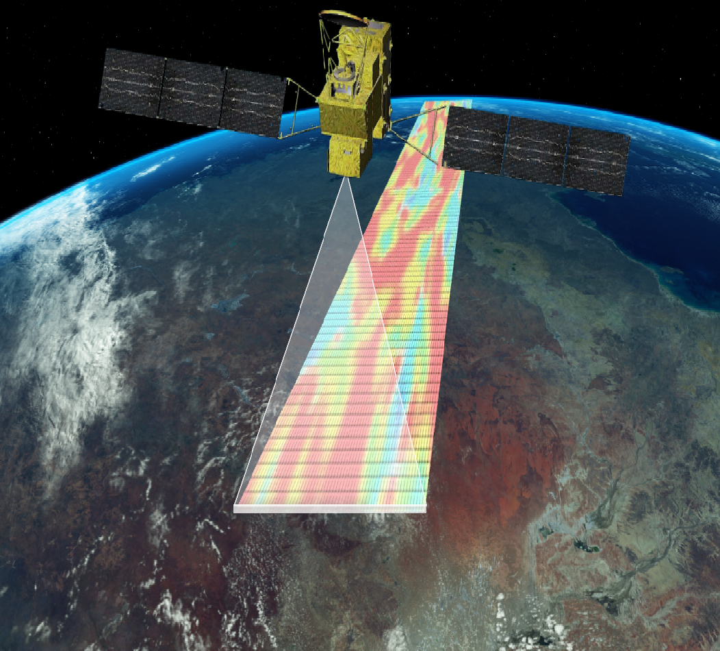
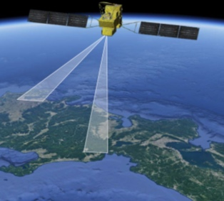
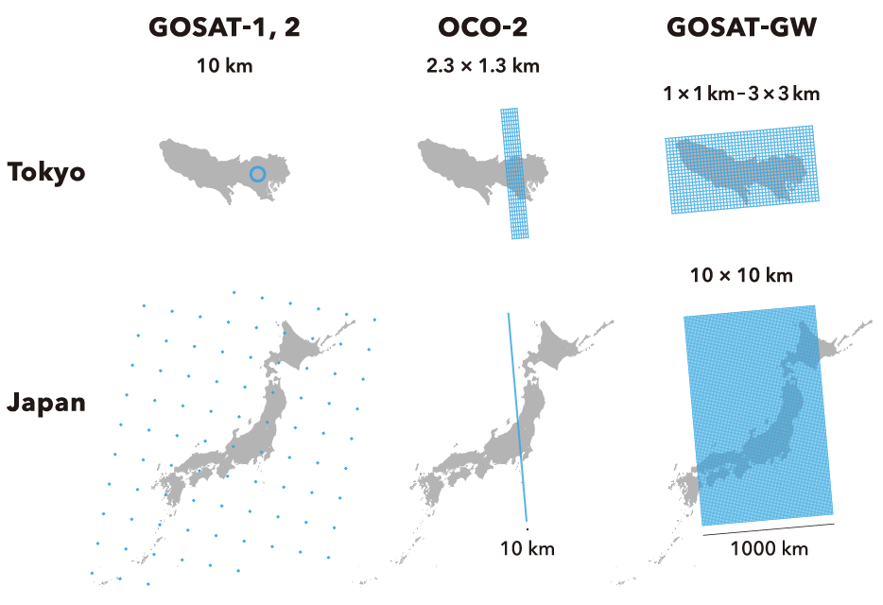
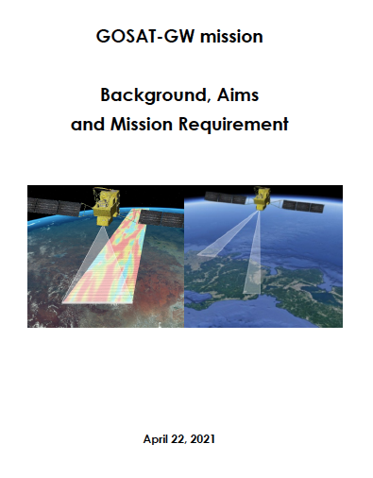
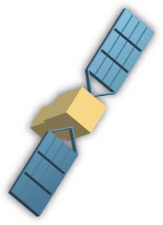
GOSAT-GW (Global Observing SATellite for Greenhouse gases and Water cycle)
TANSO-3 (Total Anthropogenic and Natural emissions mapping SpectrOmeter-3)
Project: NIES, funded by MoE-Japan
Development: JAXA, Mitsubishi Electric
Expected Launch: FY2023 (Apr 2023 – Mar 2024)
Lifetime: 7 yrs
Orbital altitude: 666 km
Sensor: grating imaging spectrometer
Band: VIS, NIR 0.7, SWIR 1.6 um
Species: CO₂, CH₄, NO₂
Swath: 911 km/90 km
Spatial resolution: 10 km/1-3 km
Global coverage: 3 days
Local time: 13:30
Wide swath - push broom
Narrow swath - pointing
Mission Requirements
Monitoring of monthly average concentrations of global atmospheric GHGs
Verification of country-specific anthropogenic GHG emissions
Identification/monitoring of large-scale emission sources (e.g. point sources)
Co-leads:
Tsuneo Matsunaga (Project Management)
Hiroshi Tanimoto (Science & Application)

Slide 2
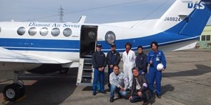
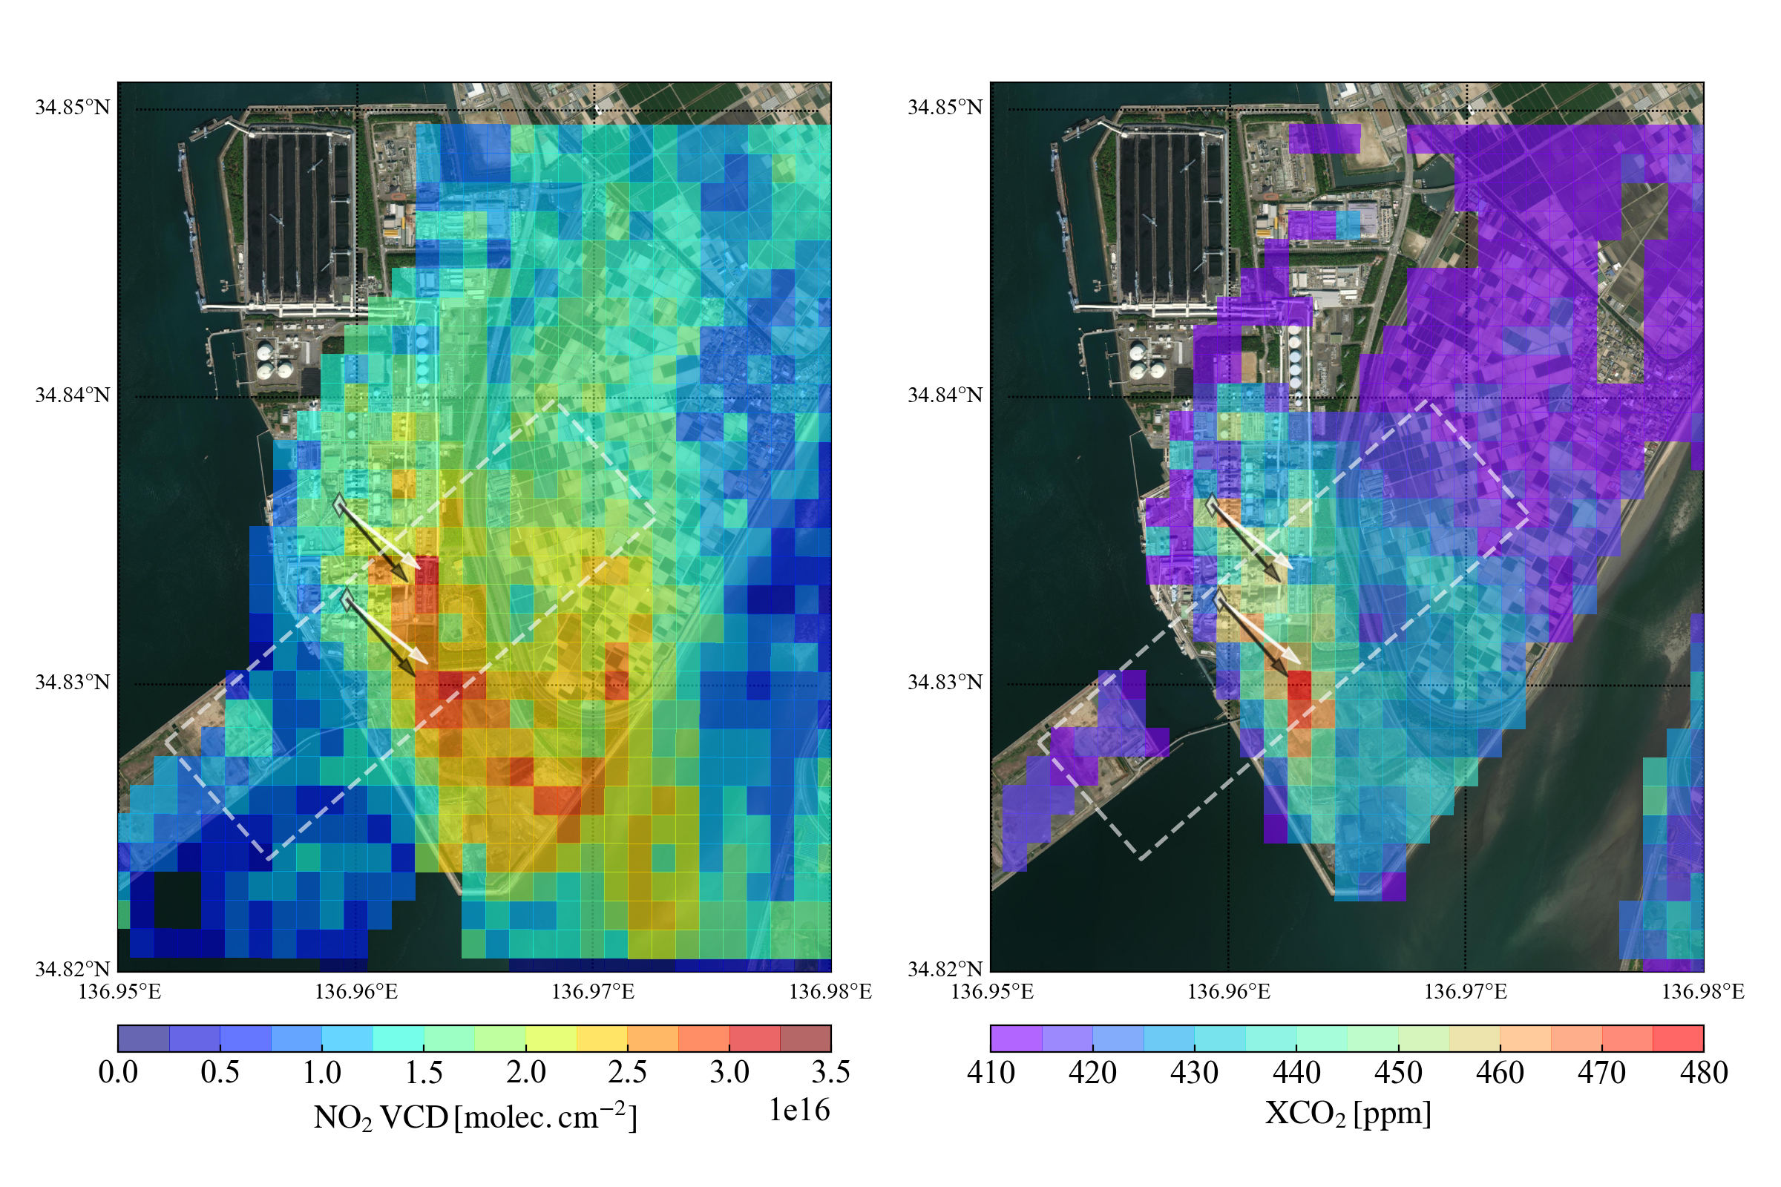
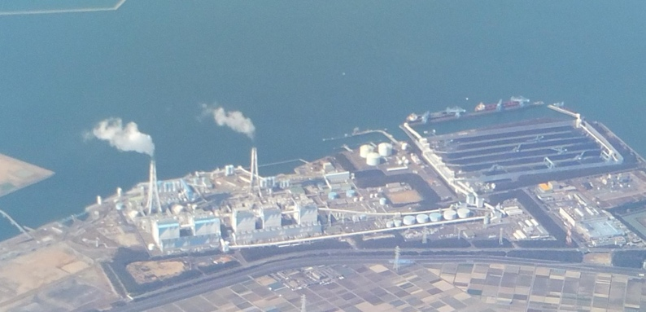
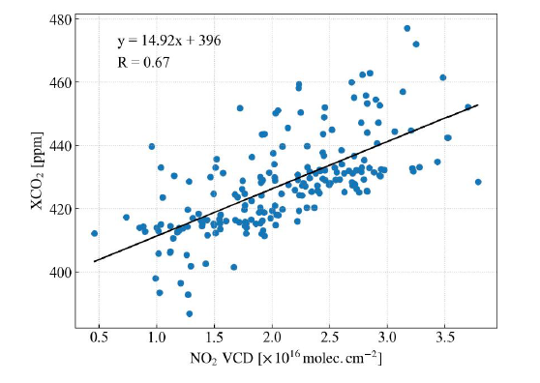
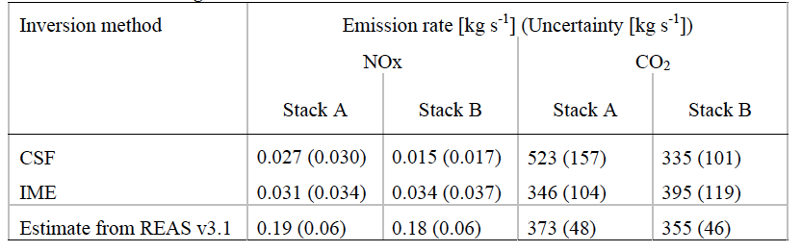
NO₂ obs. helps identify/quantify anthrop. CO₂ emissions
Fujinawa, Kuze, Suto, Shiomi, Kanaya, Kawashima, Kataoka, Mori, Eskes, Tanimoto, Geophys. Res. Lett., 2021.
“First Concurrent Observations of NO₂ and CO₂ from Power Plant Plumes by Airborne Remote Sensing”
NO₂ VCD
XCO₂
XCO₂
NOx
CO₂
Top-down
Bottom-up
NO₂ VCD
within 80%
within 11-67%

