Slide 1
Validation of TROPOMI - BASCOE tropospheric ozone
Klaus-Peter Heue^{(1,2)}, Walter Zimmer⁽¹⁾, Diego Loyola⁽¹⁾, Quentin Errera⁽³⁾, Simon Chabrillat⁽³⁾
1) DLR Oberpfaffenhofen 2) TUM München 3) BIRA-IASB Bruxelles
Notes:
9

Slide 2
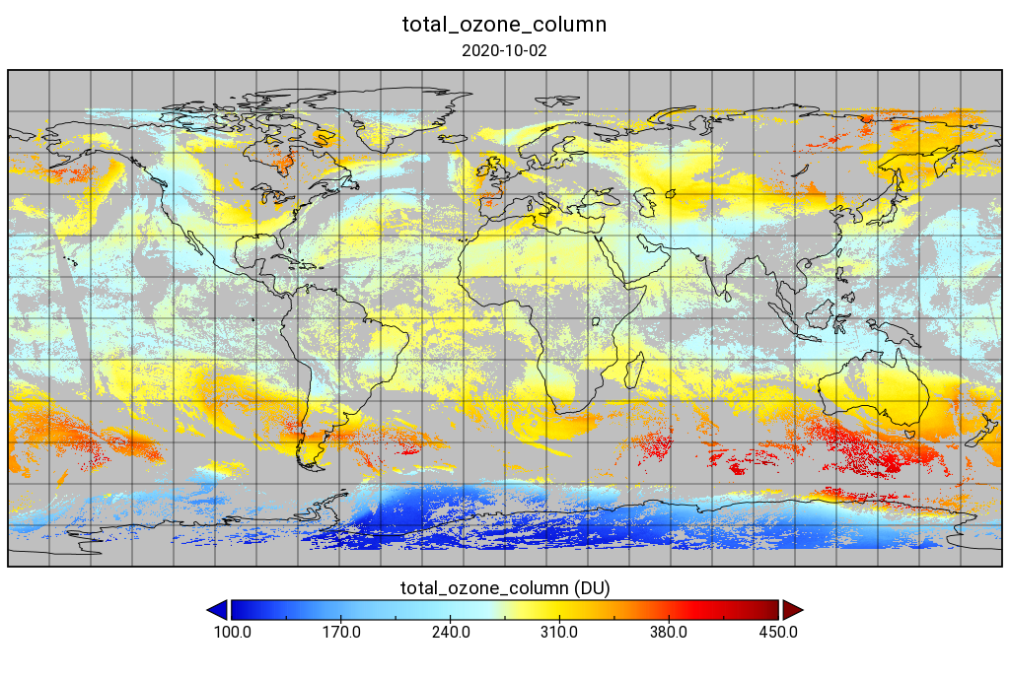
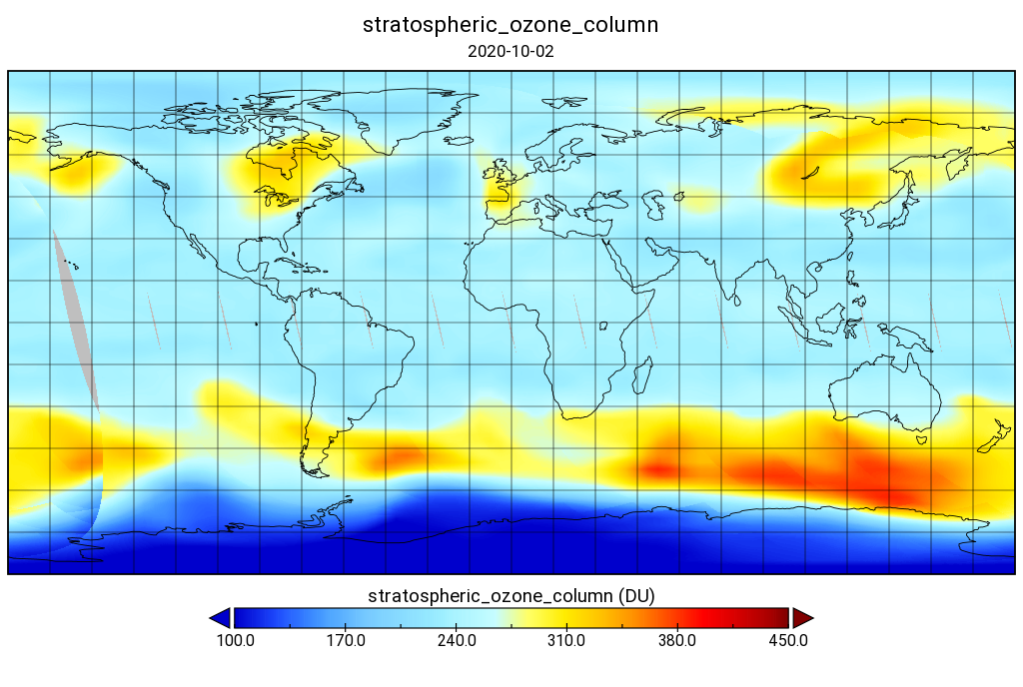
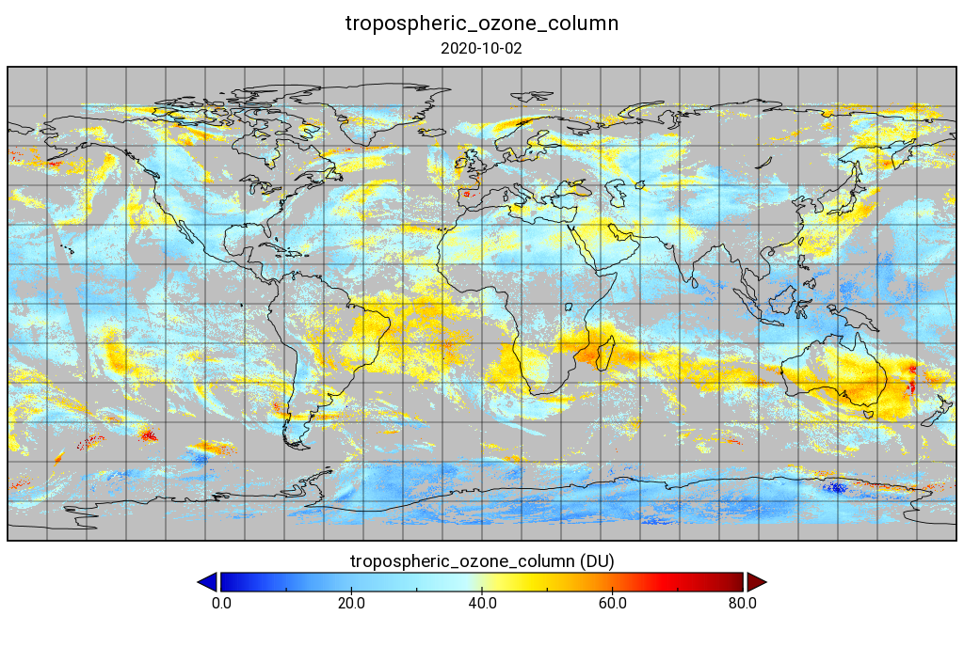
TROPOMI-BASCOE
TROPOMI total column ozone cloud free (cf<0.2)
BASCOE assimilated MLS ozone profile integrated above tropopause and interpolated to TROPOMI pixel
Tropospheric residual ozone
Notes:
9

Slide 3
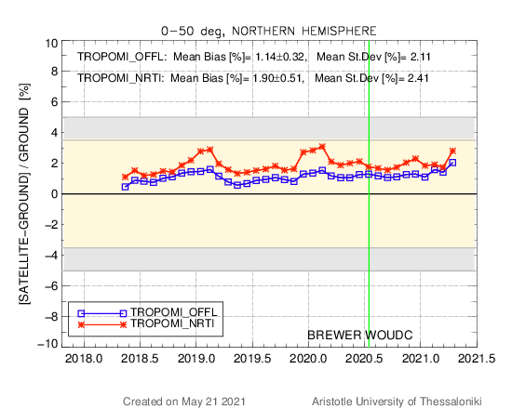
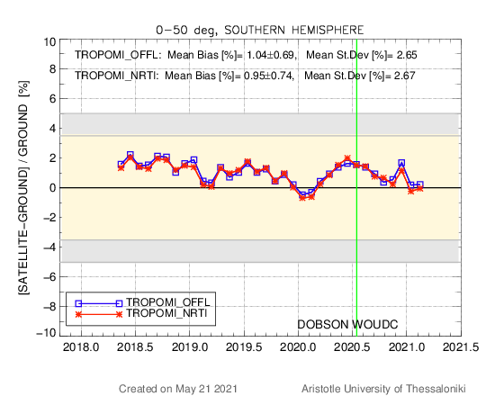
Validation results TROPOMI total column
Near Real Time total ozone columns agree with Brewer and Dobson measurements within ~3% (~6-15 DU)
Courtesy of K. Garane (AUTH)
Notes:
9

Slide 4
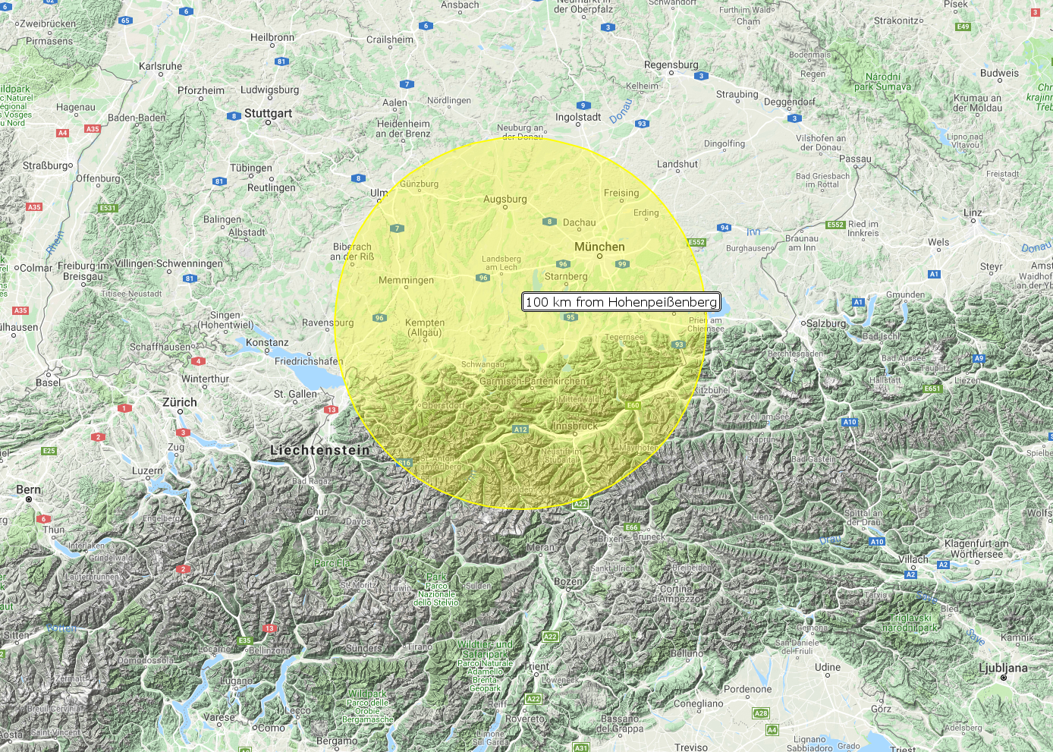
Validation approach TROPOMI-BASCOE
Tropopause pressure and tropospheric ozone column from the satellite data are averaged 100km around sonde launch and closest observation to sonde launch (*)
Sonde data are integrated up to mean tropopause pressure
Notes:
9

Slide 5
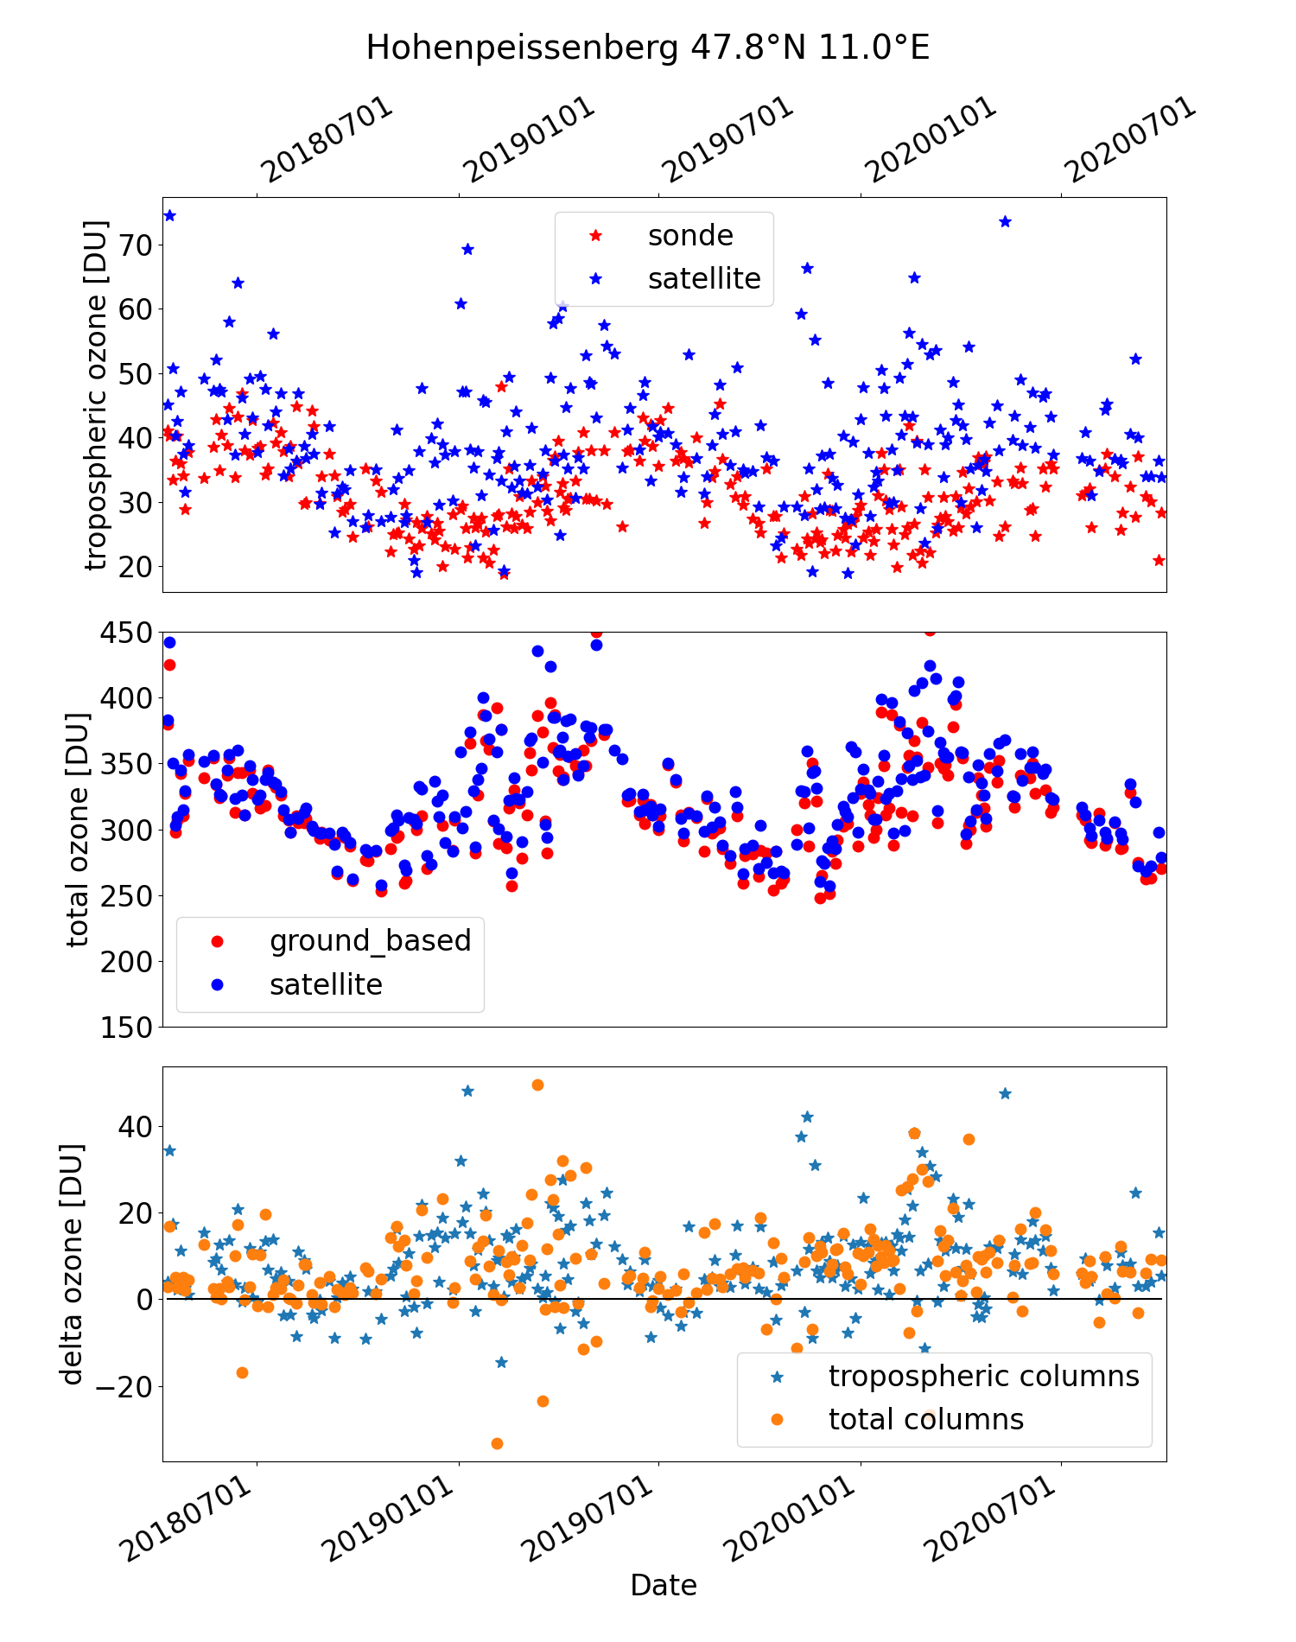
Example Results 1
Typical annual cycle in tropospheric ozone columns
Maximum in late summer
Good agreement in summer
Overestimation in winter for both tropospheric and total columns
Notes:
9

Slide 6
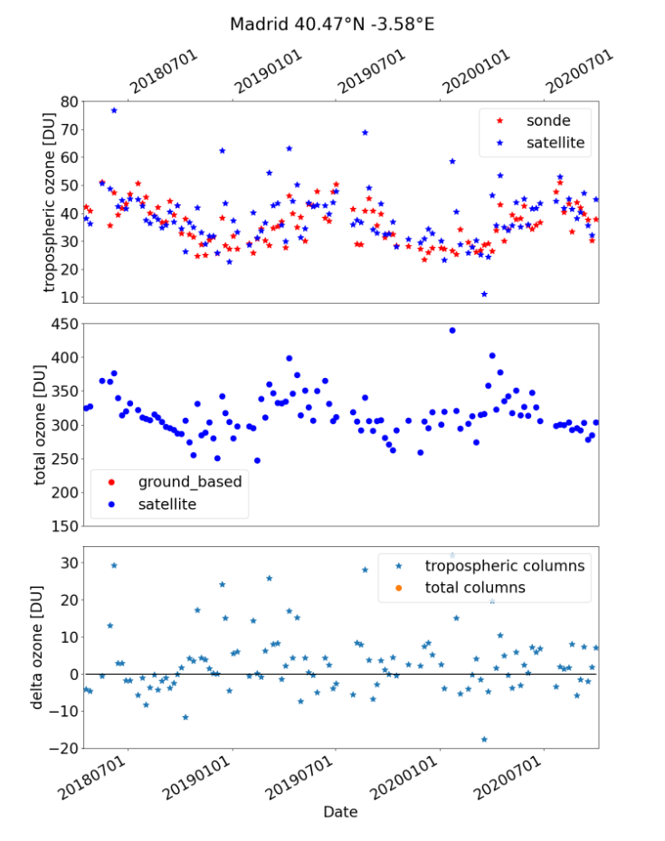
DLR.de • Chart 1
> Lecture > Author • Document > Date
Example Results 2

Slide 7
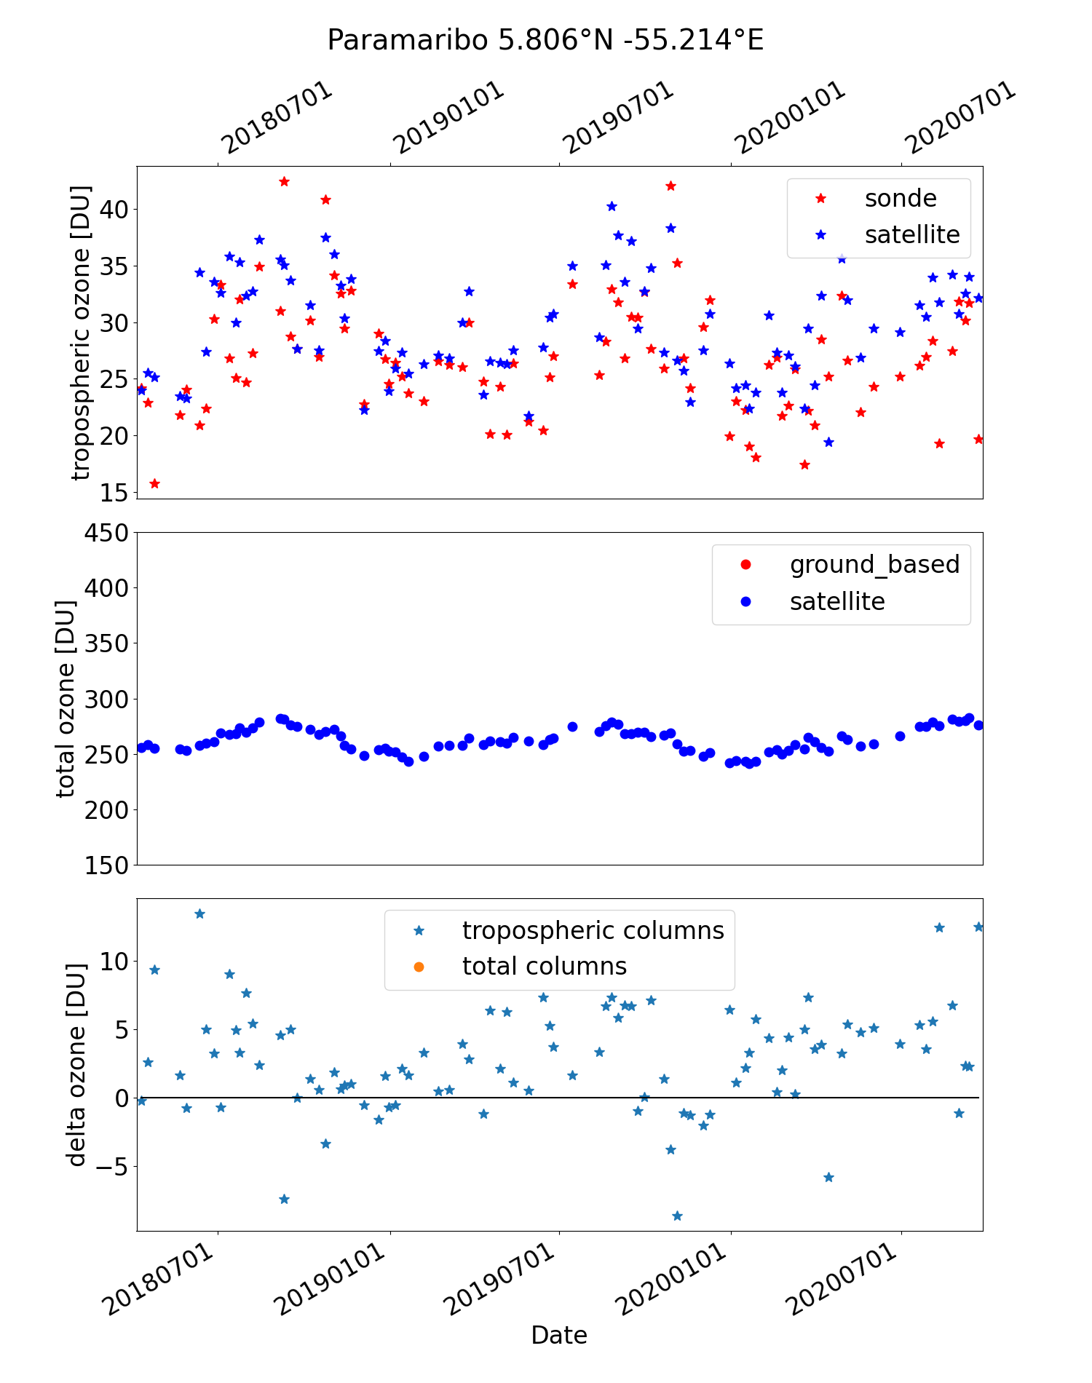
Example Results 3
Overstesimation during the burning season (~5 DU)
But better agreement compared to the CCD data (~10DU)
S5P_CCD validation courtesy of D. Hubert (BIRA)
50
40
30
20
10
0
Notes:
9

Slide 8
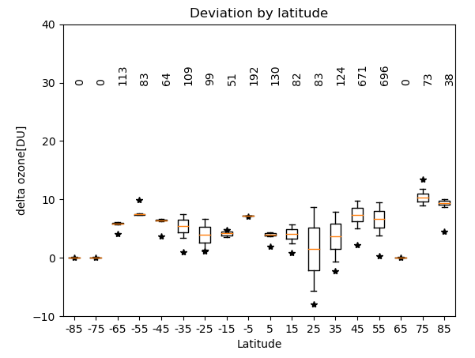
Mean values per 10° latitude bin
Number of comparisons per latitude band
Not evenly distributed e.g. 258 out of 671 data between 40° N and 50° N from Hohenpeißenberg
Mostly positive bias up to ~10 DU
Notes:
9

Slide 9
Summary and Acknowledgment
Summary
Agreement with sondes within 10DU, comparable to deviation of total columns
Typical annual cycles agrees between sondes and TROPOMI-BASCOE
The deviation itself also shows a season cycle in some places (Hohenepißenberg or Paramaribo)
Acknowledgment
Thank to all ozone sounding station for providing the data to WOUDC (Environment Canada) and SHADOZ
Thank to WOUDC and to SHADOZ for the service of providing the data to all users
Notes:
<number>

Slide 10
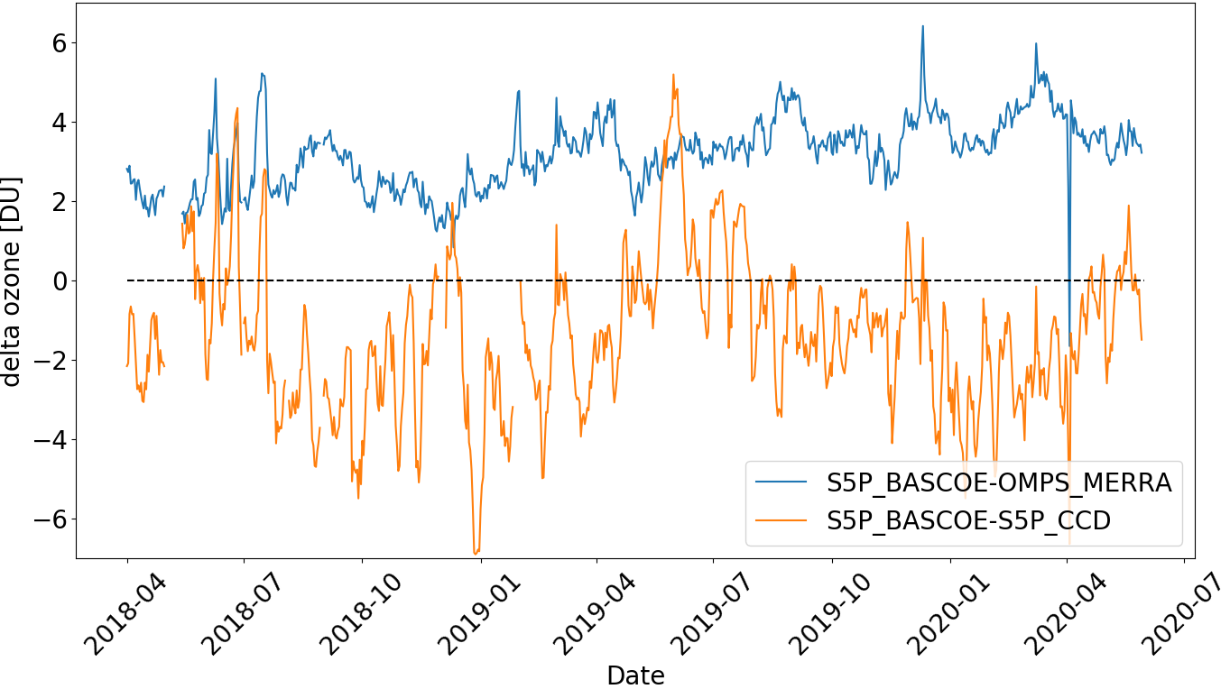
DLR.de • Chart 9
> Lecture > Author • Document > Date
Comparison to other tropospheric ozone data
OMPS-MERRA2 data provided by Jerry Ziemke
Operational S5P-CCD data available at s5phub.copernicus.eu
CCD data corrected for different tropopause height based on an ozone climatology

