Slide 1
Aerosol Information from the 3MI polarimeter
and EPS-SG sensors
Bertrand Fougnie
for the Cloud & Aerosol Team
Remote Sensing & Products Division

Slide 2
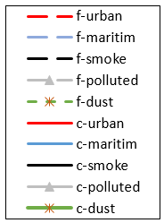
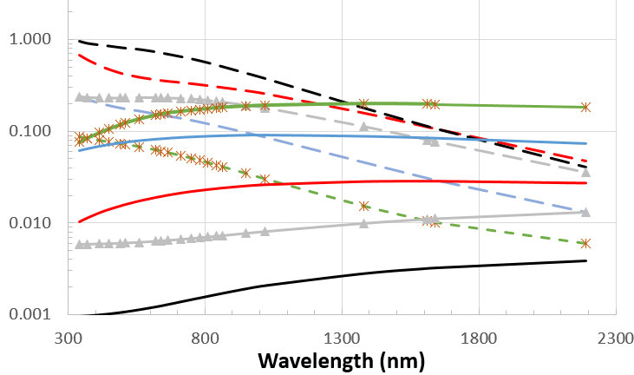
What’s the challenge ?
The aerosol optical properties
Phase function 865nm
2) Directional
Spectral phase function at 140°
1) Spectral
Polarized phase function 865nm
3) Polarised
all depend on :
Aerosol properties: type fine/coarse, microphysics, size distribution, shape, absorption…

Slide 3
Introduction
The observed TOA signal is a combination of various terms:
  The spectral variation
  The bidirectional variation
  The polarized contribution
→ The measurement is influenced by the aerosol phase function, load and absorption, i.e. aerosol properties (nature, microphysics, size distribution, optical thickness)
A proper aerosol retrieval includes:
  The analysis of the information content
  The associated identification of the constraints to be added on the retrieval (if/where needed)
  The identification of the aerosol parameters to be retrieved and their expected validity range
The information content analysis (ICA) is crucial:
  3MI provides: 12 bands, 3 polarisations, and 14 views
  EPS-SG provides in addition: the full spectral range (reflective and thermal) with high-resolution bands and a sub-pixel information
→ 3MI and EPS-SG sensors are key-elements for the aerosol retrieval
$R_{aerosol}\left(λ, view\right)$ ~ $ω_{o}\left(λ\right). τ\left(λ\right) . P_{aerosol}\left(λ, view\right)$
First order

Slide 4
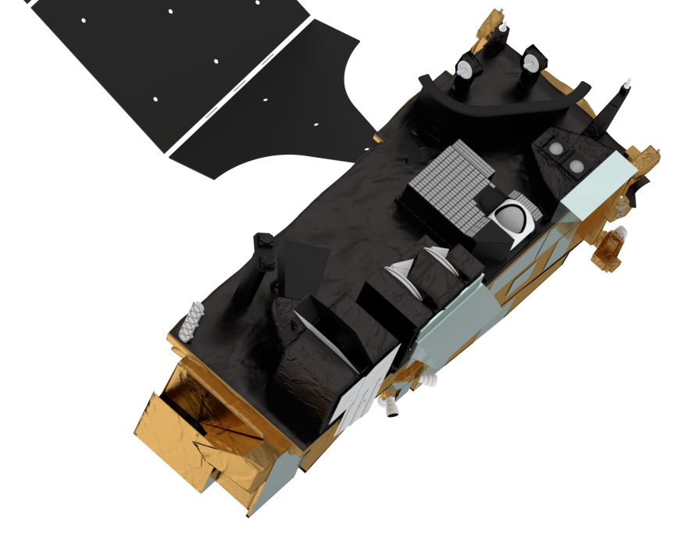

EUMETSAT Polar System - Second Generation
Metop-like orbit 9:30
Launch Apr-2024
25 years of operation
3MI:
Multi-viewing,
-channel,
-polarisation Imager
Metop-SG A
RO:
Radio Occultation
MWS: Microwave Sounder
Sentinel-5: UV-VIS-NIR-SWIR Sounder
METimage: Visible-Infrared Imager
IASI-NG: Infrared Atmospheric Sounding Interferometer – New Generation

Slide 5
3MI on an nutshell
The instrument relies on a very simple concept
  2 wide field-of-view optics (VISNIR + SWIR)
  2D detectors at focal planes (CCD for VISNIR, and CMOS for SWIR)
  1 filter wheel inc. polarizer (12 bands from 410 to 2130nm with I/Q/U)
Multi-view during the overpass
See Fougnie et al., 2018 in JQSRT APOLO’17

Slide 6
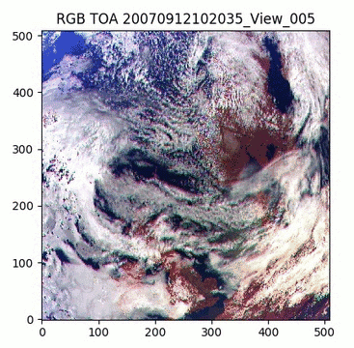
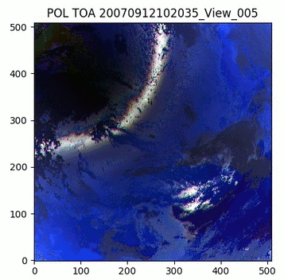
Aerosol retrieval from 3MI
Large information content:
  14 views : from -50° backward to 50° forward
  12 spectral bands: from 410 to 2130nm
  3 polarisations providing I, Q, and U (except for absorption bands)
  Potentially 420 information per pixel to feed the retrieval
The aerosol retrieval will be based on an optimal simultaneous retrieval of the surface and aerosol
  GRASP was adopted to be the best solver for this specific information
  Configured to an Operational processor (product available 1:30 after sensing)
  The simultaneous retrieval will be adjusted to optimise the performance of the aerosol retrieval

Slide 7
Aerosol retrieval from 3MI
Multi-directional polarimetry allows distinction of fine & coarse particles and characterization of their properties. As a consequence, the following aerosol properties can be addressed:
  Aerosol optical thickness
  Angstrom coefficient
  Fine/coarse fraction
  Single scattering albedo
  Absorbing aerosol optical thickness
  Refractive indexes
  Sphericity fraction
  Aerosol height
But it is unrealistic to retrieve all of them and everywhere
  The geometry of acquisition and/or the surface type strongly influence the performance of the retrieval
  With respect to our user needs, the retrieval will be optimised to derive properly for AOD and Aerosol model
  Other parameters will be retrieved when/if possible

Slide 8
A Unique Aerosol Observatory from EPS-SG sensors
Hyper-instrument for a 4-km aerosol product: MAP (Multi-sensor Aerosol Product): synergy between 3MI (core aerosol mission), Sentinel-5, METimage, IASI-NG
The MAP measurements will allow
  Consolidation and improvement of the 3MI retrieval
  Extensive list of aerosol parameters to be retrieved
    Special care for an aerosol model “compatible” with CAMS/NWP models
Gather pros from POLDER/PARASOL, MODIS,
and EPS/PMAp (GOME, AVHRR, IASI)

Slide 9
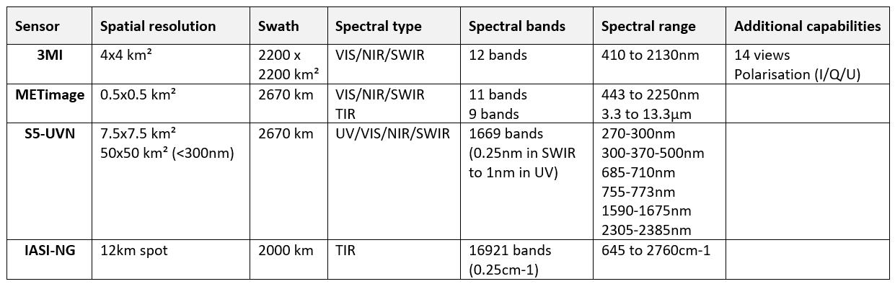
A Unique Aerosol Observatory from EPS-SG sensors
Information content = incredible collection of measurements from the same single platform
Creating an hyper-instrument with many key-elements for a 4-km aerosol product: MAP (Multi-sensor Aerosol Product)
  Extended spectral content: UV/VIS/NIR/SWIR/TIR
  Improved spectral content: highly resolved in absorption lines
  Sub-pixel radiometric characterisation
  Multi-view and polarisation

Slide 10
Conclusion
The polarimeter 3MI will provide spectral, bidirectional and polarised measurements allowing the provision of aerosol characterisation in a long-term operational framework
Combining the sensors from the EPS-SG platform, the MAP synergistic product will also greatly contribute to the aerosol characterisation by extending the performance and the number of retrieved parameters
These aerosol characterisation will support the Air Quality monitoring at the Global and Regional scale.

Slide 11
Thank you for your attention

