Slide 1






Unified Ceilometer Network
Ruben Delgado^{1,2}, V. Caicedo¹, K. Taguba¹, D. Taylor¹, P. Maniktala¹,
R. Perona¹, B. B. Demoz^{1,2}, R. K. Sakai³, F. Moshary^{2,4}, E.J. Welton⁵,
B. L. Lefer⁶,M. Woodman⁷, D. Krask⁷, J. Szykman⁸, K. Cavender⁸
¹University of Maryland, Baltimore County
²NOAA Center for Earth System Sciences and Remote Sensing Technologies
³Howard University, ⁴City College of New York
⁵NASA Goddard Space Flight Center, ⁶NASA Headquarters
⁷Maryland Department of the Environment
⁸U.S. Environmental Protection Agency
CEOS Atmospheric Composition Virtual Constellation AC-VC-17

Slide 2
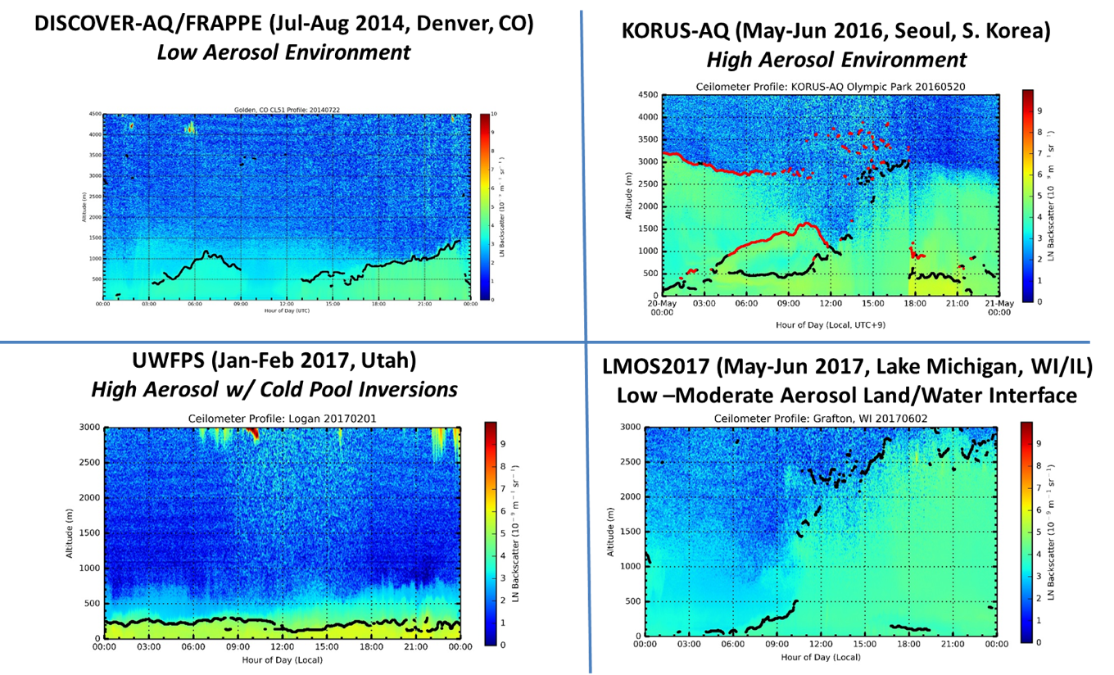
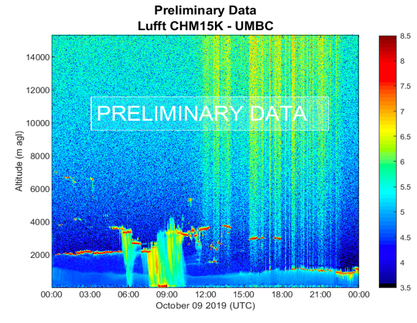
Planetary Boundary Layer (PBL) Monitoring
Understanding the evolution of the PBL is crucial for air pollution as PBL dynamics control pollutant accumulation and dispersion, which in turn also influence aerosol-radiation PBL interactions
Current observations are rarely available in the spatiotemporal scales needed to further our understanding of complex PBL dynamics. Ceilometers offer a low cost and reliable option for continuous measurements of the PBL.
Ceilometers (Aerosol Backscatter) can monitor:
  Clouds and precipitation
  PBL stratification: residual layers, nocturnal boundary layers (NBL), lofted aerosol layers, etc.
  Synoptic changes influencing PBL dynamics
  Impact of local circulation (bay/sea/lake/land breeze)
  Strong shallow inversions
Precipitation
Clouds
Clouds
Frontal passage
Lake Breeze

Slide 3
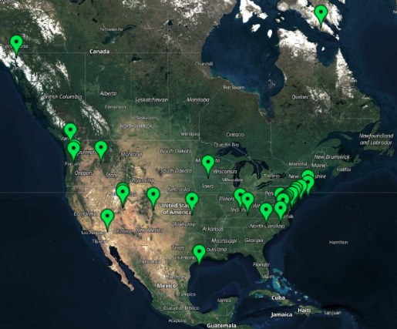
Unified Ceilometer Network (UCN)
UCN began with evaluation studies (Ad-Hoc Ceilometer Evaluation Study) and prototype networks (E-PAMS Network Testbed) since December 2016.
U.S. EPA mandate to state and local air quality agencies to measure hourly MLH at the national PAMS:
State Implementation Plan (SIP) modeling data needs
Collaboration between 32 states and 4 federal agencies (EPA, NASA, NOAA and USDA), 8 academic institutions and 1 international agency (Environment and Climate Change Canada) for extensive observational coverage in North America (40+ sites).
UCN hosts, process, display, and distribute ceilometer data and products.
https://alg.umbc.edu/ucn

Slide 4
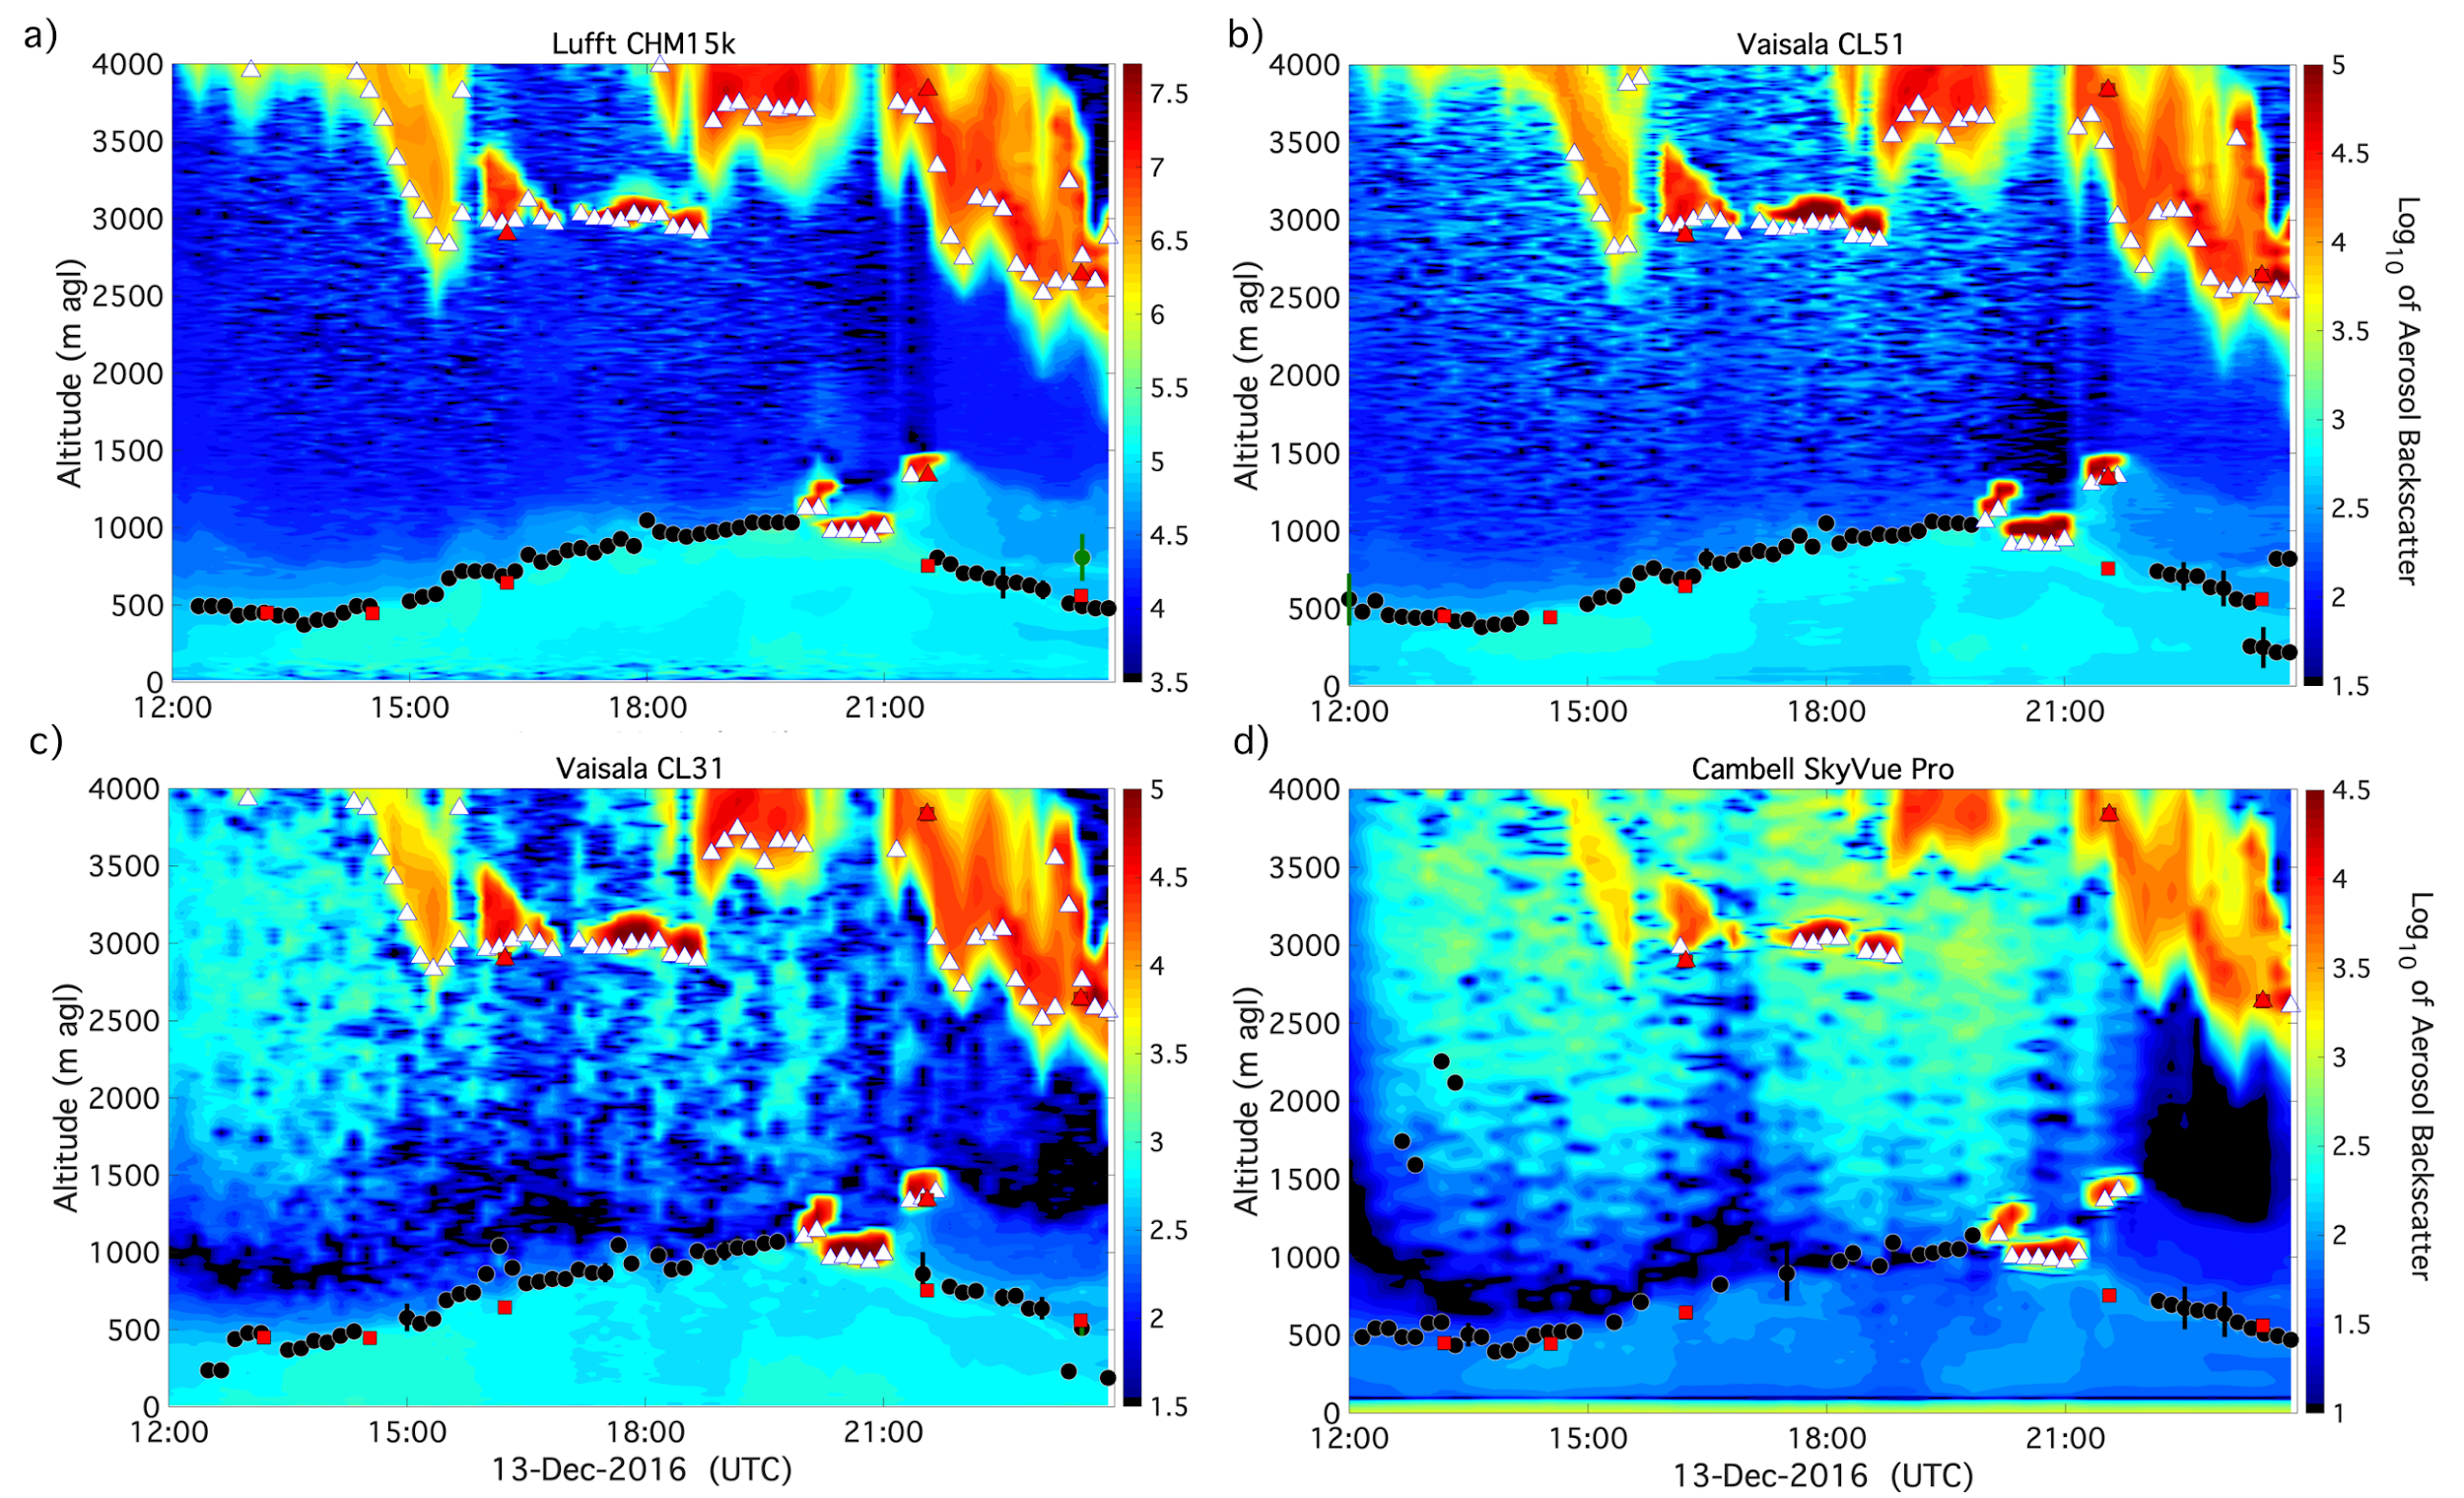
What are the most exciting opportunities?
    Over 40 Enhanced PAMS locations operational by October 2021
      Enhanced Instrumentation: Ceilometer, PANDORA, Auto GC
      Ambient air database (met, PM_{2.5}, O₃,NO₂, NOx, speciated VOCs)
    Near real-time data processing (MLH, NBL, residual layer (RL), aerosol layers)
      Near real-time particle pollution detection (e.g. haze,smoke,dust)
    Development of standardized retrieval algorithms for heterogeneous network
      Automated PBL algorithm corrects for instrument signal quality, screens for precipitation and cloud layers, and provides PBLH uncertainties.
      Ceilometer aerosol backscatter profiles are used to determine the PBL height with continuous 10-minute temporal resolution (Caicedo et al. 2020).
    Ground validation/verification for current/future models and satellite missions (TEMPO, MAIA, etc.)
    Retrospective analysis of air quality events
PBL Automated Outputs:
Cloud-base heights
Precipitation flags
Filtered PBL heights (NSL, RL, MLH)
Uncertainties for PBL heights

Slide 5
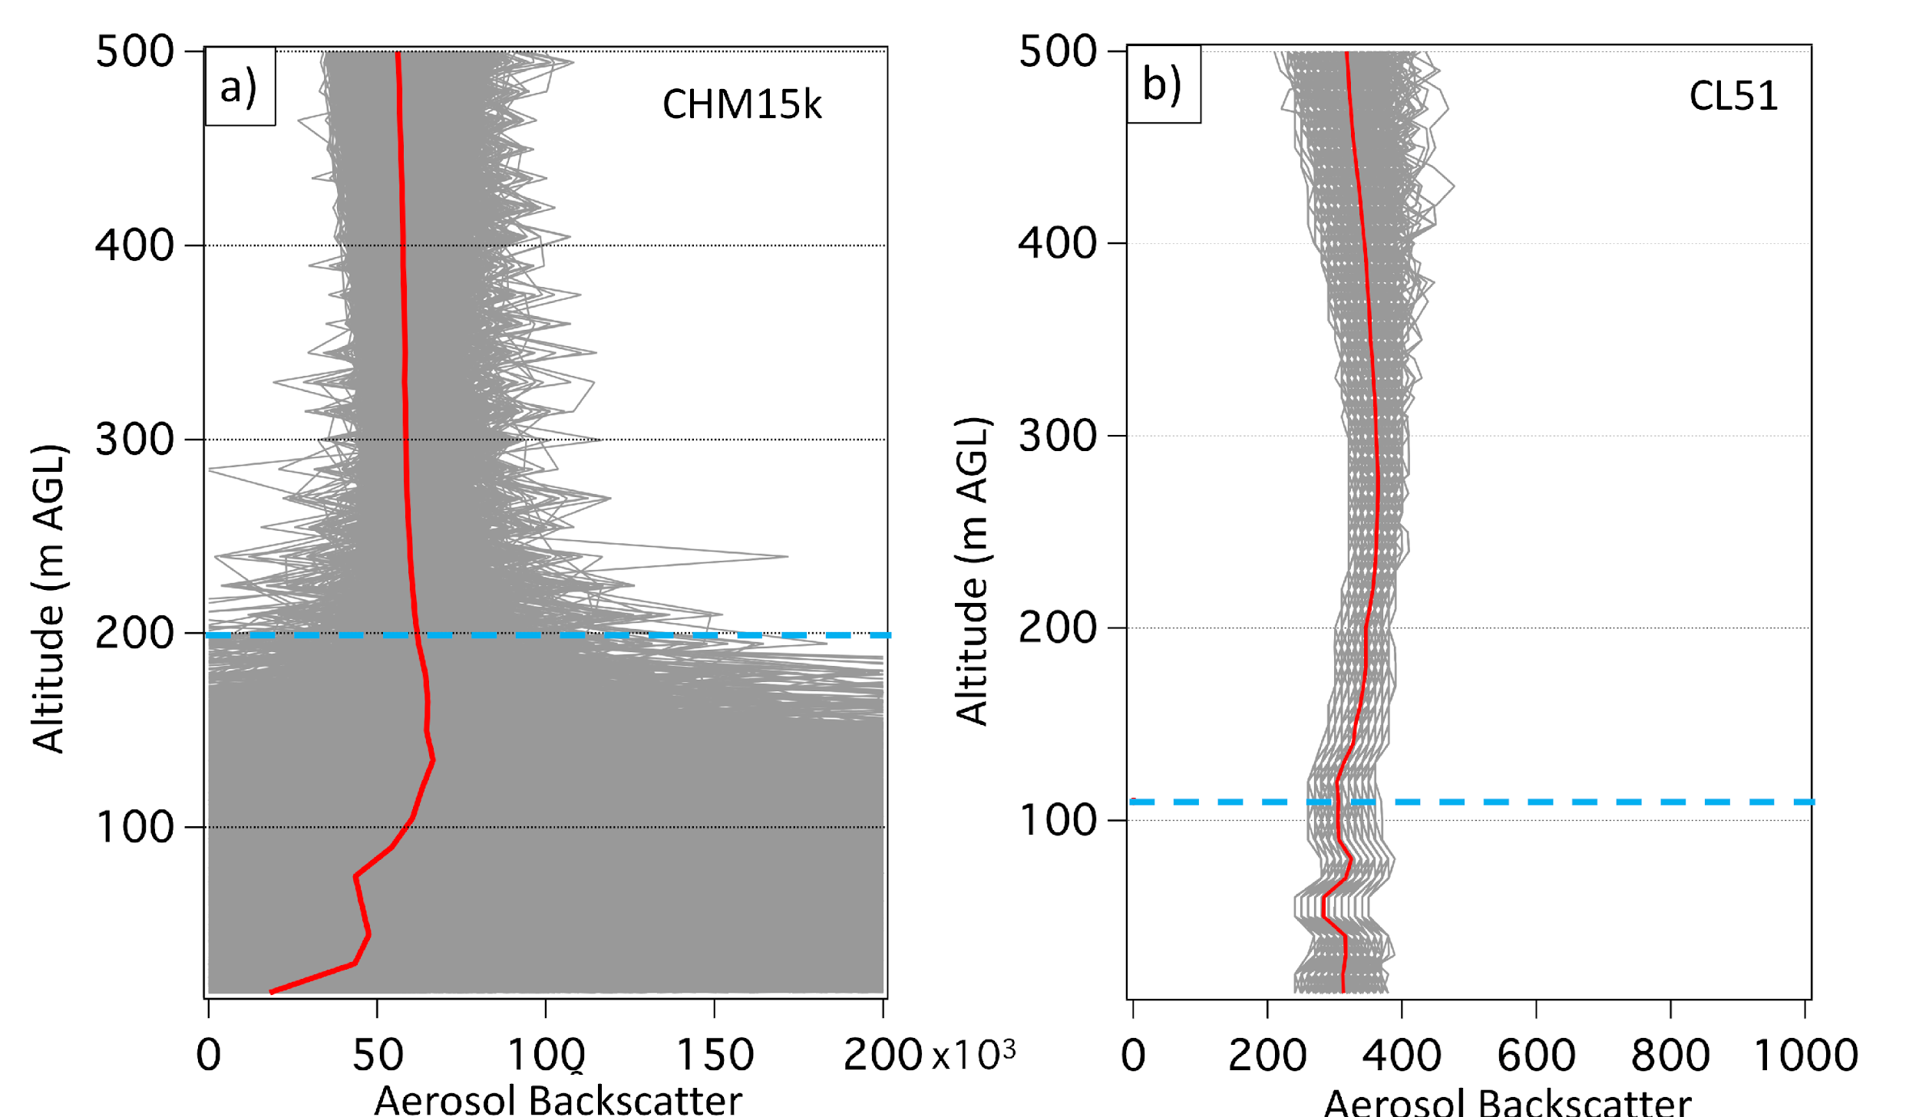
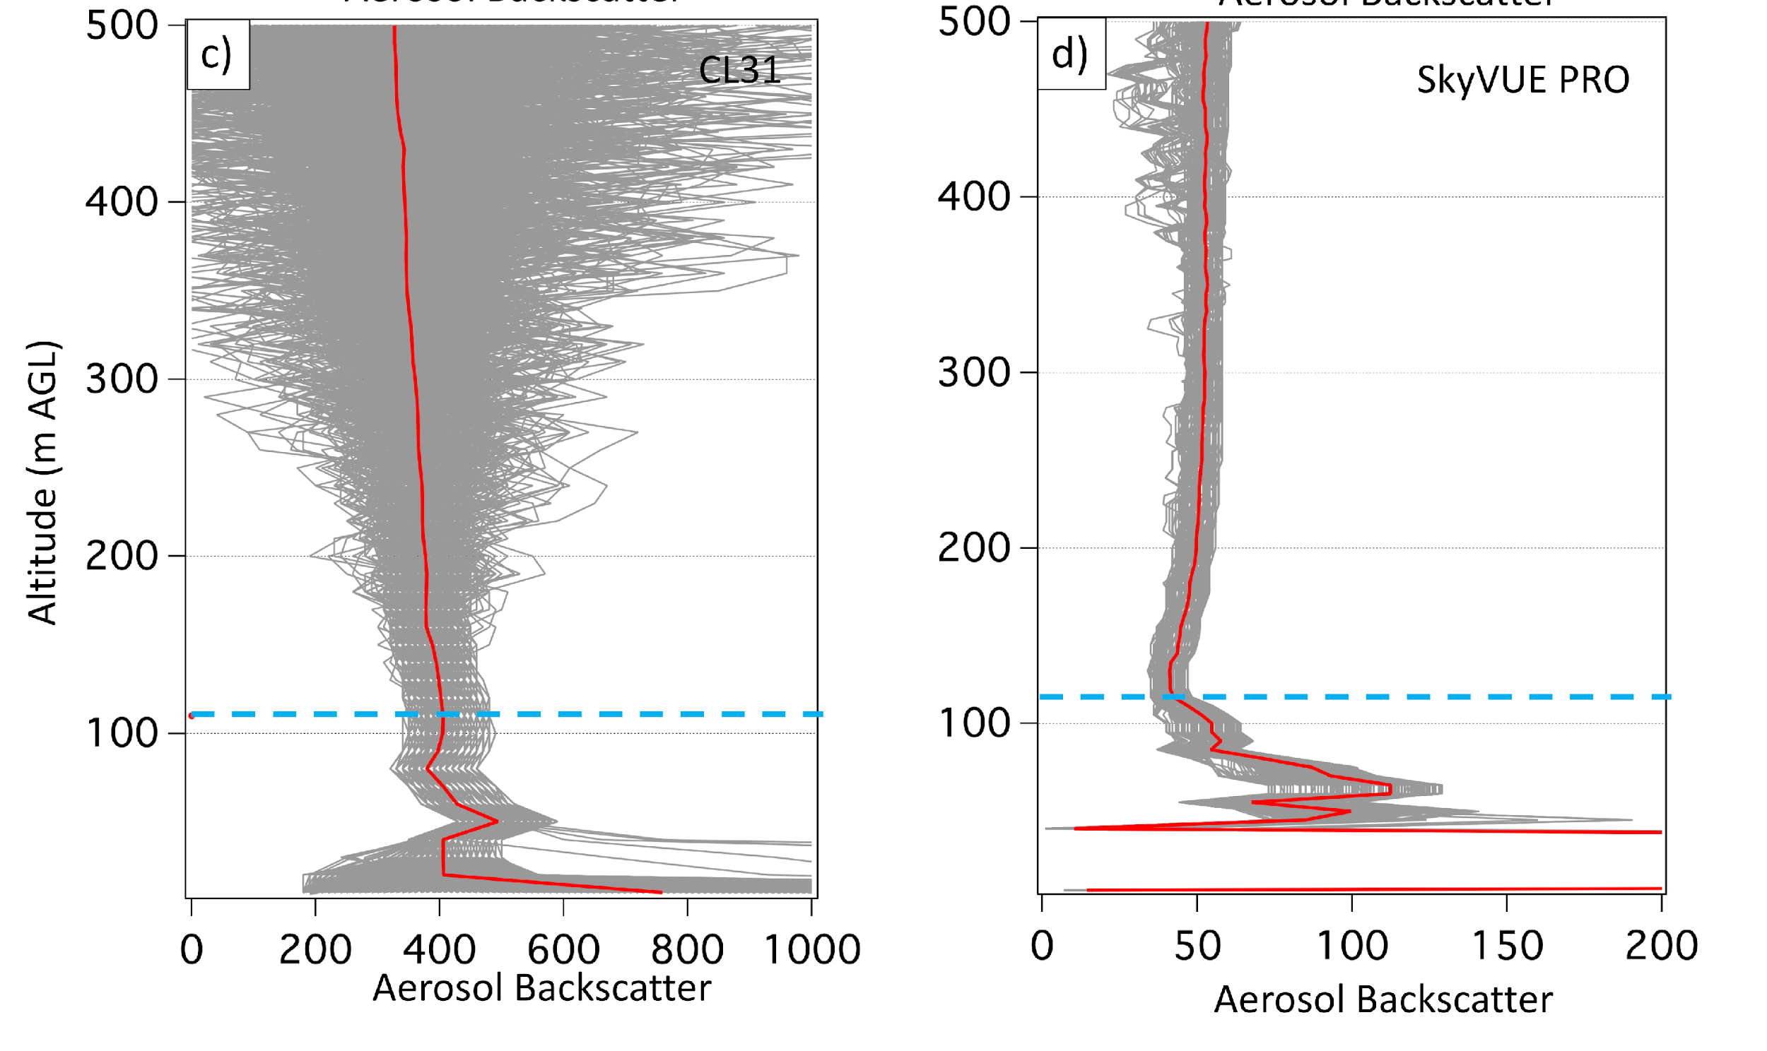
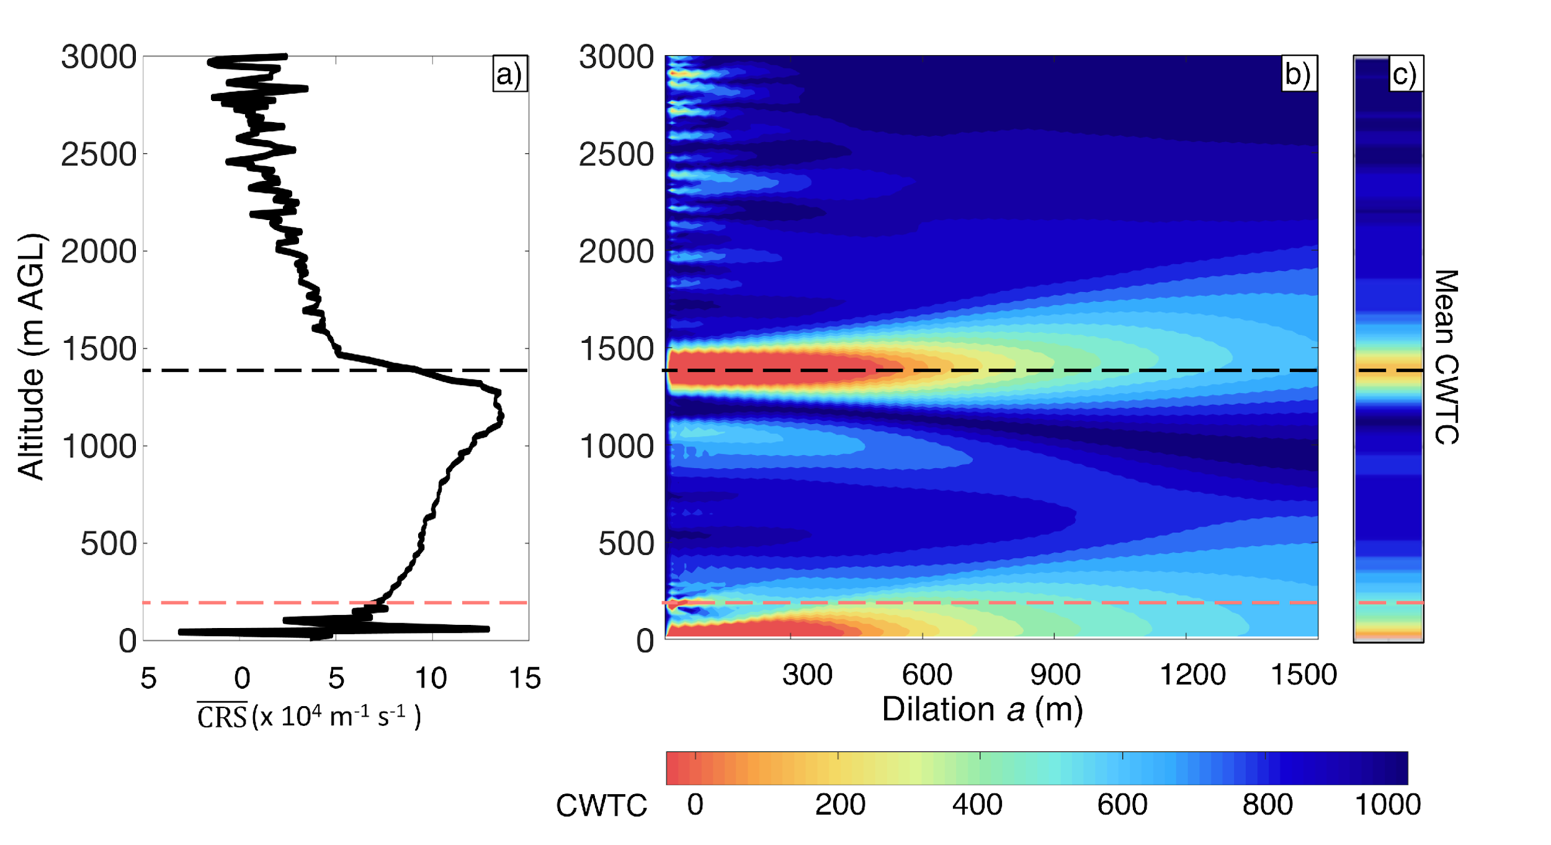
Planetary Boundary Layer Height Algorithm
An Automated Common Algorithm for Planetary Boundary Layer Retrievals Using Aerosol Lidars in Support of the U.S. EPA Photochemical Assessment Monitoring Stations Program
Addresses instrumental signal quality
(SNR, artifacts, overlap, etc.)
Haar step-function to detect changes in aerosol backscatter profiles using multiple dilations
Define minimum reliable signals and limitations
Common retrieval algorithm for heterogeneous network with proper QA applied
Caicedo et al. (2020)
https://doi.org/10.1175/JTECH-D-20-0050.1

Slide 6
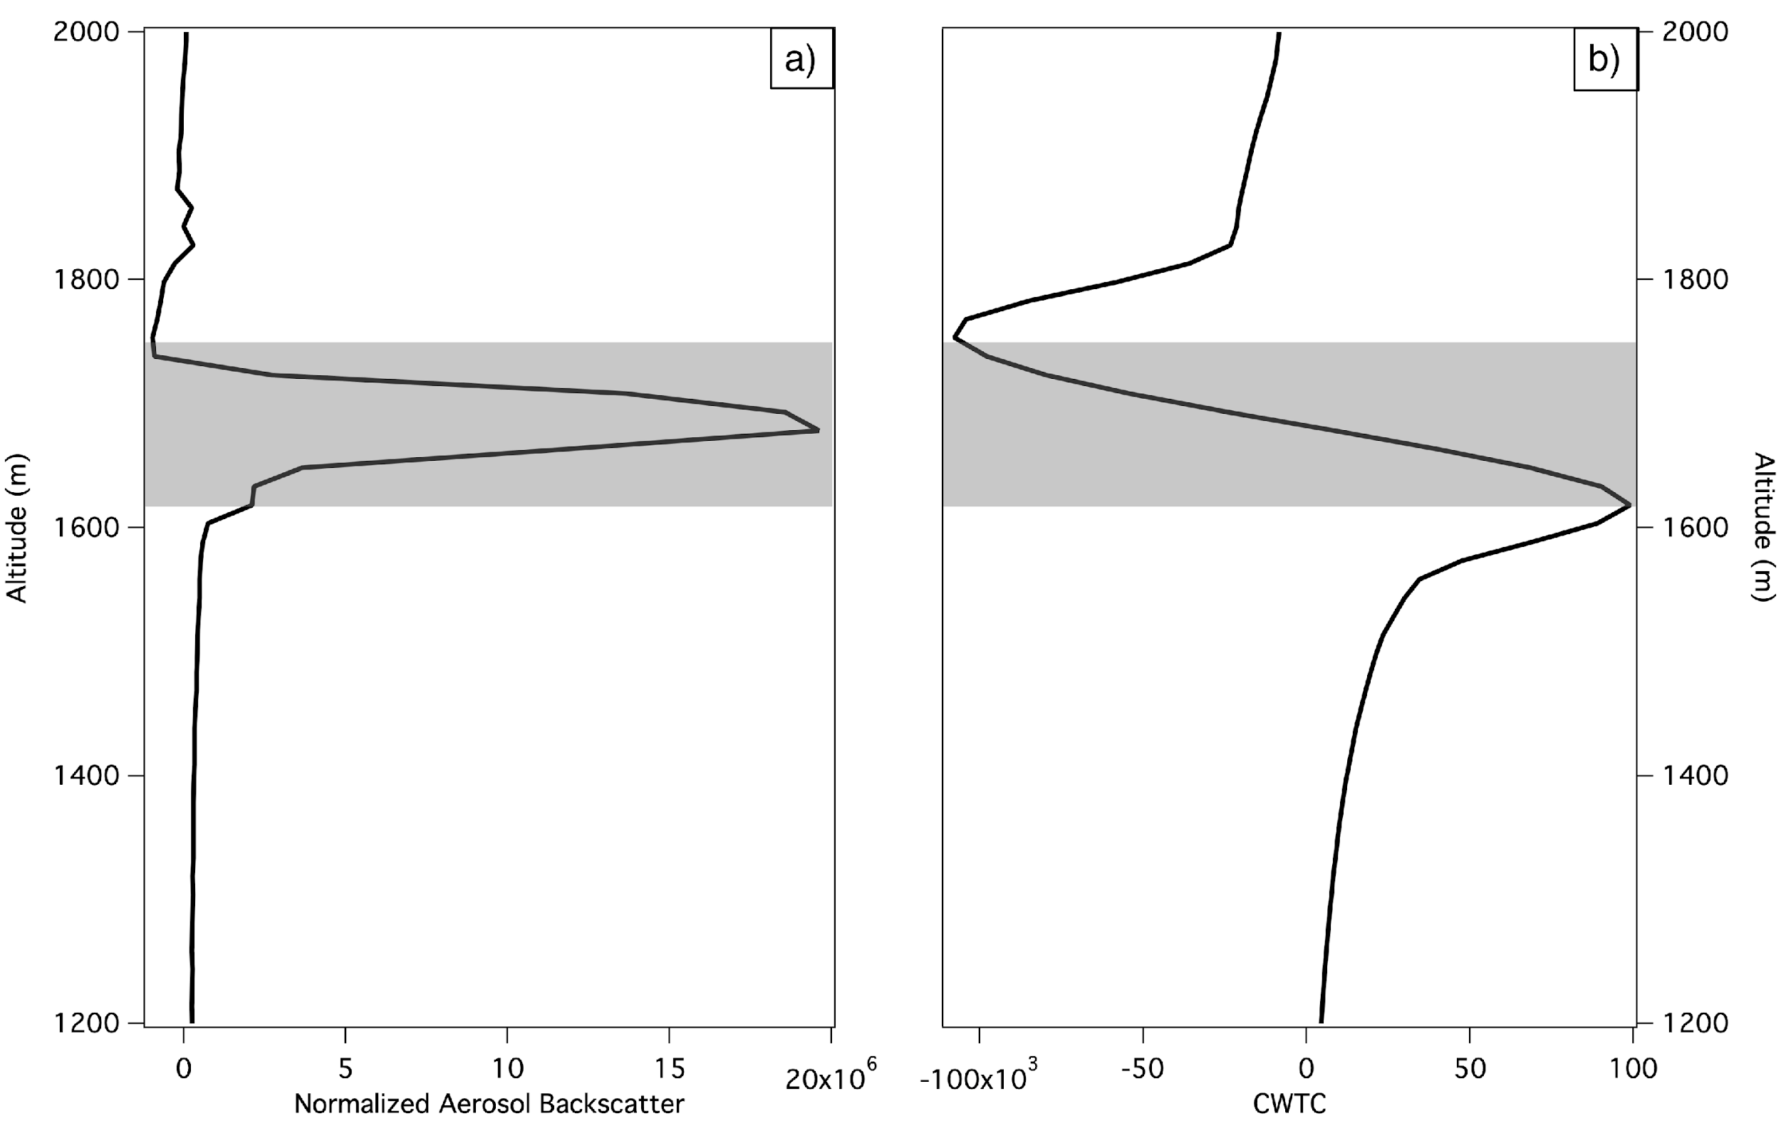
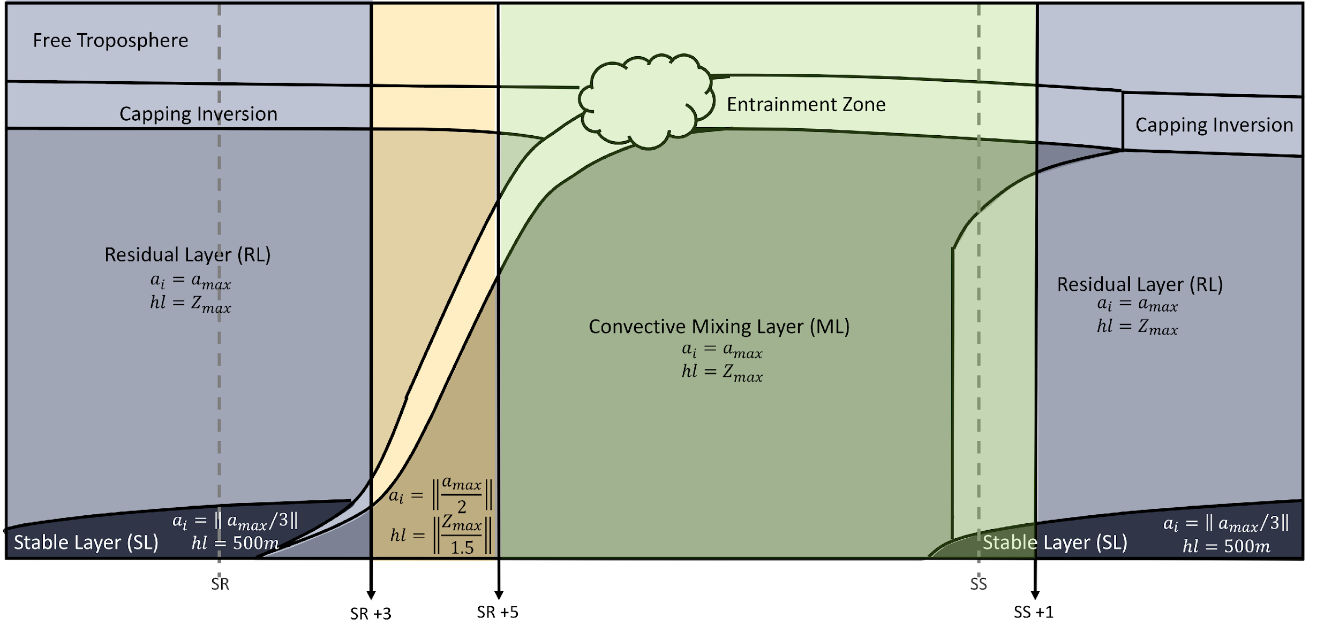
Planetary Boundary Layer Height Algorithm
Development of standardized retrieval algorithms for heterogeneous network
Automatically screens for clouds and precipitation
Derive cloud layer heights using the Haar wavelet retrieval methodology
Layer attribution for the PBL height is supported with the use of continuation and time-tracking parameters
Cloud Layer
Aerosol backscatter
Wavelet Transform

Slide 7
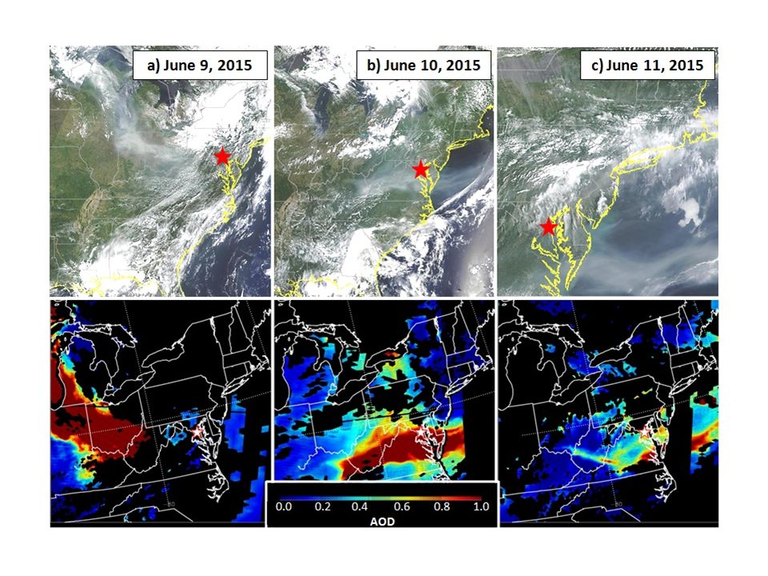
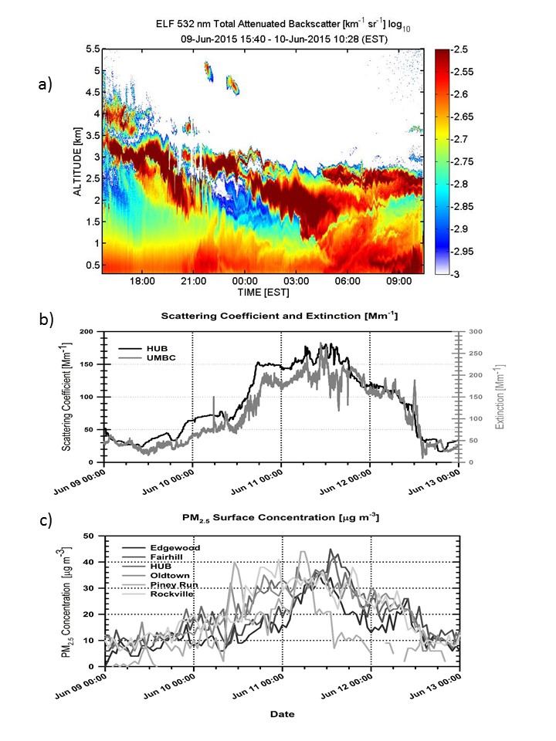
Three-Dimensional Air Quality System (3D-AQS)
UCN is at the center of a re-invigorated effort to combine remote sensing and ground-based measurements of aerosol concentrations into a 3D-view of the atmosphere.
Designed to improve the accessibility of data for the air quality community across the U.S.
Serving two distinct audiences who need:
  Real-time tools that are used by forecasters for interpretation and guidance on the day of measurement
  Retrospective analysis tools for compliance assessment, analysis, and event interpretation
Dreessen et al. 2016

Slide 8
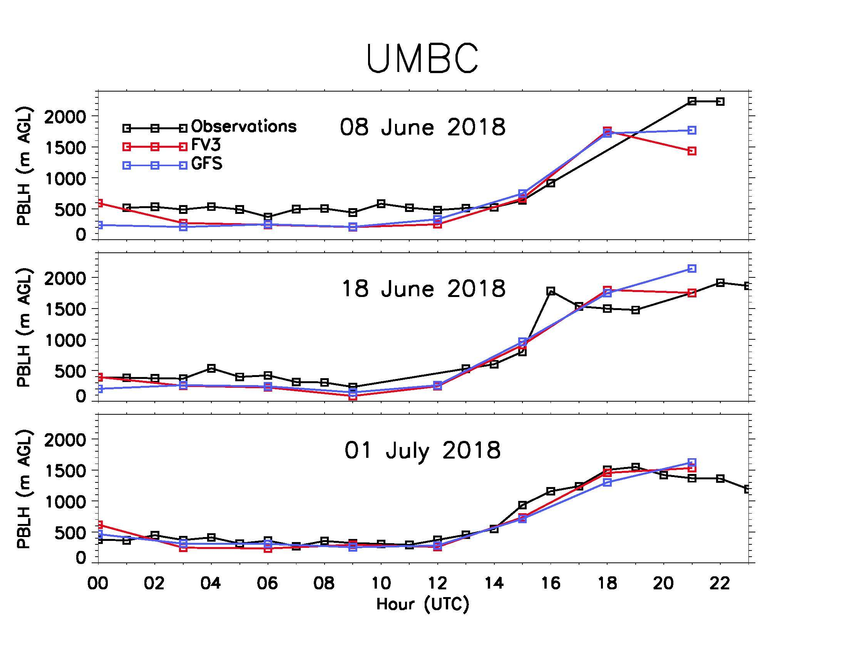
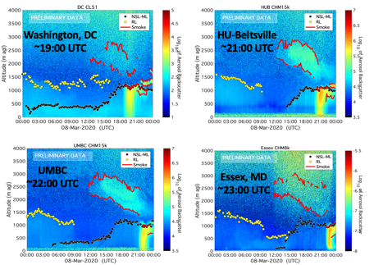
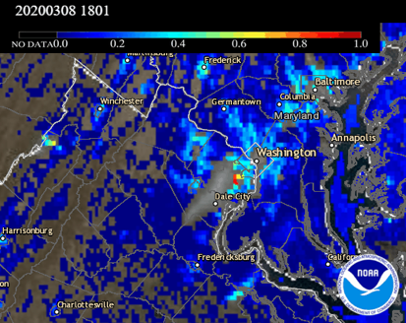
Three-Dimensional Air Quality System (3D-AQS)
Verification/Validation of Models and Satellite Products
PBL Height:
Ceilometer vs NOAA FV3 and GFS model
(Loughner et al. 2019)
Smoke transport within PBL observed by ceilometers network supplementing GOES-16/ABI AOD
Huff et al. 2021
DOI: 10.1175/JTECH-D-20-0162.1
  UCN is at center of re-invigorated effort to combine remote sensing and ground-based measurements of aerosol concentrations into a 3D-view of the atmosphere.

Slide 9
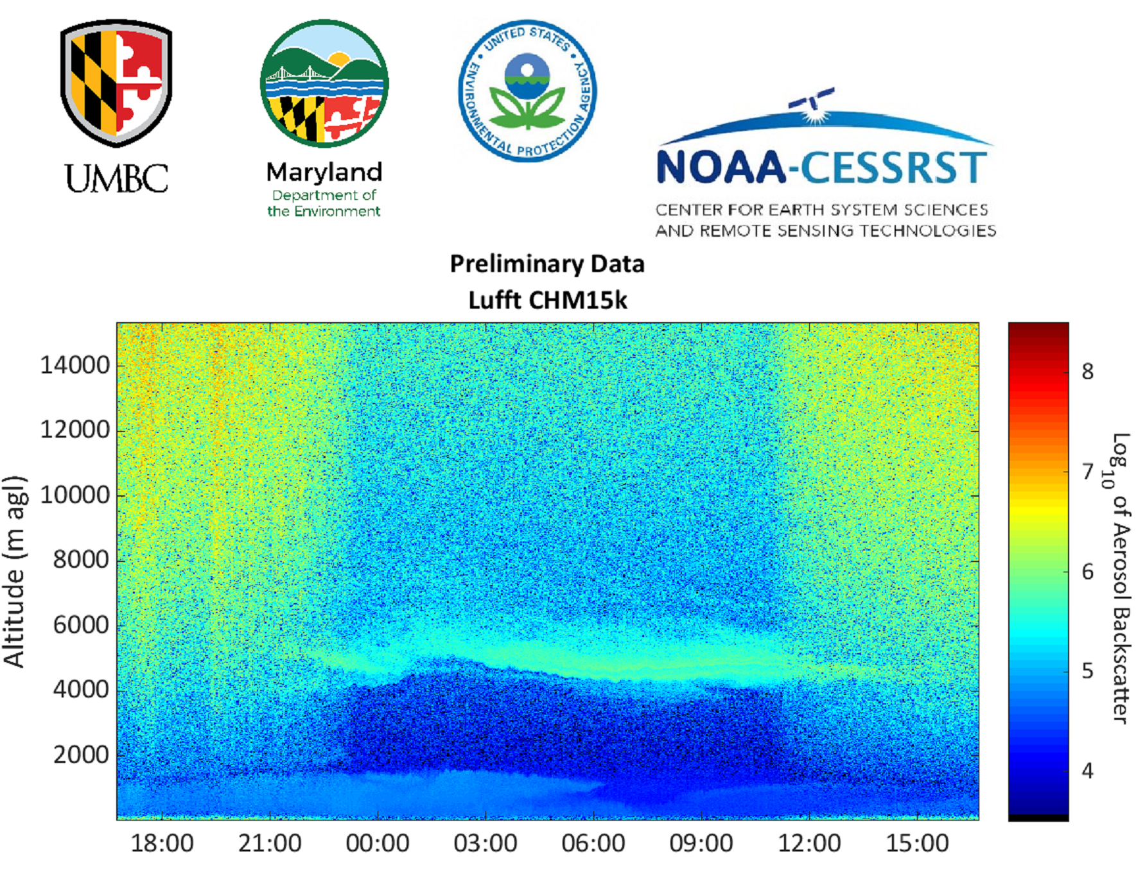
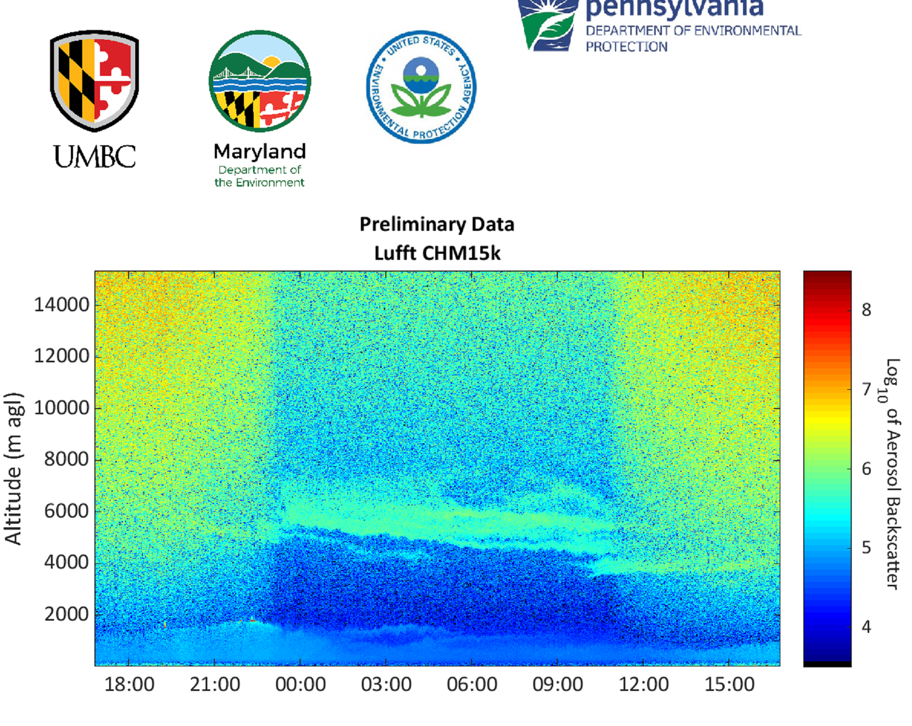
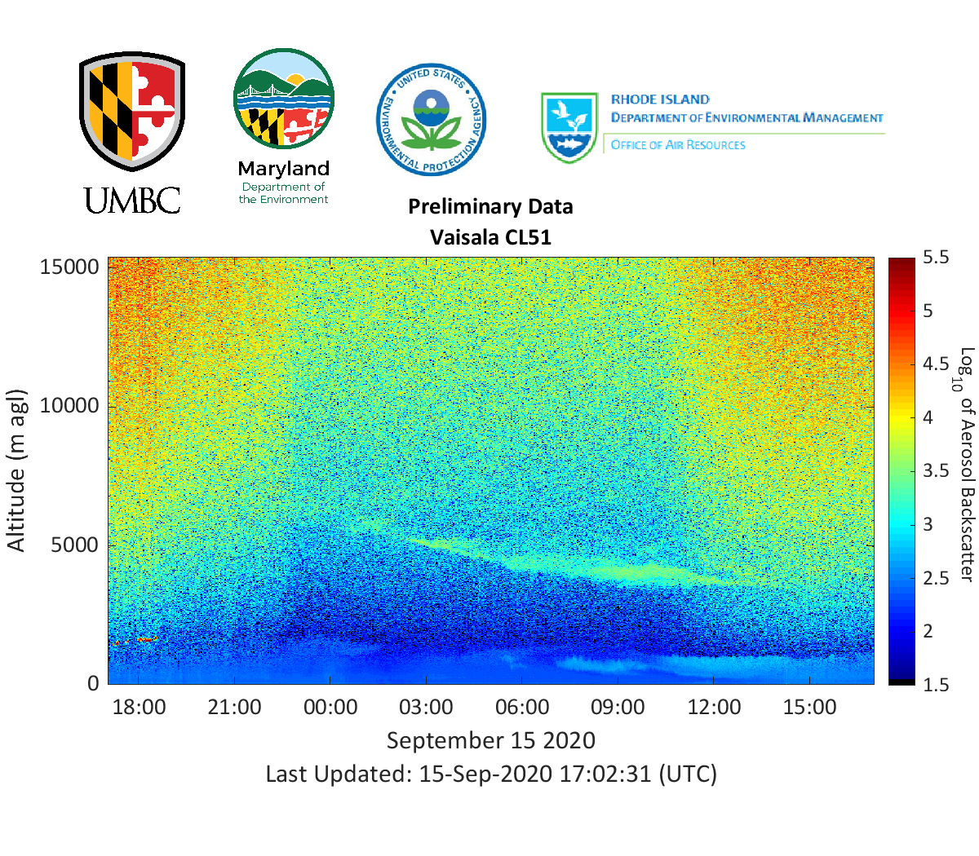
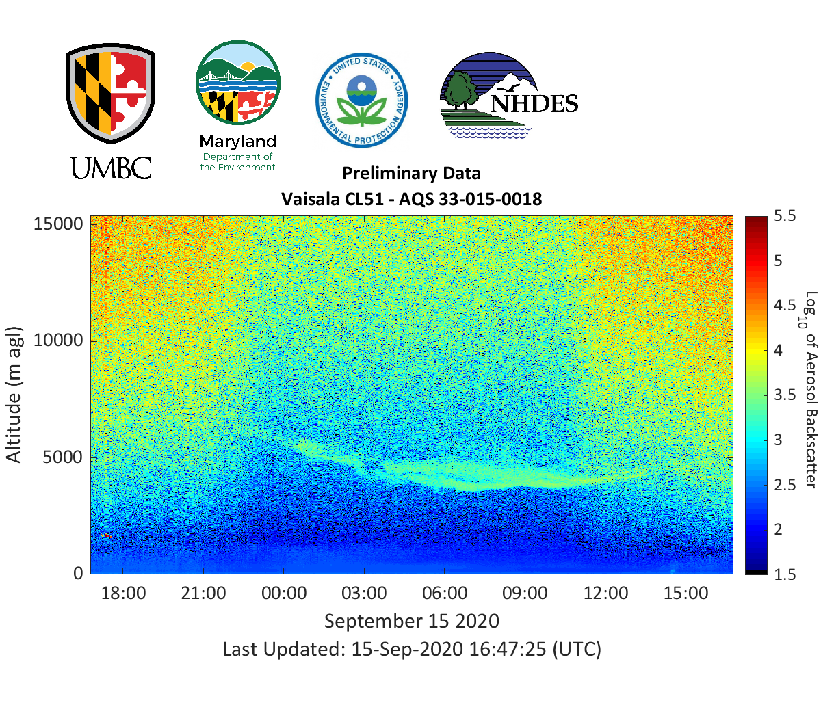
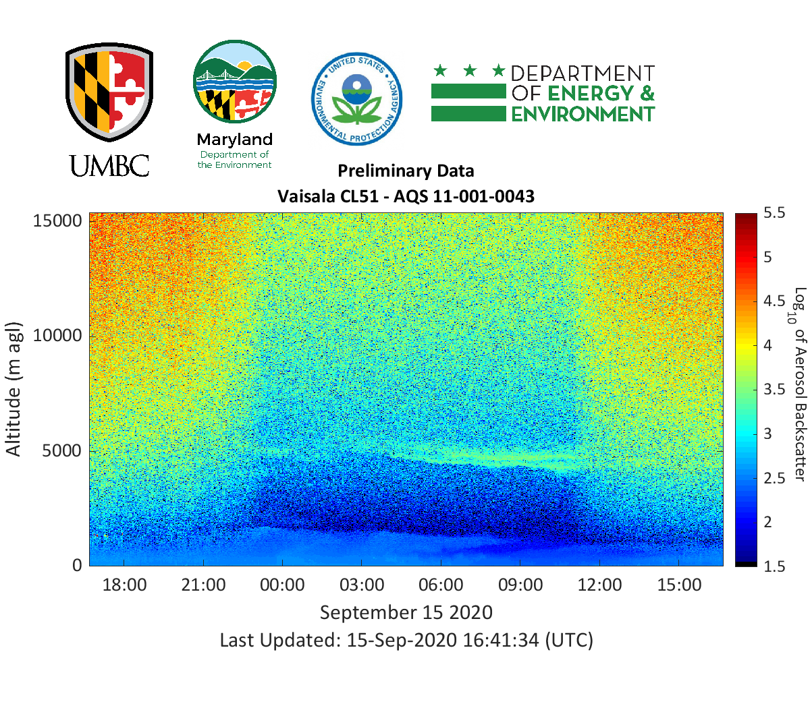
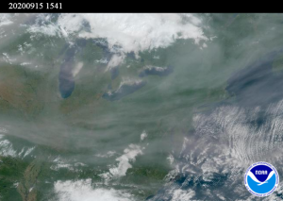
California Wildfire Smoke Transport to Eastern U.S.
September 15, 2020
MD
PA
RI
NH
DC
NOAA GOES-16

Slide 10
Summary
Vertical and temporal resolution of lidar allows:
  Assessment of long-range transport of natural and anthropogenic aerosols vs. local sources to local air quality.
  Aid source allocation of particle pollution for during Air Quality Action Days. Evidence for Exclusion of Air Quality Exceedance due to Exceptional Events.
  Continuous monitoring of PBL –verification and validation of satellite, forecasts and models.
Lidar + real time ground monitoring of pollutants: Characterization of temporal and spatial changes of particle pollution, oxidants, and precursors.

Slide 11











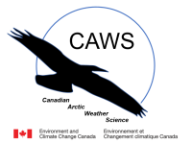








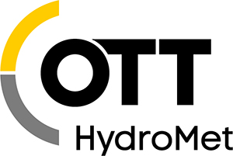

Acknowledgements
Primary Contacts:
University of Maryland, Baltimore County
Ruben Delgado (delgado@umbc.edu)
Vanessa Caicedo (vacaiced@umbc.edu)

