Slide 1
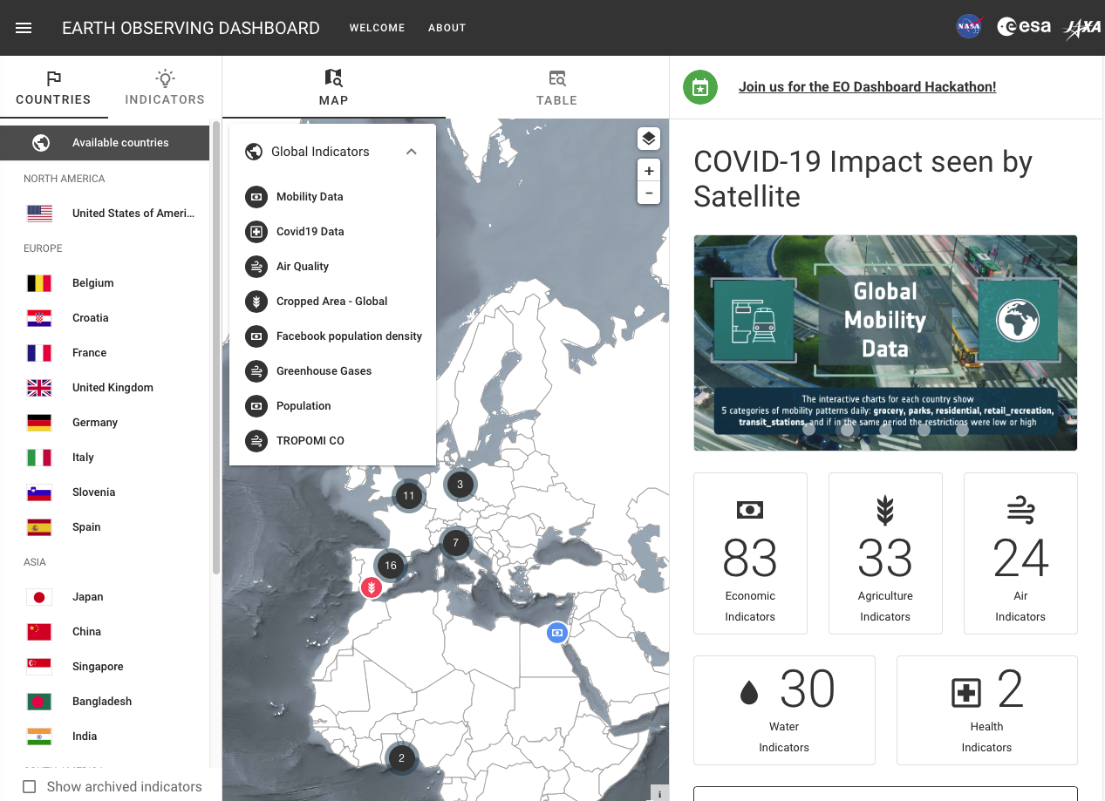
EO Dashboard www.eodashboard.org
Notes:
Here is the NASA-ESA-JAXA Earth Observing Dashboard homepage. In this challenge we are hoping you all can improve our analysis tools for air quality.

Slide 2
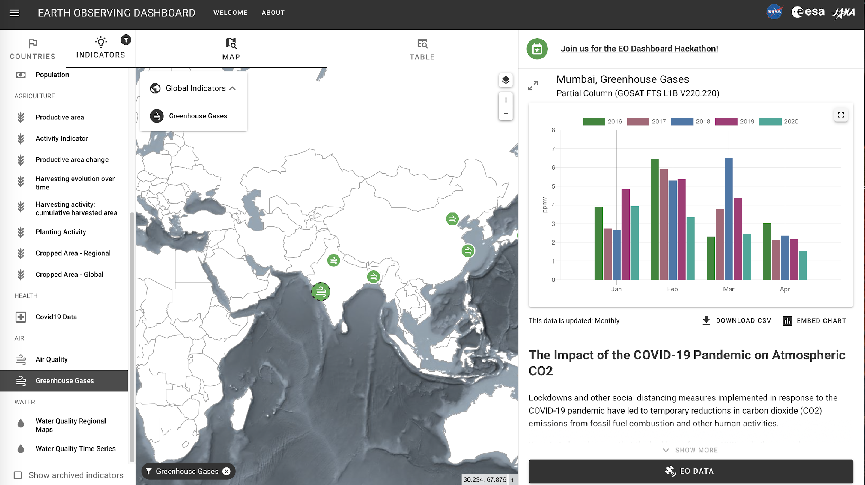
EO Dashboard www.eodashboard.org
Notes:
Here is the NASA-ESA-JAXA Earth Observing Dashboard homepage. In this challenge we are hoping you all can improve our analysis tools for air quality.

Slide 3
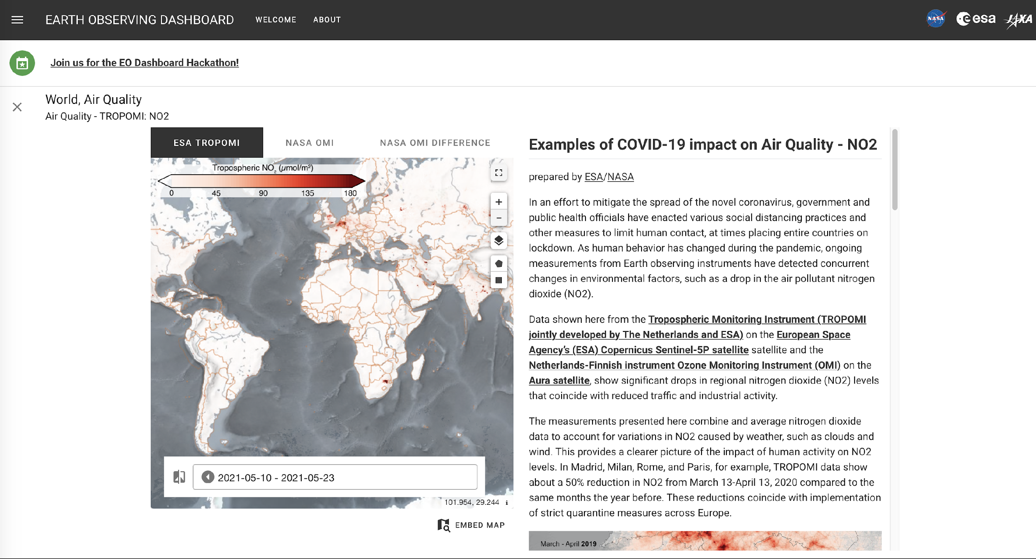
EO Dashboard World Air Quality

Slide 4
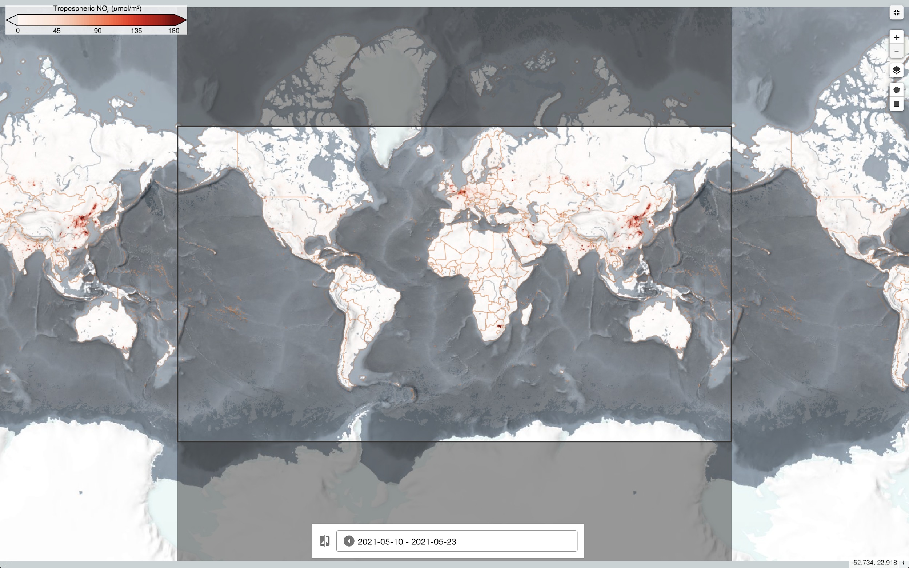
Challenge Title: Spatial analysis and time series for Air Quality Data

Slide 5
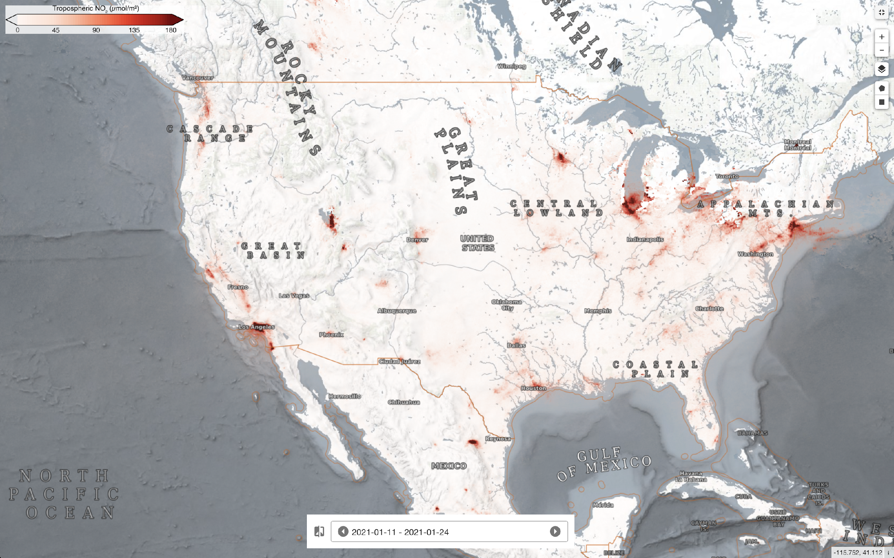
Challenge Title: Spatial analysis and time series for Air Quality Data

Slide 6
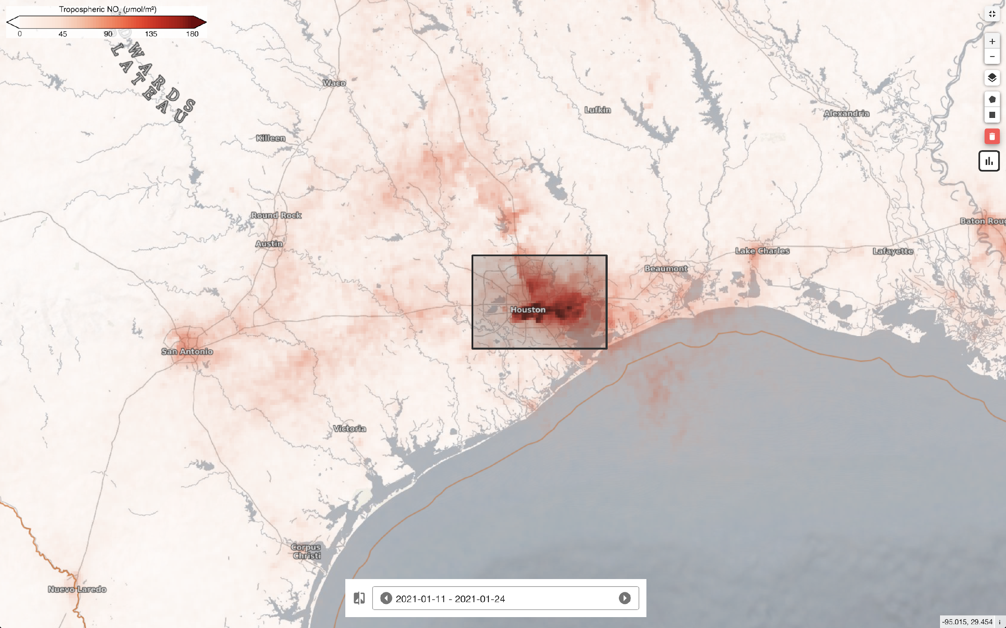
Challenge Title: Spatial analysis and time series for Air Quality Data

Slide 7
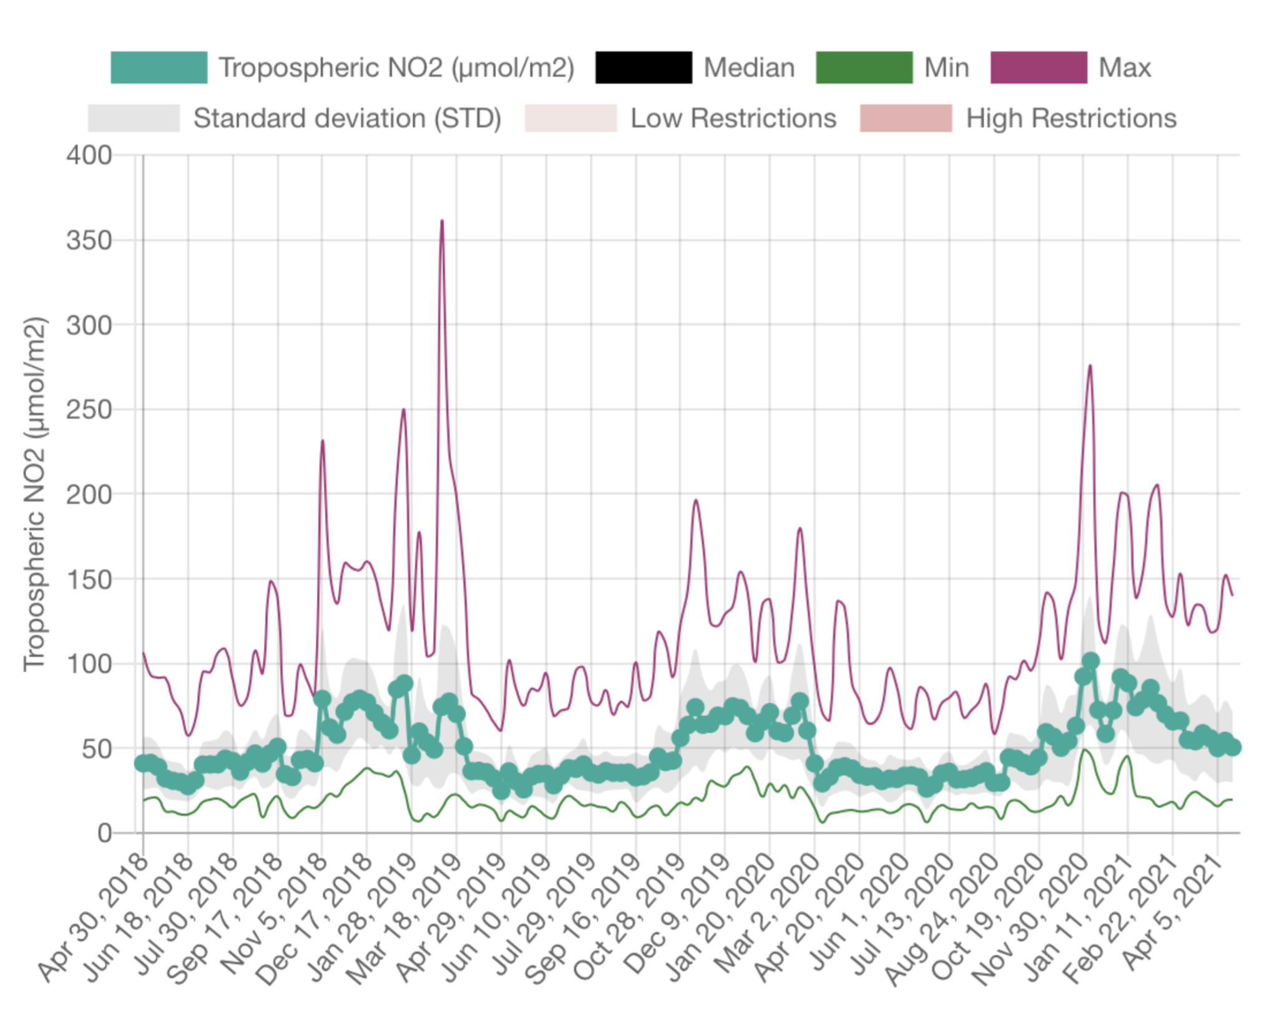
Challenge Title: Spatial analysis and time series for Air Quality Data

Slide 8
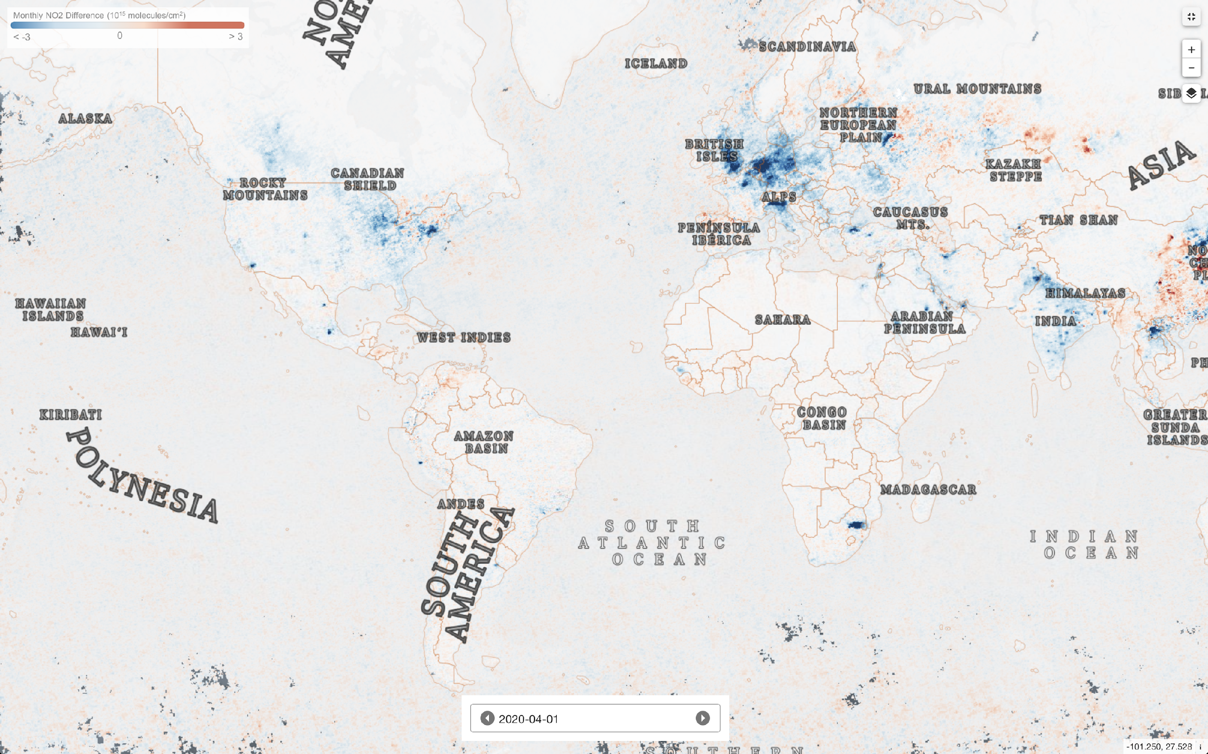
EO Dashboard OMI NO₂ Difference Plot

Slide 9
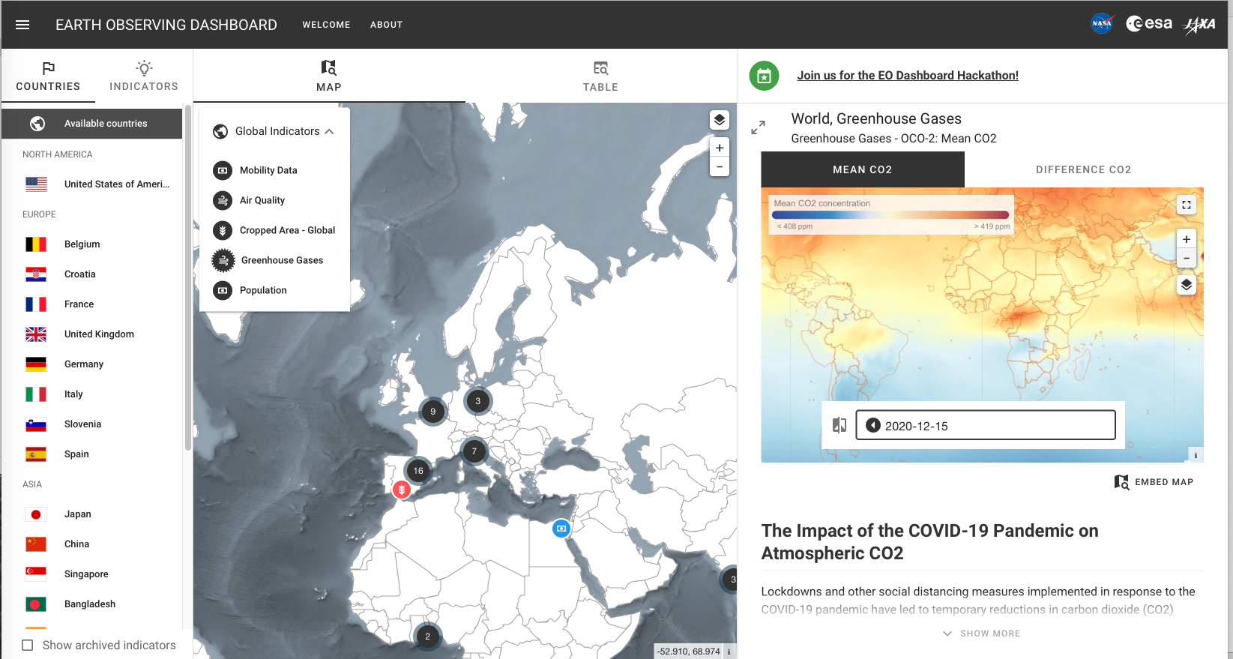
EO Dashboard CO₂ Data

Slide 10
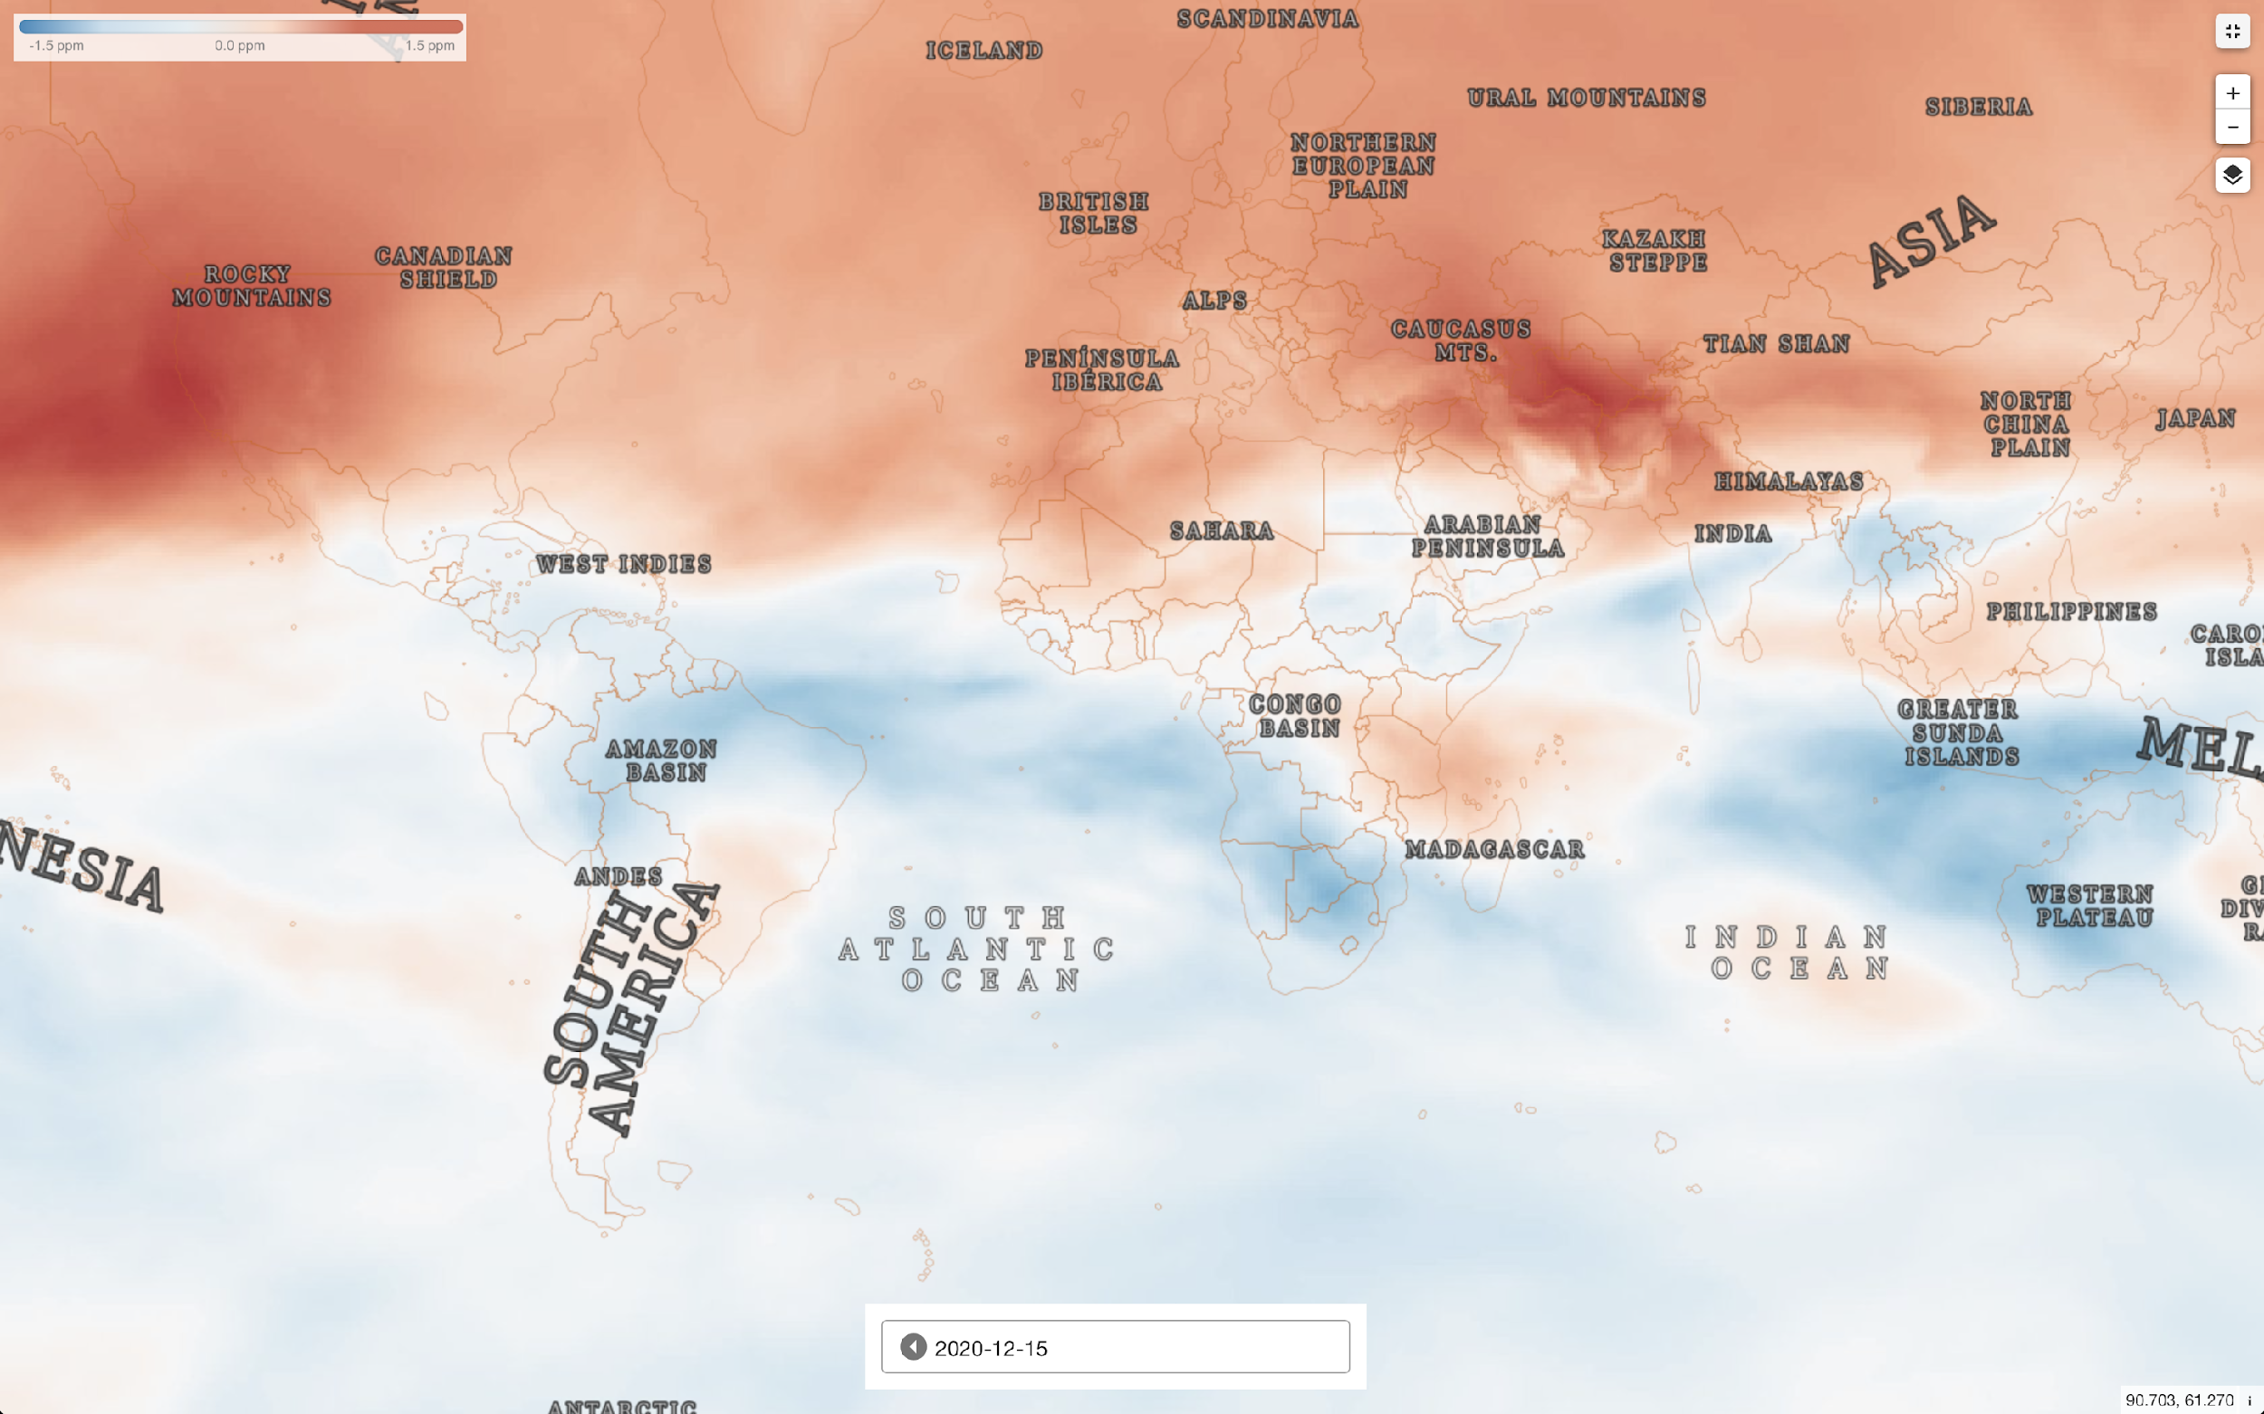
EO Dashboard CO₂ Difference Data

Slide 11
Let us know your ideas on how to improve the EO Dashboard
Barry Lefer barry.lefer@nasa.gov
Claus Zehner claus.zehner@esa.int
Akihiko Kuze kuze.akihiko@jaza.jp
David Crisp david.crisp@jpl.nasa.gov
Ken Jucks kenneth.w.jucks@nasa.gov

