Slide 1
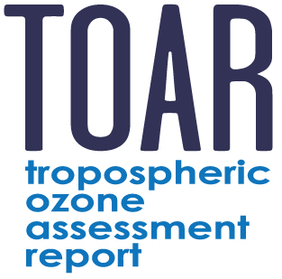


The Tropospheric Ozone Assessment Report (TOAR)-II
Helen Worden (TOAR-II co-Chair)
National Center for Atmospheric Research, Boulder, USA
Martin G. Schultz (TOAR-II co-Chair)
Forschungszentrum Jülich, Germany
Owen R. Cooper, TOAR-II Special Issue Coordinator
CIRES, University of Colorado Boulder/NOAA CSL, USA
+ TOAR Steering Committee

Slide 2







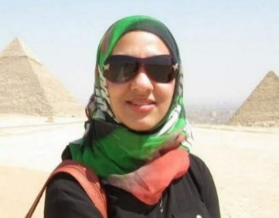


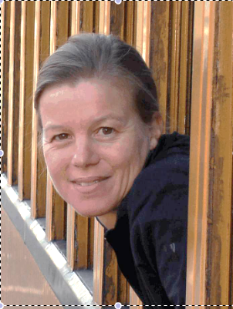


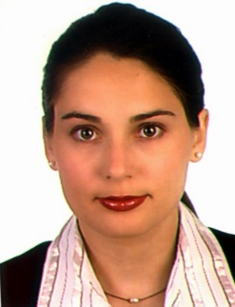







TOAR-II Steering Committee, Aug. 2022 – Apr. 2026
Helen Worden (co-Chair), National Center for Atmospheric Res., Boulder, USA
Martin Schultz (co-Chair), Forschungszentrum Jülich, Germany
Lisa Emberson, University of York, UK
Yugo Kanaya, Japan Agency for Marine-Earth Science and Tech. (JAMSTEC)
Raeesa Moolla, University of the Witwatersrand, South Africa
Gabi Pfister, National Center for Atmospheric Res., Boulder, USA
Erika von Schneidemesser, Institute for Advanced Sustainability Studies
Potsdam, Germany
Rodrigo Seguel, Center for Climate and Resilience Research (CR)2
Universidad de Chile, Santiago, Chile
Bärbel Sinha, Indian Institute of Science Education and Research, Mohali, India
Jason West, University of North Carolina, Chapel Hill, USA
Keding Lu, Peking University, Beijing, China
Jacek W. Kamiński, Inst. of Env, Protection - National Research Inst., Poland

Slide 3





TOAR-I 2014-2019
Mission: Provide the research community with an up-to-date scientific assessment of tropospheric ozone’s global distribution and trends from the surface to the tropopause.
Delivered:
The first tropospheric ozone assessment report based on all available surface observations, the peer-reviewed literature and new analyses. Covered in 10 publications (Elementa, 2018-2020) with over 1500 citations.
2) A database containing ozone exposure metrics at thousands of measurement sites around the world, freely accessible for research on the global-scale impact of ozone on climate, human health and crop/ecosystem productivity.
Stakeholders:

Slide 4
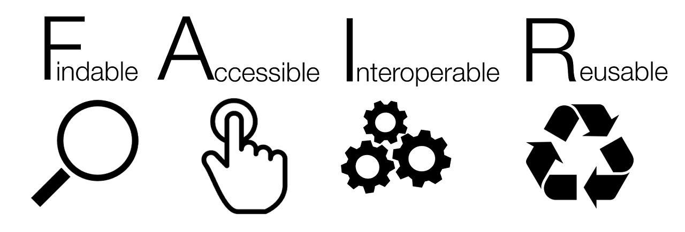
TOAR-II Primary Goal and Scientific Scope
Final Product: An observation-based, up-to-date assessment of tropospheric ozone’s distribution and trends on regional, hemispheric and global scales.
TOAR-II will assess the physical science basis for tropospheric ozone’s global distribution and trends, including the role of ozone precursor emissions (similar to IPCC Working Group I)
TOAR-II will also explore and quantify the impacts of tropospheric ozone on human health, crop and ecosystem productivity and climate change (similar to IPCC Working Group II)
Foundation: An enhanced data infrastructure based on open data and FAIR principles

Slide 5
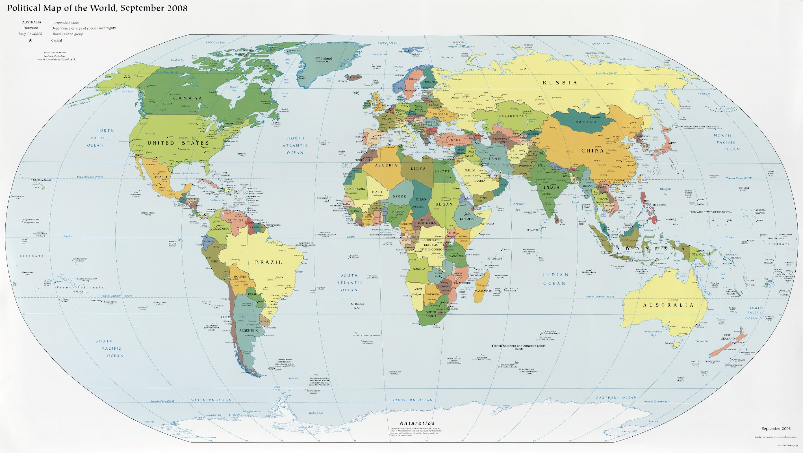

Participants at 1st TOAR-II Manuscript Scoping Event (virtual): 150 scientists from 31 nations

Slide 6
TOAR-II Focus Working Groups
New research is being led by 16 independent Focus Working Groups:
Chemical Reanalysis
East Asia
Global and Regional Models
HEGIFTOM (Harmonization and Evaluation of Ground Based Instruments for Free Tropospheric Ozone Meas.)
Human Health
Machine Learning for Tropospheric Ozone
Ozone over the Oceans
Ozone and Precursors in the Tropics (OPT)
Ozone Deposition
Radiative Forcing
ROSTEES (Role of Strat. Trop. Exchange in the Earth System)
Satellite Ozone
South Asia
Statistics
Tropospheric Ozone Precursors (TOP)
Urban Ozone

Slide 7
TOAR-II Status and roadmap
Finalize database
Complete data analyses
Paper submissions to the Community Special Issue
First TOAR-II workshops
Formation of working groups (WGs)
Beginning of new data collection
2021
March 2023 to Nov. 2024
WGs: Develop manuscripts and initial data analysis
Develop new ozone metrics and populate database
Publication of TOAR-II
assessment papers
Selection of new steering committee
Planning of objectives and roadmap
Development of enhanced data infrastructure
Dec., 2025
We are here
2022
2020
Notes:
Launch was 202—2021
We are still in the in-flight stage
Landing will start with the writing of the assessment papers.

Slide 8




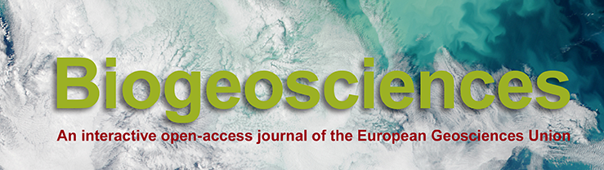
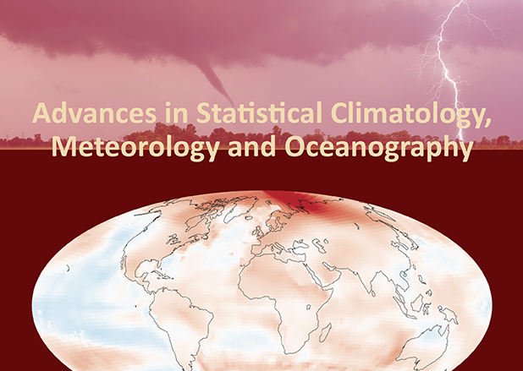
TOAR-II Community Special Issue
Focus Working Group findings submitted to the Community Special Issue in 2023
An inter-journal special issue hosted by Copernicus
O. Cooper, “TOAR Scientific Coordinator of the Community Special Issue”
Deadline for submission was
November 30, 2024
As of June 2025:
56 papers submitted
28 papers published

Slide 9
Satellite O3 TOAR Community Special Issue papers
Intercomparison/Harmonization papers (2 published, 3 in review)
Satellite O3 trend papers (4 published, 4 in review)
Reanalysis papers (1 published, 2 in review)
Satellite O3 precursor trends (1 published)
Other analyses (COVID period, O3 production rates, O3 RF, model evaluation – 3 published, 1 in review)
21 total
Notes:
The next four talks will present some of the findings in these papers, so I won’t go into all the details, but I wanted to show some of the results using satellite O3 and O3 precursor observations as examples..

Slide 10
Tropical Tropospheric Col. O3 from Satellites compared to SHADOZ O3sondes
From Gaudel et al., ACP, 2024

Slide 11
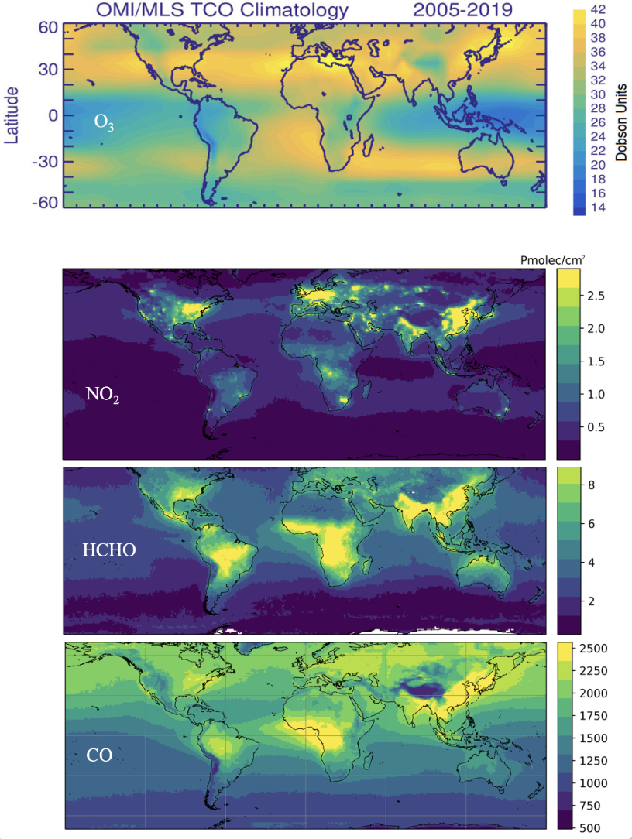
Elshorbany, et al., ACP, 2024
Tropospheric ozone precursors:
global and regional distributions,
trends, and variability

Slide 12
TOAR-II Assessment Papers
Health G. Kerr
Vegetation L. Emberson
Climate O. Cooper/S. Szopa
S. America Regional R. Seguel
Africa Regional R. Moola
Ozone over Oceans A. Saiz Lopez/R. Sommariva
Strat/Troposphere Exchange J. Keeble/P. Griffiths
Satellite Data D. Hubert/K. Miyazaki
Potential topic (TBD): Tropics A. Gaudel/B. Sauvage
Green = Coordinating Lead Author (CLA)

Slide 13
Summary:
TOAR-II is on track to provide high quality-controlled data up to 2021 for the community special issue papers and 2nd assessment of tropospheric ozone on climate, human and vegetation health.
Working group papers were submitted to the TOAR-II Community Special Issue (Copernicus journals ACP, GMD, AMT, ESSD, etc) - 28 published, 28 in discussion
TOAR-II Assessment papers to be published in Phil. Trans. A
Formulating ideas for TOAR-III, e.g.:
          Impact of wildfires and wildland-urban interface fires to O₃
              Policy-relevant outcomes, e.g. “what reductions in precursor emissions would achieve a 0.1 K reduction from O₃ RF?”
              GEO observations for diurnal observations of ozone
                Expanded use of AI for predicting surface O₃
Notes:
Royal Society Philosophical Transactions A

