Slide 1

Assessing the relative impacts of satellite ozone and its precursor observations to improve global tropospheric ozone analysis using multiple reanalysis systems
Takashi Sekiya (JAMSTEC)
Emanuele Emili (BSC), Kazuyuki Miyazaki (NASA JPL), Antje Inness (ECMWF),
Zhen Qu (NCSU), Brad. Pierce (UW-Madison), Dylan Jones (Univ. of Toronto), Helen Worden,
Will Cheng (NCAR), Vincent Huijnen (KNMI), and Gerbland Koren (Utrecht Univ.)
2025/6/10 CEOS AC-VC-21@Takamatsu
Notes:
Thank you for introduction. I’m Takashi Sekiya from Japan Agency for Marine-Earth Science and Technology. I really appreciate the opportunity to share our results at CEOS AC-VC. I’m going to talk about observing system experiment (OSE) study to assess relative impacts of individual satellite observations on tropospheric ozone analysis, as a part of TOAR-II chemical reanalysis WG.

Slide 2
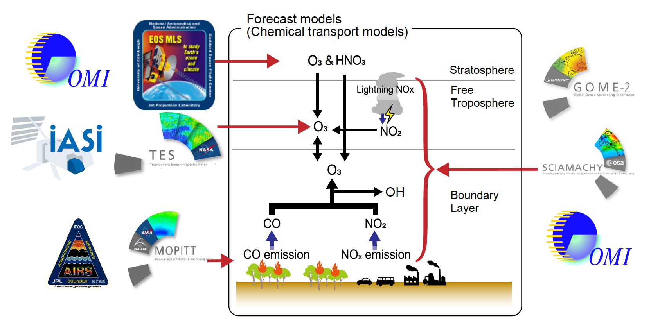
Background and Motivation
Chemical reanalysis is systematic approach to produce consistent long-term records by combining multiple satellite observations with data assimilation (DA) technique.
Information on relative impacts of individual observations on improving tropospheric ozone analysis help design future observing system.
Implications obtained from single DA system can be strongly affected by the model performance and the DA system configurations.
This study evaluates the relative impacts of satellite ozone and its precursor observations on tropospheric ozone analysis using multiple chemical reanalysis systems.
Notes:
You know chemical reanalysis is a systematic approach to produce long-term record of atmospheric composition by combining various species and platform observations, including satellite, with data assimilation technique. Furthermore, information on relative importance of individual observations would help design future observing system that better capture spatial and temporal variability of ozone. However, implications obtained from single DA system can be strongly affected by the model performance and the DA system configurations. Therefore, this study utilizes multiple reanalysis systems to evaluate the relative impacts of satellite ozone and its precursor observations on tropospheric ozone analysis.

Slide 3
Chemical reanalysis systems
Reanalysis | DA method | Emis. inversion | Assimilated satellite observations
 |  |  | Stratospheric ozone (S) |  | Tropospheric ozone (T) | Precursor gases (P)
 |  |  | Total column | Profile
CAMS (Inness et al., 2019) | 4D-Var |  | OMI, GOME-2, SCIAMACHY, TROPOMI, OMPS | SBUV, MLS, MIPAS |  | MOPITT (CO), OMI (NO₂)
TCR-2 (Miyazaki et al., 2020) | EnKF | X |  | MLS | TES | MOPITT (CO), OMI, SCIAMACHY, GOME-2 (NO₂)
GEOS-CHEM (Qu et al., 2020) | 4D-Var | X |  |  |  | OMI (NO₂)
RAQMS (Pierce et al., 2009) | 3D-Var | X | OMI | MLS |  | AIRS (CO), OMI (NO₂)
IASI-r (Emili and El Aabaribaoune, 2021) | 3D-Var |  |  | MLS | IASI (L1)
Sekiya et al. (2025), ACP
Notes:
We used five global chemical reanalysis datasets, CAMSRA, TCR-2, IASI-r, GEOS-Chem adjoint, and RAQMS Aura reanalysis. As summarized in this table, these five reanalysis system used a variety of assimilated observations as well as forecast models, data assimilation technique and emission optimization.

Slide 4
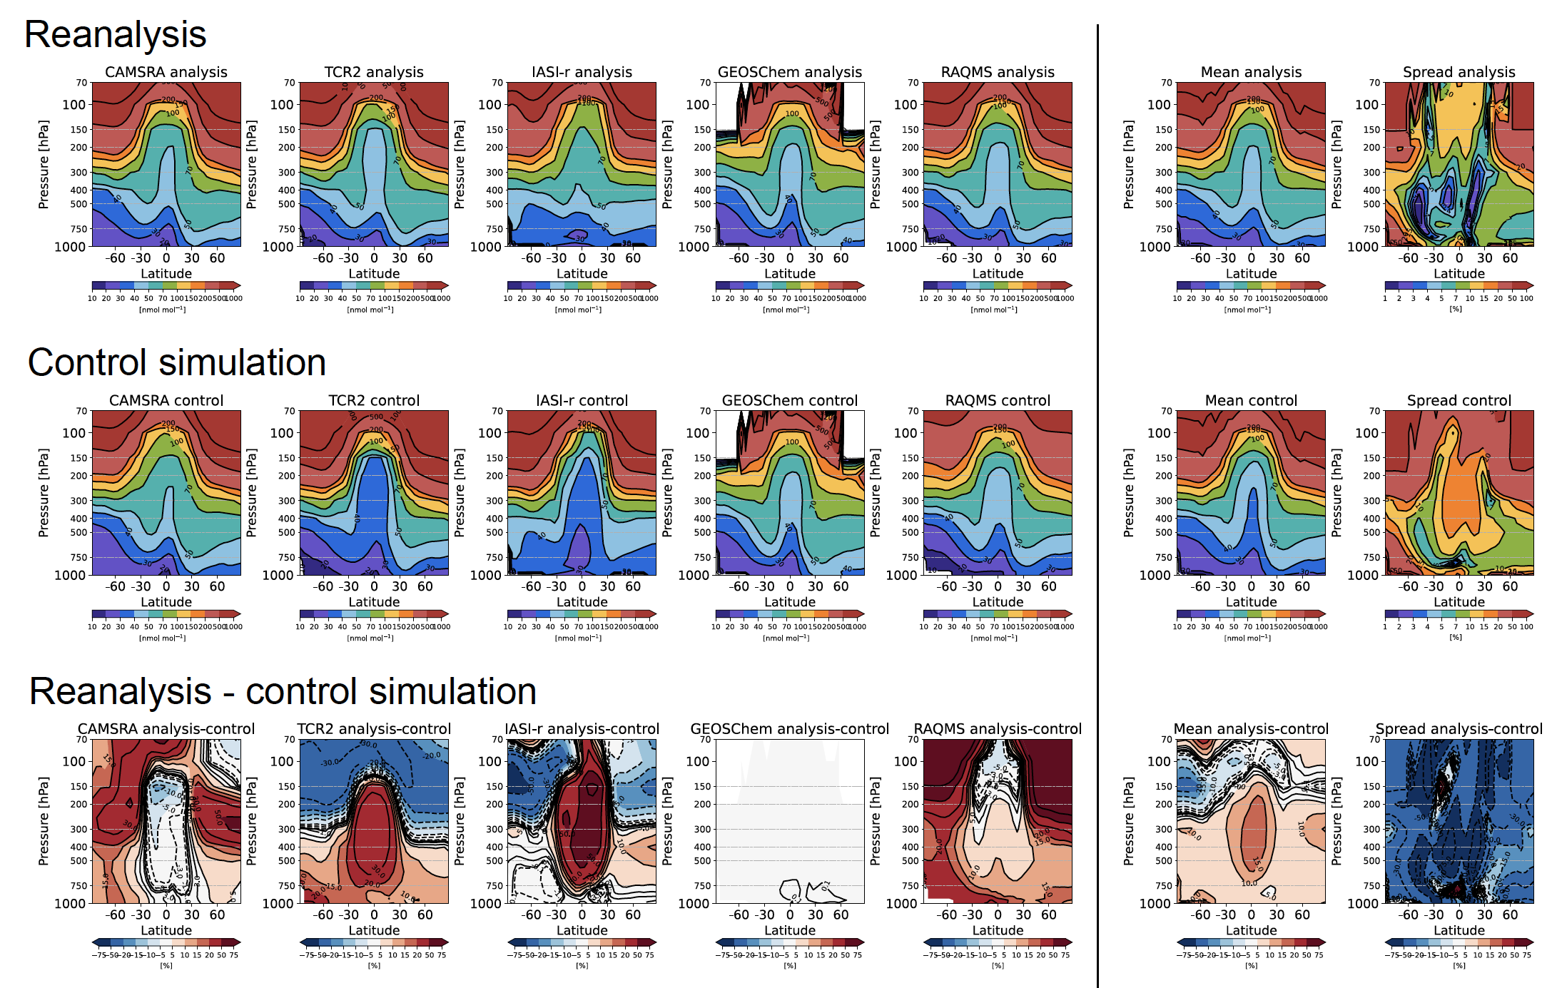
Intercomparison of ozone reanalysis
Notes:
Here we show zonal mean ozone distributions in the reanalysis, the control simulation without any data assimilation, and their difference obtained from individual reanalysis datasets, and multi-system mean and spread. We focus on changes in multi-system mean ozone analysis and its spread owing to data assimilation.

Slide 5
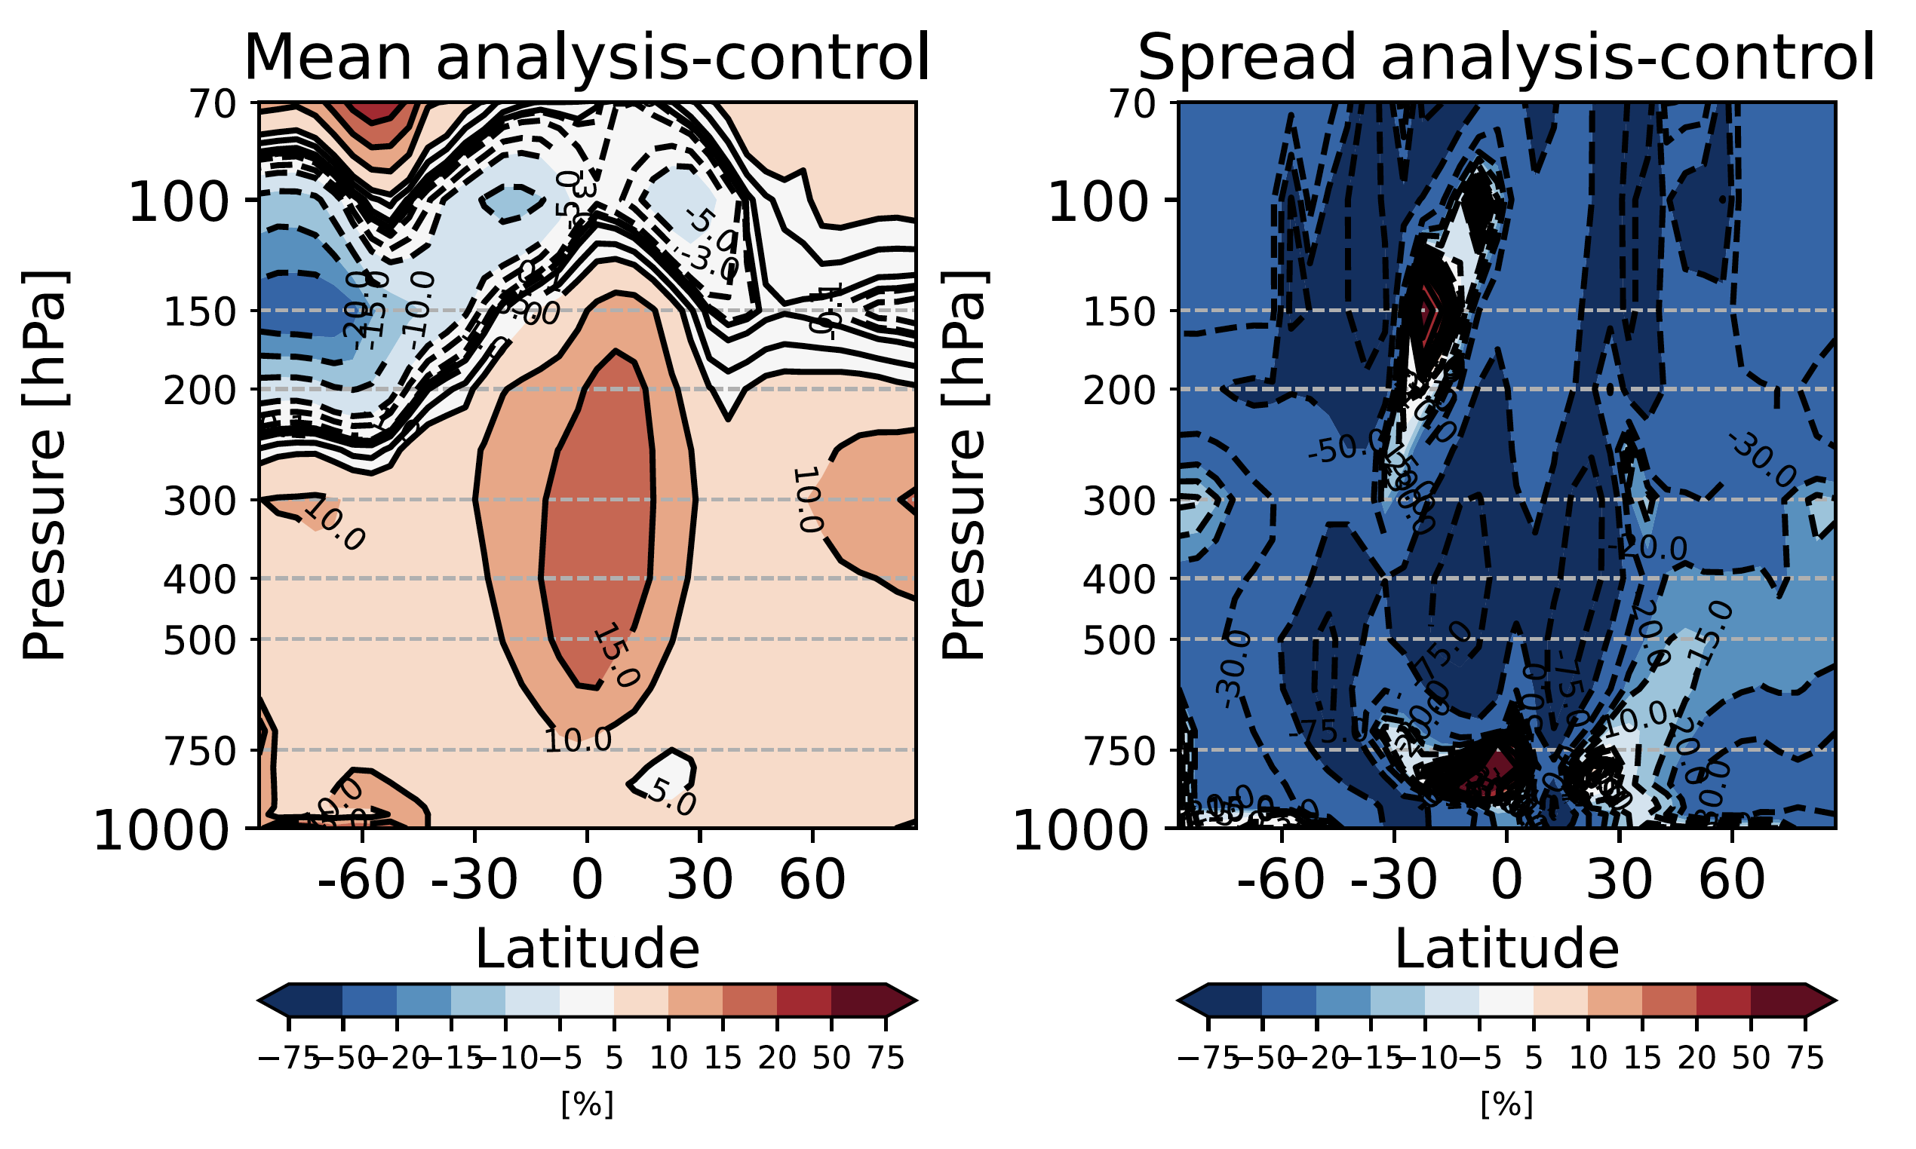
Data assimilation improved consistency between different reanalysis systems
Mean-system mean of ozone reanalysis is increased by 5-15% due to DA.
Mean-system spread of ozone reanalysis is reduced by more than 15% due to DA.
Notes:
The chemical reanalysis systems increased tropospheric ozone concentrations for most cases, whereas discrepancies between different systems in the control simulations were greatly reduced by satellite data assimilation.

Slide 6
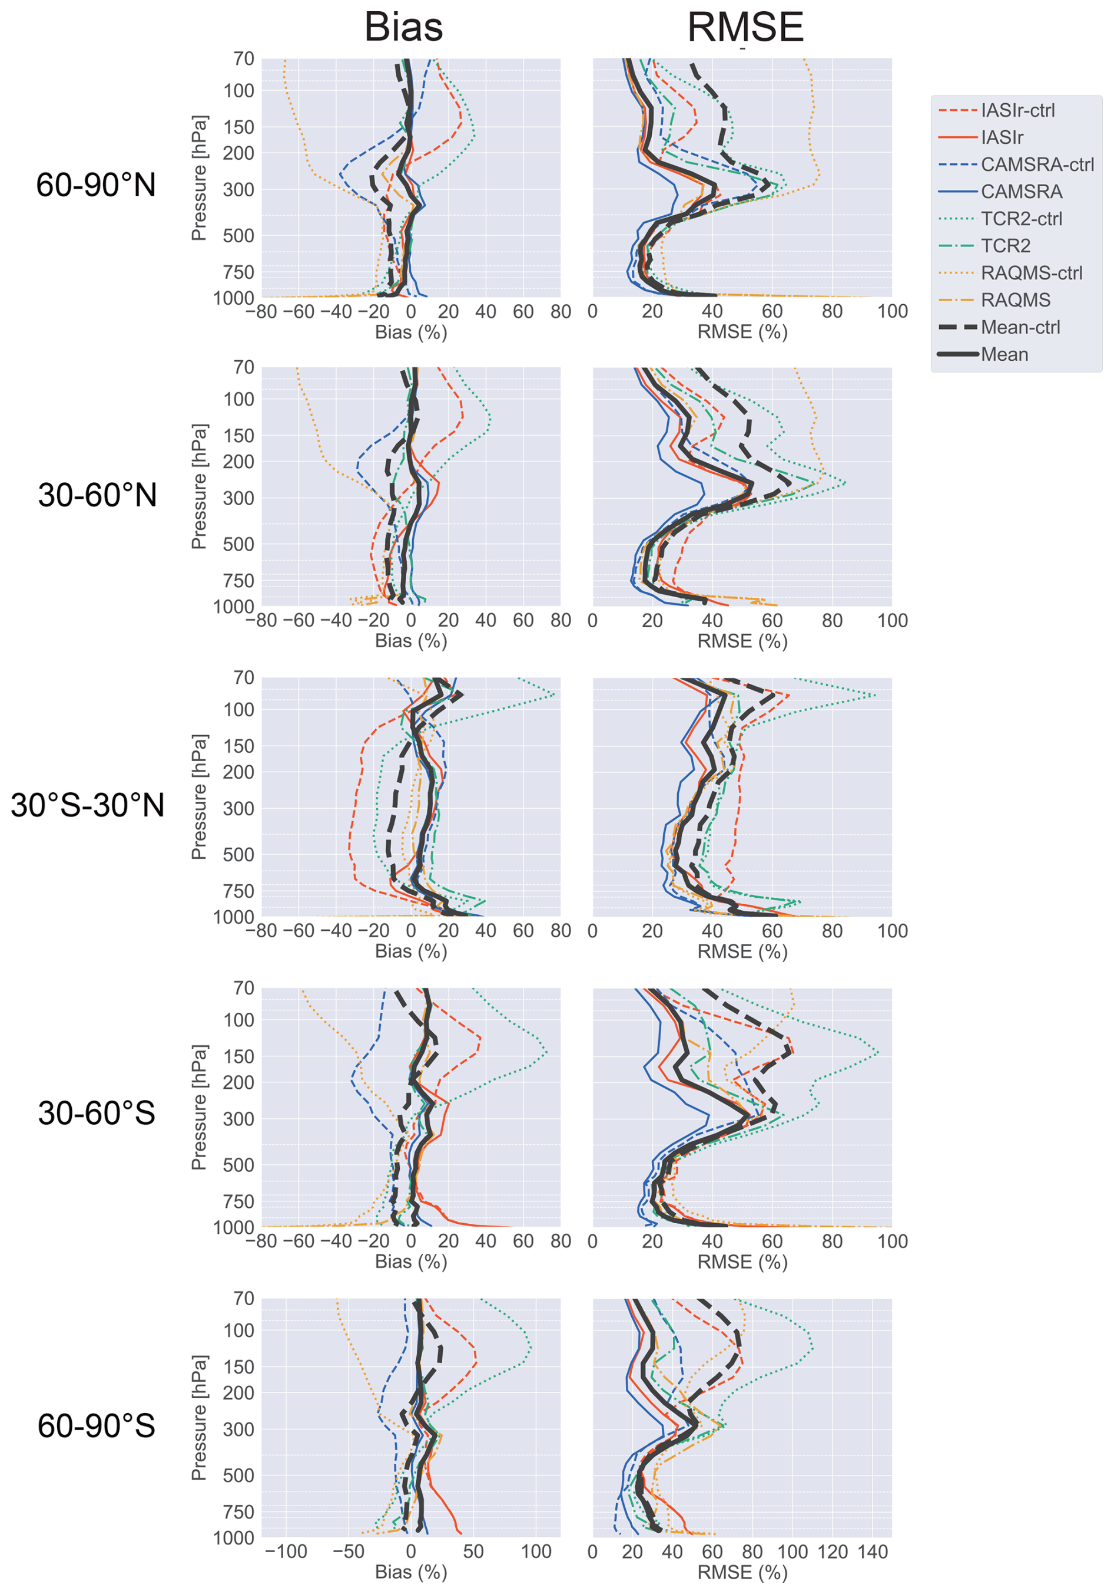
DA reduced model biases against ozonesonde observations in the whole troposphere
Large biases in individual models were reduced in the UTLS.
Mean Bias
RMSE
Common negative model biases were improved in the middle and lower troposphere by satellite DA.
Notes:
We also validate these ozone reanalysis using independent ozonesonde observations. Here we show mean biases and RMSE relative to ozonesonde over the northern midlatitudes, for example. Thin colored lines are individual reanalysis systems, and thick black lines are multi-system mean. Solid and dashed/dotted lines indicate data assimilation analysis and control model simulation, respectively. In the UTLS, large model biases in the individual models were mostly removed by data assimilation. In the middle and lower troposphere, satellite data assimilation improved common negative model biases.

Slide 7
Relative impacts of satellite ozone and its precursor observations
Relative impacts are assessed by comparing sensitivity DA calculations with and without specific observation, so called Observing System Experiments (OSEs):
Reanalysis | Simultaneous (Ozone+Precursor) |  | Ozone |  |  | Precursor
 | S+T+P | S+P | S+T | S | T | P(NO2) | P(CO)
CAMS |  | X^{F}
TCR-2 | X^{F} |  |  | X | X | X | X
GEOS-CHEM |  |  |  |  |  | X^{F}
RAQMS |  | X^{F}
IASI-r |  |  | X^{F} |  | X
X^{F}: Full set of assimilated observations for individual reanalysis systems.
Notes:
Let’s move on next part. We assess relative impacts of satellite ozone and its precursor observations by comparing sensitivity data assimilation calculations with and without specific observations, so called Observing System Experiments (OSEs) in weather prediction applications. In this study, five reanalysis and five additional OSEs are divided into three categoly: (1) the simultaneous assimilation of ozone and its precursor observations, (2) the assimilation of ozone observations, and (3) the assimilation of ozone precursor observations.

Slide 8
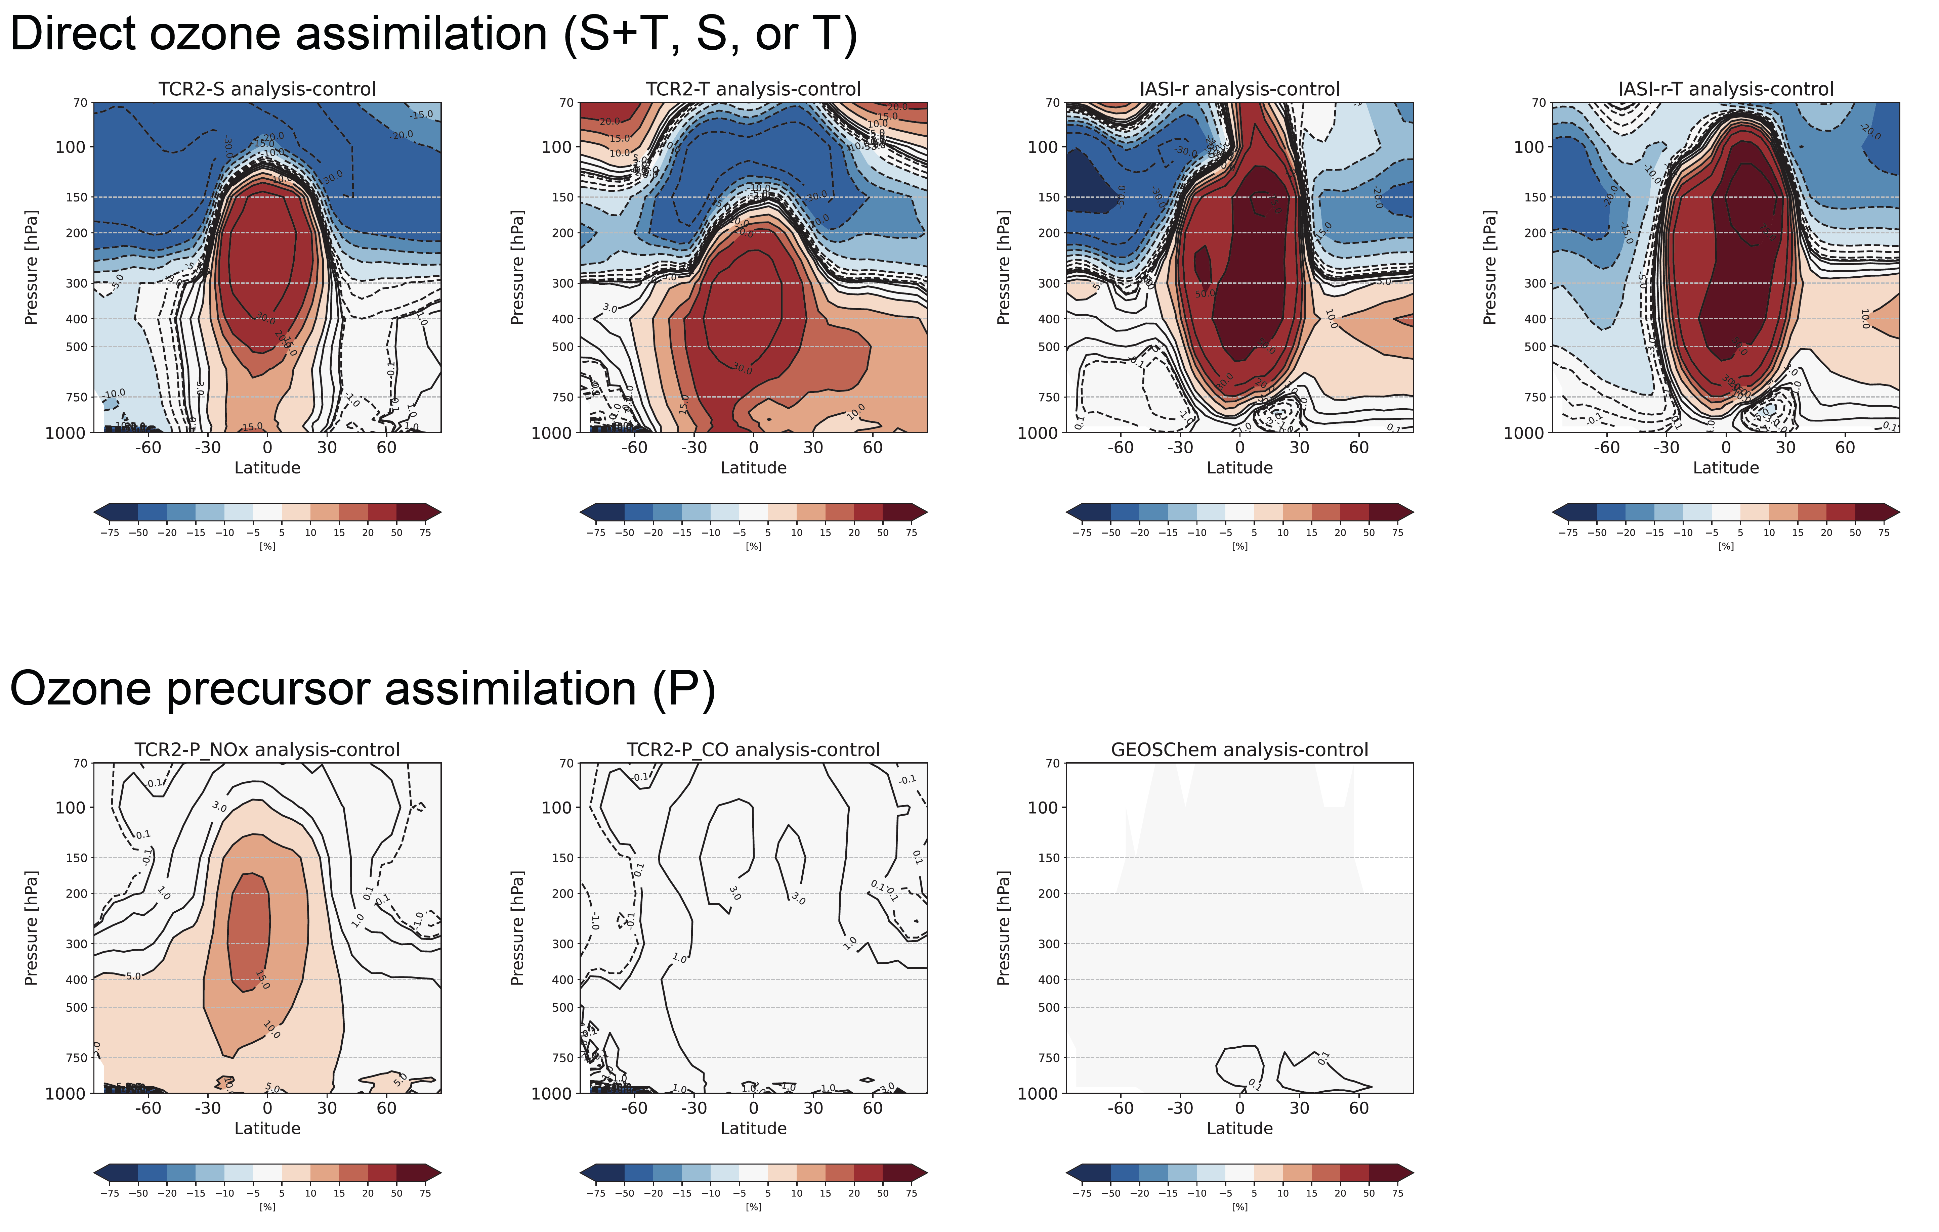
Relative impacts are qualitatively similar, but varied between different systems
Ozone assimilation show a similar latitudinal and vertical patterns in the DA impacts
TCR-2(MLS)
TCR-2(TES)
IASI-r
IASI-r(IASI)
-21%
-8%
-4%
-2%
+6%
+20%
+22%
+20%
Precursor assimilation commonly increased ozone in the troposphere.
TCR-2(OMI)
TCR-2(MOPITT)
GEOS-Chem-adjoint
+7%
+1.5%
+0.1%
Notes:
Here we show changes in zonal mean ozone concentrations owing to data assimilation. The assimilation of direct ozone observations show a similar latitudinal and vertical patterns, reflecting similar model biases. We can see decreases in the upper troposphere by 2–21% and increases in the middle troposphere by 6–22% , with the maximum of tropical middle and lower troposphere. The assimilation of ozone precursor observations commonly increased ozone in the lower and middle troposphere. But the impacts varied among the systems, ranging from 0.1% (GEOS-Chem) to 7% (TCR-2), probably because of differences in satellite product versions, model chemical processes, and a priori emission inventories.

Slide 9
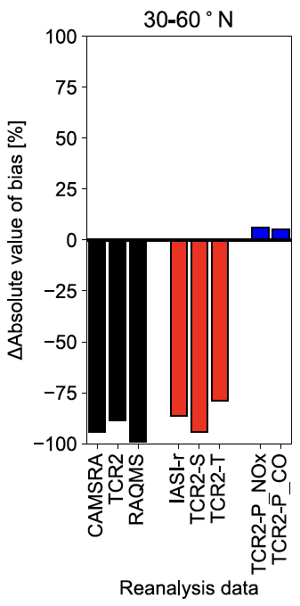
Direct ozone assimilation is dominant in the UTLS.
Degrade
Lower stratosphere/ Upper troposphere
(70-250 hPa)
Simultaneous assimilation
Ozone assimilation
Improve
Notes:
Finally, we evaluate how satellite ozone and its precursor observations improve the bias relative to ozonesonde observations. This figure shows changes in absolute values of mean biases owing to data assimilation in the northern midlatitudes, for example. The black bars indicate simultaneous assimilation of ozone and its precursor observations, the red bars are the assimilation of ozone observations, and the blue bars indicate the assimilation of ozone precursor observations. In the UTLS, the direct ozone observations are dominant in the bias reductions.

Slide 10
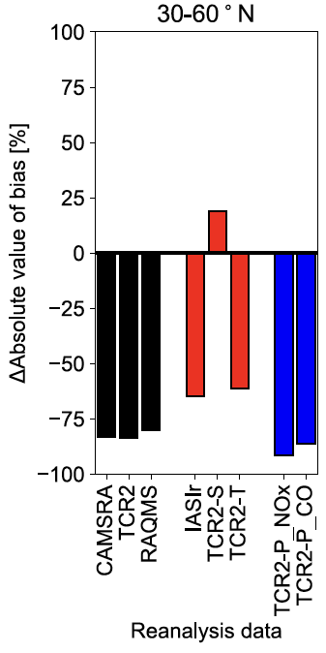
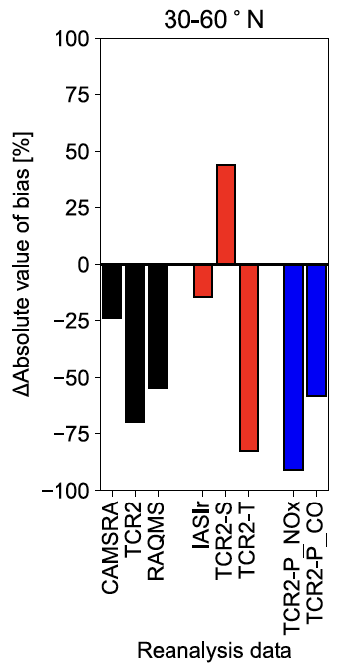
Both ozone and precursors assimilation play important roles in the lower and middle troposphere
Degrade
Lower stratosphere/ Upper troposphere
(70-250 hPa)
Middle troposphere
(400-600 hPa)
Lower troposphere
(800-900 hPa)
Ozone assimilation
Precursor assimilation
Simultaneous assimilation
Improve
Notes:
In the middle and lower troposphere, the assimilations of tropospheric ozone profile and ozone precursor observations are important for reducing model biases.

Slide 11
Summary and conclusion
The combined use of ozone and its precursor observations is effective way to improve the overall tropospheric ozone analysis, while the impacts of individual satellite observations varied widely between different reanalysis systems.
These results indicate the importance of employing multiple systems to ensure robustness in assessing impacts of individual observations and to provide unbiased insights for designing future observing systems.
To draw more robust conclusions, further studies involving intercomparisons with a more consistent and improved protocol are needed.
Notes:
In summary, this study confirmed that combined use of ozone and its precursor observations is effective way to improve the overall tropospheric ozone analysis. Meanwhile, the impacts of individual observations on ozone analysis varied widely among different systems. These results indicate the importance of employing multiple systems to ensure robustness in assessing impacts of individual observations and to provide unbiased insights for designing future observing systems. To draw more robust conclusions, further studies involving intercomparisons with a more consistent and improved protocol are needed.

Slide 12
New generation chemical reanalysis assesses relative impacts of various observations more comprehensively.
Talk by Kazuyuki Miyazaki (ID: 3.25) reports recent progress on TCR-3.
Notes:
In addition, some current generation chemical reanalysis systems do not assimilate some of key species satellite observations. New generation reanalysis can assess impacts of individual satellite observations on atmospheric composition analysis more comprehensively.

Slide 13
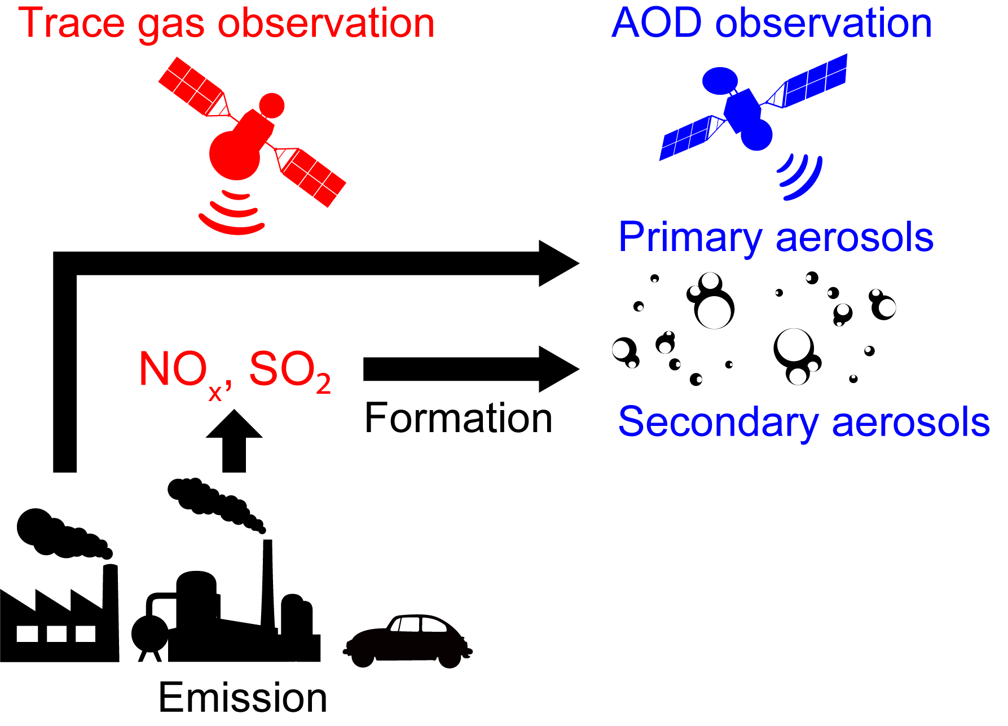
Simultaneous assimilation of Aerosols and Trace gas
What are the impacts of the assimilation of satellite aerosol and trace gas observations?
Simultaneous assimilation show better agreements compared to separate assimilations.
Relative to surface obs. in the U.S. | Mean bias of PM2.5 [μg m⁻³] | Mean bias of Sulfate [μg m⁻³]
Trace gas + AOD | -0.46 | -0.03
Trace gas only | -0.84 | -0.13
AOD only | -0.50 | 0.30
Sekiya et al. (in prep.)
Notes:
For example, we are trying to assess impacts of simultaneous assimilation of aerosol and trace gas observations. This table summarizes mean biases of PM2.5 and sulfate aerosols relative to independent surface observation over the United States in these OSEs. The simultaneous assimilation of trace gas and AOD observations show better agreements, compared to separate assimilation of trace gas or AOD observations.

Slide 14
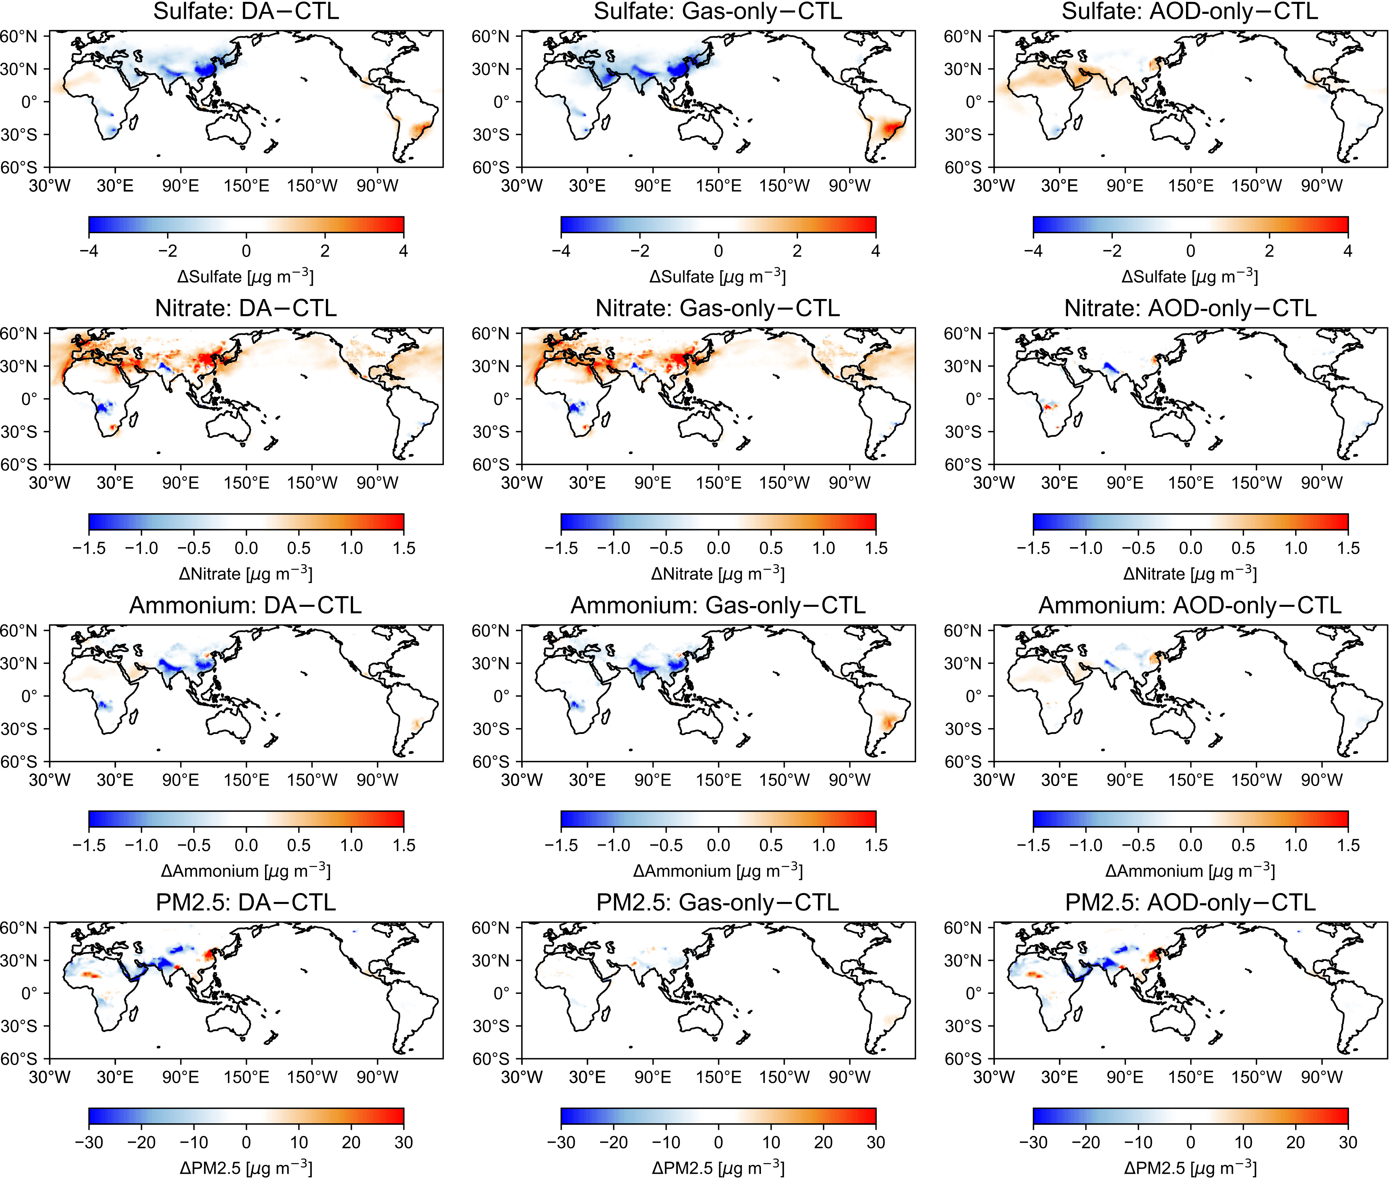
Trace gas + AOD DA
Trace gas DA
AOD DA
Δ Sulfate
Δ PM2.5
[μg m⁻³]
[μg m⁻³]
[μg m⁻³]
Sekiya et al. (in prep.)
Combined DA provide better agreements with independent aerosol species and PM2.5 observations
Optimized speciation/aerosol emission information support more detailed policy decision
Enhanced constraints by the modern satellites (TROPOMI+VIIRS) than the previous gen. (OMI+MODIS)
Notes:
These are spatial maps of corrections made by assimilation of trace gas and AOD observations simultaneously and separately. We can see corrections in sulfate and PM2.5 analysis from both trace gas and AOD observations. Such a new reanalysis products can provide better optimization in aerosol speciation and emissions, which support more detailed policy decision.

