Slide 1





Highlights of tropospheric ozone
data harmonization
CEOS AC-VC-21
Takamatsu, Japan
June 10, 2025
A. Keppens, D. Hubert, J. Granville, J.-C. Lambert
+ many data providers

Slide 2
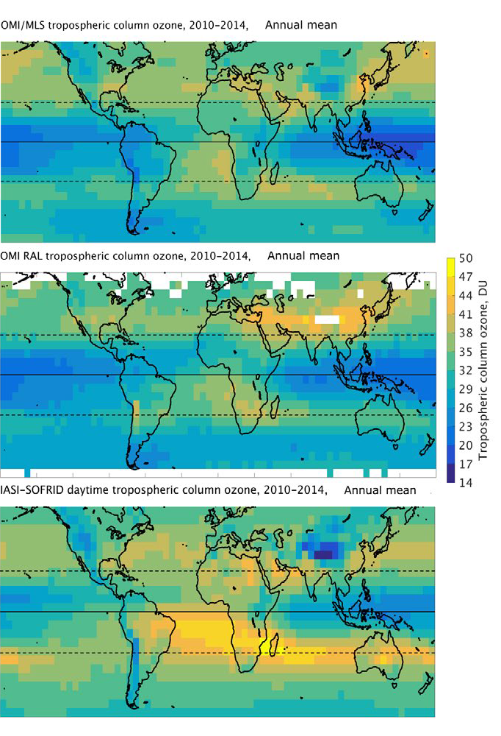
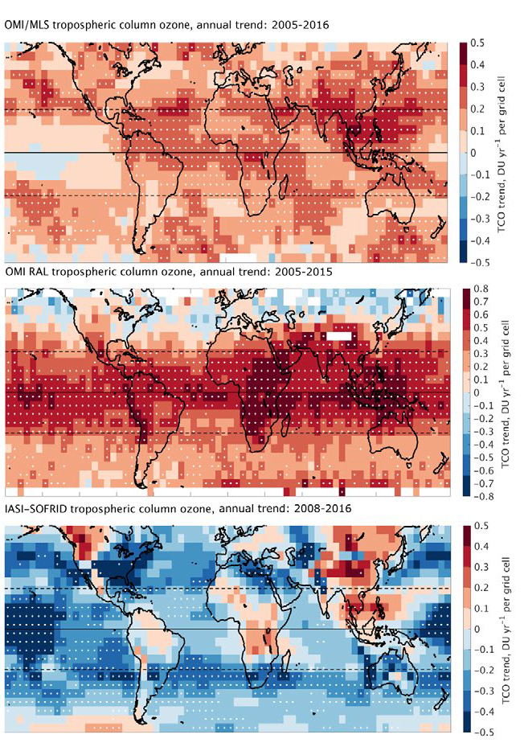


Motivation: Tropospheric Ozone Assessment Report I
Gaudel et al. (2018)
“Despite potentially large differences for different satellite observations at a local level, the global mean tropospheric ozone burden estimates are remarkably consistent.”
“… we are unable to provide a definitive statement regarding the change in tropospheric ozone burden over the past decade and future work is required to reconcile the different satellite products.“
“[caused by] … time-varying instrument biases, differences in vertical sensitivity and sampling, differences in tropopause definitions…”
Response: CEOS VC-20-01 Activity in support of TOAR II Satellite WG
2010-2014 mean
decadal trend

Slide 3
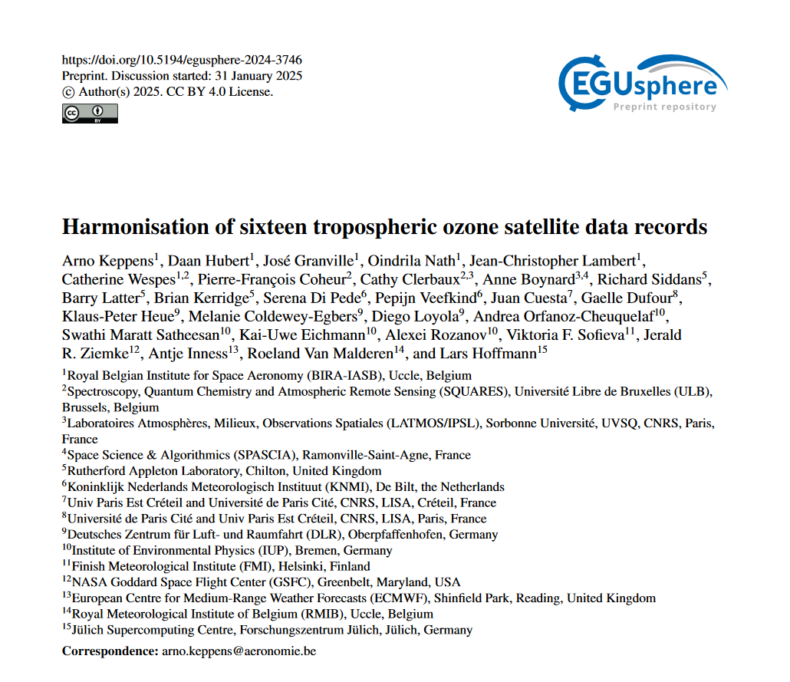

Slide 4

Measuring tropospheric ozone from space
Total columns
(clear-sky & cloudy)
Total column
Limb /
reanalysis
profile
Free troposphere
Nadir profile

Slide 5
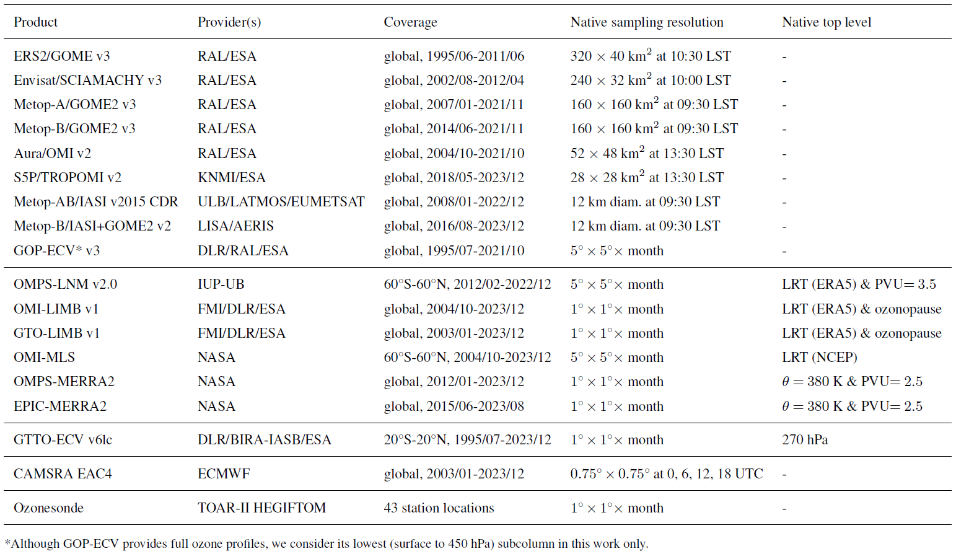
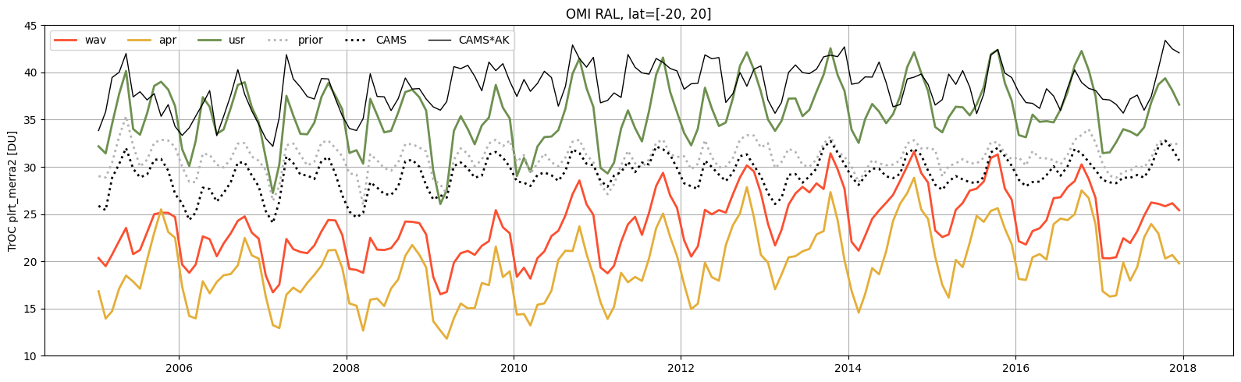
Towards harmonized Level-3 monthly gridded data

Slide 6
Harmonization needs
Vertical representations & units
Tropospheric top levels
Surface pressures
Spatial sampling
Temporal sampling
A-priori information sources
A-priori information (effective) contributions (vertical smoothing)

Slide 7
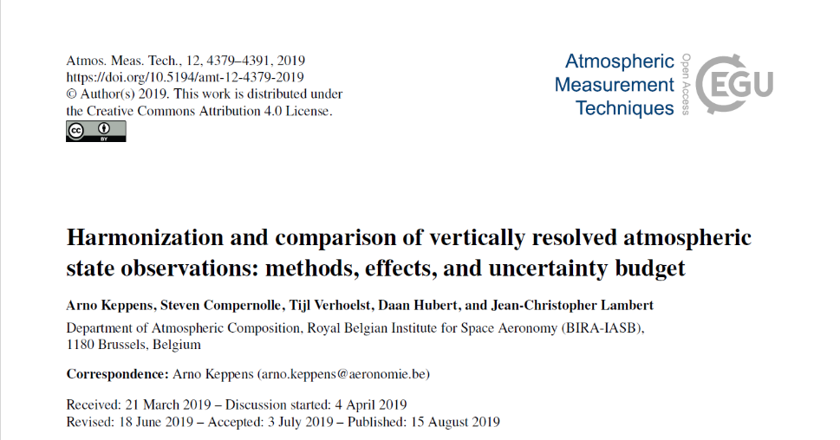
Harmonization needs
Vertical representations & units
Tropospheric top levels
Surface pressures
Spatial sampling
Temporal sampling
A-priori information sources
A-priori information (effective) contributions (vertical smoothing)

Slide 8
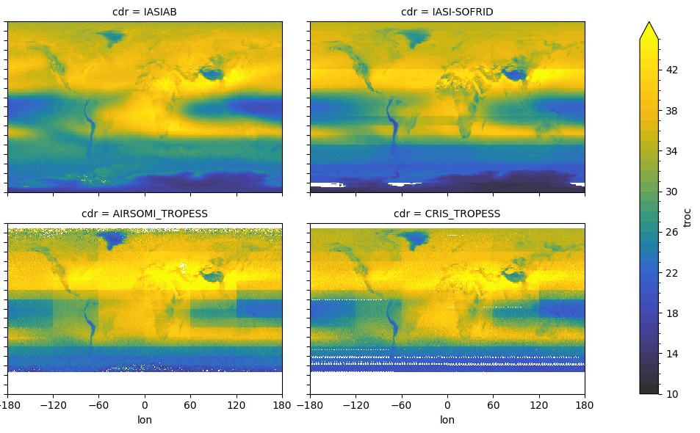
Harmonization needs
Vertical representations & units
Tropospheric top levels
Surface pressures
Spatial sampling
Temporal sampling
A-priori information sources
A-priori information (effective) contributions (vertical smoothing)

Slide 9
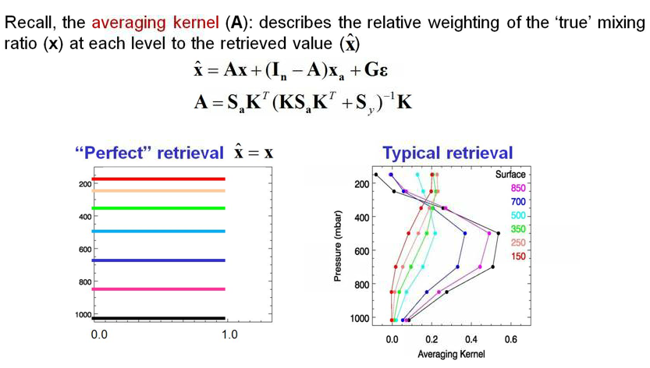

Nadir L2 retrieval equation
$x=Ax_{t}+\left(I−A\right)x_{a}+ε$
Matrix $A$ contains “averaging kernel” as non-normalized vertical smoothing window function for each element of the retrieved profile
$ε$ (co)variances captured in matrix $S$

Slide 10
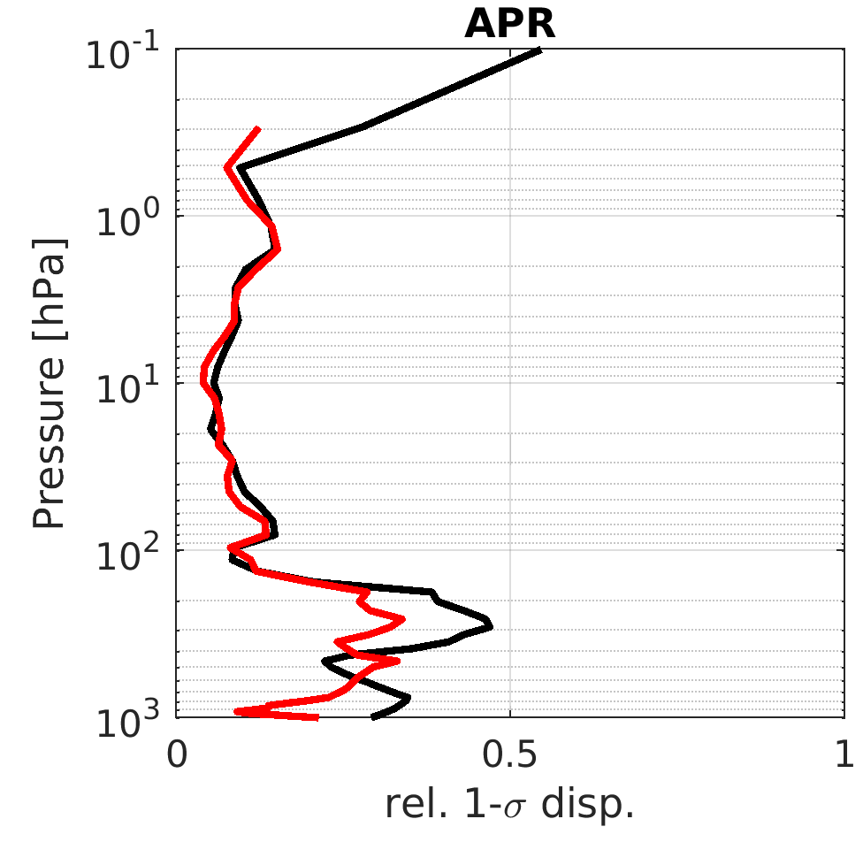

Nadir L2 to (harmonized) L3
$x=Ax_{t}+\left(I−A\right)x_{a}+ε$
$x_{APR}^{′}=x−\left(I−A\right)\left(x_{a}−x_{m}\right)=x+x_{m}−\left[Ax_{m}+\left(I−A\right)x_{a}\right]$ (non-OE!)
constrained by model (CAMSRA), to identical prior source
$x_{MLR}^{′}=A^{−1}\left[x−\left(I−A\right)x_{a}\right]$
$x_{USR}^{′}=A^{u}x_{MLR}^{′}={\left(Au\right)}^{−1}\left[x−\left(I−A\right)x_{a}\right]$
not constrained by model

Slide 11
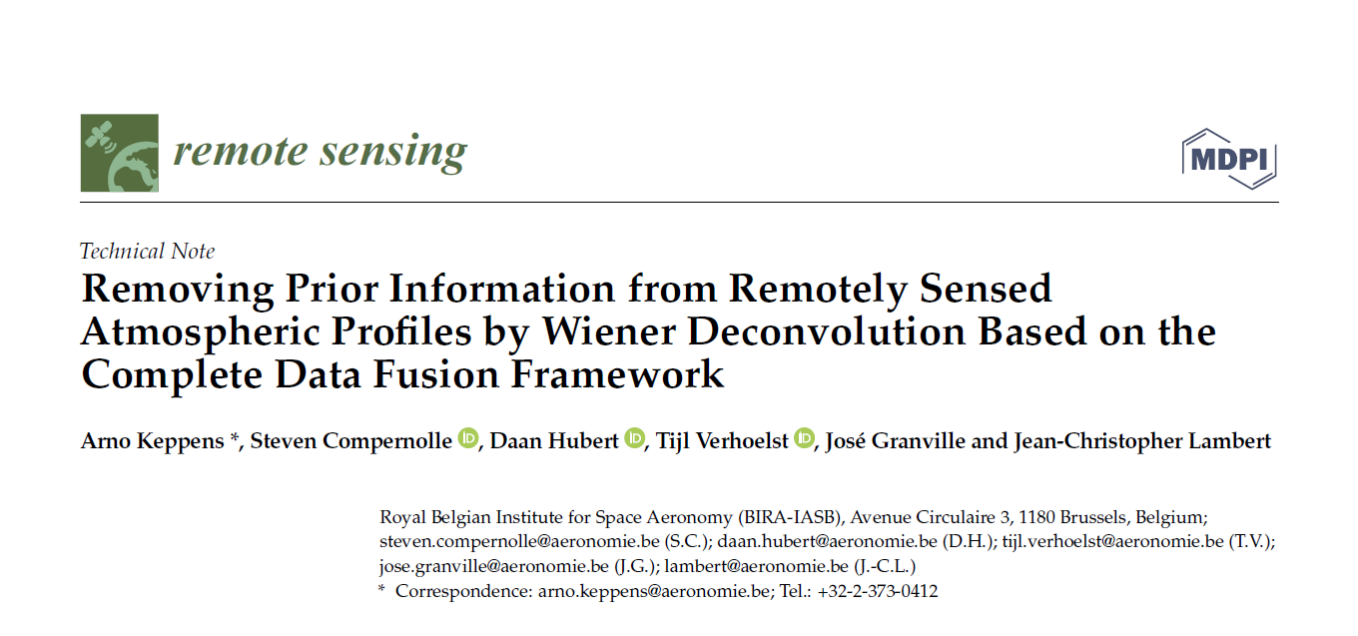

Nadir L2 to (harmonized) L3
$x=Ax_{t}+\left(I−A\right)x_{a}+ε$
$x_{APR}^{′}=x−\left(I−A\right)\left(x_{a}−x_{m}\right)=x+x_{m}−\left[Ax_{m}+\left(I−A\right)x_{a}\right]$ (non-OE!)
constrained by model (CAMSRA), to identical prior source
$x_{MLR}^{′}=A^{−1}\left[x−\left(I−A\right)x_{a}\right]$
$x_{ICR}^{′}=Wx_{MLR}^{′}=WA^{−1}\left[x−\left(I−A\right)x_{a}\right]$
$x_{USR}^{′}=A^{u}x_{MLR}^{′}={\left(Au\right)}^{−1}\left[x−\left(I−A\right)x_{a}\right]$
not constrained by model, but zero effective prior contribution

Slide 12
Nadir L2 to (harmonized) L3
$x=Ax_{t}+\left(I−A\right)x_{a}+ε$
$x_{APR}^{′}=x−\left(I−A\right)\left(x_{a}−x_{m}\right)=x+x_{m}−\left[Ax_{m}+\left(I−A\right)x_{a}\right]$ (non-OE!)
constrained by model (CAMSRA), to identical prior source
$x_{MLR}^{′}=A^{−1}\left[x−\left(I−A\right)x_{a}\right]$
$x_{ICR}^{′}=Wx_{MLR}^{′}=WA^{−1}\left[x−\left(I−A\right)x_{a}\right]$
$x_{USR}^{′}=A^{u}x_{MLR}^{′}={\left(Au\right)}^{−1}\left[x−\left(I−A\right)x_{a}\right]$
not constrained by model, but zero effective prior contribution

Slide 13
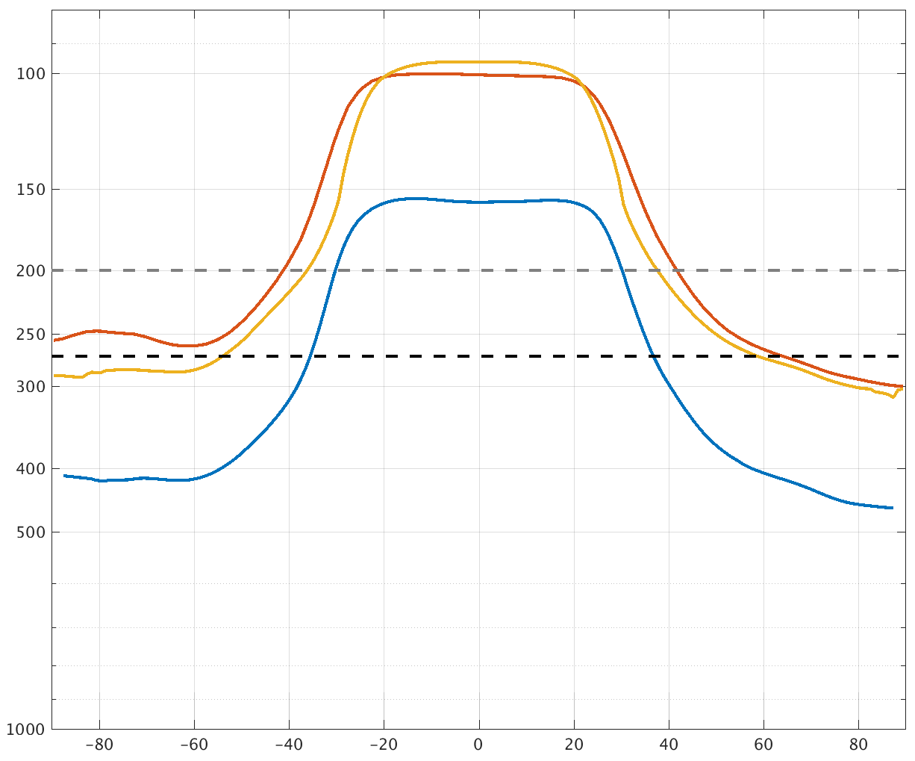
Harmonization needs
Vertical representations & units
Tropospheric top levels
Surface pressures
Spatial sampling
Temporal sampling
A-priori information sources
A-priori information (effective) contributions (vertical smoothing)
top of tropospheric column (pressure, hPa)
dynamical TP
TOAR “A”
lapse rate TP
270 hPa
TOAR “B”
fixed levels
lapse rate TP – 3 km
Latitude

Slide 14
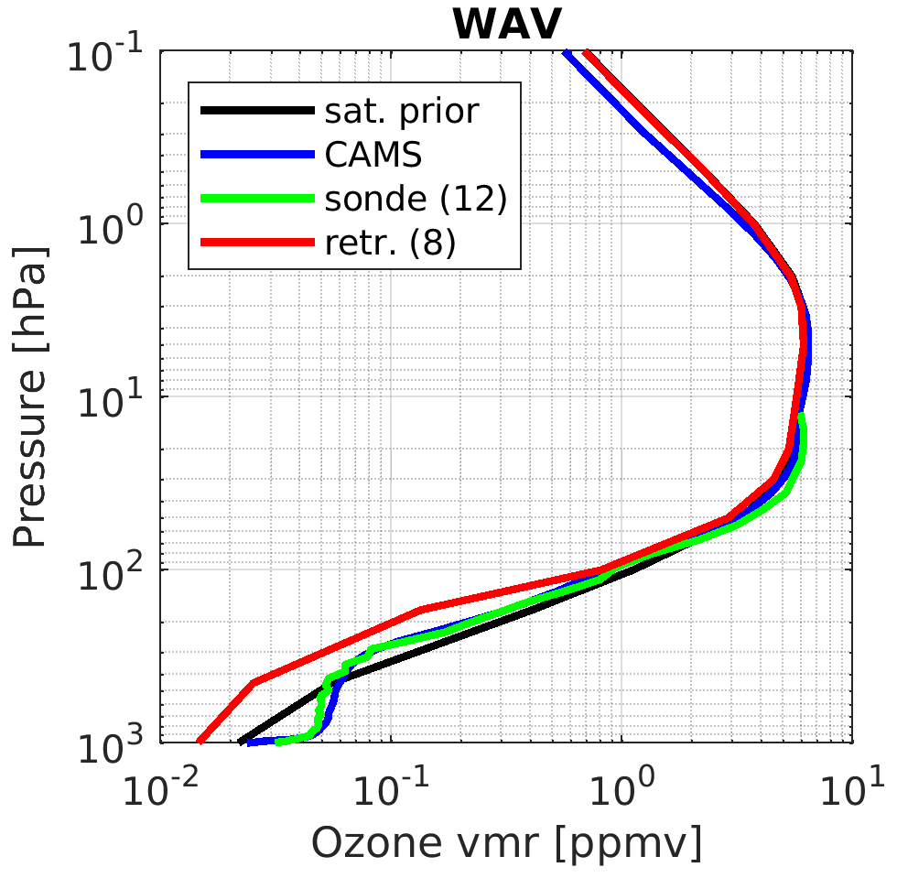

L3 vertical harmonization
$c^{′}=c+\left(c_{m}^{′}−c_{m}\right)\left(c/c_{m}\right)=c\left(c_{m}^{′}/c_{m}\right)$ [DU]
constrained by model (CAMSRA)
XO3 $=c/\left(p_{s}−p_{t}\right)$ [$\sim$ ppmv]
not constrained by model
b
a

Slide 15
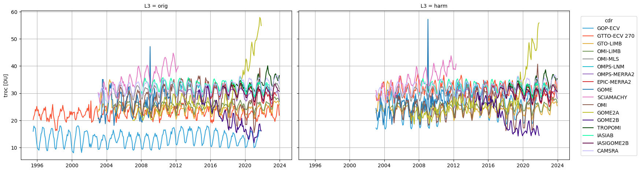
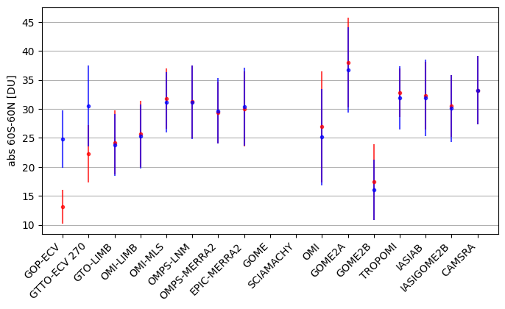
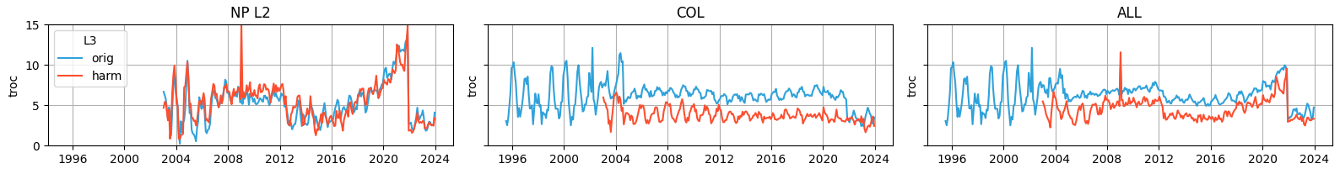
L3 harmonization effects

Slide 16


Highlights
Harmonization for CEOS & TOAR
  Column-based products: fill-in harmonization is more successful than XO3 harmonisation
  Profile-based products: constrained harmonization more successful, but very challenging in case of insufficient vertical sampling or quality of averaging kernels
  Satellite data harmonization efforts partially account for observed discrepancies: reduction of ~10-40 % of inter-product dispersion
  Uncertainty is dominated by dispersion between (harmonised) satellite data records
Ongoing
  Uncertainties from multiple collocations
  Comparison to ground-based data (HEGIFTOM)
  Tropospheric ozone assessment (+ IASI-KOPRA, IASI-SOFRID, and TROPESS datasets)

Slide 17















Acknowledgements
Funding Collaborative Frameworks
Data and Expertise
Ozone_cci+
ProDEx TROVA
BRAIN-be 2.0 TAPIOWCA
AC-VC and WGCV
Joint Activity VC-20-01

