Slide 1
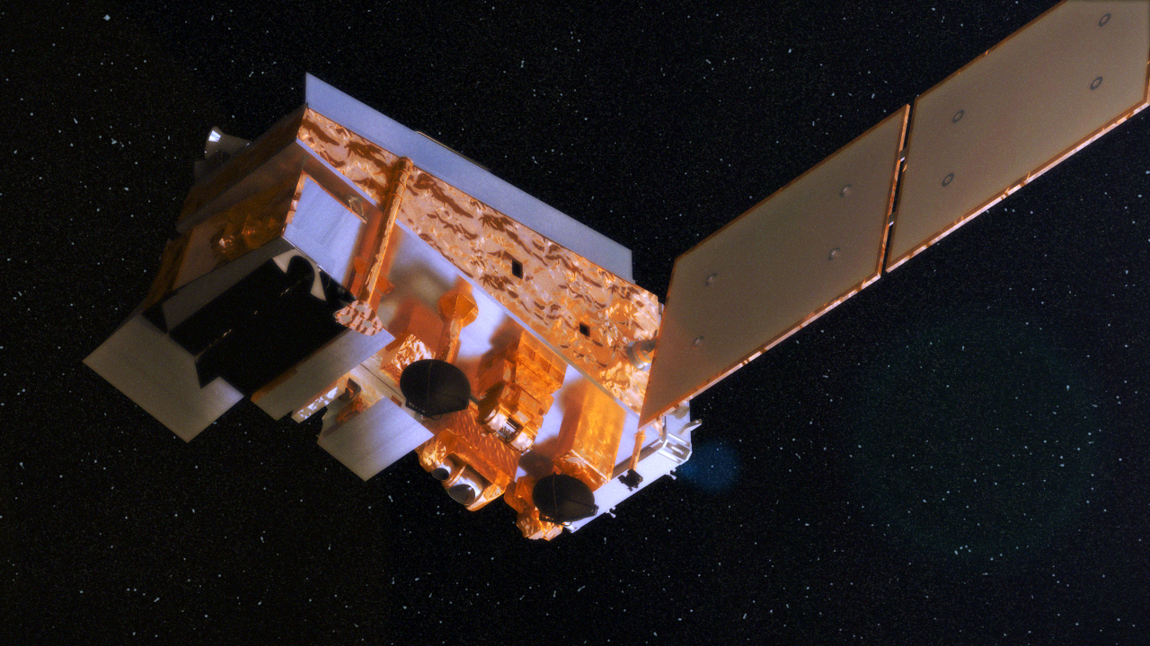
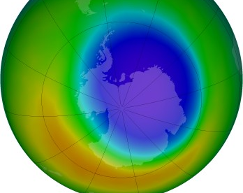






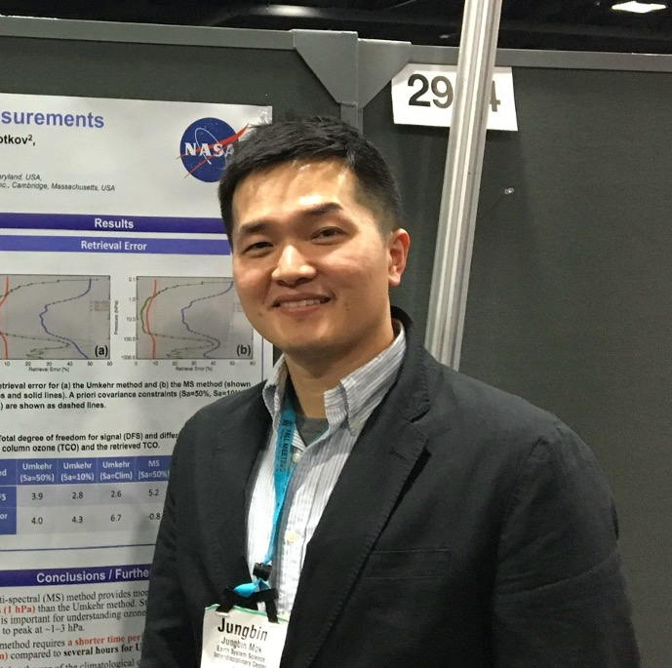

Ozone Profile Observations with OMPS Limb Profilers
Natalya Kramarova¹, Philippe Xu^{2,1}, Jungbin Mok^{3,1}, Nigel Richards^{4,1}, Zhong Chen^{3,1}, Jerald Ziemke^{5,1}, P.K. Bhartia*, and Glen Jaross¹
1-NASA GSFC, Maryland, USA; 2-SAIC, Maryland, USA; 3- SSAI, Maryland, USA; 4- UMBC, Maryland, USA; 5- MSU, Maryland, USA; *-Emeritus

Slide 2


OMPS Ozone measurements
OMPS Limb Profilers will extend limb/occultation O₃ profile measurements into the coming decades, serving as
a critical bridge between historical records and future missions such as ALTIUS, CAIRT, and STRIVE.
Notes:
The timeline of satellite ozone sensors. This figure includes UV mapper sensors that produce daily maps of total ozone columns, UV nadir profilers that measure vertical profiles and total columns, and limb and occultation instruments that measure high-resolution ozone profiles. OMPS instrumental suite with 3 sensors is aimed to continue all types of ozone measurements into the next decades.
But more critically OMPS LP is the only limb mission that will continue ozone
Contact: e-mail: natalya.a.kramarova@nasa.gov

Slide 3
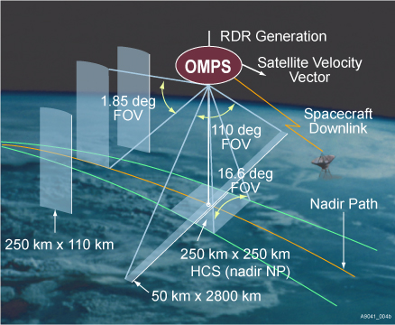
Ozone Mapper and Profiler Suite (OMPS)
OMPS Limb Profiler (LP)
LP makes limb scattering measurements viewing backwards along orbit;
Wavelength range = 290-1000 nm, with variable resolution (1.5-40 nm);
Altitude range = 0-80 km, 1 km sampling;
LP collects radiance spectrum simultaneously at all altitudes;
LP has three slits separated horizontally by 4.25 (about 250 km) to expand the sensor cross-track coverage;
NOAA-21 OMPS LP has the same basic design as SNPP with improved performance in NIR.
Suomi NPP OMPS | April 2012-present | All 3 sensors
NOAA-20 OMPS | February 2018 - present | 2 nadir sensors
NOAA-21 OMPS | February 2023 - present | All 3 sensors
Natalya.A.Kramarova@nasa.gov
Notes:
The OMPS LP sensor measures solar radiances scattered from the atmospheric limb in the UV and visible spectral ranges.
The UV wavelength measurements provide information about ozone concentration in the upper and middle stratosphere whereas visible wavelength measurements provide information on the lower stratosphere.
OMPS LP has three slits separated horizontally by 4.25 (about 250 km) to expand the sensor cross-track coverage.
It makes about 160–180 measurements per orbit with 14 orbits per day, resulting in full global coverage every 3–4 days.
Each slit provides a 1.85 vertical FOV (corresponding to 112 km vertical extent at the tangent point), allowing for atmospheric coverage of 0–60 km plus an offset allowance.
Three ozone profiles (one for each slit) are produced every 19 s, which corresponds to a 1 latitude sampling.
The OMPS LP ozone retrieval algorithm uses pairs of wavelength in UV range and triplets in Vis to retrieve ozone profiles.
SNPP is on 824 km orbit with an ascending, 1:30 PM equator crossing time.

Slide 4
OMPS LP Data Products
Product | Description | Status | SNPP | N-21
Level 1G | Gridded Limb Sun-Normalized radiances | operational | V2.6 | V1.0
Ozone Profile | Retrieved ozone profile (12.5-57.5 km) from UV+VIS | operational | V2.6 | V1.0
 | NRT retrieved ozone profile delivered in <6 hours | NRT* | V2.6 | V1.0
Aerosol | Aerosol Extinction Profiles (VIS/NIR) at 6 waves | operational | V2 | V1.0
 | NRT Aerosol with ML algorithm delivered in <6 hours | NRT* | V1 | V1
Cloud height | Cloud top heights [km] from the ratio of 674 and 868 nm | operational | X | X
 | Polar Mesospheric Clouds | RESEARCH | X
 | Polar Stratospheric Clouds | RESEARCH | X
Temperature | Upper stratospheric-mesospheric temperature | operational | V1.0 | -
NO2 | NO2 stratospheric profiles using ML approach | RESEARCH | X | -
H2O | H2O stratospheric profiles using ML approach | RESEARCH | X | -
Tropospheric O₃ | Global maps of tropospheric ozone using LP and NM | RESEARCH | X
Natalya.A.Kramarova@nasa.gov
*provided on demand
Notes:
Table with various products derived from OMPS LP

Slide 5
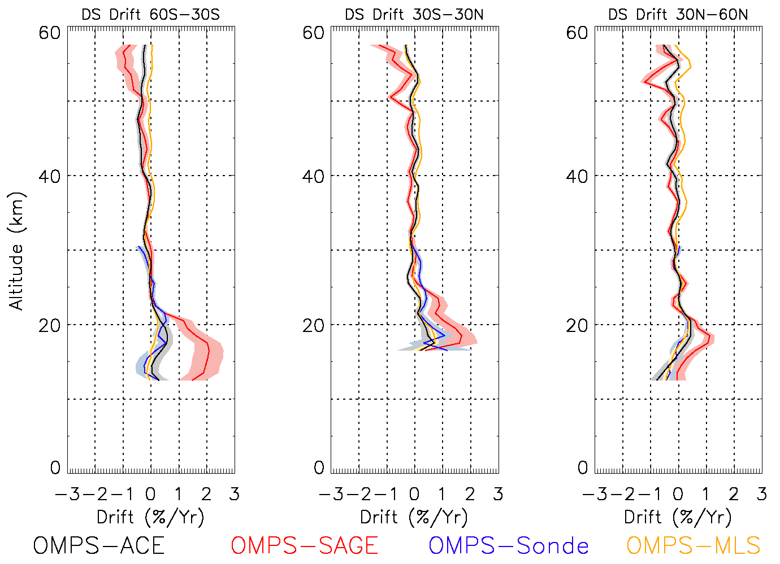
SNPP OMPS LP Version 2.6
“The version 2.6 SNPP LP ozone can be used with higher confidence for monitoring changes in stratospheric ozone.”
Increased drifts and uncertainties in the lower stratosphere after the 2022 Hunga eruption
Kramarova et al., 2024, Earth and Space Science https://doi.org/10.1029/2024EA003707
No systematic patterns
Notes:
This figure shows relative drifts estimates for LP v2.6 ozone product with respect to all correlative measurements MLS, ACE-FTS, SAGE III and sondes. Shaded area represent 1-sigma uncertainties for a liner fit. Uncertainties are larger for LP-SAGE due to a shorter overlap. Based on these results we believe that LP v2.6 has no clear systematic patterns in drifts with respect to independent measurements.
Contact: e-mail: natalya.a.kramarova@nasa.gov

Slide 6
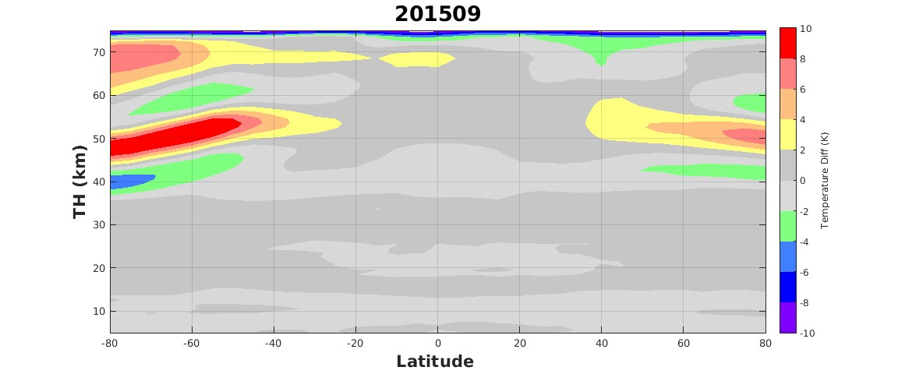
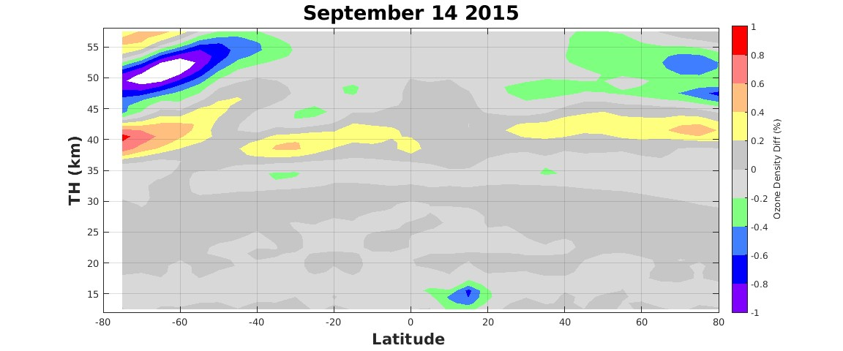
Status of SNPP OMPS Limb Profiler
Changes in Ancillary Data
SNPP satellite experienced anomalies in GPS record
GEOS-FPIT dataset will be discontinued later this year and replaced with GEOS-IT.
Since Mar. 2025, SNPP and NOAA-21 ANC are based on GEOS-IT.
Typically, 𝛥T ~ ±2-5K at Z< 50 km →
𝛥O₃ < ± 0.2-0.5%, except for:
a) SH polar latitudes in Sep. ~ 50 km
where 𝛥T >10-20K → 𝛥O₃ <1.0-1.5% due to T sensitivity of O₃ absorption coefficients;
b) Tropical UTLS where small 𝛥T → AER(675 nm) ~10-20% → 𝛥O₃ ~3-5%
SNPP GPS anomaly time periods | Nadir Mapper | Nadir Profiler | Limb Profiler
May 25 – June 3, 2024
July 9 - July 16, 2024
Sep. 24 - Sep. 27, 2024
Nov. 2 – Nov. 6, 2024
*Table’s keys good quality; use with caution; do not use data
September
September
The GPS anomalies resulted in geo-location and pointing errors;
Orbits affected by these GPS anomalies have been retracted;
Our team has changed the protocol for releasing SNPP OMPS LP data (release data weekly).
Natalya.A.Kramarova@nasa.gov
Notes:
This slide lists our objectives for the next year.
Contact: e-mail: natalya.a.kramarova@nasa.gov

Slide 7
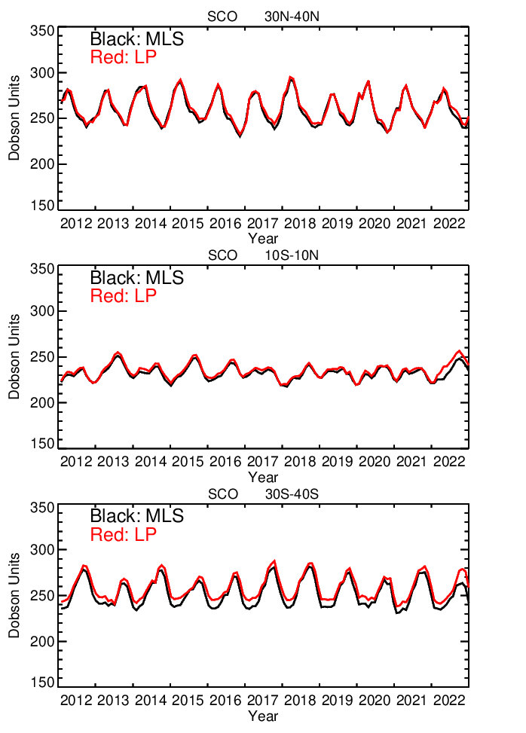
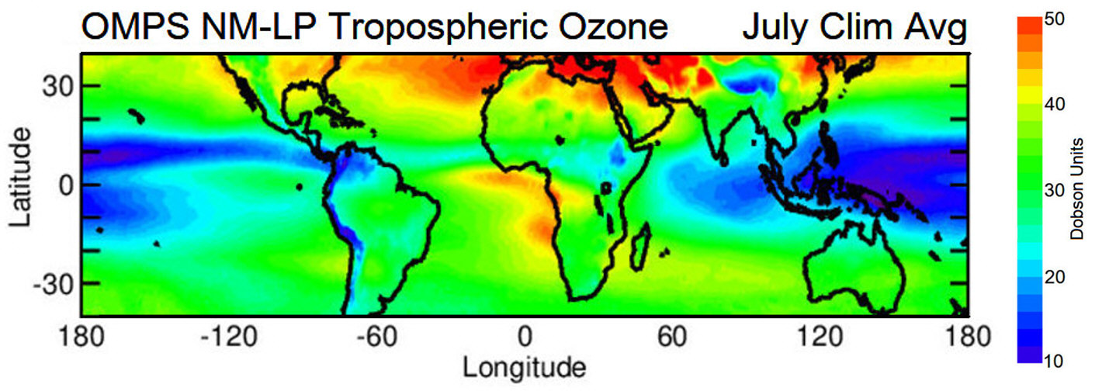
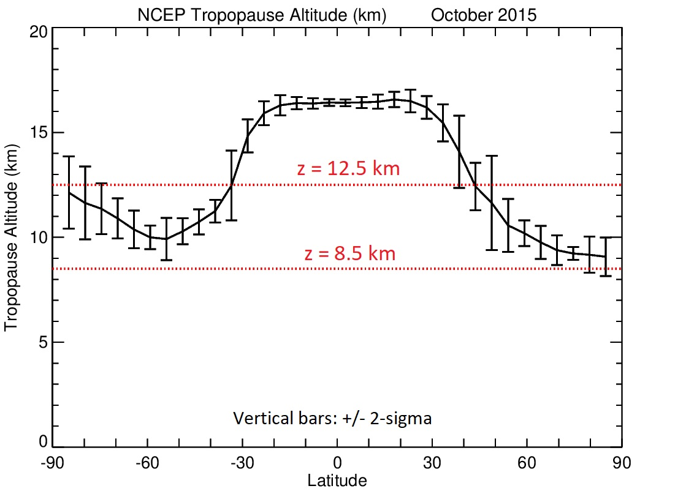
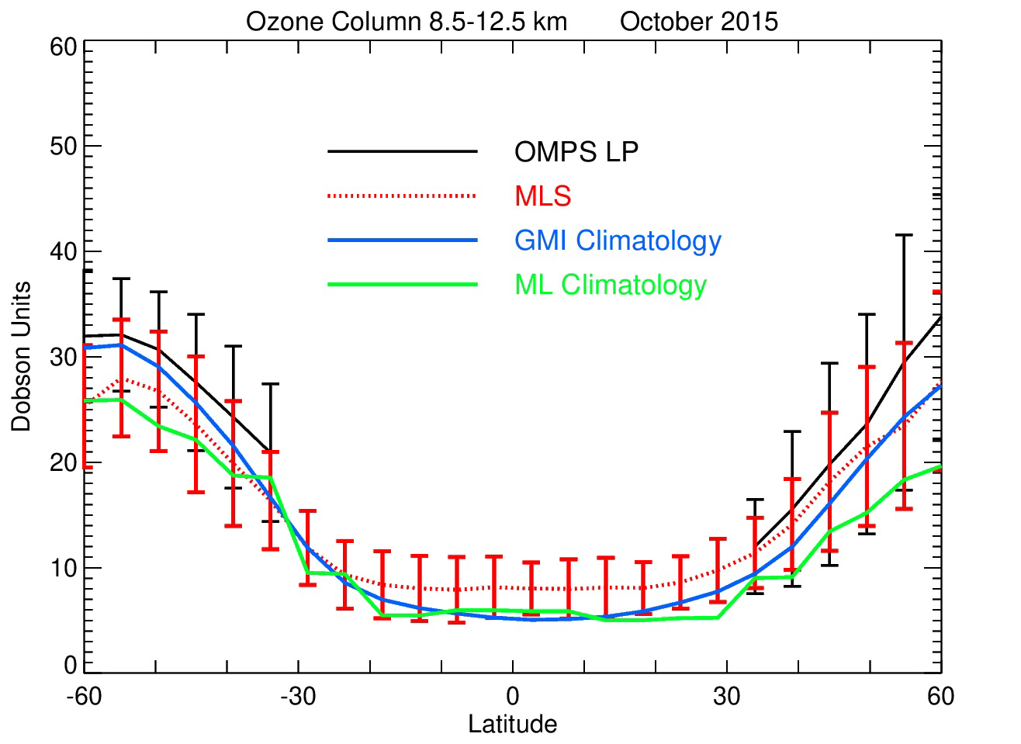
Extend O3 profiles down to tropopause height
The current 12.5 km low altitude cutoff for LP ozone profiles limits global coverage to about ±40º latitudes
The 8-12 km column adds 15-35 DU to stratospheric column
Upper troposphere
Natalya.A.Kramarova@nasa.gov
Notes:
To derive tropospheric ozone, we need to have an accurate estimate of stratospheric ozone column. Currently, the lowest altitude is 12.5 km whish is above the tropopause height outside of the tropics (40-90S/N).
Upper panel shows the map of tropospheric ozone derived by subtracting SOC obtained from OMPS LP from total ozone maps obtained from OMPS NM. The left lower panel shows the tropopause heights as a function of latitude in October 2015 with the error bars showing variability in tropopause height. The middle panel on the bottom shows ozone column amount between 8 and 12 km derived from MLS (red), LP (black) and two climatologies (green and blue). The error bars show variability in the 8-12 km ozone column in October. Right panels show time series of SOC derived from MLS (black) and LP (red) for several latitude zones. We can see good agreement between LP and MLS.
These results show that outside of the tropics the ozone column in this layer is 15-30 DU with about 20 DU variability. It means that we can not use ozone climatology to substitute the SOC. We need to have retrievals. That is our motivation for extending LP ozone retrievals in the lower stratosphere.

Slide 8
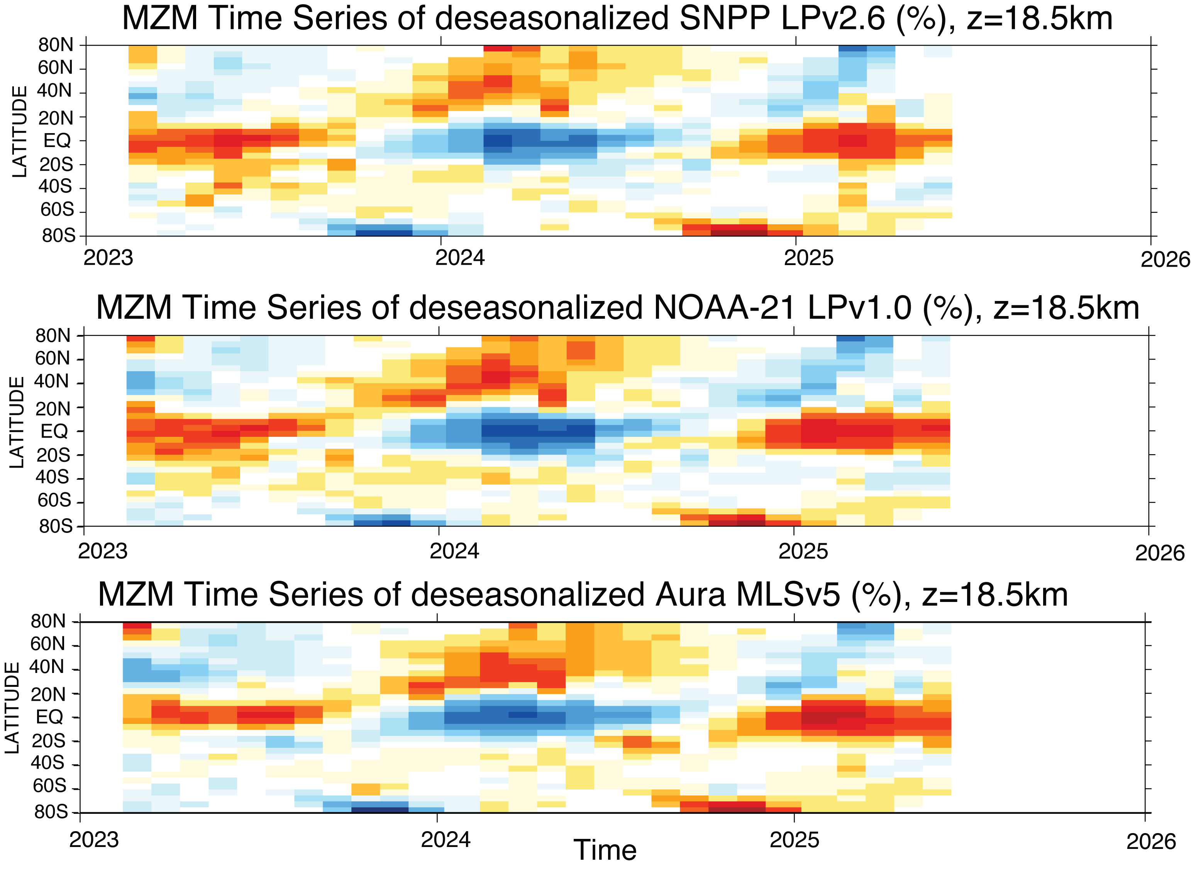
NOAA-21Limb Ozone Measurements
  NOAA-21 OMPS LP has the same basic design as SNPP with improved performance in NIR;
  NOAA-21 OMPS launched in Nov. 2022; observations since Feb. 2023;
  NOAA-21 is a ¼ orbit ahead of SNPP;
  NOAA-21 LP with ~0.5º step in latitude resulting in ~6k profiles per day (compared to ~2.5k for SNPP);
  NOAA-21 LP data have been processed with the v2.6 LP algorithm;
  NOAA-21 Level 1 and Level 2 data have been released in Sep. 2024.
Natalya.A.Kramarova@nasa.gov
Notes:
This slides summarizes comparisons between SNPP LP and NOAA-21 LP by showing comparisons for both LPs with ACE-FTS and SAGE III. Panels on the left show differences in % for SNPP (top two panels) and N-21 (bottom two panels). The figure on the right show mean biases in 3 wide latitude bins.
We found good agreement between the two LP instruments, however, NOAA-21 shows better agreement below 20 km with all correlative measurements (MLS, ACE, SAGE). Particularly, the stripe of positive anomalies seen in SNPP between 16-19 km is not detected in NOAA-21. There is also a smoother transition between UV and VIS measurements around 28-32 km.
Contact: e-mail: natalya.a.kramarova@nasa.gov

Slide 9
NOAA-21Limb Ozone Measurements
NOAA-21 has a smaller bias in lower stratosphere compared to SNPP
NOAA-21 has smaller biases in the upper stratosphere
Larger biases between NOAA-21 and SNPP are seen in EQ mid-stratosphere ~30 km
Overall NOAA-21 and SNPP agree within 3-5%, with some exceptions
SNPP-MLS NOAA21-MLS
Natalya.A.Kramarova@nasa.gov
Notes:
This slides summarizes comparisons between SNPP LP and NOAA-21 LP by showing comparisons for both LPs with ACE-FTS and SAGE III. Panels on the left show differences in % for SNPP (top two panels) and N-21 (bottom two panels). The figure on the right show mean biases in 3 wide latitude bins.
We found good agreement between the two LP instruments, however, NOAA-21 shows better agreement below 20 km with all correlative measurements (MLS, ACE, SAGE). Particularly, the stripe of positive anomalies seen in SNPP between 16-19 km is not detected in NOAA-21. There is also a smoother transition between UV and VIS measurements around 28-32 km.
Contact: e-mail: natalya.a.kramarova@nasa.gov

Slide 10
-Both NOAA-21 and SNPP OMPS LP are fully operational. We provide NRT products for both instruments (available on-demand).
-SNPP LP Ozone record will be re-processed (late 2025- early 2026)
-Use consistent ancillary GEOS-IT meteorological data;
-Extend ozone profiles down to tropopause outside of tropics;
-Update aerosol correction algorithm (employ longer wavelength 745 nm and Optimal Estimation-type algorithm with sensitivity kernels).
Summary:
Data:
SNPP OMPS LP doi 10.5067/8MO7DEDYTBH7
https://disc.gsfc.nasa.gov/datasets/OMPS_NPP_LP_L2_O3_DAILY_2.6/summary?keywords=OMPS%20LP
NOAA-21 OMPS LP doi 10.5067/FG4G5E4EKYAU
https://disc.gsfc.nasa.gov/datasets/OMPS_N21_LP_L2_O3_DAILY_1.0/summary?keywords=OMPS%20LP
Natalya.A.Kramarova@nasa.gov
Notes:
To derive tropospheric ozone, we need to have an accurate estimate of stratospheric ozone column. Currently, the lowest altitude is 12.5 km whish is above the tropopause height outside of the tropics (40-90S/N).
Upper panel shows the map of tropospheric ozone derived by subtracting SOC obtained from OMPS LP from total ozone maps obtained from OMPS NM. The left lower panel shows the tropopause heights as a function of latitude in October 2015 with the error bars showing variability in tropopause height. The middle panel on the bottom shows ozone column amount between 8 and 12 km derived from MLS (red), LP (black) and two climatologies (green and blue). The error bars show variability in the 8-12 km ozone column in October. Right panels show time series of SOC derived from MLS (black) and LP (red) for several latitude zones. We can see good agreement between LP and MLS.
These results show that outside of the tropics the ozone column in this layer is 15-30 DU with about 20 DU variability. It means that we can not use ozone climatology to substitute the SOC. We need to have retrievals. That is our motivation for extending LP ozone retrievals in the lower stratosphere.

