Slide 1







Best practice protocol for validation of Aerosol, Cloud, and Precipitation Profiles (ACPV)
FP – Final Presentation of ESA contract with consortium led by National Observatory of Athens, supporting and fostering international community convergence, and co-authoring and editing the best practice document
(names on slide 18)
Extract for 2025-06-10 CEOS-WGCV-ACSG

Slide 2

ACPV motivation: Validation challenges for aerosol, cloud profiling
Needs for synergies for synthetic products
Extremely narrow sampling volume
Small
correlation
length of
target features
Product
Diversity
Need for in-situ
Measurements
of microphysical
properties
Gaps in
spaceborne
data records

Slide 3
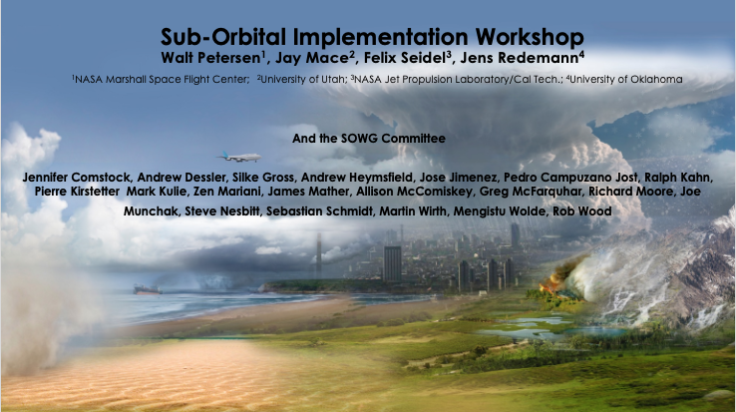
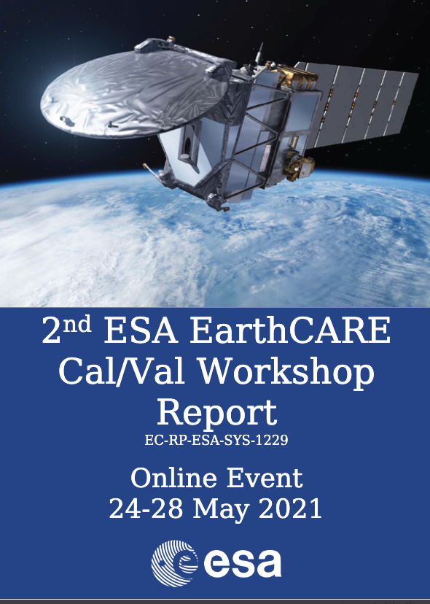
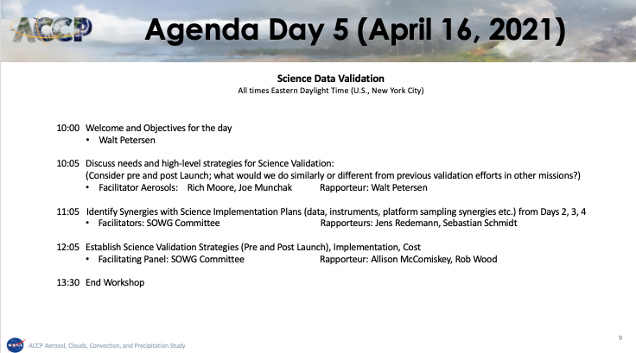
EarthCARE and AOS scientists highlighted validation synergies
Lessons Learned
Many of 2nd ESA workshop recommendations
involved
COMMON
PRACTICE
CONVERGENCE
And need for consolidating common practices in a document at CEOS level
Methods and Approaches
In-orbit validation
⬄
pre-launch validation/verification
AOS 2nd Sub-orbital Workshop,
April 2021
Airborne campaigns
&
Networks

Slide 4



















Community coordination towards a common protocol for ACPV
Cal/val community contributors
(networks, Research Infrastructures)
Implementation Group
Foster community convergence on best practices for ACPV
Develop sub-orbital-to-orbital transformation tools for lidars, radars, imagers
Document the consensus and the best practices for ACPV for CEOS
Promote the implementation of ACPV best practices in the wider communities
Additional
EarthCARE
Teams

Slide 5

Project Outline
Lead: NOA
WP 1000:Management, reporting and dissemination
  Lead: NOA
WP 2000: Development of suborbital data conversion tool for radar (lidar, imager through other contract)
  Lead: UoC
WP 3000: Gap analysis and historical data to support community convergence on the best practices
  Lead: TROPOS
WP 4000: Perform selected studies on historical data to support community convergence on best practices
  Lead: DLR
WP 5000: Development and documentation of best practices for validation of cloud and aerosol profiles
  Lead: NOA
WP 6000: Synthesis and recommendations
  Lead: FMI

Slide 6
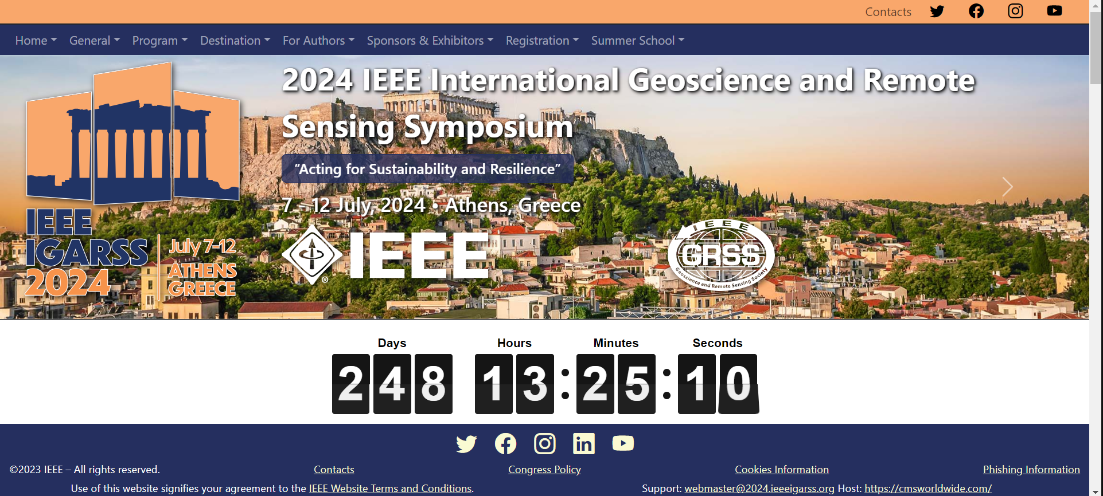
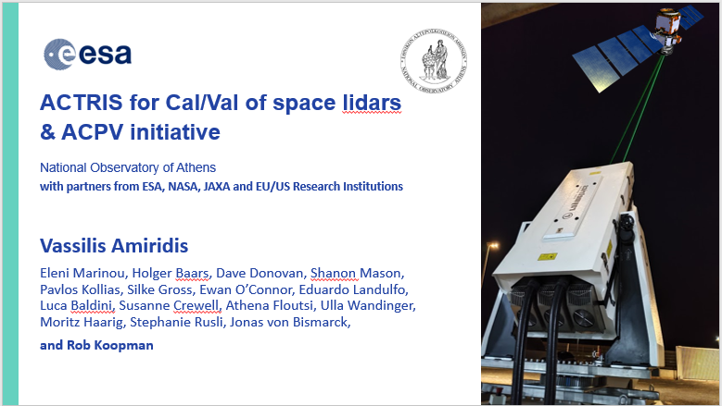
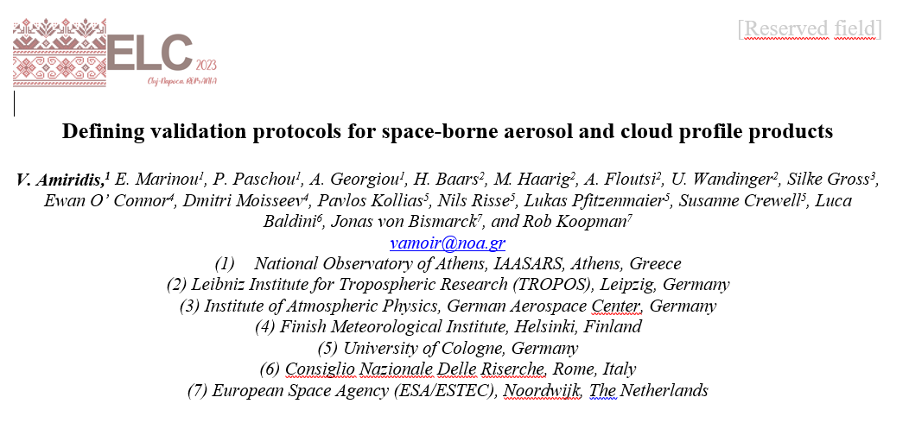
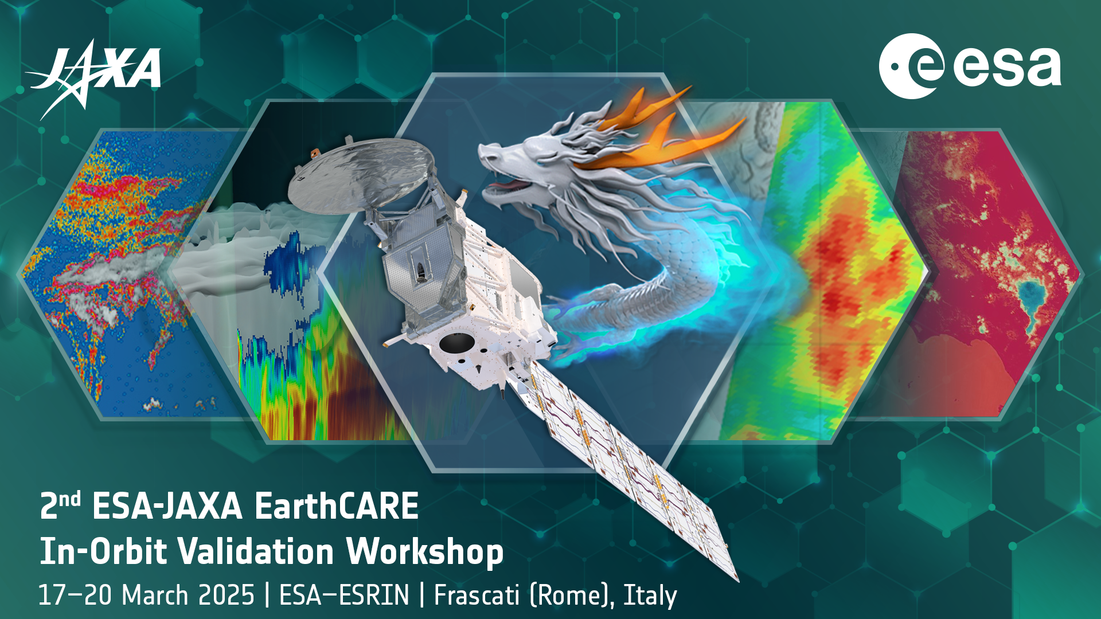
WP1000: Management, reporting and dissemination
WP Lead: NOA
Mar 2023 -> Sep 2024
Dissemination:
Monthly meeting of the International ACPV Implementation Group
Side-meetings for each chapter
Side meetings for ACPV:
  AGU side meeting with NASA and ARM
  CPEX weekly meetings for data harmonization
  Aeolus-2023 conference side-meetings with CyI/Slovenia for airborne in-situ EarthCARE
  IEEE Milos conference: side meetings with Silke and Raymetrics for the Mediterranean campaign (and Cabo Verde/Barbados)
Conference participation:
IGARSS (2024, Athens, Greece)
IEEE lidar conference (2023, Milos, Greece)
European Lidar Conference (2023, Cluj, Romania)
EarthCARE Conference (2023, ESA-ESRIN)
EarthCARE 2nd Validation Workshop (2025, ESA-ESRIN)
97 authors!

Slide 7
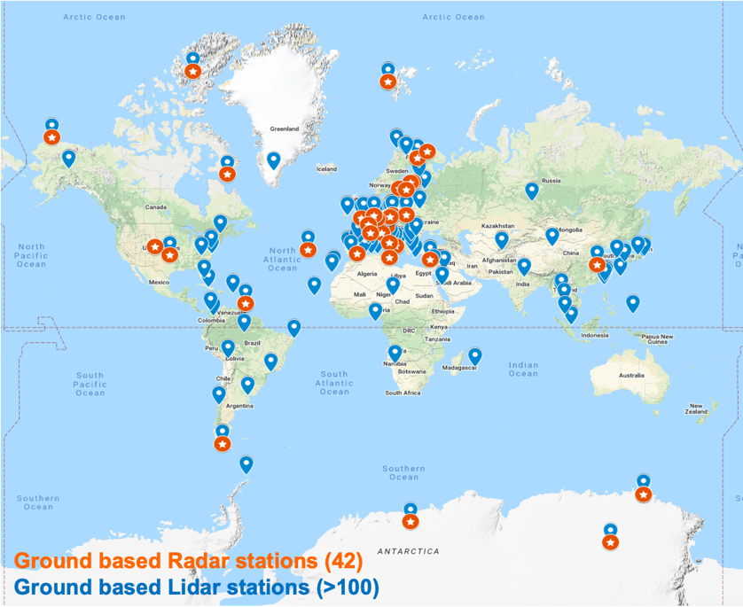
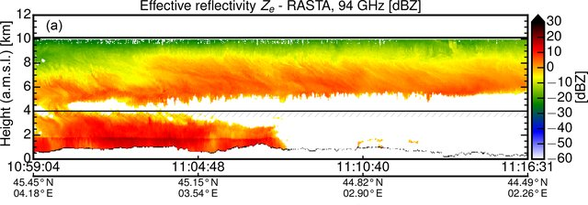


Suborbital radar observations
Over the last 15 years, we have witnessed the development of well-established multi-sensor surface-based observatories that collect continuous long-term observations and a plethora of complimentary airborne/ship-based campaigns
Geographical distribution of surface-based observatories with short-wavelength radars and backscatter lidar systems (source: R. Koopman, ESA LPS 2022). NB (very dense networks not shown)

Slide 8
Cloud Profiling Radar (CPR) L1 simulator
The main objective of the CPR L1 tools is the development of simulated CPR L1 signals that can be used for:
  L2 algorithm development and testing (CARDINAL and previous ESA activities)
  Facilitate the comparison between sub-orbital and orbital (doppler) cloud profiling radar observations in support of Cal/Val activities (e.g., FRM4RADAR, ACTRIS, airborne campaigns)
  Objective interface between numerical model output and CPR observations for an apples-to-apples comparison
High resolution numerical model output
E/M forward model
CPR instrument model
L1/L2 development
Fast surrogate models
for suborbital platforms

Slide 9
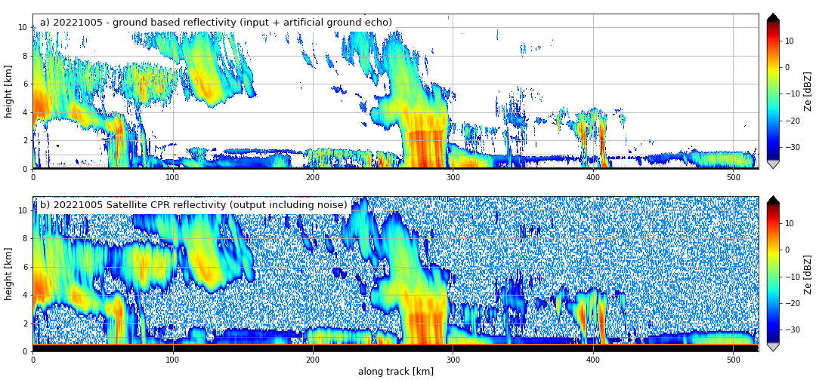
Surface based observations
Surface-based observations
Norunda, Sweden
CPR simulated observations
Exclude rain periods

Slide 10

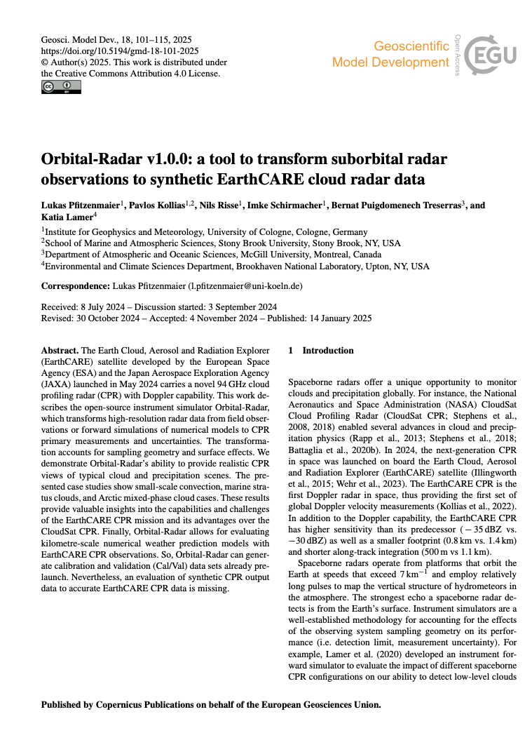
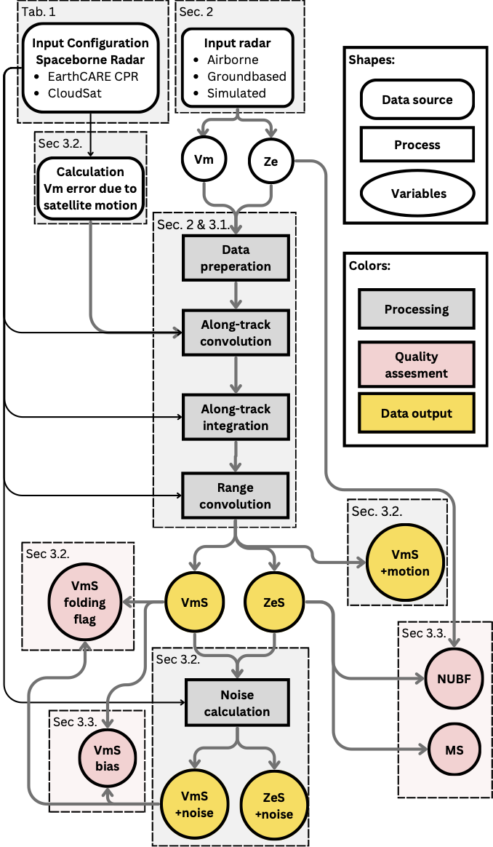
WP2000: Development of suborbital data conversion tool for radar
WP Lead: UoC
Mar 2023 -> Sep 2024
orbital-radar tool is ready to use:
Paper acts as documentation: https://doi.org/10.5194/gmd-18-101-2025
Github repository of the code: https://github.com/igmk/orbital-radar
Code can be cited via: https://doi.org/10.5281/zenodo.13375014
Test data set on Zenodo: https://zenodo.org/records/12547896
Motivation of the work
  use to generate large data set, use in networks
Description input data format
Description of the code
Assumptions and equations used
Estimation and implementation of noise
Estimation of the quality flags
show examples for different input data
all data used are in the test data set

Slide 11
Radar, Lidar, Imager suborbital to orbital transformation tools
All tools are freely available
  Radar tool: https://github.com/igmk/orbital-radar
  Lidar tool : https://gitlab.com/KNMI-OSS/satellite-data-research-tools/cardinal-campaign-tools
  Imager: https://gitlab.com/wew_fub/msi-tool
Fully Open Source: initially pre-configured for EarthCARE, but can be easily adapted for future missions

Slide 12
WP3000: Gap analysis and historical data to support community convergence on the best practices
WP Lead: TROPOS
Mar 2023 -> June 2023
Proposed studies overview:
4.1 Representativeness study based on ASKOS/JATAC and LIVAS-CALIPSO data set
4.2 Validation of Level 1 data with CARDINAL level 1 tool
4.3 Wavelength conversion for aerosol mixtures
4.4 Study on smoke identification and/or separation
4.5 Depolarization ratio at 1064 nm – Literature and data set review
4.6 Retrievals of ice cloud properties in rain cases
4.7 Validation of CPR Doppler velocity and fall velocity products
4.8 Ice microphysics: Size distribution

Slide 13
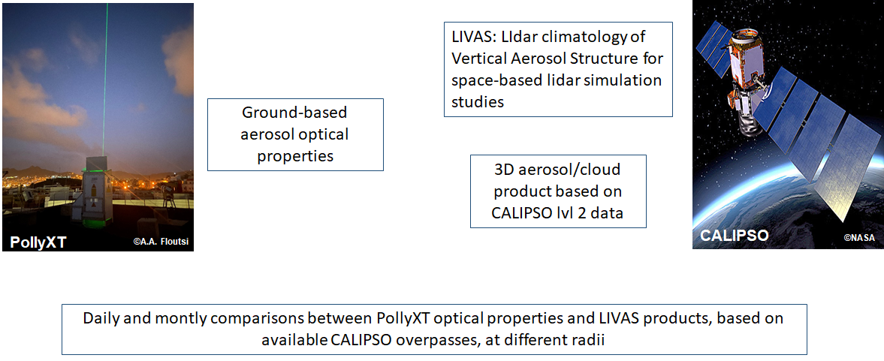
WP4000: Perform selected studies on historical data to support community convergence on the best practices
WP Lead: DLR
Jul 2023 -> Mar 2024
4.1 Study of representativeness based on ground-based observation at Mindelo, Cabo Verde and LIVAS-CALIPSO data set

Slide 14
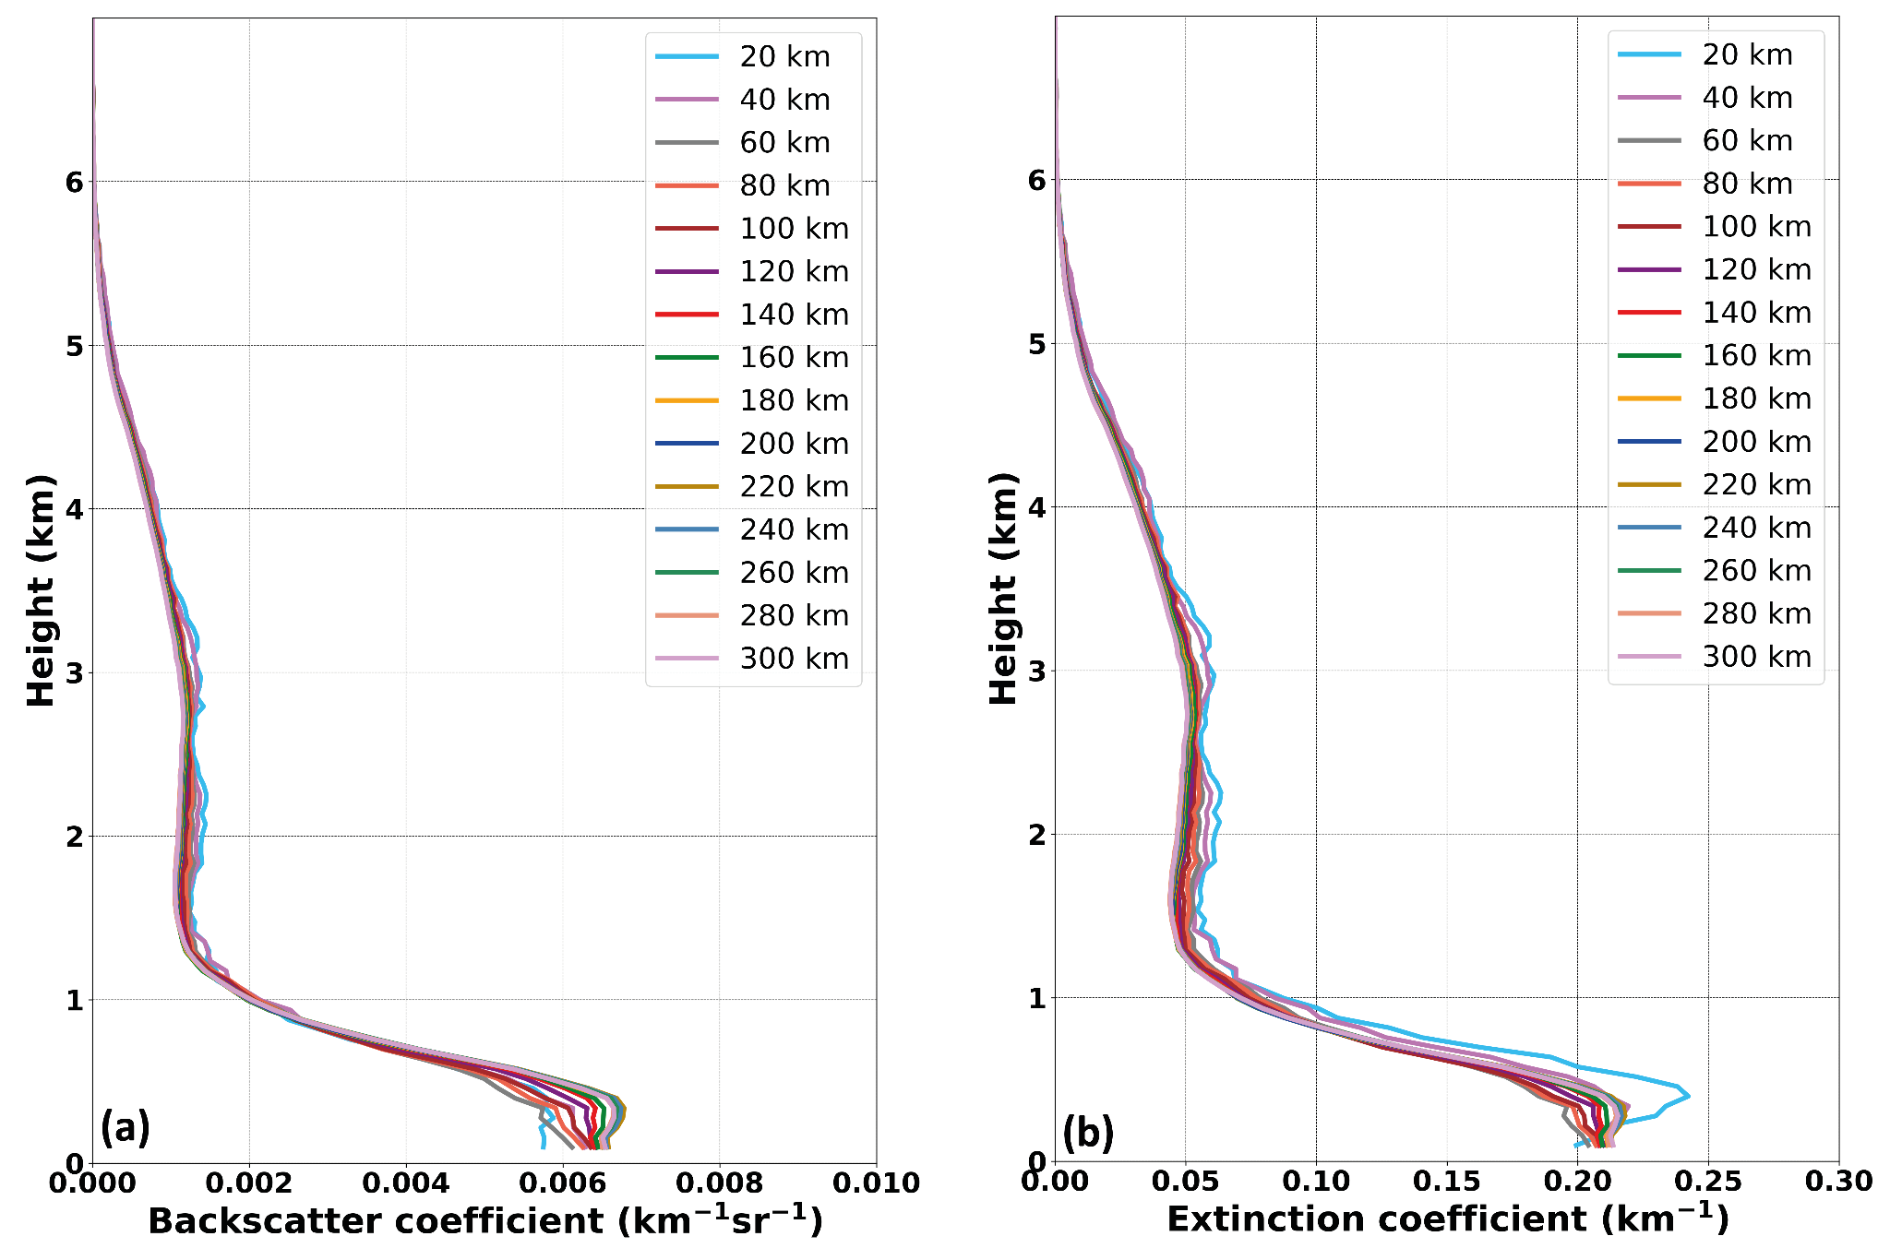
WP4000: Perform selected studies on historical data to support community convergence on the best practices
WP Lead: DLR
Jul 2023 -> Mar 2024
4.1 Study of representativeness based on ground-based observation at Mindelo, Cabo Verde and LIVAS-CALIPSO data set
Initial assessment of the degree of representativeness of the Polly^{XT} measurements in the context of Cal/Val activities by utilizing 17 complete years of CALIPSO overpasses (from 2006 till 2022)
Excellent agreement for most radii at altitudes between 2 - 5 km, where lofted aerosol layers mostly occur
Comparison for the PBL affected by potential cloud contamination, overlap issues
No solid conclusions for radii < 40 km, due to sampling effects
Overall, the ACTRIS ground-based station at Mindelo can be considered representative in terms of Cal/Val activities, even for a radius as large as 300 km
Manuscript in preparation to be submitted to the AMT/ACP JATAC SI
Longterm mean backscatter and extinction coefficient around Mindelo, Cabo Verde (LIVAS)

Slide 15
WP4000: Perform selected studies on historical data to support community convergence on the best practices
WP Lead: DLR
Jul 2023 -> Mar 2024
4.2 Validation of Level 1 data with ground-based systems with the CARDINAL level 1 tool
Study: Use the Level 2 lidar data as input in the EarthCARE level 1 lidar simulator tool (CARDINAL Campaign Tool; CCT) to simulate what ATLID would measure from space and its limitations due to the effect of resolution, attenuation and surface reflectance under different aerosol conditions
Status:
Simulation runs using L2 lidar profiles from eVe measurements during the ASKOS/JATAC campaign
  a pure dust with cirrus cloud on top
  a mixed dust with volcanic aerosols
  a mixed dust case
  a pure dust case
ATLID L2A realistic profiles from A-PRO processor using simulated ATLID L1 for the comparison with the corresponding eVe L2 profiles
  pure dust case
  pure dust with cirrus cloud on top [pending]
  mixed dust with volcanic aerosols [pending]
  mixed dust case [pending]

Slide 16
WP4000: Perform selected studies on historical data to support community convergence on the best practices
WP Lead: DLR
Jul 2023 -> Mar 2024
4.7 Validation of CPR Doppler velocity and fall velocity products
EarthCARE is the first Doppler radar in space,
→ there are no consolidated methods for the validation of spaceborne Doppler radar observations.
narrow swath of CPR → direct validation limited to mobile platforms deployed at satellite track or aircraft observations
Idea: Use of scanning weather radars, but the weather radar data needs to be processed in an appropriate way.
Goals: Develop framework to retrieve:
air velocity profiles from Doppler weather radar observations
fall velocities of raindrops from dual-polarization radar observations
reflectivity-velocity statistics in different cloud types from ground-based cloud radar observations
Datasets:
Dual-polarization weather radar data from European countries (e.g FMI, Italy), European network (OPERA) or NEXRAD in US
ACTRIS Cloud profiling and disdrometer data
Disdrometer data

Slide 17
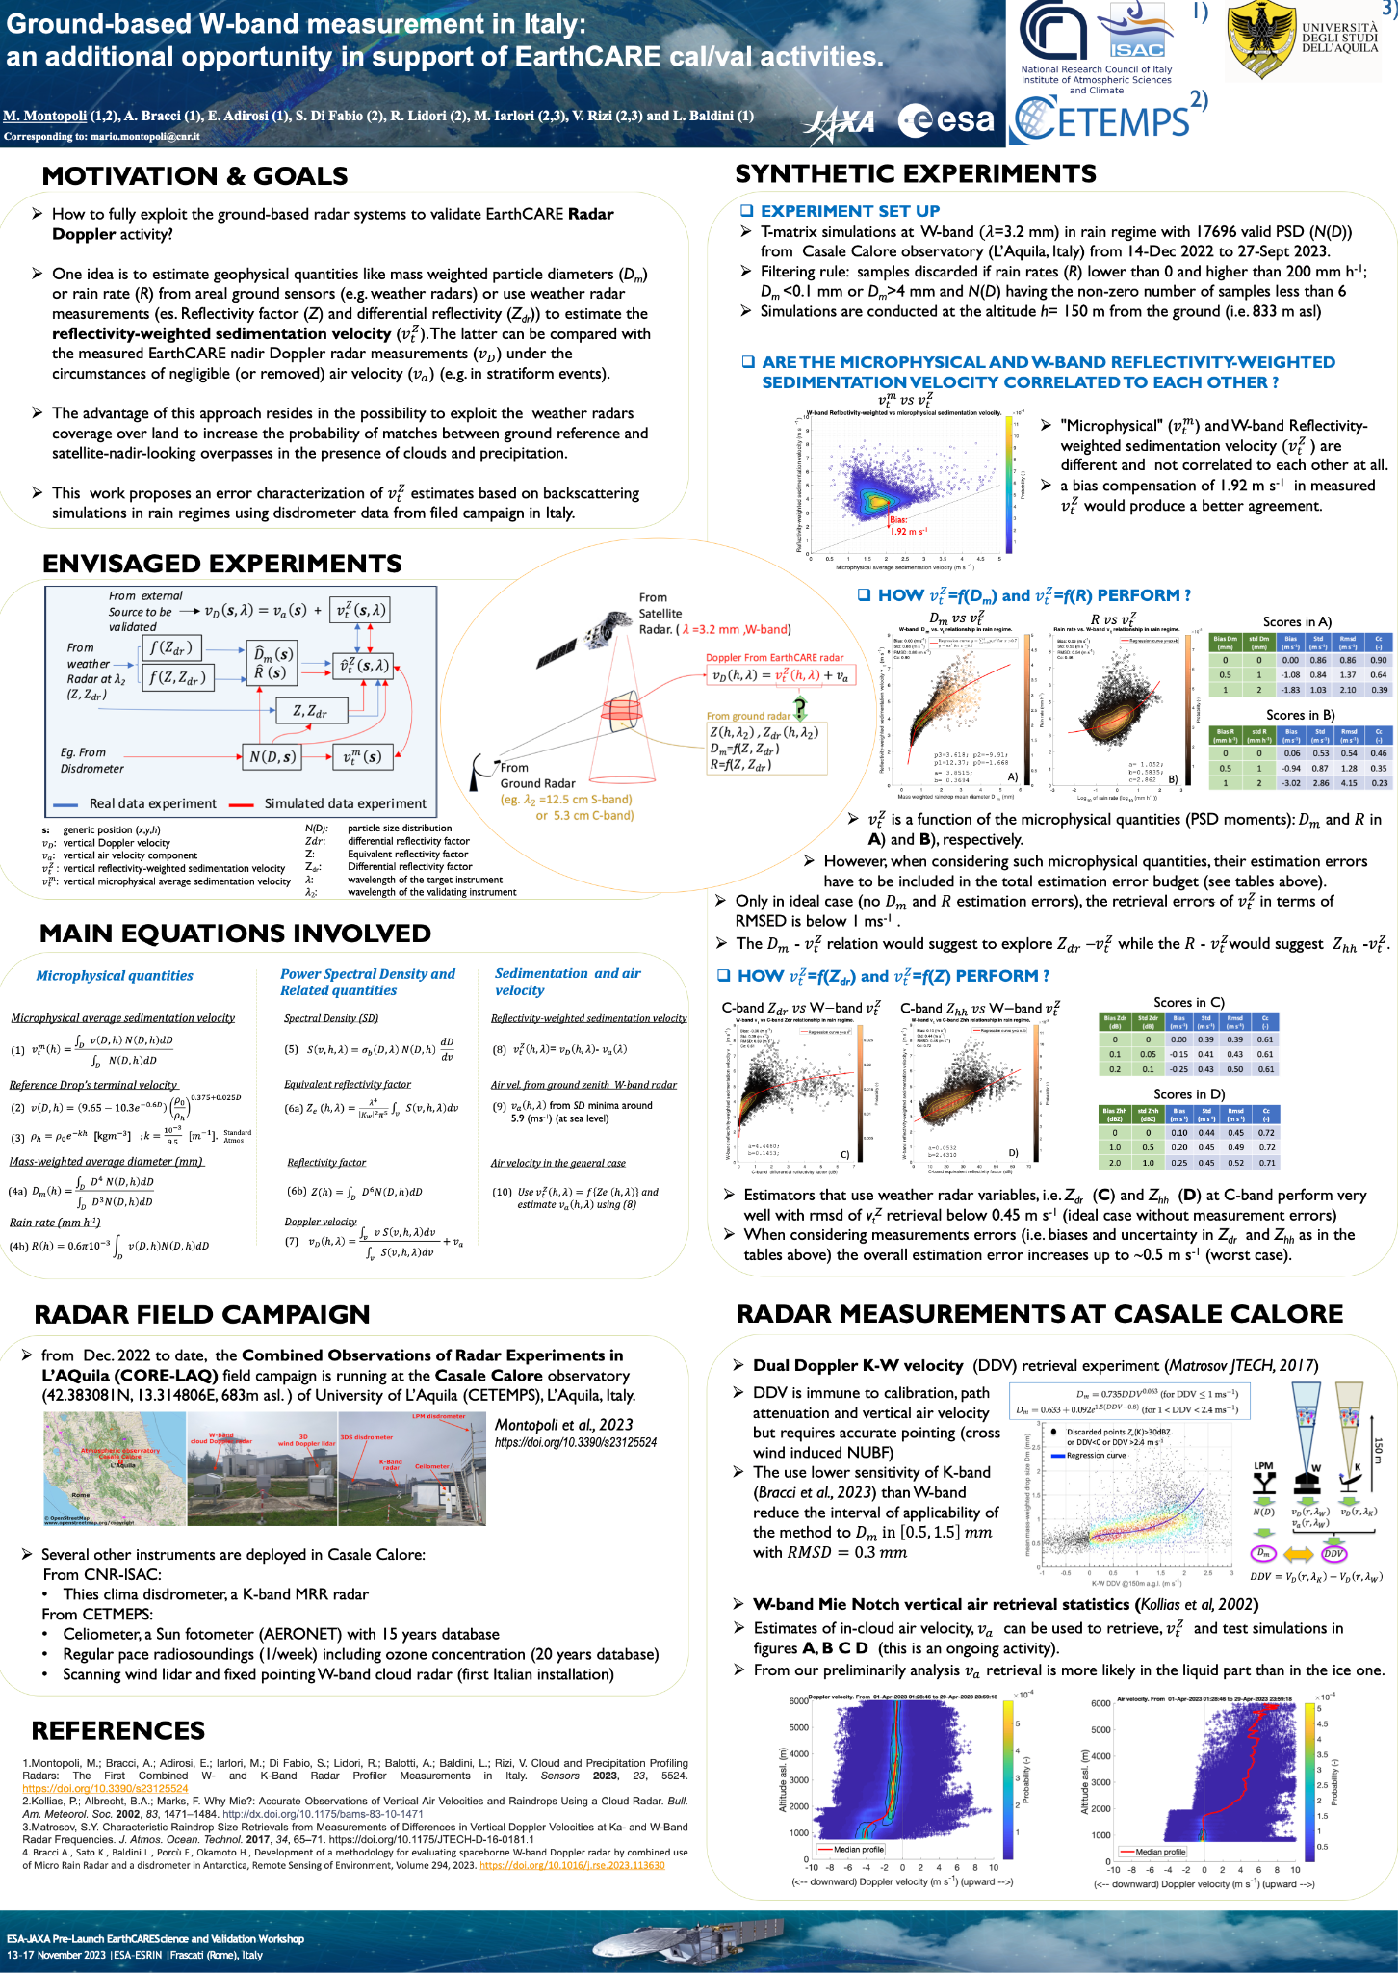
WP4000: Perform selected studies on historical data to support community convergence on the best practices
WP Lead: DLR
Jul 2023 -> Mar 2024
4.7 Validation of CPR Doppler velocity and fall velocity products
Presentations at ESA calval workshop by Montopoli et al. and Moisseev et al. discussed the use of dual-pol weather radar observations for validation of EarthCARE CPR Doppler observations
Next step: a joint publication

Slide 18
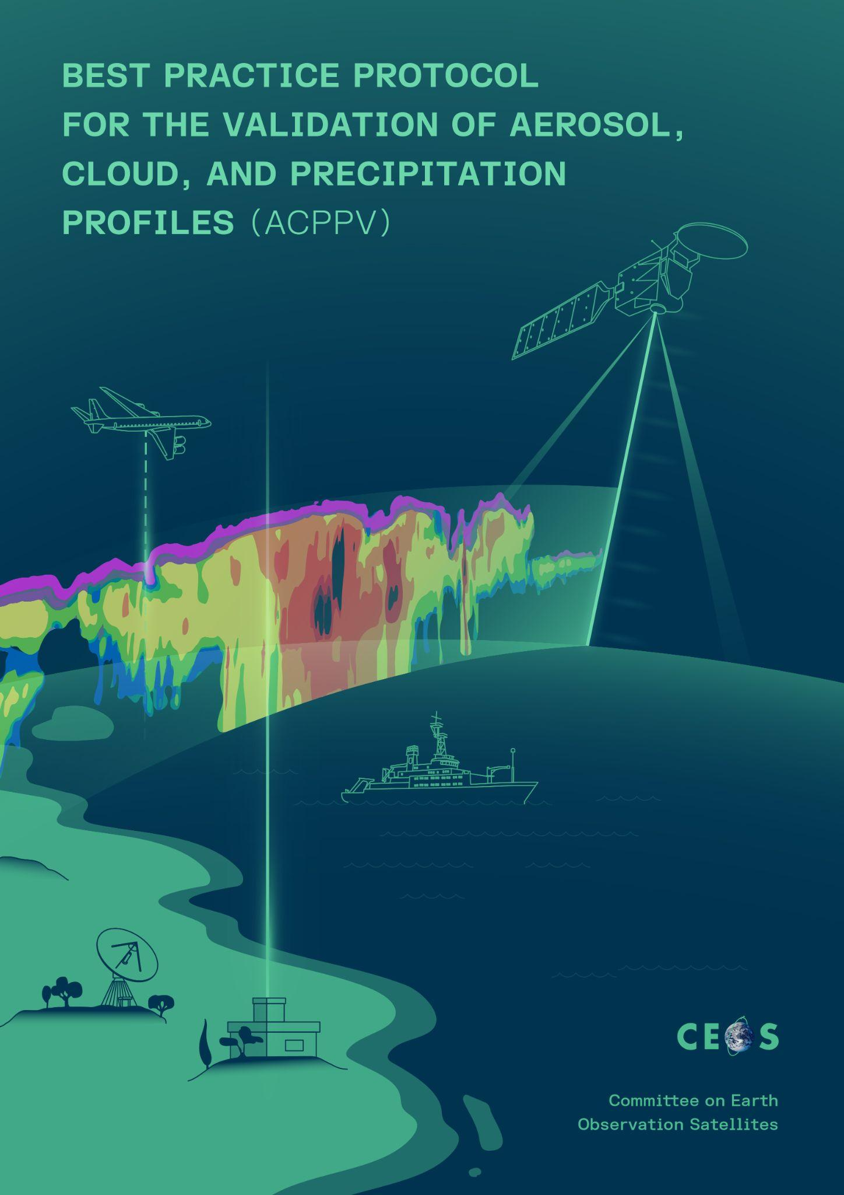
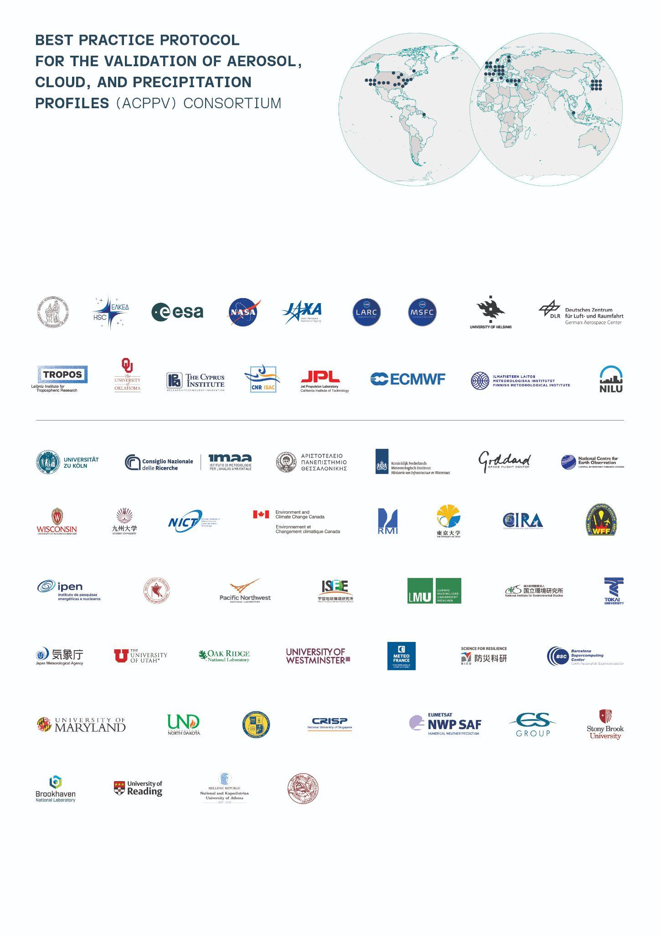
ACPPV document at CEOS WGCV
WP Lead: NOA
Mar 2023 -> Sep 2024
DOI assignment in Zenodo: https://zenodo.org/records/15025627
Published in CEOS portal
97 authors from 58 institutions
Amiridis, Vassilis; Marinou, Eleni; Hostetler, Chris; Koopman, Rob; Cecil, Daniel; Moisseev, Dmitri; Tackett, Jason; Groß, Silke; Baars, Holger; Redemann, Jens; Marenco, Franco; Baldini, Luca; Tanelli, Simone; Fielding, Mark; Janiskova, Marta; Tanaka, Τoshiyuki; O'Connor, Ewan; Fjaeraa, Ann Mari; Paschou, Peristera; Voudouri, Kalliopi Artemis; Ferrare, Richard; Burton, Sharon; Schuster, Gregory; Kato, Seiji; Winker, David; Shook, Michael; Bley, Sebastian; Haarig, Moritz; Floutsi, Athena Augusta; Wandinger, Ulla; Trapon, Dimitri; Pfitzenmaier, Lukas; Papagiannopoulos, Nikolaos; Mona, Lucia; Posselt, Derek; Mason, Shannon; Rennie, Michael; Benedetti, Angela; Hogan, Robin; Sogacheva, Larisa; Balis, Dimitris; Michailidis, Konstantinos; van Zadelhoff, Gerd-Jan; Nowottnick, Edward; Yorks, John; Mroz, Kamil; Donovan, David; L'Ecuyer, Tristan; Okamoto, Hajime; Sato, Kaori; Henderson, David; Nishikawa, Tomoaki; Barker, Howard; Cole, Jason; Qu, Zhipeng; Clerbaux, Nicolas; Nakajima, Takashi; Chase, Randy; Wolff, David; Landulfo, Eduardo; Kirstetter, Pierre-Emmanuel; Mather, Jim; Ohigashi, Tadayasu; Ryder, Claire; Tzallas, Vasileios; Tsikoudi, Ioanna; Tsekeri, Alexandra; Tsichla, Maria; Koutsoupi, Iliana; Kubota, Takuji; Siomos, Nikolaos; Takahashi, Nobuhiro; Horie, Hiroaki; Suzuki, Kentaroh; Mace, Jay; McLean, William; Borderies, Maria; Mangla, Rohit; Escribano, Jerónimo; Moradi, Isaac; Zhang, Jianglong; Juli, Rubin; Ikuta, Yasutaka; Marbach, Thierry; Bojkov, Bojan; Accadia, Christophe; Fougnie, Bertrand; Spezzi, Loredana; Bozzo, Alessio; Chimot, Julien; Jafariserajehlou, Soheila; Flament, Thomas; Mattioli, Vinia; Strandgren, Johan; Barlakas, Vasileios; Kollias, Pavlos.

Slide 19
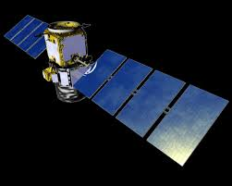
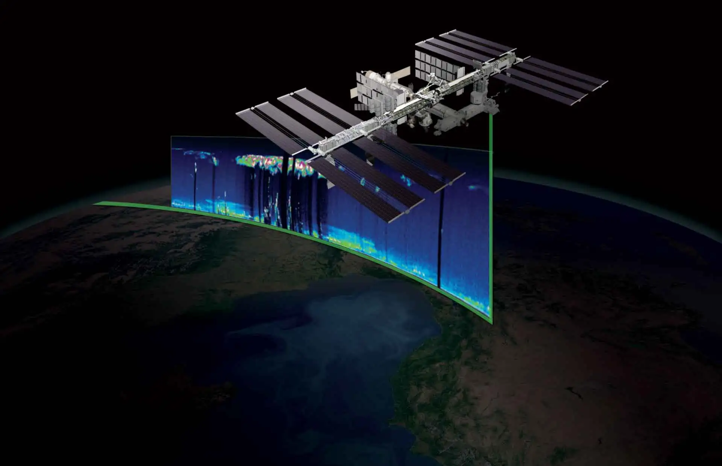
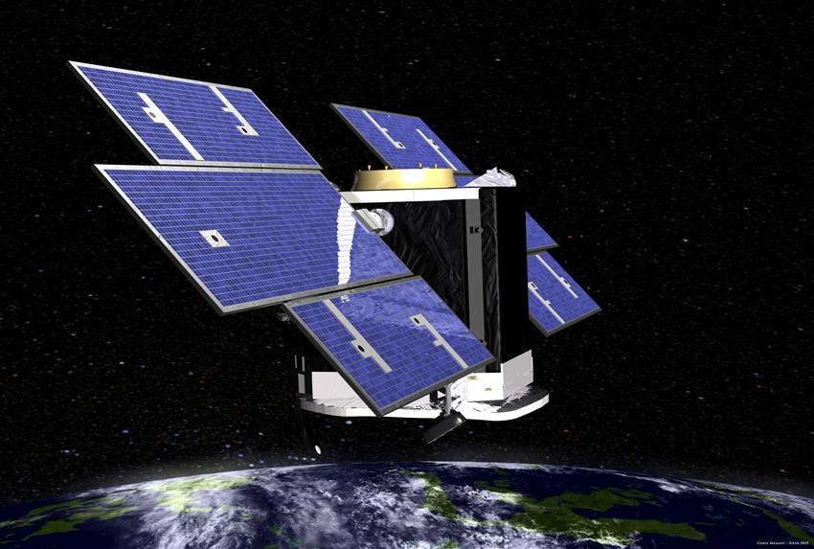
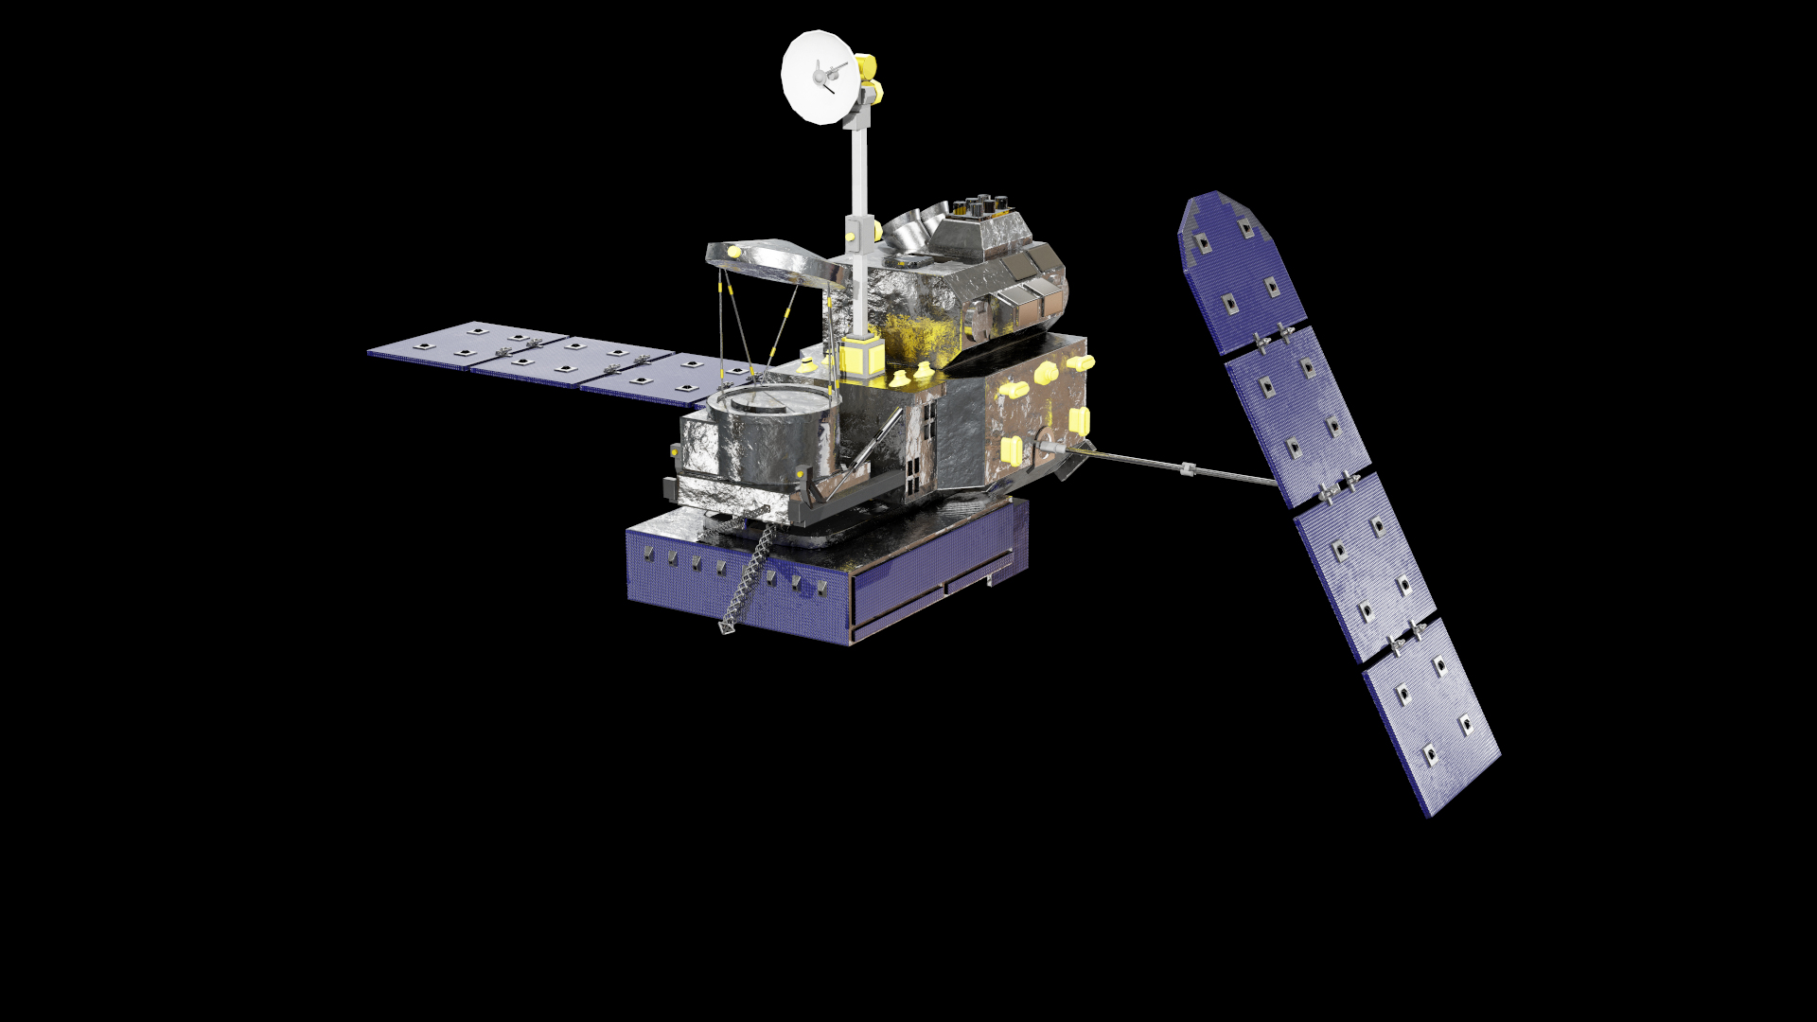
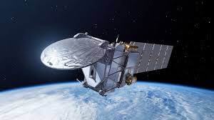
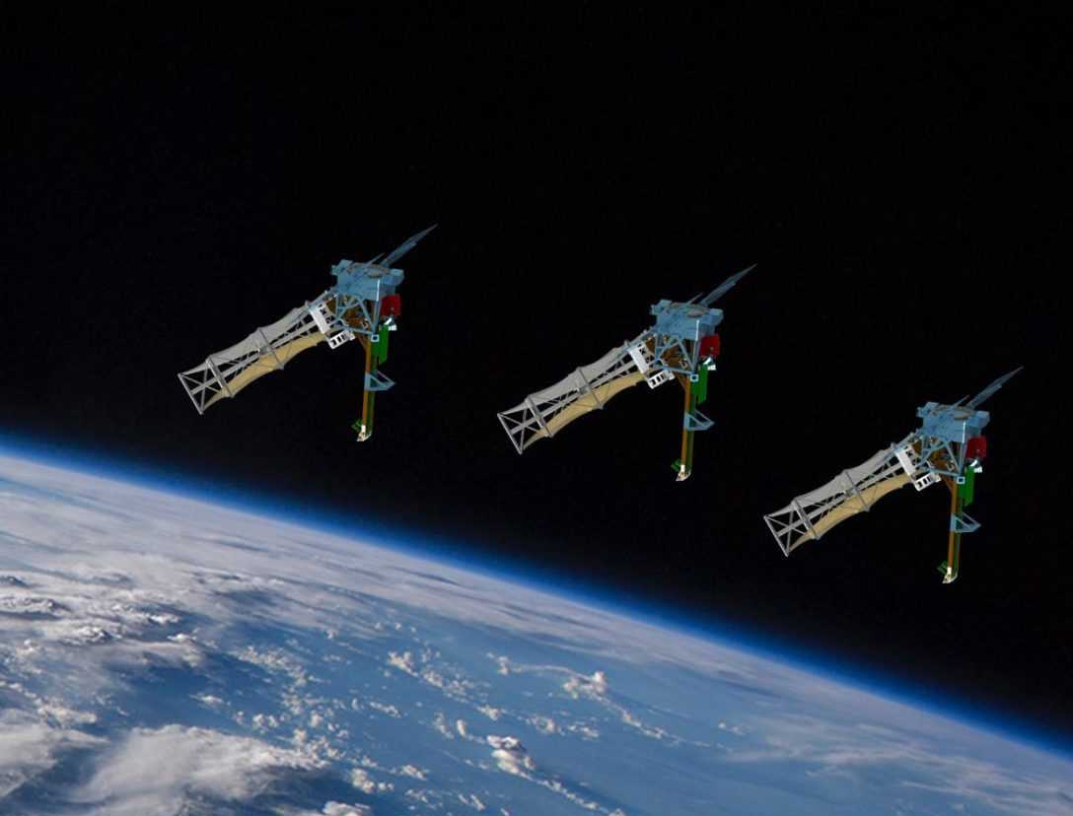
WP5000: Development and documentation of best practices for validation of cloud and aerosol profiles
Chapter 1: Introduction [Contact: Vassilis Amiridis, Dan Cecil]
Overview of past, present, and future space missions
Validation objectives for space profilers
Cal/Val definitions/nomenclature and validation metrics
Chapter 2: Validation needs for Space Profilers [Contact: Luca Baldini, Tristan l’Ecuyer, Hajime Okamoto]
Detailed list of products from space profilers (CALIOP, CATS, CloudSat, GPM, EarthCARE ATLID & CPR, INCUS)
Validation needs from the product developer’s perspective

Slide 20
WP5000: Development and documentation of best practices for validation of cloud and aerosol profiles
Chapter 1: Introduction [Contact: Vassilis Amiridis, Dan Cecil]
Overview of past, present, and future space missions
Validation objectives for space profilers
Cal/Val definitions/nomenclature and validation metrics
Chapter 2: Validation needs for Space Profilers [Contact: Luca Baldini, Tristan l’Ecuyer, Hajime Okamoto]
Detailed list of products from space profilers (CALIOP, CATS, CloudSat, GPM, EarthCARE ATLID & CPR, INCUS)
Validation needs from the product developer’s perspective
Chapter 3: Survey of validation measurements [Contact: Jens Redemann, Silke Gross, Franco Marenco]
Types of validation instruments & specific instruments
Spatiotemporal representativeness, scene homogeneity and co-location criteria for correlative measurements
Quality of measurements
Chapter 4: Correlative metadata and data format [Contact: Ewan O’Connor, Ann Mari Fjæraa]
Guidelines on a proper definition of metadata and data formats for Cal/Val archives

Slide 21
WP5000: Development and documentation of best practices for validation of cloud and aerosol profiles
Chapter 5: Guidance for the validation of lidar and aerosol products [Contact: Eleni Marinou, Holger Baars]
Guidelines for validation of different lidar and aerosol products with ref. on past studies
Chapter 6: Guidance for validation of radar, cloud, and precipitation products [Contact: Dmitri Moisseev, Simone Tannelli]
Guidelines for validation of different radar, cloud, and precipitation products with ref. on past studies
Chapter 7: Statistical validation [Contact: Jason Tackett]
Near-instantaneous comparisons
Climatological comparisons
Chapter 8: Near-real time validation through data assimilation [Contact: Mark Fielding, Marta Janisková]
Key considerations and data quality principles
Demonstrations of data quality monitoring
Chapter 9: Gaps and Challenges [Contact: Holger Baars]

Slide 22
WP6000: Synthesis and recommendations WP Lead: FMI
Geographical gaps
Significant regions currently lacking sub-orbital measurements
  continental Africa,
  Oceania,
  northern Asia,
  polar regions,
  oceans.
New supersites if possible;
  Even campaign deployments beneficial
Over oceans
  Research vessels as supersites already demonstrated
    concentrate on a particular location or perform transects
  enhanced with buoys and commercial vessels.

Slide 23
Recommendations
Measurement Methodologies
More
  airborne validation
  mobile ground stations (e.g. ship.borne
Complement with balloons and UAVs
Require
  More humidity profiles
  More co-located radiation measurements
  Quantitative retrievals above precipitation
  Standardisation of in-situ size and shape precipitation measurements

Slide 24
Recommendations
Statistical validation
Climatological
  Probability distributions and confidence intervals
  Global averages alone not recommended, require regional too
    Potential systematic satellite bias
Direct intercomparisons
  Near instantaneous in space and time
Spatio-temporal representativity
  Varies with target type
Scanning cloud radars to estimate the spatial distribution of clouds
  provide statistical criteria for overpass spatio-temporal representativeness

Slide 25
Recommendations
Differing observation geometries
Different profiles of
  Attenuation
  Signal propagation
  Geophysical error propagation
Radiatively important (supercooled) liquid clouds may be missed by both geometries. Need to assess
  radiative impact
  Radar attenuation
Impacts amount of multiple scattering
  Especially lidar, but does impact radar too
  Ensure it is considered in comparisons and simulators.

Slide 26
Recommendations
Aerosol profiling
Require more knowledge on
  Mixtures, full range of mixing states
  Aerosol in the lowest 1-2 km - too close for many powerful lidar systems
  Identification of smoke
  European background and pollution aerosols
  Carbonaceous aerosols
    Sources and radiative impact
  Brown carbon
    Radiative impacts
  Dry marine aerosol – often misclassified as dusty-marine mixture
    Radiative impact
    More shipborne observations
Majority of depolarisation ratio observations are at 532 nm
  More observations at other wavelengths
    Need to be harmonised and current discrepancies at certain wavelengths need to be understood.

Slide 27
Recommendations
Cloud and precipitation profiling
Better identification of supercooled liquid layers
Attenuation of ground-based radar
  no quantitative IWC above precipitation
    Develop new attenuation corrections, validate with multi-frequency radar
PRF varies with latitude
  Perform Doppler velocity validation at different latitudes
Air motion contribution to Doppler velocity
  must be accounted for in retrievals with a terminal fall speed term.
  Particularly challenging in convection
    likely require scanning agile adaptive radar observations to track convective cores

Slide 28
Recommendations
Simulators
Crucial tools for validation
  Sub-orbital to orbital
  NWP model to orbital
Continue development
  Specific adaptions for each new spaceborne profiler
  Don’t forget historic satellite profilers

Slide 29
Recommendations
Monitoring and Data Assimilation
Requires
  Good forward models
  Adequate representation of ACPV properties in NWP, AC models
Use additional DA techniques
  Bias correction schemes
  Screen scenes with large systematic bias
  Use observation errors (e.g. covariance matrices)
Estimate representativeness of ground-based stations
Direct assimilation of many aerosol/cloud parameters still challenging

Slide 30
Conclusion and outlook
Conclusion
Comprehensive study on best practice for space profiler validation
  Large community working together
  Gaps identified and recommendations made
New tools provided
Some knowledge/measurement gaps already identified and filled
Outlook
Keep large community working together
Continue to develop best practices
Continue to identify and fill knowledge/measurement gaps
Continue to improve tools

