Slide 1





Horizon 2020 – Copernicus Cal/Val Solution
‘Two-Years-After’ Update
Cal/Val gap Analysis for Copernicus
Atmospheric Composition Missions
Tijl Verhoelst (BIRA-IASB)
With contributions from
CEOS AC-VC-21 & ACSG Meeting
Takamatsu, Japan, 10-13 June 2025

Slide 2















Scope of the H2020 CCVS project
Objective:
  To define a holistic solution for all Copernicus Sentinel missions (either operational or planned) to overcome current limitations of Calibration and Validation (Cal/Val) activities.
Project duration: Dec. 2020 to Nov. 2022
Project website: https://ccvs.eu
Contact us: contact@ccvs.eu

Slide 3
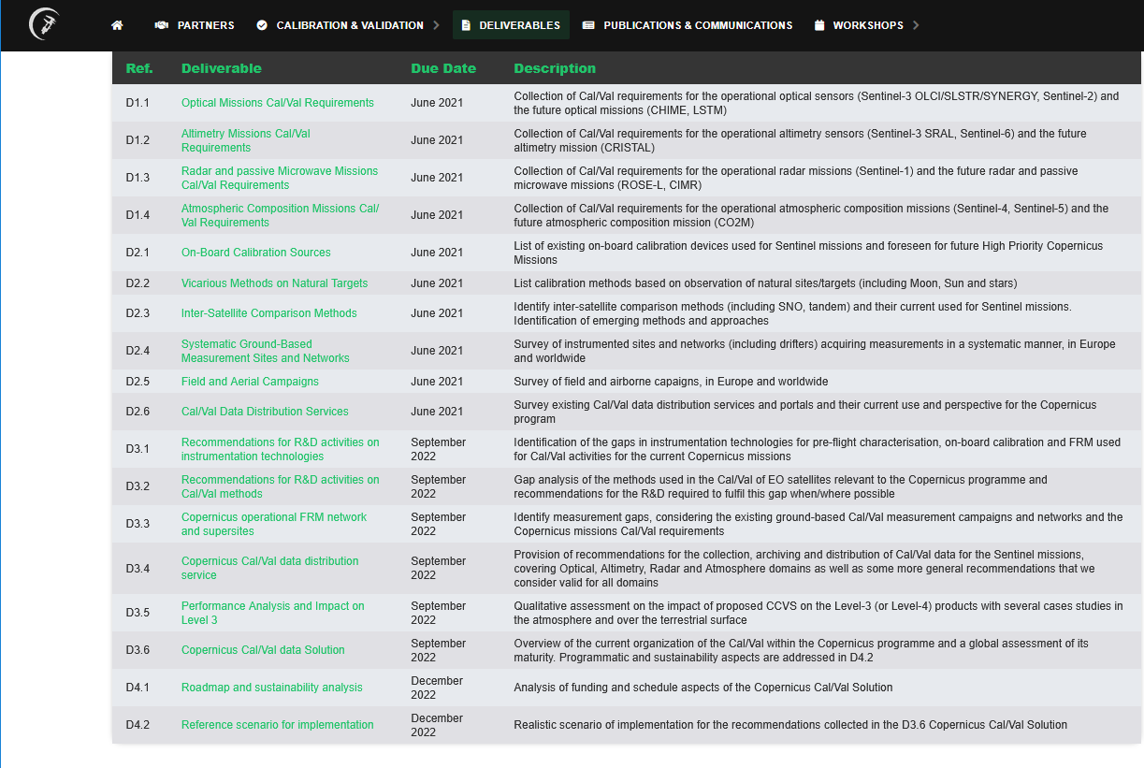
Deliverables
https://ccvs.eu
Sentinel Cal/Val Requirements
Existing Cal/Val resources
Gap analysis and Copernicus Cal/Val solution
Implementation roadmap

Slide 4
CCVS Project – Gap Analysis
CCVS actions taken towards Cal/Val Solution, Scenario and Roadmap
Discussions in major events
  2 CCVS Workshops 2021 and 2022
  Space Agencies WG meeting 2022
  CEOS WGCV and NDACC Steering Committee meetings
  CCVS event at ESA LPS22 (2022/05)
Analysis of practices, facilities and capacities (in D2.x and D3.x)
  ESA/Copernicus ATM-MPC, ESA CCI+ projects
  EUMETSAT AC SAF, CO2M Cal/Val Study
  Copernicus CAMS evaluation and C3S (L3/L4) quality assessment
  Ground-based monitoring networks, FRM4xxx projects, EVDC, EU RIs ACTRIS & ICOS
  Peer-reviewed literature and orientation papers
Dedicated gap analysis for Sentinel-5P, -4 -5 and CO2M constellations following
  CCVS defined maturity assessment
  Generic atmosphere validation protocol
  CEOS WGISS Data Management & Stewardship MM (‘Validation’ column)
  Building on previous gap analyses (QA4ECV, GAIA-CLIM, FIDUCEO)

Slide 5
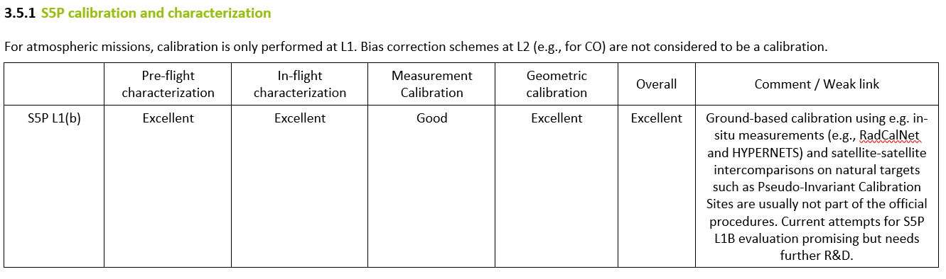
CCVS Project – Gap Analysis
D3.6, Section 3.5: Cal/Val status assessment for Atmospheric Composition

Slide 6
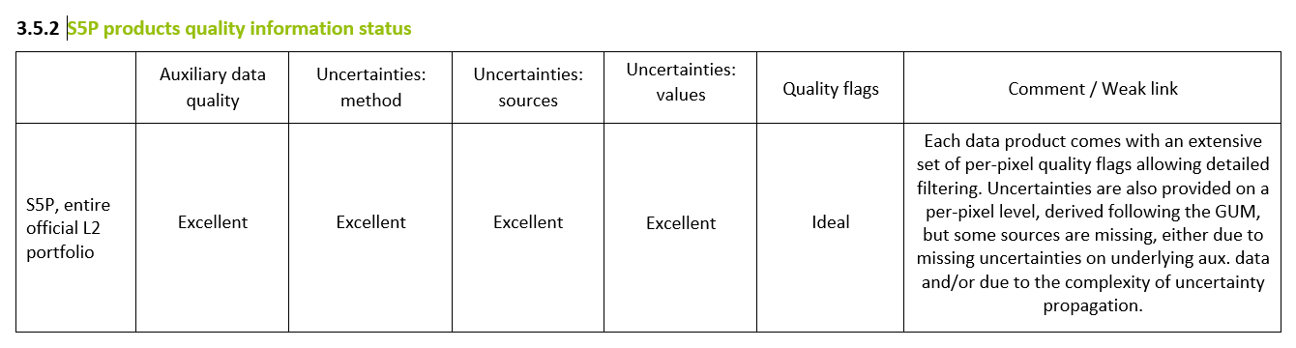
CCVS Project – Gap Analysis
Note: GUM shortcomings and caveats (for atmospheric remote sensing) partly solved in SPARC/APARC Activity TUNER

Slide 7
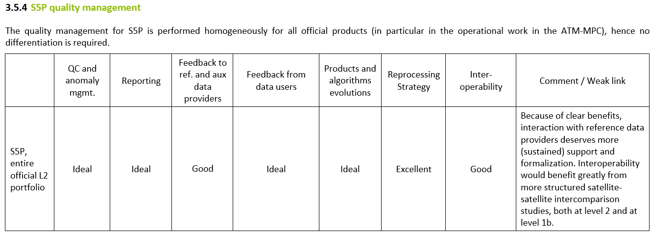
CCVS Project – Gap Analysis

Slide 8
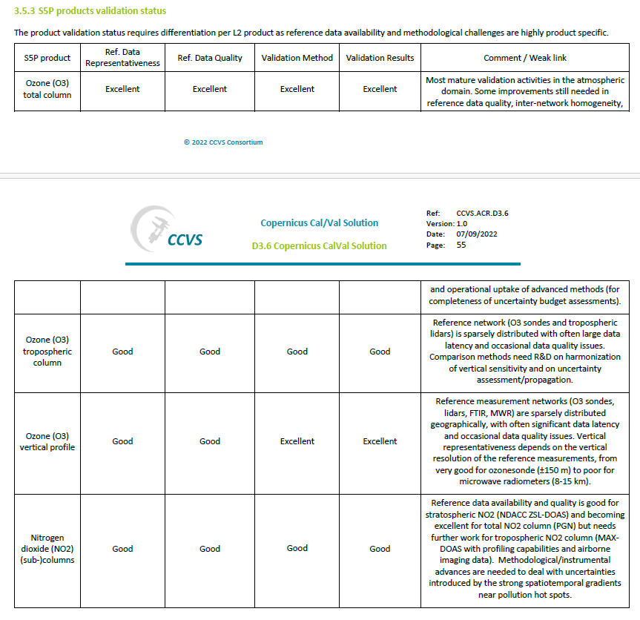
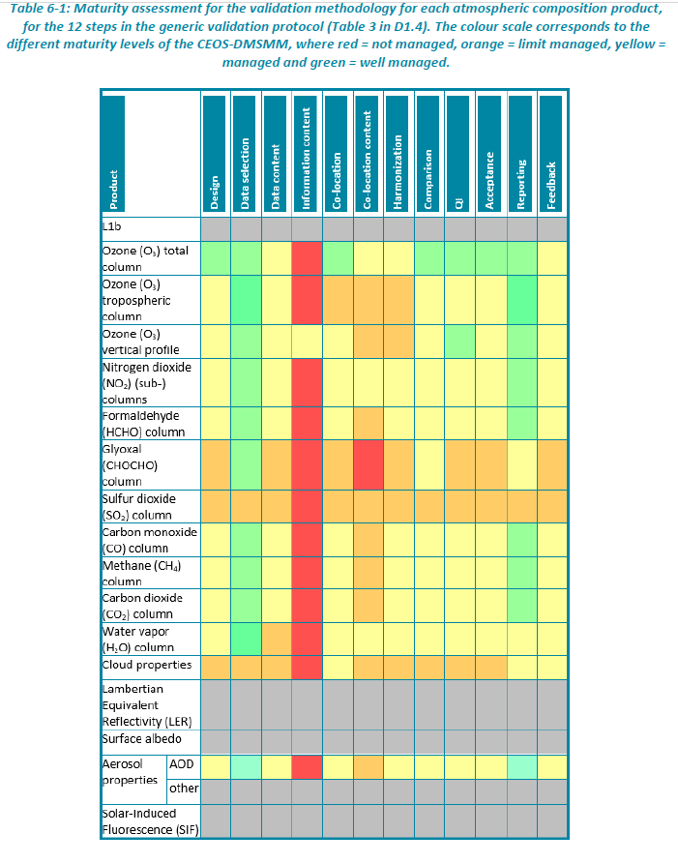
CCVS Project – Gap Analysis
3.5.3: Validation maturity: varies by product

Slide 9
CCVS Project – Gap Analysis
Analysis vs. CEOS DMSMM Criteria (MMP6 – Validation)
Reference data representativeness
  In general, representativeness hardly assessed
  Need to cover full range of Sentinel measurand values
  Need to cover all key atmospheric states
  Need to cover full range of influence quantities
  Care to be given to spatio-temporal co-location, including smoothing effects, and to remaining mismatch errors
  Role of campaigns with multi-instruments and airborne mapping
Reference data quality
  Essential role of FRM4xxx projects (R&D + operational)
  Sustain dialogue with reference data providers (monitoring networks)
  Next generation instrumentation

Slide 10
CCVS Project – Gap Analysis
Necessary improvements of reference data quality
  Improved spectroscopic data with improved traceability, and related impact studies
  Central instrument calibration, characterization and maintenance facilities whenever industrial instrument providers are not able or likely to perform those operations
  Increased accuracy / precision of reference data
  Improved intra- and inter network consistency, across spectral domains and techniques
    travelling standard
    dedicated intercomparison campaigns
    harmonisation of measurement and data analysis procedures (incl. airborne)
  FRM maturity assessment framework/tools to be developed and applied

Slide 11
CCVS Project – Gap Analysis
Needed evolution of instrument technologies and data analysis techniques
  Bring ‘new’ R&D type instrumentation to maturity
  → e.g., airborne instruments, UAV-type experiments, COCCON, Pa-NIR
  Bring research grade instrumentation and analysis to operational level (NRT delivery where possible)
Timely availability and access to reference data must be improved
  Distributed data distribution service across all domains – according to FAIR data principles
  Copernicus missions and services do require fast data delivery.
Existing capacity must be kept alive
  Long-term records of consolidated reference data need to continue
  Need for data rescue and “homeless” data archiving

Slide 12
CCVS Project – Gap Analysis
Structural funding issues
  Most of ground-based network instruments rely on short/mid-term funding: projects, universities… This bottom-up approach has consequences for long-term sustainability and for network (data and design) tailoring to Copernicus needs.
  EU Research Infrastructures (ACTRIS, ICOS) try to find a good compromise between top-down user-based strategy and bottom-up interests and heritage of existing facilities. They require funding commitments by the contributing states.
Coordination and sustained dialogue between different stakeholders (e.g., CEOS bodies, Copernicus components, EU Research Infrastructures…), and with (ground-based network) data providers

Slide 13
CCVS Project – Gap Analysis
Ground-based networks design
There is a need for R&D on network design, in particular for emerging measurement networks, but also for FRM-tailoring and sustainability of the existing networks.
  Range of measurand
  Geographical coverage, types of atmospheric states (or regimes)
  Range and sampling of main influence quantities (SZA, T profile, surface albedo, aerosols, clouds…)
  Assessment of the spatio-temporal representativeness of measurements at a given location – requiring also assessment of spatio-temporal variability at that location => complementarity of airborne campaigns and modelling
  Co-location of instruments at ‘supersites’, e.g., SWIR with UVVIS, atmospheric composition and ancillary data (incl. surf. albedo) for in-depth validation of retrieval algorithms, validation of attribution proxies (simultaneous measurements of CO2, NO2, HCHO, SIF, smoke AOD)…

Slide 14
CCVS Project – Gap Analysis
Analysis vs. CEOS DMSMM Criteria (MMP6 – Validation)
Validation method
  Mature for a few products, product-specific improvements (R&D) needed for others.
  General R&D needs:
    Data harmonization approaches
    Validation of Sentinel prognostic uncertainties
    End-to-end uncertainty budget of the validation process (regridding, smoothing…)
    Propagation of quality information along L0 to L3/L4 processing chain
    L3/L4 validation methods (and reference data)
    Gap between methods developed in research context and their operationalization
  R&D needs for L1B, LER surface albedo, aerosol properties (non AOD), SIF

Slide 15
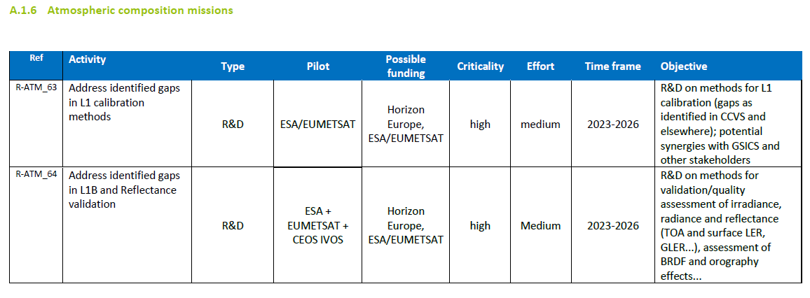
CCVS Project – Gap Analysis
D4.2: Reference scenario for implementation
Generic recommendations
Domain specific recommendations

Slide 16
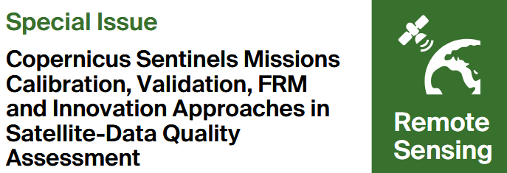

CCVS Project – Gap Analysis
Details of CCVS gap analysis and roadmap archived on https://ccvs.eu
Follow-up activities
Special issue of MDPI Remote Sensing
  COCCON, FRM4DOAS and TCCON assessed vs. CEOS-FRM Maturity Assessment Framework v1
Special session at ESA Living Planet Symposium 2025 (Vienna, 23-27 June 2025)
Survey of ongoing activities at ESA, EUMETSAT and elsewhere addressing CCVS Gaps

Slide 17
CCVS Project – Gap Analysis
Details of CCVS gap analysis and roadmap
archived on https://ccvs.eu
Examples of activities underpinned by CCVS roadmap/gap analysis’:
Development of CEOS-FRM Maturity Assessment Framework v1
ESA & EUMETSAT Cal/Val support and FRM projects
Uptake by ACTRIS; set-up of Expert Group on Satellite Validation (EG-SAT)
ESA/EUMETSAT/ECMWF coordination on Cal/Val support
CEOS/CGMS GHG constellation roadmap v2/Annex C – needs & gaps tracking system for Cal/Val networks and operational systems

