Slide 1

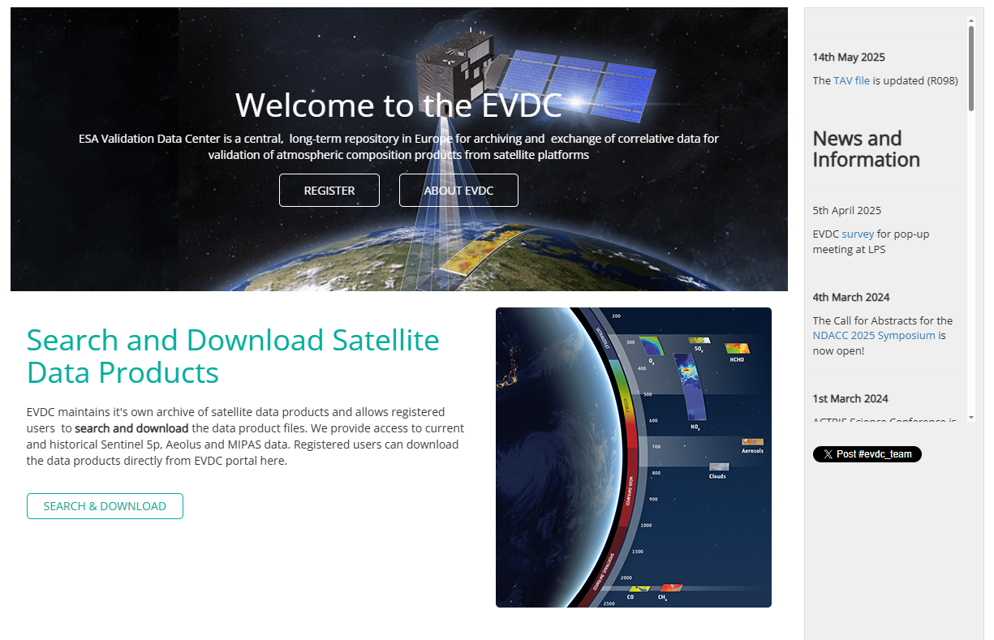


EVDC
ESA atmospheric Validation Data Center
IWGGMS-21 /CEOS AC-VC-21, Japan, June 2025
Ann Mari Fjaeraa ann.mari.fjaeraa@nilu.no
Ian Boyd, Yong Lin, Paul Eckhardt and EVDC team

Slide 2
https://evdc.esa.int/
Repository operated by the European Space Agency (ESA) for archiving and exchanging correlative Cal/Val and FRM data
- used in validation of atmospheric composition products
- data supporting e.g ENVISAT, Aeolus, Sentinel-5P, EarthCARE.
Developed in collaboration with NASA, NDACC and a number of international institutions and universities over the past 30 years.
Builds on the NADIR system (NILU’s Atmospheric Database for Interactive Retrieval)
and the ENVISAT Cal/Val database.

Slide 3
https://evdc.esa.int/
Supports both online near-real-time data and field campaigns
Tools for data formatting, data upload, data storage
Access to data delivered by operational networks such as Pandonia Global Network (PGN), The COllaborative Carbon Column Observing Network (COCCON) and all (around 50) Cal/Val teams contracted by ESA.
Complete backup of the NDACC database and its web pages.
Provision of data to ATM-MPC for Sentinel-5P, and o3sonde data to CAMS.
More than 1.9 mill files from aircrafts, balloons, drone/UAVs, ships and groundbased platforms from around 30 measurement principles (per May 2025)

Slide 4
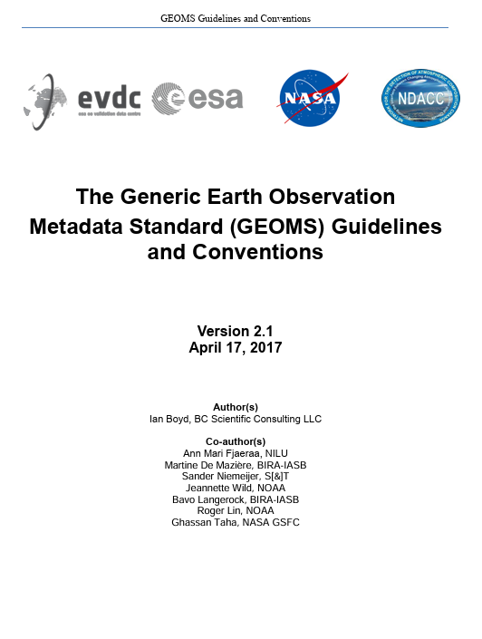
GEOMS
The Generic Earth Observation Metadata Standard
Metadata descriptions, using file formats HDF and NetCDF.
Developed over time, as a joint effort between NASA, ESA and
NDACC.
Started with the need for generic metadata guidelines on
atmospheric and oceanographic datasets for the ENVISAT
Calibration and Validation project by the
Aura Validation Data Centre (AVDC).
May be applied to any project where Cal/Val data are to
be exchanged.

Slide 5
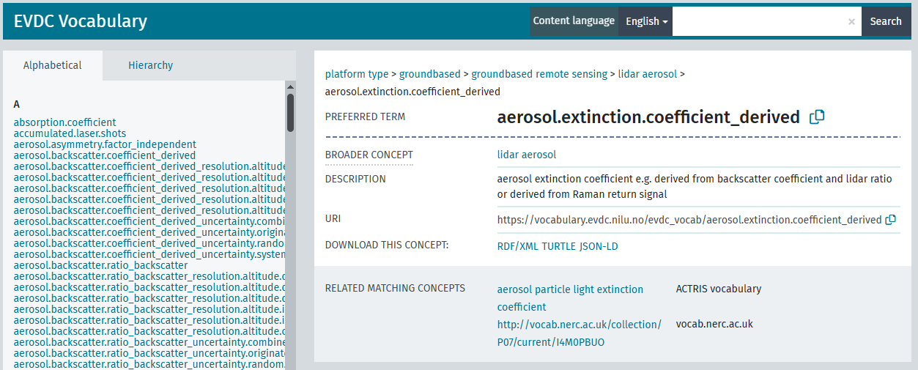
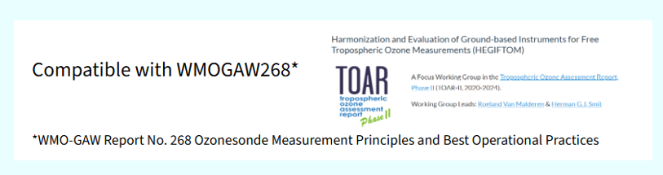
Skosmos; JSON-LD and XML (with XSD schema validation – machine readable)
Vocabulary controlled by the EVDC metadata stewards and working groups (GEOMS forum)
NDACC WGs, AVDC, EVDC, ESA (COCCON, PGN), o3sonde community and beyond

Slide 6




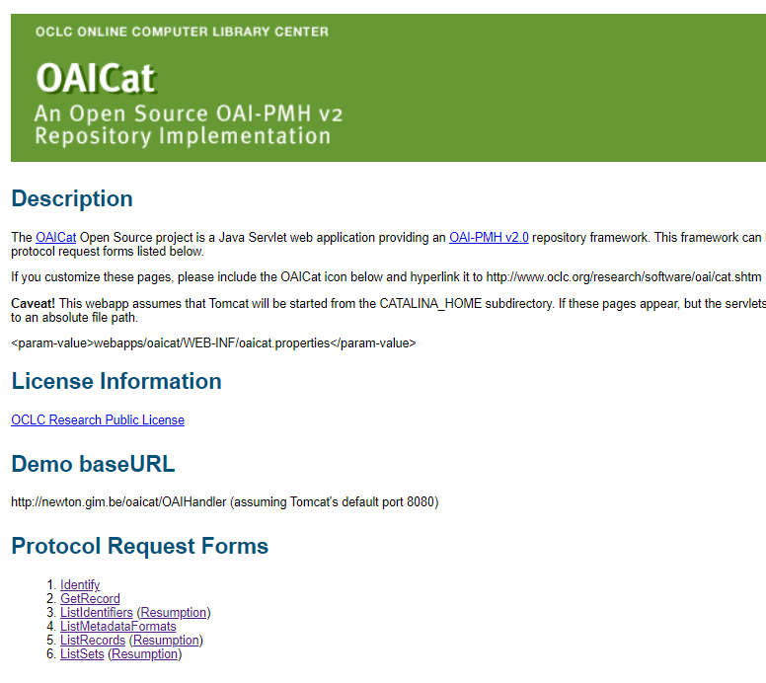
DCIO – Data Center Inter-Operability
Forum of EO Cal/Val data repositories and data providers.
Seamless exchange access and data exchange between data producers and data users.
Established agreements between several data centers and networks e.g NDACC, WOUDC, AVDC, MATCH/VINTERSOL o3sonde, AD-Net, CLOUDNET, EARLINET, TCCON (brokered dataset) Display of data from COCCON, PGN (primary datacenter).
Version control handled centrally.
DCIO:
“What is new, updated or deleted since last time I visited”
DCIO working group (DCIO forum)
Contact EVDC nadirteam@nilu.no in case you want to be part of the GEOMS and/or DCIO forum

Slide 7
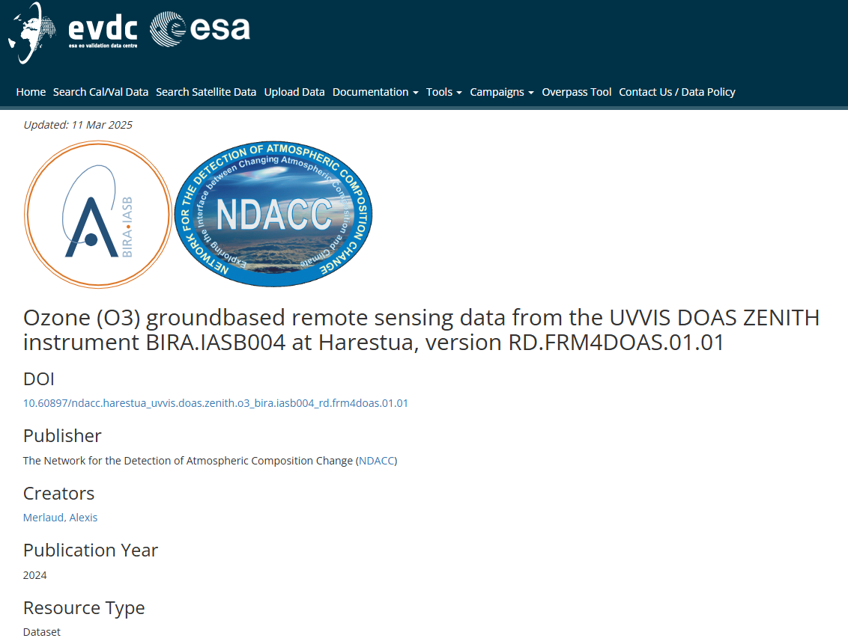
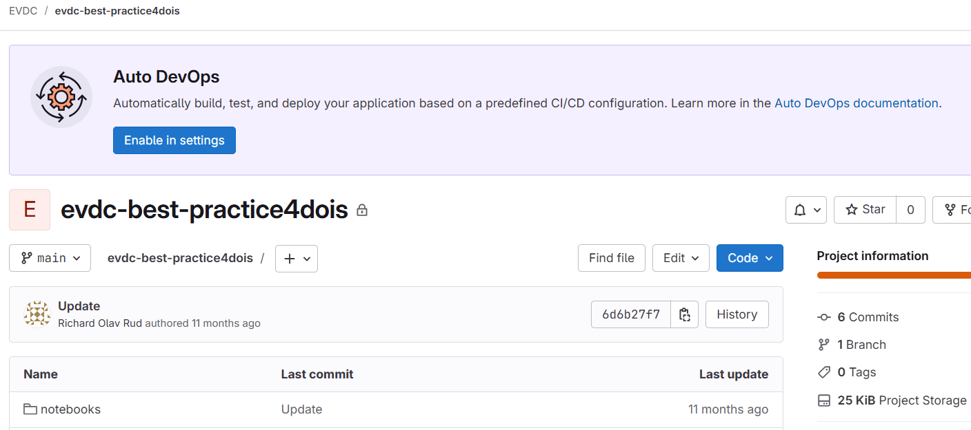
Self-assign system for Digital Object Identifier - DOIs
Funding agencies, publishers, and data repositories often require DOIs for reporting and FAIR (Findable, Accessible, Interoperable, Reusable) data practices.
EVDC users have access to self-assignment jupyter notebooks.
EVDC can assign DOIs for datasets
Provision of landing pages (10 years)
Secures reliable citation, increased visibility, proper acknowledgment, interoperability, version control, transparency and compliance.
Open GIT repository

Slide 8
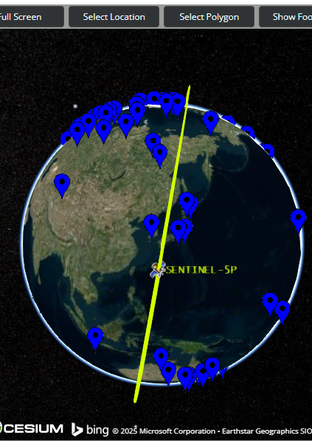
The Orbital Prediction and Overpass Tool (OPOT)
Online tool that generates and visualizes satellite overpasses.
Helpful resource for campaign teams, LIDAR operators, and mobile platforms such as EMORAL and UAV’s.
Data submitter assistance
GEOMS tool for file formatting (IDL and Python)
Online file format checker
Provision of training for all these tools

Slide 9
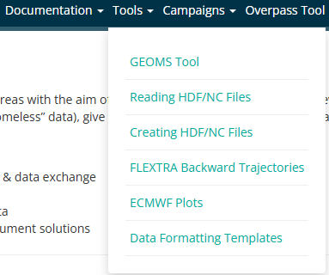
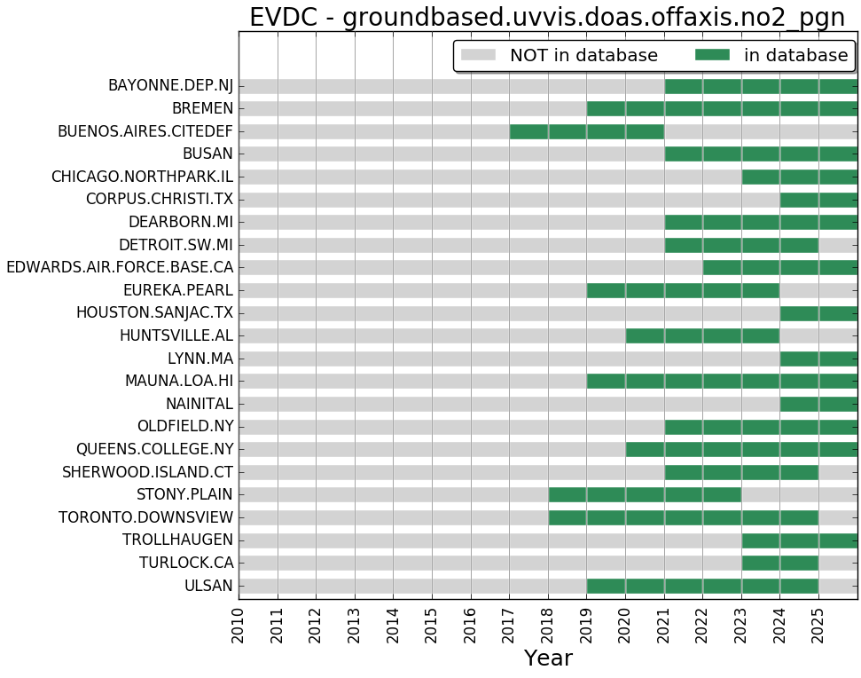
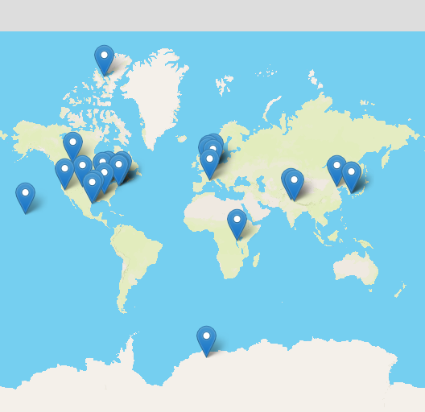

Data formatting templates
11 new templates created over the past 12 months, in collaboration with the GEOMS forum
Aerosol, cloud radar, broadband radiometer, disdrometer, nephelometer, skycamera, Pandora doas offaxis
Open GIT repository
https://git.nilu.no/geoms/templates

Slide 10
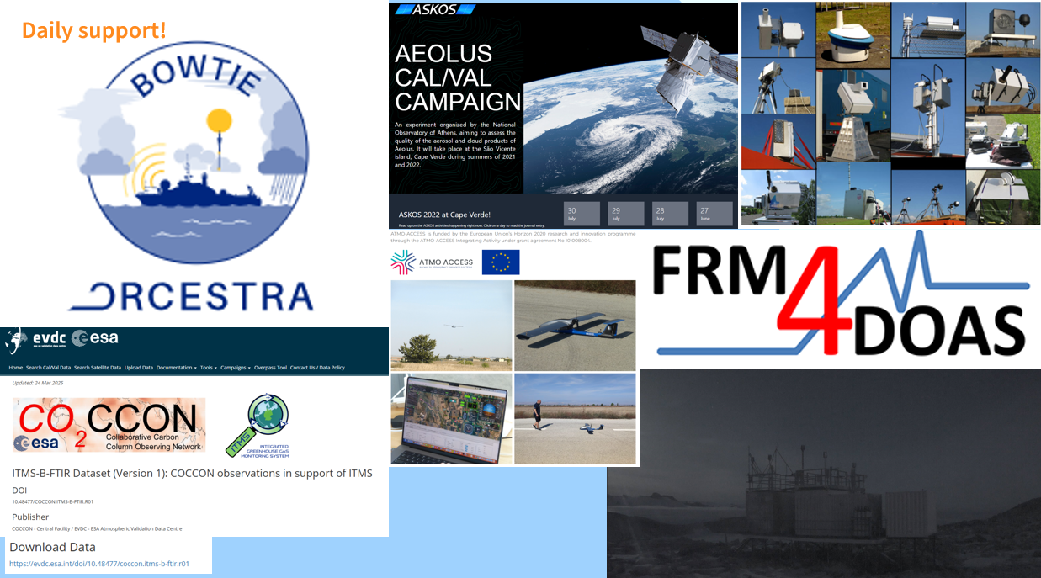

Slide 11
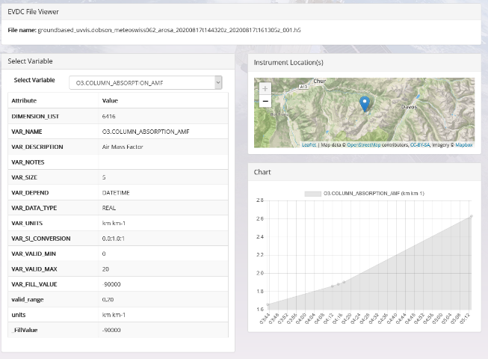
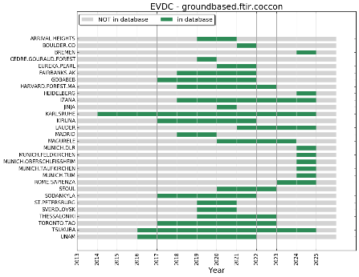
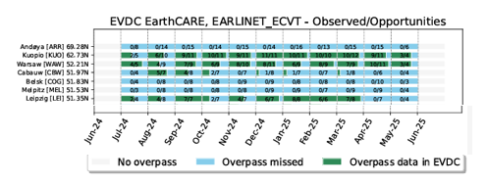

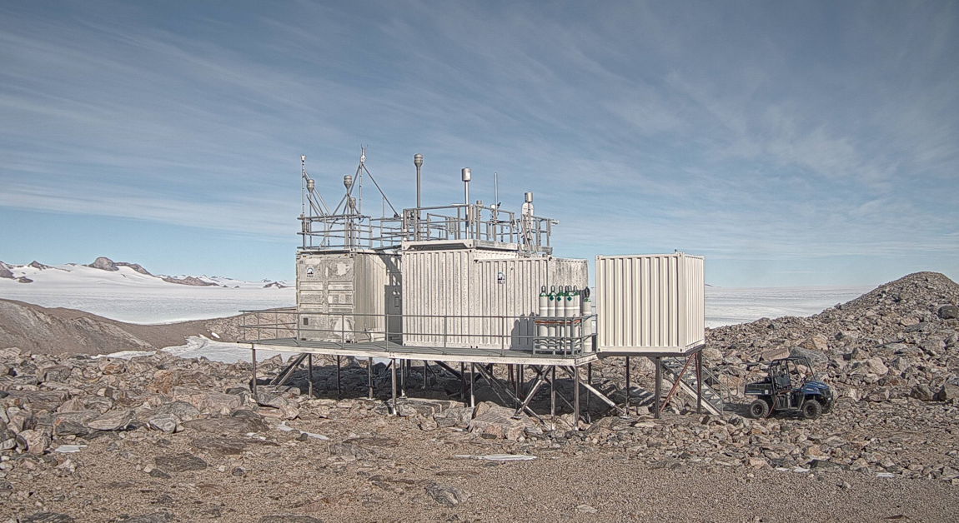
2)
1)
Planned functionalities
1) Quicklooks for file inspection
2) Harmonizations of landing pages
3) Better resolution of monitoring plots
4) Improved overpass monitoring
5) Expansion to new measurement principles/areas
3)
4)
5)

Slide 12
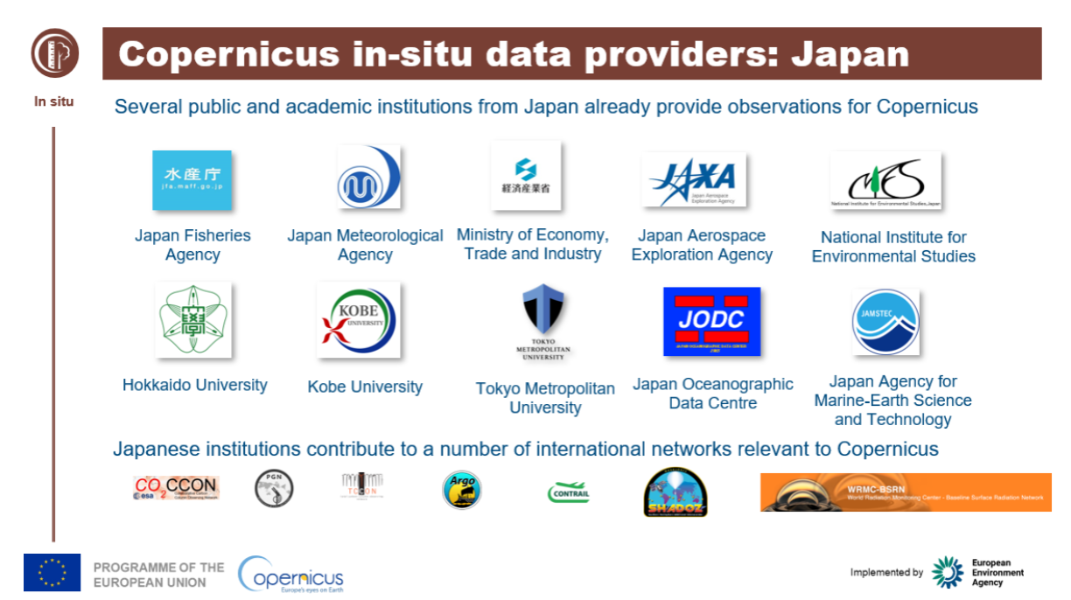

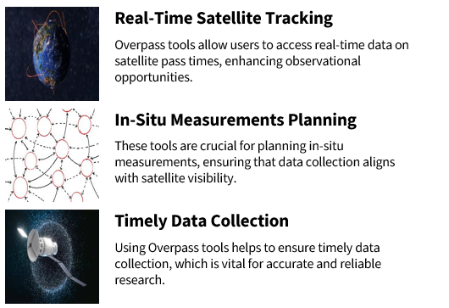
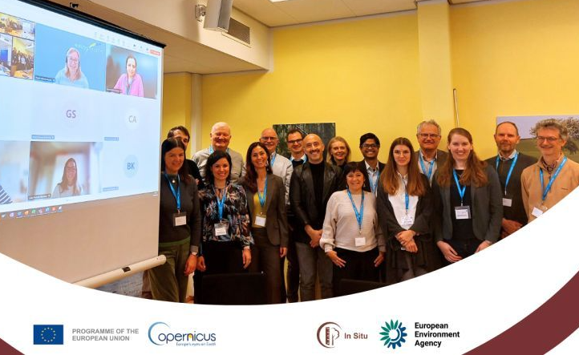
The future role of in-situ data in Copernicus, and in a global perspective
In-situ data will remain crucial for the Copernicus services, ESA and EUMETSAT, playing a vital role in validating, calibrating, and improving the accuracy of satellite-based Earth observation products.
Expanding partnerships with data providers, addressing data access challenges, and ensuring fast and reliable interoperability.
EVDC is strengthening its collaboration and partnership with
the European Environment Agency (EEA)

Slide 13
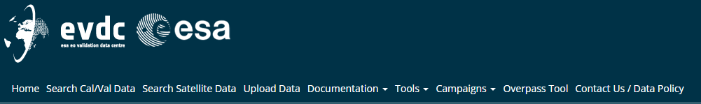

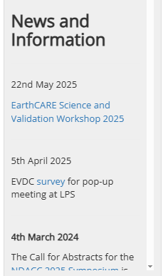
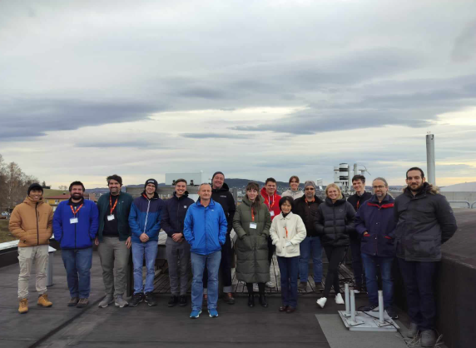
Get in contact with EVDC
https://www.evdc.esa.int
Meet EVDC at
Sentinel-4, Sentinel-5 meeting in Darmstadt, Germany, June 2025
Living Planet Symposium, Vienna, Austria, June 2025
EarthCARE Science and Validation Workshop in Tokyo, Japan, December 2025
Contact: nadirteam@nilu.no
Newsletters, GEOMS and DCIO forums, training, reporting of homeless data and requests for new data formatting templates.

