Slide 1
Atmospheric Toolbox (CODA, HARP, VISAN, AVL)
Sander Niemeijer, S[&]T
10 June 2025

Slide 2

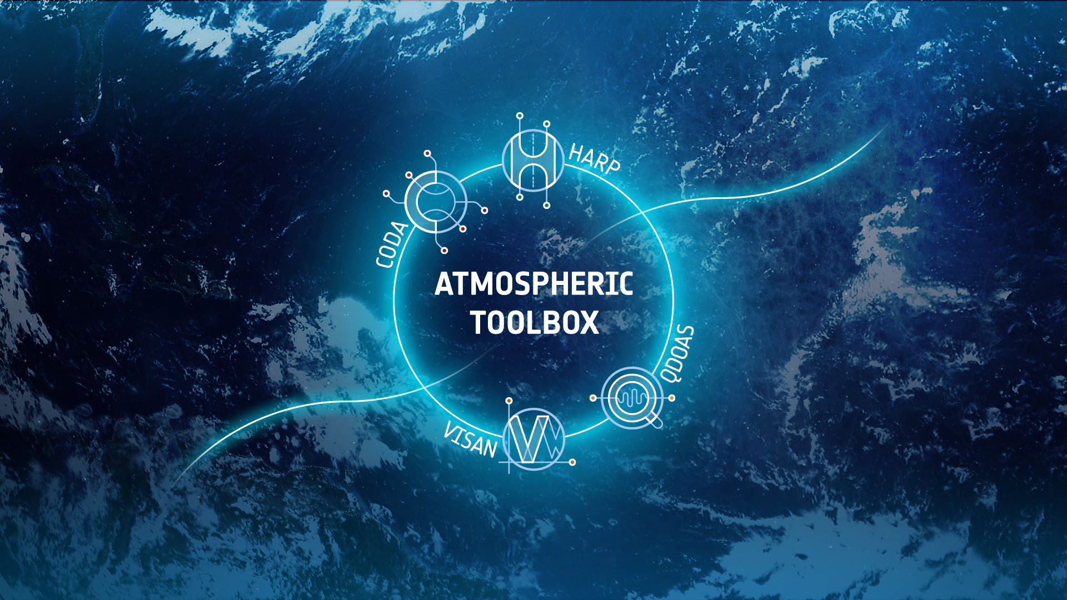
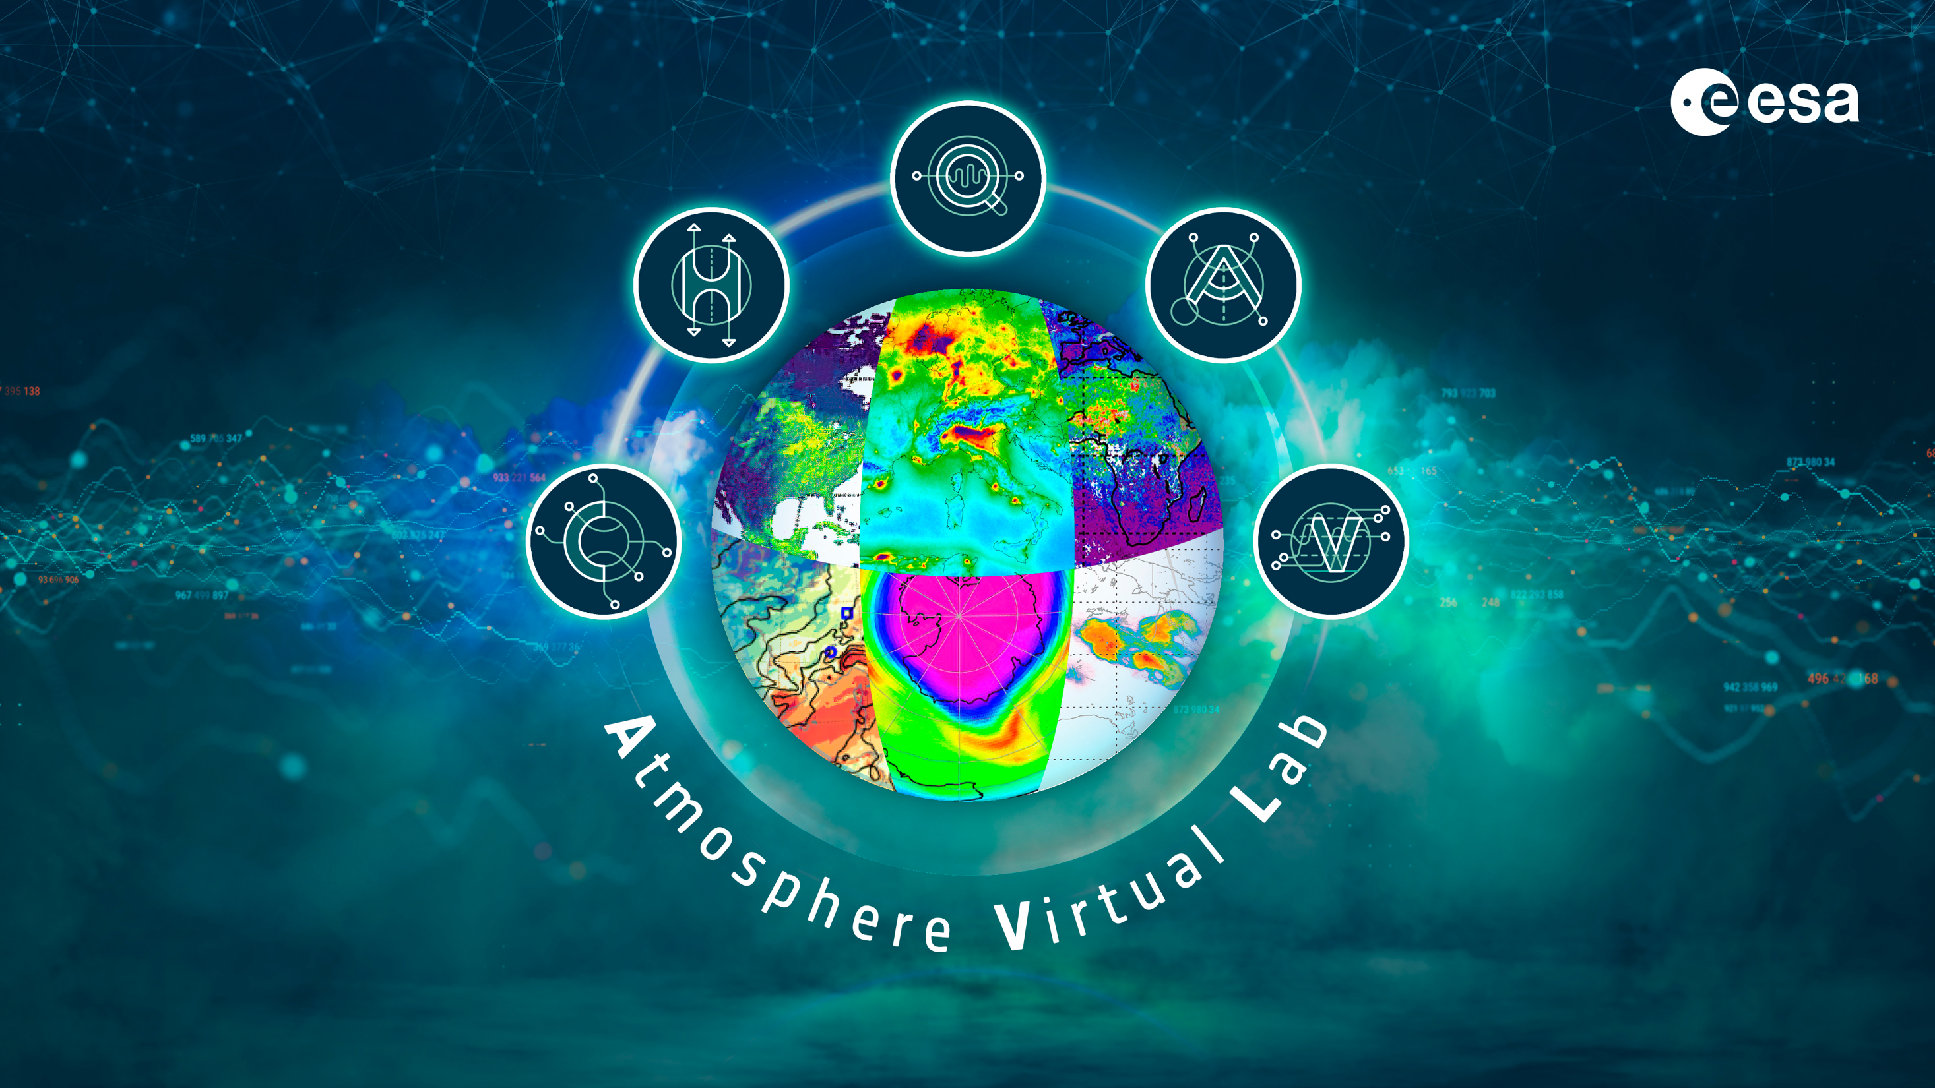
Atmospheric Toolbox
ESA project(s) with a long history:
  2002: BEAT (Basic ENVISAT Atmospheric Toolbox)
  2004: VISAN
  2008: CODA (formerly BEAT-I)
  2016: HARP (formerly BEAT-II)
  2017: QDOAS
  2020: AVL visualisation (desktop -> jupyterlab)
  2025: AVL cloud platform (datacubes + workspaces)
https://atmospherictoolbox.org

Slide 3
Atmospheric Toolbox
direct product reading interface
CODA
data harmonization interface
HARP
visualization & analysis environment
VISAN (desktop application)
AVL (jupyterlab notebooks)
DOAS retrieval
QDOAS (*BIRA-IASB)
All Free, Open Source and Cross Platform!

Slide 4
HARP
HARP - Toolset for Harmonization of Products
  Dimensions
  Names
  Units
  Time
  Location
  Resolution
Facilitates comparison through harmonization and collocation functions
Focuses on (but not limited to) atmospheric data products

Slide 5
HARP
harpconvert
harpdump
harpcollocate
Python interface
R interface
Matlab interface
IDL interface
harpmerge
harpcheck
other...
HARP C library
Unit
conversion
Derived
variables
Collocation
Ingestion modules:
Sentinel 5P, EarthCARE, OMI/TES/MLS/HIRDLS, GOME-2/IASI, GOMOS/MIPAS/SCIAMACHY, GOSAT, Odin/OSIRIS, Atmospheric CCI, CAMS, NDACC, ...
Filtering
Regridding
Import/
Export
CODA C library
HDF4 library
HDF5 library

Slide 6
HARP
Import of data products to common data format
Introduces HARP data format standard
https://stcorp.github.io/harp/doc/html/conventions/
Conventions on top of netCDF, HDF4, HDF5
Focus is not on being descriptive, but on being able to standardize automated operations on data
This means: variable naming, dimension naming/ordering, unit

Slide 7
HARP
HARP product ingestion using Python:
    >>> product = harp.import_product(......)
    >>> print(product)
    source product = 'MIP_NL__2PODPA20020925_010931_000060262009_00418_02977_0147.N1'
    double datetime {time=74} [seconds since 2000-01-01]
    double altitude {time=74, vertical=17} [km]
    double latitude {time=74} [degree_north]
    double longitude {time=74} [degree_east]
    double pressure {time=74, vertical=17} [hPa]
    double pressure_uncertainty {time=74, vertical=17} [hPa]
    double temperature {time=74, vertical=17} [K]
    double temperature_uncertainty {time=74, vertical=17} [K]
    double O3_number_density {time=74, vertical=17} [molec/cm^3]
    double O3_number_density_uncertainty {time=74, vertical=17} [molec/cm^3]
    double O3_volume_mixing_ratio {time=74, vertical=17} [ppmv]
    double O3_volume_mixing_ratio_uncertainty {time=74, vertical=17} [ppmv]
    long index {time=74}

Slide 8
HARP
Filters:
latitude<=10;latitude>=-10;longitude_range(179,-179)
point_distance(52.012, 4.357, 3 [km])
valid(aerosol_optical_depth)
exclude(aerosol_extinction_coefficient)
keep(latitude, longitude)
Regridding:
regrid(vertical, altitude [km], 10, 0.5, 1.0)
bin_spatial(181,-90,1,361,-180,1)
Derived variables:
derive(<variable> <datatype> <dimensions> <unit>)
You can combine these into small `scripts` that are performed during import:
derive(solar_zenith_angle {time});solar_zenith_angle<80;exclude(solar_zenith_angle)

Slide 9
HARP
What if you want to generate the total column AOD from extinction profiles?
"derive(aerosol_optical_depth {time} [])"
aerosol_optical_depth {time} [] from
aerosol_optical_depth {time, vertical} [] from
aerosol_extinction_coefficient {time, vertical} [1/m] from
altitude_bounds {time, vertical, 2} [m] from
altitude {time, vertical} [m] from
altitude {vertical} [m] from
altitude {vertical} [km]

Slide 10
HARP
Collocation example
harpcollocate -d 'datetime 12 [h]' -d 'point_distance 500 [km]' -ny point_distance
-nx datetime .../sat_data_dir .../ref_data_dir collocations.csv
harpmerge -a 'collocate_left("collocations.csv")' .../sat_data_dir sat_data.nc
harpmerge -a 'collocate_right("collocations.csv")' .../ref_data_dir ref_data.nc
You can then further manipulate the data (e.g. smoothing, profile -> column, ...)
harpconvert –a '.....' data.nc data_modified.nc

Slide 11
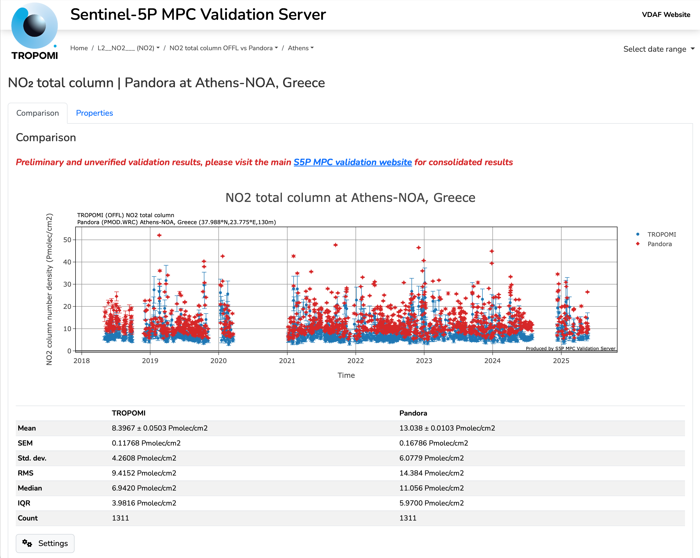
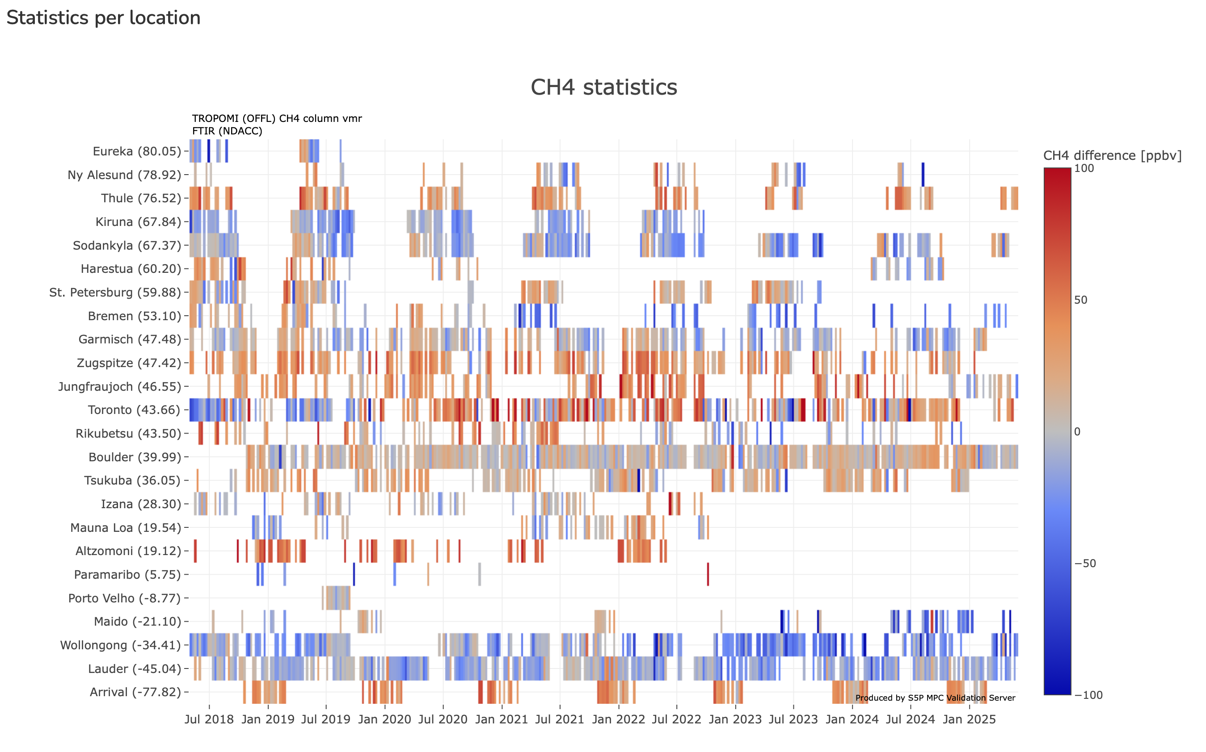
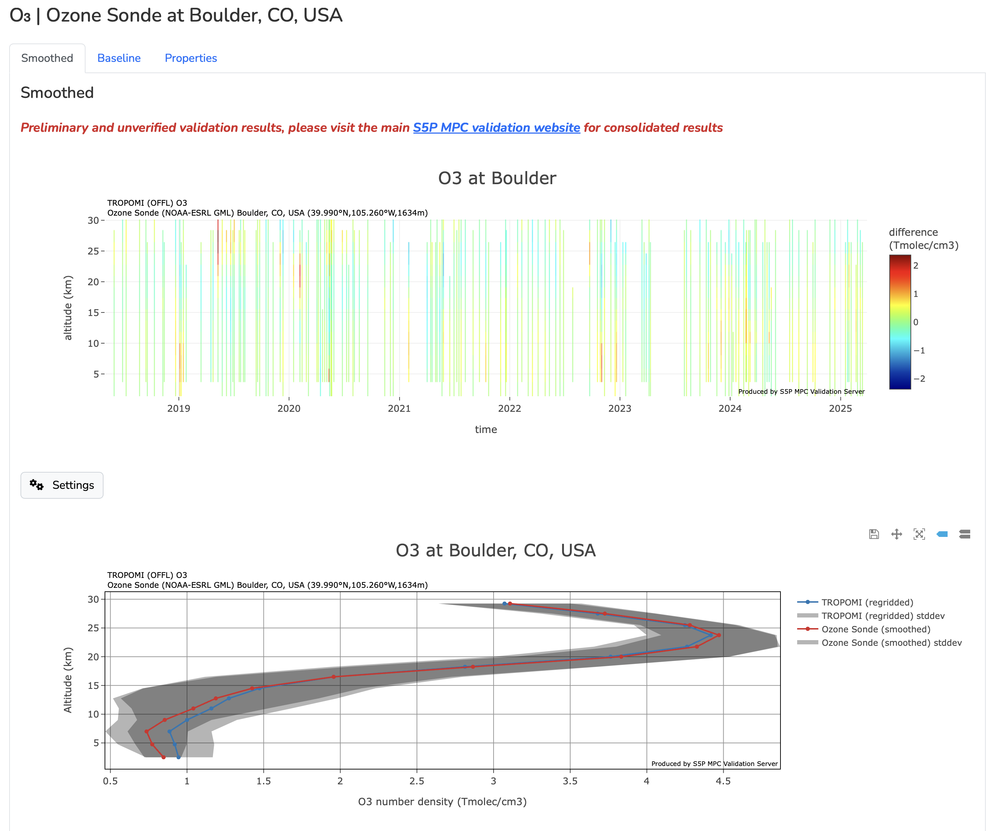
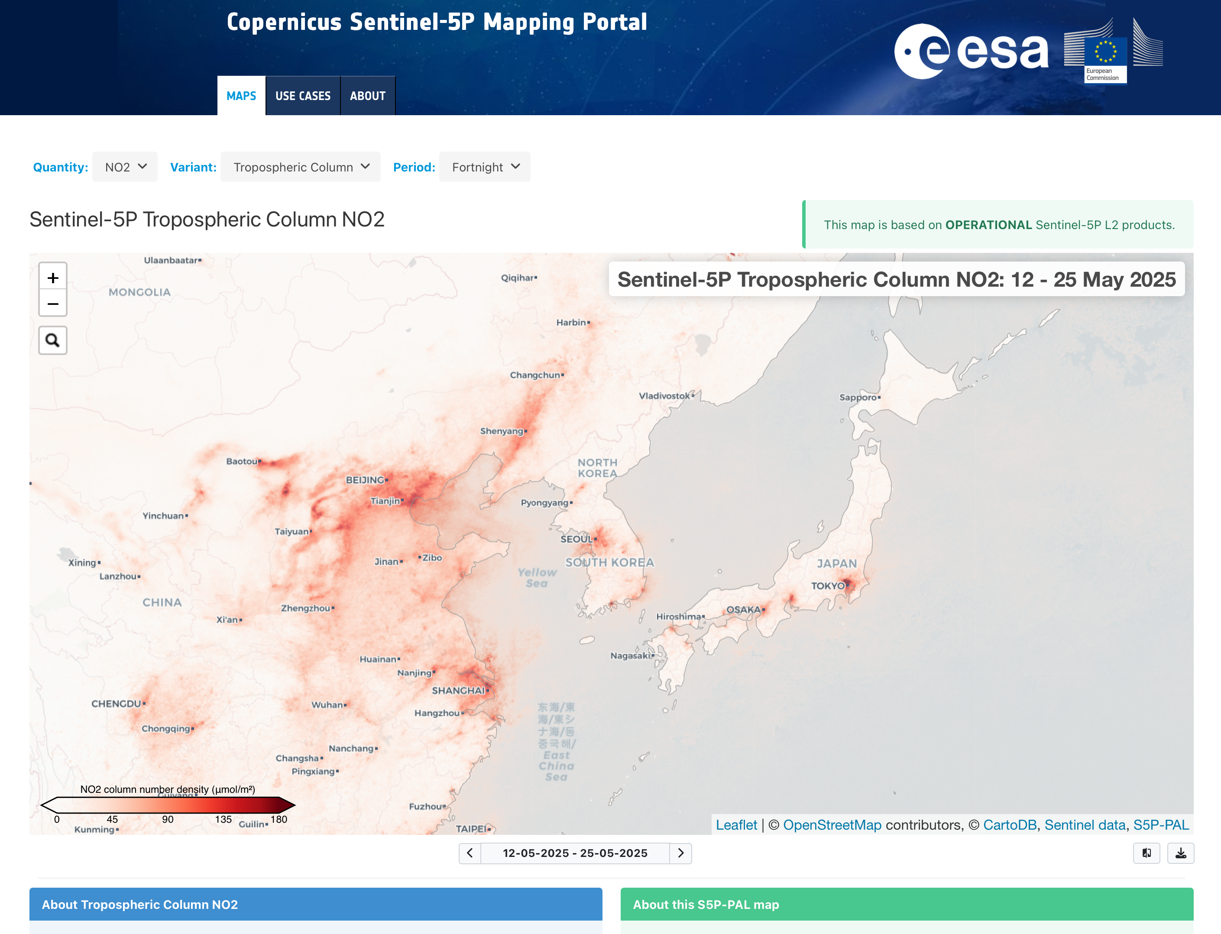
HARP
HARP is used as engine within:
  ATM-MPC VDAF Validation Server https://mpc-vdaf-server.tropomi.eu
  CAMS2-82 Global Evaluation Server https://global-evaluation.atmosphere.copernicus.eu
  S5P-PAL Mapping Portal https://maps.s5p-pal.com

Slide 12
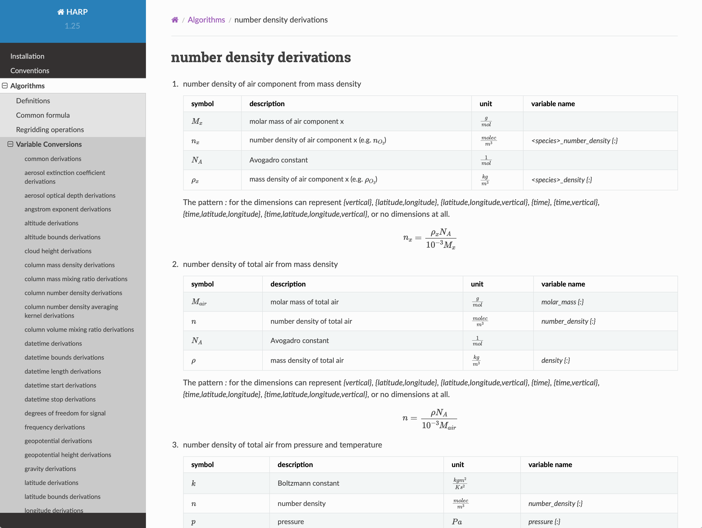
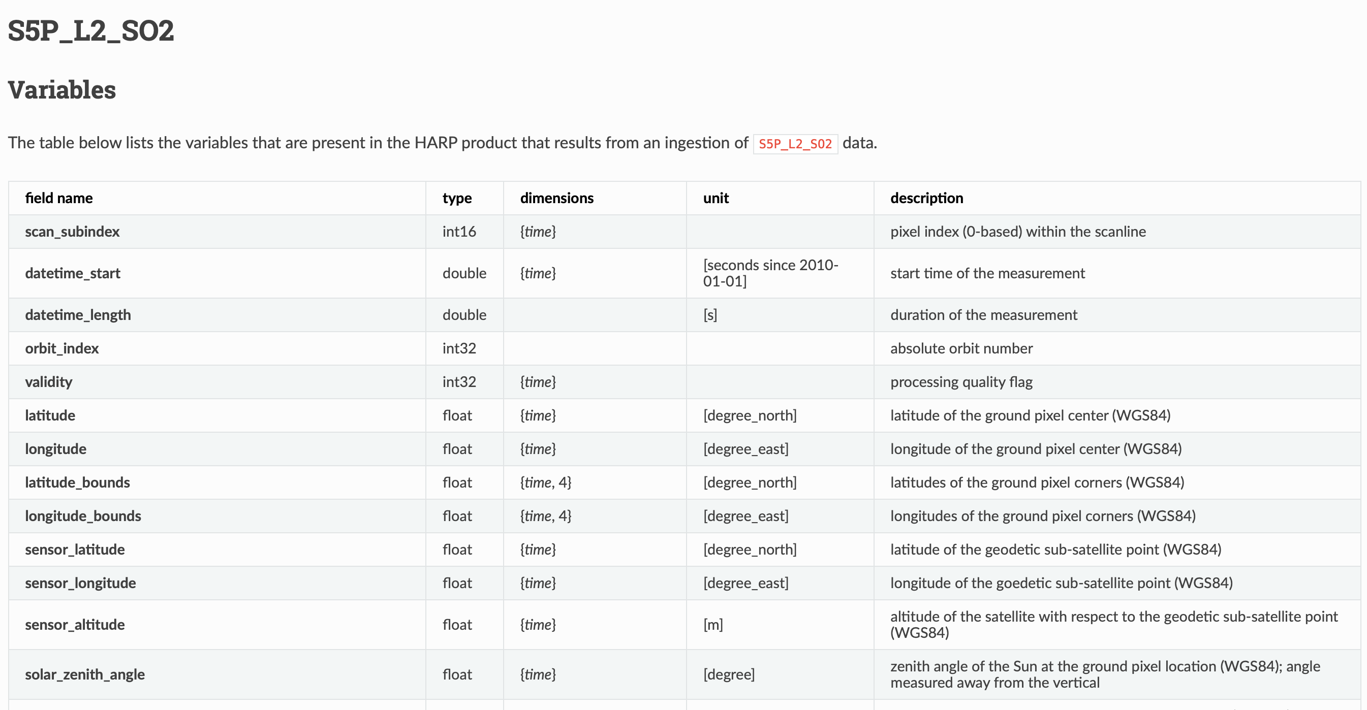
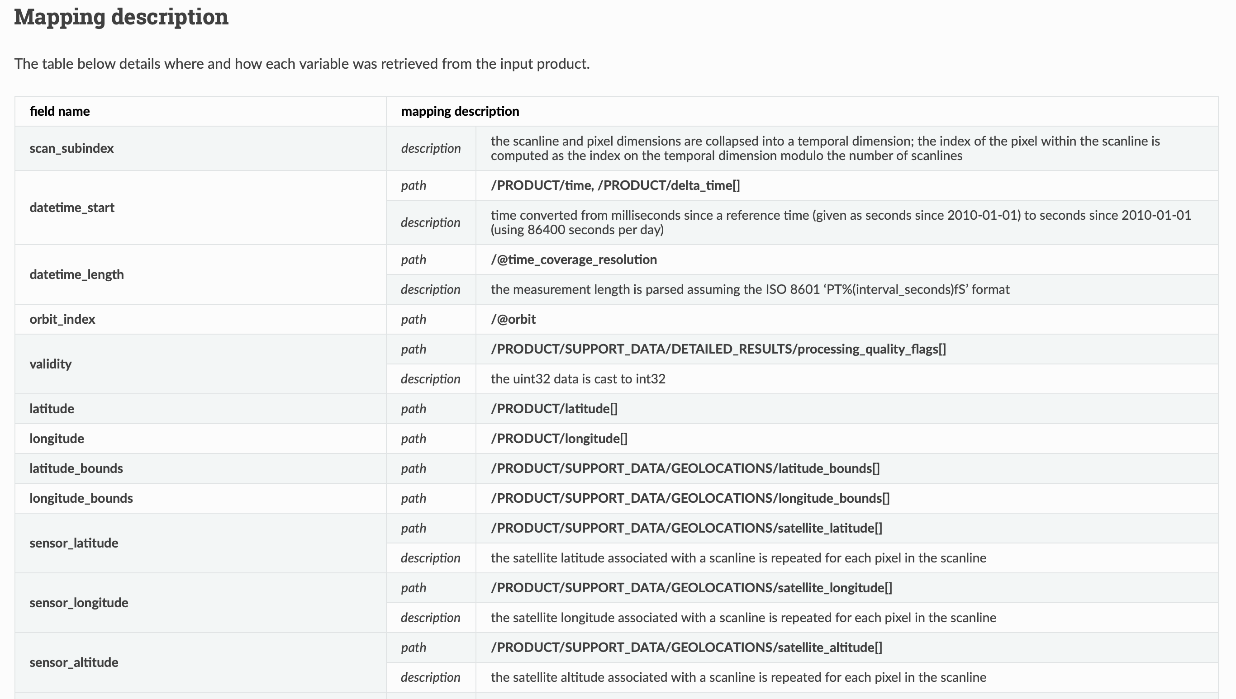
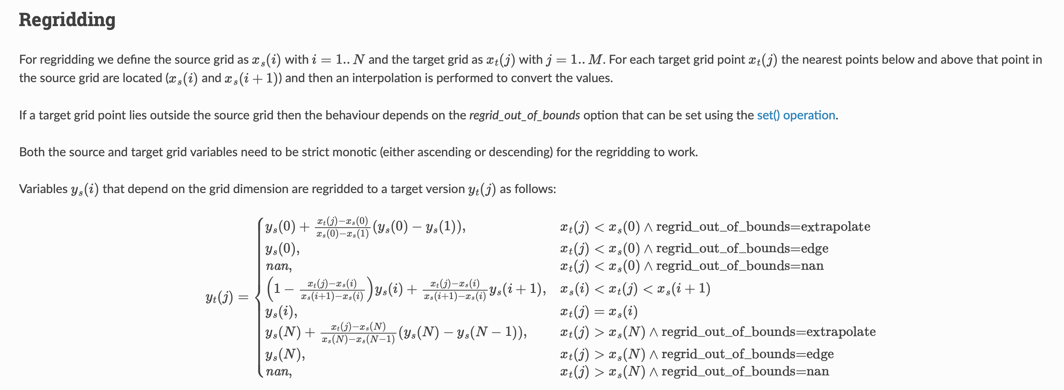
HARP
HARP comes with extensive documentation
https://stcorp.github.io/harp/doc/html/

Slide 13
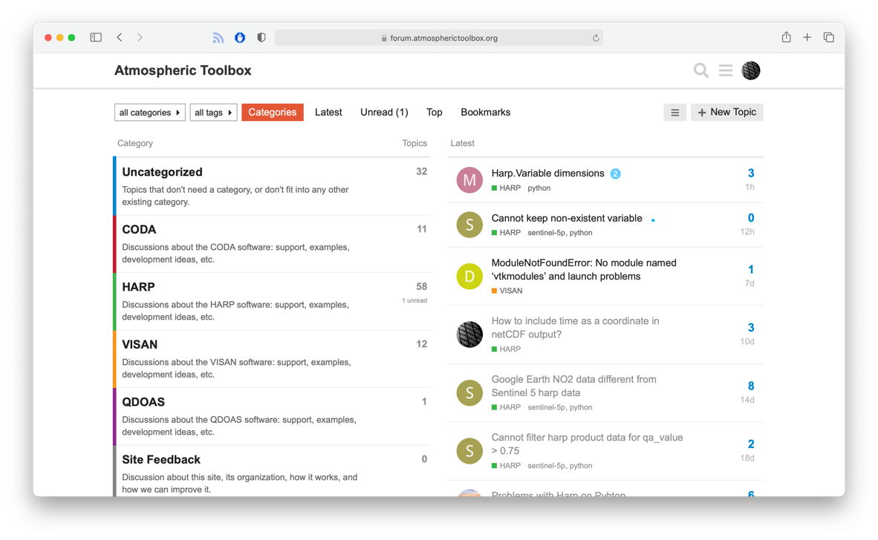
Atmospheric Toolbox
Online forum
https://forum.atmospherictoolbox.org

