Slide 1
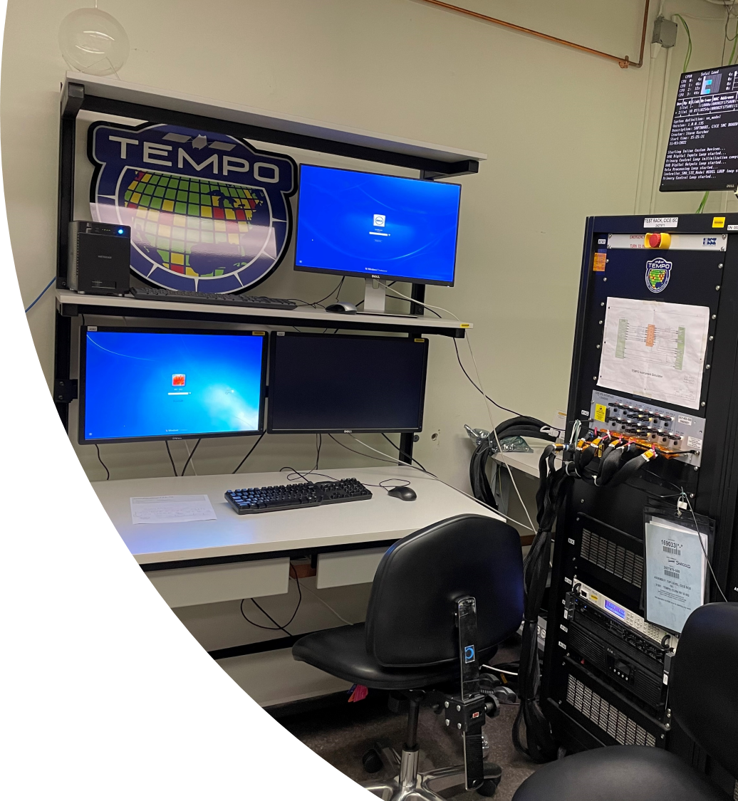
TEMPO Instrument Operation Center
Smithsonian Astrophysical Observatory
Cambridge, MA
EPA Operational Validation Plans
CEOS AC-VC21
10 June 2025
Jim Szykman¹, Luke Valin¹​, Barron Henderson¹,
Eric Baumann¹, David Williams¹, Heidi Paulsen^{2,3}, Matt Freeman³, and Todd Plessel³
¹Center For Environmental Measurements and Modeling​
U.S. EPA Office of Research and Development, RTP NC USA​
Office of Information Technology and Operations
²U.S. EPA Office of Mission Support, RTP NC USA
³U.S. EPA Environmental Modeling and Visualization Lab,
RTP NC USA​
Disclaimers: The views expressed in this presentation are those of the authors and do not necessarily represent the views or the policies of the U.S. Environmental Protection Agency.

Slide 2
TropOMI and TEMPO offer key measurements directly aligned with EPA research as directed under Clean Air Act as Amended
Clean Air Act, codified as 42 U.S.C. 7403 - Research, investigation, training, and other activities
(a)RESEARCH AND DEVELOPMENT PROGRAM FOR PREVENTION AND CONTROL OF AIR POLLUTION The Administrator shall establish a national research and development program for the prevention and control of air pollution and as part of such program shall—
  (1)conduct, and promote the coordination and acceleration of, research, investigations, experiments, demonstrations, surveys, and studies relating to the causes, effects (including health and welfare effects), extent, prevention, and control of air pollution;
(b)AUTHORIZED ACTIVITIES OF ADMINISTRATOR IN ESTABLISHING RESEARCH AND DEVELOPMENT PROGRAM In carrying out the provisions of the preceding subsection the Administrator is authorized to—
  (2) cooperate with other Federal departments and agencies, with air pollution control agencies, with other public and private agencies, institutions, and organizations, and with any industries involved, in the preparation and conduct of such research and other activities;
(c)AIR POLLUTANT MONITORING, ANALYSIS, MODELING, AND INVENTORY RESEARCH In carrying out subsection (a), the Administrator shall conduct a program of research, testing, and development of methods for sampling, measurement, monitoring, analysis, and modeling of air pollutants. Such program shall include the following elements:
  (3)Development of improved methods and technologies for sampling, measurement, monitoring, analysis, and modeling to increase understanding of the sources of ozone precursors, ozone formation, ozone transport, regional influences on urban ozone, regional ozone trends, and interactions of ozone with other pollutants. Emphasis shall be placed on those techniques which—
  (A)improve the ability to inventory emissions of volatile organic compounds and nitrogen oxides that contribute to urban air pollution, including anthropogenic and natural sources;
  (C)improve the ability to identify and evaluate region-specific prevention and control options for ozone pollution.

Slide 3
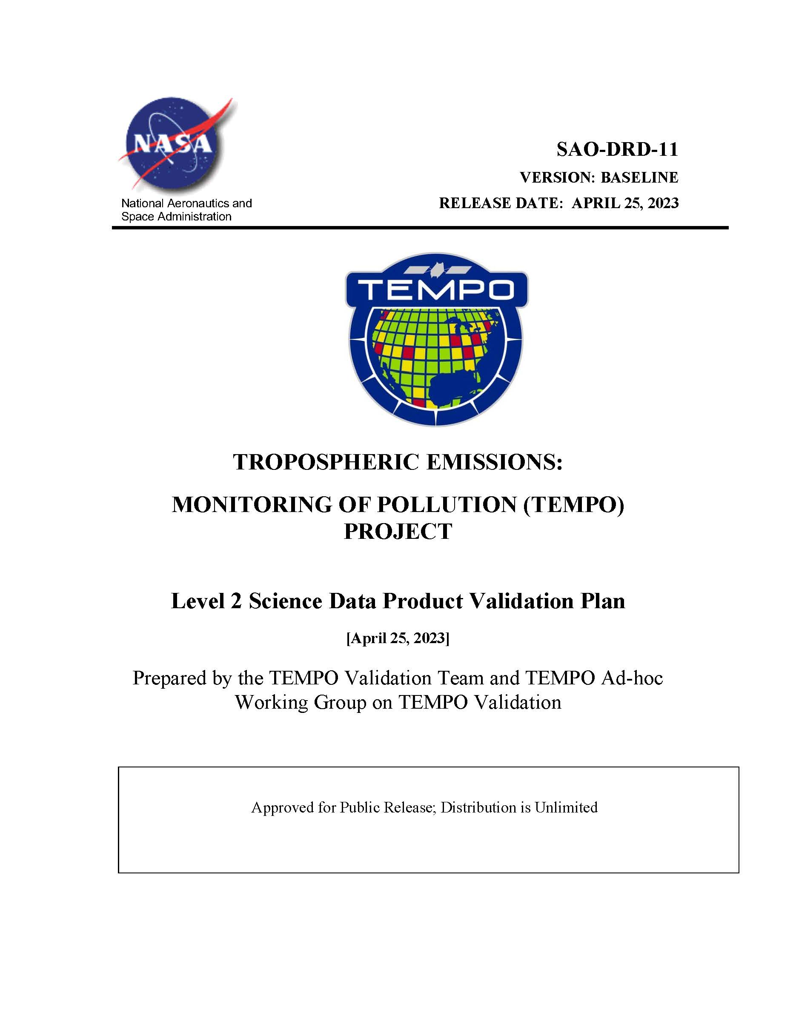
EPA investments for satellite validation driven by TEMPO selection in 2012
NASA Earth Venture Instruments focused on technology development. TEMPO is not an operational mission like GEMS or Sentinel-4.
Validation not balanced with the interests of science and applications of TEMPO high demand data products, impacting acceptance and use of the data by operational agencies like EPA.
EPA made strategic investments to move towards routine and systematic validation of L2 data products.
Efforts leveraged existing investments largely made by CEOS agencies. For TEMPO initial goal was to have product specific metrics to provide a ‘fit for purpose’ applications framework consistent with EPA Environmental Information Quality Policy.
Ultimate goal of accuracy estimations by the end of TEMPO and the beginning of GeoXO ACX.

Slide 4
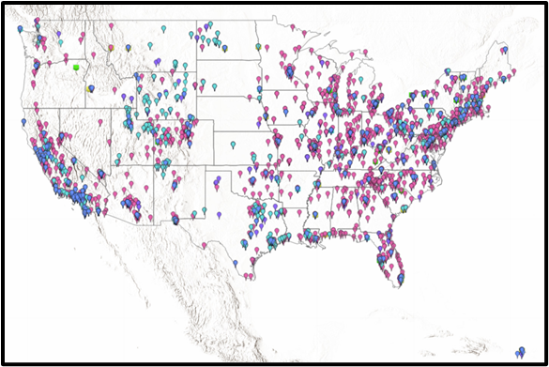
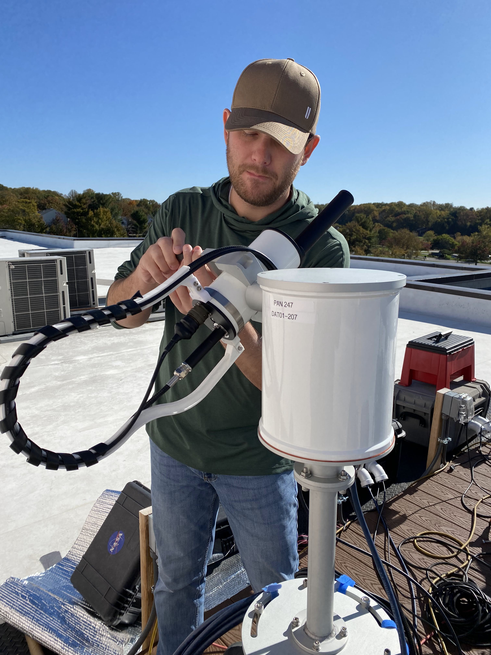
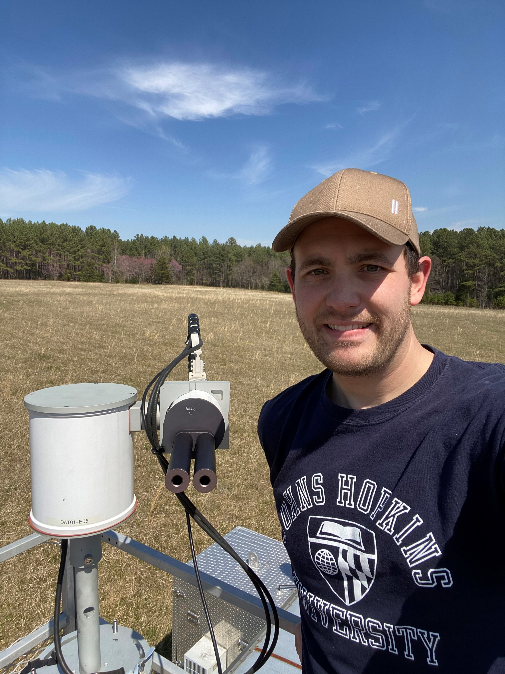
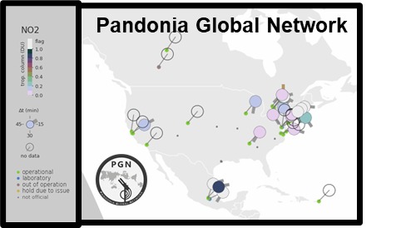

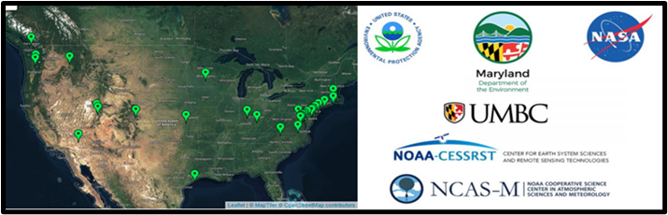
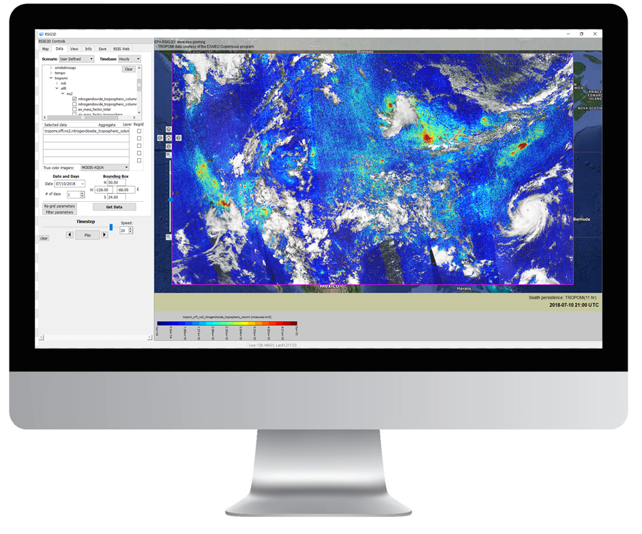
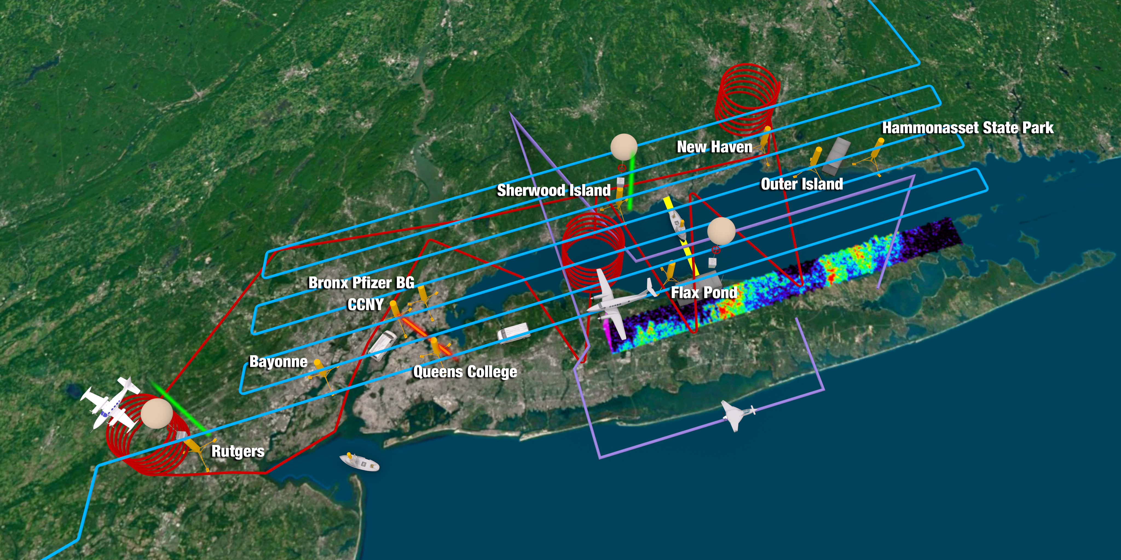
EPA ORD Areas of support related to satellite validation
FTE for Science Team participation, capacity building for validation
Supporting and building networks with added validation and profiling measurements
US EPA and state air quality monitoring networks
Unified Ceilometer Network
Field Campaigns support via ground-measurements systems for validation
IT systems development to support AQ community needs for data and analysis
Notes:
U.S. EPA has incorporated TEMPO preparatory activities under their Air, Climate, Energy Research Program starting with the StRAP 2 planning cycle - Investments ~$0.5M+/yr including dedicated CS FTE.
Current focuses areas for EPA include:
Making U.S. Air Quality Networks more relevant to Satellite Atmospheric Composition Observations.
Regionally focused air quality field campaigns in conjunction with NASA and State and Local Air Quality Partners focused on TEMPO relevant science and U.S. areas with persistent air quality problem, Baltimore (2011), Houston (2013), Denver/Front Range (2014), Chicago/Western shores of LM (2017), CT/NJ/NYC/LIS (2018), Detroit/Windsor (2021).
Continued development of Information Technology Research and Development through ORD-OSIM EMVL to reduce barriers for access and use of air quality relevant satellite data.

Slide 5
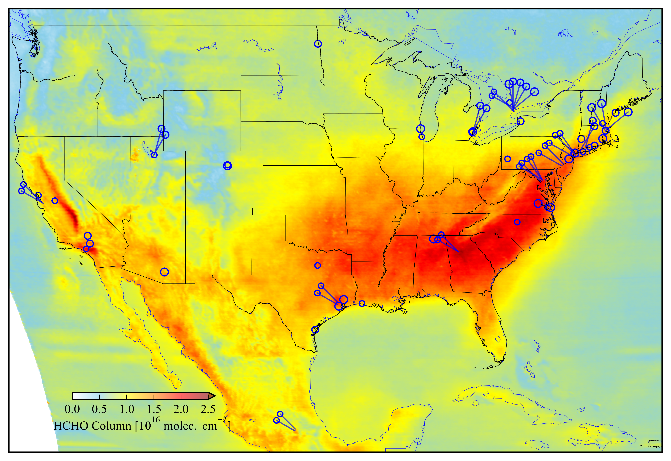
Pandonia Global Network and EPA Photochemical Assessment Monitoring Station (PAMS) Network
PGN locations and TEMPO L2 HCHO (July 2024)
In collaboration with the NASA Pandora Project, EPA integrated a subset (~24) Pandora spectrometers within the U.S. surface air quality network contributing to larger Pandonia Global Network. Effort facilitated by Agency level EPA-NASA Memorandum of Agreement and EPA’s commitment to TEMPO mission.
EPA currently provides led Network Operator for the PGN, Eric Baumann. Luke Valin serves as EPA lead for PGN activities and is a member of the PGN Work Group.
Development API for pandora data through EPA’s Remote Sensing Information Gateway.
EPA Pandoras are collocated with in-situ measurement of trace gas and aerosols to promote development and validation of applications.

Slide 6
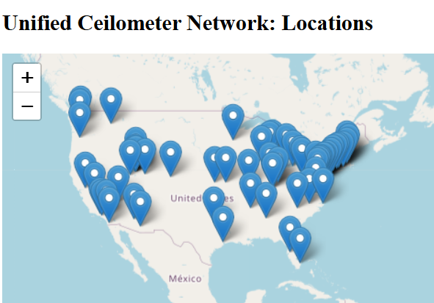
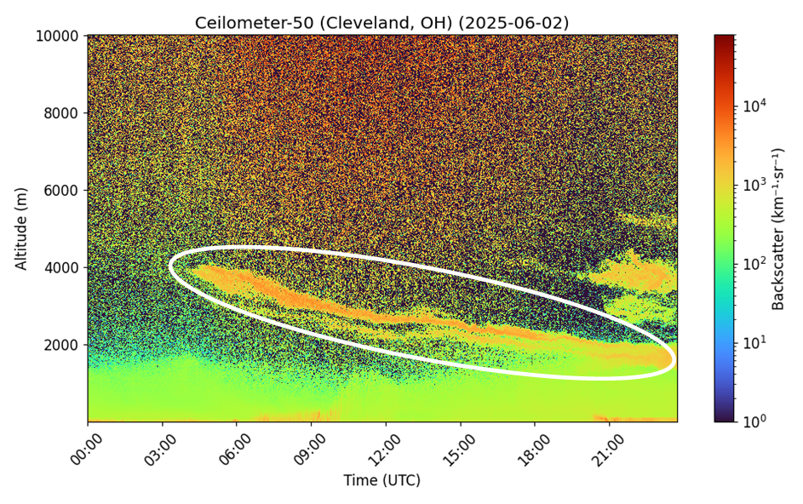
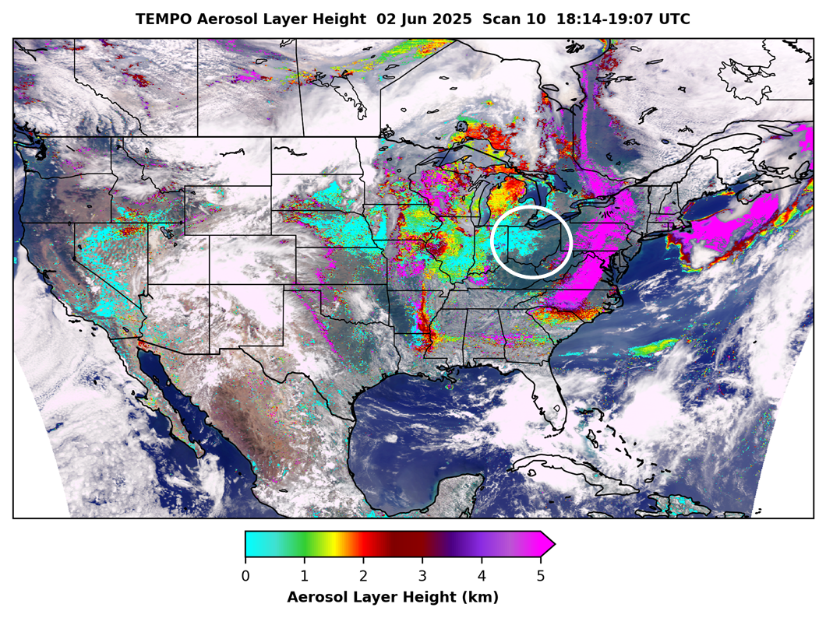
Unified Ceilometer Network (UCN)
Collaboration between Hampton University, EPA, NASA, NOAA and state and local agencies.
Centralized data archive of ceilometer attenuated backscatter coefficient profiles β(z) from U.S. Air Quality Network (~72 sites) and Academic Institutions.
Automated PBL algorithm corrects for instrument signal quality, screens for precipitation and cloud layers, and provides PBLH uncertainties (Caicedo et al. 2020).
HU, EPA, and NOAA collaborating on UCN as validation source for NOAA NRT TEMPO of Aerosol Heights Index.
Many ceilometers collocated with pandora and in-situ measurement of trace gas and aerosols.
PAMS ceilometer in Cleveland, OH shows smoke mixed down to the boundary layer by ~18:30 UTC; correlates with aerosol layer height from TEMPO Scan 10
Smoke plume
https://ucn.cas.hamptonu.edu

Slide 7

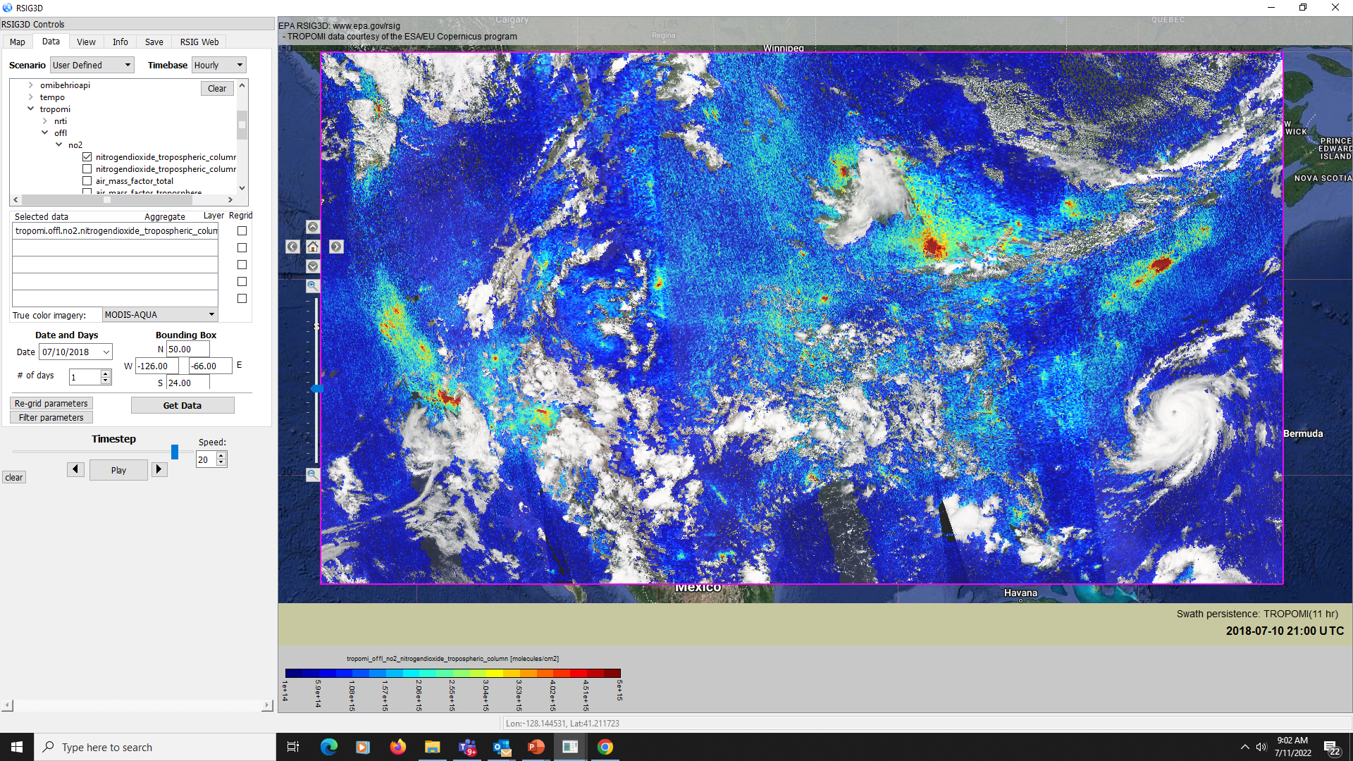
U.S. EPA Remote Sensing Information Gateway
Free multi-platform, scriptable software system which creates a consolidated access point to 100’s of terabytes (TB) of air quality relevant model, measurement and satellite data sets.
Provides quick and easy ways of retrieving, visualizing and saving subsets of these selected geospatial atmospheric data.
Built to assist EPA with access to high value remote sensing data and enable air quality research and applications, including satellite validation analyses.
RSIG facilitates access to complex data sets through web services, exports data analysis-ready-format for further use in their own software, R, python, excel, etc.
Now has python scriptable interface (pyrsig).
RSIG3D is the client graphical user interface
https://www.epa.gov/rsig

Slide 8
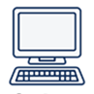






RSIG Server is a Web of Servers
RSIG User
-GUI
-Scripts
-pyrsig
-RSIG access both graphical and programable scripts (APIs)
MODIS
Surface Measurement Data
AirNow
& AQS
Satellite Data
TROPOMI
RSIG
PGN
CALIOP
& TEMPO
HRRR
VIIRS
Popular Air Quality Data Sets:
Moderate Resolution Imaging Spectroradiometer (MODIS)
Visible Infrared Imaging Radiometer Suite (VIIRS)
Cloud-Aerosol Lidar with Orthogonal Polarization (CALIOP)
Air Quality System (AQS)
EPA’s Air QUAlity TimE Series (EQUATES)
TROPOspheric Monitoring Instrument (TROPOMI)
Tropospheric Emissions: Monitoring of POllution (TEMPO)
High-Resolution Rapid Refresh (HRRR)
EQUATES
Model
Data

Slide 9
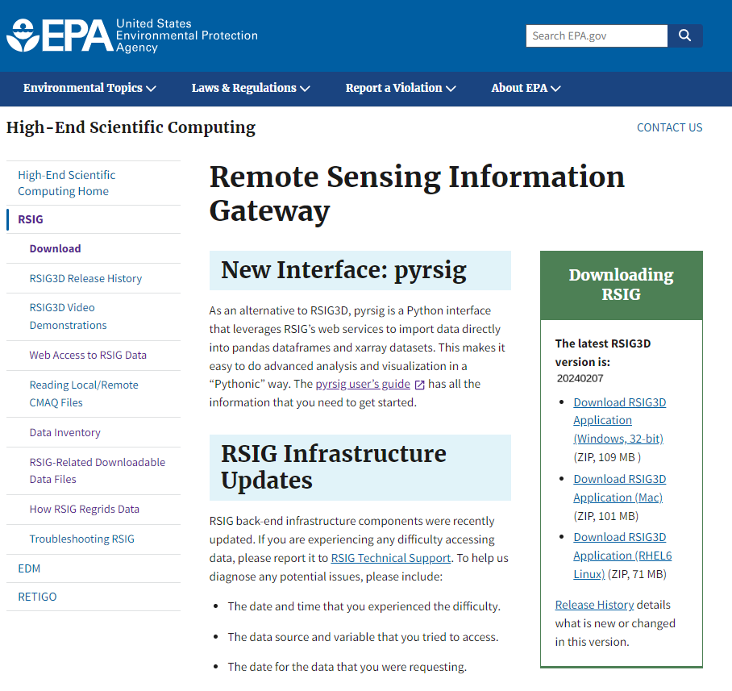
www.epa.gov/rsig
“Getting started” video tutorials
Web access to RSIG data
RSIG3D application download
Windows
Mac
Linux (RHEL7)
Standalone/remote CMAQ* file reader tutorial
How RSIG regrids data
*Community Multiscale Air Quality Modeling System

Slide 10
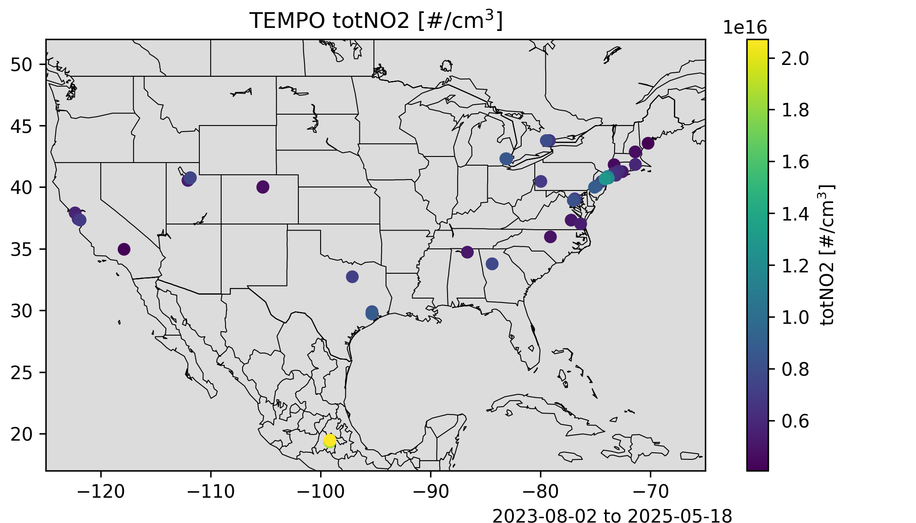
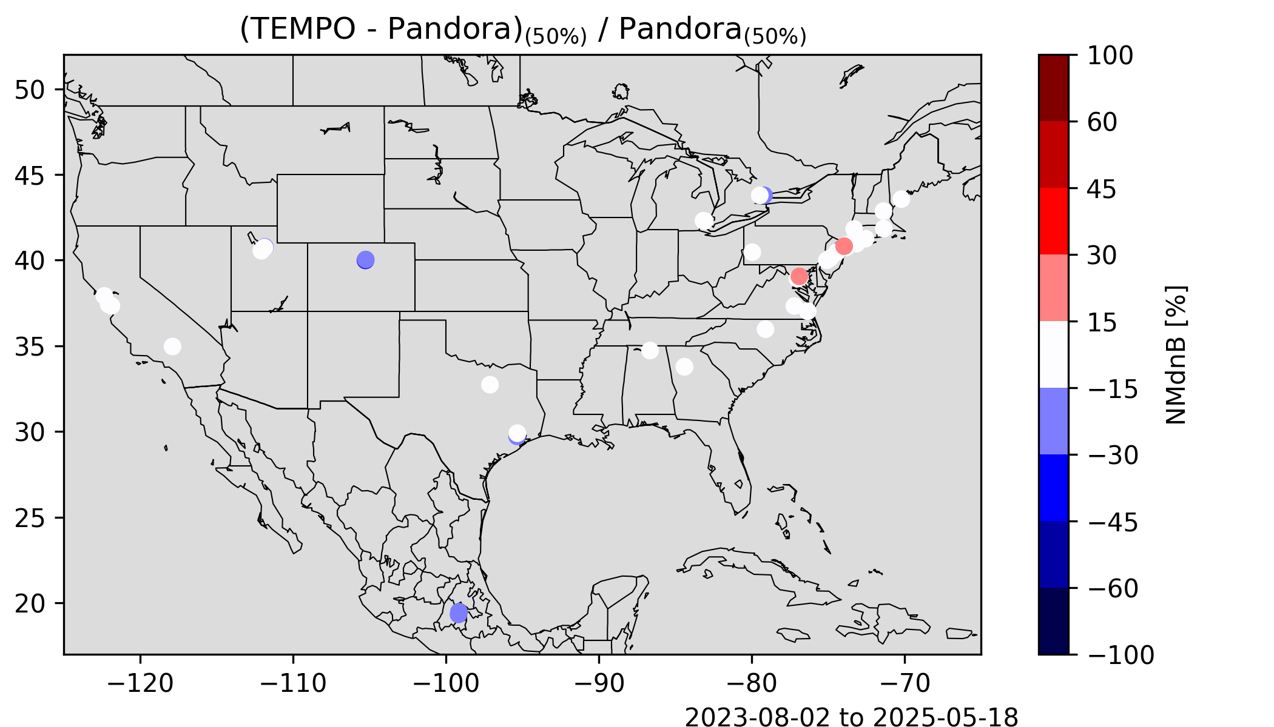
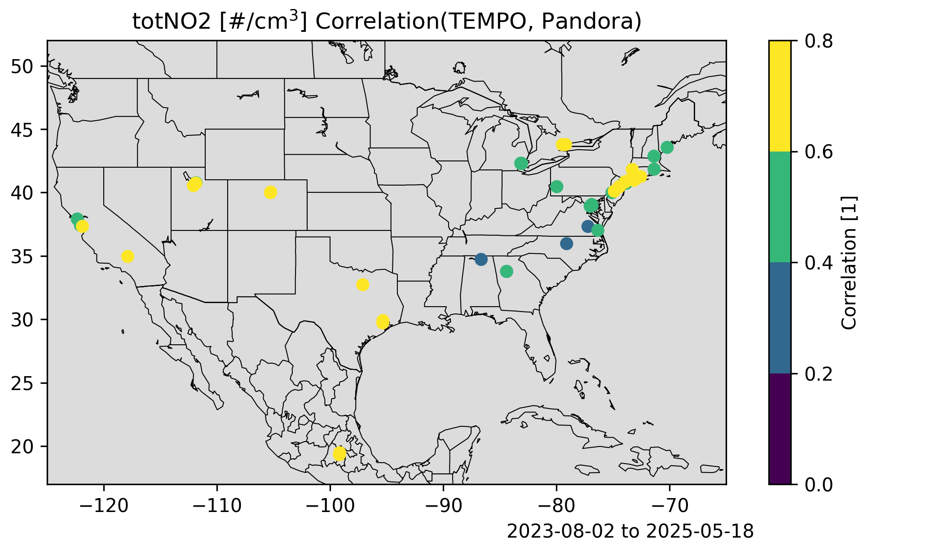
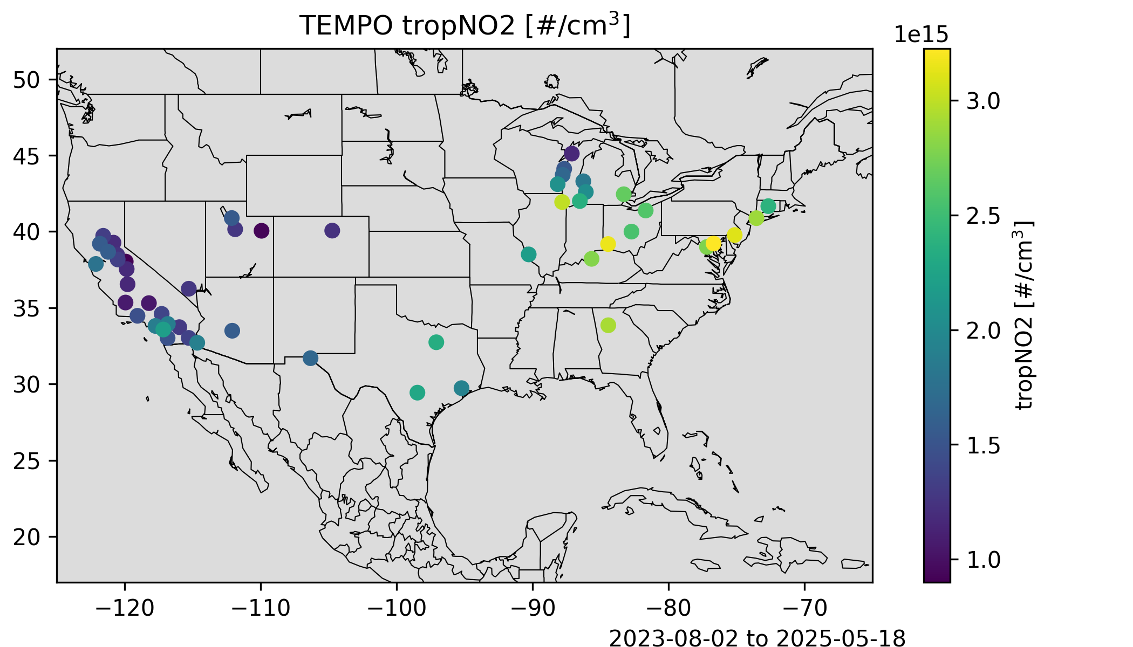
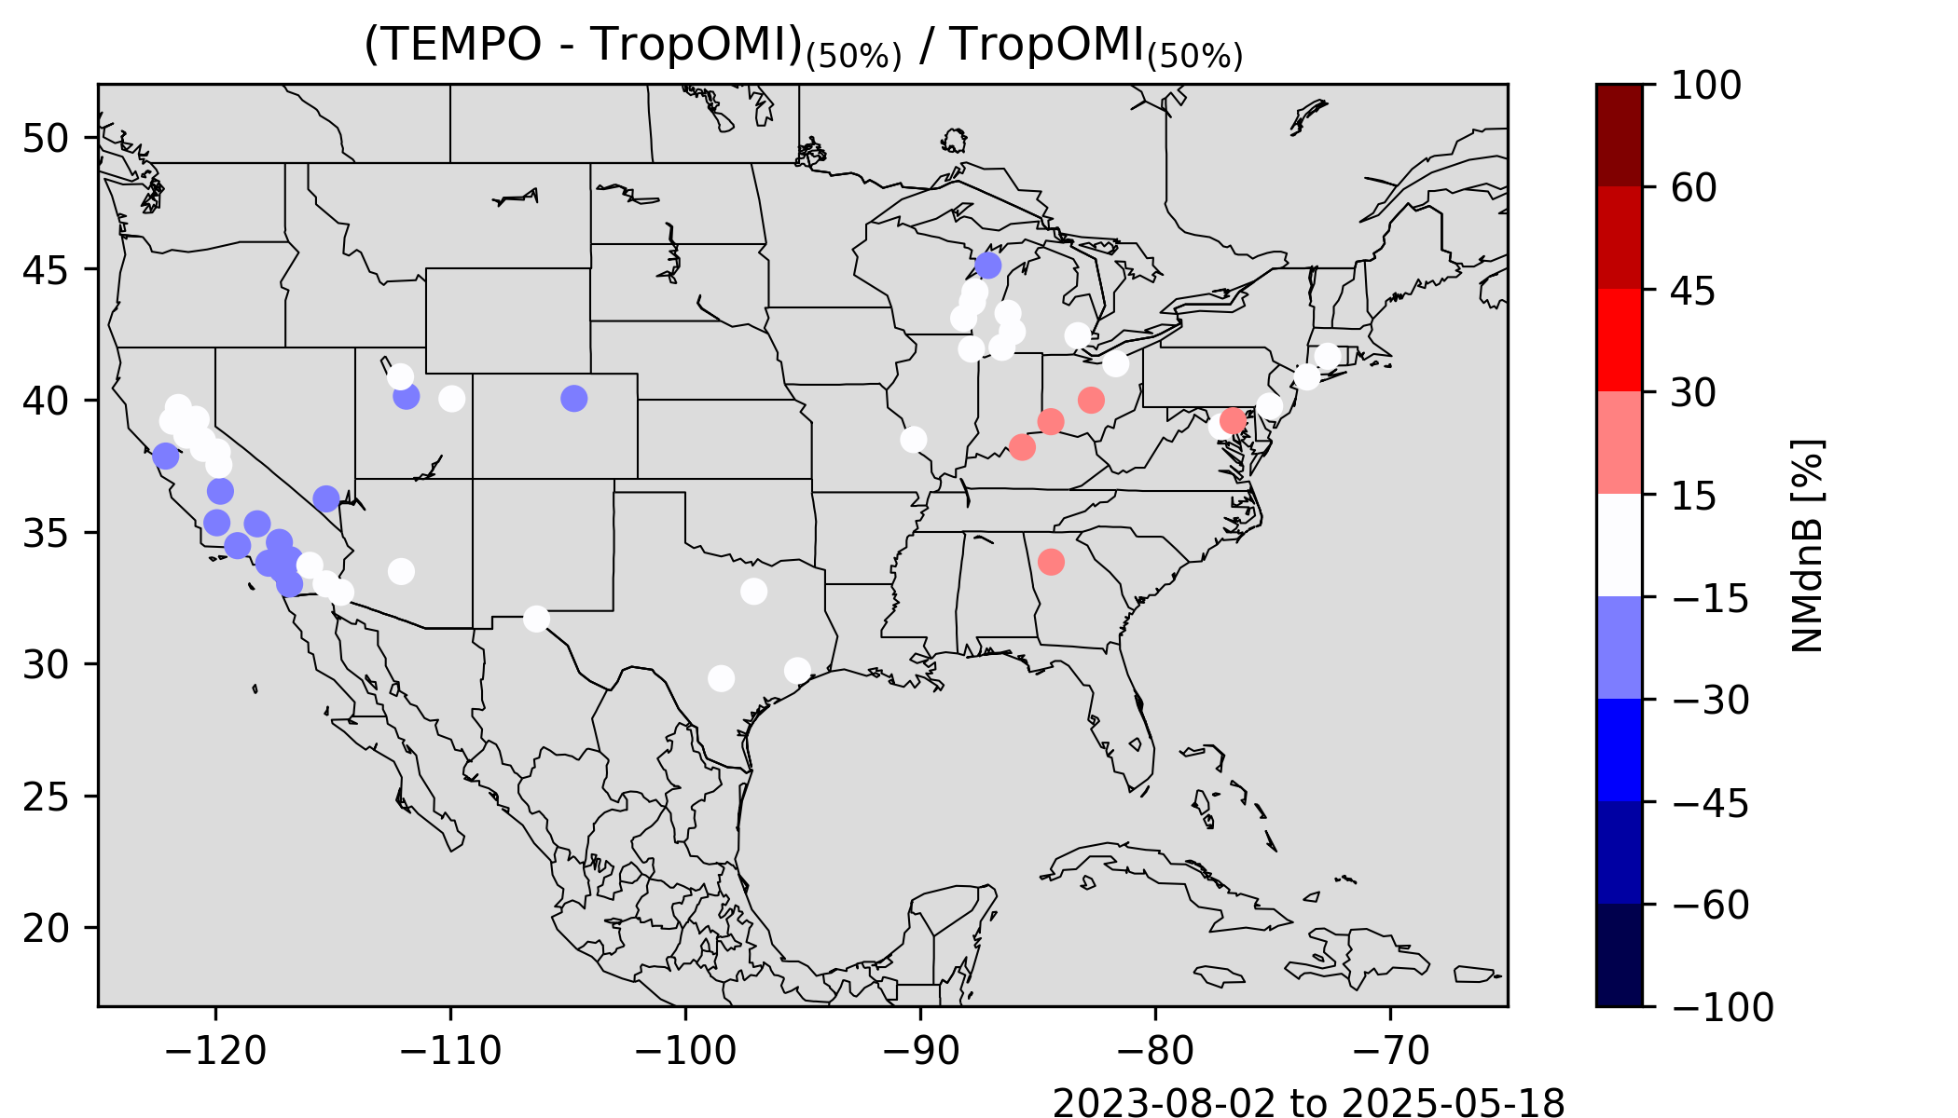
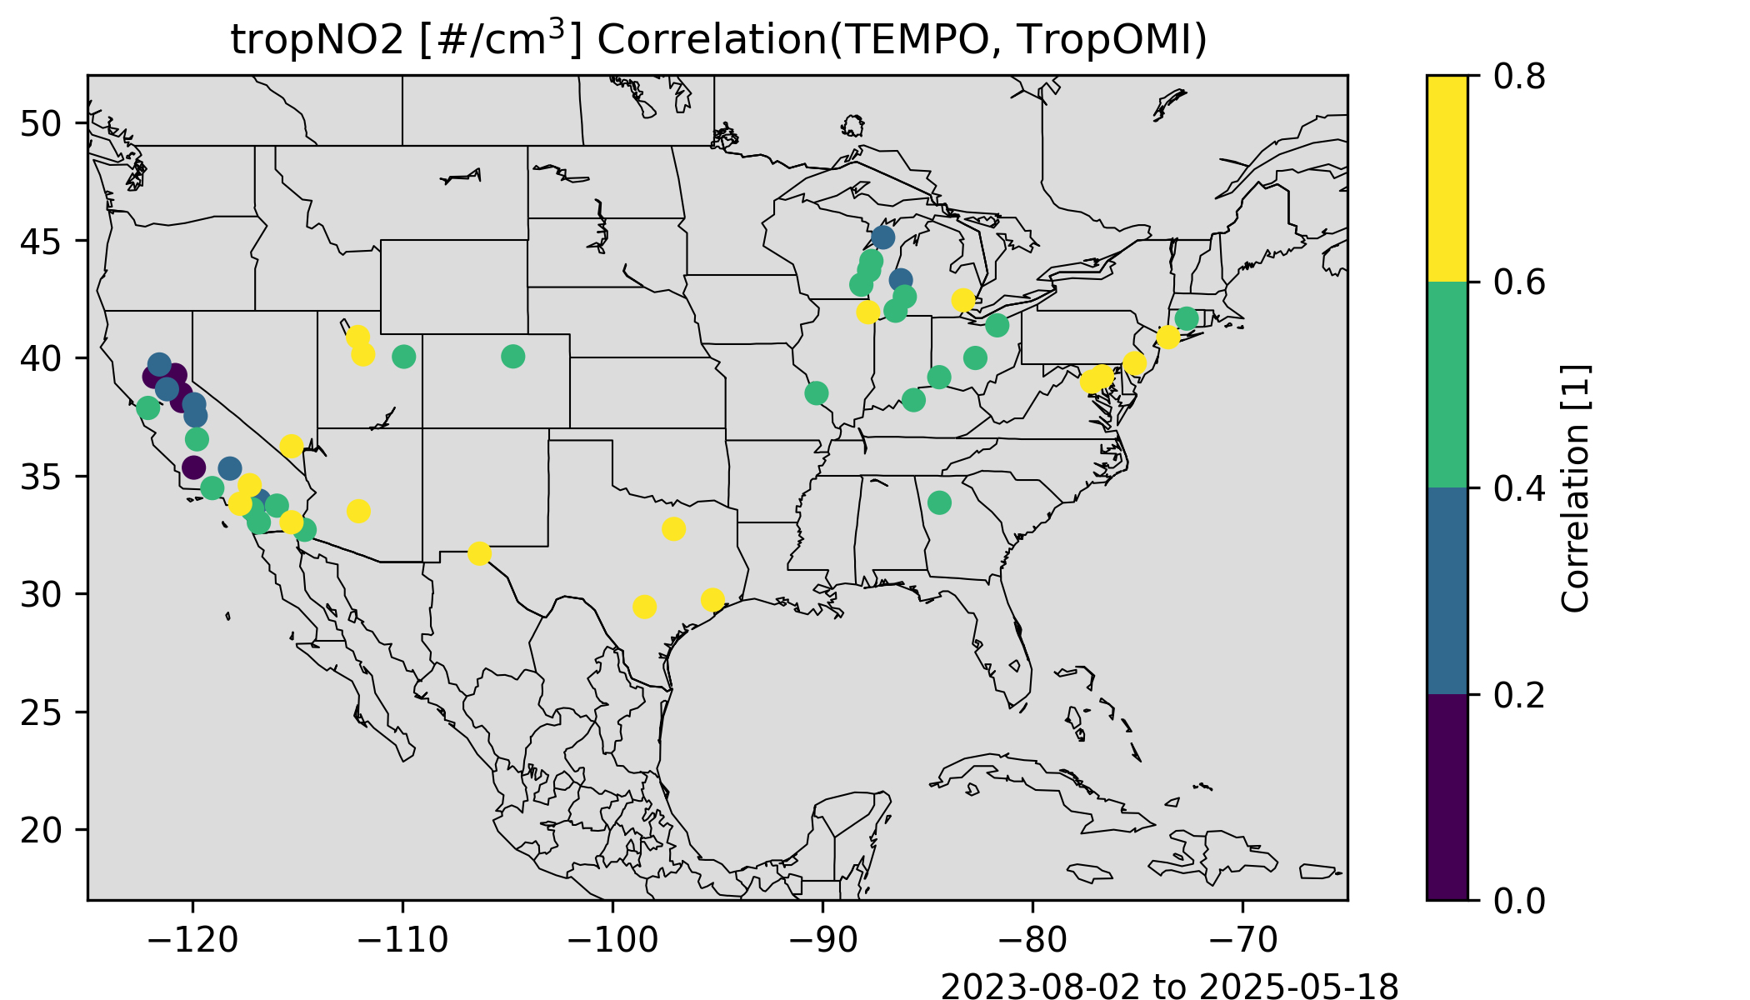
TEMPO Validation Analysis facilitated by EPA’s Remote Sensing Information Gateway
Pandora
Pandora
Pandora
Contributing to PSPIs NO₂₋01, 02, 04 & 06.
Comparison between Pandora and TROPOMI are being conducted on an on-going basis.
Analyses will be critical for provisional and full validation.
1: Spatial Variability
2: Good Biases
4: Correlation
TropOMI @ NAA
TropOMI @ NAA
TropOMI @ NAA
1: Spatial Variability
2: Good Biases
4: Correlation
More results will be presented by Barron Henderson on Wednesday @12:15 pm, 3.18 in AQ Trace Gas Session expanding on use of TROPOMI and Pandora for TEMPO validation.

Slide 11
Summary
EPA CEOS talks will provide additional information on current operational capabilities
  AQ Trace Gas Session 3.18 - Barron Henderson, EPA Validation Activities, Wednesday 12:15 pm
  AQ Aerosol Session 4.02 – Jim Szykman and Ruben Delgado (Hampton Univ.), Aerosol Layer Height Discussion, Thursday 08:35 am
  AQ Aerosol Session 4.08 - Barron Henderson, AirFuse, Thursday 11:15 1:00 am
EPA pending reorganization likely to impact current and future capabilities
Primary contacts on EPA efforts moving forward will be Luke Valin and Barron Henderson

Slide 12
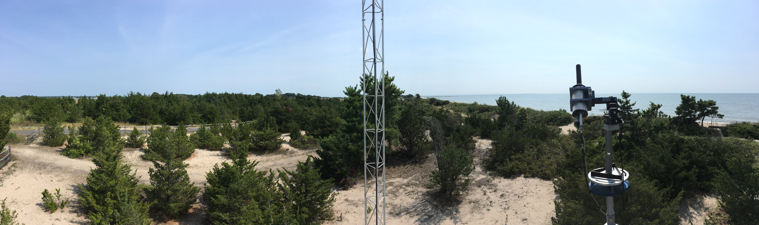
Jim Szykman
Senior Research Engineer
Center for Environmental Measurements and Modeling
US EPA Office of Research and Development
Szykman.Jim@epa.gov
Thank You!
Disclaimers: The views expressed in this presentation are those of the authors and do not necessarily represent the views or the policies of the U.S. Environmental Protection Agency.
Any mention of trade names, products, or services does not imply an endorsement by the U.S. Government or the U.S. Environmental Protection Agency. The EPA does not endorse any commercial products, services, or enterprises.

