Slide 1

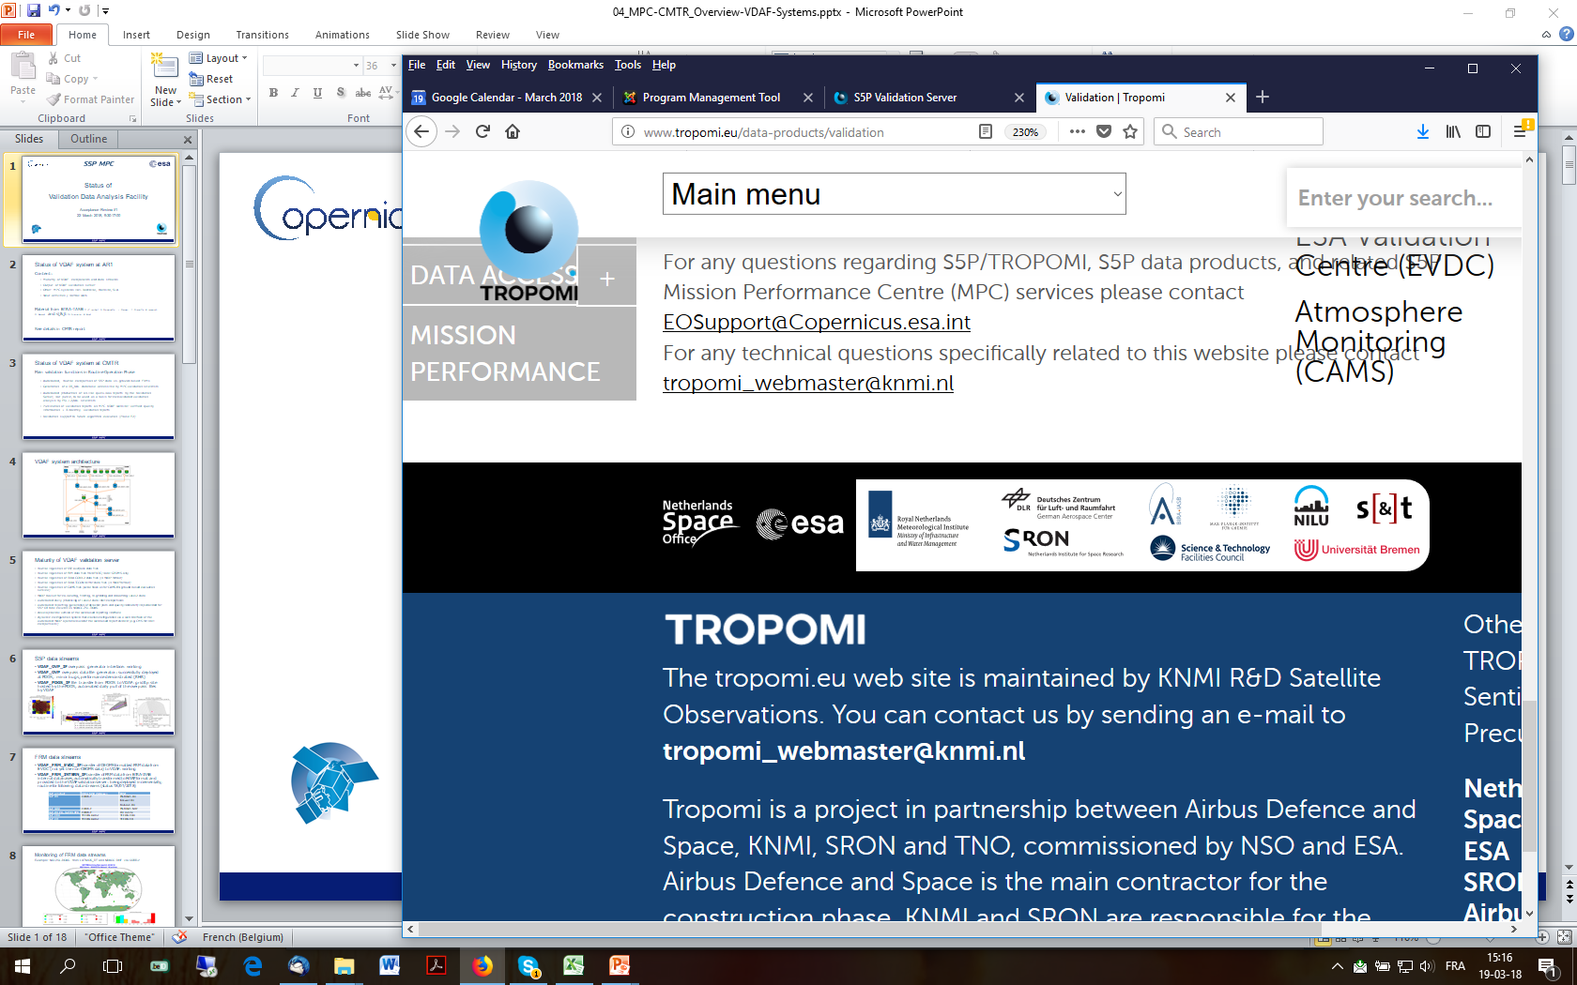



Atmospheric Mission Performance
Cluster (ATM-MPC)
ESA / Copernicus ATM-MPC
Routine Validation Service
  J.-C. Lambert, S. Compernolle, Arno Keppens, B. Langerock, M.K. Sha, T. Verhoelst (BIRA-IASB),
  D. Stein-Zweers (KNMI), A.M. Fjæraa (NILU), S. Niemeijer (s[&]t), A. Dehn (ESA)
  D. Hubert, Y. Geunes, J. Granville, O. Rasson, I. De Smedt, T. Ooms, G. Pinardi, M.K. Sha, N. Theys, C. Vigouroux (BIRA-IASB),
  A. Argyrouli, M. Coldewey-Egbers, K.-P. Heue, P. Hedelt, G. Lichtenberg, R. Lutz, F. Romahn (DLR),
  D. Balis, K. Garane, ML. Koukouli, K. Michailidis, A. Pseftogkas (AUTH), S. Beirle, T. Wagner (MPI-C),
  J. Claes, M. de Graaf, H. Eskes, E. Loots, E. van der Plas, J. van Geffen (KNMI), K.-U. Eichmann (IUP-UB), M. Alparone, C. Zehner (ESA)

Slide 2
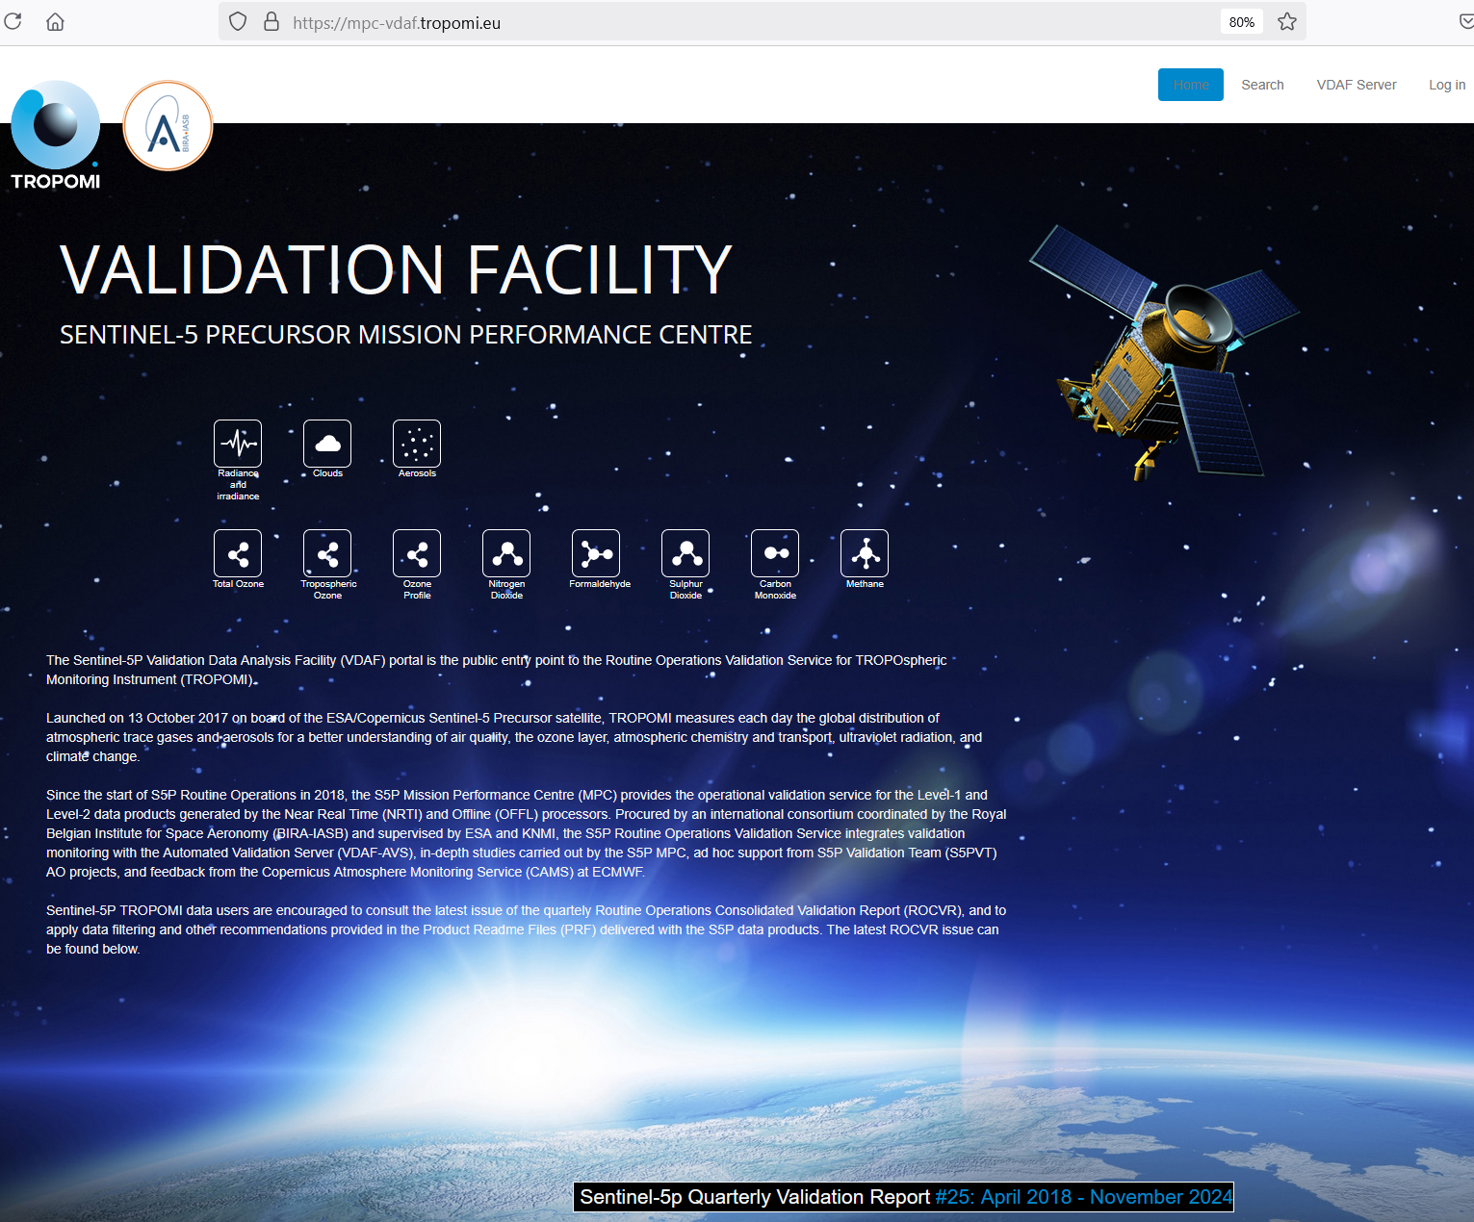
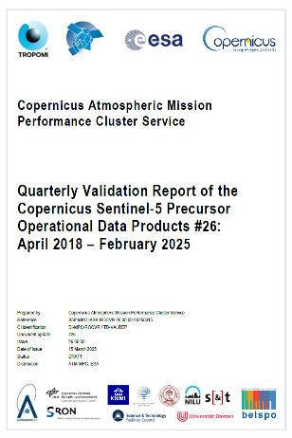
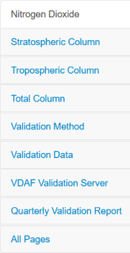
S5P TROPOMI Routine Validation Service Portal
Routine Operations Validation Platform https://mpc-vdaf.tropomi.eu
Up-to-date quality information on TROPOMI L1B and L2(+) data based on monthly teleconferences and quarterly validation reports
Search engine to browse
results by processor
versions, networks etc.
To the Automated
Validation Server
Results and resources by product
Direct access to quarterly report

Slide 3

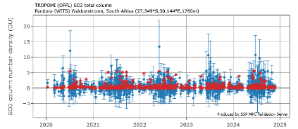
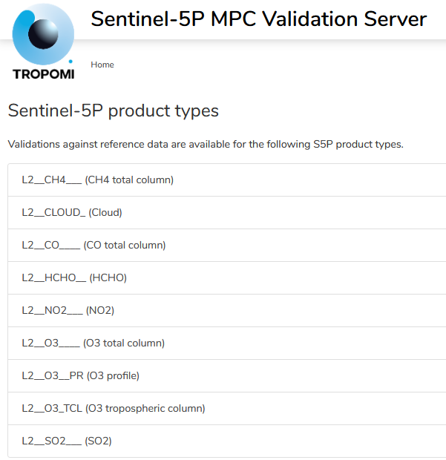
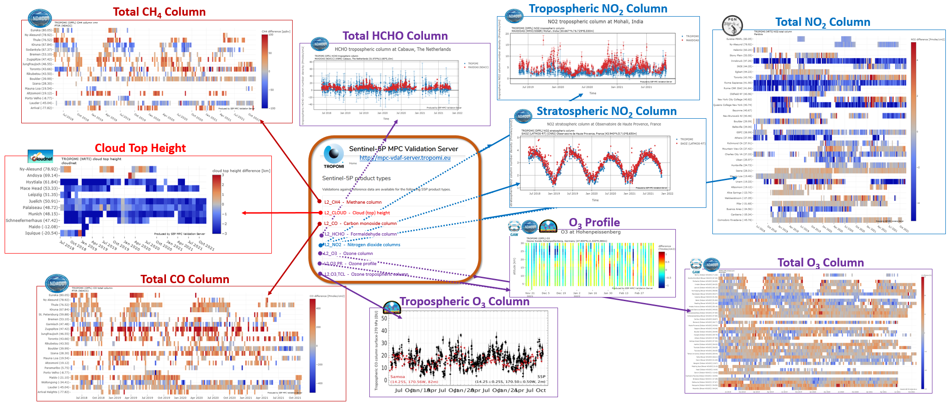

VDAF-AVS: Automated comparison to ground-based networks and permanent reporting of S5P TROPOMI L2(+) data Quality Indicators
https://mpc-vdaf-server.tropomi.eu
Total SO₂ column
New since AC-VC-20

Slide 4
VDAF Automated Validation Server
Community-agreed validation methods & metrics (CEOS, QA4EO, pubs…)
Reference measurements from ground-based monitoring networks and ESA FRM4xxx programme; substantial progress on harmonization, traceability, uncertainty assessment, documentation
Validation database and services at EVDC (NILU and partners), including harmonization with network data centers (GEOMS, DCIO…)
(Reference and satellite) data harvesting and handling tools from ESA Atmospheric Toolbox (CODA, HARP, VISAN) implemented by s[&]t
Monthly evaluation and feedback from ATM-MPC validation team
Permanent evolution: new data sources, new validation channels, improved efficiency, enhanced QA/QC…

Slide 5






















Fiducial Reference Measurements and Other Validation Data
S5P data Product | Mission requirements Systematic Random |  | Fiducial Reference Measurements and other ground-based data sources | Satellite data sources
L1B radiance & irradiance | band dependent |  | PICS based monitoring | OMPS-NP, OMPS-NM
O₃ total column | 5% | 2.5% | Brewer, Dobson, ZSL-DOAS, PGN | OMI, GOME-2
O₃ vertical profile | 30% | 10% | ozonesonde, DIAL (strato+tropo) | OMI, GOME-2
O₃ tropospheric column | 25% | 25% | ozonesonde | OMI, GOME-2
NO₂ stratospheric column | 10% | 0.5 e15 | NDACC ZSL-DOAS | OMI, GOME-2
NO₂ tropospheric column | 50% | 0.7 e15 | NDACC MAX-DOAS | OMI, GOME-2
NO₂ total column | - | - | PGN | OMI, GOME-2
SO₂ total column SO₂ layer height | 30% - | 30% - | MAX-DOAS, PGN - | OMI, OMPS-NP IASI-B, IASI-C, CALIPSO
HCHO total column | 80% | 1.2 e16 | MAX-DOAS, NDACC FTIR, PGN | OMI, GOME-2
CO total column | 15% | 10% | NDACC FTIR, TCCON, COCCON | GOSAT-2, OCO-2
CH₄ total column | 1.5% | 1% | NDACC FTIR, TCCON, COCCON | GOSAT-2, OCO-2
Cloud Fraction | 20% | 0.05 | FRM not available | VIIRS, OMI, GOME-2
Cloud Height (pressure) | 20% | 0.5 km | CLOUDNET lidar/radar | VIIRS, OMI, GOME-2
Cloud Optical Thickness | 20% | 0.05 | FRM not available | VIIRS, OMI, GOME-2
Aerosol Absorbing Index | 1 AAI | 0.1 AAI | FRM not available | OMI, OMPS-NP
Aerosol Layer Height | 100 hPa | 50 hPa | EARLINET lidar | CALIPSO, VIIRS, GOME-2
ESA FRM Programme
Monitoring Networks
Colour code: automated production of S5P QIs by the VDAF-AVS manual data collection and/or validation
FRM not available, quality evaluation mainly via diagnostics and satellite data intercomparisons

Slide 6
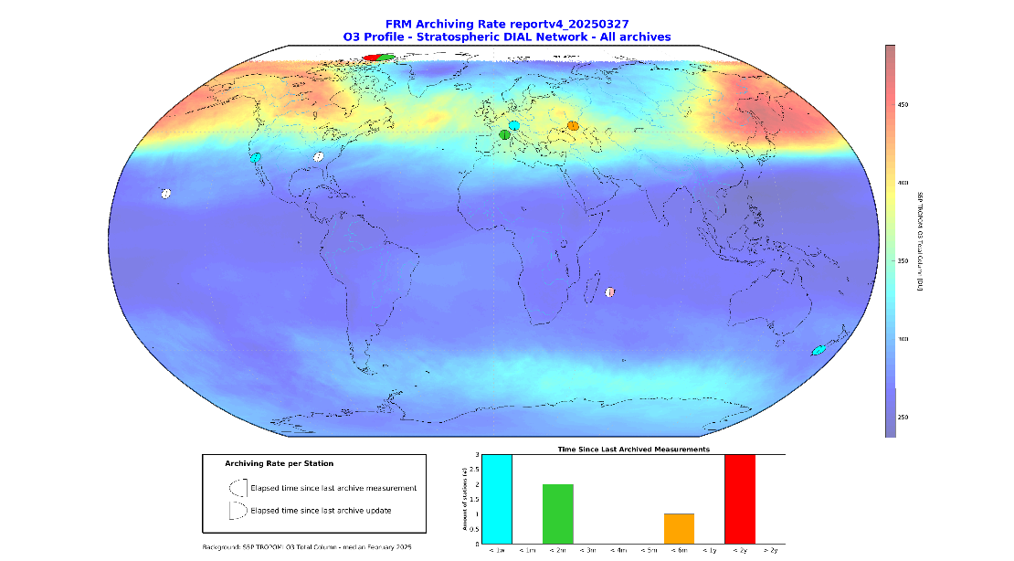
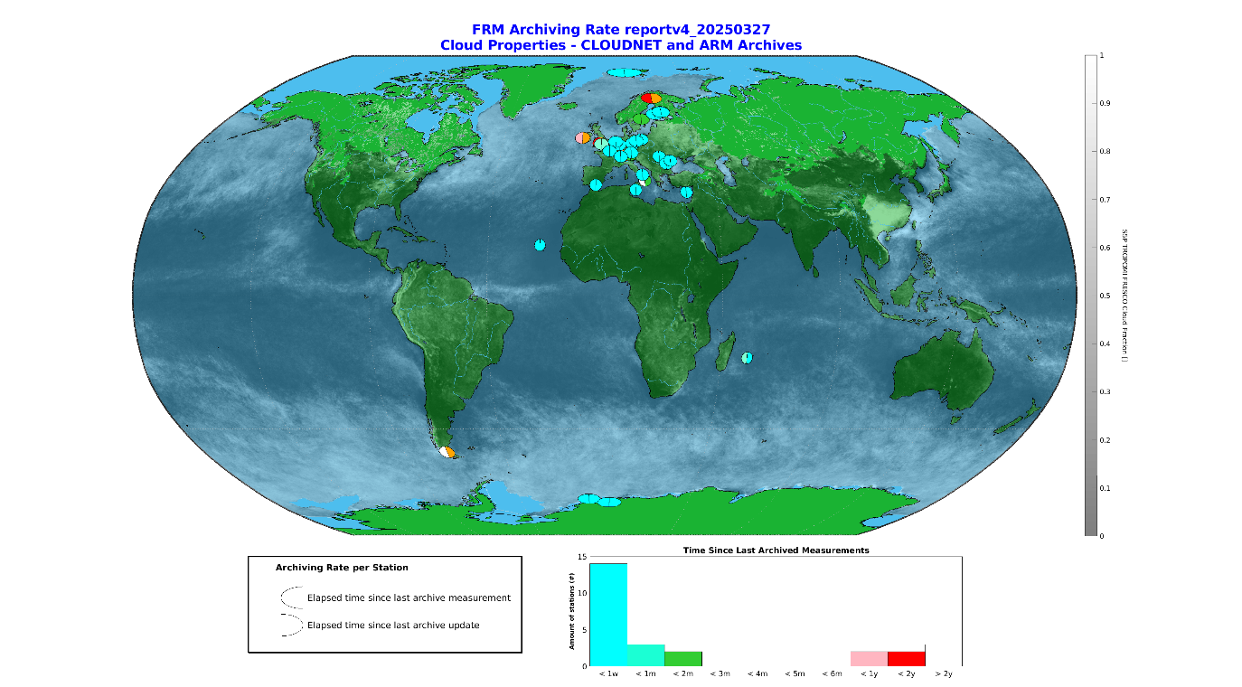
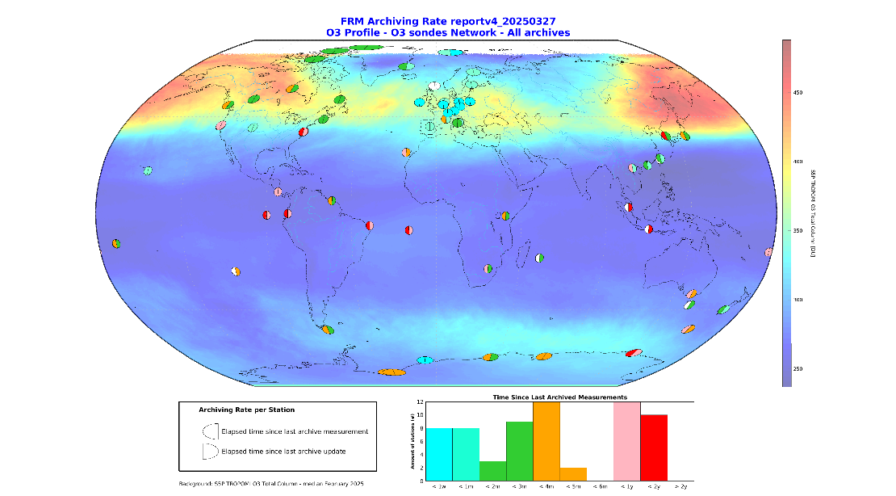
Timeliness of FRM / Validation Data Streams: O₃ profile & clouds
from CLOUDNET, NDACC, SHADOZ, TOLNet and WOUDC collected via EVDC (NILU) and Multi-TASTE/CORR-2 (BIRA-IASB)
L2_O3_PR Lidar
L2_O3_PR L2_O3_TCL Ozonesonde
Enhanced data provision in collaboration with CAMS validation
L2_CLOUD Lidar/radar
Enhanced data provision via ACTRIS-CLOUDNET

Slide 7
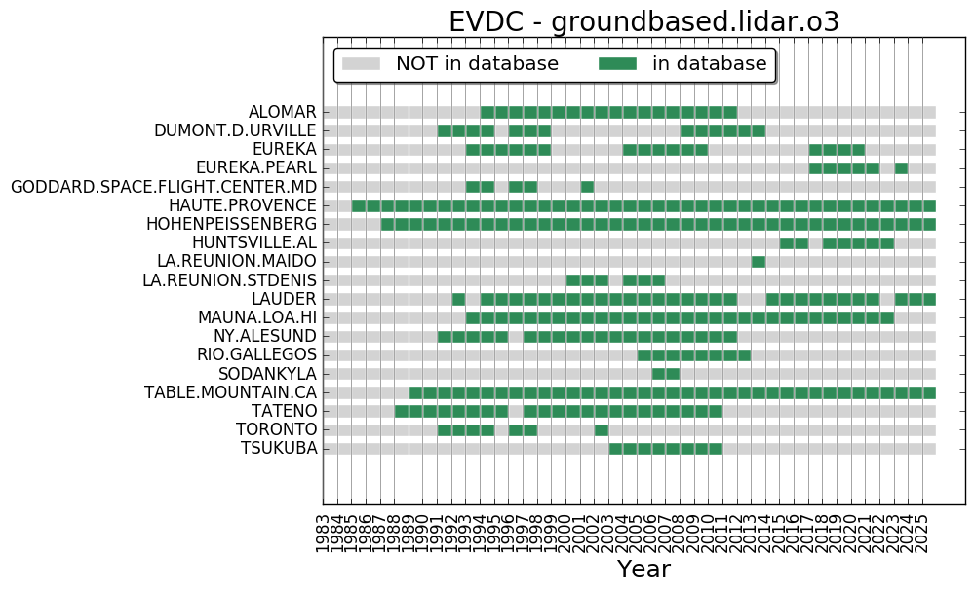
Time dependent operation of NDACC ozone lidars (funding, staff, supplies, station access…)
Incomplete validation coverage: no recent measurements in Arctic/Antarctica and tropics !
Coverage of FRM / Validation Data: O₃ profile
TROPOMI

Slide 8
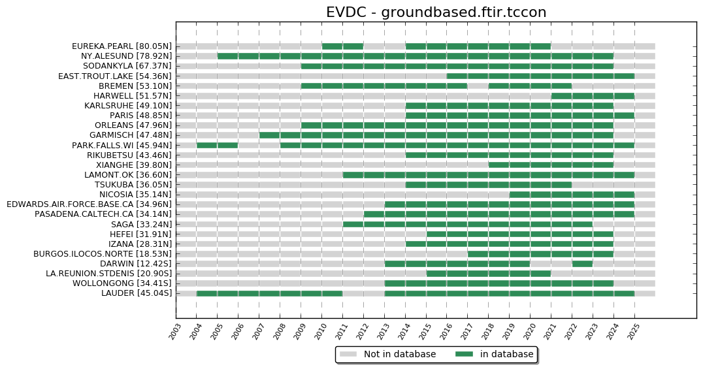
TCCON data at EVDC (active sites only, GGG2014 & GGG2020)
TROPOMI

Slide 9
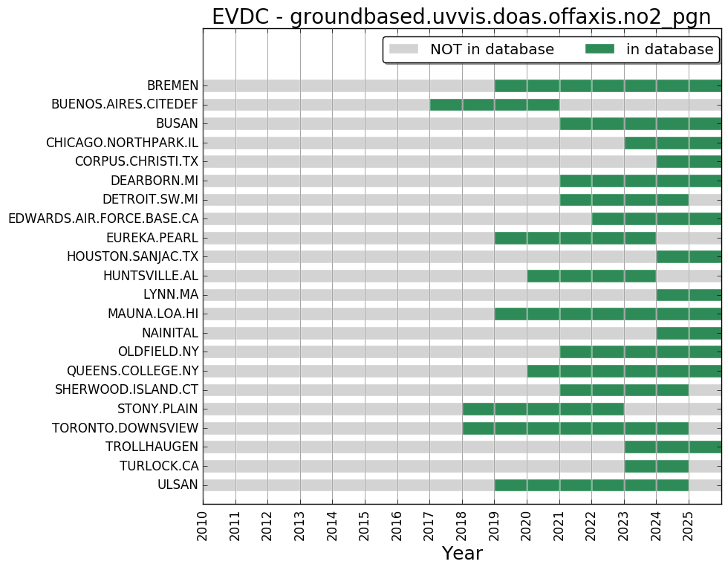
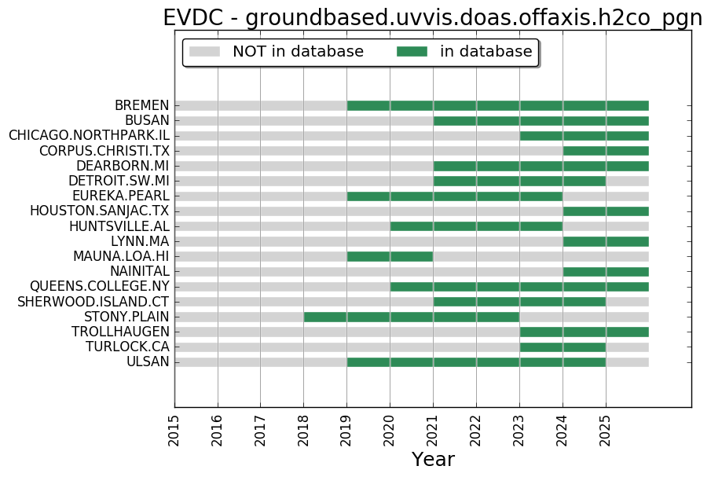
New PGN off-axis HCHO & NO₂ data at EVDC
Upcoming FRM Data Streams

Slide 10
Service Extension to Copernicus Contributing Missions (CCM)
ESA, BIRA-IASB, DLR, KNMI, s[&]t
Set-up Phase (2024-2025)
Pilot engagement of two New Space companies – 3 facility scale CH₄ satellites
Requirements and specifications for L1 & L2+, validation and documentation
Guidance on community standards and FRMs (RadCalNet, GHG networks…)
Exchanges with NPL, JPL and NASA/GSFC on EDAP+ maturity assessment
Service Operations Phase (2025-2027)
VDAF-AVS extension to CCMs
CCM data quality assessment and reporting
Expert support and guidance
Dedicated parts in ESA-led VH-RODA annual workshop

Slide 11
Conclusion
  ATM-MPC routine validation in service for Sentinel-5P TROPOMI since 2018; ongoing extension to facility-scale CH₄ missions (CCM)
  VDAF-AVS Automated Validation Server performing well and in permanent evolution: collaborative development of new validation channels, operationalization of data streams, Cal/Val methods R&D…
  Test bed e.g. for EDAP+ and CEOS-FRM Maturity Assessment Framework
  External dependence on FRM availability and timeliness; important source of feedback to ground-based monitoring networks: quality, network evolution, uncertainty budget, CEOS-FRM maturity level…
  Pathfinder for constellation-wide and facility-scale operational validation. Several challenges require R&D on validation methods, uncertainties...

