Slide 1
EUMETSAT preparations for operational validation of S4/S5
Rasmus Lindstrot, Sebastian Gimeno-Garcia, Frank Ruethrich, Christopher Diekmann for the Remote Sensing Products Team
IWGGMS-21 / CEOS AC-VC-21 - Takamatsu

Slide 2
Outline
S4/S5 Cal/Val plan
S4/S5 Cal/Val facilities
UVN-STAR / UVNS-STAR
MICMICS (Radiometry)
PICMICS (Geometry)

Slide 3
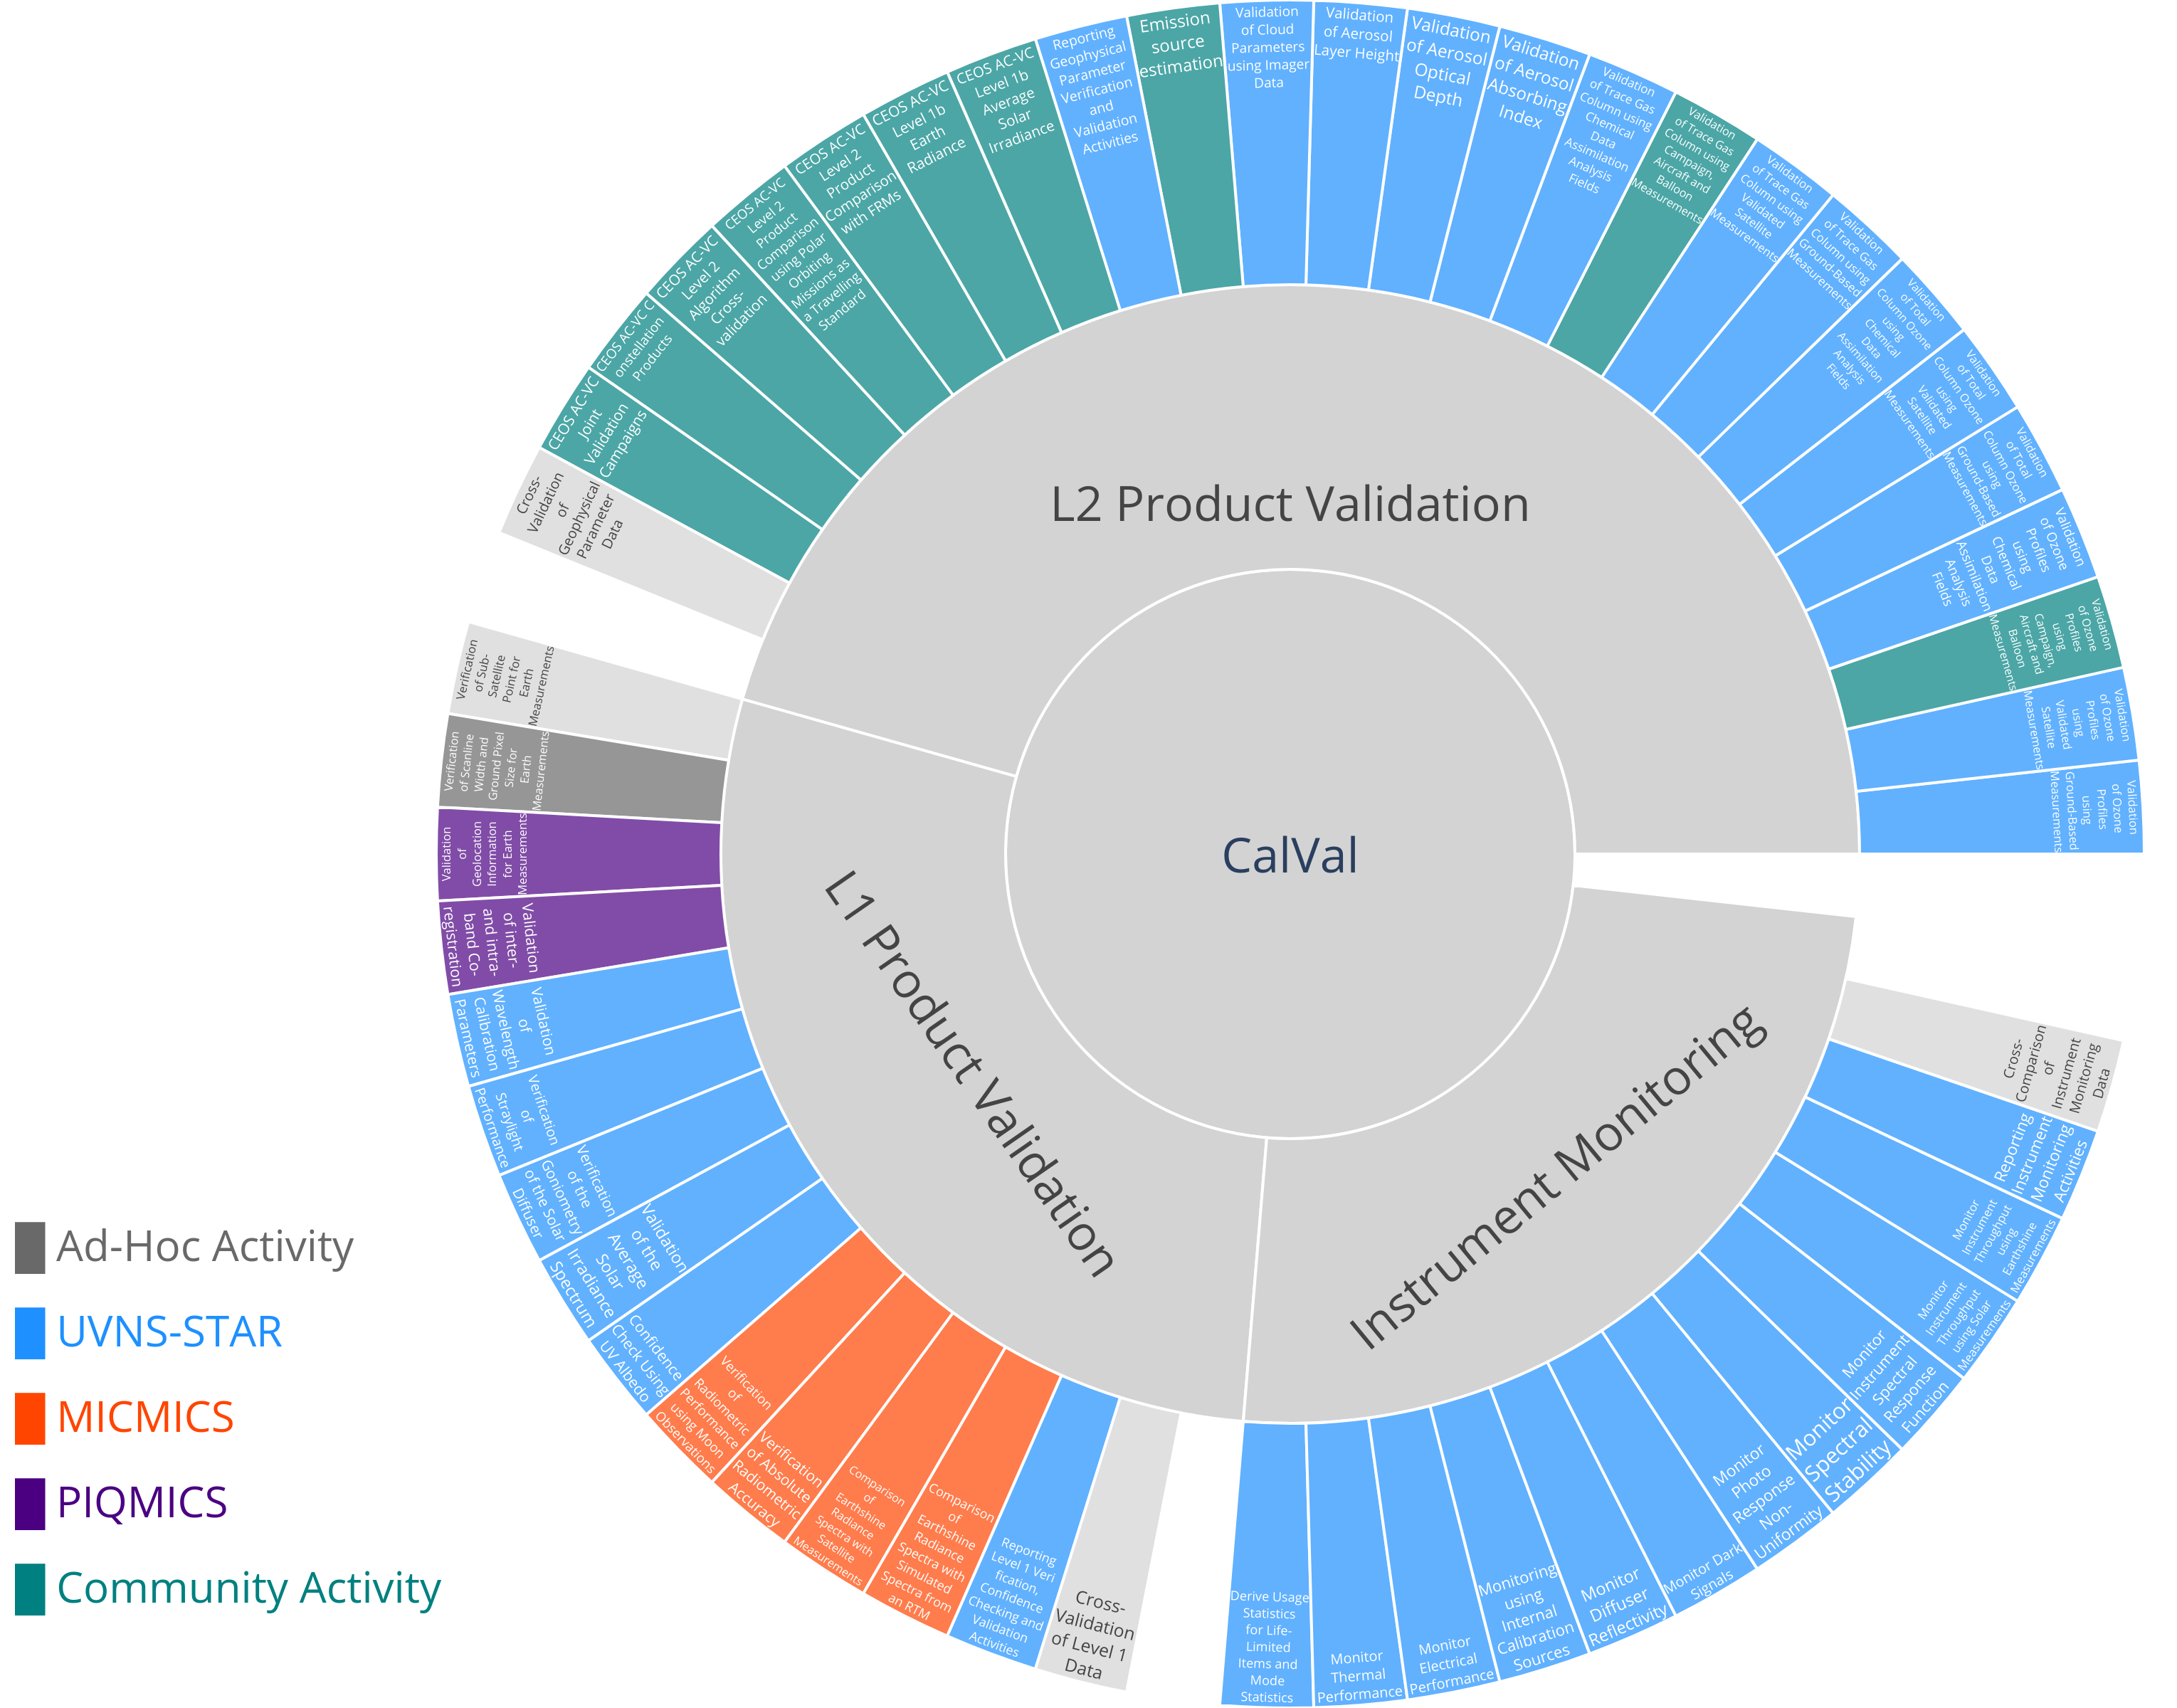
S4 and S5 Cal/Val Plan
Joint plan for activities of calibration and validation
for Sentinel-4 and Sentinel-5 during commissioning and routine operations
Ad-hoc activities
  Formal testing
  CKD Validation and Update
Performance monitoring
  Routine processing using Offline Environment
  (e.g. UVNS-STAR, MICMICS, PIQMICS)
  Includes routine validation of L2
  Scheduled reporting of instrument and product quality
Community activities
  Service Contracts for L1 and L2 activities
  AO Call for external L2 products validation

Slide 4

S4 and S5 Cal/Val Plan – AO call
The Announcement of Opportunity Call activities will
  contribute to the initial post-launch assessment of the product quality and
  provide inputs for the Product Validation Review Boards (PVRBs)
22 proposed projects accepted by EUM/ESA
A first Cal/Val preparation workshop will take place at EUMETSAT on 16-18 June, 2025.

Slide 5
S4 / S5 Cal/Val and monitoring: facilities at EUMETSAT
Purpose | Tool | Functionality
Instrument and housekeeping monitoring | UVN-STAR / UVNS-STAR L0 | Monitoring / reporting of thermal and electrical performance, life-limited items status
L1 product quality and on-board calibration monitoring | UVN-STAR / UVNS-STAR L1 | Monitoring / reporting of L1 product quality, on-board calibration sources, solar irradiance
Geolocation validation and monitoring | PIQMICS | Verification / validation / monitoring of geolocation, intra-band and inter-band co-registration
Radiometric calibration verification and monitoring | MICMICS | Verification and monitoring of radiometric bias and stability, using PICTs (desert, DCC, ….), Satellite inter-comparisons (imager & hyperspectral) and lunar calibration.
L2 product quality monitoring and continuous validation | UVN-STAR / UVNS-STAR L2 | Monitoring / reporting of L2 product quality, continuous validation against Fiducial Reference Measurements and comparison against other satellite retrievals

Slide 6
STAR – Framework
FCI-STAR
UVN-STAR
MTG
CLIM-STAR
METi-STAR
MAP-STAR
CO2M
STAR
EPS-SG
UVNS-STAR
CO2I-STAR
Sentinel-3
operational
OLCI-STAR
SLSTR-STAR
in dev.
planned

Slide 7
UVNS-STAR Tools
UVNS-STAR
L0
Thermal Performance
Electrical Performance
Life-Limited Items
Monitoring of instrument health from an engineering point of view
Products | Scope | Cal/Val Ref
Life limited products | Monitor expected lifetime and characteristics (e.g. total duration per mode, number of actuations, …): White Light Source (WLS) Spectral Line Source (SLS) LEDs scanner aperture covers calibration assembly mechanisms | A4.1.1
Thermal Performance | Time-series of radiator Optical bench temperatures Relevant thermistor temperatures Relevant detector temperatures | A4.1.2
Electrical Performance | Time-series of voltages and currents (SLS, WLS) Time-series of lamp stabilisation time | A4.1.3

Slide 8
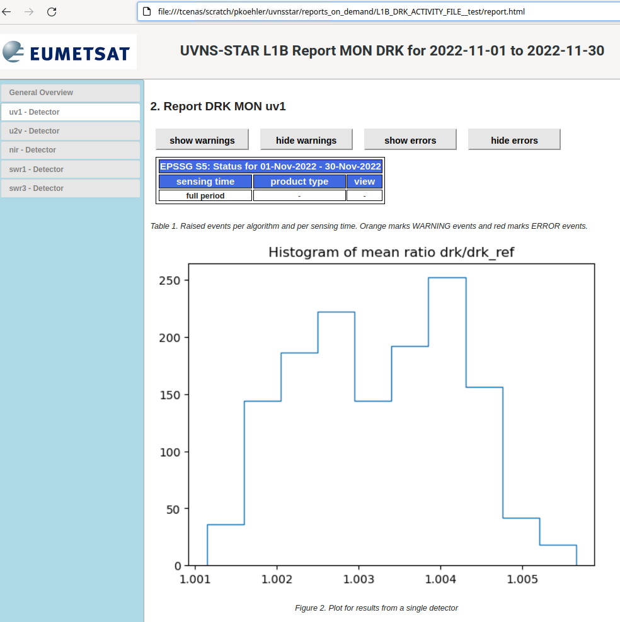
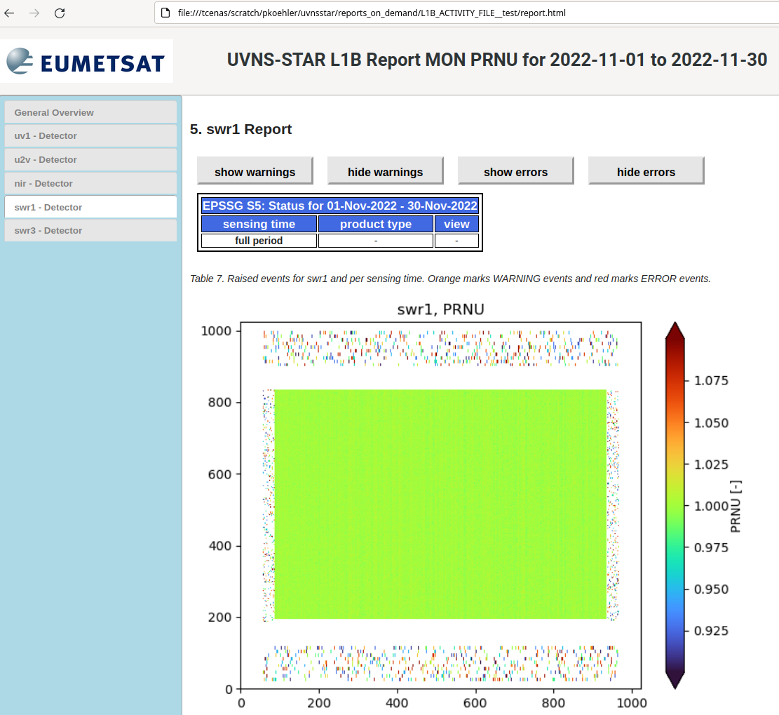
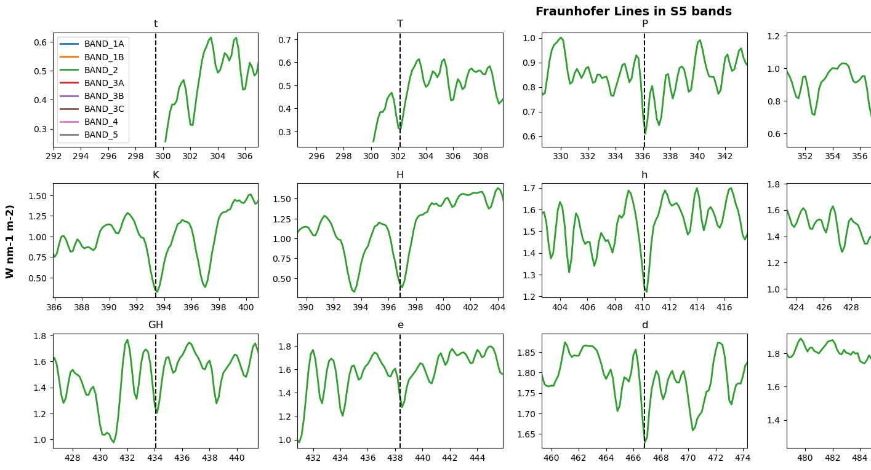
UVNS-STAR Tools
Solar Irradiance Monitoring
UVNS-STAR
L1B
CAL Monitoring
CKD Monitoring
Monitoring of instrument calibration based on internal calibration sources, sun measurements, CKD updates and earth spectra statistics
Earth Radiance Monitoring
Example:
Monitoring of In-Flight Calibration Parameters against on-ground calibration parameters (S5-L1B-AUX-CKD)
Dark Signal
PRNU
ISRF Stability
Offset
Spectral Stability
Wavelength Stability

Slide 9

UVNS-STAR Tools
SAT-FRM Monitoring
UVNS-STAR
L2
Product State Monitoring
Monitoring of geophysical parameters against external reference data
SAT-MOD Monitoring
SAT-SAT Monitoring
Satellite instruments
Reference Data Service
UVNS-STAR L2
S5
…
Polygon Extraction
Routine Web Reports
Rolling Filebuffer
Overlap Check
Fiducial Reference Measurements
Ad-Hoc Analyses
…
Point Extraction
ReferenceDB
ValidationDB
Overlap Module
L2 Analysis
Reference Data Service
Extract the geo-information of reference datasets into a central PostGIS database (file-driven for satellites, static for fixed stations)
Automatically assess overlaps between products on UVNS-STAR level
Create overlap subsets and run data comparison analyses
Overlap subsets (.nc)

Slide 10
Validation Datasets L2 Products (S5/UVNS case)
Data sets from satellite instruments
TROPOMI
IRS
GOME-2
OMI
TEMPO
GEMS
IASI
IASI-NG
GOSAT-1
GOSAT-2
OMPS
METimage
EarthCARE
NO₂
SO₂
O₃
CO
CH₄
HCHO
CHOCHO
Clouds
Srf. Refl.
Aerosols
UV Index
TCCON
PANDORA
COCCON
NDACC
WDCGG
TOLNet
WOUDC
EUBREWNET
ACTRIS
AERONET
MPLNet
AD-Net
Data sets from Fiducial Reference Measurements (FRM)

Slide 11
External Reference Data L2 (S5/UVNS case)
UVNS L2 Cal/Val – Model Data Sets
Type | Model | Relevant Products
Atmospheric Models | CAMS Analysis | O3, SO2
 | CAMS Forecast | Aerosols, O3, NO2, SO2, C2H2O2, HCHO, …
 | CAMS Forecast Delayed Mode | CO2, CH4
 | IFS Forecast | Met. parameters

Slide 12

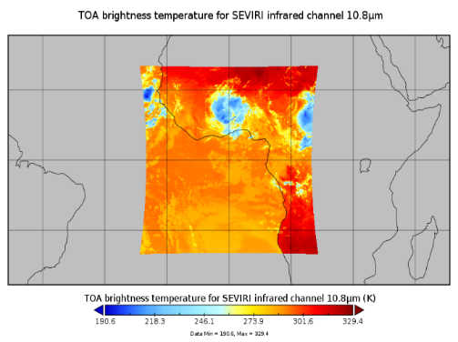
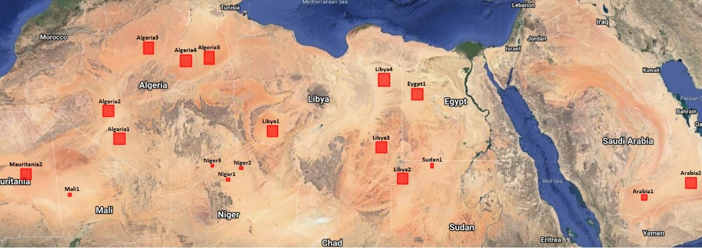
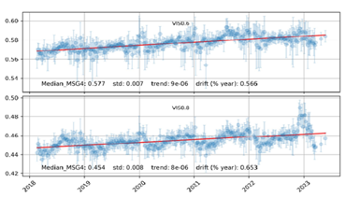
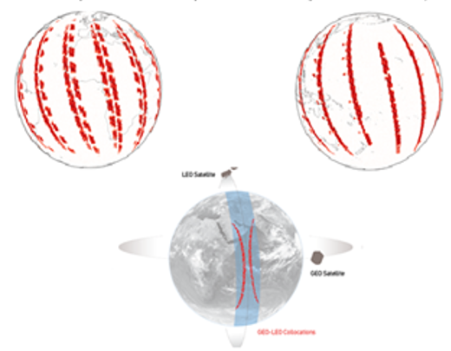
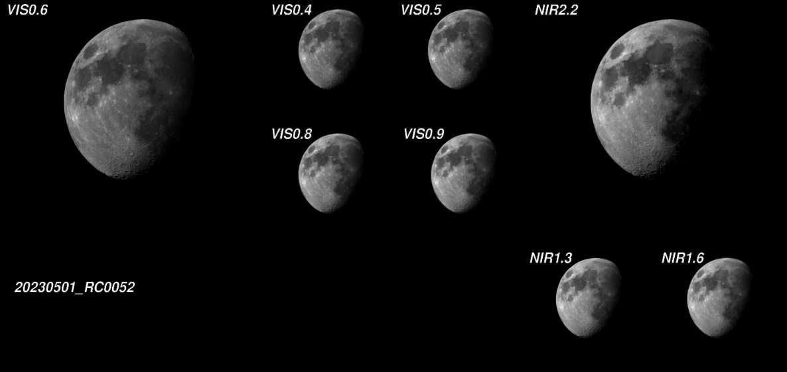
MICMICS for UVN and UVNS
Already supporting the EUMETSAT diagnostics on SEVIRI, AVHRR, OLCI & SLSTR, FCI & LI
Absolute Calibration:
  RTM over Deserts [DCC and Sea]
  Lunar model (GIRO)
  Sensor to sensor collocations
Drift Monitoring
Support the operational generation of GSICS products (and intermediate products such as collocations) and the generation of Climate Data Records
Challenges in short wavelength ranges not typically covered before (<400nm).

Slide 13
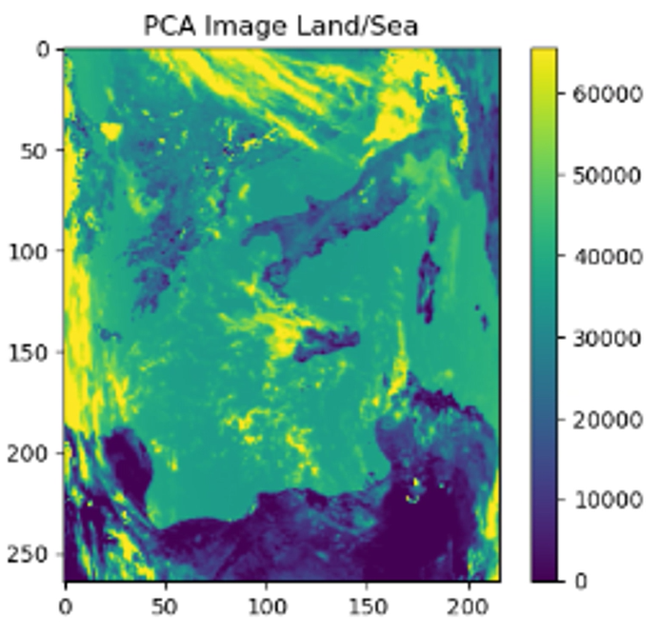
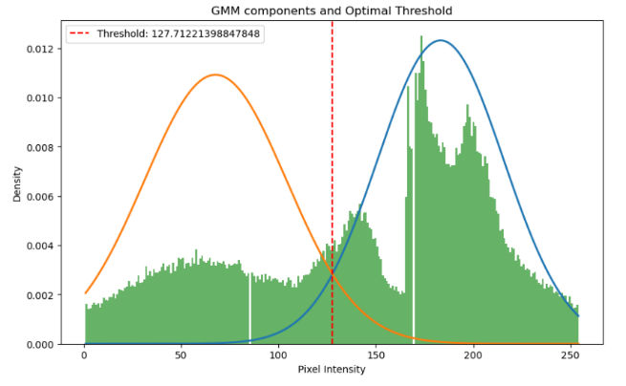
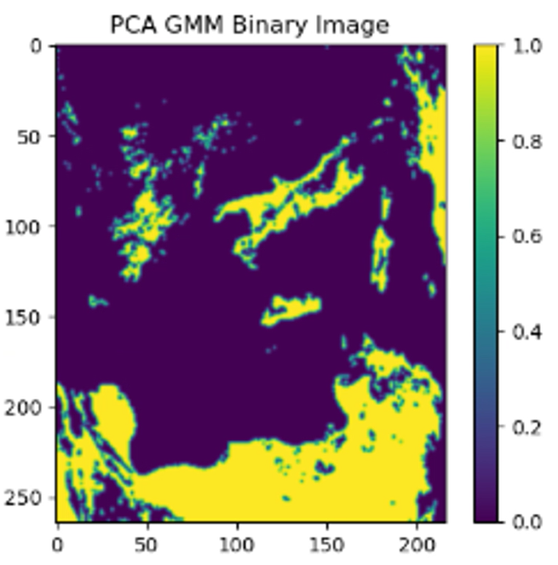
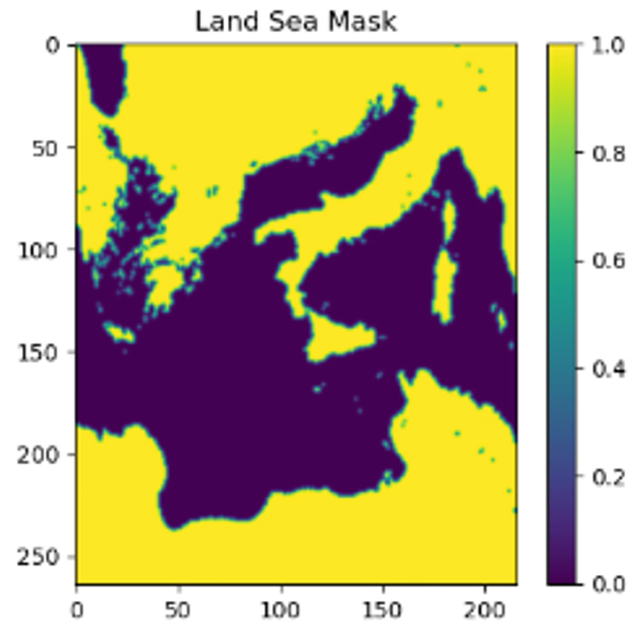
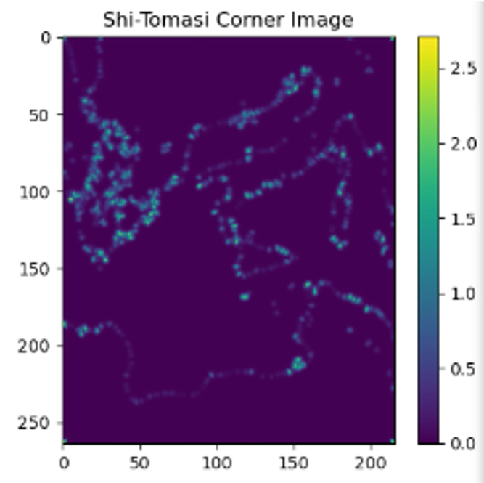
PIQMICS (sub-modules for S5 & S4 L1B)
The input for IDEAL and IRAT tools are 2D images. As S5 is a hyperspectral imager, the first step in the process is to obtain a 2D image from the 3D S5 L1B data.
This is achieved applying Principle Component Analysis (PCA) on a given (configurable) spectral range and selecting the component that best discerns Land and Water. This includes the full information from the analysed spectral band.
Gaussian Mixture Model (GMM) thresholding is then applied to discriminate between land and water.
Shi-Tomasi Feature tracking (STF) is used to identify features in the reference image (land water mask).
Phase Cross Correlation (PCC) of the resulting 2D image is used to estimate the displacement of identified features to either
  check the absolute geolocation accuracy (IDEAL) by comparing with a reference (land water mask)
  check the inter band co-registration (IRAT): two images are derived from two different bands and compared
  check the intra band co-registration (IRAT): two images are derived from the same band and compared
The overall sequence is named PGSP.
PCA
GMM
STF

Slide 14
Summary
The EUMETSAT Cal/Val activities are a combination of:
Well established, internal facilities (L0, L1 & L2)
  Extended to hyperspectral sensors
  Inspired by GSICS methods e.g. for simultaneous nadir overpasses
Outreaches to the scientific community (~L2)
  Service contracts and AO call

