Slide 1
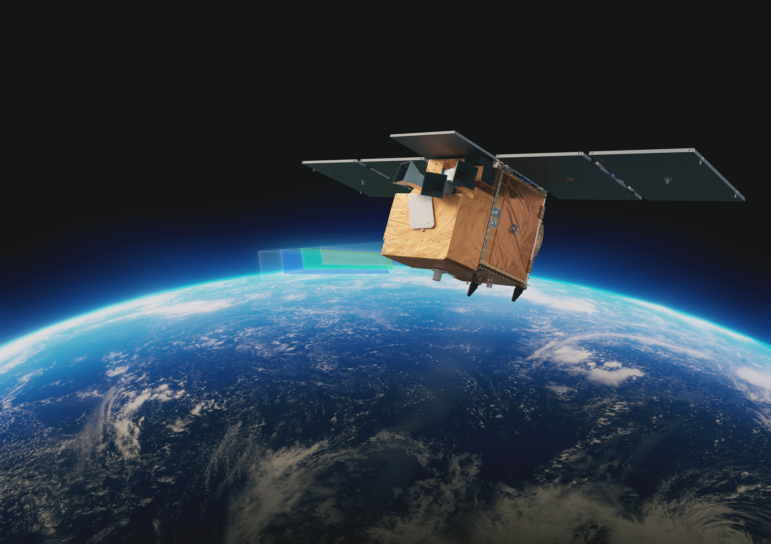
ALTIUS
status and expected performance
E. Dekemper, and BIRA-IASB’s ALTIUS team
USASK’s ALTIUS team
ESA’s ALTIUS team

Slide 2
Mission objectives
limb scattering
stellar/planetary occultations
solar/lunar occultations
still to be evaluated
Mesosphere
Stratosphere
Troposphere
O₃
NO₂
H₂O
aero
OClO
BrO
NO₃
T°

Slide 3
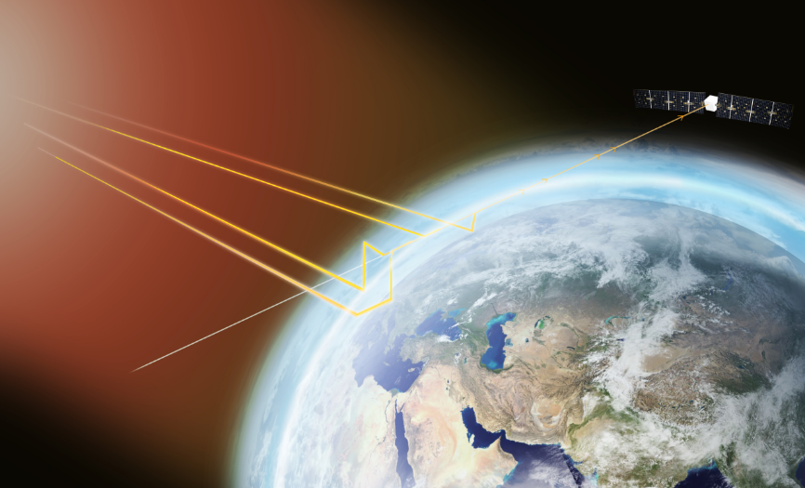
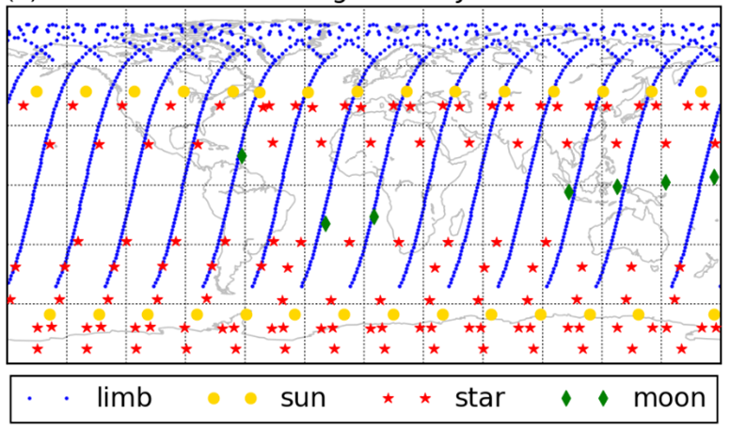
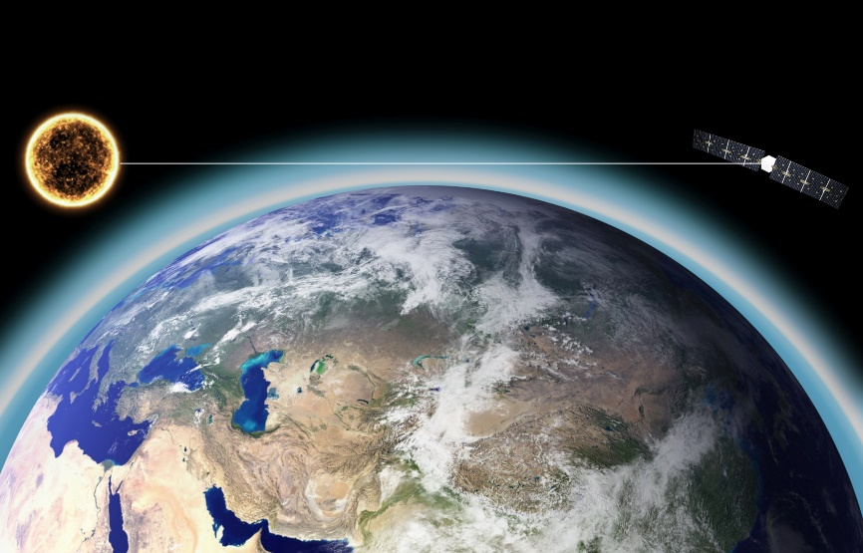
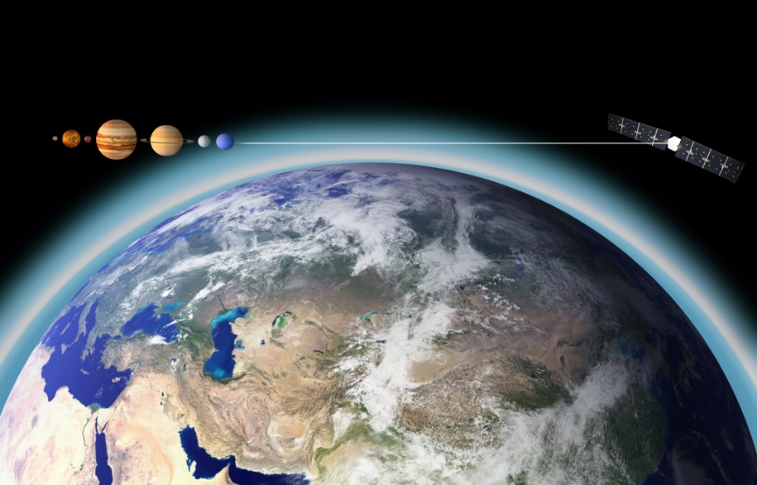
Mission concept
Limb-scattering
Solar/Lunar occultations
On the capability of the ALTIUS data to constrain modelled stratospheric O₃
→ Errera et al., AMT 14, 2021
Stellar/Planetary occultations

Slide 4
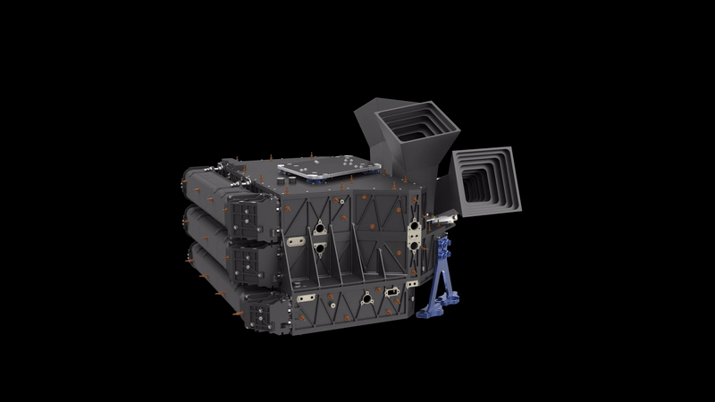
Mission concept
UV channel
 | bright limb | solar/lunar occultations | stellar/planetary occultations
Field of view | 2° x 2° | 2° x 2° | 0.2° x 0.2°
Vertical sampling | 600 m | 600 m | 60 m
Spectral filter technology | stack of 4 Fabry-Pérot interferometers
Spectral domain | 250-355 nm
Spectral resolution | 2-3 nm
Target species | O₃, T° | O₃, BrO, OClO, T° | O₃
VIS channel
 | bright limb | solar/lunar occultations | stellar/planetary occultations
Field of view | 2° x 2°
Vertical sampling | 200 m
Spectral filter technology | acousto-optical tunable filter (AOTF)
Spectral domain | 440-675 nm
Spectral resolution | 2-10 nm
Target species | O₃, NO₂, aerosols | O₃, NO₂, aerosols, NO₃, | O₃, aerosols
NIR channel
 | bright limb | solar/lunar occultations | stellar/planetary occultations
Field of view | 2° x 2°
Vertical sampling | 400 m
Spectral filter technology | acousto-optical tunable filter (AOTF)
Spectral domain | 600-1020 nm
Spectral resolution | 2-10 nm
Target species | aerosols | aerosols, H₂O | aerosols

Slide 5
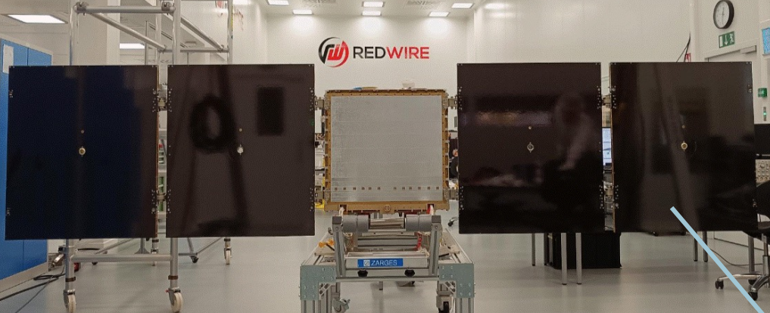
Mission status
Space segment CDR closed in June 2024

Slide 6
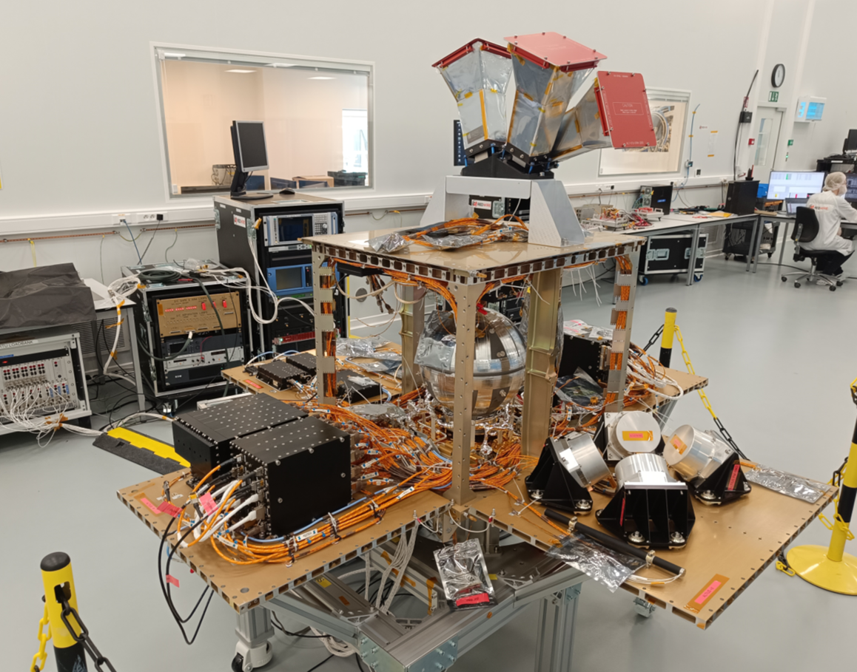
Mission status
Platform at Redwire in May 2025.

Slide 7
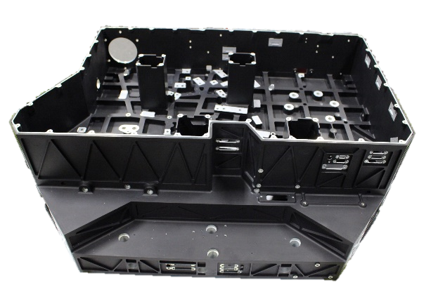
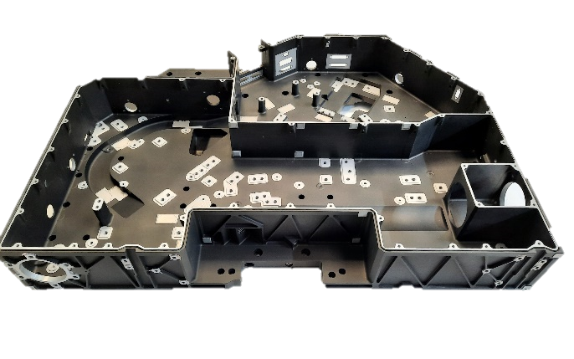
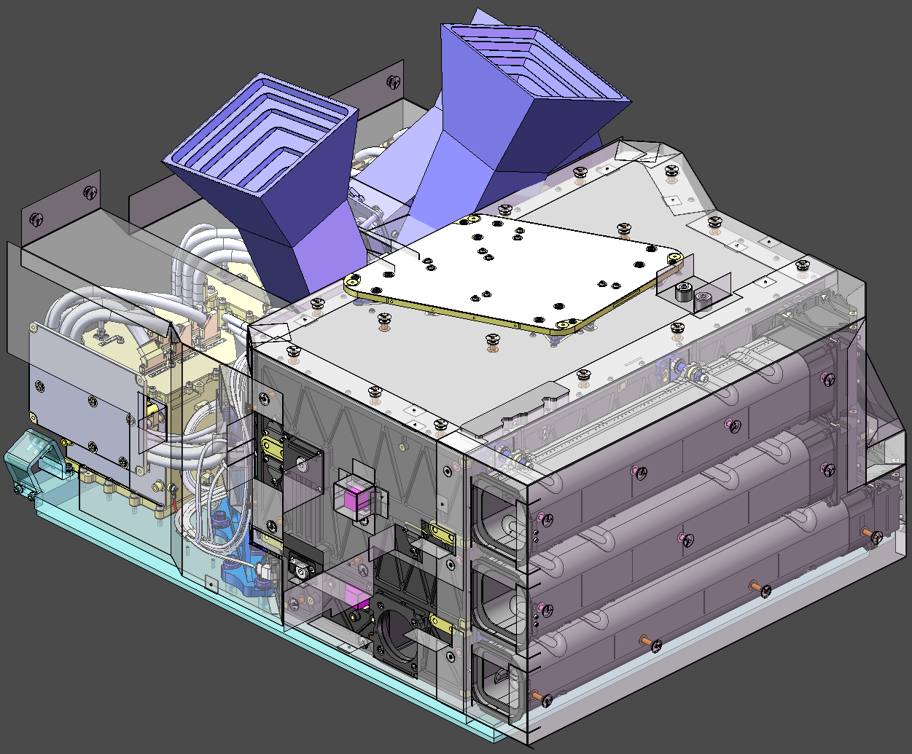
Mission status
Many subsystems are delivered.
CCUs (mechanics)
FM manufacturing ongoing
VIS/NIR cover
Use of STM
Star trackers
FM ready
Radiator
FM procurment to start
MLI
FM available
External Harness
FM under manufacturing
Baffles
FM under manufacturing
NIR & VIS Bench
ready
UV Bench
ready
UV cover
Use of STM

Slide 8
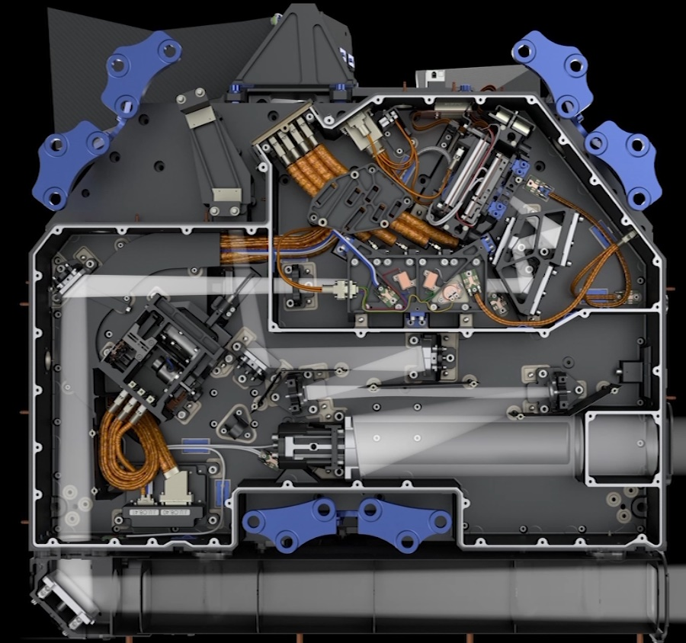
Mission status – UV channel
STO M3
Ready for integration with mount
Periscope Mirror
Under performance assessment
STO M2
Ready for integration with mount
STO M1
To be re-coated
STO M4
Under re-manufacturing
FPI FM
TRB completed
BEO structure
Ready for mirror assembly
Mechanism FM
Ready
Folding mirror
StO M5: ready for mount integration
BL Fold: Under performance assessment
BEO M1, M2, M3
Under manufacturing
FPA
Under manufacturing
UV band pass filter
Ready for integration with mount
UV Harness
FM available

Slide 9
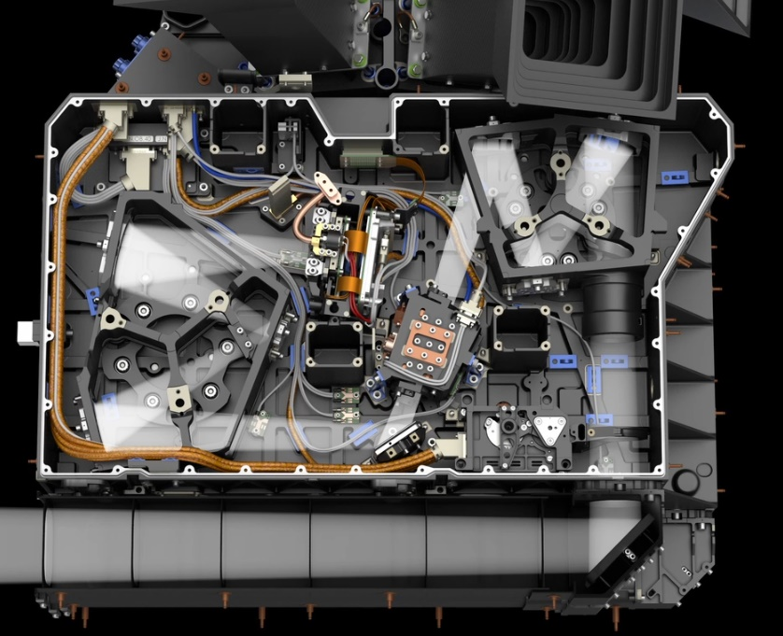
Mission status – VIS/NIR channel
FPA
Under manufacturing
VIS/NIR FEO Mirrors
NIR: integrated
VIS: under manufacturing
VIS/NIR Harness
Ready
VIS/NIR BEO Structure
Ready for assembly
NIR FEO structure ready
VIS FEO structure
Under repair
VIS/NIR BEO Mirrors:
NIR mirrors ready
VIS mirrors under manufacturing
VIS/NIR AOTF Assembly
Delivered
VIS/NIR Mechanism FM
ready
VIS/NIR Folding Mirror
Ready for mount integration
VIS/NIR Periscope Mirror under manufacturing

Slide 10
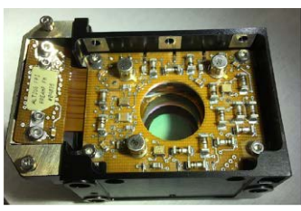
Mission status
Fabry-Pérot Interferometer (UV channel) manufactured and characterized by VTT in Finland.

Slide 11
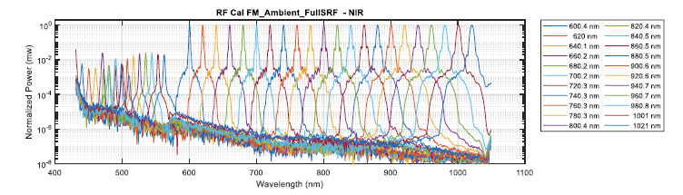
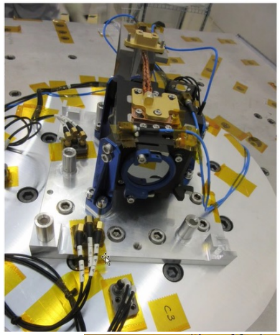
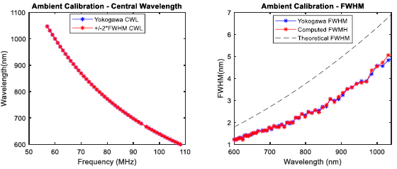
Mission status
VIS and NIR AOTFs produced by Gooch & Housego in UK.

Slide 12
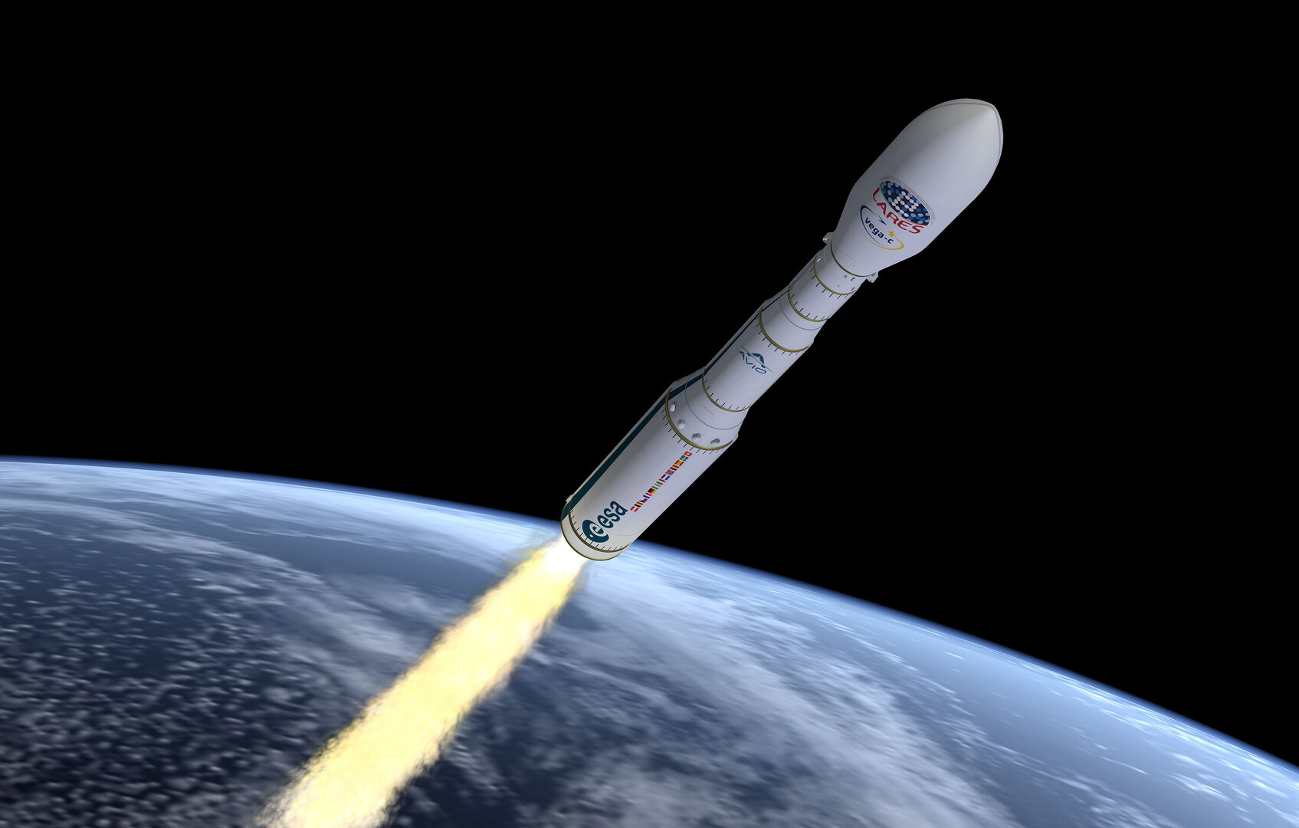
Mission status
Space segment CDR closed in June 2024
Payload subsystems integration is starting at OIP (Belgium)
Calibration and characterization will start in 2026 at CSL (Belgium)
Ground segment CDR in progress
Shared launch with ESA’s FLEX is becoming highly hypothetical. Ride share in 2027 being negotiated with AVIO.

Slide 13
Mission performance verification approaches
Based on synthetic data
RTM-generated scenes
System Performance Simulator (SPS)
Instrument + Satellite Model
L0
(raw images)
L1a
(radiometric corrections)
L1b
(geo-referencing)
L1c
(straylight removal)
Synthetic L1 generator
(spectral convolutions, radiometric noise, images formation)
L2

Slide 14
Mission performance verification approaches
Based on synthetic data
Based on existing satellite data
RTM-generated scenes
Satellite L1 data
System Performance Simulator (SPS)
Instrument + Satellite Model
L0
(raw images)
L1a
(radiometric corrections)
L1b
(geo-referencing)
L1c
(straylight removal)
Synthetic L1 generator
(spectral convolutions, radiometric noise, images formation)
L2

Slide 15
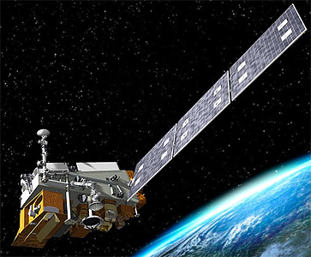
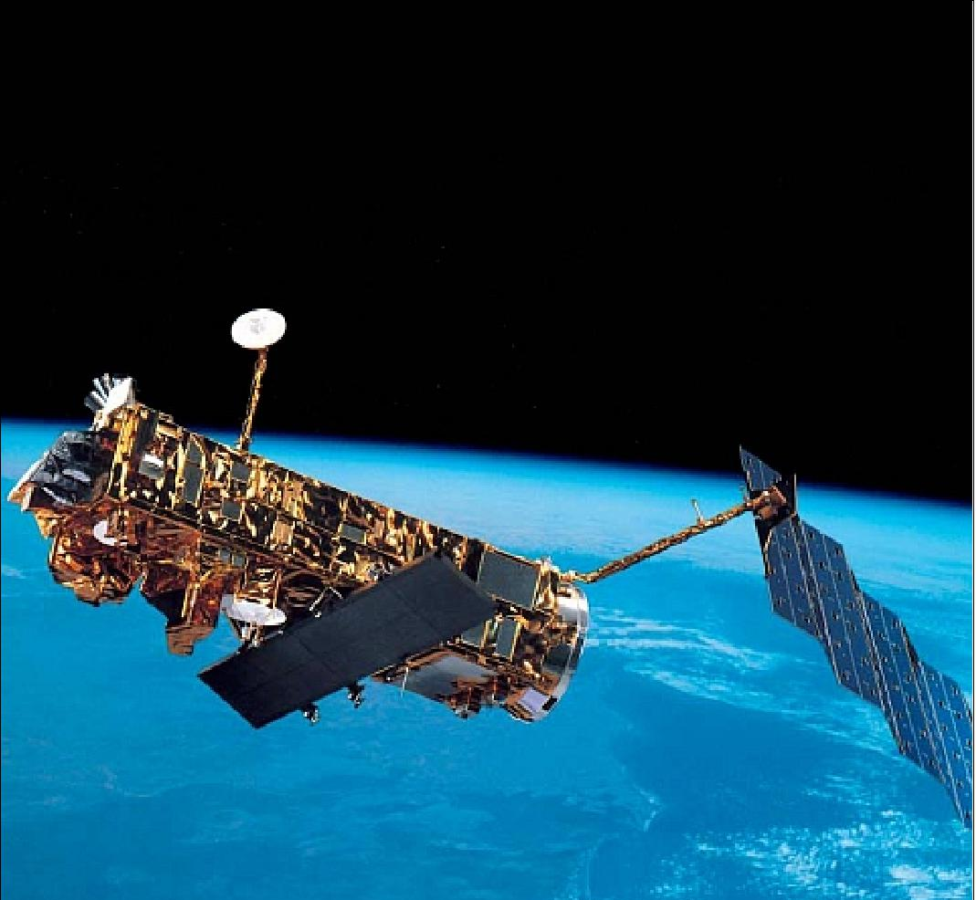
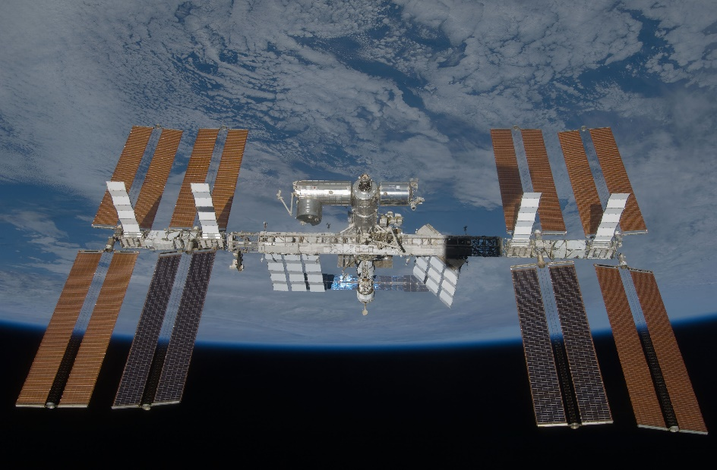
Mission performance verification approaches
Bright limb
OMPS-LP
Solar occultations
SAGE-III
Stellar occultations
GOMOS

Slide 16
Mission performance verification approaches
Satellite instrument L1 file
OMPS-LP: -limb radiance spectra
-solar angles
-satellite position/velocity
GOMOS: -atmospheric transmittance spectra
-1kHz scintillation term
-star ID and TOA spectrum
SAGE-III: -atmospheric transmittance spectra
“Altiusification”
-Creation of a pseudo stimuli
-Replacement of atmospheric parameters (T°, P, O3, etc)
-Update the light source settings (solar angles or star ID)
-Interpolation/extrapolation of the (ir)radiance spectra on the ALTIUS altitude and wavelength grid
ALTIUS SPS
-Simulation of the spectral images at the requested wavelengths (according to an acquisition plan)
-Estimation of measurement errors
-Georeferencing
ISM -> L0 -> L1a -> L1b -> L1c
L2
Processor
O₃ profile retrieval
Satellite instrument L2 file
-O3 profile
-Aerosol extinction coef. profiles
-Temperature
-Pressure
-Albedo
Satellite instrument L2 validation report
-Latitude and altitude-dependent O3 profile random and systematic differences
Source: Ozone CCI+ PVIR v4.0
Performance Evaluation Module (PEM)
-Comparison of the 2 retrieved O3 profiles
-Assessment of significance with respect to the satellite product validation report
Intercomparison report

Slide 17
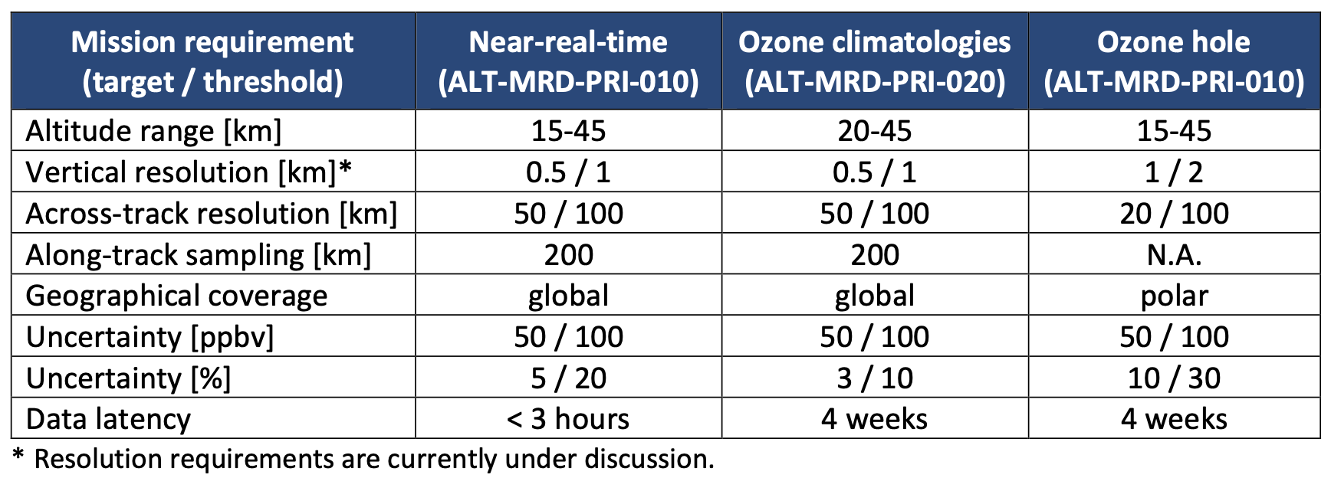
Limb scattering mode – O₃
End-to-end simulations show that the mission (space + ground segment) is currently meeting the primary scientific requirements.

Slide 18
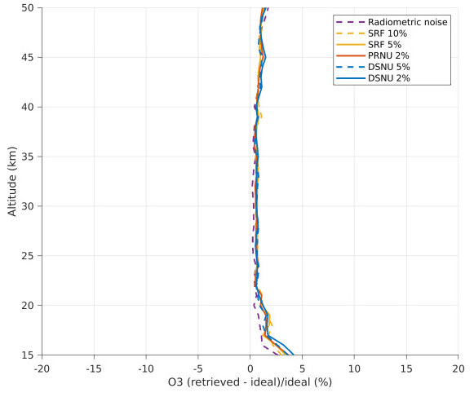
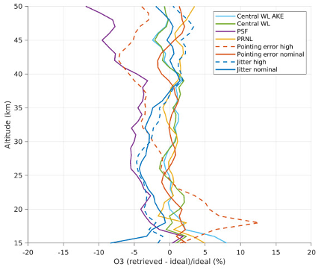
Limb scattering mode – O₃
This is based on L1 → L2 sensitivity analyses…
Random errors Systematic errors

Slide 19
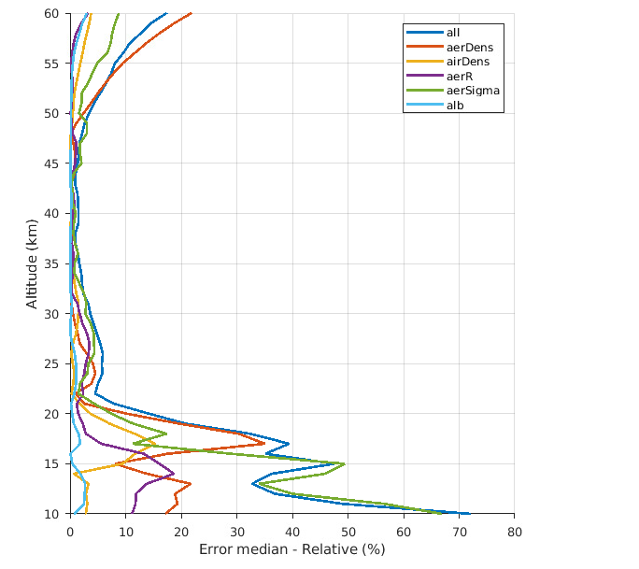
Limb scattering mode – O₃
… and on L2 sensitivity analyses (modeling errors, auxiliary data uncertainties, etc).
ALTIUS is not different than other limb scattering instruments, and the driver of the error budget is the uncertainty on the aerosol particles in the atmosphere.

Slide 20
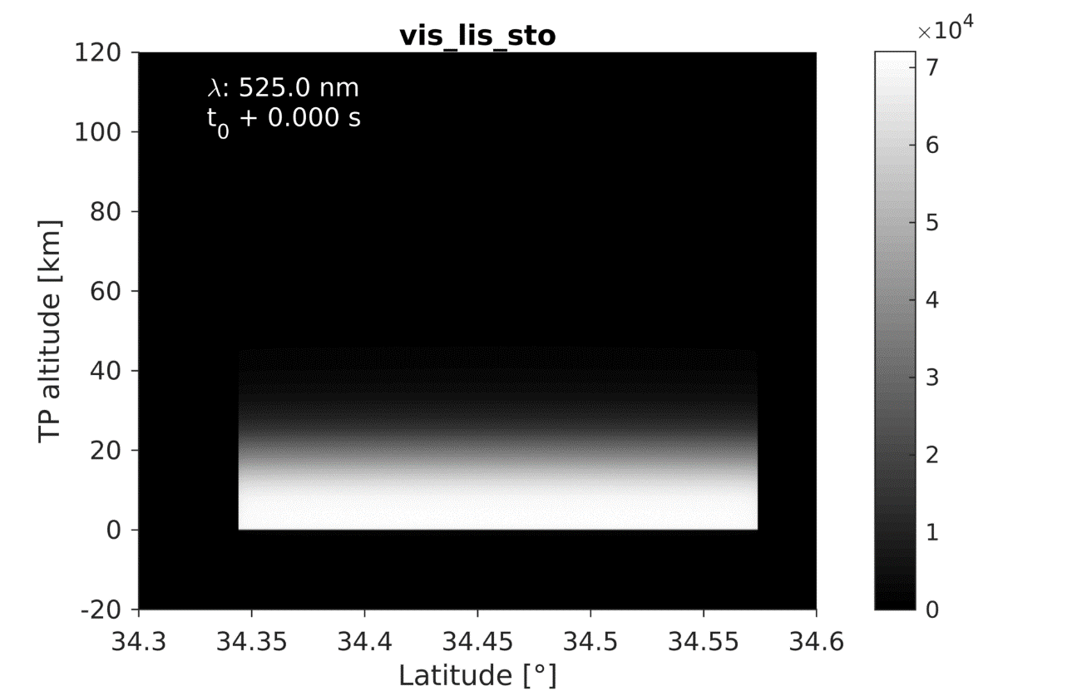
Limb scattering mode – O₃
E2E simulations using OMPS-LP L1 radiances is a complex exercise, as there are many differences between the two instruments:
  Polarisation sensitivity
  Different spectral resolutions
  Imaging vs non-imaging system (and different vertical resolution)
The raw data of ALTIUS take the form of spectral images.

Slide 21
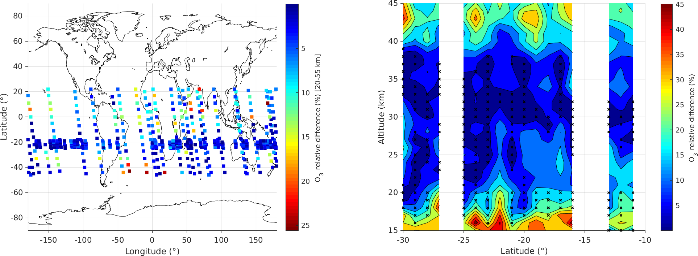
Limb scattering mode – O₃
Still solving issues with O₃ cross sections and aerosol model, but results obtained with the OMPS-LP L1 radiances are encouraging.

Slide 22
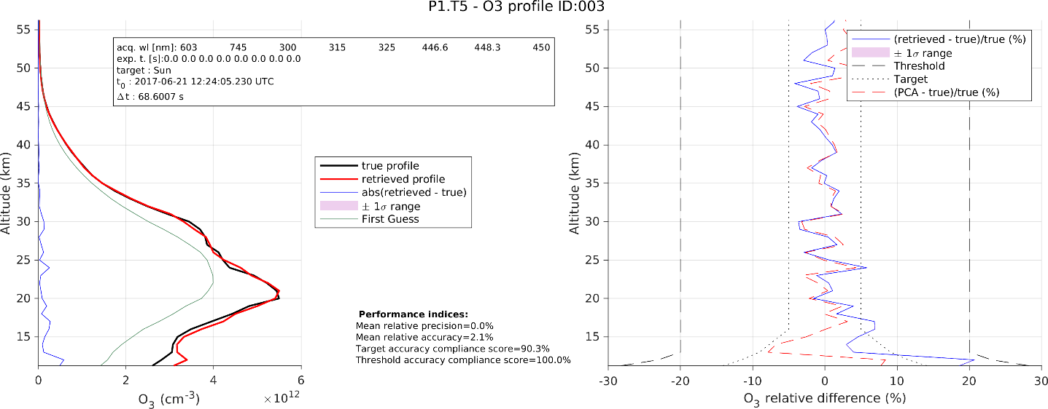
Solar occultation mode – O₃, k_{aer} , NO₂
E2E simulations of solar occultation show no particular difficulty for O₃, aerosol extinction, and NO₂ retrievals.
Typical performance of an O₃ retrieval in solar occultation.

Slide 23
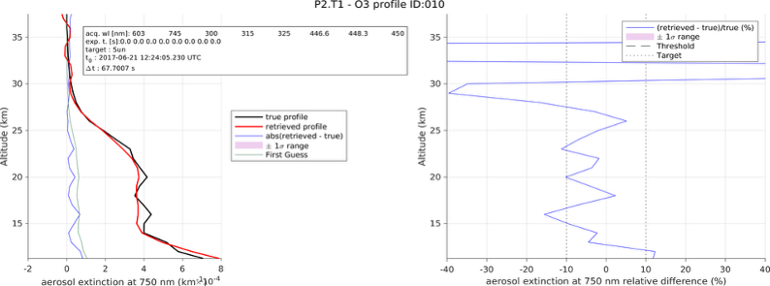
Solar occultation mode – O₃, k_{aer} , NO₂
E2E simulations of solar occultation show no particular difficulty for O₃, aerosol extinction, and NO₂ retrievals.
Typical performance of an aerosol extinction coefficient retrieval in solar occultation.

Slide 24
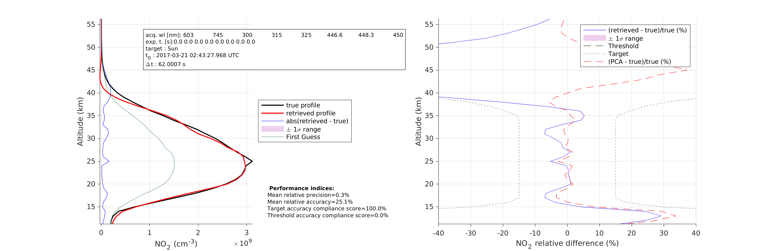
Solar occultation mode – O₃, k_{aer} , NO₂
E2E simulations of solar occultation show no particular difficulty for O₃, aerosol extinction, and NO₂ retrievals.
Typical performance of an NO₂ retrieval in solar occultation.

Slide 25
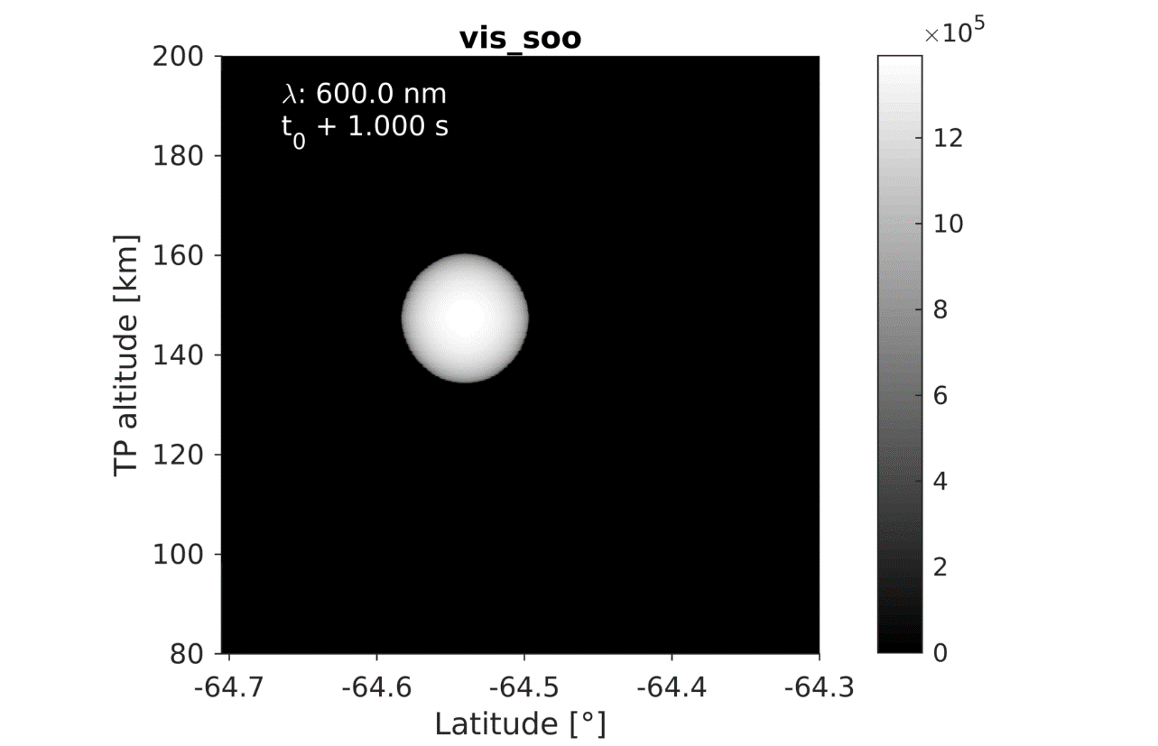
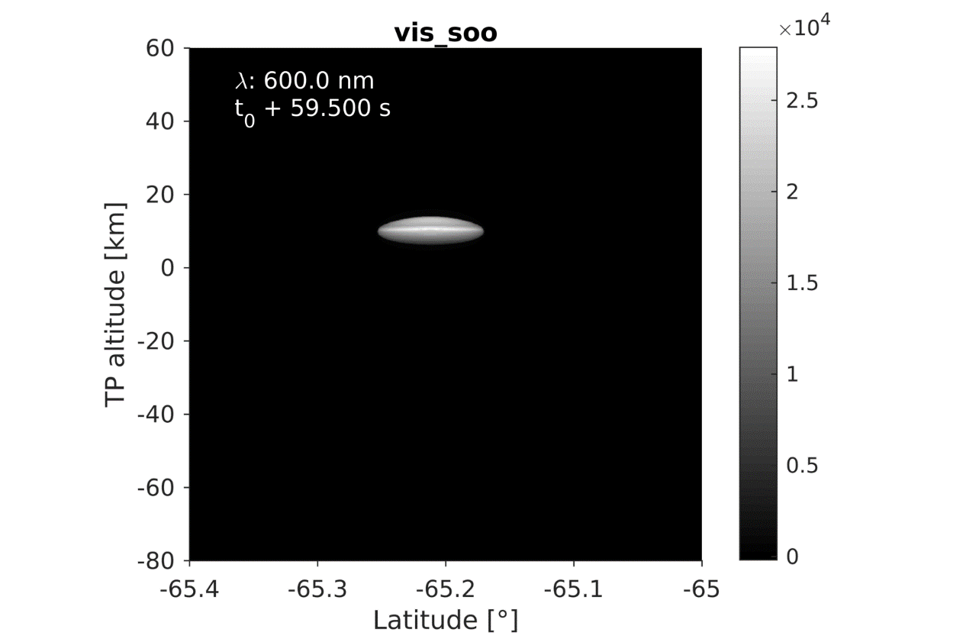
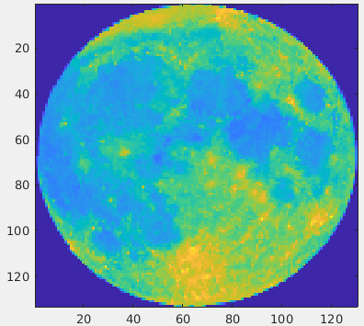
Solar occultation mode – O₃, k_{aer} , NO₂
E2E simulations based on the SAGE-III/ISS L1 transmittances are also performed for testing the solar (and soo the lunar) occultation mode.

Slide 26
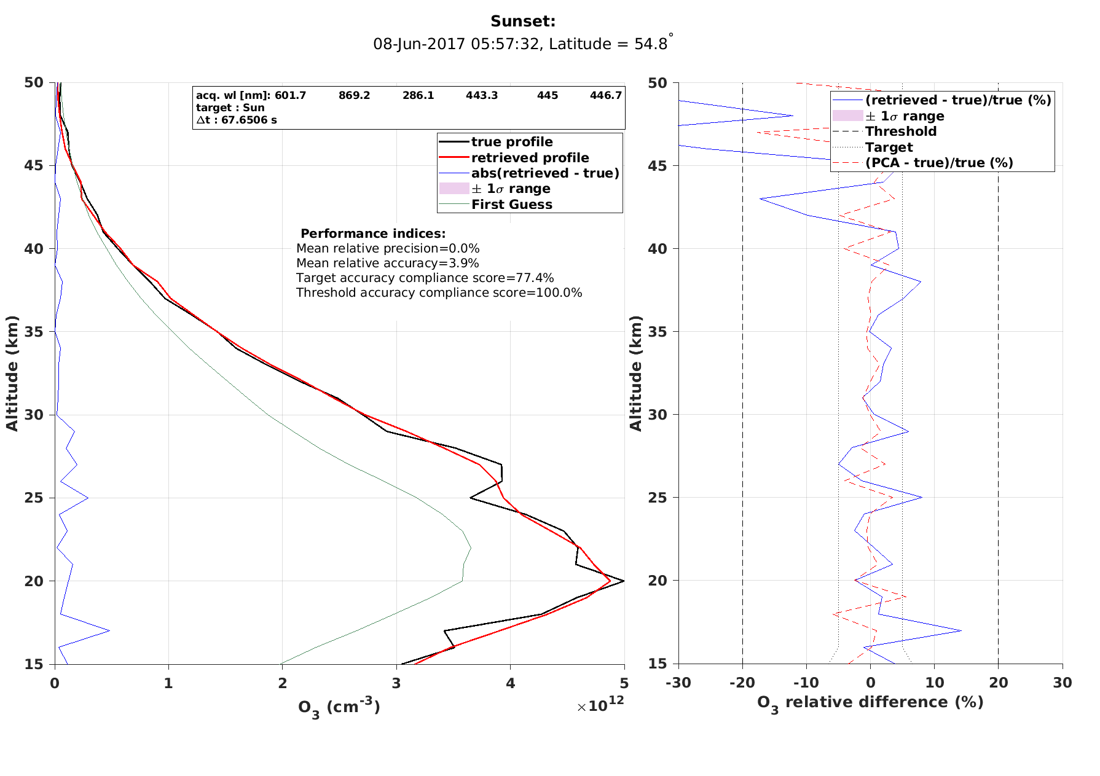
Solar occultation mode – O₃, k_{aer} , NO₂
Full end-to-end processing of a few SAGE-III occultations
! The SPS takes ages to fabricate the hundreds of spectral images acquired by ALTIUS during the occultation !
O₃ retrievals are always in excellent agreement with SAGE-III solution.

Slide 27
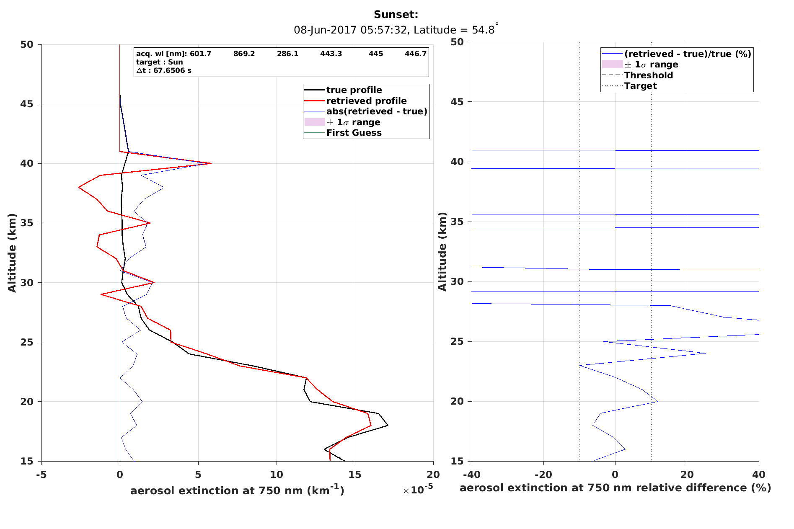
Solar occultation mode – O₃, k_{aer} , NO₂
Full end-to-end processing of a few SAGE-III occultations
! The SPS takes ages to fabricate the hundreds of spectral images acquired by ALTIUS during the occultation !
O₃ retrievals are always in excellent agreement with SAGE-III solution.
Aerosol extinction coefficient at 750nm are also good (now considering to use v6.0 for easier conversions over wavelengths).

Slide 28
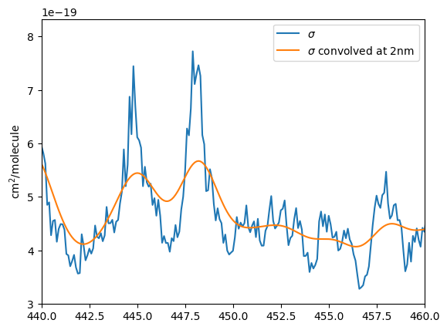
Solar occultation mode – O₃, k_{aer} , NO₂
Full end-to-end processing of a few SAGE-III occultations
! The SPS takes ages to fabricate the hundreds of spectral images acquired by ALTIUS during the occultation !
O₃ retrievals are always in excellent agreement with SAGE-III solution.
Aerosol extinction coefficient at 750nm are also good (now considering to use v6.0 for easier conversions over wavelengths).
NO₂ retrievals are not yet ok due to:
Spectral resolution of ALTIUS is at the limit
Spectral gaps in SAGE L1s are filled arbitrarily

Slide 29
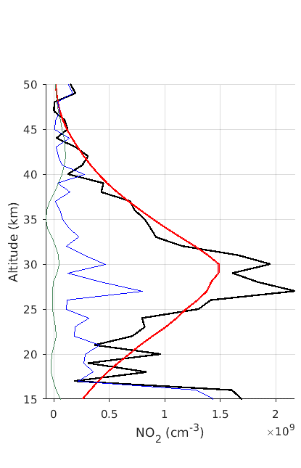
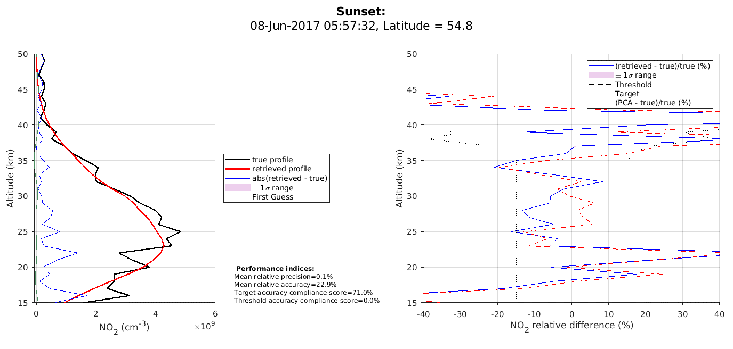
Solar occultation mode – O₃, k_{aer} , NO₂
Full end-to-end processing of a few SAGE-III occultations
! The SPS takes ages to fabricate the hundreds of spectral images acquired by ALTIUS during the occultation !
O₃ retrievals are always in excellent agreement with SAGE-III solution.
Aerosol extinction coefficient at 750nm are also good (now considering to use v6.0 for easier conversions over wavelengths).
NO₂ retrievals are not yet ok due to:
Spectral resolution of ALTIUS is at the limit
Spectral gaps in SAGE L1s are filled arbitrarily
Sunrise Sunset

Slide 30
Stellar occultation mode – O₃, k_{aer} , NO₂
The stellar occultation mode is struggling with a low SNR.
Star scintillation is more difficult to manage in absence of fast photometers like in GOMOS.
→ E2E simulations confirm feasibility with 10 stars + 5 planets.

Slide 31
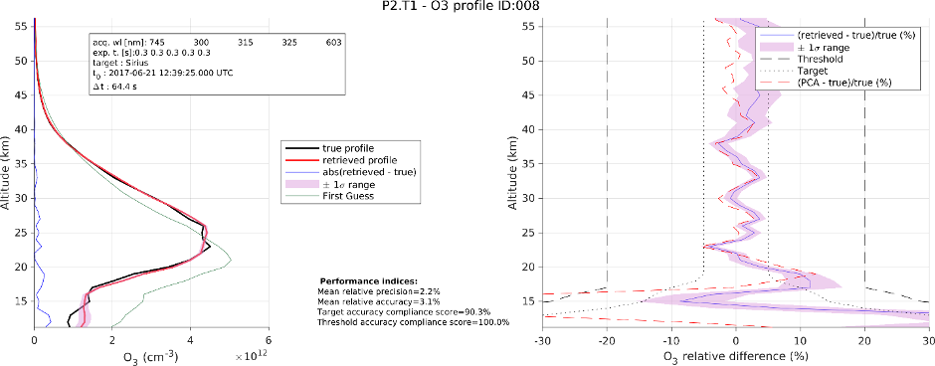
Stellar occultation mode – O₃, k_{aer} , NO₂
The stellar occultation mode is struggling with a low SNR.
Star scintillation is more difficult to manage in absence of fast photometers like in GOMOS.
→ E2E simulations confirm feasibility with 10 stars + 5 planets.
Typical synthetic retrieval performance for O₃ retrieval.

Slide 32
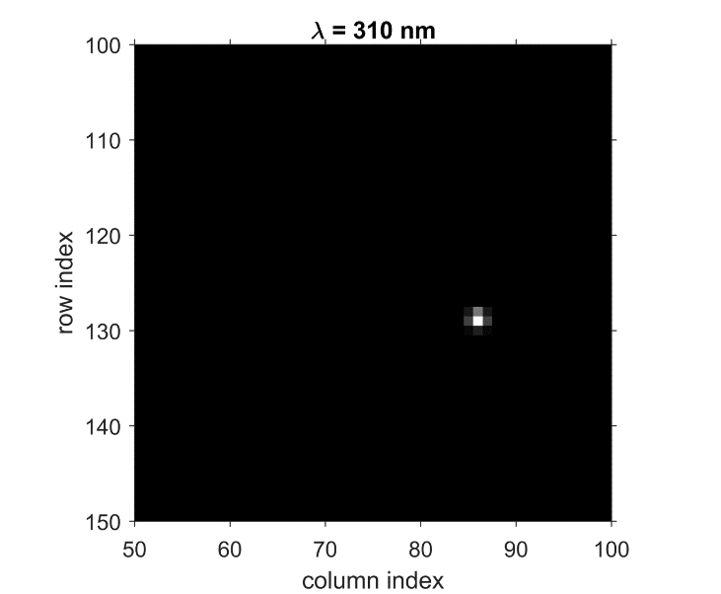
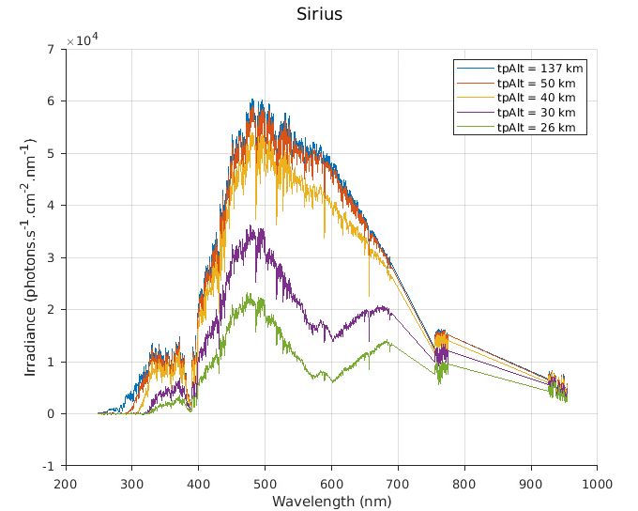
Stellar occultation mode – O₃, k_{aer} , NO₂
E2E simulations based on GOMOS L1 star irradiance spectra are confirming that ALTIUS can will be able to deliver nighttime O₃ profiles, and aerosol extinction profiles in case of event.
ALTIUS
GOMOS

Slide 33
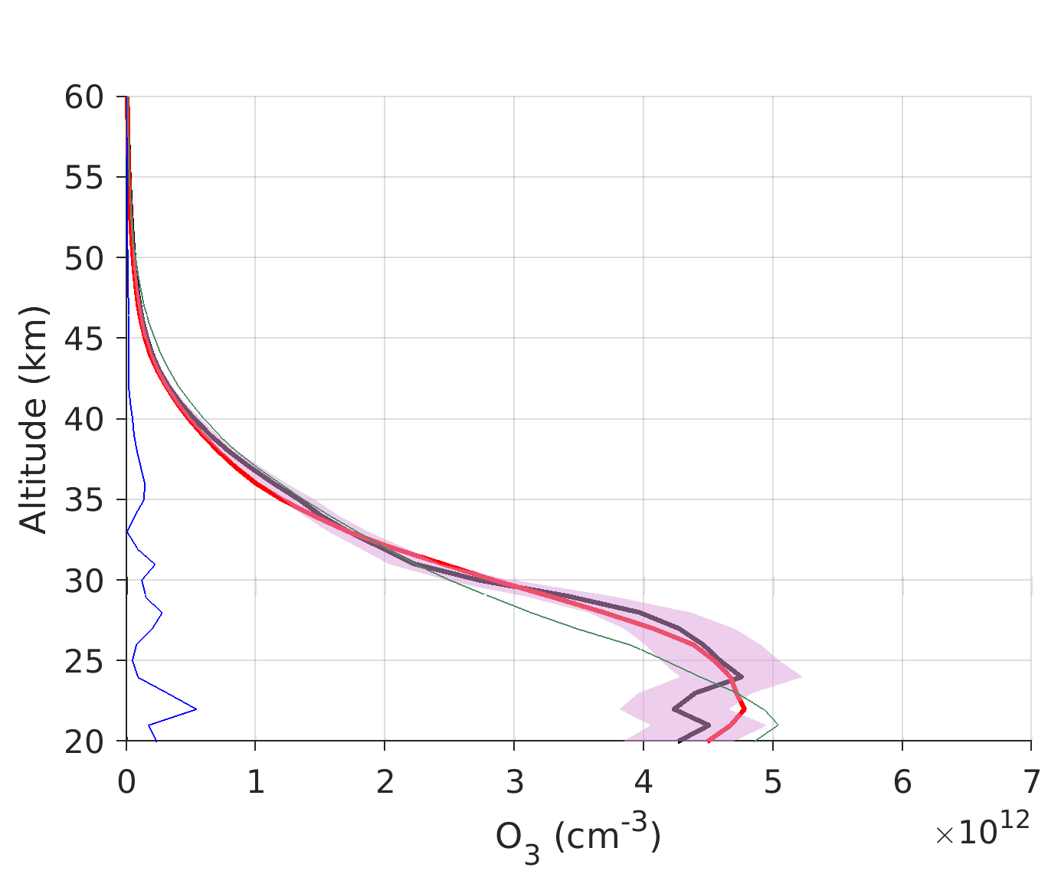
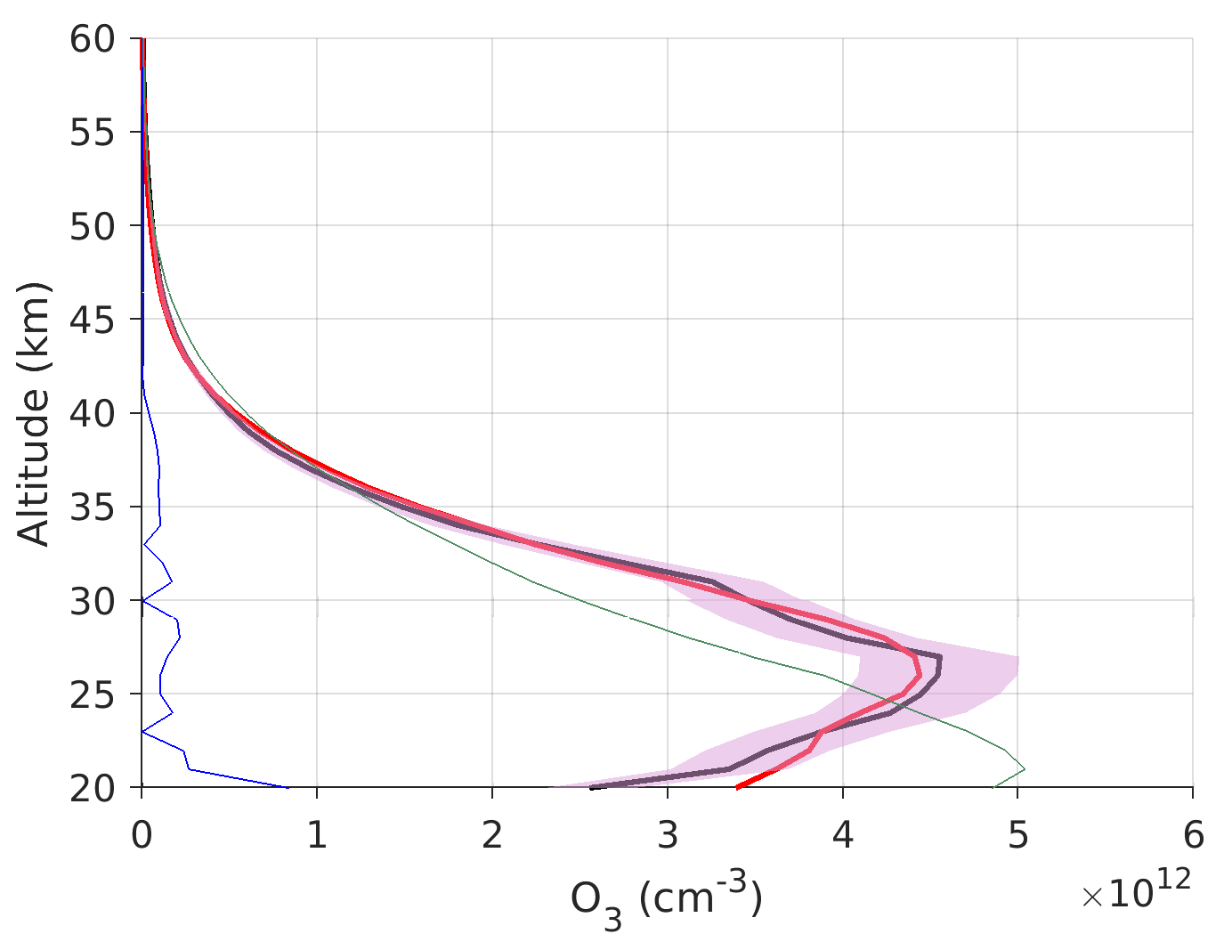
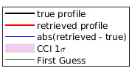
Stellar occultation mode – O₃, k_{aer} , NO₂
Full end-to-end processing of GOMOS data were achieved with the SPS, and the baseline L2P.
The 10 brightest stars + 5 planets seem feasible.
Rigil
Achernar

Slide 34
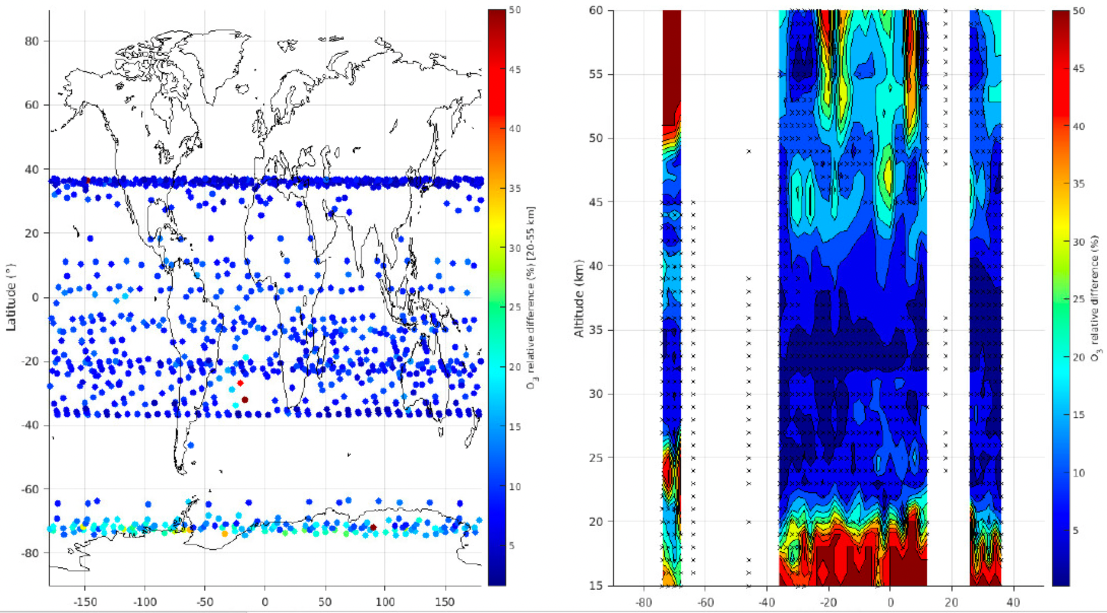
Stellar occultation mode – O₃, k_{aer} , NO₂
Full end-to-end processing of GOMOS data (O₃) were achieved with the SPS (very slow), and the baseline L2P.
Hundreds of occultations of year 2004 were processed. Good agreement is observed down to 20km for O₃.

Slide 35
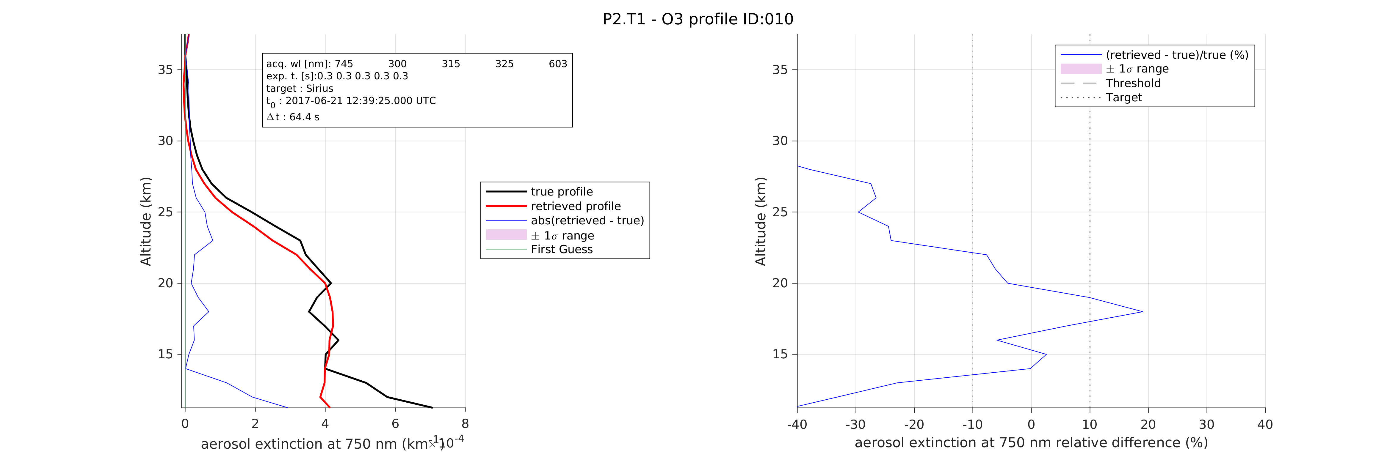
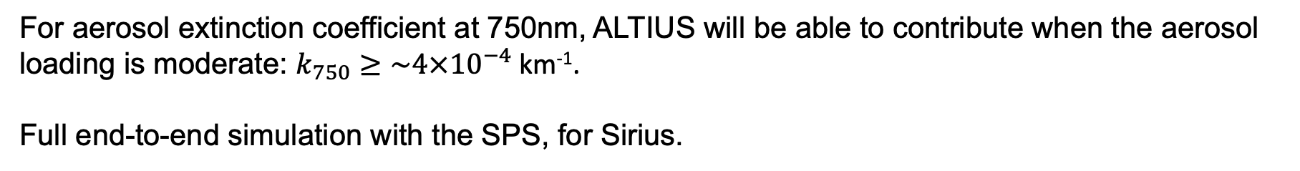
Stellar occultation mode – O₃, k_{aer} , NO₂
For aerosol extinction coefficient at 750nm, ALTIUS will be able to contribute when the aerosol loading is moderate: $k_{750}≥\sim 4×{10}^{−4}$ km⁻¹.
Full end-to-end simulation with the SPS, for Sirius.

Slide 36
Stellar occultation mode – O₃, k_{aer} , NO₂
For NO₂, there is not enough SNR in the stars signal.
Planetary occultations still need to be tested with the SPS.

Slide 37

Conclusions
ALTIUS space segment is making progresses → calibration in 2026 → launch in 2027
The L1 and L2 products performance are assessed with the SPS (instrument perf. simul.)
“Altiusification” of L1s from other limb sounders is helping checking our perf. and algos.
 | O₃ | k₇₅₀ | NO₂ | H₂O
Limb-scatter | Simul: Real: OMPS-LP | Simul: see USASK Real: see USASK | To be started | In progress
Solar/Lunar occultation | Simul: Real: SAGE-III | Simul: Real: SAGE-III | Simul: Real: SAGE-III | In progress
Stellar occultation | Simul: Real: GOMOS | Simul: >4.10⁻⁴km⁻¹ Real: GOMOS | Simul: x Real: x | x
Planetary occultation | Simul: Real: TBD | Simul: Real: TBD | Simul: TBD Real: TBD | ?

Slide 38

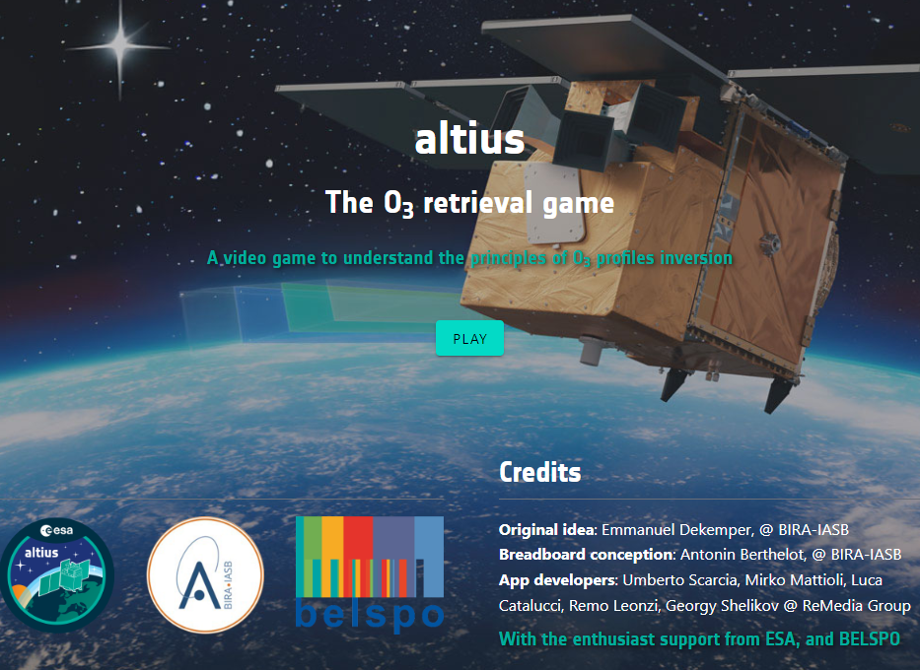
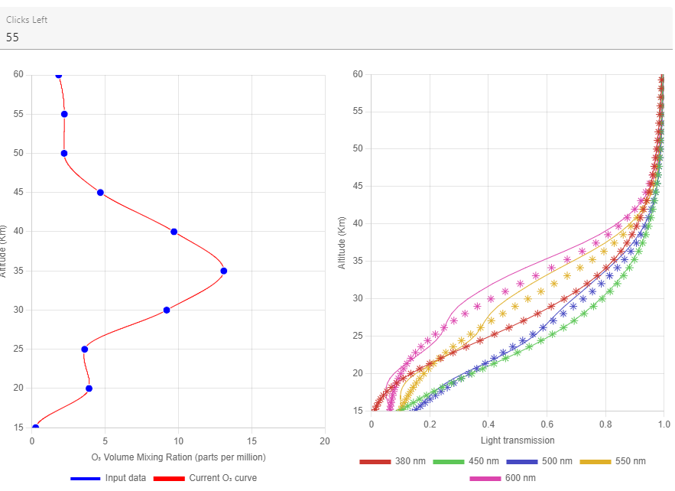
The O₃ retrieval game
visit → altius.aeronomie.be/altius-video-game

