Slide 1
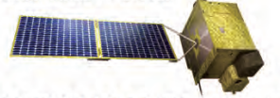
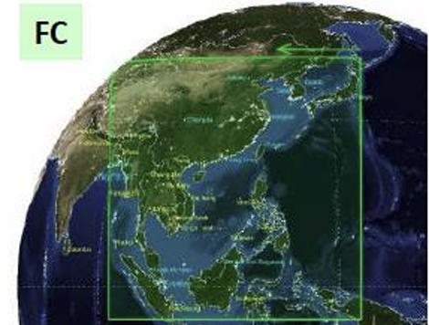
GEMS OZONE PODUCTS
Total Column Ozone and Ozone Profile
Jaehwan Kim
Juseon Bak, Hyunjin Lee, Sungjae Hong
Pusan National University

Slide 2
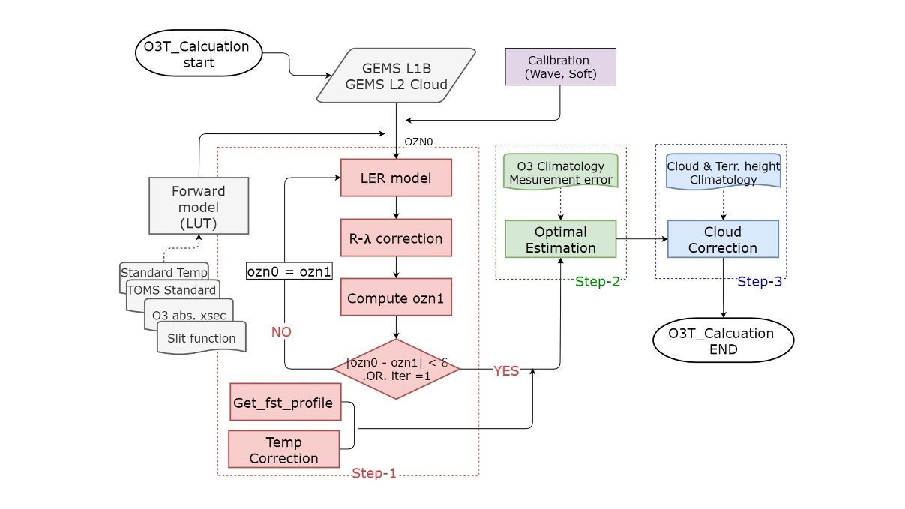
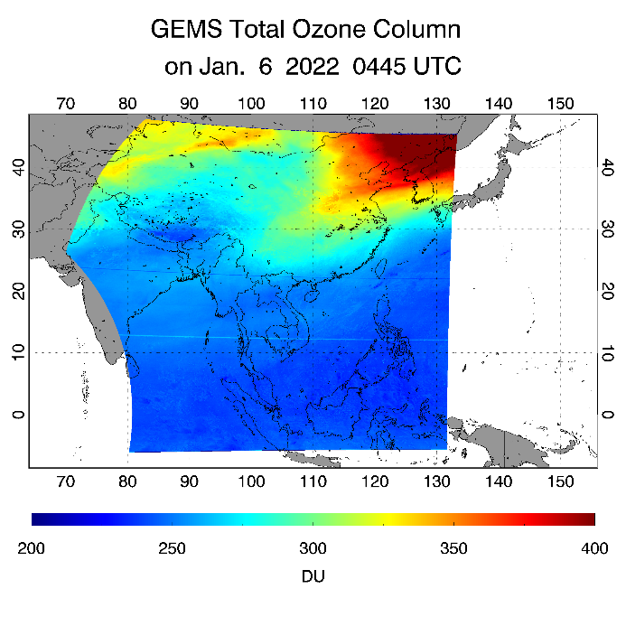
GEMS Total Column Ozone (O3T) algorithm
GEMS O3T algorithm (V2.1)
Based on NASA/TOMS V9 algorithm retrieved total ozone with (312.5, 317.5, 331nm) and then optimized them to get final total ozone
GEMS TCO is retrieved 6 to 10 times per day, depending on the season.
GEMS TCO on Jan 6., 0445 UTC

Slide 3
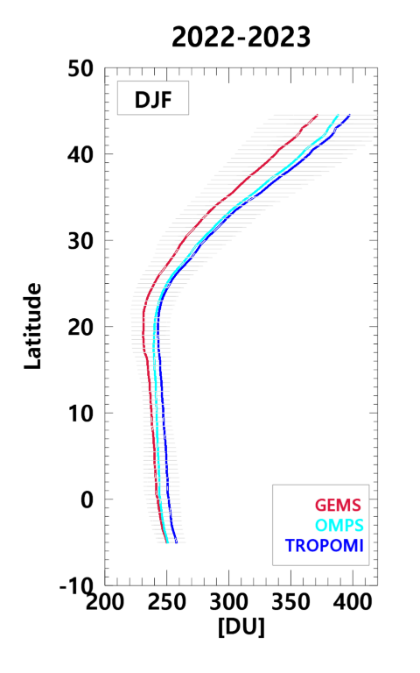
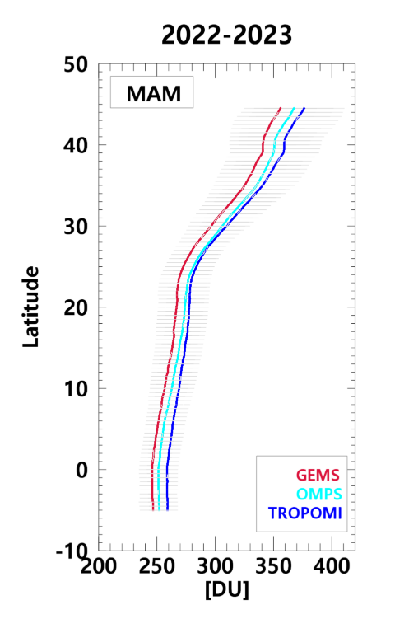
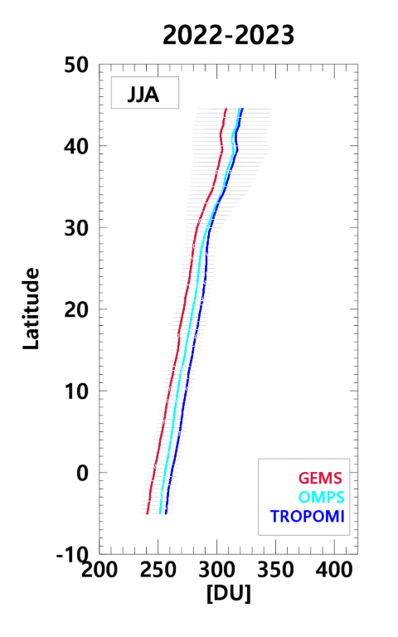
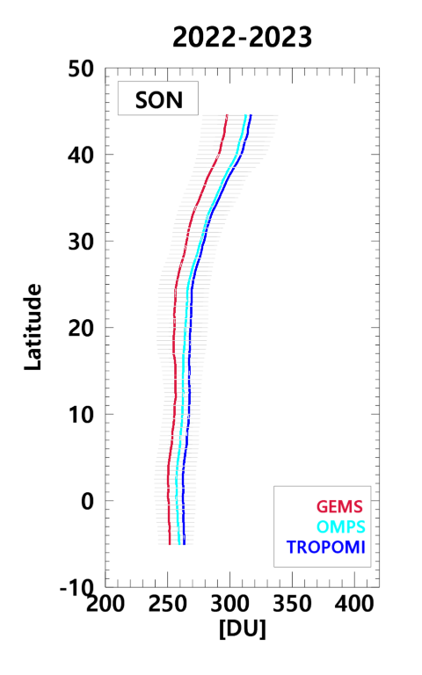
GEMS vs TROPOMI vs OMPS
Zonal mean TCO
for each season
from satellites
GEMS TCO patterns are generally similar to those of TROPOMI and OMPS.
GEMS shows a systematic low bias in TCO compared to TROPOMI, with differences of approximately 10 DU in equatorial regions and up to 30 DU in the mid-latitudes during winter.

Slide 4
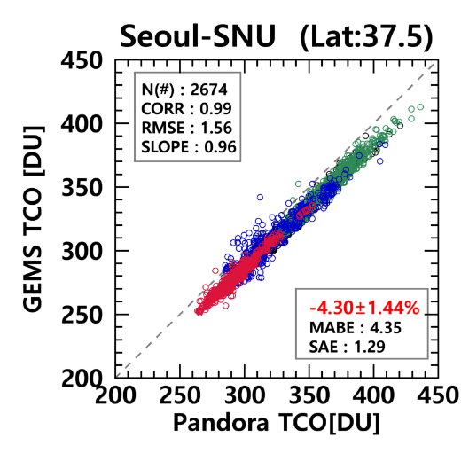
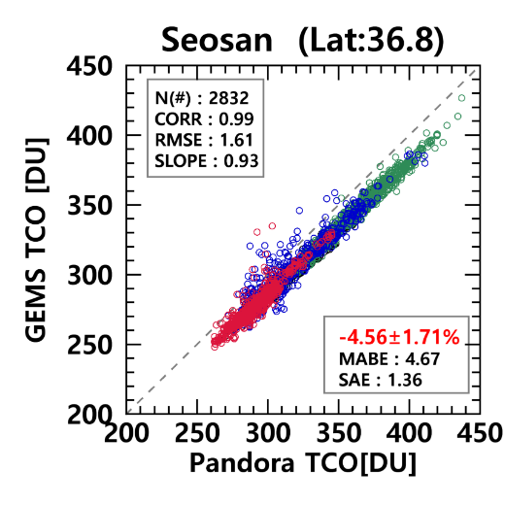
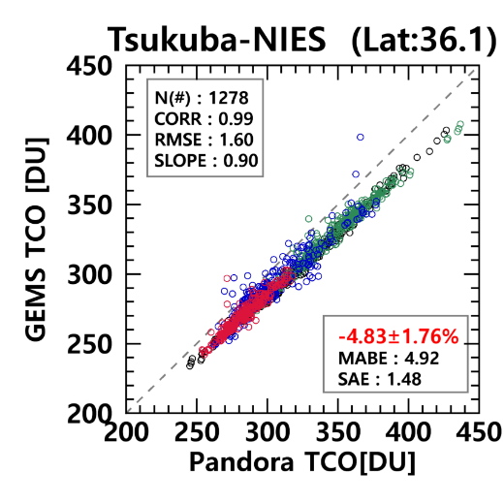
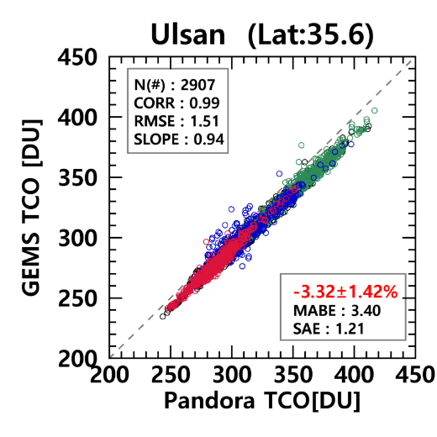
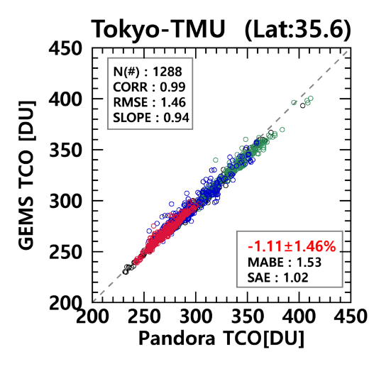
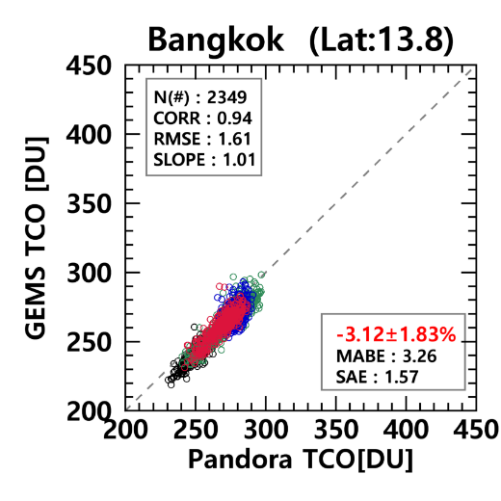
Validation for GEMS O3T with Pandora
Scatter plots of Pandora with GEMS
Seasons : Black (Winter)
Green (Spring), Blue (Summer),
Red (Autumn)
Consistent negative bias
(-4.8% to -1.1%) of GEMS vs
Pandora TCO
No significant seasonal variation observed.

Slide 5
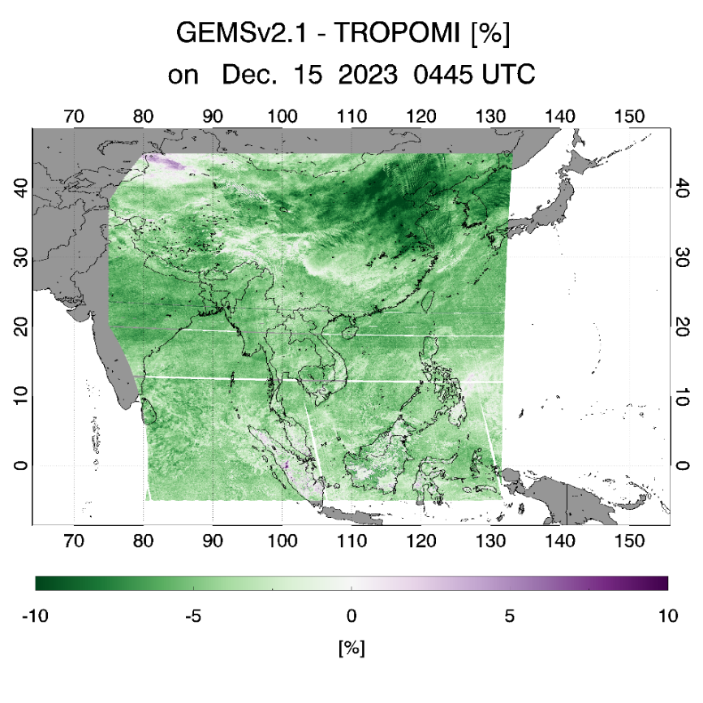
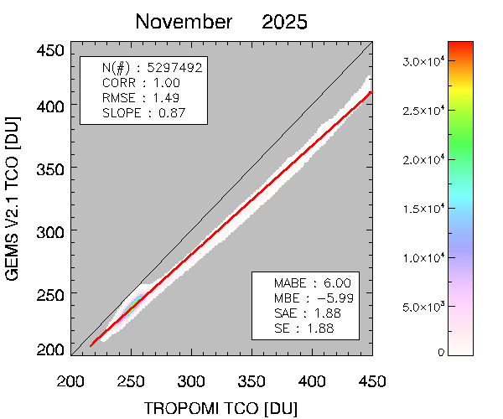
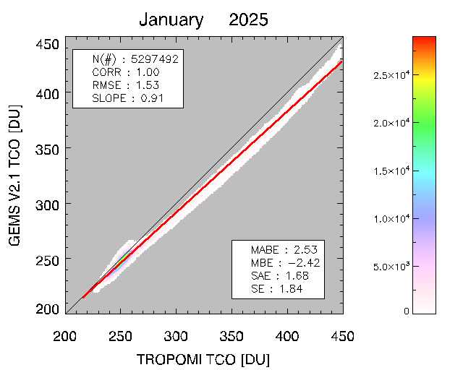
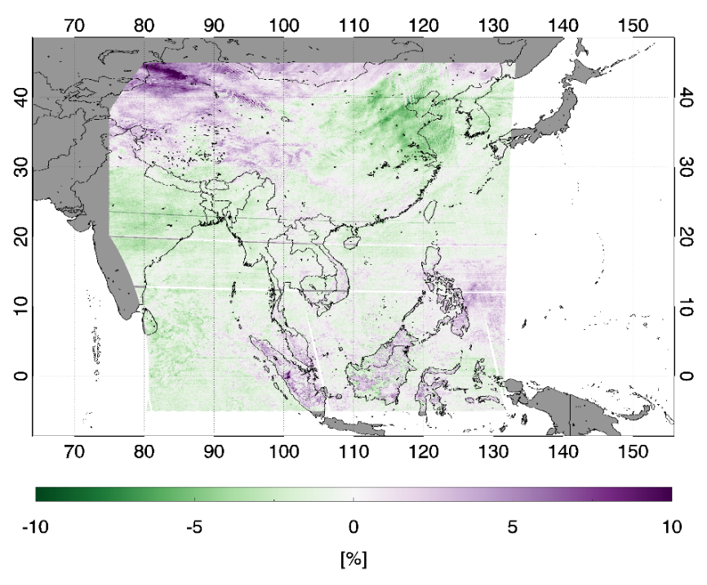
Further Plans
GEMS O3T V2.1 shows improved stability with reduced seasonal variation and latitude dependent bias.
However, it still tends to underestimate TCO compared to other satellites and ground based observations.
Two approaches were considered to resolve the issue; one will be implemented.
1. L1C data suitable for GEMS O3T
2. Post calibration
  Applied correlation equation derived from ground- based vs. GEMS TCO
GEMS – TROPOMI [%]
Dec. 15 2023 0445 UTC
2025-updated irradiance data
-4.36±1.98
January 2025
January 2025
-0.42±1.89
GEMS V2.1 [DU]
GEMS V2.1 O3T_corr [DU]
-5.99
±1.88
-2.42
±1.68
V3.0
operation
TROPOMI TCO [DU]
TROPOMI TCO [DU]
operation
V3.0

Slide 6

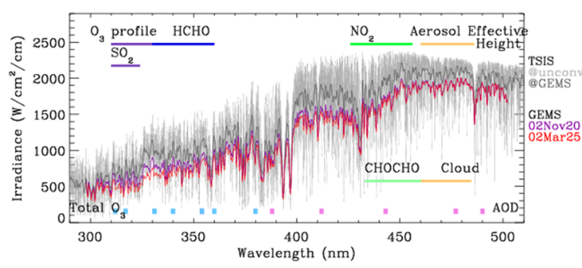
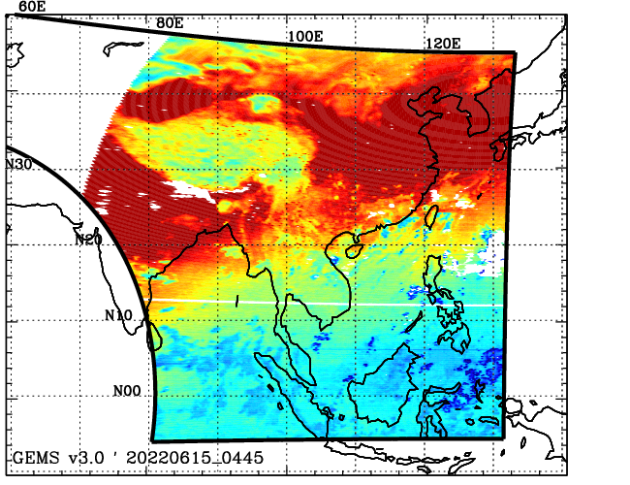
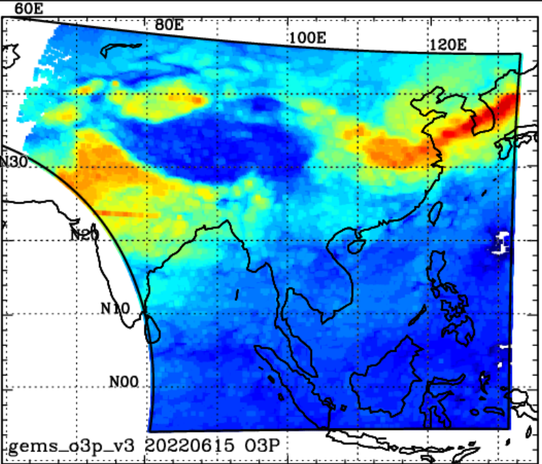

GEMS O3Profile algorithm
Inverse method is an optimal estimation, which iteratively estimates the geophysical variables until the simulated spectrum closely matches the measured spectrum, within the retrieval constraints of the a priori information.
GEMS (310-330 nm) + on-line radiative transfer (VLIDORT) + A priori constraints (climatology)
O3 partial columns (DU) for 24 layers from surface to 65 km (2.5 km thickness)
+ integrated column amounts up to the tropopause
$$\hat{X}=F^{−1}\left(y\right) ⇔X_{ap}$$
GEMS radiometric uncertainties
Implement calibration modules in v3.0 processing
<Irradiance offset> - 30 % @ 325 nm
GEMS v2.0
GEMS v3.0
Solar reference
GEMS Irradiance
Tropospheric column ozone (20220615)

Slide 7
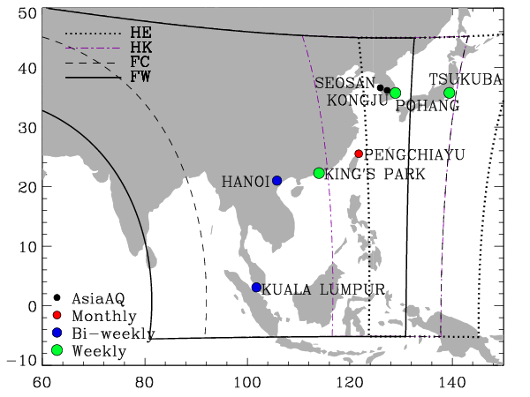
Validation for GEMS 2021.01-2024.12
Global international network
Station | Pohang | Tsukuba | King’s park | Hanoi | Pengchiayu | Kuala Lumpur
Country | South Korea | Japan | Hong Kong | Vietnam | Taiwan | Malaysia
Lon, LAT (deg.) | 36.03, 129.38 | 36.06, 140.13 | 22.31, 114.17 | 21.02, 105.804 | 25.63, 122.08 | 2.73, 101.7
Provider | WOUDC | WOUDC | WOUDC | SHADOZ | WOUDC | SHADOZ
Frequency | Weekly | Weekly | Weekly | Bi-weekly | Monthly | Bi-weekly
Launch Time (LT) | 2:00 pm | 2:30 pm | 1:30 pm | 1:00 pm | 12:00 am | 12: 30 am
Beginning date | 1995-01-12 | 2017-06-22 | 2000-01-05 | 2004-09-18 | 2022-04-18 | 1998-05-04
Latest update | 2024-06-26 | 2025-02-27 | 2024-12-31 | 2024-02-23 | 2024-05-12 | 2022-12-22
GEMS 04:45 UTC (13:34 UTC) Full west (FW) observations are used for comparison with ozonsonde
observations mostly launched in the late afternoon (12:30 – 2:30 pm. LT)
Tsukuba ozonesondes are matched with GEMS Full center (FC) observations available at 01:45, 02:45, & 03:45 UTC

Slide 8
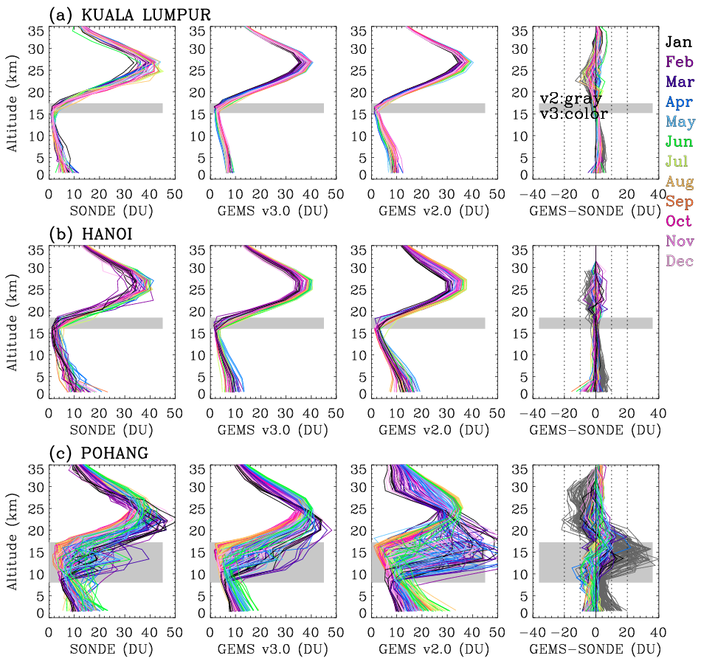
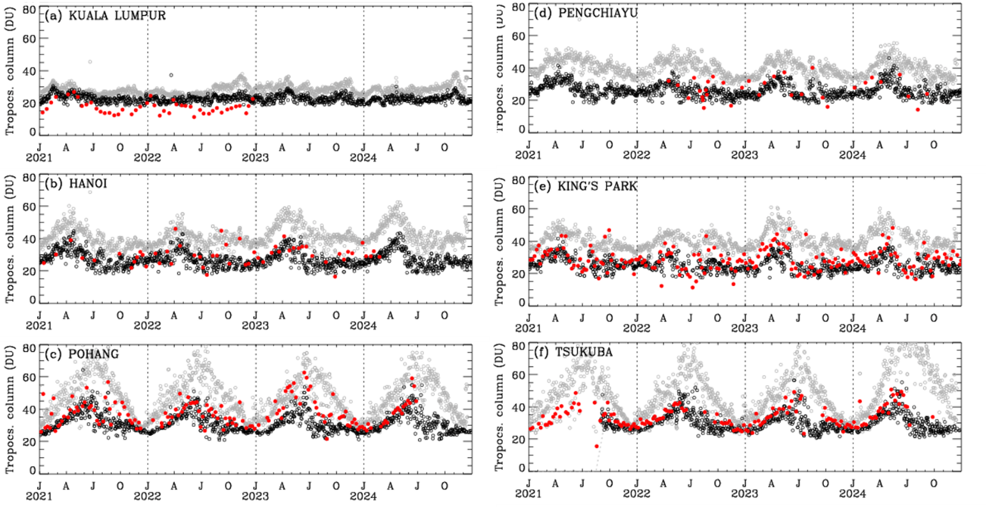
Ozone vertical profiles
Time series of TCO (sfc-300 hPa)
(tropics)
Ozonesonde
GEMS v2.0
GEMS v3.0
(sub-tropics)
(mid-latitude)
Compared to GEMS v2.0, the updated GEMS v3.0 demonstrates substantial improvements in reproducing ozone vertical profiles, particularly at the mid-latitude site of Pohang.
V3.0 column ozone reasonably reproduces this seasonal pattern observed in ozonesonde
ozone amounts in 2023 and 2024 compared to earlier years

Slide 9
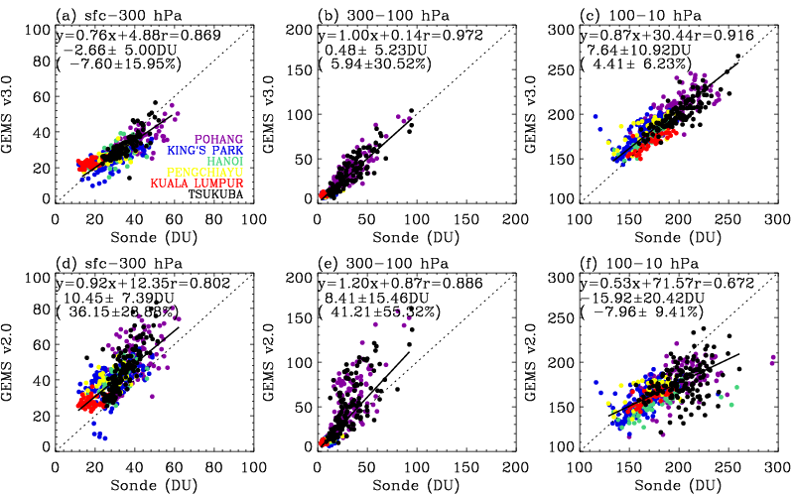
Quantitative comparison between GEMS and ozonesonde
v3.0
Sfc-300 hPa
300-100 hPa
100-10 hPa
GEMS v3.0 shows a marked improvement, reducing the bias shown in GEMS v2.0 tropospheric column ozone to −7.6% with lower scatter (±15.95%) and achieving a higher correlation with ozonesonde observations
GEMS v2.0 also underestimate the upper stratospheric column ozone by
-16 DU(-8 %), but this bias becomes
smaller in GEMS v3.0, with a slight
overestimation of 4%.
v2.0
GEMS v3.0 provides a better representation compared to both GEMS v2.0 and the a priori information.

Slide 10


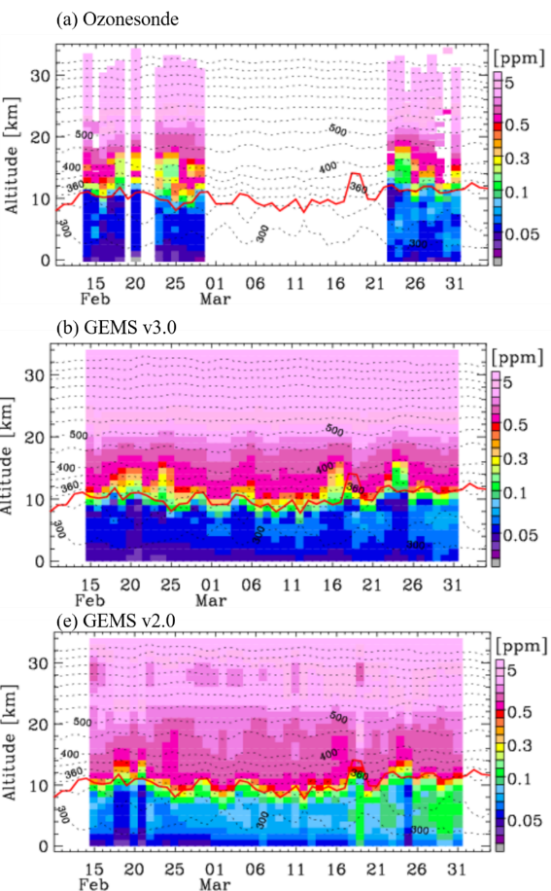
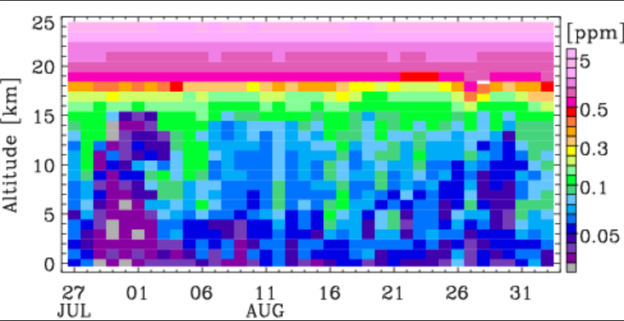
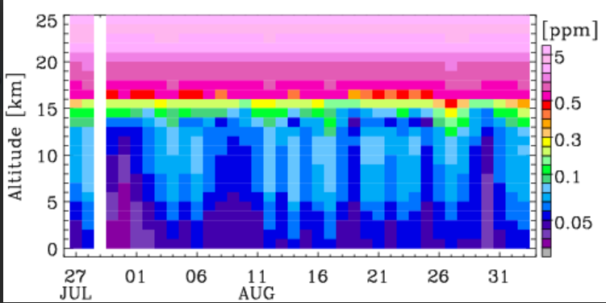
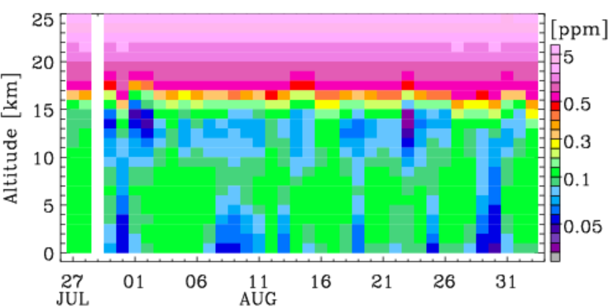
Ozone profiles during and campaigns
2024 winter (Feb/Seosan-March/KongJu) Asia AQ
O3sonde
GEMS v3.0
GEMS v2.0
- the increase of ozone concentration from 50 ppb to 70 ppb in the troposphere
2022 summer (August @ Anmyeondo) ACCLIP campaign
O3sonde
GEMS v3.0
GEMS v2.0

Slide 11
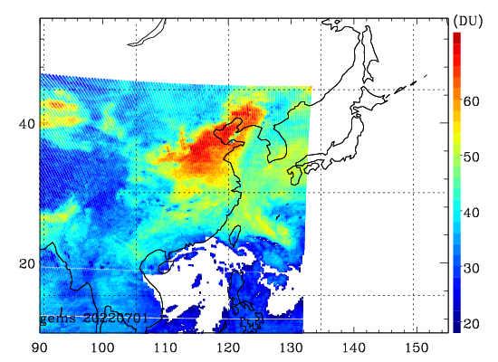
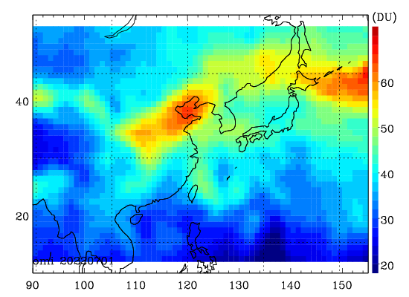
Tropo. Column ozone distribution (Aug 06, 2022)
GEMS 04:45 UTC Aug 06
OMI Aug 05-07

Slide 12
Summary
Total O3
The updated GEMS O3T v2.1, released in 2024, is stable for all variables and shows significant improvements in reducing bias dependence on latitude and season compared to GEMS O3T v2.0. However, v2.1 exhibits an increased negative bias.
The negative bias in v2.1 is expected to be improved through updated in L1C and post calibration, and will be addressed in the planned O3T v3.0 updated.
O3 profile
GEMS wavelength and radiometric calibration processes have been implemented for both radiances and irradiances, leading to significant improvements in ozone profile retrievals for GEMS v3.0
We demonstrate that GEMS v3.0 reasonably represent ozone vertical structures across latitudes and capture its temporal variations.
Compared to ozonesonde measurements, GEMS total column ozone (TCO) and stratospheric column ozone (SCO) show biases of −7% and +4%, respectively.
The enhanced GEMS v3.0 product is now available via NIER data distribution platform

