Slide 1
Sentinel 4 total ozone columns current status
K.-P. Heue¹, W. Zimmer¹, D. Loyola¹ and the Sentinel-4 Level-2 team
Institut für Methodik der Fernerkundung am Deutschen Zentrum für Luft- und Raumfahrt (DLR), Oberpfaffenhofen, Germany
Notes:
<number>

Slide 2
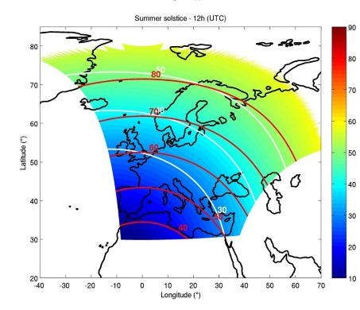
Sentinel-4
Will be geostationary over Europe, the Mediterranean and northern most Africa
Hourly scans from east to west
Current launch date ~ 1st July
Courtesy of: Jeroen van Gent (BIRA)

Slide 3
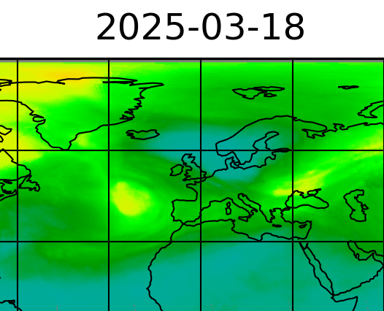
total ozone column over Europe
Small ozone depletion over Europe (mid March)
A daily cycle is not expected
Annual cycle with springtime maximum
https://mpc-l2.tropomi.eu/#

Slide 4
Sentinel 4 ozone algorithm
Based on a long experience of ozone retrieval from GOME-2 (GDP 4.9 AC SAF) and S5P
  DOAS for the retrieval of SCD
  Iterative online AMF calculation for the VCD
Some updates with respect to DOAS retrieval:
  Include Puķīte terms
  Iterative molecular Ring correction with DOAS retrieval (Lerot et al., 2014)

Slide 5
Algorithm tests
MPIC (Jānis Puķīte) generated test spectra for 17 location in Europe, modified with noise and convolved with S4 slit function.
  Different input parameters (O3 profiles, clouds, other trace gases e.g. SO2, HCHO, NO2, )
  Hourly changes, SZA, SAA, ...
Retrieve total ozone columns with operational proccessor and compared to input total columns

Slide 6
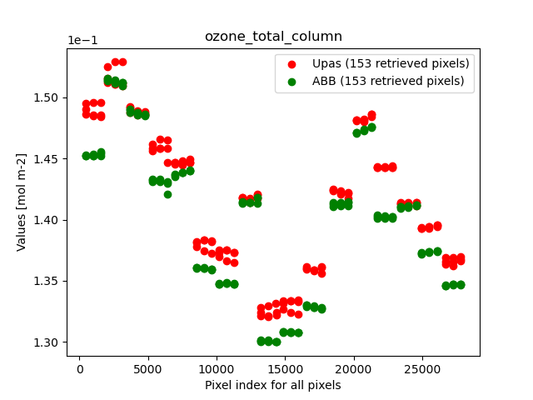
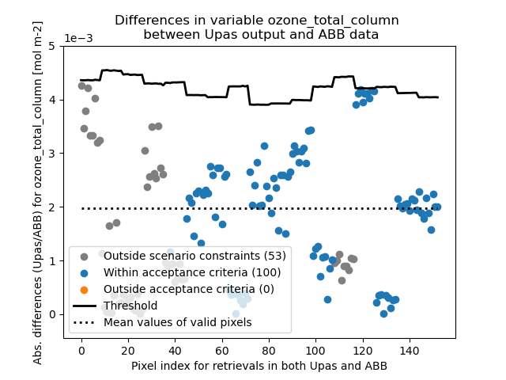
Algorithms test results
Cloudy cases (cloud fraction 0-1)

Slide 7
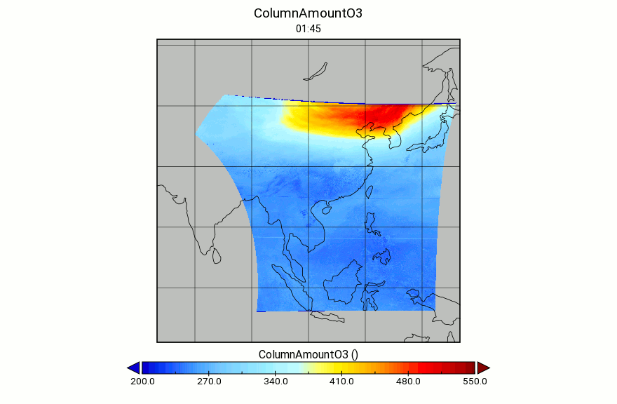
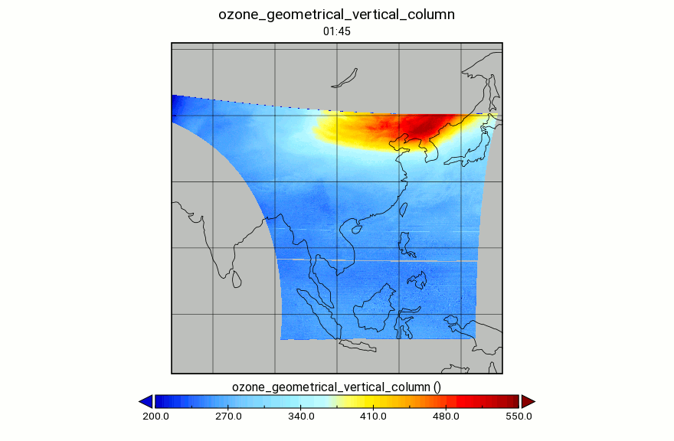
DOAS analysis of GEMS level 1
GEMS Product
S4 algorithm

Slide 8
VCDs from GEMS
Are to be proccessed
Are to be proccessed
SCD and VCD from TEMPO

Slide 9
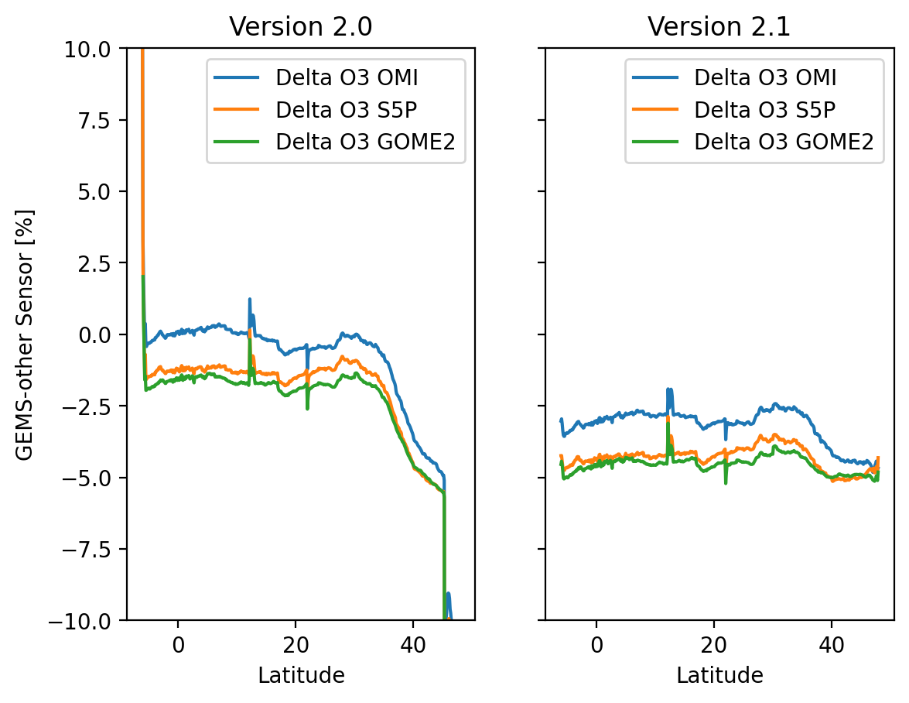
Validation plans
Compare to exsisting LEO-satellite Instruments TROPOMI, GOME-2
(see PEGASOS presentation 3.21 )

Slide 10
Summary
The Sentinel 4 total ozone processor is running and performing well on synthetic test data.
Also L2-input data e.g. clouds have been successfully tested
First spectra expected by End of September

