Slide 1



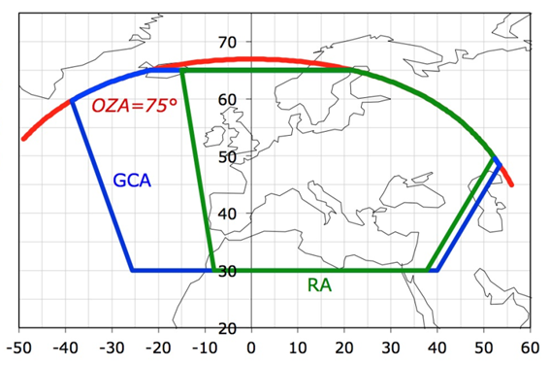
Sentinel 4
Tropospheric Ozone
AC-VC#21 Geo Ozone Missions, 10 June 2025
Richard Siddans, Andy Smith, Ka Lok Chan, Barry Latter, Brian Kerridge
Rutherford Appleton Laboratory Space, Harwell Oxford, United Kingdom

Slide 2
Sentinel 4 (S4) Tropospheric Ozone (OTR) processor
Tropospheric Ozone processor based on RAL nadir-uv ozone profile scheme,
as applied to GOME, SCHIAMACHY, GOME-2, OMI and S5P via ESA Ozone CCI / Copernicus C3S
(Munro, 1997; Siddans 2003, Miles 2015)
Developed via ESA Sentinel 4 L2 Operational Processor contract, led by DLR
  Main output:
    Sub-column averaged mixing ratio between surface and 450 hPa (~6km)
    Required precision 25% goal, 40% threshold (~12-18 ppb or 5-8 DU)
    ATBD: https://zenodo.org/records/15359728
Testing of the processor mainly based on comprehensive set of (independently) simulated test data.
Also tested via limited application to GEMS and TEMPO
  Further optimisation + application to GEMS and TEMPO planned within Ozone CCI
Core ozone profile algorithm is the same as that implemented in the ESA processor for Sentinel 5.

Slide 3
S4 OTR Processor:
Key details:
Optimal estimation scheme,
using McPeters+Labow as a priori
Retrieval optimises ozone profile, then
computes / reports sub column amounts
(tropospheric, lower-stratospheric and total)
Temperature / pressure from
ECMWF forecast (via S4 ECA product)
Cloud and surface reflectance from S4 L2
On-line radiative transfer by LIDORT
  Highly optimised via “PCFM”:
  Only 20 spectral points evaluated via multiple scattering model
Ring effect model includes multiple-scattering and ozone absorption
Cloud model via effective albedo + air-mass-factor profile from LUT (account for light path with cloud)
Developed using Serdyuchenko ozone cross-sections but plan to use Birk+Wagner in flight
Co-retrieves NO₂, HCHO, BrO, SO₂ + spectral shift/squeeze, radiometric gain + offset, scene inhomogeneity parameters
Like other S4 L2, output is to NetCDF files with set of error/ warning flags and “qa_value” to identify problematic scenes

Slide 4
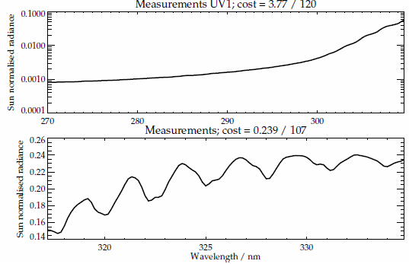
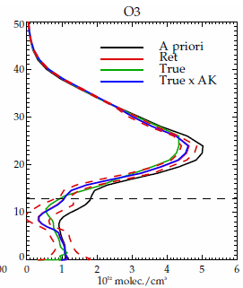
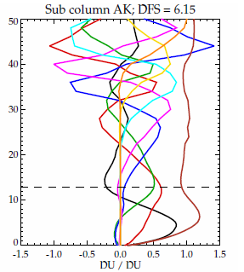
Retrieval Simulations: Sentinel 5 (Hartley + Huggins bands)
Prior / retrieved / true
Ozone profiles
Sub-column averaging kernels
Measurements: UV1 Hartley Band 270-310nm
Measurements: UV2 Huggins bands 317-339nm
Like previous polar orbiting uv spectrometers measuring Hartley + Huggins bands from 270-340nm,
S5 has ~6 degrees of freedom for ozone profile, spanning stratosphere and troposphere

Slide 5
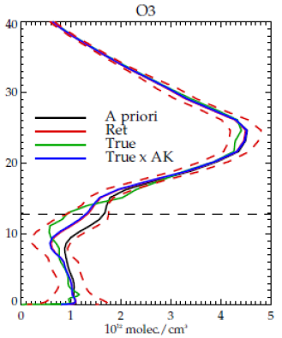
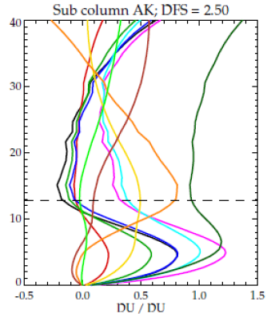
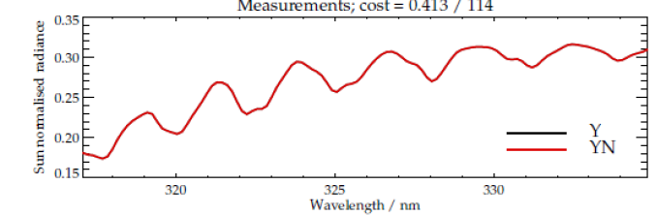
Retrieval Simulations: Sentinel 4 (Huggins bands only)
Prior / retrieved / true
Ozone profiles
Sub-column averaging kernels
Measurements: UV2 Huggins bands 317-339nm
Like GEMS + TEMPO Sentinel 4 only measures the Huggins band so lacks strospheric profile information.
S4 has ~2 degrees of freedom including tropospheric ozone sensitivity

Slide 6
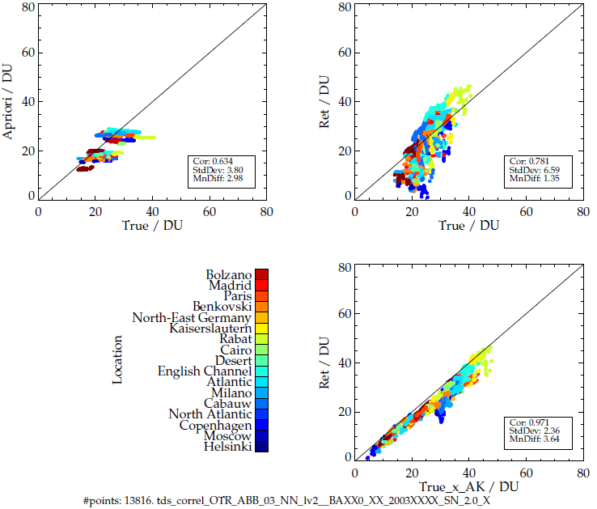
S4 OTR verification via MPIC simulated test data
Main testing during S4 developments is based on a set of simulated test data generated by Max Planck Institute for Chemistry, Mainz
Spectra simulated for 17 locations, all times of day, summer + winter, including aerosol, cloud, Ring effect, polarisation (using SCIATRAN)
OTR shown to perform as it should:
  Works well under most clear / cloud / aerosol conditions
  Ozone retrieval fails in extreme volcanic cases (cannot cope with optically thick SO2 and/or volcanic aerosol), but poor fit is flagged by L2 warning flags (and “qa_value”)
Retrieved vs True
A priori vs True
Retrieved vs True
(accounting for averaging kernel)

Slide 7
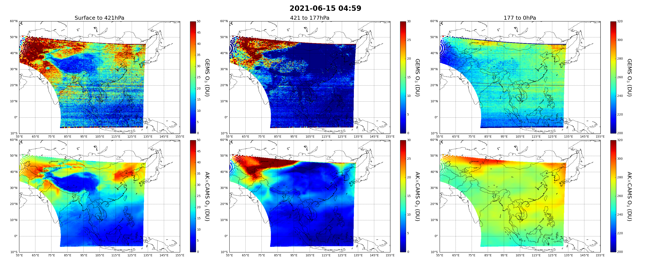
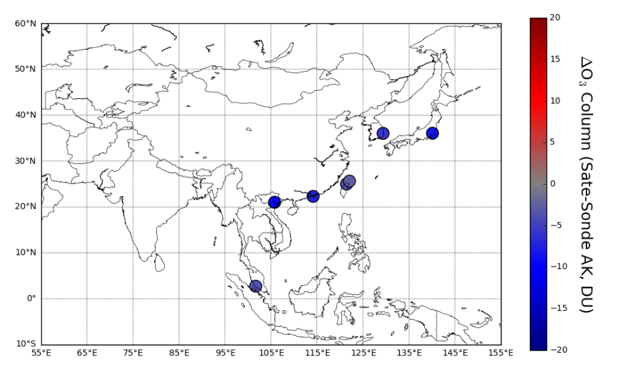
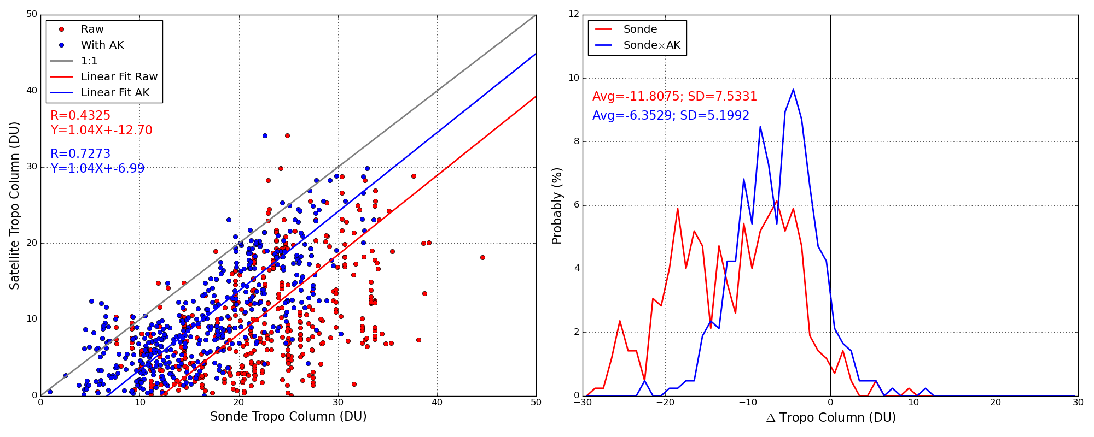
S4 OTR Applied to GEMS
E.g. scene retrieval (top) vs CAMS (bottom)
2021-06-15 05:00
Sonde comparisons:
Based on processing data on 5,15 and 25th of each month from
Nov 2020 to July 2024

Slide 8
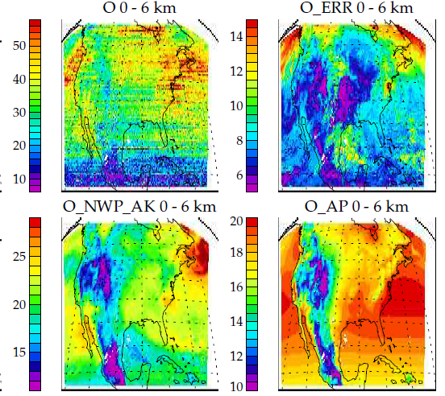
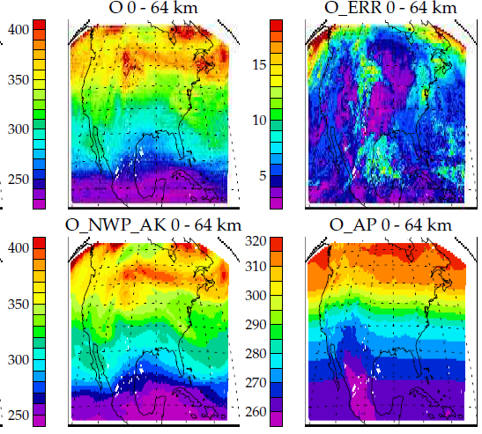
S4 OTR applied to TEMPO
Initial retrievals without degradation correction on 23 Dec 2023 18:00.
Reasonable spatial pattern in retrieval but tropospheric column has high bias.
For Both GEMS and TEMPO, an approach to empirically correct L1 systematic instrumental artefacts is being developed (based on approach used for earlier nadir sensors)
De-striping algorithm also being tested
Retrieved ozone 0-6km
Retrieved total
Trop ozone / DU
Total ozone / DU
ERA-5 ozone 0-6km (with AK)
ERA-5 total ozone (with AK)
Trop ozone / DU
Total ozone / DU

Slide 9
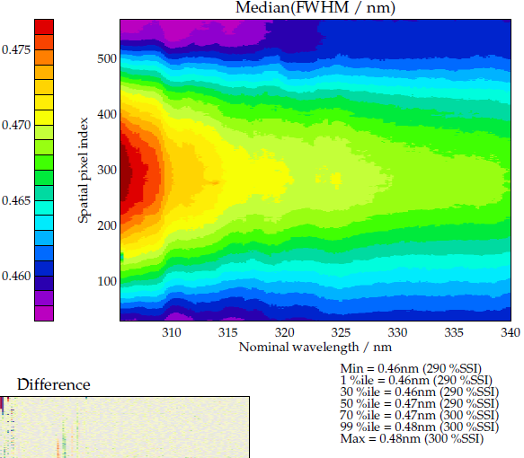
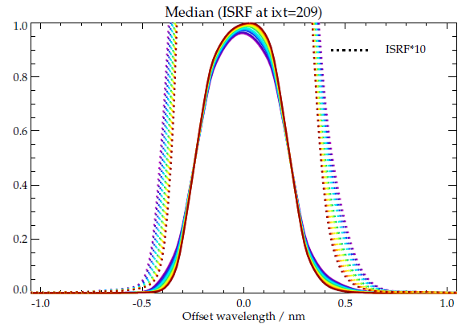
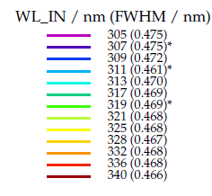
Sentinel 4 (S4) PFM Measured slit functions
Characterisation of instrument spectral response vital for tropospheric ozone retrieval
Detailed measurements available from on-ground calibration for all detector pixels.
Generally, S4 exhibits small variation in ISRF shape and width spatially and spectrally

Slide 10
Summary & Future Work
Sentinel 4 tropospheric ozone scheme developed based on the RAL ozone profile scheme used to generate multi-decade data-sets from nadir uv sounders in Ozone CCI / C3S
  Effectively same scheme to be used for also Sentinel 5
  (with full profile information from Hartley + Huggins)
S4 Processor verified using independently simulated test data
S4 Processor also applied to analyse limited sub-sets of TEMPO and GEMS
  Results assumed limited by instrumental features
  Optimising empirical approach to deal based on approaches adopted for earlier sensors
    Corrections will likely also be needed also for S4, but TBC in commissioning phase
  Plan to process 1 year of GEMS and TEMPO (with radiometric correction) via Ozone CCI
    Keen to get latest info on L1 + instrument calibrations status
Looking forward to launch in July !

