Slide 1
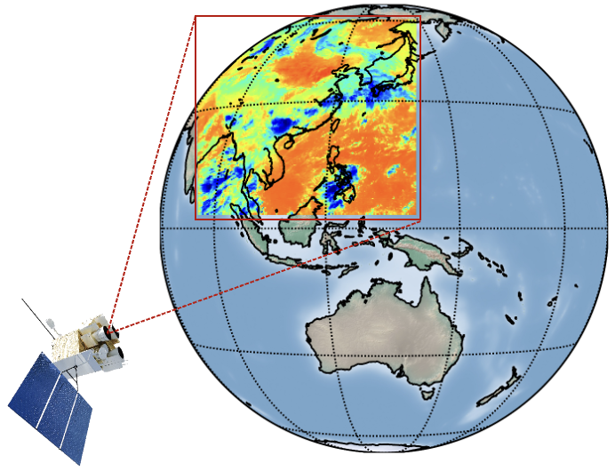

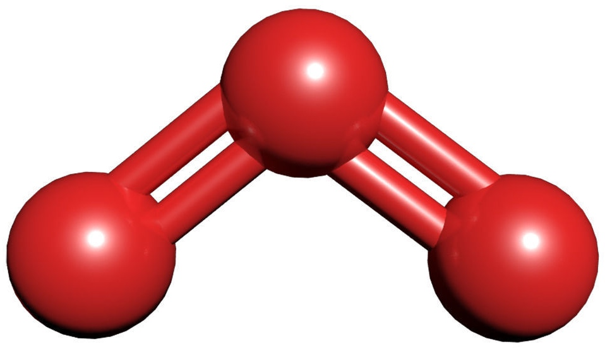
21st meeting of the CEOS Atmospheric Composition Virtual Constellation (AC-VC)
Total ozone column in East Asia observed from the Geostationary Interferometric Infrared Sounder (GIIRS)
Zhao-Cheng Zeng (zczeng@pku.edu.cn)
School of Earth and Space Sciences, Peking University, Beijing, China
Mengya Sheng, Shangyi Liu, Shan Han
(Peking University)
Lu Lee, Chengli Qi, Feng Lu
(National Satellite Meteorological Center)
O₃
Geostationary Interferometric Infrared Sounder

Slide 2
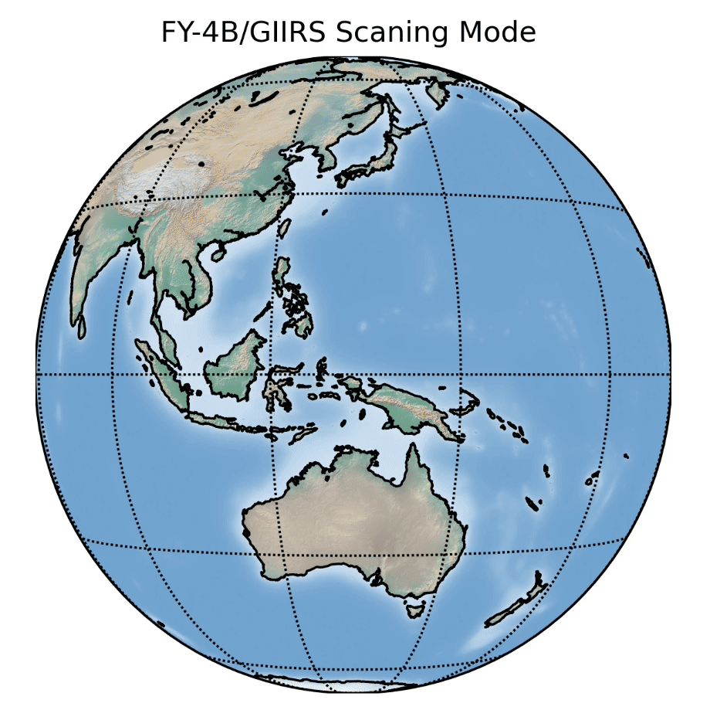
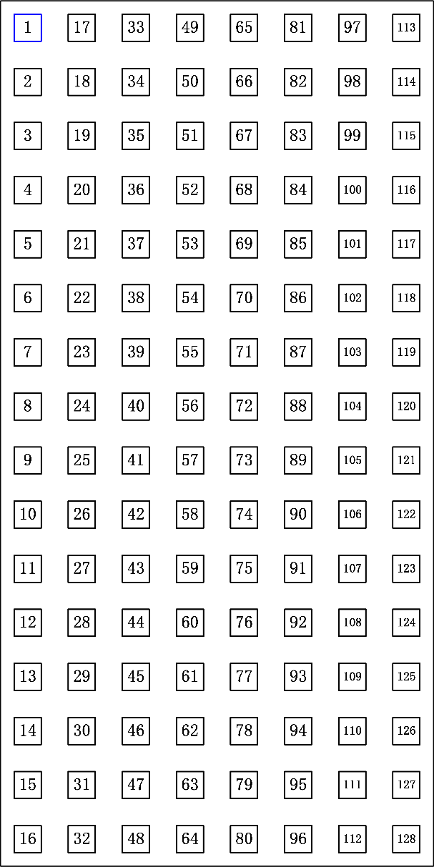
The Geostationary Interferometric Infrared Sounder (GIIRS)
27 FORs
FY-4A/GIIRS (launched in Dec 2016), spectra need re-calibration;
FY-4B/GIIRS was launched in June 2021 (data available from June 2022)
It was located at 105°E before March 2024, and now at 133°E.
GIIRS scans the Earth in a “step-stare” mode: Each field of view collects16×8 interferograms
One coverage takes about 2.0 hours. 12 maps in a day covers day and night.
Footprint size at Nadir: about 12 by 12 km.
Detector layout
(16×8 interferograms)
12 Scans
By courtesy of Dr. Lee Lu (NSMC)

Slide 3
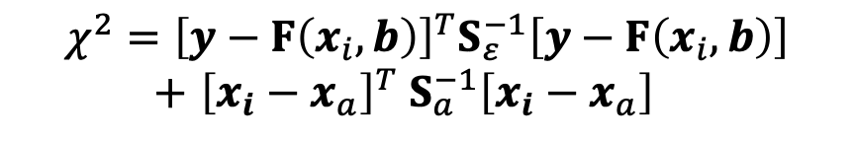
Ozone retrieval algorithm using FY-4B/GIIRS spectra
Optimal Estimation
Variables | Number of variables | A priori values | A priori uncertainty | Descriptions
O₃ | 26 | fixed |  | derived from ERA5 reanalysis
H₂O | 26 | ECMWF ERA5 reanalysis | 20%
CO₂ | 1 | ECMWF CAMS | 5% | only proﬁle scaling factors are retrieved
Surface skin temperature | 1 | ECMWF ERA5 | 5K
Air temperature proﬁle | 1 | ECMWF ERA5 | 0.05% | only a proﬁle scaling factor is retrieved
Surface emissivity slope and curvature | 4 | [0.0, 0.0, 0.0, 0.0] | [0.1%, 0.01%, 0.001%, 0.0001%] | the a priori surface emissivity data come from the University of Wisconsin-Madison
The solution from the retrieval algorithm is the state vector which minimizes the following cost function:
Forward Model
Observation error covariance
$${χ^{2}=\left[y−F\left(x_{i},b\right)\right]}^{T}S_{ε}^{−1}\left[y−F\left(x_{i},b\right)\right]$$
$+$ ${\left[x_{i}−x_{a}\right]}^{T} S_{a}^{−1}\left[x_{i}−x_{a}\right]$
State Vector
Priori Covariance
The Levenberg-Marquardt modification of the Gauss-Newton method is used to search the solution. The averaging kernel (AK) matrix is used to characterized the quality of the retrieval results.
Table. Parameters in the state vector to be retrieved in the ozone retrieval algorithm
The a priori O₃ profile in the retrieval algorithm is fixed.
Liu et al., 2025, JGR-Atmosphere
Notes:
Here is the inverse model
The solution from the retrieval algorithm is the state vector that minimizes this cost function. The lm method is used to search the solution.
State vector: target gas, interfering gases, surface temperature, temperature profile (scale factor), surface emissivity (polynomial scale factor)

Slide 4
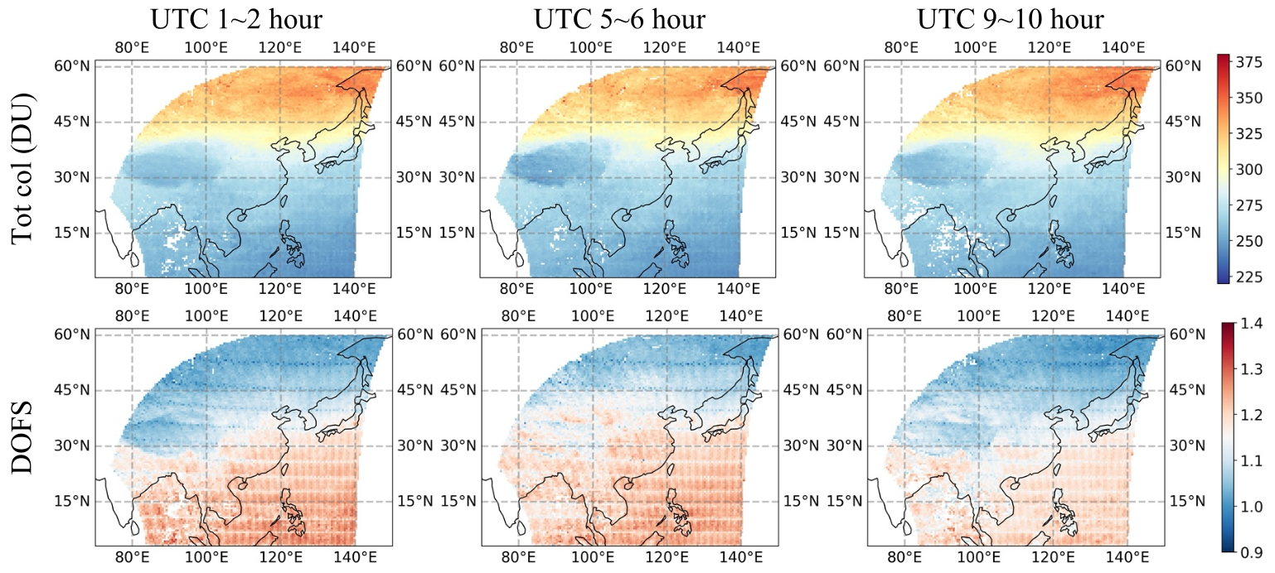
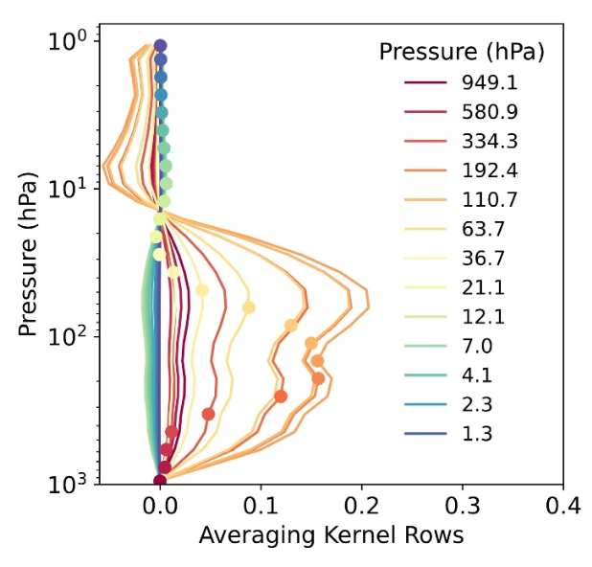
Total ozone column from FY-4B/GIIRS
Averaging Kernels
Examples of monthly averages of Ozone total column for three different hours and the associated DOFS (between 0.9 and 1.4)
The vertical sensitivity indicated by AK, showing the peak sensitivity in the UTLS region.
Liu et al., 2025, JGR-Atmosphere

Slide 5
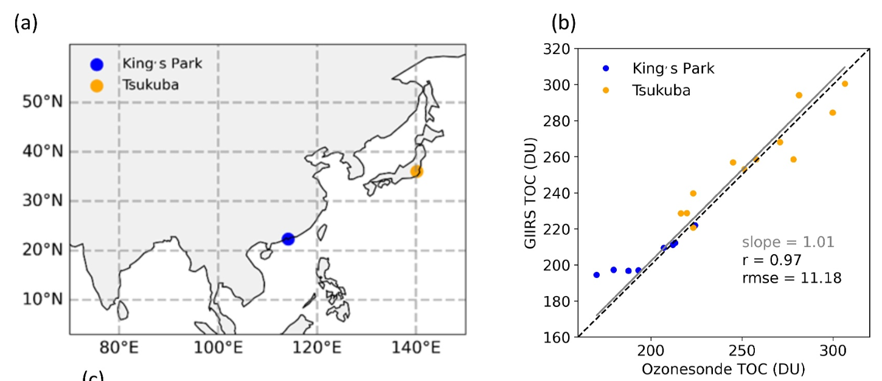
GIIRS O₃ compared to ozonesonde
Intercomparison of ozone data between GIIRS and ozonesonde at King’s Park in southern China and Tsukuba in Japan;
Good agreement in general, but some difference with King’s Park data.
Liu et al., 2025, JGR-Atmosphere

Slide 6
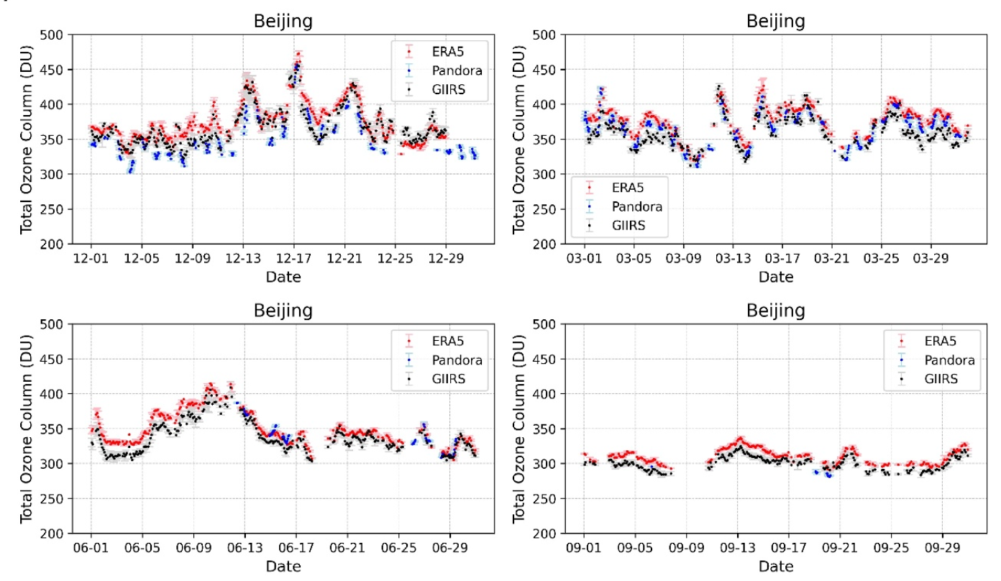
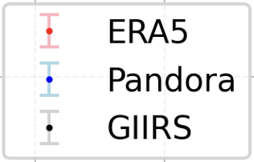
GIIRS O₃ compared to ERA5 and Pandora (Beijing)
December 2022
March 2023
Liu et al., 2025, JGR-Atmosphere
June 2023
September 2023
Time series of TOC from GIIRS, ERA5 and Pandora in December of 2022 and March, June, September of 2023;
The three datasets show good agreement in day-to-day variabilities. GIIRS is closer to Pandora data compared to ERA5.

Slide 7
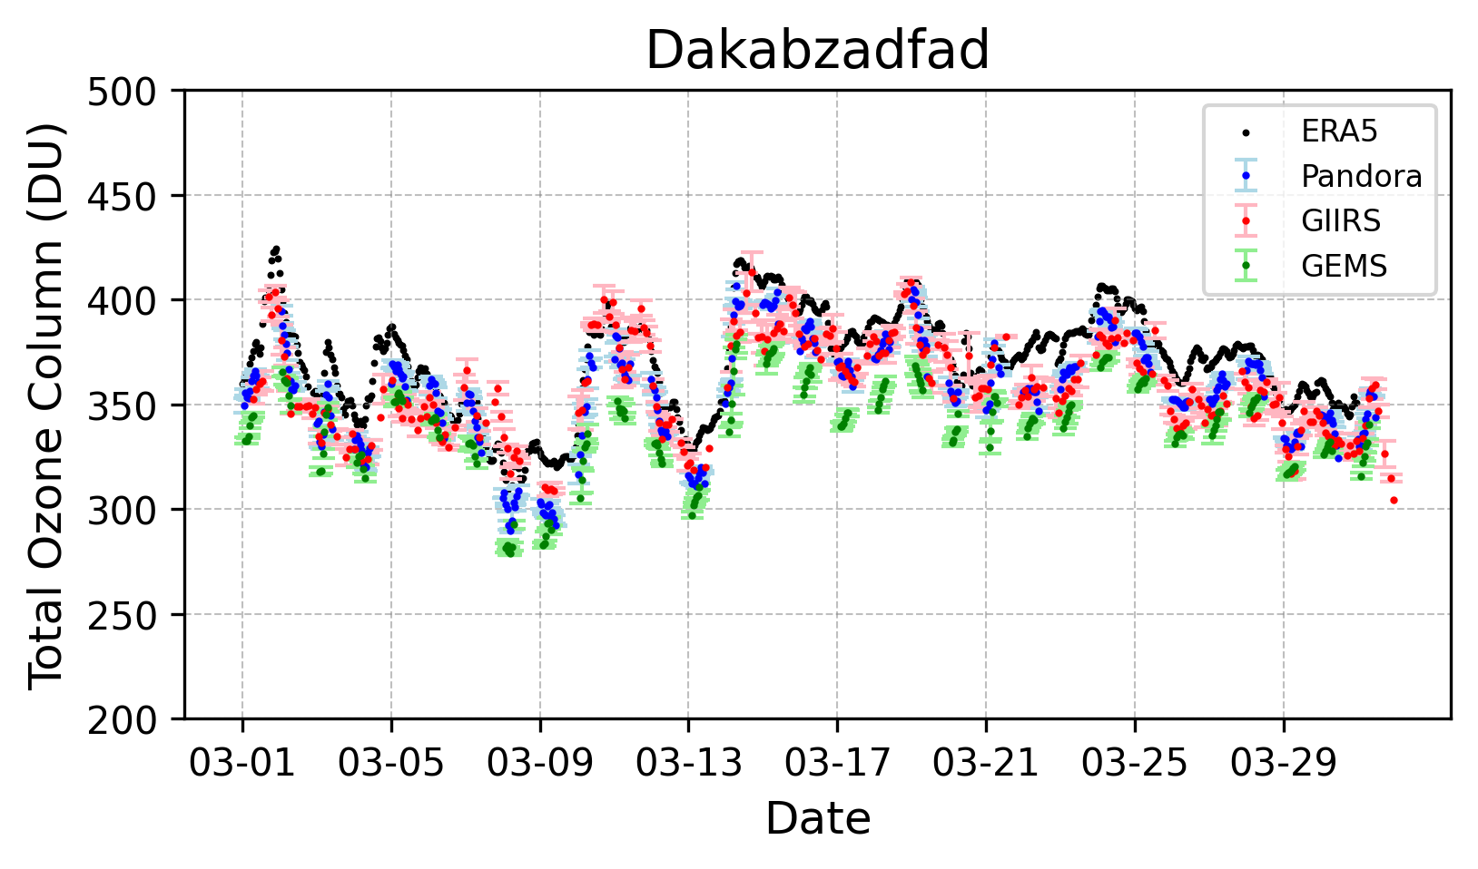
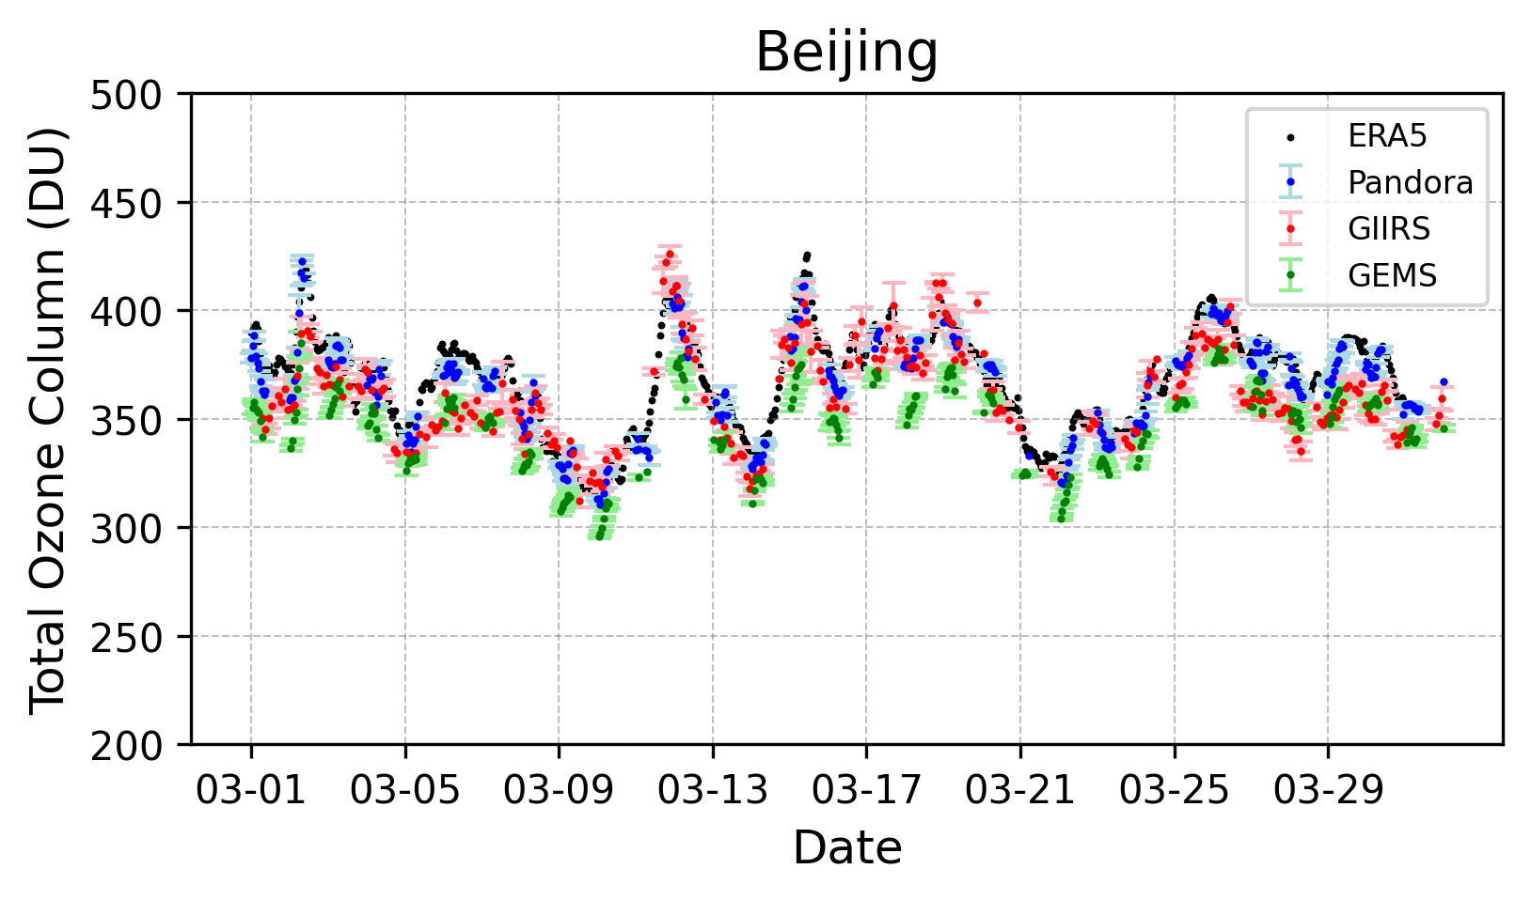
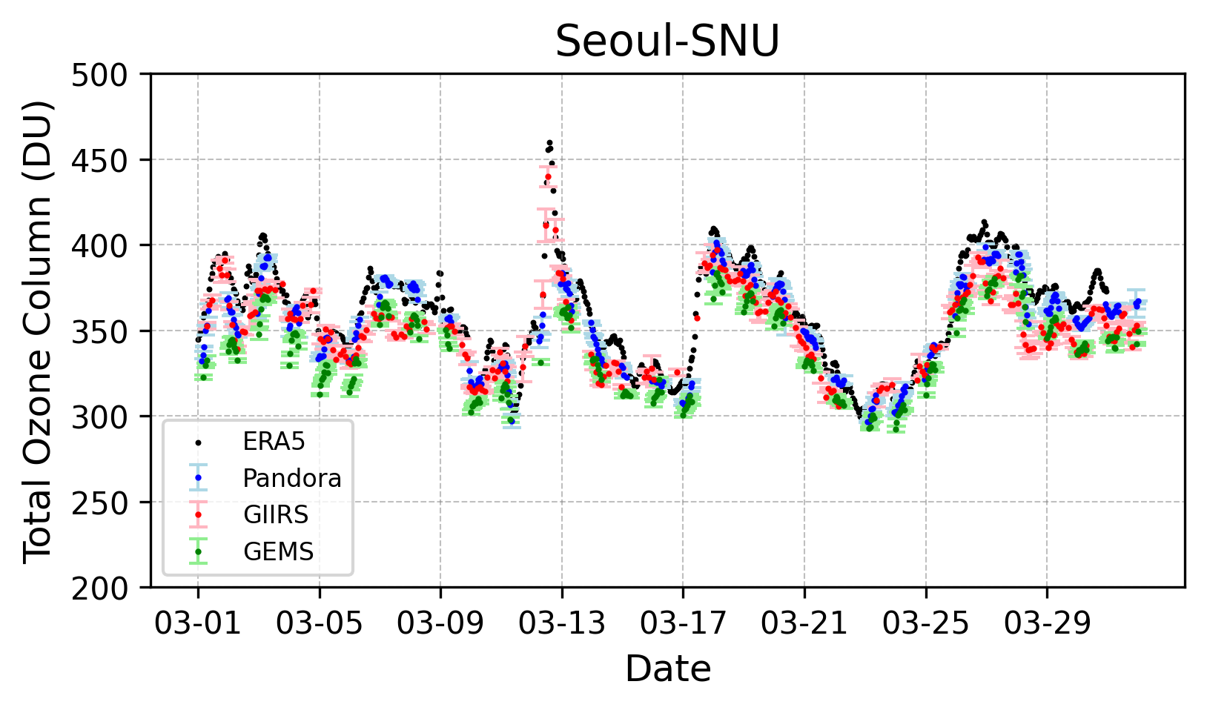
O₃ from GIIRS, GEMS, ERA5 and Pandora (3 sites)
Observations at three Pandora sites confirm strong consistency in total ozone column between GIIRS, GEMS, ground stations, and ERA5

Slide 8
O₃ from GIIRS, GEMS, ERA5 and Pandora (3 sites)
March 11
March 12
Observations at three Pandora sites confirm strong consistency in total ozone column between GIIRS, GEMS, ground stations, and ERA5;
These O3 peaks may represent a stratosphere-troposphere exchange event​ that propagates from west to east.
March 13

Slide 9
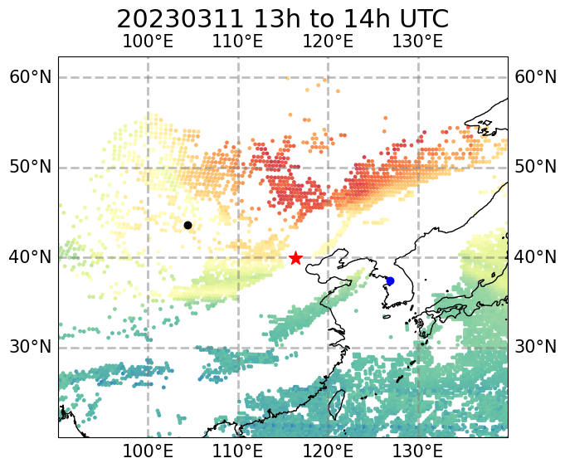
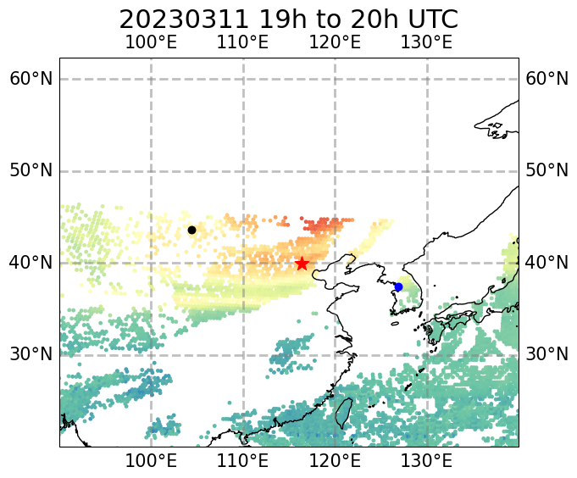
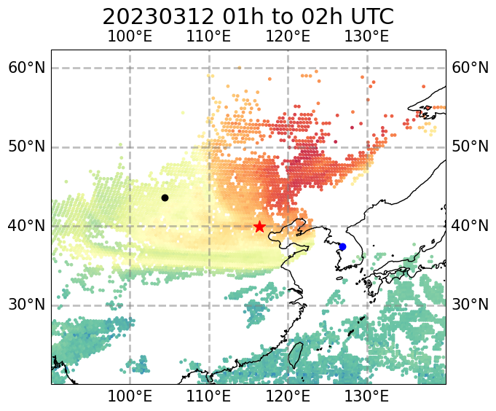
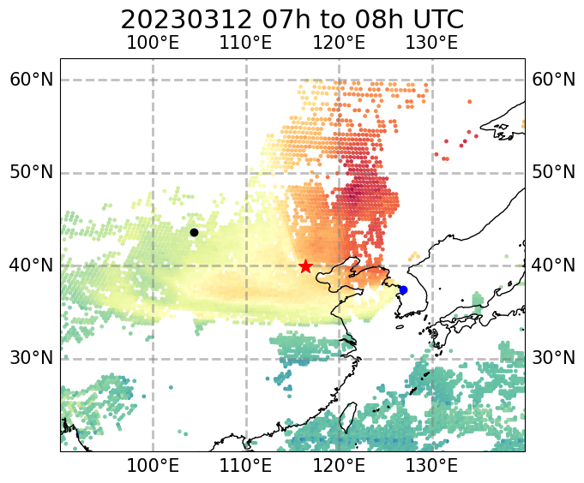
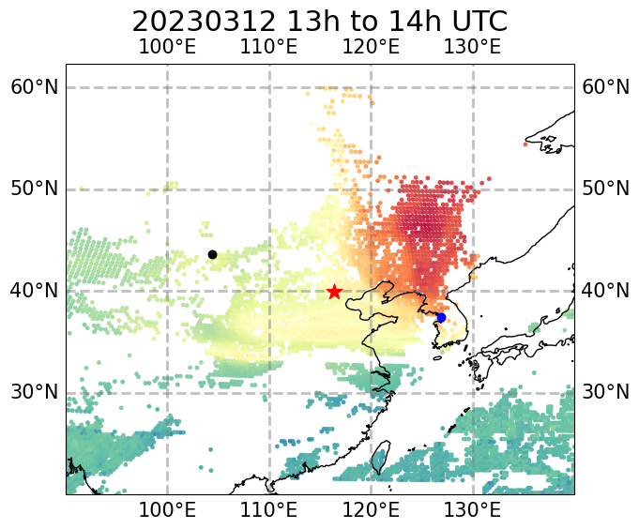
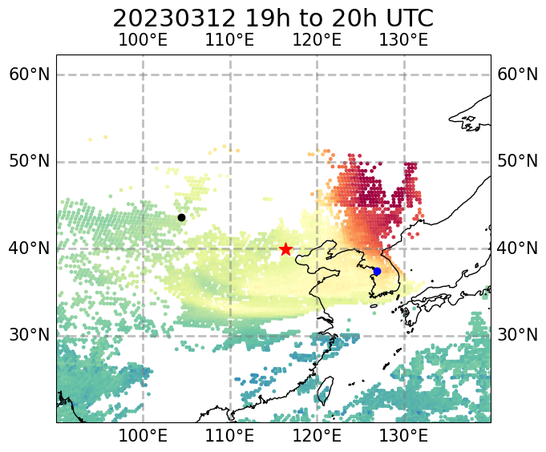
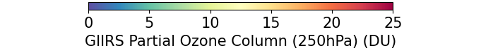
A stratosphere-troposphere exchange event​
GIIRS Partial Ozone Column (250hPa)
GIIRS has a relatively high sensitivity at 250hPa;
It effectively detects the upper-tropospheric ozone increases during stratosphere-troposphere exchange (STE) events.
A major factor driving vertical ozone transport is the re-distribution of vertical momentum resulting from Rossby Wave Breaking in the Upper Troposphere Lower Stratosphere (UTLS).
Mar 11, 13h
Mar 11, 19h
Mar 12, 01h
Seoul
Dakabz-adfad
Beijing
Mar 12, 07h
Mar 12, 13h
Mar 12, 19h
Notes:
A major factor driving vertical ozone transport is the re-distribution of vertical momentum resulting from Anticyclonic Wave Breaking (AWB) in the Upper Troposphere Lower Stratosphere (UTLS).

Slide 10
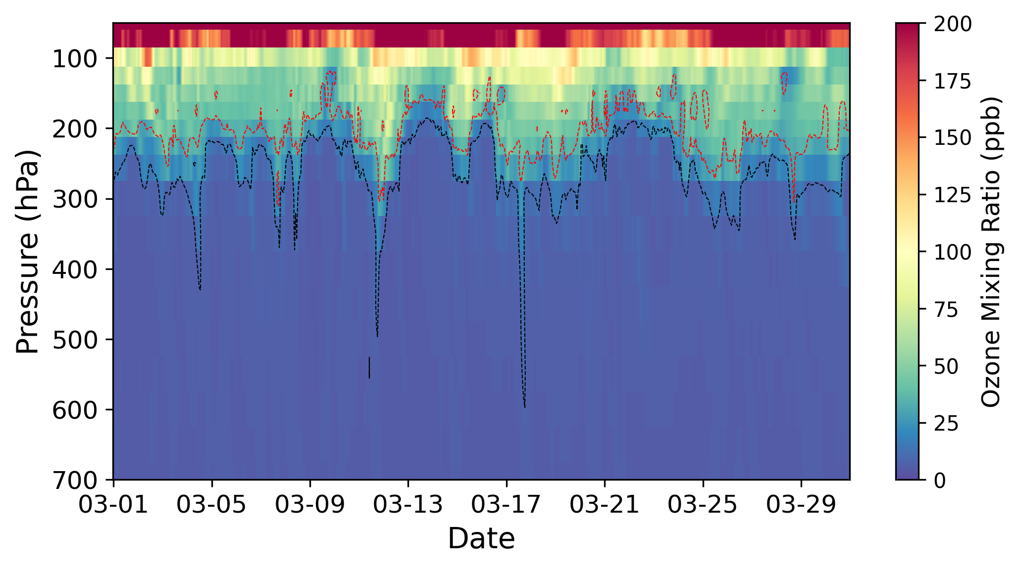
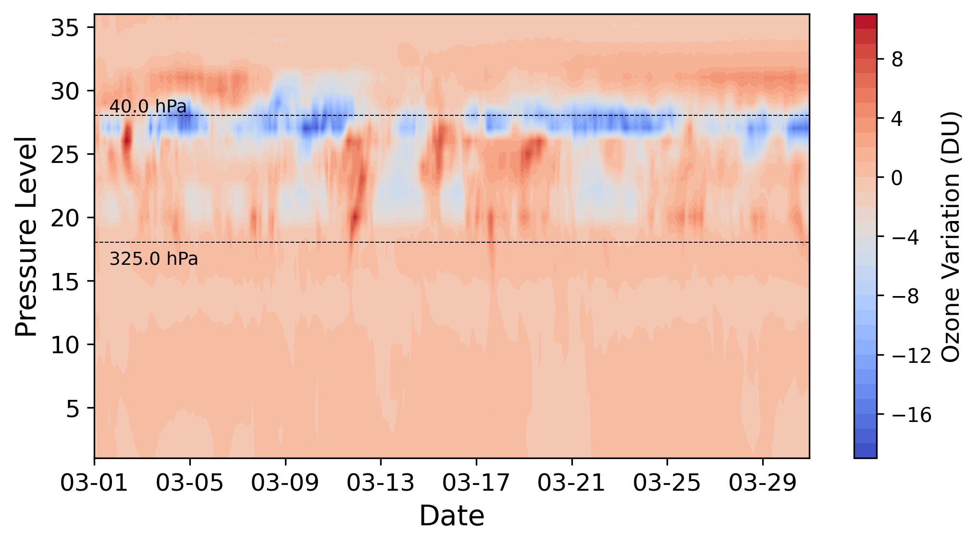
Stratosphere-troposphere exchange events​
ERA5
GIIRS O₃ profile anomalies
Hourly ozone profiles and the potential vortex (PV) isopleths from ERA5 reanalysis data over the Beijing site in March 2023.
PV values of 2 are shown with black line and PV values of 6 with red line.
The temporal variation of the ozone partial column for different air pressure layers, with the data at 0:00 on March 1 as a reference, based on ERA5 data.
It reveals the contribution of ozone variations in the vertical direction to the variation of TOC.
PV isopleths is a parameter to characterize the boundary between the troposphere and the stratosphere

Slide 11
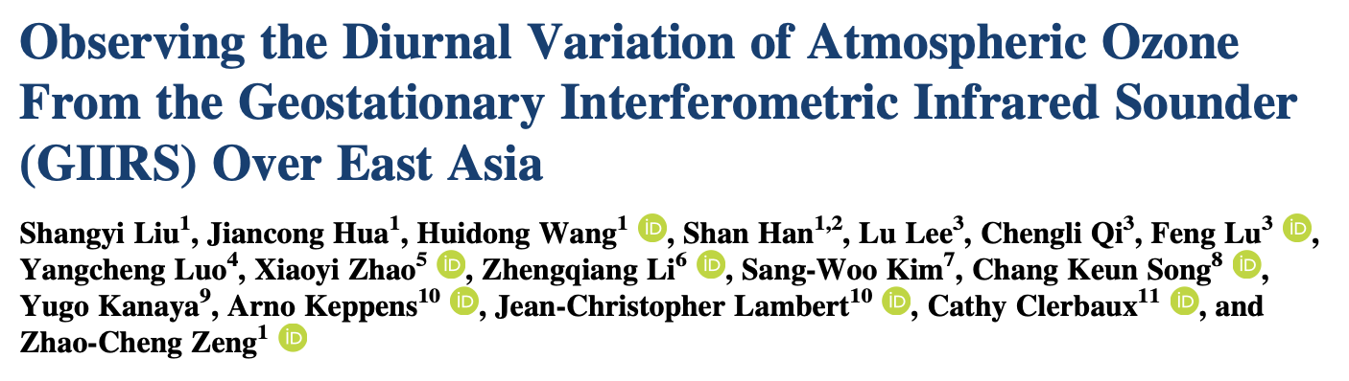
Conclusions
Data availability:
The GIIRS L1 spectra are publicly available from the National Satellite Meteorological Center: http://satellite.nsmc.org.cn/portalsite/.
Early portion of Ozone are publicly available online, links are provided in the paper (Liu et al., 2025, JGR); Full 2-year datasets are available (zczeng@pku.edu.cn).
We show the ozone retrieval algorithm for FY-4B/GIIRS observations over East Asia for every two hours (12 observations in a day).
The total column data (December of 2022 and March, June, September of 2023) have good agreement with IASI, ECMWF reanalysis, and ozonesonde data.
A continuous observations (with peak sensitivity in the UTLS) from GIIRS allows us to track the troposphere-stratosphere exchange events;
FY-4C/GIIRS, planned to launch in late 2025. The combination of FY-4B and FY-4C will provide better coverage and higher frequency observations.
Acknowledgement:
National Science Foundation of China;
IASI (https://iasi.aeris-data.fr/); ECMWF ERA5 (https://cds.climate.copernicus.eu/); GEMS (https://tccondata.org/); Pandora (http://data.pandonia-global-network.org/); World Ozone and Ultraviolet Radiation Data Centre.
JGR-Atmosphere 2025
Thank you!

