Slide 1
MTG-IRS Ozone retrievals
Dorothee Coppens, Stefan Stapelberg, Marc Crapeau
EUMETSAT
AC-VC June 2025
Notes:
Title slide template 2 of 2 with presentation title/information on the right. Please choose between slide 1 or 2 for the title slide and delete the other.

Slide 2
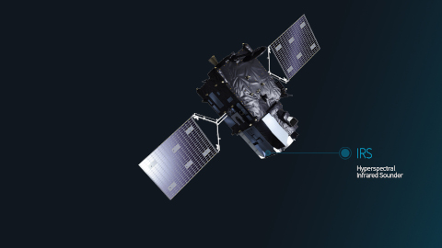
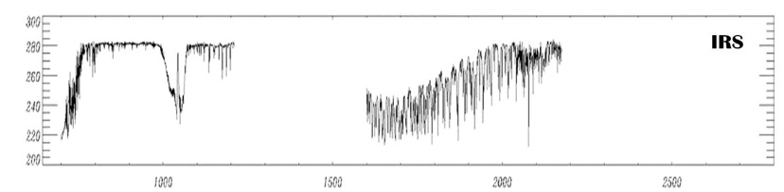
The EUMETSAT IRS Mission
EUMETSAT will launch the first European geostationary sounder satellite in July 2025. It will provide:
High spatial resolution: 4km
High temporal resolution: 96 LACs per day, with a revisit over Europe every 30 min
Timeliness:
  25600 spectra covering 640x640 km² in 15 min!
  Level 2 products in 30 min!
 | Description
L1C | Radiances
L1D | Principal Components
L2 | Geophysical Variables
 | Description
L1C | Radiances
L1D | Principal Components
L2 | Geophysical Variables
O₃
MTG-S1 Launch
IRS L2 Commissioning
 | Q1 | Q2 | Q3 | Q4 | Q1 | Q2 | Q3 | Q4 | Q1 | Q2 | Q3 | Q4 | Q1 | Q2 | Q3 | Q4 | Q1 | Q2 | Q3 | Q4
 | 2023 |  |  |  | 2024 |  |  |  | 2025 |  |  |  | 2026 |  |  |  | 2027
MTG-S1 (L1 commissioning)
MTG-S1 (L2 commissioning + operations)
Metop-B/C
Metop-C
Notes:
As you know, EUMETSAT is currently operating one series of hyperspectral infrared sounders, which is IASI on-board the Metop platforms. But soon, two new instruments will be added to the list: IASI-NG, the successor of IASI on-board Metop-SG, and IRS, on-board MTG-S, the first geostationary hyperspectral infrared imager of EUMETSAT.
From these three families of instruments, EUMETSAT is generating, or will generate, several levels of data. The L1 products of course, but also a L2. These L2 products are used in many different ways by the EUMETSAT users community; for example together with the L1, using the L2 as auxiliary information or as geophysical inputs to derive, for example, atmospheric composition products. They are also used alone, to derive products as well, like the IASI 3D winds, or of course, in Climates activities.
These last years, thanks to the raise in maturity of our products and to the development of different categories of instruments, new types of HSIR L2 usages have emerged, like the direct assimilation of L2 products in NWP models, or the support to the nowcasting of severe weather events. This activities should materialize operationally in the coming years thanks to, amongst other, the launch of IRS. The list of geophysical variables …

Slide 3
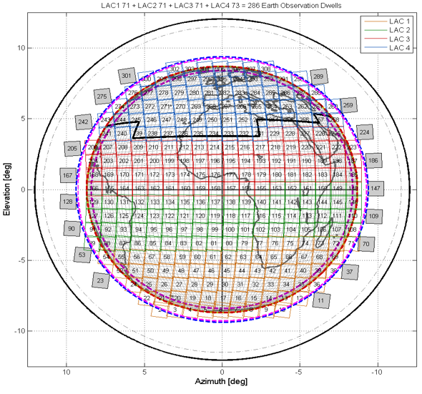
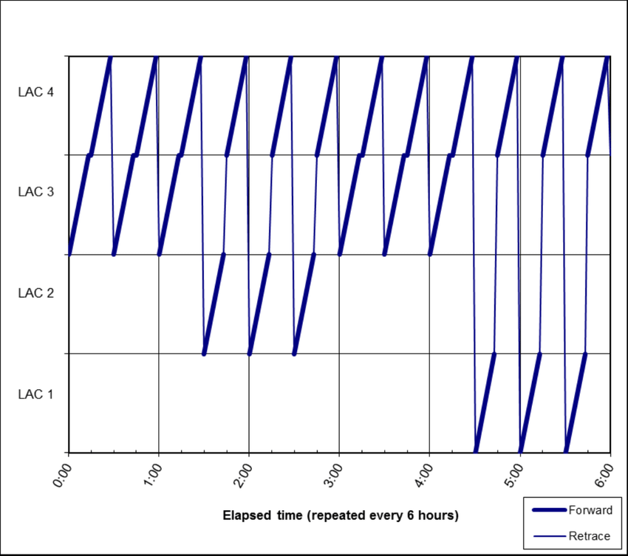
Temporal and spatial resolution
Nominal Scan Pattern and LAC Coverage
Earth Disk Division: visible Earth disk divided into 4 Local Area Coverages (LACs), numbered 1 to 4 from South to North
Scan Mechanism: IRS uses a step-and-stare approach, acquiring a single dwell in 9.7 seconds, stepping East/West or West/East to form a line of dwells, then moving northward to complete a LAC
LAC Coverage Time: each LAC fully scanned in 15 minutes. LAC 4 (covering Europe) is scanned every 30 minutes
Configurable Pattern: nominal scan pattern optimized for coverage and calibration needs and is fully configurable
LAC 4
LAC 3
LAC 2
LAC 1
6-hour repeat cycle
x4 for full day
The Earth disk is divided in 4 regions of interest, namely Local Area Coverage (LAC). Each LAC is acquired in 15 minutes, with a revisit of LAC 4 covering Europe every 30 minutes.

Slide 4
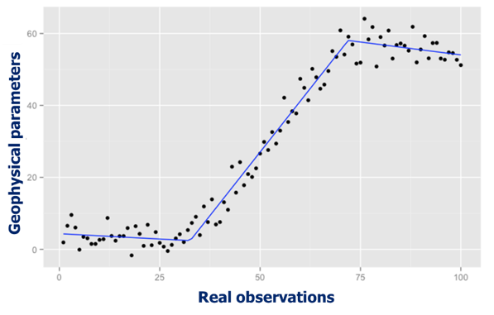
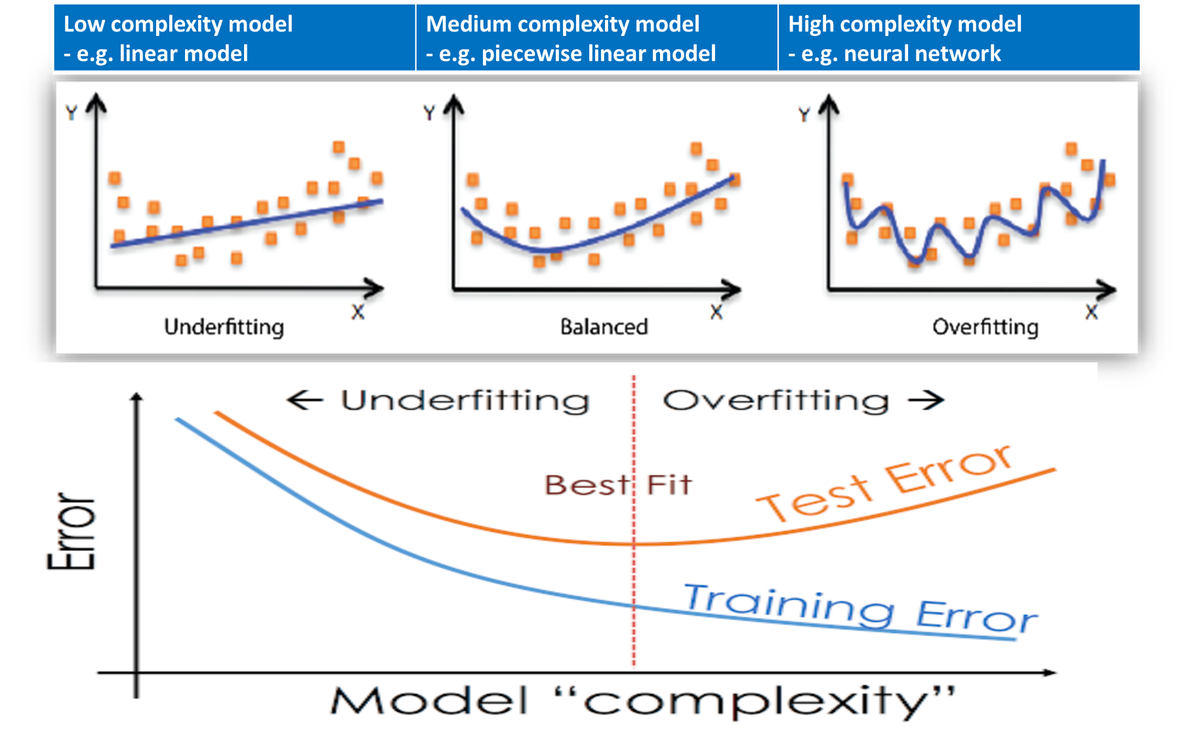
The EUMETSAT PWLR approach for HSIR L2 products
Piece-Wise Linear Regression
  Principle: Supervised machine learning approximating the non-linear
  relationships between observations and geophysical parameters with
  multiple linear models in classes built using K-means classification
  Characteristics:
    ML for geophysical retrievals
    [IR-MW synergy (AMSU/MHS)]
    Horizontal correlation (FOV)
    Radiances PC scores as predictors
    Ensemble retrieval approach
    Training with huge ref. datasets
Advantages:
  All-sky retrieval, allowing new type of uses like e.g. to derive 3D winds
  Excellent error characterisation, including vertical characterisation for profiles
  Versatile approach, applicable to several types of observations and geophysical parameters
  No use of forward model !
  Drawback: Global reference data is needed for the training
  → As fast as alternative ML (e.g. NNs)
  → All-sky retrievals (>99%)
  → Use of full IRS spectral information
  → Decrease random error

Slide 5
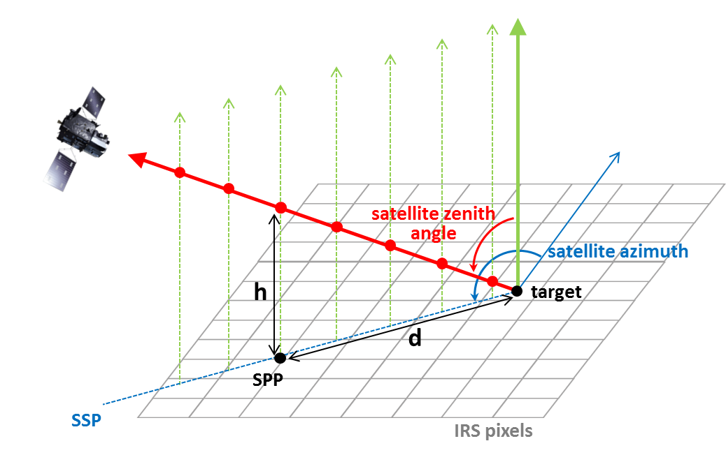
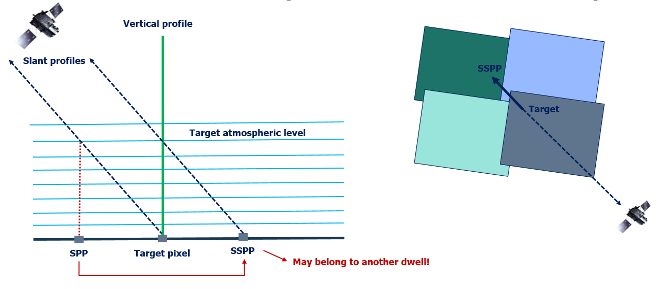
L2 Processing chain / Post-processing
Profile conversion : reconstructs the information at the vertical of the target point from the slanted retrievals that are intercepting the vertical line;
Performs total column integration for H₂O and
O₃ from converted profiles;
Computes the instability indices derived from
the retrieved profiles;
Encodes the retrieved geophysical quantities
and associated processing information into
final IRS L2 Products.
Observed slanted (purple) and vertical profile provided to the End-Users (green)

Slide 6
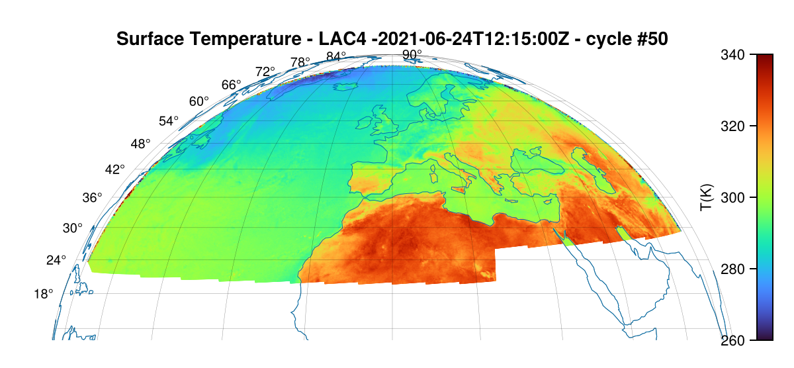
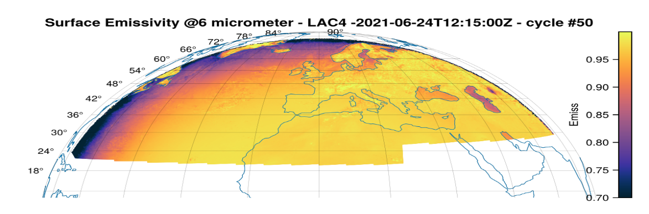
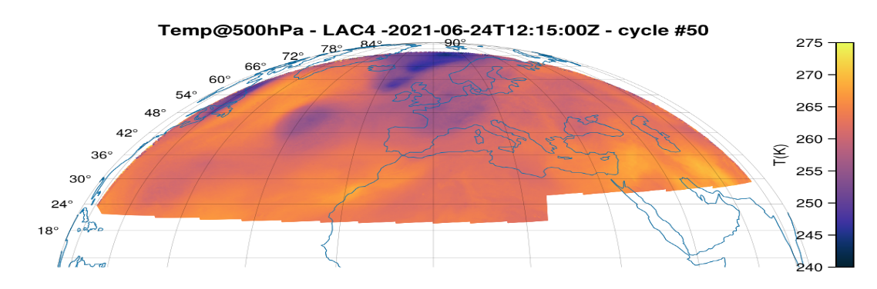
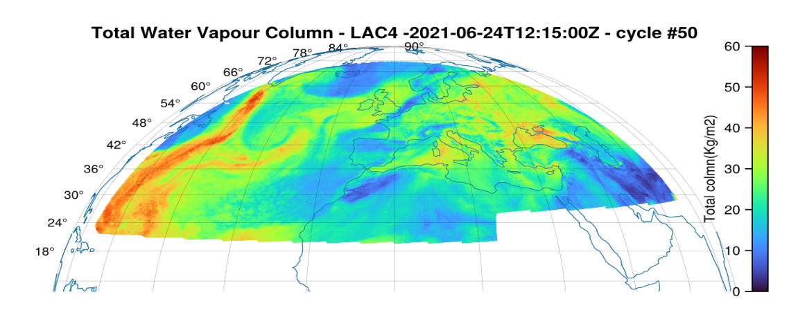
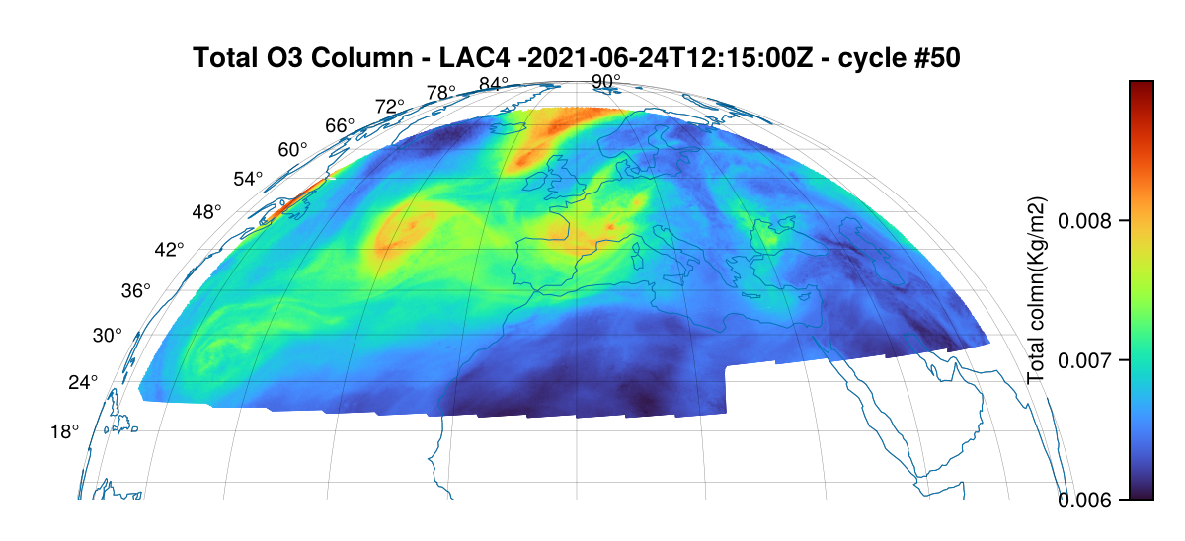
MTG-IRS L2 Product Test Data for users’ familiarization purposes
6-hour realistic test dataset
(0800 – 1400 UTC)
LAC 4 only
➔ Available on the EUM user’s portal

Slide 7
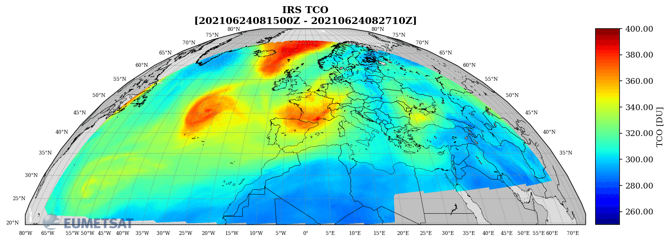
MTG-IRS L2 Product Test Data 6h Total Column Ozone LAC4 (Europe)

Slide 8
IRS L2 Ozone Validation Strategy
IRS L2 Product Validation
Model comparison
Space borne reference datasets
Dedicated
Campaigns
Ground-based & in-situ
ECMWF
CAMS
MLS
TROPOMI
Ozone Sondes
Brewer
Next slides will show some examples on validation results with PWLR deployed on IASI

Slide 9
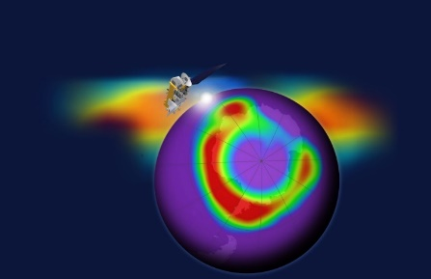
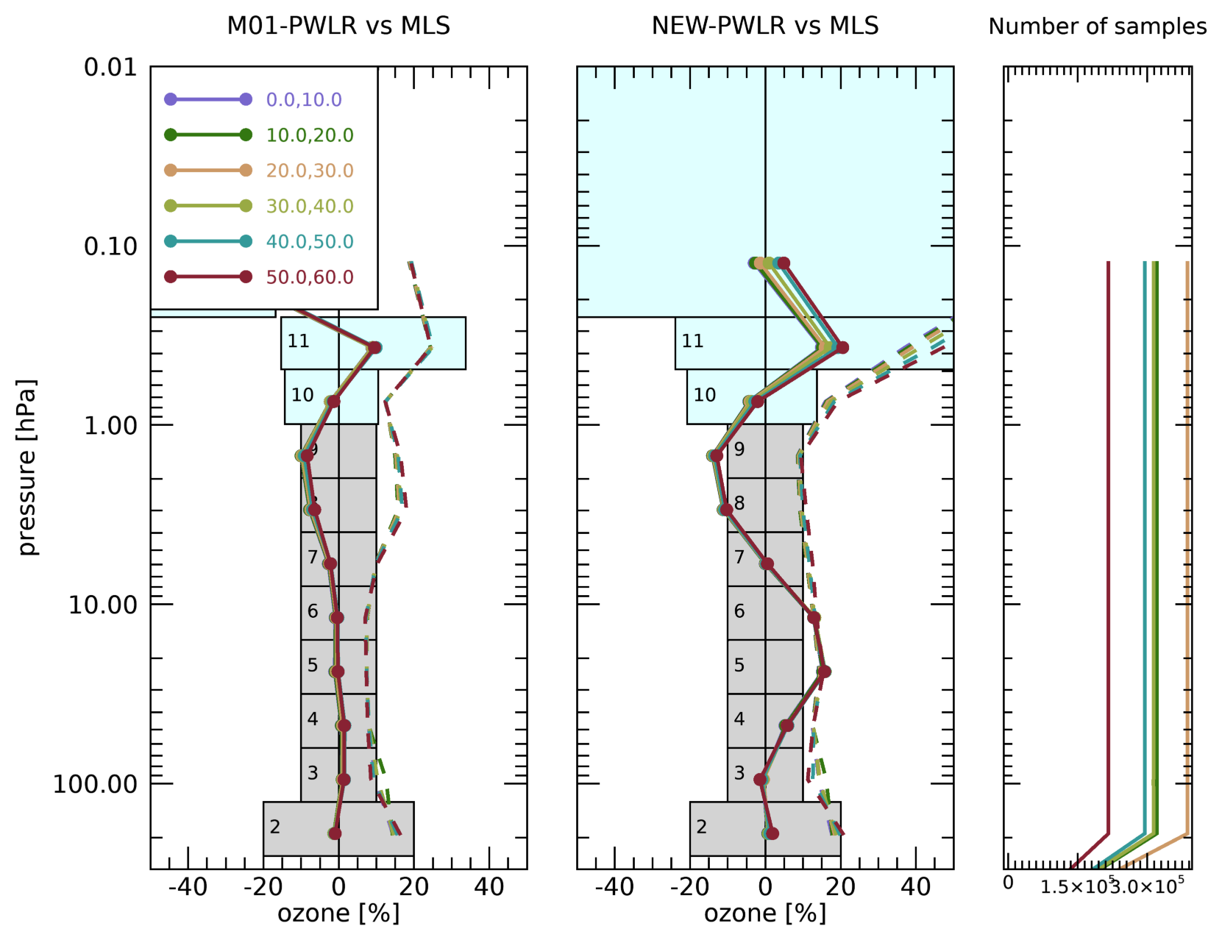
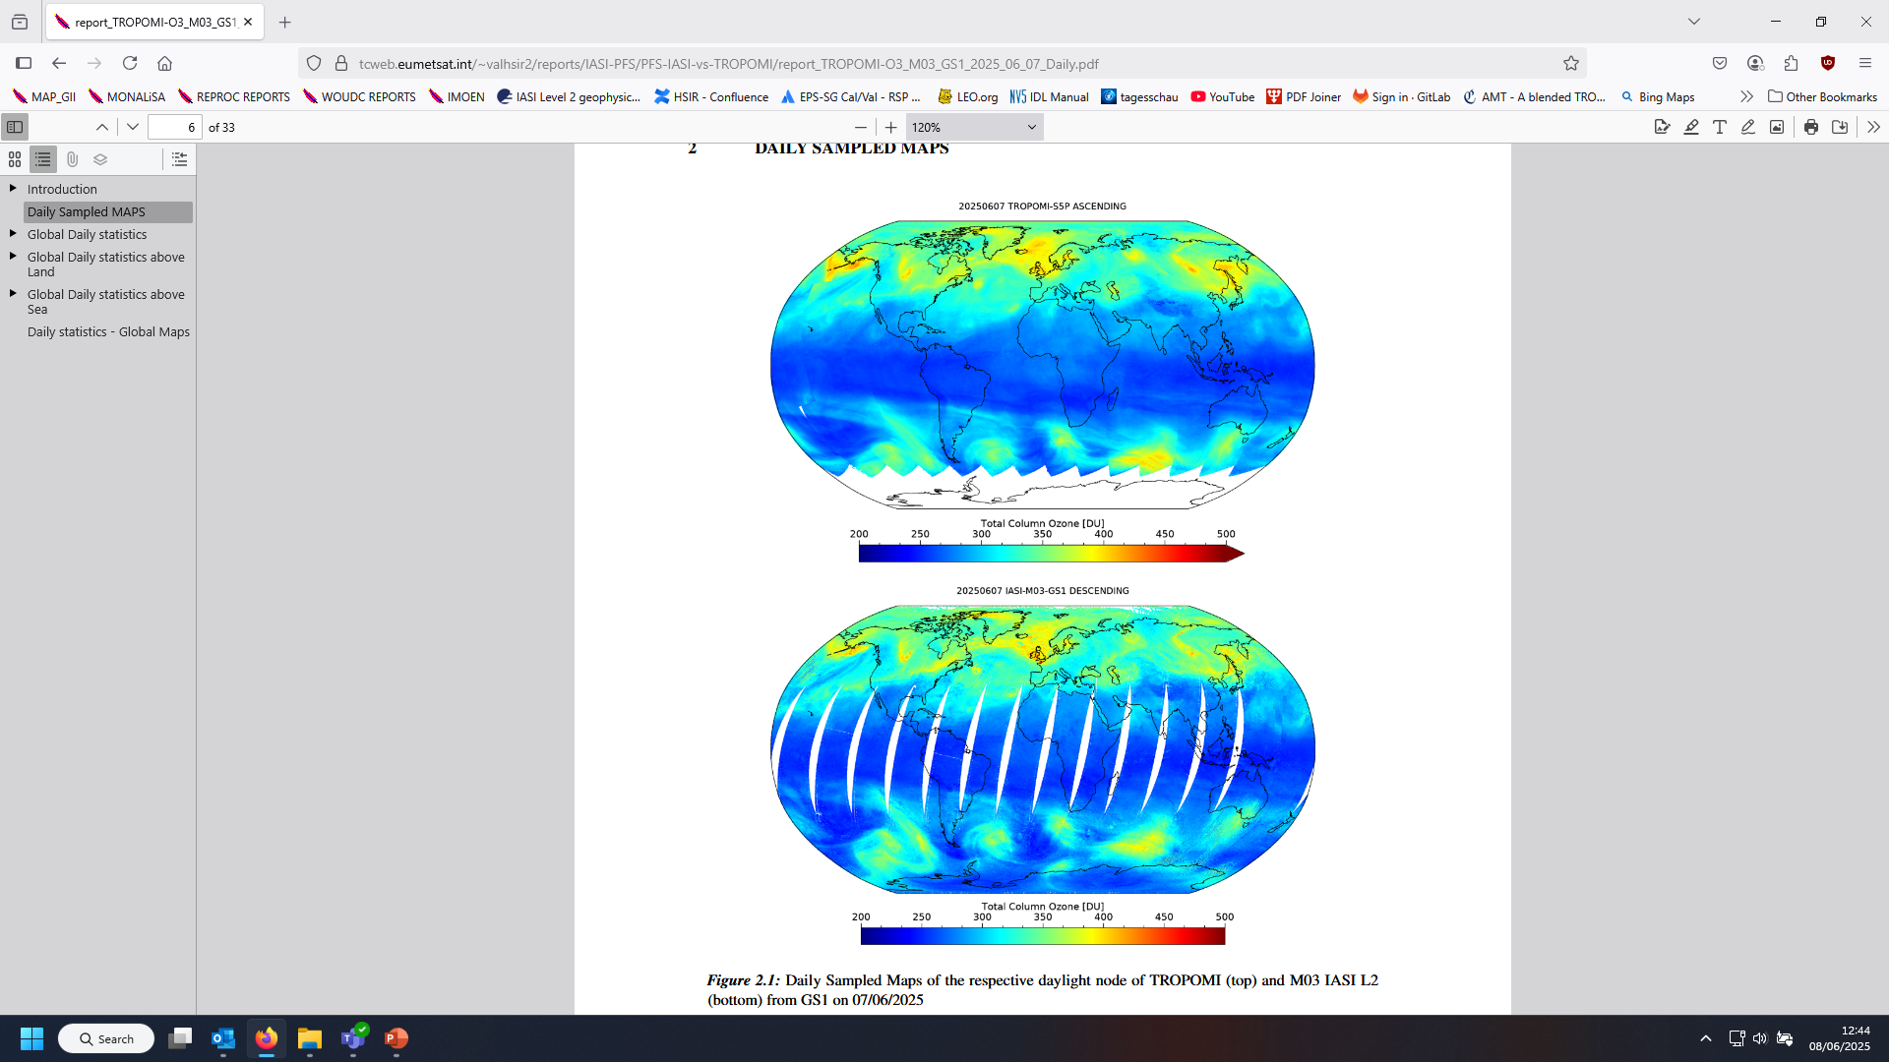
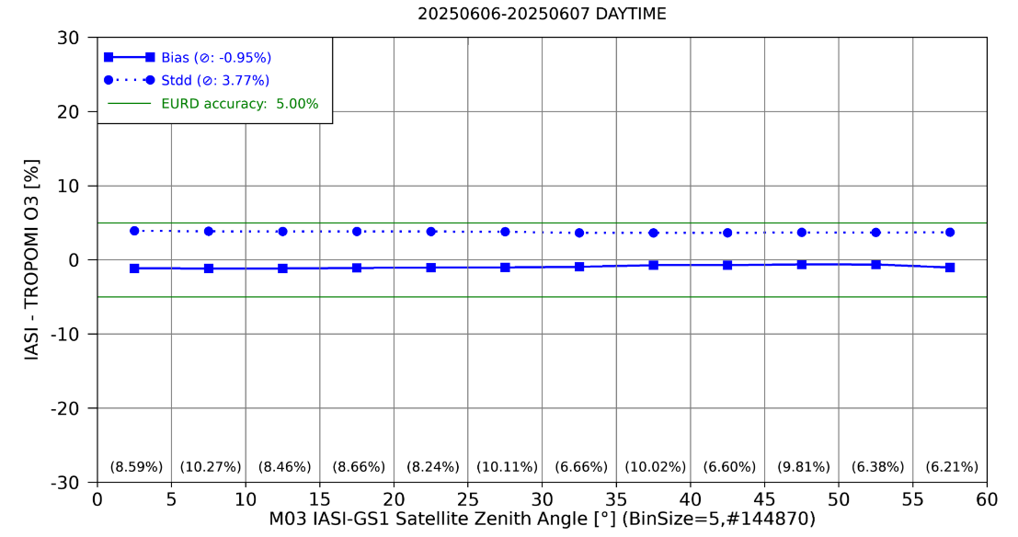
Intercomparison with space borne reference data
Microwave Limb Sounder MLS
Stratospheric Ozone
TROPOMI Sentinel 5P
Total Column Ozone
TROPOMI
IASI-PWLR
Variation of
IASI Viewing
angles
Width of grey box reflects End User
Requirements

Slide 10
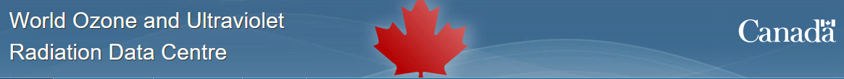
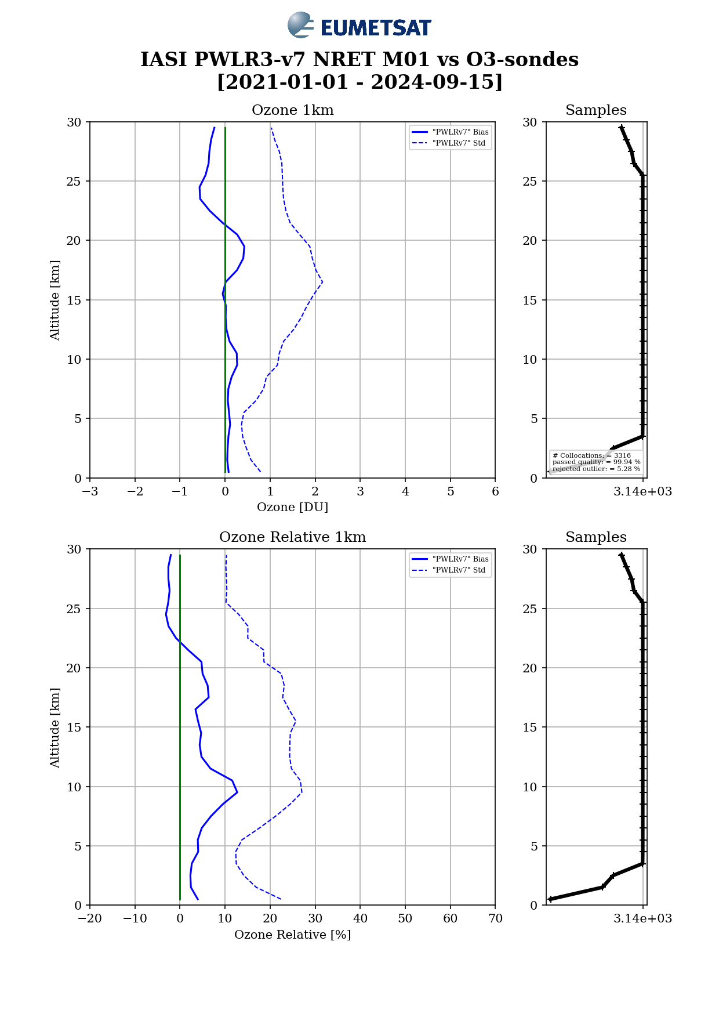
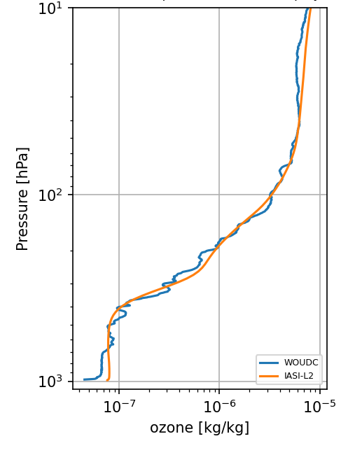

Validation with Ozonesondes
Example: NY-ALESUND Station
19th Jan. 2017
Stratosphere 10%
End User Requirements
Accuracy:
Troposphere : 20%

Slide 11
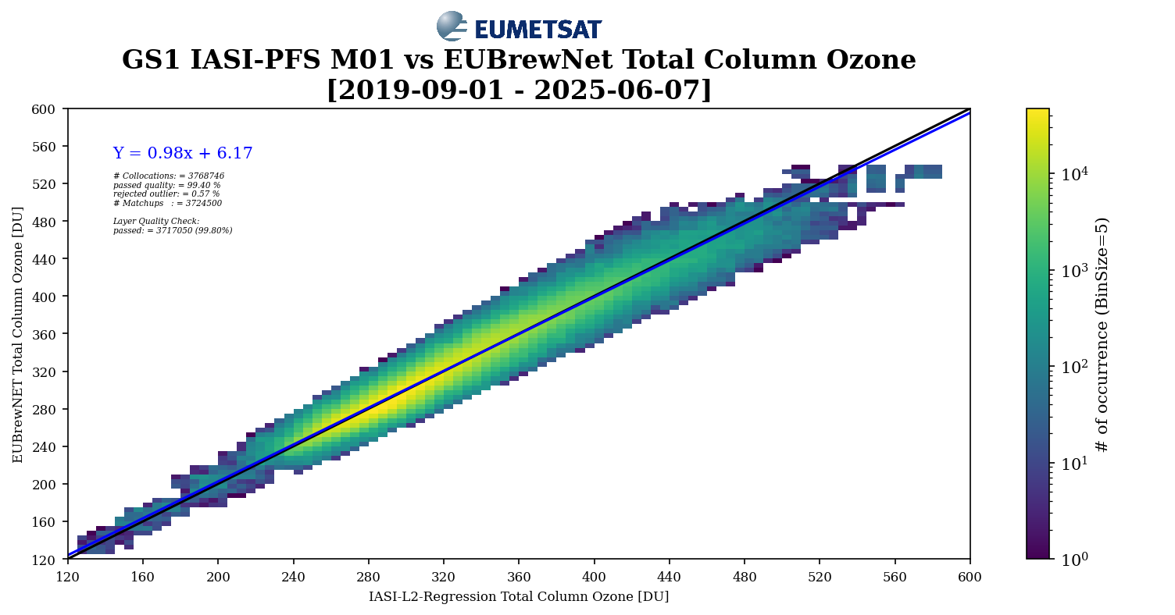
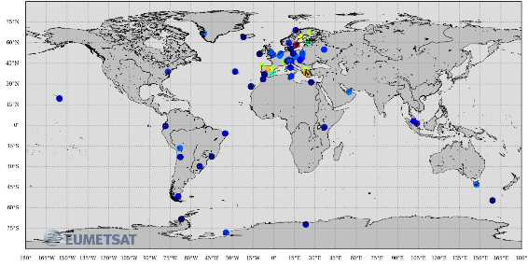
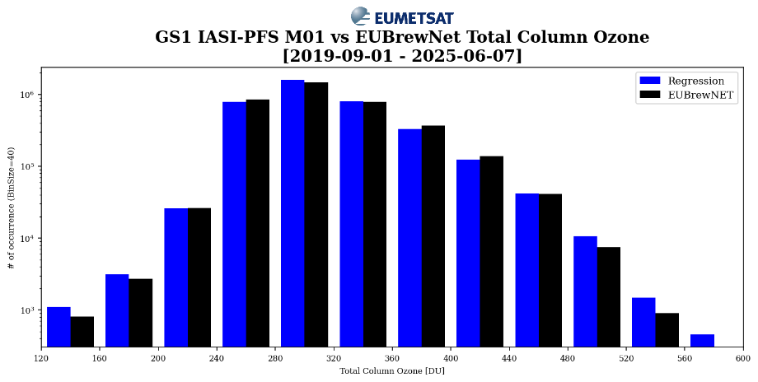
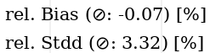
Total Column Ozone vs Brewer Photospectrometer (EUBrewNet)

Slide 12
Ozone on IRS Summary
EUMETSAT provides an All-sky Ozone profile product which serves as base line for 3D Winds and fulfills timeliness demands for NRT disseminations
PWLR with IASI Comparisons to Ozone-Sondes show very good and stable results in troposphere and UTLS - with some seasonal dependencies in precision
Inter-comparison to MLS show very good agreement in the Stratosphere up to 40 km
Results of IRS L2 USER for Forecasters / Nowcasting most valuable assets of EUM IRS products:
3D Winds (PWLR O3 and q profiles will be used)
Relation of IRS Profiles to Sondes and Models (extended validations)
Forecast free Observations (=PWLR)
Error estimates as Profiles
Vertical Profiles from slanted views
Cloud Information together with profile error estimates
For IRS an Evolution of PWLR will be used:
Extended Training-Set
More regression classes
Improved classification scheme
Quality indicators as profiles
Thank you!
Questions are welcome.
Next to IASI the PWLR retrieval will be deployed on IRS and IASI-NG on EPS-SG
Notes:
And this version 6 will receive its last updates this year.
First it was with the version 6.7 deployed end of March this year. It introduced an update to the methane retrieval and a major evolution of the Principal Components processing scheme. This is very important because it introduces the ground-breaking concept of hybrid PCs and because this scheme will be the baseline of the IRS L1 products.
Then, later this year, in September, we will have the v6.8 that will deploy the long-awaited update to the FORLI library. This update was supposed to be part of the v6.7, but for technical reasons, it was not possible to do it. We still have a small bug on one of the auxiliary information, but it should solved soon.
And finally, end of this year, the v6.9 will deploy a major quality update to the PWLR3. This update will compile all the PWLR3 improvements that have been developed these last years and will bring important enhancements to several products like the CO2, the SST or the all-sky O3.
One last information: EUEMTSAT is currently moving all the EPS GSs from using the IMB AIX operating system to Linux. This is an activity that has already started and which is supposed to end, for the IASI L2, end of Q3 2024. The change is expected to be transparent to the users, but it will imply some periods of freeze of the GS and some ad hoc increases of the work load for our teams.

