Slide 1

Sentinel 5 Precursor / TROPOMI
Mission Status
Pepijn Veefkind, Diego Loyola, Claus Zehner

Slide 2
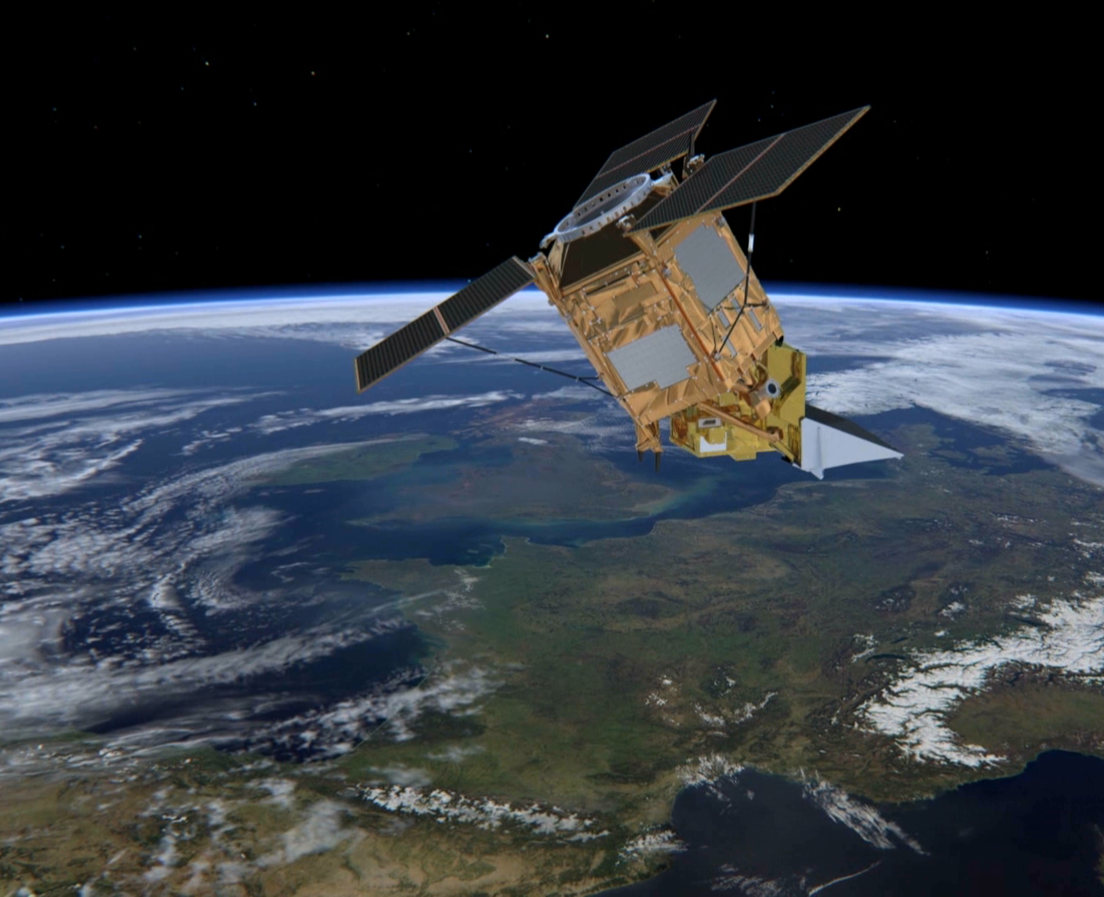
Sentinel-5 Precursor:
first atmospheric Sentinel Mission
Launched: 13 October 2017, Plesetks
Launcher: Rockot
Main Payload: TROPOMI (co-funded by The Netherlands and ESA) - Hyper-spectral push-broom imaging spectrometer, 4 spectrometers with 2D detectors with 4000 spectral channels
Orbit: Altitude of 820 km, 227 orbit repeat cycle
Daily Global Coverage: 13:30 ascending node crossing time
Spatial Sampling: 5.5 x 3.5 km (mission requirement: 7 x 7 km)
Mission Control: ESOC
TROPOMI Mission Planning: KNMI
Ground Stations: Svalbard (NOR) and Inuvik (Canada)
Operational Data Processing: DLR (on behalf of ESA)
Mission Design Life Time: ~7 years
National co-funding during Routine Operations (e.g. on Algorithm Development/QA Monitoring): Belgium, Germany, and The Netherlands
Key User: Copernicus Atmospheric Monitoring Service (ECMWF)

Slide 3
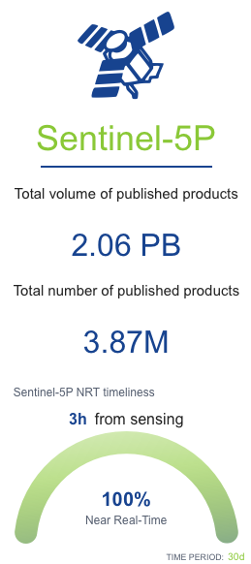
S5P Mission Status
The performance of the mission after 7 years in orbit is excellent. No open anomalies.
All operational data products are generated within quality and data latency requirements.
Routine CAL/VAL activities are performed.
Data uptake by the scientific and operational communities is high and still growing
In 2026 it is expected that the NPP/VIIRS data will stop; workarounds have been prepared.
From a technical point of view
the S5P mission can continue until 2035

Slide 4
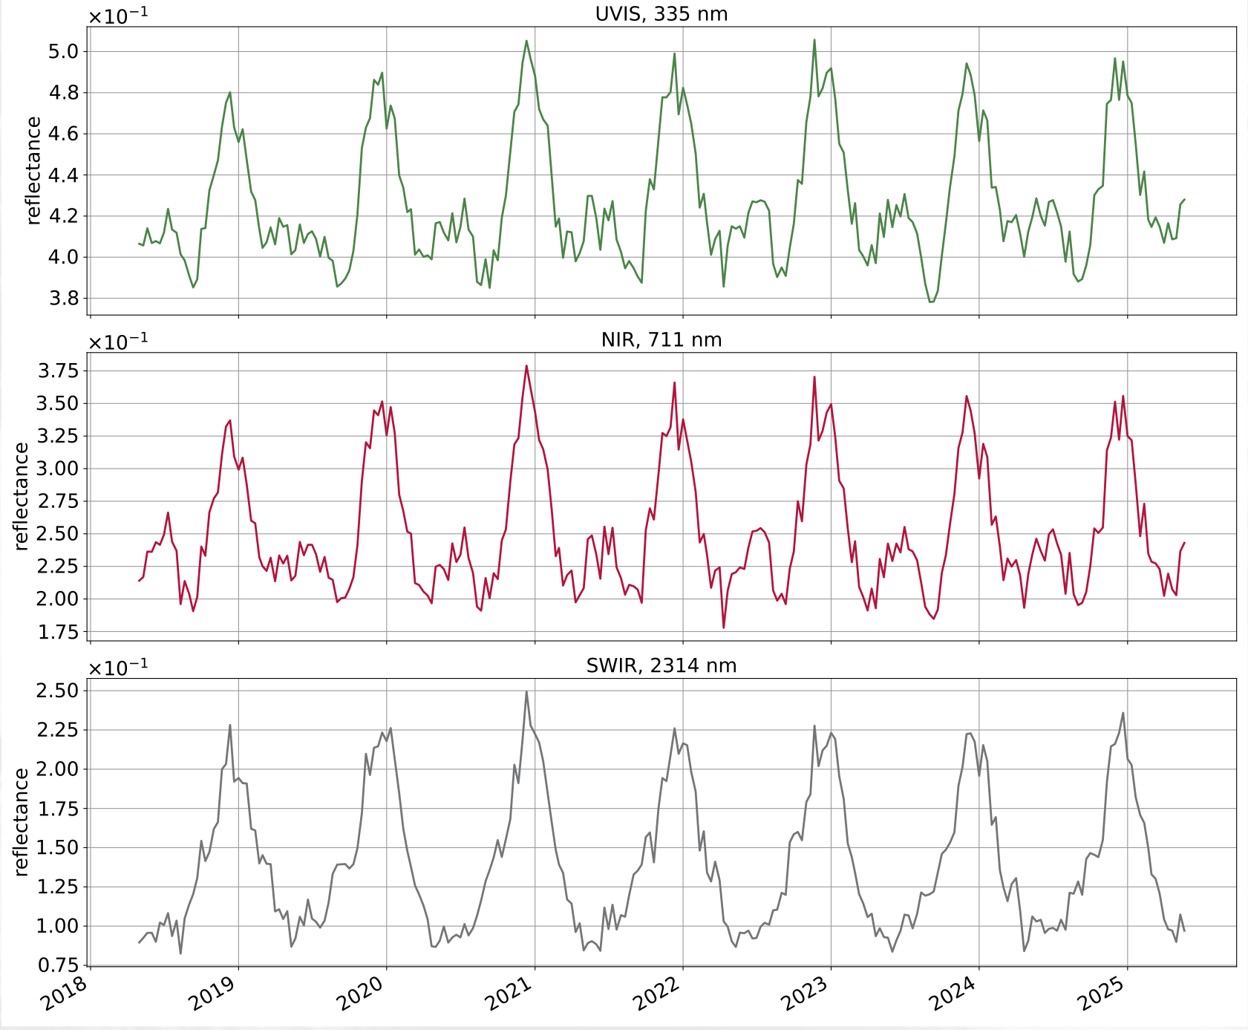
In-Flight Calibration
TROPOMI Global Mean Reflectance
The optical degradation of Tropomi is predictable and corrections are implemented using time dependent Calibration Key Data.
New corrections algorithms are introduced in the next L0-1B processor:
  UV (Band 1&2) dynamic straylight correction
  Offset correction (only significant impact in the UV)
  Detector feature correction in Band 3 (no impact on reflectance)
The calibration updates primarily target the UV, to further improve the ozone profile retrievals and reduce the magnitude of the soft calibration.
In calibration reports are available at https://mps.tropomi.eu/reporting
Global mean reflectance at 325, 711 and 2314 nm, showing no trends over the mission lifetime

Slide 5
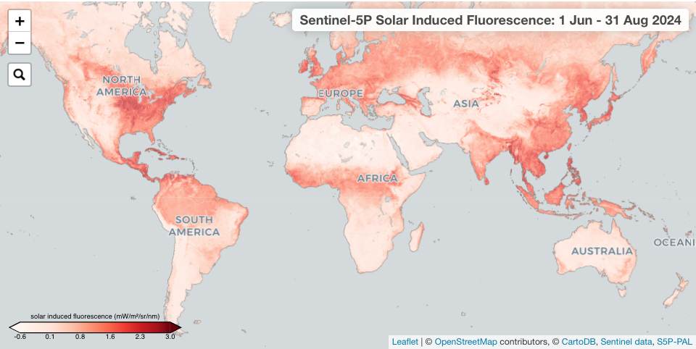
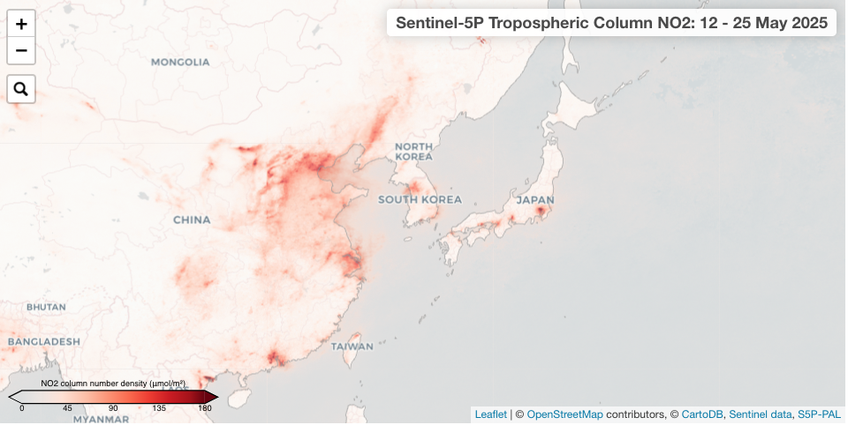
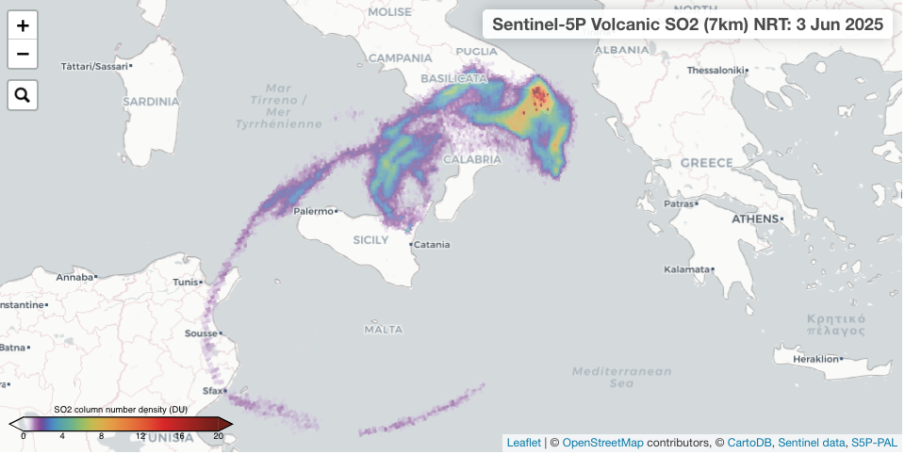
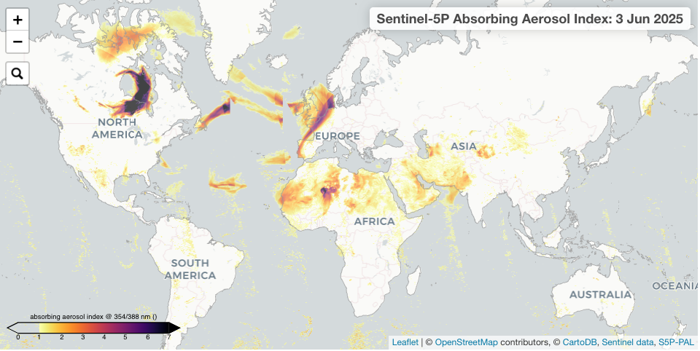
Level 2/3 Data Products
L2 OPERATIONAL | Parameter | L3
L2__O3____ | Ozone total column | D3DMSY
L2__O3_TCL | Ozone tropospheric column
L2__O3__PR | Ozone profile
L2__NO2___ | Nitrogen Dioxide (NO2) | FMSY
L2__SO2___ | Sulfur Dioxide (SO2) | D
L2__CO____ | Carbon Monoxide (CO) | 3DFMSY
L2__CH4___ | Methane (CH4) total column | WMSY
L2__HCHO__ | Formaldehyde (HCHO) | 3DFMSY
L2__CLOUD_ | Cloud fraction, albedo, top pressure | DMSY
L2__AER_AI | UV Aerosol Index | DMSY
L2__AER_LH | Aerosol Layer Height (mid-level pressure) | DMSY
UV product | Surface Irradiance/erythemal dose
L2__NP_BDx, x=3, 6, 7 | Suomi-NPP VIIRS Clouds
L2 SCIENTIFIC | Parameter | L3
AOT | Aerosol Optical Thickness | DMSY
BrO | Bromine Monoxide (BrO) | DFMSY
CHOCHO | Glyoxal (CHOCHO) | FMSY
HDO | HDO/H2O ratio
SO2 Cobra | Sulfur Dioxide (SO2) | D
SIF | Solar Induced Fluorescence | D3DMSY
TCWV | Water vapor (H2O) | DMSY
DLER | Surface directional reflectance
L3 Legend
D | 1 day mean
3D | 3 day mean
W | Weekly mean
F | 14 day mean
M | Monthly mean
S | Seasonal mean
Y | Yearly mean

Slide 6
Data Product Updates
L1B updates are planned for Q4-2025:
Update of the Calibration Key Data
Improved straylight correction in Band 1 & 2
Residual background correction (impact Band 1 & 2)
Detector feature correction (Band 3)
L2 updates are planned for Q4-2025:
Ozone profile soft calibration update
ALH NRT/fallback cloud clearing using Machine Learning
CH₄ available in NRT
Improved retrievals for SO₂ and HCHO over water
NO₂ fitting adjustment to reduce effects of Raman scattering in water
Enhanced cloud slicing algorithm for Tropospheric O₃
Preparations for L1/L2 Mission Reprocessing will start in 2026
Notes:
For the L1B processor there will be an important update, with most impact for the UV processor (B1&B2). It is planned that this will also be the version used for the mission reprocessing.
For L2 an important step is the ALH cloud clearing algorithm, independent of NPP-VIIRS. This will improve the NRT data and can serve as a NPP-VIIRS fallback.
New is the CH4 data produced in NRT, which is a request from the user community.
@Diego: add UPAS update highlights.

Slide 7
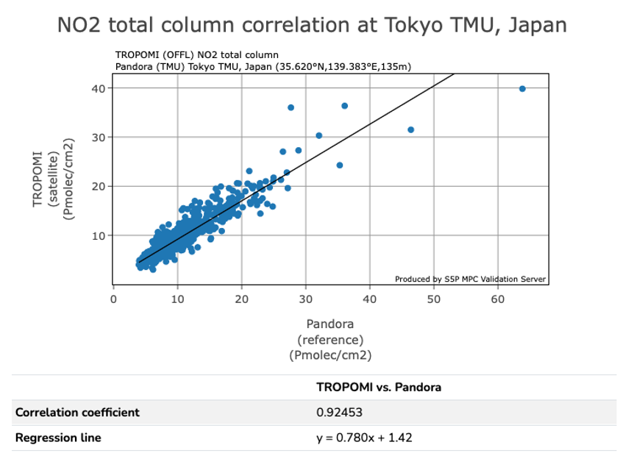
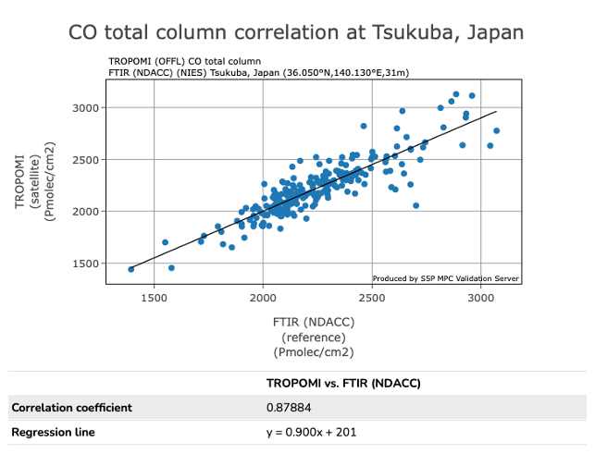
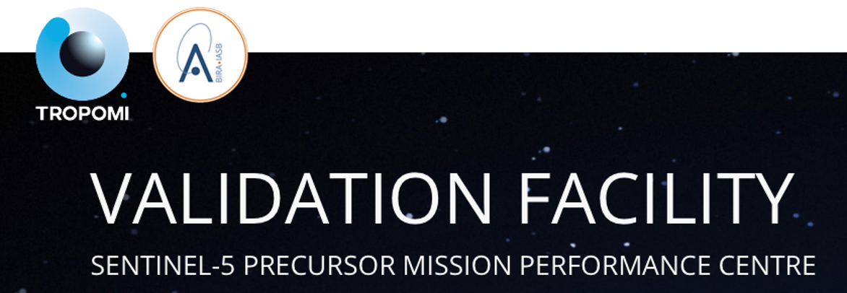
Validation
The S5P Mission has an extensive routine validation system, combining automatically generated comparisons with scientific analyses
All reports and data are open to the user community (link to latest report)
Notes:
Figures show examples from the automated validation data server for NO2 and CO.

Slide 8
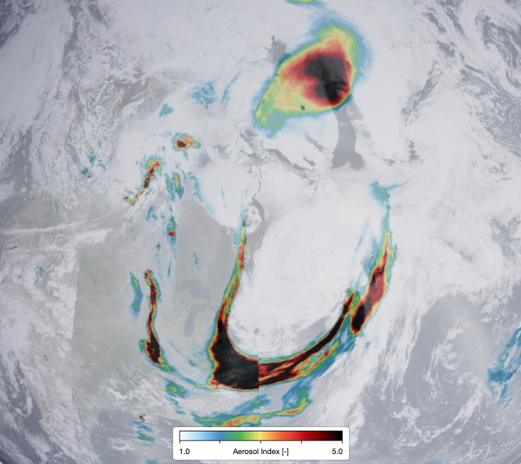
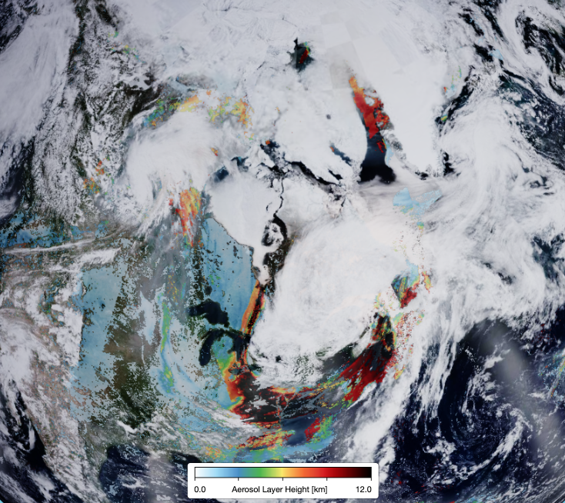
Science Highlight: Canadian smoke plumes [2025-06-02]
Tropomi UVAI
Tropomi ALH
Smoke from Canadian wildfires is transported over Greenland and reaches altitudes >10 km. The Tropomi ALH values are confirmed by the EarthCARE Lidar.
EarthCARE Mie backscatter
Notes:
In recent weeks there have been severe wildfires over Canada.
The smoke plumes can be tracked all the way to Europe.
Some plumes are transported towards the North and reach high altitudes of more than 10 km.
The Tropomi ALH data are confirmed by the detailed EarthCARE Lidar data.

Slide 9
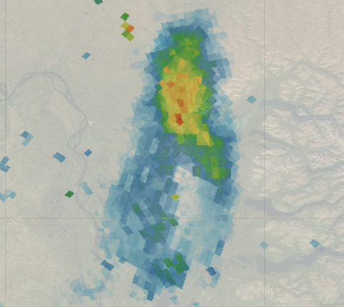
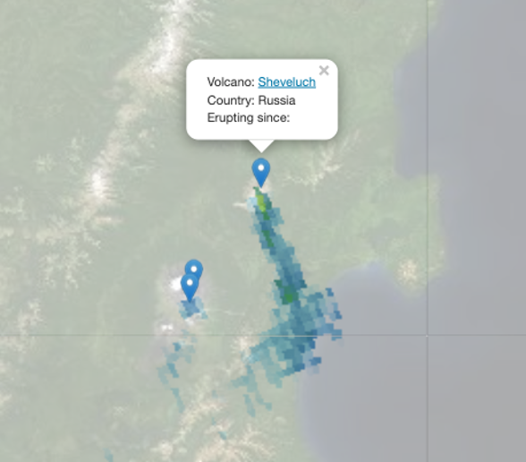
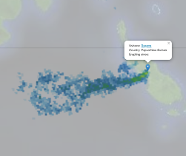
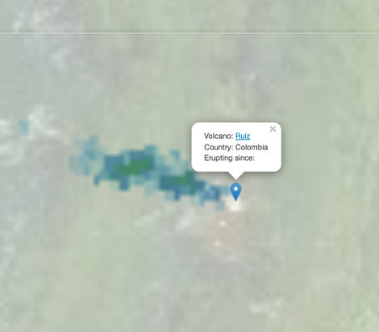
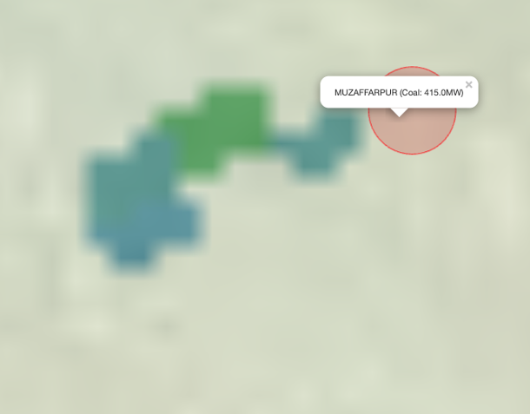
Science Highlight: SO2 COBRA Mission Reprocessing
Norilsk Smelter, Russia
Bagana Volcano
Papua New Guinea
Sheveluch Volcano, Russia
Example of COBRA SO₂ for 2025-06-03
Ruiz Volcano, Colombia
Muzzaffarpur power plant, India
Notes:
Strongly reduced noise allow for detection of smaller sources. Shown results are for 1 day,

Slide 10
Mission Extension
In the coming year, a decision will be made on the S5P mission extension after 2028.
Arguments for S5P mission extension:
  The complementarity with Sentinel 5 (S5 morning | S5 afternoon);
  The excellent quality of the S5P/Tropomi data products;
  The high spatial resolution of S5P/Tropomi;
  The continuation of the afternoon data record started with OMI;
  Better coverage of high latitudes compared to S5 due to lower SZA;
  …
The voice of the user community will be important for the S5P mission extension!

Slide 11

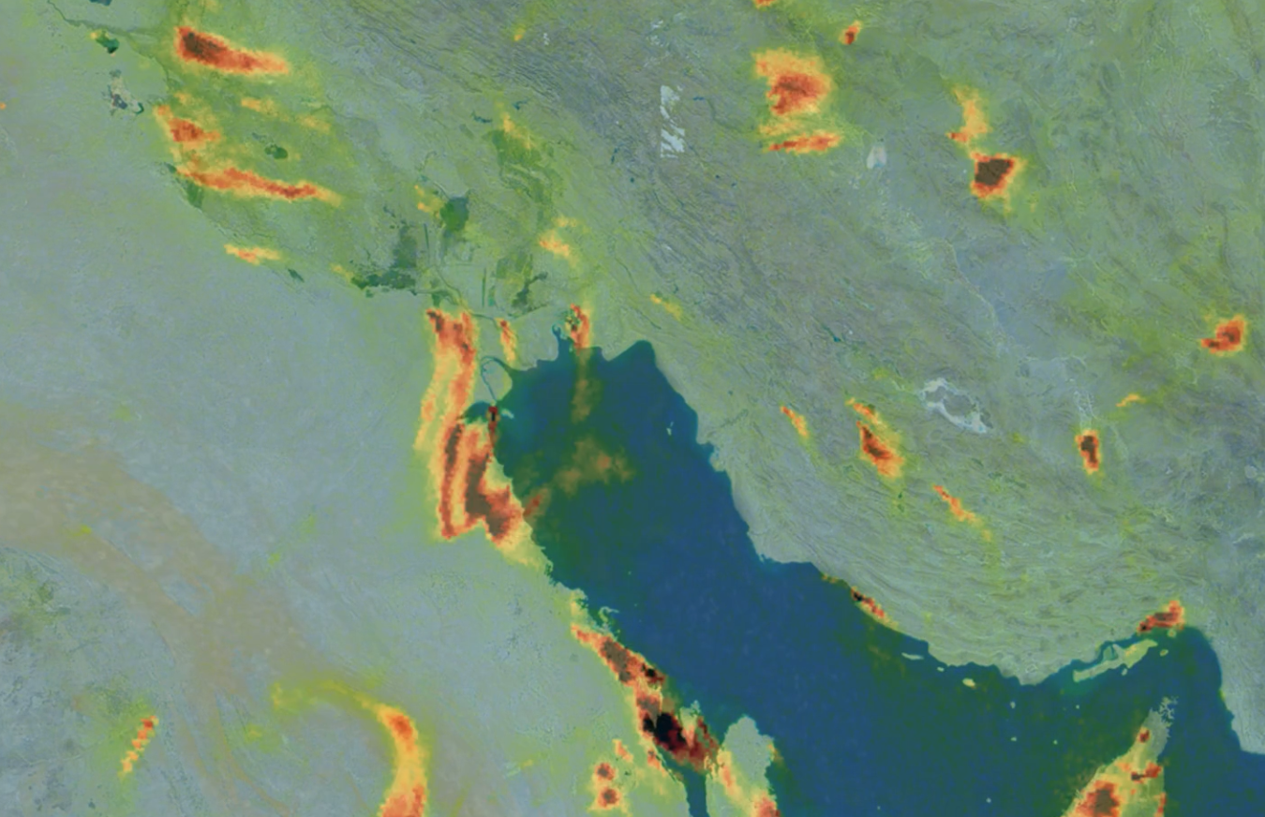
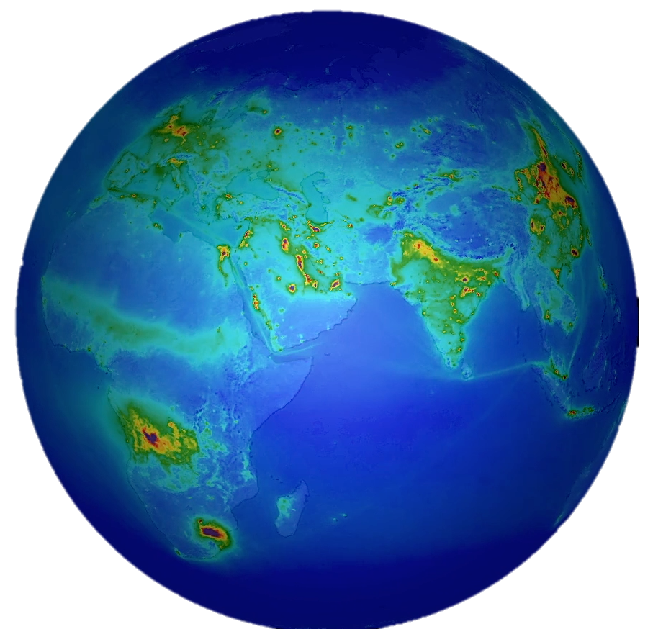
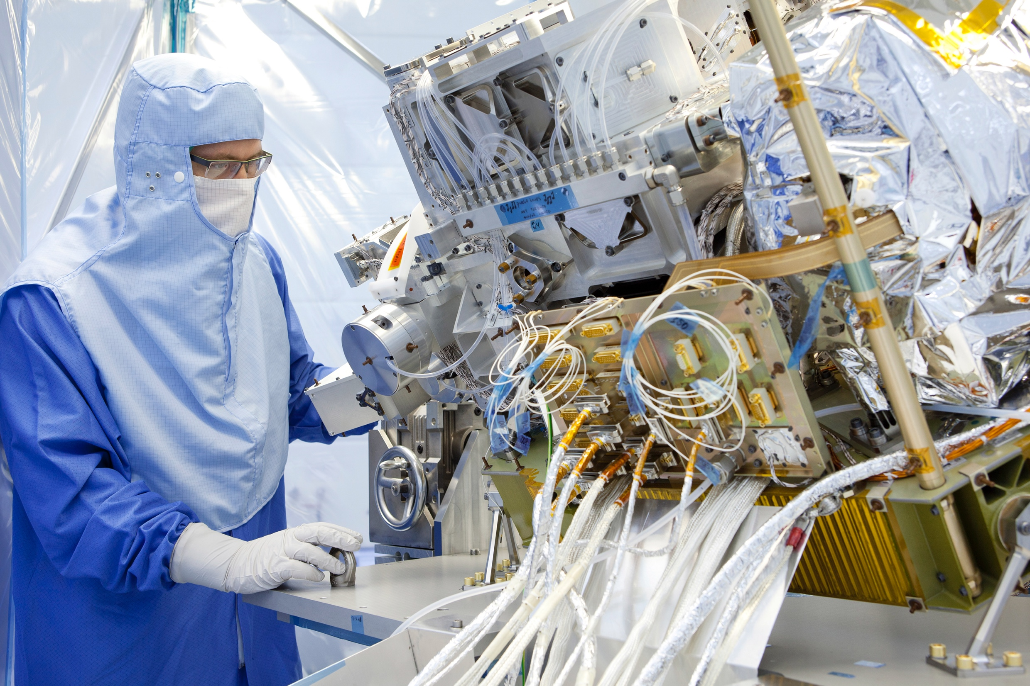
TROPOMI Data Availability
Copernicus Dataspace
Operational L1 and L2 data
https://dataspace.copernicus.eu
S5P-PAL
Scientific L2 and L3 data
https://data-portal.s5p-pal.com
TEMIS
Regional and gridded NO2 data
https://www.temis.nl
NASA
Operational L1 and L2 data
https://www.earthdata.nasa.gov/sensors/tropomi
... and …
Google Earth Engine
https://geoservice.dlr.de
https://terrascope.be/en
https://atmos.eoc.dlr.de/inpuls/visualization/

