Slide 1
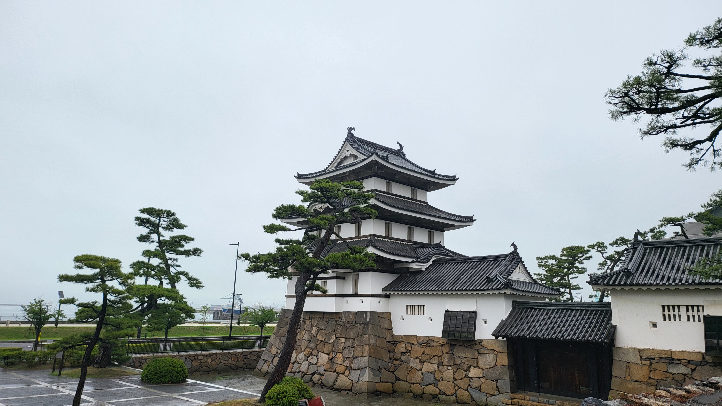
GEMS Status
Jhoon Kim*, M.H. Ahn, R. Park, H. Lee, J. H. Kim, K.-S. Han, Y.S. Choi,
S. Park, C.K. Song, S.W. Kim, Y.J. Seo, Y. Chae, H. Cha, W. Kang,
NIER ESC Staffs, and GEMS Science Team
* Lee Youn Jae Fellow Professor of Atmospheric Science
Yonsei University, Seoul, Korea

Slide 2
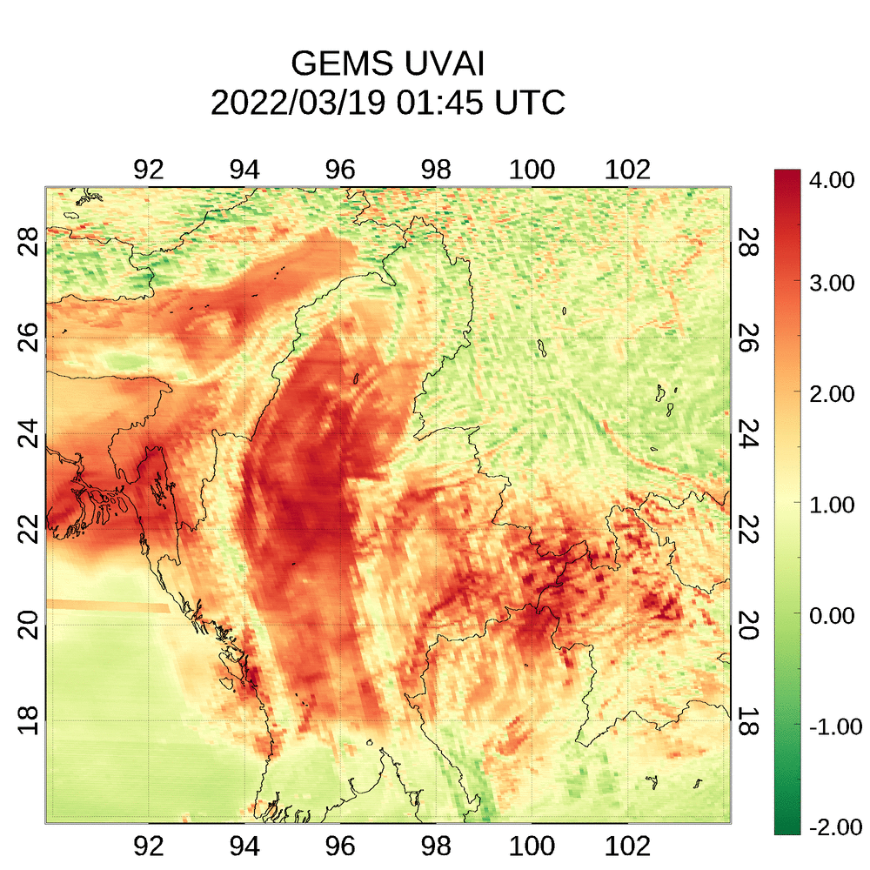
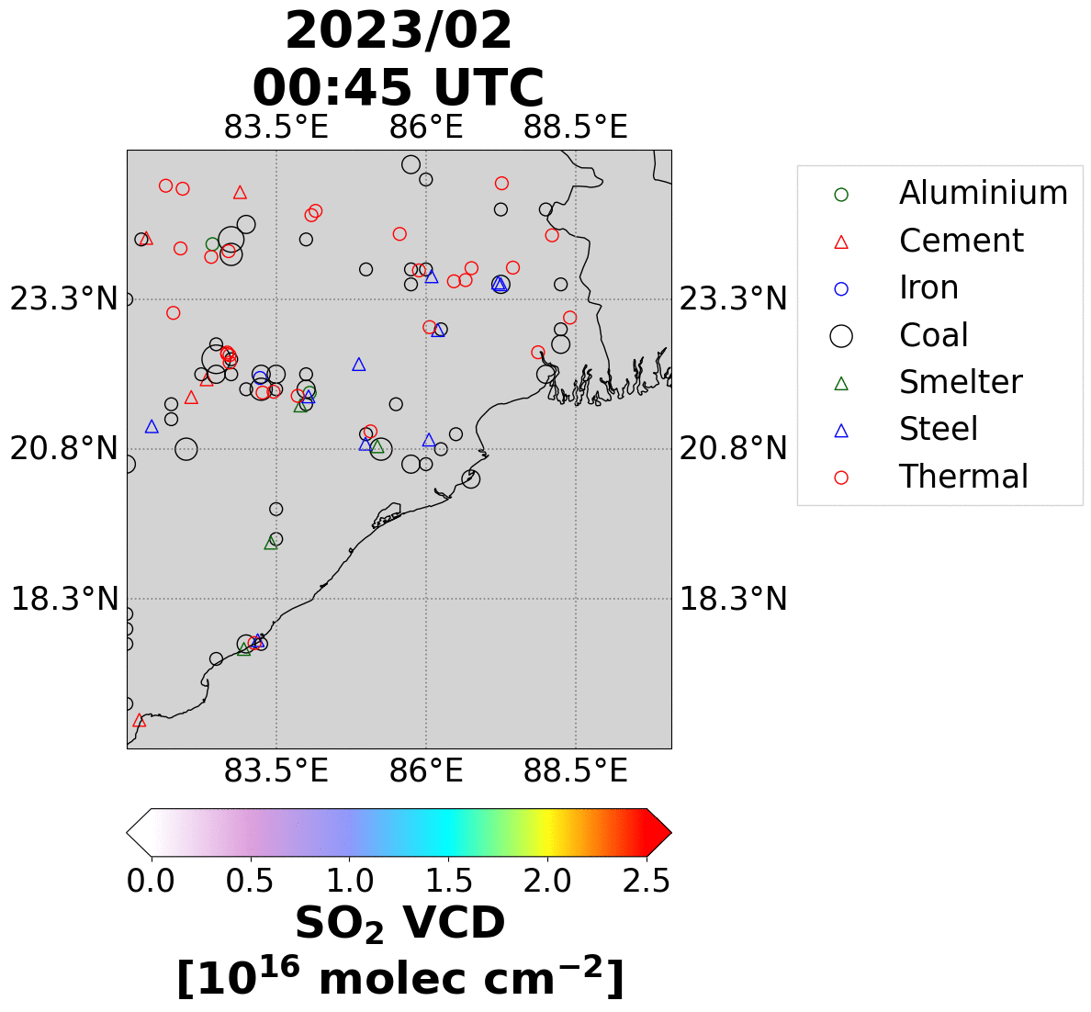
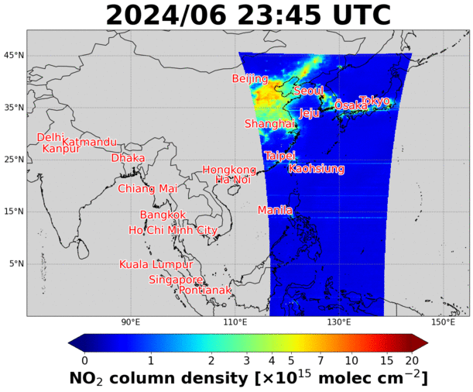
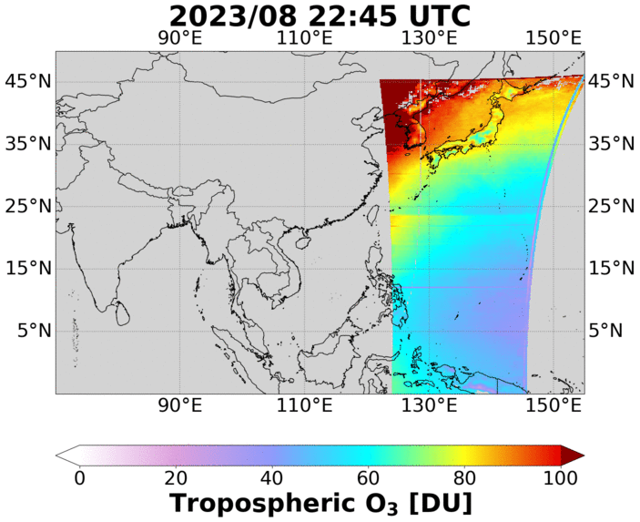
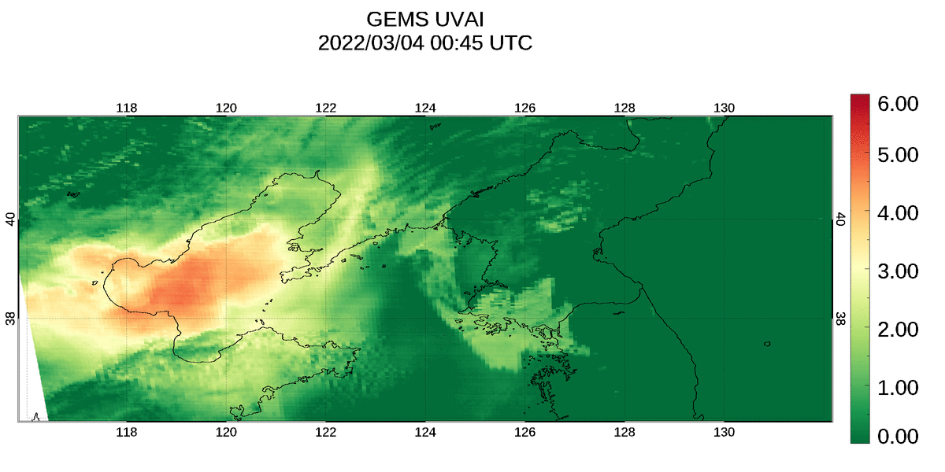
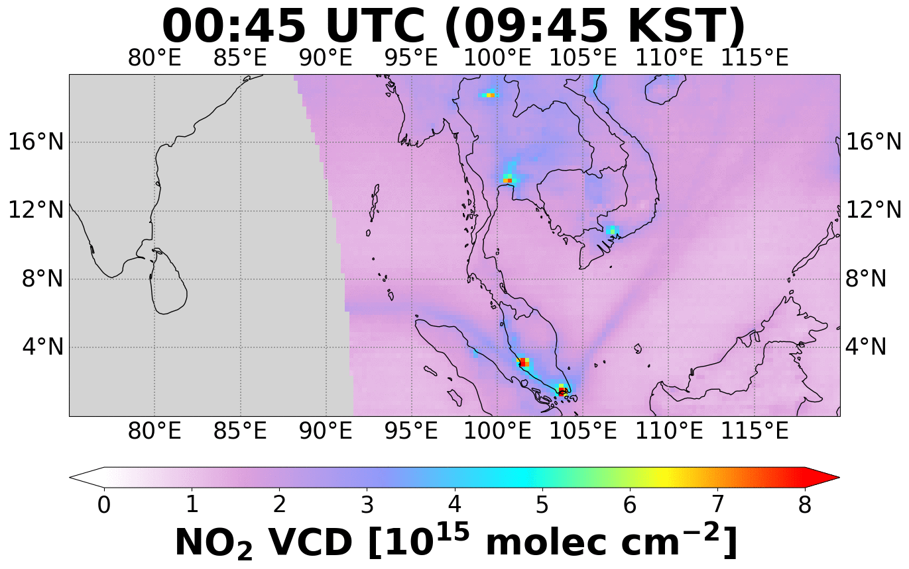
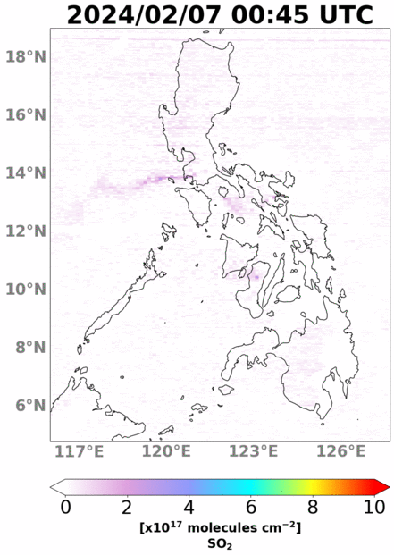

GEMS Data Products
Urban Emission
Wildfires
Trop Ozone
Coal PP & Smelters
UV Aerosol Index
Dust & Wildfires
Ship Track Emission
Volcanic Eruption
Aerosol Optical Depth

Slide 3
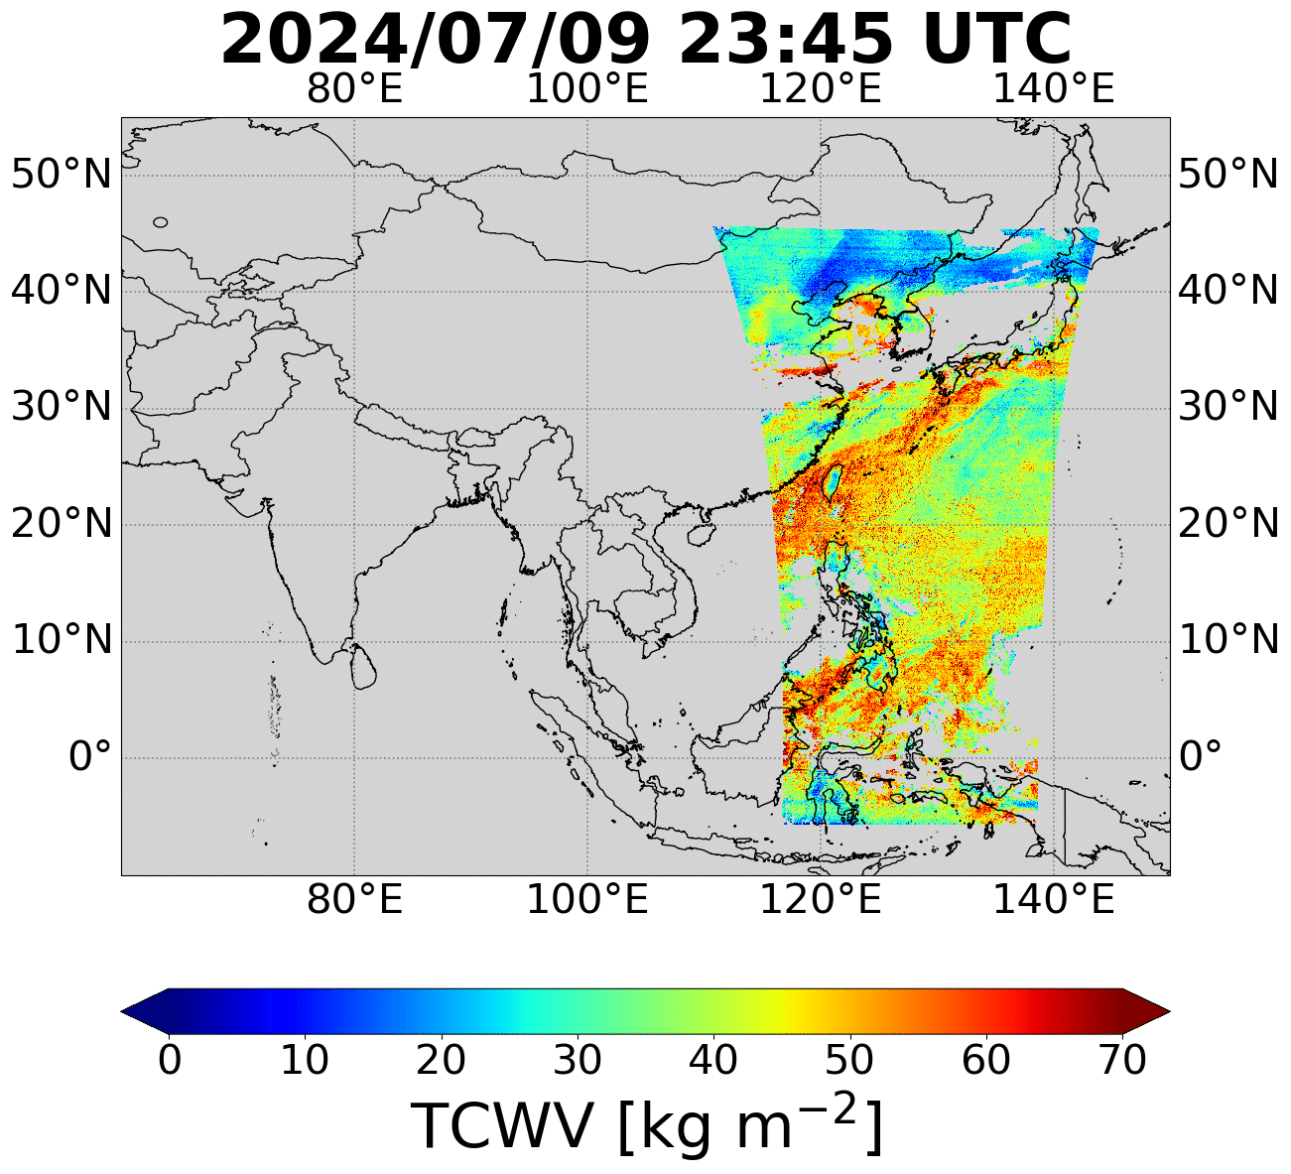
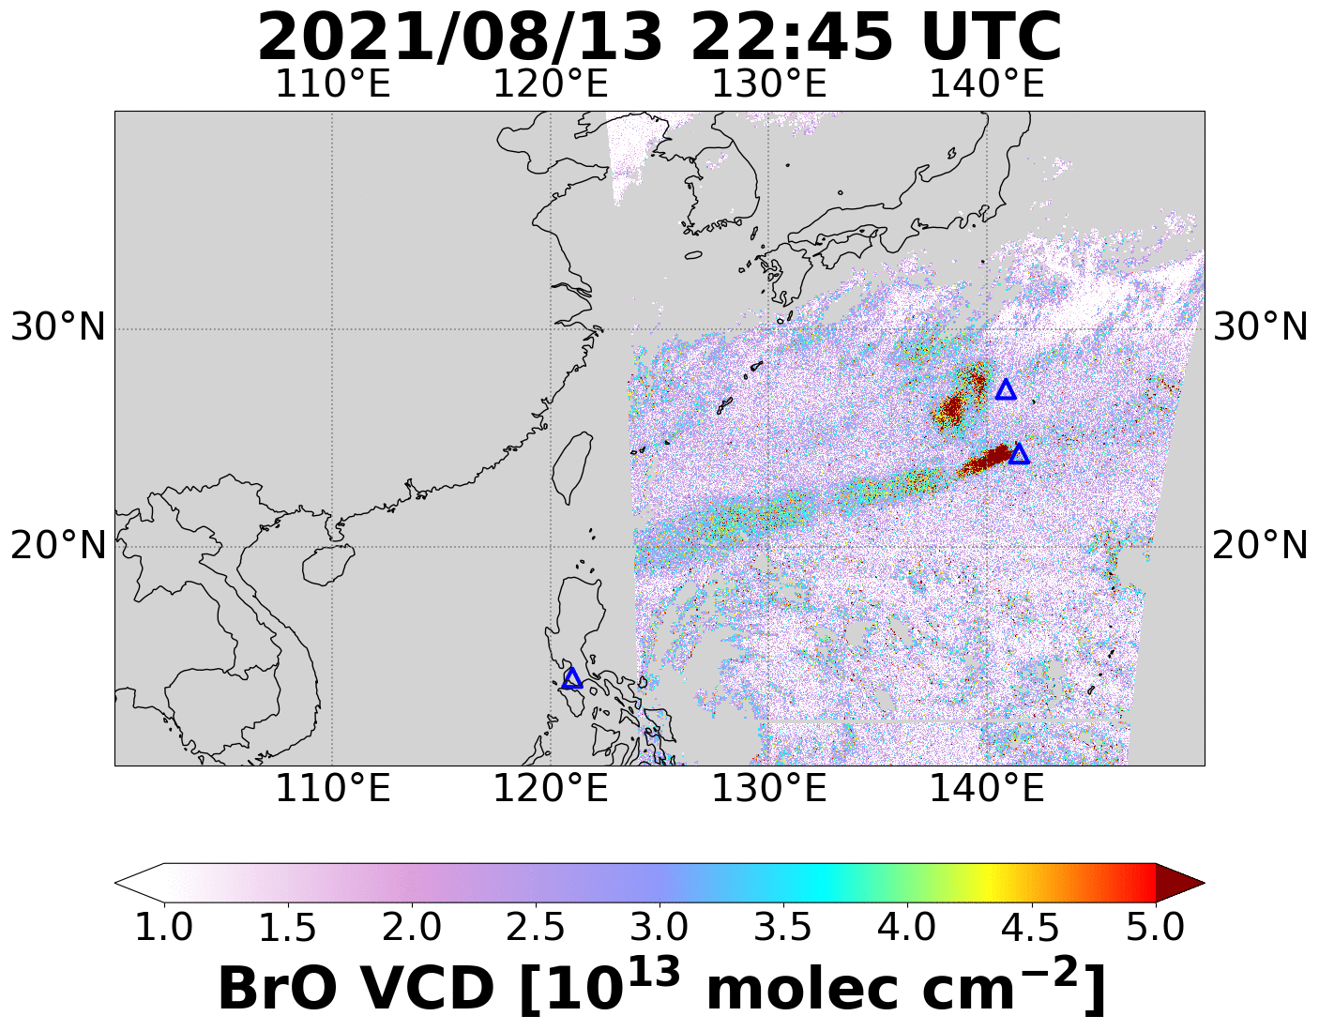
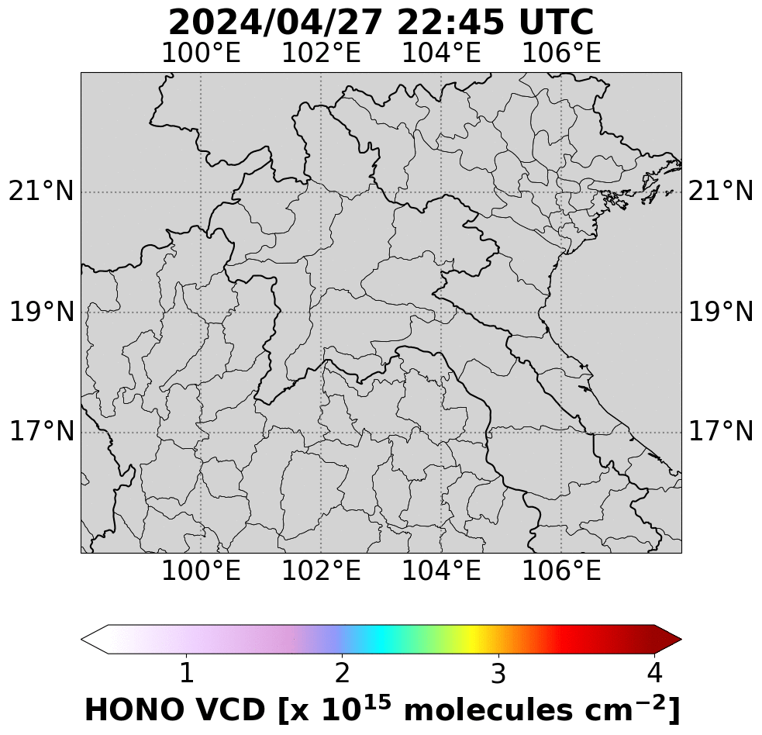
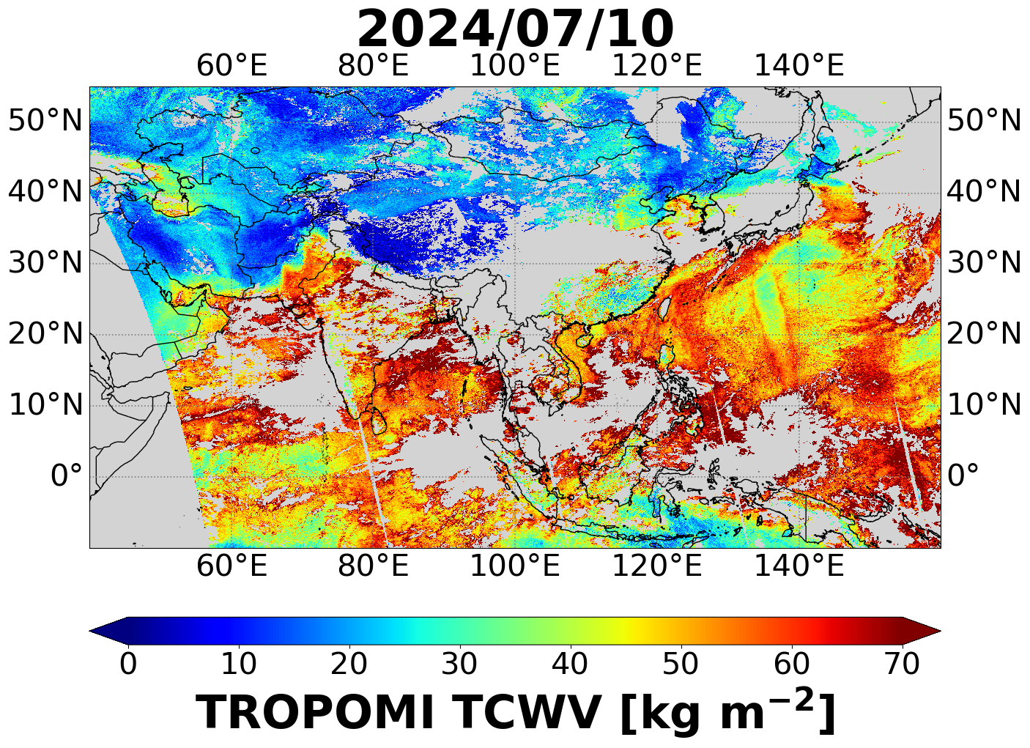
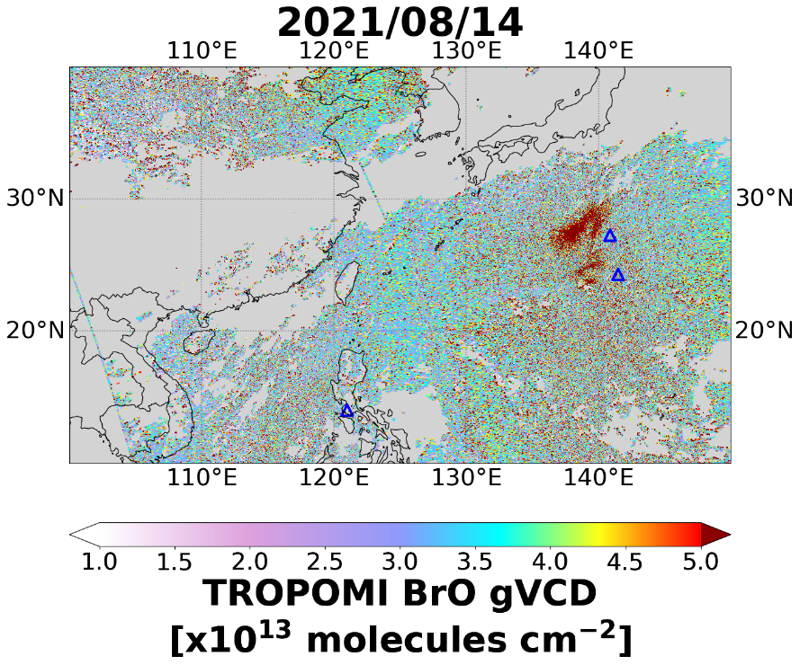
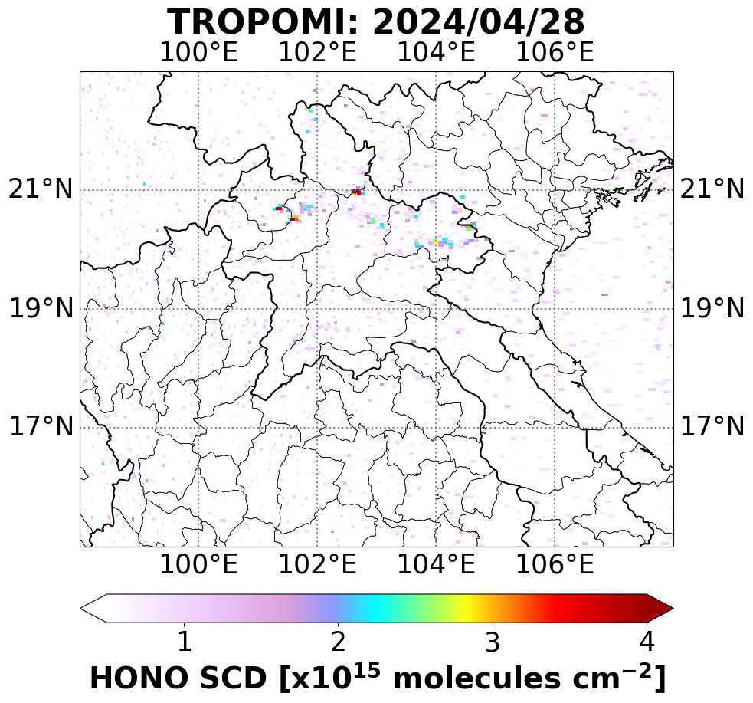
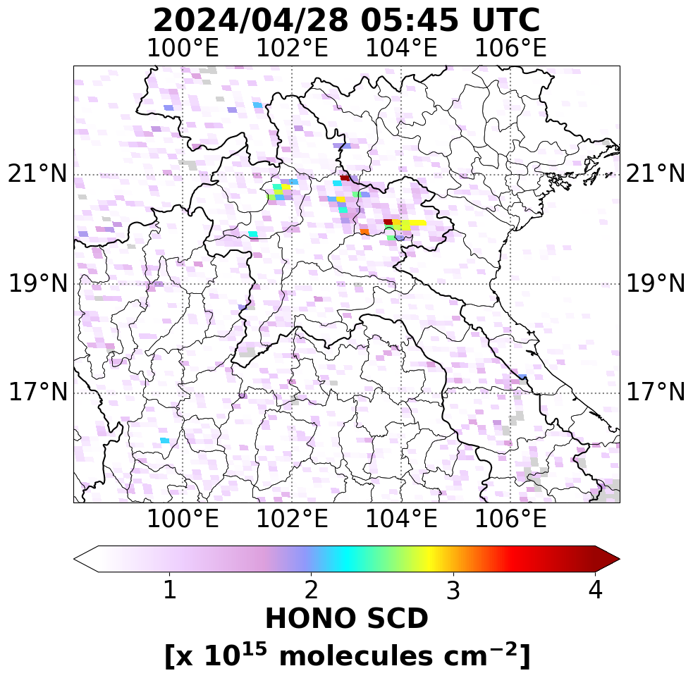
New products of GEMS
H₂O
BrO
HONO
GEMS
HONO VCD
Nishinoshima
GEMS
Taal
Fukutoku-Okanoba
TROPOMI
HONO SCD
GEMS
HONO SCD
TROPOMI
Notes:
Wildfire in northern Laos

Slide 4
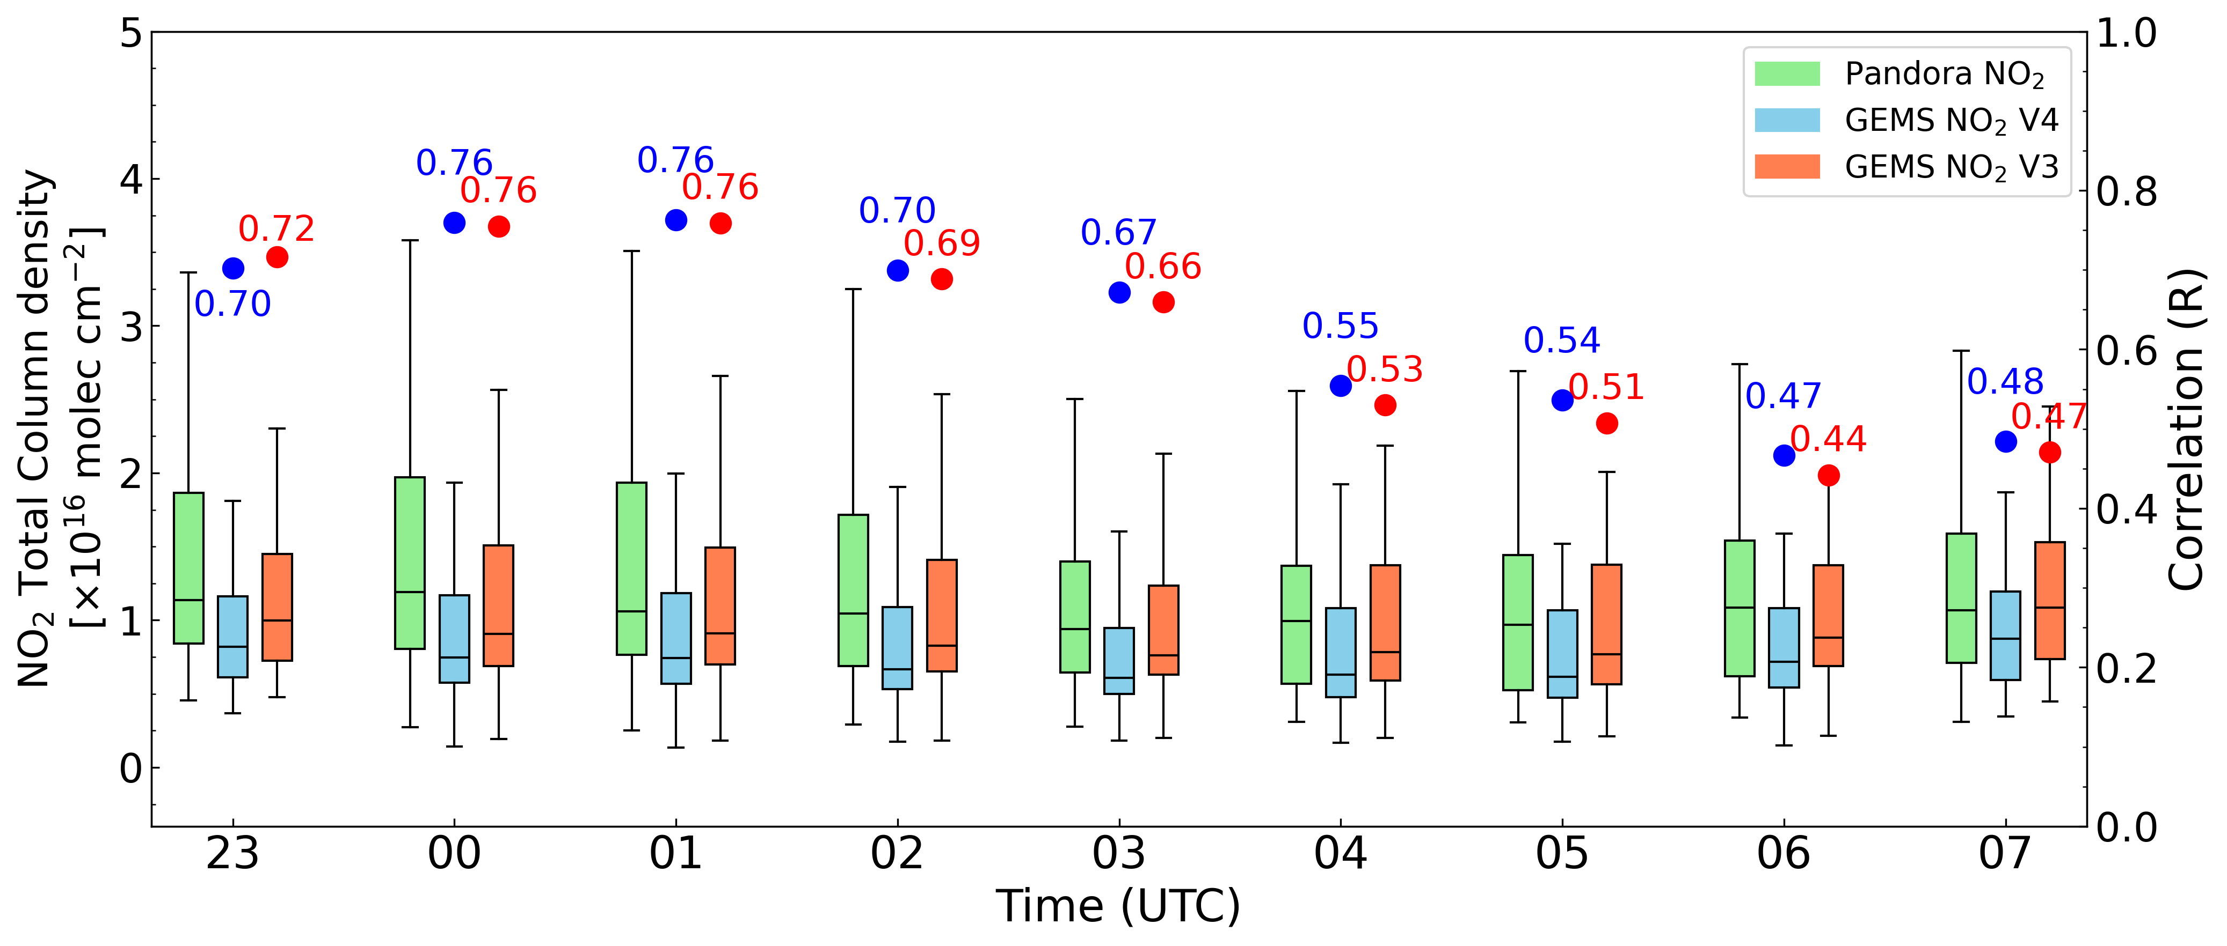
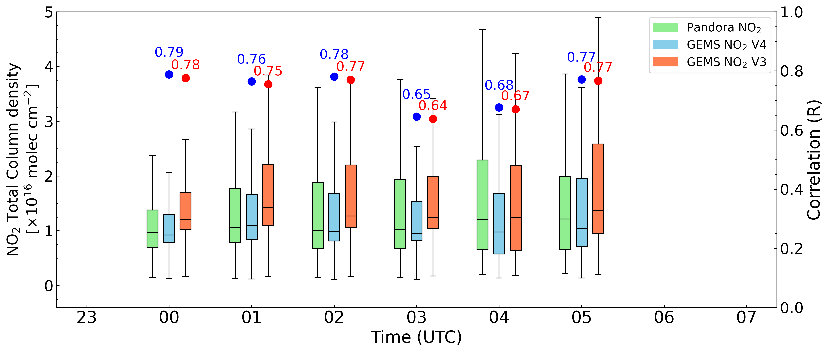
NO₂ v4.0 Diurnal Variation
June 2024
In summer, NO₂ concentrations are elevated in the morning due to heavy traffic emissions in East Asia, which are observed starting from 23 UTC.
Correlation (R) are generally higher in winter than summer.
In summer, higher R values are observed in the morning when NO₂ levels are high, and R values decrease toward the afternoon along with NO₂ levels.
In addition, GEMS NO₂ V4.0 shows higher R values compared to V3.0.
December 2024

Slide 5
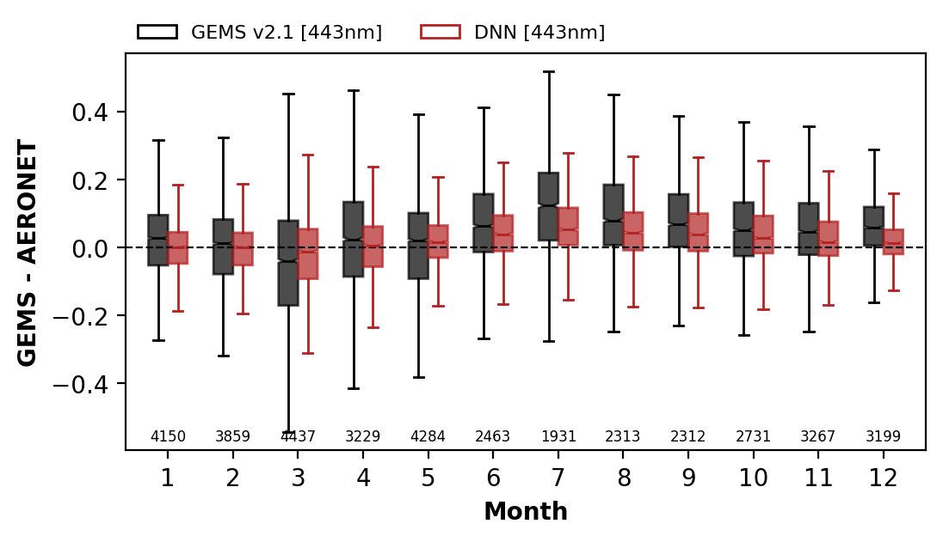
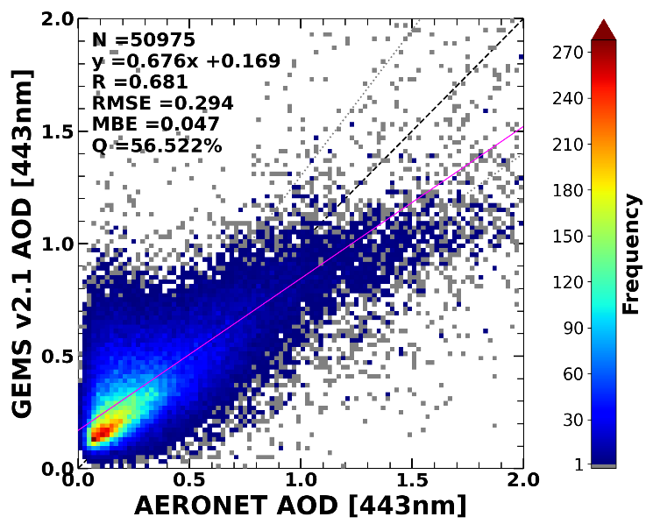
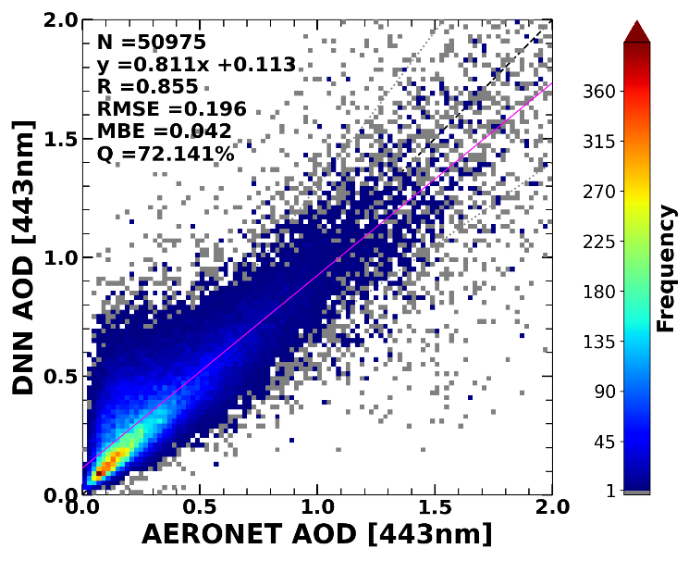
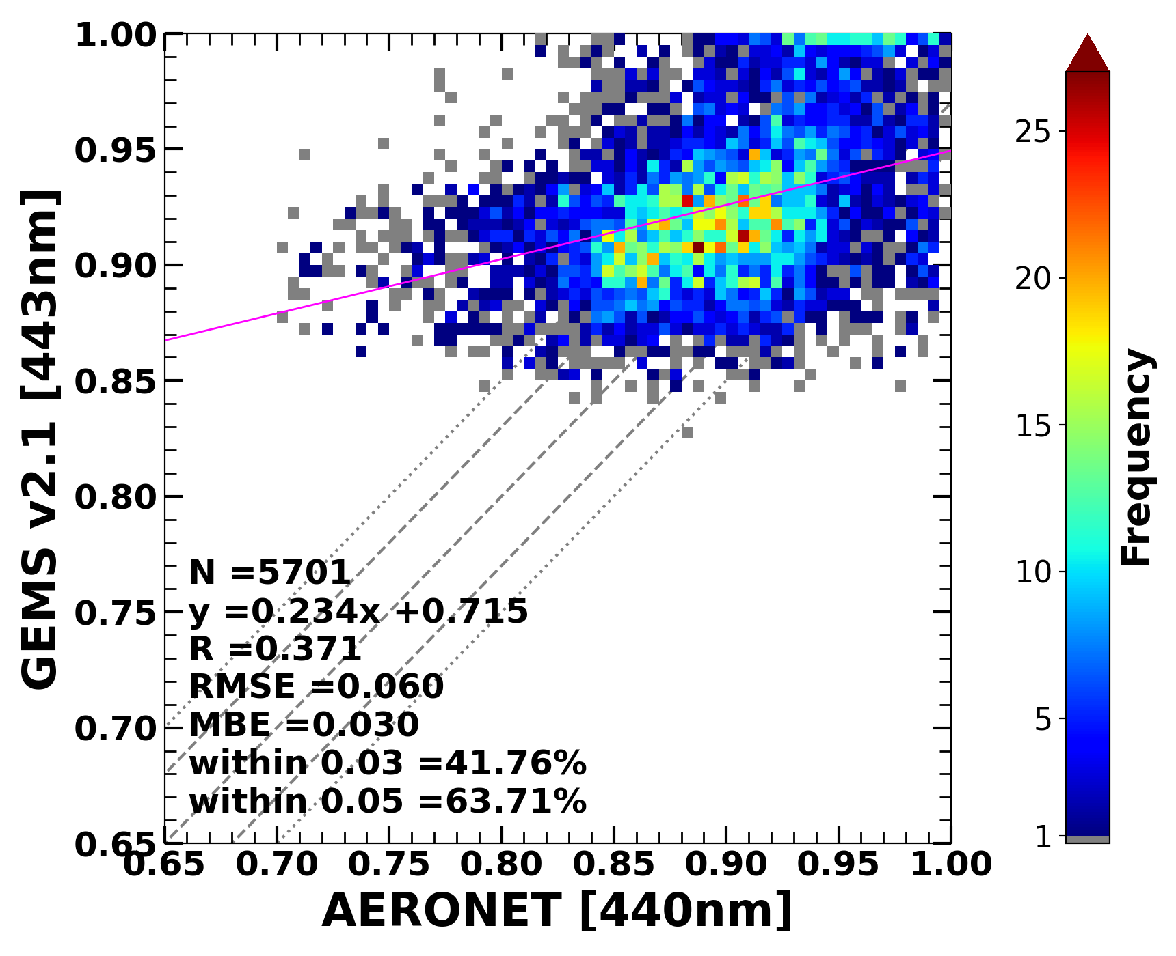
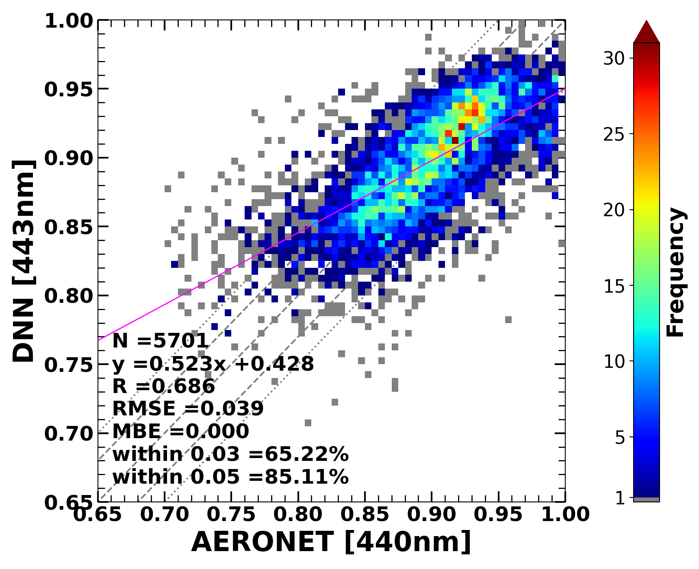
Aerosol – post-processing
AOD (2024/05 – 2025/04)
SSA (2025/01 – 2025/04, AOD≥0.2)
GEMS AOD, SSA, viewing geometry, aerosol index, radiance, …
AERONET
DNN
Corrected
GEMS
Notes:
시간별 변화 비교 플롯 추가

Slide 6
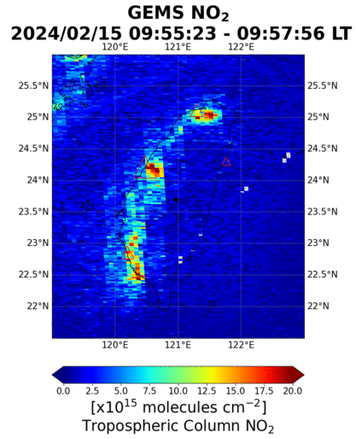
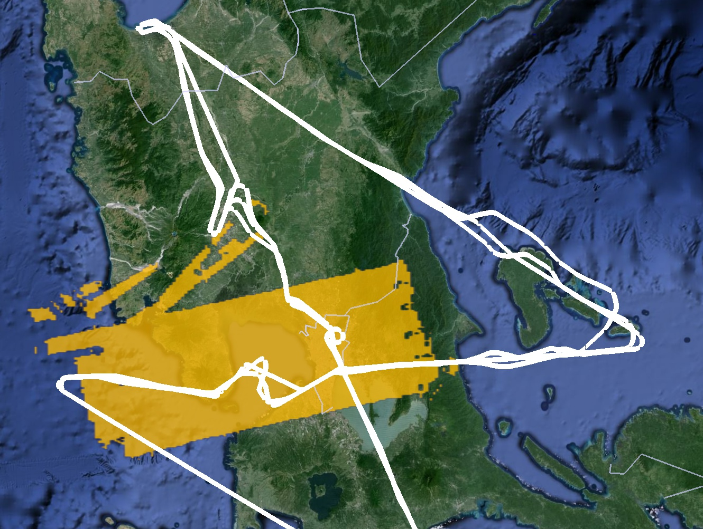
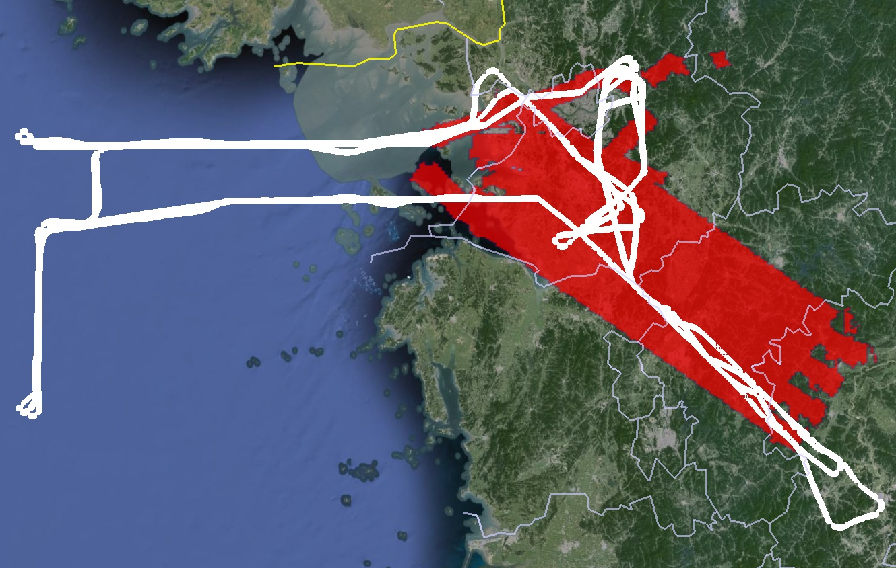
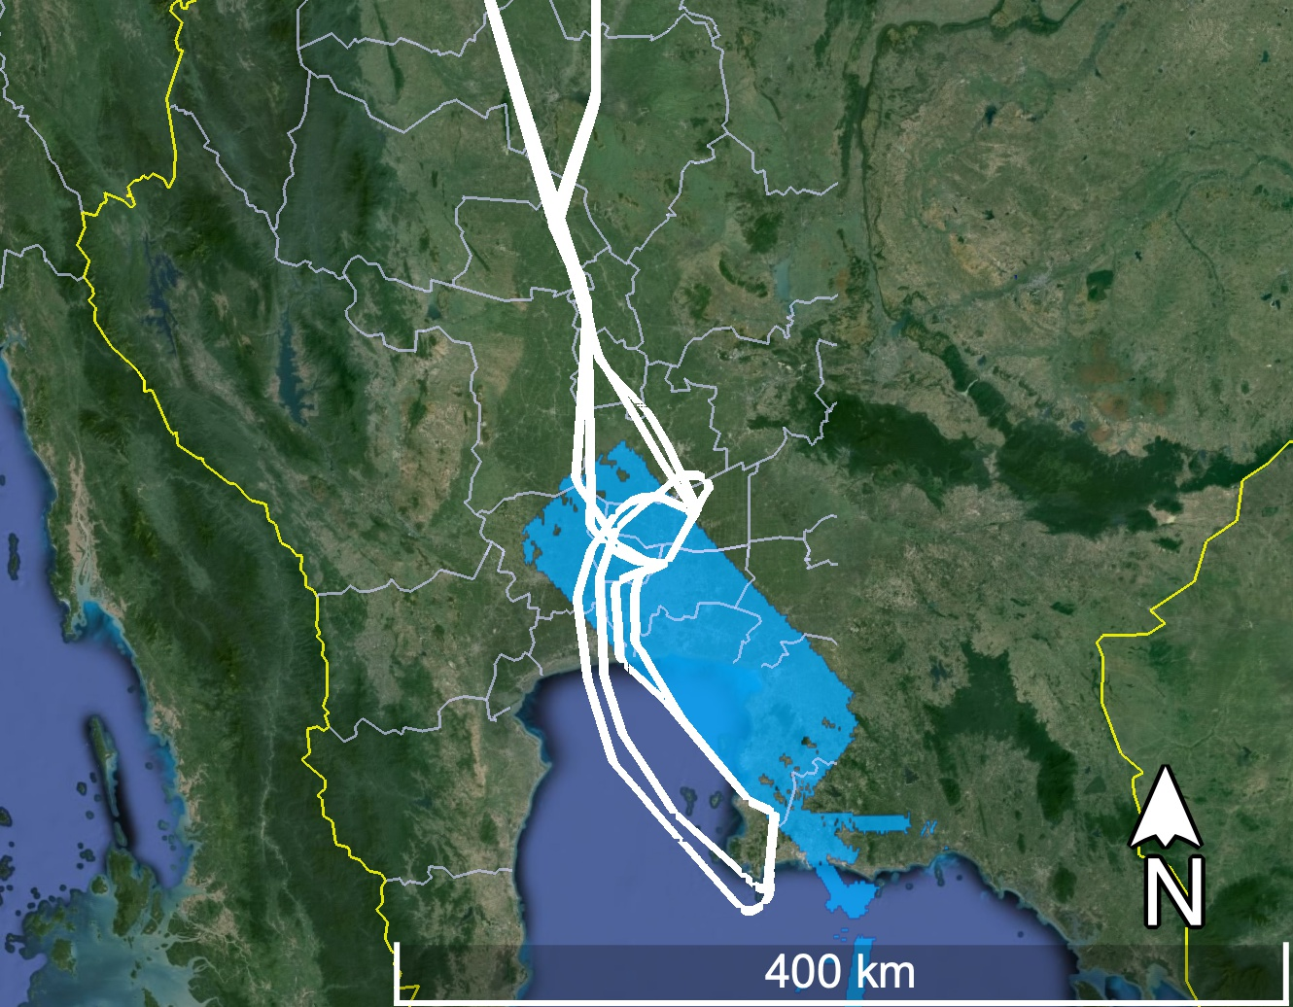
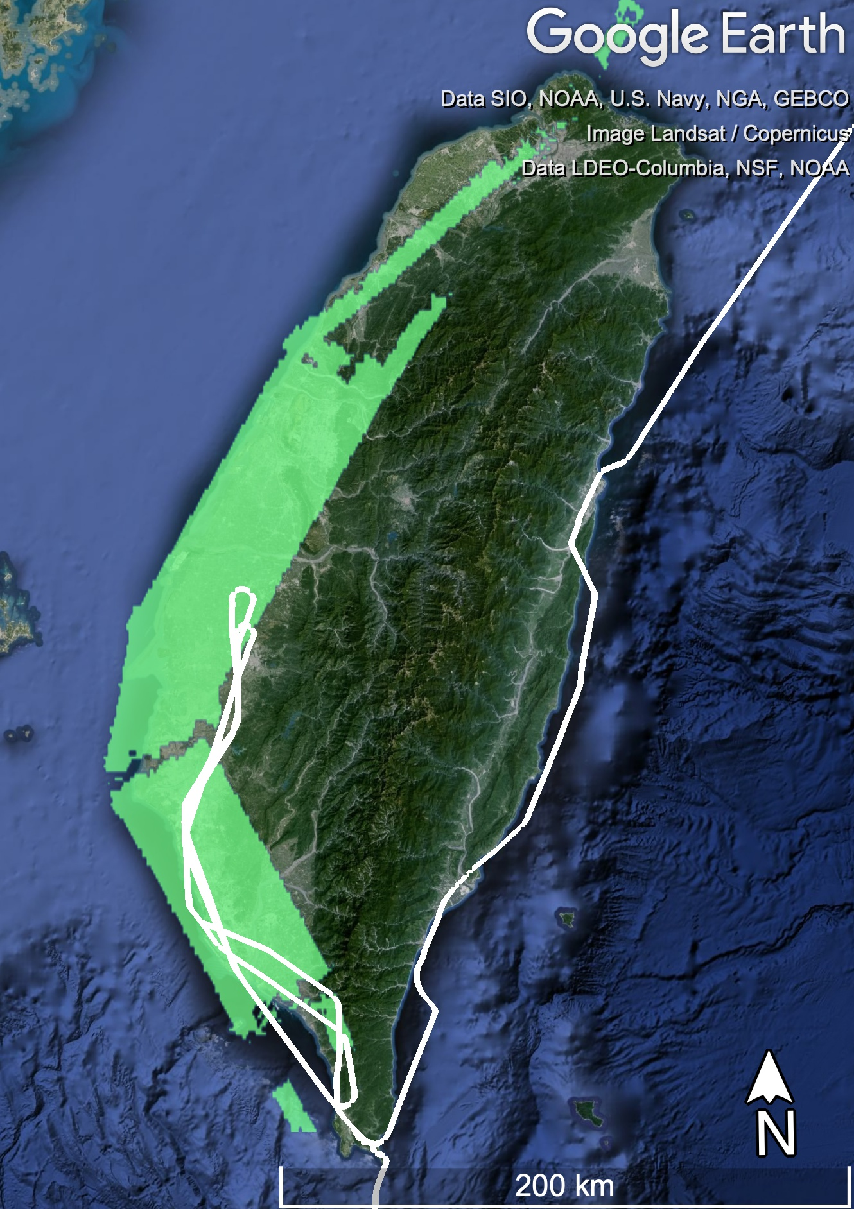
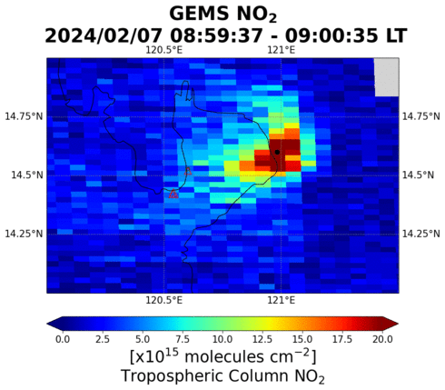
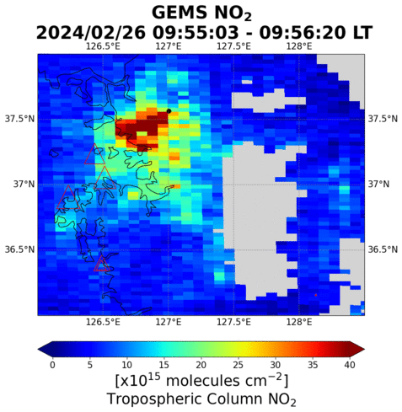
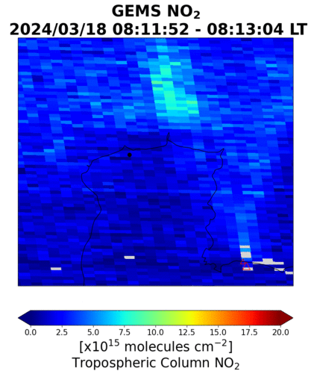

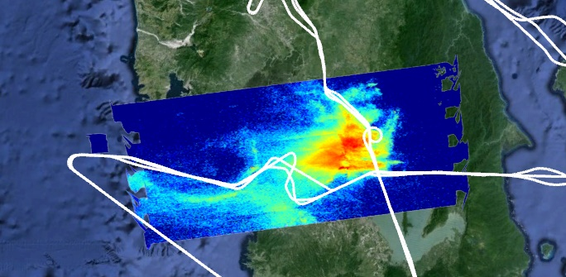
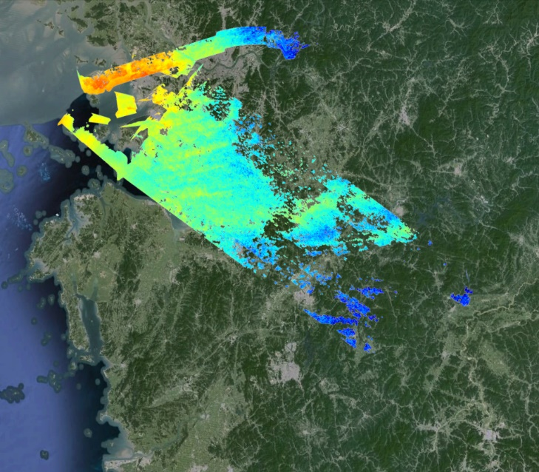
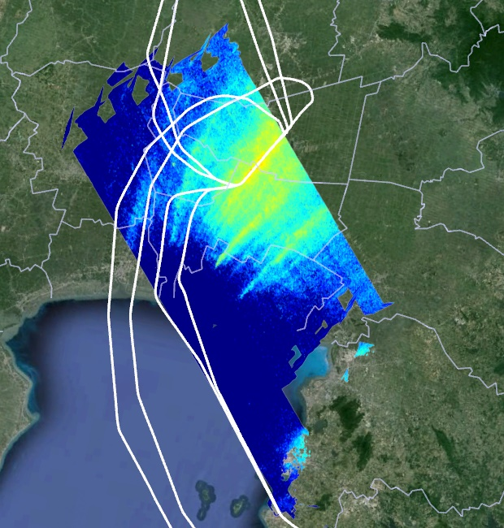

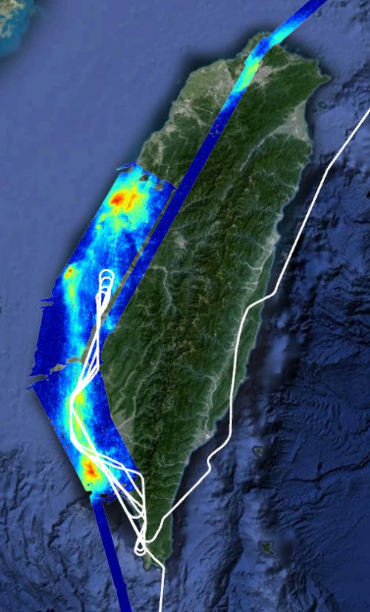
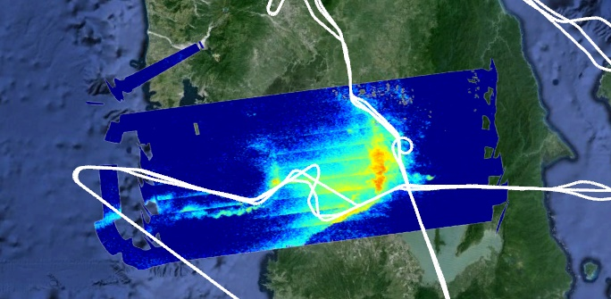
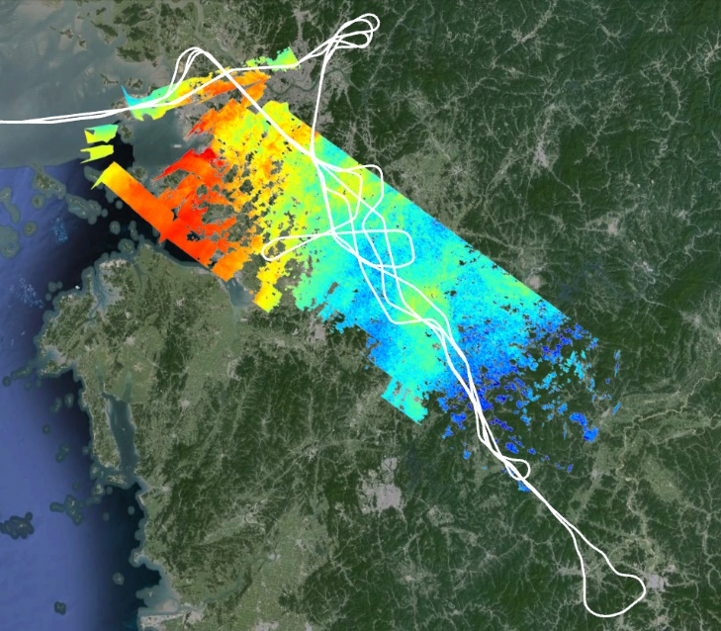
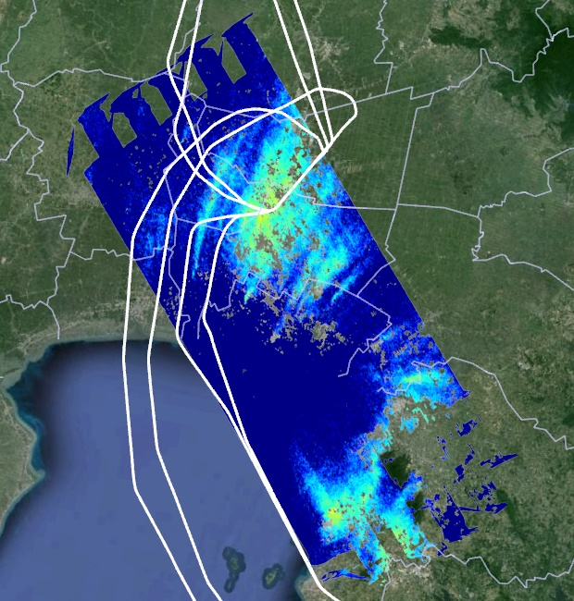
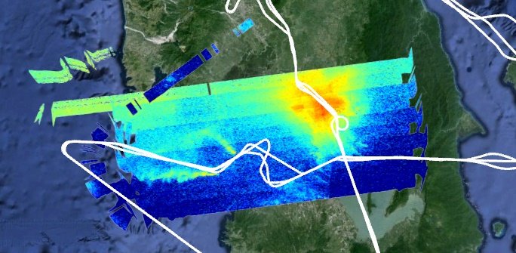
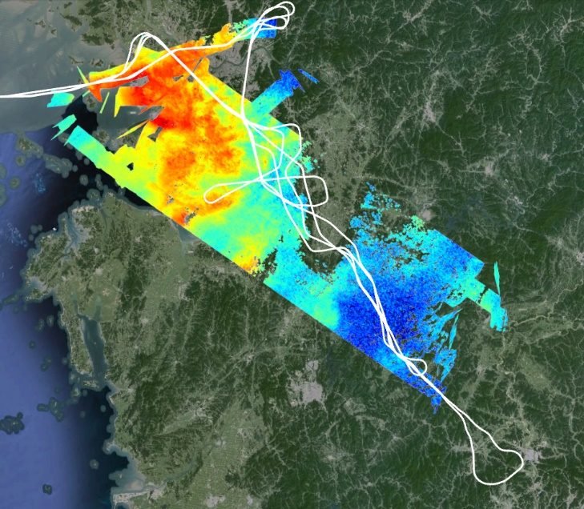
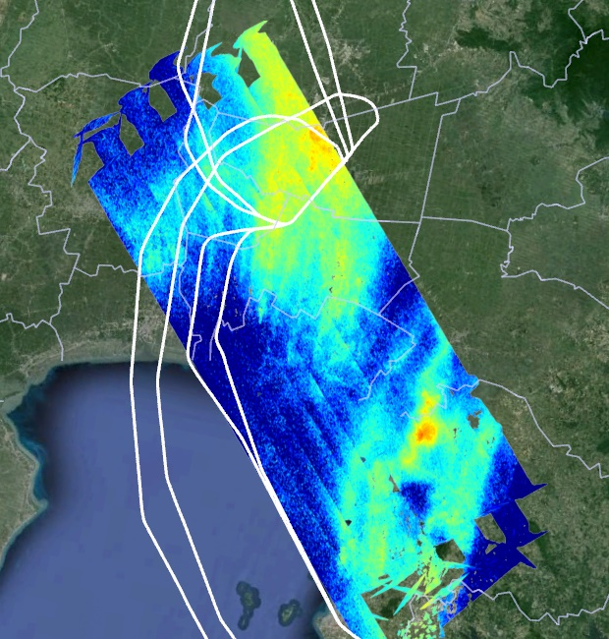

Full extent of DC-8 sampling
NO₂
S. KOREA
GEMS
THAILAND
PHILIPPINES
TAIWAN
Talk by L. Chang
this afternoon
7 Feb Morning
23 Feb
18 Mar
Morning
GCAS
7 Feb Midday
26 Feb
18 Mar
Credit: J. Crawford, Laura Judd, Scott Janz, Jhoon Kim, Hanlim Lee
Midday
18 Mar
Feb-Mar,
2024
7 Feb Afternoon
26 Feb
After-
noon
Notes:
Gulf of Thailand
ASIA-AQ Philippines Science Flights
4 days with three G-III rasters and three DC-8 circuits
1 day with a morning G-III raster
GCAS Preliminary Slant column data (kmz files on archive)

Slide 7
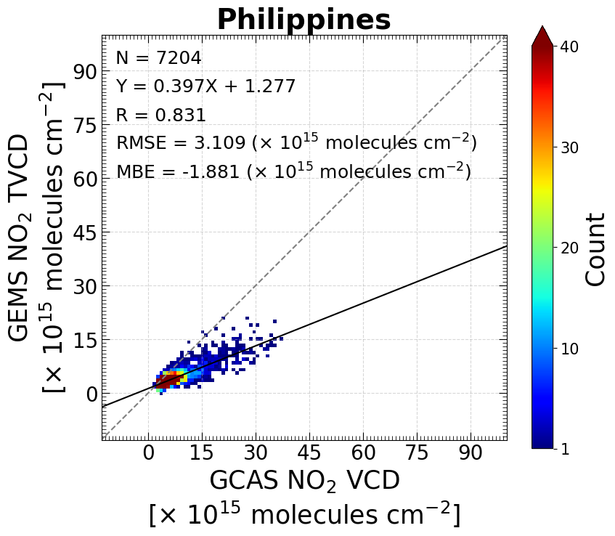
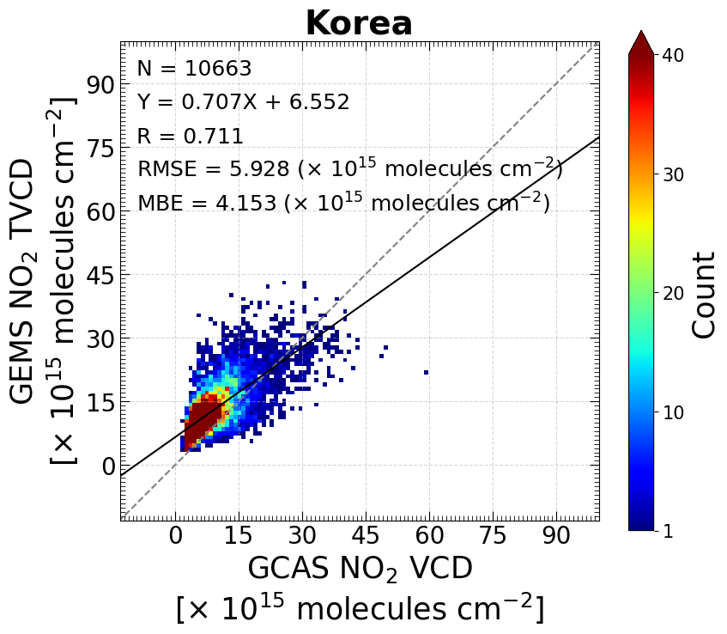
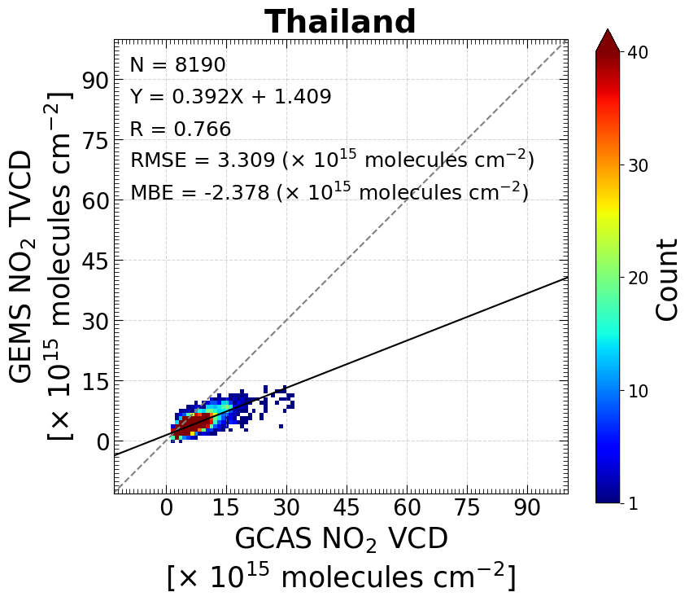
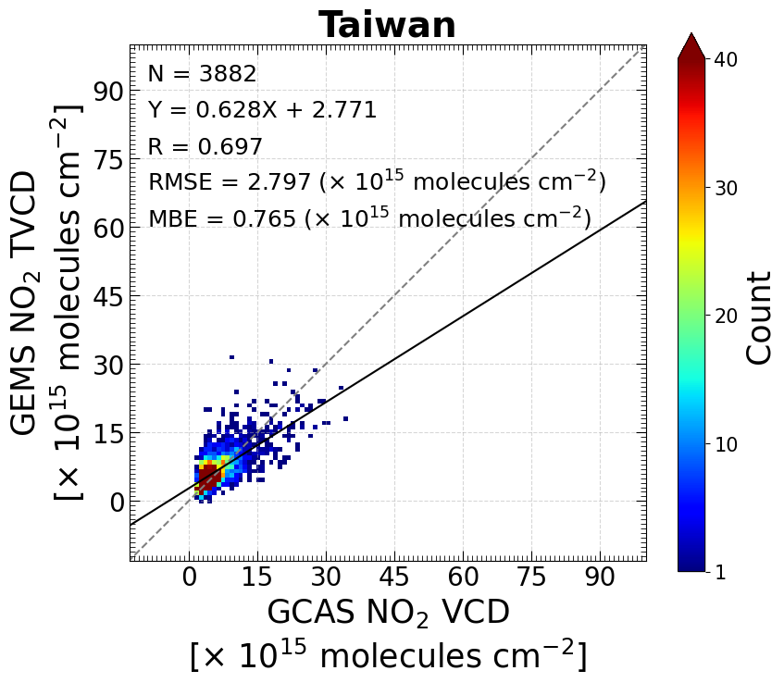
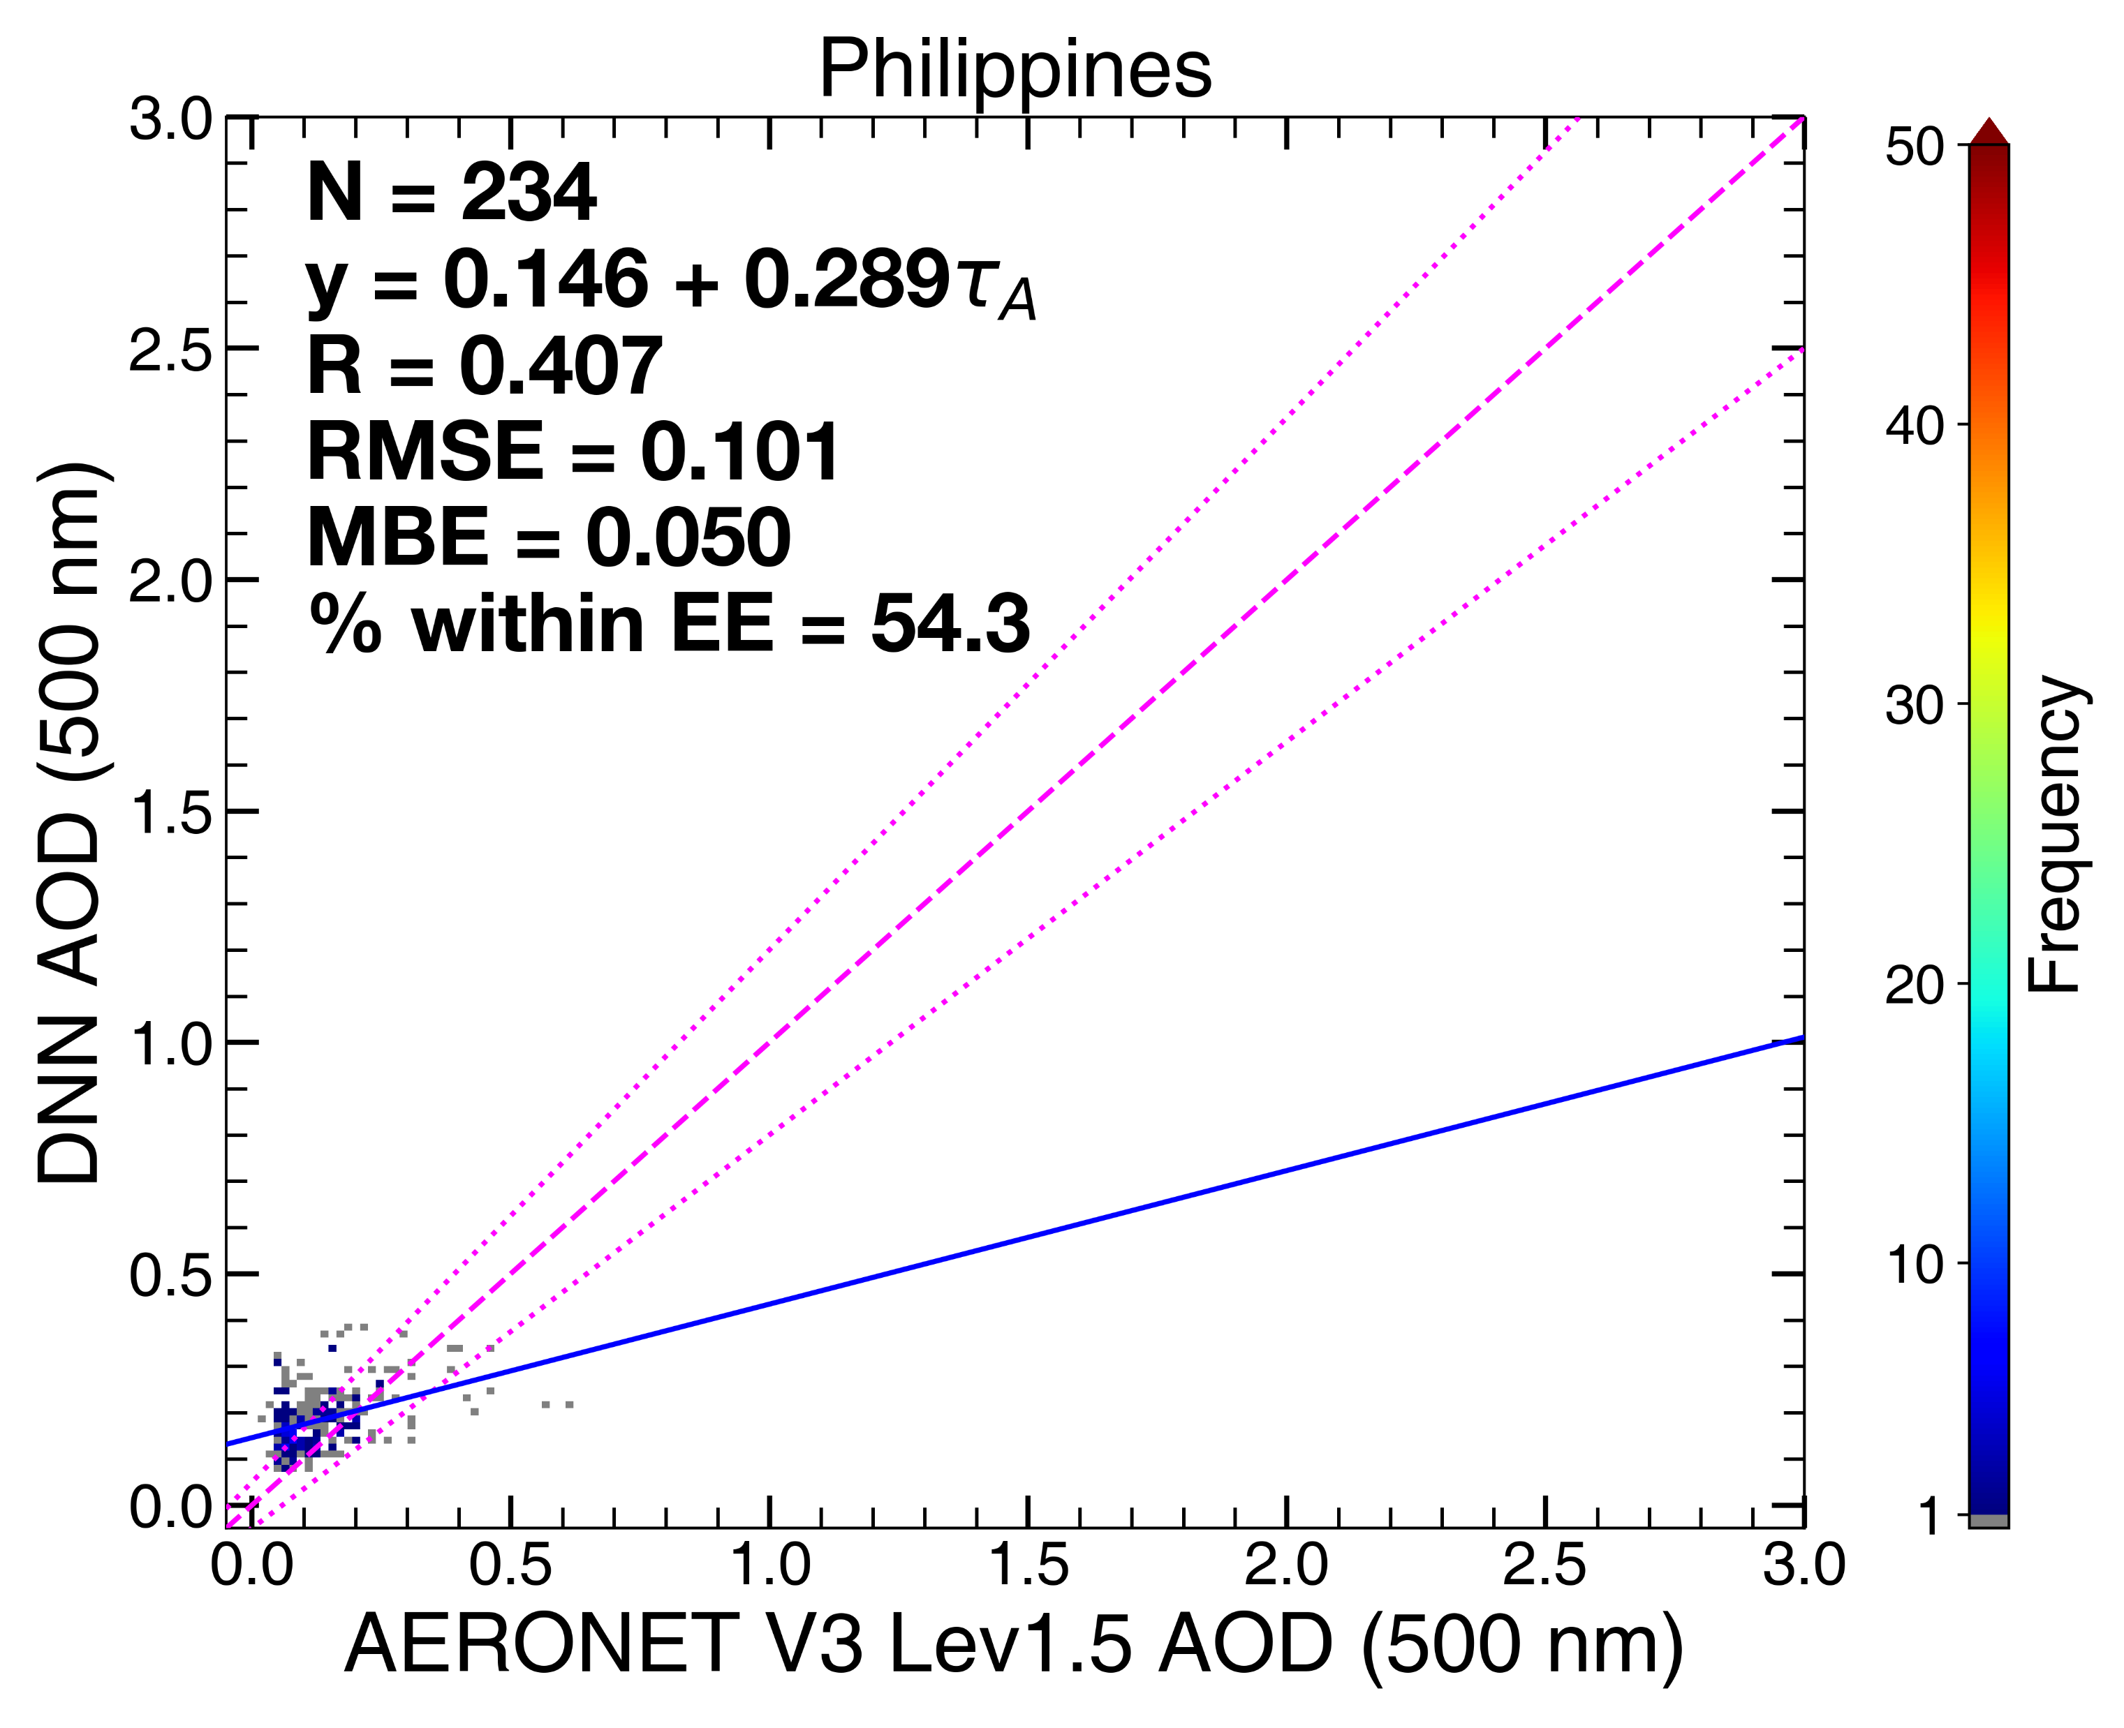
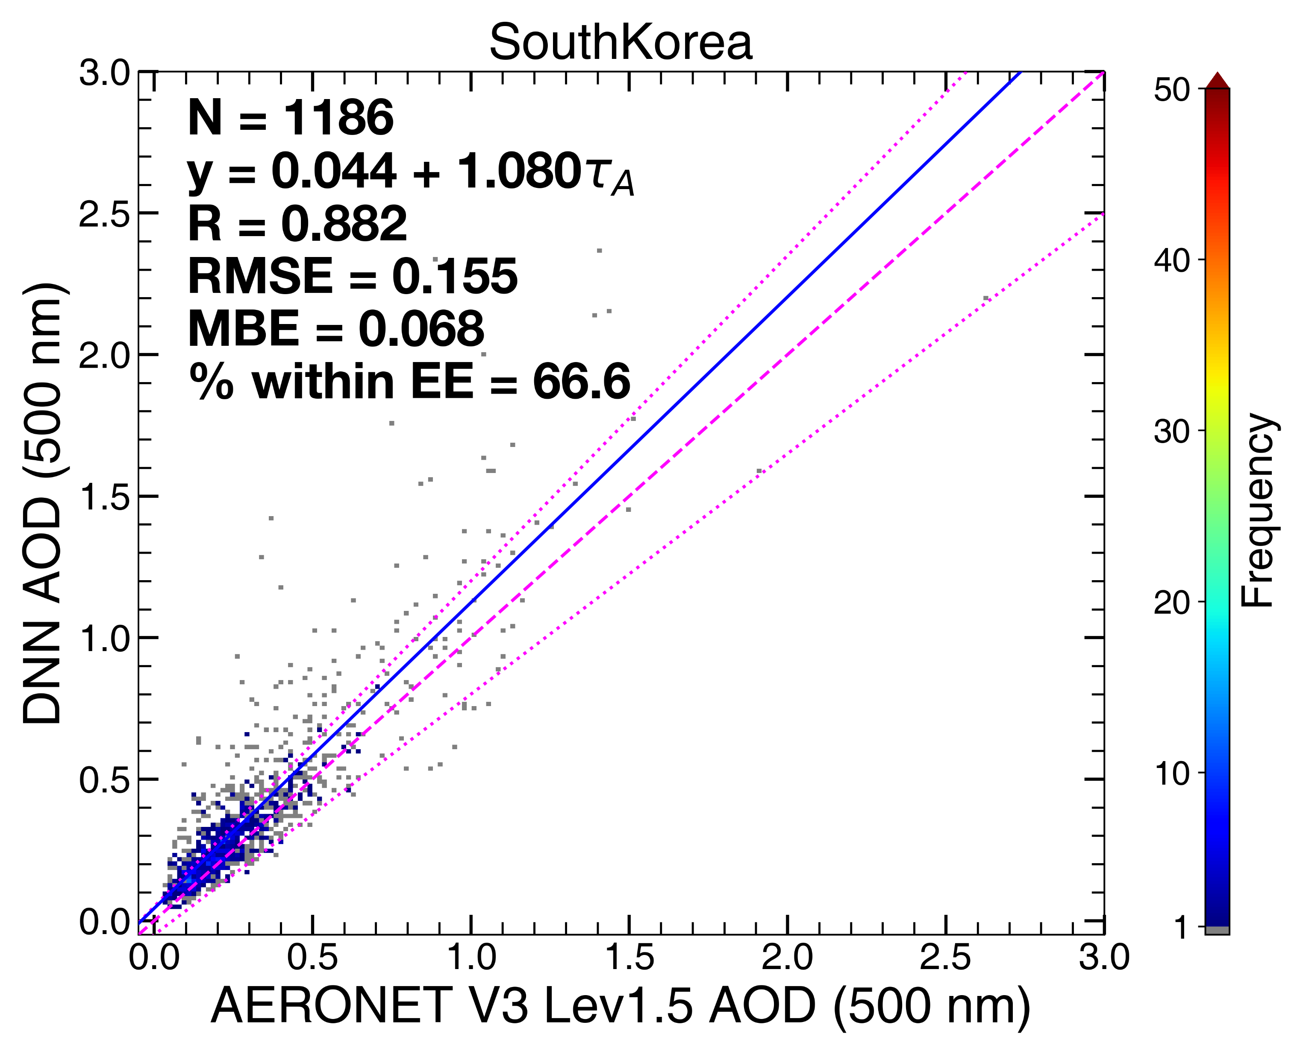
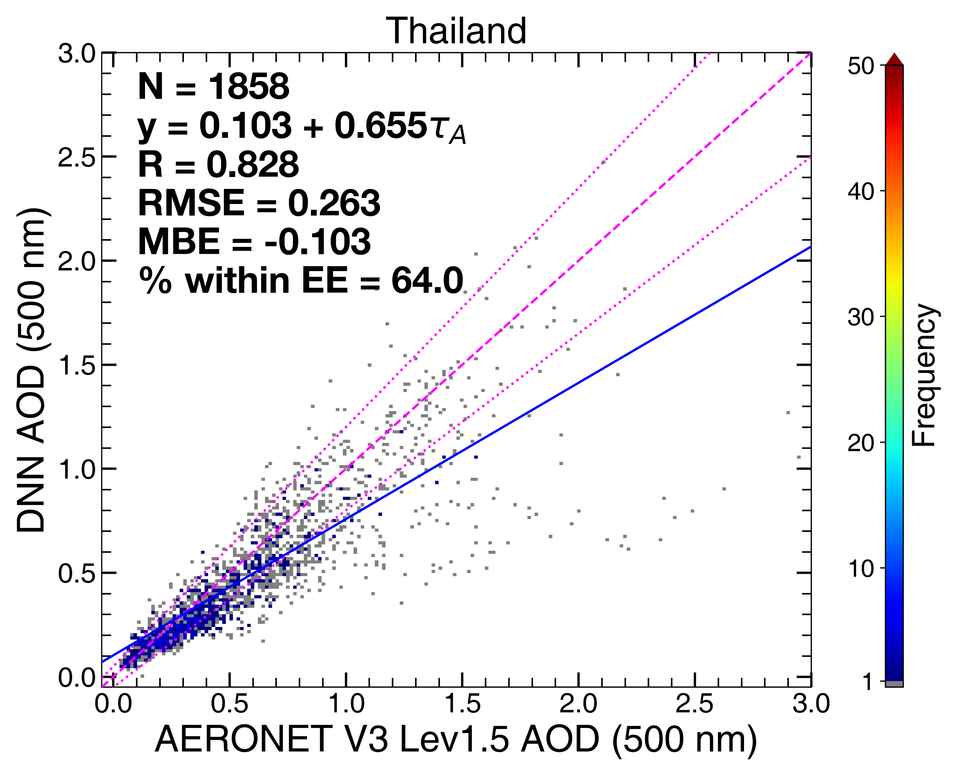
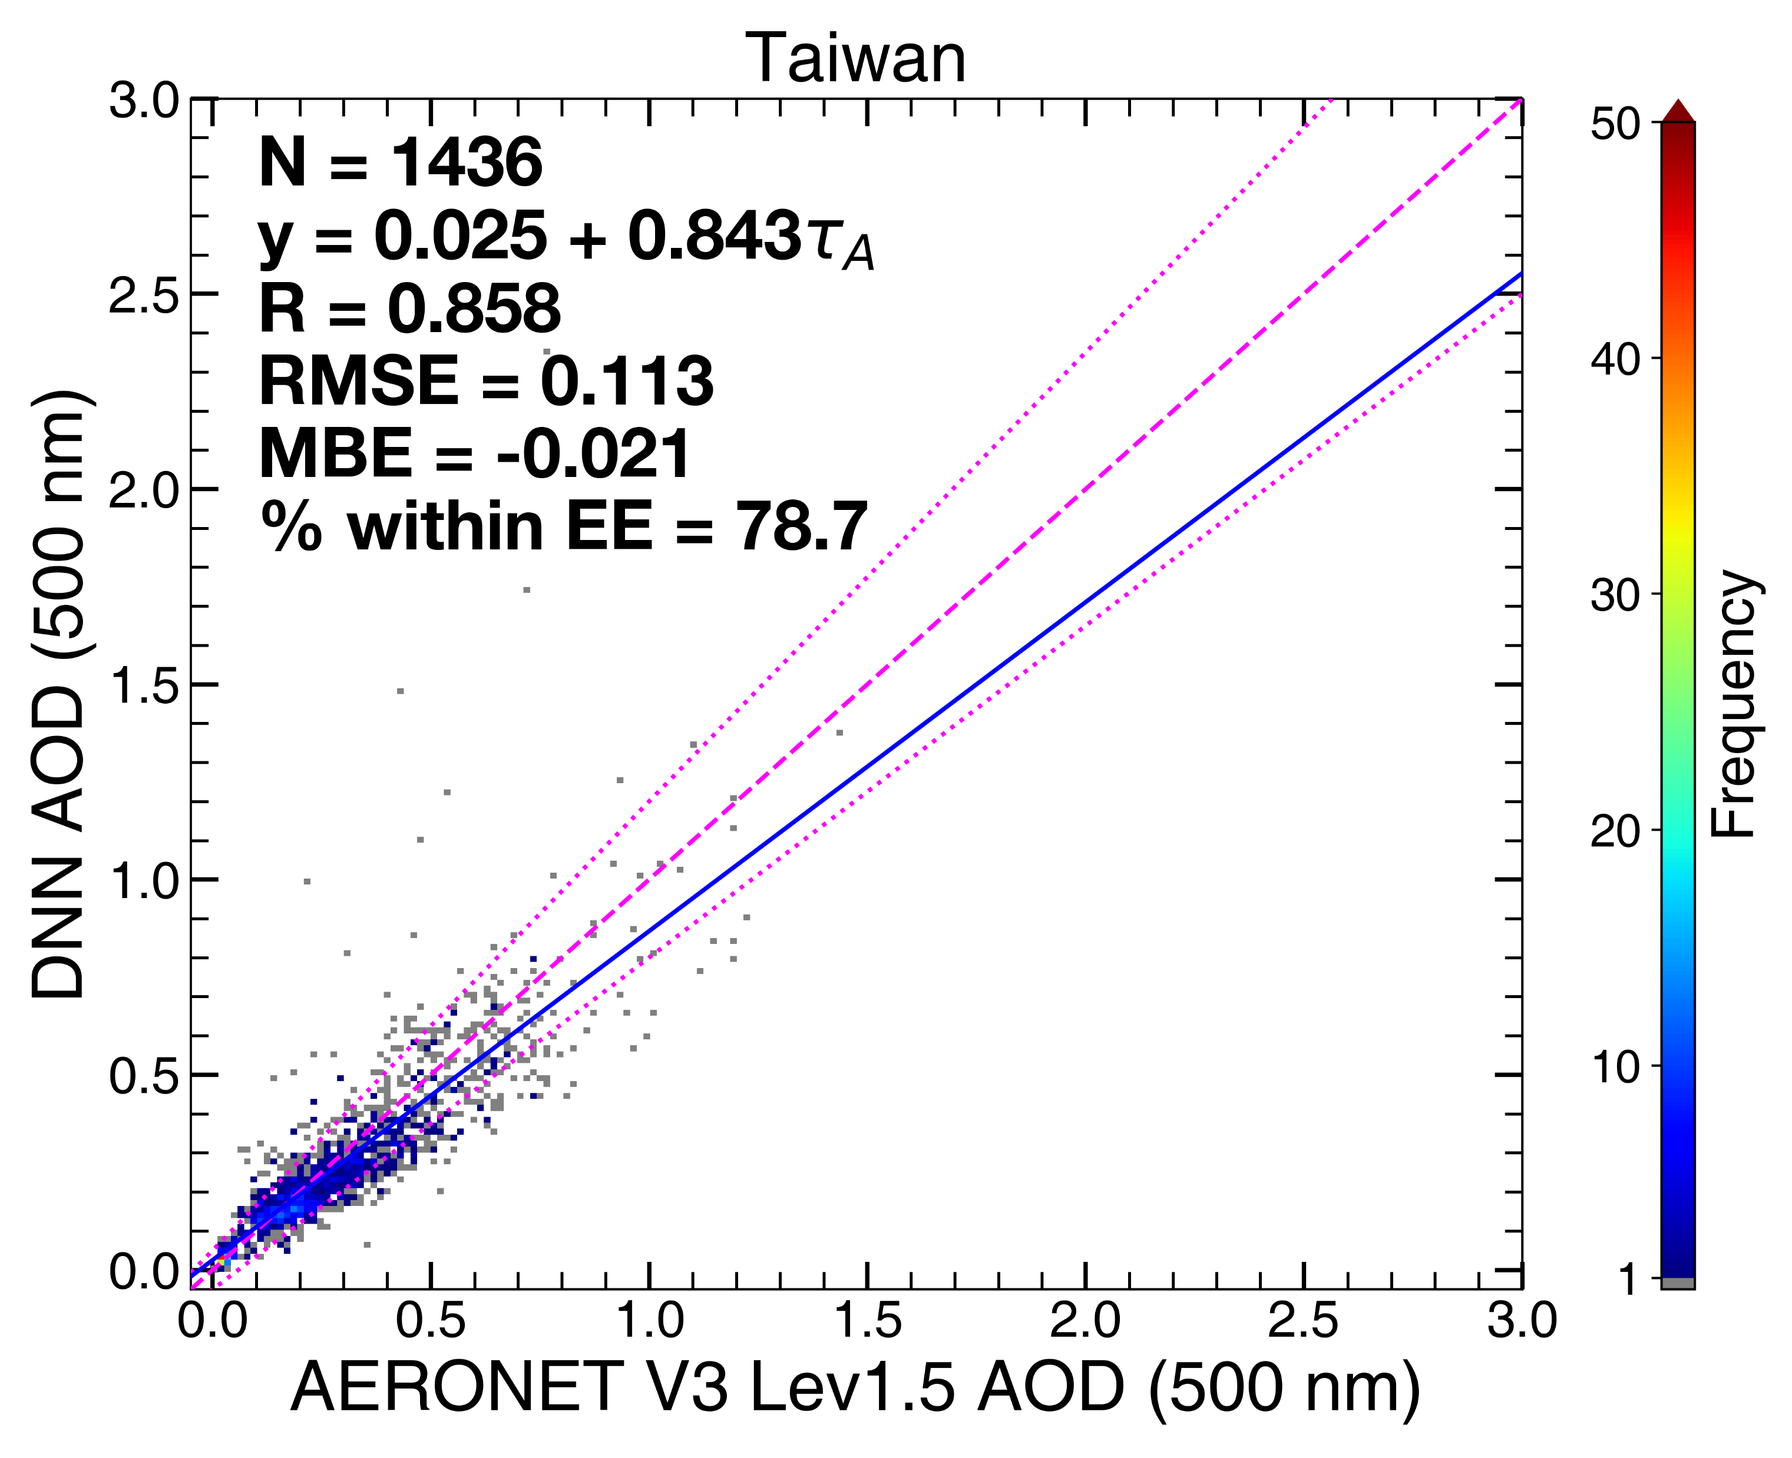
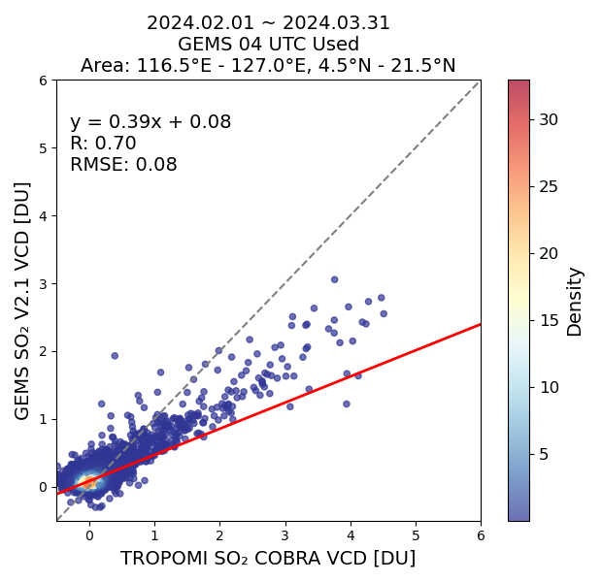
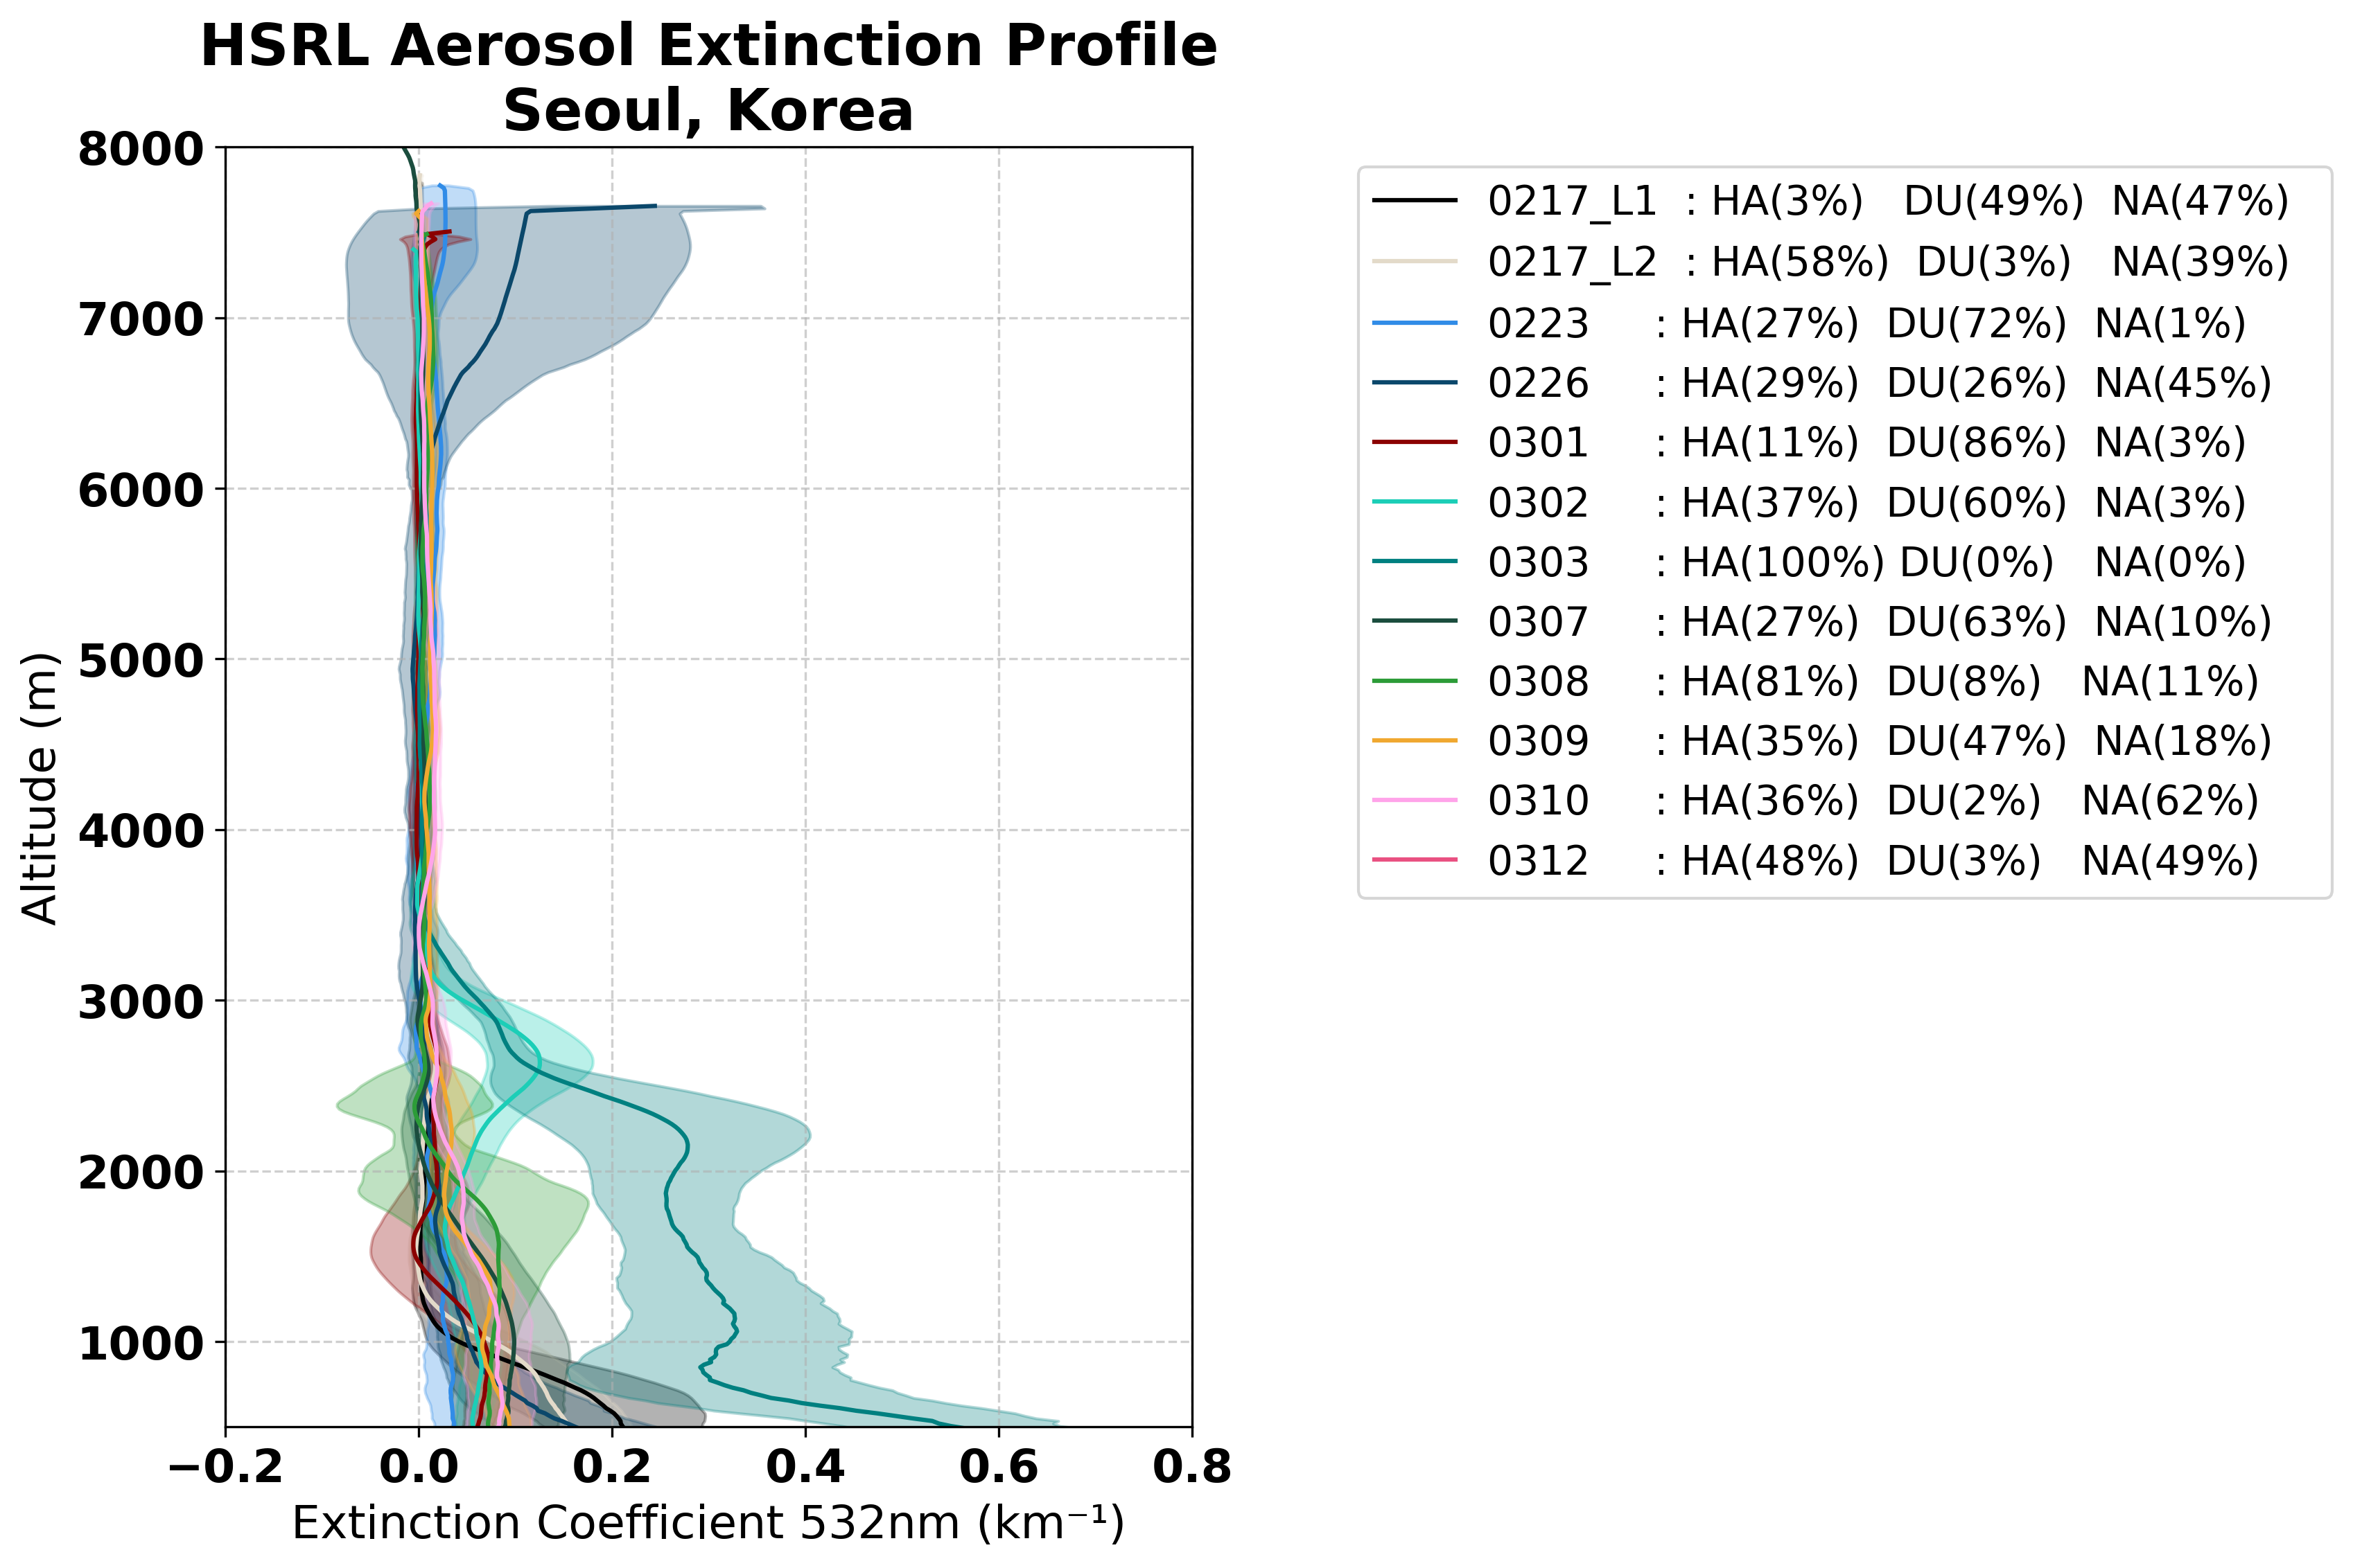



1. Philippines
2. Korea
3. Thailand
4. Taiwan
GEMS NO2
GEMS NO2
GEMS NO2
GEMS NO2
NO2
NO2
NO2
NO2
GCAS NO2
GCAS NO2
GCAS NO2
GCAS NO2
GK-2 DF AOD
GK-2 DF AOD
GK-2 DF AOD
GK-2 DF AOD
AOD
AOD
AOD
AOD
AERONET AOD
AERONET AOD
AERONET AOD
AERONET AOD
O3 Profiles
P4
GEMS SO2
P4
P3
P3
HSRL aerosol
ext. profile
GEMS L4 Aerosol
Mass Flux
SO2
P1
TROPOMI SO2
HSRL
GEMS
Notes:
NE flow = from mountain breeze 영향, dry & cooler air 유입, 대개는 대기질 좋아짐.
Across Manila aby = PP, industry and shipping port, (Petrochem, oil refinery, PP)
Manila = shipping port, industry, and Ninoy-Acquino airport in South
O3 enhancement moves to SW in the afternoon (across Manila Bay) w/NE Monsoon ➔ see w/ GCAS & GEMS TropO3 !
Q. PM2.5 는 P1 과 P2 기간중 어떻게 달랐는가?
1)왼쪽 위 timeseries :GEMS AOD is found to overestimate compared to AERONET and HSRL AOD.
2)오른쪽 아래
During the campaign, taal volcano erupted.
GEMS SO₂ well captures SO₂ plumes especially showing the clear plume shape on 8th Feb
3) 오른쪽 위 gcas and no2 그림 : When compared with the locations of power plants, it was found that NO₂ concentrations were higher in the northern Philippines excluding Manila, and elevated NO₂ levels were primarily observed near power plants around Manila.
Additionally, more cases of high NO₂ concentrations were identified in February compared to March.
Observations from GCAS revealed significant NO₂ emissions both in Manila and from power plants.

Slide 8








5. GEMS L2 product version improvement – O₃P
GEMS O₃P v3.0
2024 Feb ~ Mar
Algorithm Improvements
2024 Feb 15
2024 Feb 16
 | V2.0 | V3.0
Fitting range | 310 – 340nm | 310 – 330nm
Input data | UM, SAO, BDM | GFS, TSIS, BW
GEMS 3.0
sonde
GEMS 2.0
A priori
GEMS v2.0 (green) overestimated lower stratospheric ozone and underestimated upper stratospheric ozone in February cases.
➔ GEMS v3.0 (blue) produces data with high consistency with ozone sondes, independent of a priori.
Seasonal changes in the vertical distribution of stratospheric ozone from February to March were also captured in GEMS v3.0.
While GEMS v2.0 showed a high bias of approximately +9.5 DU compared to ozone sondes, GEMS v3.0 significantly improved, demonstrating consistency within –1 ± 2.35 DU.
2024 Mar 24
2024 Mar 26
Notes:
GEMS 수직 프로파일 검증 자료로 v2.0 -> v3.0으로 변경하면서 오존 존데와 비슷한 경향성을 보임
GEMS ozone profile v2.0은 성층권 하부에서 매우 큰 과대모의를 하고 있었음
GEMS O3P 알고리즘 개선 및 변경 내용
핏팅 정확도 향상을 위해 310-340 nm에서 310-330 nm 핏팅 범위 변경 및 GEMS level1c 파장 및 복사자료에 대한 검보정 전처리 과정을 최적화함 (1. 궤도상 변동성을 반영하기 위해 Super-Gaussian 기반의 실시간 기기반응함수 산출, 2) irradiance 파장할당, 3) irradiance offset 수정 4) normalized radiance 기준 soft calibration 적용)
대류권계면 자료 안정적 획득을 위해 기상자료 변경 (UM-> GFS), 태양기준자료 (SAO->TSIS), 오존흡수자료 (BDM-BW) 등의 입력 자료 최신화

Slide 9
Validation Results
Parameter | Statistics |  | Reference | Period
L1 IRR | Mean bias: -4.0% (320-495 nm) |  | DCC: TROPOMI BD3-4 | 2021/01/01 - 2021/12/31, every 5 day
 | Mean bias: -7.6% (310-380 nm) |  | DCC: OMPS NM | 2021/01/01 - 2021/12/31, everyday
 | (2020): avg.~ -5% / (2024): avg.~ -10% |  | KNMI Reference solar spectrum | 2020, 2024 - everyday
L1 REF | Mean bias: 1.7% (320-495 nm) |  | DCC: TROPOMI BD3-4 | 2021/01/01 - 2021/12/31, every 5 day
 | Mean bias: 3.3% (310-380 nm) |  | DCC: OMPS NM | 2021/01/01 - 2021/12/31, everyday
O3T | R=0.99, y=0.94x+5.9, MBE=-3.7 |  | Pandora ( all sites within the GEMS FOR ) | 2022/01/01~2023/12/31
O3P | Strato. | bias: 10.57DU, SD: 25.64DU | ASIA-AQ ozonesonde | 2024.02.14~02.28 (Seosan), 2024.03.21~03.31 (Kongju Natl Univ)
 | Tropo. | bias: -1.07DU, SD: 3.25DU
NO2 | Total | R = 0.91, y = 0.94x-0.05, MBE = 0.13 | TROPOMI | 2022/01/01-2022/12/31 0445 UTC only
 | Tropo | R = 0.86, y = 0.70x-0.01, MBE = 0.14
SO2 | Volcan | R = 0.85, y = 0.79x+0.04, MBE = 0.17 DU | LEO Sat(TROPOMI, OMI, OMPS) average | 2023/12/01 - 2023/02/28,
 | PBL | R = 0.76, y = 1.51x+0.07, MBE = -0.26DU |  | 2024/04/17~20, 30, 05/01~02, 06/04
HCHO | R = 0.54, y = 0.92x-2.9E+14, NMB = -12.5% |  | TROPOMI | 2024/01/02 - 2024/12/31
CHOCHO | R = 0.52, y = 1.67x-1.9E+14, NMB = -39 % |  | TROPOMI | 2021. Jan. 1,7, Mar. 1,5,10,15,25,30, Jun. 1,5,10,15,20,25,30, Sep. 1,10,15,20,30, Dec. 5,10,15,20,25,30
AOD | R = 0.697, y = 0.642x+0.181, MBE = 0.013 |  | AERONET | 2023/01/01 - 2023/12/31
AEH | %EE = 40.3%(1km), 61.6%(1.5km) Diff. = 1.45+/-1.21 km |  | TROPOMI | 2024/01/01-2024/12/31
H2O | R=0.959, y=0.95x-0.515, MBE=-1.806 kg m-2 |  | AERONET level 1.5 PW | 2021/03/01 - 2023/02/28
BrO | R=0.616, y=0.743x-0.813, MBE=-1.721x10^13 molecules cm-2 |  | TROPOMI s5p-pal BrO v1.2.4 | 2023/01/01 - 2023/12/31 (Monthly avg.)

Slide 10

GEMS Status Summary
In successful operation since 2020.
Oct. 2024: Level 4 data Release (sfc conc.)
Dec. 2024: Version 3 data Release
Version 4 data in R&D phase
L2 data: R > 0.9 (O3T), > 0.8 (NO2, AOD, volcanic SO2, H2O, CCP, BSR), > 0.7 (SO2, ECF), > 0.6 (BrO), > 0.5 (HCHO, CHOCHO)
Issues:
- degradation : 19% @320 nm, 1% @470 nm
- BTDF corr. residuals, Degradation corr.
- L1 updates and impact to L2
- Underestimation: trop NO₂ in summer, volcanic SO₂, trop O₃, VOCs, AOD, ALH, ECF
- Overestimation: PBL SO₂, strat O₃, AEH
- E-W contrast: HCHO
- Latitudinal dependency: O3T
Publications:
- GEMS SI (ACP/AMT): 22 papers
- More journal publications: total 105 papers
Data downloads: > 6 M(‘24), total > 12 M
from 24 countries
Application studies:
- Diurnal variation : Edward et al.(ACP, 2024)…
- Trend analysis : Oak et al. (ACP, 2024) …
- Surface concentrations using AI : Yang et al. (npj CAS, 2023), S. Park et al. (EP, 2022) …
- Top-down emission : J. Park et al. (npj CEE, 2025). J. Park et al. (AMT, 2023), …
- Public health : Li et al. (Ncomm, 2025)..
Employment : 47+ (faculty, research scientist, civil servants, …)
Startup foundation: 3

