Slide 1
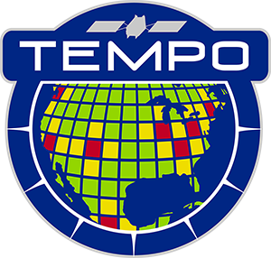



Tropospheric Emissions:
Monitoring of Pollution
TEMPO Mission Status
Xiong Liu¹, K. Chance¹, C.R. Nowlan¹, G. Gonzalez Abad¹, R. Suleiman¹, J. Houck¹, J. Davis¹, H. Wang¹, H. Chong¹, W. Hou¹, J. Park¹, J. Bak¹, L. Carpenter¹,
C. Chan Miller¹, J. Fitzmaurice¹, A. Oppenheimer¹, E. O’Sullivan¹,
K. Daugherty², D.E. Flittner², C. Fenn², D. Rosenbaum², C. Brown², N. Mishra²,
R.T. Neece² , E. Roback², J. Strickland², L. Judd², P. Rawat², K. Travis², J. Carr³,
J. Szykman⁴, B. Henderson⁴, L. Valin⁴, J. Joiner⁵, Z. Fasnacht⁵, S. Frith⁵,
D. Haffner⁵, E. Knowland⁵, N. Kramarova⁵, N. Krotkov⁵, C. Li⁵, W. Qin⁵,
G. Jaross⁵, C. Seftor⁵, A. Vasilkov⁵, E.-S. Yang⁵, J. Ziemke⁵, M. Newchurch⁶,
Naeger⁶, R. Cohen⁷, J. Geddes⁸, J. Herman⁹, B. Pierce¹⁰, R. Spurr¹¹,
S. Kondragunta¹², J. Wang¹³, O. Torres⁵, H. Zhang¹², P. Ciren¹²,
X. Zhao¹⁴, and the TEMPO Team
¹Smithsonian Astrophysical Observatory (SAO), CfA
²NASA LaRc ³Carr Astro. ⁴EPA ⁵NASA GSFC ⁶UAH ⁷UCB
⁸BU ⁹UMBC ¹⁰UWM ¹¹RT Sol. Inc ¹²NOAA ¹³UI ¹⁴ECCC
CEOS AC-VC-21
Takamatsu, Japan
June 11, 2025

Slide 2
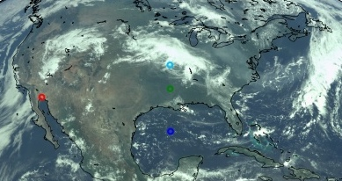
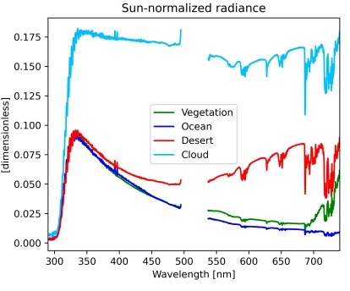
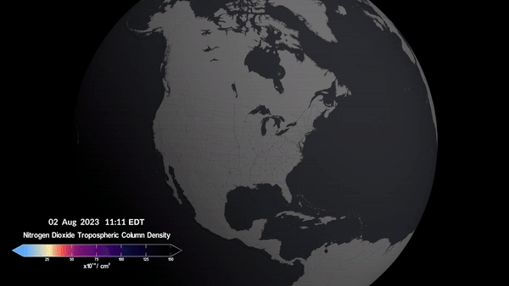
Tropospheric Emissions:
Monitoring of Pollution
NASA’s first Earth Venture Instrument (EVI-1), selected in 2012
Led by Smithsonian Astrophysical Observatory (SAO) in partnership with NASA LaRC, with instrument built by Ball Aerospace (now part of BAE Systems)
NASA’s first host payload, launched on board Intelsat-40e in April 2023 on to the GEO at 91 ∘ W
Hourly daytime air pollution over North America at neighborhood scale (2x4.75 km² at the center of the field of regard)
Global Geostationary Air Quality Constellation along with GEMS (2020) and Sentinel-4 (2025)
538-741 nm
293-494 nm
TEMPO first light RGB and examples of spectra
Credit: Heesung Chong
Credit: NASA’s Scientific Visualization Studio

Slide 3
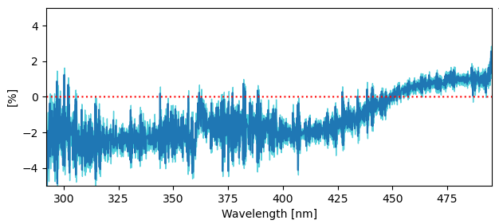
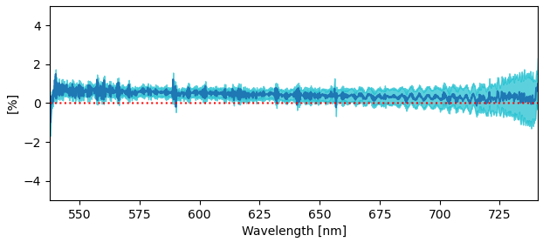
TEMPO Commissioning and
Nominal Operation
TEMPO
Power On
Launch
First Light
PLAR
L+0 (4/7/23)
L+61 days (6/7/23)
L+115 days (7/31-8/2/23)
L+194 days
(10/19/23)
Outgassing
S/C Activity
(TEMPO Off)
TEMPO Commissioning
Nominal Operations
Activation
Instrument Characterization and Analysis
TEMPO commissioning: SAO + LaRC + Intelsat + Maxar + Ball + Carr Astronautics
Nominal operation on 10/19/2023: 20 months Baseline mission Phase E until 6/18/2025
NASA approved TEMPO mission extension through 9/2026: further extension via NASA senior review
Trending solar irradiance: 2024/8/1 vs. 2023/8/2
Credit: Heesung Chong
Successful TEMPO commissioning and nominal operation, instrument performing very well

Slide 4
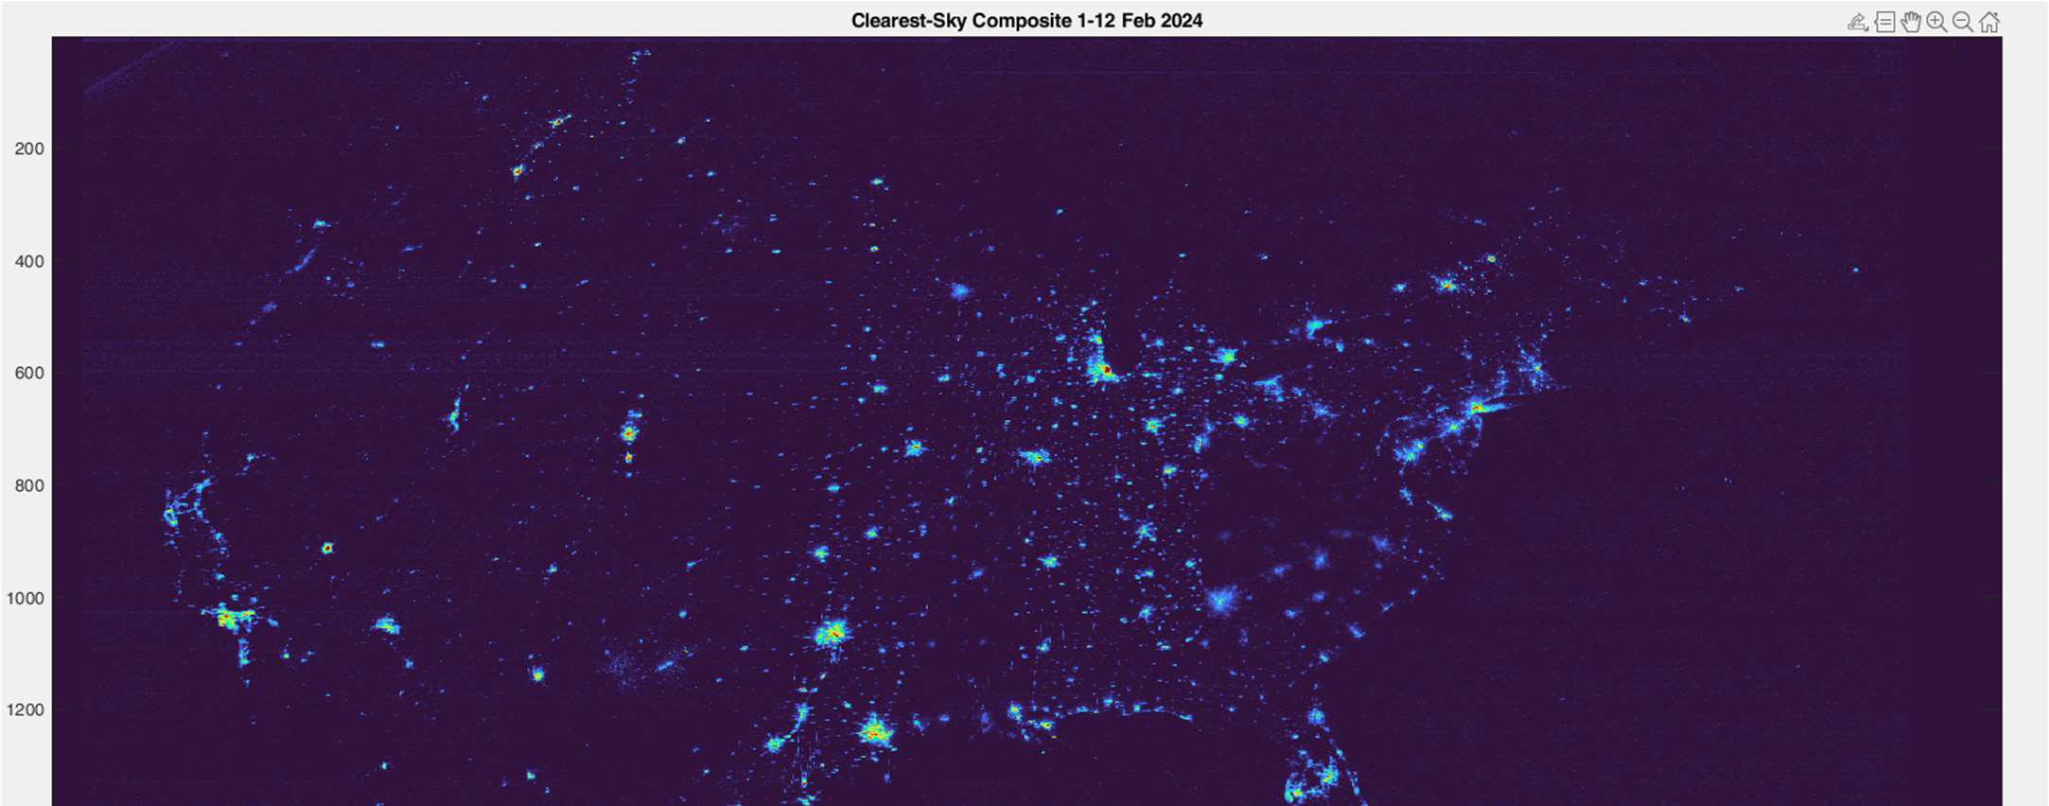
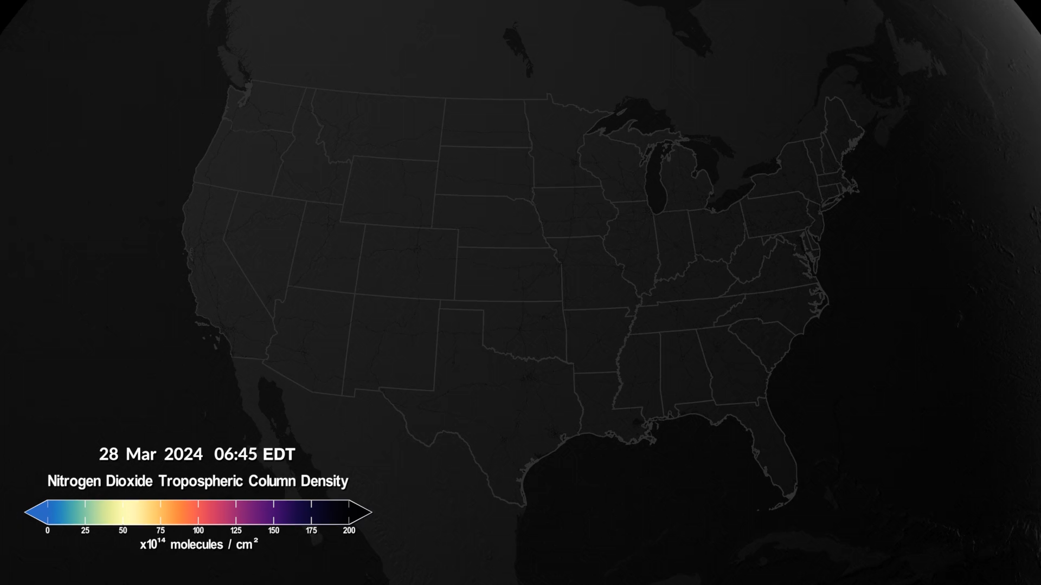
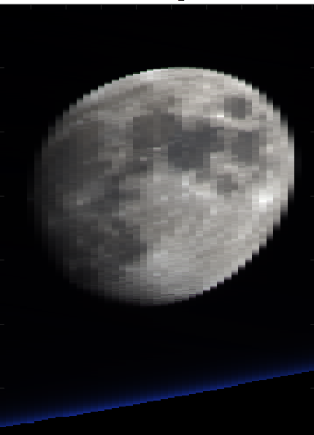
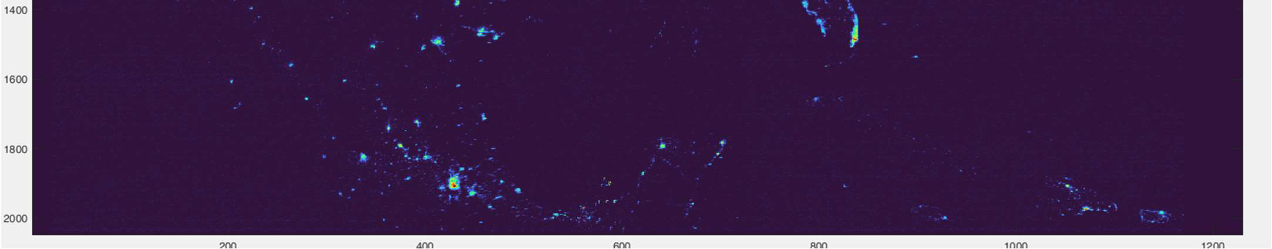
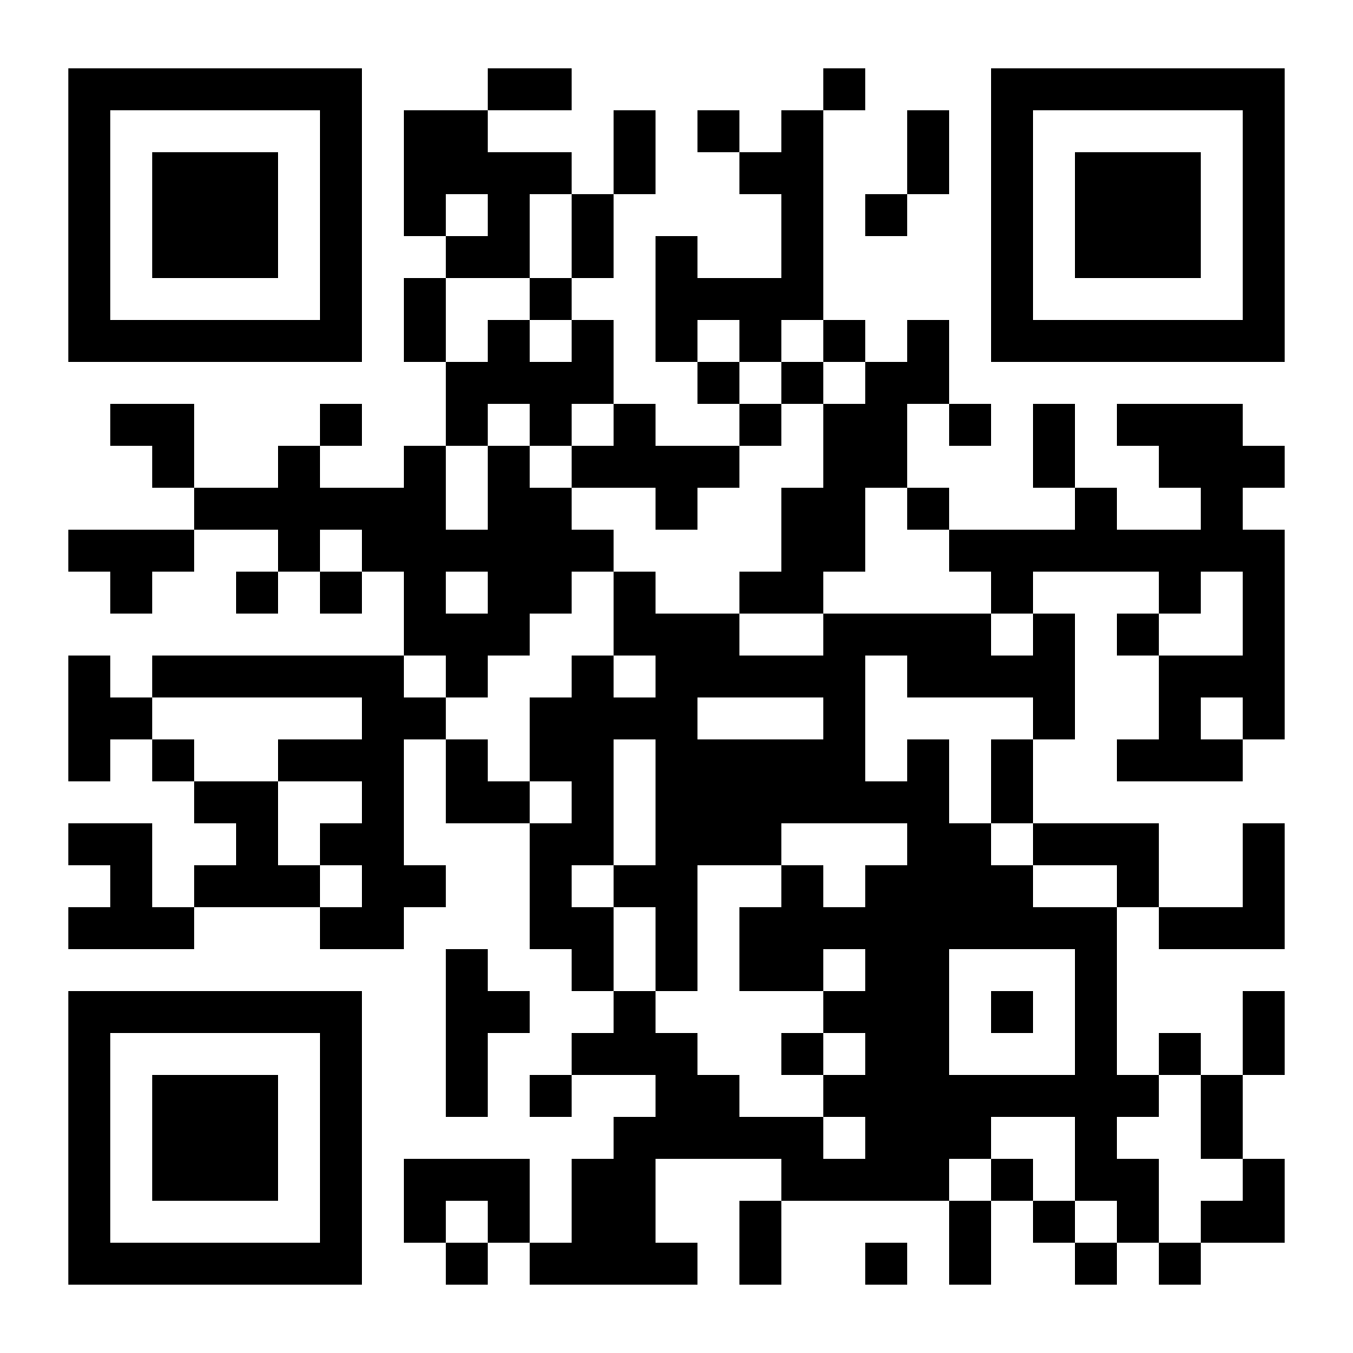
TEMPO Scanning
Nominal scans: hourly, 2.4M pixels
  2035 North/South pixels
  1181 East/West steps per hour
  2 x 4.75 km² at center of field of regard
Optimized scans
  Higher temporal resolution scans in early AM and late PM over coasts (40 mins)
Twilights scans
  Performed during darkness (~Aug. 15-Apr. 15)
  City lights, moonlights, Aurora, airglow, gas flaring, lightning, fires
Special observations: can be requested with strong science justification
  High-time scans (5-10 mins) over selected longitudes (several hours, alternate hourly scan/1 hour high-time scans)
  Lunar collect
  RRV 2024/2025 (side slither)
Clearest-Sky City lights Composite 1–12 February 2024
Credit: NASA’s Scientific Visualization Studio
Radiance derivation → Post-processing (de-speckling, de-streaking, etc.) → Composite
Request special observations at TEMPO Early Adopter Website
Credit: Jim Carr

Slide 5
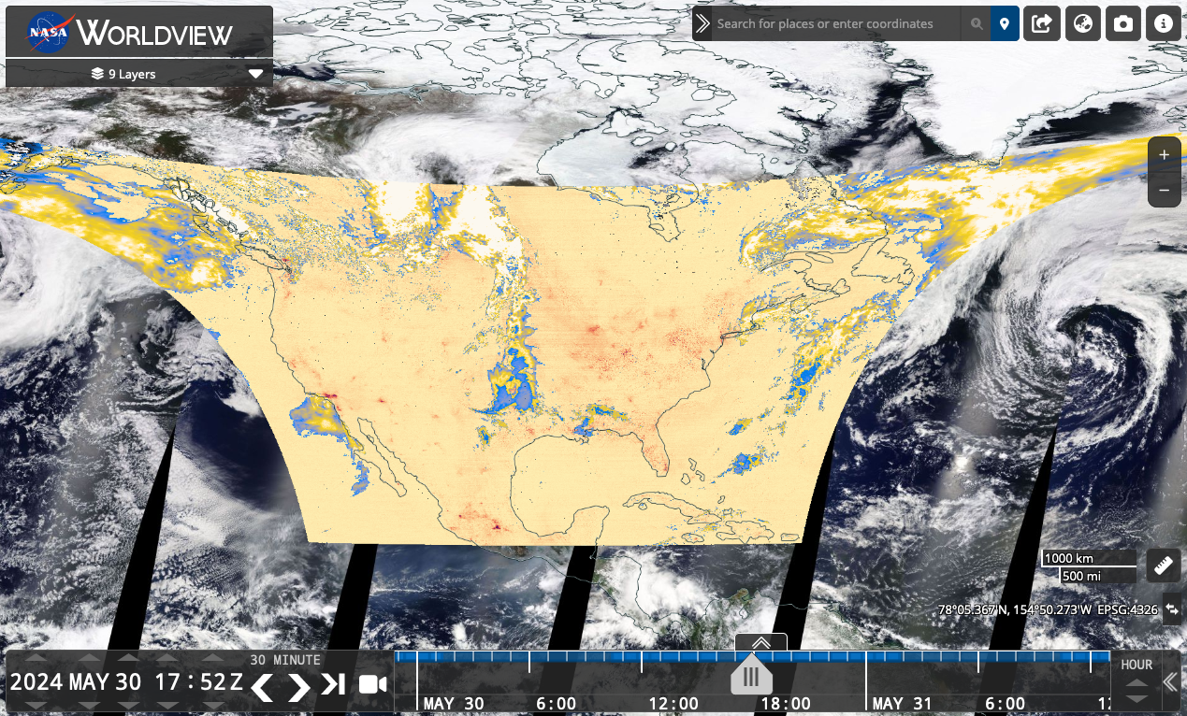

TEMPO Data Products Public Release
NASA’s Atmospheric Science Data Center (ASDC)
Public Release | Date | Details
V01 | Feb. 2024 | Limited 3 weeks released
V02 | Feb. 2024 | Level 1 (spectra) released
V03 | May 2024 | L1 updated, Level 2/3 cloud, NO₂, HCHO, total O₃ V3 O3 profile (ASDC June 9, 2025, not for the public)
V04 | Aug. 2025 | Release ozone profile, update L1 + other L2/L3
TEMPO data now publicly available at NASA’s ASDC (~6 hours latency).
Multiple tools:
  Earthdata Search, OPeNDAP
  NASA Worldview: all data products (L2+L3)
  ArcGIS services: currently L3 NO₂ + HCHO ^{new}
  RSIG (EPA)
  TEMPO-Lite (CfA): currently L3 NO₂
  NASA SPoRT Viewer
For more information check out:
  User Guides (known issues)
  Daily operation & commissioning logs
  Validation reports (coming soon)
  Algorithm Theoretical Basis Documents (drafts available upon request, L2 ATBDs released)
ASDC TEMPO
2 Petabyte of TEMPO V3 data downloaded from Earthdata within 1 year!

Slide 6
Baseline TEMPO Data Products
Level | Product | Validation Status
L1 | Irradiance | Provisional
 | Radiance | Provisional
 | Radiance (twilight – city lights) | Provisional
L2 | Clouds | Provisional
 | NO₂ | Provisional
 | HCHO | Provisional
 | O₃ (total) | Provisional
 | O₃ (profile) | Beta June 9, 2025
L3 | L2 gridded to 0.02° × 0.02° | Provisional
The data products are upgraded to provisional status after the validation team approval in Dec. 2024!
*Beta: “minimally validated”, publication “not recommended and highly discouraged”
*Provisional: “performance demonstrated”, "suitable for scientific publication”

Slide 7
Baseline TEMPO Data Products +
SNWG TEMPO NRT + TEMPO Enhanced
Level | Product | Developer
L1 | Irradiance | SAO
 | Radiance ^{NRT} | SAO
 | Radiance (twilight – city lights) | SAO
L2 | Clouds ^{NRT} | SAO/GSFC
 | NO₂ ^{NRT} | SAO
 | HCHO ^{NRT} | SAO
 | O₃ (total) | SAO/GSFC
 | O₃ (profile) | SAO
 | TEMPO/GOES-R synergy aerosol product ^{NRT} | NOAA
 | C₂H₂O₂ | SAO
 | H₂O | SAO
 | BrO | SAO
 | SO₂ ^{NRT} | NASA GSFC
 | UVAOD | NASA GSFC
 | Aerosol layer height | U. Iowa
 | UVB | NASA GSFC
Baseline Products
Satellite Needs Working Group (SNWG)
Cycle 3 NRT Products (~2-3 hours)
Public release (~Sep. 2025)
SNWG Cycle 4
TEMPO Enhanced Products
To be funded ~Q3 2025
Research Products
  Ocean color
  Vegetation
  Solar induced fluorescence
  City lights/lighting types
  HNO₂
  Surface albedo
  Surface concentrations
  Free tropospheric NO₂
  Emissions
  IO
  NO₃

Slide 8
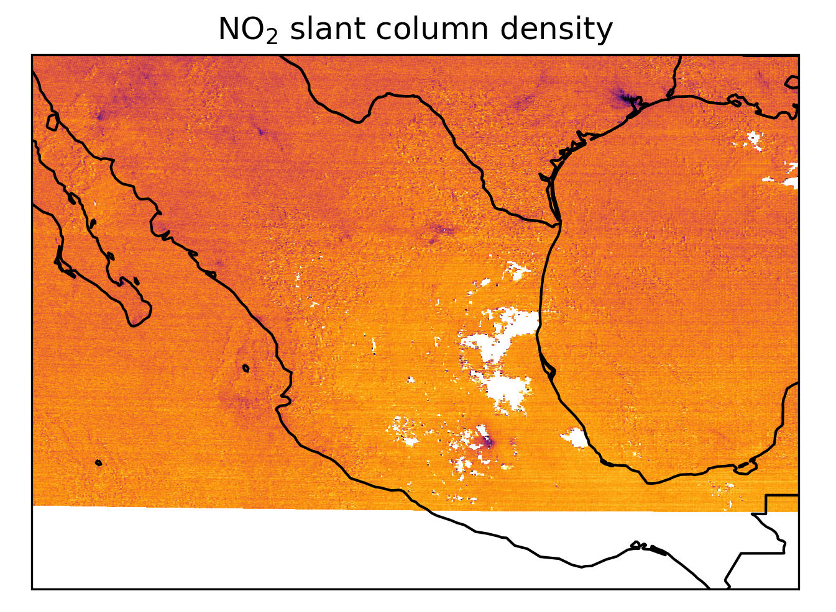
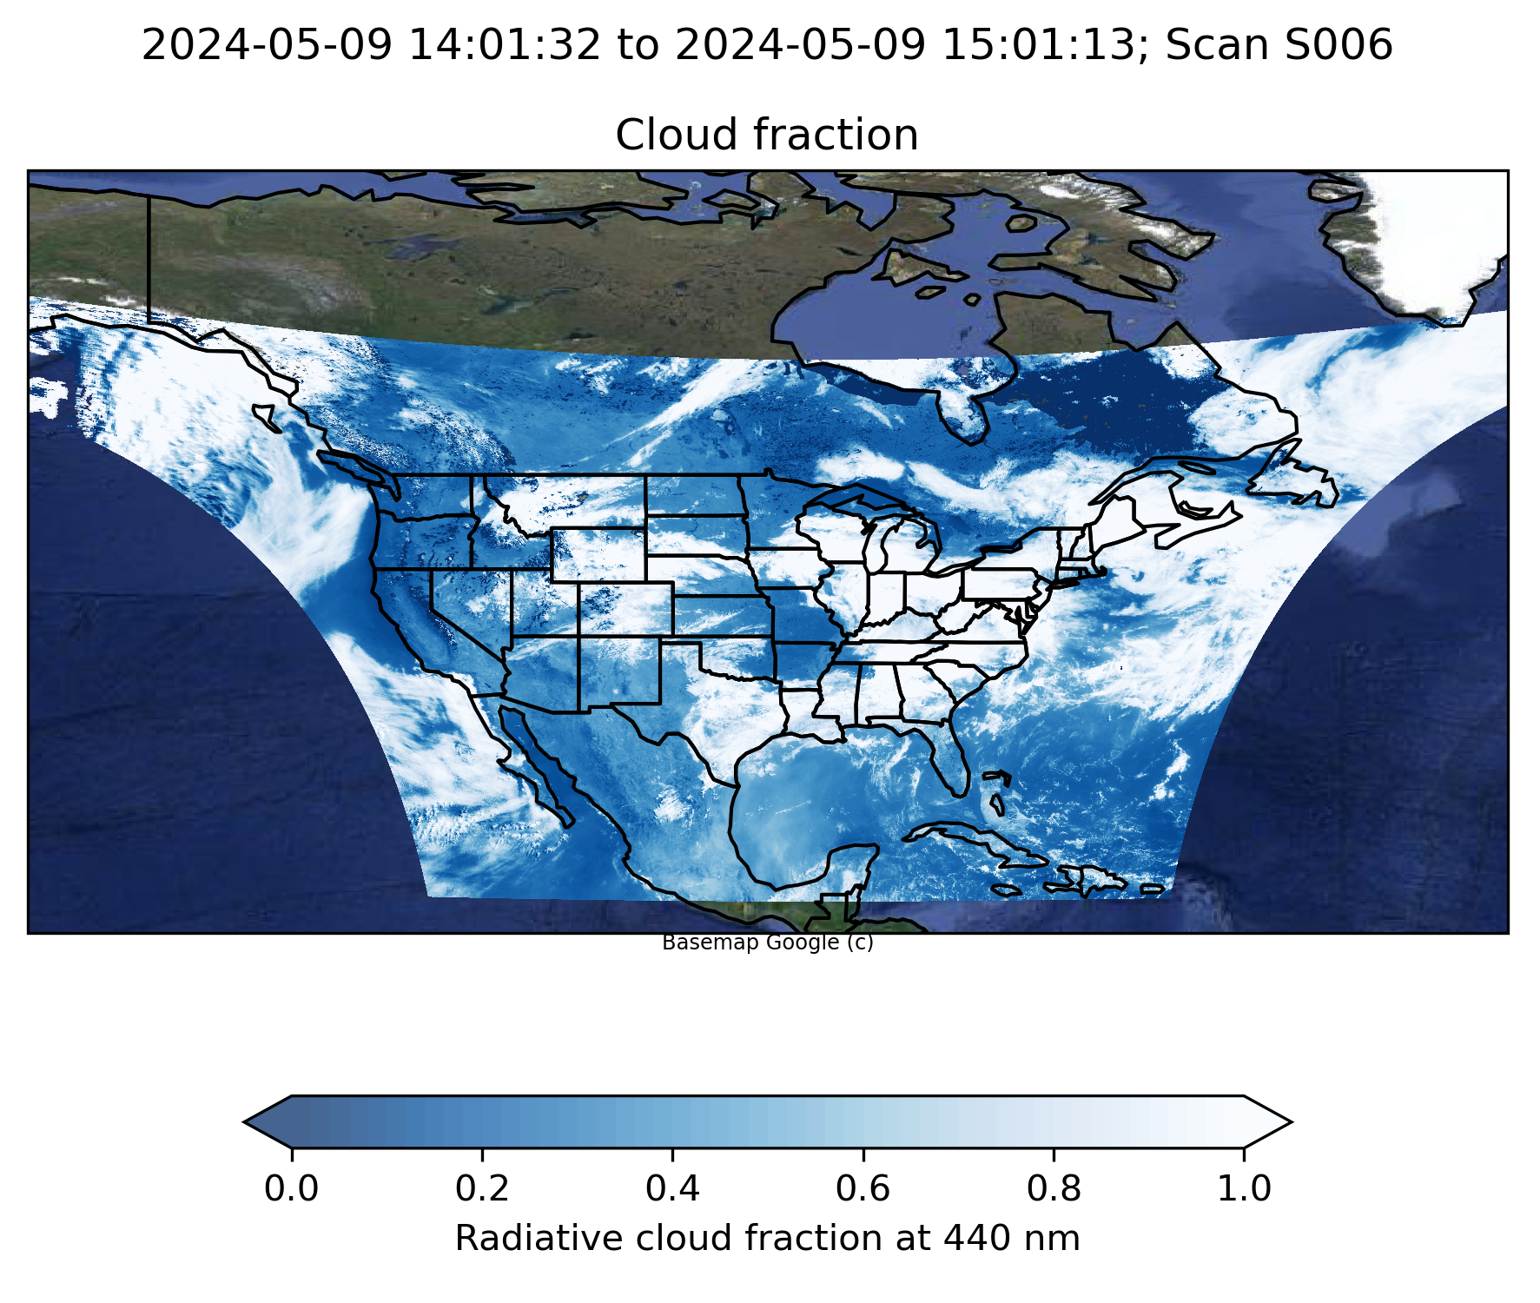
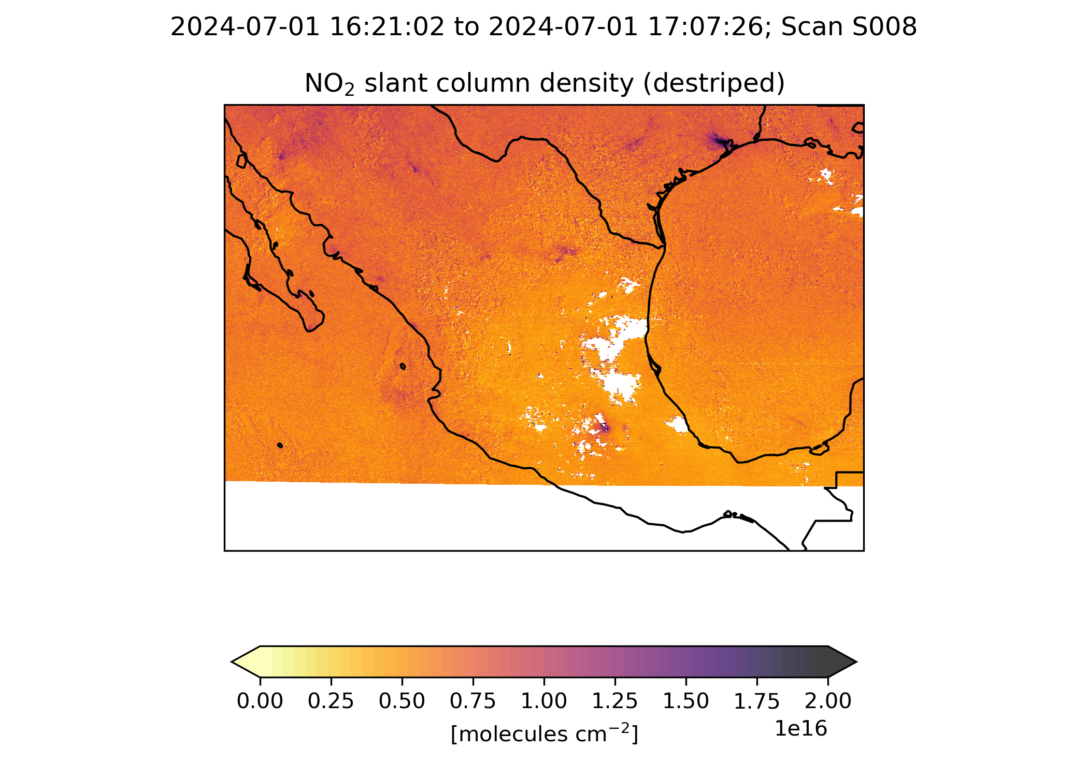
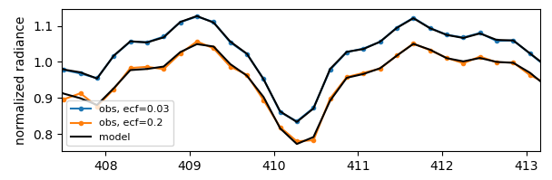
Algorithm Updates for V4 (~8/2025)
L1b
  Improve absolute calibration (~10% overestimation in normalized radiance)
  Improve straylight correction
  Improve wavelength calibration (wrt cal. coeff.)
  Improve INR (geolocation)
GEOS-CF (met/a priori): V1 → V2
Trace gases and clouds
  NO₂ / O₂-O₂ de-striping
  HCHO reference & background correction
  Improve GLER-based surface albedo
  Fix surface pressure anomaly
Total O₃
  Reduce latitude-dependent bias from improved L1b
Profile O₃
  Soft calibration & optimization
  Preliminary Validation
Cloud-free
20% cloud cover
→ High residuals
wavelength [nm]

Slide 9
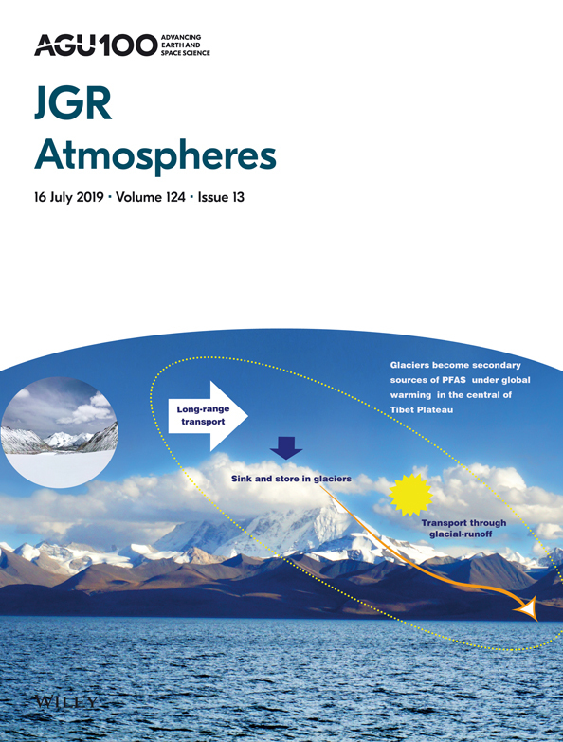
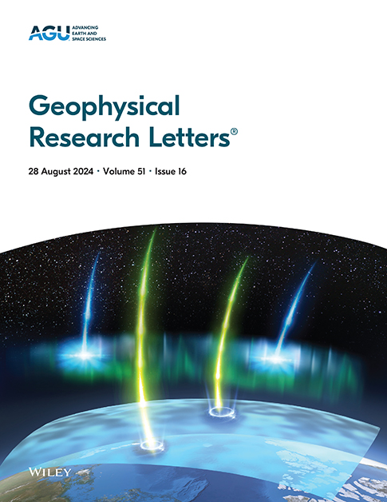
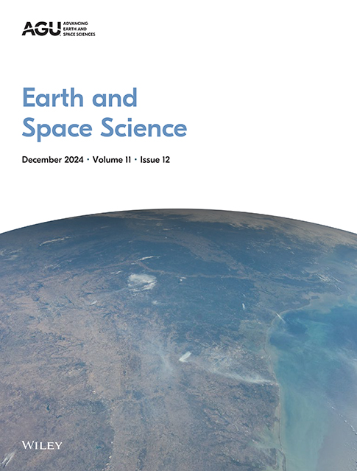
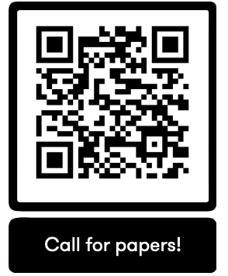
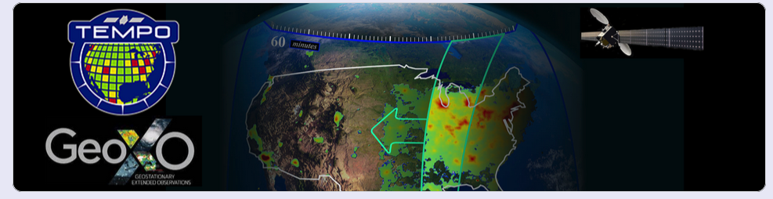
TEMPO AGU Special Collection &
Joint TEMPO/ACX STM 2025
Call for Papers
TEMPO Data Products, Science, and Applications
Submission Deadline: December 31, 2025
Joint TEMPO/ACX STM
SAO, Cambridge, MA
August 19-22, 2025

Slide 10
Summary and Outlook
TEMPO operations are nominal, and instrument is performing very well.
L1b (including twilights), cloud, NO₂, HCHO, total O₃ are publicly available and upgraded to provisional status. O3 profile product is operationally produced.
Next version including ozone profile and NRT products expected ~August 2025
Mission extended to September 2026, further extension via Senior Review
Many more TEMPO products to come!
AGU Special Collection “TEMPO data products, science and applications” are open until 12/31/2025.
Acknowledgements: Funding from NASA (TEMPO, NNL13AA09C; SNWG TEMPO NRT, 80MSFC24CA004)
Thank you!

Slide 11










