Slide 1
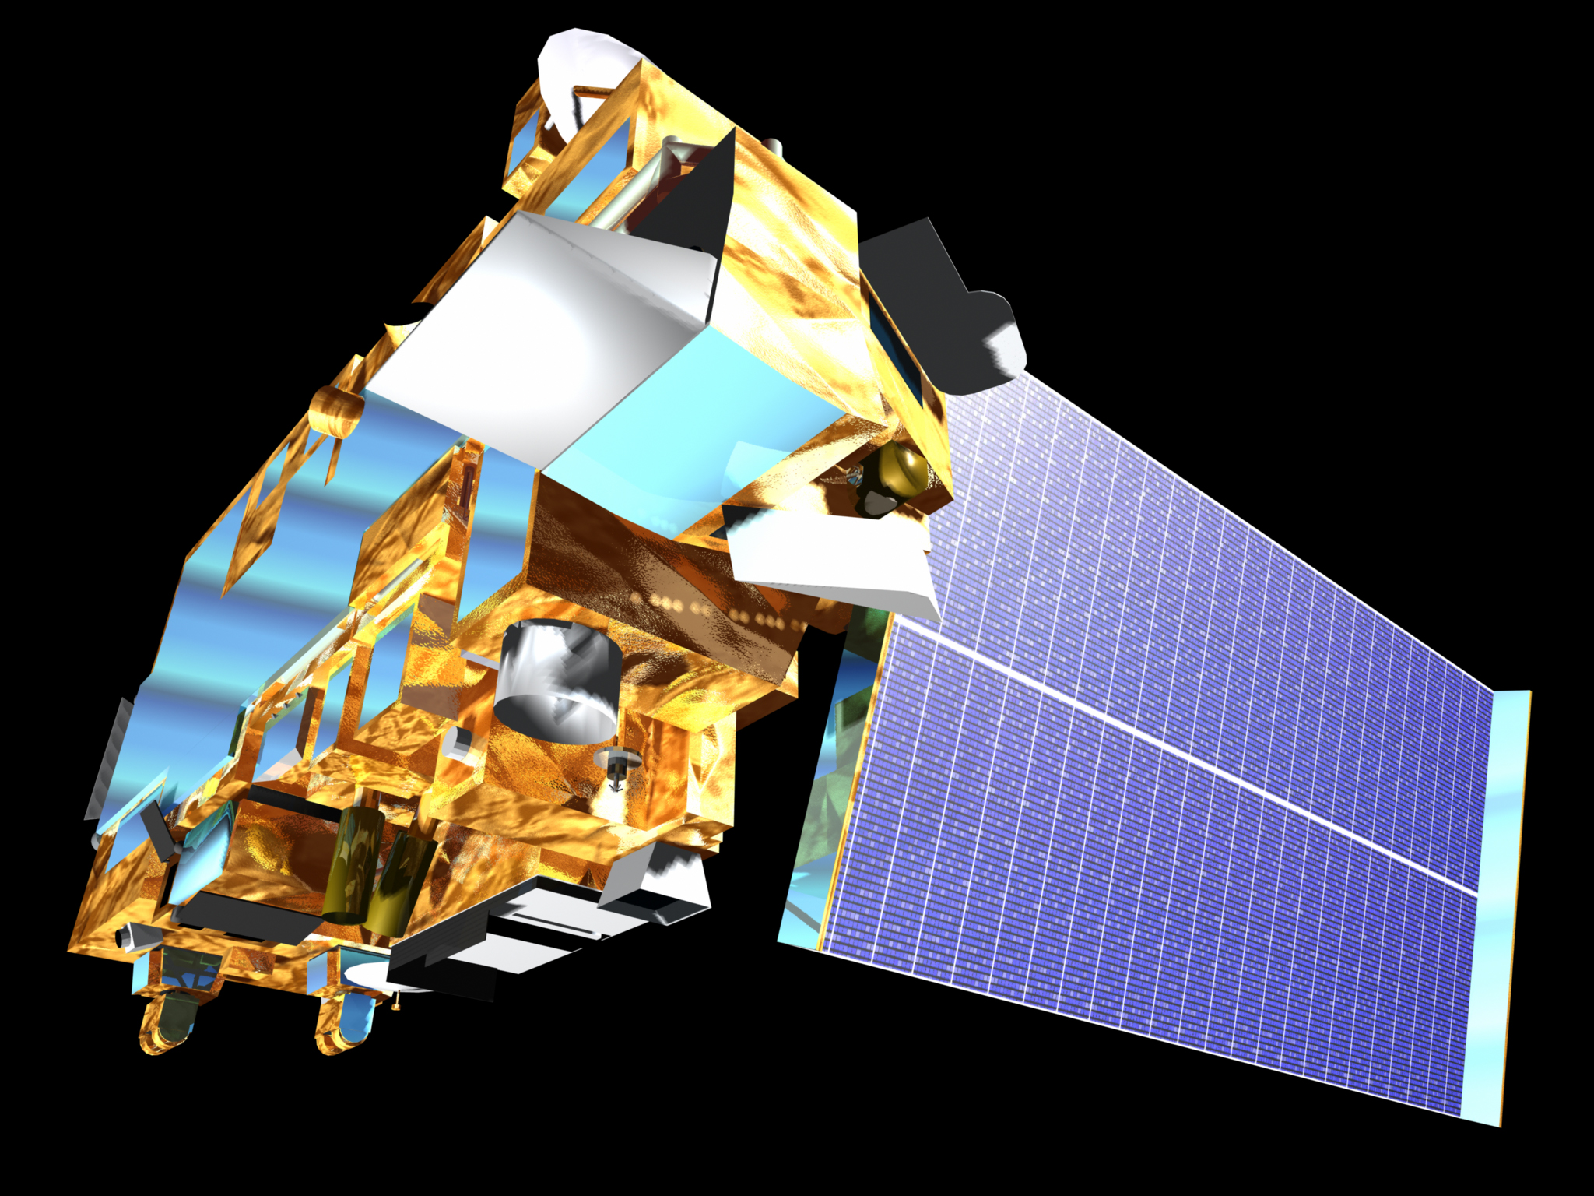
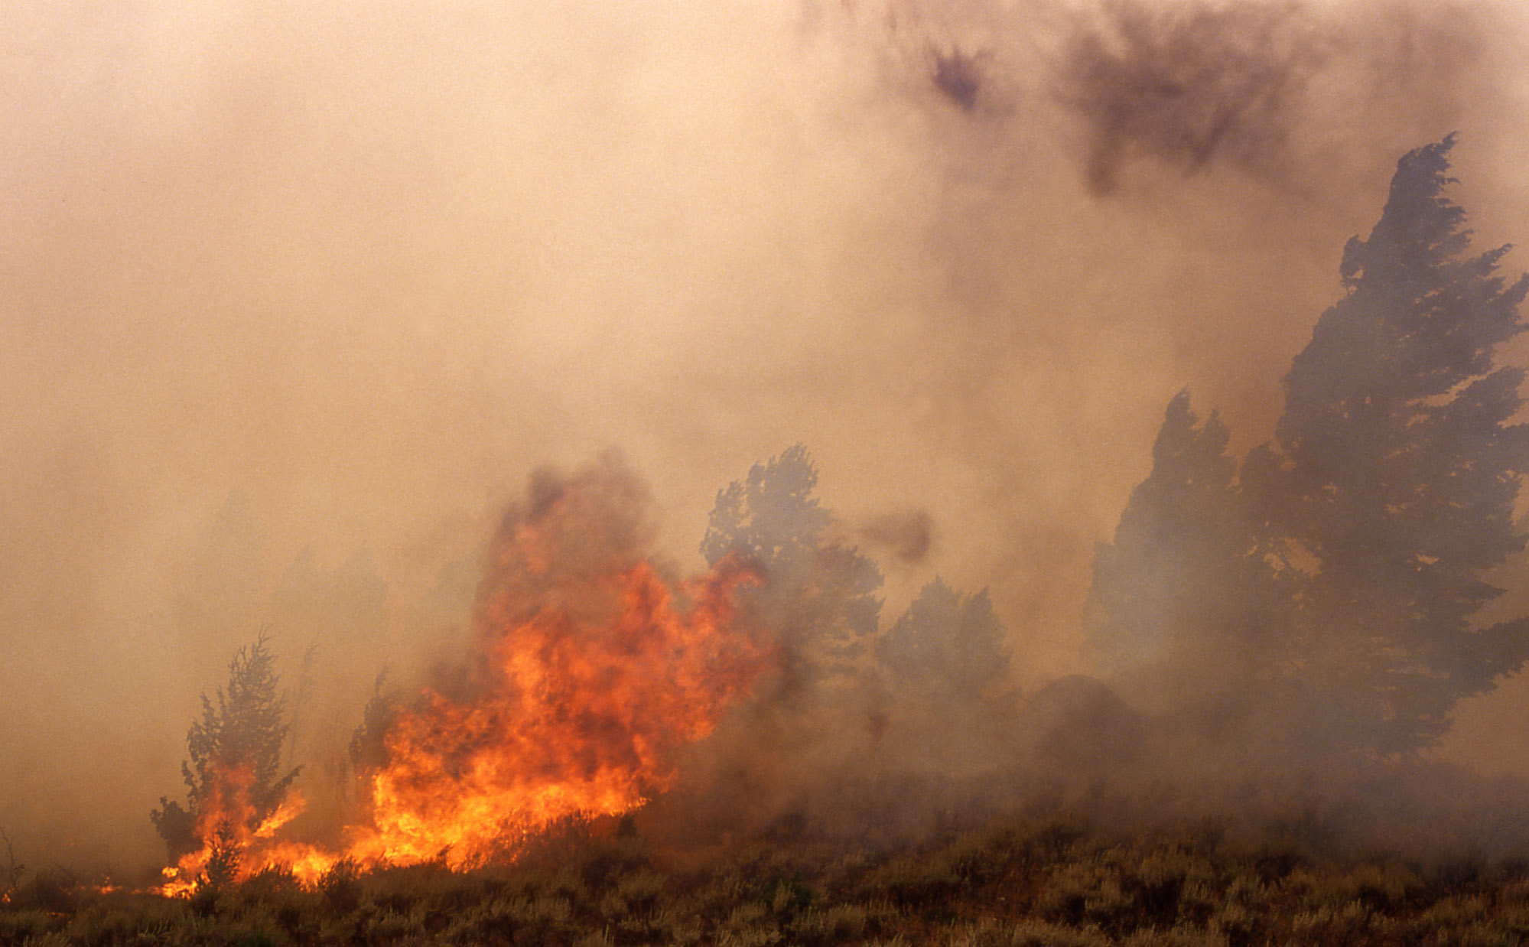

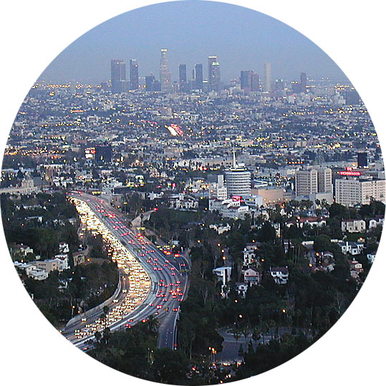

IR sounder status:
IASI (Clerbaux)
CrIS (Kevin/TROPESS, Millet group)
and MOPITT (RIP)
H. Worden, NCAR MOPITT Team

Slide 2













SO₂ volcanoes vs pollution
CO pollution and fires
C₂H₄ leaks
for air quality
Cathy Clerbaux, and the LAMOS + ULB Teams

Slide 3
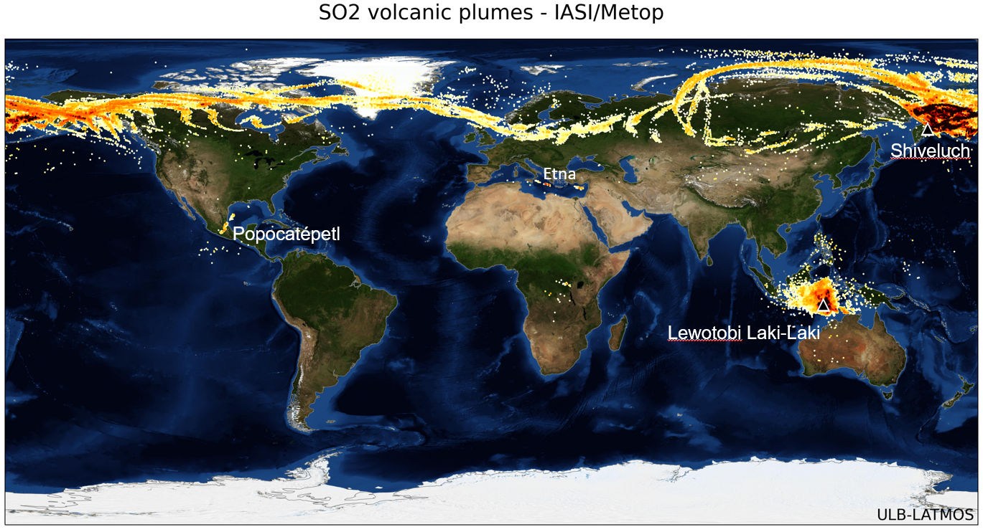

Slide 4
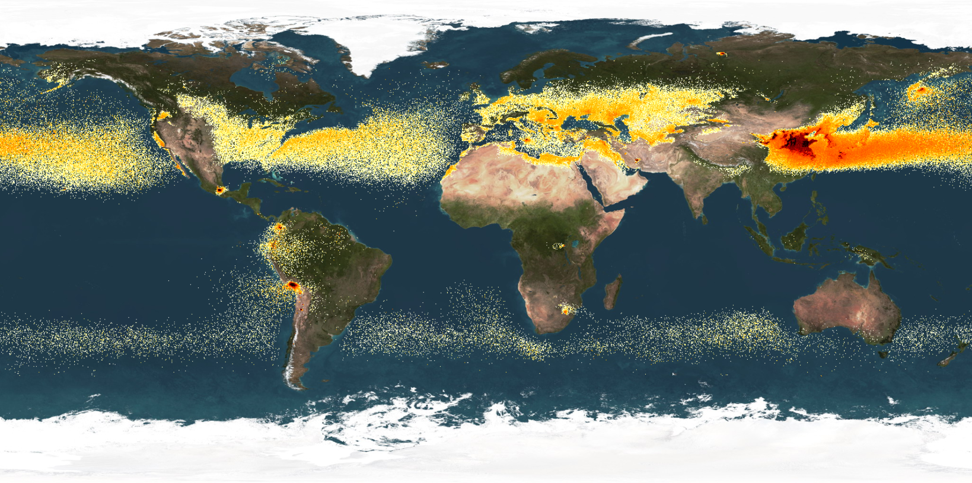
SO₂ low altitude plumes IASI/Metop B & C

Slide 5
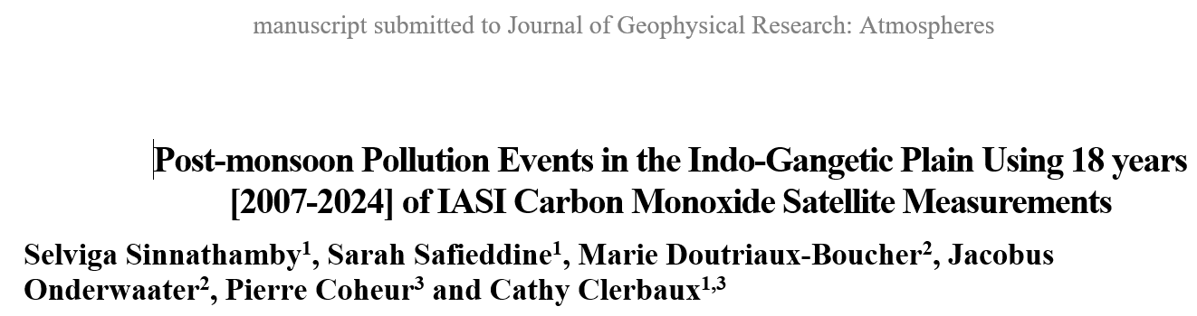
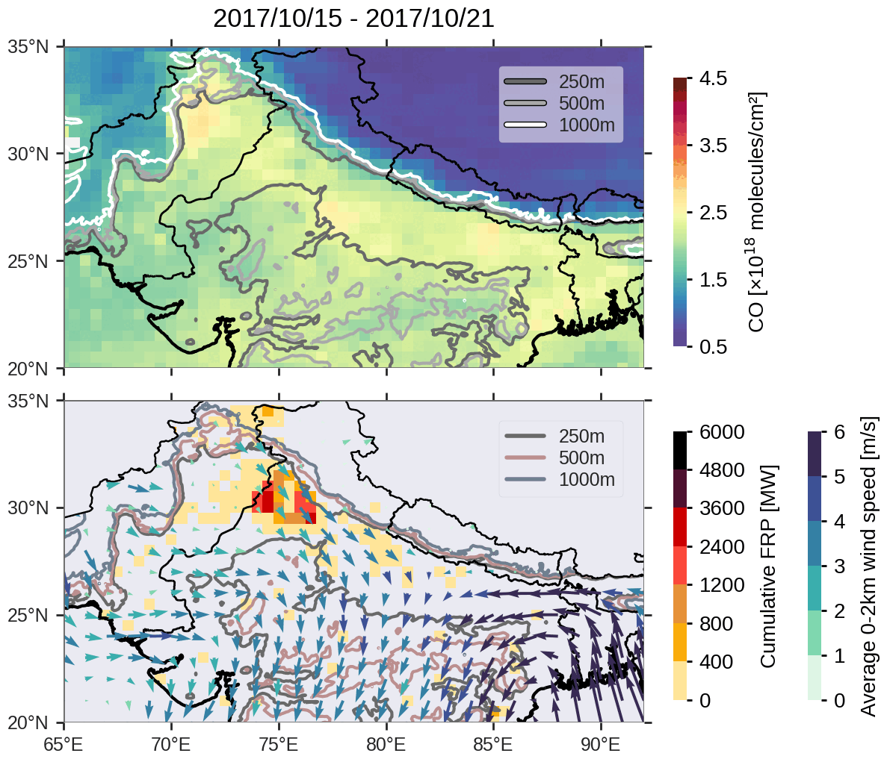
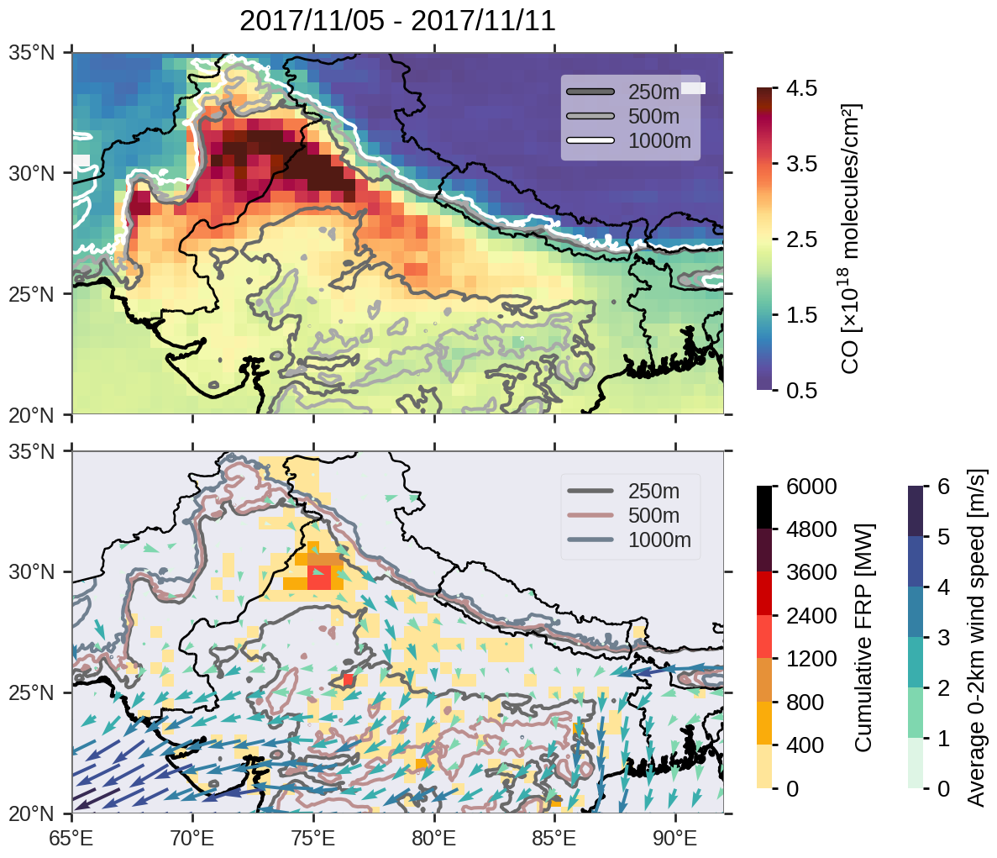
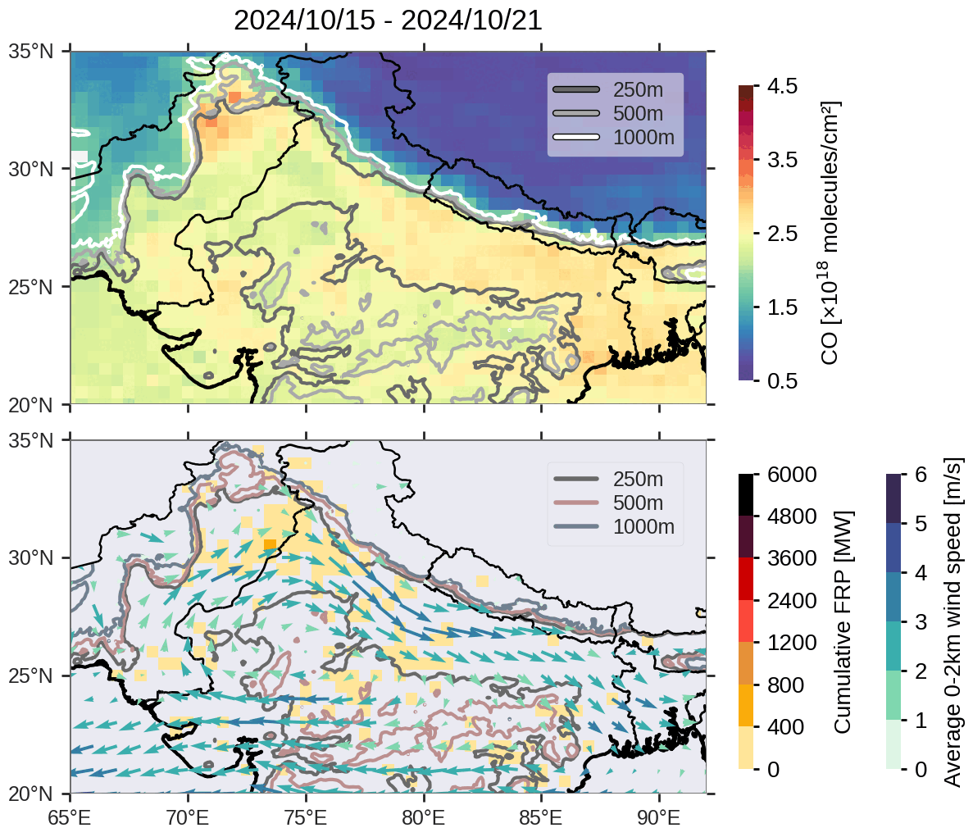
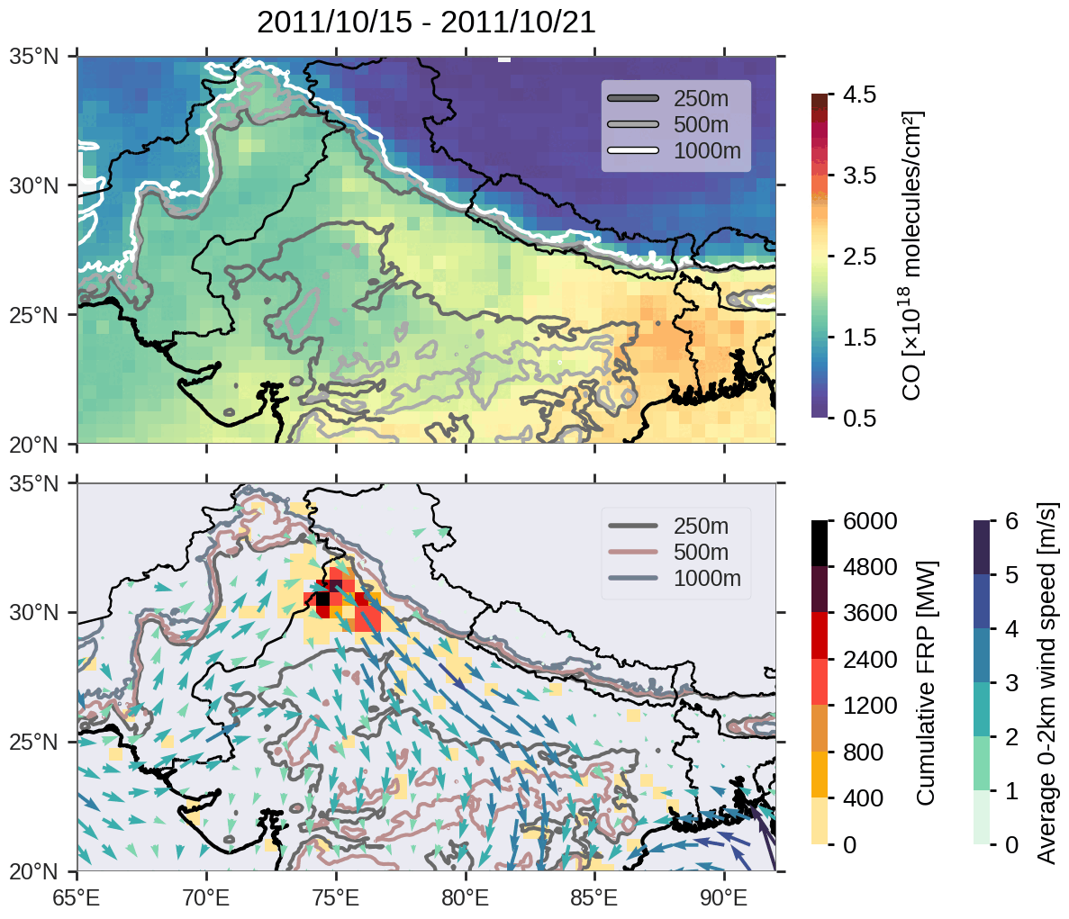
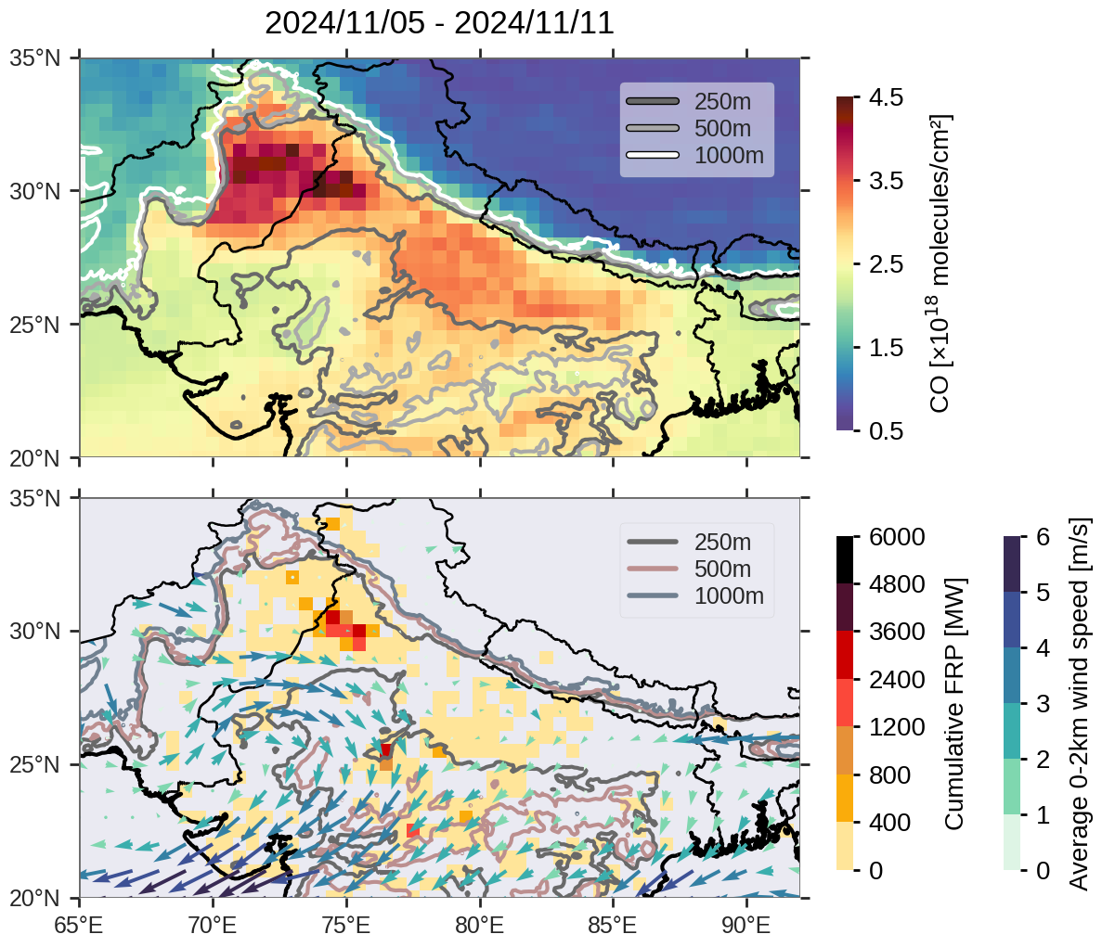
Comparison of 2024 with 2017 and 2011
In 2024, weak winds between November 5-11 contributed to the accumulation of CO in the region.
Same for 2017 but over ~2 weeks, starting from October 29.
Strong southeastward winds were found in 2011, which facilitated transport of CO + high fire activity.
Notes:
In 2024, weak winds between November 5-11 contributed to the accumulation of CO in the region.
Same for 2017 but over ~2 weeks, starting from October 29.
Strong southeastward winds were found in 2011, which facilitated transport of CO + high fire activity.

Slide 6
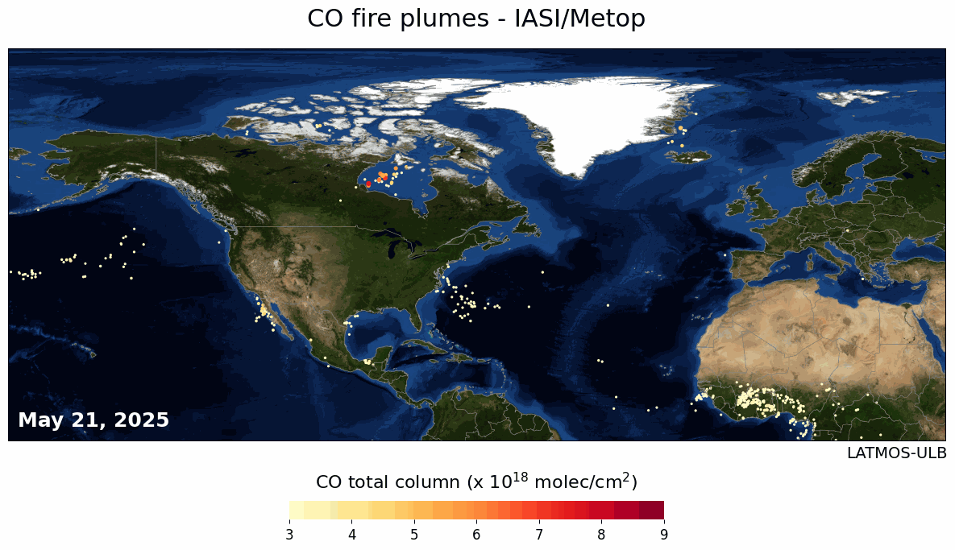

Slide 7
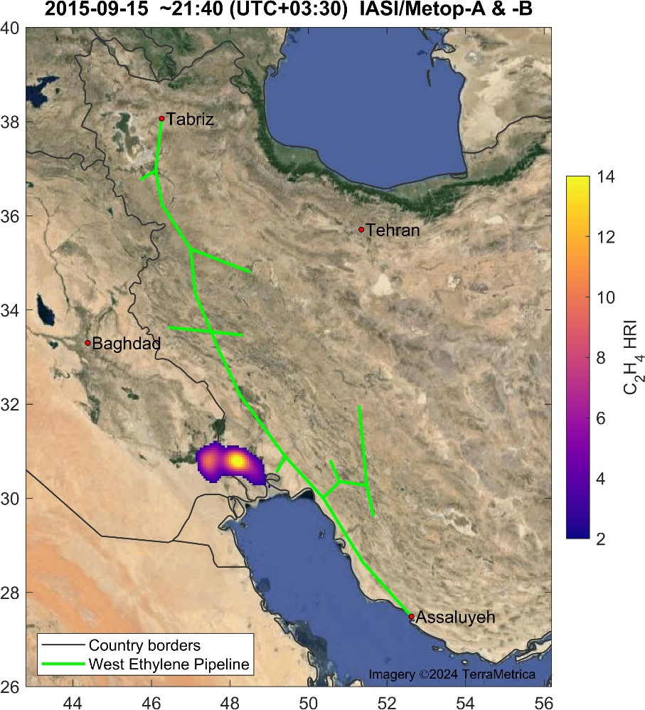
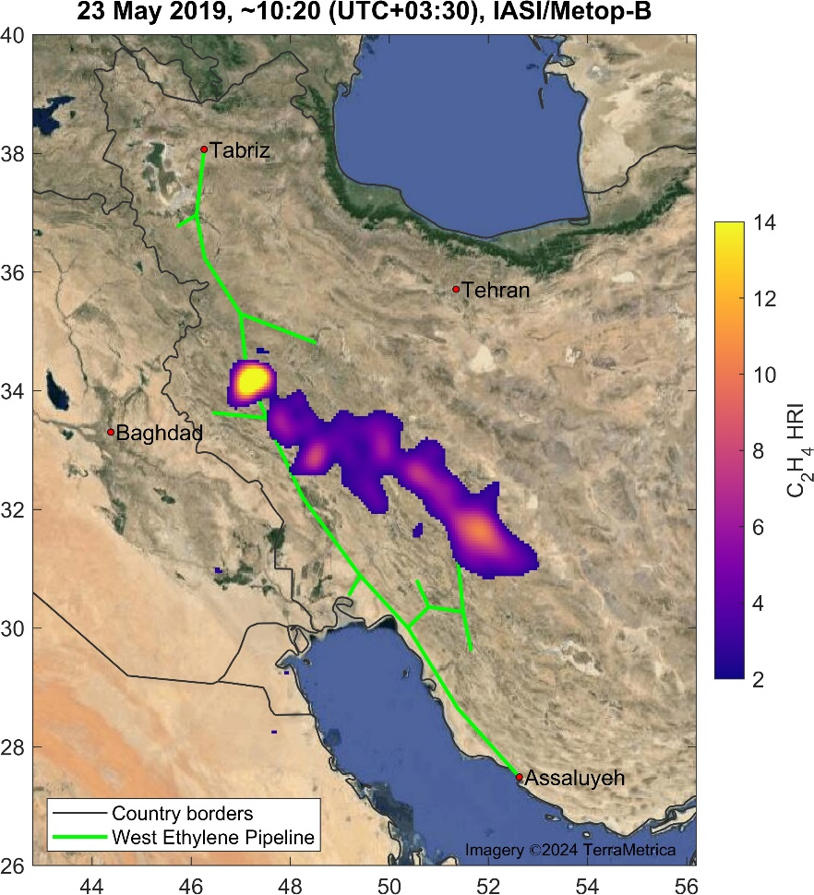
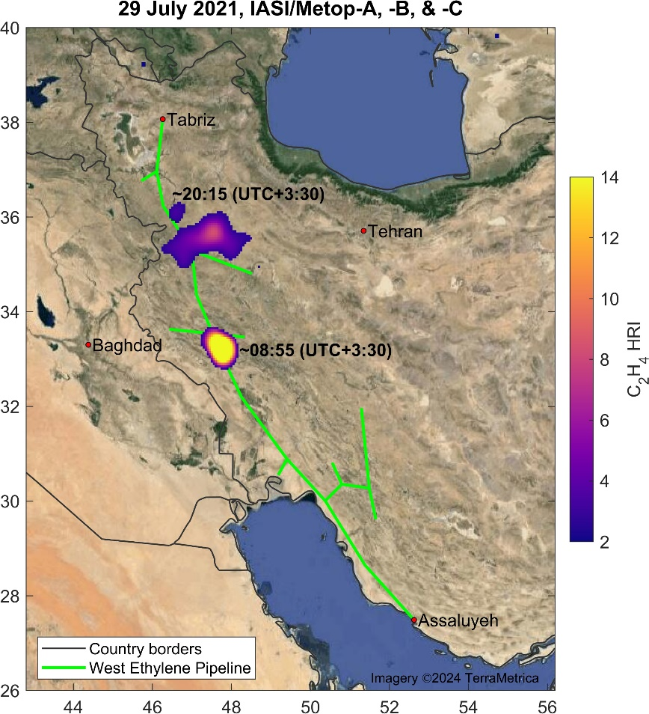
Petrochemistry - C₂H₄ leaks, detected long the Iranian West Ethylene Pipeline starting from 2012
B. Franco/L. Clarisse/C. Clerbaux (ULB-LATMOS)

Slide 8
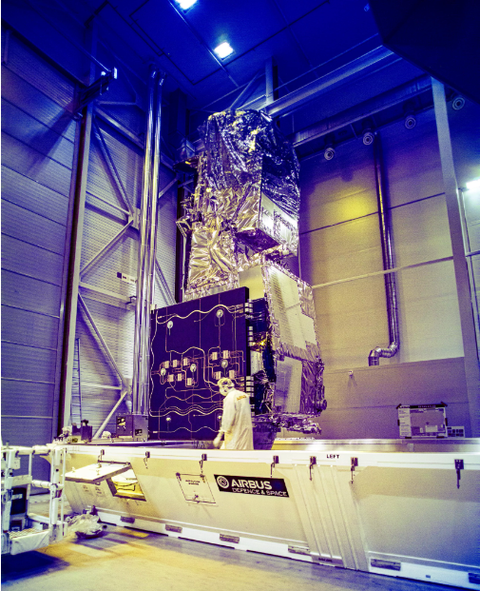
Looking forward to working with IASI-NG data (see Cyril Crevoisier’s presentation)

Slide 9


NASA Tropospheric Ozone and Its Precursors from Earth System Sounding (TROPESS)"
Kevin W. Bowman and the TROPESS team
© 2025 California Institute of Technology. Government sponsorship acknowledged.
Notes:
Acknowledge the substantial success of environmental policy in the US. 70% reduction in NOx emissions. Challenges of air quality in the 21st century.

Slide 10
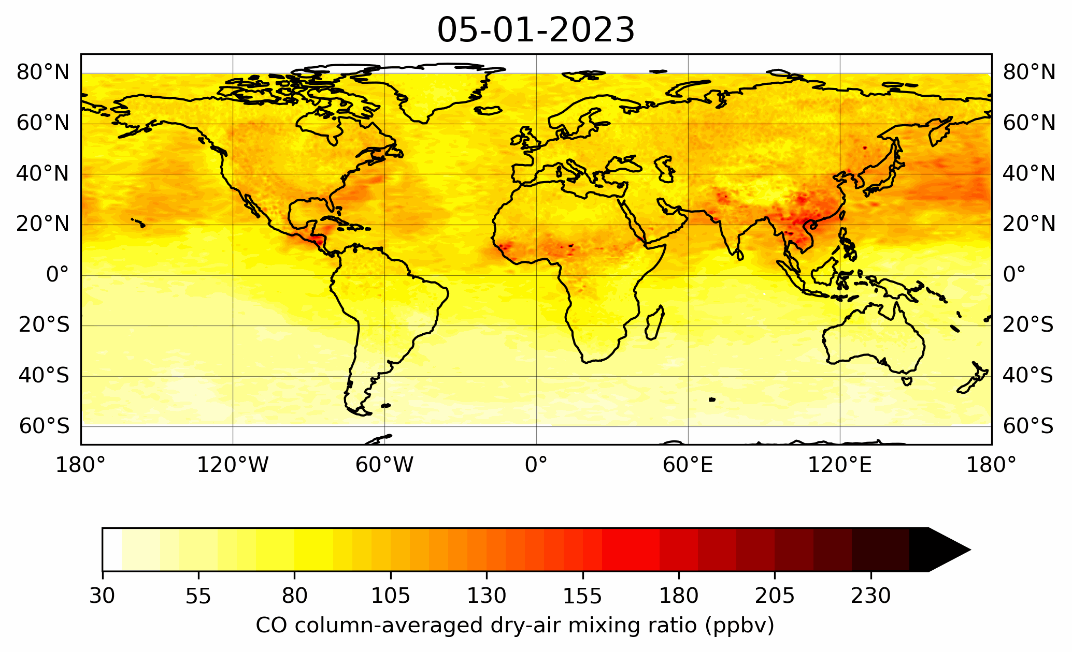
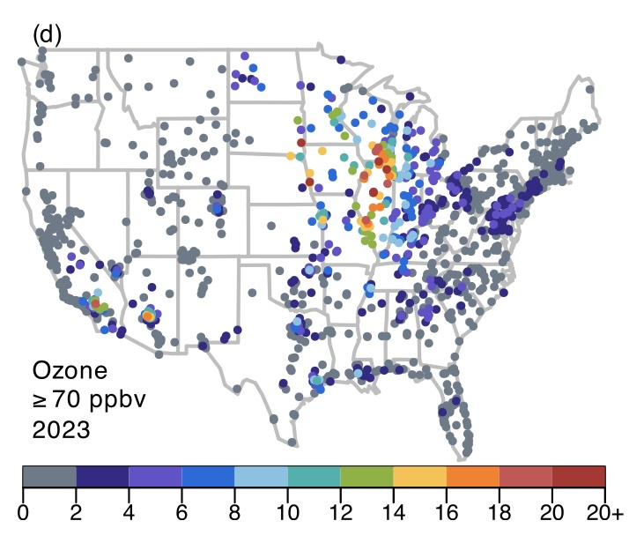
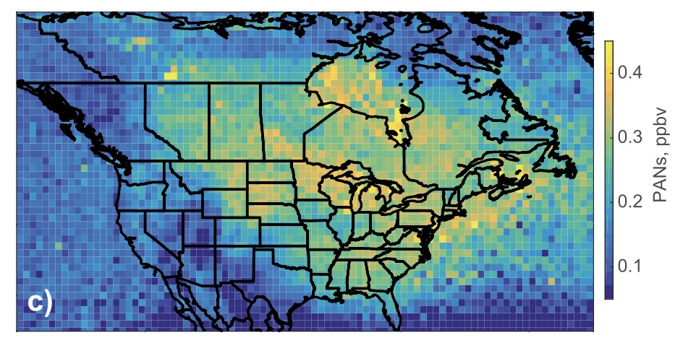
Early Season 2023 Wildfires Generated Record Breaking
Surface Ozone Anomalies Across the U.S. Upper Midwest
- Early summer 2023 wildfires caused the highest surface ozone ever recorded across the Upper Midwest. Ozone levels matched those seen during peak pollution years in the late 1990s and early 2000s.
- TROPESS CrIS satellite data was critical for interpreting O3 formation revealed through elevated CO and PANs in smoke plumes, pinpointing zones of active ozone production. These observations highlighted the vertical structure of reactive gases driving photochemistry.
Cooper, O. R., et al. (2024). *Early season 2023 wildfires generated record-breaking surface ozone anomalies across the U.S. Upper Midwest*. Geophysical Research Letters, 51, e2024GL111481. https://doi.org/10.1029/2024GL111481

Slide 11
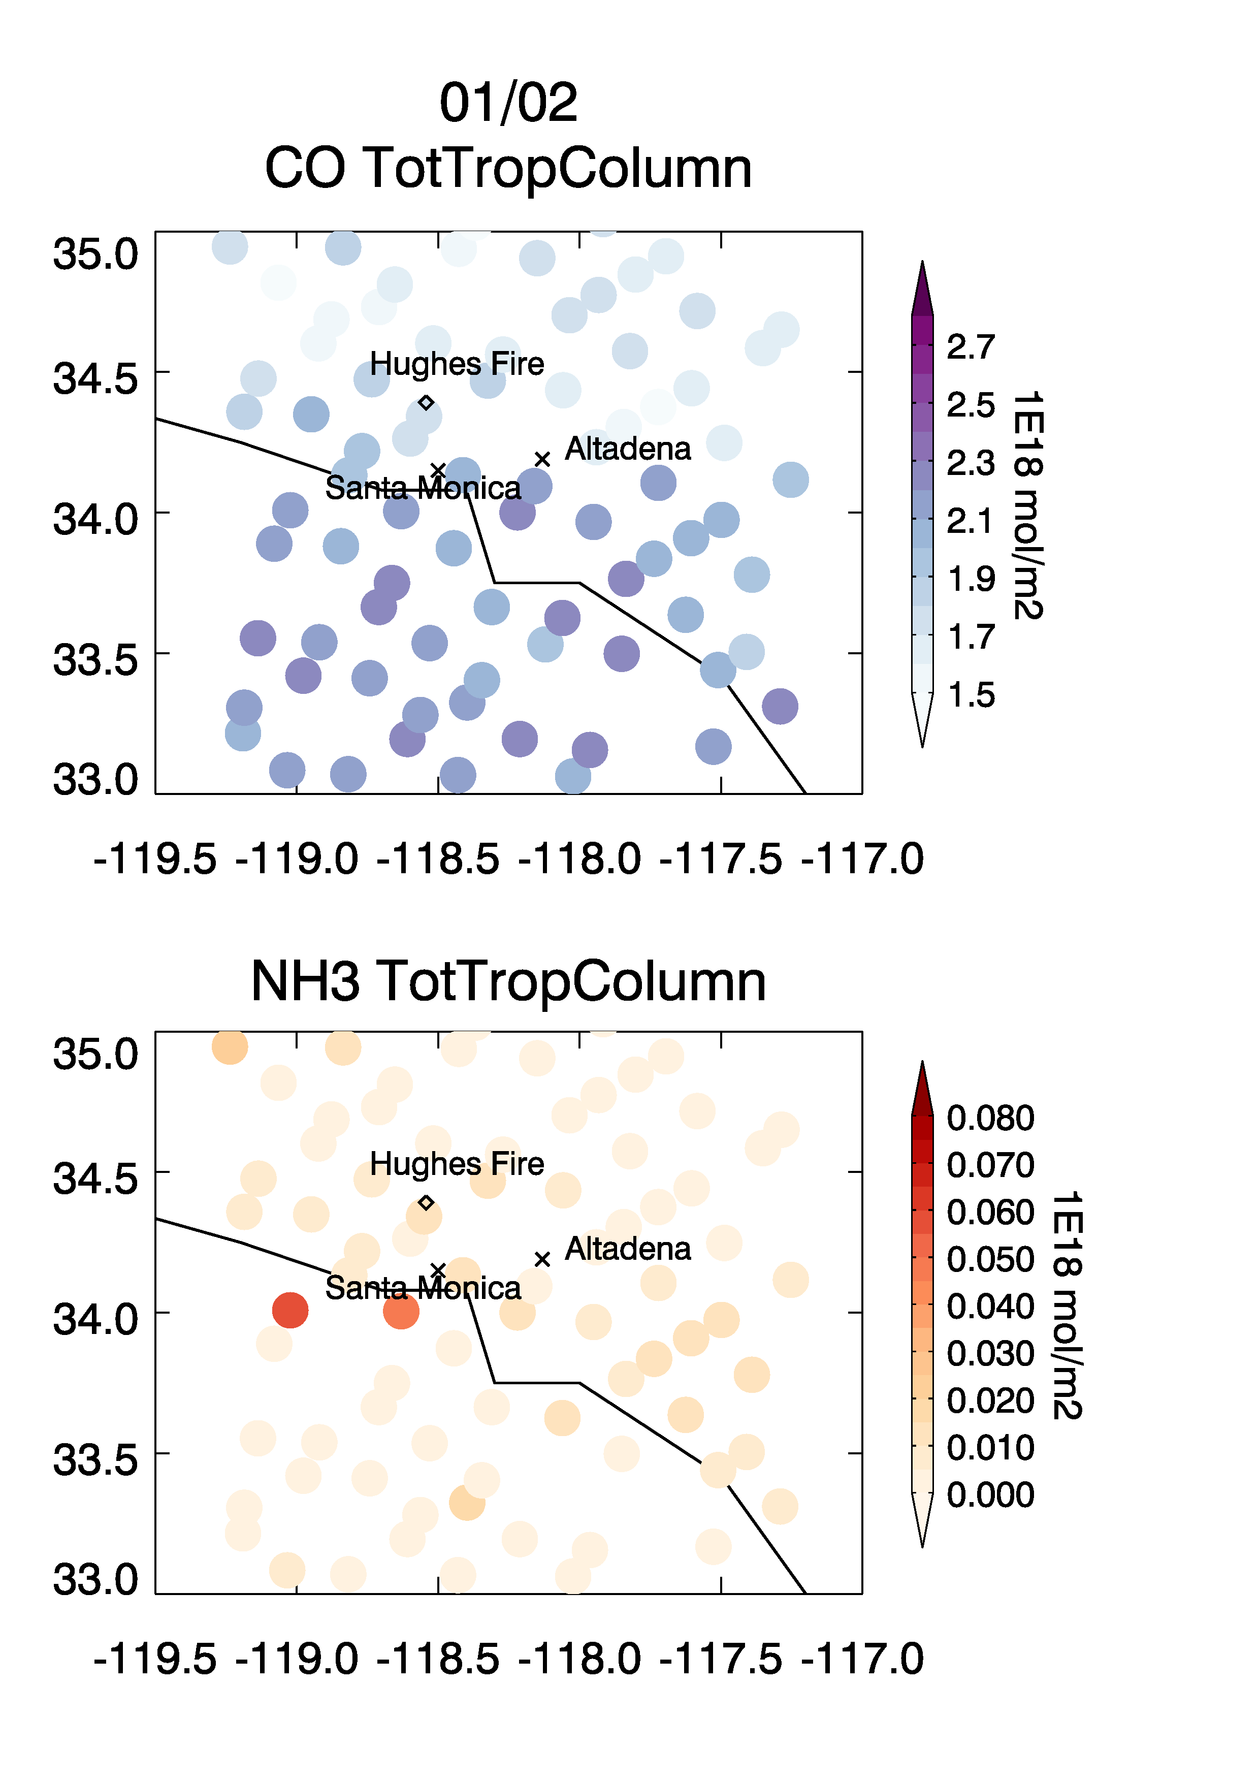
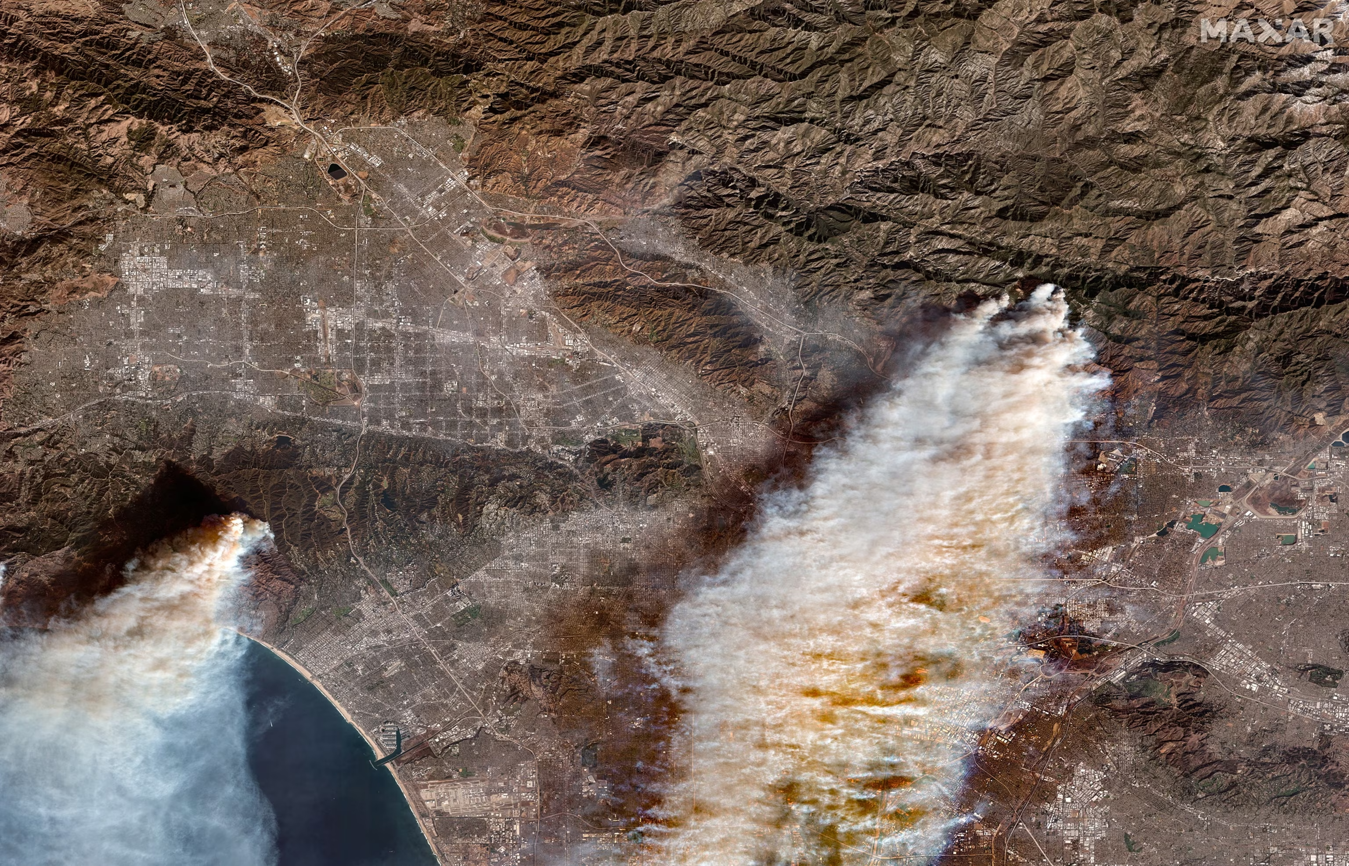
2025 LA fire outflow from TROPESS CrIS CO and NH3
The Eaton Fire and Palisades destroyed over 16 000 structures
AccuWeather estimated that the total damage plus broader economic slowdown would add up between $250 billion and $275 billion.
That would make the 2025 Los Angeles fires the costliest natural disaster in US history.

Slide 12
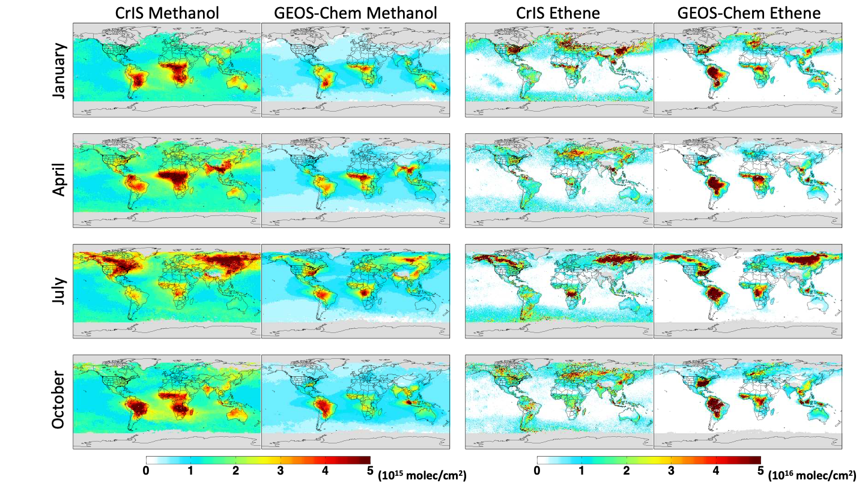
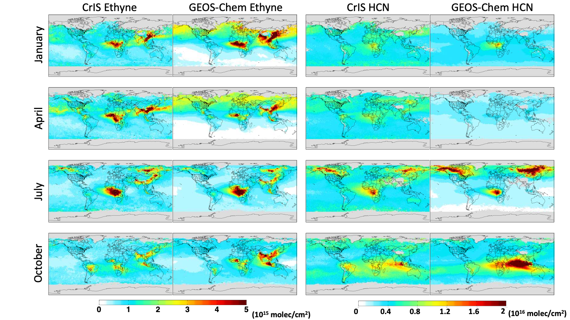

A range of volatile organic compounds (VOCs) can be measured with CrIS:
Complementary tracers for understanding biogenic, pyrogenic, anthropogenic emissions and changes over time
 | Main sources: Biog / Fires / Anthro | Lifetime (d)
Isoprene | B | < 0.1
Methanol | B (f, a) | 13
Ethane | A (f) | 45
Ethene | B, F, A | 1
Ethyne | A, F | 13
HCN | F | 150
Millet group
University of Minnesota
[Wells et al., Atmos. Meas. Tech., 2025]

Slide 13
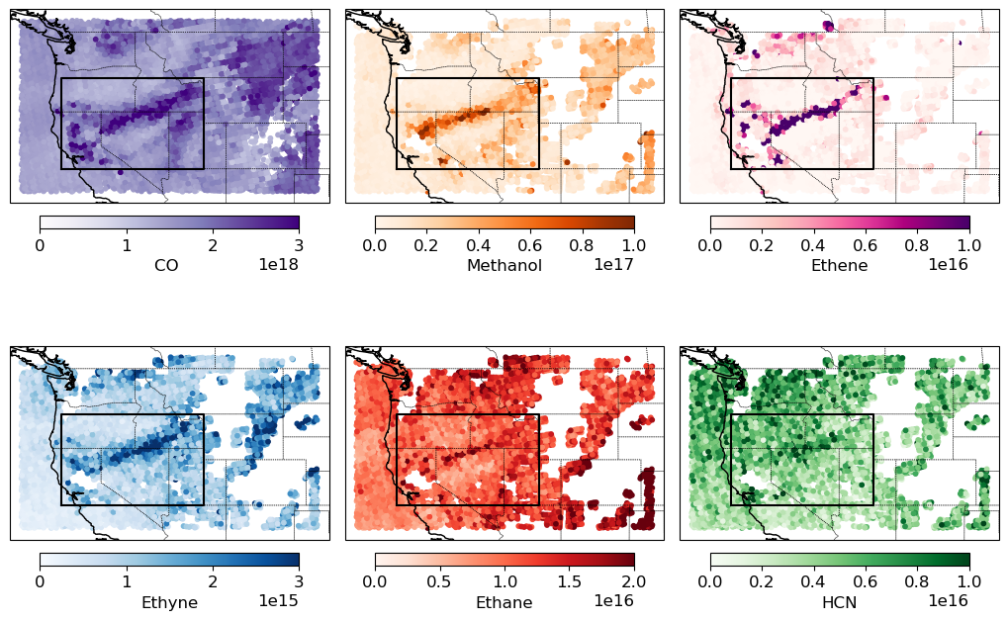
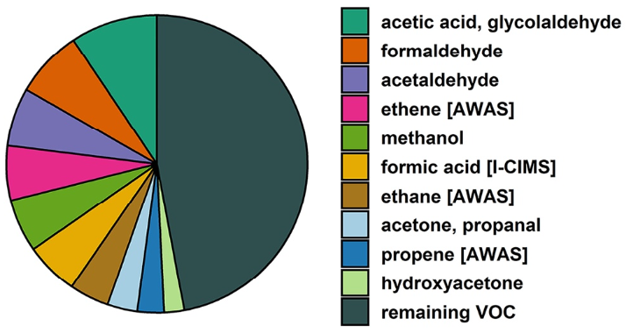
These VOC observations provide valuable information for understanding fire emissions and impacts
[Juncosa Calahorrano et al., in prep.]
CrIS columns (molecule cm⁻²)
Together, TIR and UV/Vis space-based observations can characterize the main fire VOCs
CH₃OH
C₂H₄
*
*
*
*
* Detectable in TIR
* Detectable in UV/Vis
*
*
C₂H₂
HCN
*
*
Cumulative mass fraction of measured VOC emissions during WE-CAN
[Permar et al., 2021]
The CrIS VOC data map individual fire plumes and can:
Quantify emission ratios
Test biomass burning inventories
Show how VOC speciation depends on fire and fuel properties
Millet group
University of Minnesota

Slide 14
Terra/MOPITT Status
On August 11, 2024 MOPITT experienced failure of the MWIR PMC (channel 7) with sensitivity in the upper troposphere.
After several attempts, the PMC has not recovered.
MOPITT LMC observations with sensitivity in the lower troposphere remain unchanged (both MWIR and SWIR)
MOPITT continued to produce vertical profiles and columns; reported diagnostics (AK) describe the reduced sensitivity until we went into SAFE mode on 1 Feb. 2025 to address Terra power losses.
Due to continued power issues on Terra, MOPITT was powered off 2025.04.09
Notes:
On August 11, MOPITT experienced failure of the MWIR PMC-2 (channel 7) with sensitivity in the upper troposphere. Sensitivity in the lower troposphere remains good in the MWIR and the SWIR observation was not impacted. MOPITT will continue producing vertical profiles and columns; AK describes the reduced sensitivity.

Slide 15
MOPITT surface layer CO observations over land
Notes:
And this is how that change over the record looks for multispectral compared to TIR only. So we would like a way to use both TIR and SWIR information going forward.

Slide 16
MOPITT Phase F plans
NCAR will produce MOPITT V10 as the final MOPITT dataset
  Updated climatology for apriori
  Updated growth rate for N2O in forward model
  Assessment of changes in HITRAN, MT_CKD for significance across MOPITT bands
  Basic validation with NOAA aircraft data
  As funding and time allows - other validation (ground, aircore, urban flight campaigns, etc)
New: Lower troposphere column product using only the LMC channels. This will be consistent over the entire MOPITT record and will be useful for studying changes in CO emissions over 25 years.
Potential: variogram analysis for validation of error profiles, posterior covariance
Notes:
On August 11, MOPITT experienced failure of the MWIR PMC-2 (channel 7) with sensitivity in the upper troposphere. Sensitivity in the lower troposphere remains good in the MWIR and the SWIR observation was not impacted. MOPITT will continue producing vertical profiles and columns; AK describes the reduced sensitivity.

Slide 17
CONCLUSIONS for MOPITT CO record continuation
Although there is no replacement of MOPITT’s unique multispectral record of global CO, IASI, CrIS TIR and TROPOMI and GOSAT-2 SWIR CO observations can provide continuity to monitor global CO trends, especially with data assimilation to account for different sampling and vertical sensitivity.
Multispectral combinations (profile or TIR profile + SWIR column) were best for studying surface sources of CO
Notes:
On August 11, MOPITT experienced failure of the MWIR PMC-2 (channel 7) with sensitivity in the upper troposphere. Sensitivity in the lower troposphere remains good in the MWIR and the SWIR observation was not impacted. MOPITT will continue producing vertical profiles and columns; AK describes the reduced sensitivity.

