Slide 1
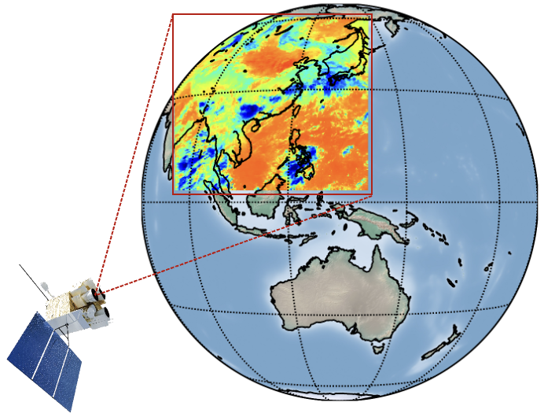



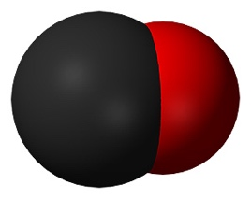
21st meeting of the CEOS Atmospheric Composition Virtual Constellation (AC-VC)
Atmospheric composition (CO, NH₃, and HCOOH) from the Geostationary Interferometric Infrared Sounder (GIIRS)
Zhao-Cheng Zeng (zczeng@pku.edu.cn)
School of Earth and Space Sciences, Peking University, Beijing, China
Mengya Sheng, Shangyi Liu, Jiancong Hua, Yingjun Zheng, Shan Han, Runyi Zhou, Sirui Wu (Peking University)
Lu Lee, Chengli Qi, Feng Lu, Xiuqing Hu (National Satellite Meteorological Center)
Wei Wang (Chinese Academy of Sciences)
Cathy Clerbaux (LATMOS)
CO
HCOOH
NH₃
Geostationary Interferometric Infrared Sounder

Slide 2
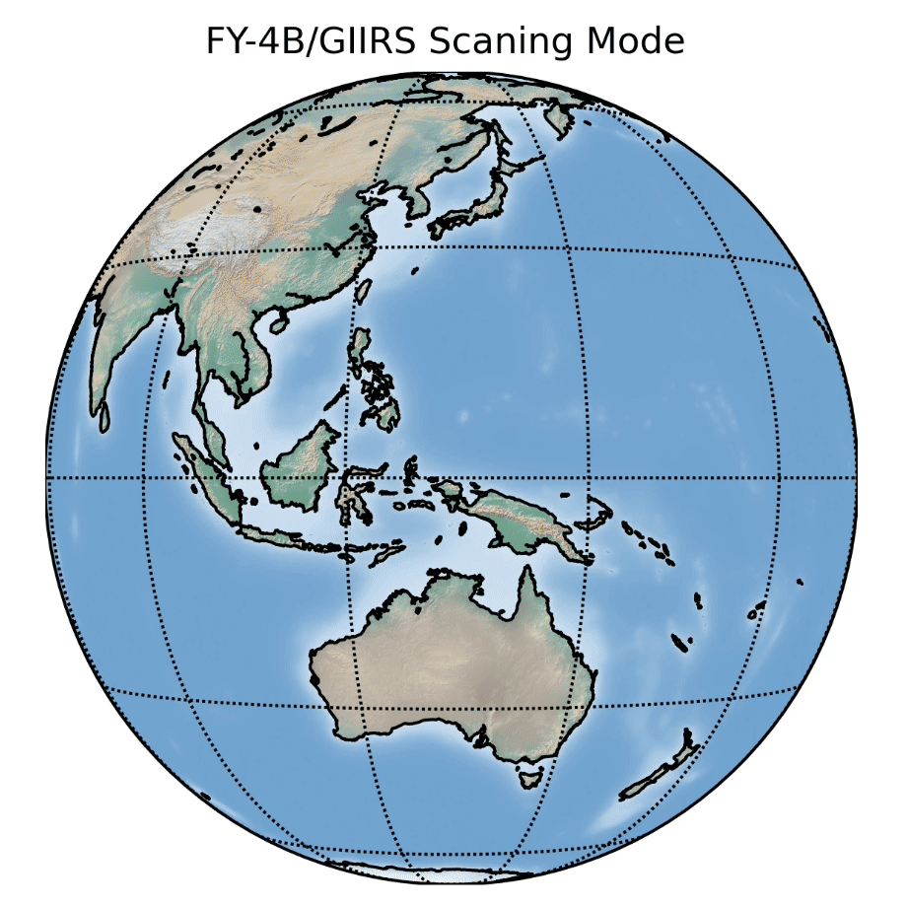
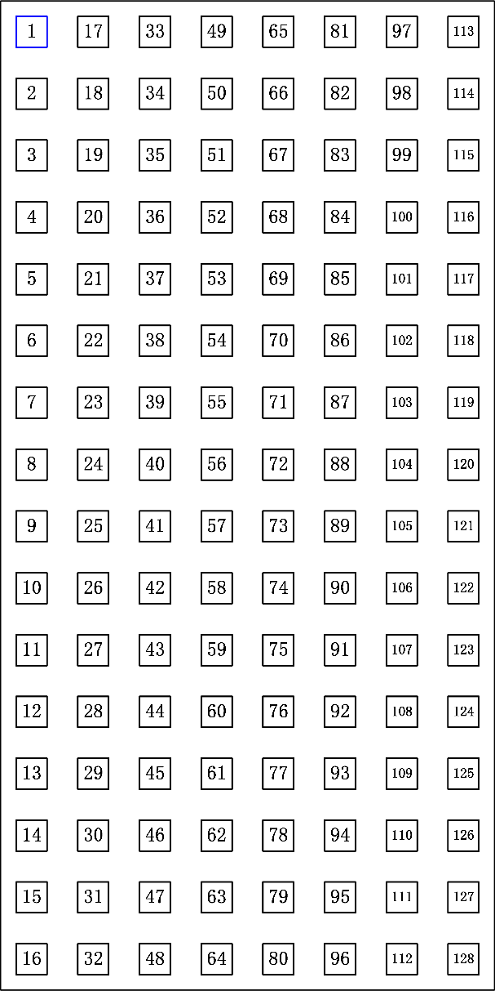
The Geostationary Interferometric Infrared Sounder (GIIRS)
27 FORs
FY-4A/GIIRS (launched in Dec 2016), spectra data need re-calibration improvement for AC retrieval;
FY-4B/GIIRS was launched in June 2021 (data available from June 2022)
It was located at 105°E before March 2024, and now at 133°E.
GIIRS scans the Earth in a “step-stare” mode: Each field of view collects16×8 interferograms
One coverage takes about 2.0 hours. 12 maps in a day covers day and night.
Footprint size at Nadir: about 12 by 12 km.
Retrievals of CO, NH₃, HCOOH from June 2022 to May 2024 (more is coming). This talk will focus on validation and comparison with exiting datasets.
Detector layout
(16×8 interferograms)
12 Scans
By courtesy of Dr. Lee Lu (NSMC)

Slide 3
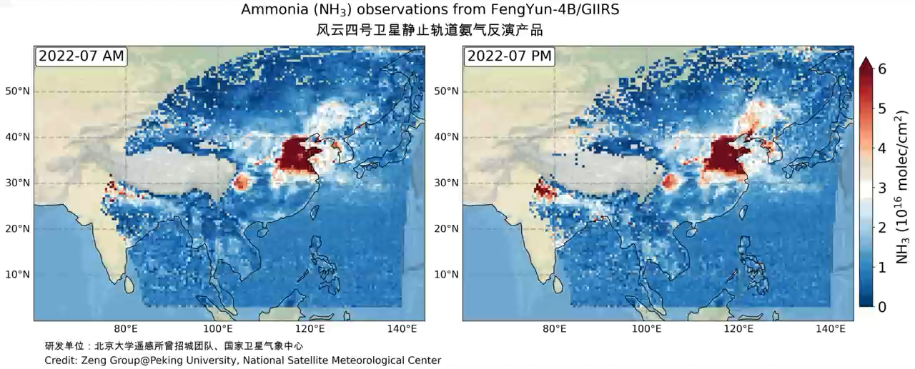
Ammonia (NH₃)
Retrievals are avaialble from June 2022 to May 2024, and more is coming
Two major source regions (North China Plain and Northern India)
We see the difference betwee morning and afternoon (filtered by DOFS and TC)
Zeng et al., 2023a, AMT

Slide 4
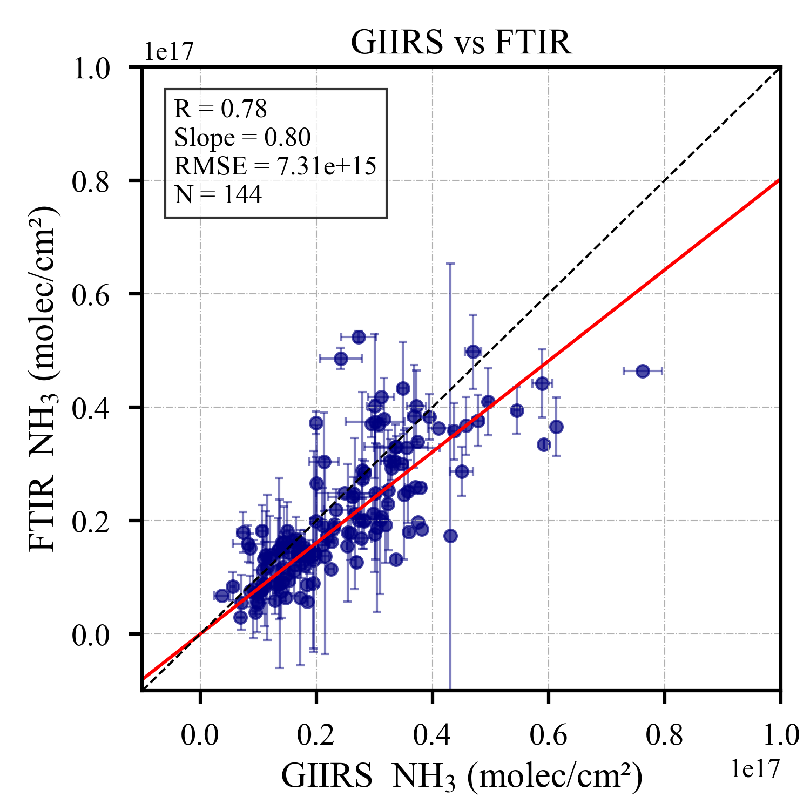
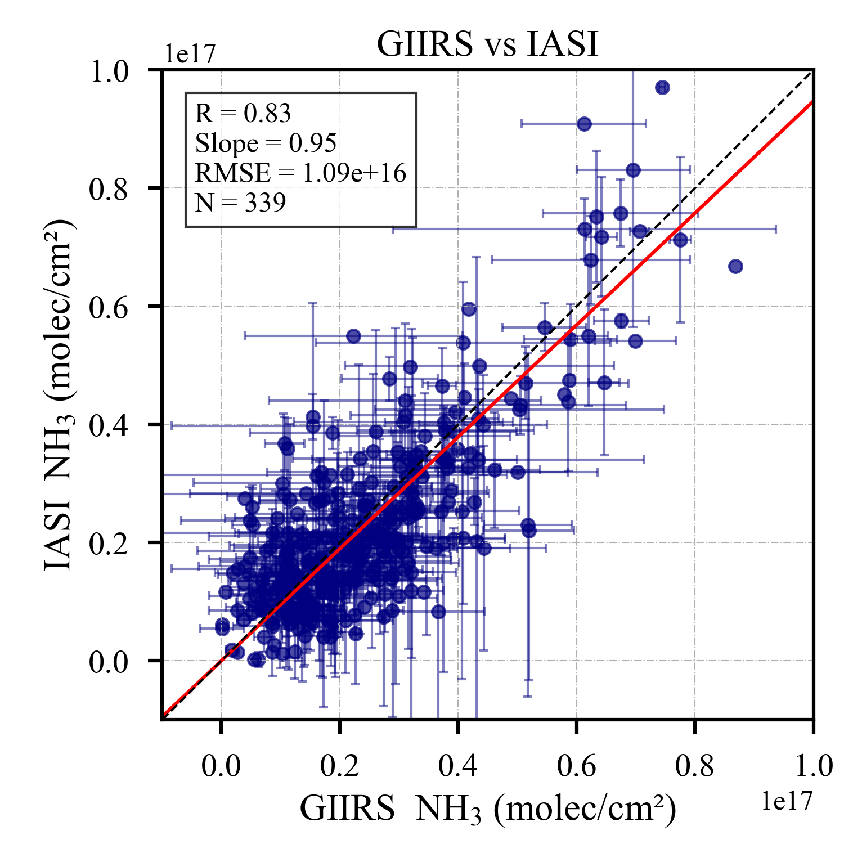
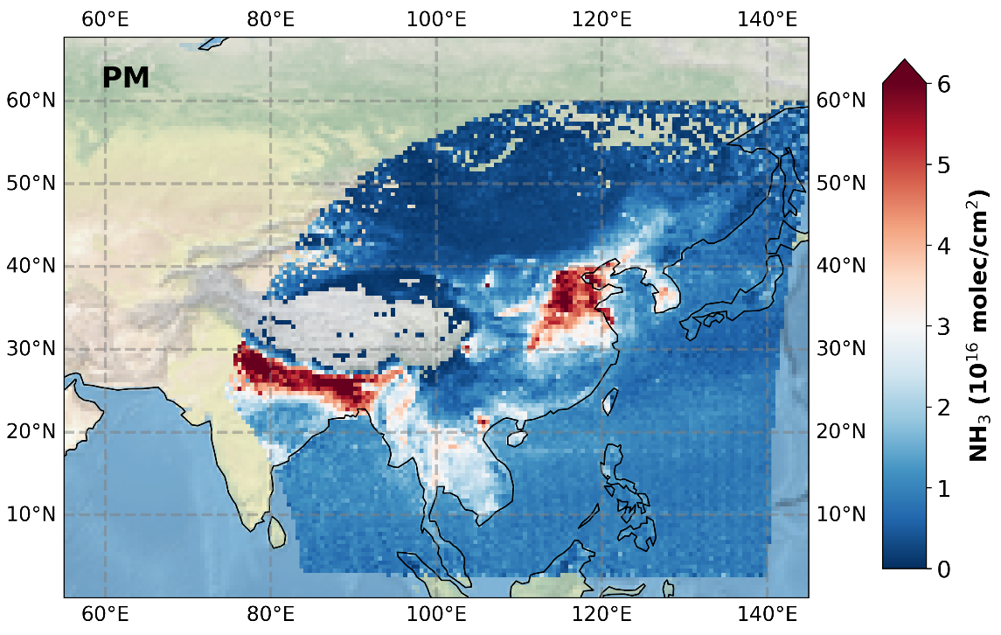
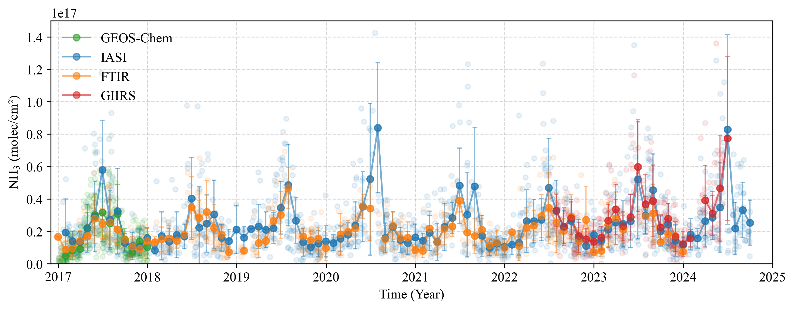
Comparison with ground-based FTIR and IASI
GIIRS vs FTIR
GIIRS vs IASI
Hefei
(31.8°N, 117.2°E)
FTIR in Hefei retrieves NH₃ column from 2017 to 2023.
Consistent seasonality with high values during summer
GIIRS data have good agreement with FTIR and IASI

Slide 5
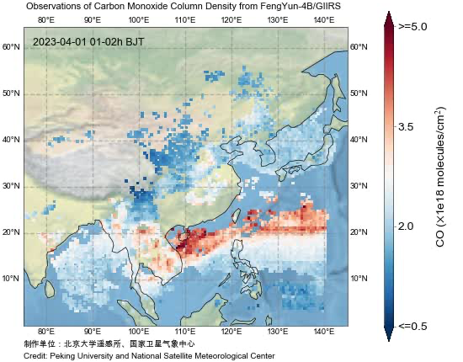
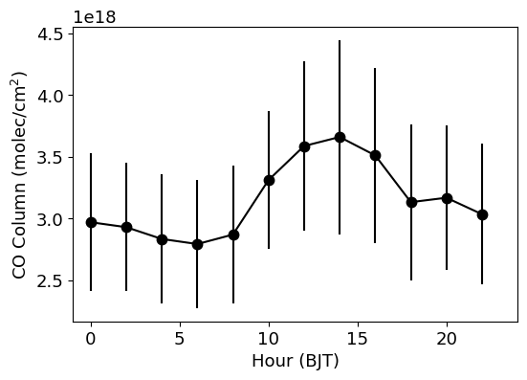
Diel cycle of wildfire CO columns from Southeast Asia
Maps of CO columns every 2-hour in Apr 2023
2-hour averages over the SE Asia land
LT: 13 pm
Strong CO emissions transported toward the South China Sea and the Pacific;
The diel cycle represents typical fire emissions caused by changes in temperature/humidity/agricultural activities
Observation sensitivity changes (indicated from AK matrix)
Zeng et al., 2023b, AMT

Slide 6
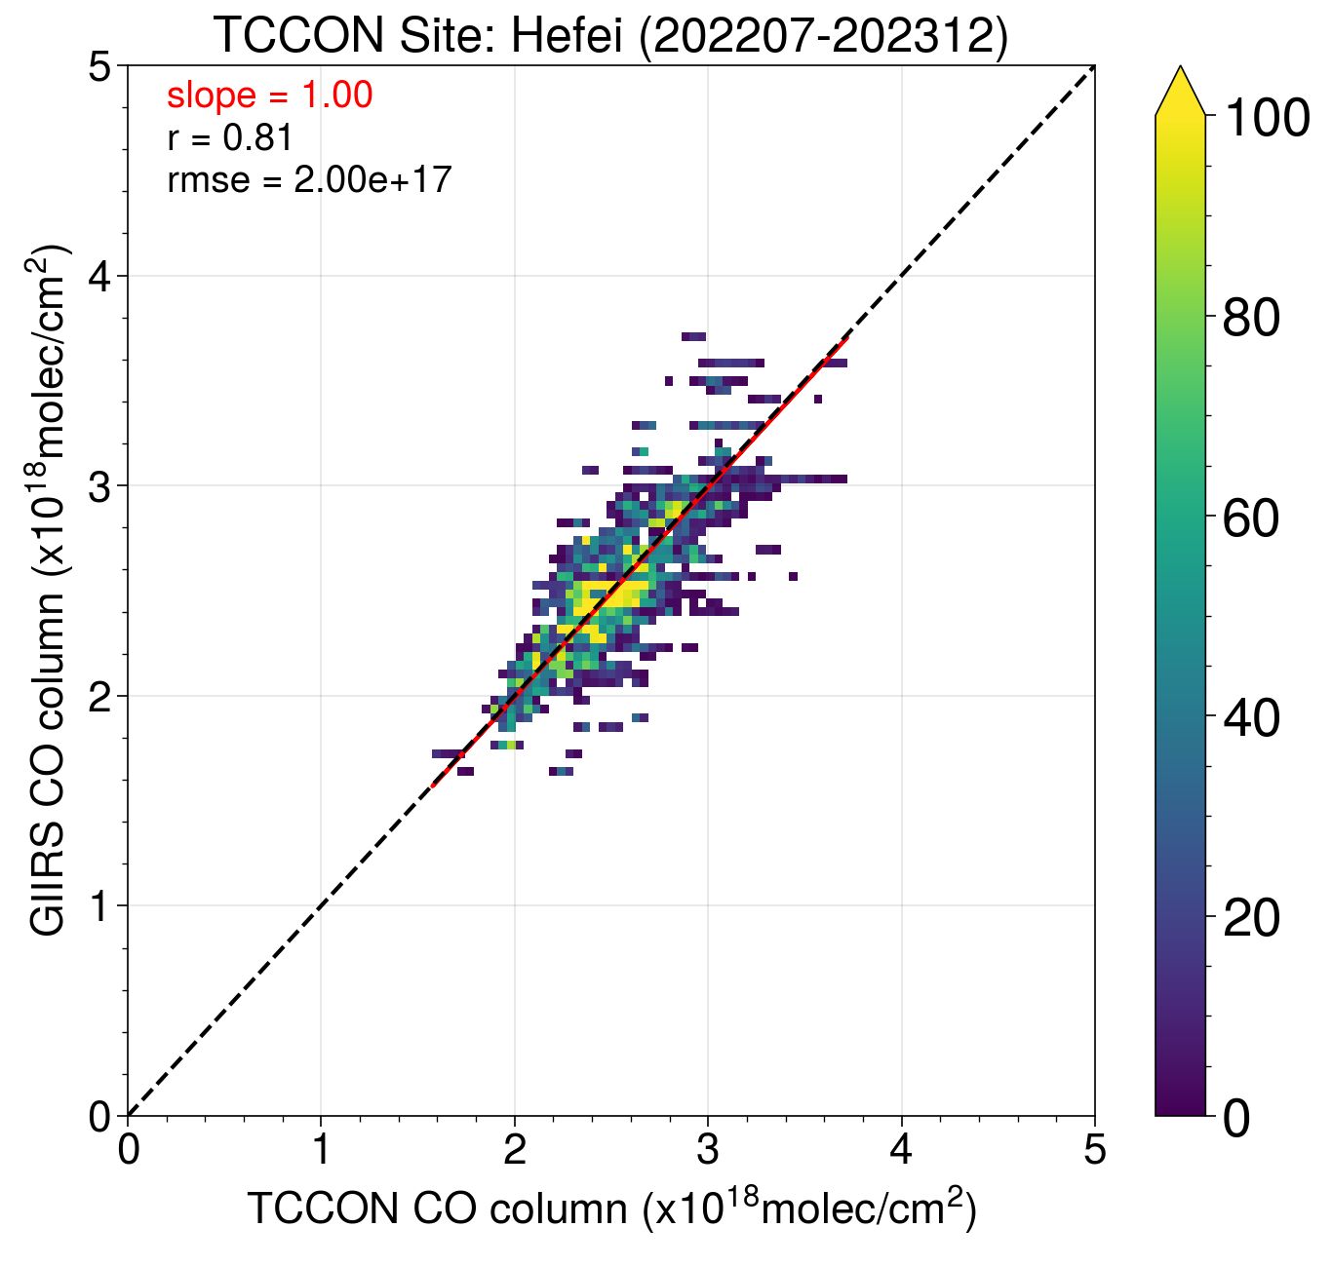
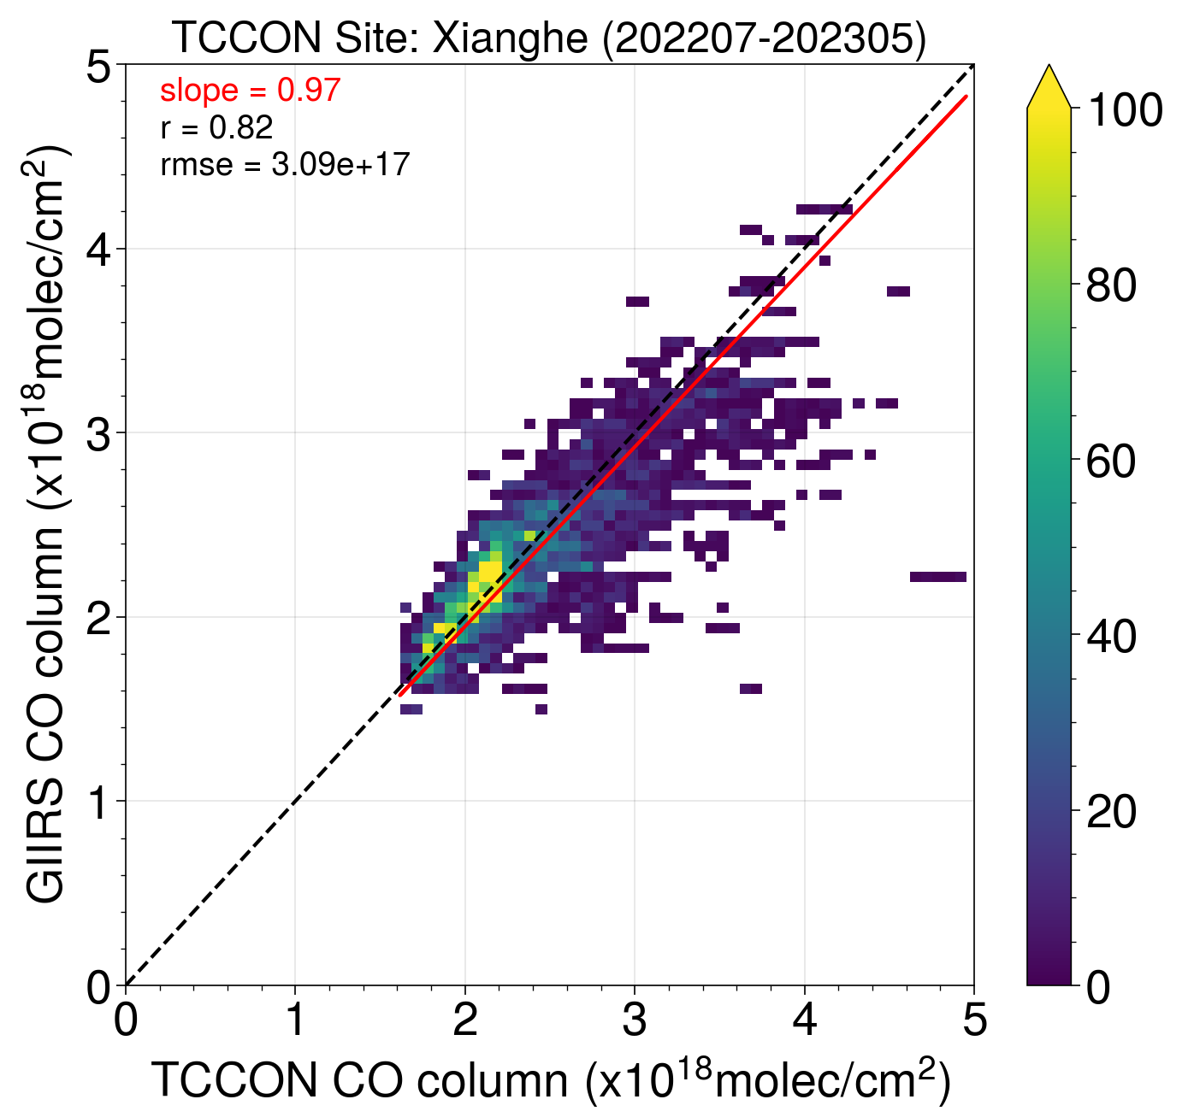
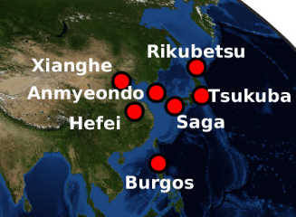
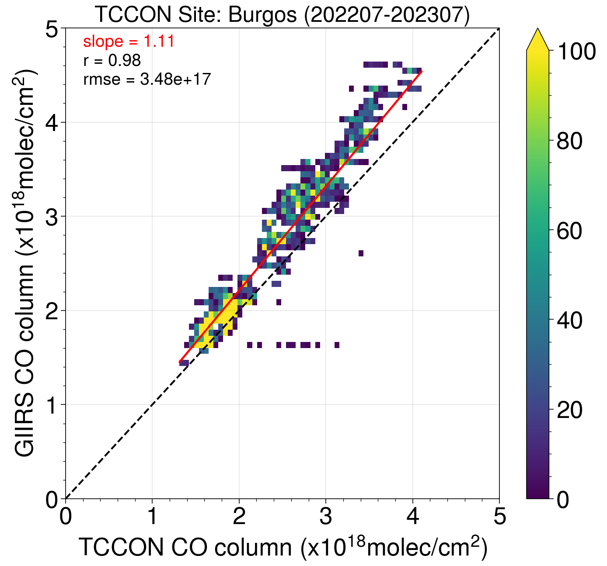
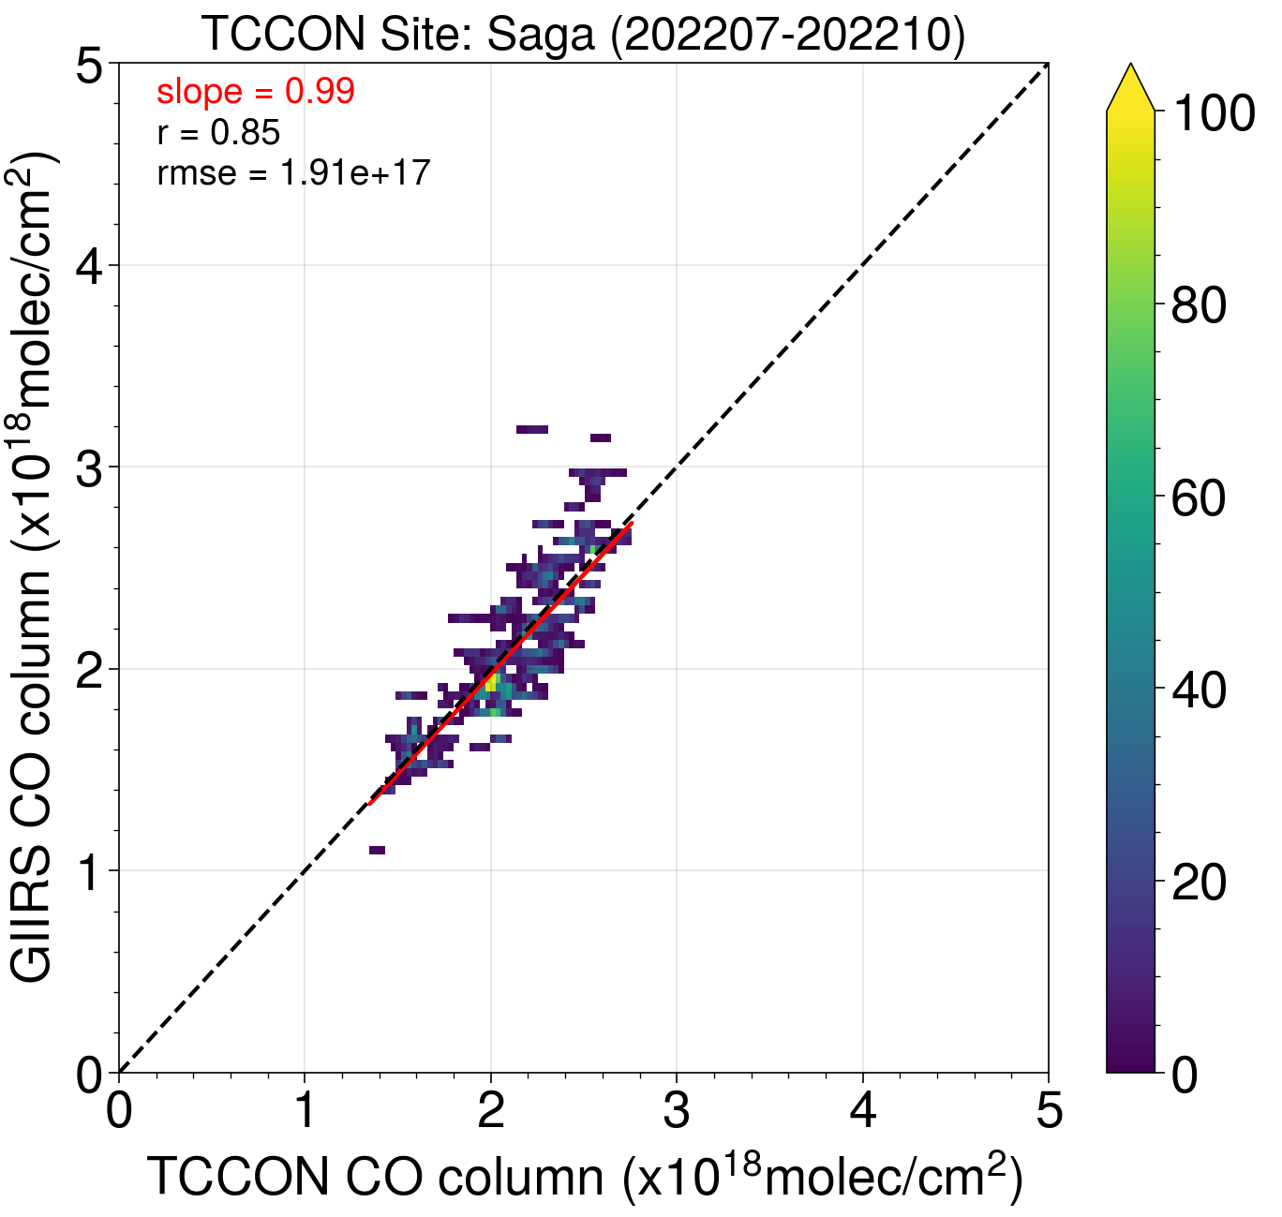
Comparison with TCCON CO
TCCON @ Heifei
TCCON @ Xianghe
Data collocation: Lat ±0.5° and Lon ±0.5°; Time ± 1 hour;
Convolved with averaging kernel
Good correlation between all TCCON sites;
A systematic difference over the Burgo site, showing GIIRS is overestimating over the region.
TCCON @ Burgos
TCCON @ Saga

Slide 7
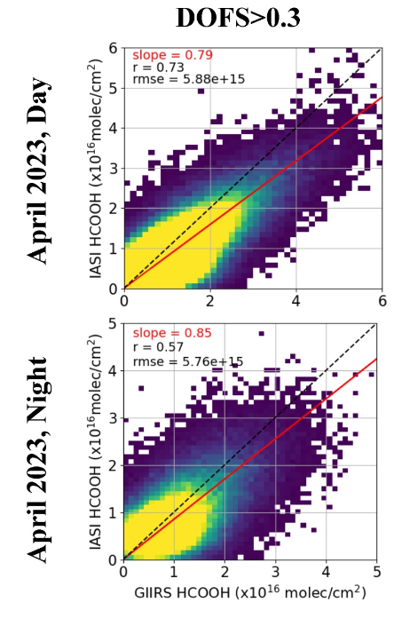
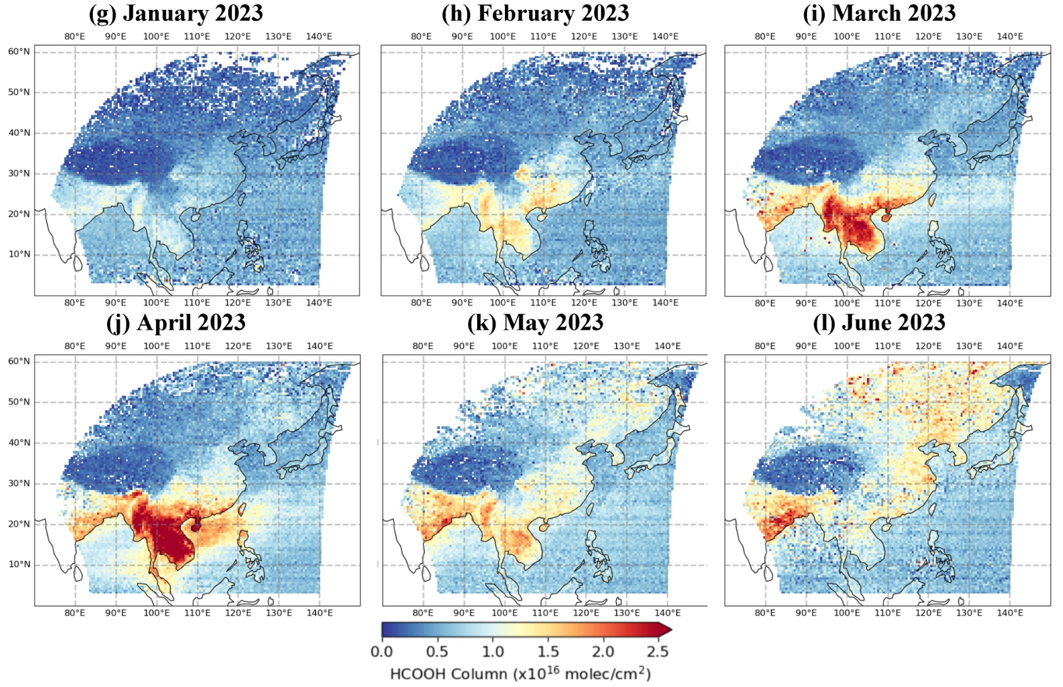
Formic Acid (HCOOH)
Zeng et al., 2024, JGR-Atmosphere
HCOOH is an important VOC;
Large enhancement can be seen from wildfires from southeast Asia (Mar and Apr) and Siberia (June);
No ground-based observations are available; Comparison with IASI show good agreement.

Slide 8
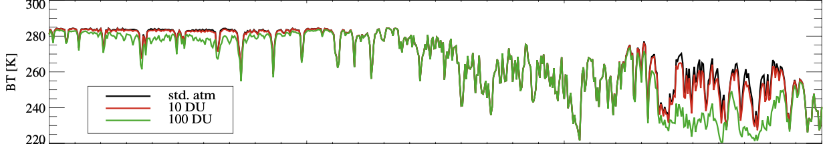
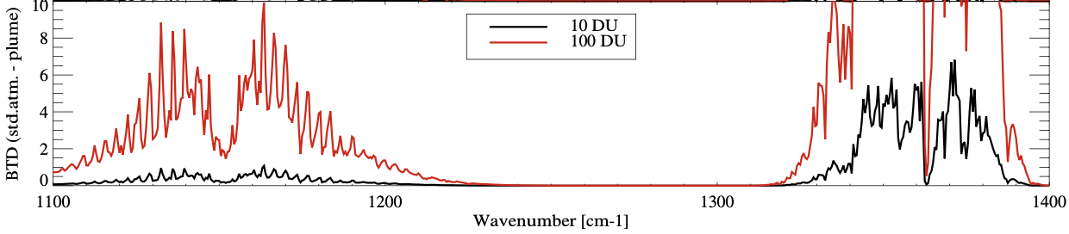
SO₂ observations from FY-4B/GIIRS
SO₂ ν1 (weak absorption band)
SO₂ ν3 (strong absorption band)
GIIRS spectra only cover part of the ν1 weak absorption band
SO₂ absorption feature
Figures from Carboni et al. (2012)
Covered by GIIRS (<1130 cm⁻¹)

Slide 9
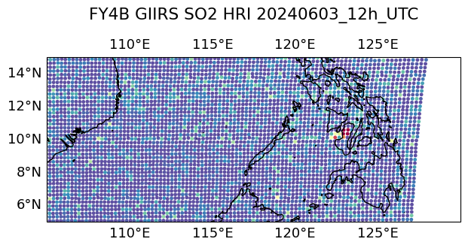
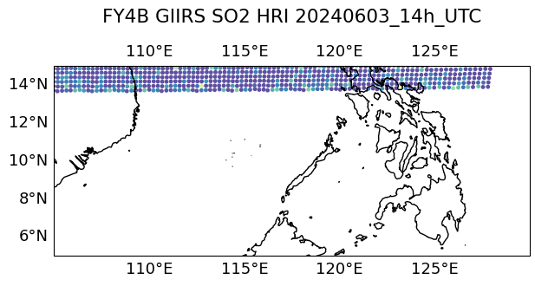
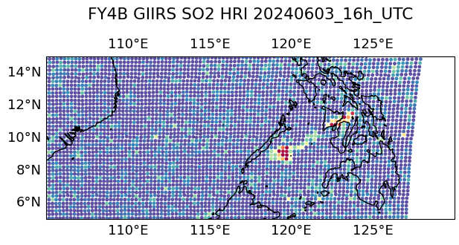
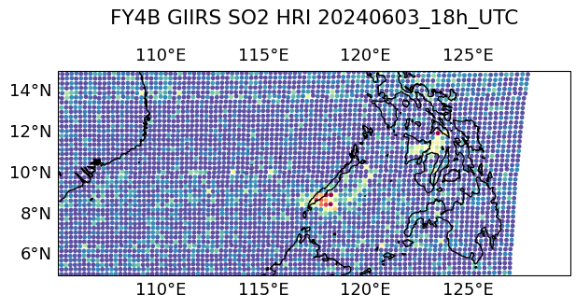
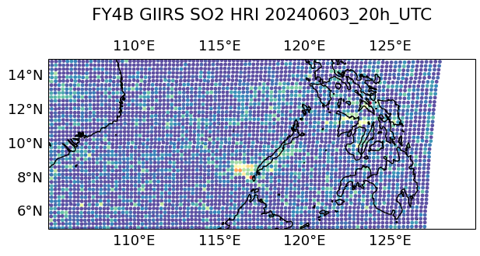
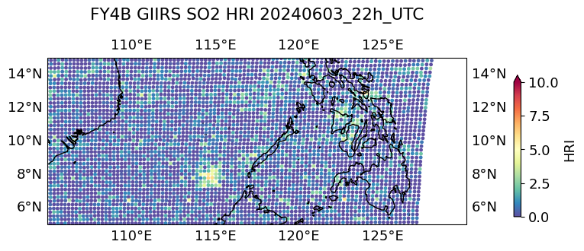
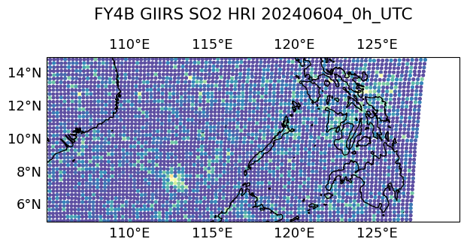
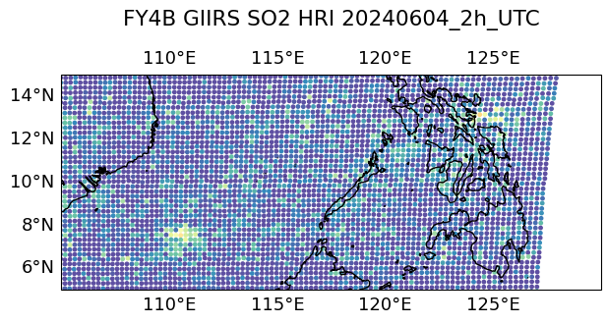
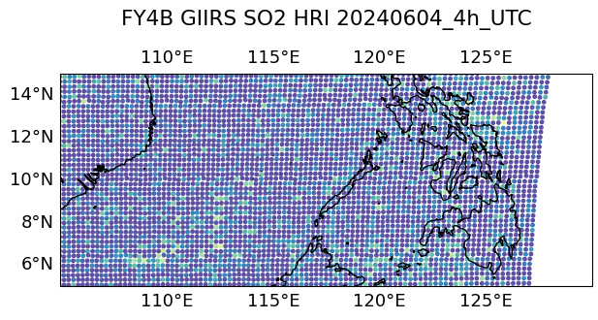
SO₂ observations from FY-4B/GIIRS (Kanlaon volcano)
Kanlaon (10.4°N, 123.1°E)
12h
14h
16h
18h
20h
22h
0h
02h
04h

Slide 10
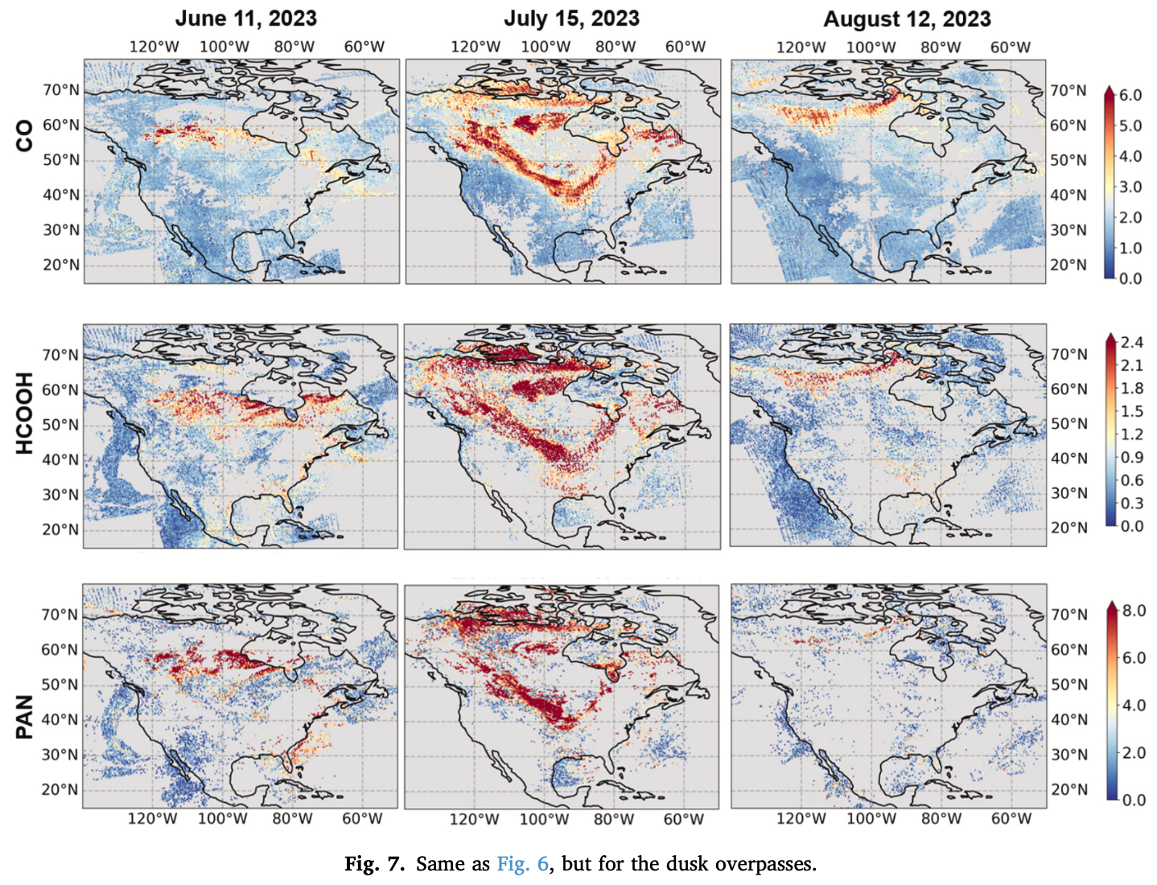
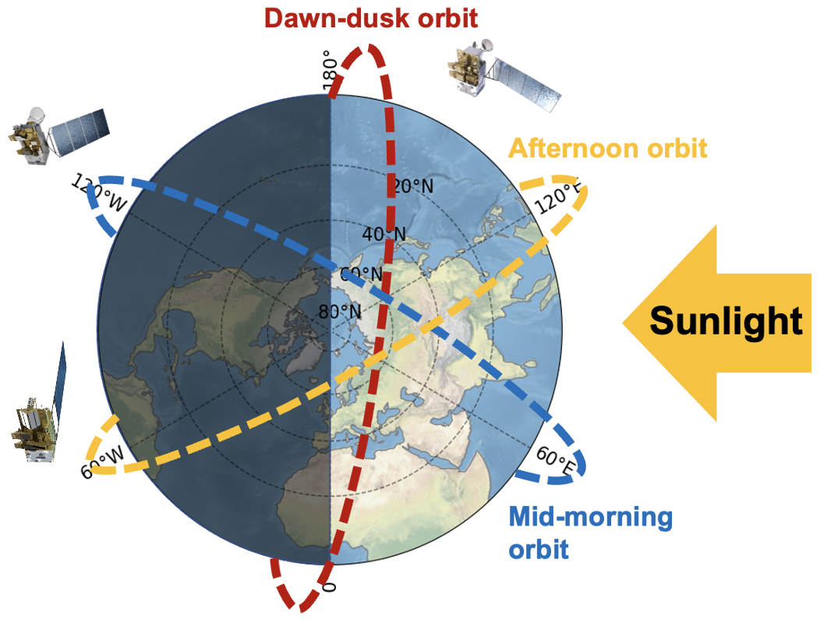
Wildfire emissions during dawn-dusk from FengYun-3E/HIRAS
Hyperspectral Infrared Atmospheric Sounder (HIRAS)
Low Earth Orbit constellation
FY-3D/HIRAS: afternoon orbit (2am/pm)
FY-3E/HIRAS-II: dawn-dusk orbit (5:30am/pm): world’s first for civil use.
FY-3F/HIRAS-II: mid-morning orbit (10am/pm)
Dawn-dusk orbit is not optimal for trace gas retrieval (TC can be low)
Hua et al., 2025, RSE

Slide 11
Conclusions
FY-4B/GIIRS provide measurements of CO, NH3, HCOOH over East Asia;
Comparison with ground-based observations or IASI (when available) shows good agreement in general;
GIIRS in IR is complementary to GEMS in UV/VIS, a synergy of the two allows the study of (NH₃+NO₂).
FY-4C/GIIRS, planned to launch in late 2025. The combination of FY-4B and FY-4C will provide better coverage and higher frequency observations.
Data availability:
The GIIRS L1 spectra are publicly available from the National Satellite Meteorological Center: http://satellite.nsmc.org.cn/portalsite/.
Early portion of CO, NH3, HCOOH, and Ozone are publicly available online, links are provided in the related papers; Full 2-year datasets are available (zczeng@pku.edu.cn). The recent data are in processing.
Acknowledgement:
National Science Foundation of China;
IASI data (https://iasi.aeris-data.fr/);
ECMWF ERA5 (https://cds.climate.copernicus.eu/);
TCCON (https://tccondata.org/);
Thank you for your attention!

