Slide 1
High Resolution AI/ML Trace Gas Products from PACE OCI
***Paper accepted by ERL
Zachary Fasnacht^{1,2}, Joanna Joiner², Eric Bucsela^{1,2}, Matthew Bandel^{1,2}
Sergey Marchenko^{1,2}, Lok Lamsal³, Can Li², Nickolay Krotkov²
¹SSAI, ²NASA GSFC, ³Dept of Interior - BOEM,

Slide 2
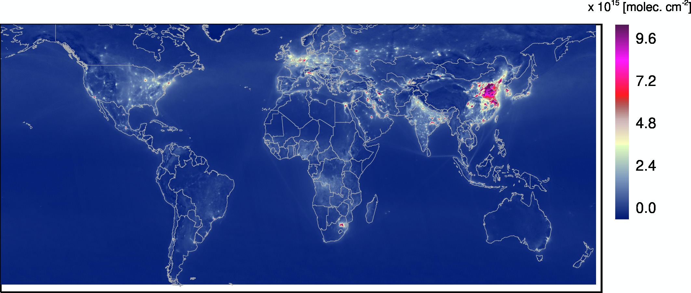
Motivation
NO₂ sources are both natural (wildfires, soil, lightning) and anthropogenic (burning of fossil fuels, biomass burning)
NO₂ has adverse health effects and contributes to the formation of aerosols and tropospheric ozone
NO₂ impacts ocean color algorithms. Errors under high loading (1x10¹⁶ mol cm⁻²) of 10-20% in water leaving radiance (Ahmad et al., 2007).
2021 annual averaged TROPOMI troposphere NO₂ column (courtesy Lok Lamsal)
Can we retrieve NO₂ accurately with PACE OCI and if so, can it provide value-added data for the atmospheric chemistry community (for downscaling emissions, etc)?

Slide 3
Heritage Trace Gas (NO₂) Instruments
Traditional trace gas satellite instruments (OMI, TROPOMI, TEMPO) have lower spatial resolution (~10x coarser) than PACE OCI, but higher spectral resolution
Previous ocean color multi-spectral instruments such as MODIS and VIIRS have spectral resolution of 20nm+, too coarse for NO₂ retrievals
 | Spatial Res. at nadir | Spectral Res. | Spectral Range | Orbit
OMI | 13x24km² | 0.42-0.63nm | 264-504nm | Polar
TROPOMI | 3.5x5.5km² | 0.25-0.55nm | 267-499nm 661-786nm 2.3-2.389um | Polar
TEMPO | 2x4.7km^{2 **} | 0.6nm | 290-490nm 540-740nm | Geo
PACE OCI | 1km² | 5nm | 315-895nm | Polar
**Spatial resolution at center of field of regard

Slide 4
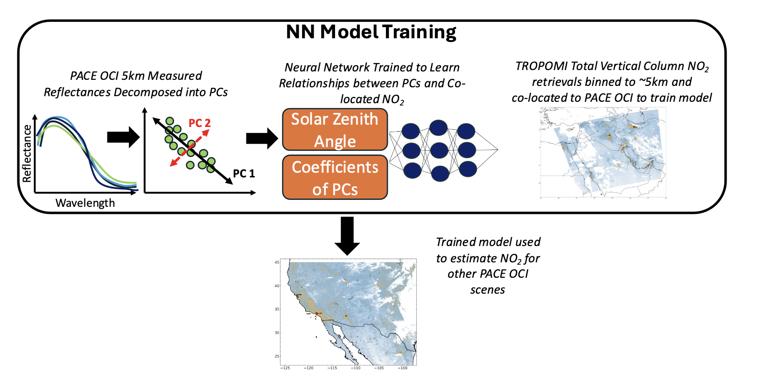
Basic approach
Approach is purely data driven with trained model only using PACE OCI measurements as input
Model trained using ~10% of TROPOMI data from random 10 days per month
Current model trained globally for land scenes, NO₂ model over water is still in development

Slide 5
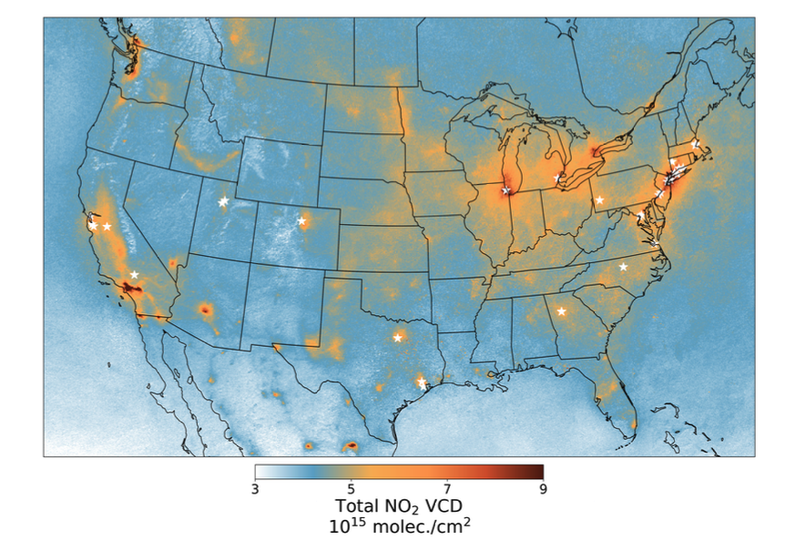
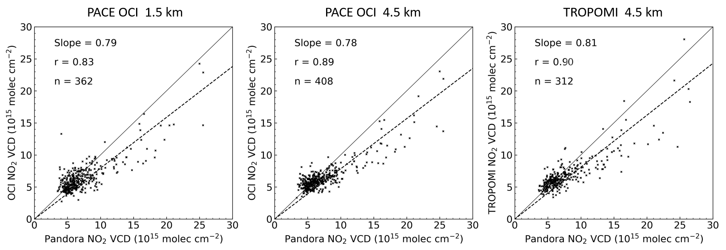
Comparison with Pandora NO₂
TROPOMI May 2024
Comparisons with Pandoras from U.S. sites (stars on TROPOMI NO₂ map to left) shows similar results as the TROPOMI comparison (ML model will only do as well as the data it’s trained on)
Provided by Eric Buscela

Slide 6
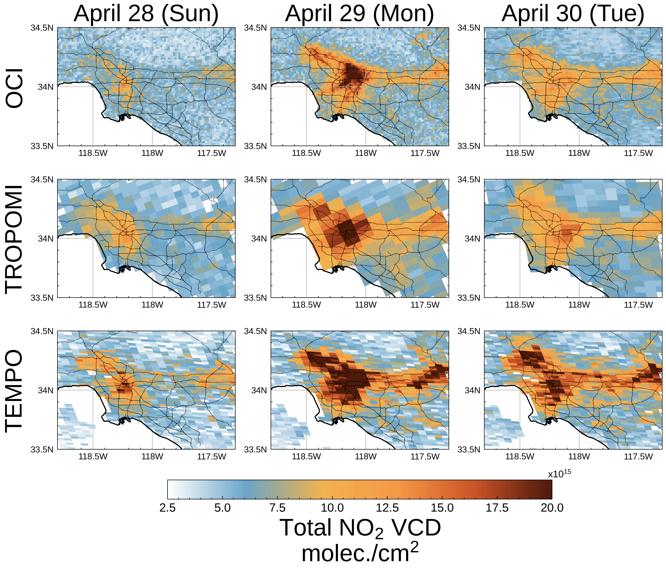
Weekend vs Weekday NO₂ in LA Metro
Air quality in LA region is heavily dominated by vehicular traffic leading to a significant weekend/weekday effect as seen in NO₂ retrievals on right
Unlike TROPOMI and TEMPO, with PACE OCI spatial resolution we can begin to see individual highways, particularly in heavy vehicular traffic such as Monday April 29

Slide 7
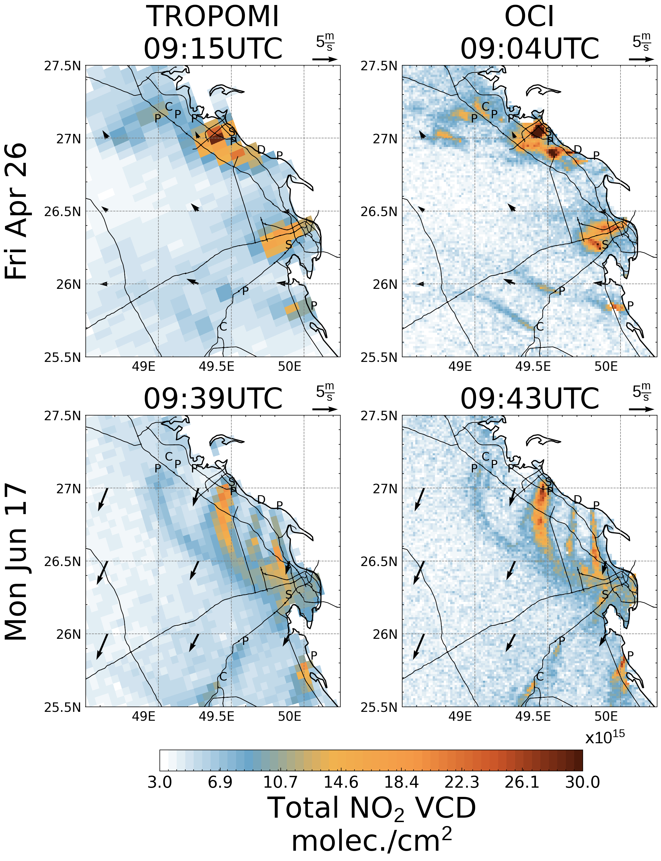
NO₂ in Eastern Saudi Arabia
NO₂ in eastern Saudia Arabia is elevated due to many power plants and manufacturing plants in the region
  P: Power Plant
  C: Cement Factory
  D: Desalination Plant
  S: Steel Factory
PACE OCI shows better defined NO₂ plumes such as to the north where there are two power plants and a cement factory (dashed circle)

Slide 8
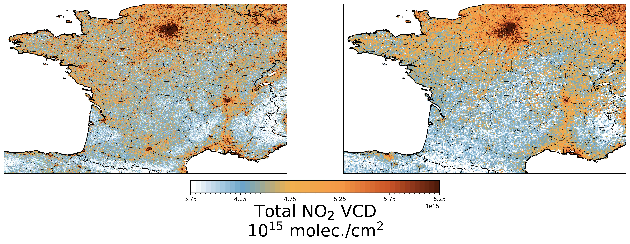
Downscaled Monthly NO₂ in France
September 2024
PACE OCI 0.5km Resolution
TROPOMI 1km Resolution
Caen
Caen
Paris
Paris
Rennes
Rennes
Nantes
Nantes
Lyon
Lyon
Bordeaux
Massif Central
Alps
Bordeaux
Massif Central
Alps
Toulouse
Toulouse
Pyrenees Mountains
Pyrenees Mountains
Monthly NO₂ from PACE OCI provides much finer detail of smaller cities, highways, and terrain

Slide 9
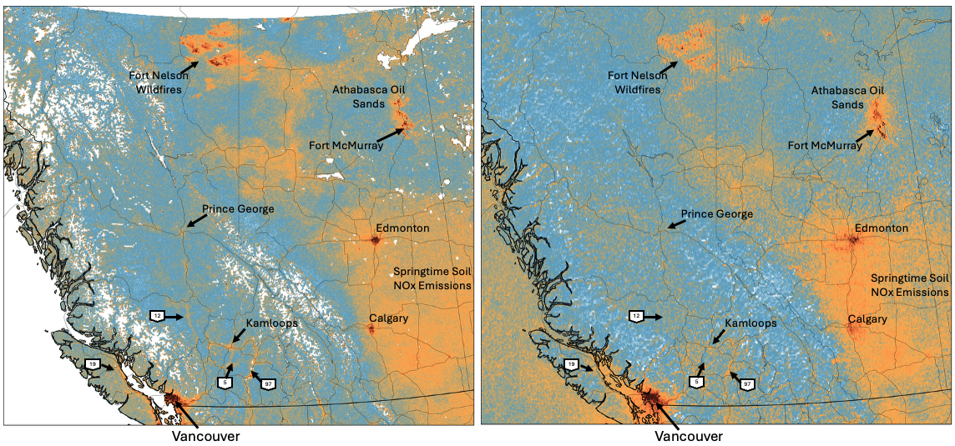
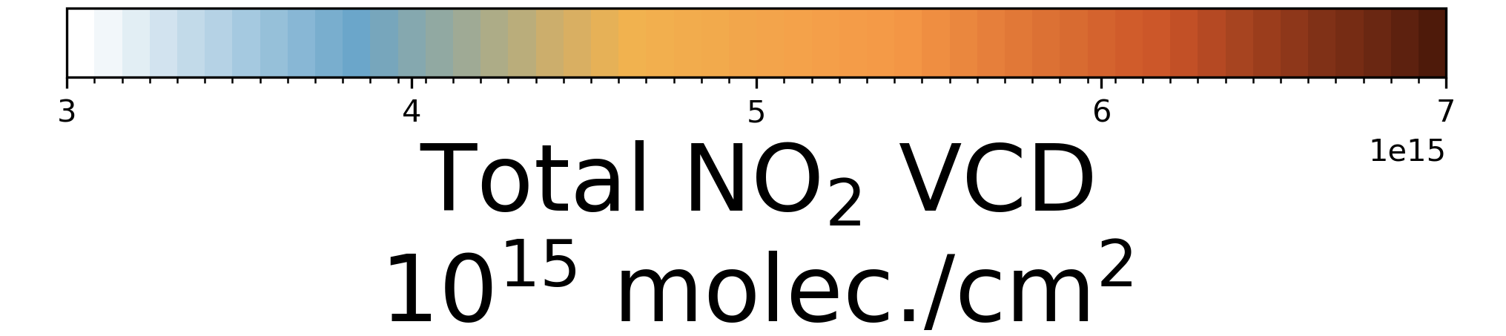
Downscaled Monthly NO₂ in Canada
May 2024
PACE OCI 1km Resolution
TROPOMI 5km Resolution

Slide 10
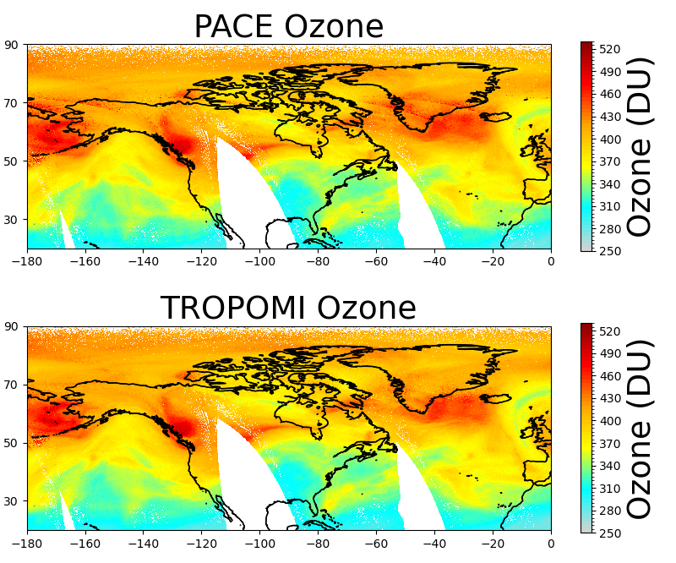
Applying Approach to Retrieve Ozone from PACE
May 21, 2024
Similar PCA+NN approach applied to retrieve ozone from PACE OCI, utilizing ozone retrievals from TROPOMI as truth
OCI also provides the opportunity to retrieve ozone with coverage down to 315nm
Calibration of OCI below 340nm is more uncertain, but ozone results suggest there is useful information in these shorter OCI wavelengths
Potential for improved tropospheric ozone at 1-2km resolution?

Slide 11
Potential Applications and Future Work
Applications
Improved spatially resolved emissions estimates
Better resolved exposure estimates
Improved ocean color retrievals
Improved chemistry-transport modeling
Spatial downscaling of TEMPO hourly measurements (complementary)
Future Work
Expanding approach to include water scenes
More validation with aircraft as well as ground-based
Develop approach for tropospheric NO₂

