Slide 1

Hyper Local Air Quality Monitoring Using TEMPO
Shobha Kondragunta
GeoXO ACX Product Lead
Zigang Wei (Science and Technology Corporation at NOAA)
Acknowledgements：TEMPO V3 L1B data from NASA
Disclaimer: The scientific results and conclusions, as well as any views or opinions expressed
herein, are those of the author(s) and do not necessarily reflect those of NOAA or
the Department of Commerce.

Slide 2

Species Specific Pollution Exposure
With GEMS and TEMPO in orbit, we are able to monitor NO₂ and AOD/PM_{2.5} simultaneously on an hourly time scale
  Critical for exposure and cumulative health impact studies
  Critical to understand sectoral emissions
    High AOD and high NO₂ - fires
    High AOD and low NO₂ – dust or transported smoke
    Low AOD and high NO₂ – transportation sector in urban areas, lightning, soil
    Low AOD and low NO₂ – rural areas
For 21% improvement in particulate pollution, 6 million cars have to transition from gasoline to electricity

Slide 3
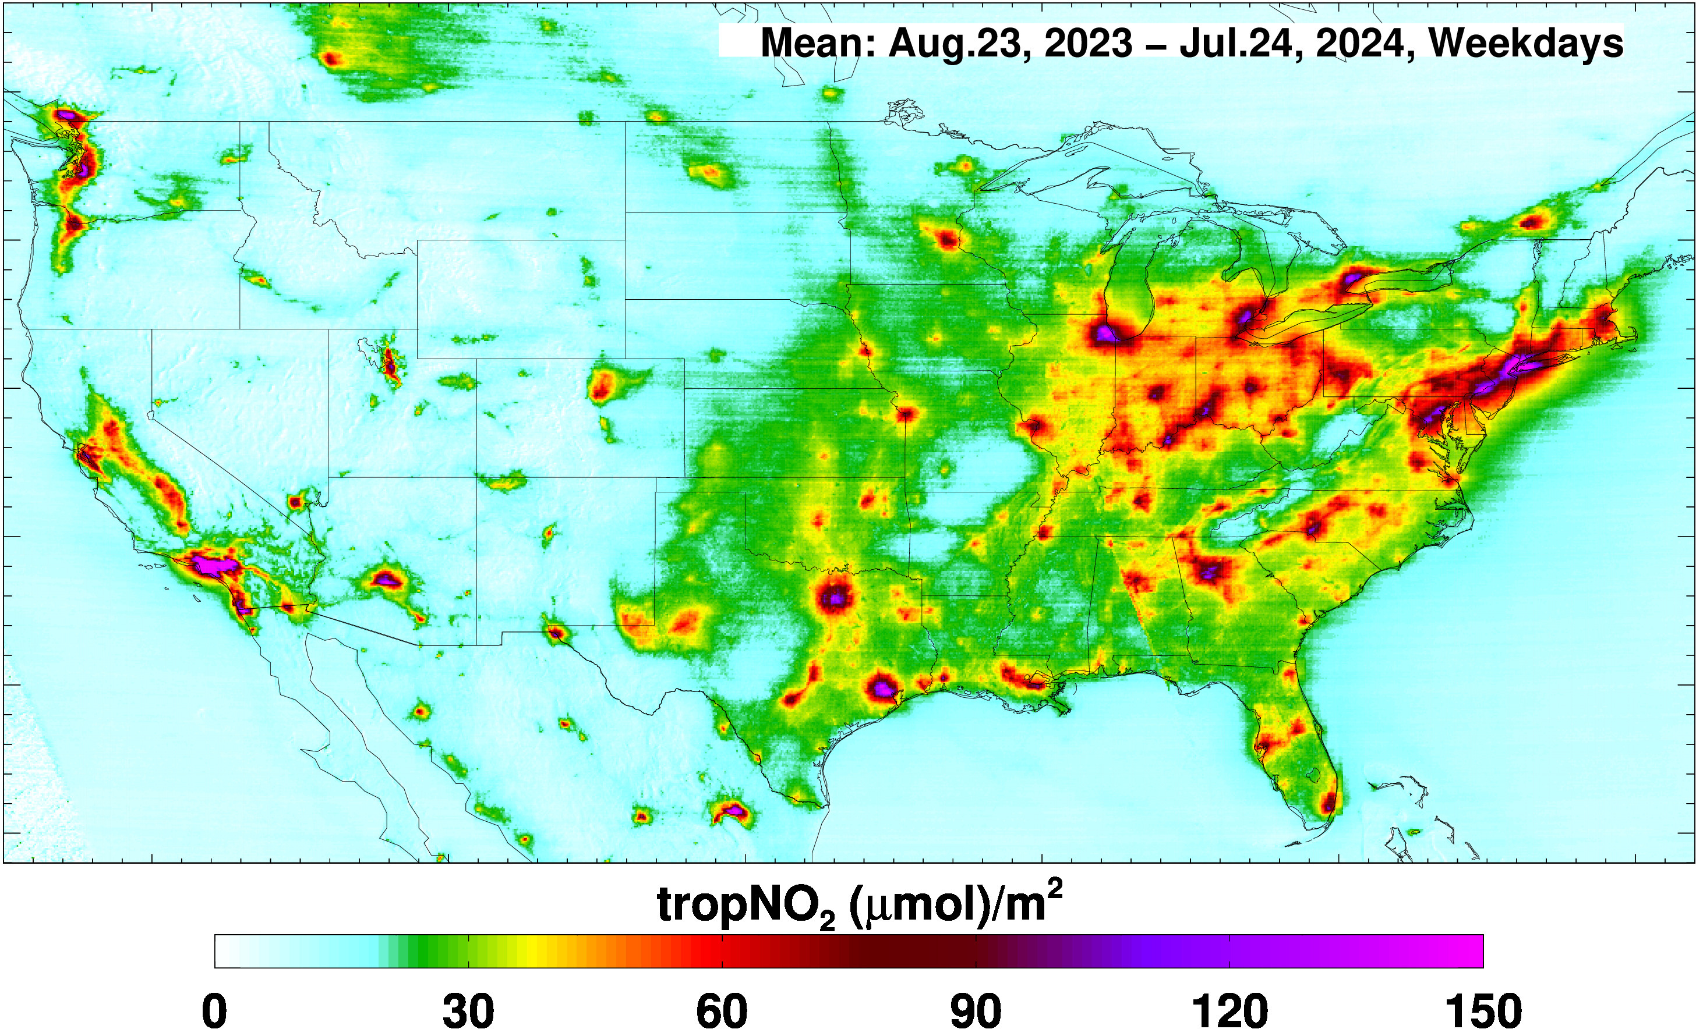

Slide 4
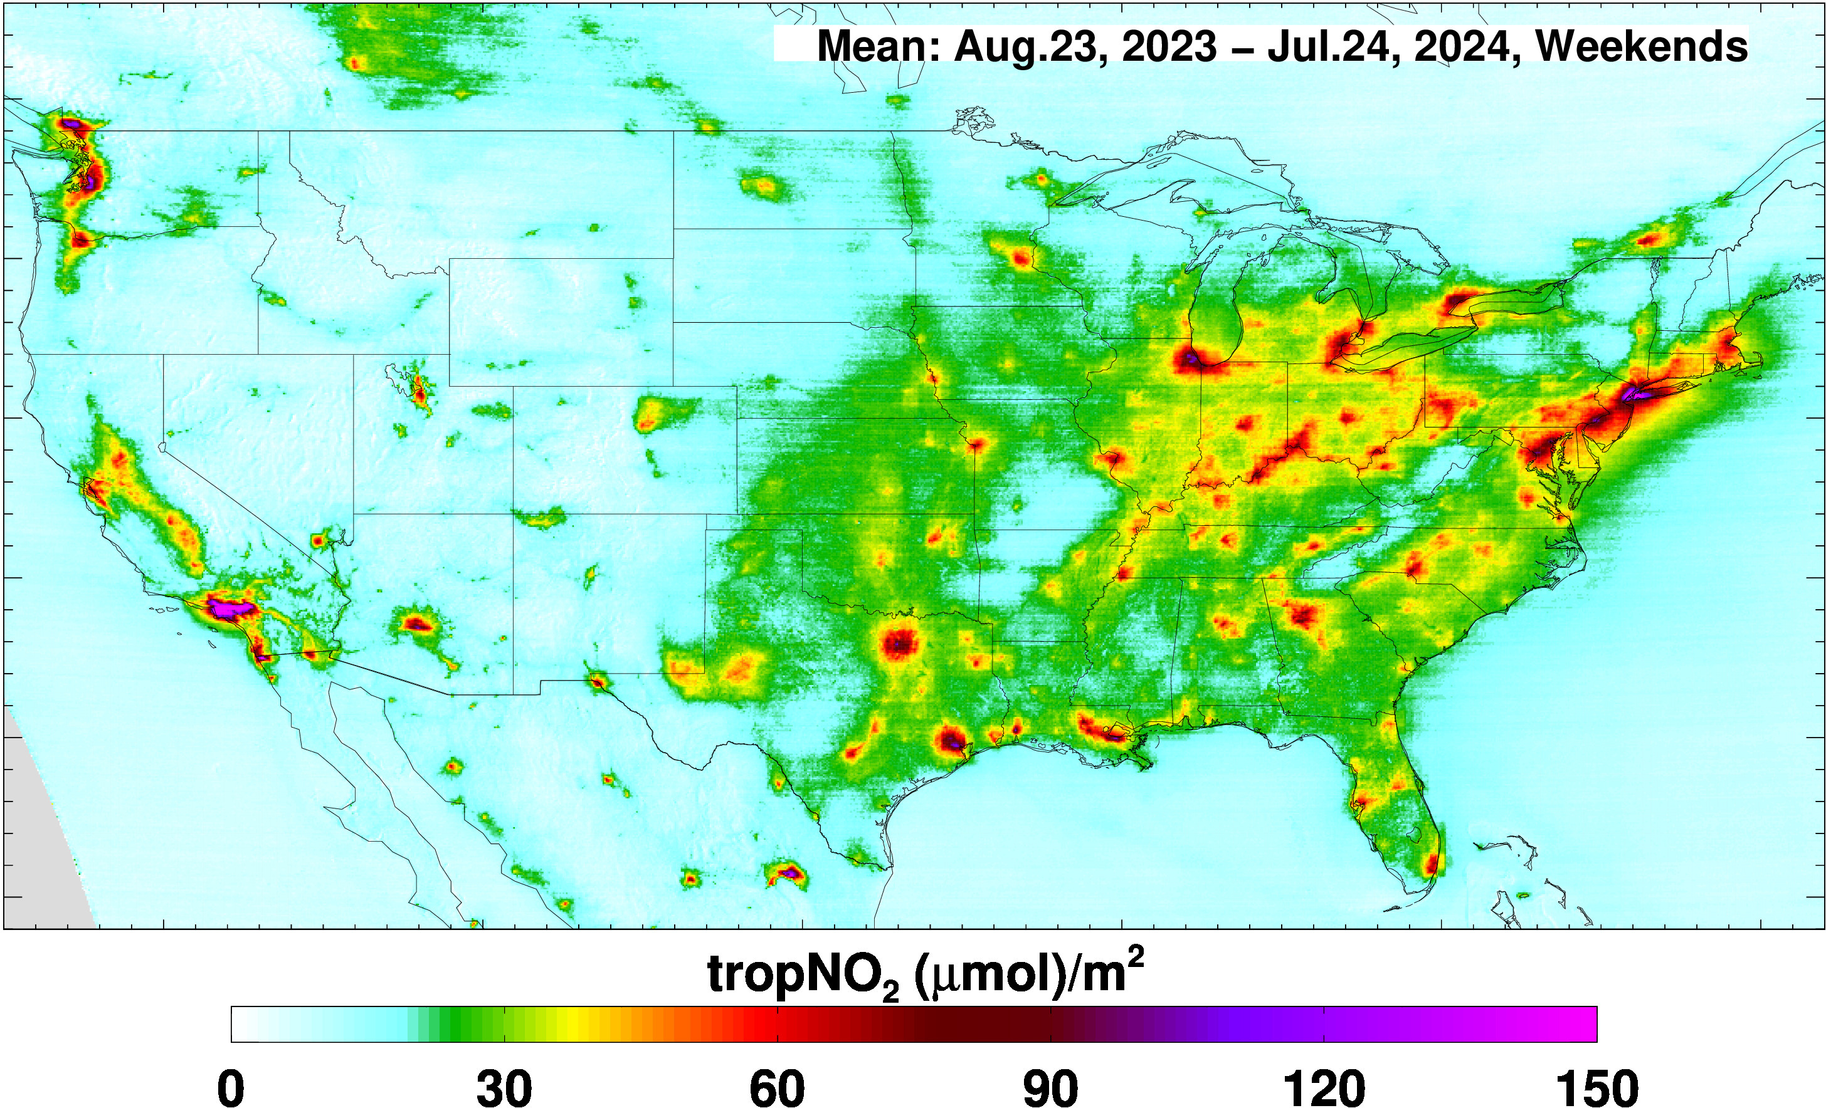

Slide 5
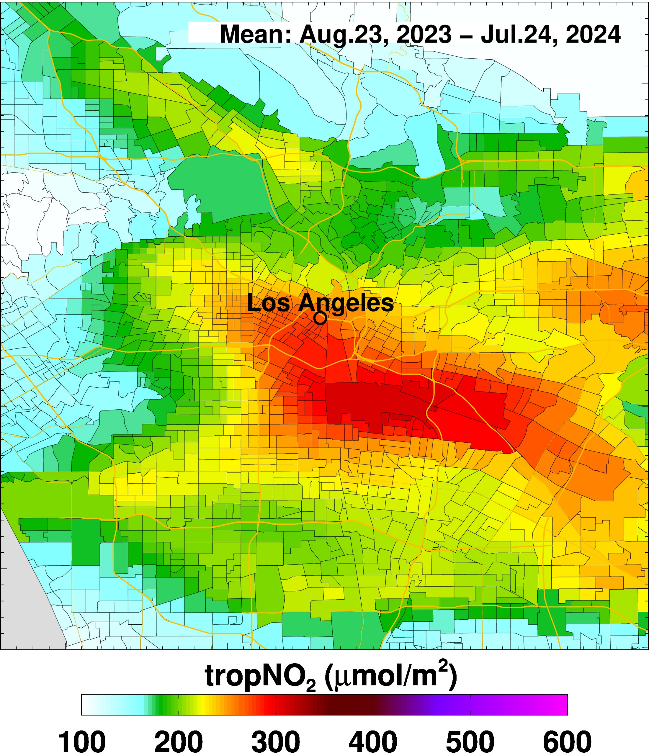
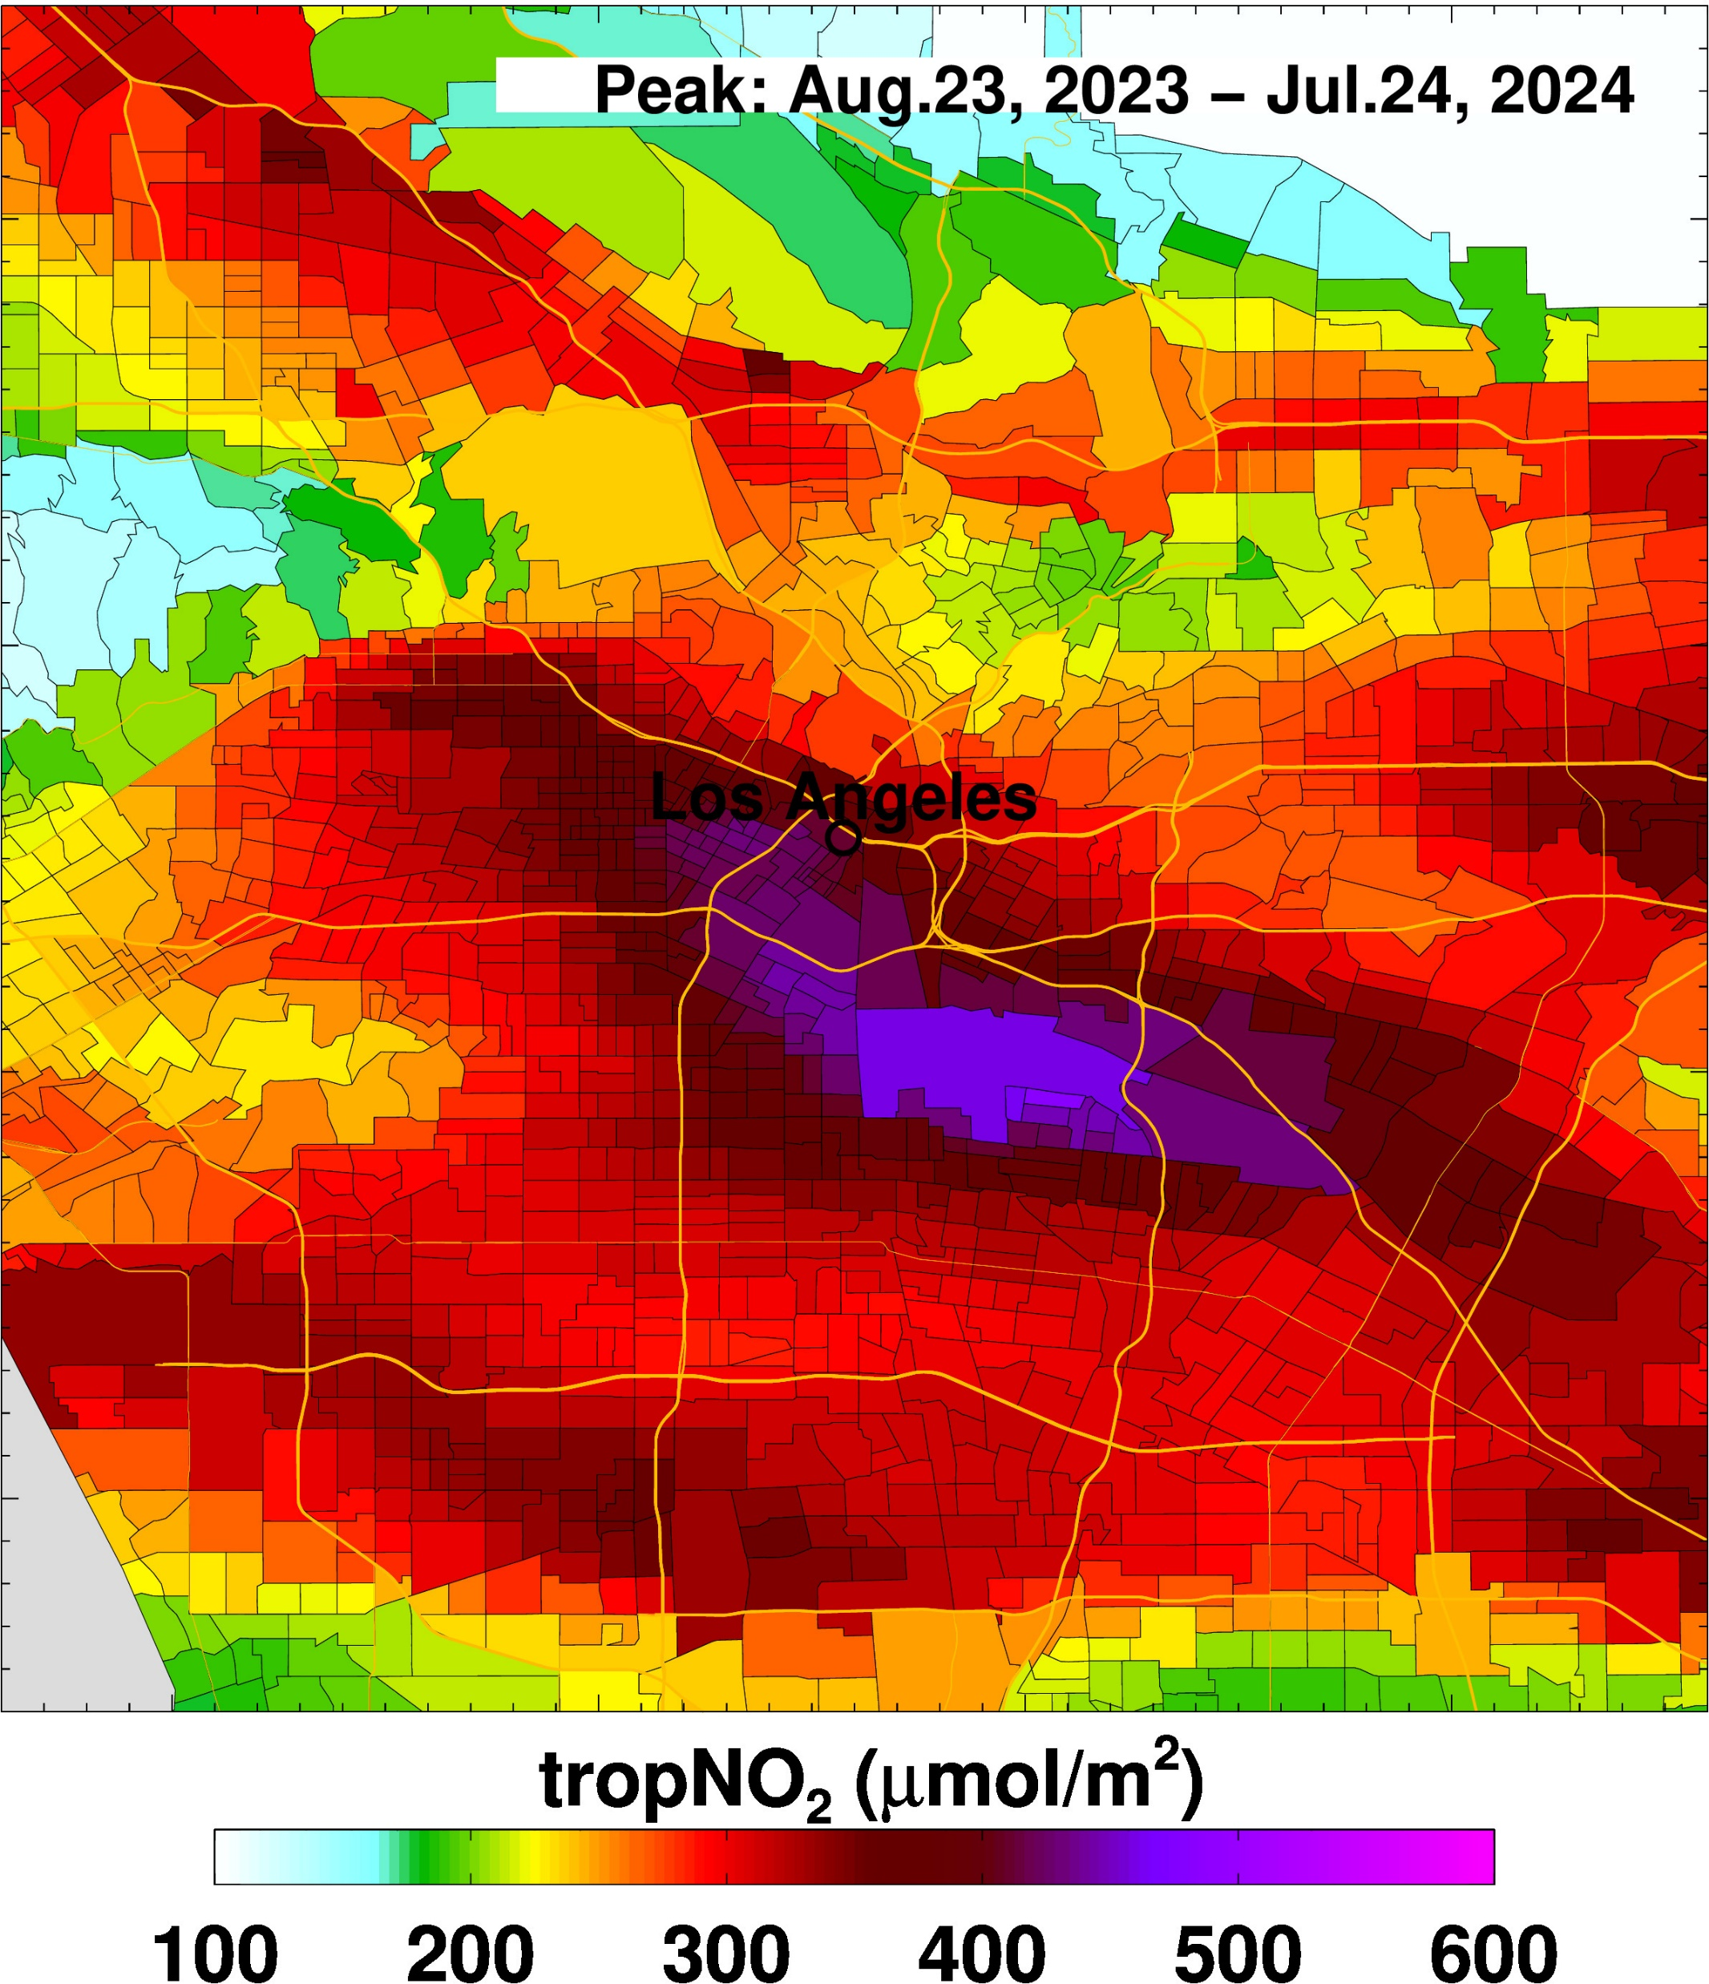
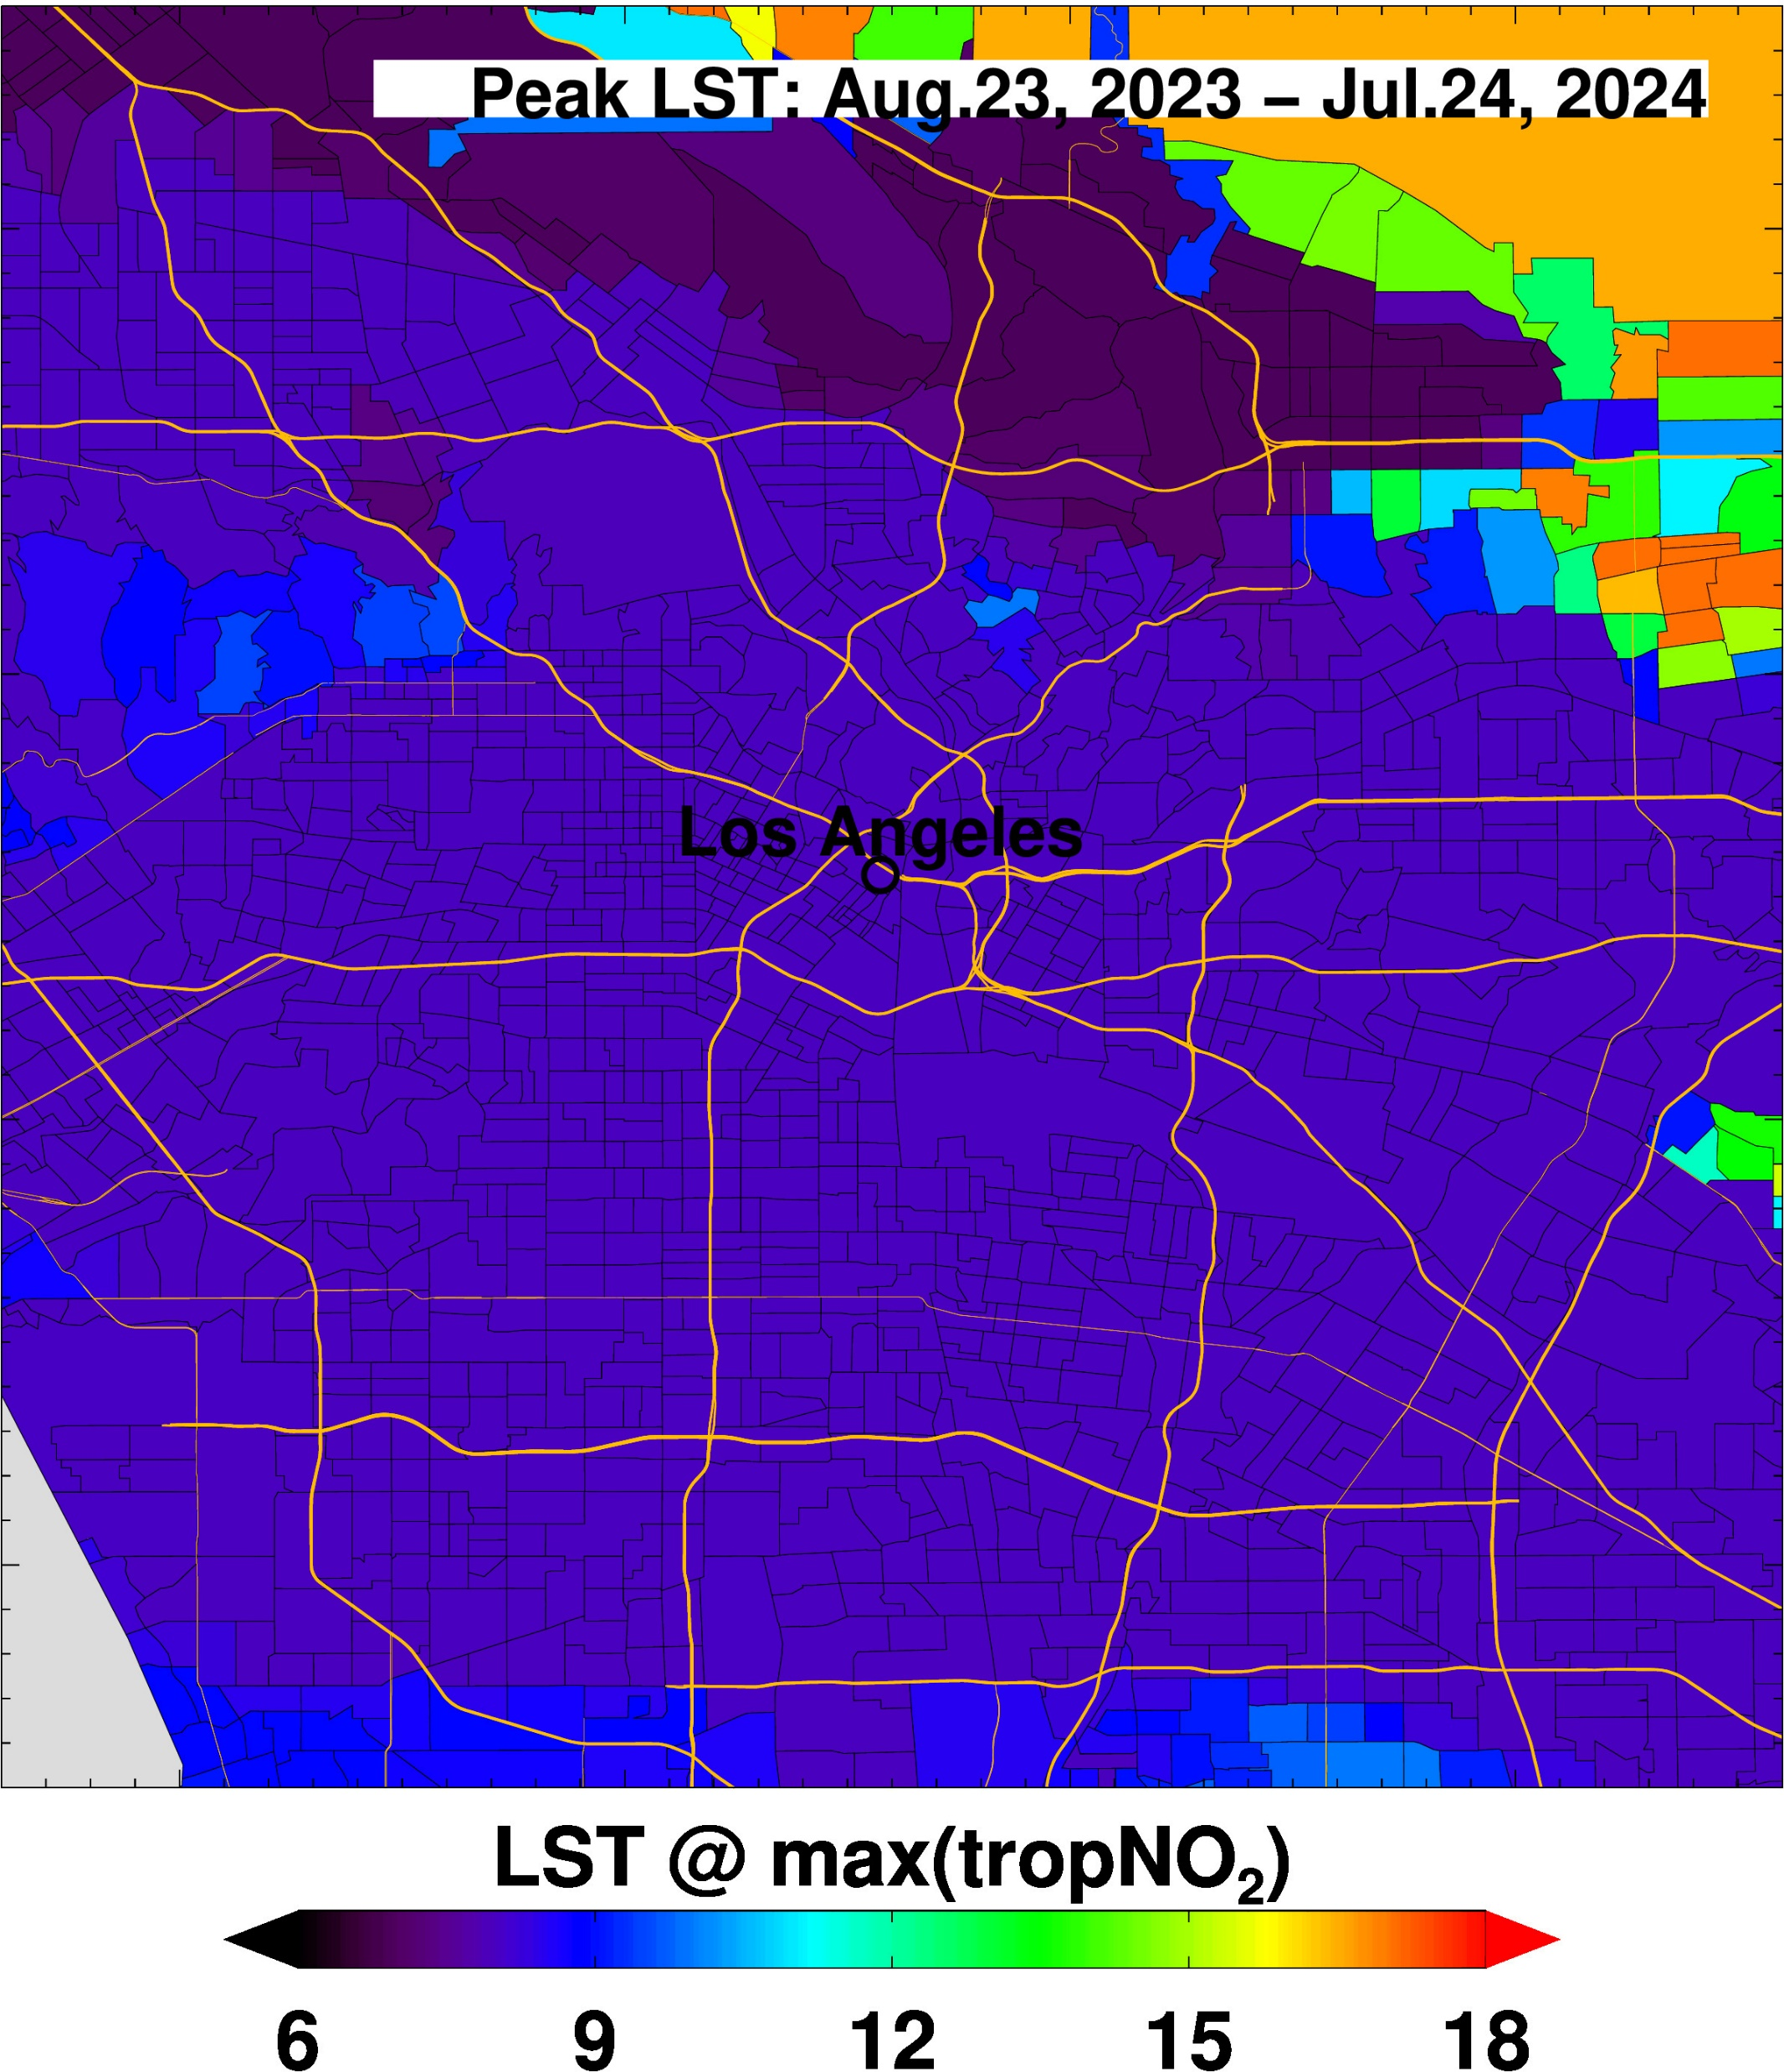
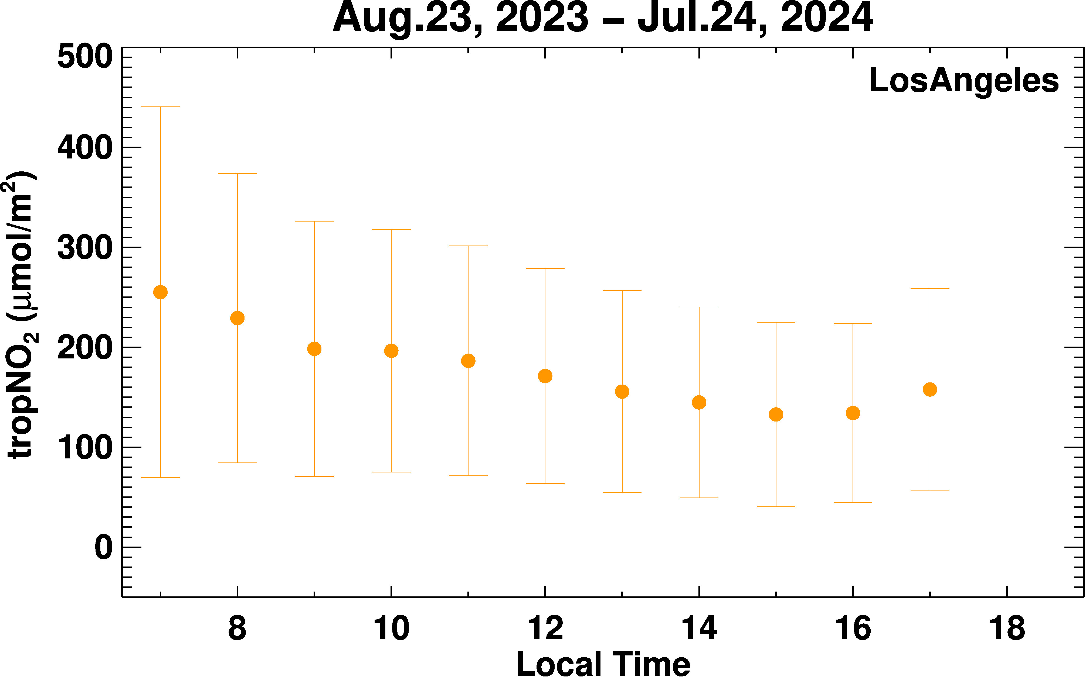
Annual Pollution Exposure: NO₂ for Los Angeles

Slide 6
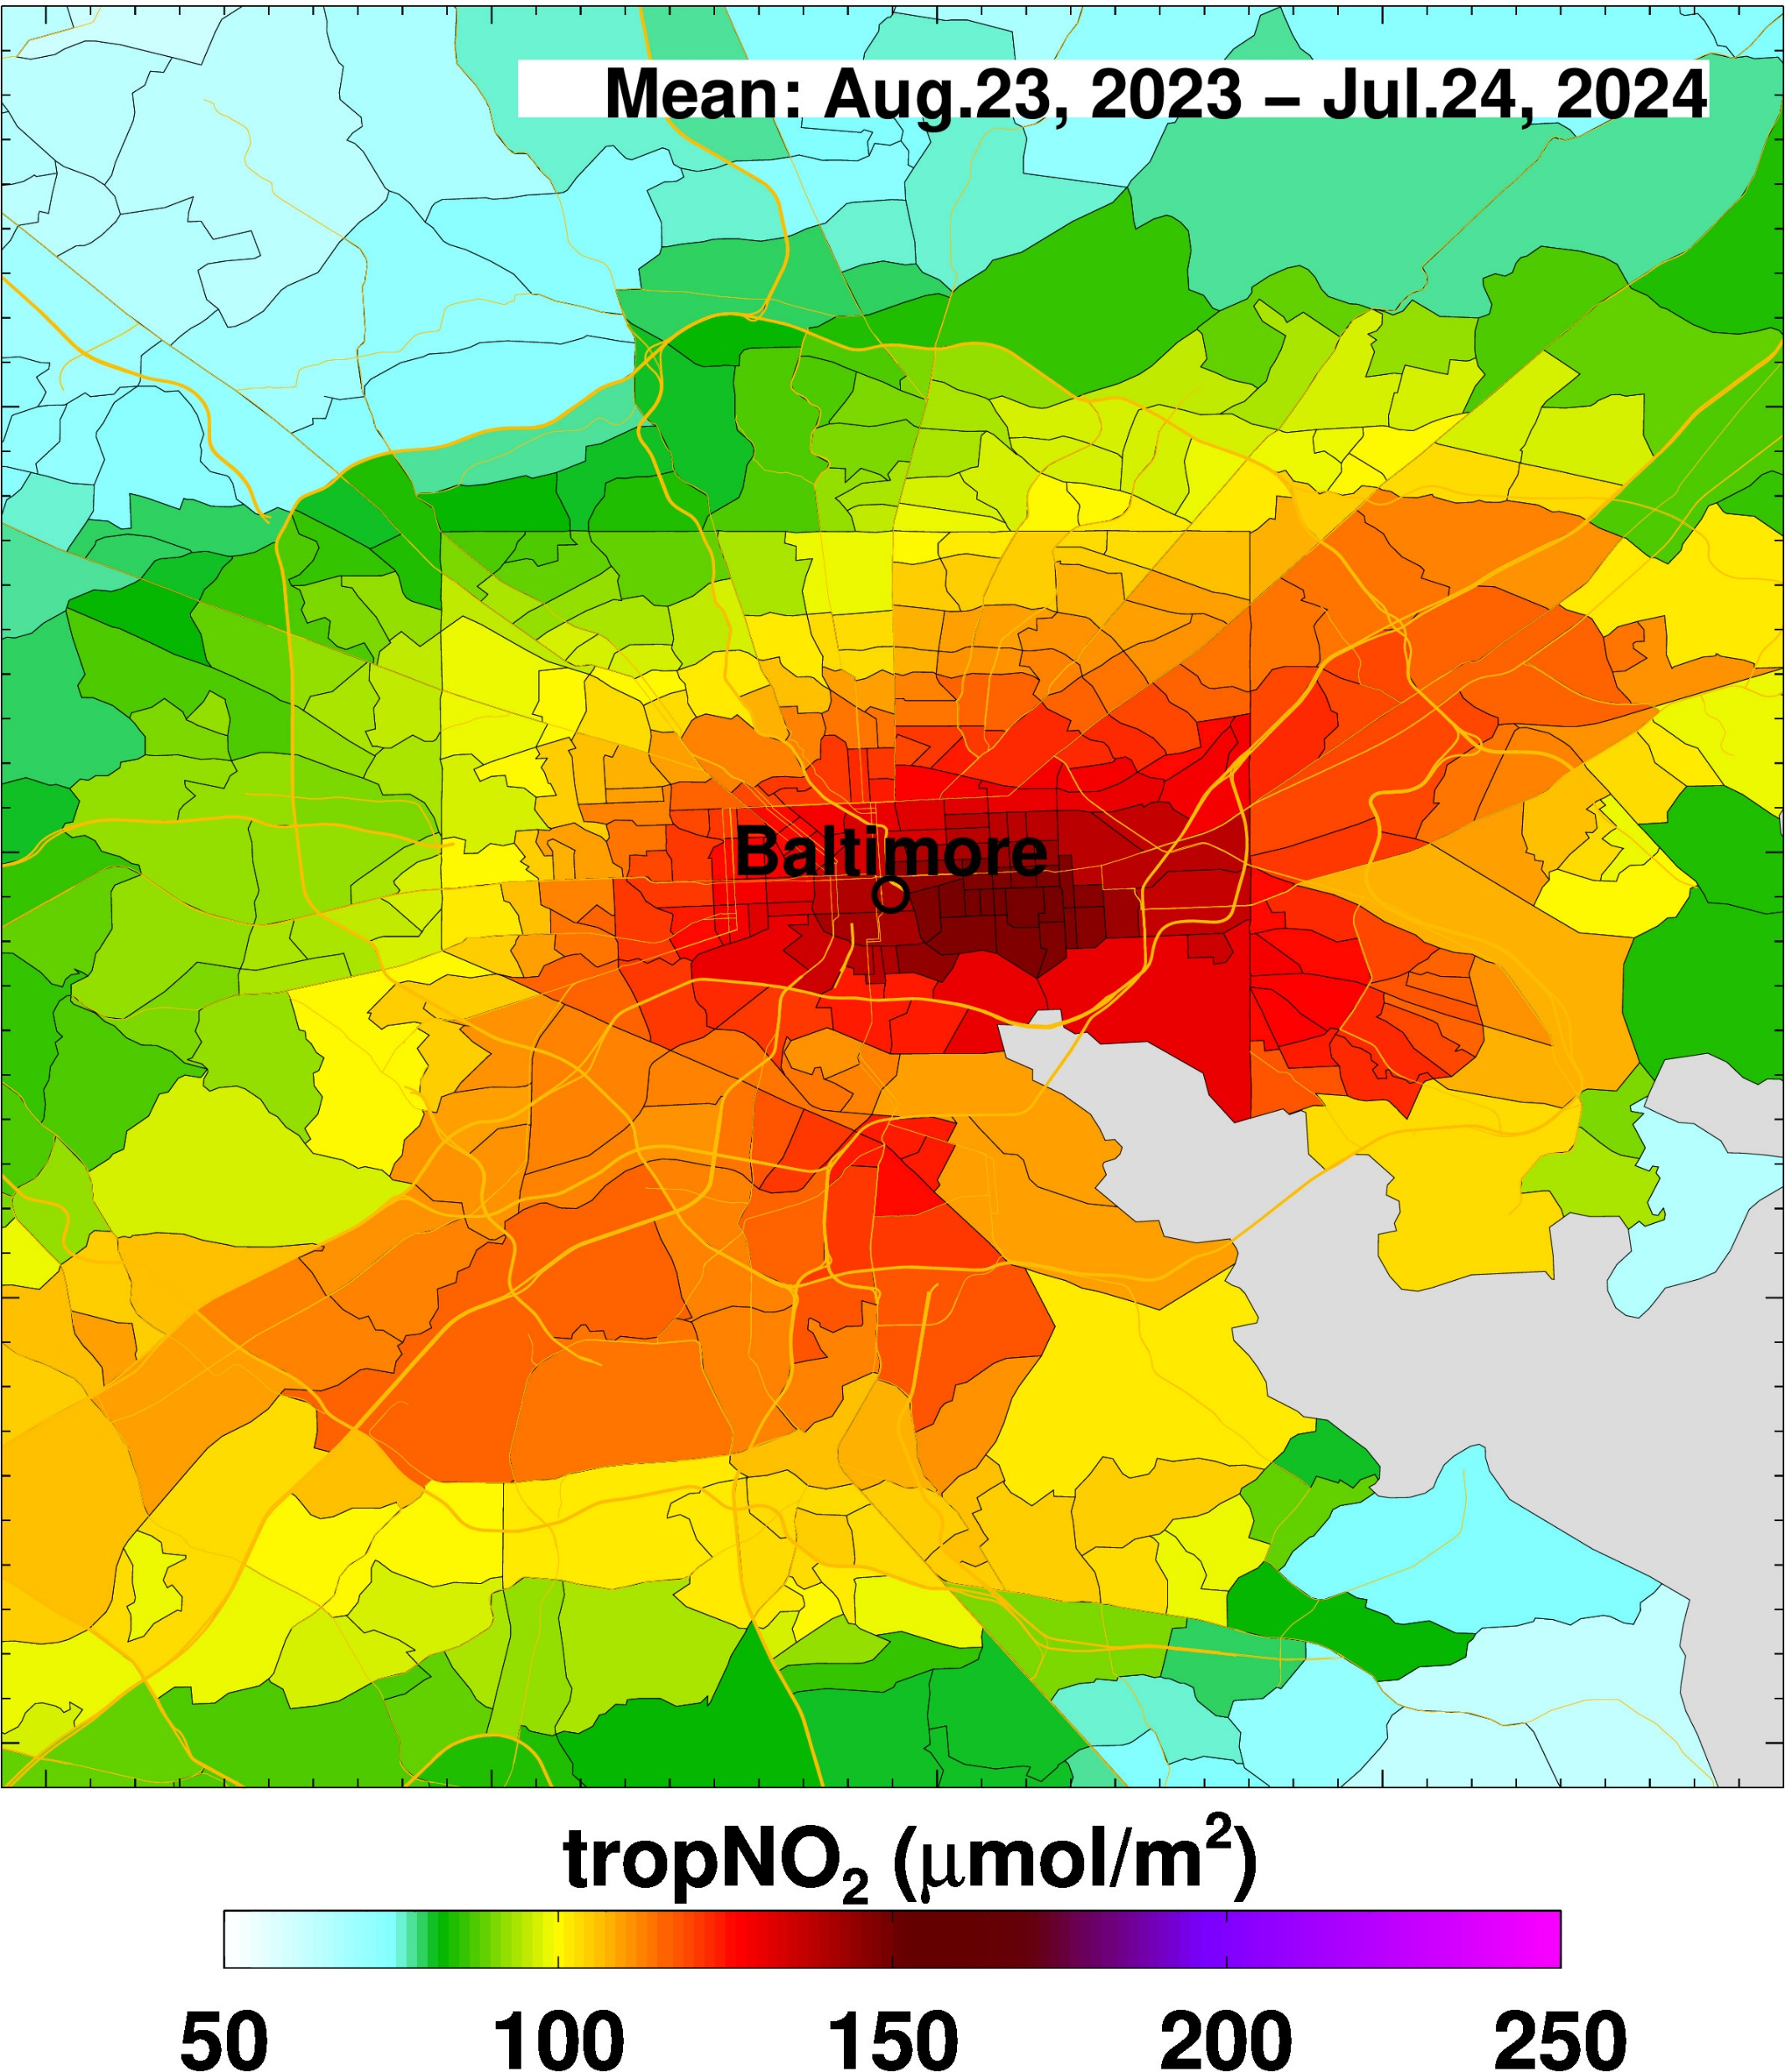
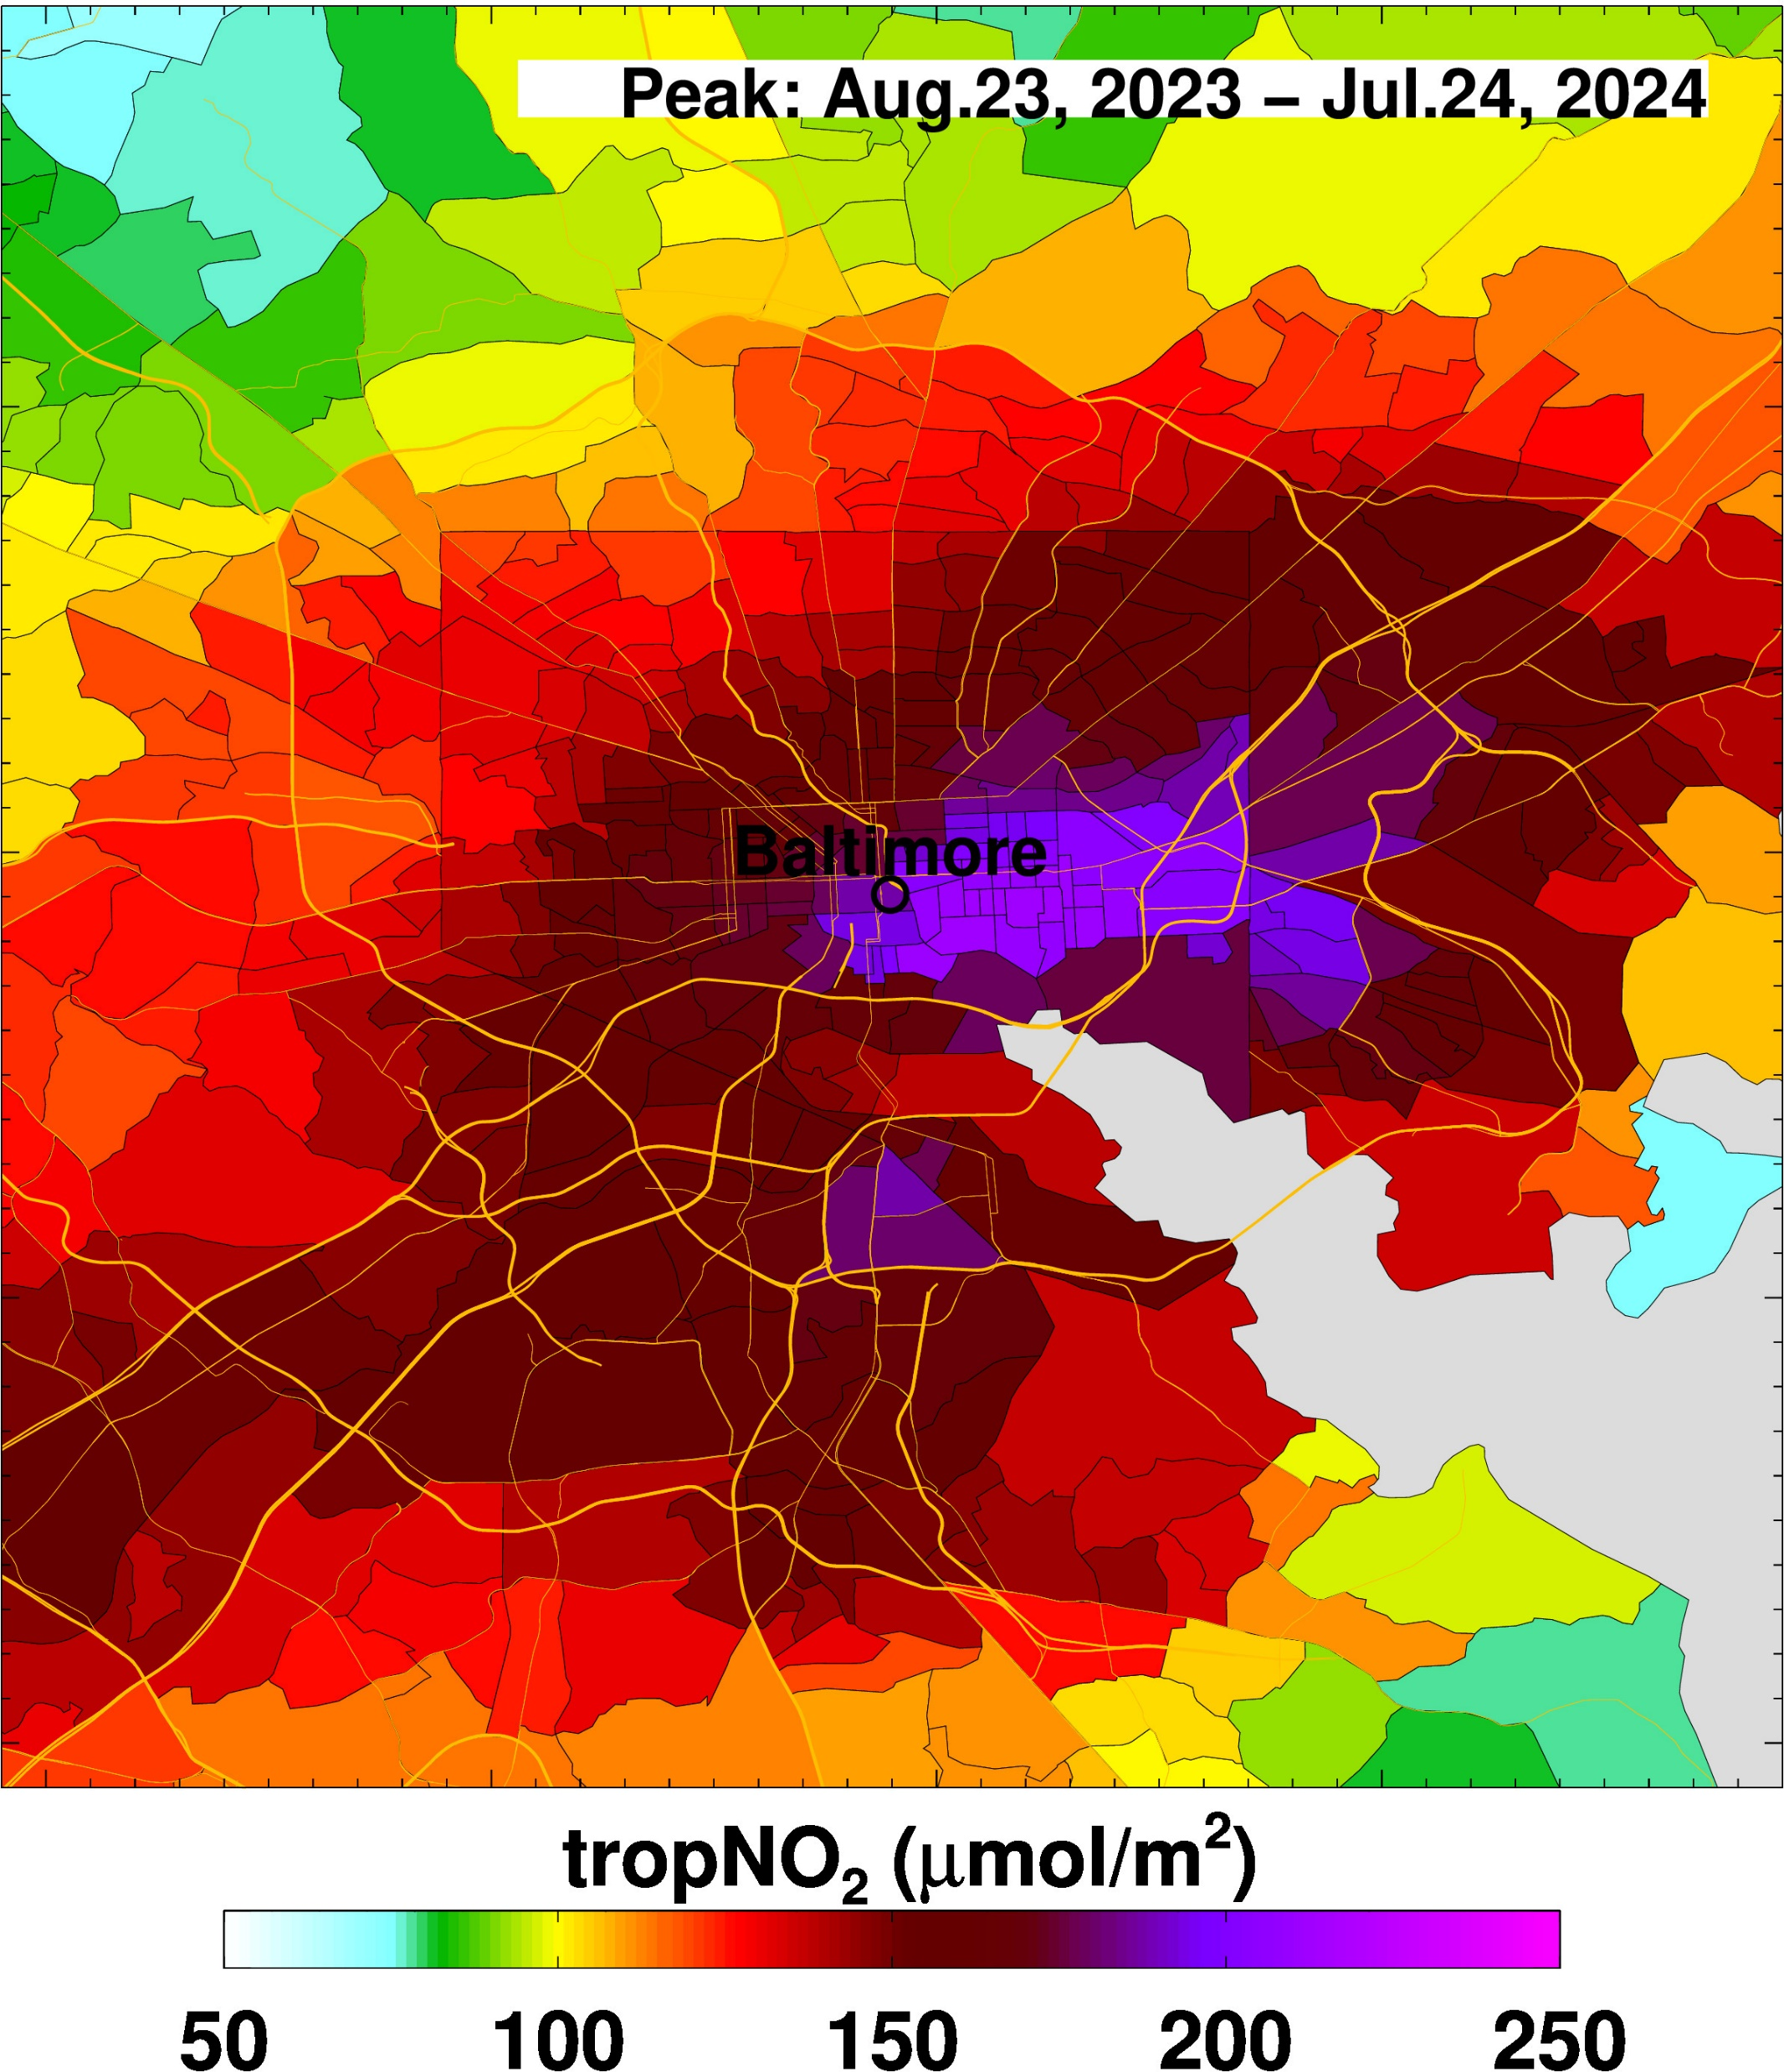
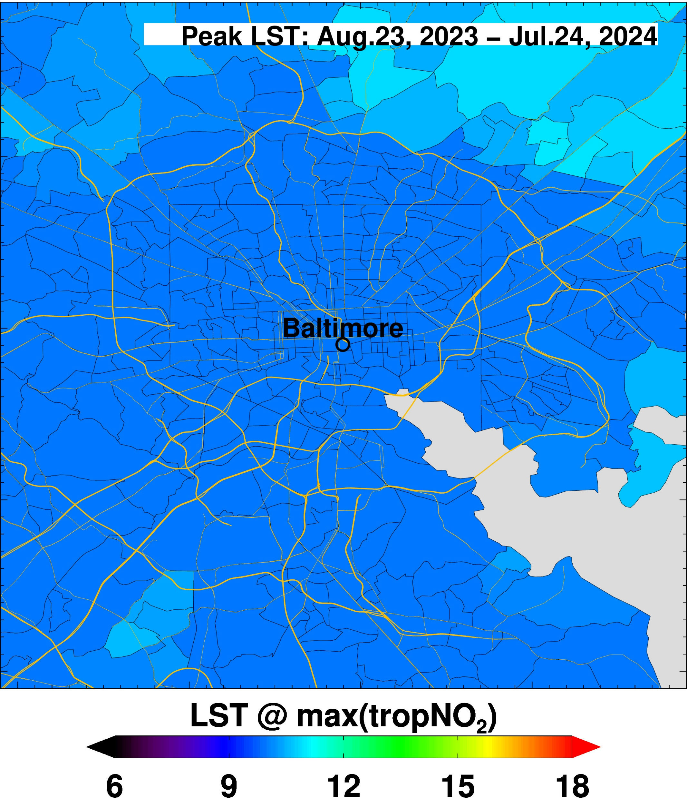
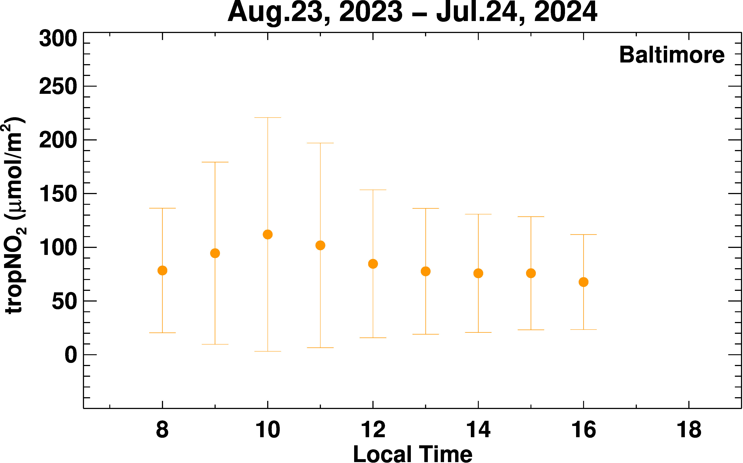
Annual Pollution Exposure: NO₂ for Baltimore

Slide 7
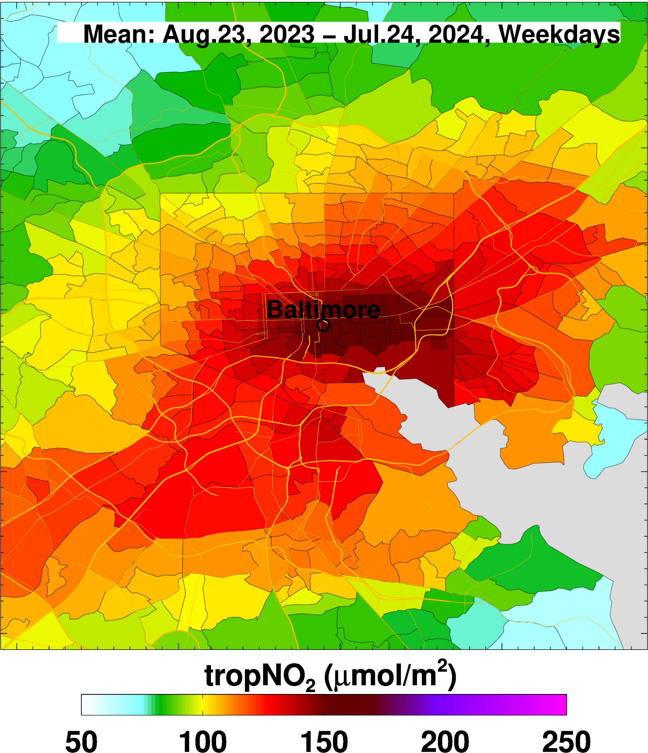
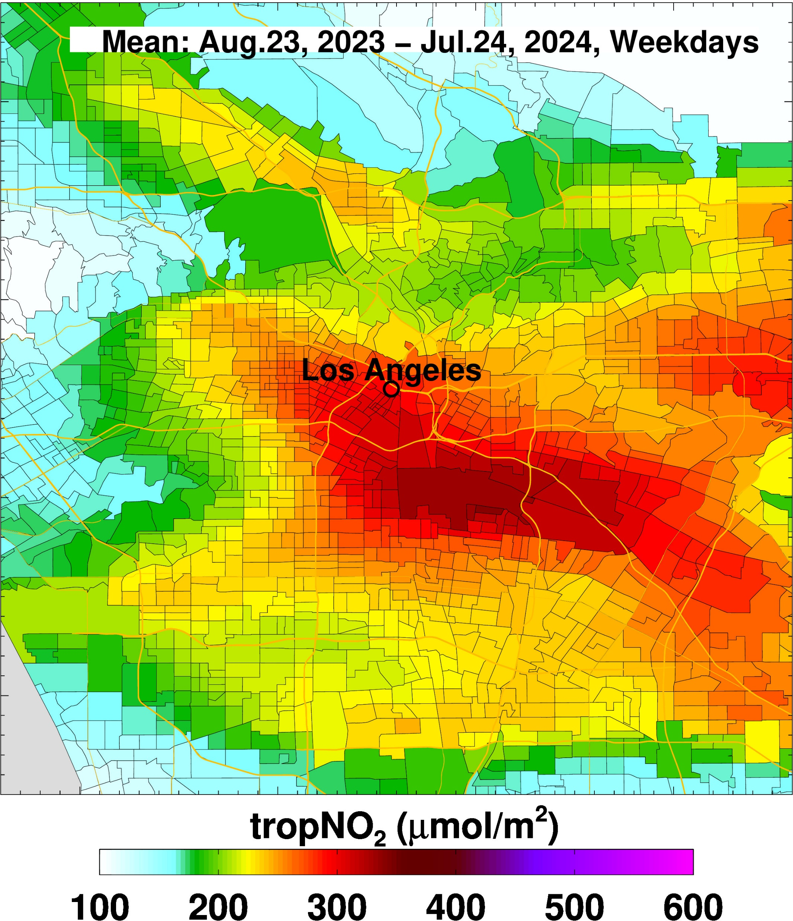
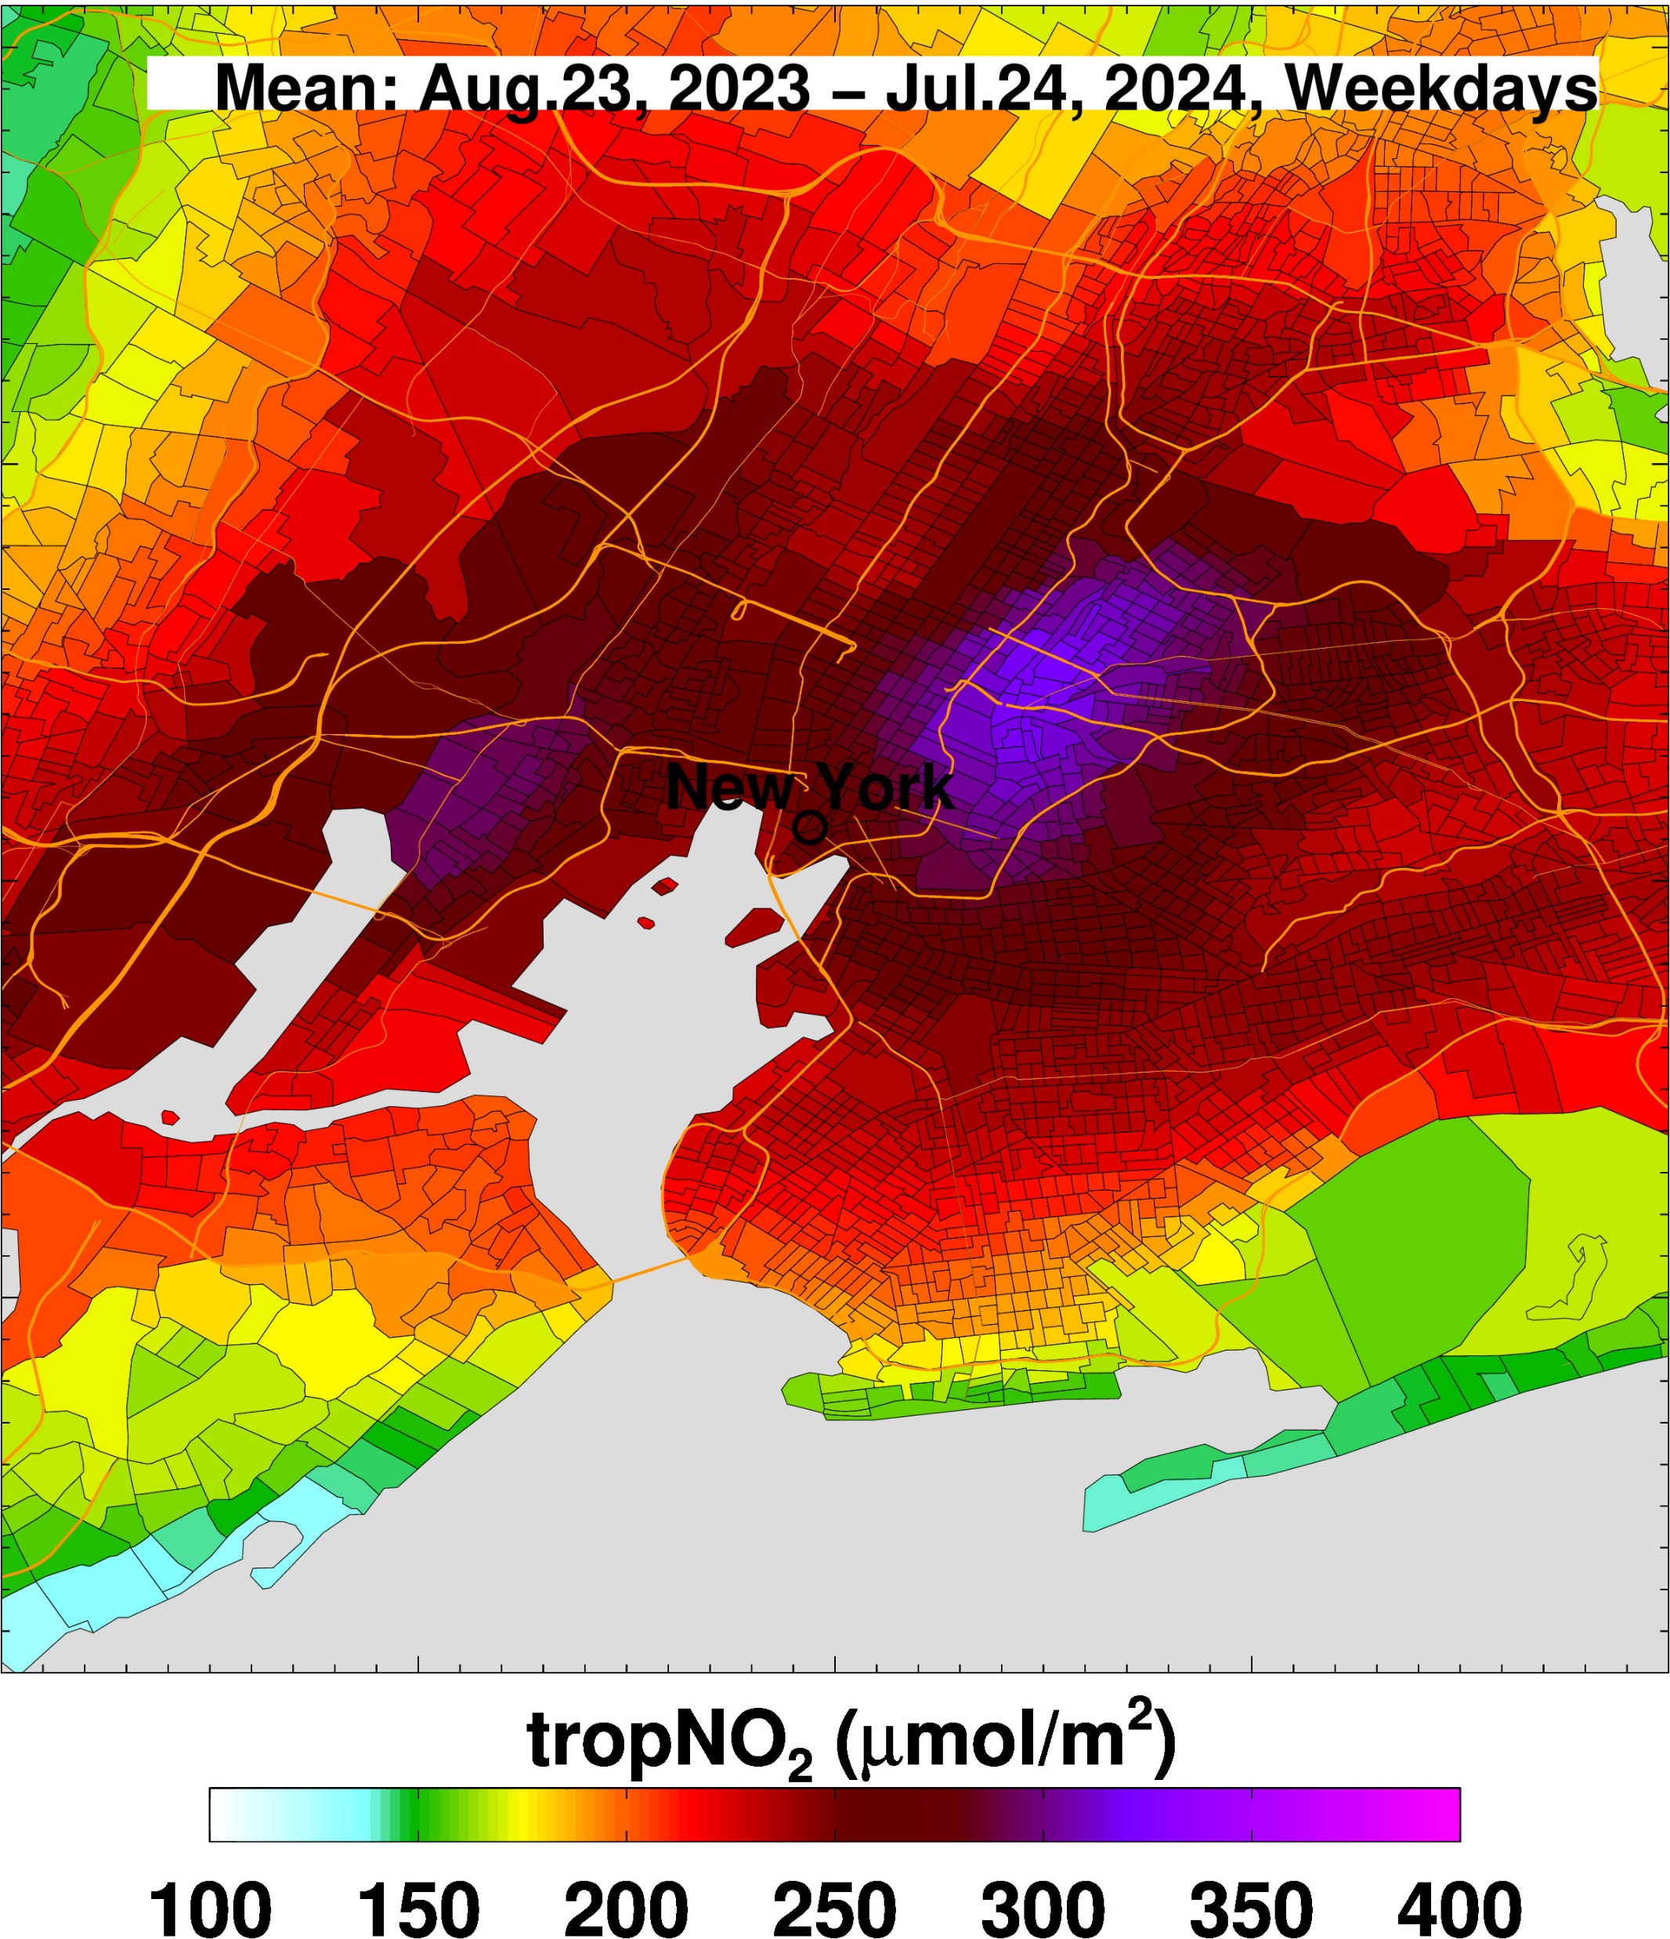
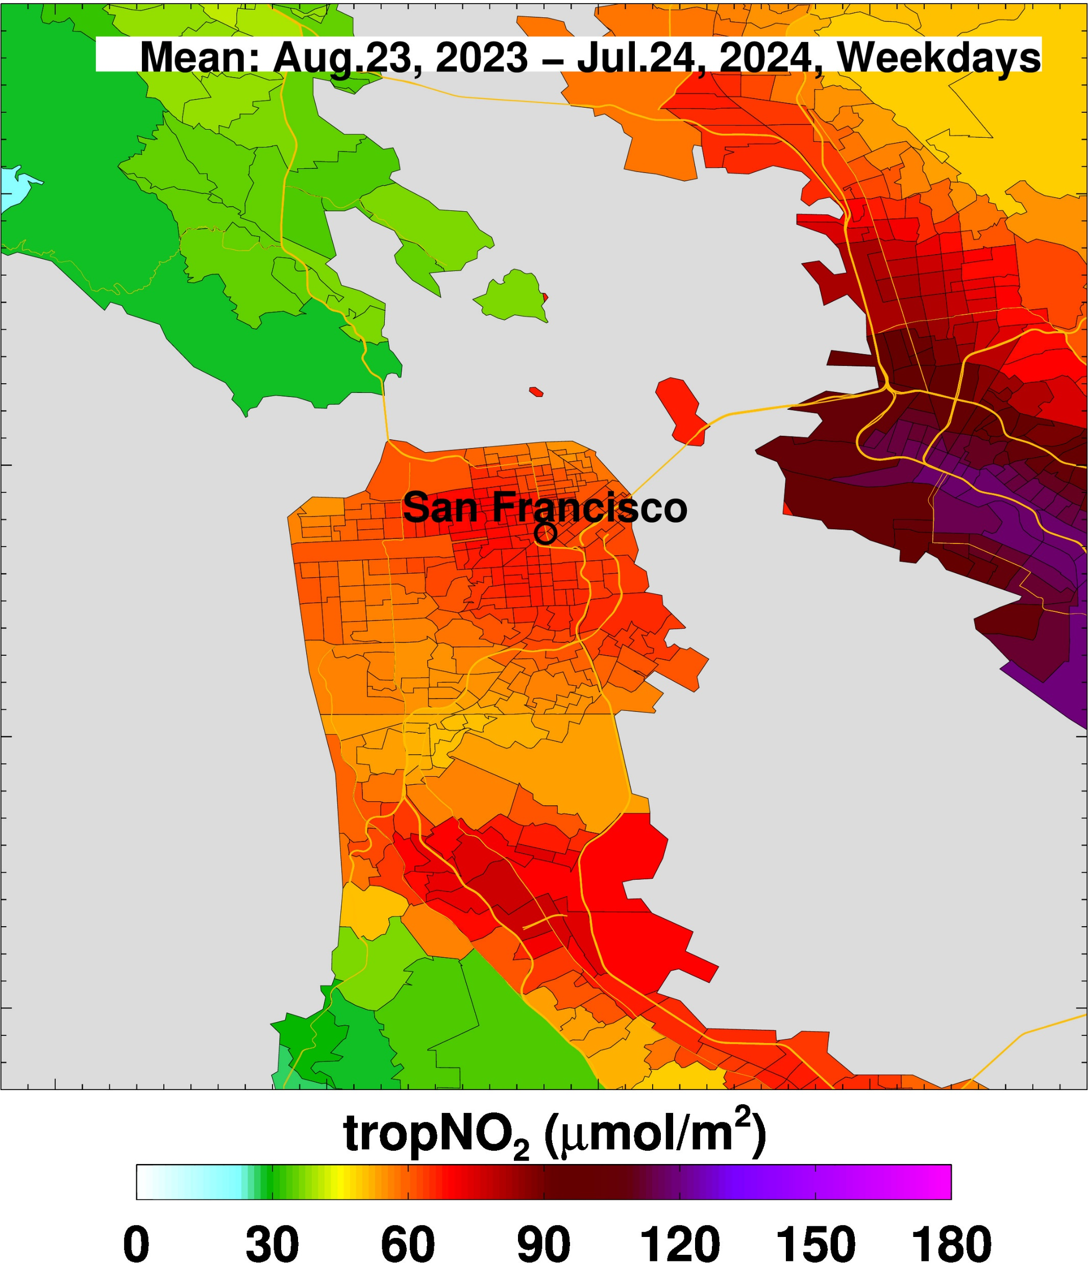
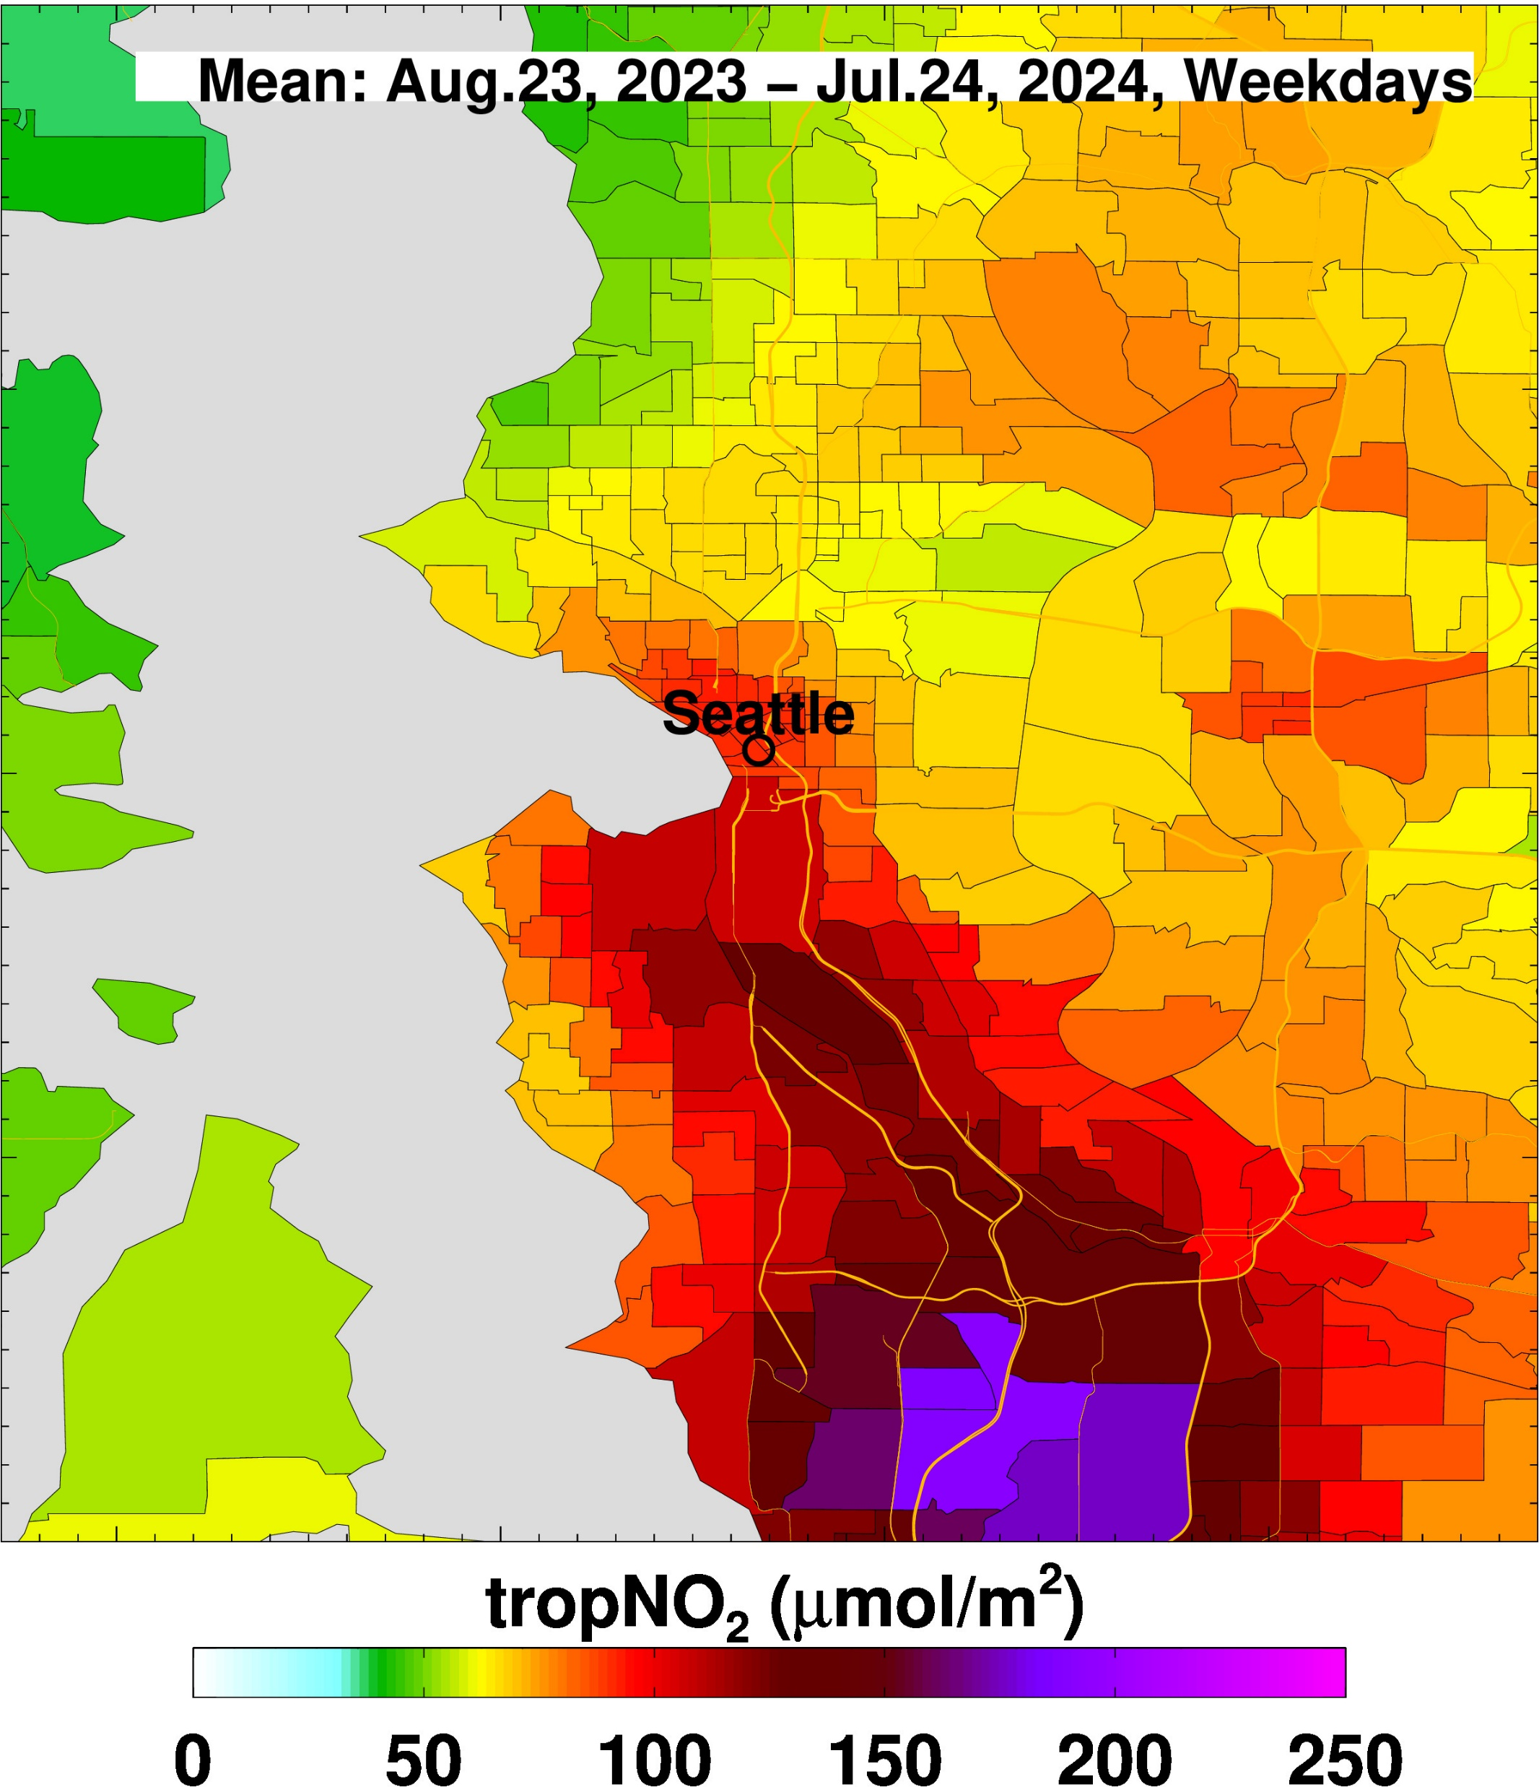
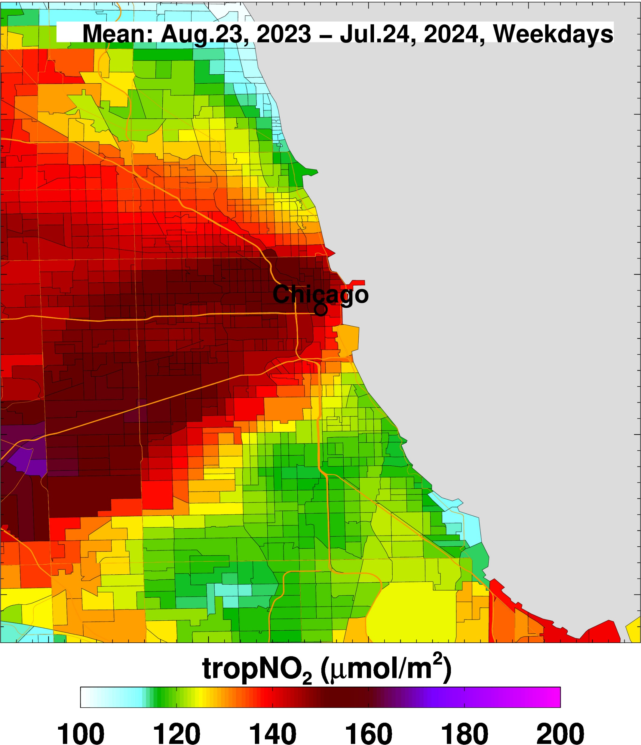
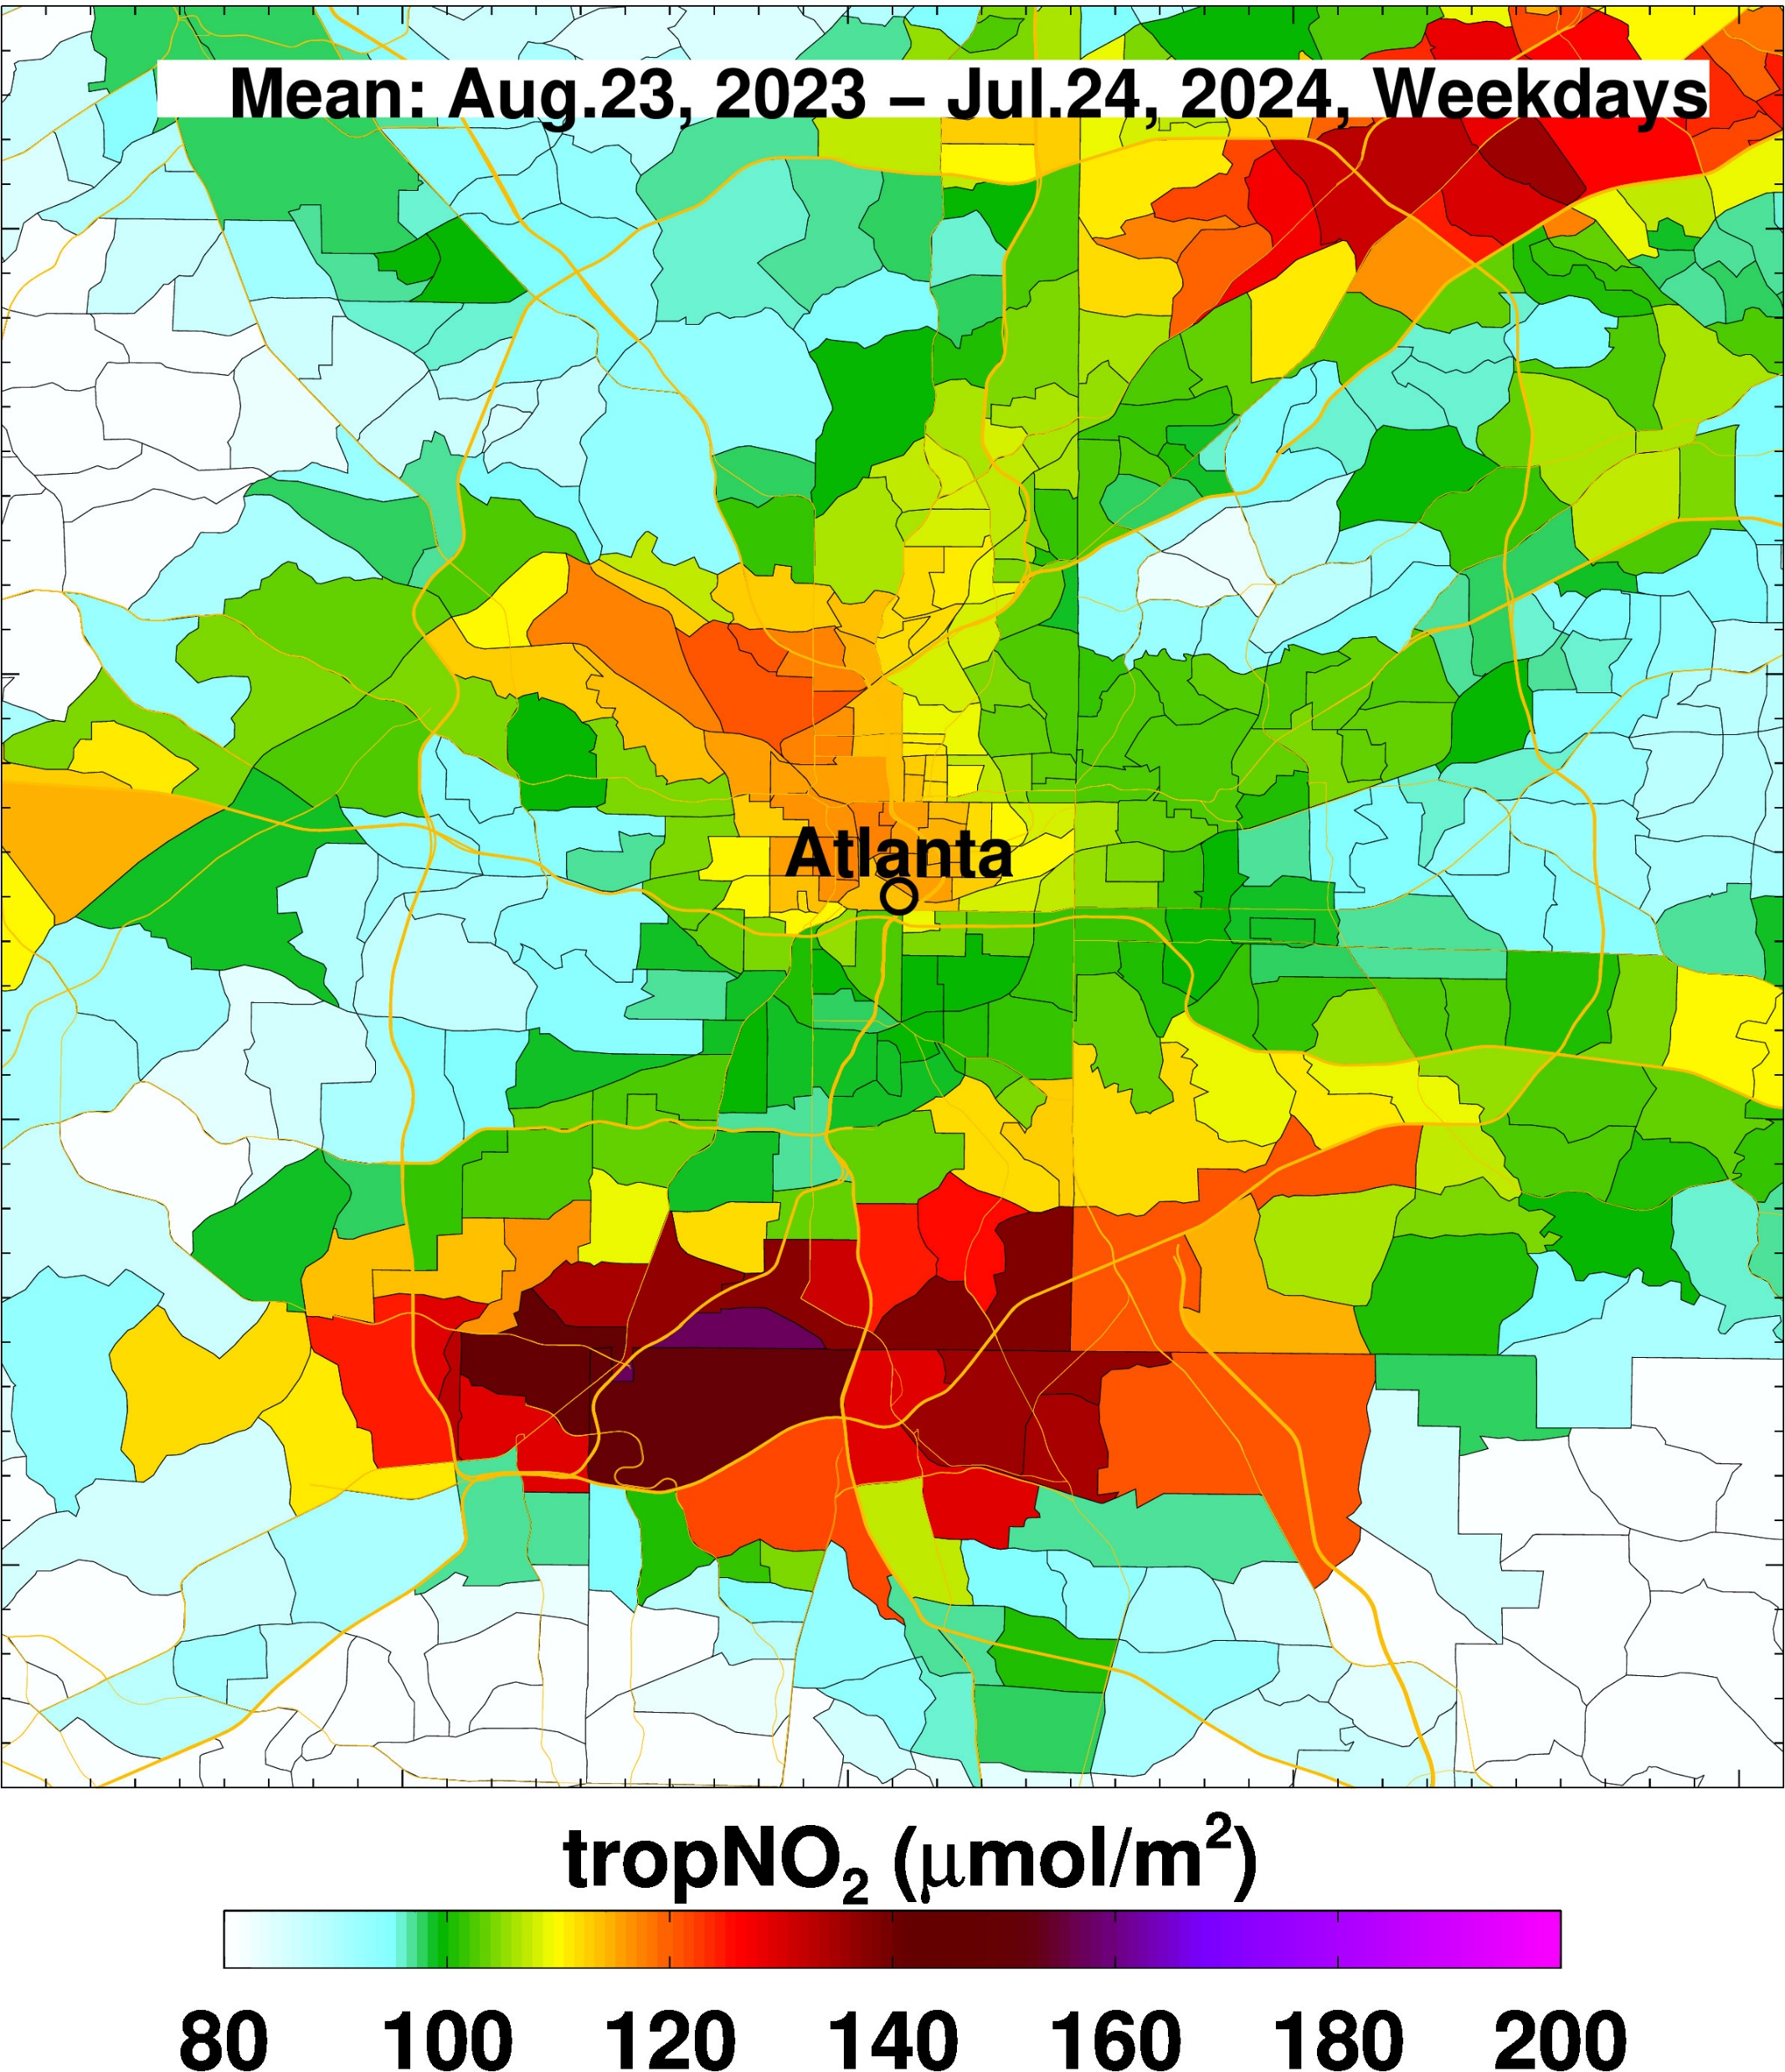
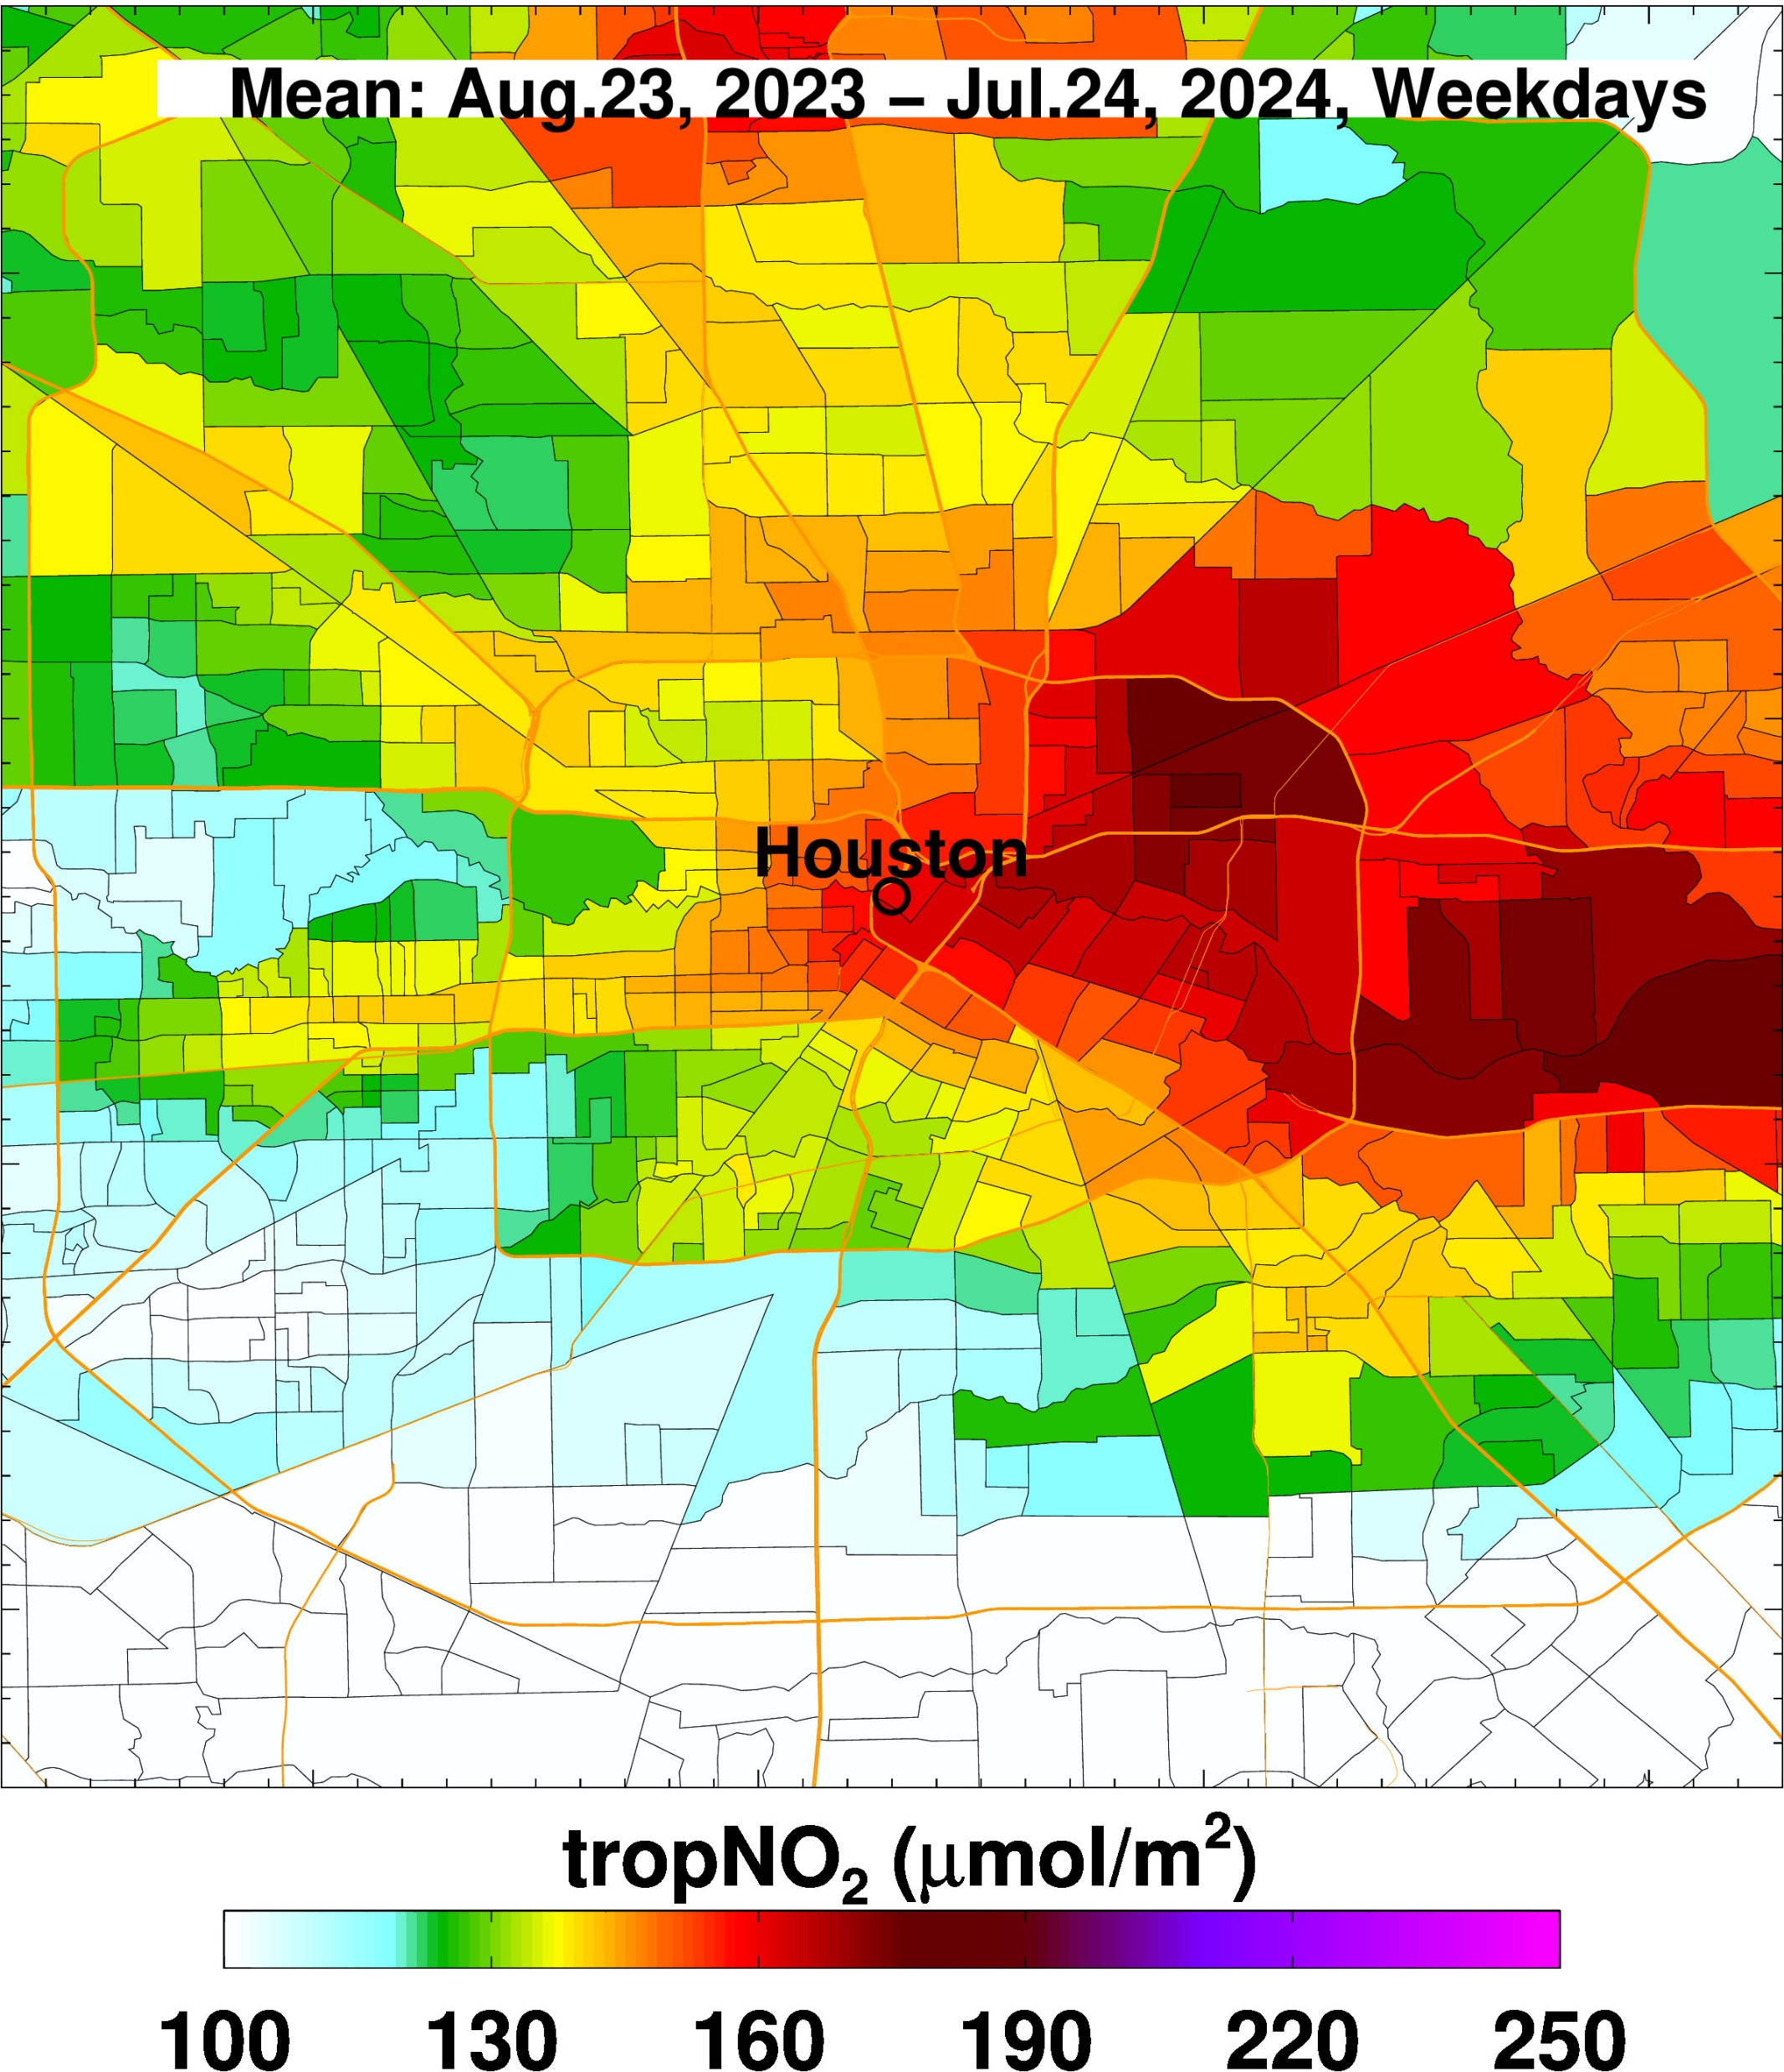
Weekedays

Slide 8
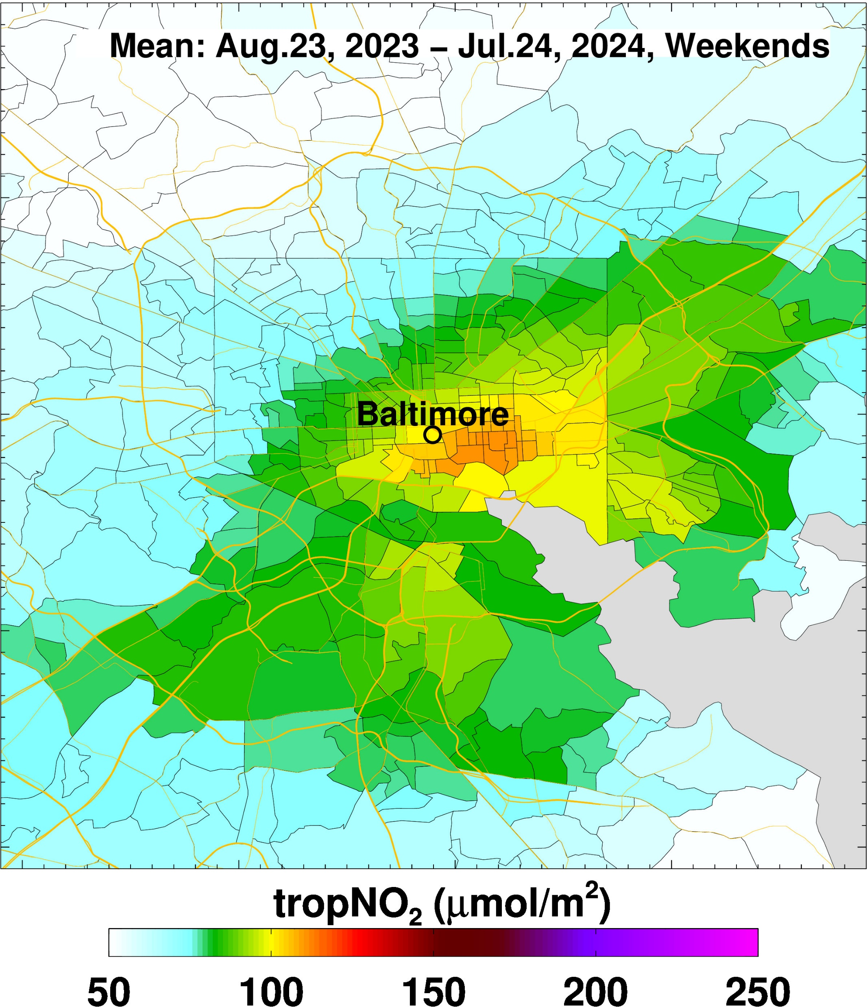
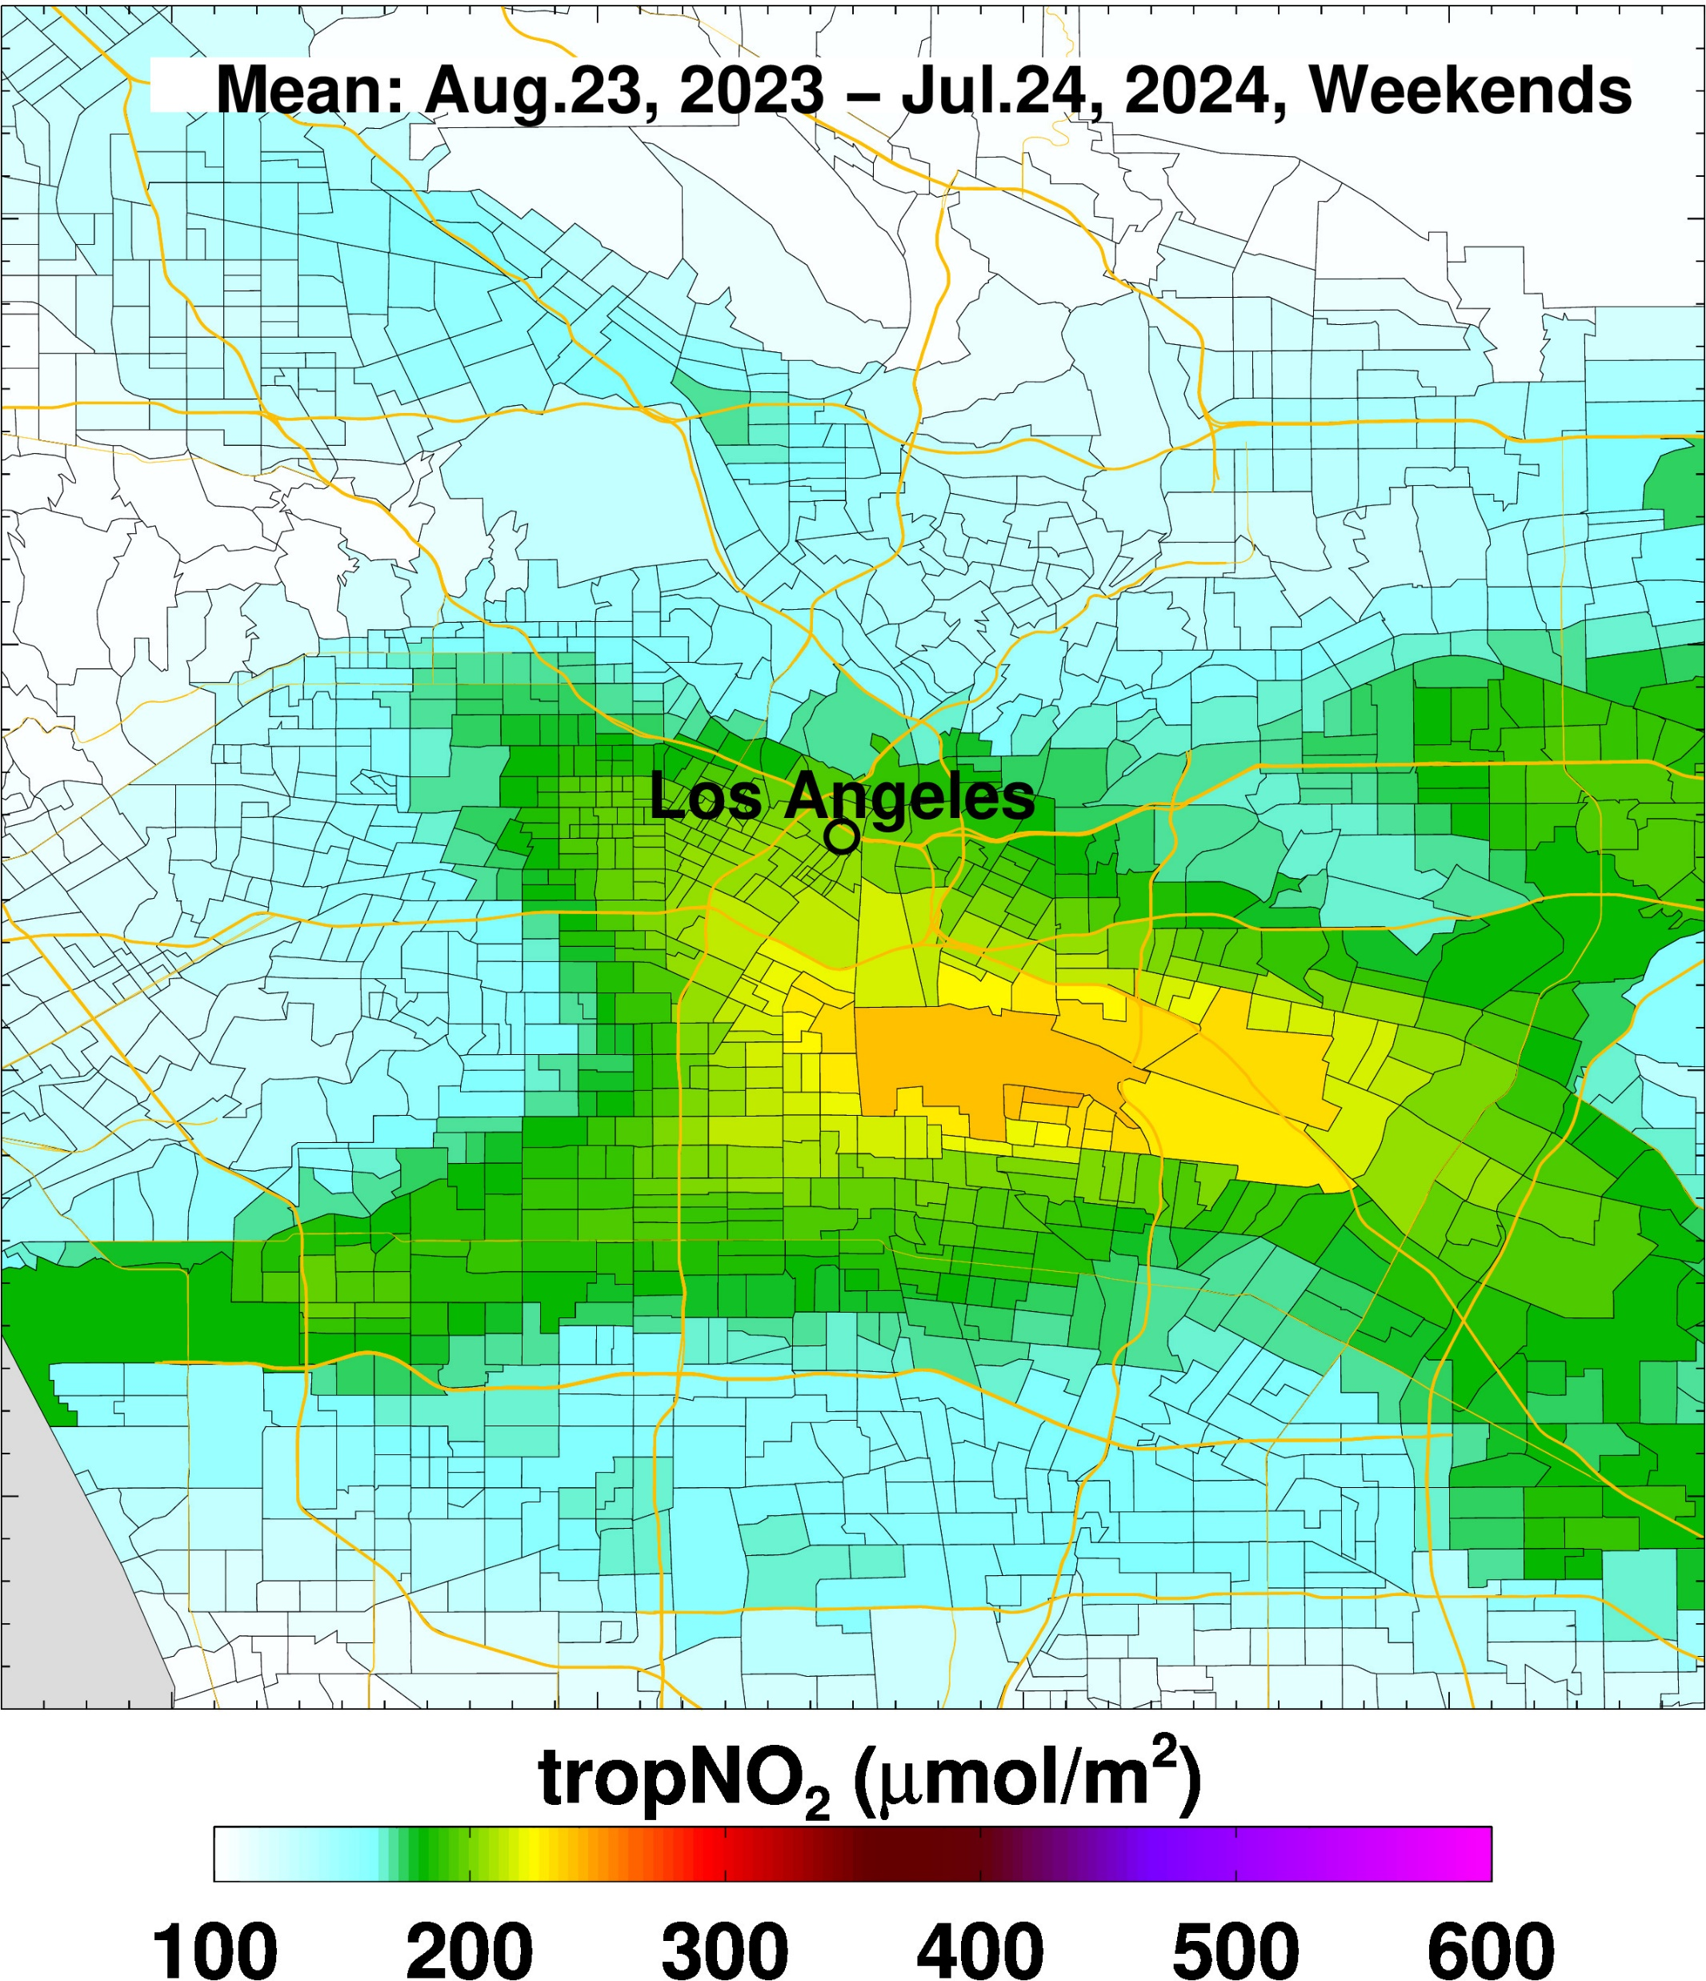
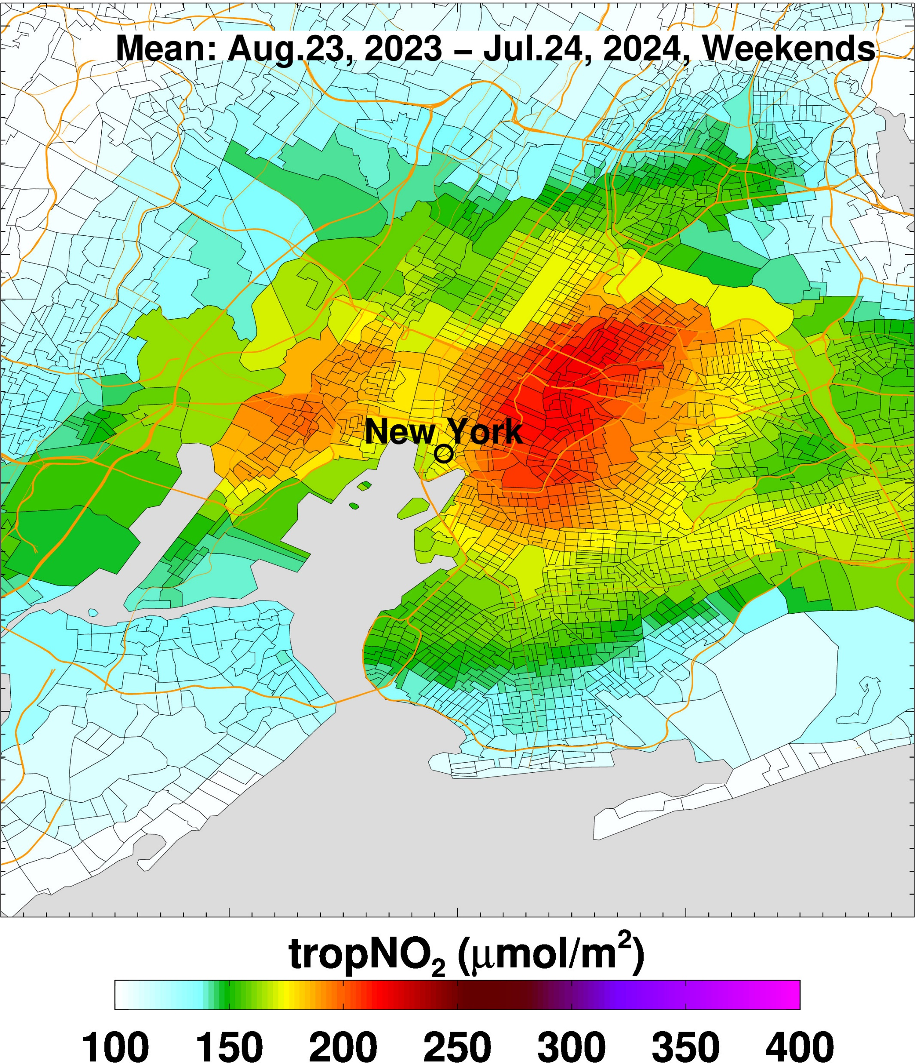
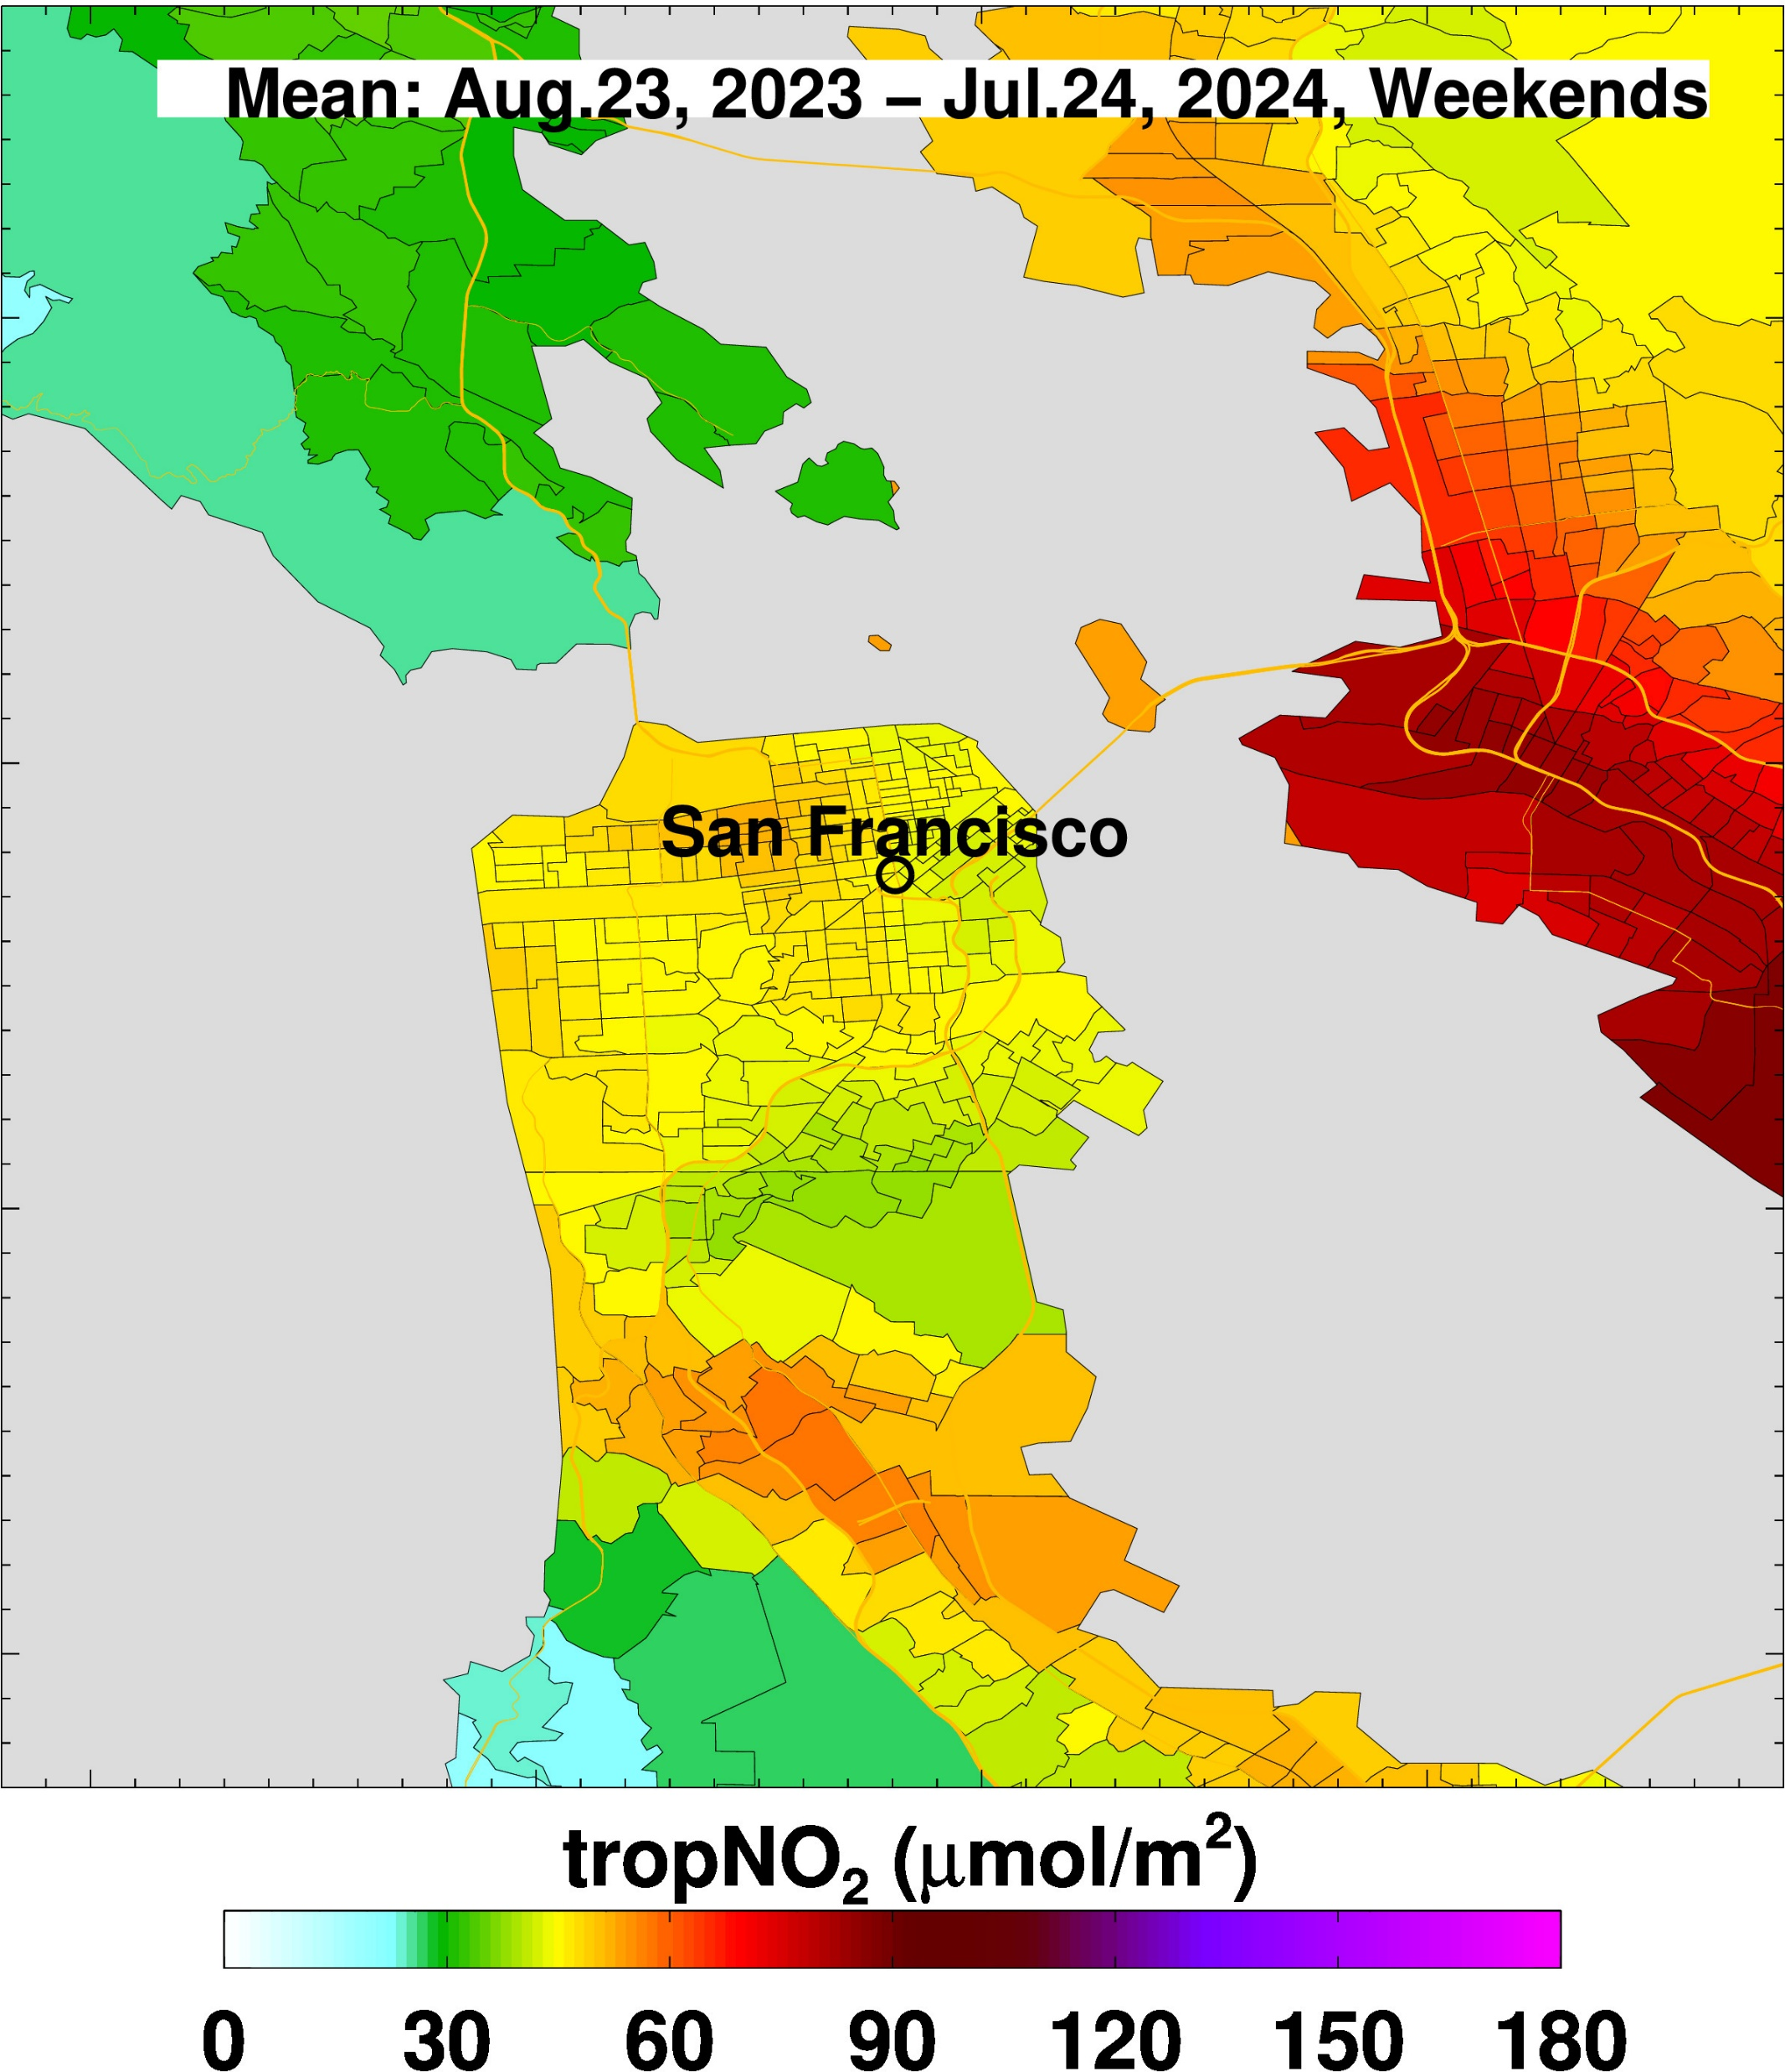
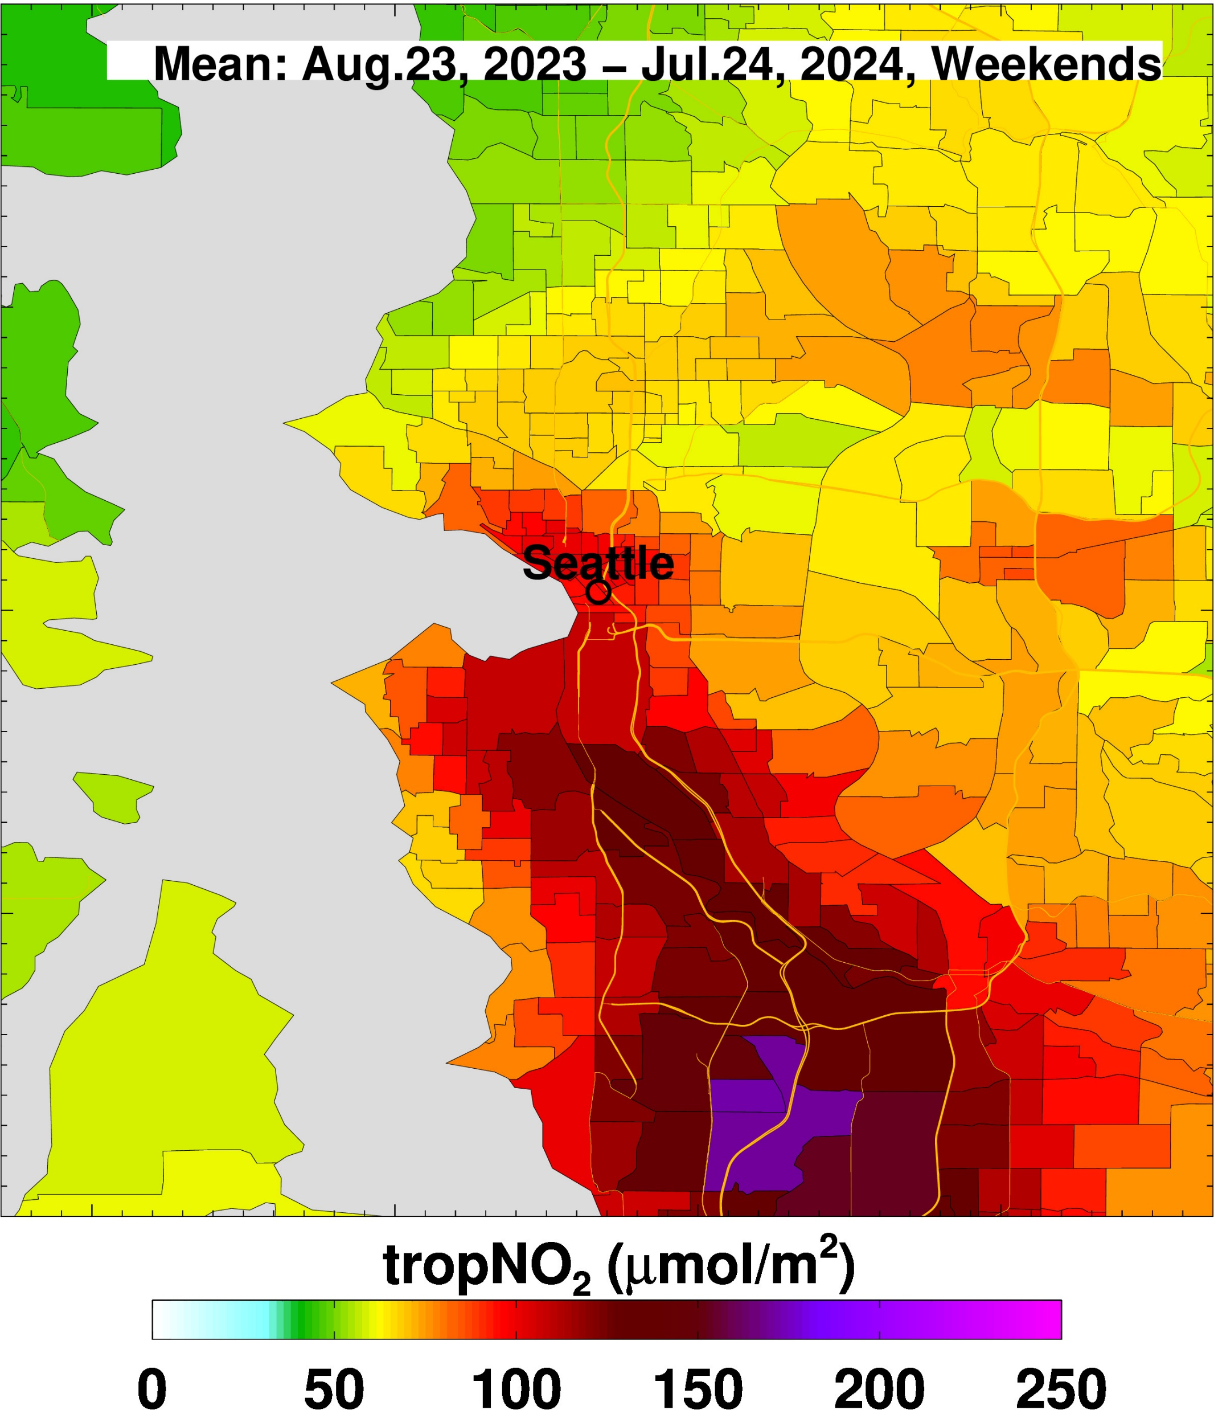
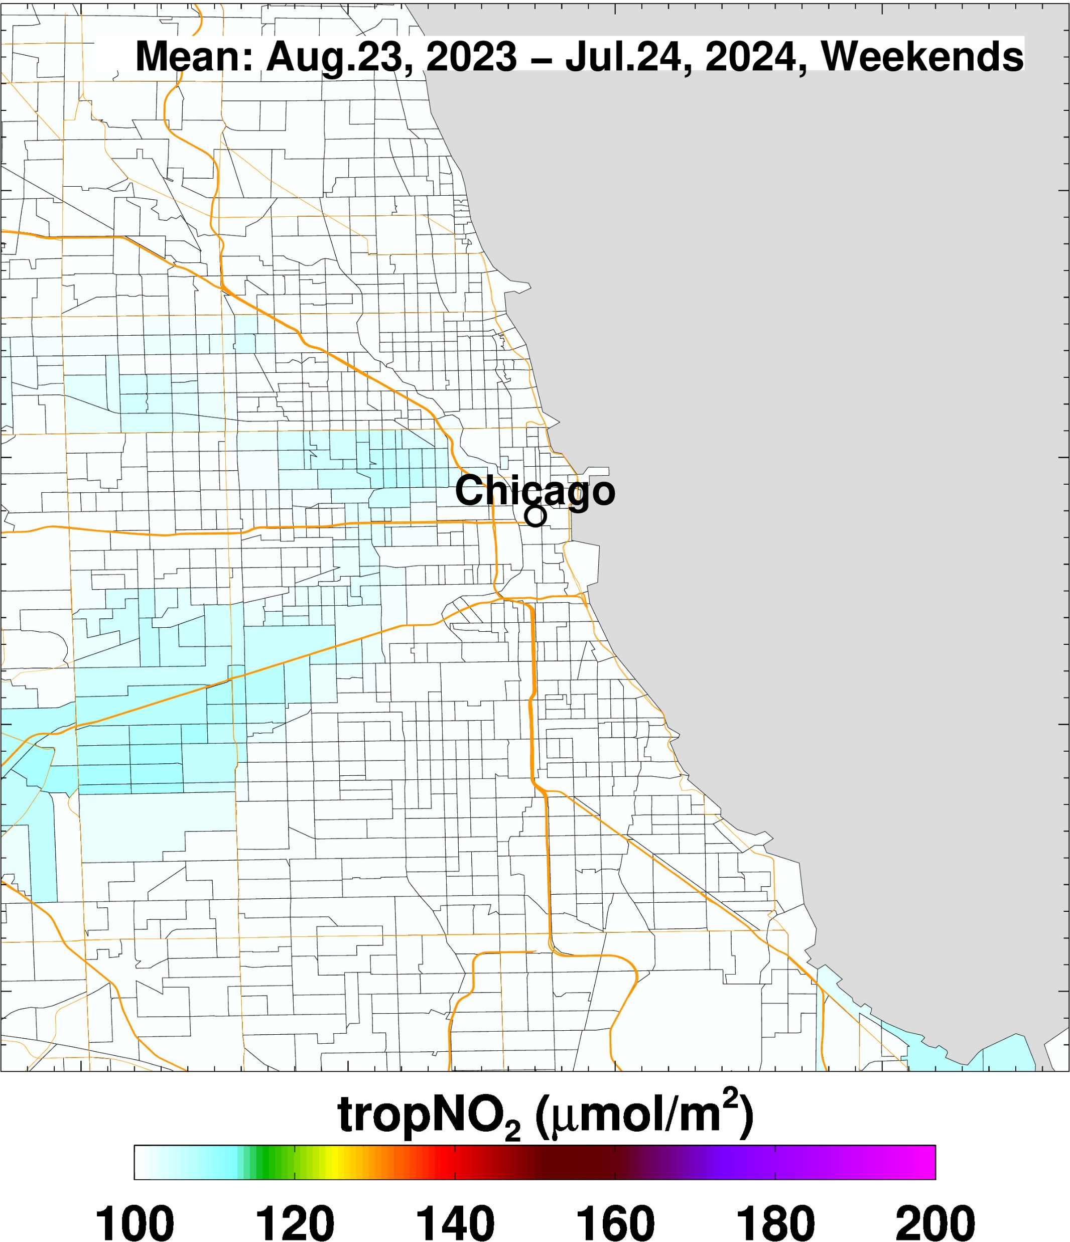
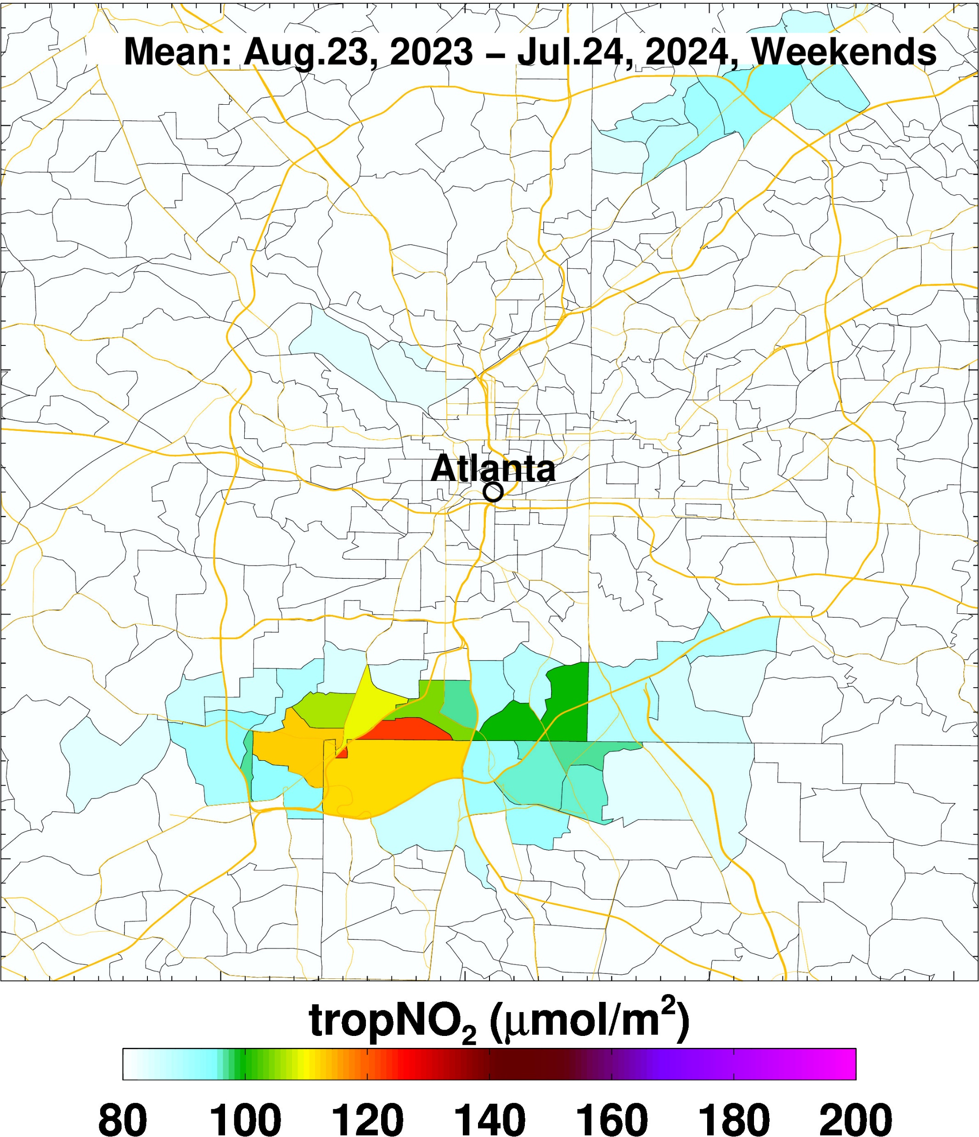
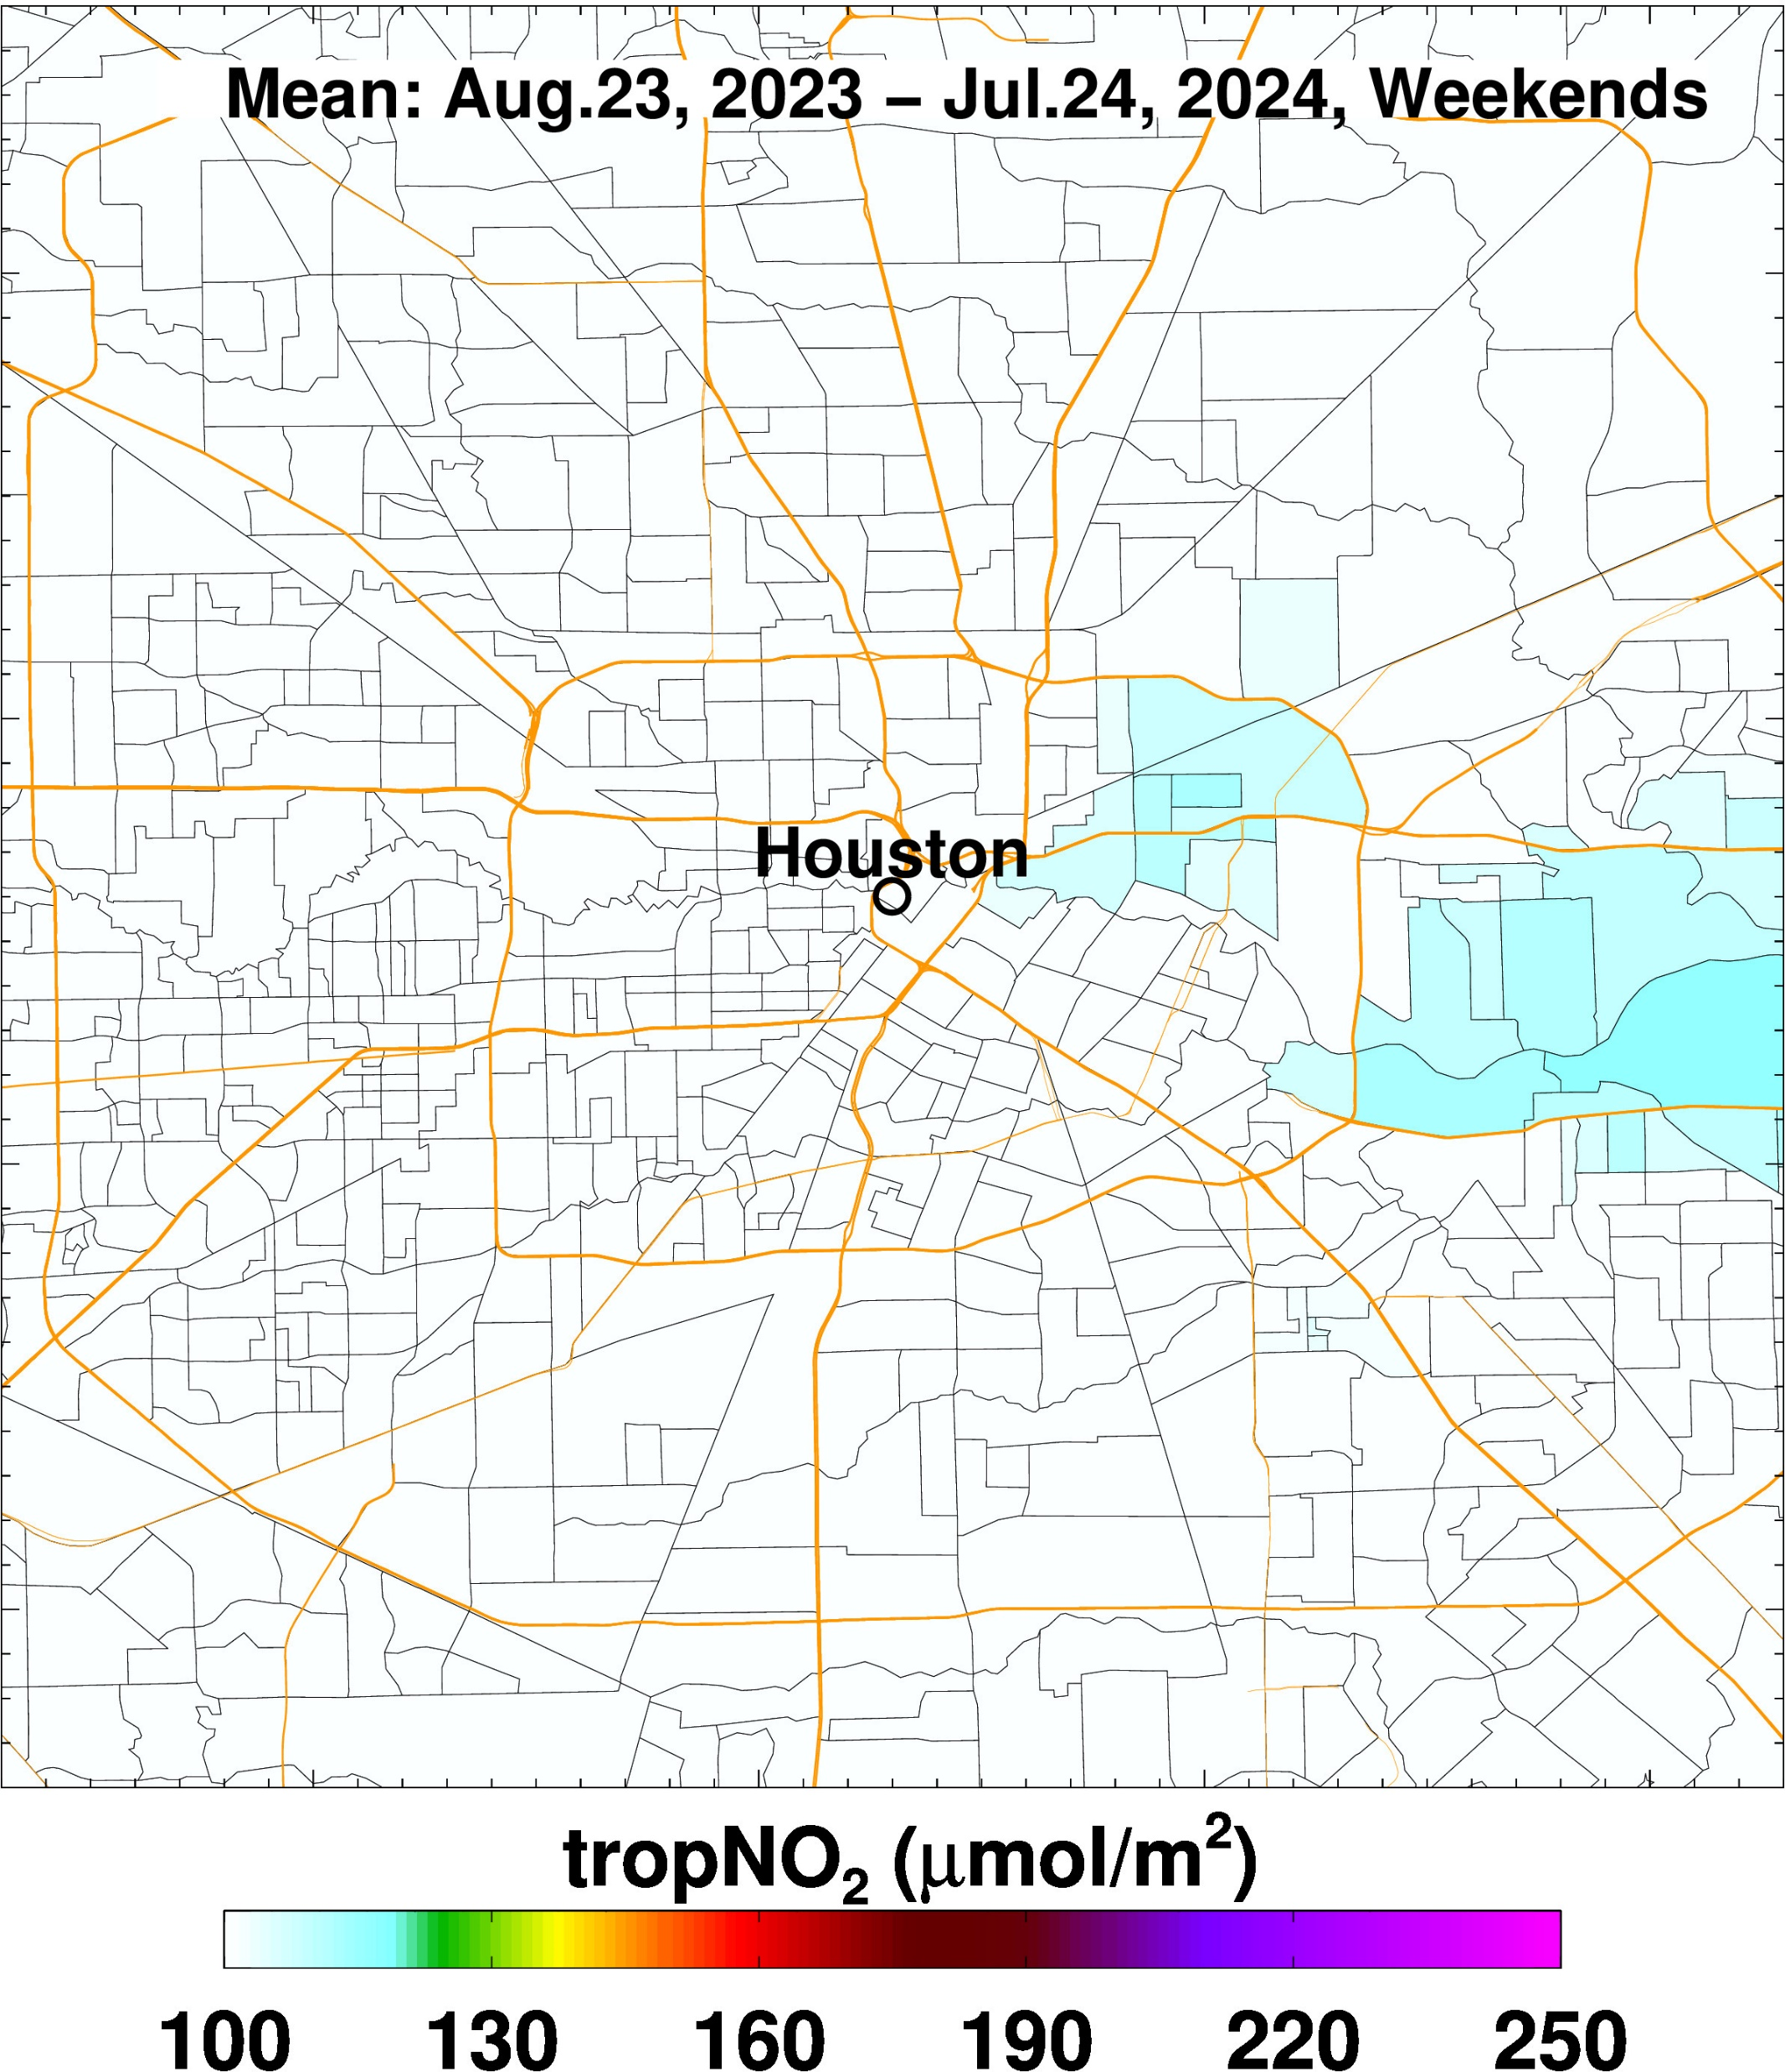
Weekends

Slide 9
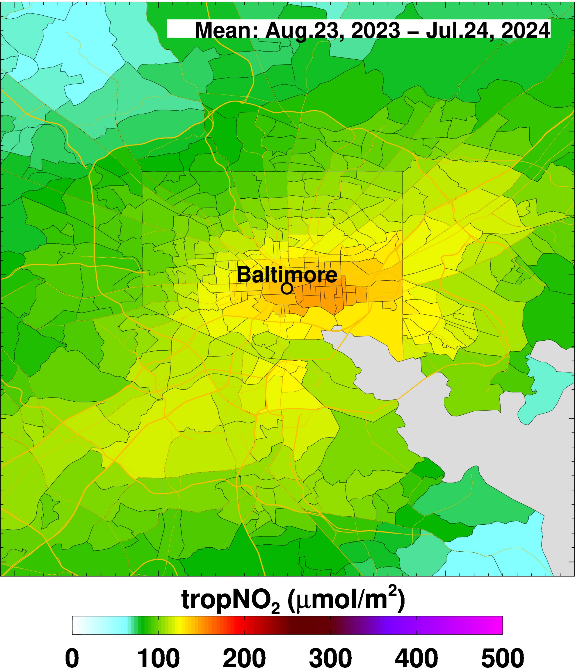
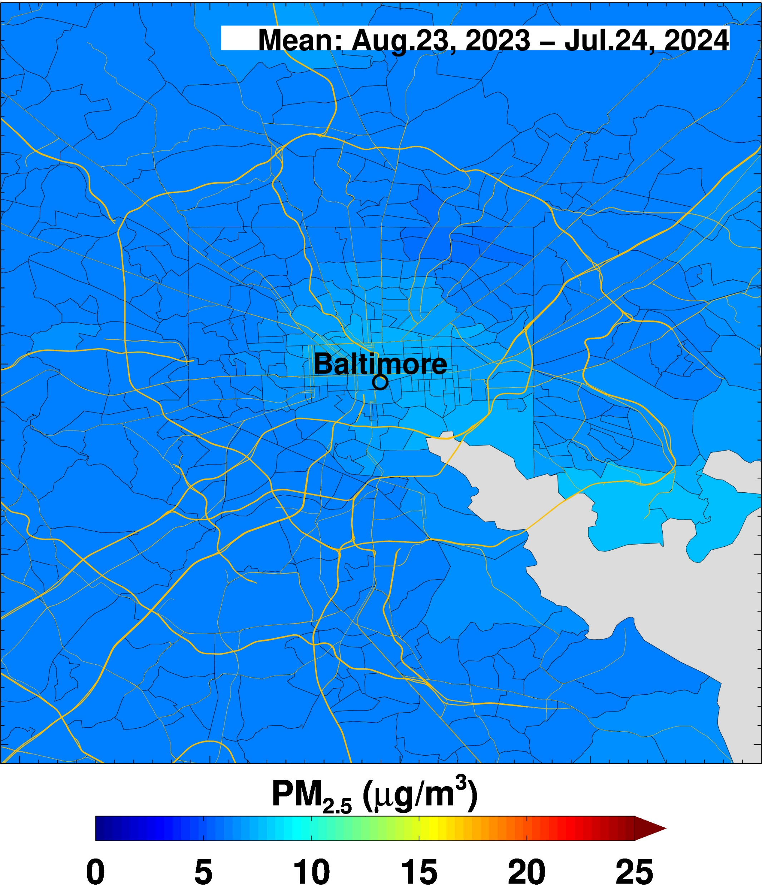
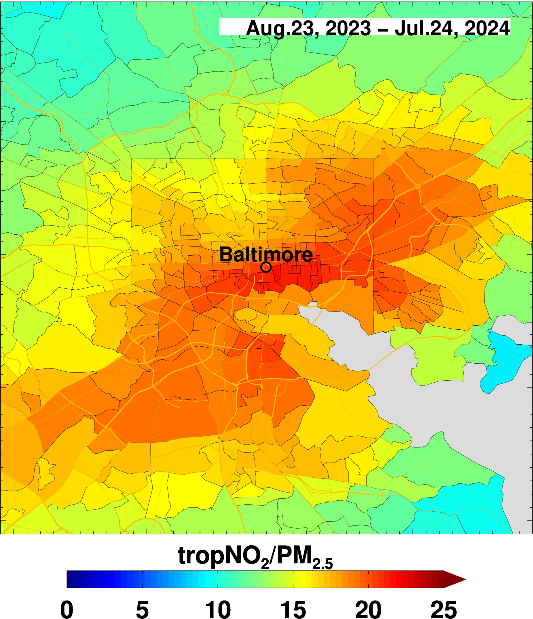
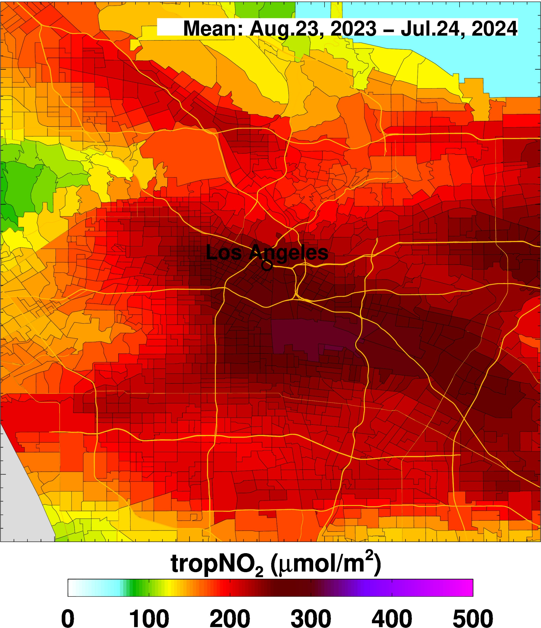
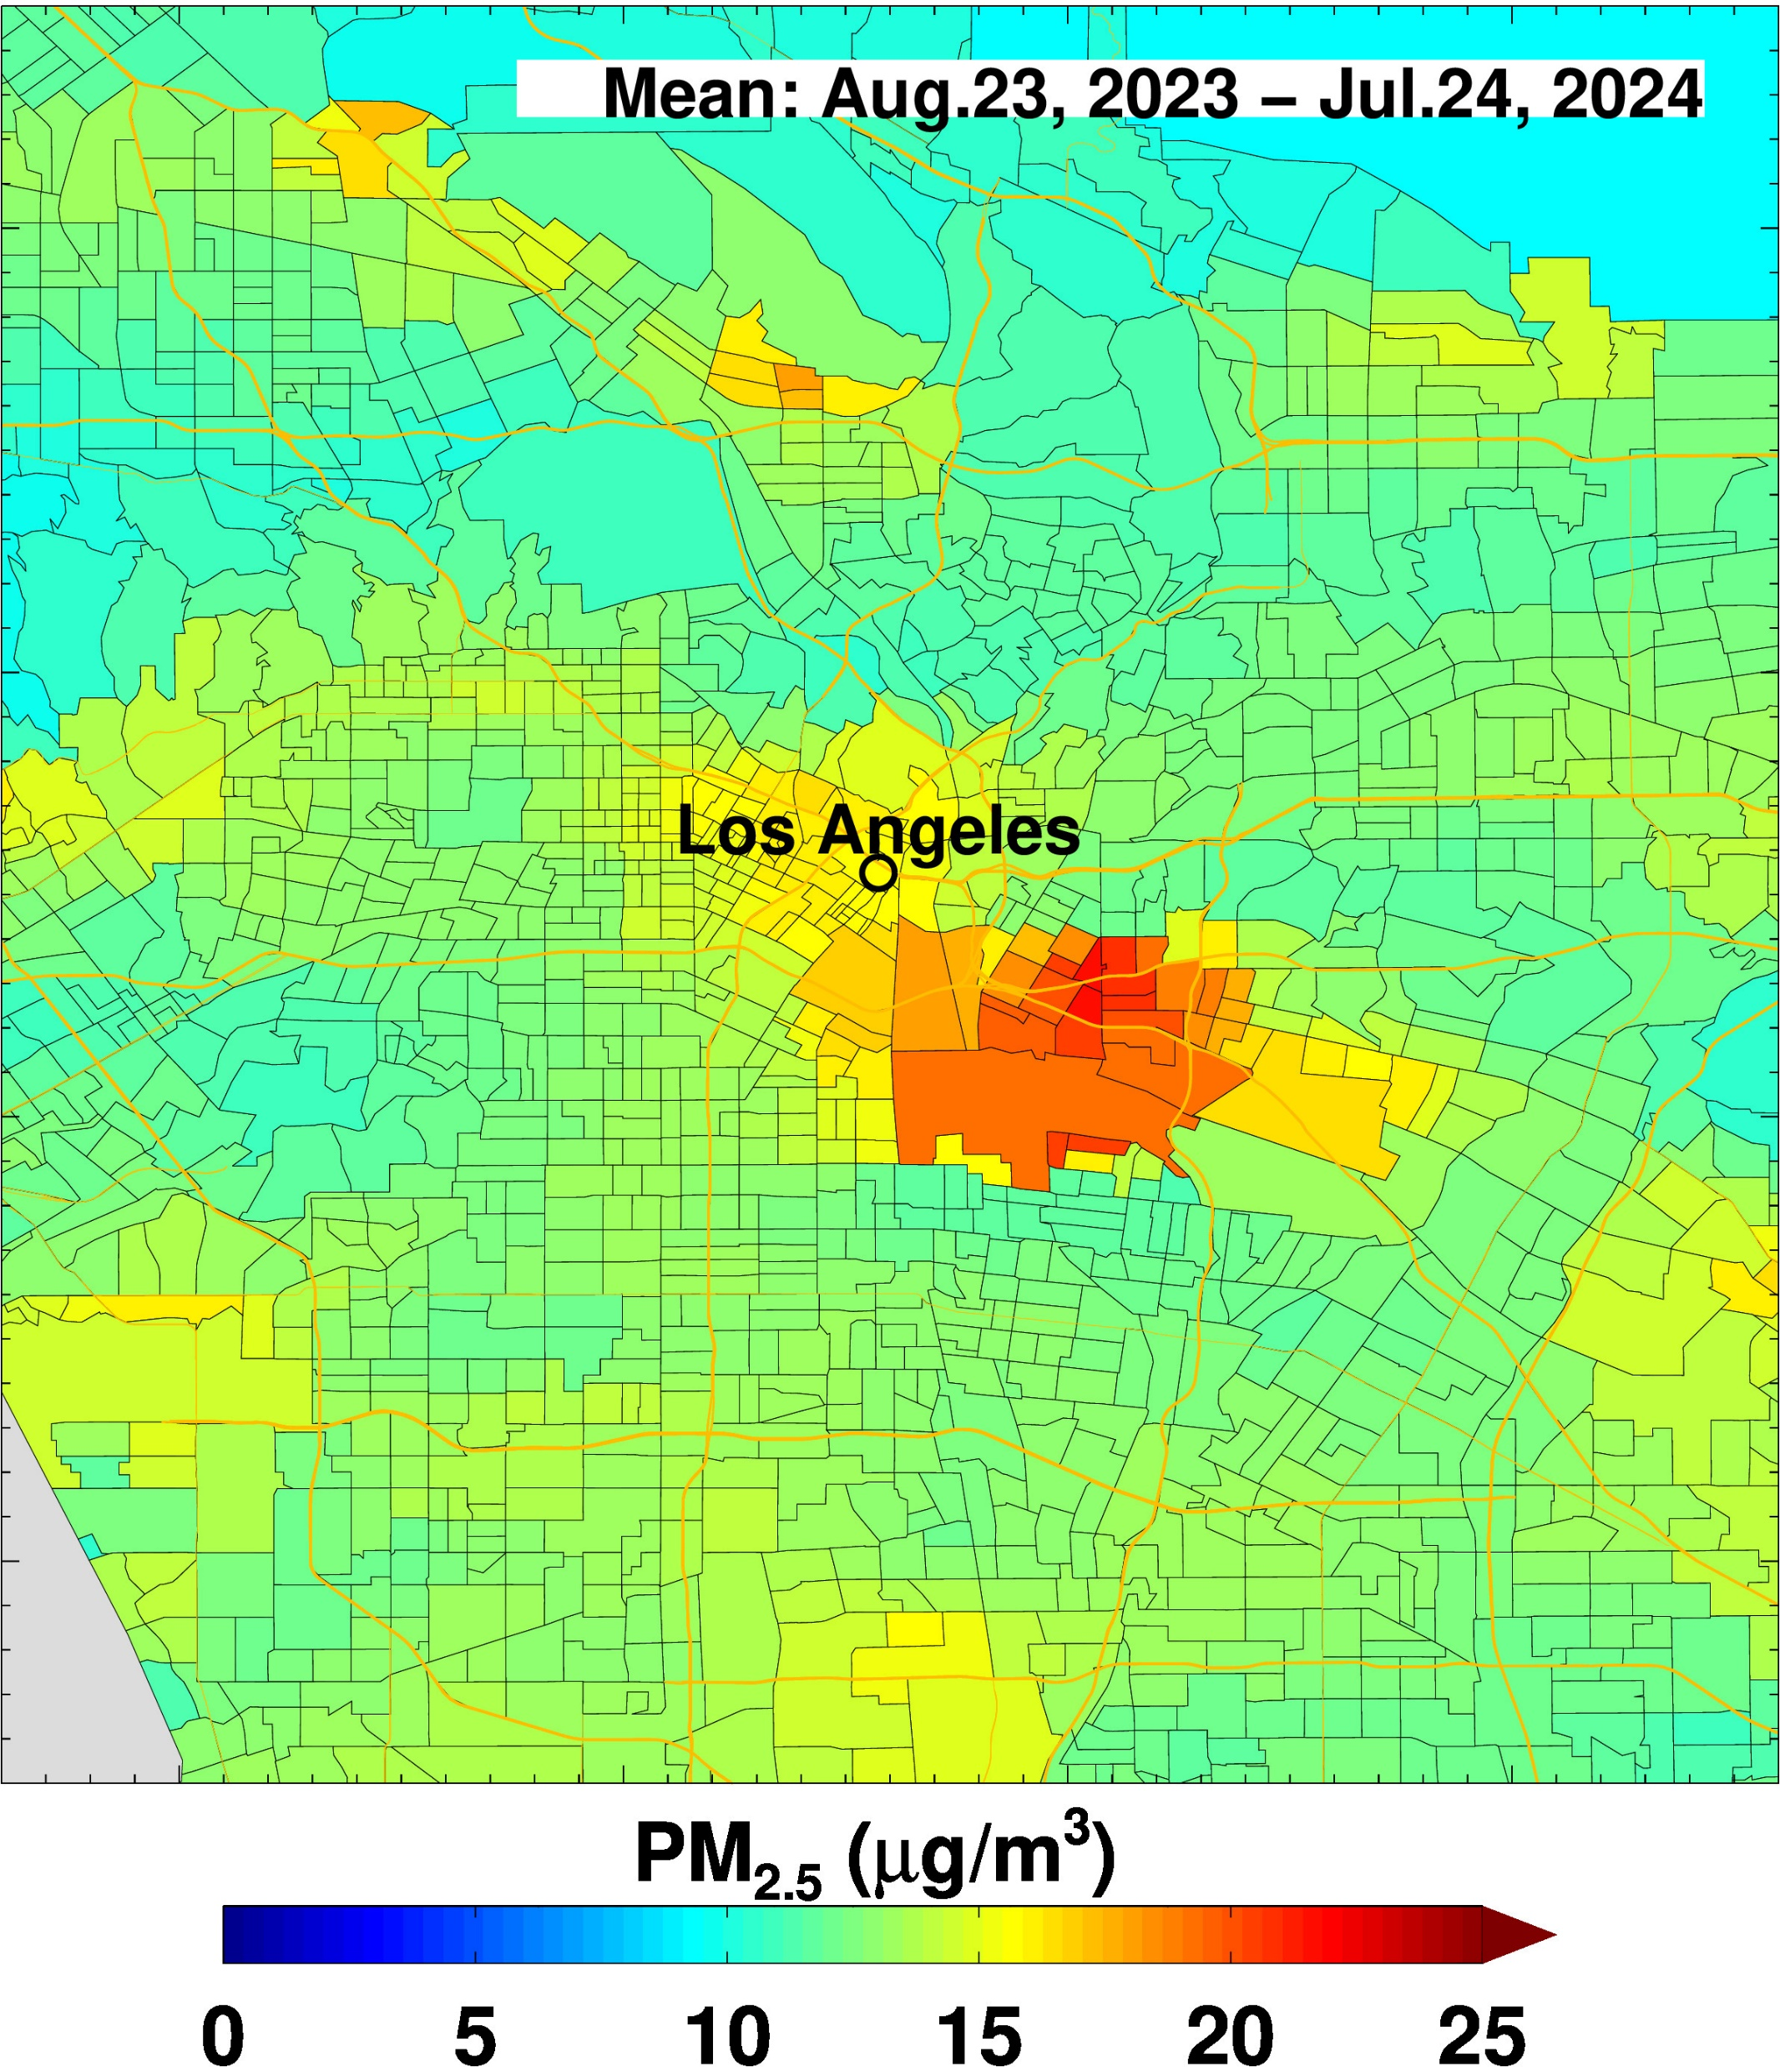
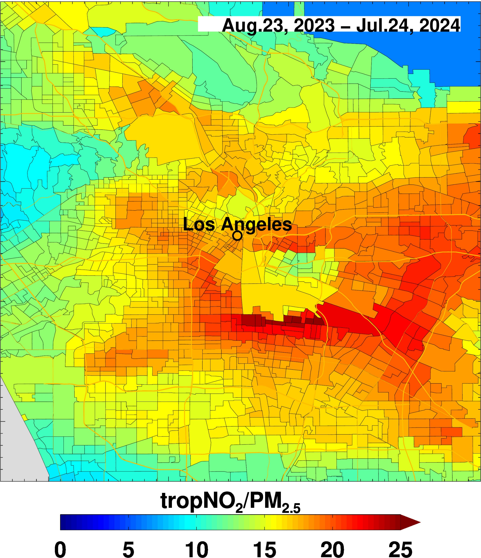
Ratio of tropNO₂/PM_{2.5} reveals that spatial patterns in pollution are mostly dominated by NO₂ except in regions with PM_{2.5} hot spots

Slide 10

