Slide 1




The Copernicus Missions
Sentinel-4 and Sentinel-5
B. Veihelmann, R. Lindstrot, F. Rüthrich, Sentinel-4 and Sentinel-5 teams at ESA and EUMETSAT
Acknowledgements: industrial consortia led by Airbus, Level-2 consortia led by DLR led by S&T, Sentinel-5P community
AC-VC#21, Takamatsu, Japan, June 2025

Slide 2
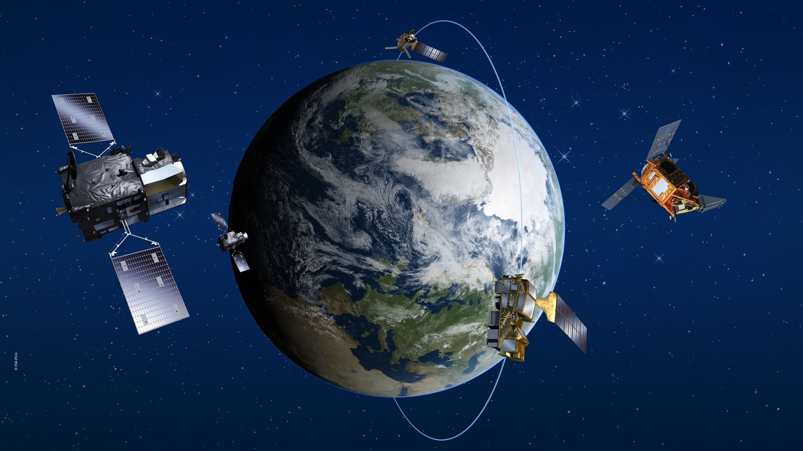
Copernicus Missions for Atmospheric Composition
Image: ESA
Sentinel-5 Precursor
TROPOMI
LTAN = 13:30 h
Sentinel-4 on MTG-S
UV-Vis-NIR (UVN) Imaging Spectrometer
observing air quality over Europe with hourly revisit time
Sentinel-5 on MetOp-SG A
UV-Vis-NIR-SWIR (UVNS) Imaging Spectrometer
For observing the atmospheric composition with daily global coverage, LTDN = 09:30 h

Slide 3
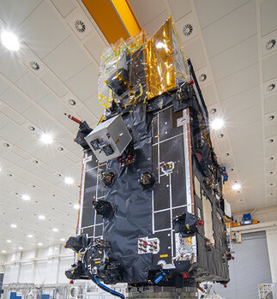
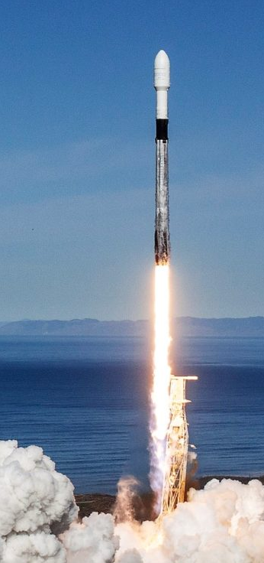
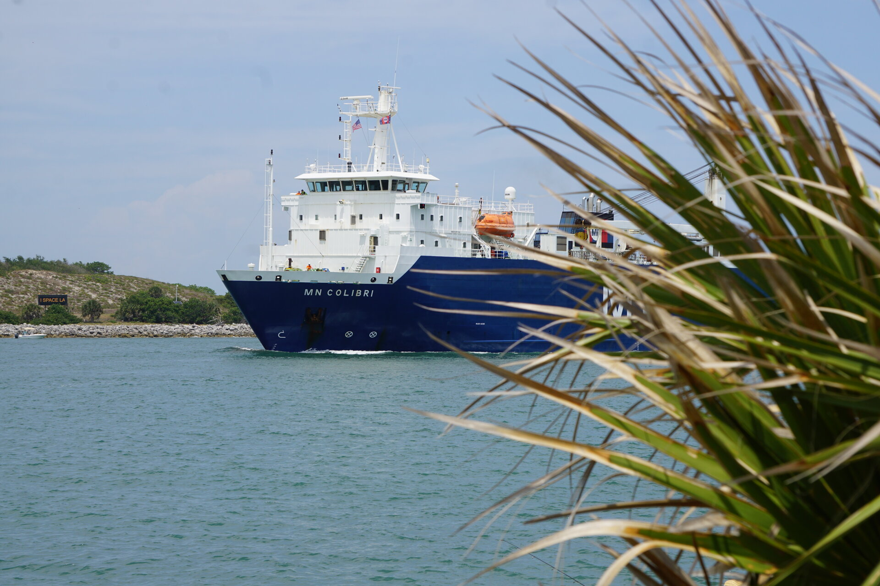
Copernicus Sentinel-4
S4 PFM
on MTG-S1
Built under the responsibility of ESA
  Instruments and L1bPP by a consortium led by Airbus
  L1 Reference Processor (L1RP) by Huld
  Level-2 Operational Processor (L2OP) by a consortium led by DLR
Operated by EUMETSAT
Ground Segment preparation @ EUMETSAT
FM2, integration, processors preparation @ ESA
S4 PFM integrated in MTG-S1
Shipment to Port Canaveral, Florida, US, arrived on 6 May
Launch with Falcon 9 in July 2025
  1 July ~14:30 PT, ~17:30 local time (ET)
  1 July ~23:30 CEST, ~06:30 JST
Cargo ship
‘MN Colibri’
Falcon 9
www.esa.int/sentinel-4
https://www.eumetsat.int/launch-mtg-s1-and-copernicus-sentinel-4

Slide 4
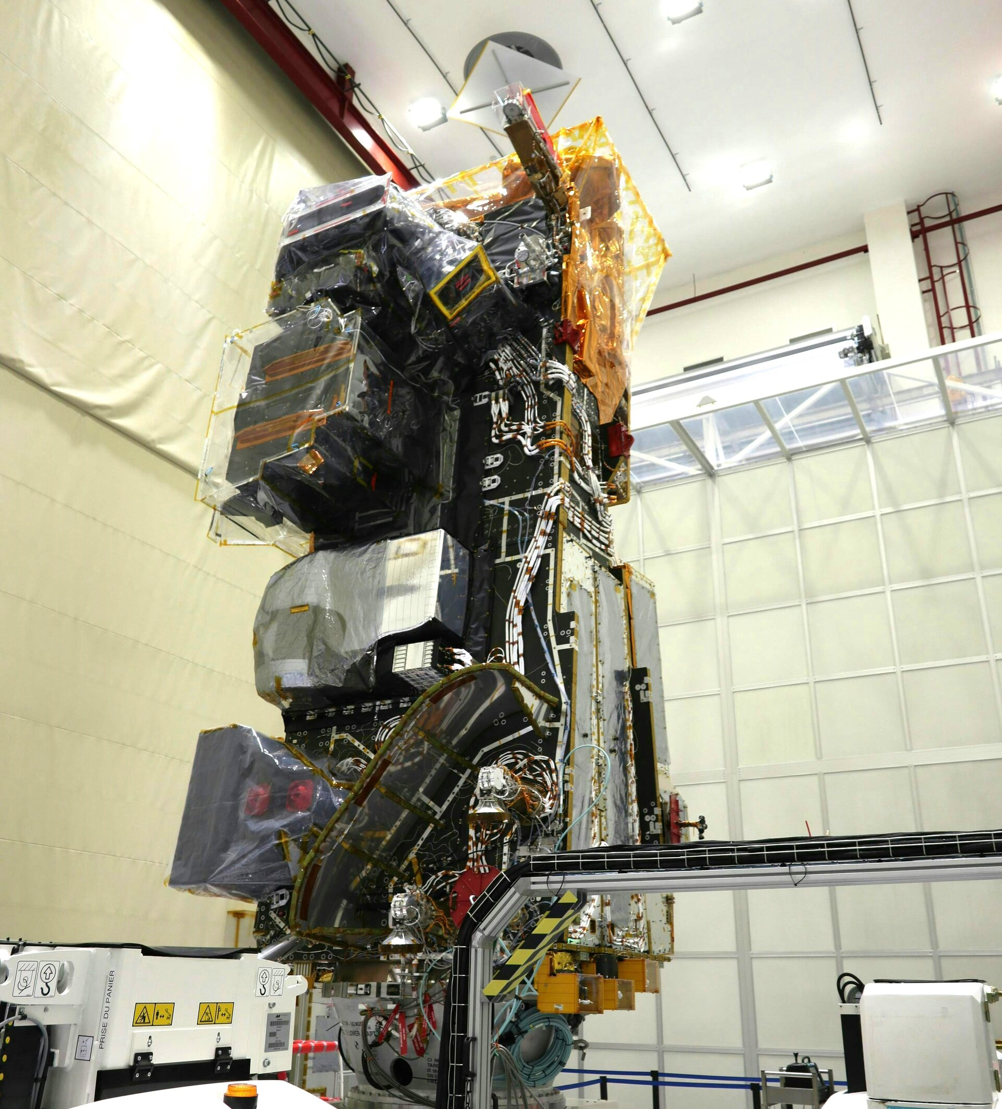
Copernicus Sentinel-5
S5 PFM
On MetOp-SG-A1
Built under the responsibility of ESA
  Instruments and L1bPP by a consortium led by Airbus
  L1bPP extensions by Huld
  Level-2 Prototype Processor (L2PP) by a consortium led by S&T
Operated by EUMETSAT
Ground Segment preparation @ EUMETSAT
FM2, FM3 integration, processors preparation @ ESA
S5 PFM integrated in MetOp-SG-A1
Now on the ship “Canopée” to Kourou, French Guiana
Launch with Ariane 6 in August 2025
  12 August 17:38 PT, 20:38 ET, 21:38 local time
  13 August 02:38 CEST, 09:38 JST
Canopée
Ariane 6
www.esa.int/sentinel-5
www.eumetsat.int/metop-second-generation-a1-and-copernicus-sentinel-5

Slide 5
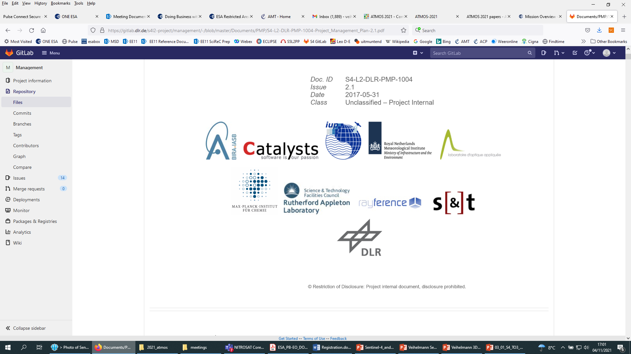
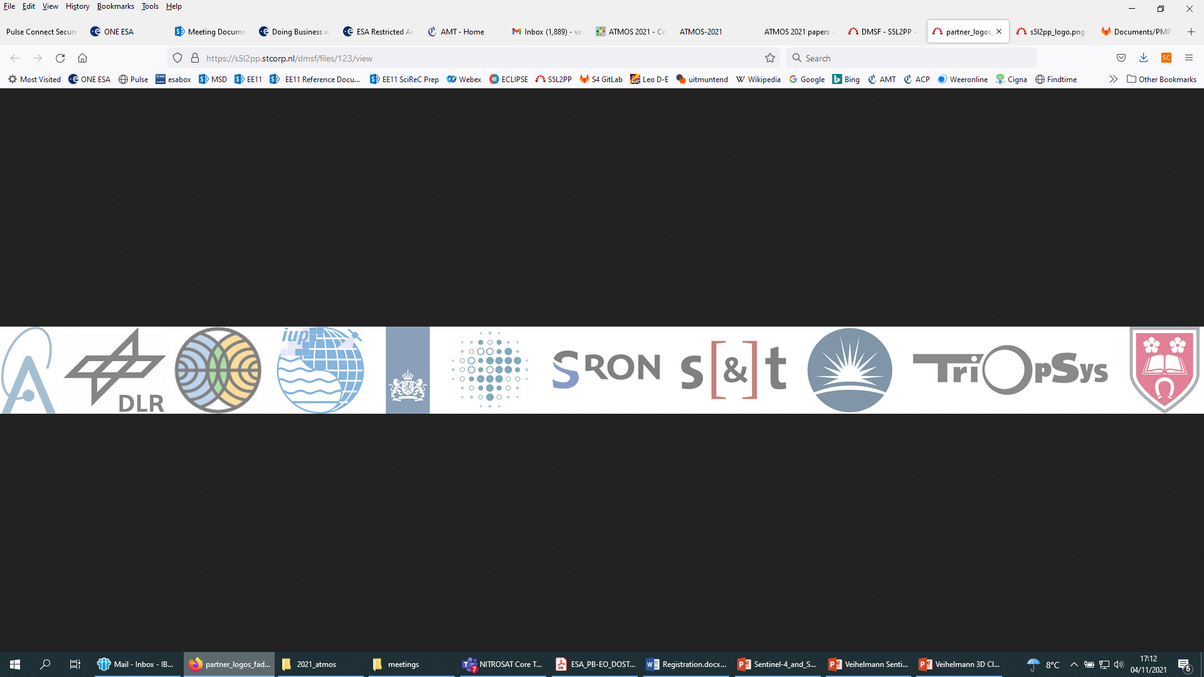
Atmospheric Sentinels Level-2 Products
 | S4 | S5 | S5P
O₃ | TOC & TRC | TOC & PRO | TOC, TRC, PRO
NO₂ | TOC & TRC | TOC & TRC | TOC & TRC
SO₂ | TOC | TOC & layer height | TOC & Layer height
HCHO | TOC | TOC | TOC
CHOCHO | TOC | TOC
Aerosol | AOD, Layer height UV index | AOD, Layer height, UV index | Layer height, UV index
CH₄ |  | TOC | TOC
CO |  | TOC | TOC
Cloud | AUX | AUX | AUX
Surface | AUX | climatology | climatology
UV |  | Near surface downwelling | Near surface downwelling
L2
Breadboard (BB)
Verification
Implementation
S4 L2OP consortium lead by DLR
TOC = total column
TRC = tropospheric column
PRO = profile
S5 L2PP consortium lead by S&T

Slide 6

AO Call Calibration & Validation (Cal/Val)
  Joint ESA & EUMETSAT AO Call for Sentinel-4 and Sentinel-5 issued July 2024 to
    Trigger & coordinate Cal/Val activities
    Establish in-flight data quality, verify that performance targets are met
  22 proposals received for Cal/Val activities using ground-based, model, and other satellite data
  Cal/Val Preparation Workshop 16-18 June 2025 @ EUMETSAT, Darmstadt, DE
  Next steps after launches
    Health check of in-flight Level-1 and Level-2 data at ESA
    Checks and ramping up processing chains at EUMETSAT
    Staggered approach to start Cal/Val activities: ASAP per product
Launch
Jul/Aug 2025
Public release of products
AO Activities
Notes:
Calibration and Validation (Cal/Val) are critical. A joint ESA & EUMETSAT AO Call for Sentinel-4 and Sentinel-5 Cal/Val was issued in July 2024 to coordinate activities and verify performance targets. We received 21 proposals. A preparation workshop was held in June 2025.
After launch, health checks of initial data and processing chain ramp-up will occur. Cal/Val activities will start as soon as possible per product in a staggered approach. The timeline shows AO activities underway, the launch expected in August 2025 (specifically mid-August 2025 for the PFM), followed by Cal/Val and public product release.

Slide 7
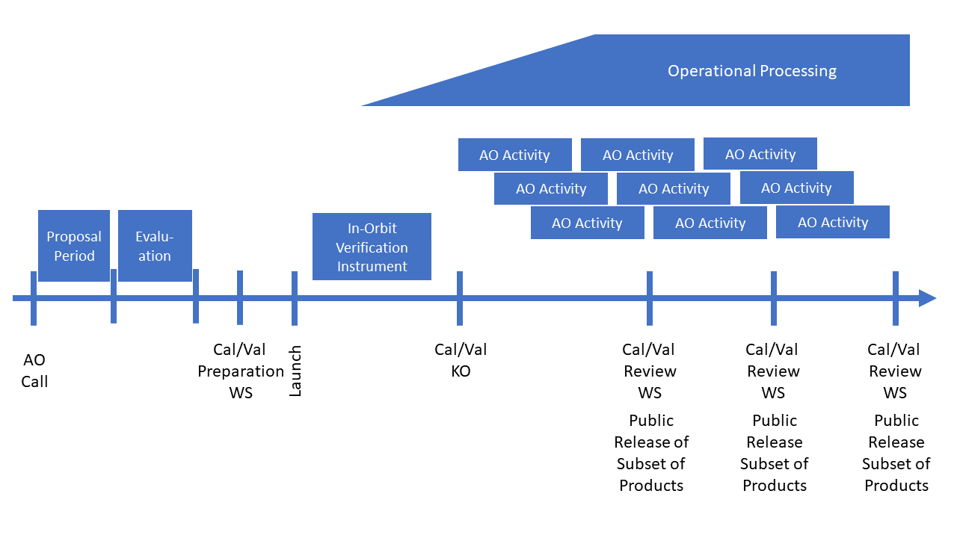

Slide 8
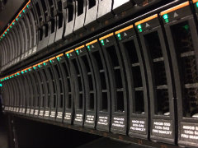
Ground Segment Status
S4
  The operational Ground Segment will be ready in Q3 2026
  The gap is filled by a fully operationalised version of the S4 L1 Reference Processor
  Cross-comparison activities of both processors are planned to conclude before the end of the L1 Cal/Val phase
S5
  Cal/Val will be done with the S5 L1 Reference Processor
  The operational ground segment will take over after the L1 Cal/Val phase

Slide 9
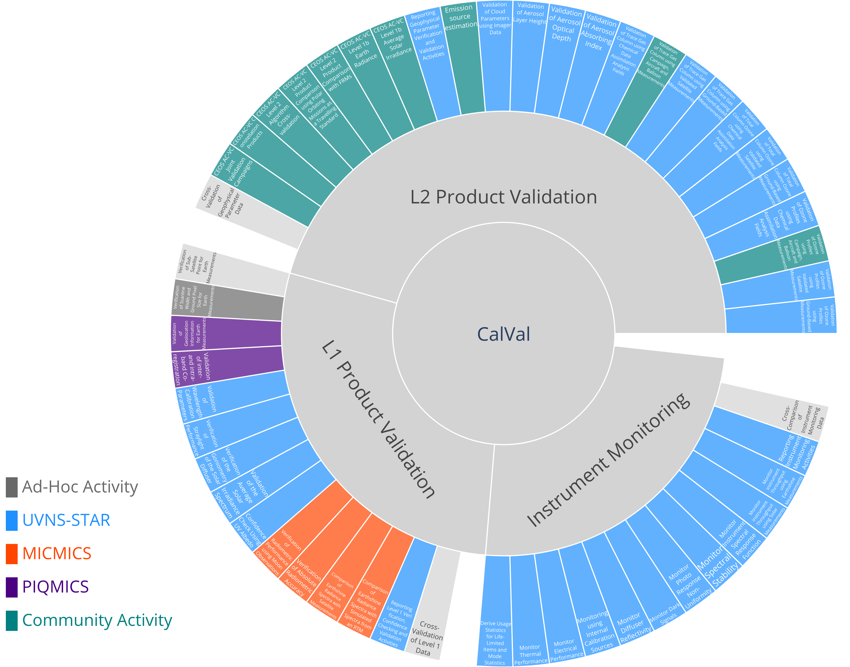
S4 and S5 Cal/Val Plan
Joint plan for activities of calibration and validation
for Sentinel-4 and Sentinel-5 during commissioning and routine operations
Ad-hoc activities
  Formal testing (one-off)
  CKD Validation and Update
Performance monitoring
  Routine processing using Offline Environment
  (e.g. UVNS-STAR, MICMICS, PIQMICS)
  Includes routine validation of L2
  Scheduled reporting of instrument and product quality
Community activities
  Service Contracts for L1 and L2 activities
  AO Call for external L2 products validation

Slide 10






Thank you for your attention

