Slide 1
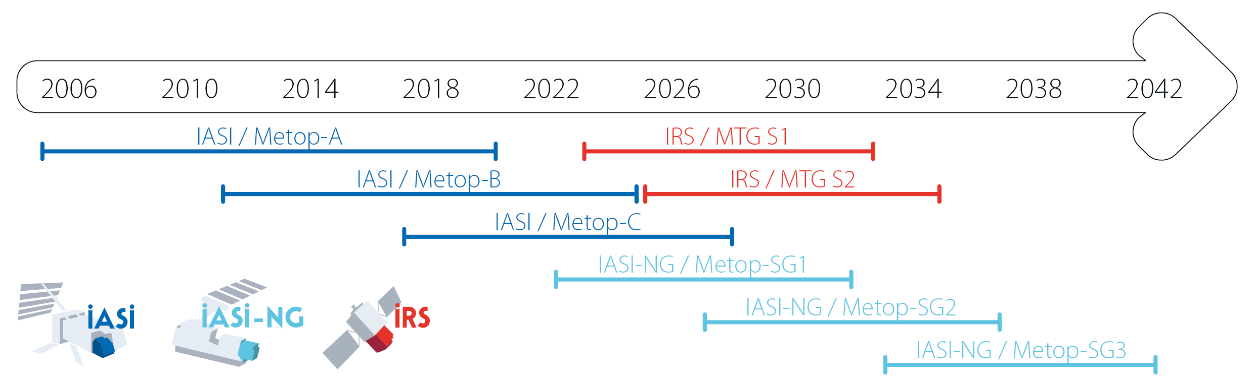
IRS/MTG
Cathy Clerbaux, with inputs from Eumetsat, ULB and LATMOS

Slide 2
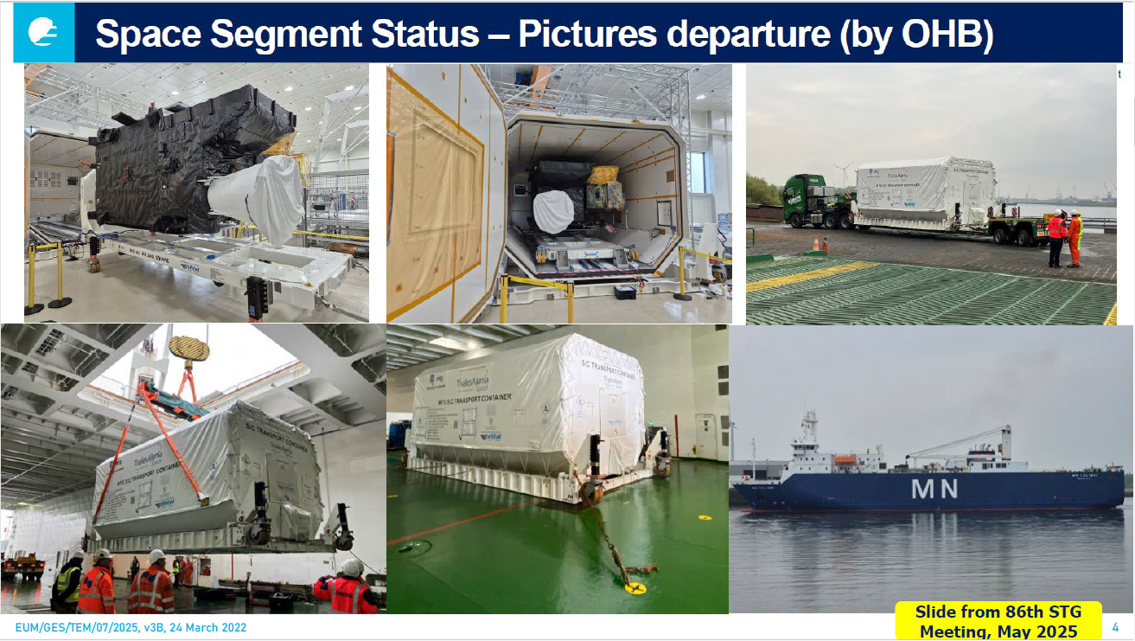

Slide 3
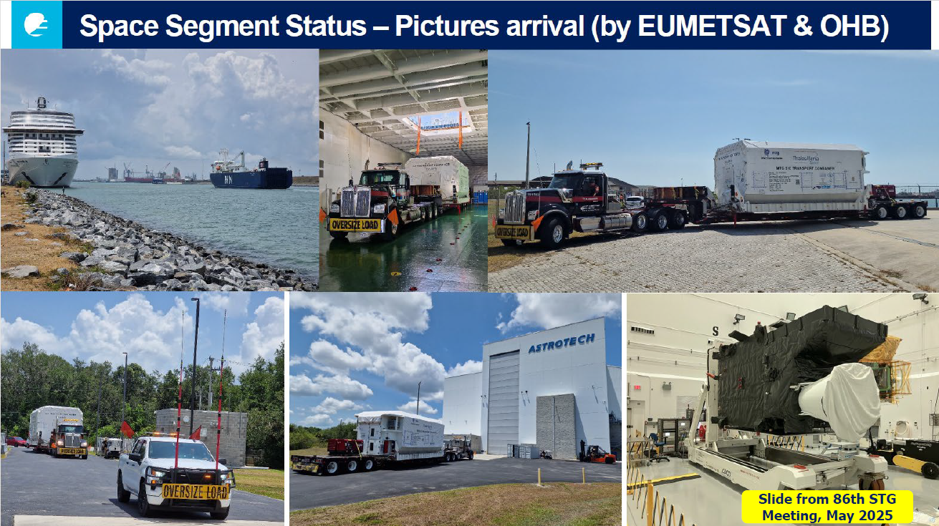

Slide 4
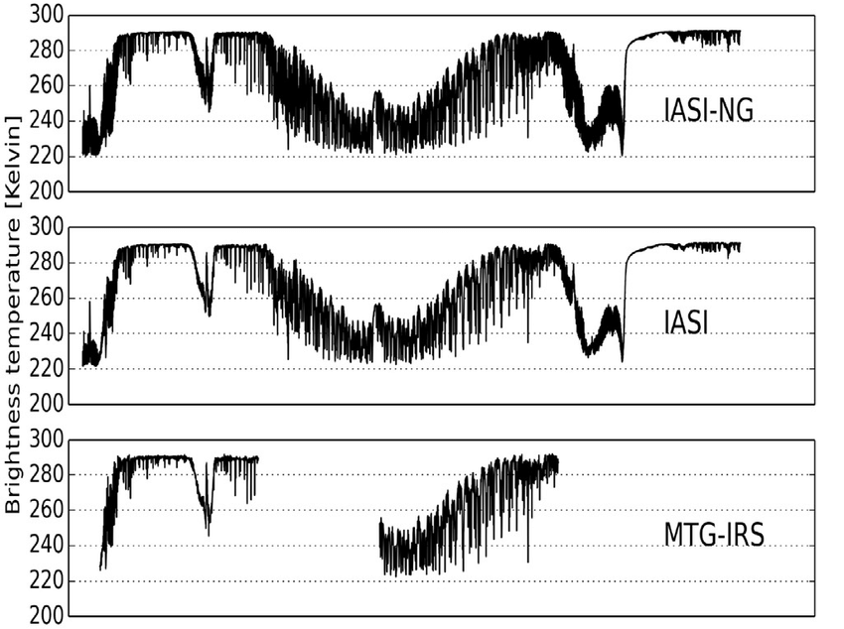
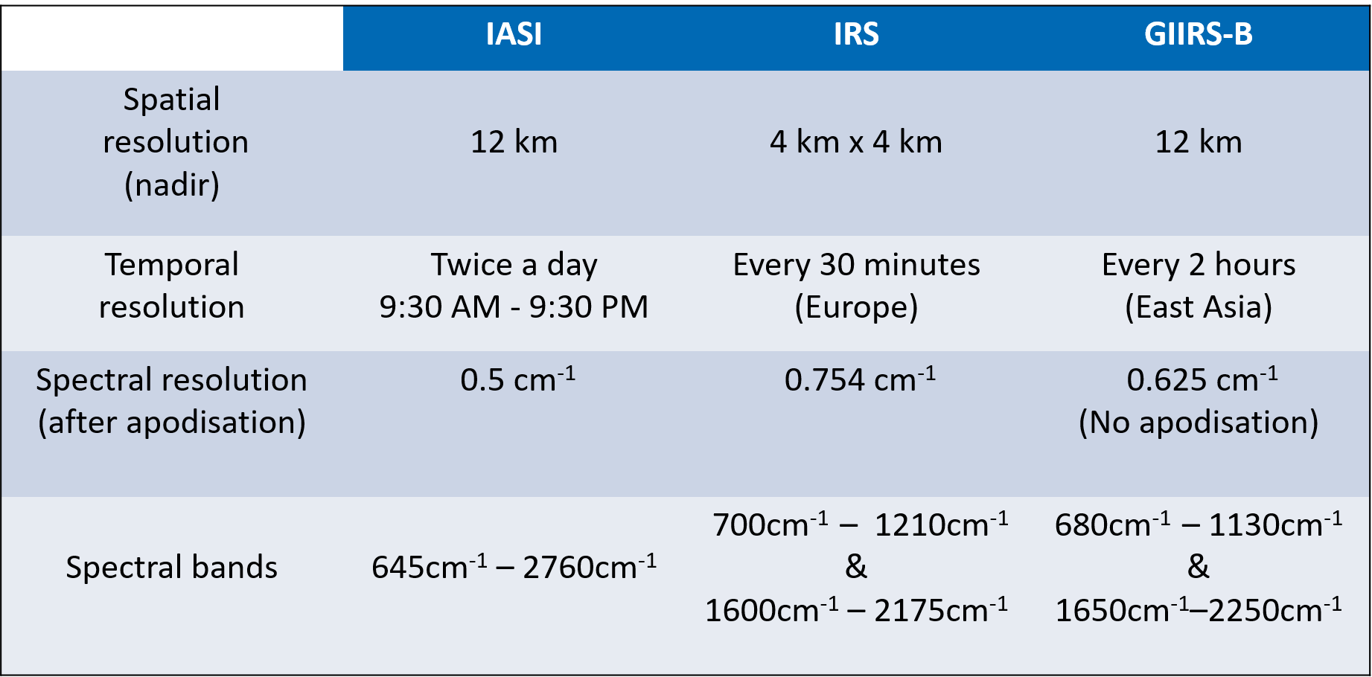
IRS = IR hyperspectral sounder on geostationary satellites
Continuous coverage of the Earth surface ⇨ Better mapping opportunities
Higher spatial resolution (~7 km on-ground pixel size at mid-latitudes) ⇨ improved resolution of sources
High temporal sampling ⇨ Diurnal sampling; rapidly changing chemistry

Slide 5
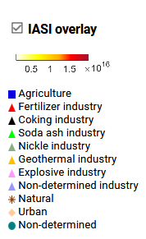
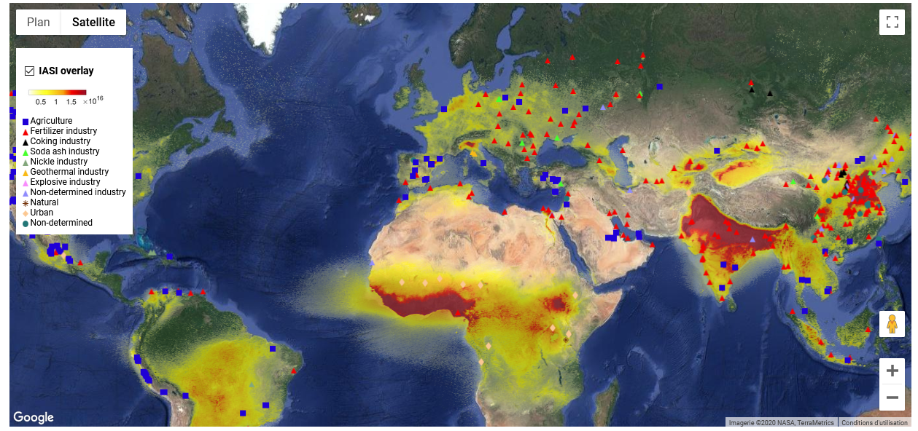
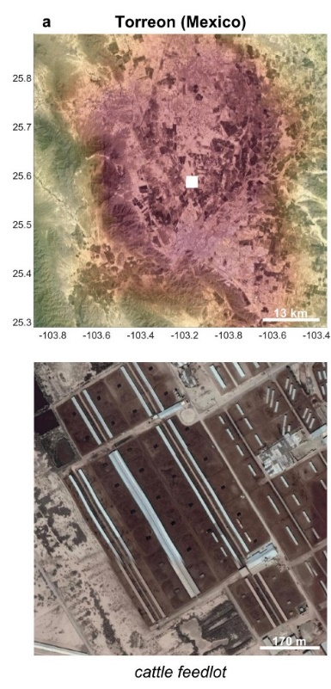
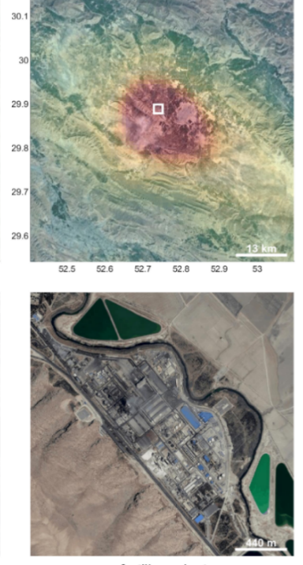
  Tracking down emission sources of NH₃
Torreon (Mexico)
Marvdasht
⇨https://www.ulb.ac.be/cpm/NH3-IASI.html
Missing or large underestimation of emissions in inventories

Slide 6
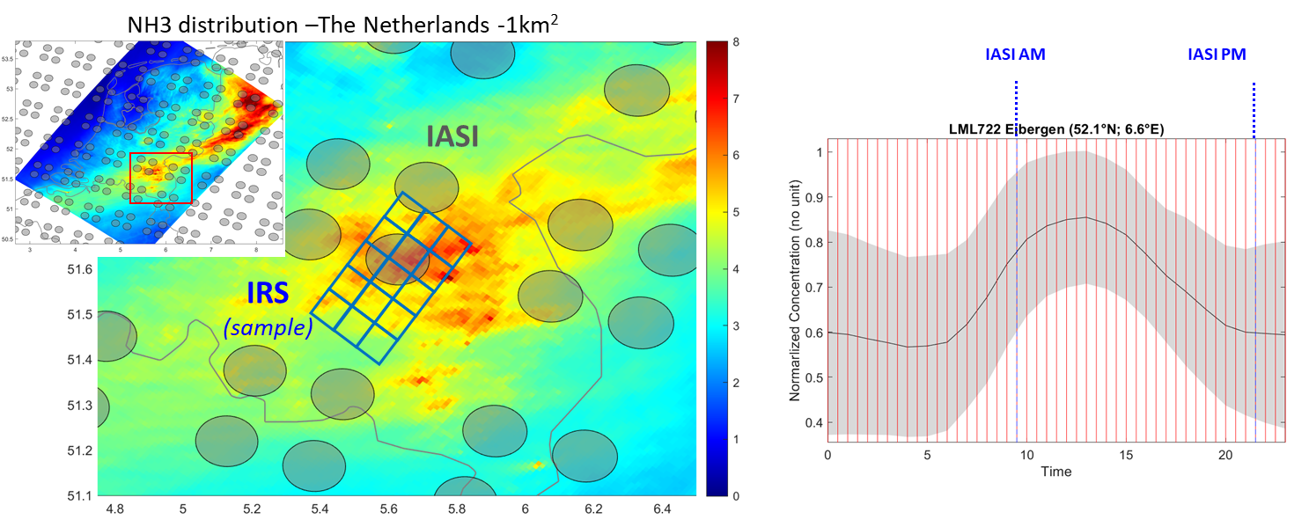
Contribution of IRS to air pollution and point source monitoring – example of ammonia
Mapping at higher spatial resolution and high sampling

Slide 7
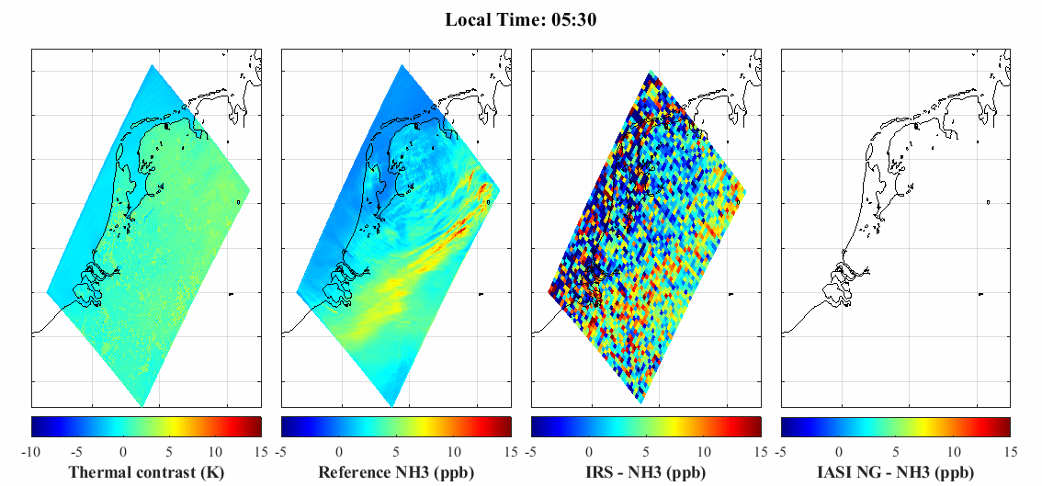
Contribution of IRS to air pollution and point source monitoring – example of ammonia
End-to-end simulations for IRS (and IASI-NG)
NH₃ mean PBL VMR @ 5:30 AM
Thermal
contrast
Reference
model distribution
Retrieved distribution
IRS
IASI-NG
?
?
MIMAG; EUMETSAT, 18-19.11.2019

Slide 8
Contribution of IRS to air pollution and point source monitoring – example of ammonia
End-to-end simulations for IRS (and IASI-NG)
NH₃ mean PBL VMR @ 5:30 AM
Thermal
contrast
Reference
model distribution
Retrieved distribution
IRS
IASI-NG
MIMAG; EUMETSAT, 18-19.11.2019

Slide 9
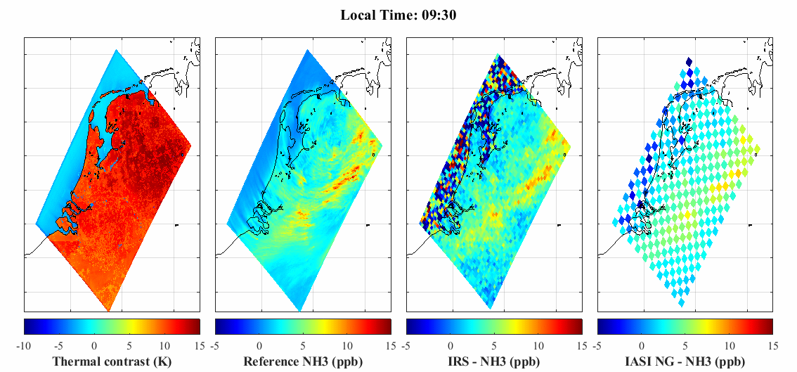
Contribution of IRS to air pollution and point source monitoring – example of ammonia
End-to-end simulations for IRS (and IASI-NG)
NH₃ mean PBL VMR @ 9:30 AM
Thermal
contrast
Reference
model distribution
Retrieved distribution
IRS
IASI-NG
?
?
MIMAG; EUMETSAT, 18-19.11.2019

Slide 10
Contribution of IRS to air pollution and point source monitoring – example of ammonia
End-to-end simulations for IRS (and IASI-NG)
NH₃ mean PBL VMR @ 9:30 AM
Thermal
contrast
Reference
model distribution
Retrieved distribution
IRS
IASI-NG
MIMAG; EUMETSAT, 18-19.11.2019

Slide 11
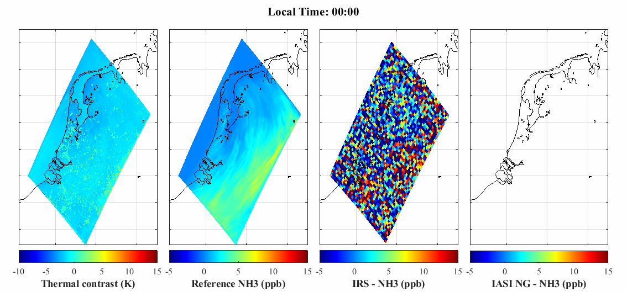
Contribution of IRS to air pollution and point source monitoring – example of ammonia
End-to-end simulations for IRS (and IASI-NG)
NH₃ mean PBL VMR @ ½ hour revisit time
Thermal
contrast
Reference
model distribution
Retrieved distribution
IRS
IASI-NG
MIMAG; EUMETSAT, 18-19.11.2019

Slide 12
Summary
IRS will be a central instrument for monitoring at high spatial resolution the diurnal cycle of emissions and air pollution
Certainly for short-lived species (NH₃; C₂H₄; dust); demonstrated here with NH₃ , but strong dependency on temperatures >> main contribution during daytime above land
Very high added value over polar hyperspectral IR sounders
Similar impact of IRS for longer-lived species (eg CO, O₃) is possible
GIIRS is a great instrument to test our retrieval algorithms

