Slide 1
Expanding Geostationary Atmospheric Composition Satellite Constellation: Towards Global Coverage
Ali Omar, Arlindo daSilva, Jonathan E Hickman, Barry Lefer, NASA
Pieternel Levelt, UCAR/NCAR, KNMI, TU Delft
Helen Worden, UCAR/NCAR
Shoba Kondragunta, NOAA
Sheldon Drobot, Dennis Nicks, BAE
Raid M Suleiman, CfA | Harvard & Smithsonian
Omar Emam, Intospass, UK
Ben Veihelmann, ESA, the Netherlands
Paulo Artaxo, University of Sao Paulo, Brazil
Jun Wang, University of Iowa

Slide 2
Outline of White Paper and this Presentation
01
THE CHALLENGE
02
CURRENT LANDSCAPE
Observation Gap
Limitations of existing observations
03
CLOSING THE GAP
04
CO₂ and CH₄ GAPS
Geostationary Solution
The case for Geo Obs. of GHG
05
COMMERCIAL DATA
06
GROUND TRUTH
Opportunities and Limitations
Strengthening ground-based monitoring in the global South
07
SYNERGISTIC BENEFITS
08
A CALL TO ACTION
Integrated Observations plus Modeling
Case for improved atmos. composition observations
Notes:
This White Paper exposes a critical gap in our ability to understand and address climate change and air quality: our limited observation of atmospheric composition. This presentation will make the case for investing in geostationary satellites as a vital complement to existing observation systems."

Slide 3
Action: White paper expanding current Geo AC-VC observations to the Middle East, Africa, South America and the Oceania Region and adding GHGs
Expanding Geostationary Atmospheric Composition Satellite Constellation: Towards Global Coverage
In 2024, the CEOS Atmospheric Composition Virtual Constellation (AC-VC) commissioned a team to work on a White Paper that calls for global coverage of air quality and greenhouse gas observations and complements the current virtual constellation of GEMS, TEMPO and Sentinel 4
A small team has been meeting bi-weekly to develop this white paper and submit a draft to the CEOS Strategic Implementation Team (SIT) at its October 2025 Meeting with a finalized White Paper by December 31, 2025
Notes:
Commissioned might be too strong a term – We volunteered to outline the white paper during an AGU side meeting in 2023 and are now working on writing it. We have presented the concept at AMS, EGU and others have spoken about it at WMO

Slide 4
Expanding Geostationary Atmospheric Composition Satellite Constellation: Towards Global Coverage
The Challenge – Addressing the Gap in Observations
  Atmospheric composition is rapidly changing, driven by human activities.
  Changes impact climate, air quality, and human health.
  Accurate monitoring is essential for effective mitigation and adaptation.
  Evaluate the effects of regulations and mitigation strategies on air quality and GHG globally
  Establish geostationary satellites for measurements of CO₂ and CH₄
  Many parts of the Global South and highly populated regions of the Global North are not covered by the current constellation of geostationary satellites
Notes:
Our atmosphere is undergoing rapid and unprecedented changes. Driven primarily by human activities, these changes have profound impacts on our climate, the air we breathe, and ultimately, our health. Accurate monitoring is the cornerstone of any effective strategy to mitigate these impacts and adapt to a changing world. Other speakers following this talk will address regional challenges and solutions.

Slide 5
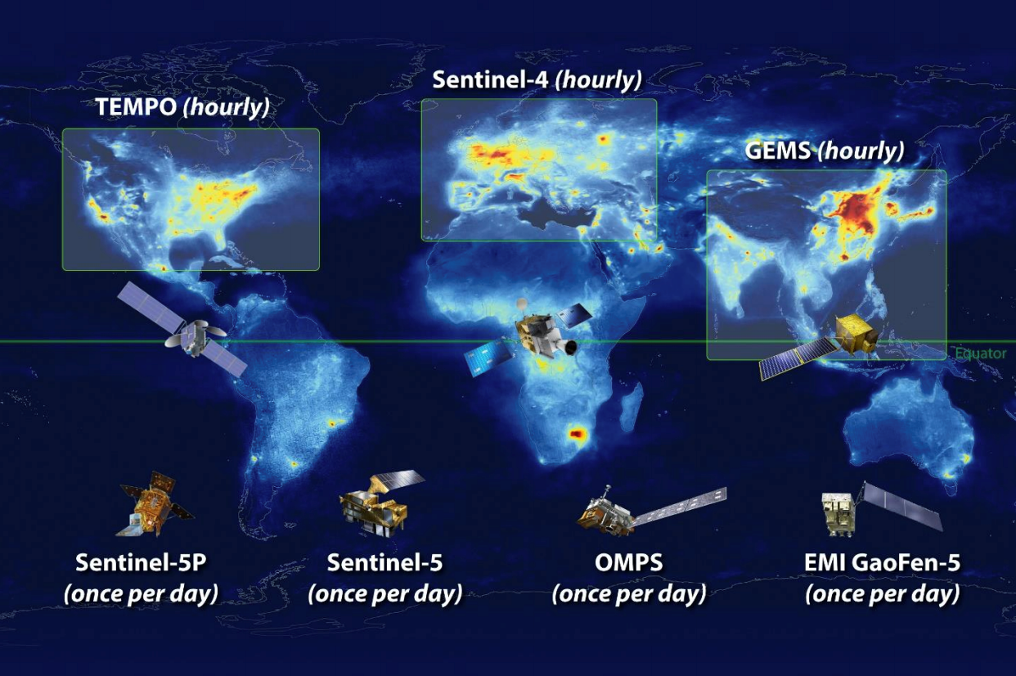
The Current Landscape
Expanding Geostationary Atmospheric Composition Satellite Constellation: Towards Global Coverage
  The CEOS Atmospheric Composition Virtual Constellation (AC-VC) provides valuable data.
  Polar-orbiting satellites offer global coverage, but limited temporal resolution.
  Gaps remain in observing diurnal cycles, rapidly changing events, and specific pollutants.
Notes:
The CEOS AC-VC represents a significant effort to coordinate global atmospheric composition observations. However, relying primarily on polar-orbiting satellites means we only get a 'snapshot' of a given location once or twice a day. This limits our ability to capture rapidly evolving events, understand diurnal variations, track certain critical pollutants, and improve forecasting skill for key conditions such as daily air quality.

Slide 6
Closing the Gap: The Global Geostationary Satellite Solution (hourly)
Expanding Geostationary Atmospheric Composition Satellite Constellation: Towards Global Coverage
  Four new geostationary satellites in the next decade
  Continuous, wide-area coverage over the Global South.
  Complementing and enhancing existing constellation
  Identifying pollution hotspots and tracking transboundary pollution to and from the Global South
  Significant ownership and participation at the regional level to build capacity.
MEASMA
Geo-N
Geo-SA
Geo-AUS
Geo-S
The benefits of investing in geostationary atmospheric composition monitoring extend far beyond the scientific realm. By improving our ability to predict and respond to environmental challenges, we can realize significant economic savings in areas such as healthcare, agriculture, resource management, and reducing the economic impact of disasters and extreme weather.

Slide 7
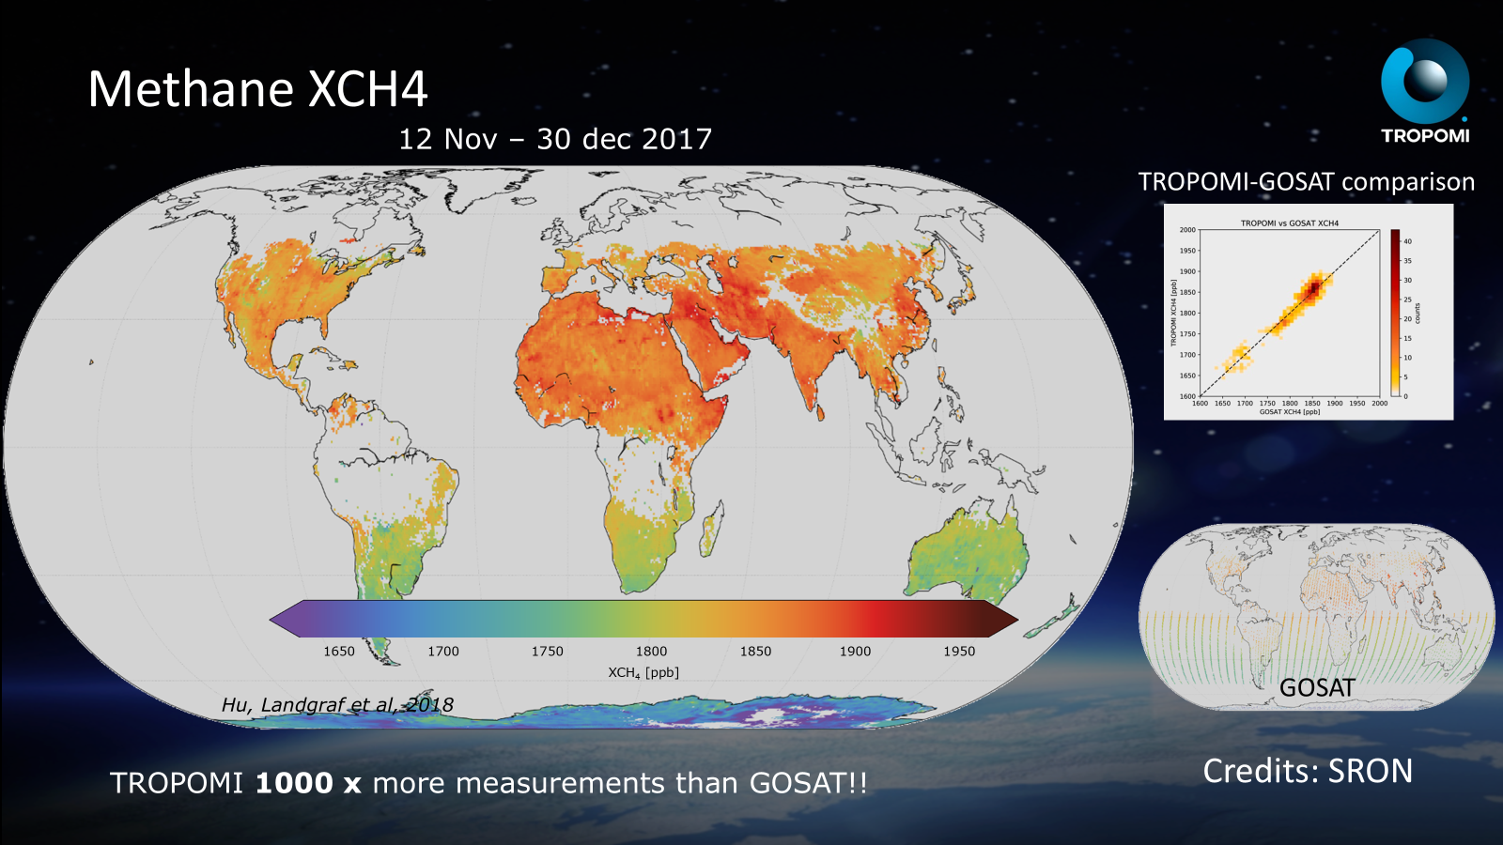
CO₂ and CH₄ Measurement Gaps
Expanding Geostationary Atmospheric Composition Satellite Constellation: Towards Global Coverage
CH₄ sources are highly localized .
Existing constellation lacks continuous CO₂ and CH₄ high temporal measurements.
Geostationary satellites with appropriate sensors can fill this gap.
Improved monitoring of methane leaks and other sources.
A geostationary satellite equipped with advanced sensors can provide the necessary temporal resolution to track these gases effectively, enabling better monitoring of methane leaks from oil and gas operations, wetlands, and other key sources
Notes:
While current satellites measure a variety of atmospheric components, continuous monitoring of critical greenhouse gases like carbon dioxide and methane remains a challenge. The white paper team could use volunteers to participate or advise in this area

Slide 8
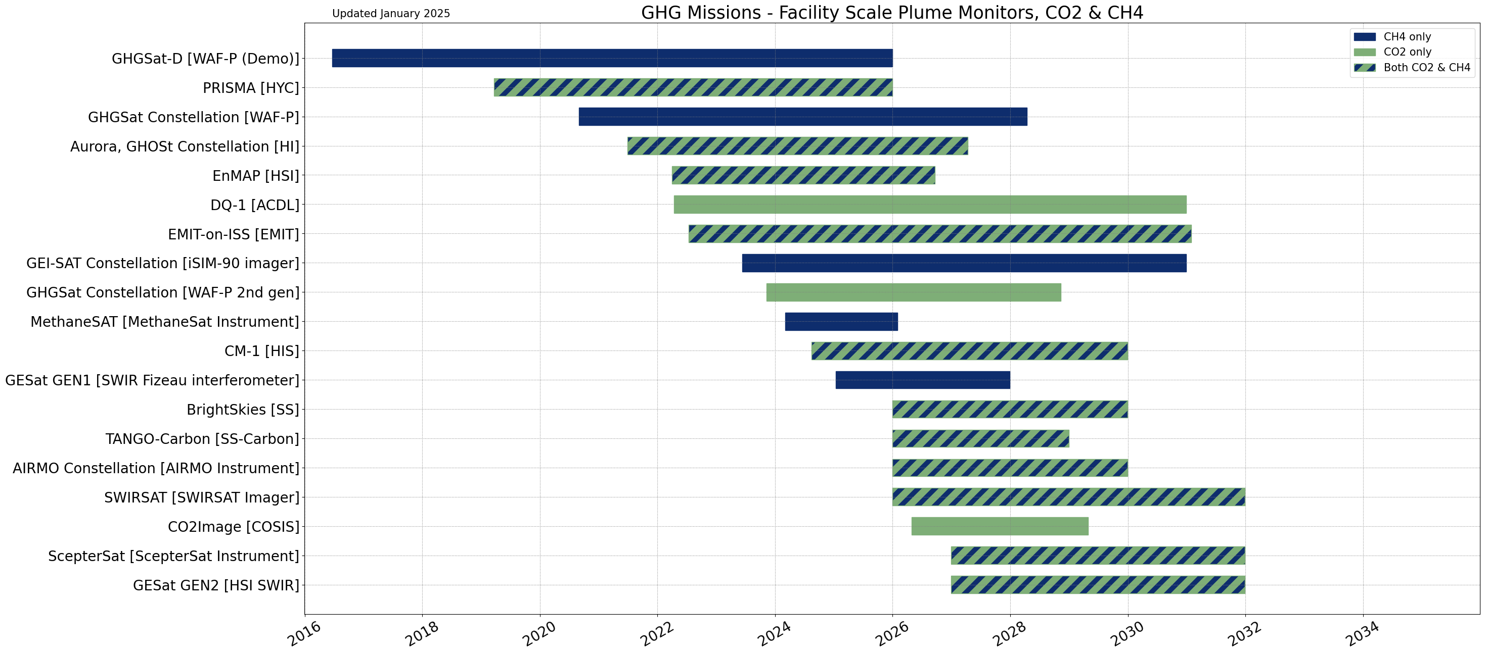
Expanding Geostationary Atmospheric Composition Satellite Constellation: Towards Global Coverage
CEOS-CGMS coordination to tap into emerging commercial satellite capabilities to track facility scale GHG emissions. Targeted high resolution spatial mapping of plumes to detect, report, and mitigate.
A comprehensive, international effort to coordinate civil space and New Space (commercial) observations, led by CEOS
and CGMS, could yield benefits to both stakeholders in two areas:
Source attribution via “tip and cue” methods – civilian satellite maps out methane or carbon dioxide anomalies and commercial satellite zooms in to map out the plumes at high spatial resolution
Standards and best practices - the adoption of common, internationally recognized standards for the collection, analysis, documentation and distribution of space-based GHG products for interoperability and transparency of commercial satellite data
https://ceos.org/document_management/Publications/Publications-and-Key-Documents/Atmosphere/CEOS_CGMS_GHG_Roadmap_Issue_2_V1.0_FINAL.pdf
Notes:
This is a slide from Shoba, so if she is online, we could discuss it further. The white paper will address how we can leverage Analysis Ready Data (ARD) concepts and define the relevant Product Family Specifications (PFS)

Slide 9
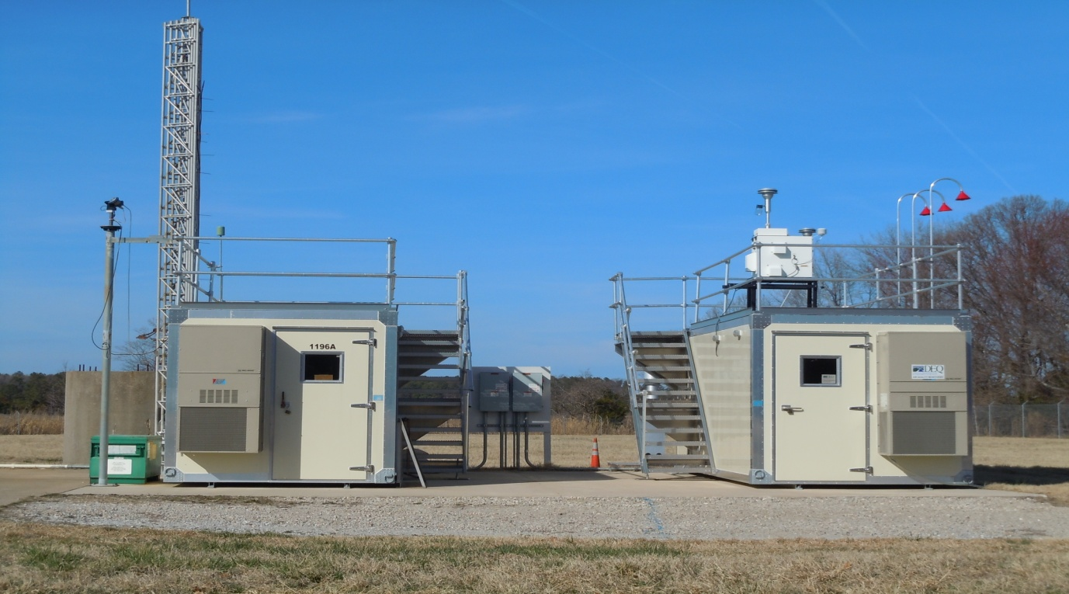
Strengthening Ground-Based Monitoring in the Global South
Expanding Geostationary Atmospheric Composition Satellite Constellation: Towards Global Coverage
9
  Existing ground-based networks (e.g., AERONET, TCCON) need expansion.
  Establishment of strategically located "super sites."
  Focus on comprehensive instrumentation and local capacity building.
  Engage diaspora scientists in the north to reach local institutions (AMS Townhall)
Credit: Ali Omar
  The stark disparity in atmospheric composition monitoring between the Global North and the Global South creates an issue, as these regions are often disproportionately impacted by pollution and climate change but lack the resources to monitor and mitigate the impacts effectively.
Notes:
To address the observation deficit, we need to strengthen ground-based monitoring in the Global South. This includes expanding existing networks and establishing strategically located "super sites" equipped with a comprehensive suite of instruments. Crucially, these sites should be designed to foster local scientific capacity and promote data sharing

Slide 10
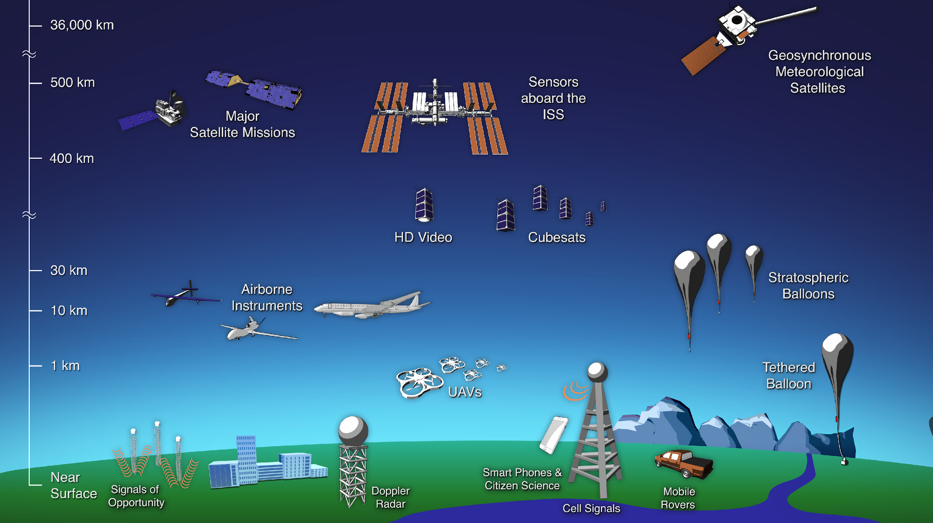
Synergistic Benefits: Integrated Observations
Expanding Geostationary Atmospheric Composition Satellite Constellation: Towards Global Coverage
  Combining geostationary, polar-orbiting, and ground-based data.
  Creating a more complete and accurate picture of atmospheric composition.
  Data fusion techniques and algorithms.
  Artificial intelligence and machine learning methods to squeeze more information out of the data
  A complete global geostationary constellation affords a great opportunity
  Improvements in modeling and forecasting skill
Improvements in modelling skill have significant economic and social benefits
Notes:
Quantify the potential economic benefits of improved modeling skill. This could include:
Reduced healthcare costs associated with air pollution-related illnesses.
Improved agricultural yields through better predictions of drought and extreme weather.
More effective resource management (e.g., water resources).
Reduced economic losses from climate change impacts

Slide 11
Expanding Geostationary Atmospheric Composition Satellite Constellation: Towards Global Coverage
Schedule
White Paper Outline and Assignments Approved
Submit Final White Paper to CEOS AC-VC
Mar 19
AMS / Townhall on African Air Quality/ Engage AfMS
Jan 31
Dec 31
2025
Q1
Q2
Q3
Q4
2025
Jan
Feb
Mar
Apr
May
Jun
Jul
Aug
Sep
Oct
Nov
Dec
Today
First Draft of the White Paper
55 days
Apr 2 - Jun 13
21st CEOS AC-VC Joint with IWGGMS
5 days
Jun 9 - Jun 13
Second Draft of the White Paper
36 days
Jun 16 - Aug 4
Third Draft of White Paper including Secondary Co-authors
45 days
Aug 5 - Oct 6
22nd CEOS AC-VC Meeting
5 days
Oct 15 - Oct 21
COSPAR 2025 Scientific Symposium
5 days
Nov 2 - Nov 7
AGU Fall Meeting
5 days
Dec 15 - Dec 19

Slide 12
Call to Action
  Urgent need for improved atmospheric composition monitoring.
  Geostationary satellites are a vital complement to existing systems.
  Invest in geostationary atmospheric composition monitoring for a sustainable future.
  Join our team if you want to participate
  Write to: ali.h.omar@nasa.gov
Notes:
Social and Economic Benefits
Reduced healthcare costs (air pollution).
Improved agricultural yields (climate predictions).
More effective resource management.
Reduced losses from extreme weather events.

Slide 13

THANK YOU!

Slide 14
Expanding Geostationary Atmospheric Composition Satellite Constellation: Towards Global Coverage
Commercial Data Utilization
Leverage the Analysis Ready Data (ARD)* concepts for Geostationary Air Quality/Greenhouse Gas Observing Satellites and include relevant Product Family Specifications (PFS)
Enables Easier Commercial Data Integration: ARD standards reduce the burden on commercial users to pre-process and harmonize data from different sources. This promotes wider adoption of commercial satellite data products, as users can focus on analysis and application rather than data preparation.
Facilitates Interoperability: ARD ensures data from different sensors and platforms (including commercial and public) can be easily combined for synergistic analysis. This is crucial for comprehensive monitoring of air quality and greenhouse gases.
Supports Time-Series Analysis: ARD specifications for temporal consistency are vital for tracking changes in air quality and greenhouse gas concentrations over time. This is particularly relevant for long-term monitoring programs.
Promotes Data Quality and Trust: The CEOS-ARD assessment process provides a mechanism to verify and validate data quality, enhancing user confidence in the reliability of commercial data for critical applications.
Potentially Lowers Costs for Users: By shifting the burden of pre-processing to data providers, ARD can potentially reduce the costs associated with data preparation and analysis for commercial users.
Geostationary Applications: ARD helps bring standardization and quality control to data obtained from geostationary sensors, which could then be more easily incorporated with data from polar orbiting satellites or ground based sensors.
*Definition: Analysis Ready Data (ARD) are satellite data processed to a minimum set of requirements, organized for immediate analysis, requiring minimal additional user effort, and ensure interoperability (time & other datasets) CEOS-ARD WG.
Notes:
The white paper will address how we can leverage ARD concepts and define the relevant PFS

