Slide 1

Geostationary Atmospheric Composition: Observational Needs for South America
Arlindo da Silva¹ and Paulo Artaxo²
¹NASA Goddard Space Flight Center, Maryland, USA
²University of São Paulo, São Paulo, Brazil
With contributions from the Global Geostationary AC-VC Community

Slide 2
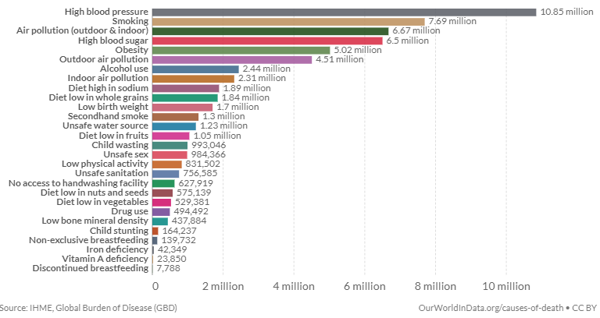
Air-quality & Human Health
4 million premature deaths attributed to outdoor air pollution
Poor air quality is leading cause of premature fatalities
World Bank estimates air pollution costs global economy $8.1 Trillion dollars in losses
Slide Courtesy: BAE Systems

Slide 3
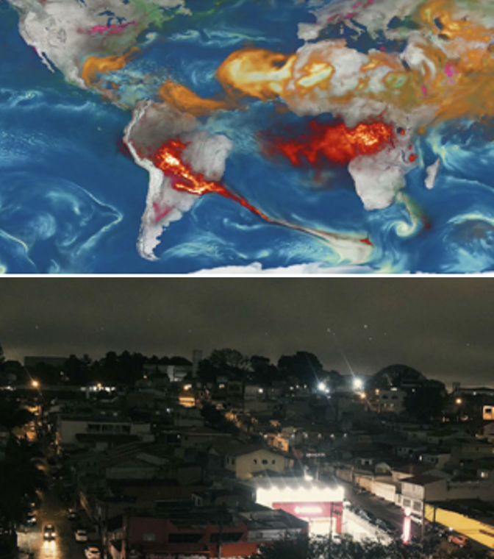
Increased Wildfire Threat
Smoke AOD from the GEOS-FP Aerosol Data Assimilation System
São Paulo in the middle of the day
Source: The Washington Post
August 19, 2019

Slide 4
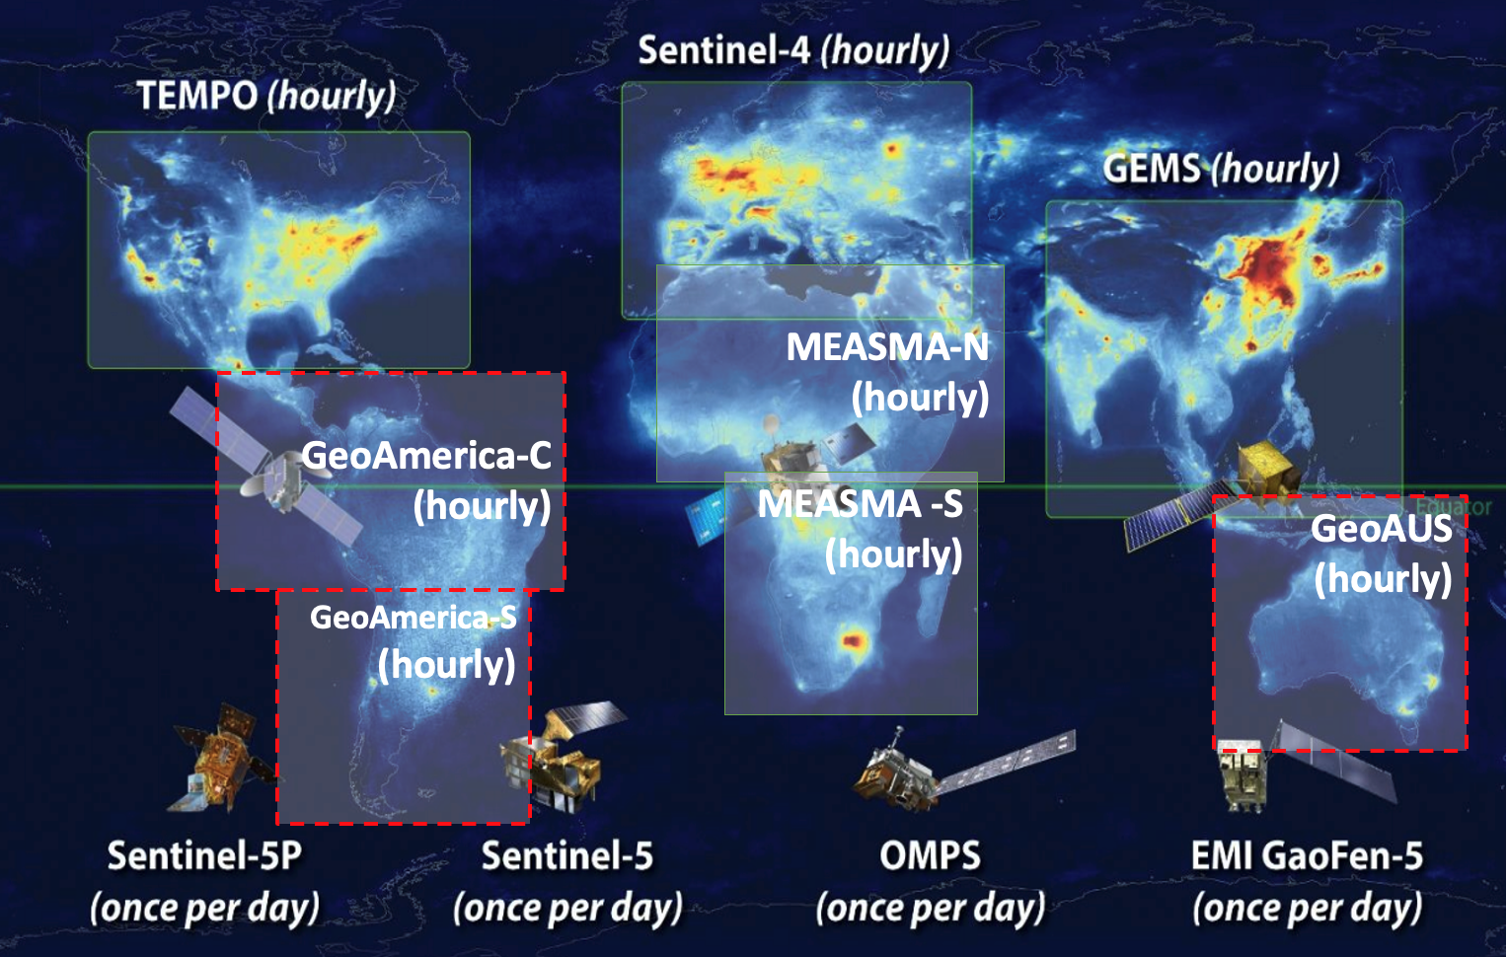
The Atmospheric Composition PoR:
TEMPO, GEMS & Sentinel 4
The Low-Earth Orbit (LEO) satellites, while offering global coverage, provide only once per day measurements
The geostationary satellites TEMPO, GEMS and Sentinel-4 are offering revolutionary approaches for high spatial and temporal air quality monitoring, especially over North America, Europe, and Southern & Eastern Asia
However, significant coverage gaps remain across the southern hemisphere.

Slide 5
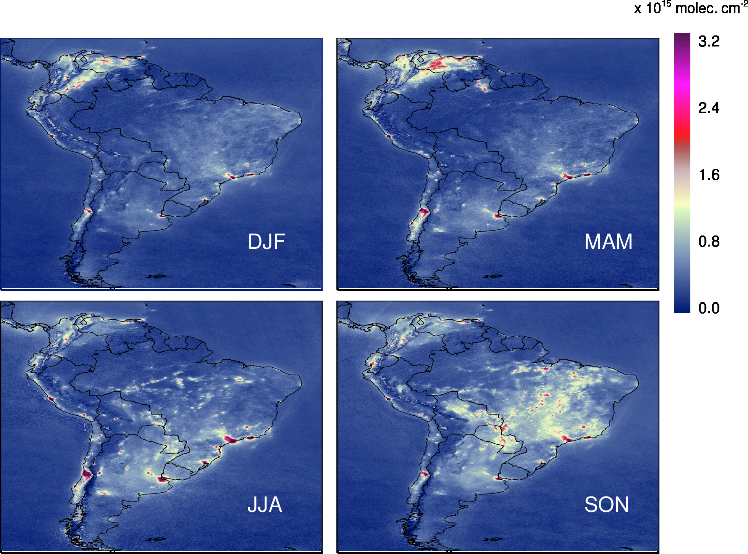
South America
All pollution sources are present in South America:
Smoke – biomass burning
O3 – anthropogenic emissions
NO₂ – fossil fuel combustion
HCHO – Biogenic Emissions
There are limitted ground-based measurements
There is a lack of emission estimates over South America
There is an urgent need for new capability for air quality management for health and environment
Image Credit: Lok Lamasal (NASA/GSFC)

Slide 6
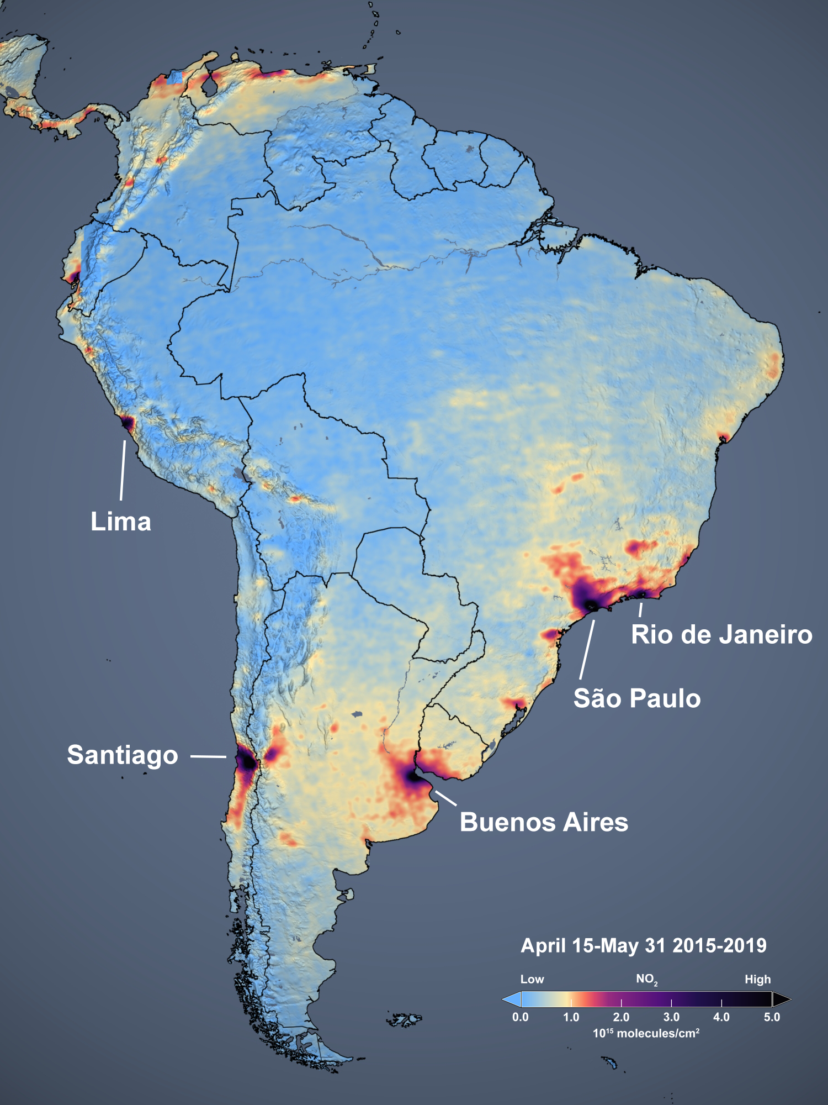
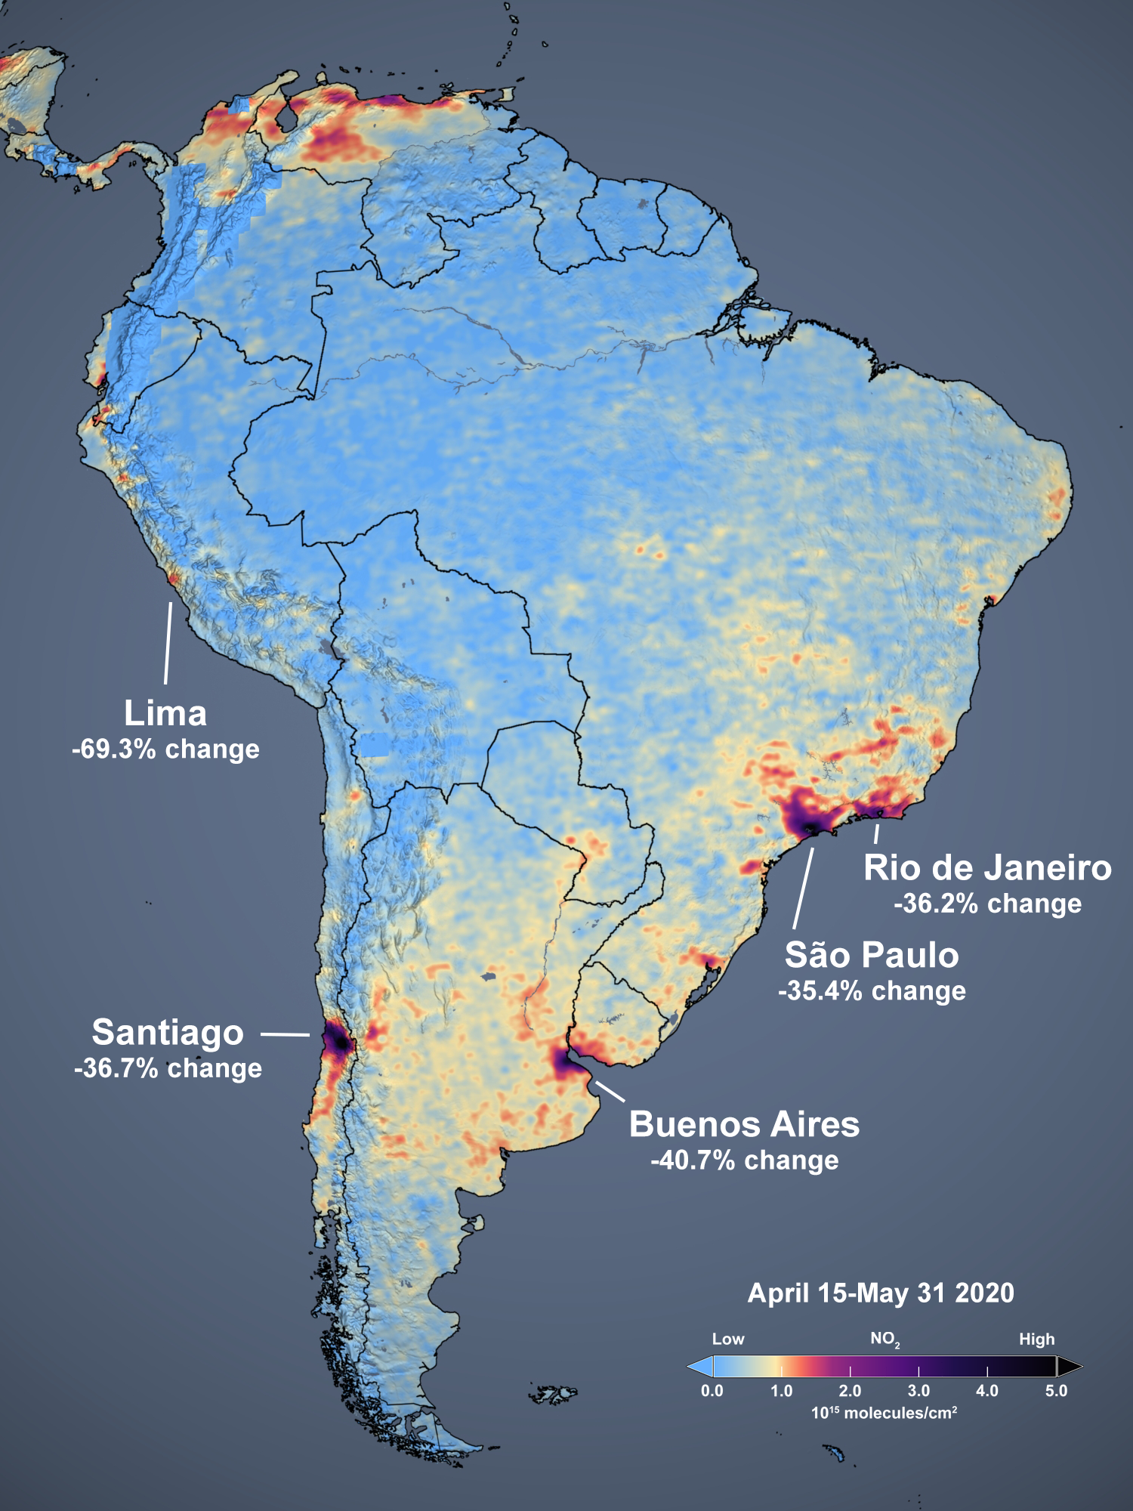
OMI NO₂ Measurements over South America:
COVID Lockdown
Image Credit:
NASA GSFC
Scientific
Visualization
Studio
Slide Courtesy:
A. da Silva
(NASA/GSFC)

Slide 7
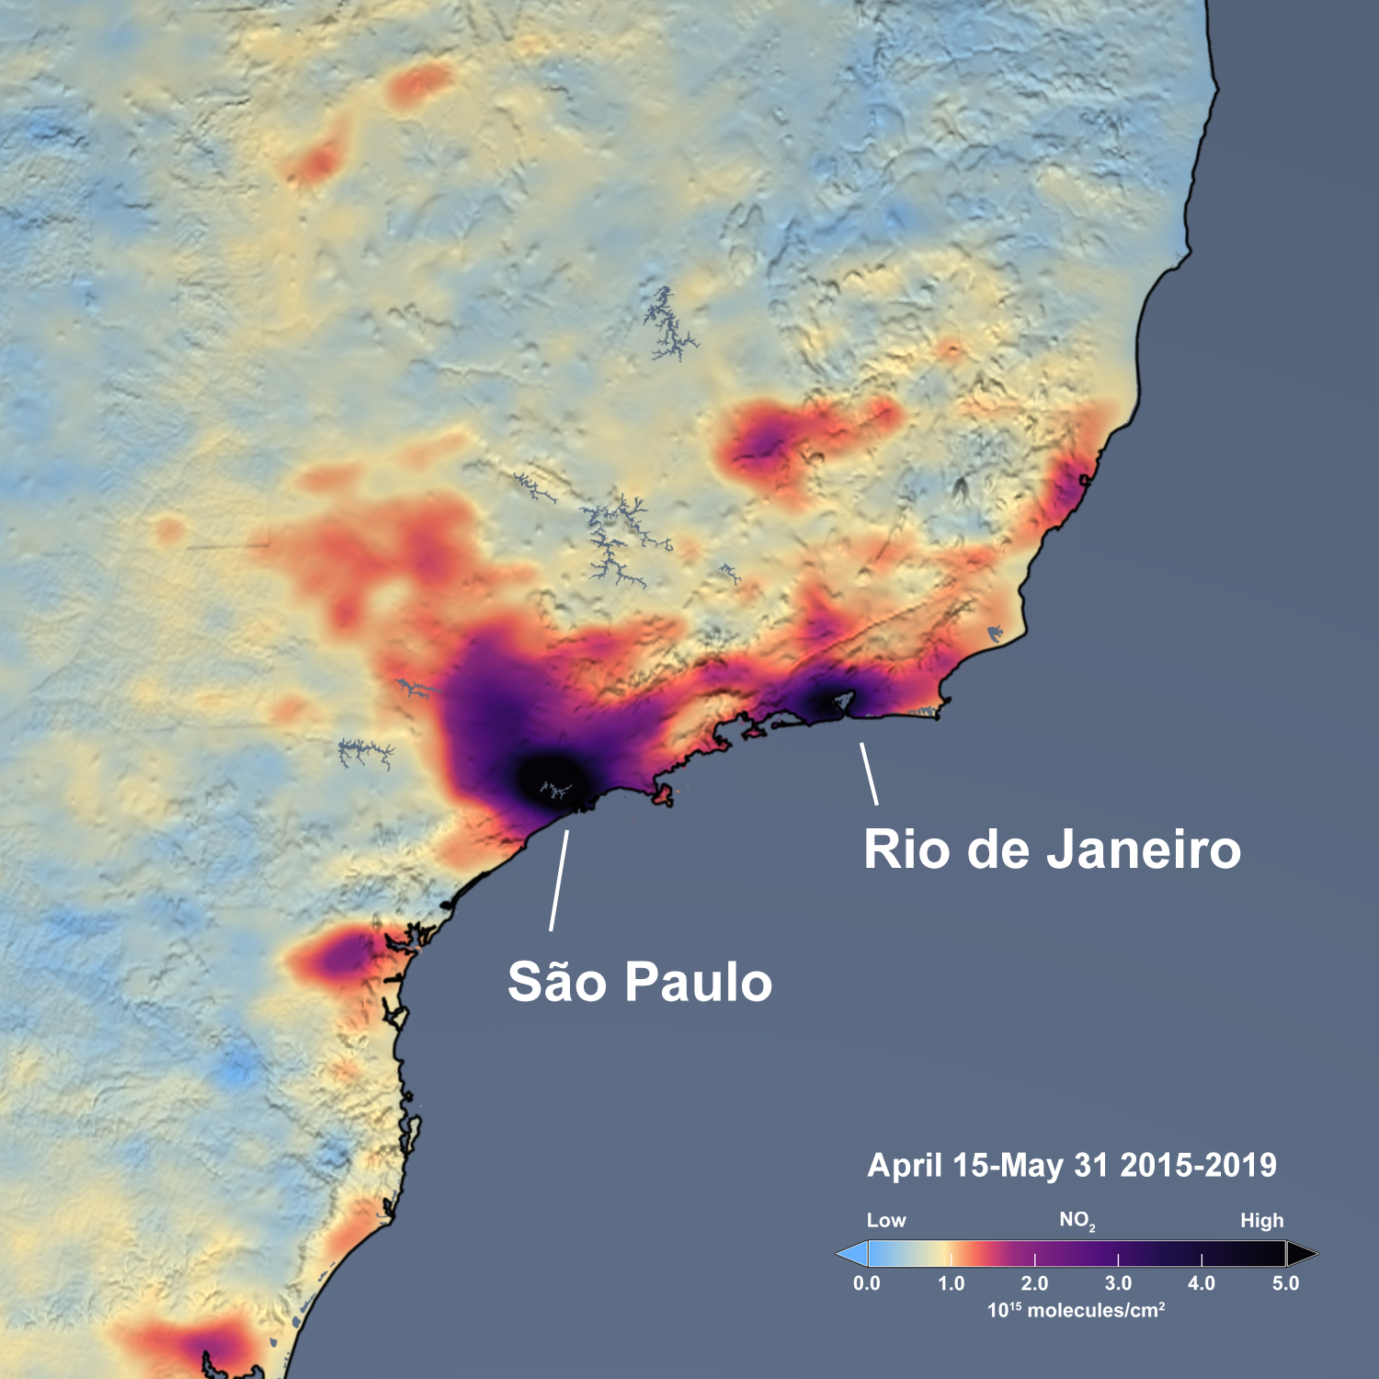
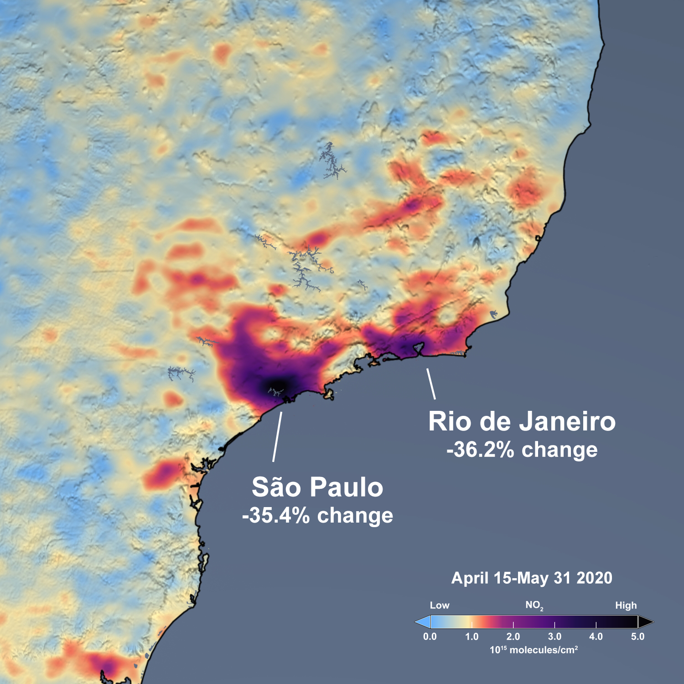
OMI NO₂ Measurements over South America:
COVID Lockdown
Image Credit:
NASA GSFC
Scientific
Visualization
Studio
Slide Courtesy:
A. da Silva
(NASA/GSFC)

Slide 8
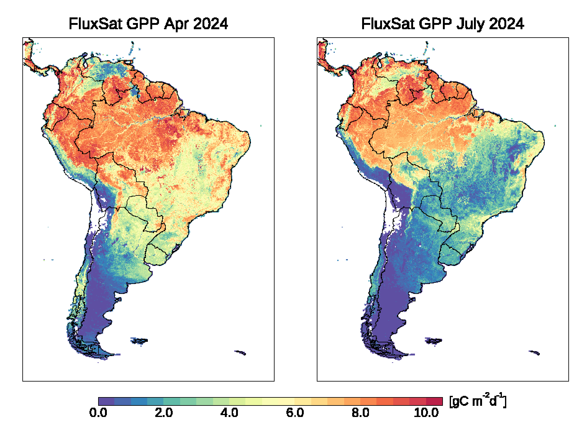
Gross Primary Production of Vegetation
MODIS generated GPP using AI/ML algorithm trained on Flux Tower Data
With MODIS, a 16-day time window is required to produce these images
With hyperspectral GEO data similar maps can potentially be created in near real-time, even under moderate cloudiness.
Slide Credit: Joanna Joiner (NASA/GSFC)

Slide 9
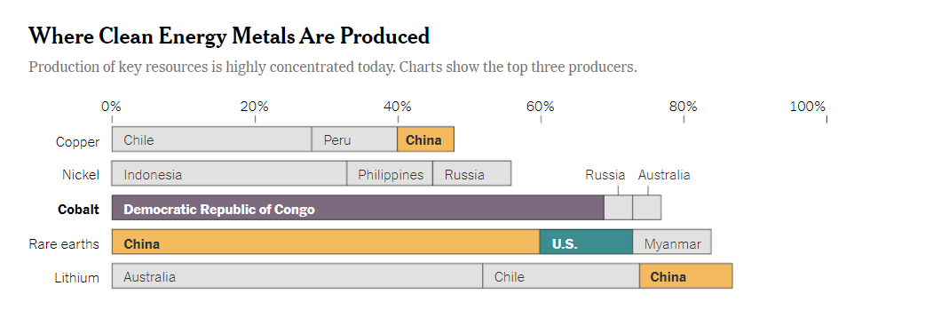
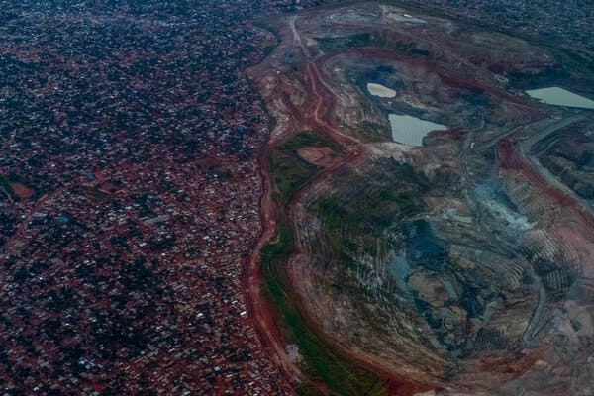
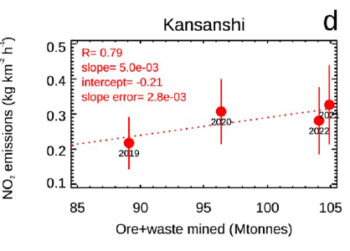
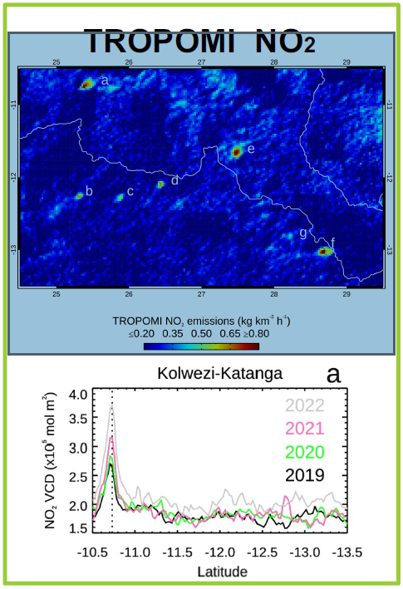
Emissions from Metal Mining
Source: New York Times 2021
NOx Emissions follow Production
Martinez-Alonso et al., JGR 2023, NCAR ACOM
Slide Courtesy: Pieternel Levelt (NCAR)

Slide 10
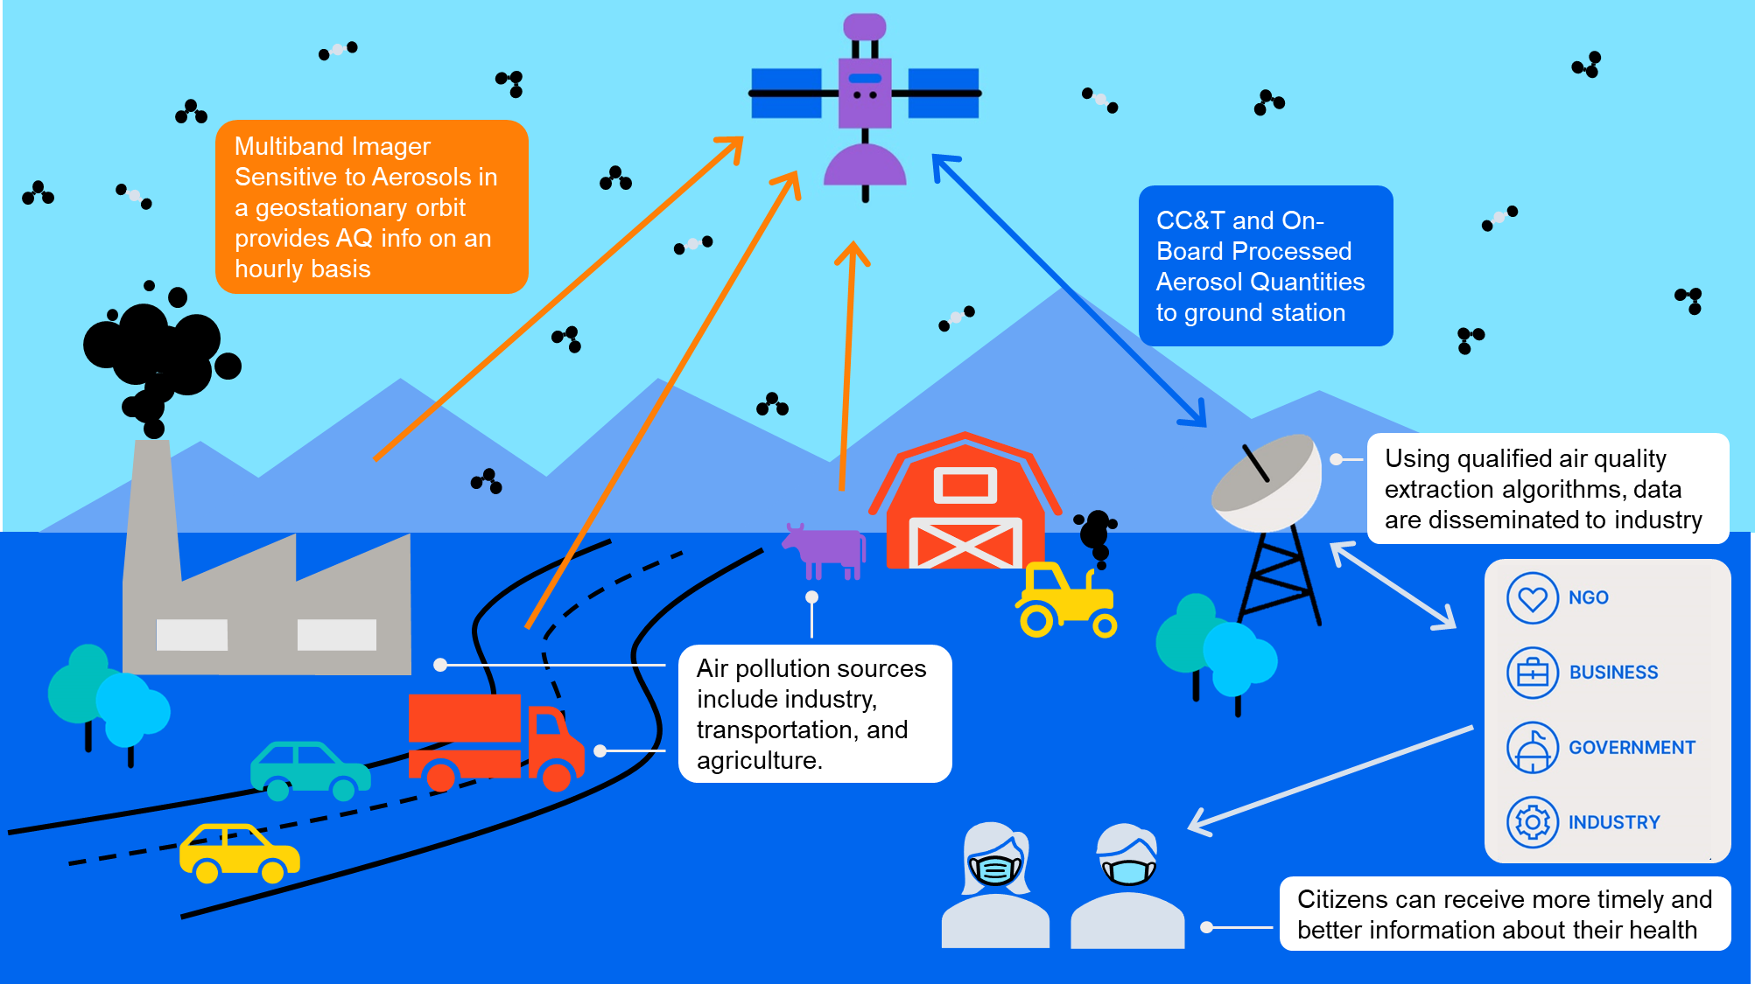
A Global Air-quality Network
Vision
  An integrated observing, modeling and warning system
Approach
  Integrate LEO, GEO, airborne and ground-based measurements into physical and AI/ML based modeling and data assimilation systems
Measurements
  Ozone, aerosols (such as PM2.5), NOx, SOx, and numerous other gases
Image Courtesy: BAE Systems

Slide 11

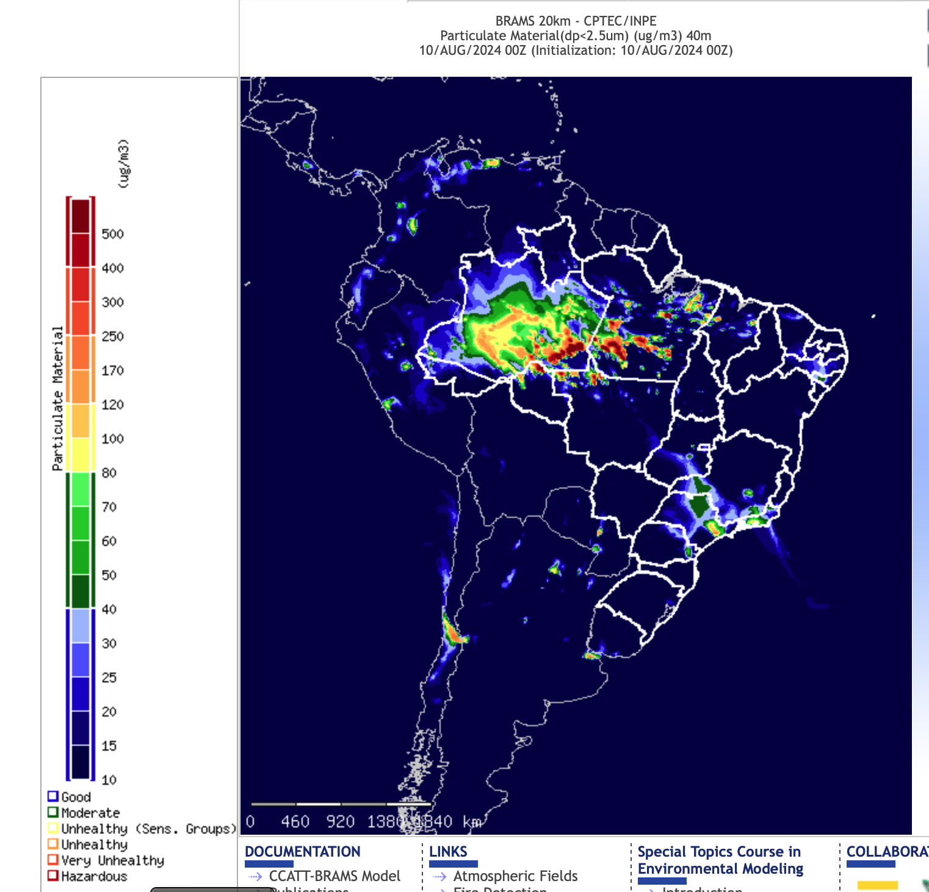
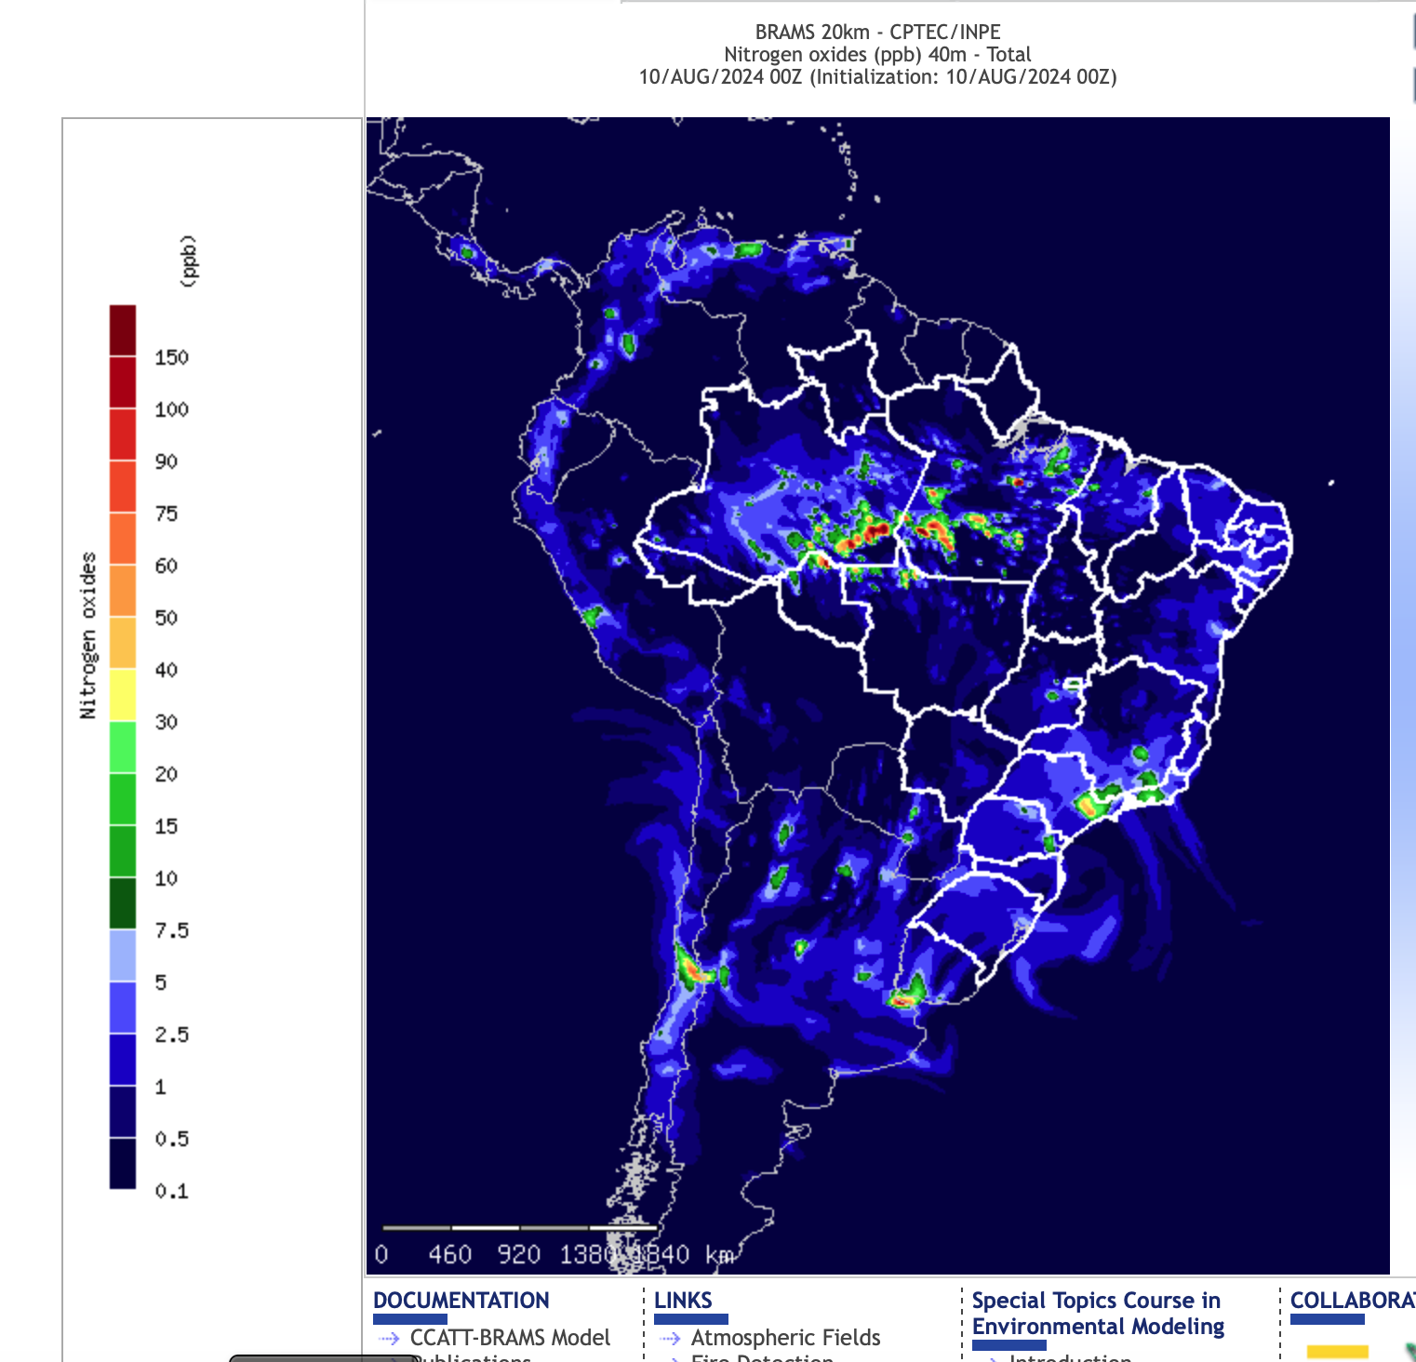
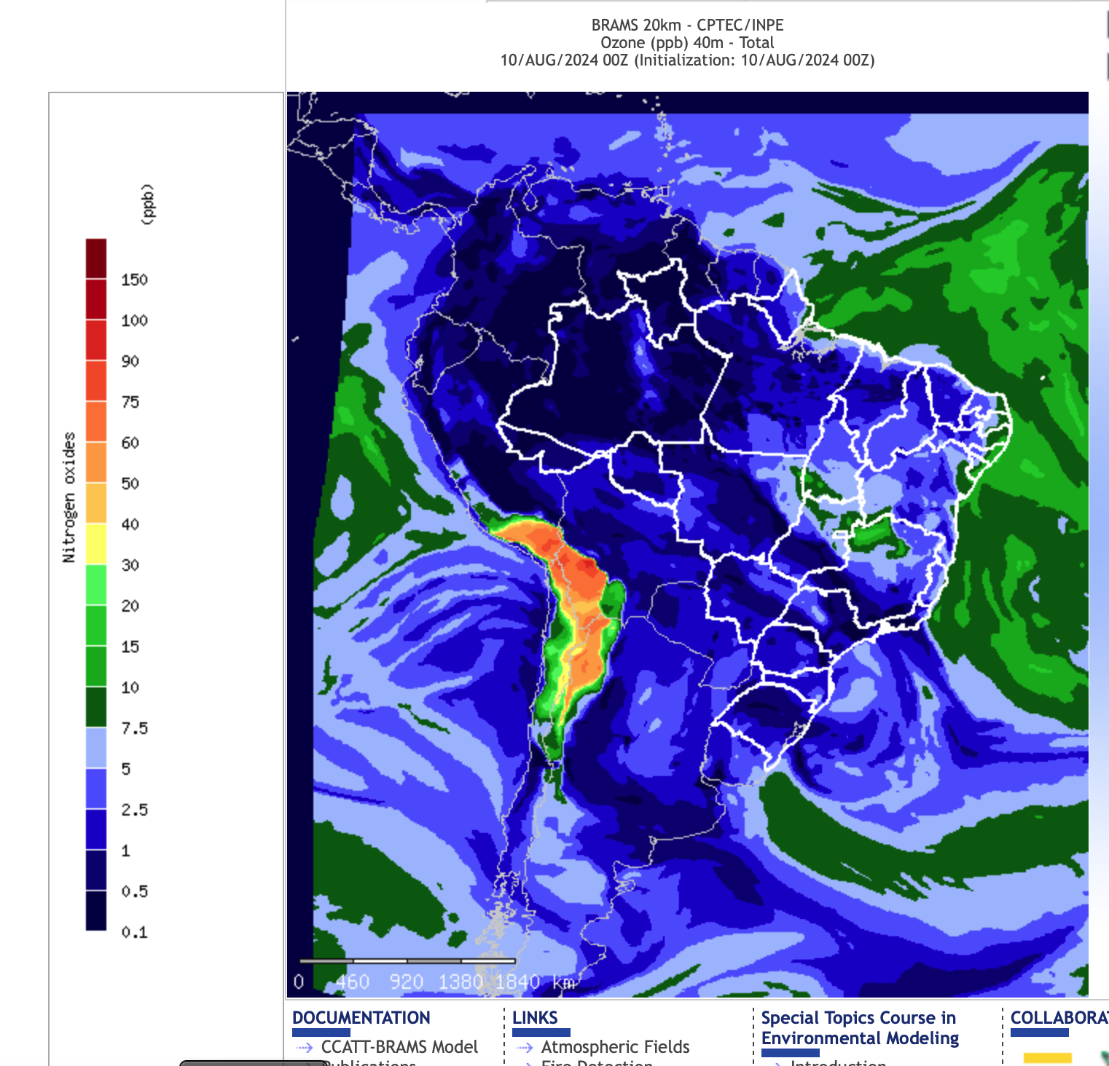
Air-quality Modeling at INPE
Image Credit: http://meioambiente.cptec.inpe.br
Slide courtesy: A. da Silva (NASA/GSFC)

Slide 12
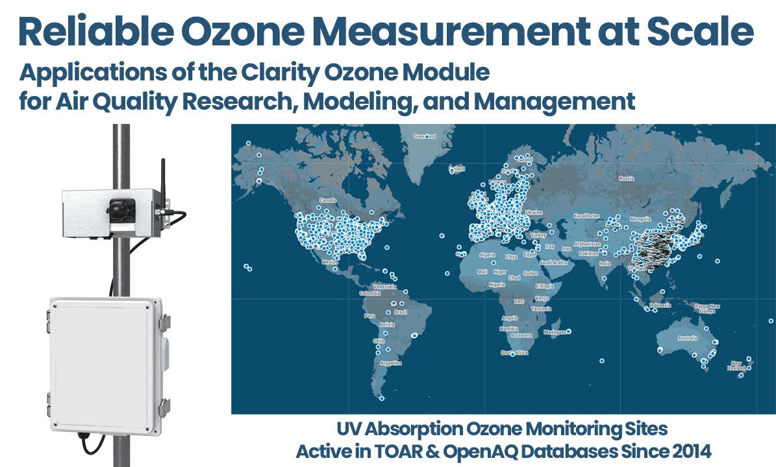
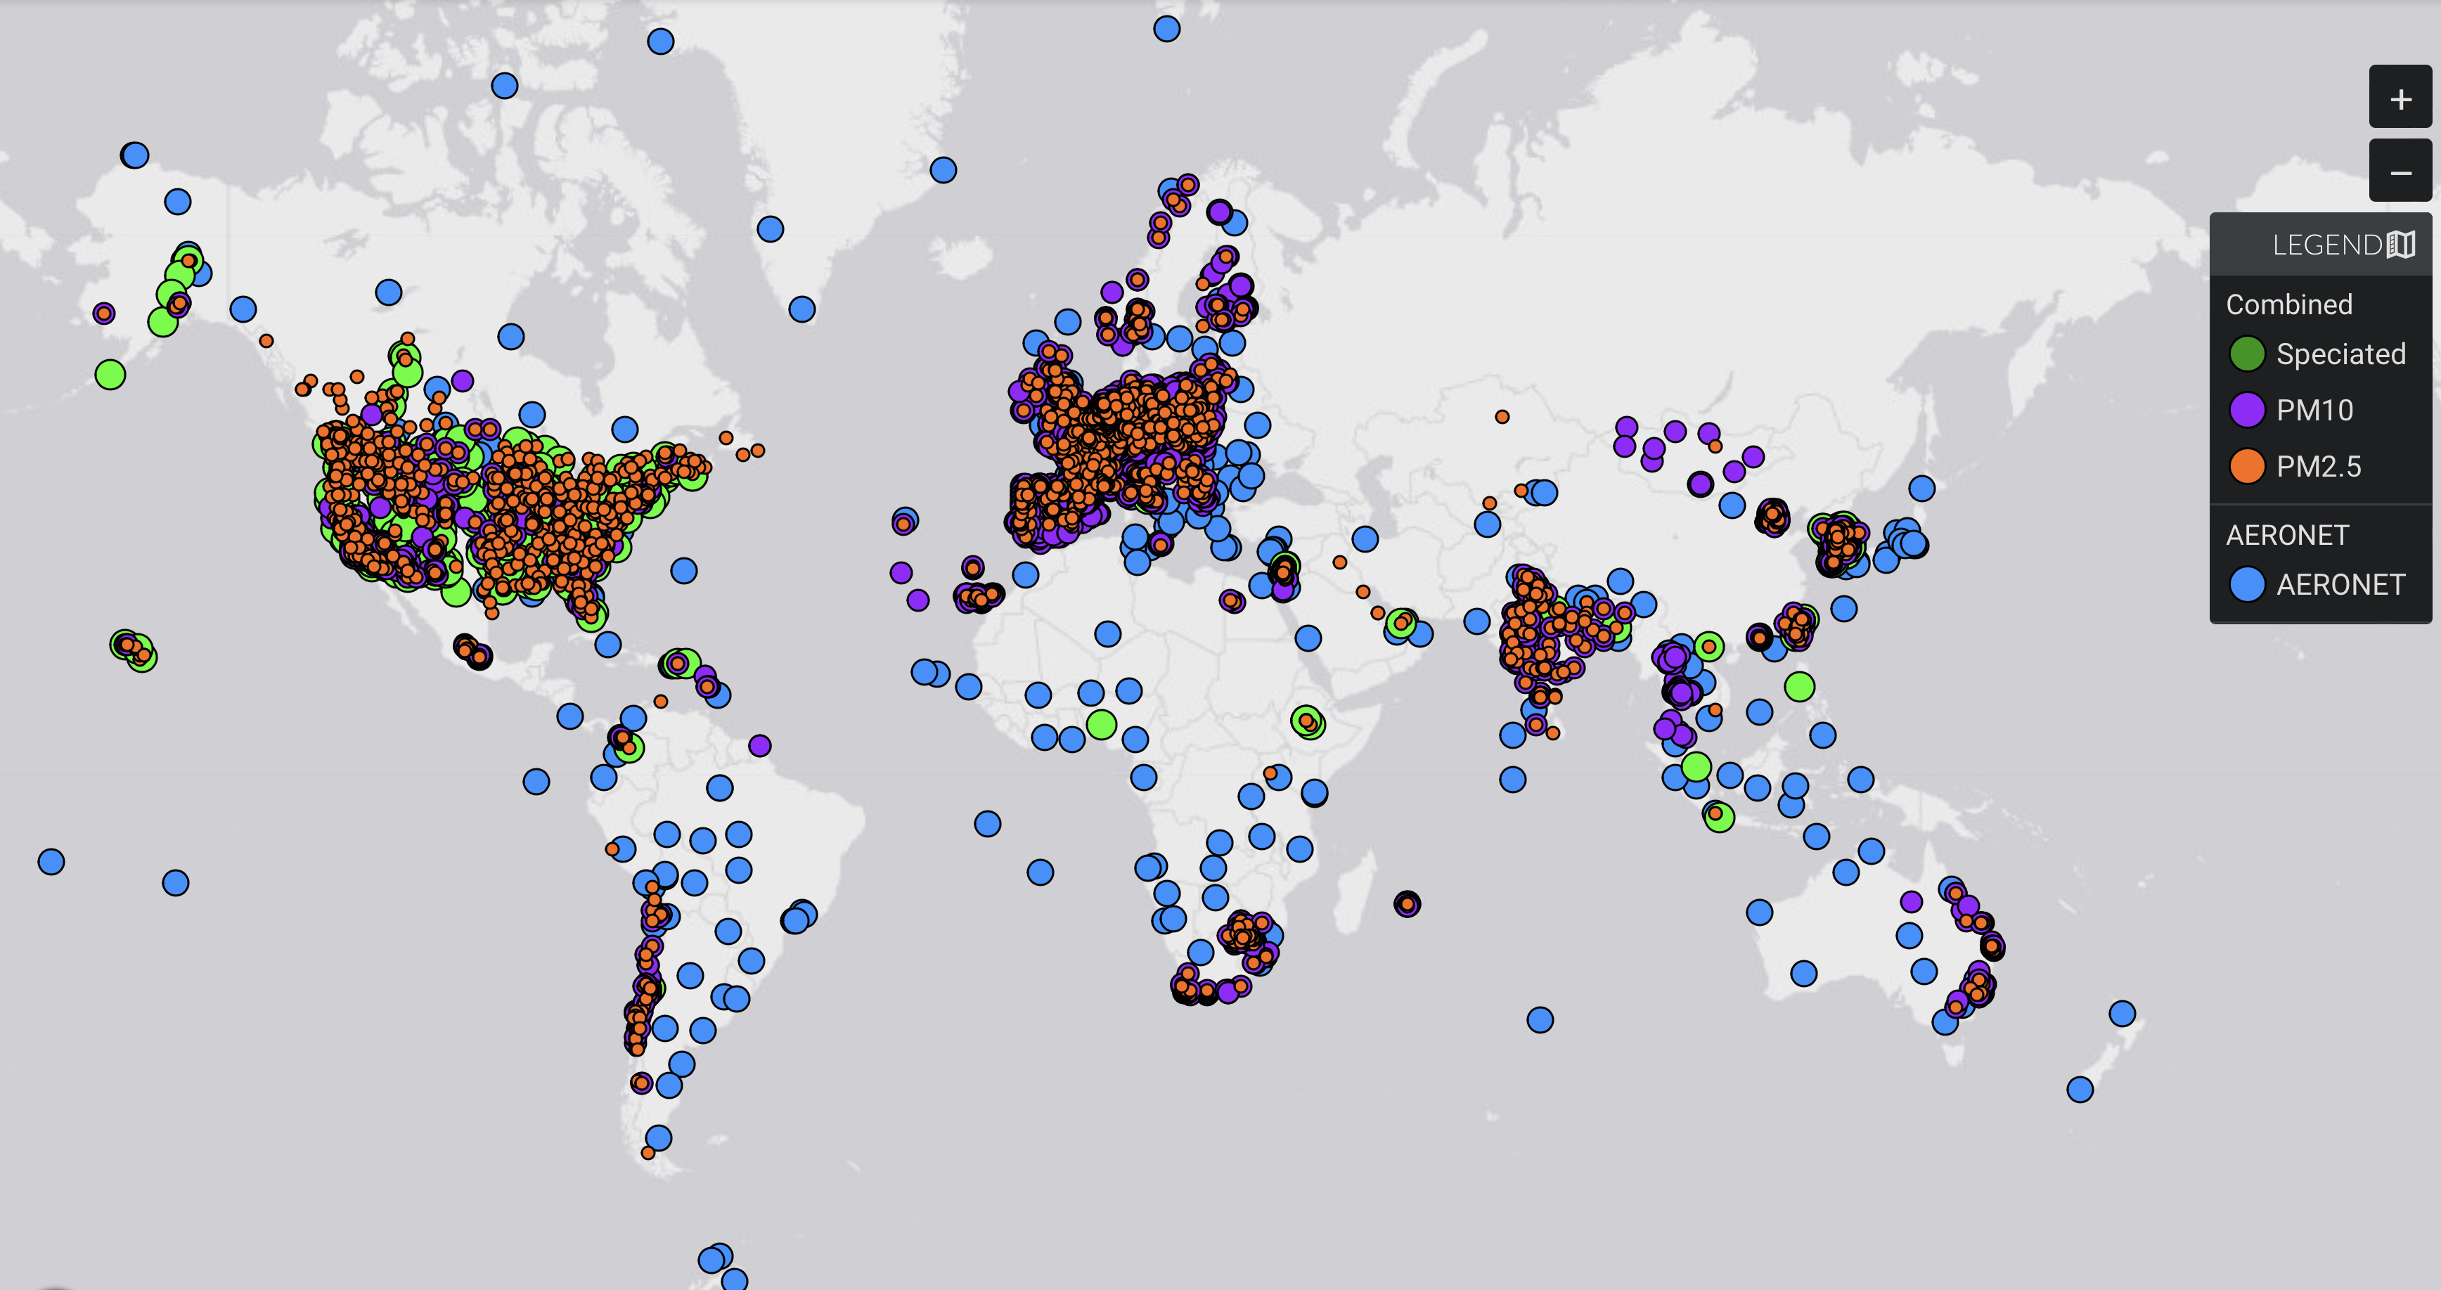
Limited Ground-based Atmospheric Composition Observations in the Global South
Ozone Monitoring sites
(TOAR and Open AQ)
Aerosol Surface Monitoring sites
(MAIA Data Visualization Tool)
Slide Courtesy: Pieternel Levelt, NCAR ACOM

Slide 13
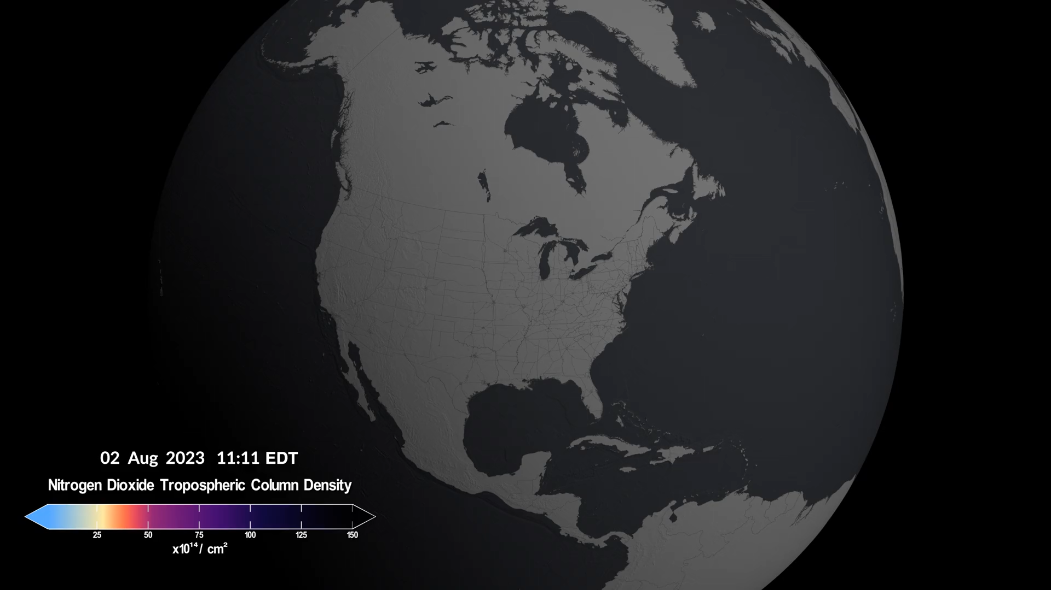
TEMPO and GEMS: Trend Setters
Tropospheric Emissions: Monitoring of Pollution (TEMPO)
Geostationary scanning ultraviolet/visible spectrometer
Enables accurate air quality forecasting by providing hourly measurements of major pollutants
First funded NASA Earth Venture Instrument
Launched in 2023
Geostationary Environment Monitoring Spectrometer (GEMS)
Developed in tandem with TEMPO, capturing efficiencies
Launched in 2020, monitoring air pollution over Asia
Funded by Korea Aerospace Research Institute
Nitrogen dioxide (NO₂) is a byproduct of fossil fuel combustion, lightning, and wildfires. NO₂ contributes to the formation of ground-level ozone and particulate matter pollution and is itself a toxic gas (EPA criteria pollutant).
Credit: NASA's Scientific Visualization Studio. Data provided by the Smithsonian Astrophysical Observatory at the Center for Astrophysics | Harvard & Smithsonian.
Image Credit: TEMPO Team

Slide 14
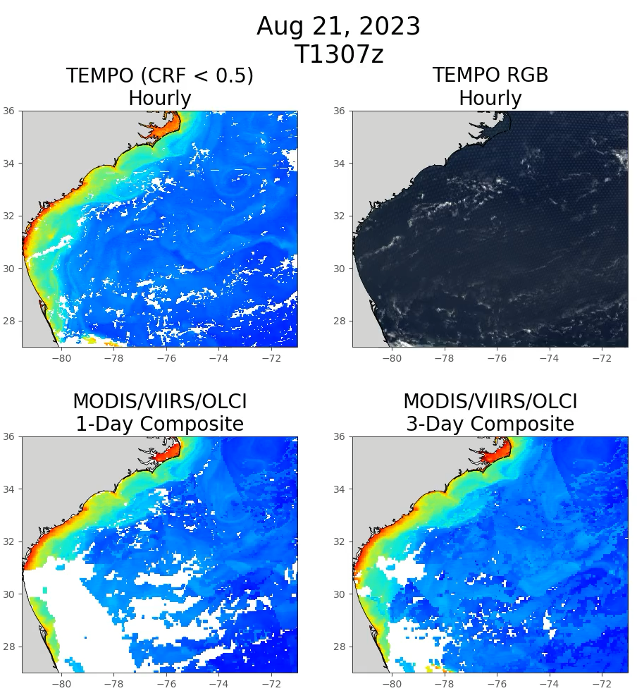
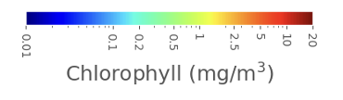
Hourly ocean color from TEMPO
NASA’s Tropospheric Emissions: Monitoring of Pollution (TEMPO) demonstrates hourly ocean color
Machine learning with TEMPO’s hyperspectral data produces parameters like chlorophyll even in glint and moderately cloudy conditions
TEMPO provides hourly ocean color over N. America with coverage comparable to daily average of 3 multi-spectral LEO sensors
Dynamic movement of the gulf stream is seen with TEMPO hourly data
Presented at: European Geophysical Union, Vienna, Austria, April, 2024 (Z. Fasnacht et al.)
Slide Courtesy: Zach Fasnacht (NASA/GSFC)
Notes:
14
14
14
14
14
14

Slide 15
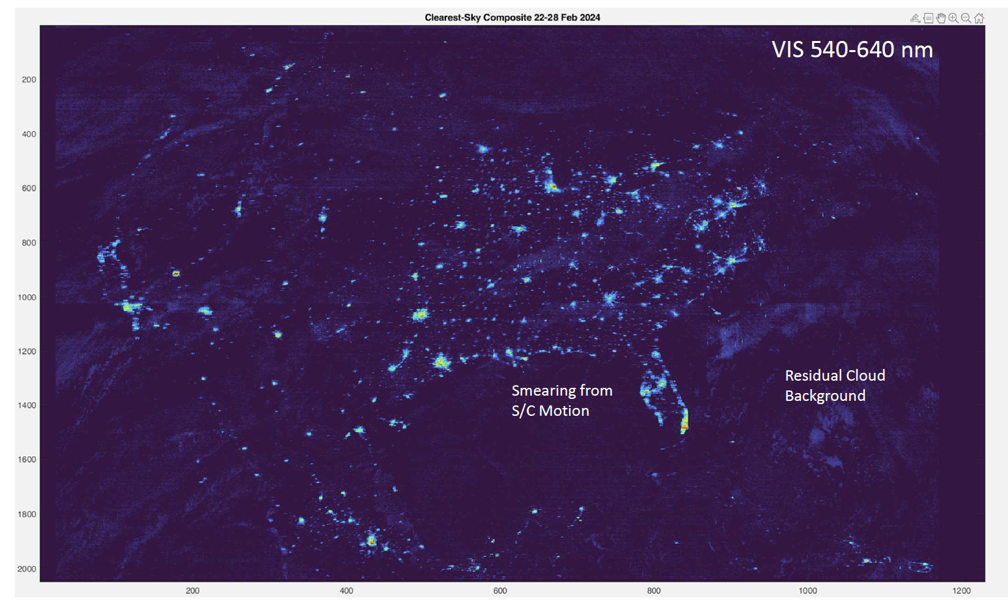
Night Lights from TEMPO
Hyperspectral Atmospheric Composition instruments can sense low clouds under moonlight
  Thermal IR on imager/sounder has difficulty distinguishing low clouds from surface at night).
Demonstration of nigh light measurements with TEMPO was possible from Autumn to Spring equinox when sun is not shining on the instrument
With 12 second exposures, observations of clouds in moonlight as well as spectrally-resolved measurement of night lights can be achieved
Slide Courtesy: TEMPO Team

Slide 16
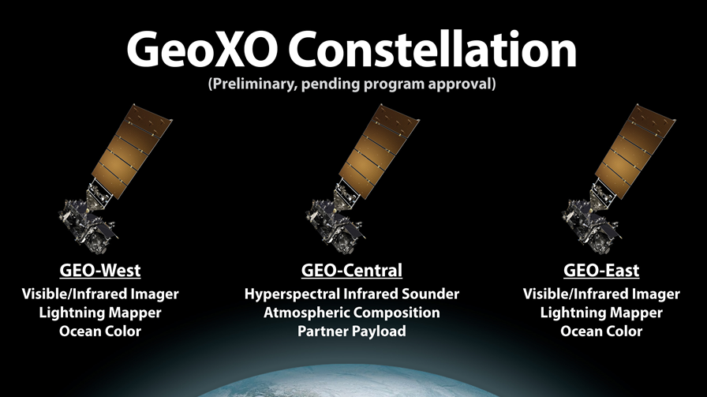
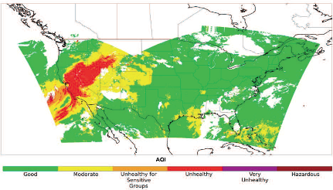

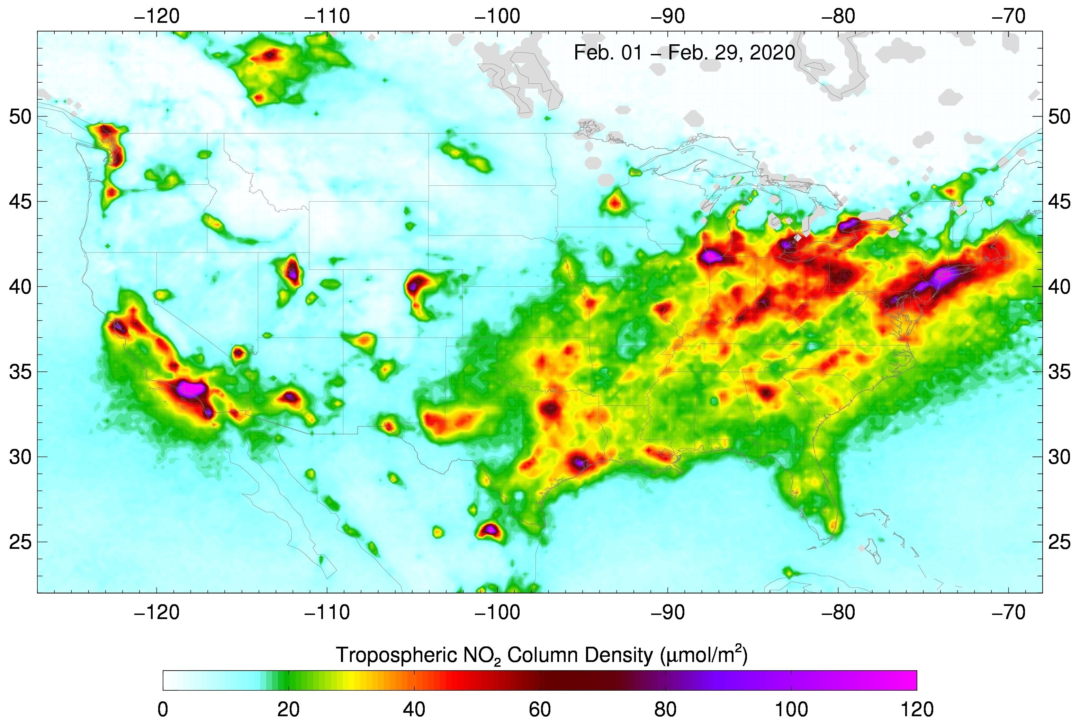
GeoXO atmospheric composition will be a multi-instrument strategy for various NOAA applications
Applications
Near real time emissions | Air quality forecasting
Air quality monitoring | Fire weather forecasting
Fire emissions monitoring | Ozone monitoring
Hazards forecasting | Greenhouse gas monitoring
Climate modeling and Earth system science research
  Fire detection
  Fire radiative power
  Aerosol type
  Aerosol optical depth
  Aerosol concentration
  Large methane leaks
  Sulfur Dioxide (night)
Ozone
Carbon monoxide
Carbon dioxide
Ammonia
Isoprene
Ozone
Nitrogen dioxide
Sulfur dioxide
Formaldehyde
Aerosol layer height
UV aerosol index
UV aerosol optical depth
Full Geo Disk, every 30 minutes
4 km resolution
VIS-IR IMAGER
GXI
IR SOUNDER
GXS
UV-VIS SPECTROMETER ACX
Slide Credit: GeoXO Team

Slide 17
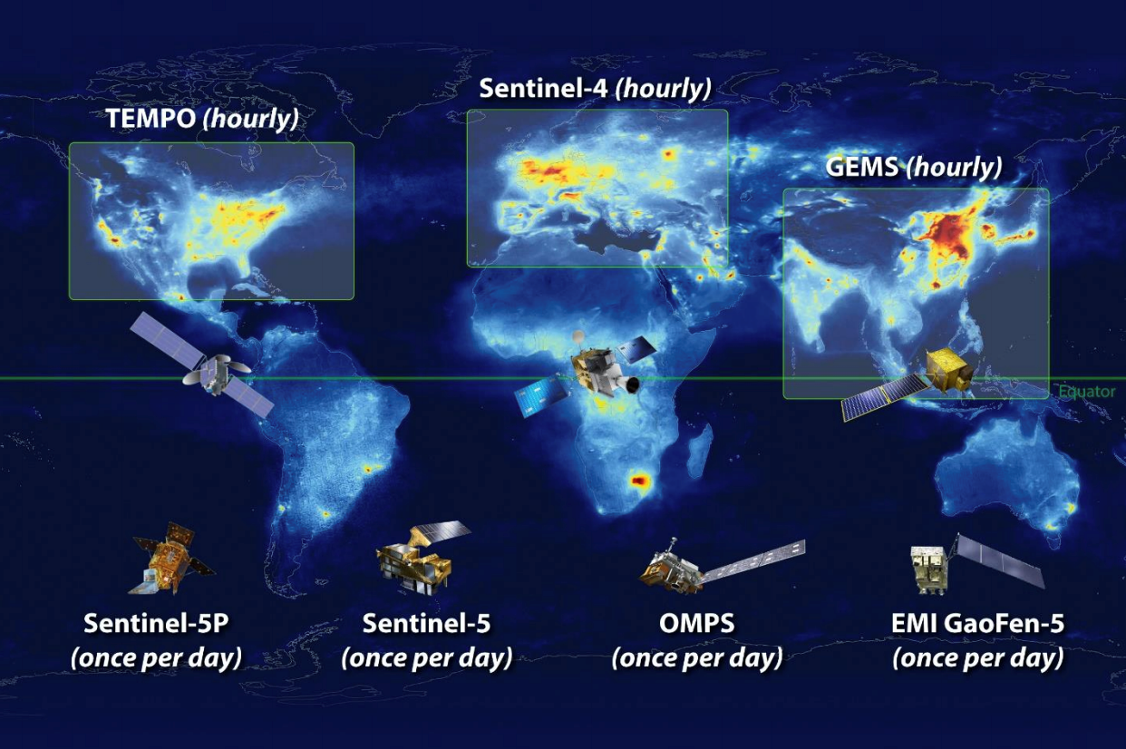
Toward a Global Geostationary AC-VC
GEO AC Program of Record:
TEMPO
GEMS
Sentinel-4
MEASMA-N
(hourly)
African Initiatives:
MESMA-North
MEASMA-South
GeoAmerica-C
(hourly)
MEASMA -S
(hourly)
GeoAUS
(hourly)
GeoAmerica-S
(hourly)
Seeking Interest:
GeoAmerica-Central
GeoAmerica-South
Geo Australia

Slide 18
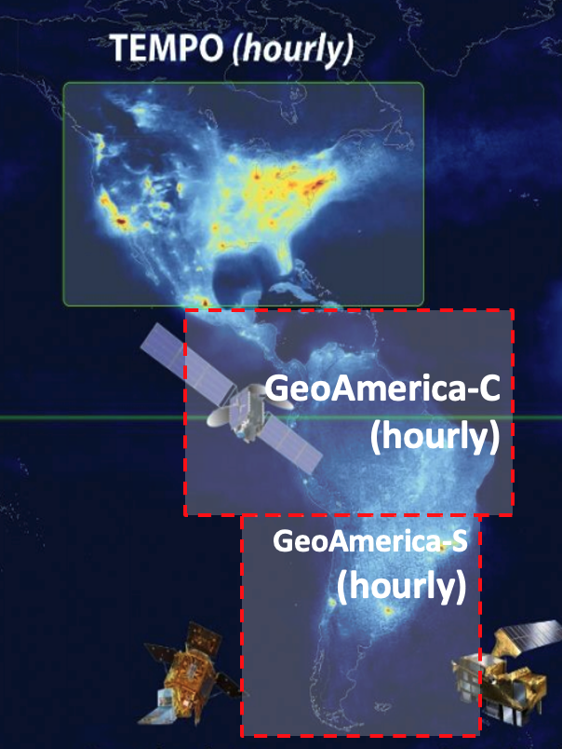
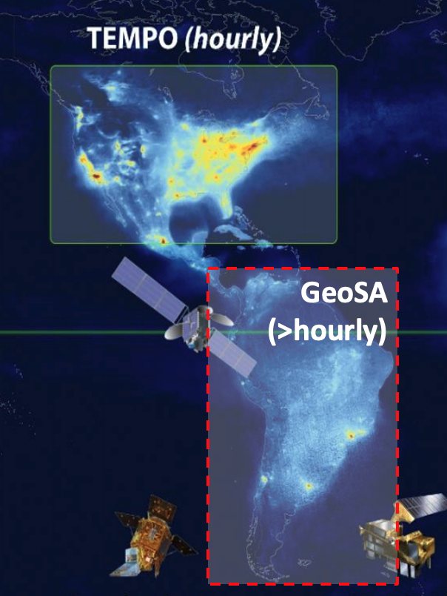
Geo AC Solutions for the Americas
Two Satellite Solution
Hourly measurements
Covers Central & South America
Single Satellite Solution
> hourly measurements (90 minutes?
Limited Central America Coverage

Slide 19
Summary
Increase in air pollution, particularly from enhanced biomass burning, is expected to increase on the coming years
The ability to measure trace gases, vegetation parameters and ocean color from space on an hourly frequency calls for spaceborne hyperspectral geostationary measurements
GeoAQ sensors such as those on TEMPO, GEMS and Sentinel-4 have the ability to provide such measurements in near real-time
  These measurements greatly complement other geostationary meteorological sensors (imagers and sounders)
  Great synergisms enabled by hyperspectral capability
While GeoAQ sensors have been deployed for the Northern Hemisphere, a great gap exists in the Global South
Existing initiatives such as MEASMA addresses this gap for Africa and the Middle-east
We are seeking the leadership from Central & South American institutions to develop a Geo Central/South American capability.
  Engagement of other Central/South American countries very desirable
  Great opportunity for integrating the All-Americas science community
Image Credit: NASA GSFC Scientific Visualization Studio

