Slide 1

INTOSPASS® INTERNATIONAL OUTER SPACE ASSOCIATION
Vision
Mission
Goal
Supporting Earth’s Sustainability from Outer Space
Through International collaboration, leverage space-based technologies funding and research to monitor, manage and enhance the sustainability of Earth's ecosystems, ensuring a balanced coexistence between humanity and the natural environment.
Safeguard Earth's future by harnessing the vantage point of space to drive informed decision-making, proactive environmental management, and sustainable development, ensuring a thriving planet for generations to come.
Notes:
A brief overview of INTOSPASS its Vision, Mission and Goal(s)

Slide 2
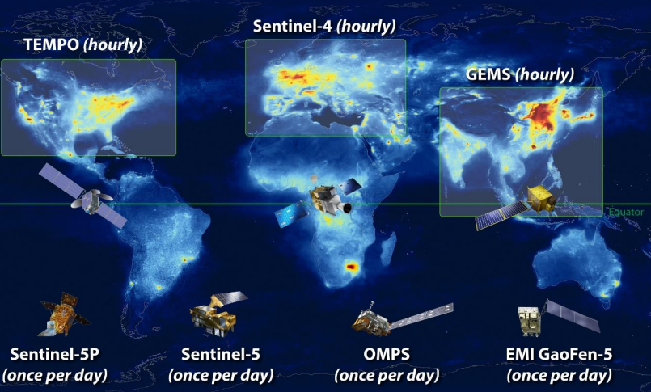
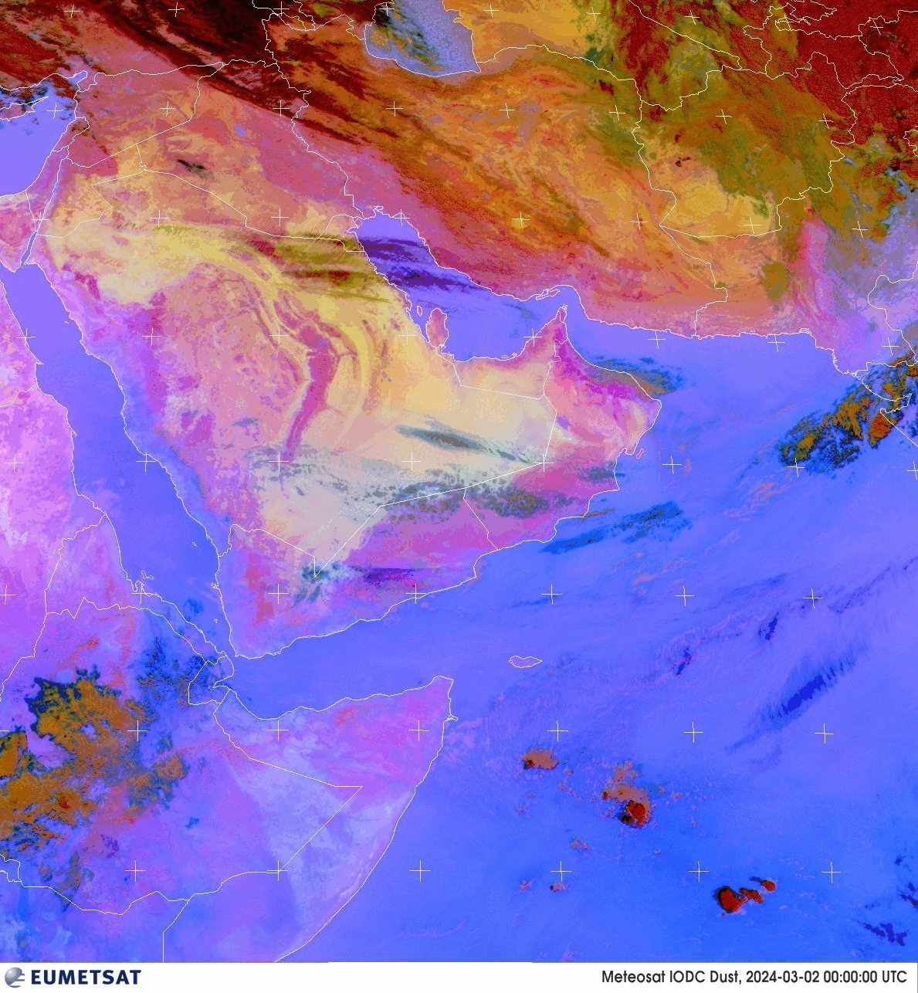

MEASMA-GEO Observatory Project
“Middle East & Africa Space-based Monitoring of Atmospheric-pollution”`
Gaps in the Satellite Based Global Atmospheric Prolusion Monitoring
https://ceos.org/document_management/Virtual_Constellations/ACC/Documents/GEO%20AQ%20Constellation%20Geophysical%20Validation%20Needs%201.1%202Oct2019.pdf
Image on the right illustrates how collective RGB Data from EUMETSAT satellites’ observations over KSA can provide high temporal resolution – but only give visual indications of Dust - pink areas.
https://dust.aemet.es/
Notes:
The video clip on the right shows that RGB data that can enable the monitoring of dust and sand storms over the Middle East and Africa is readily available. However, there is a lack of high temporal resolution data (hourly) over the Middle East and Africa that can provide Aerosol optical depth information – in particular for monitoring dust and sand storms distribution and mobility, as shown by the the image on the left.

Slide 3
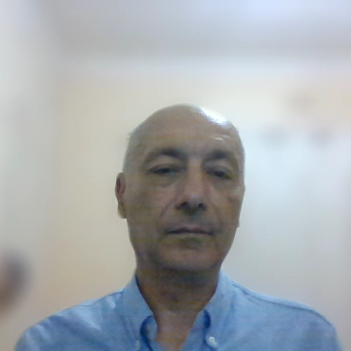
MEASMA-GEO Observatory Project
“Middle East & Africa Space-based Monitoring of Atmospheric-pollution”`
  Observatory Instrument Science Overview:
What are the temporal and spatial variations of emissions of gases and aerosols important for air quality and climate?
How do physical, chemical, and dynamical processes determine tropospheric composition and air quality over scales ranging from urban to continental, diurnally to seasonally?
How does air pollution drive climate forcasting and how does climate change affect air quality on a continental scale?
How can observations from space improve air quality forecasts and assessments for societal benefit?
How does intercontinental transport affect air quality?
How do episodic events, such wildfiresres, dust outbreaks, and volcanic eruptions, affect atmospheric composition and air quality?
MEASMA-GEON
MEASMA-GEOS
MEASMA-GEON emulating TEMPO file view using OMI data
Notes:
INTOSPASS is lobbying for a Geostationary satellite with an instrument based on TEMPO that will be designed to cover the Middle East and North Africa. A similar instrument covering Africa from the Equator to its southern tip has been proposed by UCAR. The image on the left shows the profile of the field of regard based on a GEO communication satellite slot that can be offered by one of the MENA commercial satellite communications operators. With the field of regards being close to the Equator, the analysis shows that the special resolution can be better than 2.5km assuming a TEMP like instrument.

Slide 4
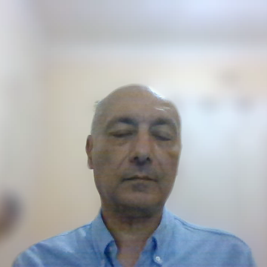
MEASMA-GEO Observatory Project
“Middle East & Africa Space-based Monitoring of Atmospheric-pollution”`
  MEASMA- GEO - Examples of Atmospheric Monitoring Applications:
Socio-economic studies and National pollution inventories
Monitor short lived Dust storms, that can last less than one day.
Enables identify dust sources and tracking a dust plume backwards to the place where it first appears, i.e., the source area.
Provide continuous measurements of aerosols/dust and water vapor that will enhance understanding of the microphysical processes governing storm formation/suppression.
Mapping NO₂ and SO₂ dry deposition at high resolution
Halogen oxide studies in coastal and lake regions
Enable the characterization air quality degradation due to the dispersion of dust over large areas, including for example the uptake of tropospheric O3 by dust particles.
Notes:
The most relevant application that seems to attract a lot of interest in the MENA region is the ability to monitor dust and sand storms over the region with an hourly revisit. There is a need in the region for an SDS early warning system and improving the prediction of SDS events.

Slide 5
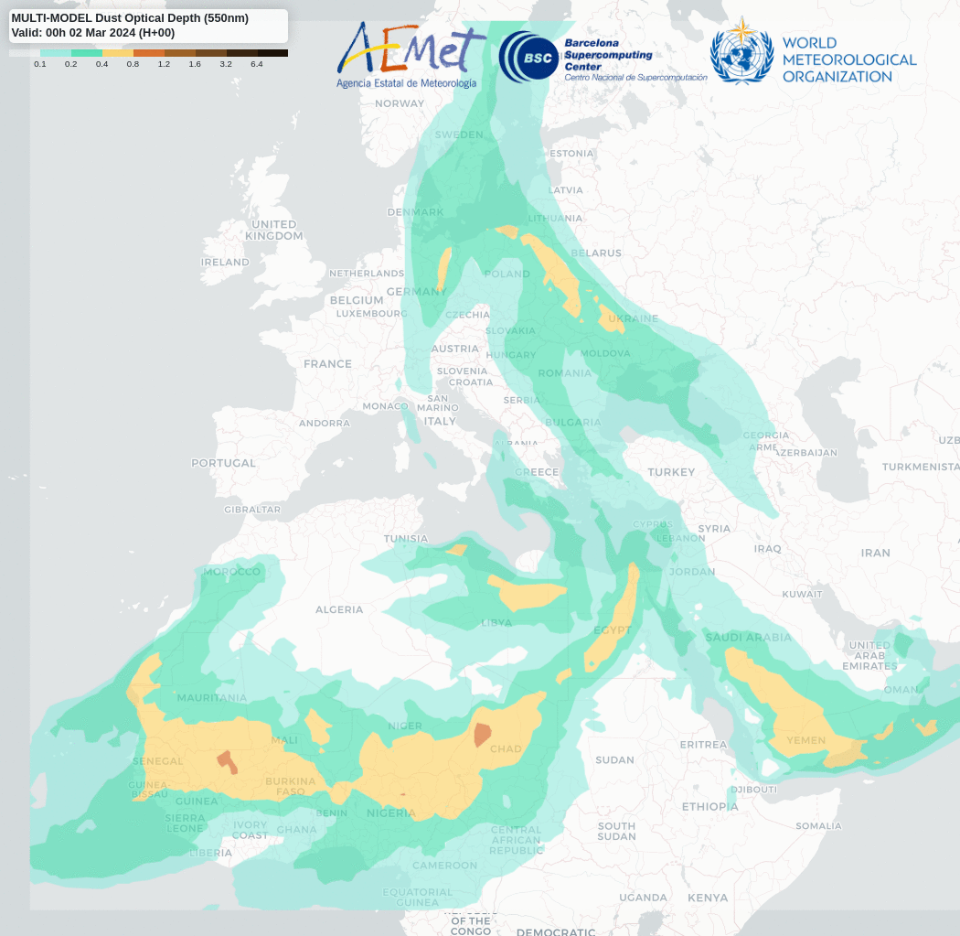
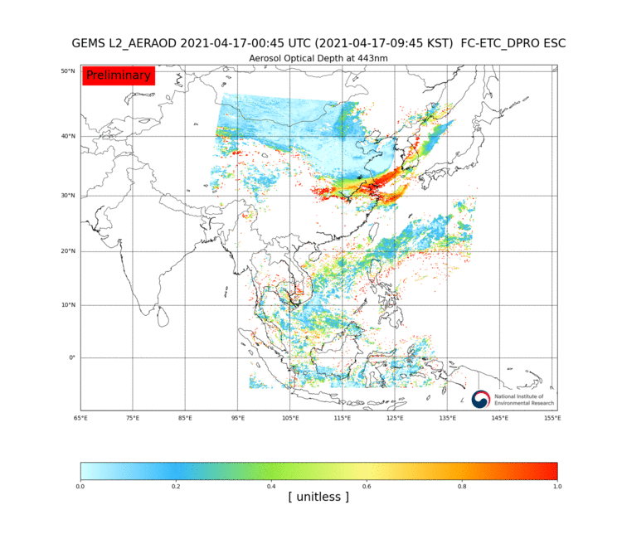

MEASMA-GEO Observatory Project
MEASMA-GEO with its hourly coverage will provide near real time monitoring of Dust storms, evolution, mobility and transport.
GEMS - April 17, 2021 Mongolian dust event
(AOD 443nm)
Dust storm models that combine and fuse data from heterodyne instruments both in Space and on the ground, such as those developed by the WMO Barcelona Dust Regional Center, WMO SDS-WAS Regional Center for Northern Africa, Middle East and Europe, and the EU Copernicus CAMS project that also produces special Sahara dust products would greatly benefit from the MAESMA-GEO Observatory data.
https://dust.aemet.es/
Notes:
One of the MEASMA objectives is to monitor and predict SDS. The image of the right shows SDS simulations with hourly intervals. With MEASMA actual hourly SDS observations can be made similar to those that have been achieved by GEMS, image on the left.

Slide 6
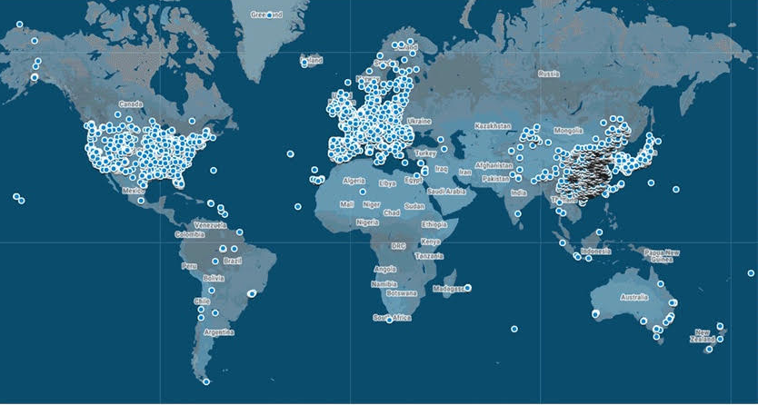
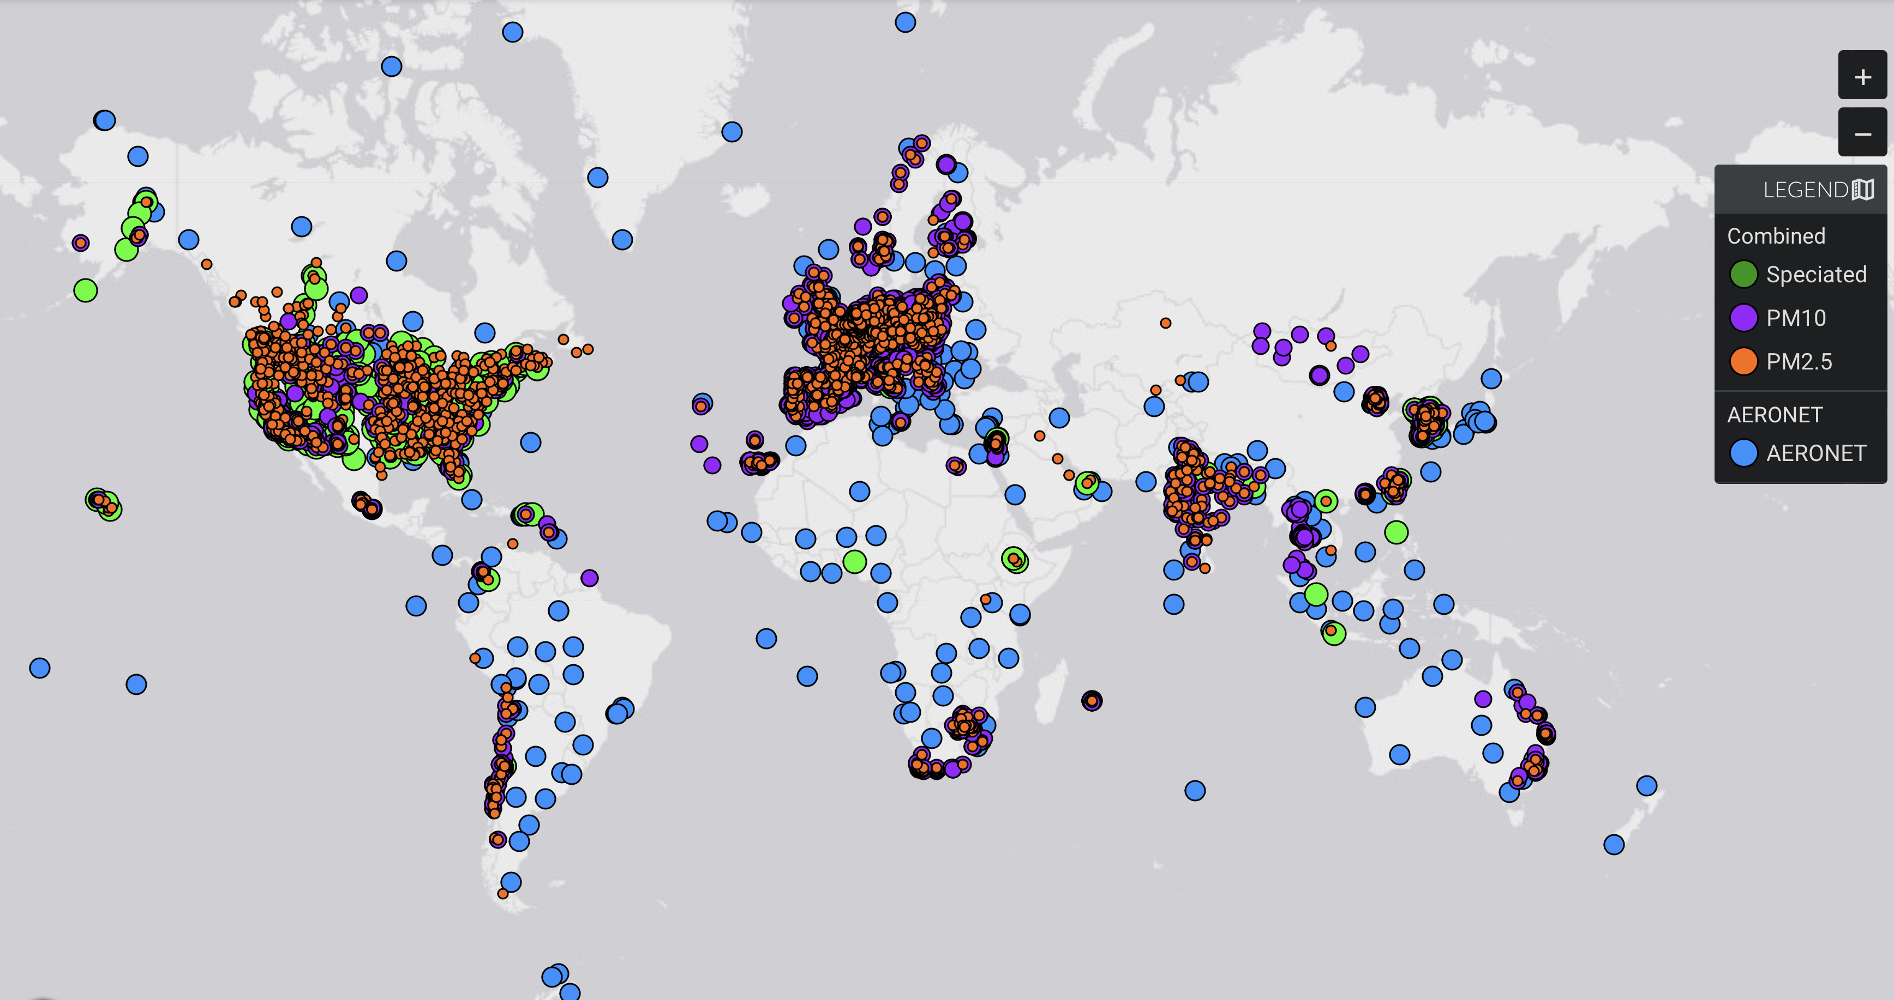


Severe Lack of reliable ground-based observations in the Global South
Ozone Monitoring sites
(TOAR and Open AQ)
Aerosol Surface Monitoring sites
(MAIA Data Visualization Tool)
Slide courtesy: Pieternel Levelt, NCAR ACOM
Pieternel Levelt, Atmospheric Chemistry and Observations Laboratory
Notes:
These two images show the sparsity of ground based air quality monitoring across the Middle East and Africa. These are essential for institute monitoring as well as to validate and calibrate the data from the air quality monitoring satellites, including the proposed MEASMA.

Slide 7
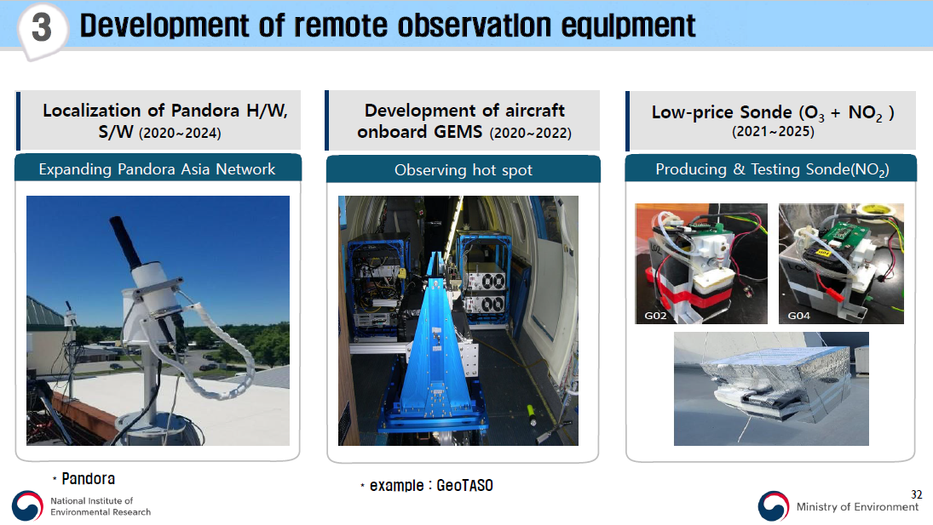

MEASMA-GEO Observatory Project
“Middle East & Africa Space-based Monitoring of Atmospheric-pollution”`
Ground Based Atmospheric Monitoring
Essential for Validation and Verification of Satellite Data
Important to be part of international network for global atmospheric monitoring
Critical to the successful fusion of heterogeneous data from different type of sensors is:
  Standardisation of data formats for the various data products
  Regular maintenance and calibration of data to an agreed standard – against standardised benchmark instruments.
https://www.unescap.org/sites/default/d8files/event-documents/Session%201_Introduction%20to%20the%20GEMS%20project_by%20Mr.%20Dongwon%20LEE.pdf
Slide Cursey of by Mr. Dongwon LEE.
Director of Environmental Satellite Center (ESC)
National Institute of Environmental Research (NIER)
Notes:
The MEASMA program proposes the installations of extensive network air quality monitoring stations’ network that includes monitoring of Aerosoles, such as dust. These are essential for calibration and validation of the MEASMA generated data. The plan is to have an educational and research training program that will empower the locals in the Middle East and Africa to be able to analyse the data from these stations as well as maintaining them. These stations can also be integrated to the various global air quality monitoring networks.

Slide 8

MEASMA-GEO Observatory Project
“Middle East & Africa Space-based Monitoring of Atmospheric-pollution”`
MEASMA Filling the Gap in Global Atmospheric Prolusion Monitoring
The MEASMA-GEO Observatory will compliment NASA’s TEMPO that covers North America, and KARI/NIER’s GEMS that covers the Far-East, and ESA’s Sentinel-4. The aim is to be part of a global virtual network that will provide
atmospheric pollution data across the globe that can be shared freely for the benefit of all mankind as outlined by the whitepaper published by CEOS AC-VC.
This project and the data it will generate will be of great value to support the efforts of the United Nation/UNOOSA, CEOS, GEO and Eye on earth, as well as all environmental and meteorological agencies/orgainsations including academic and research organizations across the globe.
MEASMA-GEON
MEASMA-GEOS
https://ceos.org/document_management/Virtual_Constellations/ACC/Documents/GEO%20AQ%20Constellation%20Geophysical%20Validation%20Needs%201.1%202Oct2019.pdf

Slide 9
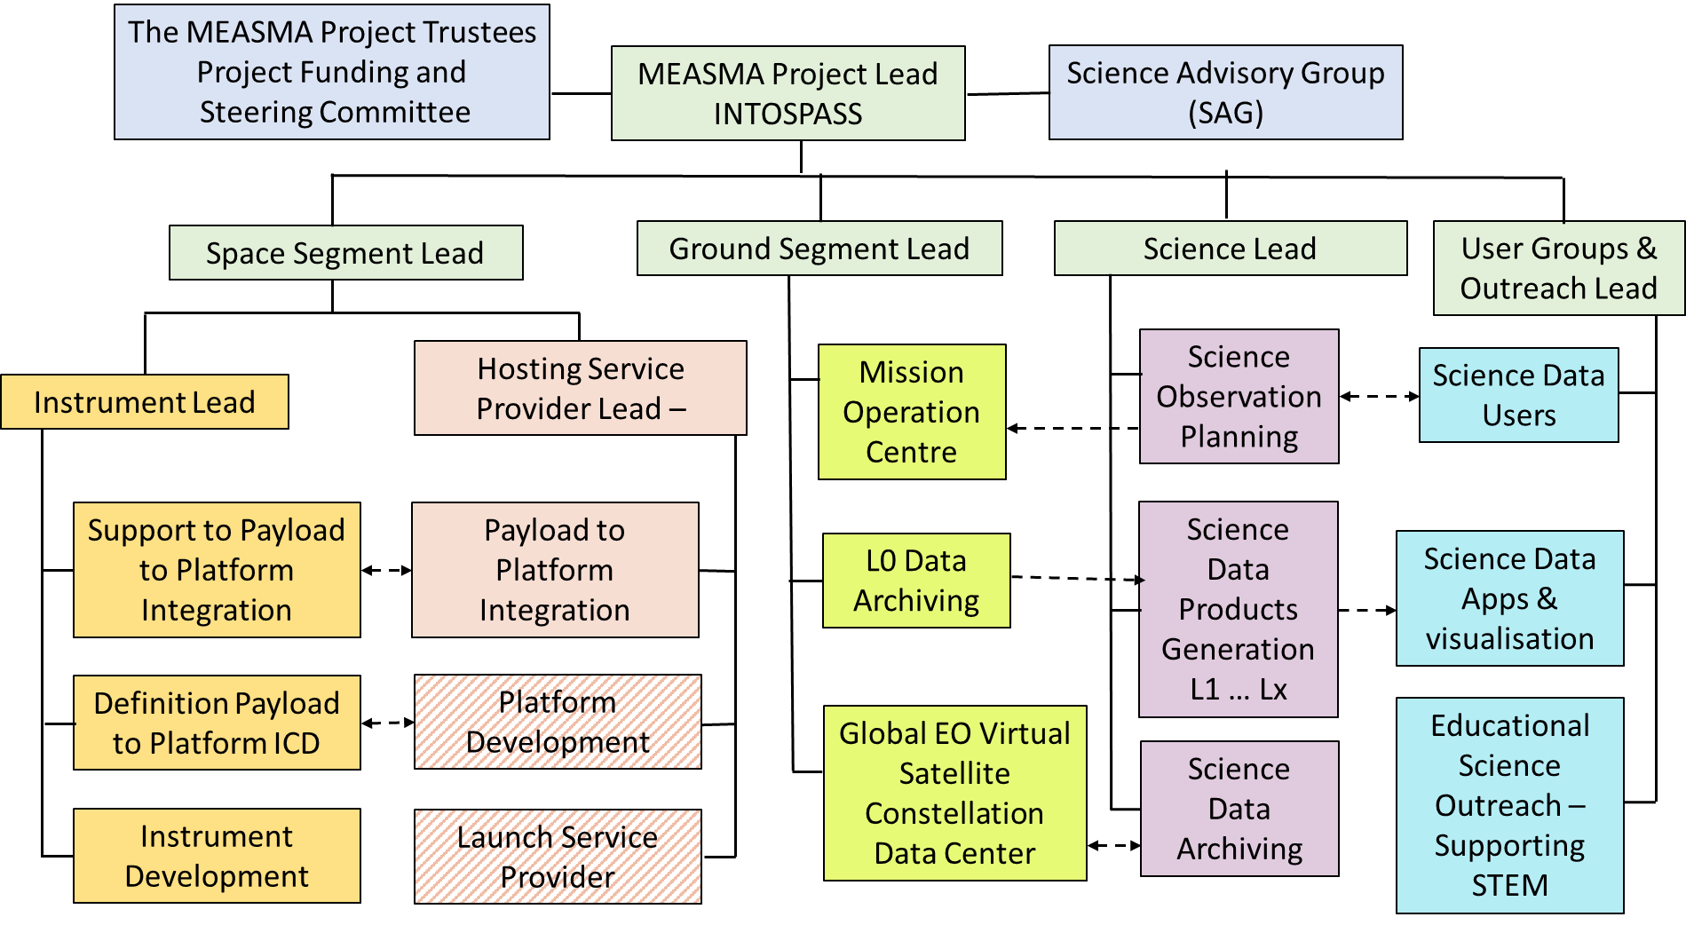
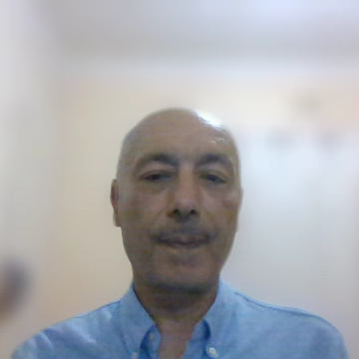
MEASMA-GEO Observatory Project
“Middle East & Africa Space-based Monitoring of Atmospheric-pollution”`
MEASMA-GEO Observatory Project Organisation Chart

Slide 10

MEASMA-GEO Observatory Project
“Middle East & Africa Space-based Monitoring of Atmospheric-pollution”`
MEASMA MSc Dissertation Projects at Surrey University – UK Slide 1 of 3
Air Quality Management in the Middle East and Africa (MEA): Bridging the Research Gap through Space-Based Monitoring (Student: Ms. Shraiya Pandey – Supervisor: Dr. Ana Andries)
Abstract:
The study will incorporate inputs from end-user organizations, environmental advocacy groups, industry associations, and scientific organisations to develop a comprehensive framework for improved air quality monitoring in Middle East Africa (MEA). This will be done by conducting a survey both questioner based, for qualitative analysis, and a topic focused interview, for subjective analysis. The findings will inform policymakers and guide investments in sustainable technologies, ultimately contributing to better public health outcomes and environmental sustainability.
Overarching Research Questions:
How can MEA countries bridge the gap between satellite-derived air quality data (e.g., Sentinel-5P) and actionable policies, given challenges like limited ground validation, technical capacity, and enforcement? How can this be improved to meet the needs of policymakers, environmental advocates, industry stakeholders, and scientific communities?
Explore barriers to integrating space-based data with local air quality management.
Can community-led air quality campaigns use Sentinel-5P data to drive faster policy changes than top-down approaches in the region?
Notes:
INTOSPASS is collaborating with Surry University – UK, Dr. Ana Andries and two of her MSc students. The first one, in this slide, is by Ms. Shraiya Pandey who is doing an MSC Sustainable Development.

Slide 11
MEASMA-GEO Observatory Project
“Middle East & Africa Space-based Monitoring of Atmospheric-pollution”`
MEASMA MSc Dissertation Projects at Surrey University – UK Slide 2 of 3
Analysing the Climate and Health Impacts of Tropospheric Pollutants in the Middle East and Africa
(Student: Mr. Max Foster – Supervisor: Dr. Ana Andries)
Abstract:
The lack of a dedicated atmospheric air quality satellite monitoring system in the region limits effective assessment and mitigation strategies needed to managing and reducing atmospheric pollutants, including aerosols. This study aims to evaluate the impact of these pollutants on climate and public health by analysing ground-based data and highlighting gaps in current monitoring infrastructure. Through spatial mapping and correlation studies, the research will provide evidence-based recommendations for improved air quality monitoring and policymaking. In particular, the research will explore ground data using spatial interpolation techniques at multiple scales—such as 300 km buffers and national-level mapping —coupled with satellite data.
Research Questions:
How do tropospheric pollutants impact climate and public health in the Middle East and Africa?
What are the key air pollution hotspots in the region based on available data?
What are the health risks associated with exposure to specific pollutants (e.g., NO₂, PM₂.₅)?
How does the absence of dedicated satellite monitoring affect air quality management and policy decisions?
Notes:
This is study number 2 by Max Foster doing an MSc Sustainable Development – his research is analytical and he is analysing data from ground based and space based air quality monitoring instruments.

Slide 12
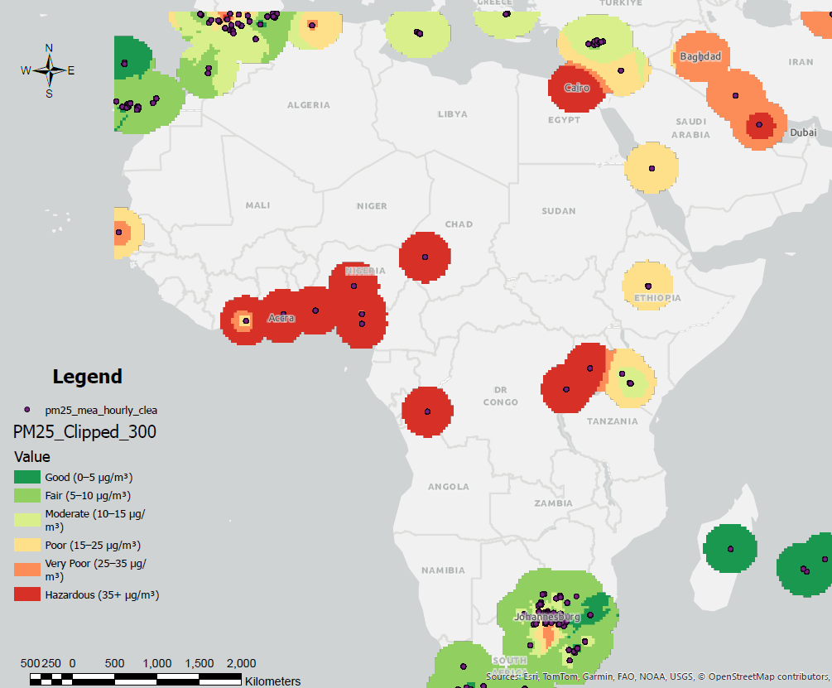
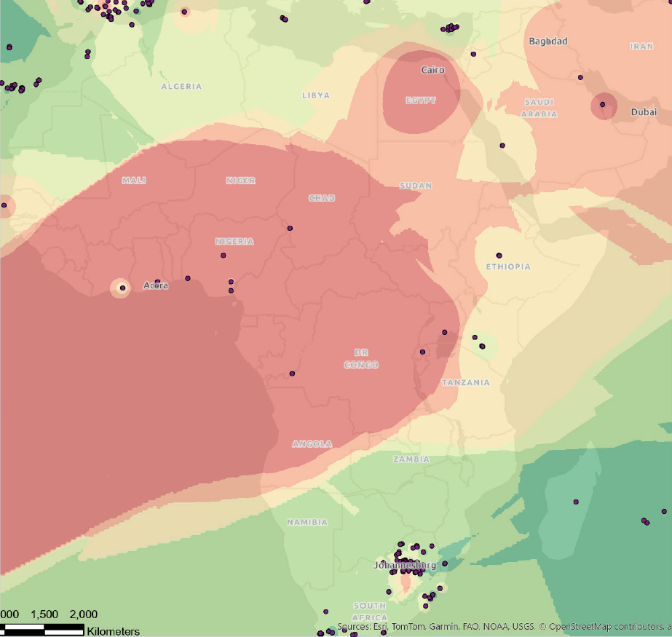
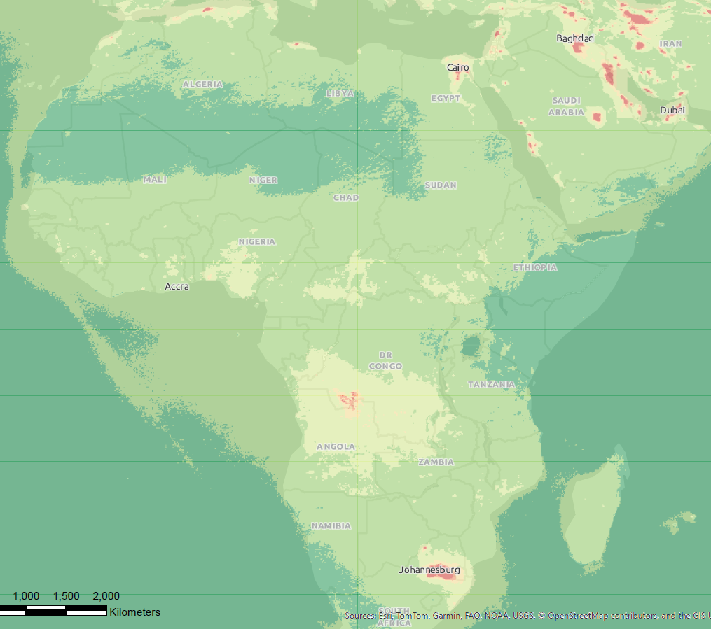
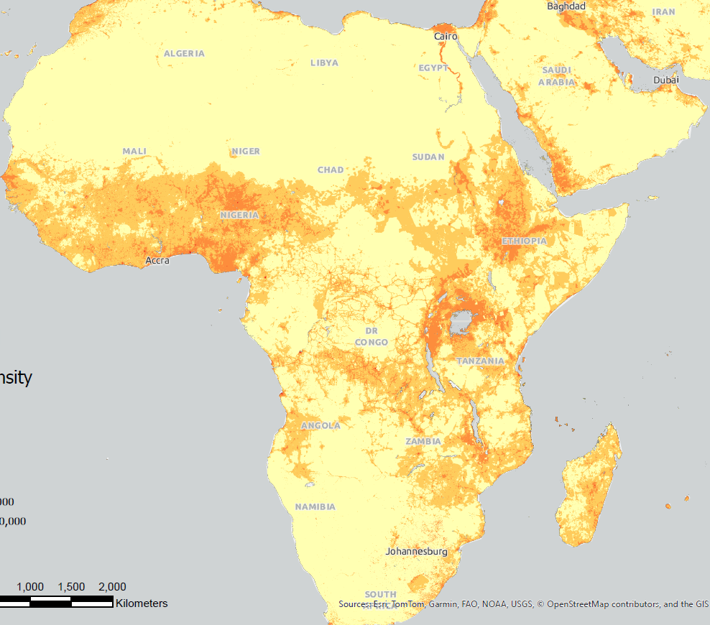
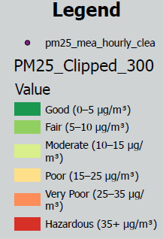
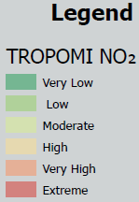
MEASMA-GEO Observatory Project
“Middle East & Africa Space-based Monitoring of Atmospheric-pollution”`
MEASMA MSc Dissertation Projects at Surrey University – UK Slide 2 of 3
Analysing the Climate and Health Impacts of Tropospheric Pollutants in the Middle East and Africa:
Interpolated PM25 Concentrations Buffered 300km Mapped Over Population Density
Ground Interpolated PM2.5 Concentrations in the Middle East & Africa (Jan–June 2024)
TROPOMI NO2 Concentrations in the Middle East & Africa
Notes:
Some examples of Max initial analysis.

Slide 13



MEASMA Working Group Workshop at UNCCD CoP16 - Green Zone Science Pavilion – Riyadh 10th of December 2024
Working Group discussion:
Monitoring of atmospheric constituents and assessing air quality over the Middle East and Africa. Realising a virtual GEO remote sensing satellite constellation as proposed by CEOS AC-AV white paper. Working towards monitoring Dust and Sand Storms (SDS), smoke generated by mass burning of vegetation, Monitoring stratospheric Ozone … etc and impact of Air Quality (AQ) on quality of life
Discussion points:
The need to improve monitoring of atmospheric constituents and assessing air quality over the Middle East and Africa is a critical unmet need.
How can MEASMA help better understand and forecast the impacts of dust storms and air pollutants on people and our environment.
Propose building on the success of TEMPO, GEMS, and Sentinel-4 – filling the global gap of air quality monitoring from GEO.
What are the most essential requirements for defining the MEASMA Observatory specifications?
MEASMA is Aligned with and Meet the UNCCD CoP16 SDS Decisions and Agreed SDS Actions:
INTOSPASS did an alignment study of the MEASMA Observatory Proposal document with the Report of the CoP16 Outcomes - Part Two: Action taken by the CoP16. The study clearly demonstrated the strong alignment between the planned MEASMA SDS related services and the CoP16 SDS actions. The resulting document was acknowledged by UNCCD.

Slide 14

Proposal for MEASMA Air Quality Community of Practice (CoP)
The primary objectives of the MEASMA Air Quality CoP are as follows:
Foster local, regional and global collaboration and networking among researchers, scientists, practitioners, and policymakers interested in space-based monitoring of aerosols and air quality in the region.
Share knowledge, expertise, and best practices in the acquisition, processing, and interpretation of satellite data for aerosol and air quality analysis.
Define the needs and science objectives for space based remote sensing system, that may lead to the definition of space mission objectives, requirements and concept for a spaceborne remote sensing instrument(s) and related satellite architecture.
Identify and address key challenges and gaps in aerosol and air quality monitoring, modelling, and impact assessment through collaborative research and innovation.
Support capacity building initiatives and skill development in space-based aerosol and air quality monitoring among CoP members and stakeholders.
Contribute to evidence-based decision-making and policy development for mitigating the environmental and health impacts of aerosols and air pollution in the region.
Encourage and grow a vibrant community in the domain of aerosols and air quality remote sensing, including participation and hosting of working groups, technical meetings and conferences.

Slide 15

INTOSPASS® INTERNATIONAL OUTER SPACE ASSOCIATION`
Notes:
Invite attendees to attend in2space.me and submit papers for presentation and posters.

Slide 16
INTOSPASS® INTERNATIONAL OUTER SPACE ASSOCIATION`
THANK YOU FOR YOUR PARTICIPATION
www.intospass.org
For further details please contact
Dr Omar Emam
Email: omar.emam@intospass.org
M: +44 756 1234 155
INTOSPASS - International Outer Space Association Ltd is a nonprofit organization limited by guarantee registered in England and Wales, company registration number: 1482868.
The INTOSPASS article of association ensures that it is not established or conducted for private gain: any surplus funds are used primarily for the benefit of the worldwide Space community through INTOSPASS organised projects as well as funding proposals that get selected as part of INTOSPASS competitive calls for project proposals.

