Slide 1
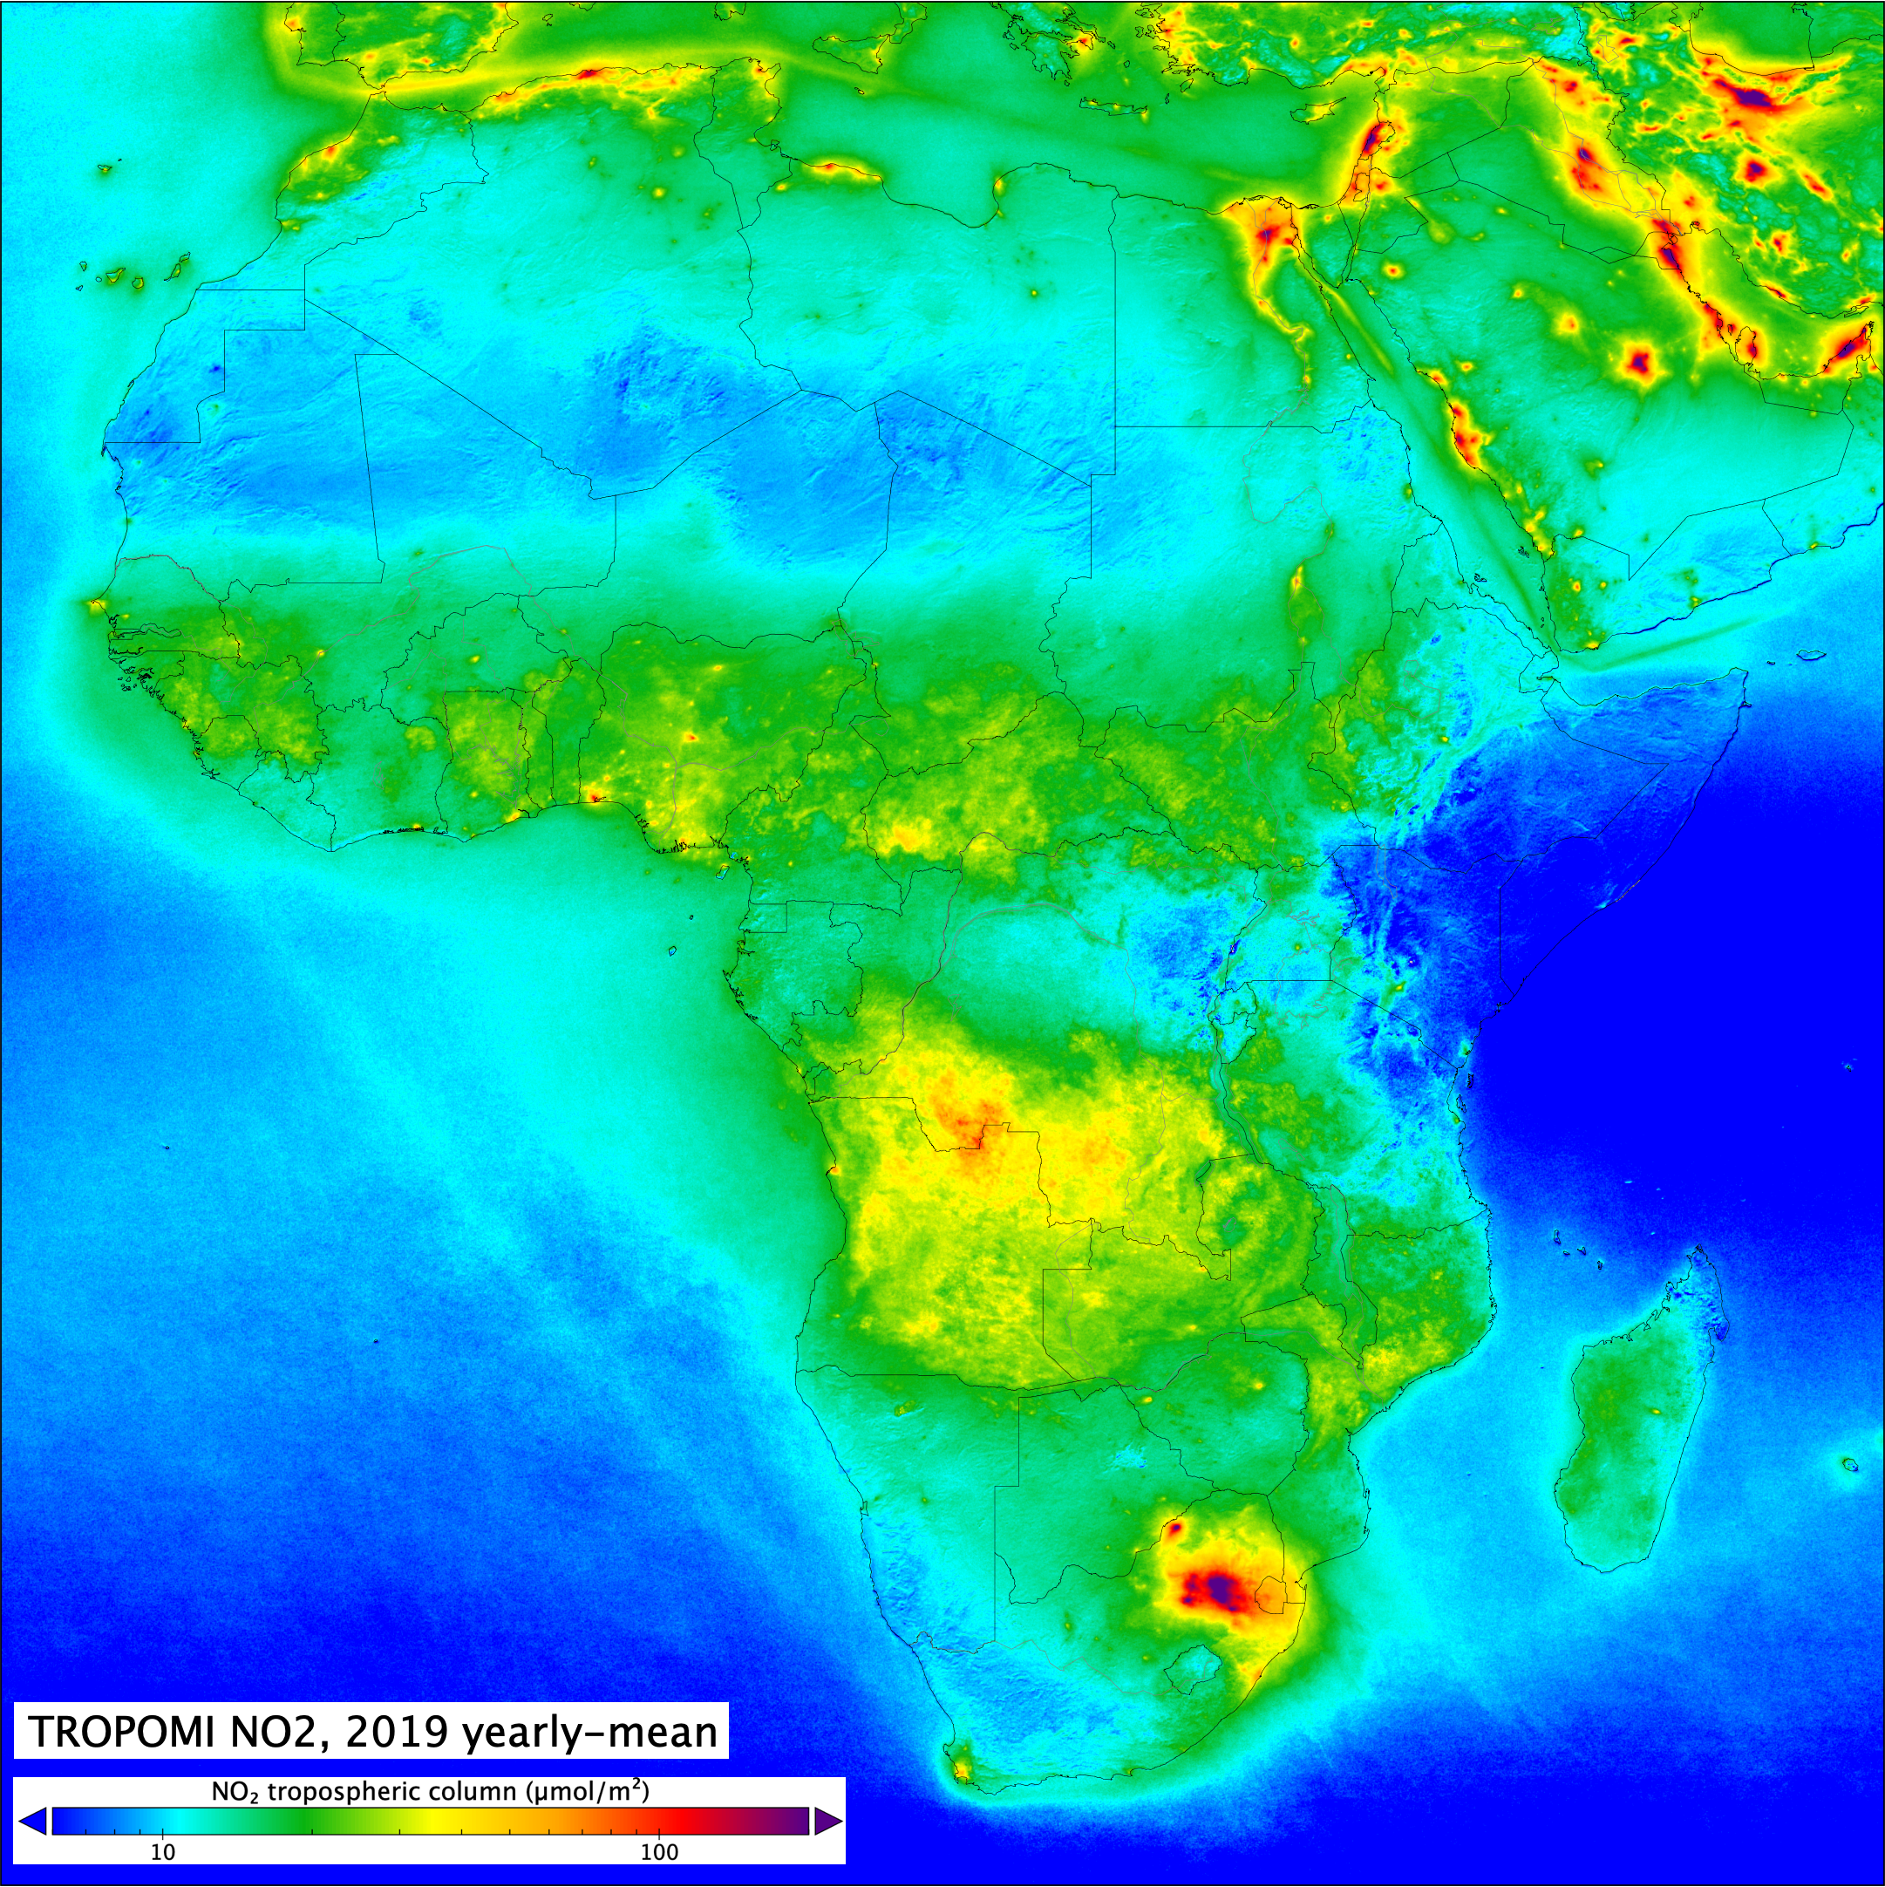

Investigating Air Quality on the African Continent: a Global South Perspective
Pieternel F. Levelt, Eloise A. Marais, Wenfu Tang, Sara Martinez-Alonso, David Edwards, Helen Worden, Henk Eskes, Pepijn Veefkind, Steve Brown, Collins Gameli Hodoli, Allison Felix Hughes, Oman Emam, Omar Ali, Barry Lefer, Drobot Sheldon, Dan Westerfelt.
EGU, Vienna, April 2025
Prof. Dr. Pieternel Levelt, NSF NCAR ACOM Director
OMI Principal Investigator (NASA Eos Aura)
TROPOMI scientific initiator (ESA sentinel-5 precursor)
KNMI, TU Delft
Courtesy, Henk Eskes, KNMI
Prof. dr. Pieternel Levelt, NSF NCAR ACOM, KNMI, TU Delft
Atmospheric Chemistry and Observations Laboratory - Director

Slide 2
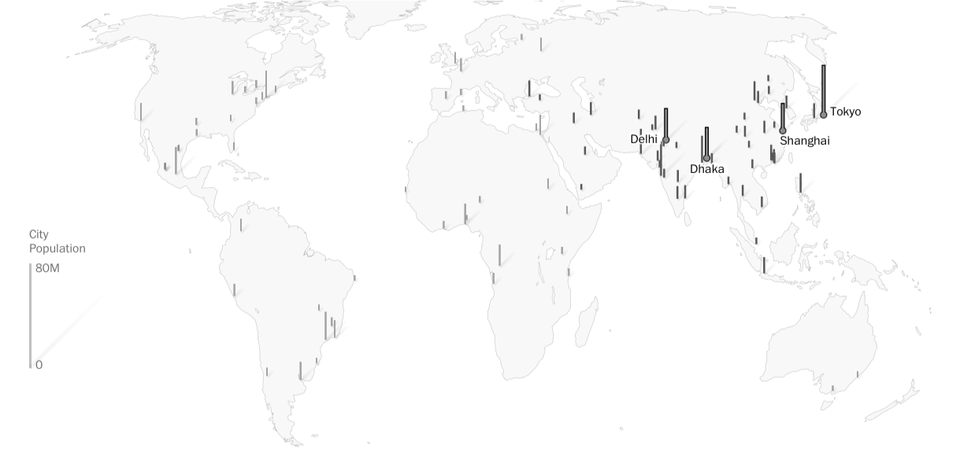
100 Largest Megacities 2025
Prof. dr. Pieternel Levelt, NSF NCAR ACOM, KNMI, TUDelft
Atmospheric Chemistry and Observations Laboratory
Source: Washington Post, 2021

Slide 3
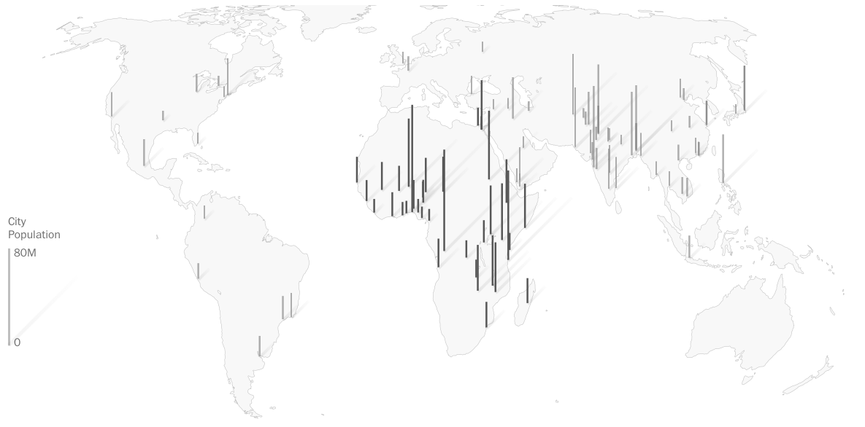
100 Largest Megacities 2100
Lagos
Kinshasa
Dar es Salaam
Prof. dr. Pieternel Levelt, NSF NCAR ACOM, KNMI, TUDelft
Atmospheric Chemistry and Observations Laboratory
Source: Washington Post, 2021

Slide 4
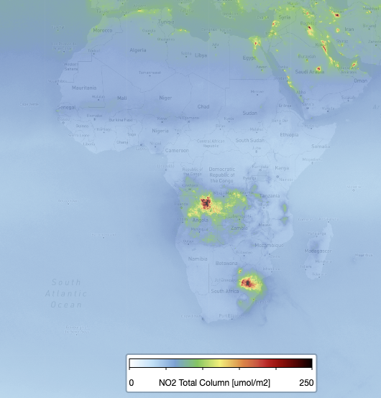
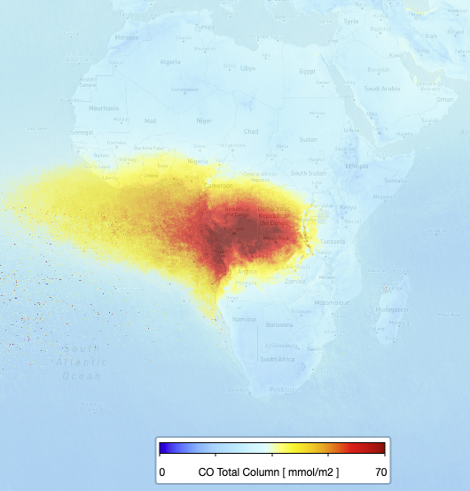
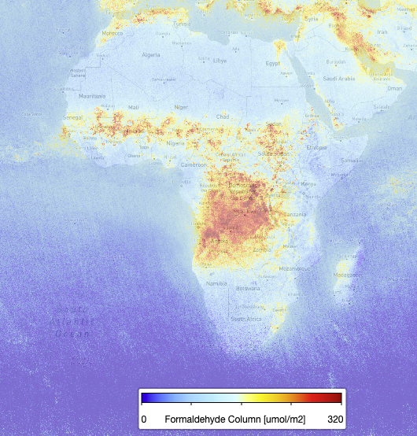
Africa
NO₂
CO
Fossil fuel
Biomass Burning
Population is expected to double in 2050
(2.5 billion) and triple in 2100 (3.8 billion)
4th industrial revolution: will lead to huge increase in air pollutants and greenhouse gases
All emission sources are present in Africa:
NO₂ – fossil fuel combustion
CO – biomass burning
HCHO – Biogenic Emissions
UVAI – Sahara Dust
There is a lack of groundbased measurements over Africa
There is a lack of emission estimates over Africa
There is an urgent need for new capability for air quality management for health and environment
HCHO
UVAI
Biogenic Emissions
Sahara Dust
Image Courtesy : Pepijn Veefkind, KNMI
TROPOMI trace gas and aerosol measurements
Africa, July 2019
Prof. dr. Pieternel Levelt, NCAR ACOM
Atmospheric Chemistry and Observations Laboratory

Slide 5
CO
NO₂
Biomass Burning over Africa
as measured by TROPOMI
CO and NO₂
April 2020
April 2020
Biomass burning in tropical Africa
June 2020
June 2020
Power plants near Johannesburg
Oct. 2020
Oct. 2020
Pepijn Veefkind, KNMI

Slide 6
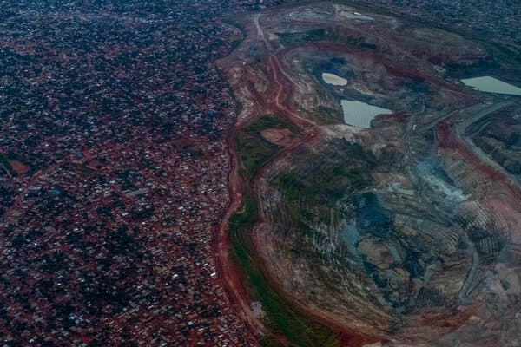
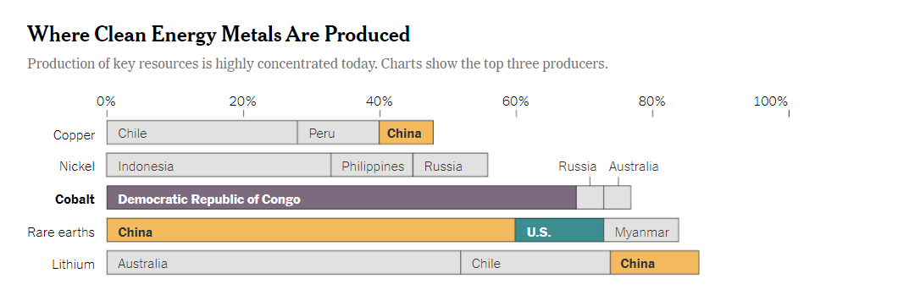
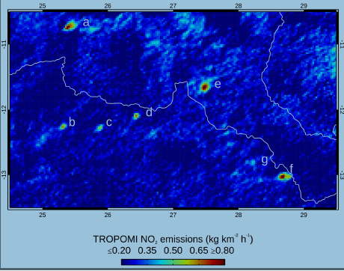
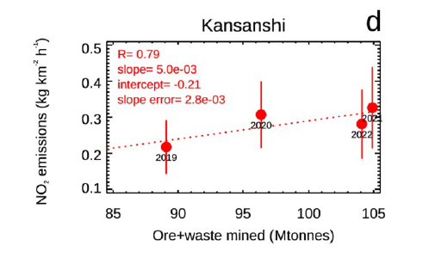
Emissions from metal mining in Africa
(New York Times 2021)
NOx Emissions follow Production
Martinez-Alonso et al., JGR 2023, NCAR ACOM
Prof. dr. Pieternel Levelt, NSF NCAR ACOM, KNMI, TU Delft
Atmospheric Chemistry and Observations Laboratory

Slide 7
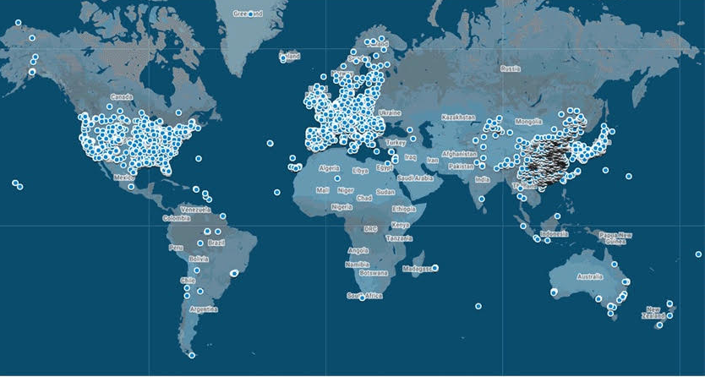
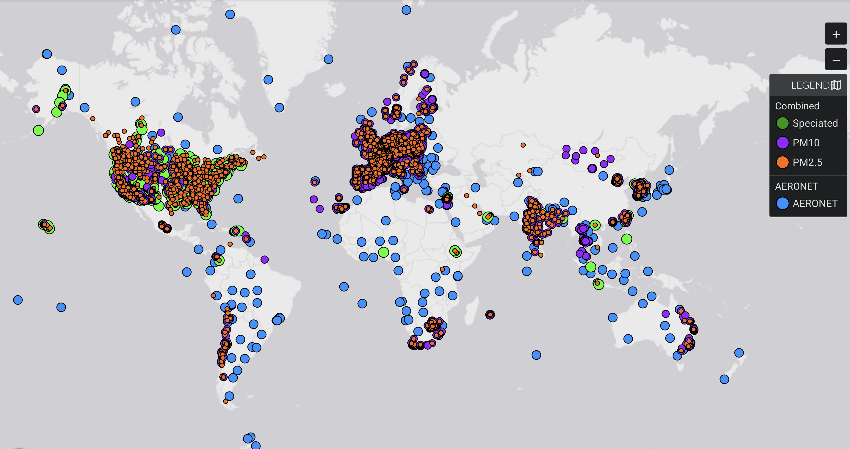
Severe Lack of reliable ground-based observations in the Global South
Ozone Monitoring sites
(TOAR and Open AQ)
Aerosol Surface Monitoring sites
(MAIA Data Visualization Tool)
Prof. dr. Pieternel Levelt, NSF NCAR ACOM, KNMI, TUDelft
Atmospheric Chemistry and Observations Laboratory

Slide 8
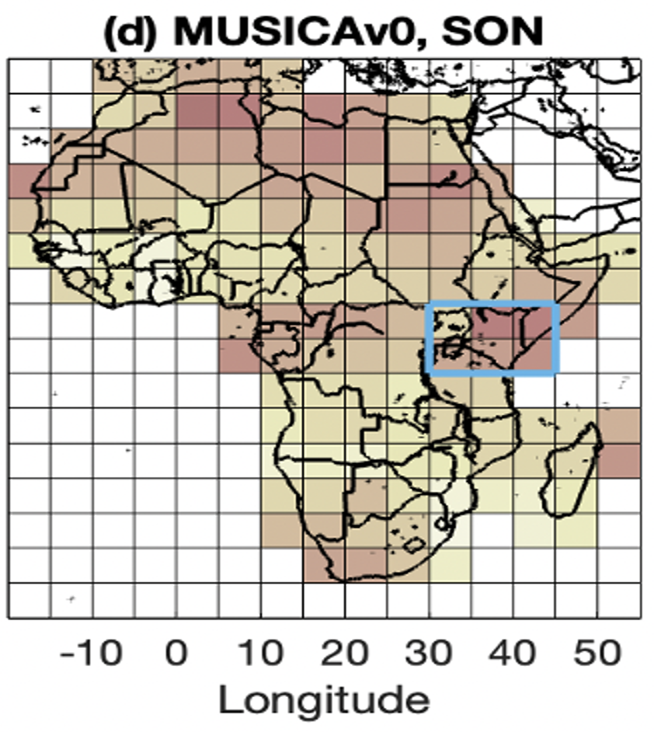
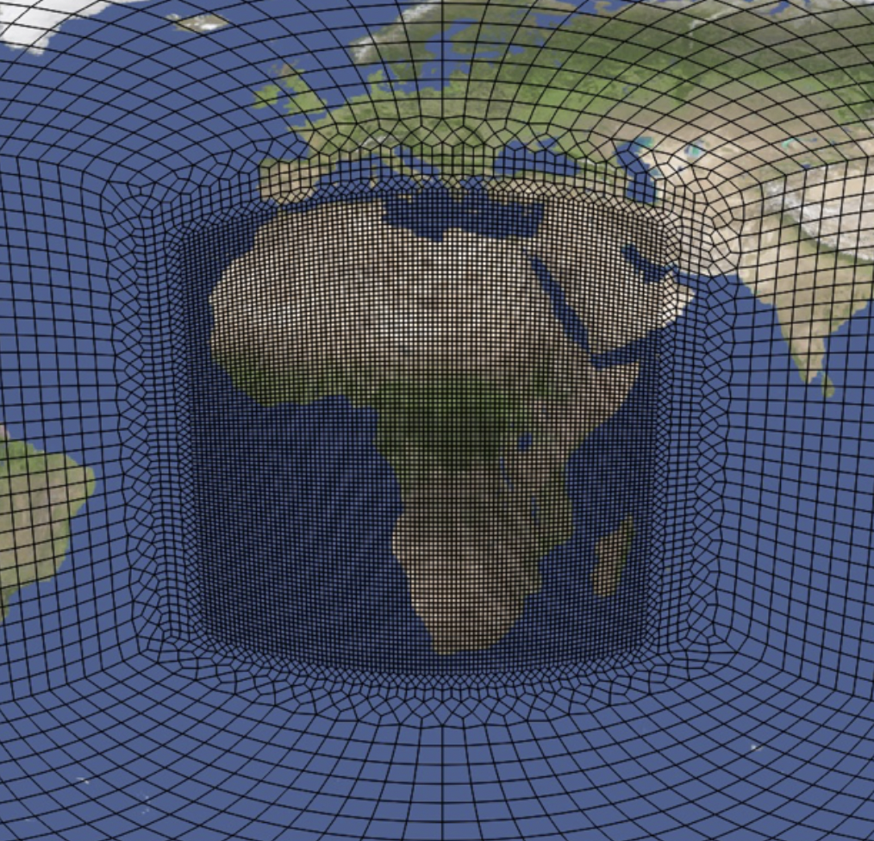

Air Quality Modelling over Africa using MUSICA
We quantify model-satellite discrepancies over Africa with MUSICAv0.
The highlighted East Africa region has the largest model-satellite discrepancies.
A field campaign there can help understand model-satellite discrepancies and improve model predictability.
MUSICAv0 grid for Africa:
MUSICA-satellite discrepancies:
Better agreement
for CO, NO2, HCHO, AOD
Worse agreement
For CO, NO2. HCHO. AOD
Aircraft campaign
East Africa?
Wenfu Tang et al., GMD 2023, NCAR ACOM
Prof. dr. Pieternel Levelt, NSF NCAR ACOM, KNMI, TU Delft
Atmospheric Chemistry and Observations Laboratory

Slide 9
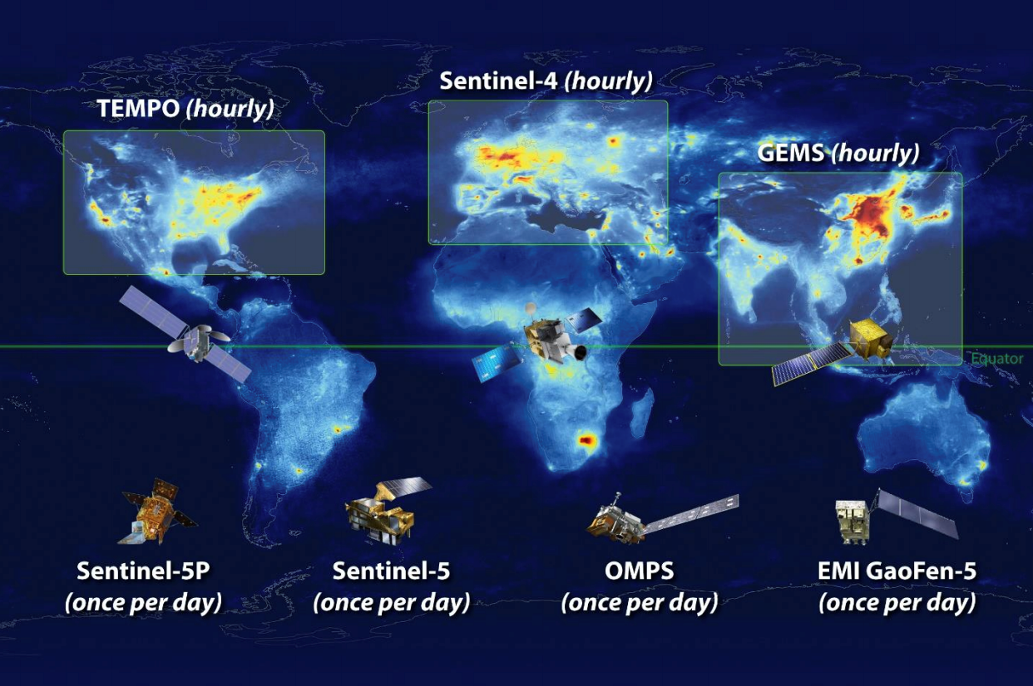
Global Atmospheric Composition Constellation
TROPOMI
1:30 pm
9:30 am
Prof. dr. Pieternel Levelt, NSF NCAR ACOM, KNMI, TU Delft
Atmospheric Chemistry and Observations Laboratory

Slide 10
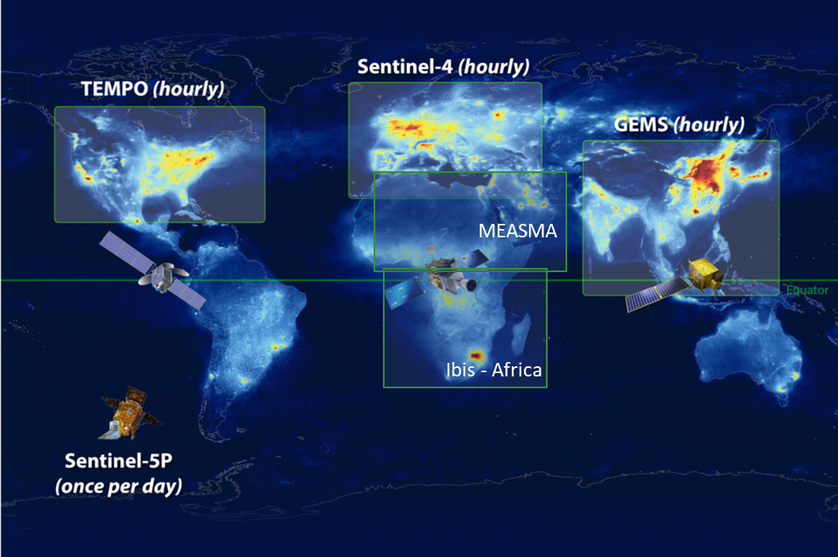
Global Atmospheric Chemistry Constellation
Global Atmospheric Composition Constellation
Global Atmospheric Chemistry Constellation
TROPOMI
MEASMA-N
We need to add Geostationary Satellites over the Global South- Africa
See also statement of the World Economic Forum
https://www.weforum.org/agenda/2023/01/davos23-air-pollution-accountability-satellites-data-transparency/
Driving air pollution accountability and action via data transparency – January 11, 2023
GEO - Africa
GEO - Aus
GEO-S America
Field of Regard for MEASMA: GEO over Middle East and North Africa
Prof. dr. Pieternel Levelt, NSF NCAR ACOM, KNMI, TU Delft
Atmospheric Chemistry and Observations Laboratory
Notes:
In the recent CEOS workshop in Washington DC it was decided that CEOS will initiatie the writing of a white paper for GEOs over the Global South.

Slide 11
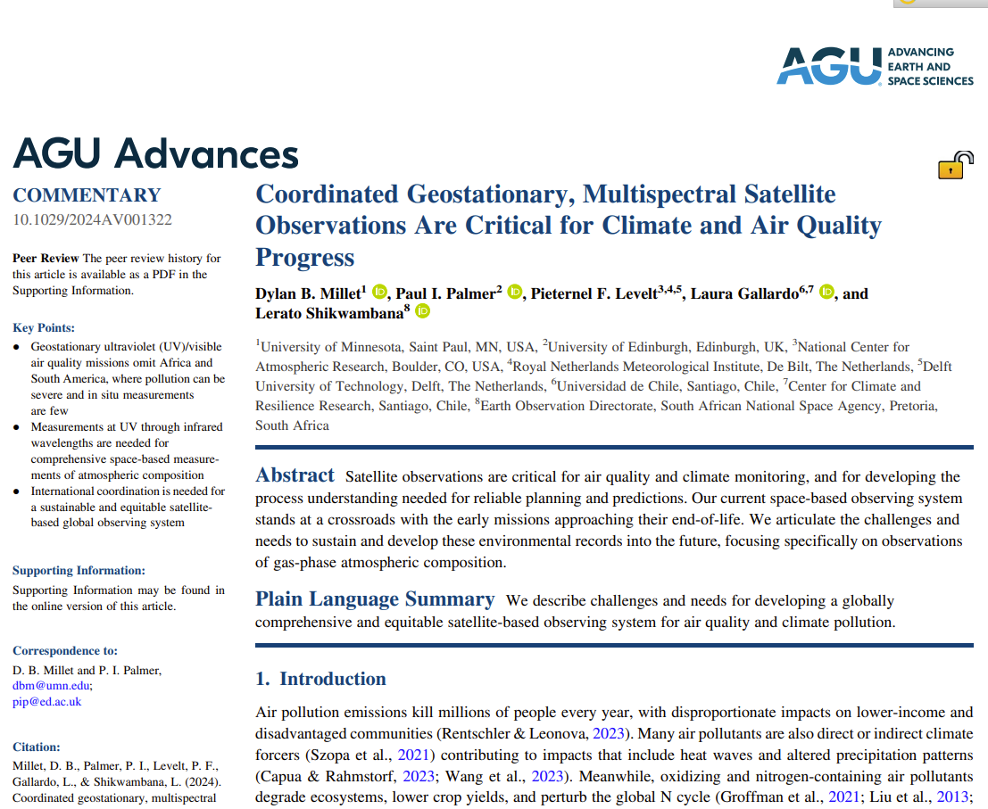
Summary
GEO’s over the Global South
Commentary in AGU Advances (Dylan Millet et al.), 2024
2 initiatives for GEO’s over Africa (Measma & Africa GEO)
Start writing CEOS scientific concept paper:
Geostationary Atmospheric Composition Satellite Constellation: Towards Global Coverage
Currently we are trying to form science teams : looking for scientists from all continents - interest? Please send me an email.
Townhall Meet GEO over the Global South was held at AMS in January 2025 with leaders in the field and cross disciplinary
Pieternel Levelt, levelt@ucar.edu
Prof. dr. Pieternel Levelt, NSF NCAR ACOM, KNMI, TU Delft
Atmospheric Chemistry and Observations Laboratory

