Slide 1

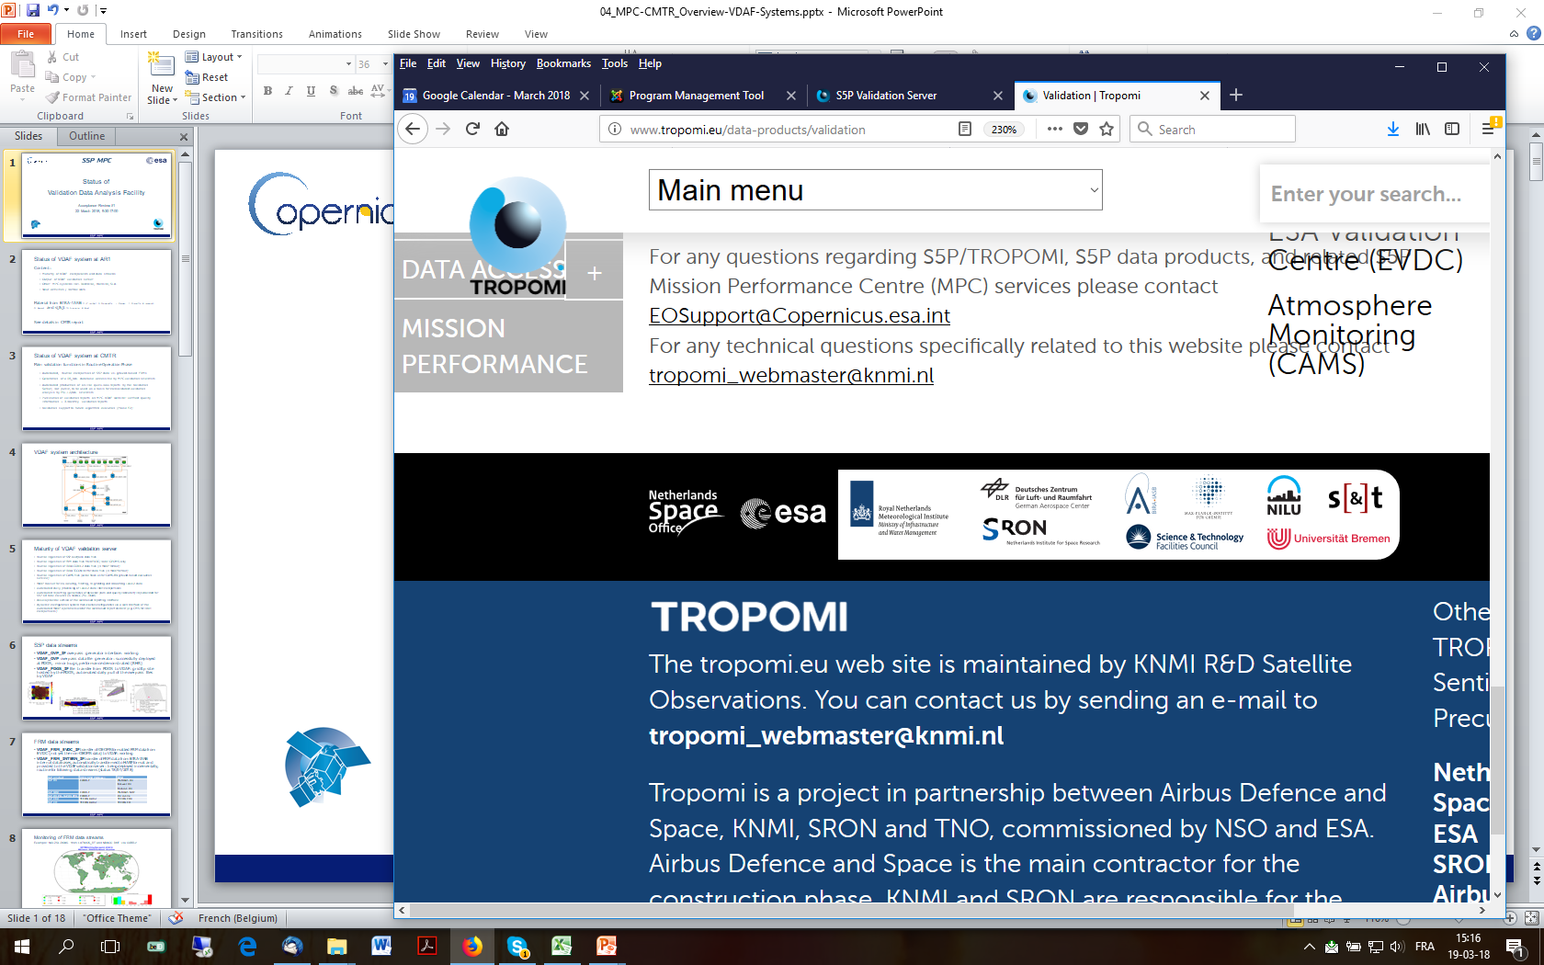



Atmospheric Mission Performance
Cluster (ATM-MPC)
Sentinel-5 Precursor TROPOMI
Validation Update
  J.-C. Lambert, S. Compernolle, Arno Keppens, B. Langerock, T. Verhoelst (BIRA-IASB),
  D. Stein-Zweers (KNMI), A.Dehn (ESA),
  D. Hubert, Y. Geunes, J. Granville, O. Rasson, I. De Smedt, T. Ooms, G. Pinardi, M.K. Sha, N. Theys, C. Vigouroux (BIRA-IASB),
  A.M. Fjæraa (NILU), S. Niemeijer (s[&]t), A. Argyrouli, M. Coldewey-Egbers, K.-P. Heue, P. Hedelt, G. Lichtenberg, R. Lutz, F. Romahn (DLR),
  D. Balis, K. Garane, ML. Koukouli, K. Michailidis, A. Pseftogkas (AUTH), S. Beirle, T. Wagner (MPI-C),
  J. Claes, M. de Graaf, H. Eskes, E. Loots, E. van der Plas, J. van Geffen (KNMI), K.-U. Eichmann (IUP-UB), M. Alparone, C. Zehner (ESA)

Slide 2
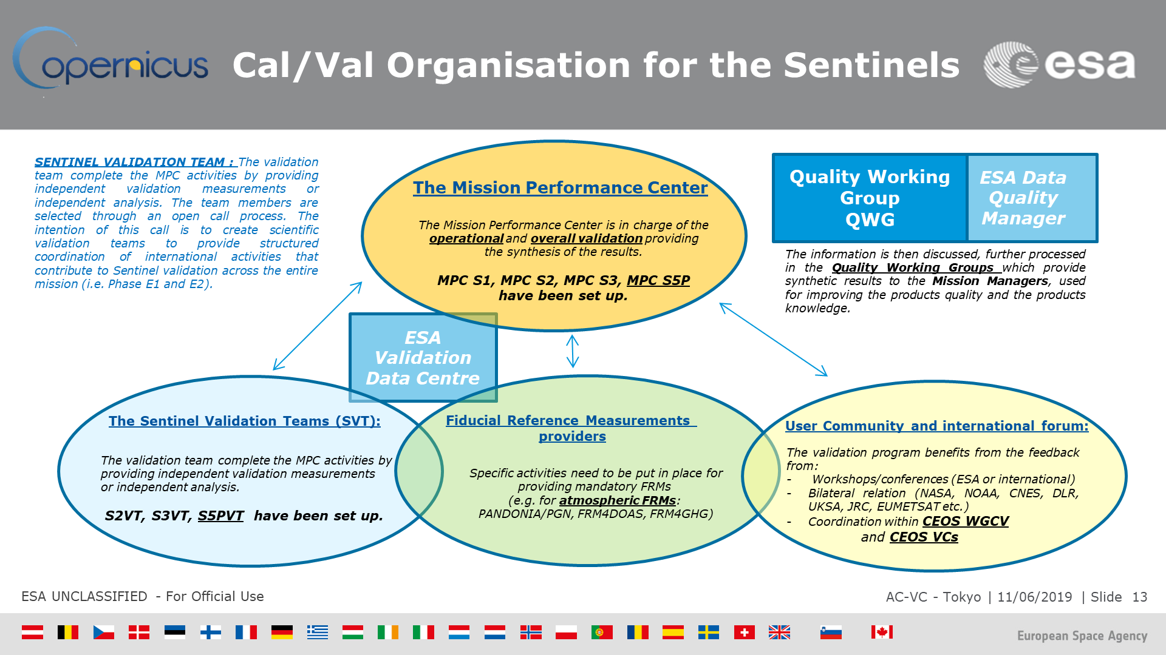

Slide 3























Fiducial Reference Measurements and Other Validation Data
S5P data Product | Mission requirements Systematic Random |  | Fiducial Reference Measurements and other ground-based data sources | Satellite data sources
L1B radiance & irradiance | band dependent |  | PICS based monitoring | OMPS-NP, OMPS-NM
O₃ total column | 5% | 2.5% | Brewer, Dobson, ZSL-DOAS, PGN | OMI, GOME-2
O₃ vertical profile | 30% | 10% | ozonesonde, DIAL (strato+tropo) | OMI, GOME-2
O₃ tropospheric column | 25% | 25% | ozonesonde | OMI, GOME-2
NO₂ stratospheric column | 10% | 0.5 e15 | NDACC ZSL-DOAS | OMI, GOME-2
NO₂ tropospheric column | 50% | 0.7 e15 | NDACC MAX-DOAS | OMI, GOME-2
NO₂ total column | - | - | PGN | OMI, GOME-2
SO₂ total column SO₂ layer height | 30% - | 30% - | MAX-DOAS, PGN - | OMI, OMPS-NP IASI-B, IASI-C, CALIPSO
HCHO total column | 80% | 1.2 e16 | MAX-DOAS, NDACC FTIR, PGN | OMI, GOME-2
CO total column | 15% | 10% | NDACC FTIR, TCCON, COCCON | GOSAT-2, OCO-2
CH₄ total column | 1.5% | 1% | NDACC FTIR, TCCON, COCCON | GOSAT-2, OCO-2
Cloud Fraction | 20% | 0.05 | FRM not available | VIIRS, OMI, GOME-2
Cloud Height (pressure) | 20% | 0.5 km | CLOUDNET lidar/radar | VIIRS, OMI, GOME-2
Cloud Optical Thickness | 20% | 0.05 | FRM not available | VIIRS, OMI, GOME-2
Aerosol Absorbing Index | 1 AAI | 0.1 AAI | FRM not available | OMI, OMPS-NP
Aerosol Layer Height | 100 hPa | 50 hPa | EARLINET lidar | CALIPSO, VIIRS, GOME-2
ESA FRM Programme
Monitoring Networks
Colour code: automated production of S5P QIs by the VDAF-AVS manual data collection and/or validation
FRM not available, quality evaluation mainly via diagnostics and satellite data intercomparisons

Slide 4
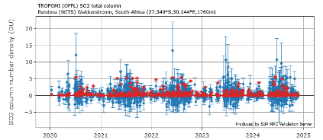
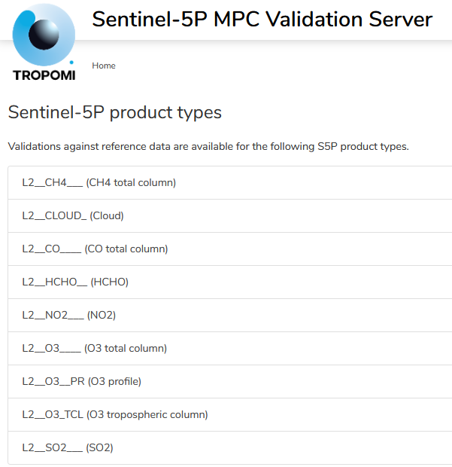
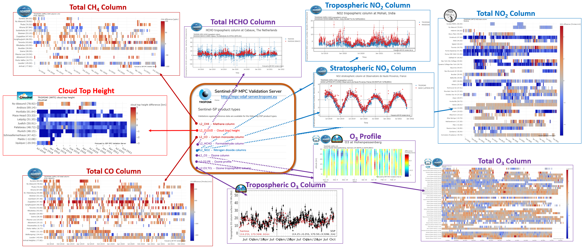

VDAF-AVS: Automated comparison to ground-based networks and permanent reporting of S5P TROPOMI L2(+) data Quality Indicators
https://mpc-vdaf-server.tropomi.eu
Total SO₂ column

Slide 5
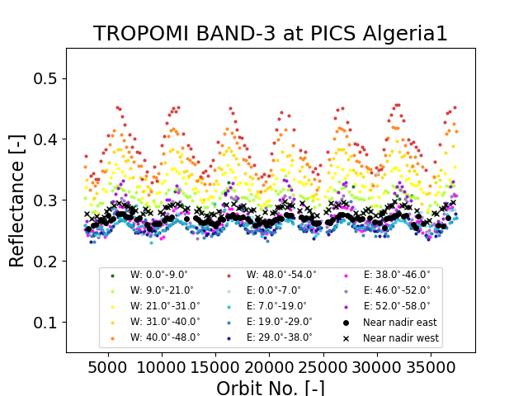
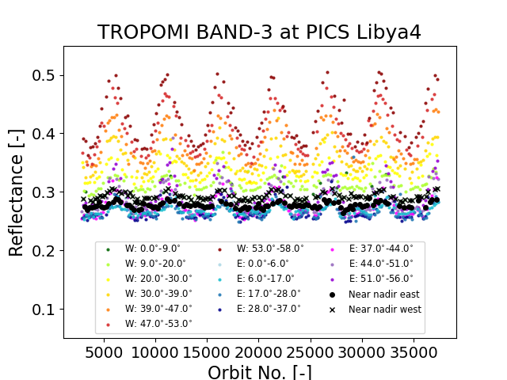
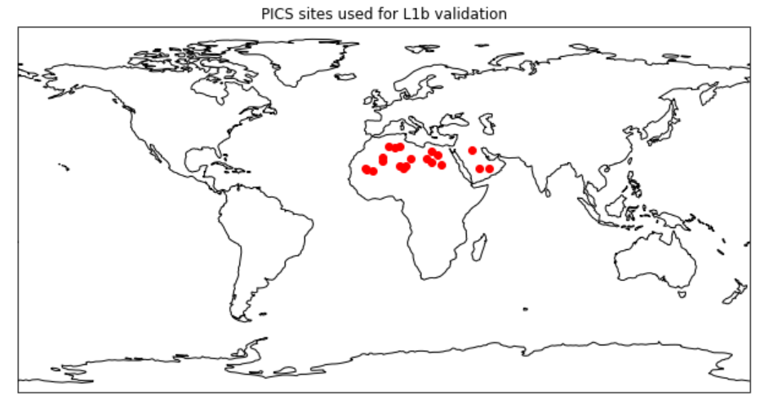
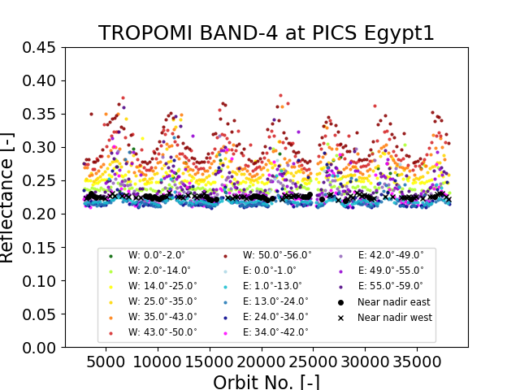
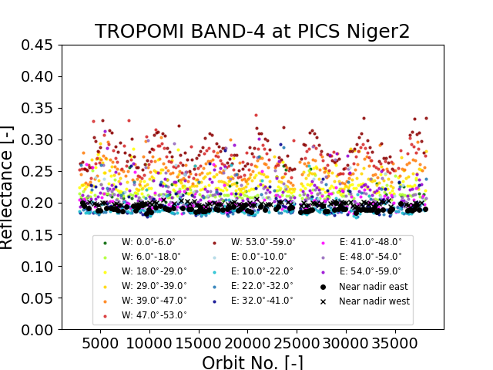
L1B Radiance, Irradiance and Reflectance Stability
Coordinator: Emiel van der Plas (KNMI)
Contributors: Melanie Coldewey-Egbers (DLR), Erwin Loots (KNMI)
Reflectance BAND 3
  Example: Analysis of long-term stability of L1B V02.01.00 cloud-free reflectance over ~20 CEOS Pseudo-Invariant Calibration Sites (Saharan Desert and Arabian Peninsula) in band 3 and band 4
  Results: L1B v02.01.00. reflectance over PICS stable for both band 3 and band 4. Long-term drift <0.5% over the current lifetime of TROPOMI
Reflectance BAND 4

Slide 6
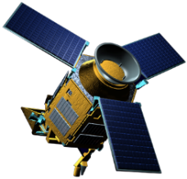
Validation of S5P Cloud Products as Major Influence Quantities for Other S5P Data Products
Cloud products are used by other S5P products
to mask pixels that are too cloudy for use
to account for cloud (radiative) effects in trace gas and aerosol data retrievals
S5P CLOUD
S5P OCRA/ROCINN_CAL
Radiometric cloud fraction
Cloud top pressure/height
Cloud optical thickness
S5P O₃ NRTI total VCD
S5P O₃ trop VCD
S5P OCRA/ROCINN_CRB
Radiometric cloud fraction
Cloud pressure/height
Cloud albedo
S5P O₃ OFFL total VCD
S5P HCHO trop VCD
S5P SO₂ VCD
S5P FRESCO
Radiometric cloud fraction
Cloud pressure/height
S5P NO₂
trop & strat & total VCD
aerosol
S5P O₃ profile
CH₄
BrO
SO₂
HCHO
S5P ALH
O₃
NO₂
CO
CHOCHO
S5P CH₄
Back-up cloud mask

Slide 7
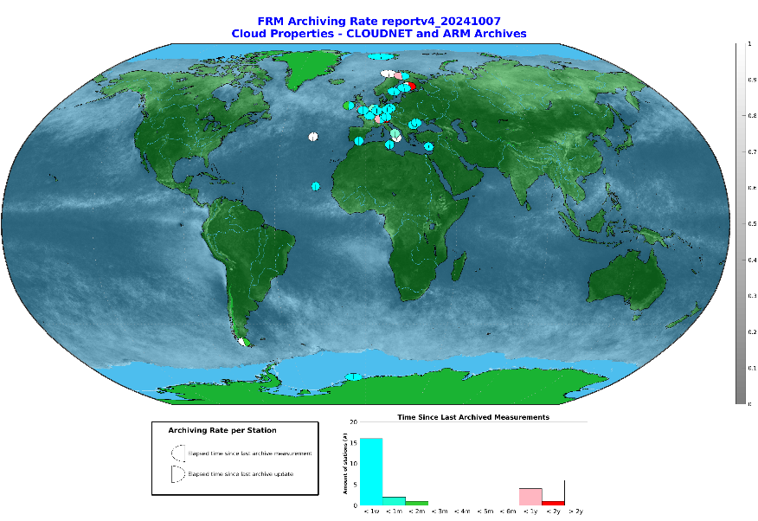
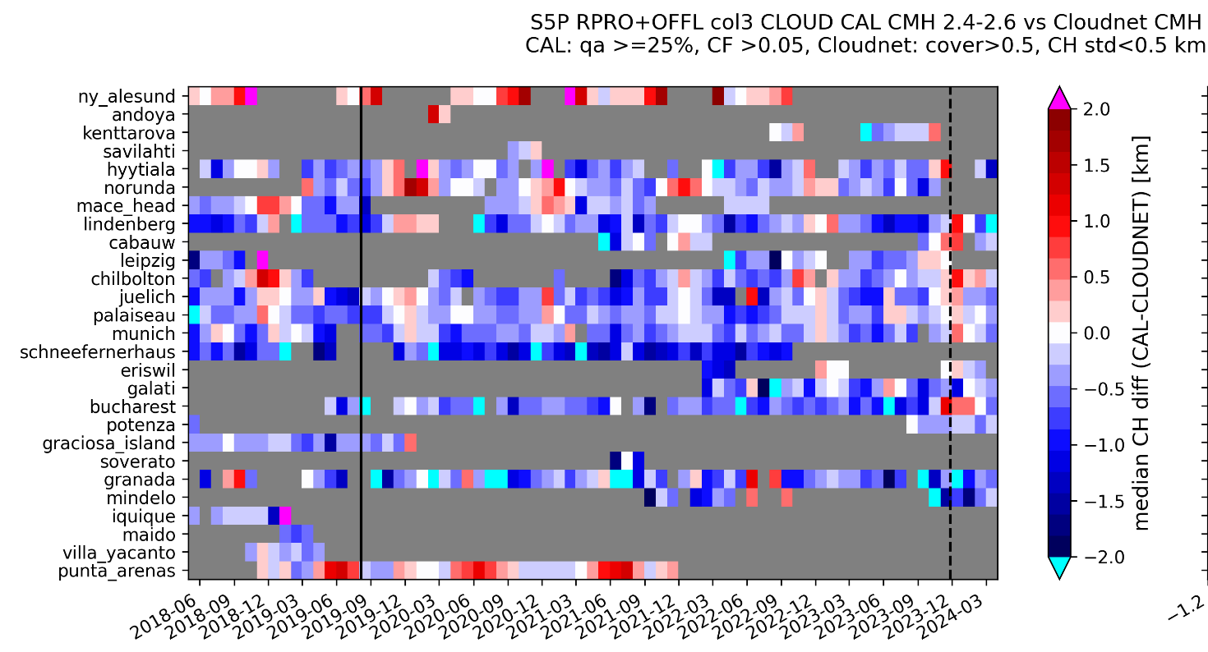
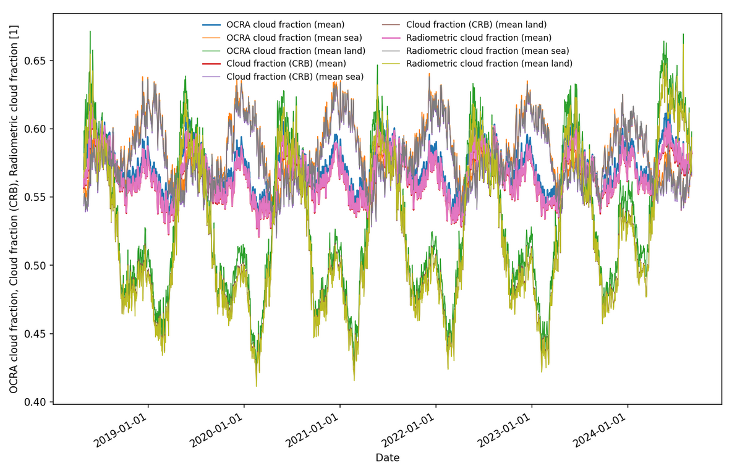
Cloud Properties Validation
Coordinator: Steven Compernolle (BIRA-IASB).
Contributors: Ronny Lutz, Athina Argyrouli, Victor Molina Garcia (DLR),
Maarten Sneep (KNMI)
Vs. ACTRIS-Cloudnet networks of cloud lidars & radars
L2_CLOUD Lidar/radar
Cloud parameters scrutinized
Top and mean heights, fractional cover, optical thickness
Processors: OCRA/ROCINN CAL & CRB, FRESCO
Validation particulars
Low/middle cloud fraction with focus on AQ and O₃ retrievals
Vs. OPERATIONAL network ACTRIS-Cloudnet
Vs. satellites: OMI, VIIRS
Effects of S5P OCRA cloud fraction version changes
V2.6.1

Slide 8
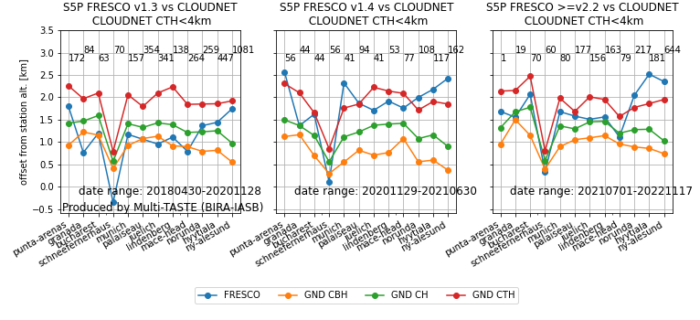

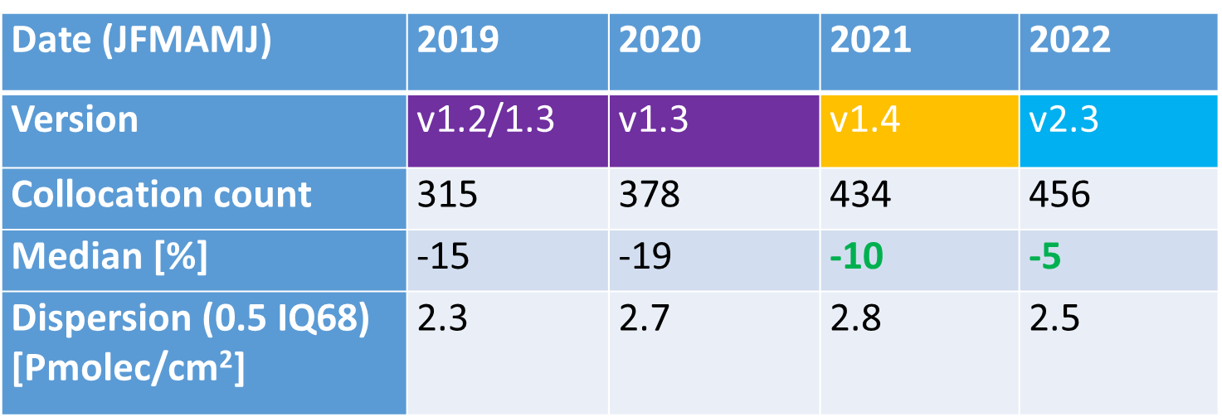
Cloud Properties Validation
Coordinator: Steven Compernolle (BIRA-IASB).
Contributors: Ronny Lutz, Athina Argyrouli, Victor Molina Garcia (DLR),
Maarten Sneep (KNMI)
FRESCO v1.3
v1.4
v2.2-2.3
S5P FRESCO upgrade v1.4:
cloud height increase from
Cloudnet ~cloud base height to
in-between mean height and top height
lower bias in S5P NO₂
S5P NO₂ vs PGN Pandora
Comparison using low clouds: most relevant for trace gas data retrieval

Slide 9
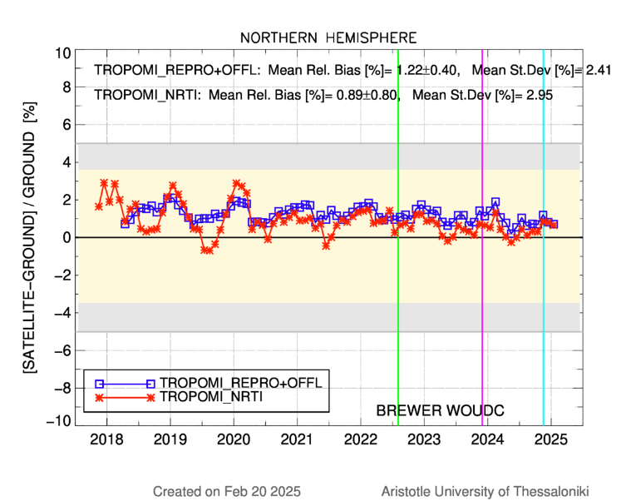
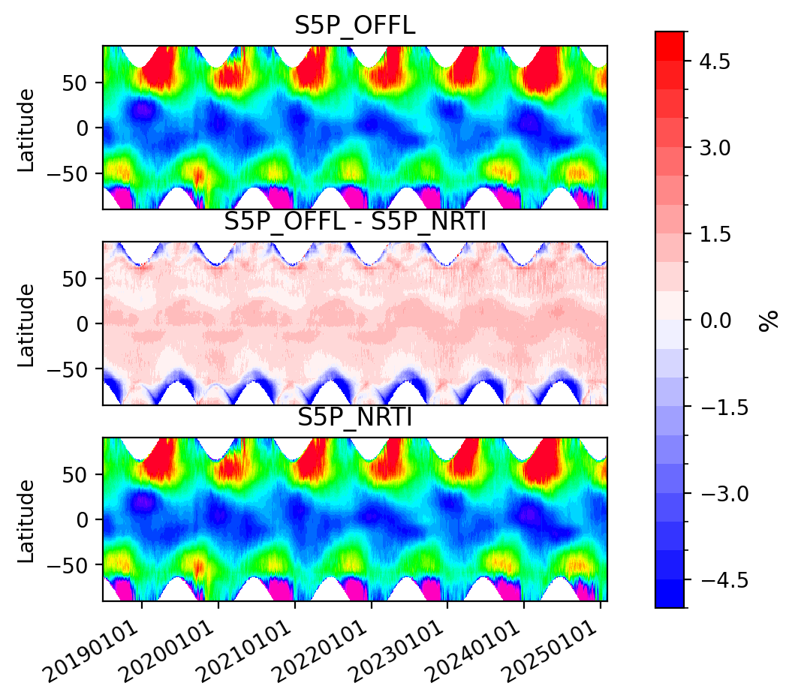
O₃ Column Validation
Coordinator: Tijl Verhoelst (BIRA-IASB) Contributors: Katerina Garane (AUTH),
Klaus-Peter Heue (DLR)
S5P OFFL vs. S5P NRTI
S5P vs. Brewer Network

Slide 10
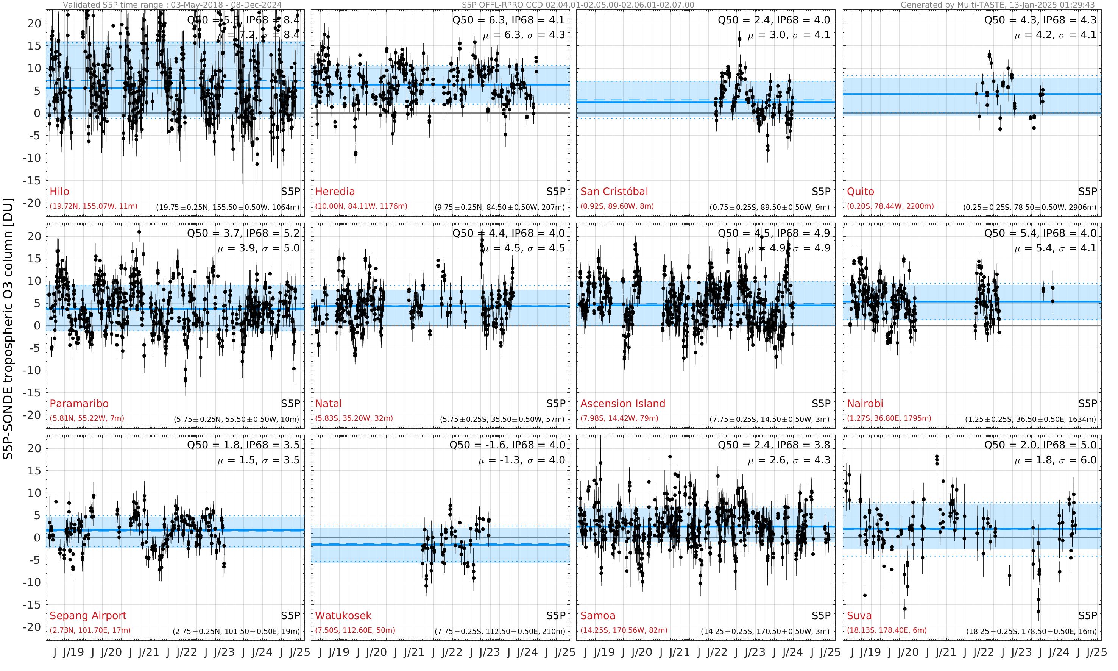
Tropospheric O₃ Column Validation
Coordinator: Daan Hubert (BIRA-IASB) Contributor: Klaus-Peter Heue (DLR)

Slide 11
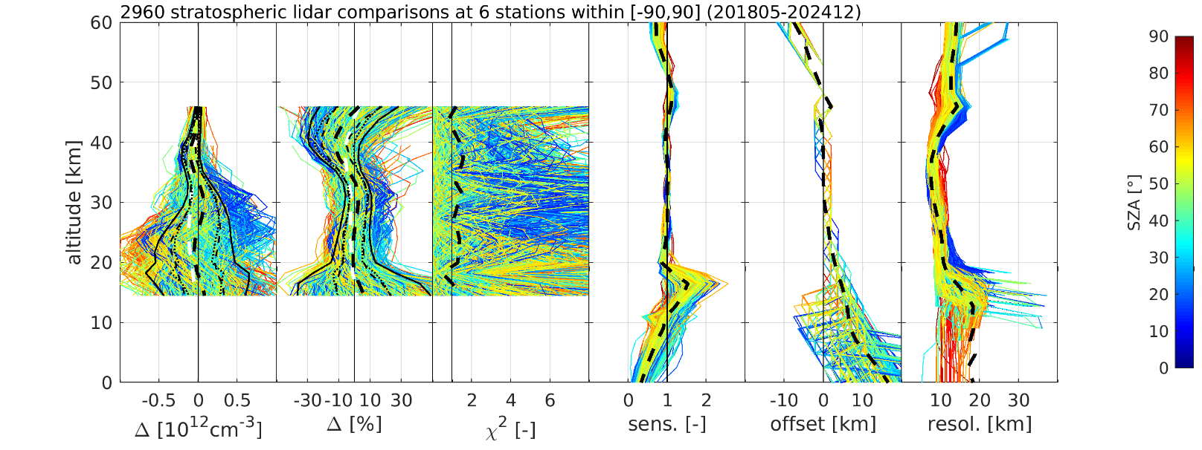
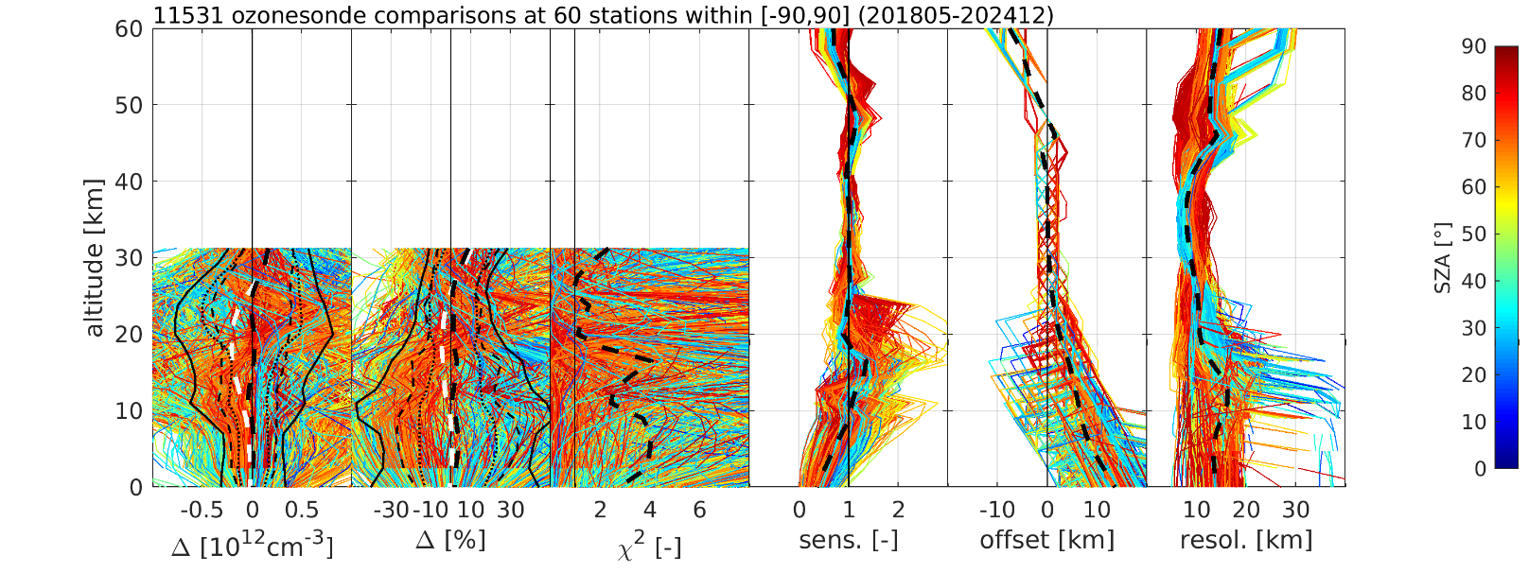
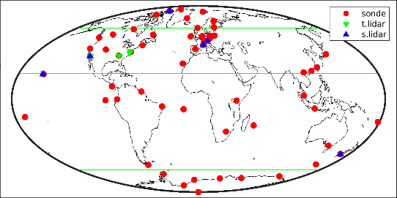
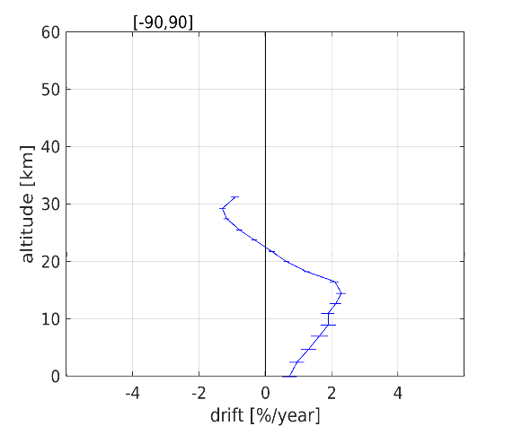
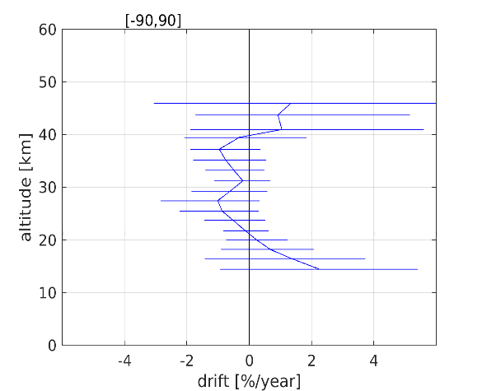
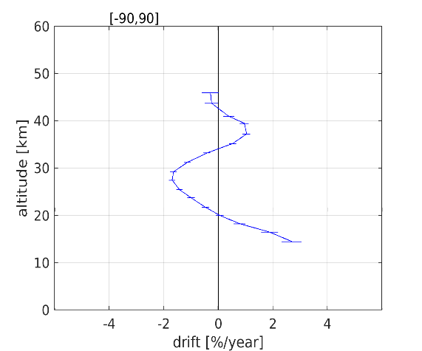
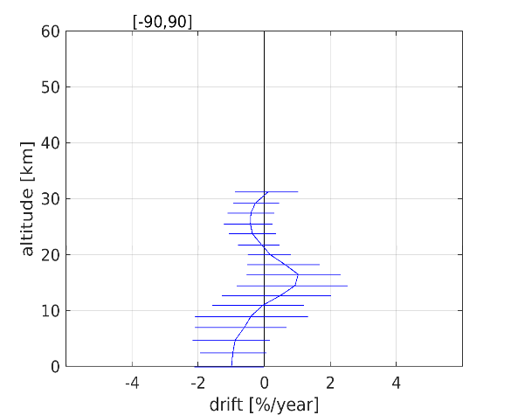
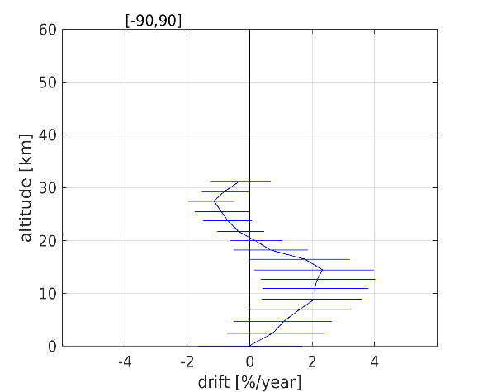
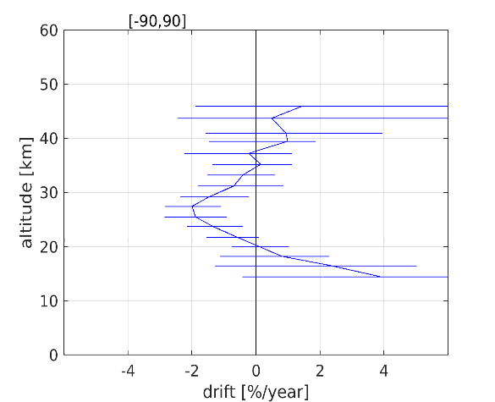
Ozone Profile Validation
Coordinator: A. Keppens. Contributors: D. Hubert, J.-C. Lambert
Key validation results
  5-6 DFS with dependence on SZA and slant column
  7-15 km effective vertical resolution
  Altitude: ~10 km offset towards surface and upper stratosphere
  Bias: 5-15 %, oscillations in stratosphere
  Dispersion: 20-30 % below TP, 5-10 % above
  Uncertainty underestimated by factor ~2 below tropopause
  Lat.-dependent drift, highest in mid-latitude troposphere,
  negative in stratosphere, negligible integrated drift
  Integrated profile consistent with ozone column (~5 % diff.)
  Slight striping along orbit
  Poorer retrieval quality around Antarctic
DDS v2.8
OFFL, DDS sampling
2018/05-2024/12

Slide 12
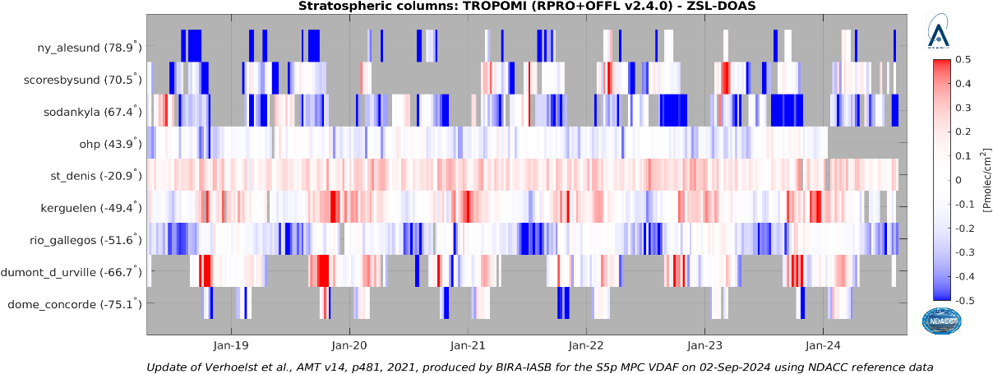
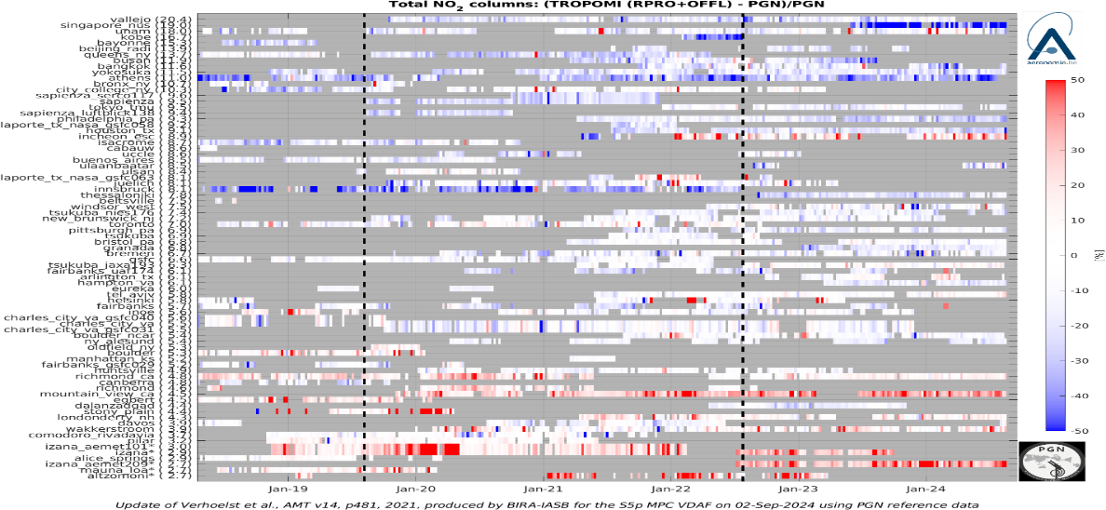
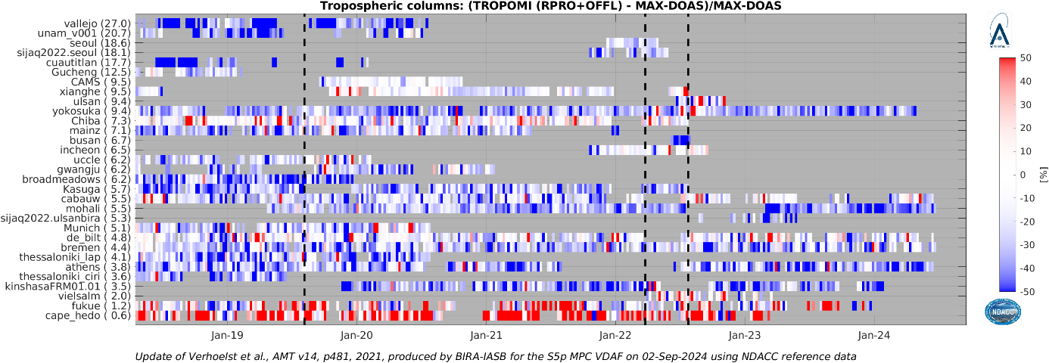
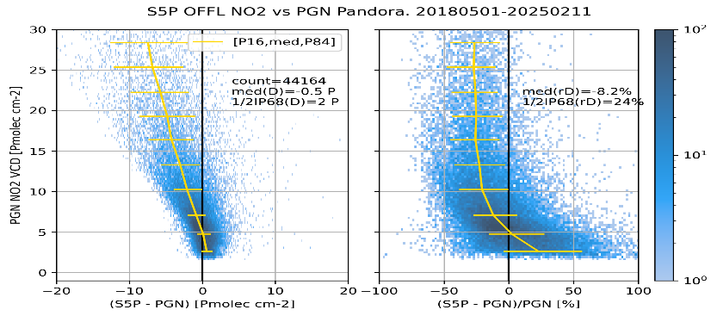
NO₂ (Partial) Columns Validation
Validation coordinator: K.-U. Eichmann (IUPB) Contributors: S. Compernolle, G. Pinardi, and T. Verhoelst (BIRA-IASB), H. Eskes, J. van Geffen (KNMI)
S5P vs. NDACC ZSL-DOAS ⇨ stratospheric NO₂
S5P vs. PGN ⇨ total NO₂
S5P vs. MAXDOAS ⇨ tropospheric NO₂
total

Slide 13
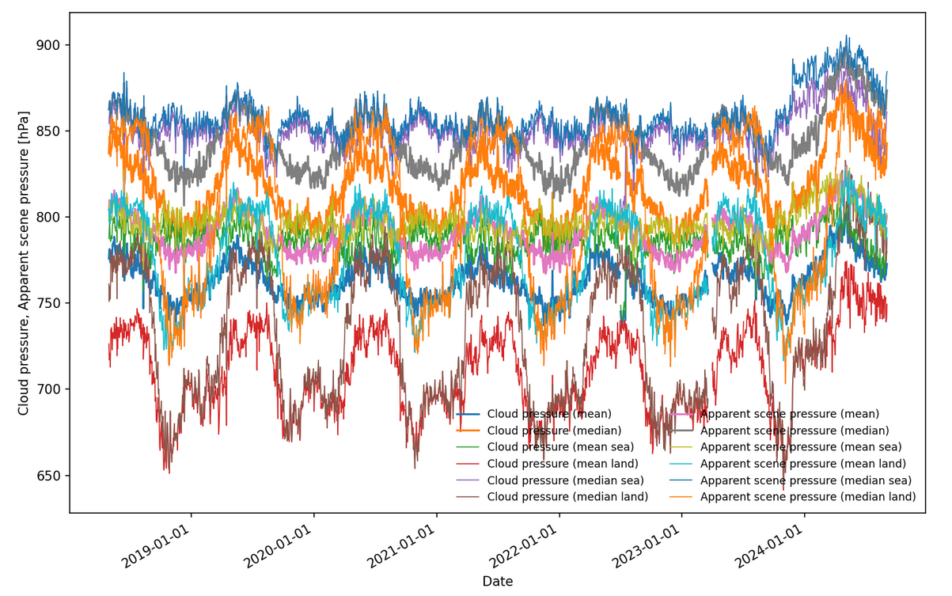
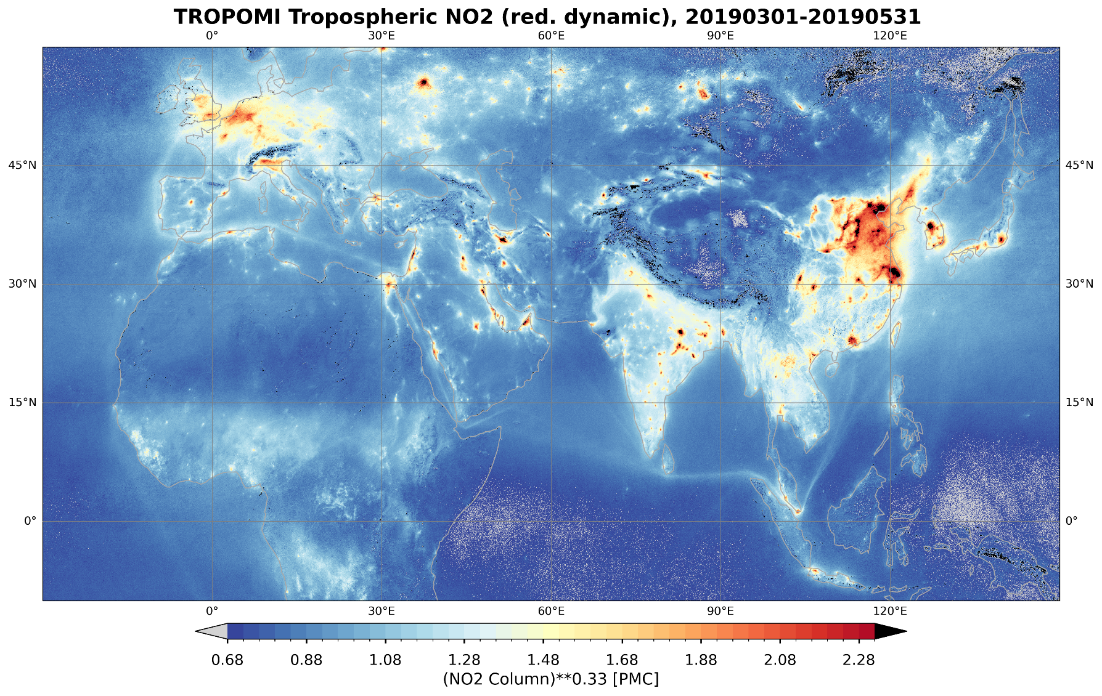
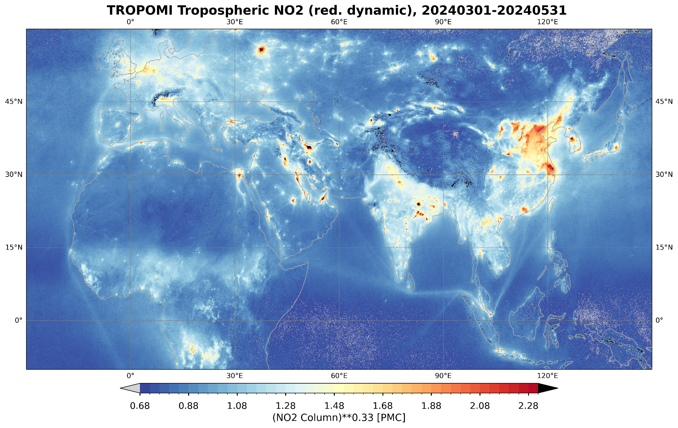
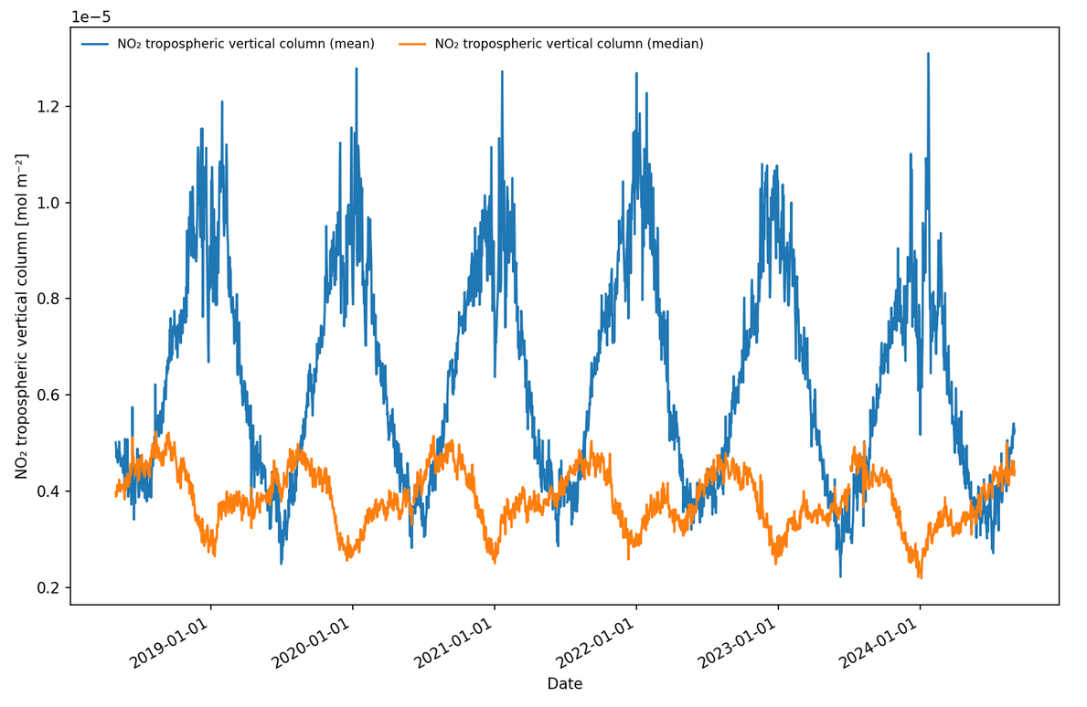

Open issue in L2_NO₂ ⇨
Need for mission reprocessing
FRESCO version change
Cloud pressure
MAR/APR/MAY 2019-2024
RES: 0.05°
COL = $\sqrt[3]{x}$
NO2 trop VCD

Slide 14
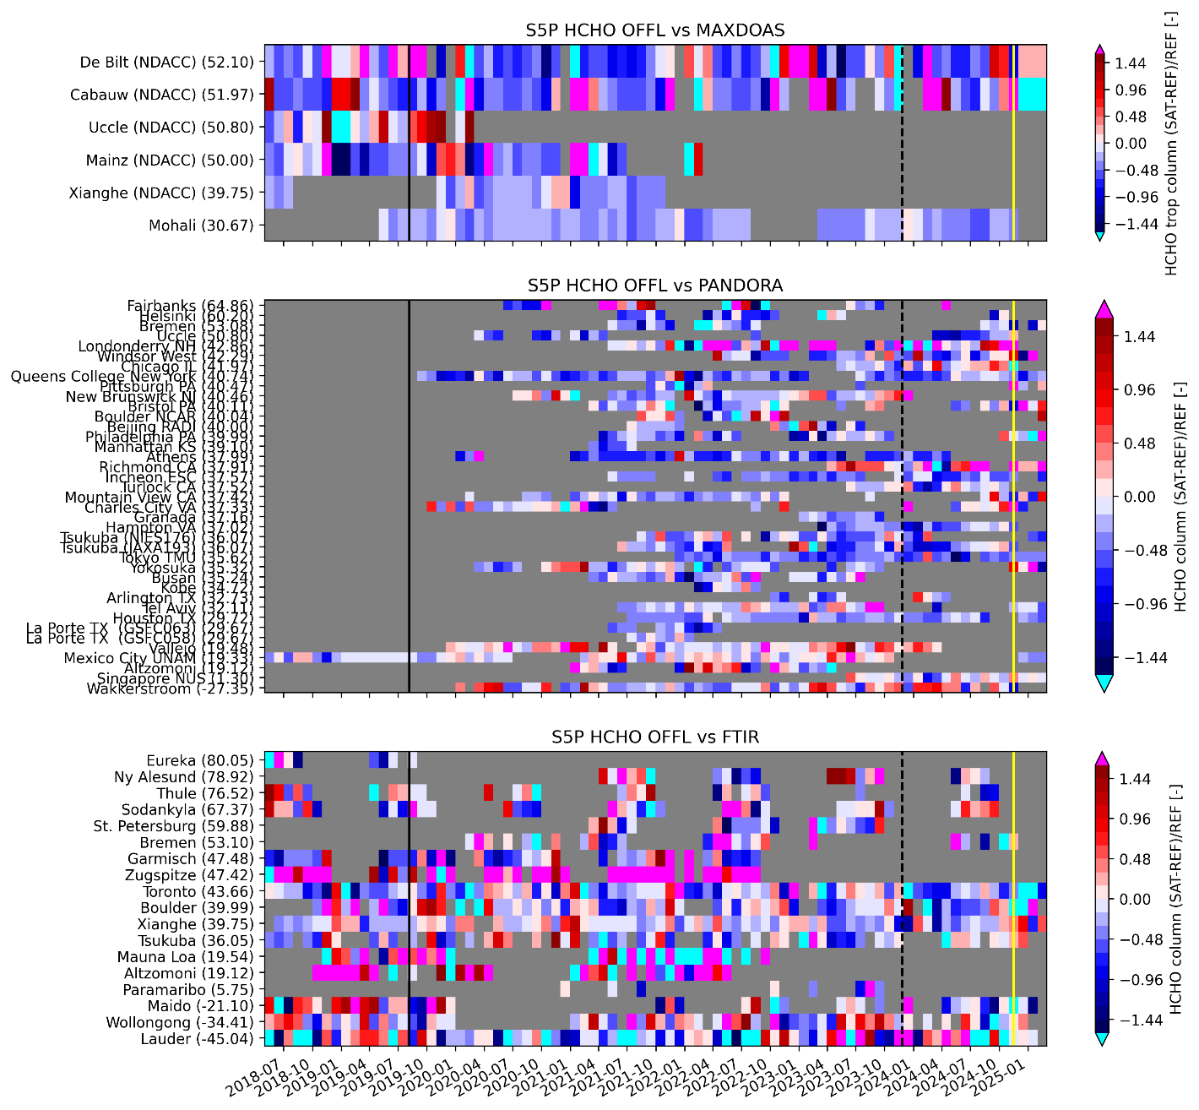

HCHO Column Validation
Validation coordinator: K.-U. Eichmann (IUPB). Contributors: S. Compernolle, I. De Smedt, G. Pinardi, C. Vigouroux (BIRA-IASB)
Processor version 02.07.00 OFFL + 02.04.01 RPRO
Bias, (Dispersion):
  FTIR [clean <2.5 Pmolec/cm²] 30%, (9 Pmolec/cm²)
  [polluted >8 Pmolec/cm²] -30%, (25 Pmolec/cm²)
  MAX-DOAS -37%, (<10 Pmolec/cm²)
  PGN -31%, (9.6 Pmolec/cm²)
  OMI [polluted >5 Pmolec/cm²] (3%, <7 Pmolec/cm²)
S5P vs. NDACC MAX-DOAS
S5P vs. PGN
S5P vs. NDACC FTIR

Slide 15
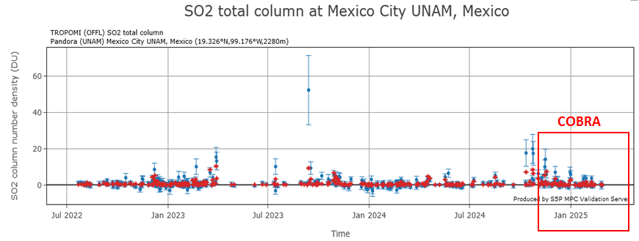


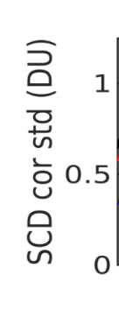

SO₂ Column Validation
Validation coordinator: T. Wagner (MPI-C)
Contributors: N. Theys, S. Compernolle (BIRA-IASB)
Switch to COBRA retrieval algorithm
Validation example using routine PGN measurements
The switch to COBRA gets smaller (and less negative values) of the TROPOMI SO2 VCds.
There are still several cases where TROPOMI VCDs are higher than the pandora values.
Results from the Sentinel-5P MPC Validation Server
The standard deviation of the SO2 is largely reduced after the switch to COBRA
(results for measurements close to the equator)

Slide 16
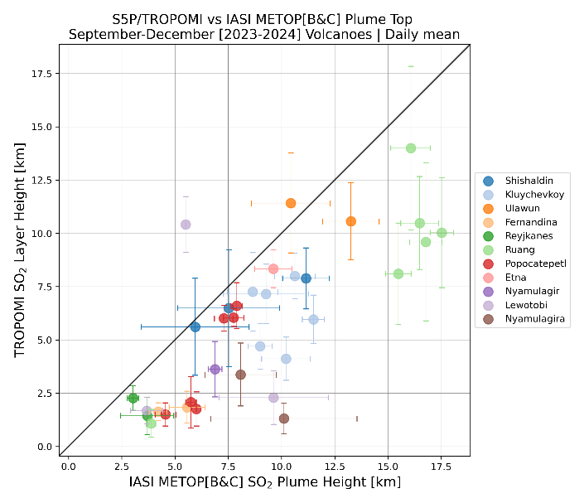
SO₂ Layer Height Validation
Validation coordinator: T. Wagner (MPI-C)
Contributors: A. Pseftogkas, M. Koukouli, K. Michailidis (AUTH)
Relatively good agreement between TROPOMI and IASI, but IASI results are systematically higher (~3km for all eruptions; ~1.5 km for strong eruptions)
Often trajectory results agree better with TROPOMI than with IASI (0.5 – 0.7 km)
Daily mean TROPOMI (y-axis) and IASI/MetopB&C SO₂ LH during volcanic eruptions of the September-November 2024 period.

Slide 17
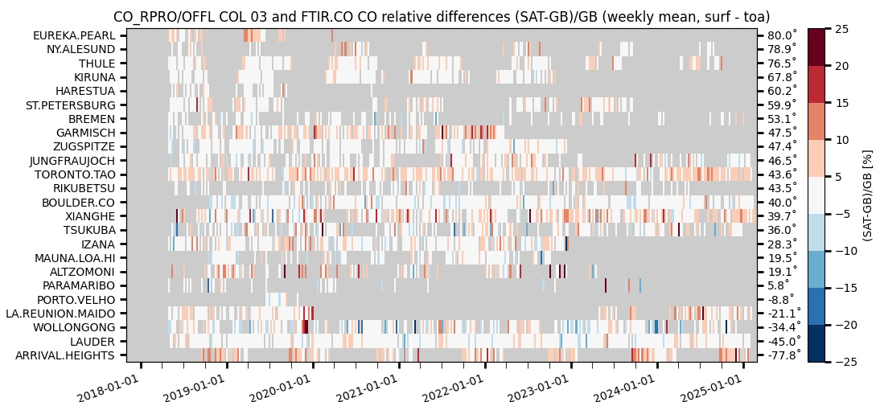
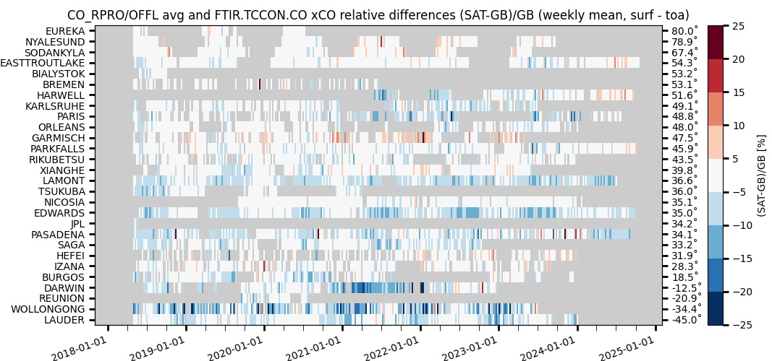
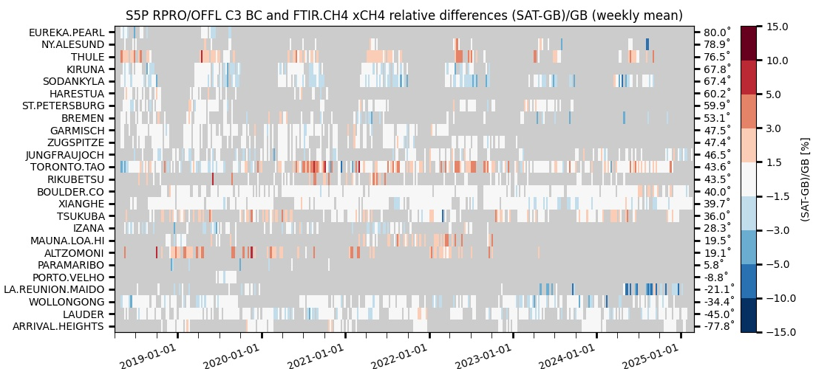
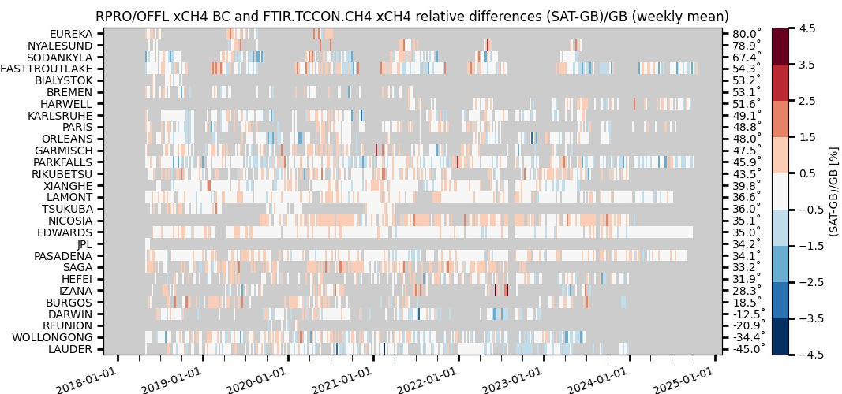
CO and CH₄ Columns Validation
Validation coordinators B. Langerock and M. K. Sha (BIRA-IASB)
NDACC
TCCON
TCCON

Slide 18
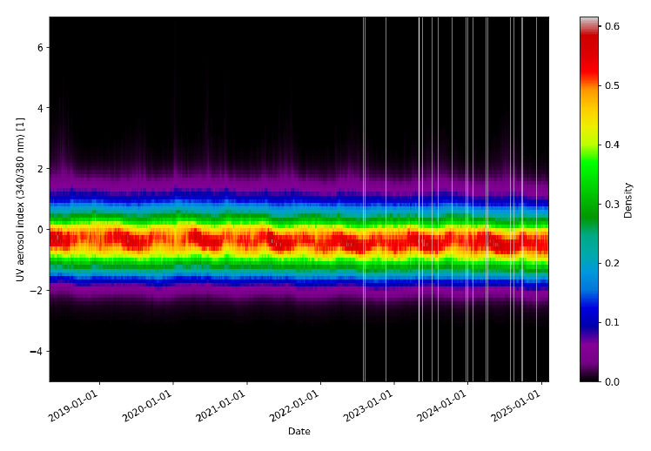
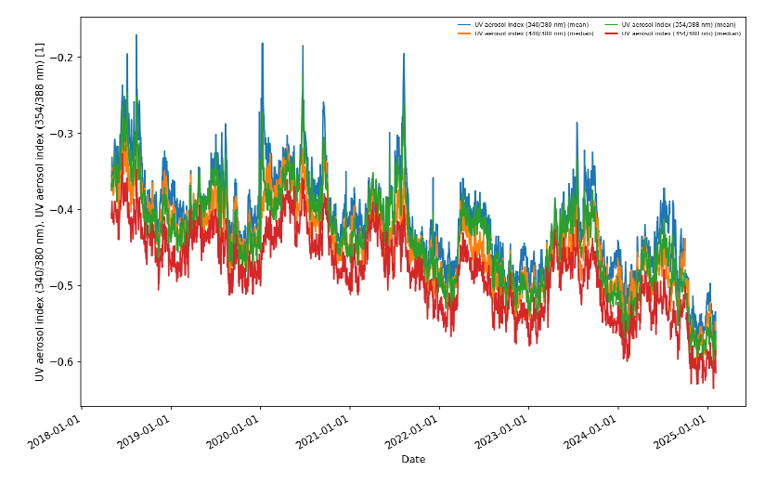
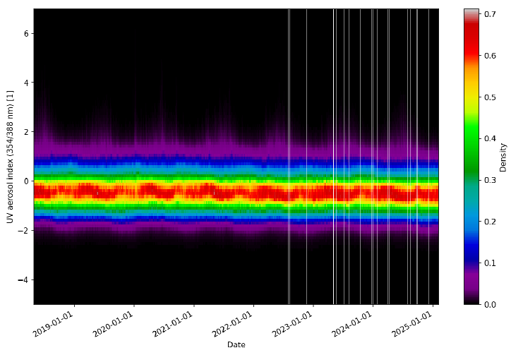
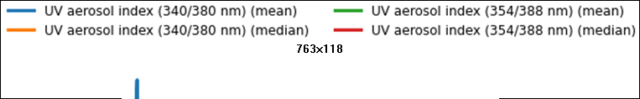
Aerosol Index Validation
Validation coordinator: T. Wagner (MPI-C)
Contributors: D. Stein Zweers (KNMI), O. Torres, C. Ahn (NASA)
340/380 nm
354/388 nm
Within requirements
Slight downward trend (2021-July to present) appears to be partly aerosol-physically-driven, and partly instrument-related. Investigations with the L1 team are ongoing

Slide 19
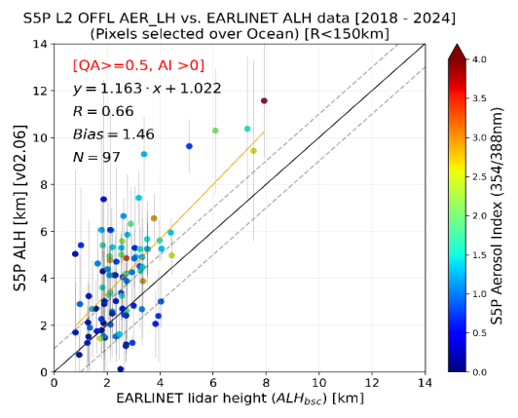



Aerosol Layer Height Validation
Validation coordinator: T. Wagner (MPI-C)
Validation contributors: M. de Graaf (KNMI), K. Michailidis , M-E. Koukouli (AUTH)
Validation against ground-based EARLINET lidars
For the version (02.06 OFFL) especially over land the results are much improved:
Mean Bias over Ocean: 1.46 ± 1.69 km
Mean Bias over Land: -0.49 ± 1.33 km
The scatter is increased compared to earlier versions
For the latest updated version (02.07, 02.08 OFFL) over land the results are:
Mean Bias over Land: -0.57 ± 0.63 km
(Results for EARLINET stations - ongoing)
Top: TROPOMI ALH (v02.06) against EARLINET data for May 2018 to August 2024. Colour-scale indicates TROPOMI retrieved UVAI (388/354nm), vertical error bars indicate the standard deviation of the spatial average of the TROPOMI ALH pixels. Bottom: Histogram of absolute difference between TROPOMI and EARLINET ALHs.

Slide 20



S5P TROPOMI Routine Validation Service Portal
Routine Operations Validation Platform https://mpc-vdaf.tropomi.eu
Up-to-date quality information on TROPOMI L1B and L2(+) data
Search engine to browse
results by processor
versions, networks etc.
To the Automated
Validation Server
Results and resources by product
Direct access to quarterly report

