Slide 1
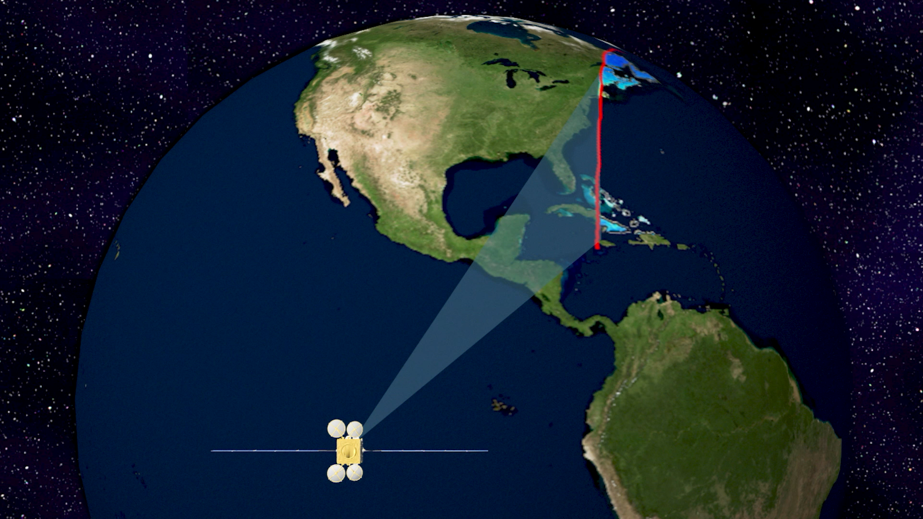
TEMPO Validation Highlights
Based on the TEMPO Validation Report
Collaborative Effort Results of TropNO₂, TotHCHO and TotO3 V3 products
Presented by Laura Judd, NASA Langley
Jim Szykman (US EPA), Barron Henderson (US EPA), Brad Pierce (UW-SSEC) + 60 coauthors from 17 organizations

Slide 2
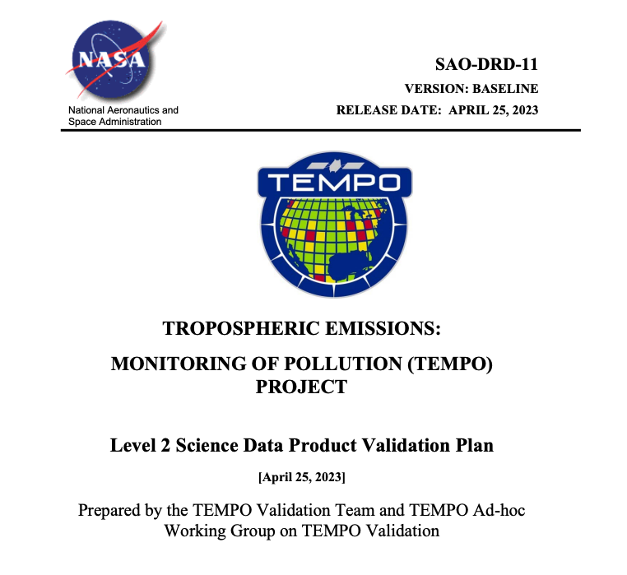

TEMPO Validation Plan & Report
Plan and execution led by US EPA with input from the TEMPO Validation Team and a large group of volunteers.
Renewed discussions started in January 2022
Written plan released in April 2023
Plan includes: TEMPO Baseline Validation + additional needed validation that could theoretically be done from satellite, ground, airborne, and models.
Centered around Product Specific Performance Indicators (PSPIs) for Beta, Provisional, and Full validation stages.
Post launch:
Validation results were discussed in bi-weekly telecons from Fall 2023-Fall 2024.
Written report put together in Fall 2024
TEMPO L2 TropNO2, TotHCHO, and TotO3 reached provisional status in December 2024 through the internal review by the TEMPO Validation Team.
Report publication expected this summer.
Notes:
The contributions to this document have been done under a best-efforts approach leveraging measurement and modeling assets and scientist volunteers’ hours

Slide 3

Very special thank you to all contributors to this effort —Stay tuned for more results not shown today!
Xiong Liu, Kelly Chance, Gonzalo Gonzalez Abad, Caroline Nowlan (SAO-TEMPO)
Barron Henderson, Lukas Valin, Eric Baumann, Dave Williams, Todd Plessel and Jim Szykman US. EPA Office of Research and Development
Aerosol and Atmospheric Composition Group at NOAA/STAR
Ivan Ortega, Sara Martinez-Alonso, Jim Hannigan, David Edwards (ACOM/NCAR)
Rainer Volkamer (CU-Boulder)
Xiaoyi Zhao, Vitali Fioletov, Debora Griffin, Chris McLinden, Sum Chi Lee (Environment and Climate Change Canada)
Ruijun Dang and Daniel Jacob (Harvard)
Alexander Cede, Martin Tiefengraber, Manuel Gebetsberger (LuftBlick)
Matthew S. Johnson, Claudia Bernier (NASA Ames)
Scott Janz, Viral Shah, Sungyeon Choi, Lok N. Lamsal, J. R. Ziemke, S. M. Frith, N. A. Kramarova, Tom Hanisco, Jay Herman and Jianping Mao (NASA Goddard)
Laura Judd, Prajjwal Rawat, Katherine Travis, James Crawford (NASA Langley)
Eleanor Waxman, Andrew Rollins Kristen Zuraski, Carrie Womack, Arthur Mizzi, Chia-Hua Hsu, Carsten Warneke, Sunil Baidar (NOAA-CSL)
Irina Petropavlovskikh, (NOAA GML)
Kanghyun Baek (Pusan University/now NASA GSFC)
Mike Newchurch, (UAH)
Wolfgang Stremme, Andrea Cadena, Michel Grutter (UNAM)
Kimberly Strong, Victoria Flood (U. Toronto)
R. Bradley Pierce, Jerrold Acdan, Maggie Bruckner (UW-SSEC)
> 60 authors from 18+ organizations!

Slide 4
Product Specific Performance Indicators (PSPI)
Beta: the product is minimally validated and publication is not recommended
01: Distinguish realistic gradients in TropNO₂, TotHCHO, and TotO₃ columns
02 Assess bias/uncertainty over one month
03:Compute variance for empirical estimate of fitting uncertainty over homogenous unpolluted dark and light albedo scenes
Provisional: product performance has been demonstrated but with a limited number of independent measurements and may be suitable for scientific publication
04: Assess bias/uncertainty over two seasons (preferably summer/winter)
05: Conduct deep-dive analyses for an episode with relatively poor product performance, identify the root cause
Full: product performance has been demonstrated over a large and wide range of representative conditions with comprehensive documentation of product performance.
06: Assess bias/uncertainty over one year
07: Assess bias, precision, and uncertainty of the products during field campaigns
We are here!

Slide 5
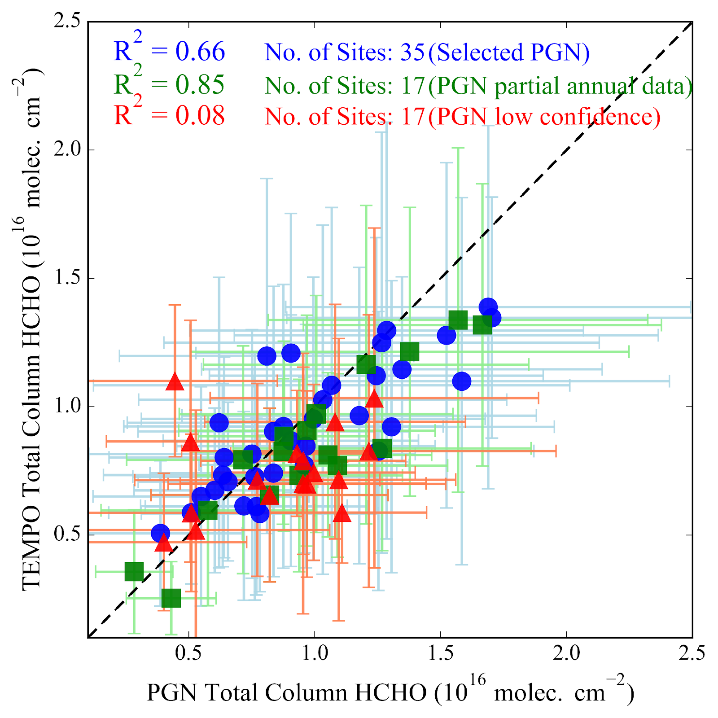
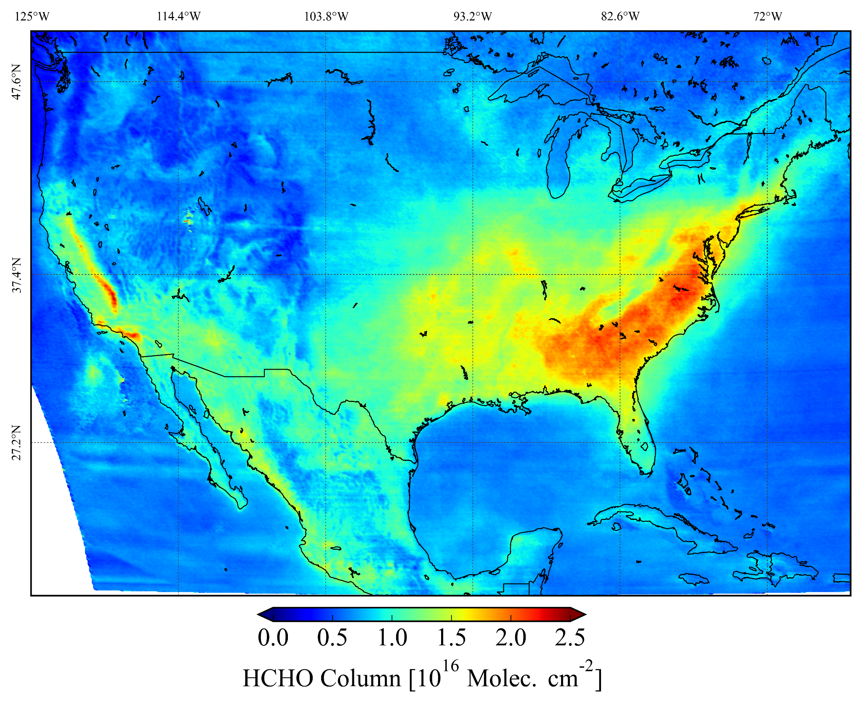
PSPI-01
Distinguish realistic gradients in TropNO₂, TotHCHO, and TotO₃ columns
TotO₃ compared to PGN
TropNO₂ compared to airborne spectrometer data
TotHCHO compared to PGN
Credit: Jay Herman and Jianping Mao
Credit: Prajjwal Rawat
TEMPO HCHO averaged over one week in July 2024
Spatial correlation of TEMPO and Pandora direct-sun ΩHCHO averaged for August 2023 to September 2024 at the 35 selected Pandora sites, 17 newer PGN with partial annual data, and 17 low confidence PGN sites.
Notes:
Dynamic range from the 5th-95th percentile is about 1-2e15 molecules cm-2 greater than

Slide 6
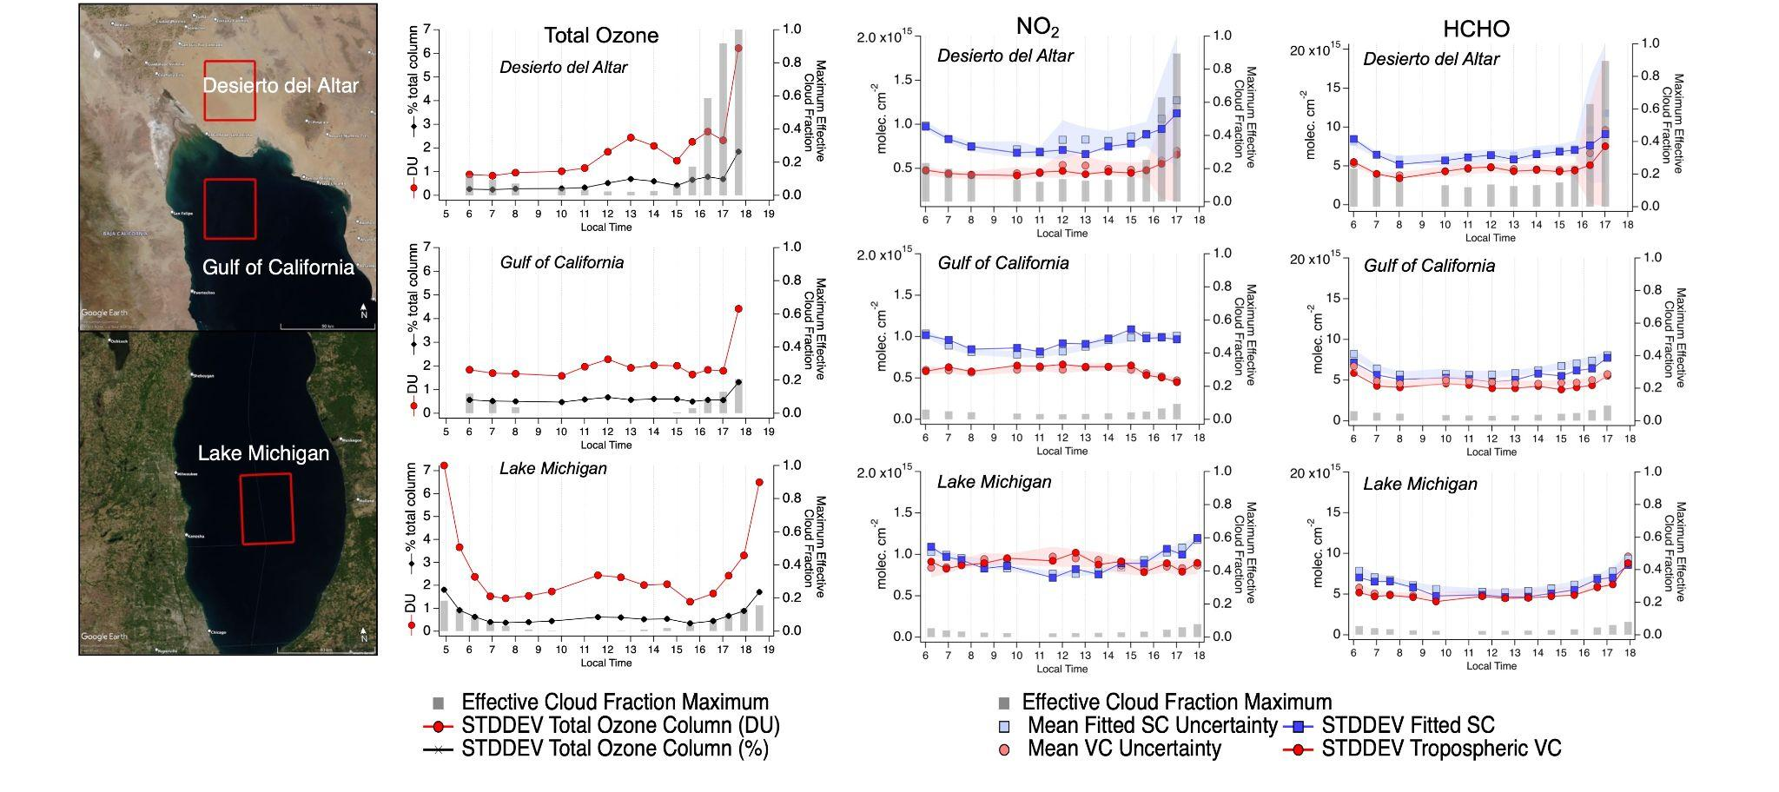
PSPI-03
Compute variance for empirical estimate of fitting uncertainty over homogenous unpolluted dark and light albedo scenes
Credit: Laura Judd, Caroline Nowlan, and Gonzalo Gonzalez Abad
Notes:
PSPI-03 for all products do not require correlative reference measurements and instead are reflective of the variability of the TEMPO L2 products independently over homogeneous scenes. Here, we present results using TEMPO data from May 30th, 2024 over three homogenous scenes: one bright desert scene over the Desierto del Altar and two water scenes over the Gulf of California and Lake Michigan (0.5º x 0.5º red boxes in Figure 3.5.1.1). These scenes did not show significant temporal variance in the L2 products and were 100% cloud free (as confirmed by GOES imagery) except for the final two hours over the Desierto del Altar (16:00-18:00 LT) where a stream of clouds moved over part of the domain.
Figure 3.5.1.1 b-d represent statistics on the standard deviation of the L2 products noted, and for NO2 and HCHO, their reported uncertainty gathered over each box during each TEMPO scan on May 30th, 2024. All NO2 and HCHO data have qa_values equal to 0, but for ozone, a qa_value filter was not applied as most pixels had qa_values greater than 0.
For total column ozone, most scans have a standard deviation much less than 1% of the total column. Exceptions to this are the first and last scan over Lake Michigan when the SZA is quite high and when clouds began to impact the Desierto del Altar in the late afternoon. All scans show that this product in these homogeneous scenes achieves better than the required precision of 3% noted in Zoogman et al. (2017).
Tropospheric NO2 VCs are near background values for all scans: 1.0x10¹⁵ molecules cm⁻² over Desierto del Altar, 0.5 x10¹⁵ molecules cm⁻² over the Gulf of California, and 0.7 x10¹⁵ molecules cm⁻² over Lake Michigan (not shown). The standard deviation of the tropospheric VCs are the same order of magnitude as the column over Lake Michigan (0.9 x10¹⁵ molecules cm⁻²) and Bay of California (0.6 x10¹⁵ molecules cm⁻²) but about half the amount over the Desierto del Altar (0.5 x10¹⁵ molecules cm⁻²). This meets the 1 x10¹⁵ molecules cm⁻² precision requirement from Zoogman et al. (2017). Qualitatively, the standard deviation of the tropospheric VCs fall within the range of reported uncertainty in the NO2 product. The reported uncertainty of the tropospheric VCs is on average 5% higher than the standard deviation of the tropospheric column over the Desierto del Altar. This value is -2% over the Bay of California and less than 1% over Lake Michigan.
For the HCHO results, the mean of the VCs vary more substantially from region to region with a mean of 8.7 x10¹⁵ molecules cm⁻² over Desierto del Altar, 4.1 x10¹⁵ molecules cm⁻² over the Gulf of California, and 2.3 x10¹⁵ molecules cm⁻² over Lake Michigan (not shown). The standard deviation of the vertical columns over each area are more similar between regions 4.7 x10¹⁵ molecules cm⁻², 4.4 x10¹⁵ molecules cm⁻², and 5.2 x10¹⁵ molecules cm⁻², respectively. This is about half the required precision requirement listed in Zoogman et al. (2017). Similar to NO₂, the standard deviation of the vertical columns fall within the range of reported uncertainty. Over the Desierto del Altar, the reported uncertainty is on average 6% higher than the standard deviation of the vertical column. This value is 13% over the Gulf of California and 9% over Lake Michigan. This makes the uncertainty estimate larger than the observed variation of the columns in these cases.
While the precision requirement is met over homogeneous scenes, more work is needed to assess the pixel-to-pixel variance over more heterogeneous scenes with respect to surface characteristics, clouds, and pollution gradients.
The grey bars in each graph indicate the maximum cloud effective fraction over the area. Hours that show an increase in effective cloud fraction also show an increase in the uncertainty and the standard deviation of the columns for both products. Note that all areas have cloud effective fractions maximizing above 0 even in cloud free scenes with even higher fractions over the bright desert case. This is not what is occurring in reality. The impact of the cloud retrieval on the trace gas retrievals should be assessed and is an area of improvement needed for future retrieval versions.
Sec 3.5.1 Background scene assessment of TEMPO , TropNO2, TotHCHO, TotO3
TEMPO (V03) data from May 30th, 2024 was assessed over three homogenous scenes: one bright desert scene over the Desierto del Altar and two water scenes over the Gulf of California and Lake Michigan. These scenes did not show significant temporal variance in the L2 products where GOES imagery was used to confirm 100% cloud free scene except for the final two hours over the Desierto del Altar (16:00-18:00 LT). This assessment of the variability of the TEMPO L2 products independently over homogeneous scenes demonstrates the NO2 data products meets PSPI NO2-03.

Slide 7
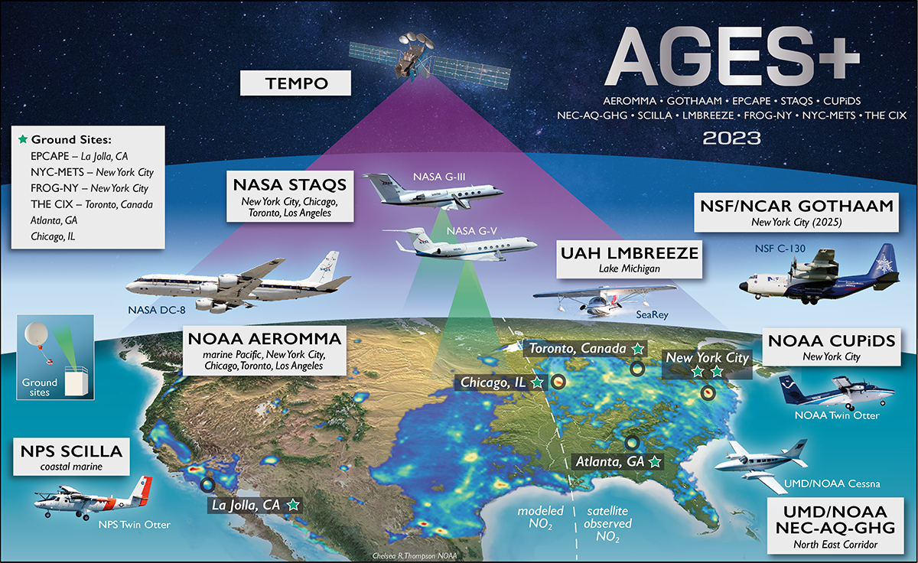


PSPI-07
Assess bias, precision, and uncertainty of the products during field campaigns
Field work that contributed to the TEMPO report comes from August 2023 during AGES+

Slide 8
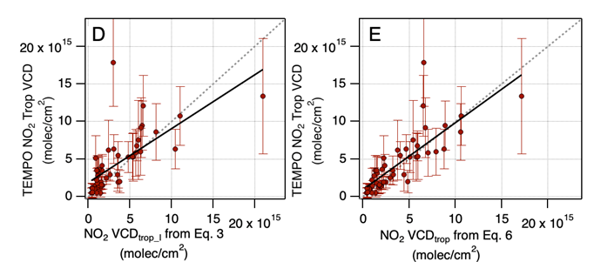

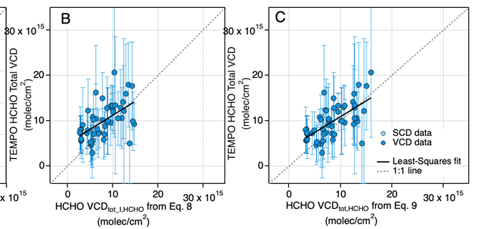
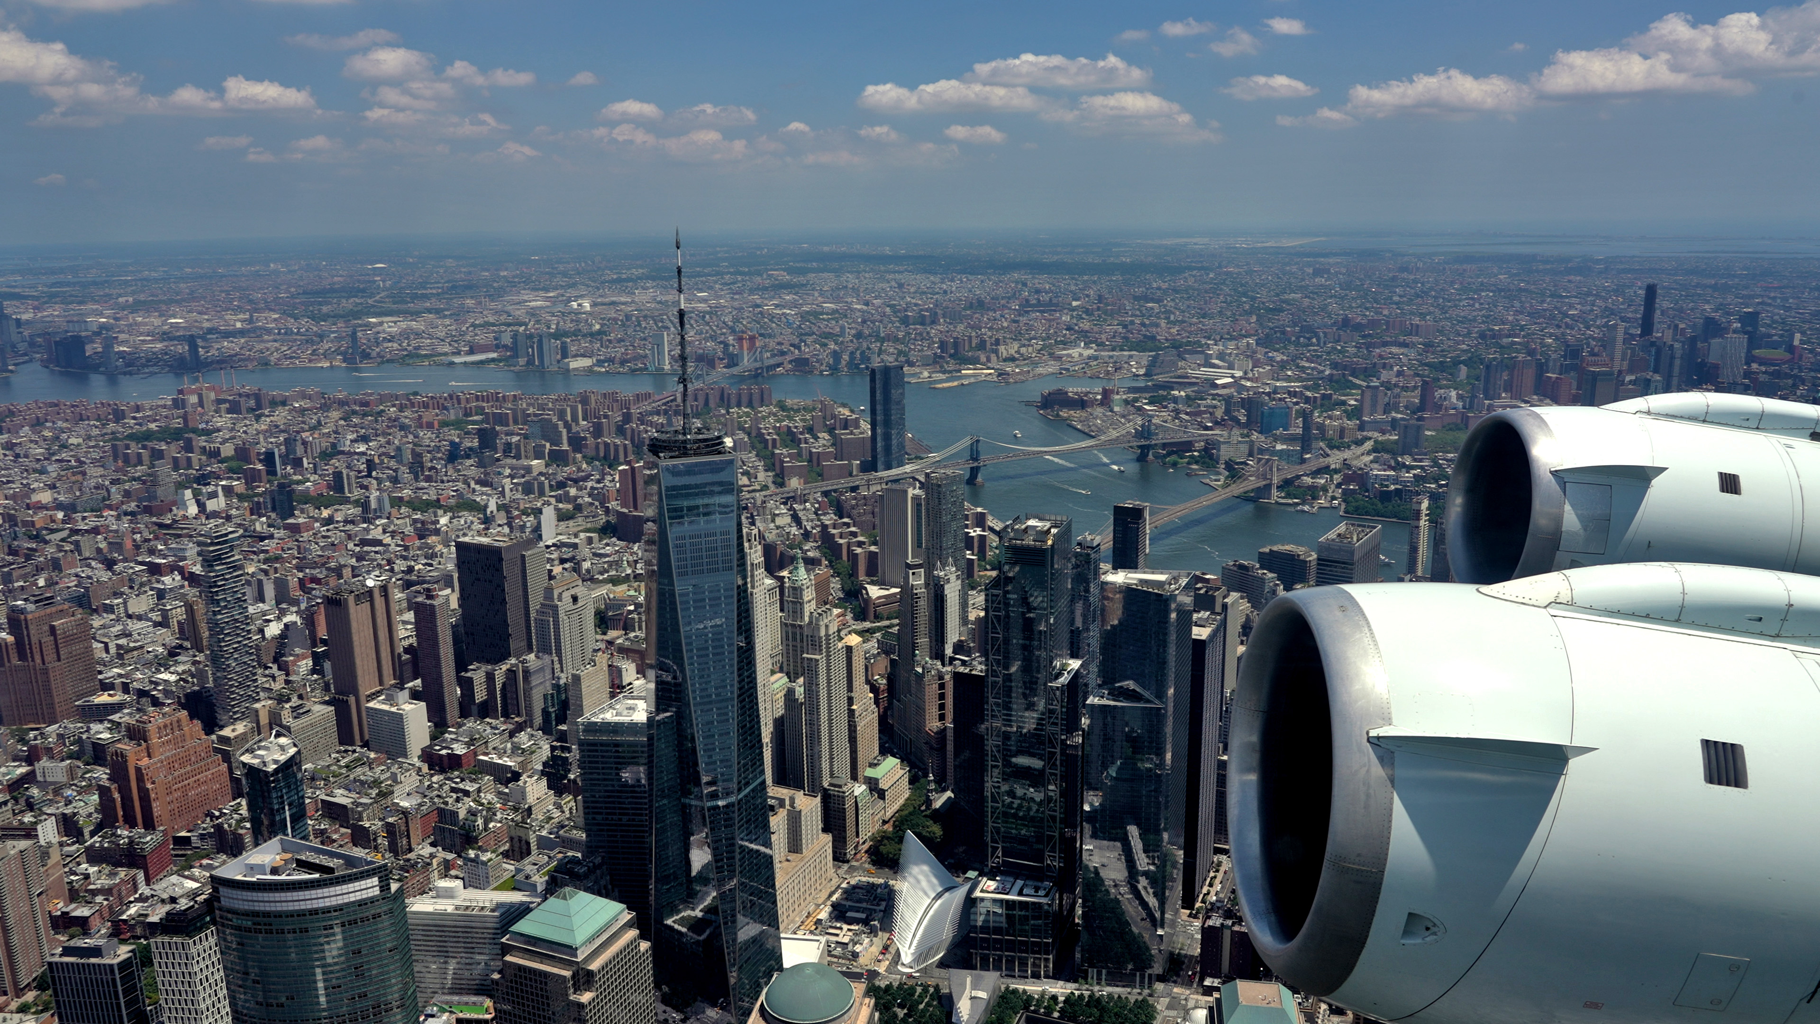

PSPI-07
Assess bias, precision, and uncertainty of the products during field campaigns
DC8 in situ data during spirals from AEROMMA are used to compare to TEMPO
Each spiral represents ~ 8-25 TEMPO pixels.
Method 1:
Binned & Integrated DC8 data.
Empty bins filled with GEOS-CF.
Method 2:
Method 1 with TEMPO scattering weights applied
TropNO₂
Method 1
Method 2
r²=0.72
RME=0.9x10¹⁵
r²=0.90
RME=0.4x10¹⁵
TotHCHO
Method 1
Method 2
Photo: Rafael Mendez Pena
r²=0.32
RME=2.0x10¹⁵
r²=0.40
RME=1.3x10¹⁵
Credit: Eleanor Waxman, Drew Rollins, Glenn Wolfe

Slide 9
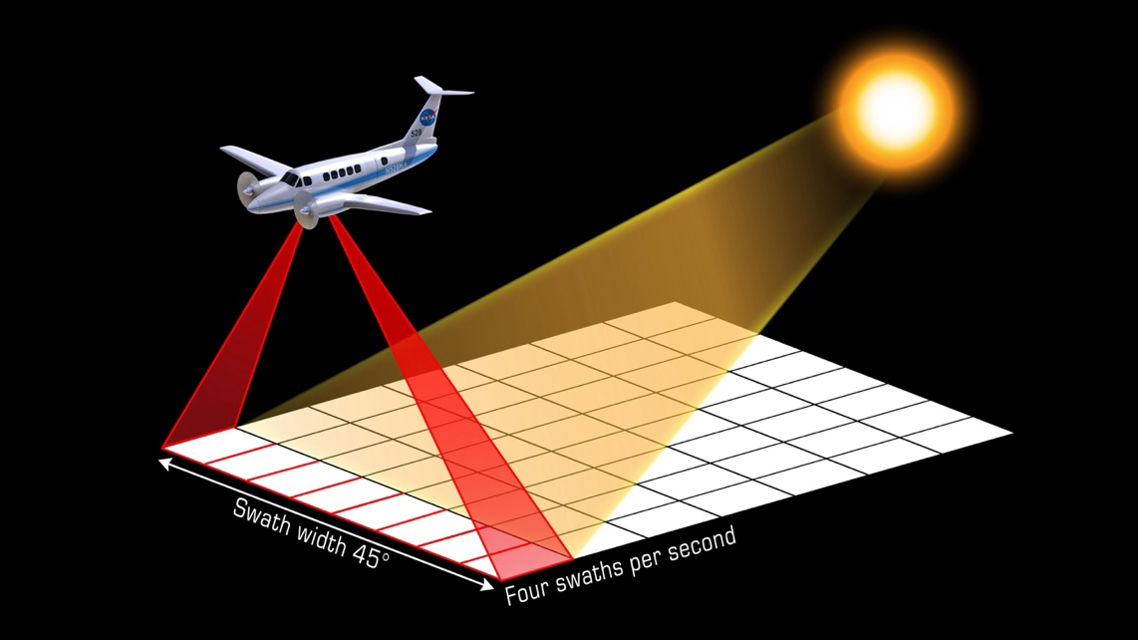
PSPI-07
Assess bias, precision, and uncertainty of the products during field campaigns
TropNO₂
GCAS data collection enabled full mapping of over 20,000 TEMPO pixels over 11 flight days.
New York City
New York City
r²=0.40
N=2930
RMSE=0.04e15
Median Difference=-0.05e15
Los Angeles
TEMPO – GCAS Percent Difference (%)
Los Angeles
TEMPO – GCAS Difference (molecules cm⁻²)
TEMPO Tropospheric Column (molecules cm⁻²)
r²=0.76
N=15284
Coincidence criteria:
+/- 30 minutes
GCAS > 75% mapped TEMPO Pixel
TEMPO qa=0
TEMPO cloud effective fraction < 0.15
RMSE=5.1e15
Median difference=1.7e15
GCAS Tropospheric Column
(molecules cm⁻²)
Hour (Local Time)
Results for TotHCHO are not in the report, but preliminary results are in the backup!

Slide 10
PSPI-02, -04, -06: TropNO₂
Assess bias/uncertainty for one month (-02), two seasons (-04), and over one year (-06)
Required precision: 1x10¹⁵ molecule cm⁻²
Reference Dataset | Bias | R² | Other notes
TROPOMI (NOAA) | -0.02 to -0.2x10¹⁵ molecules cm⁻² (mainly due to less polluted rural areas). | 0.3-0.6 | Entire FOR for Aug-Dec 2023 and May-July 2024 for monthly means. Both gridded to 0.1deg. Cloud_eff<0.2 | TEMPO > TROPOMI in polluted areas (> 90th percentile). TEMPO < TROPOMI in low pollution areas
TROPOMI (EPA) | Median bias 3.6% +/- 18%. | Skill varies by location. R²=0.98 by Pandora site. R²=0.85 by NAA. | August 2023-May 2025. Cloud_eff<0.15. Comparing individual comparisons within ozone non-attainment areas (NAA)and at Pandora locations. | The direction of the bias is different for Pandora compared to TropOMI. TEMPO is marginally low-biased compared to Pandora.
Pandora (EPA) | -2.7%+/-13% | Skill varies by site. Most sites have r² between 0.25-0.56. Site averages have an r² of 0.90. | August 2023-May 2025. Measurements within 15 minutes of TEMPO Scan. 0.03 deg spatial buffer and averaging.
WRF-Chem Transfer Standard | -0.7x10¹⁵ to -0.9x10¹⁵ molecules cm⁻² and RMSE ranging from 2.2x10¹⁵ to 2.75 x10¹⁵ molecules cm⁻². | Ranging from 0.40-0.53 in each urban area (Chicago, New York, Toronto) | During the AGES field campaign using GCAS and DC8 results as a transfer standard to quantify biases over the full domain. Cloud effective < 0.15. Also applied 2x2 boxcar average to TEMPO.
Noted in the report: General overestimation in radiances leads to positive biases in Level 2 cloud fraction retrievals, ultimately increasing errors in air mass factor calculations for NO2 and HCHO retrievals.
Barron’s talk next will dig in on Pandora results!
Notes:
There is high bias in the cloud fraction impacting the precision and use of the Level 2 NO2 and HCHO data products. Potential causes for this bias are (1) a high bias in the TEMPO absolute radiances and (2) a low bias in the A Geometry-dependent Lambertian-equivalent surface reflectivity product (GLER) used to capture the solar and satellite viewing angle dependence. Errors in the cloud retrieval propagate to the NO2 and HCHO AMFs, resulting in unrealistic AMF spatial variation leading to biases in the trace gas values. The current recommendation is the use of a very conservative cloud fraction filter (< 0.2).
The accuracy of the retrieval deteriorates at large solar zenith angles (SZA). Comparison with ground-based spectrometer show biases in the TEMPO trace gas products during the early morning/late afternoon observations. Please refer to the User Guide for the proper use of the quality flag to account for these “suspect” retrievals.
The total O3 column data product shows both a solar zenith angles (SZA) and a latitudinal bias. From V2 to V3 a new stray light correction, improved dark current correction, and radiance wavelength calibration were implemented, however the bias still remain. A SZA dependent correction factor has been developed to account for this bias.
I
The biases are estimated to be on the order of 10%, with possible signal and wavelength dependence. This general overestimation leads to positive biases in Level 2 cloud fraction retrievals, ultimately increasing errors in air mass factor calculations for NO2 and HCHO retrievals.

Slide 11
PSPI-02, -04, -06: TotHCHO
Assess bias/uncertainty for one month (-02), two seasons (-04), and over one year (-06)
Required precision: 1x10¹⁶ molecule cm⁻²
Reference Dataset | Bias | R² | Other notes
TROPOMI (EPA) | -13%+/-10% | All NAA typically have too low of r² to consider a correlation. But the site averaged data has an r²=0.56 | Same methods at TropNO2 except its August 2023-November 2024 | Agree from May-September but TEMPO totHCHO is 50% lower than TROPOMI in winter. TROPOMI has a known high bias in low HCHO areas.
Pandora (EPA) | 5% +/- 27%. Most individual sites < 30% bias. | Site statistics show r²=0.35. All individual sites have an r²<0.25. Hourly subsets range from 0.15 and 0.36 with minimums at the edges of the day. | Same methods at TropNO2 except its August 2023-November 2024 and stations filtered by quality | Agreement seasonally
Pandora (NASA) | Mean Absolute Difference is 2. 6x10¹⁵ molecules cm⁻² with most points within 1x10¹⁶ RMSE for all sites ~5e15 | Site statistics show r²=0.60. Individual sites span from 0.1 to 0.8 but most above 0.5. | Cloud eff < 0.2. Site filtered for Pandora quality. 10km spatial buffer from site within 10 minutes. | Difference may stem in use of qa filtering applied to Pandora. The bias is positive for sites with lower HCHO columns and trends negative as the HCHO column increases.
NDACC FTIR (ACOM/NCAR) | -31% to -41% depending on site. | Ranges from 0.38 and 0.61 | August 2023-June 2024. Spatial buffer of 10km and cloud_eff< 0.4
WRF-Chem Transfer Standard | Bias ranging from 0.6-3x10¹⁵. RMSE ranging from 3-6x10¹⁵ | 0.28-0.40 range between the three cities | Same methods as TropNO₂
General overestimation in radiances leads to positive biases in Level 2 cloud fraction retrievals, ultimately increasing errors in air mass factor calculations for NO2 and HCHO retrievals.

Slide 12
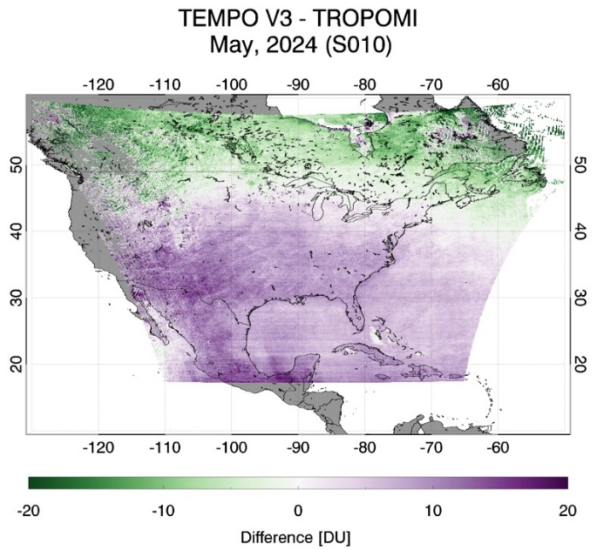
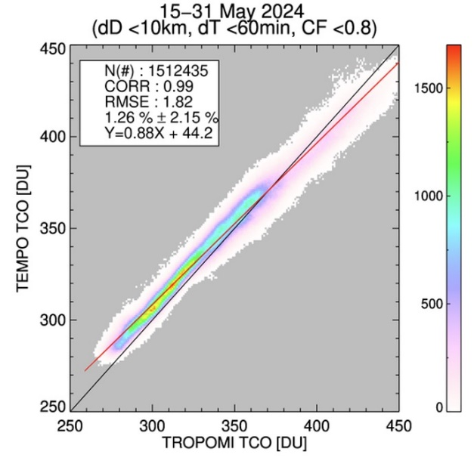
PSPI-02, -04, -06: TotO₃
Assess bias/uncertainty for one month (-02), two seasons (-04), and over one year (-06)
Required precision: 3%
Reference Dataset |  | Bias | R² | Other notes
OMPS | NASA | TEMPO total ozone is too high by ~3-5% in low latitudes and about the same too low in high latitudes. |  | December 2023-May 2024. 10 km spatial buffer, 60 min temporal matching, and cloud fractions < 0.8 Latitude-dependent bias found.
OMI
TROPOMI |  | 10-15DU high in the low latitudes and -10-15 DU low in the high latitudes. RMSE=1.8DU | 0.98
Pandora-Brewer-Dobson (ECCC) |  | 10th-90th percentile differences range from -1.9 to 1.9% | 0.98 (low in Mexico City alone) | Latitudinal changes about -0.15% per degree latitude.
The total O3 column data product shows both a solar zenith angles (SZA) and a latitudinal bias.
Credit: Kanghyun Baek

Slide 13
TEMPO Monthly Science Calls
Last or second to last Thursday of the month from 13:00-15:00 Eastern Time
Want to be added to the list?
Send blank email to tempo-science-subscribe@espo.nasa.gov with the subject ‘Subscribe’
  OR
  Email Laura.m.judd@nasa.gov and just ask
Upcoming Agendas:
June 26th
  Ron Cohen: A strategy for negating systematic bias in the TEMPO retrieval--initial evaluation
  Joel Dreessen: The Impact of TEMPO Averaging Techniques and Missing Data on NO2 Changes
  Byeong Kim: How Georgia EPD uses TEMPO data
  Dan Jaffe: Using TEMPO FNR in Salt Lake City to understand O3 formation regimes
July 24th
  Mina Kang: Validation of TEMPO L2 Products over the East Corridor with Ground-Based and Model Comparisons
  Claudia Bernier: Assessing Ozone Dynamics During the 2023 Summer STAQS Field Campaign Using Synergistic Observations and Model Simulations
  Brad Pierce: Chicago WRF-Chem/TEMPO intercomparisons during summer 2024
  Amir Souri: Rethinking HCHO/NO₂: Why It Falls Short for Hourly Ozone Sensitivity Using TEMPO

Slide 14
Very special thank you to all contributors to this effort —Stay tuned for more results not shown today!
Gonzalo Gonzalez Abad, Caroline Nowlan, Xiong Liu, Kelly Chance (SAO-TEMPO)
Barron Henderson, Lukas Valin, Eric Baumann, Dave Williams, Todd Plessel and Jim Szykman US. EPA Office of Research and Development
Aerosol and Atmospheric Composition Group at NOAA/STAR
Ivan Ortega, Sara Martinez-Alonso, Jim Hannigan, David Edwards (ACOM/NCAR)
Rainer Volkamer (CU-Boulder)
Xiaoyi Zhao, Vitali Fioletov, Debora Griffin, Chris McLinden, Sum Chi Lee (Environment and Climate Change Canada)
Ruijun Dang and Daniel Jacob (Harvard)
Alexander Cede, Martin Tiefengraber, Manuel Gebetsberger (LuftBlick)
Matthew S. Johnson, Claudia Bernier (NASA Ames)
Scott Janz, Viral Shah, Sungyeon Choi, Lok N. Lamsal, J. R. Ziemke, S. M. Frith, N. A. Kramarova, Tom Hanisco, Jay Herman and Jianping Mao (NASA Goddard)
Laura Judd, Prajjwal Rawat, Katherine Travis, James Crawford (NASA Langley)
Eleanor Waxman, Andrew Rollins Kristen Zuraski, Carrie Womack, Arthur Mizzi, Chia-Hua Hsu, Carsten Warneke, Sunil Baidar (NOAA-CSL)
Irina Petropavlovskikh, (NOAA GML)
Kanghyun Baek (Pusan University)
Mike Newchurch, (UAH)
Wolfgang Stremme, Andrea Cadena, Michel Grutter (UNAM)
Kimberly Strong, Victoria Flood (U. Toronto)
R. Bradley Pierce, Jerrold Acdan, Maggie Bruckner (UW-SSEC)
> 60 authors from 18+ organizations!

Slide 15


HAMAQ will conduct flights in Mexico City and a second site in North America still to be determined in 2028.
Do you have thoughts as to where this second site should be?
HAMAQ Whitepaper
A special session at the 2025 Joint Science Team Meeting for TEMPO and GeoXO will be convened to discuss candidate sites for the second deployment. Of particular interest are locations where both air quality challenges and TEMPO performance issues converge.
At a minimum, contributed information at the session in August should include:
science questions specific to the region,
existing measurements that could be leveraged (e.g., local monitoring network, research stations, etc.), and
local partners/stakeholders that would be interested in participating.
If your research activities point to a destination in need of investigation, please consider contributing an additional abstract to the meeting by June 16th.
The organization of the session will be dependent on abstracts submitted.

Slide 16
Thanks for your attention!
Questions about my presentation? Email: laura.m.judd@nasa.gov
TEMPO Validation Report Leads: Jim Szykman james.j.szykman@nasa.gov and Brad Pierce rbpierce@wisc.edu

