Slide 1





GEMS validation campaign results
Asian Air Pollutants Network
Limseok Chang¹, Ukkyo Jeong², Jhoon Kim³, Hyunkee Hong¹,
Donghee Kim¹, Soi Ahn¹
¹ National Institute of Environmental Research
² Pukyong National University
³ Yonsei University
* All contents are based upon the RSSR report of Jhoon Kim
Notes:
Good afternoon everybody. My name is Dongwon Lee, I`m director of Environmental Satellite Center
or ESC for short. Let me start my presentation.
My presentation title is monitoring Air Quality and climate change of Asia using GEMS.
GEMS is short for Geostationary Environmental Monitoring Spectrometer, which means jewels and this is the first of its kind in the world.

Slide 2


1
Background
+Pride
SIJAQ : Satellite Integrated Joint monitoring (Studies) of Air Quality
GMAP : GEMS Map of Air Pollution
Background
Succession of KORUS-AQ (2016.5~6)
→ In-depth analysis on wintertime PM2.5 event is required
* KORUS-AQ: the Korea‐United States Air Quality Study
Validation of GEMS(2020. 2.~), the world’s first GEO environmental satellite
Time schedule for GMAP and SIJAQ
Main campaign
Pre-GMAP
GMAP
SIJAQ
SIJAQII,III
2020. 4~5
+
2020.10.12~11.27
2022.10~2023.06
→ 2022.5~8, 2024.1
2021.10~11
Source: Sangwoo Kim

Slide 3
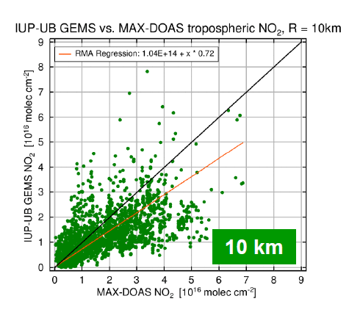
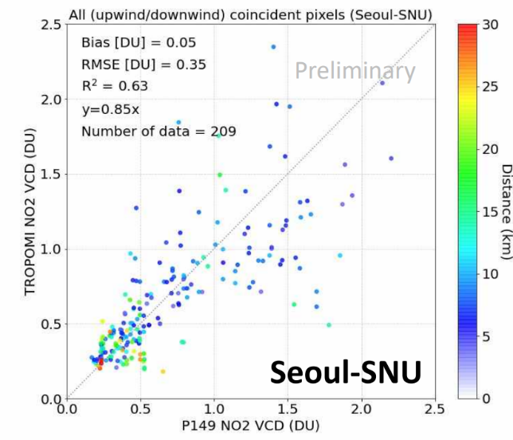
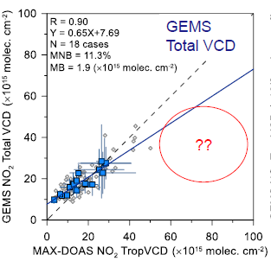
1
SIJAQ 2021 @ Seoul Metropolitan Area
+Pride
High correlation, low bias, and high scatter (or rmse) for NO₂ VCD
±30 mins, Lon & Lat < 5 km, CF <0.3, and SZA <85°
18 Oct. ~ 18 Nov. 2021
Colocation of TROPOMI pixels with Pandora by considering the wind wield (Upwind and downwind pixels)
Temporal collocation : ±5min
Source: Yongjoo Choi
Source: Andreas Richter
Source: Sangwoo Kim

Slide 4
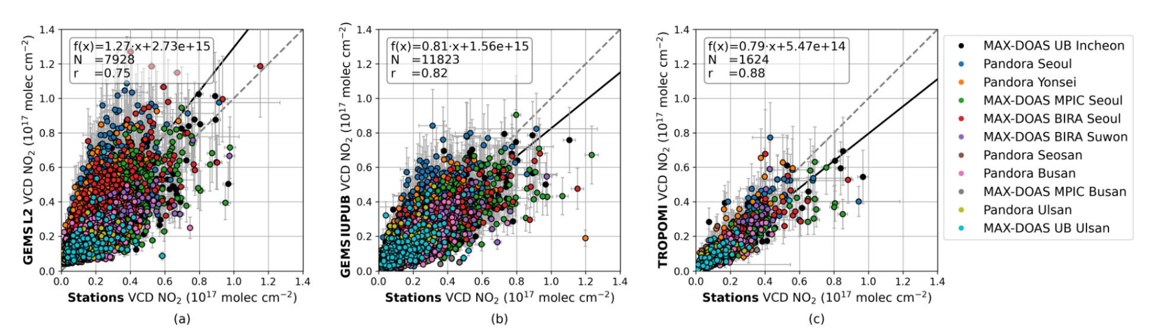
1
SIJAQ 2021 @ Seoul Metropolitan Area and Ulsan/Busan
+Pride
Lange et al., EGUsphere, 2024
The GEMS L2 and ground-based tropospheric NO₂ VCDs are correlated with a Pearson correlation coefficient of r = 0.75, with a slope of 1.27, a median relative bias of +64 %, and an offset of 2.73 × 10¹⁵ molec cm⁻² .
With a slope of 0.81 and a median bias of -1 % for the GEMS IUP-UB and a slope of 0.79 and a median bias of -14 % for the TROPOMI product,
Period: October 2021~up to December 2022
The ground-based observations are considered co-located if they are taken within ± 20 min around the satellite observation. Measurements within this period are averaged and matched to the closest satellite observation within a radius of 5 km around the station site.

Slide 5
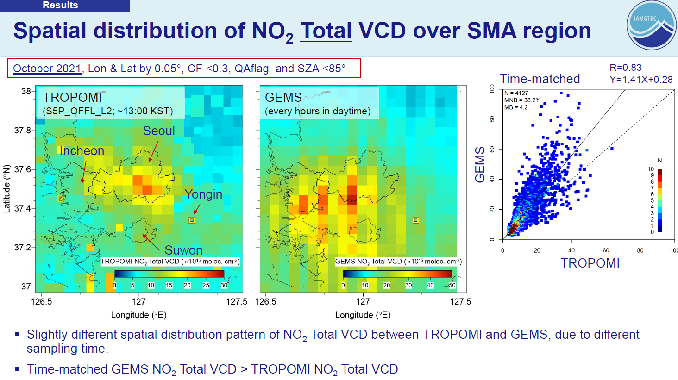
1
GEMS spatial variability
+Pride

Slide 6
1
GEMS update
+Pride
High growth period(2022~)
Developmental stage(~2021)
Release NC files
Release images
(V.2.0.X~) Optimizing algorithms including calibrating parameter, promoting the cooperation of researchers
(V.0.5.X~V.0.9.X) Analyzing the problems of released images and updating images
Initial stage(~2020)
IOT
(V.0.2.X~V.0.4.X) Algorithms updates based on GEMS data, Look Up Table updates, checking the accuracy of input/output values
Prod | V2 Issue | Update details
Trop O3 | Overestimation | Fitting window, Optimize L1 cal Data (Spectroscopy, Met, Solar Ref)
Total O3 | Underestimation | LUT Data (CLD)
NO2 | Overestimation | DOAS fitting parameter(fitting window, O4 and H2O absorption cross section, polynomials, etc)
SO2 | Stripe (High conc) Noise (Low conc) | Slit Function (2x2 pixel binning) SO₂ profile
HCHO | Underestimation | Variable background correction Data (BSR)
CHOCHO | average model conc | Background correction Data (BSR, CLD)
AOD | Hourly varying aerosol type accuracy | Threshold of AI
CLD | ECF: Overestimation CCP: lower-layer | LUT, interpolation Clear sky CCP as sfc P, Data (SFC)
SFC | Overestimation | Option handling for IRR
Groundwork stage(~2019)
Initial Algorithms
(V.0.1.X) Simulation data, applying algorithms to the data derived from other satellites data

Slide 7


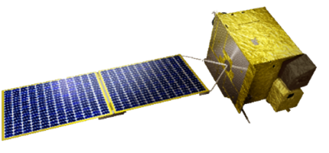


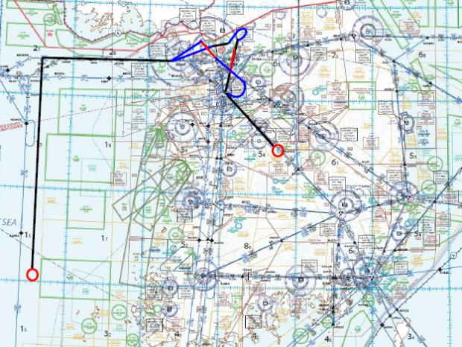
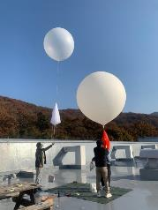

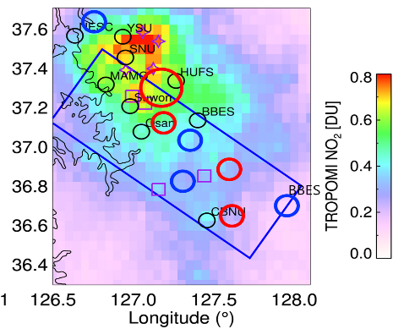

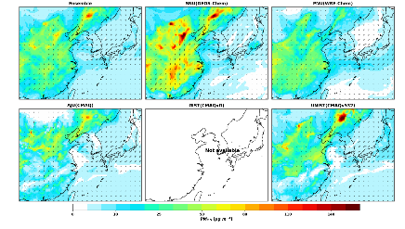
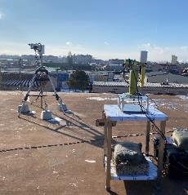
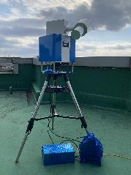






Rep. of KOREA: Feb.16 – 26(→Mar. 11), 2024
Field observations
Models
Satellite & Remote Sensing
6 research aircrafts
[Korea] B350, C90GT, 1900D, KingAirE80
[USA] NASA DC-8, G-III
4 ground sites
Multi-model ensemble prediction
[Korea]
- CMAQ-AJOU
- CMAQ-G
- WRF-GC
- WRF-CHEM
- CMAQ-UNIST
[USA]
- WRF-Chem UCLA
- MUSICA
- GEOS-FP and GEOS-CF
- UIowa WRF-Chem
Geostationary Environmental Monitoring Satellite: GEMS
12 ground remote sensing sites
EMSA
Chemical Sonde
DC-8
G-III
B350
1900D
C90GT
E80

Slide 8
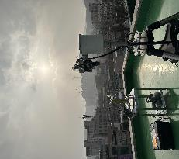
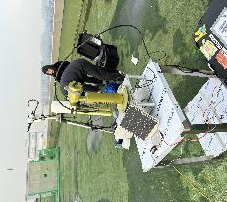
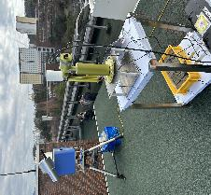
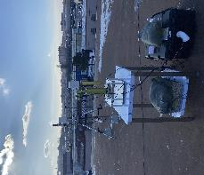
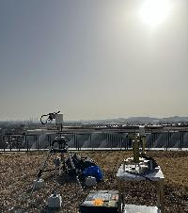
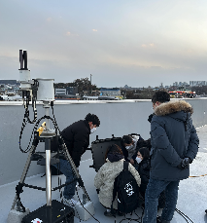
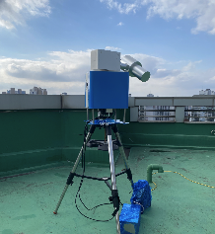
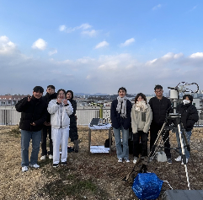
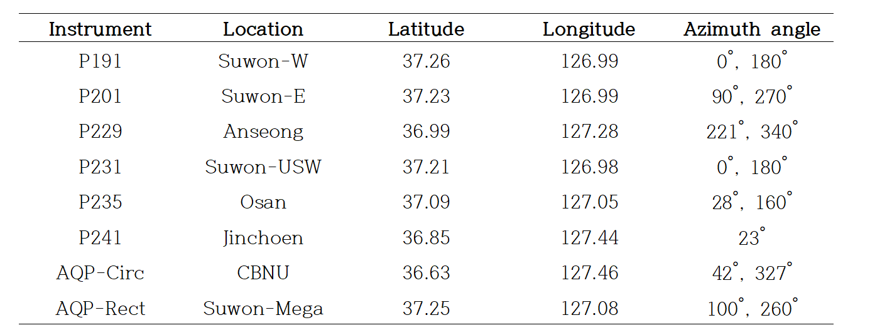
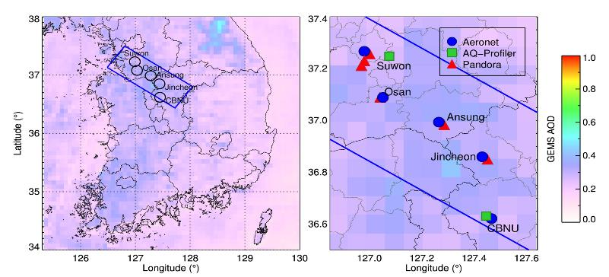
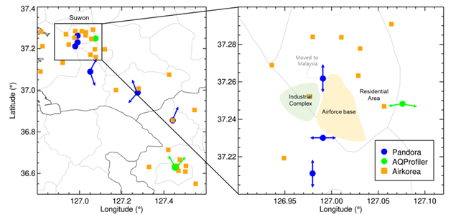
2
SIJAQ/ASIA-AQ ground remote sensing
+Pride
Jincheon
Ansung
CBNU
Osan
Suwon
Suwon
Suwon
Suwon

Slide 9
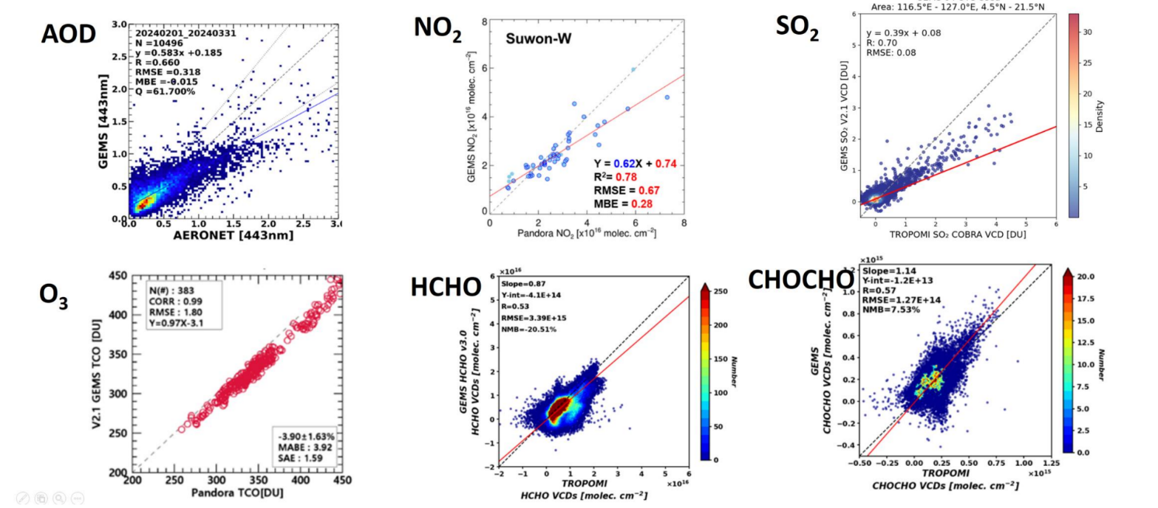
2
GEMS evaluation
+Pride
GEMS products are evaluated with in-situ, aircraft, ground remote sensing measurement (AOD: R=0.66~0.74, NO2 : R=0.83~0.88, SO2 : R=0.70, O3 : R=0.99, HCHO: R=0.53, CHOCHO: R=0.57)

Slide 10
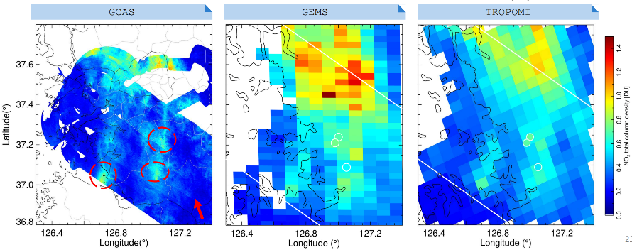
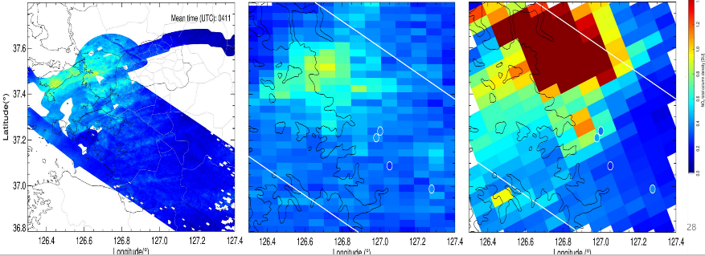
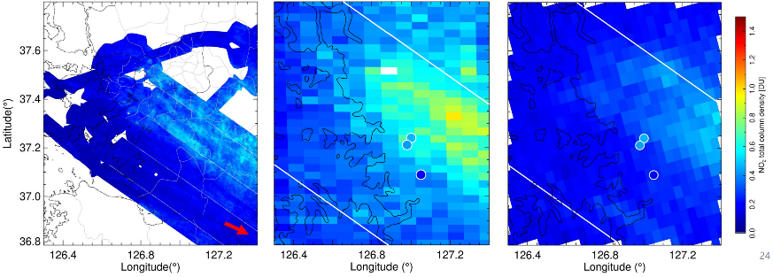
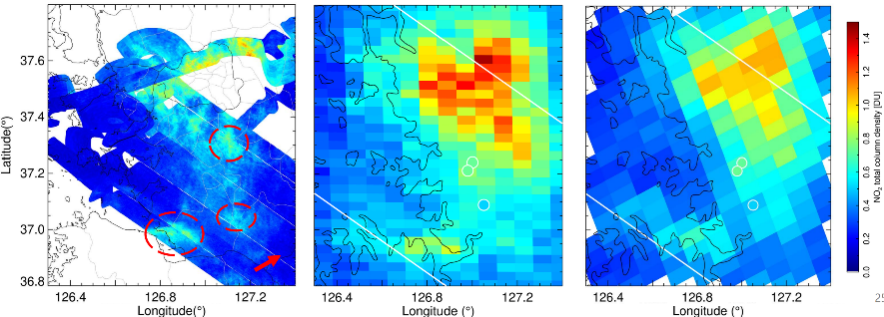
2
GEMS evaluation of inter-pixel variability
+Pride
February 17, GCAS mean time 03:33 UTC
February 23, GCAS mean time 04:11 UTC
March 8, GCAS mean time 03:19 UTC
March 10, GCAS mean time 03:17 UTC

Slide 11
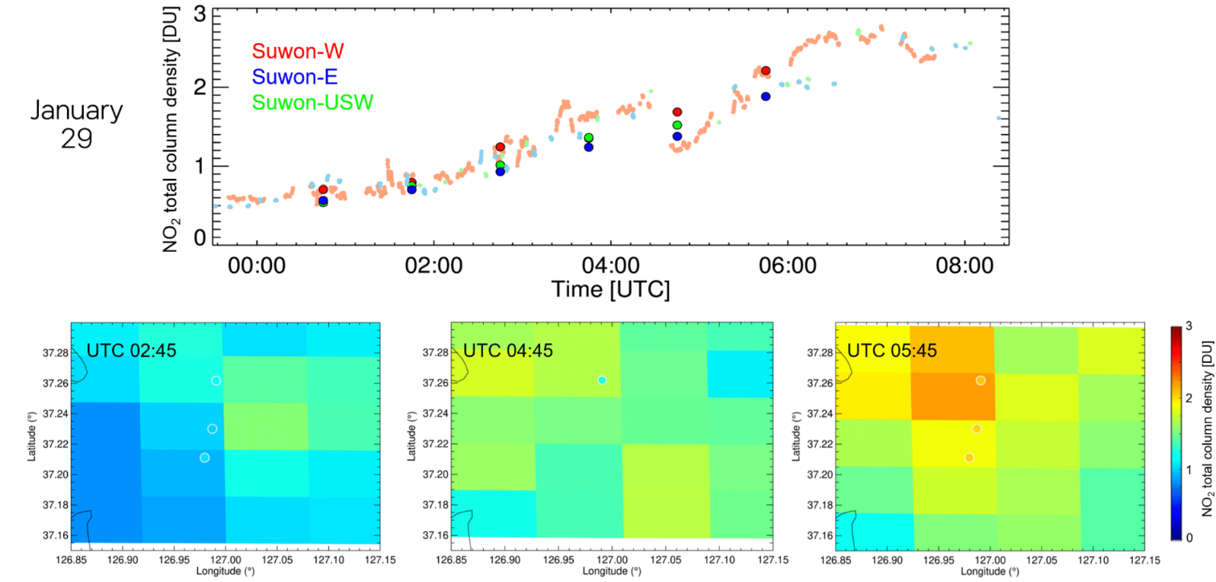
2
GEMS evaluation of diurnal inter-pixel variability
+Pride
GEMS shows good performance in detecting the relative difference between pixels, especially on 02:53, January 29, 2024

Slide 12
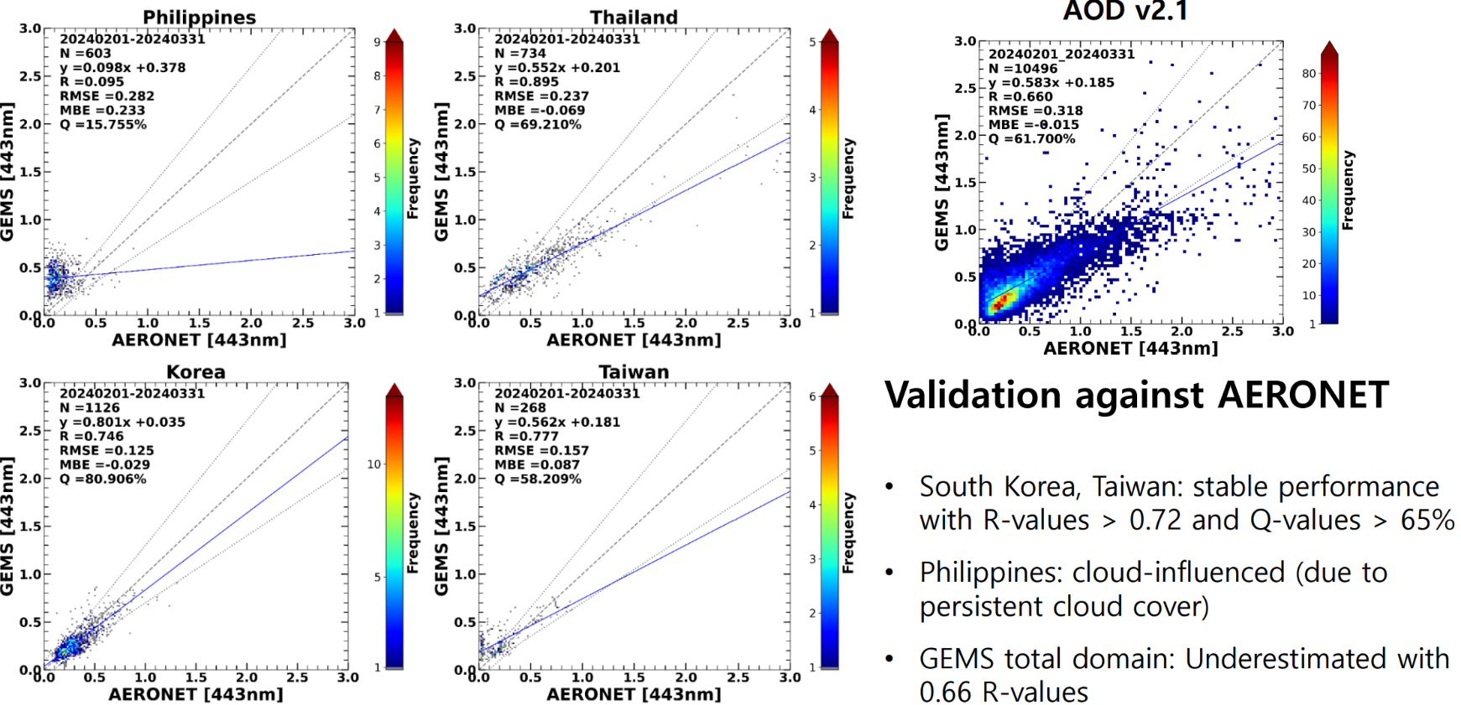
2
GEMS evaluation: AOD
+Pride
GEMS AOD v2.1 2024 Feb ~ Mar

Slide 13
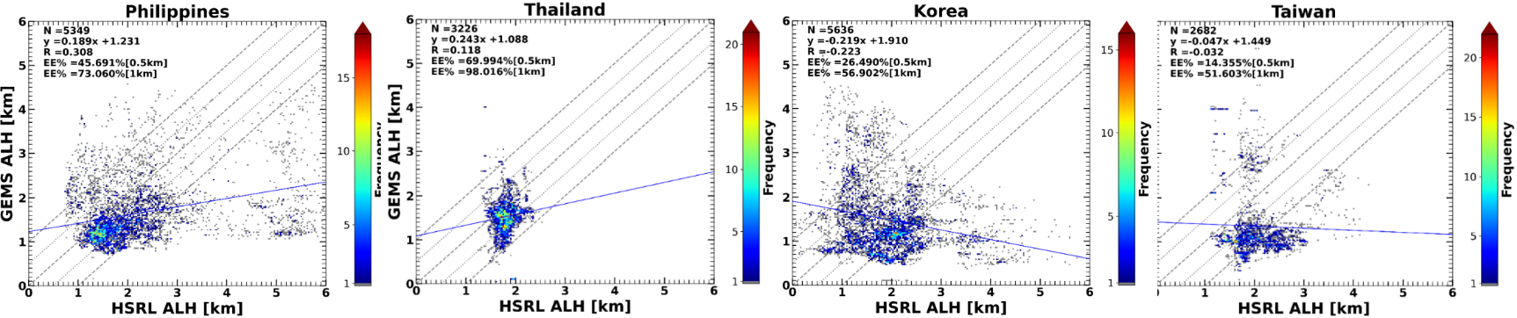
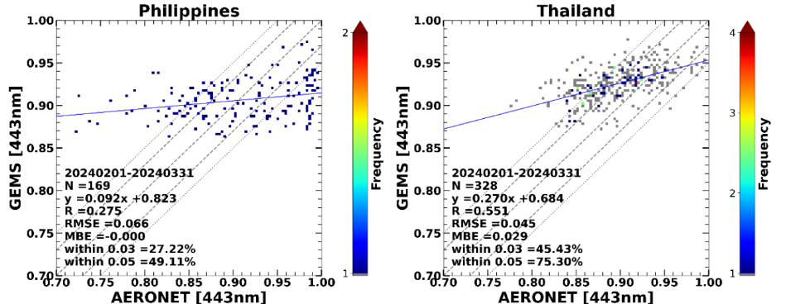
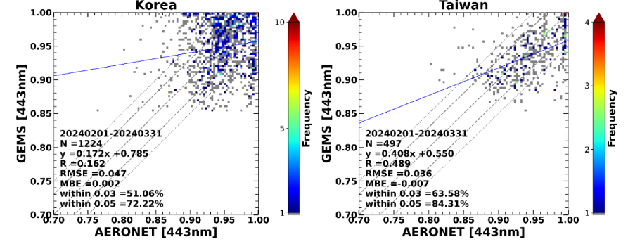
2
GEMS evaluation: ALH and SSA
+Pride
ALH
40% and 69% of GEMS ALH falls within an error range of ±0.5km, ±1km
SSA
46% of the GEMS entire domain falls within an error range of 0.03, and 68% falls within an error range of 0.05

Slide 14
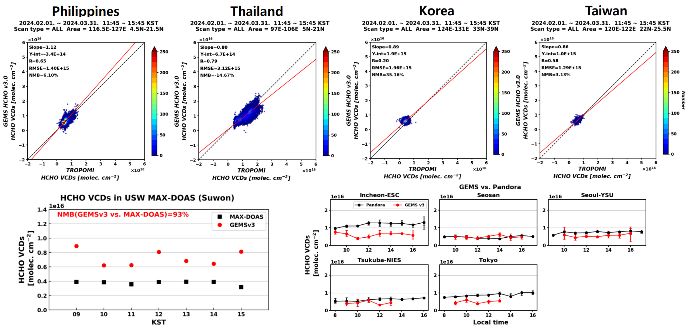
2
+Pride
GEMS evaluation: HCHO

Slide 15
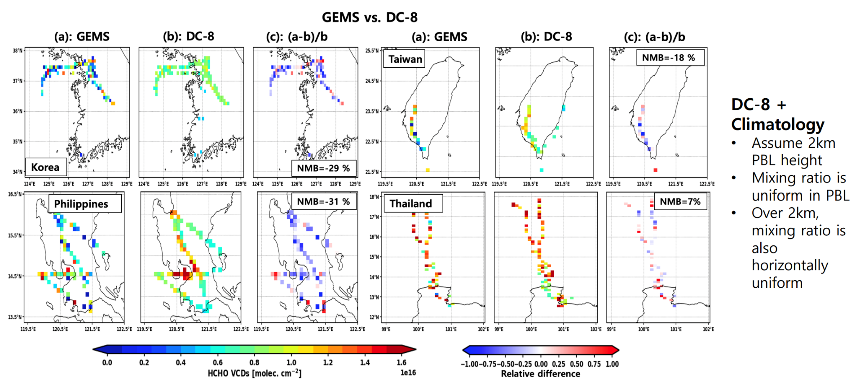
2
+Pride
GEMS evaluation: HCHO

Slide 16
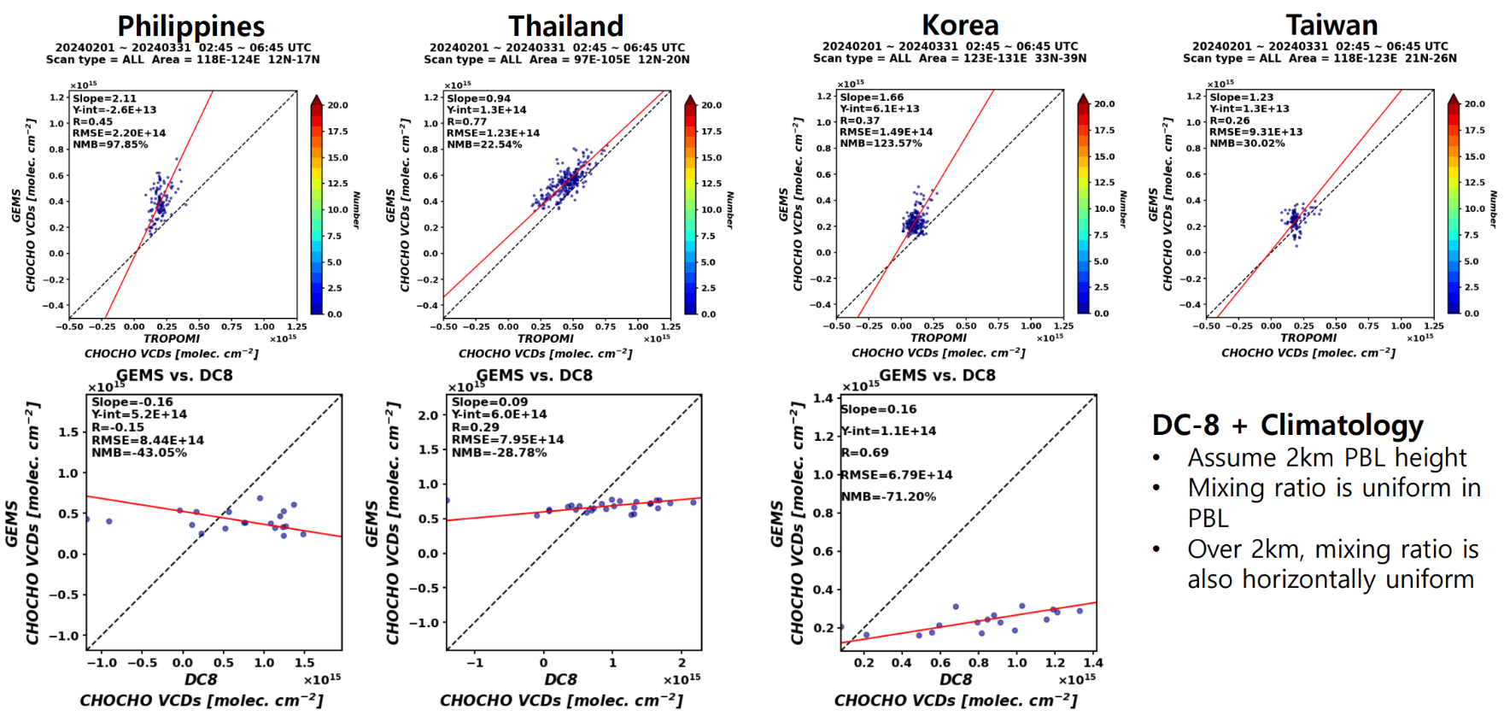
2
GEMS evaluation: CHOCHO
+Pride

Slide 17
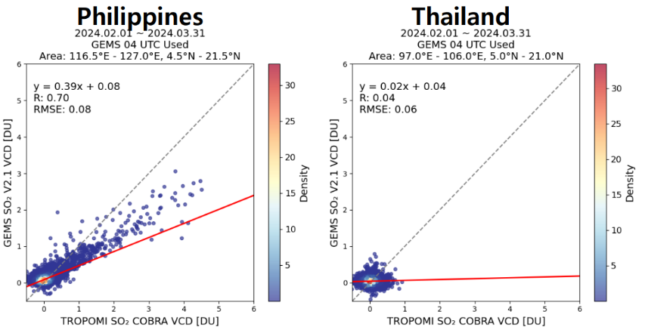
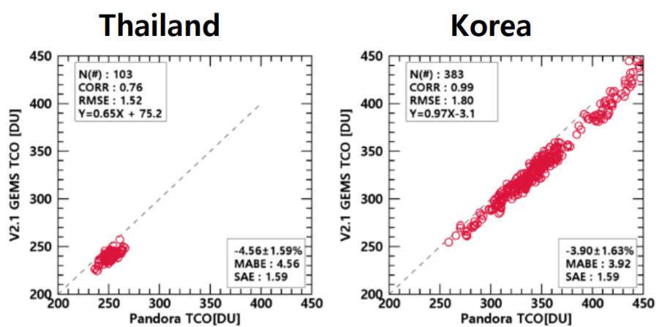
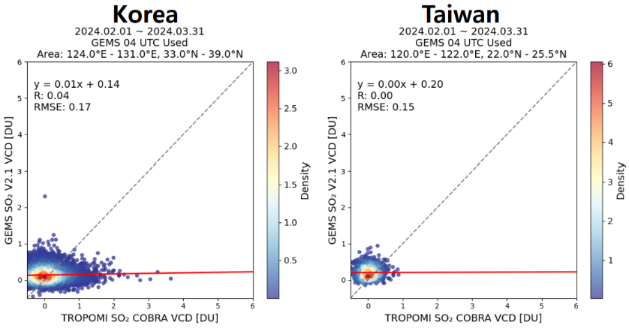
2
GEMS evaluation: SO2 and O3
+Pride
• In Philippines GEMS shows the highest correlation with TROPOMI while in other regions GEMS does not match with TROPOMI
• In South Korea, GEMS and Pandora (ground based observations) show high correlation(0.99).
• In Thailand, the accuracy is relatively lower, with a slight underestimation observed.

Slide 18
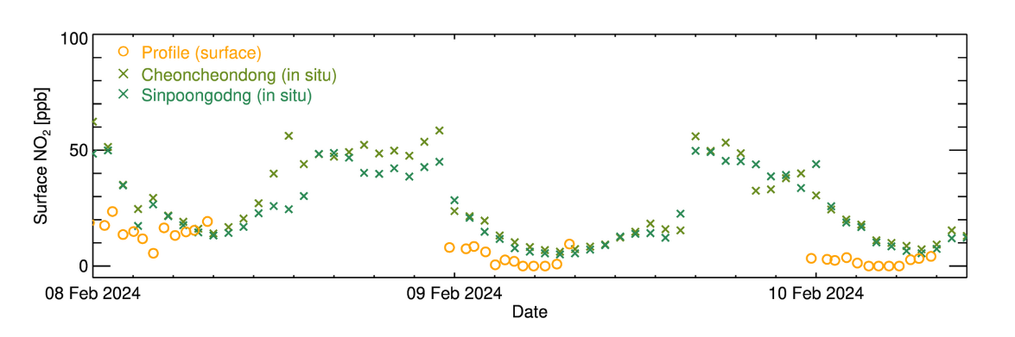
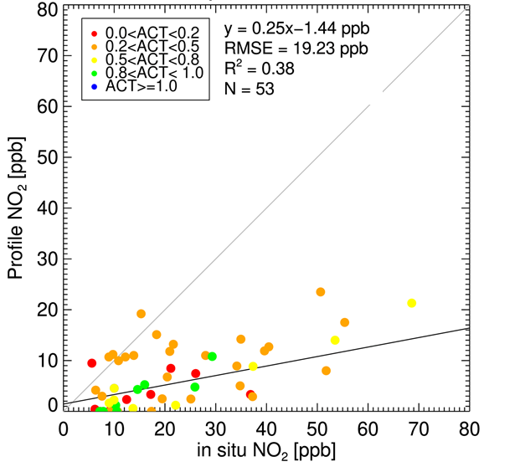
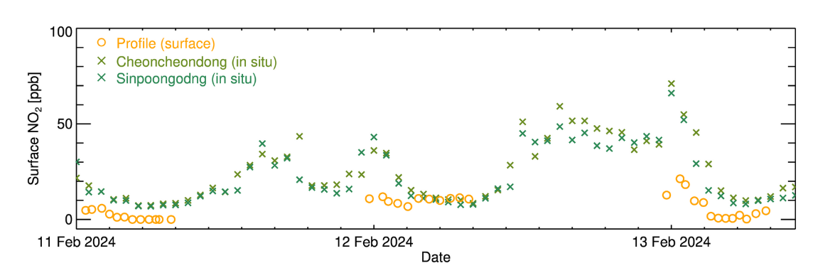
2
GEMS evaluation: surface NO₂
+Pride
Jeong et al., NIER report, 2024
GEMS surface NO₂ followed the in-situ trend well. The sensitivity test improved the tendency to under-simulate the surface concentration, but it was still slightly lower than the in-situ.
[AZI: 0°]
Pandora version | P191 (Extended version)
Location | Suwon
Latitude, Longitude | 37.26, 126.99

Slide 19
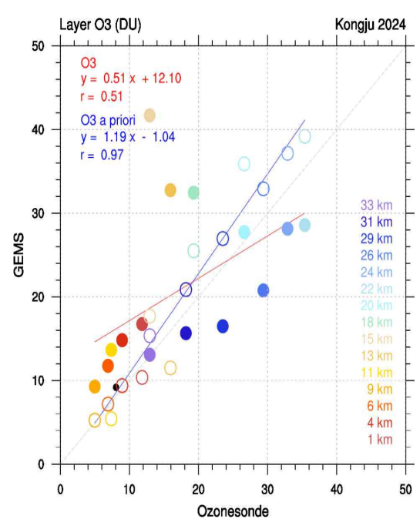
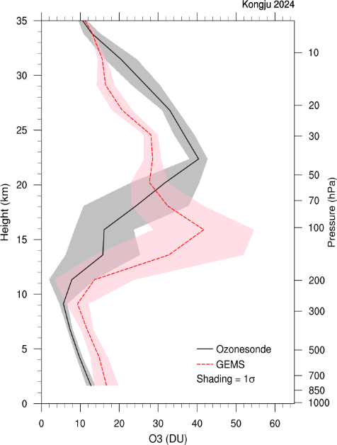
2
GEMS evaluation: O₃ profile
+Pride
Jeong et al., NIER report, 2024
Korea
at Kongju National University
Total 11 ozone profiles generated
(one at 3 PM)
GEMS a priori shows a high positive correlation of 0.97 with the sonde. However, GEMS ozone output showed a relatively lower correlation with the sonde, with a correlation coefficient of 0.51, which may be due to overestimation of ozone entrainment occurring in the upper troposphere and lower stratosphere

Slide 20
3
Summary
+Pride
1. Validation/intercomparison of the GEMS L2 products
- Aerosol: aerosol optical depth, single-scattering albedo, Angstrom exponent, Aerosol layer height
- Trace gases: NO2 , HCHO, SO2 , O3 (Total, profile with Sonde data), CHOCHO
2. Evaluation/analysis of diurnal inter-pixel variabilities of the GEMS L2 products
- Mostly for aerosol and NO2
- Using the Suwon-DRAGON data - GCAS (and possibly with the EMSA) retrievals
3. Intercomparison of the GEMS L2 products with the surface air quality data
- Aerosol vs. PM (AirKorea + campaign measurements)
- NO2 , and tropospheric O3 from the GEMS vs. surface mixing ratios (AirKorea + campaign measurements)

Slide 21
4
Asian Air Pollutants Network
+Pride
Asian air quality is expected to worsen in the future, and PM could have a significant impact on the health and environment of the entire region.
- Indonesia is at 37.1μg/m3 as of 2022, Vietnam at 29.6μg/m3, and
Laos at 27.6μg/m3
※ Bali has the highest PM-2.5 (43.7μg/m3) and is ranked 18th out of 116 capitals worldwide
Thailand, Laos, and Myanmar recognize the seriousness of the air pollution problem, and through the 'Clear Sky Strategy 2024~2030', the three countries are establishing a cooperative system among the three countries and taking joint action.

Slide 22
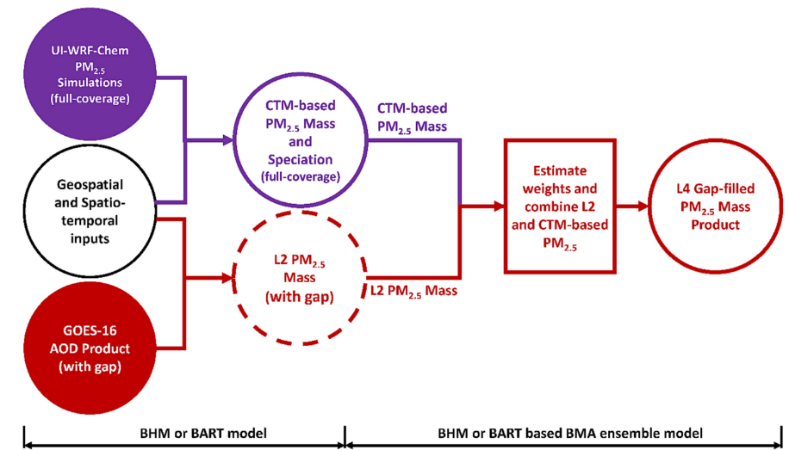
4
Asian Air Pollutants Network
+Pride
Observation of vertical distribution of air pollution and PM composition using remote sensing and in-situ instruments
Through this, policy-based data such as validation of GEMS products, identification of air pollution sources (local emission or long-range transport), and top-down emissions are needed.
Measuring PM2.5 precursors (NOx, SOx, VOC, etc.) and PM components using low cost, compact, and easy-to-maintain ground observation equipments

Slide 23
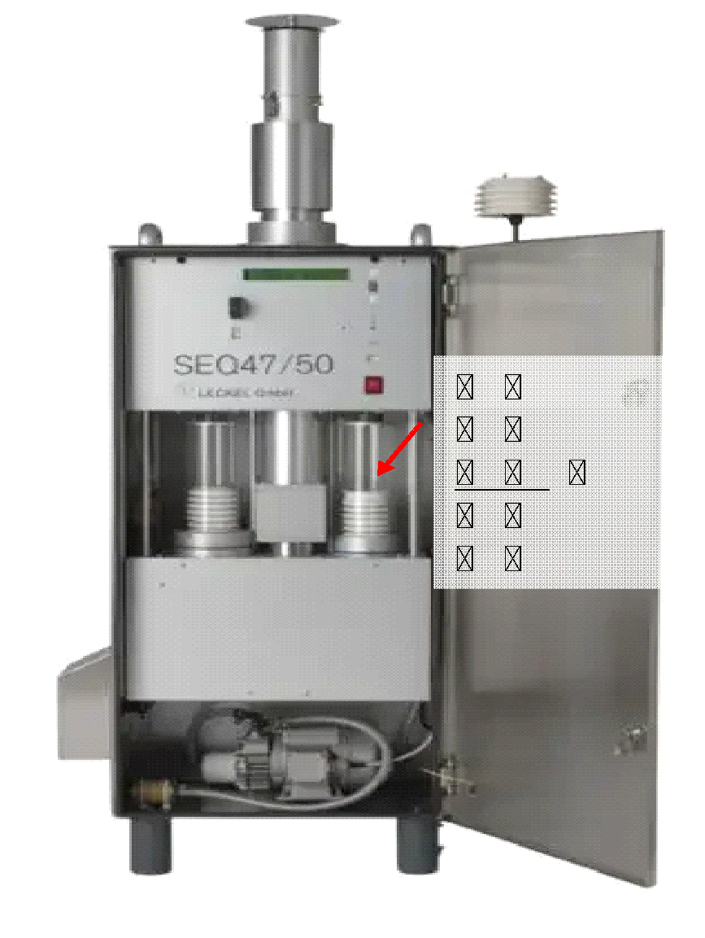
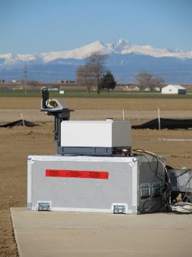
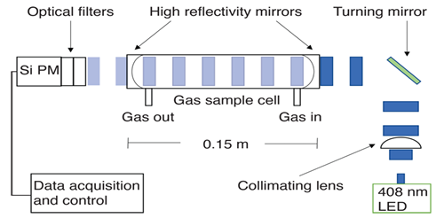
4
Asian Air Pollutants Network
+Pride
▪Preventing sample loss and deformation that may occur during the collection process,
including temperature and humidity control functions
▪Providing a solution that can collect samples stably for a long time even in tropical and
subtropical regions
→ Minimizes volatilization of nitrates that are easily decomposed at high temperatures and
short-term sample storage possible even without rapid replacement
The EM27/SUN spectrometer is a commercial equipment for observing the vertical distribution of greenhouse gases such as CO2 and CH4. It is cheaper and more portable than the FTIR equipment used in the global CO2 observation network, so it can be installed in various conditions.
- If improved to a weather proof equipment that takes into account the Asian climate and atmospheric environment, it can be operated continuously in the Asian region.
CEAS can be manufactured at a unit price of 2000$, and the reliability of the data has also been secured.

Slide 24


감사합니다
Thank you
Terima kasih
cảm ơn bạn
谢谢
Salamat
баярлалаа
ありがとうございました
ขอบคุณ

