Slide 1

PEGASOS & GEO-RING: Consistency TEMPO-GEMS-S5p
Ronny Lutz¹, Arno Keppens² and the PEGASOS and Geo-Ring teams
¹German Aerospace Center (DLR), ²Royal Belgian Institute for Space Aeronomy (BIRA-IASB)
AC-VC #21, Takamatsu (Japan) & online, 9-13 June 2025

Slide 2

PROJECT overview

Slide 3
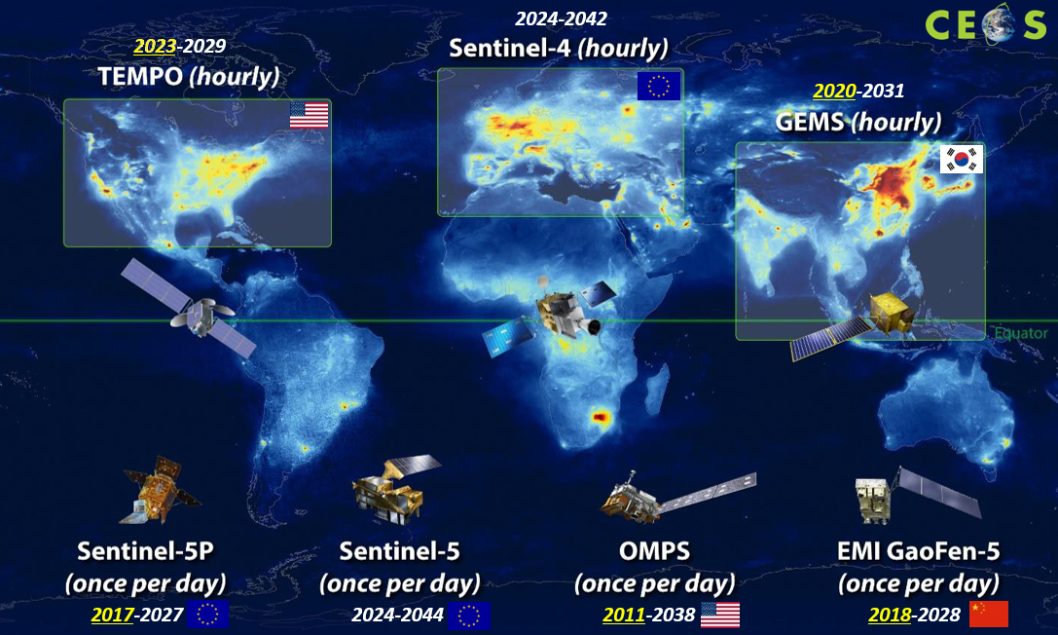
Validation initiatives for GEO observations
PEGASOS Phase 1
(2023-2024)
GEMS
PEGASOS Phase 2
(2025-2026) &
Geo-Ring Phase 1
(2025)
GEMS
TEMPO
Future
Sentinel-4

Slide 4





PEGASOS consortium
Product Evaluation of GEMS L2 via Assessment with S5P and Other Sensors
DLR
  German Aerospace Center
  Remote Sensing Technology Institute
AUTH
  Aristotle University of Thessaloniki
  Laboratory of Atmospheric Physics
BIRA-IASB
  Royal Belgian Institute for Space Aeronomy
IUP-UB
  University of Bremen
  Institute for Environmental Physics
ESA - ESRIN

Slide 5



Geo-Ring consortium
Validation of Environmental Satellites and Air pollution Studies in the Northern Hemisphere through the Geo-Ring International Collaborative Research
Yonsei University
  Dept. of Atmospheric Sciences
  Atmospheric Radiation Laboratory
SAO
  Smithsonian Center for Astrophysics
  Atomic and Molecular Physics
BIRA-IASB
  Royal Belgian Institute for Space Aeronomy
DLR
  German Aerospace Center
  Remote Sensing Technology Institute
NIER

Slide 6
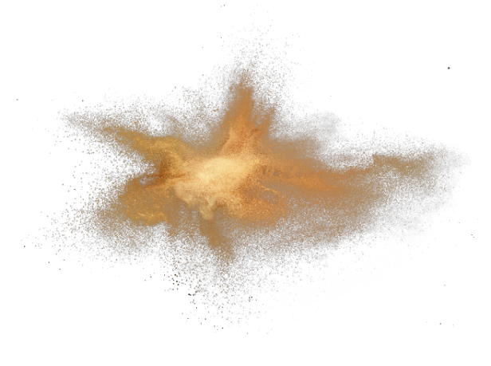





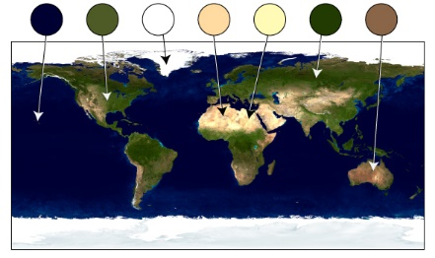
L2 products evaluated by PEGASOS & Geo-Ring
Ozone
total
tropospheric
profile
Sulfur
dioxide
total
Aerosols
index
layer height
Clouds
fraction
height
Nitrogendioxide
total
Formaldehyde
total
Surface properties
BRF
PEGASOS Phase 1: all of the above
SO2 and BRF no longer in PEGASOS Phase 2 + Geo-Ring
Additional in Geo-Ring: HONO + HCHO retrieval improvement

Slide 7


Main objective
Evaluation of and L2 data products using
LEO | GB FRM
TROPOMI / S5P | Brewer
OMI / Aura | Dobson
GOME-2 / MetOp | Ozonesondes
IASI / MetOp | FTIR
VIIRS / S-NPP | MAX-DOAS
CALIOP / CALIPSO | PGN
AMI / GK-2A | NDACC

Slide 8
selected highlights

Slide 9
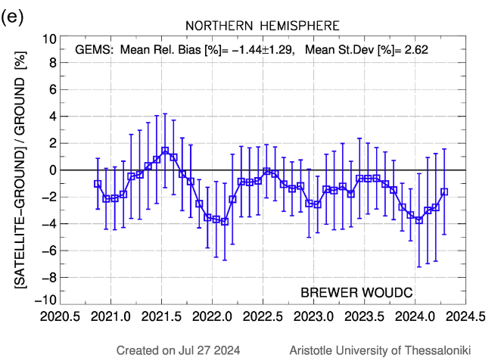
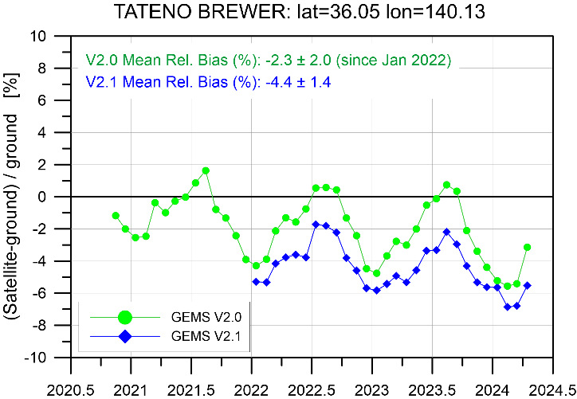
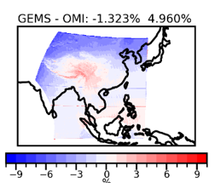
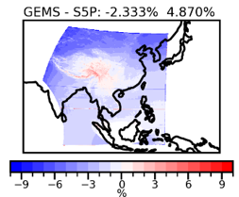
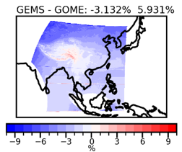
Total Ozone
Team: K. Garane, T. Verhoelst, K.-P. Heue, S. Compernolle
Results:
3.5 years of GEMS O3T v2.0 data showed:
Mean relative bias w.r.t. ground-based stations and other satellite missions: -1.8 %
Pearson correlation coefficient ≥ 0.85 (0.97 – 0.99 for the PGN co-locations), showing a very good agreement between GEMS and the reference measurements
North – South gradient with an annual cycle:
Very good agreement during spring, summer and autumn months (± 1%).
During winter months and for higher latitudes GEMS underestimates total ozone
by up to -4%
Left: Hemispherical time-series of the mean relative bias (%) of GEMS O3T observations w.r.t. ground-based reference measurements from Brewer stations within the GEMS FOV.
Right: the same, for the Tsukuba station, Japan, also showing O3T v2.1
The mean percentage difference between the O3T observations from GEMS and other satellite missions (left → OMI, middle→ S5P, right →GOME2C), over the GEMS FOV.

Slide 10
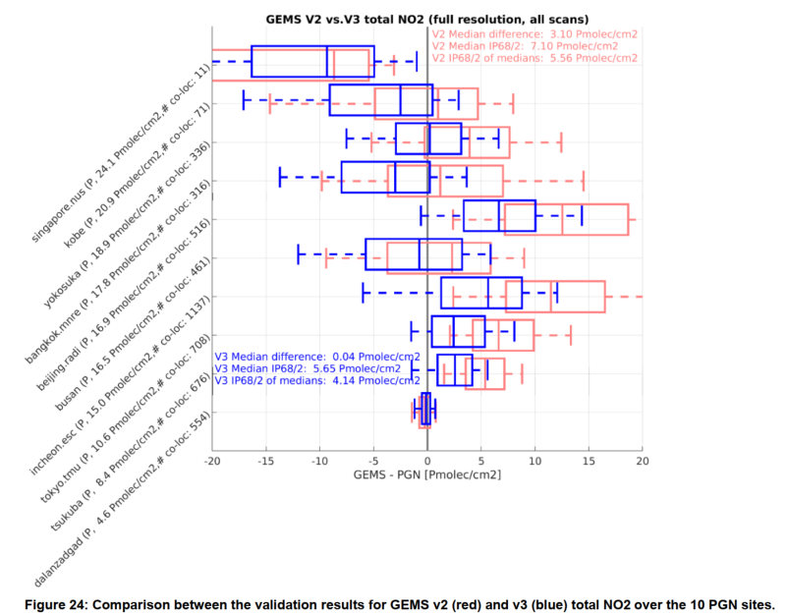
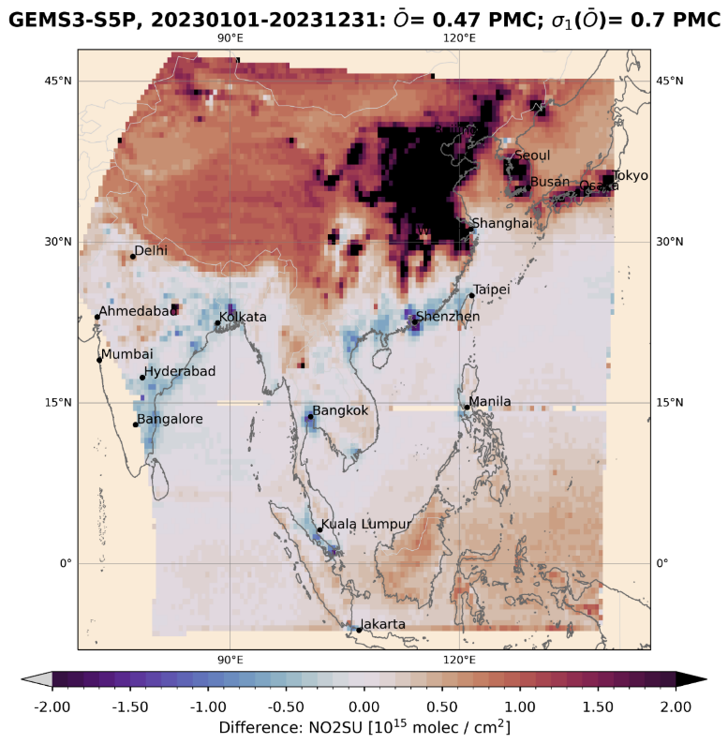
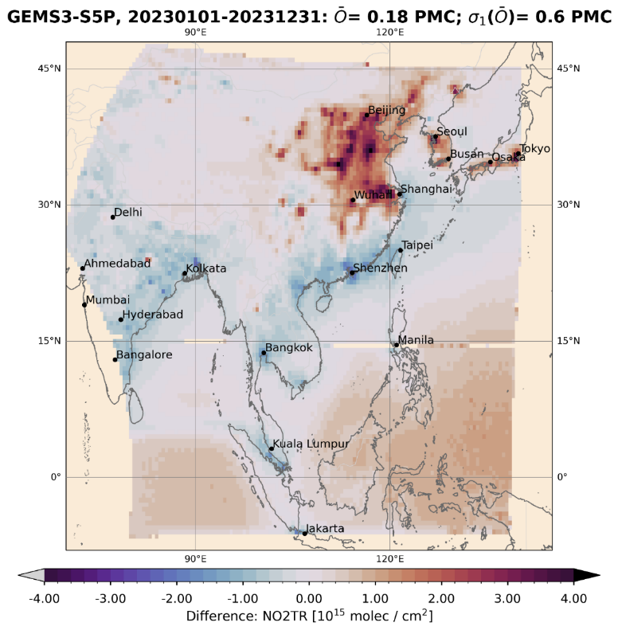
NO2
Team: K.-U. Eichmann, G. Pinardi, S. Compernolle, T. Verhoelst, S. Seo
Results:
MAX-DOAS (11 stations) tropospheric NO2 (V2): median bias 2.3 Pmolec/cm² (23.3%) and network dispersion 3.9 Pmolec/cm² (34%). V3 shows an absolute reduction in bias (~30%) and dispersion.
PGN (10 stations) total NO2 (V3): median bias ~0.04 Pmolec/cm² and network dispersion 5.6 Pmolec/cm². This is a clear improvement over V2
TROPOMI vs GEMS NO2 V3: negative GEMS bias over Ocean removed and high bias over polluted scenes reduced wrt V2.
Total
Troposphere
Comparison of GEMS V3 - TROPOMI total/tropospheric NO2 differences for 2023.

Slide 11
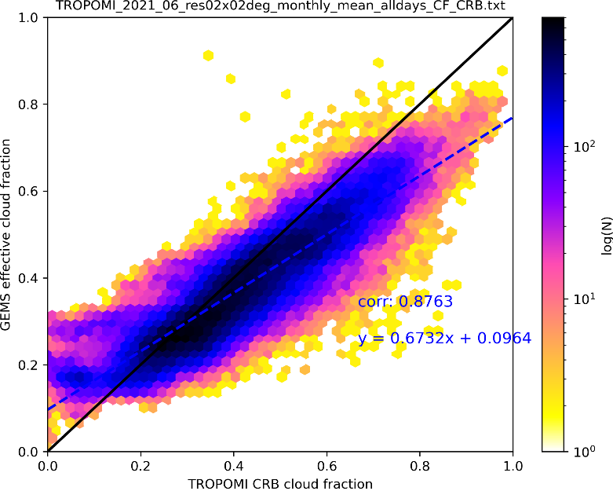
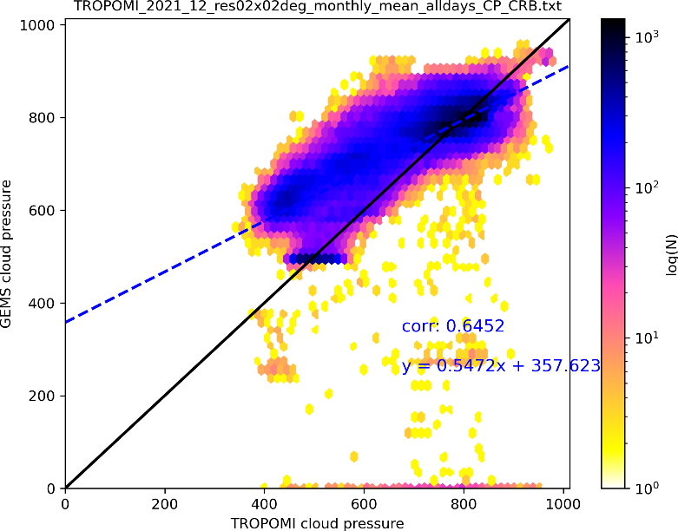
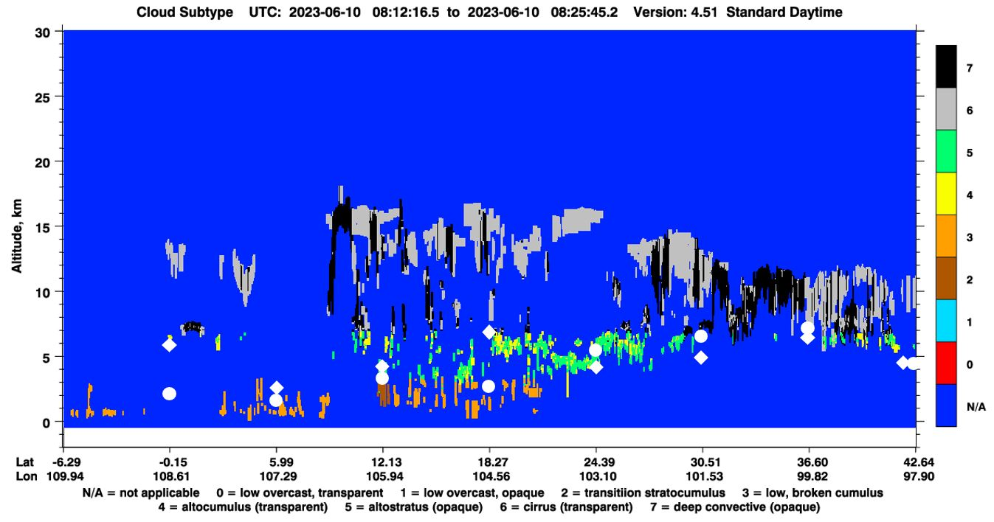
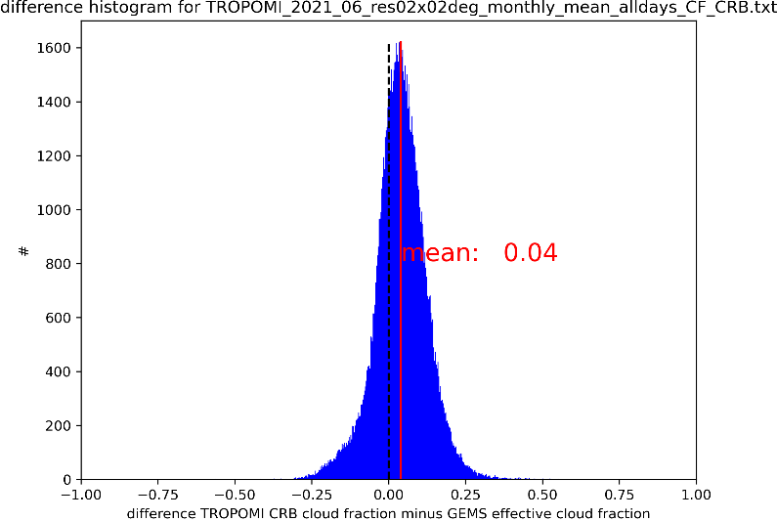
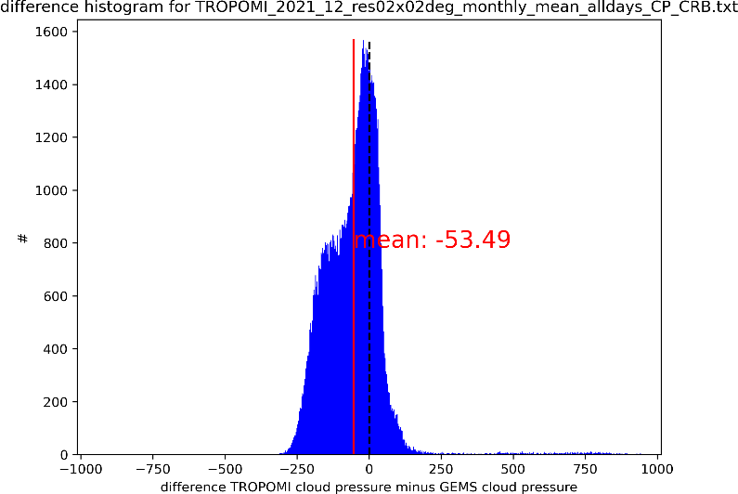
Clouds
Team: R. Lutz, V. Molina García
Results:
comparisons based on: TROPOMI, CALIOP
good agreement for cloud fraction: corr: 0.87, mean diff: 0.04
ok agreement for cloud pressure: corr: 0.65, mean diff: -50 hPa
deviations appear over bright surfaces, for low cloud coverages and extreme viewing zenith angles
Comparison with TROPOMI/S5P cloud fraction (left) and cloud pressure (right) for June and December 2021.
Comparison with CALIOP on 10 June 2023.

Slide 12
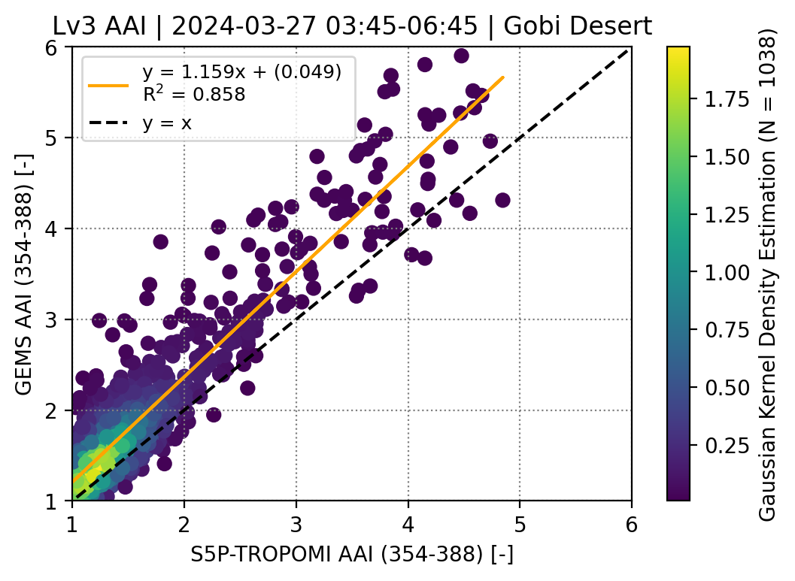
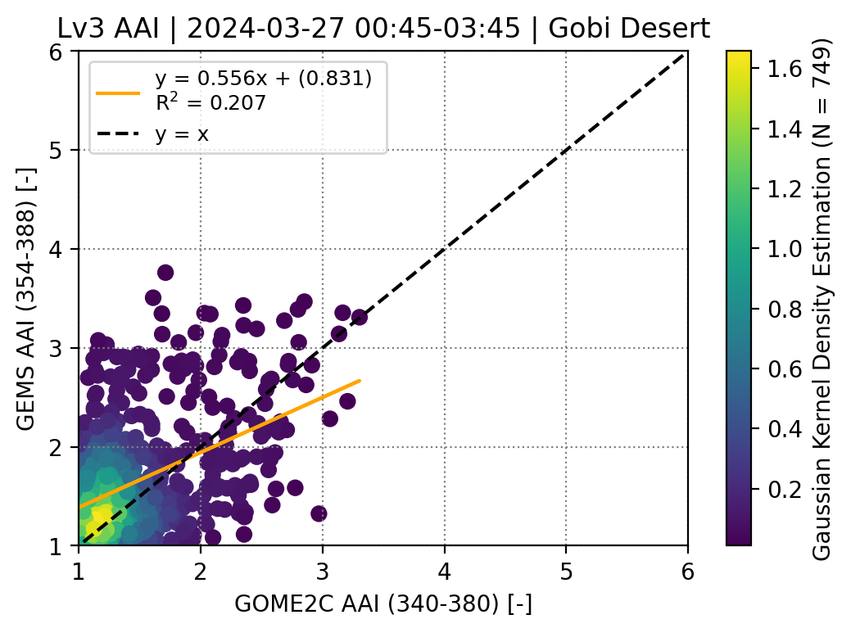
Aerosol Index
Team: P. Fountoukidis, M.-L. Koukouli, K. Michailidis, D. Balis
Results:
Overestimation of the GEMS AAI
The inter-comparisons appear to have high dependency on the event and the sensors (e.g. the wavelength pair)
Better agreement between S5P/TROPOMI and GEMS
Inter-comparisons of the GEMS L3 AAI (0.5x0.5 grid) between the respective S5P-TROPOMI (left) and GOME-2C (right) datasets, for specific dust events

Slide 13
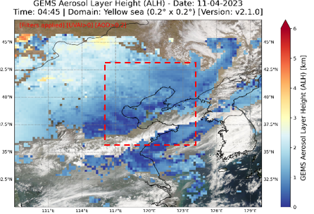
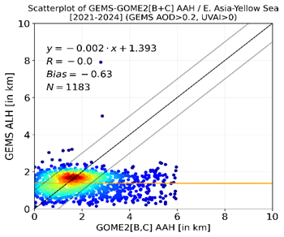
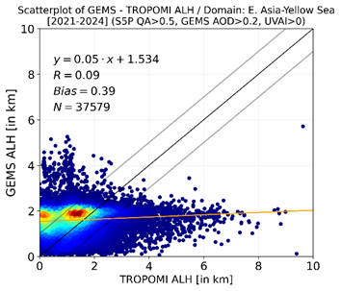
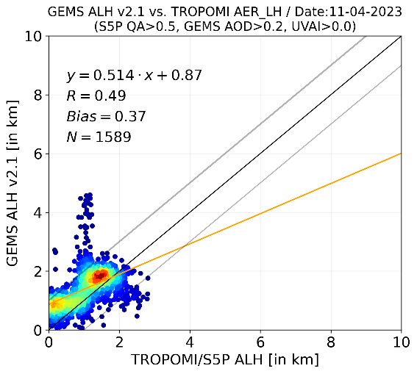
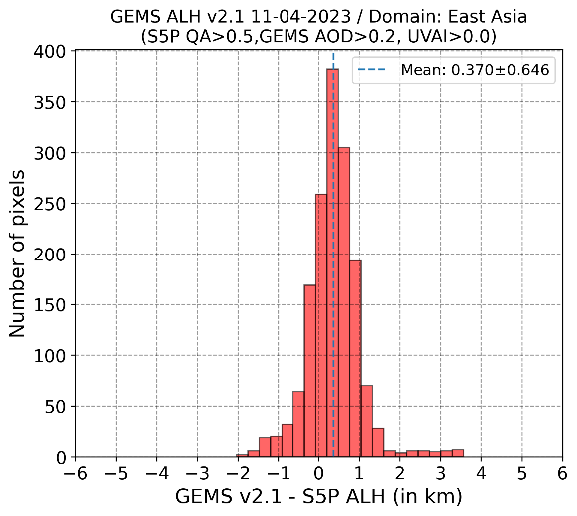
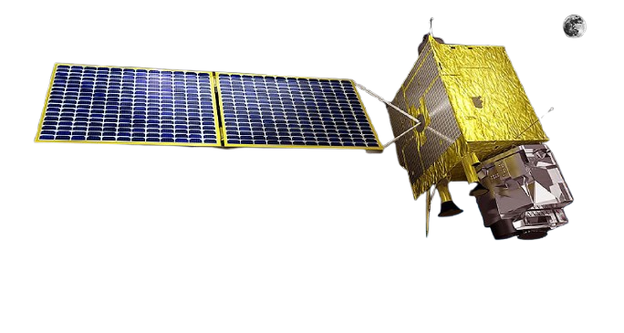
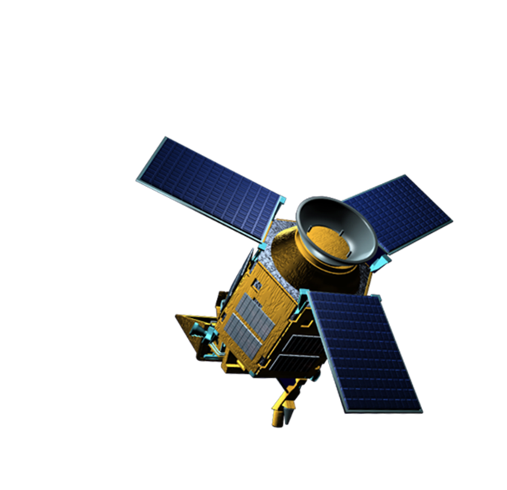

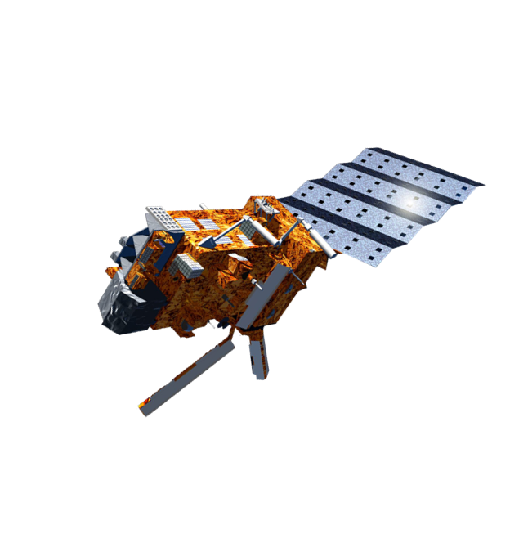
Aerosol Layer Height
Team: K. Michailidis, P. Fountoukidis, M.-L. Koukouli, D. Balis
Results:
GEMS ALH vs TROPOMI ALH | L2
GEMS ALH vs GOME2/MetOp [B+C] AAH | L2
Dust Event
GEMS vs MetOp
GEMS vs TROPOMI
Pixel-to-pixel comparisons (Quality flags applied)
L2 and L3 gridded data are used – S5P: [0.2° x 0.2°] / GOME2: [0.5° x 0.5°]

Slide 14
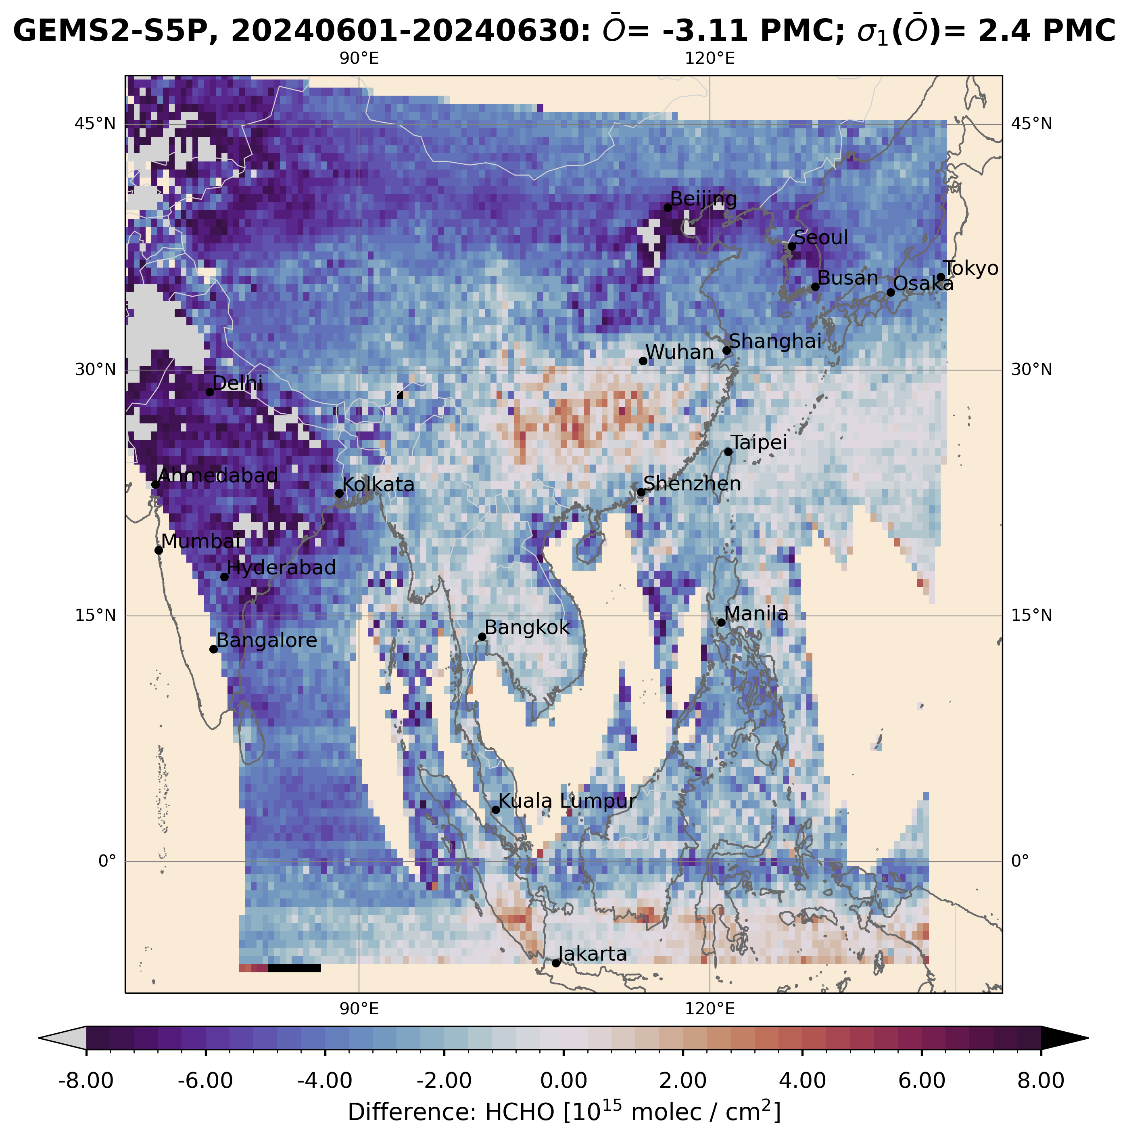
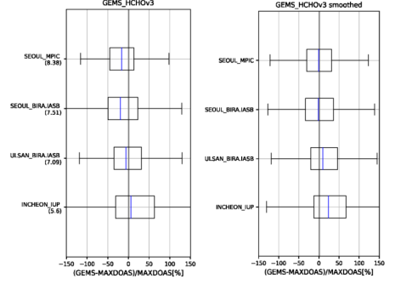
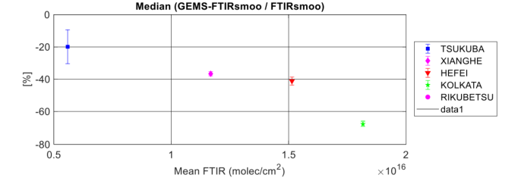
HCHO
Team: K.-U. Eichmann, I. de Smedt, C. Vigouroux, G. Pinardi, S. Compernolle, T. Verhoelst
Results:
TROPOMI: V2 GEMS HCHO has a low bias with a more negative bias towards the West. Overall bias < -60 %, dispersion 2.4 Pmolec/cm².
FTIR (4 stations): V2 GEMS median bias < -67%, dispersion < 5.6 Pmolec/cm²
MAX-DOAS (10 stations): V2 GEMS median bias -25%, dispersion 2.7 Pmolec/cm²
Box-whisker plots of GEMS V3 median HCHO [%] at MAX-DOAS sites and the effect of smoothing.
Monthly mean HCHO differences of GEMS V2 and TROPOMI (June 2024).
GEMS mean HCHO (V2) bias for the 4 FTIR sites.

Slide 15
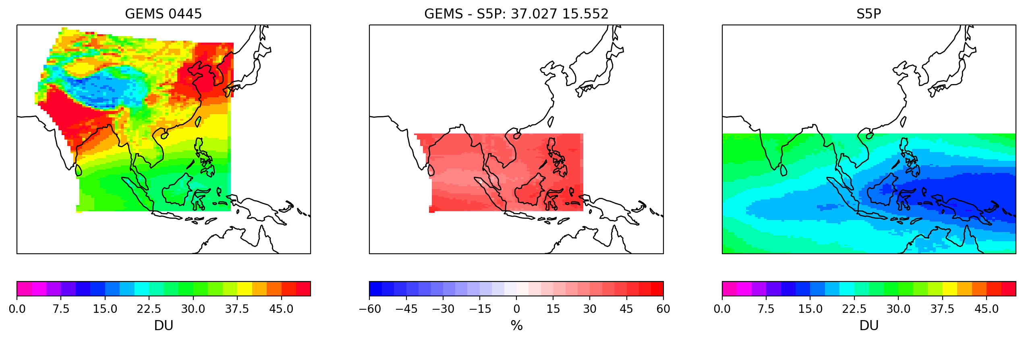
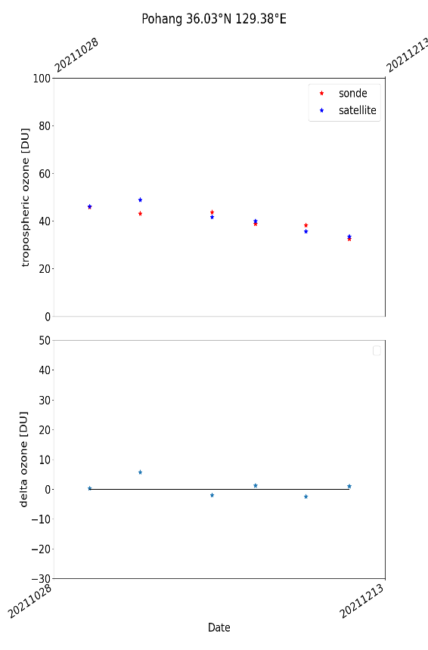
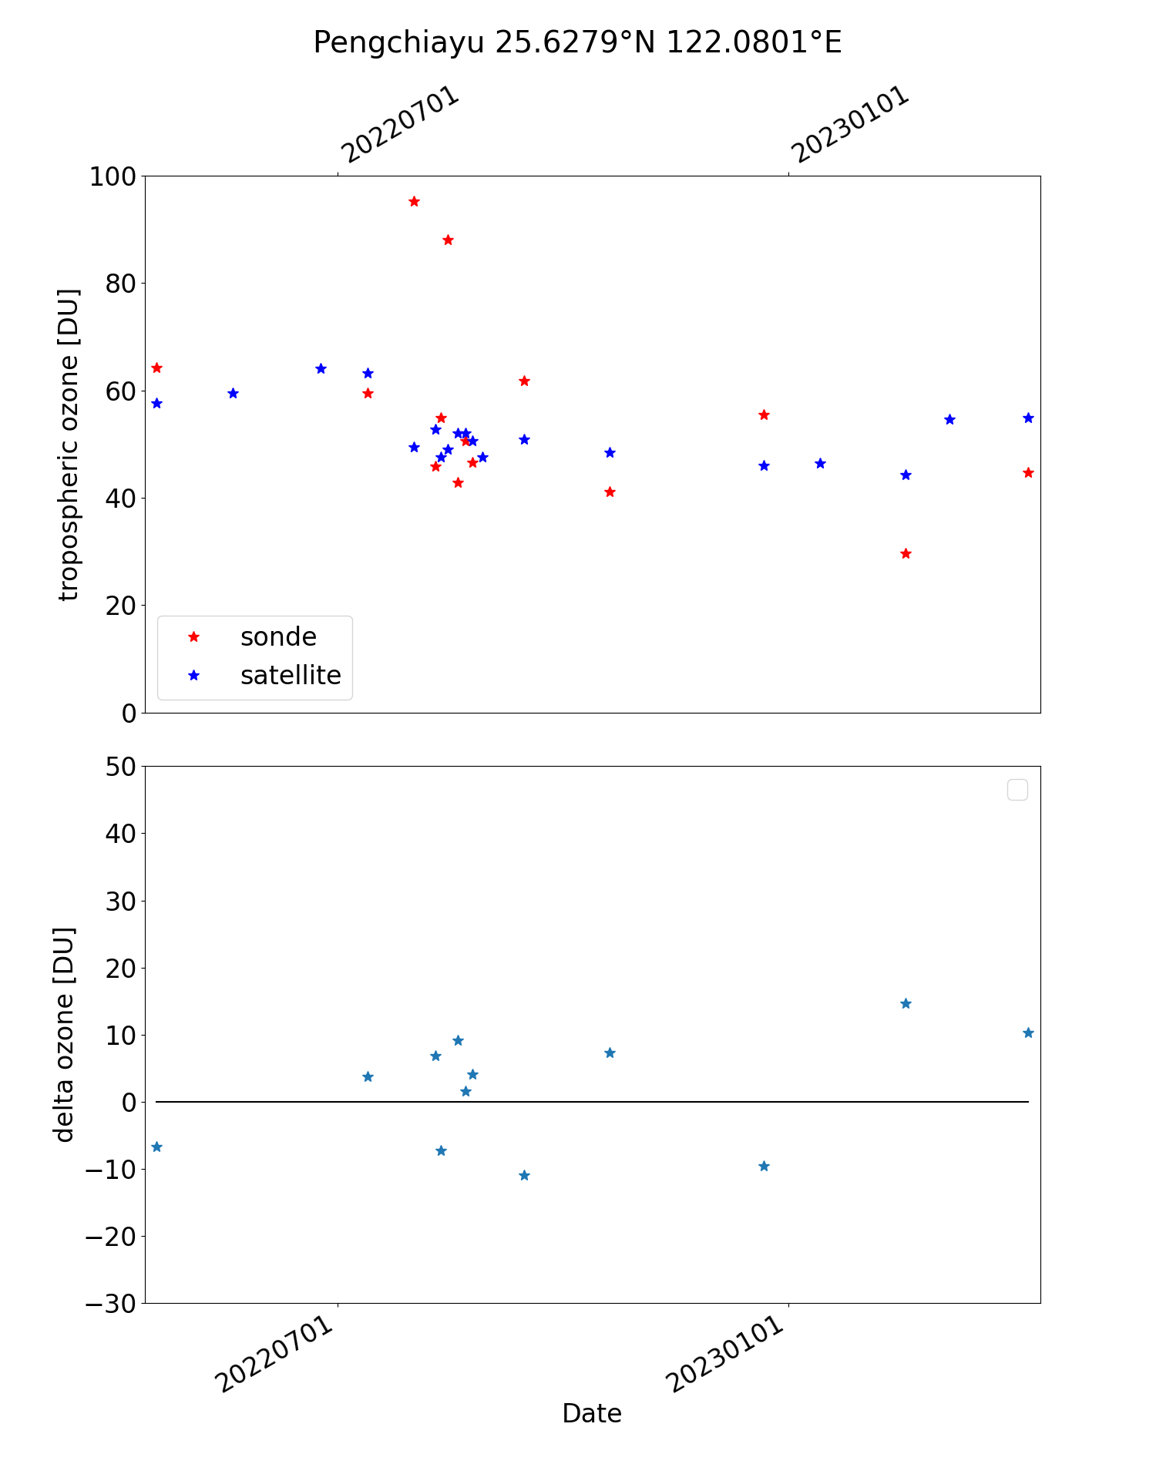
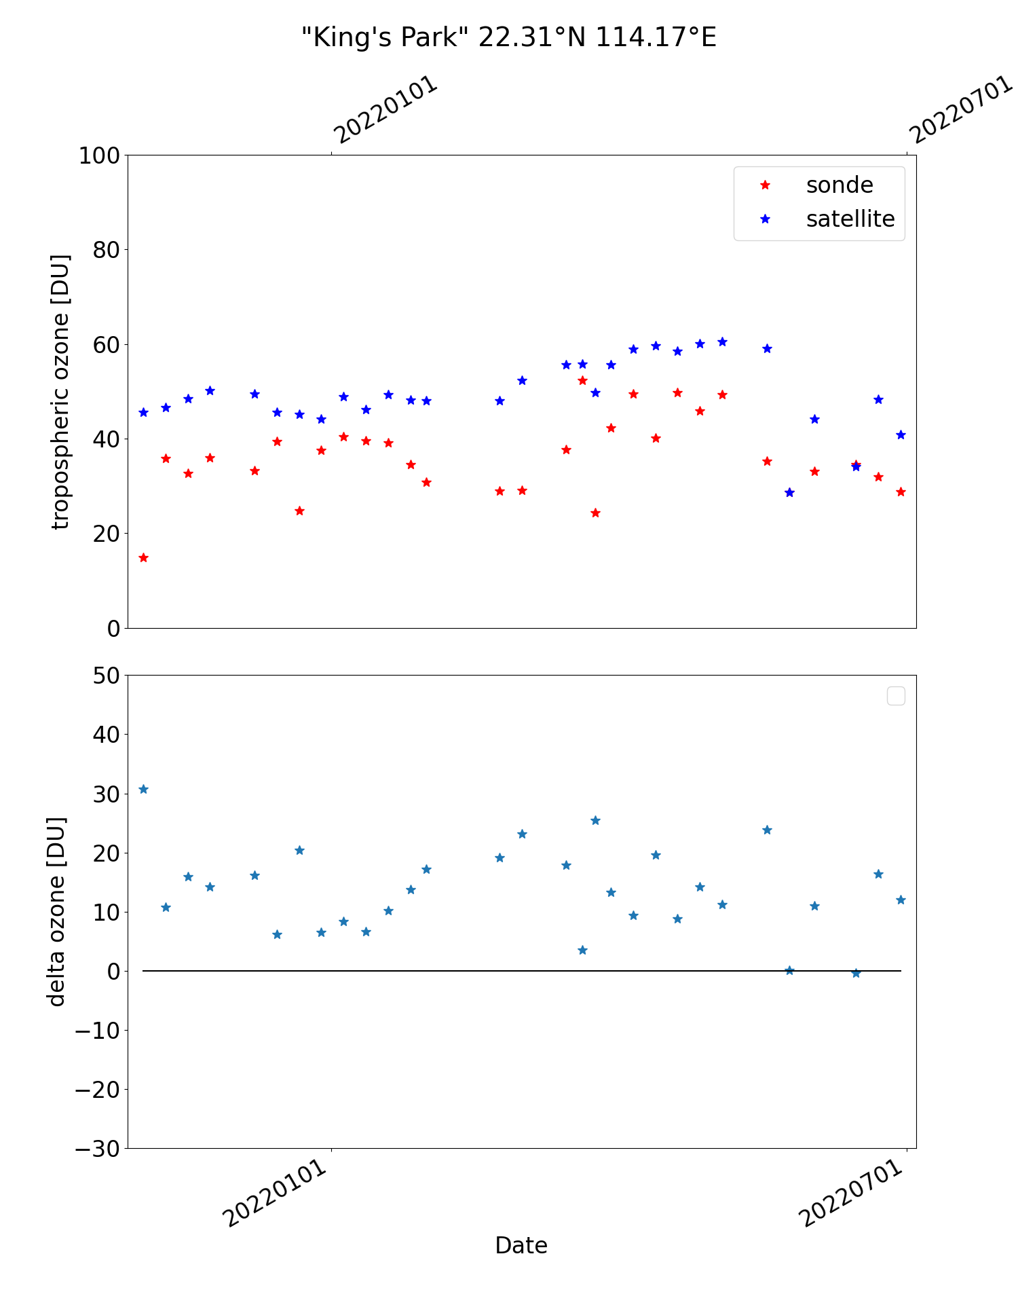
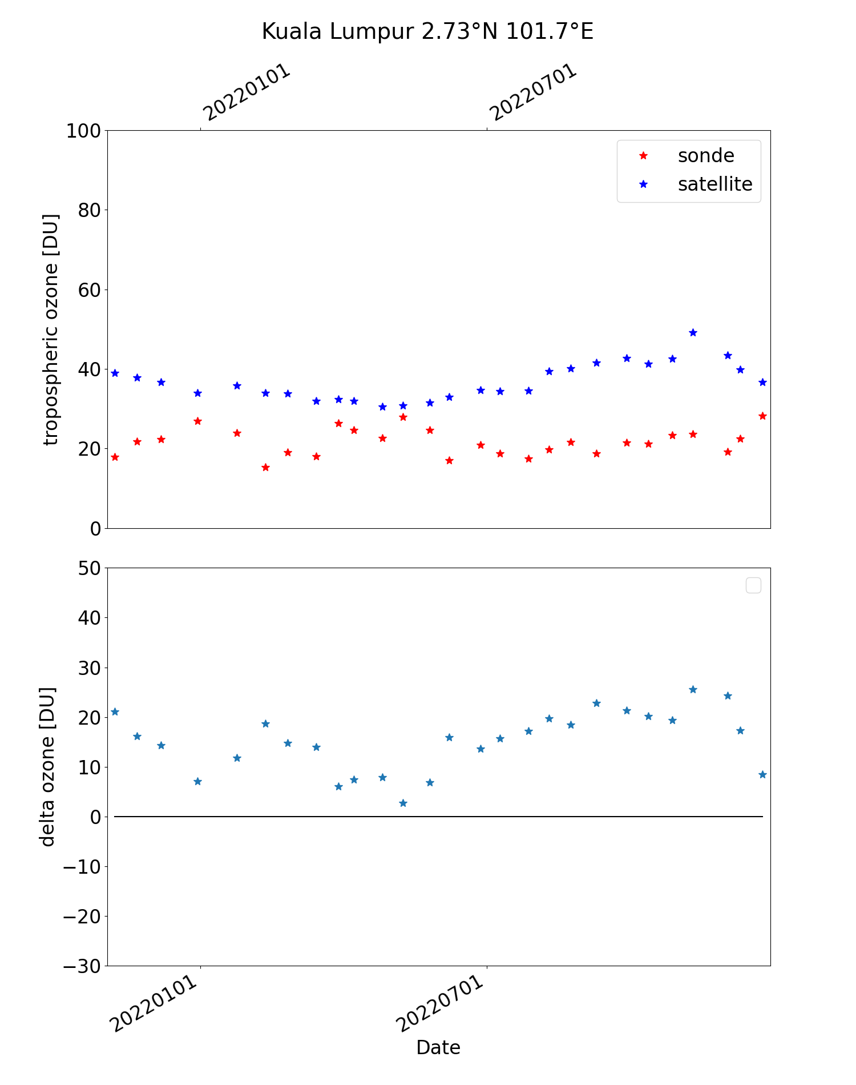
Ozone (tropospheric)
Team: K.-P. Heue, D. Hubert
Results:
Based on version 2.0
Bias 30-40% relative to S5P and GOME_2
  Within the tropics (up to 20°S)
  Confirmed by sondes in Hong Kong and Kuala Lumpur
Lower bias over Korea relative to sondes

Slide 16
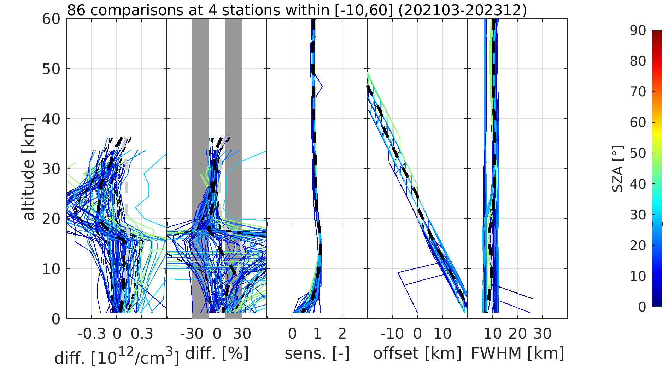
Ozone (profile)
Team: A. Keppens, D. Hubert, J.-C. Lambert
Results:
GEMS O3P v3 information content:
Mostly off-diagonal sensitivity
DFS ~1.5 from lower stratosphere (15-30 km)
5-10 km effective vertical resolution (FWHM)
GEMS O3P v3 uncertainty:
Order of 5-10 % negative bias and
10 % dispersion in lower stratosphere
10-20 % positive tropospheric bias & dispersion (increase in UTLS)
AK smoothing systematically reduces tropospheric uncertainties
Clear effect of clouds and SZA / VZA
Bak et al. “GEMS ozone profile retrieval: impact and validation of version 3.0 improvements” under review for AMT.
GEMS L2 v3 ozone profile data in comparison with vertically smoothed
ozonesonde data from four stations (2021/03 – 2023/12)

Slide 17
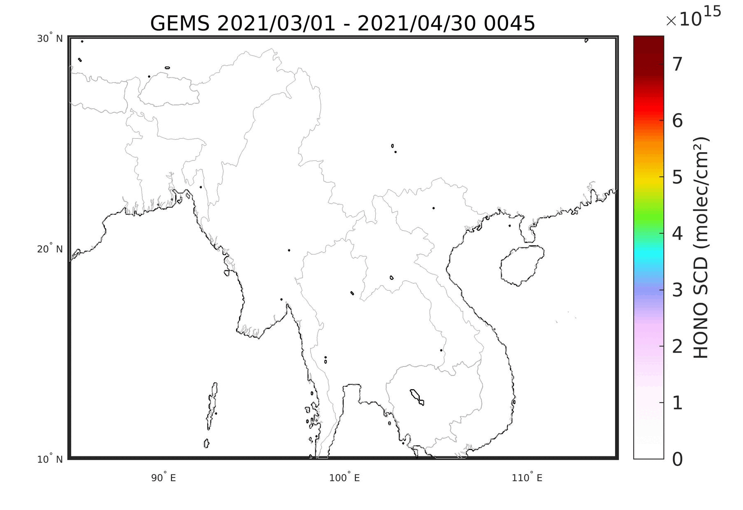
GEMS HONO & HCHO retrieval improvement
Team: N. Theys, I. de Smedt
Southeast Asia 2021 burning season (March-April)
Aim:
Support development of GEMS HONO retrieval, based on previous collaboration between BIRA-IASB and NIER
Strengthening collaboration on HCHO
Work:
Assessing and evaluating products for HONO, propose improvements and support implementation of algorithms by performing tests and comparison against TROPOMI and possible other datasets
Similar assessment for HCHO with focus on how to improve the spectral fitting and background correction
Theys et al., JGR-A, 2025

Slide 18
Credits to the GEMS and TEMPO teams!
We appreciate the good collaboration with the GEMS L2 product developers in Phase 1
We look forward to a good collaboration with the TEMPO L2 product developers in Phase 2

Slide 19
Thank you for your attention!
Comments or questions? ronny.lutz@dlr.de / arno.keppens@aeronomie.be

