Slide 1





Overview and First Results from the Third Cabauw Intercomparison of UV-Vis DOAS Instruments
M. Van Roozendael, A. Apituley, K. Kreher, D. Alves Gouveia, D. Bortoli, E. Castelli, A. Cede, Ka Lok Chan, E. Dekemper, C. Fayt, U. Frieß, M. M. Friedrich, E. Frins, P. Goloub, Hyunkee Hong, D. Karagkiozidis, Hyeong-Ahn Kwon, J-C. Lambert, J. Lampel, T. Leblanc, Ang Li, E. Spinei Lind, Cheng Liu, H. Wai Leung Mak, A. Merlaud, S. Morhenn, M. Navarro-Comas, Gyeong Park, A. Pazmino, A. Piters, A. Redondas, A. Richter, C. Rivera-Cardenas, R. G. Ryan, I. Stachlewska, K. Strong, F. Tack, M. Tiefengraber, W. Van Roy, T. Wagner, P. Xie, S. Ziegler, A. Dehn
and the CINDI-3 Scientific Team

Slide 2







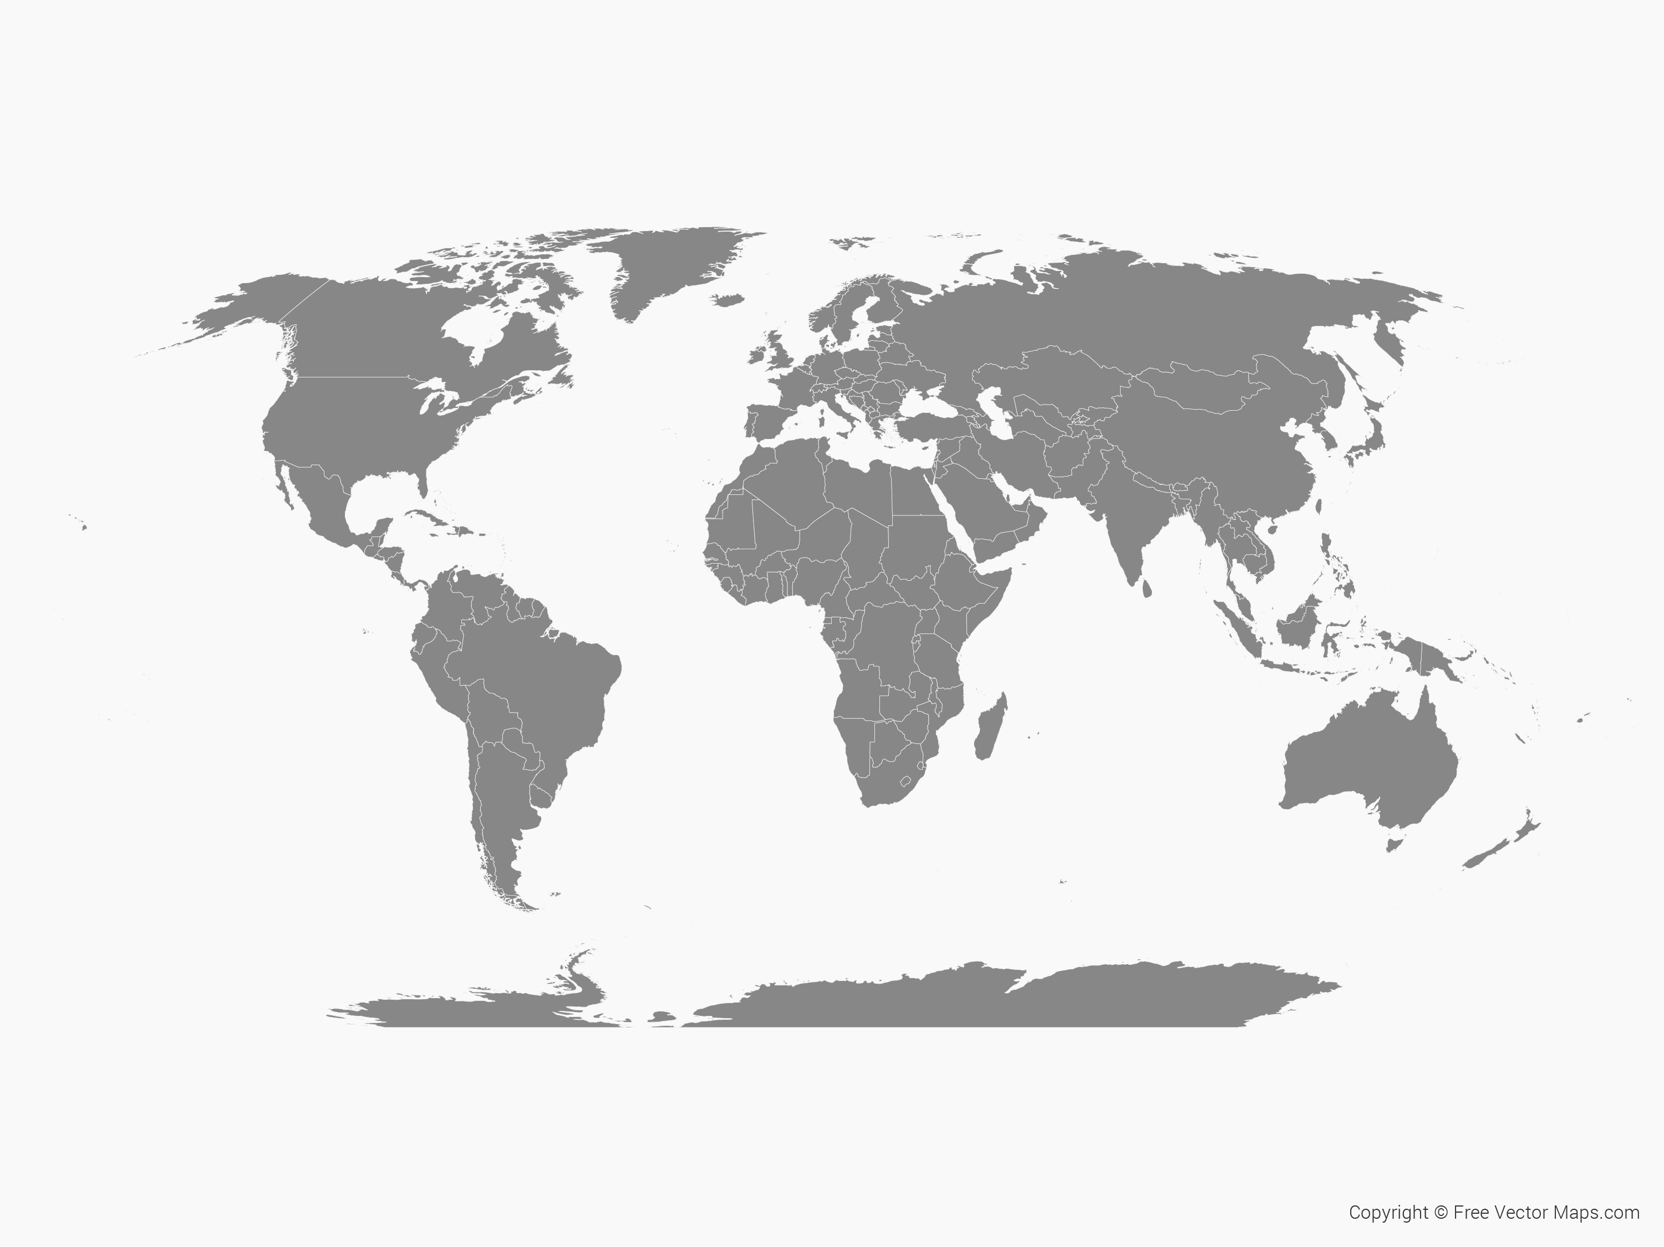


















~30 research institutes, companies and international organisations

Slide 3



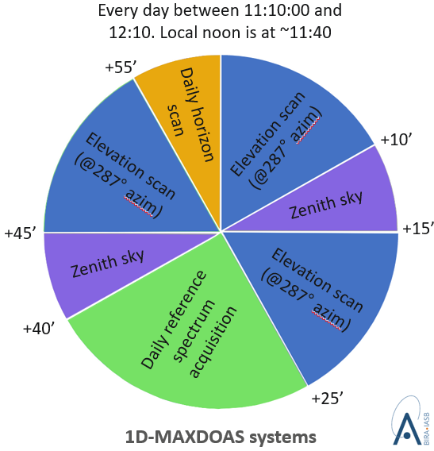
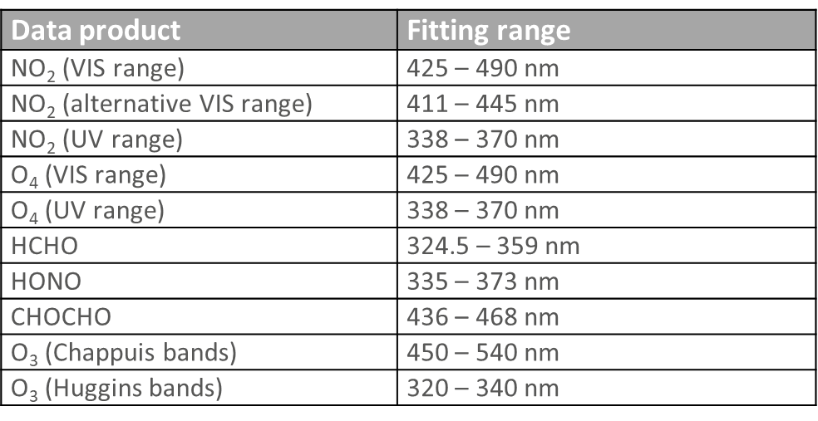
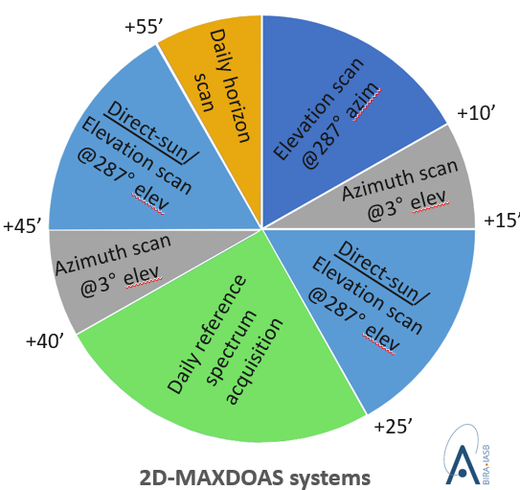
Semi-blind intercalibration campaign with external referee:
CINDI-3 (Cabauw, May 21 – June 21, 2024)
to assess mutual consistency of measurements
to certify new instruments for NDACC and ACTRIS
to improve CEOS-FRM maturity for validation of Air Quality and Ozone satellite constellations
Observation protocol
CEOS AC-VC-21 / ACSG Joint Meeting 2025, Takamatsu, Japan
June 10-13, 2025

Slide 4
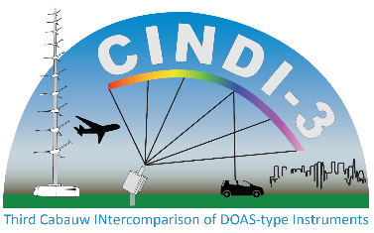
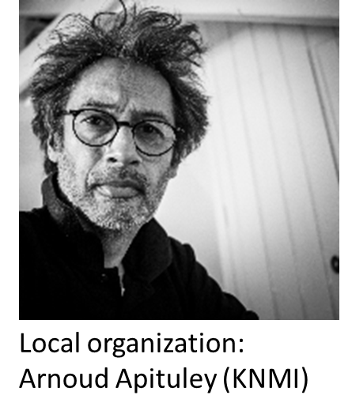
Overview
Overview of campaign activities
32 UV-Vis DOAS instruments of various types intercompared for NO₂, HCHO, O₄, CHOCHO, HONO, BrO and O₃ slant column measurements
In-field calibrations applied to all UV-Vis instruments
Interactive semi-blind data evaluation with daily briefs
Comprehensive set of ancillary measurements: aerosol and tropospheric O₃ lidars, Brewer and aerosol sunphotometers, NO₂ and O₃ sondes, in-situ instruments, long-path DOAS, etc.
Mobile measurements of NO₂ and aerosol
Airborne mapping and vertical profiling of NO₂ in Cabauw and Rotterdam area
CEOS AC-VC-21 / ACSG Joint Meeting 2025, Takamatsu, Japan
June 10-13, 2025

Slide 5
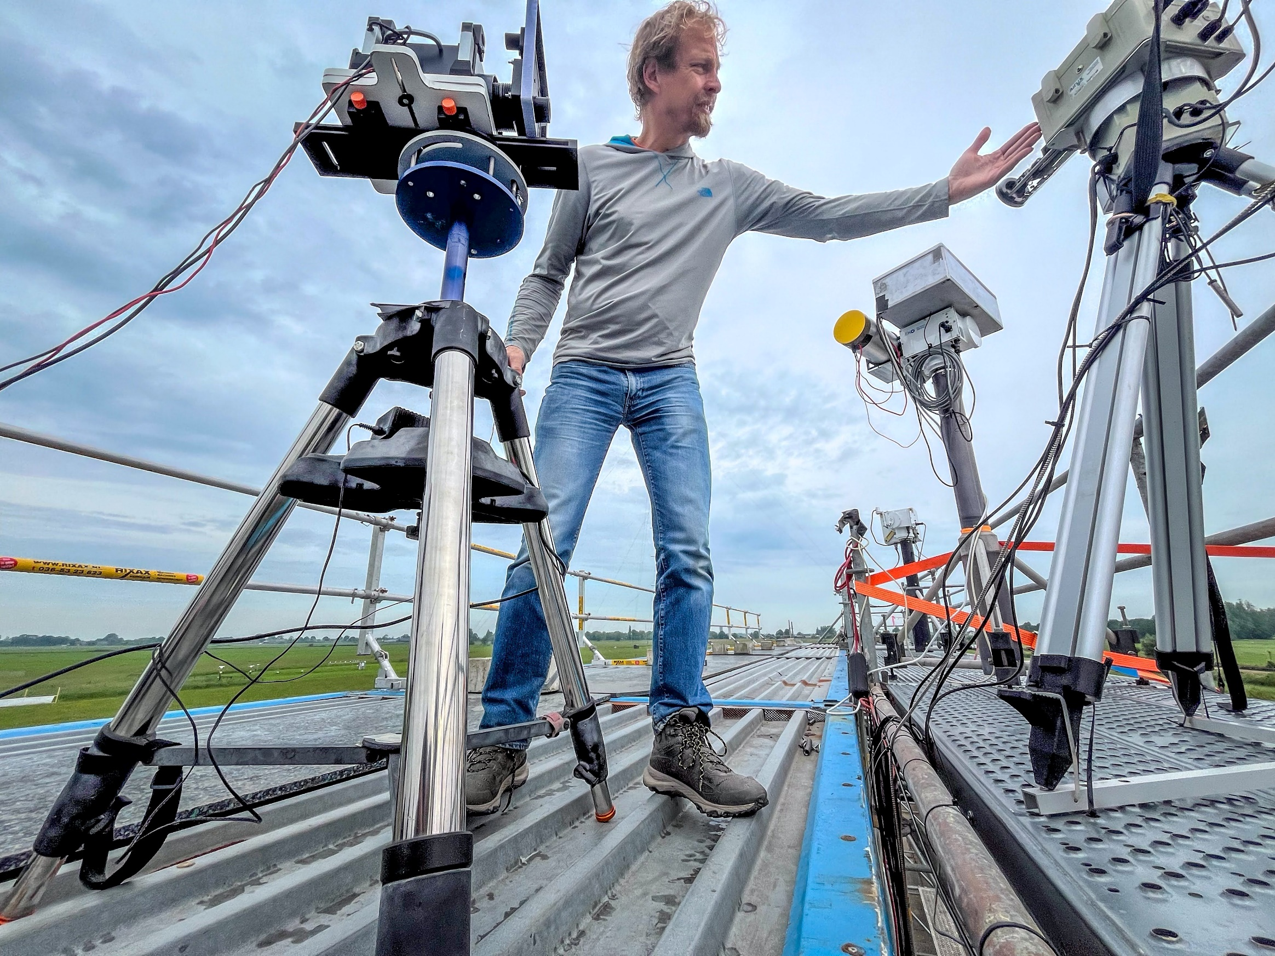
CINDI-3 in-field calibration
(Luftblick & NASA)
FCT
“Field Calibration Tool”
Goal
For each instrument, measure:
Gain and S/N ratio
Detector linearity
PRNU (Pixel Response Non-Uniformity)
Effective exposure time
Stray light
Notes:
An interesting novelty of the campaign was to perform in-field calibrations using a the so-called “field calibration tool” of Luftblick (200 W tungsten lamp mounted in a stable housing). The goal was to characterize a number of parameters that are important for the quality of the measurements, such S/N ratio, detector linearity or stray-light level.

Slide 6
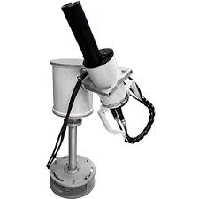
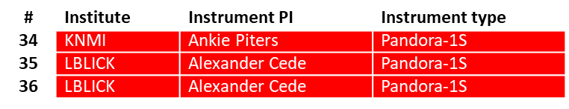
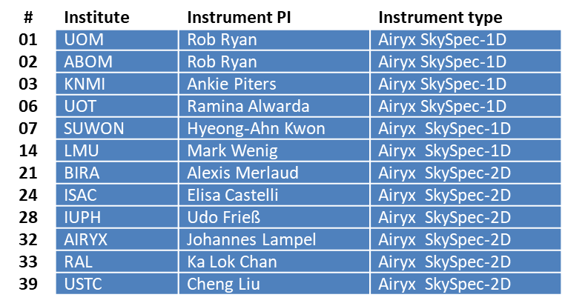
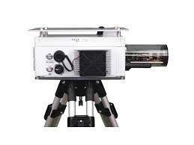
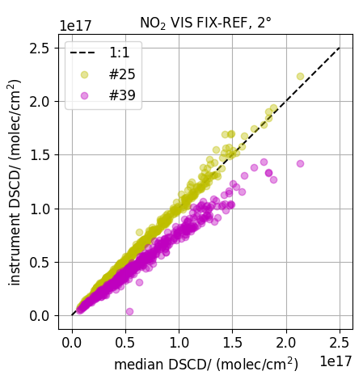
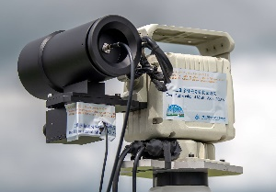
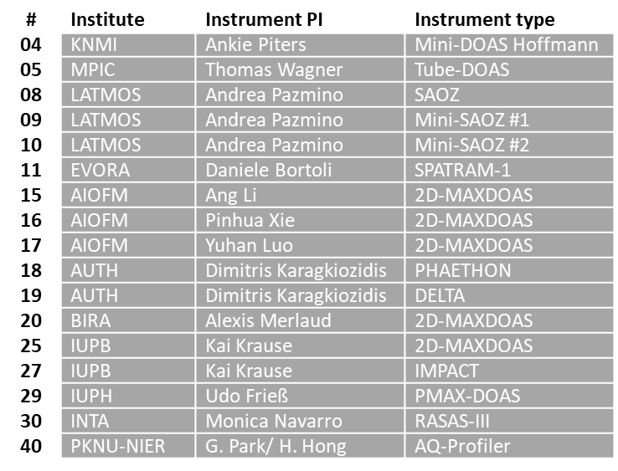
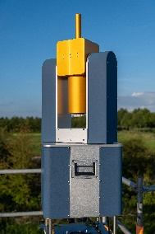
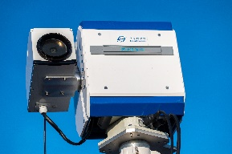
Semi-blind intercomparison of slant columns
Pandora
3
18 days (June 2 -> 19)
8 data products
3 reference spectra types
9 elevation angles
12
Airyx SkySpec
Research grade instruments
17
CEOS AC-VC-21 / ACSG Joint Meeting 2025, Takamatsu, Japan
June 10-13, 2025
Notes:
But, of course, the central activity was the intercomparison of slant column measurements, which was based on 18 days of measurements and addressed 8 data products, retrieved using 3 reference spectra types for 9 elevations angles. For this campaign we had 3 Pandoras, 12 commercial Airyx skyspec instruments and 17 research grade instruments. For each comparison case, a regression analysis similar to the one shown here was performed, where individual measurements are compared to the median from all instruments. In total, approx. 7000 such regression plots were performed.

Slide 7

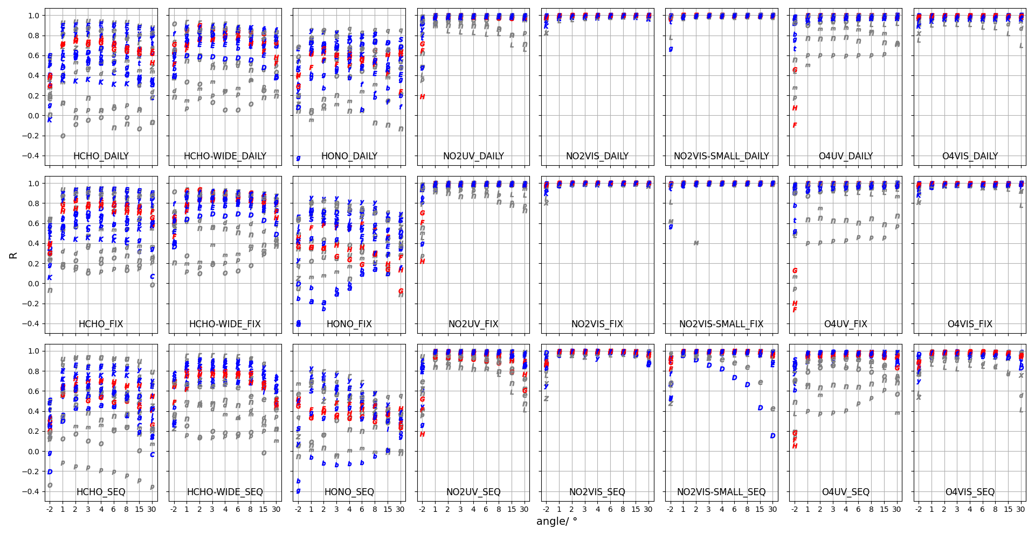
Overview of regression results
Pandora
Airyx SkySpec
DAILY REF SPECTRA
R (correlation coefficient)
FIXED REF SPECTRUM
Research grade instruments
SEQUENTIAL REF SPECTRA
CEOS AC-VC-21 / ACSG Joint Meeting 2025, Takamatsu, Japan
June 10-13, 2025
Notes:
This shows an overview of all regression results (correlation coefficient). For most instruments, a good to very good consistency is obtained for NO2 and O4 data products, but results are a lot more challenging for other trace gases, and this requires more in-depth analysis.

Slide 8
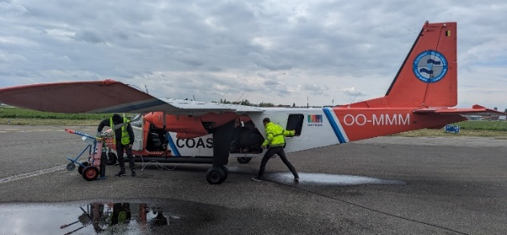
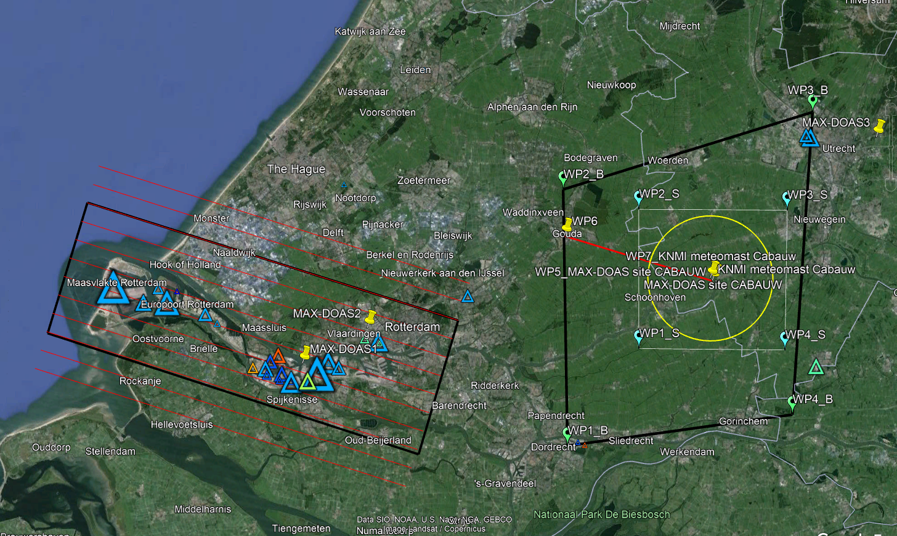
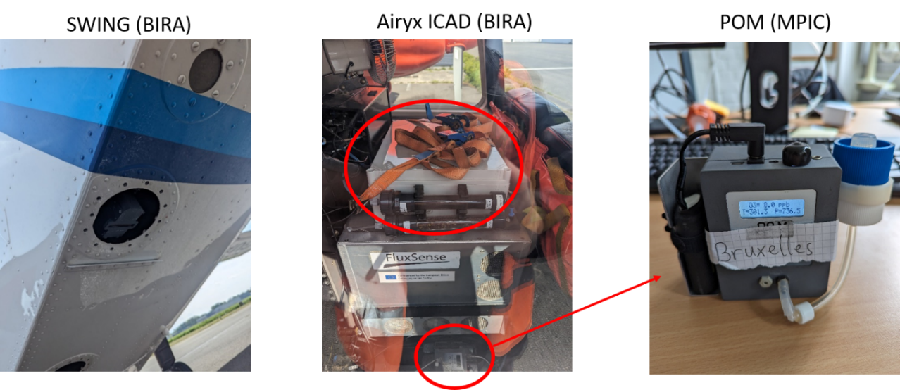
Airborne NO₂ mapping and profiling
10 flights performed (4 over Rotterdam, 6 Antwerp)
NO₂ mapping over predefined ROIs for S5p validation
Spirals for vertical distribution profiling using in-situ sensors
Region of Interests over Cabauw and Rotterdam
BN-2 Belgian Coast Guard Aircraft ‘OO-MMM’
SWING (NO₂ mapping) ICAD (NO₂) POM (O₃)
CEOS AC-VC-21 / ACSG Joint Meeting 2025, Takamatsu, Japan
June 10-13, 2025
Notes:
Now moving to airborne measurements. We had the BN-2 aircraft from the Belgian coast guards equipped with 3 instruments, SWING a compact (whiskbroom) NO2 mapper, and in-situ sensors for NO2 and O3. With this setup, we performed 10 flights over the Rotterdam and Antwerp areas. This shows an example of NO2 map obtained over Rotterdam overlayed with TROPOMI data, and the corresponding NO2 profile, which was obtained using a spiral.

Slide 9
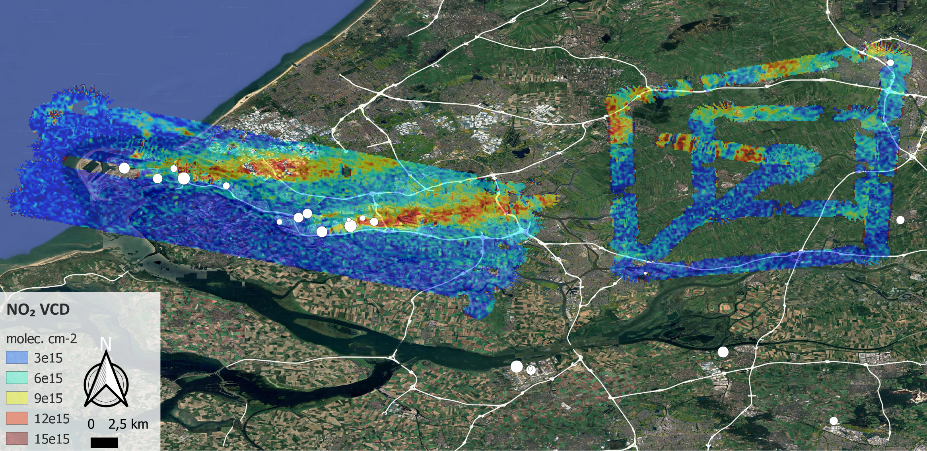
Preliminary results: SWING+ NO₂ VCD maps
Rotterdam 20240607
Notes:
This figure illustrates one of the successful survey over Rotterdam and the Cabauw area on 7 June. White dots indicate the main emission point sources from the E-PRTR database and we see clearly the pollution plumes transported by the wind. Because of the bad weather in June and the difficulty to obtain the flight clearance in the Rotterdam area, the airborne campaign had to be extended until August. This shows SWING data obtained on 27 of August. When superposed on TROPOMI data, one can clearly see the signature of a plume transported from the Antwerp area, explaining the large columns observed above the sea on this day.

Slide 10
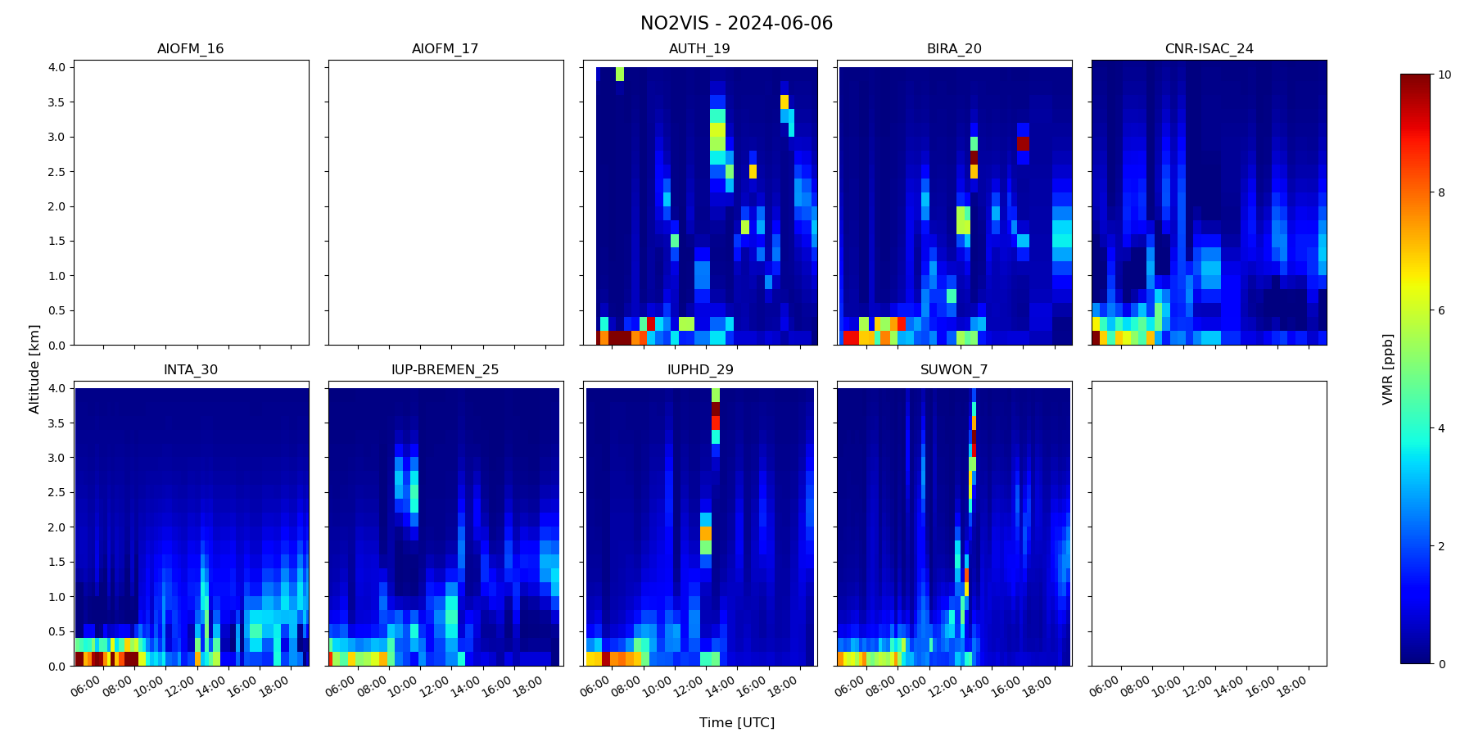
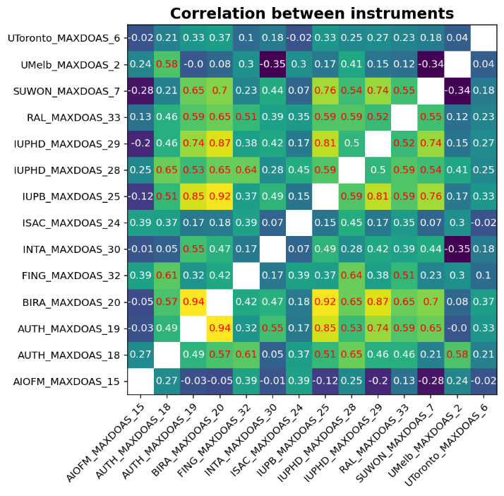
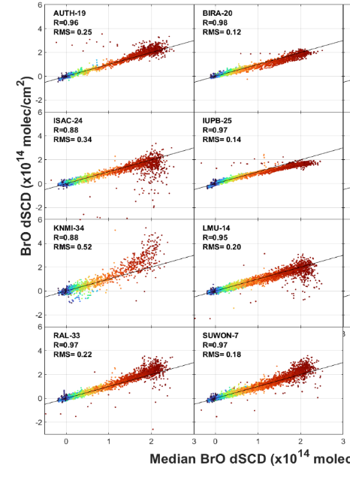
Post-campaign analysis - Task groups
MAX-DOAS vertical profiles (IUPH)
Glyoxal retrievals (IUPB)
BrO retrievals (BIRA-IASB)
Ozone columns (AEMET)
Ozone profiles (USTC/MPIC)
Direct-sun measurements (Luftblick)
Synergistic aerosol retrievals (E. Lind)
Airborne/mobile (BIRA-IASB)
…
CEOS AC-VC-21 / ACSG Joint Meeting 2025, Takamatsu, Japan
June 10-13, 2025
Notes:
The analysis of all these data is ongoing in various task groups led by different institutes as listed on this slide. Results were reported and discussed during a first CINDI-3 workshop which took place on March 17-19 in Heidelberg.

Slide 11

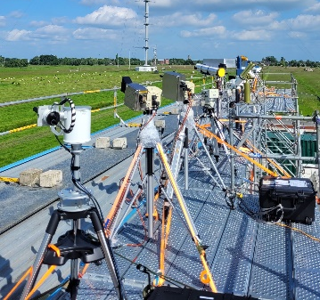
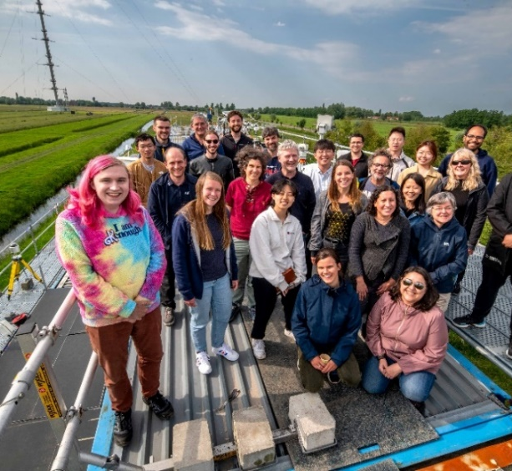
Summary
32 UV-Vis DOAS instruments were intercompared in Cabauw during one month in May-June 2024
Preliminary evaluations show good agreement for NO₂ and O₄ measurements, more challenging for other gases
In-depth analysis of data under way in several task groups
CINDI-3 workshop hosted by Kirchhoff-Institute for Physics (KIP), Heidelberg, 17-19 March 2025
  Hybrid, ~100 participants (50 in person)
  25 talks covering all data and aspects of the campaign
  Extensive discussions of results in 4 sessions
  Visit of new Airyx facility in Heidelberg
CEOS AC-VC-21 / ACSG Joint Meeting 2025, Takamatsu, Japan
June 10-13, 2025

Slide 12
Outlook
Publication plan: AMT/ACP Special Issue
CEOS-FRM maturity level (for Sentinel-4/-5 and CO2M classes)
  Initial CEOS-FRM maturity assessment of FRM4DOAS data published by Van Roozendael et al. in Remote Sens. 2024, https://doi.org/10.3390/rs16234523
  Post-campaign improvement of MAX-DOAS measurements + update to version 2 of CEOS-FRM guidelines
  Updated CEOS-FRM maturity assessment anticipated
Next meeting: DOAS Workshop, Thessaloniki, 9-11 July 2025
CEOS AC-VC-21 / ACSG Joint Meeting 2025, Takamatsu, Japan
June 10-13, 2025

