Slide 1
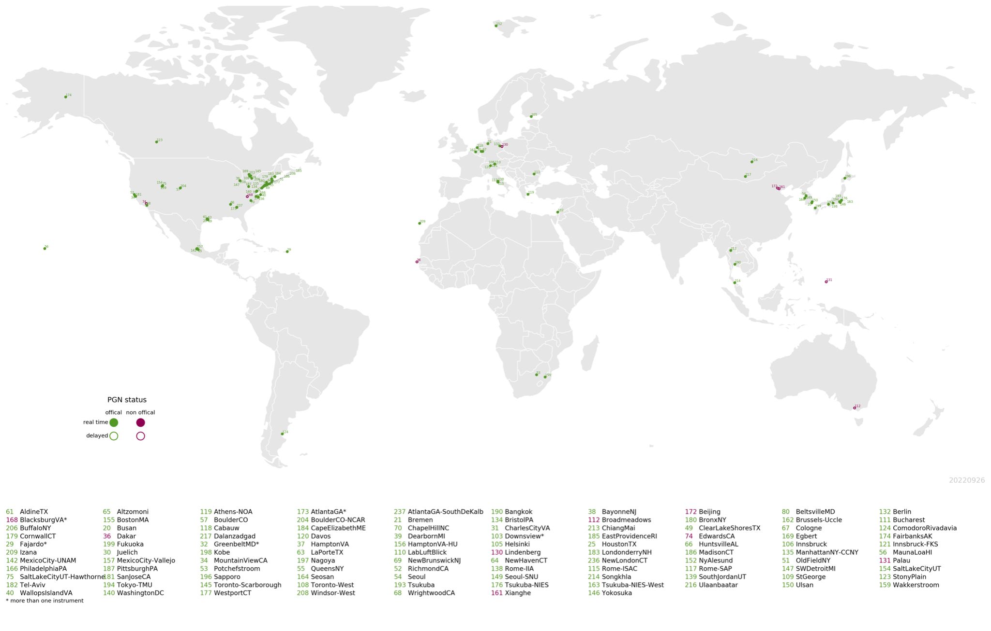
Validation and support of space-based measurements with the Pandonia Global Network of ground-based spectrometers
Thomas Hanisco¹, Alexander Cede^{1,3,5}, Nader Abuhassan^{1,2,3}, Stefano Casadio⁴, Limseok Chang⁶, Angelika Dehn⁴, Emma Knowland⁷, Elena Lind¹,Apoorva Pandey^{1,2}, Bryan Place^{1,3}, Alberto Redondas⁸, James Szykman⁹, Martin Tiefengraber⁵, Luke Valin⁹, Michel van Roozendael¹⁰, and Jonas von Bismarck⁴
¹NASA Goddard Space Flight Center, Greenbelt, Maryland, USA
²University of Maryland Baltimore County, Maryland, USA
³SciGlob, Columbia, MD, USA
⁴Earth Observation Ground Segment Department, ESA / ESRIN, Frascati, Italy
⁵LuftBlick, Innsbruck, Austria
⁶National Institute of Environmental Research, Incheon, Korea
⁷NASA Headquarters, Washington, DC, USA
⁸AEMET- Meteorological State Agency, Spain
⁹EPA Research Triangle Park, Charllotte, NC, USA
¹⁰BIRA-IASB, Brussels, Belgium
11-June, 2025
CEOS AC-VC meeting

Slide 2
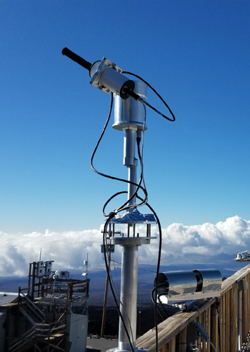

Pandonia Global Network
Calibration and Quality Assurance:
  Laboratory and Field calibration of instruments
Network operation
  Remote monitoring and repair of instruments
Retrievals
  Production of O₃, SO₂, NO₂ and HCHO Columns/Profiles
The PGN operates 185+ Pandora instruments
https://www.pandonia-global-network.org/
Thomas.Hanisco@nasa.gov, alexander.cede@luftblick.at

Slide 3
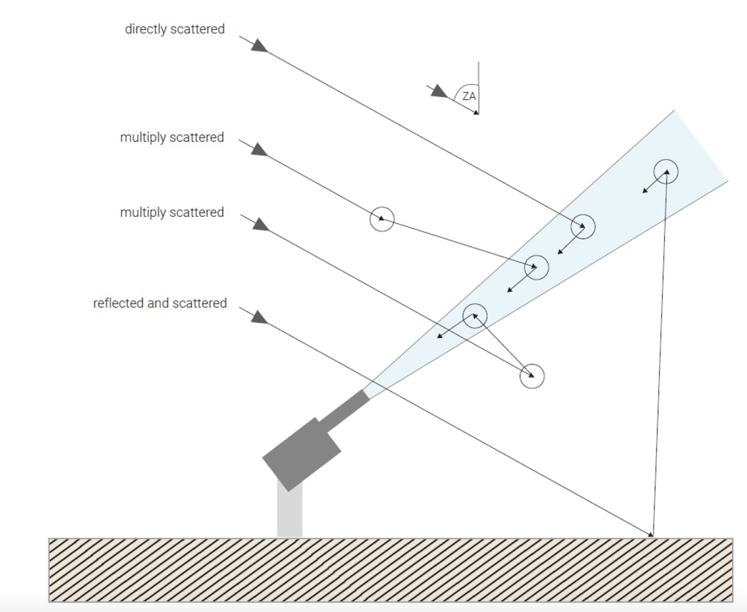
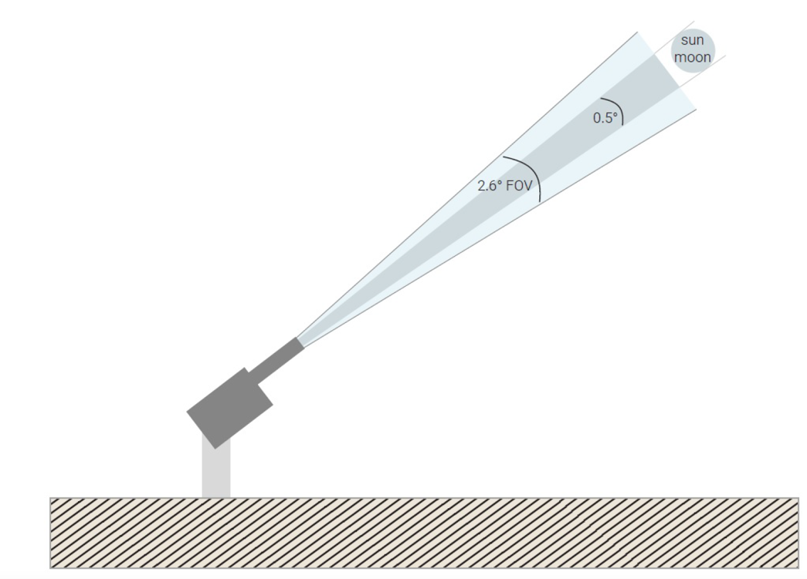
Pandora measurements
Direct sun: mostly BEER’s Law.
Total absorption used to derive the column abundance between the instrument and the top of atmosphere
MAX-DOAS: multiple angle BEER’s Law
Differential measurements used to derive the abundance at multiple elevations

Slide 4


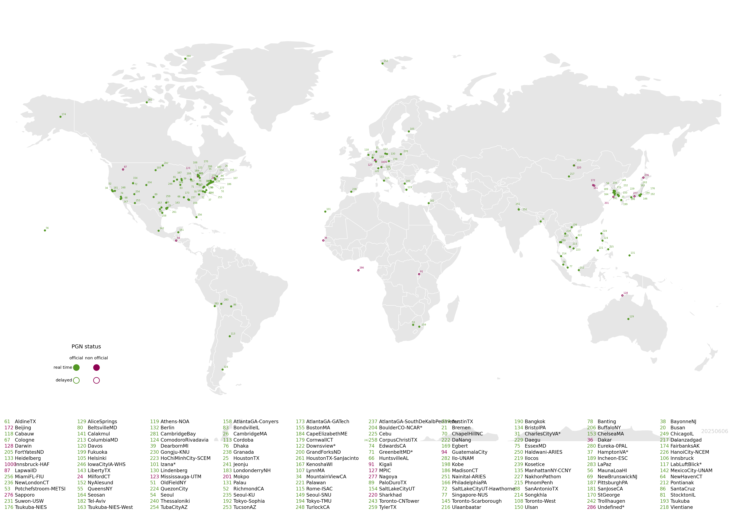
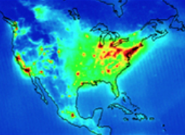
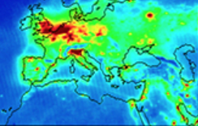
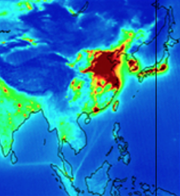
Pandonia Global Network
SENTINEL-4
            185+ Official instruments
            Unofficial
            Adding 30/year
TEMPO
GEMS
Notes:
Buenos Aires and Rivadiva, Antarctica Trollhausen, Ann Marie Fjaera NILU

Slide 5
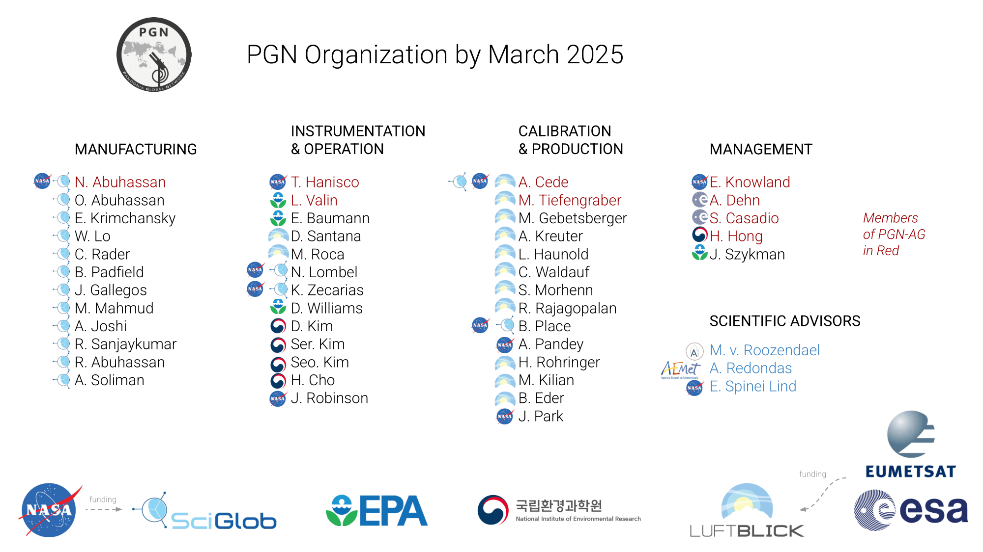
Notes:
Added Actris not up to date

Slide 6
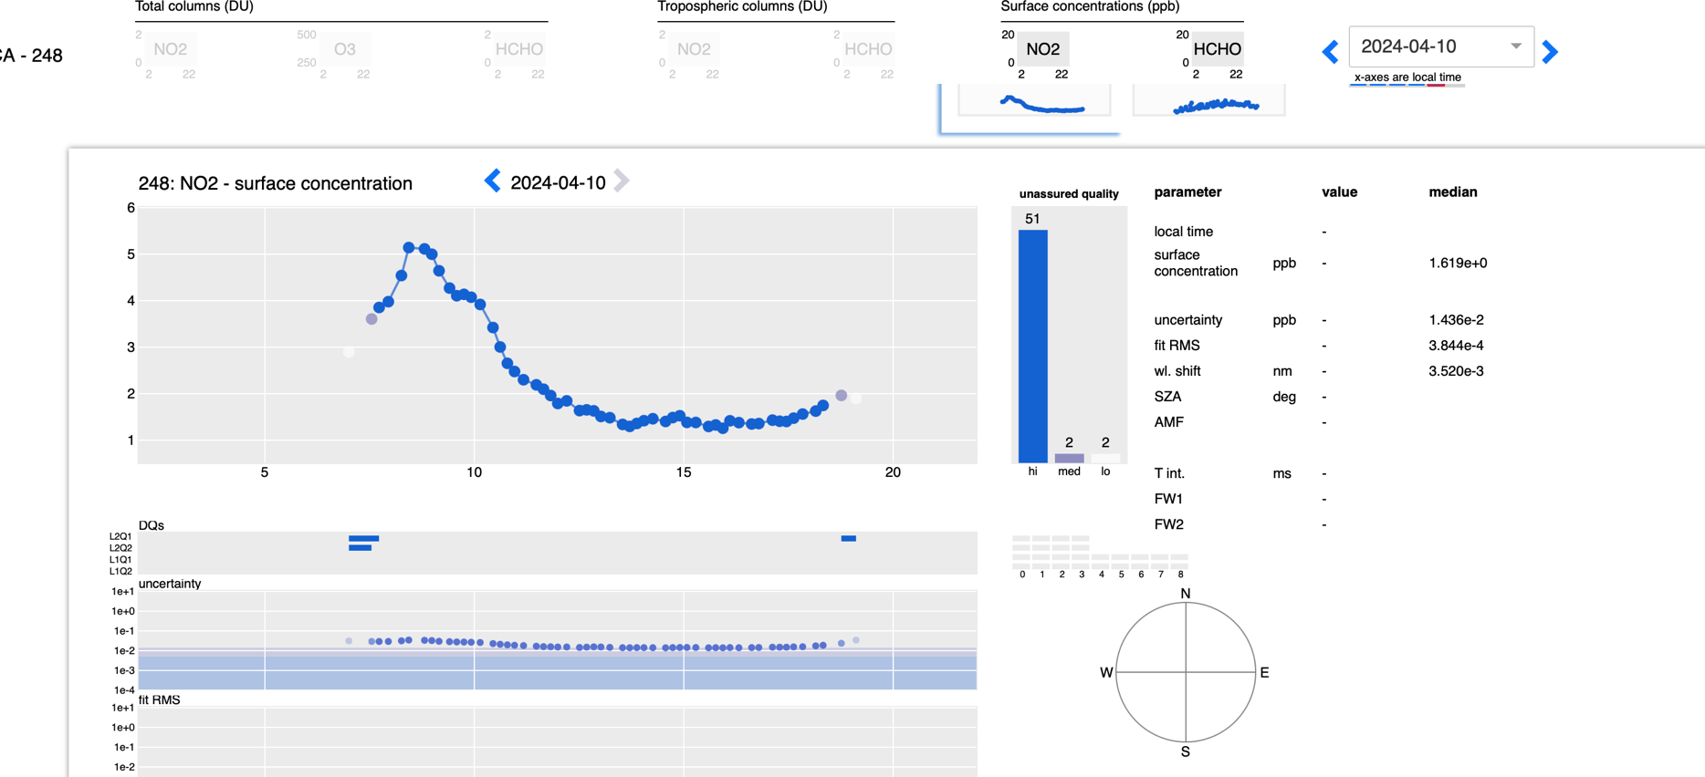
PGN Real Time Data: BlickV http://blickv.pandonia-global-network.org/
Stan State - 248
All products are available for download on BlickV.
Quality assured total column NO₂ and O₃ are archived at the EVDC.
“Out of the Box” MAX-DOAS products provided without a field calibration.
6
6
6

Slide 7
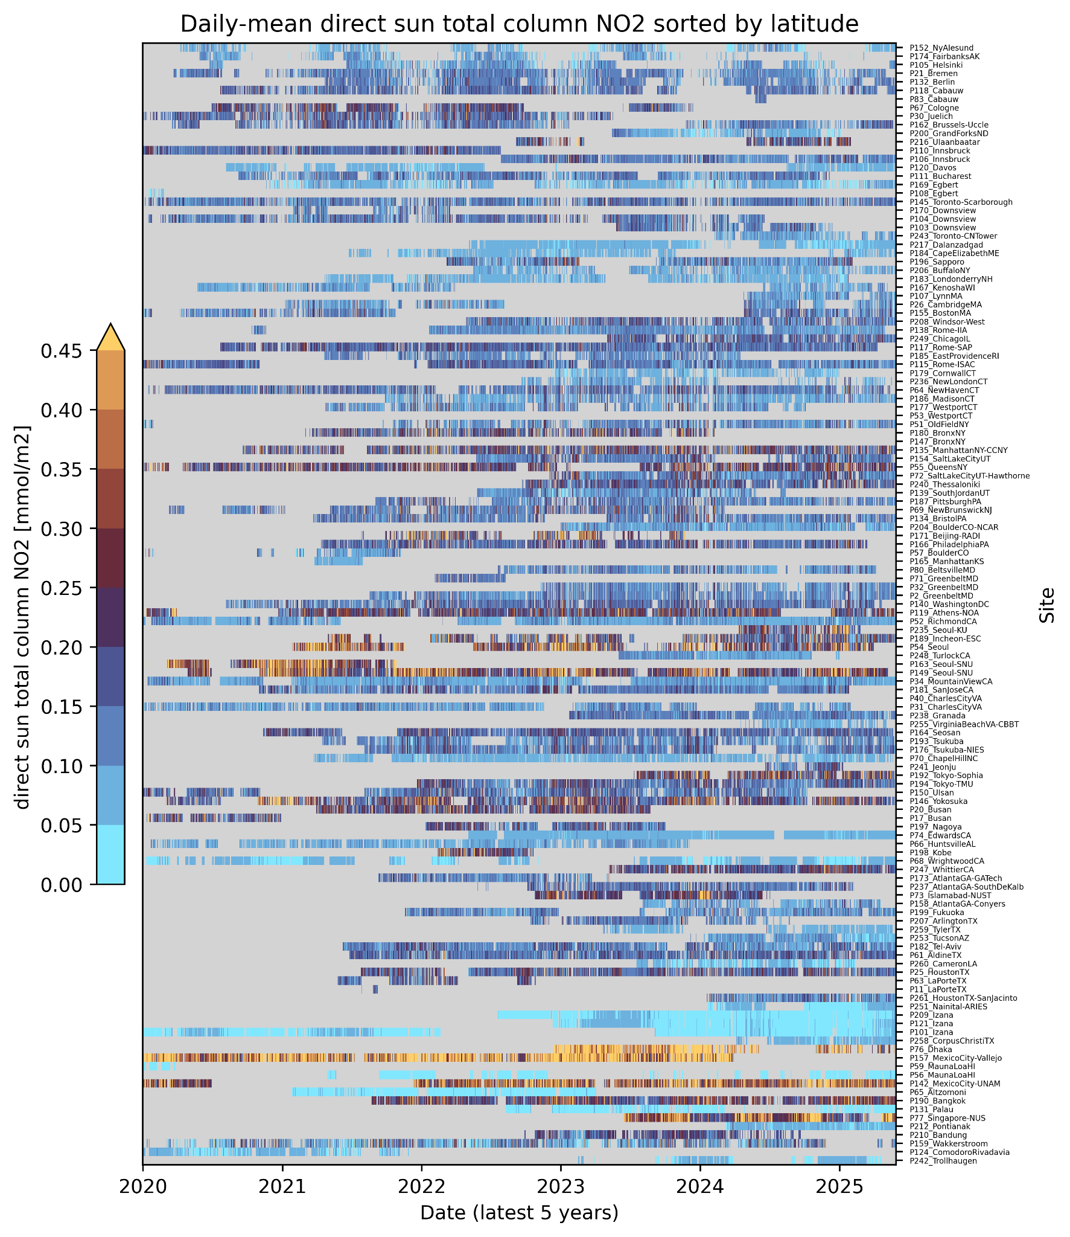
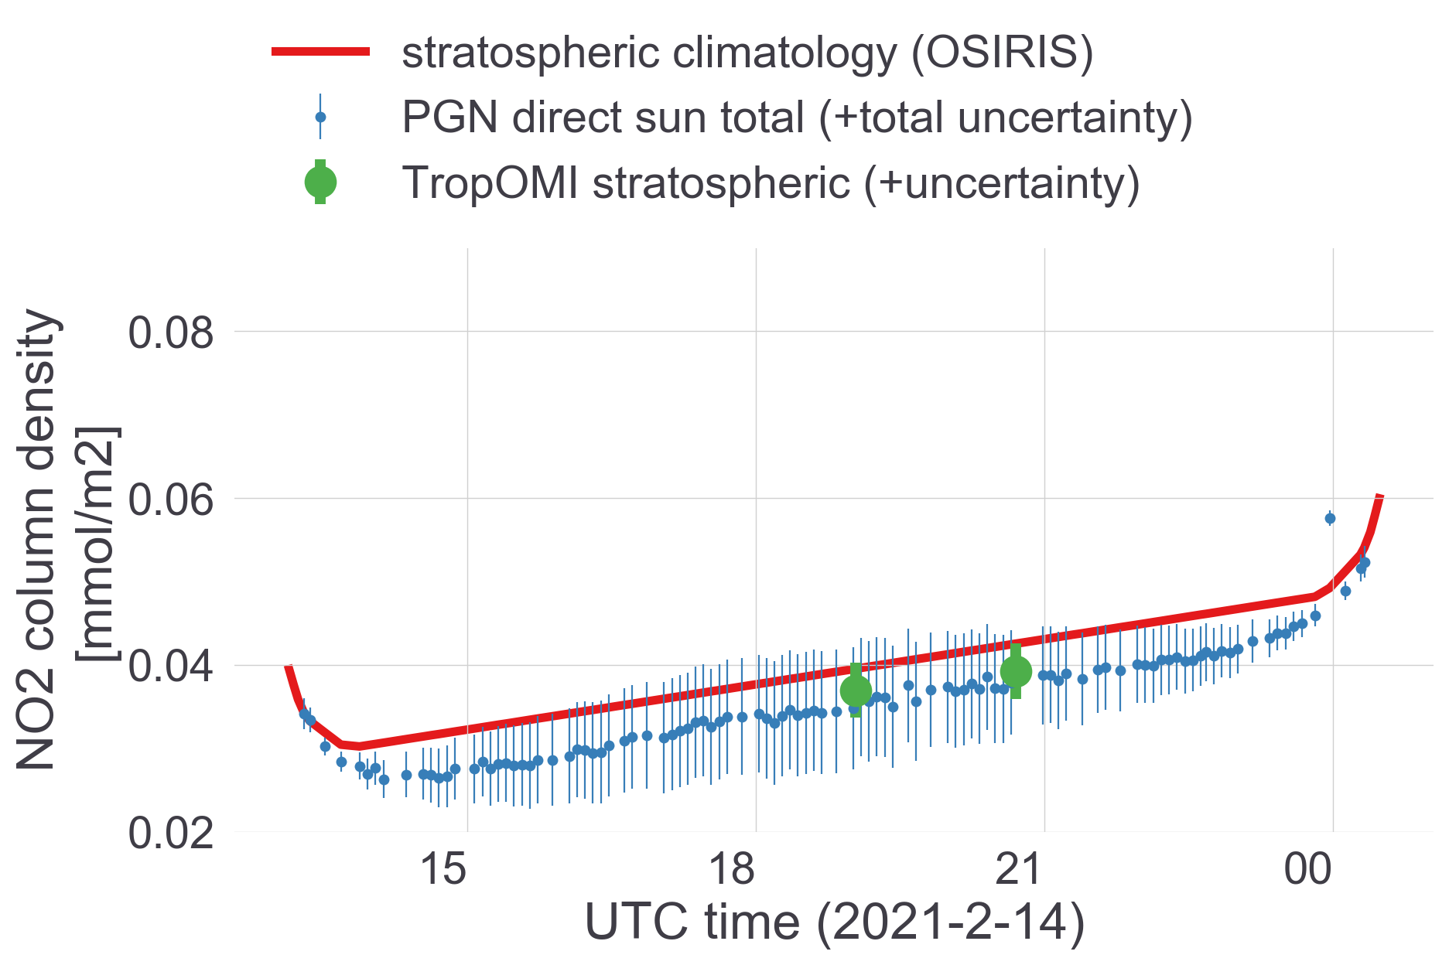
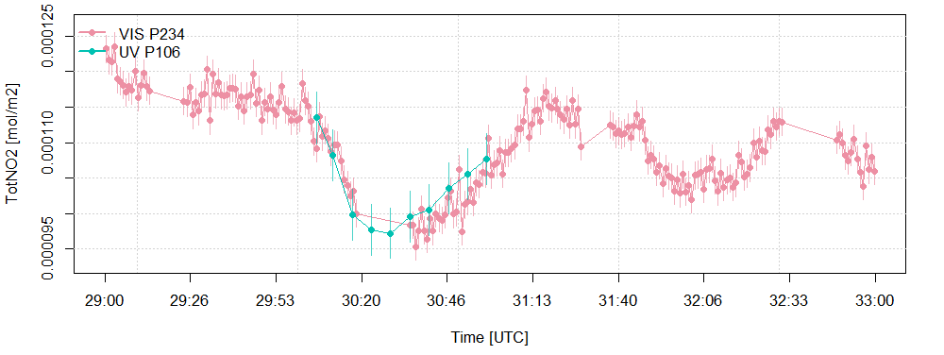
PGN NO₂ total columns (DS) and profiles (MAX)
Extended AMF validity due to effective temperature and height estimation from stratospheric climatology
1 day at Altzomoni (~4000 m.asl), Mexico City
Pandora 65
PI: Michel Grutter
High precision allows high frequency measurements to reveal small scale variability
4 minutes in Innsbruck, Austria
Pandora 106, 234, PI: Martin Tiefengraber

Slide 8
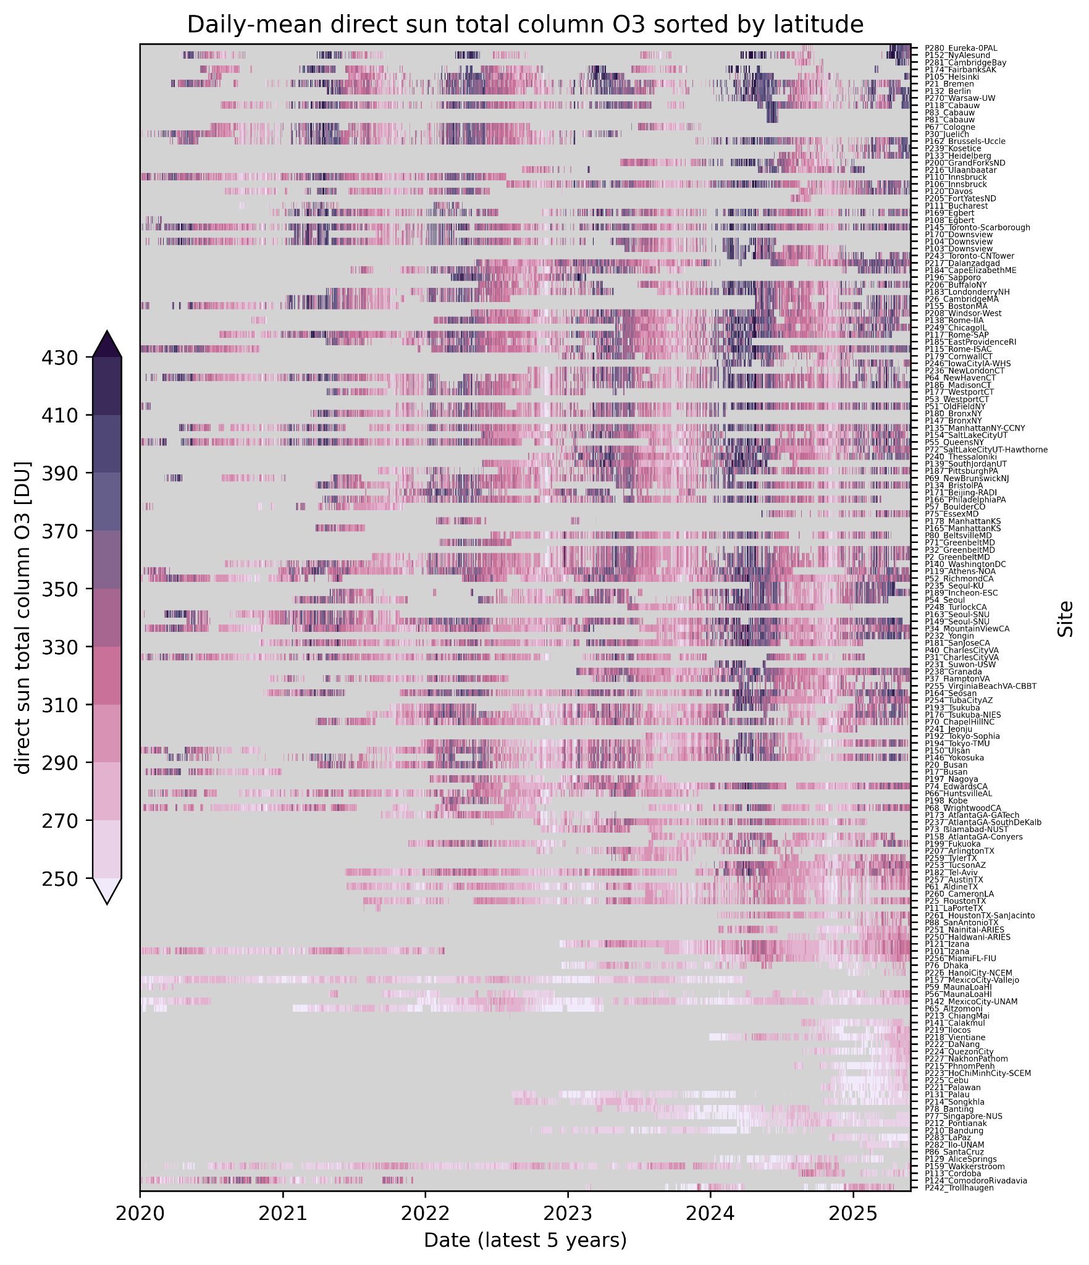
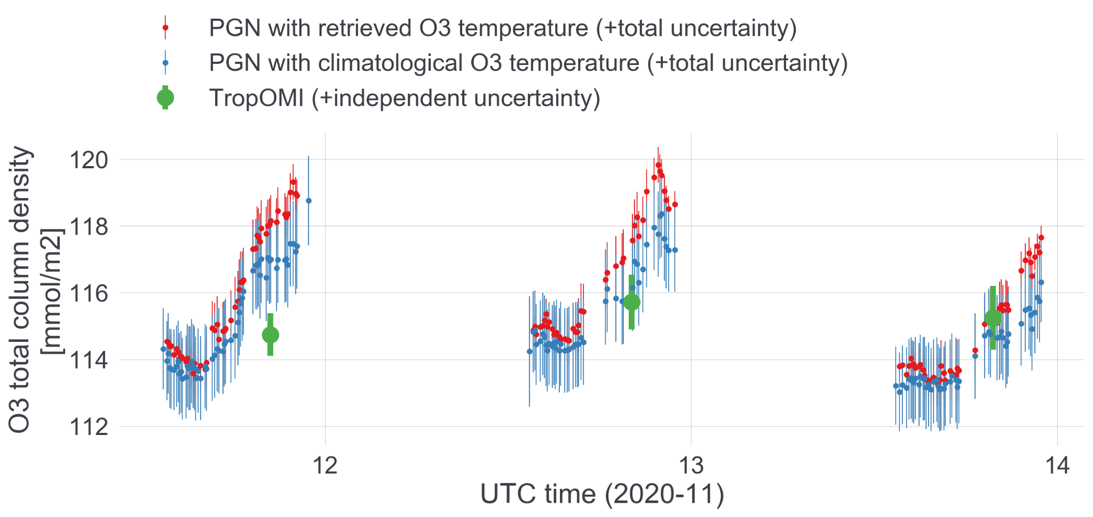
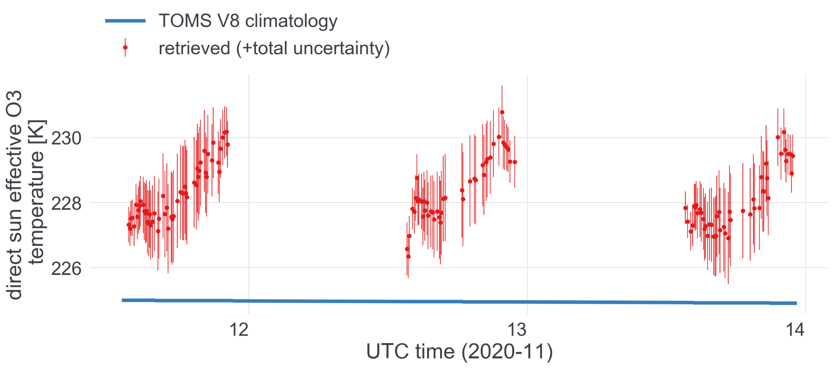
PGN O₃ total column (DS)
Upcoming version retrieves effective O₃ temperature instead of using a climatology
Increasing O₃ temperature over the day points to tropospheric O₃ accumulation
O₃ column
(clim. O3 temp.)
(retr. O3.temp.)
Pandora 142
PI: Michel Grutter
O₃ temperature

Slide 9
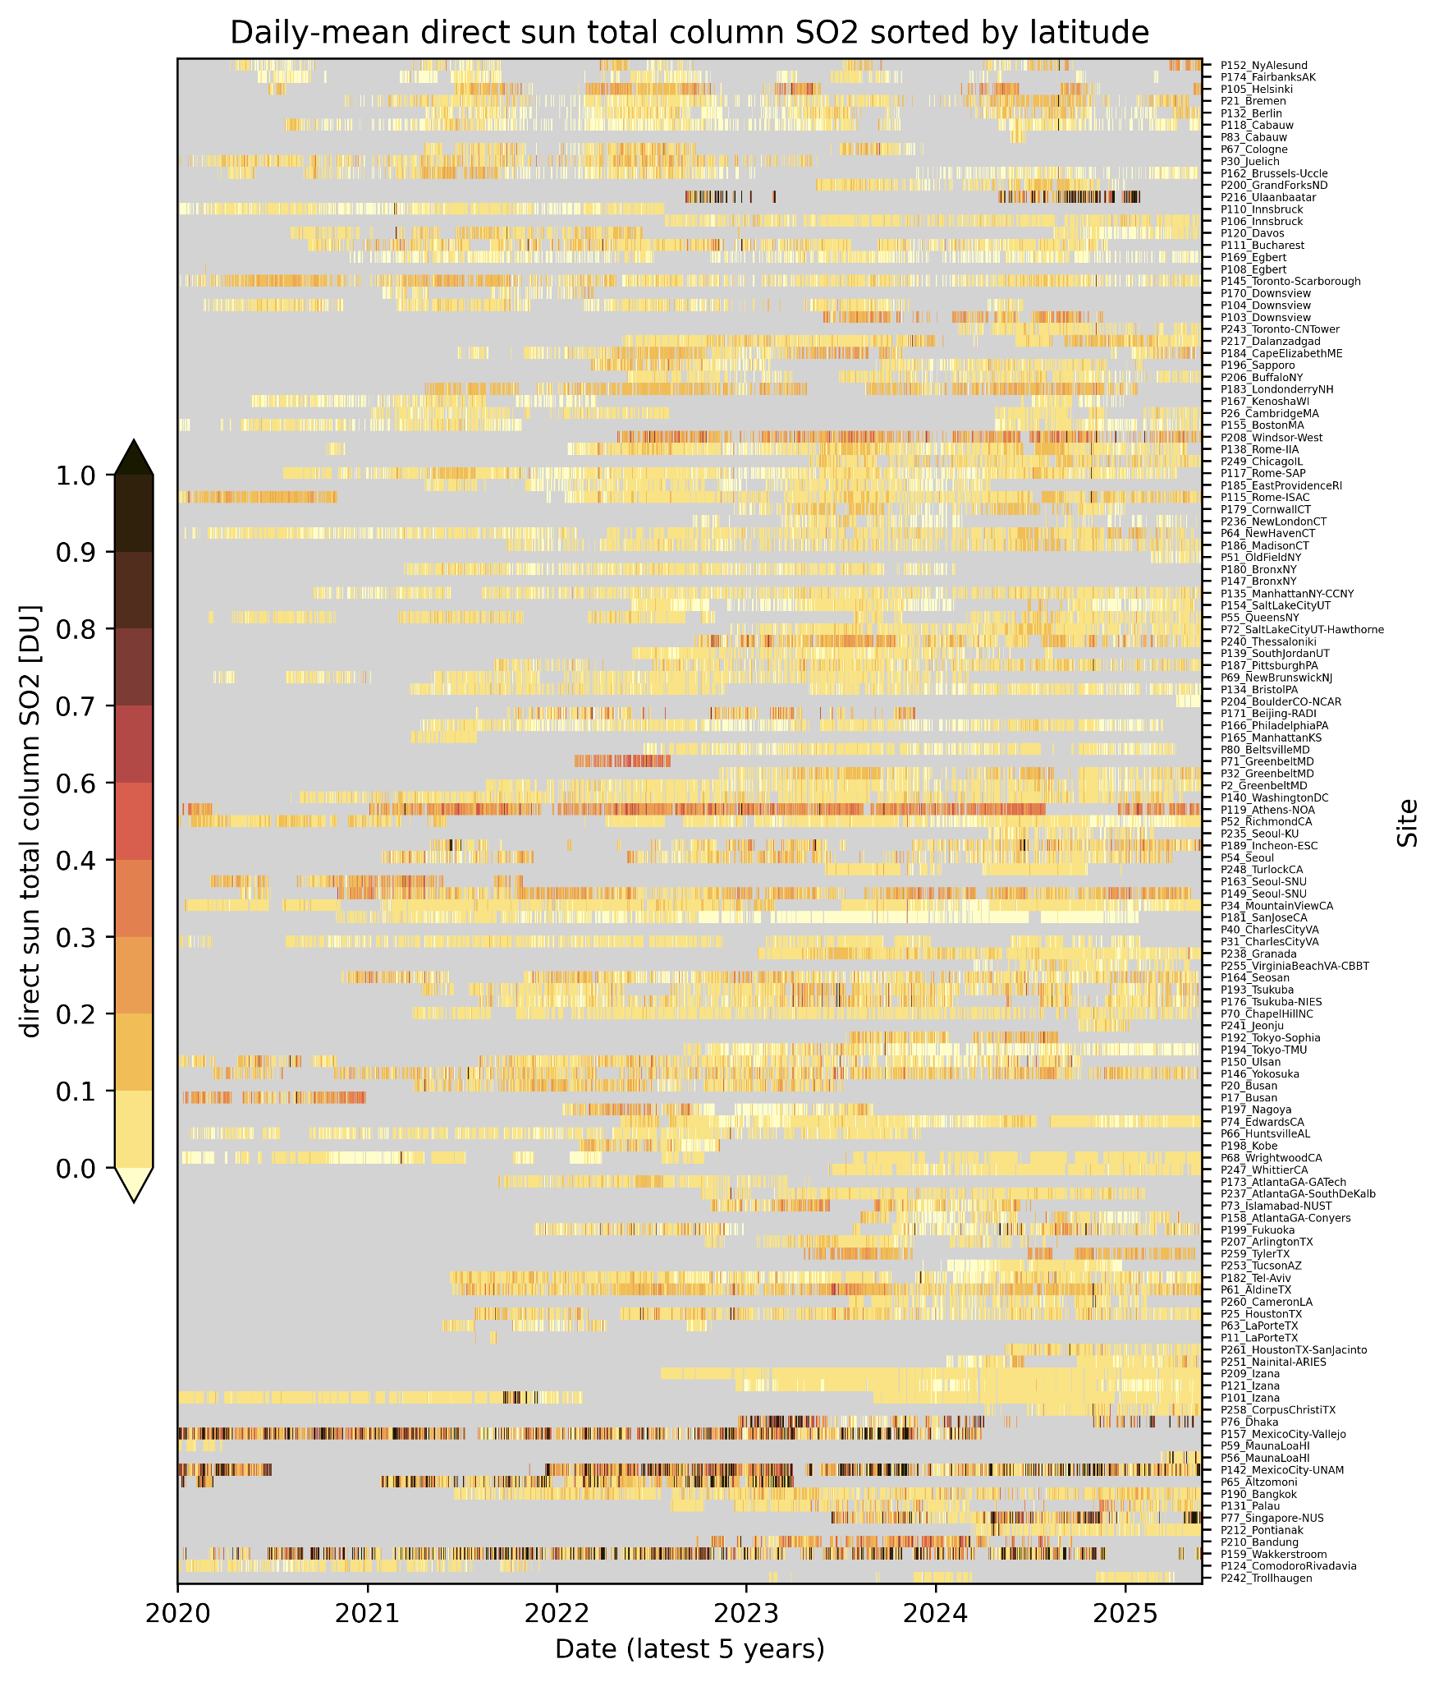
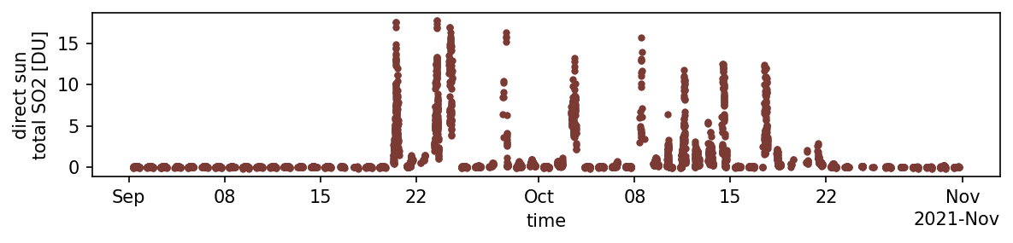
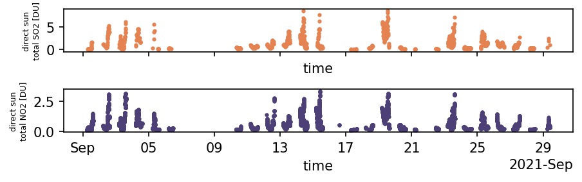
PGN SO₂ total column (DS)
High precision data allows to monitor
background signals and volcanic emissions
Pandora 101 PI: Alberto Redondas
Cumbre Vieja eruption as seen at Izana, Tenerife
Correlation with NO2 suggests anthropogenic SO2
Coal power plant emissions in Wakkerstroom, South Africa
SO₂
Pandora 159, PI: Refilwe Kai
NO₂

Slide 10
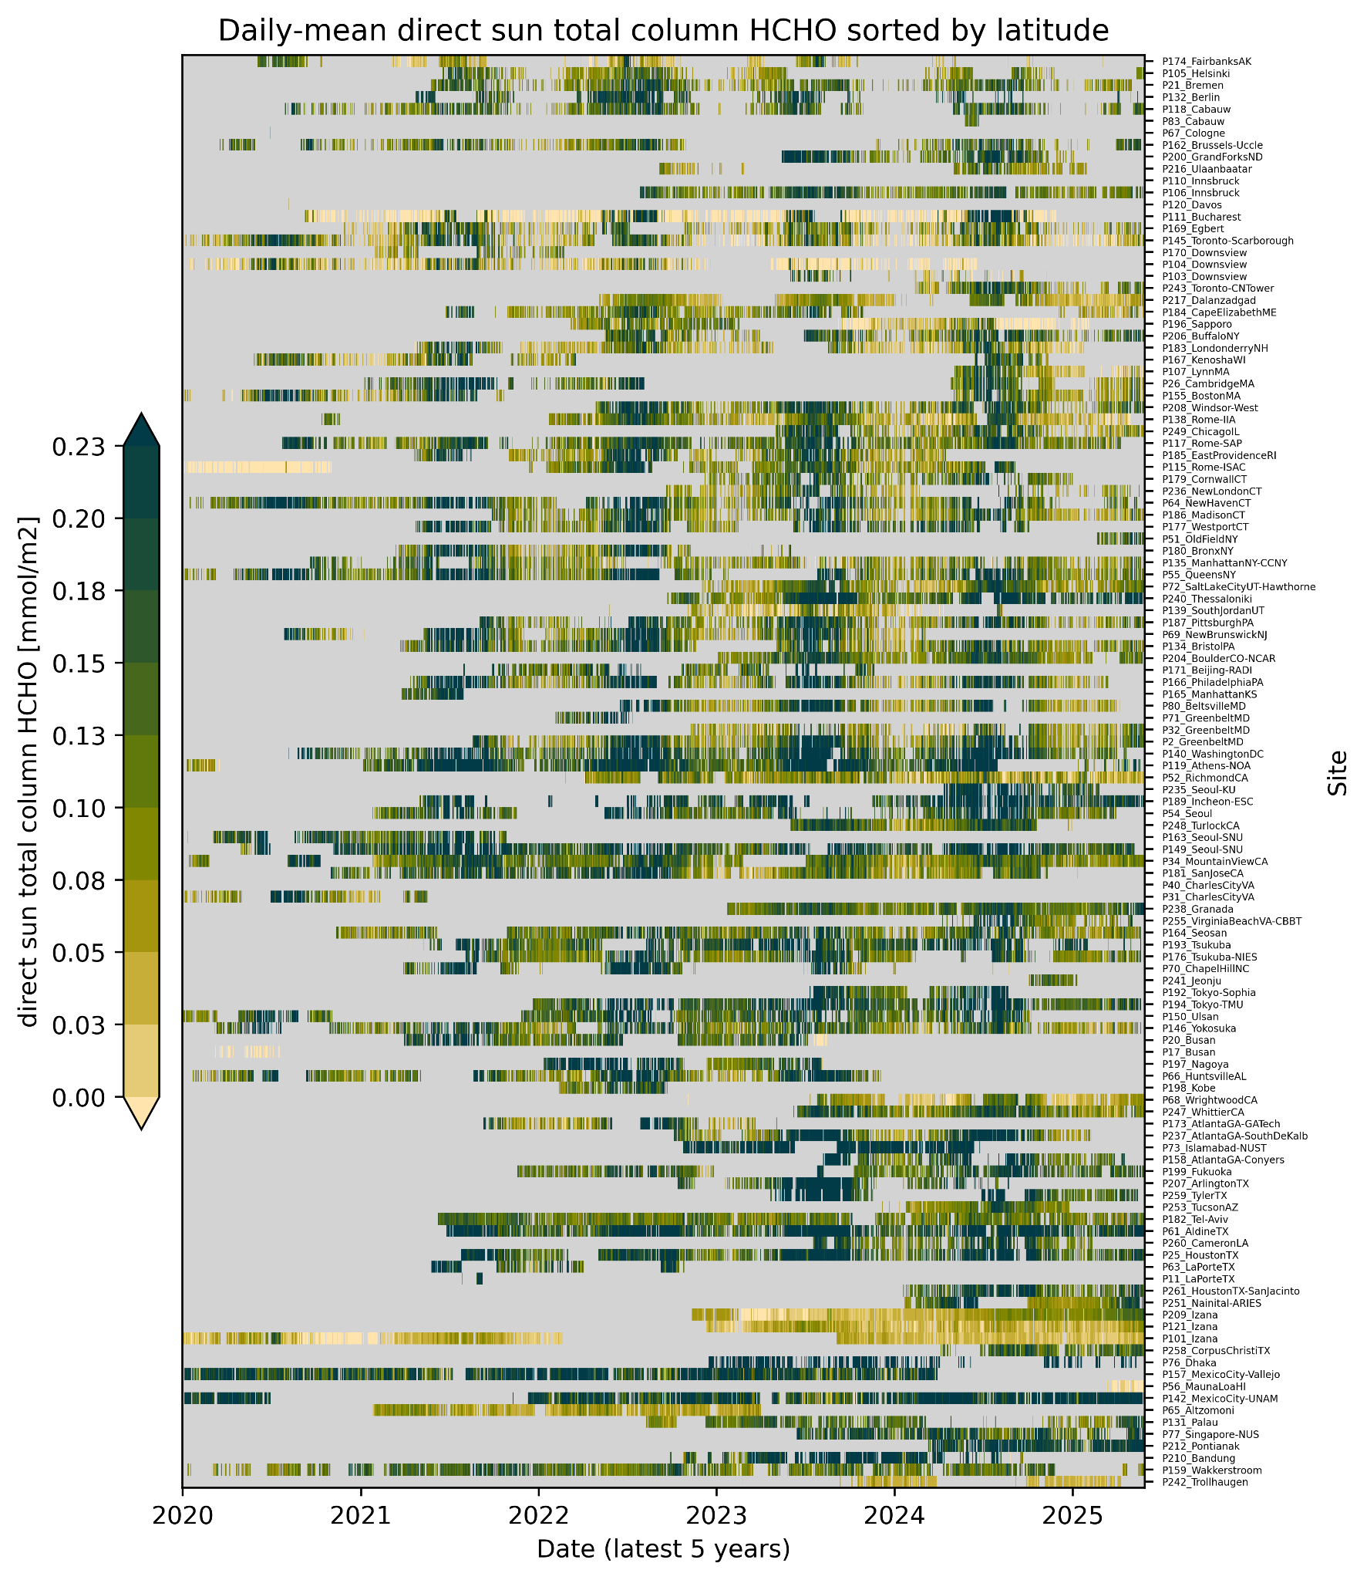
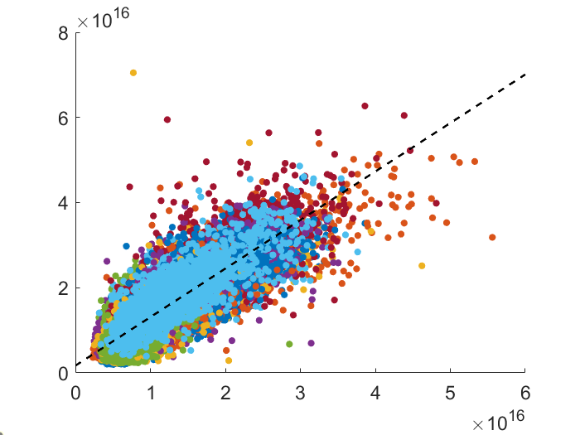
PGN HCHO total columns (DS) and profiles (MAX)
PGN still underrepresented in biomass-burning areas.
A portion of the free tropospheric column is potentially not seen by MAX-DOAS
DS HCHO column [molec/cm2]
Slope=1.14
Intercept=1.7e15
R²=0.79
MAX-DOAS HCHO column [molec/cm2]
Apoorva Pandey, NASA

Slide 11
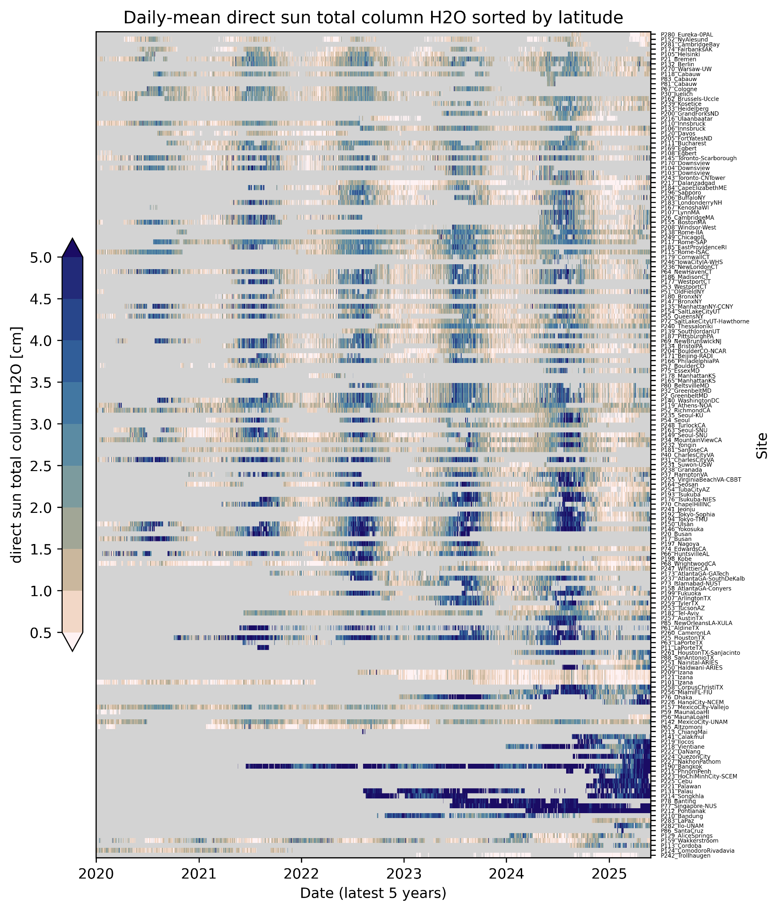
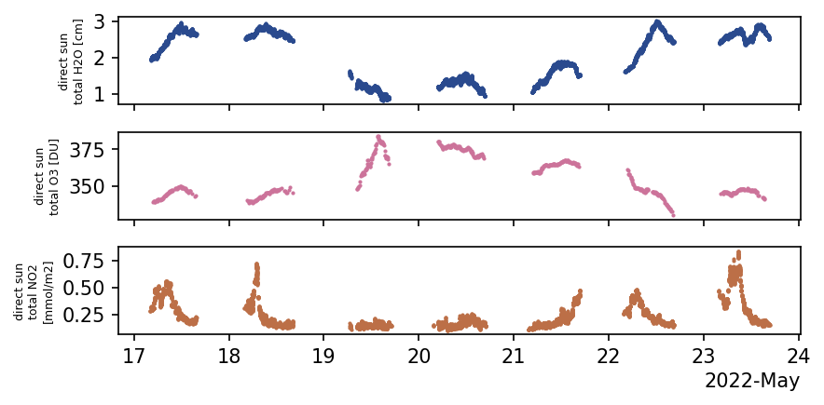
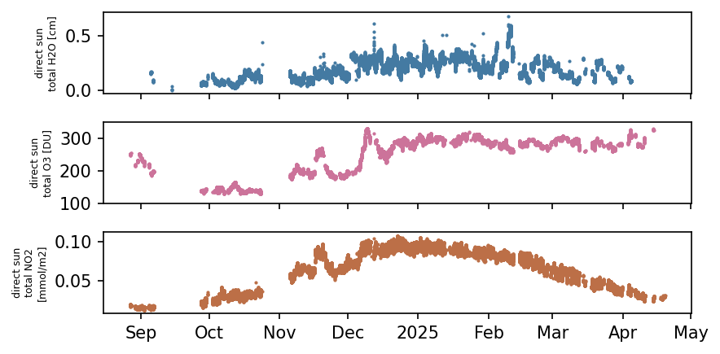
PGN H₂O total columns (DS) and profiles (MAX)
H₂O - a dynamic tracer
Dry air advection with O₃ increase and NO₂ decrease in Athens, Greece
H₂O
O₃
NO₂
Pandora 119, PI: Stelios Kazadzis
Extreme dryness at Antarctica (Troll station)
Pandora 242, PI: Ann Mari Fjaeraa
H₂O
O₃
(hole)
NO₂
vortex intrusion of NO₂ rich air?

Slide 12





Expansion programs
EPA 25+ instruments
United Nations UNESCAP/KOICA/NIER: 23 instruments in southeast ASIA.
    Completed all installations in 2024
NASA IPMSI – 13 instruments
  Completed in 2024
NASA Satellite needs Working Group (SNWG)
  10 US department of Agriculture rural sites – 4/10 installed
  20 US State Department embassy locations 2/20 installed
    10 selected and in progress
    10 additional in 2026-2027
Guatemala City, Guatemala | Kigali, Rwanda
Beijing, China | Willemstad, Curacao
Cairo, Egypt | Ashgabat, Turkmenistan
Skopje, Macedonia | Addis Ababa, Ethiopia
Antananarivo, Madagascar | Nairobi, Kenya
Notes:
Shobha Kondragunta at NOAA Bojan Bokov at Eumetsat

Slide 13
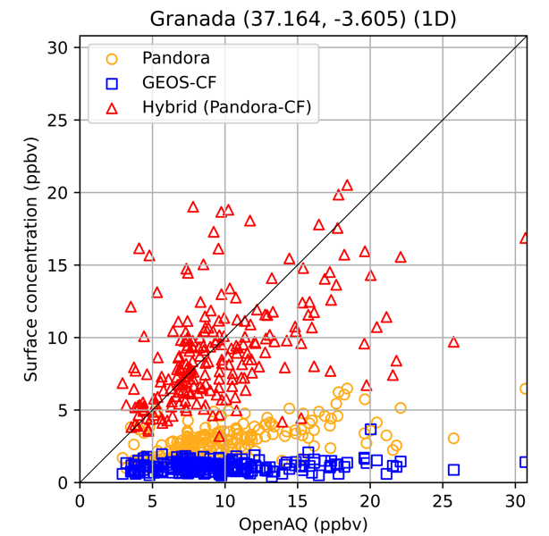
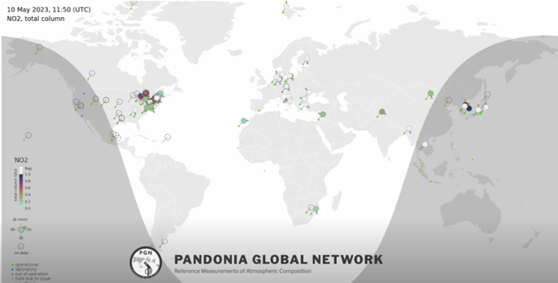
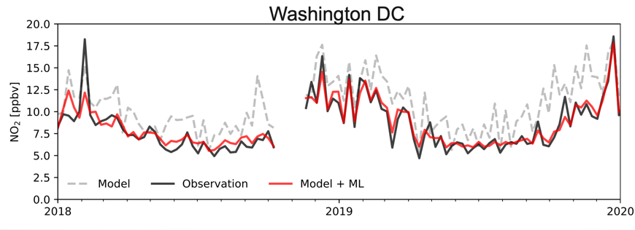
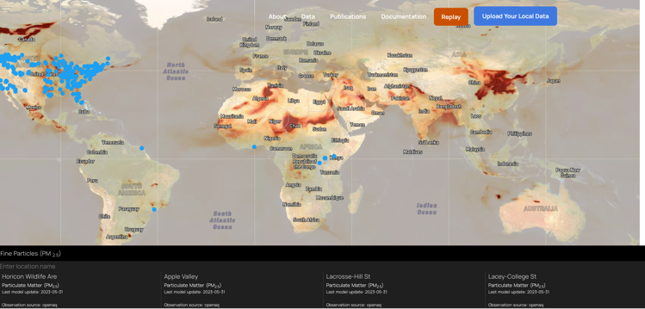
SNWG: Produce localized NO₂ forecasts by combining PANDORA observations with GEOS model output
Pandora observations
PGN +
GEOS_CF trop columns -> Surface concentration
GEOS-CF model output + machine learning
Adapt ML method developed for surface observations (Christoph Keller et al., ACP 2021)
Method is limited to locations with at least 1 year of historical data
PI Emma Knowland, NASA HQ

Slide 14
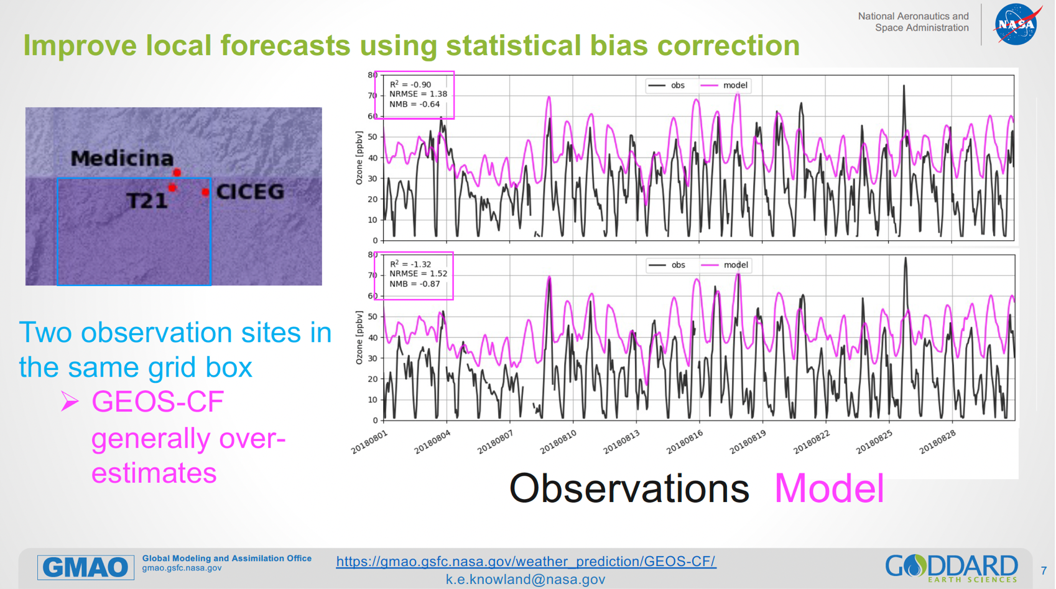
“Standard” Model Forecasting of Surface Ozone
Emma Knowland and Carl Malings

Slide 15
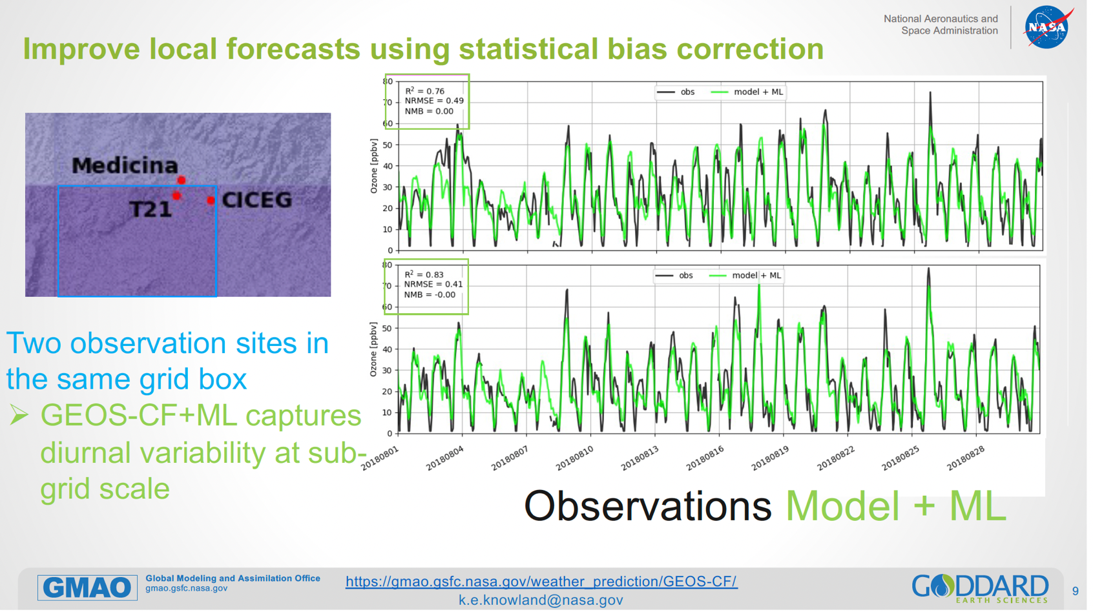
Measurement-ML Model Forecasting of Surface Ozone

Slide 16
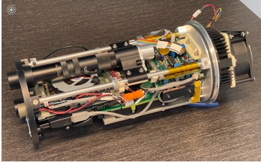
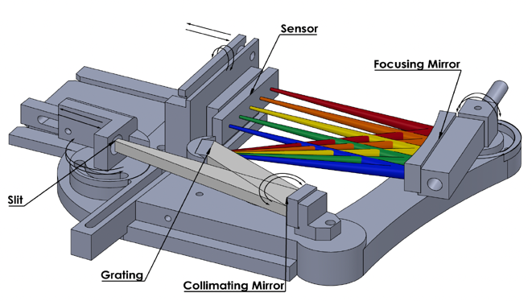
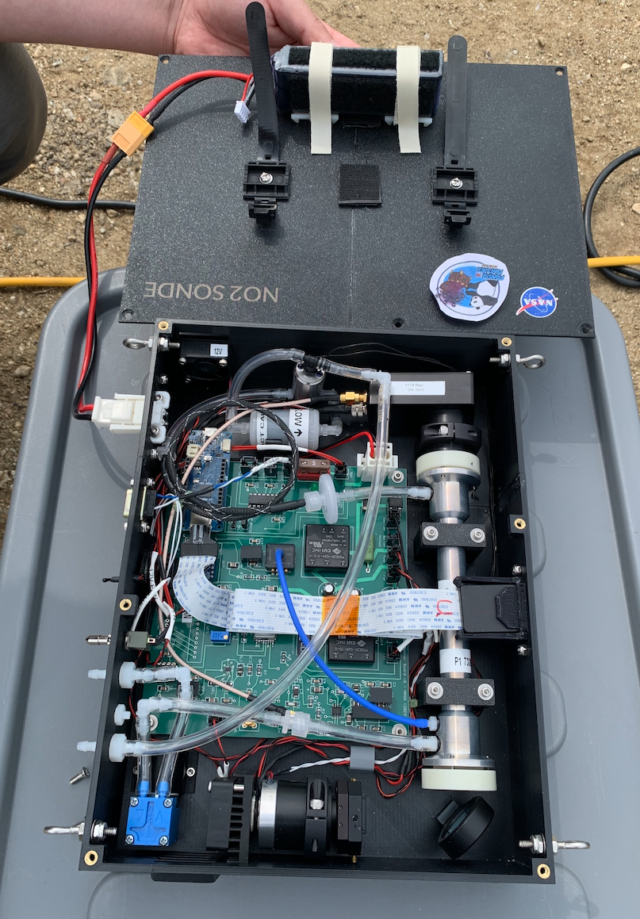
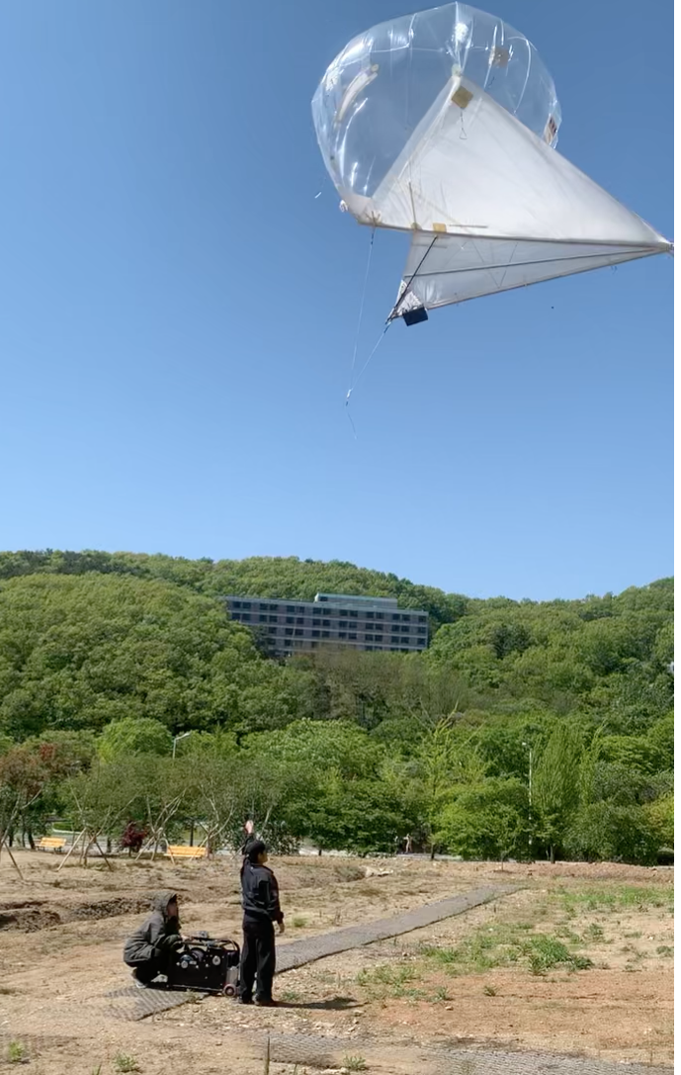

Next steps
Technology development
  Low stray-light spectrometer
Validation studies
  CINDI-3 ground-based
  SARP airborne in situ
  Balloon and drone in situ
New retrievals
  V1.9 with stratospheric temperature
SNWG-2026
  Forest fire locations (up to 20)
Notes:
Shobha Kondragunta at NOAA Bojan Bokov at Eumetsat

