Slide 1

June 11, 2025
Global Analysis of Nitrogen Dioxide and Formaldehyde
Column Densities from the Pandora Global Network (PGN)
: Variability and Implications for Satellite Validation
Sang-Woo Kim, Jong-Uk Park, Soo-Bin Lim, Thomas F. Hanisco, Nader Abuhassan,
Bryan K. Place, Apoorva Pandey, Alexander Cede, Martin Tiefengraber,
Manuel Gebetsberger, James H. Crawford, Chang-Keun Song, Limseok Chang
School of Earth and Environmental Sciences, Seoul National University
sangwookim@snu.ac.kr
Thanks all Pandora PIs and local operators @ 93 sites

Slide 2
June 11, 2025
Global Analysis of Nitrogen Dioxide and Formaldehyde
Column Densities from the Pandora Global Network (PGN)
: Variability and Implications for Satellite Validation
Outline:
Investigate seasonal and diurnal variabilities of NO₂ and HCHO VCDs across various environments from 2019 to 2023
Discuss the relative abundance between NO₂ and HCHO, as two key proxies for tropospheric O₃ pollution
Evaluate corresponding observations from the TROPOspheric Monitoring Instrument (TROPOMI)

Slide 3
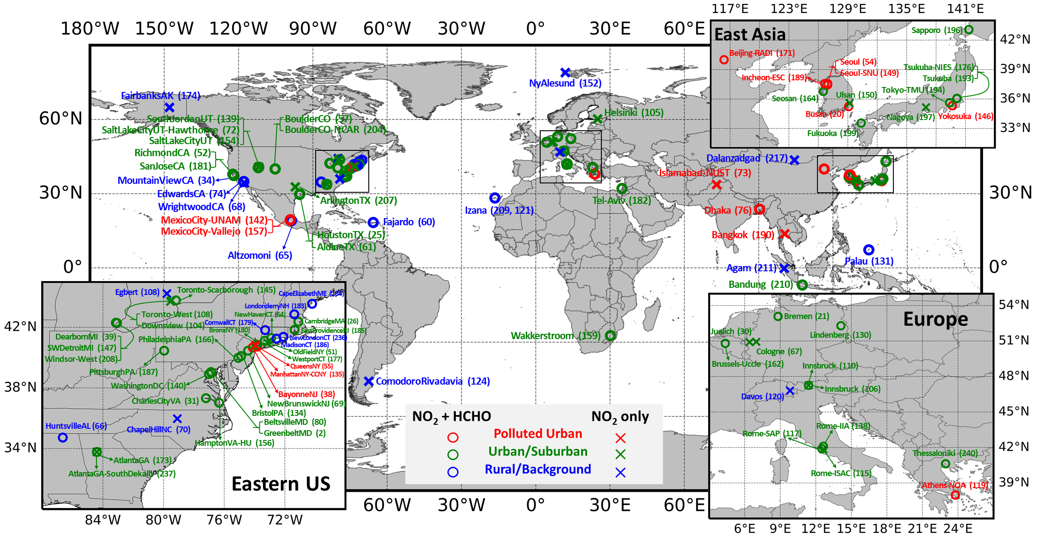
Global Pandora Data @ Pandonia Global Network (PGN)
(NO₂: 93 sites & HCHO: 68 sites, 5-Year: January 2019 - December 2023)
Notes:
93 NO2 stations / 68 HCHO stations
the geographical distribution of 93 Pandora stations worldwide with more than one full year of valid NO₂ VCD observations between January 2019 and December 2023, as analyzed in this study.
The majority of stations are located in North America, followed by stations in Asia and Europe.
Some stations had insufficient data coverage for HCHO VCDs due to various reasons, hence, HCHO VCDs from only 68 stations were analyzed.
Even though the PGN Pandora observations have rapidly grown in recent years, it is worth mentioning that there are still large gaps in Southern Hemispheric continents such as Africa and South America.

Slide 4
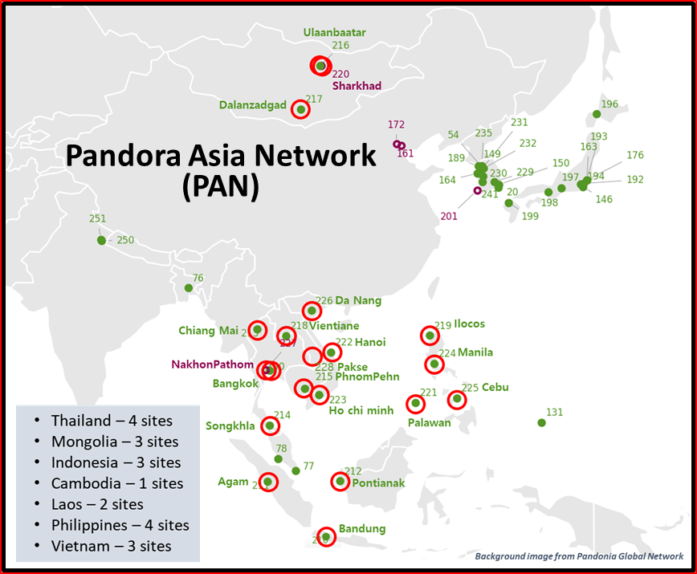
Global Pandora Data @ Pandonia Global Network (PGN)
(NO₂: 93 sites & HCHO: 68 sites, 5-Year: January 2019 - December 2023)
Notes:
93 NO2 stations / 68 HCHO stations

Slide 5
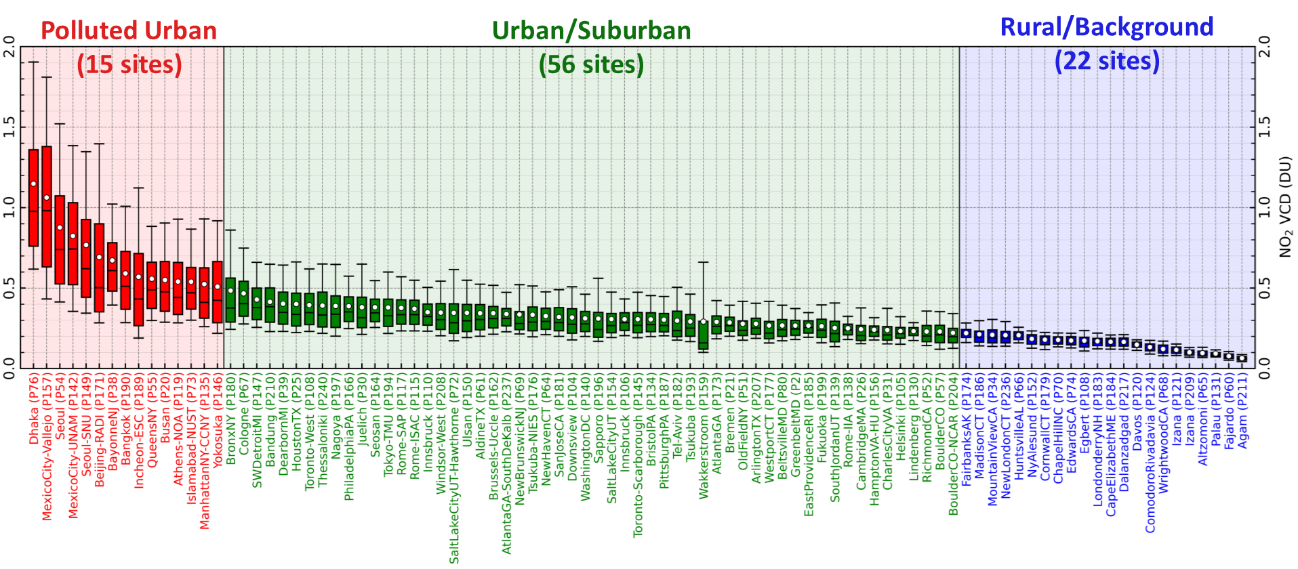
NO₂ Vertical Column Density (VCD) & Classifying Environment
NO₂ VCD from Jan 2019 to Dec 2023, sorted in a descending order of the station-averaged NO₂ VCD.
Classify 3 environmental categories: Polluted Urban, Urban/Suburban, and Rural/Background.
Notes:
shows the annual NO₂ VCD levels at each Pandora station, ranging from Dhaka (P76), which has the highest annual mean NO₂ VCD (1.15 DU), to Agam (P211), with the lowest value (0.06 DU).
These stations are classified into three environmental categories: Polluted Urban, Urban/Suburban, and Rural/Background. Polluted Urban stations are the stations with a mean NO₂ VCD higher than 0.5 DU, whereas Rural/Background stations are the stations with upper 25th percentile NO₂ VCD below 0.25 DU.
Most Polluted Urban stations are located in Asian megacities, such as Dhaka, Seoul, Beijing, and Bangkok, with some exceptions, including Mexico City and New York City.
Most urban stations in Europe and the United States are categorized as Urban/Suburban, whereas those located at high altitudes, in the Arctic, or on remote islands are mostly classified as Rural/Background.

Slide 6
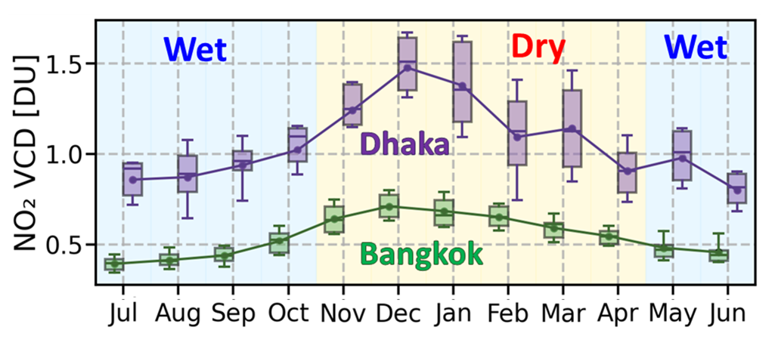
NO₂ Vertical Column Density (VCD) & Classifying Environment
Dhaka (P76), Bangladesh, has the highest annual mean NO₂ VCD (1.15 DU).
The station with the most significant TROPOMI NO₂ VCD underestimation is Dhaka.

Slide 7
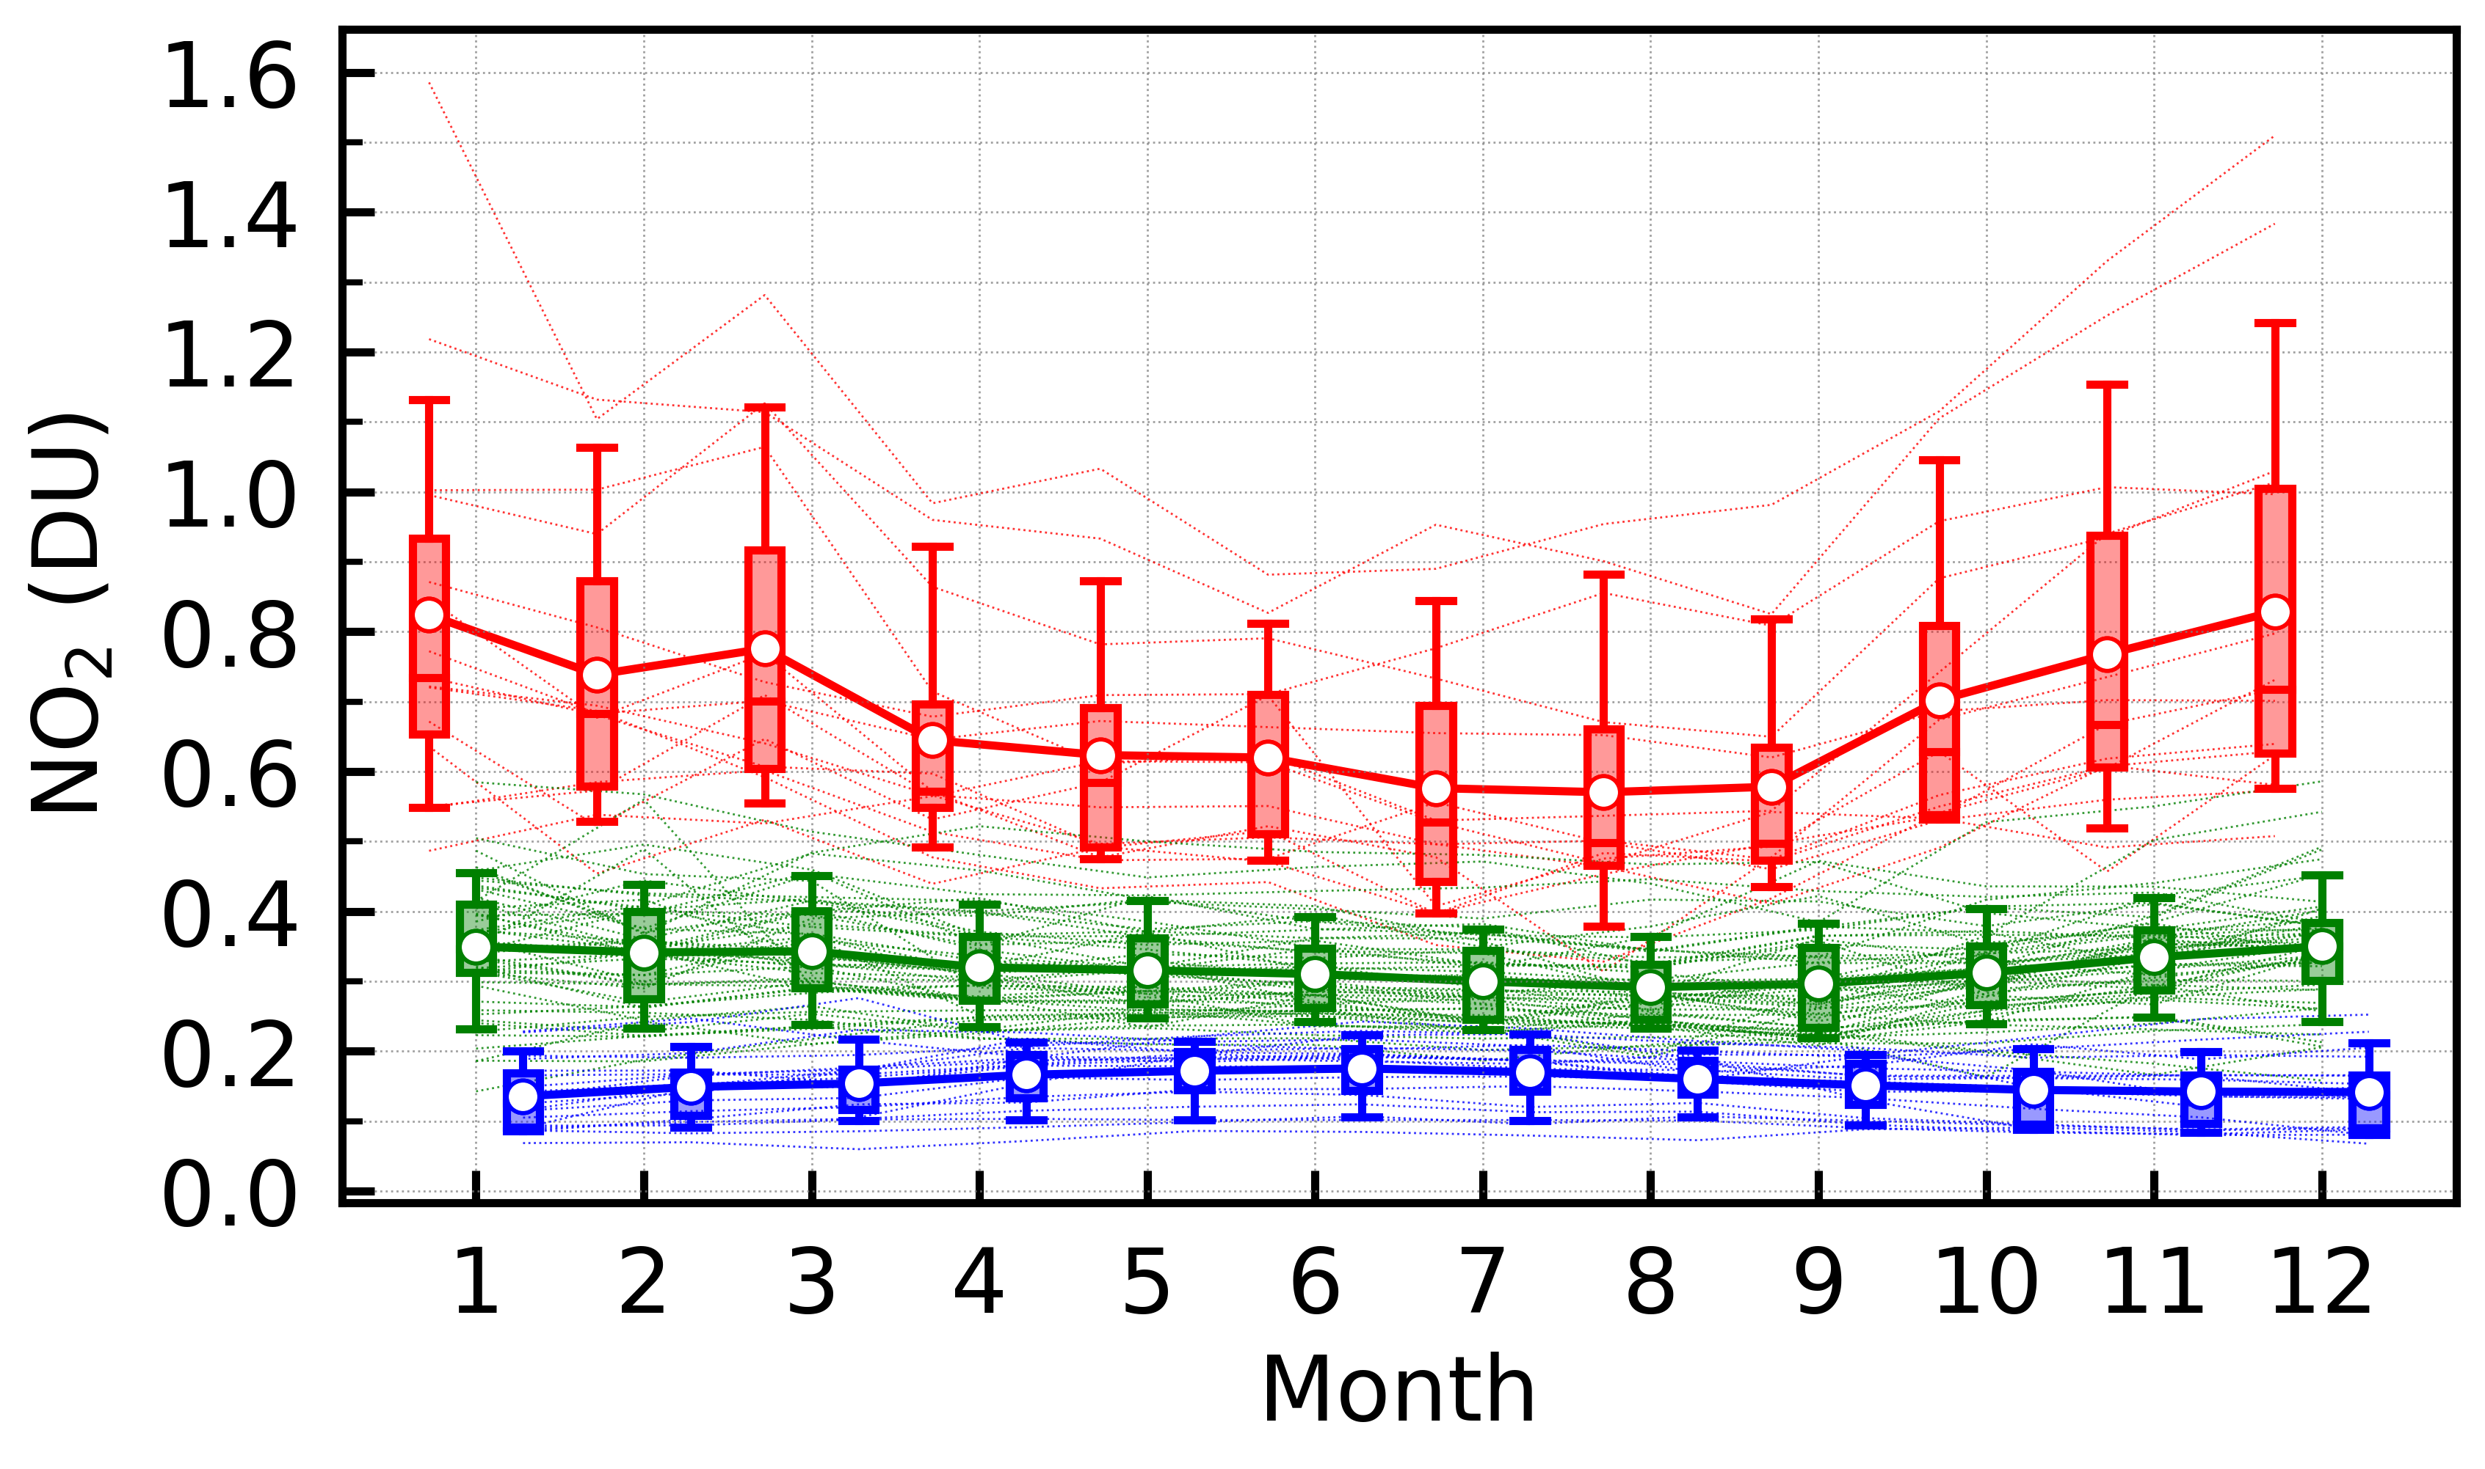
Monthly Variation of NO₂ Vertical Column Density
N.H. only
Polluted Urban (15 sites)
Urban/Suburban (54 sites)
Rural/Background (20 sites)
NO₂ VCDs at Polluted Urban stations generally exhibit winter maxima and summer minima.
Notes:
illustrates the seasonal variation pattern of NO₂ VCDs across different environmental categories.
NO₂ VCDs at Polluted Urban stations generally exhibit winter maxima and summer minima.
the majority of NOx emissions in developed megacities are from the mobile sector, such seasonal variability can be attributed to atmospheric NOx loss processes; station-specific meteorological characteristics.
However, photochemical losses, driven by the formation of nitric acid (HNO₃) and peroxy nitrates (e.g., PAN), universally increase during the summer months with higher temperature and insolation, leading to a decrease in NO₂ concentrations in the troposphere.
NO₂ VCD is higher in summer and lower in winter at Rural/Background stations due to the variability in stratospheric NO₂, exhibiting higher concentrations in the summer.

Slide 8
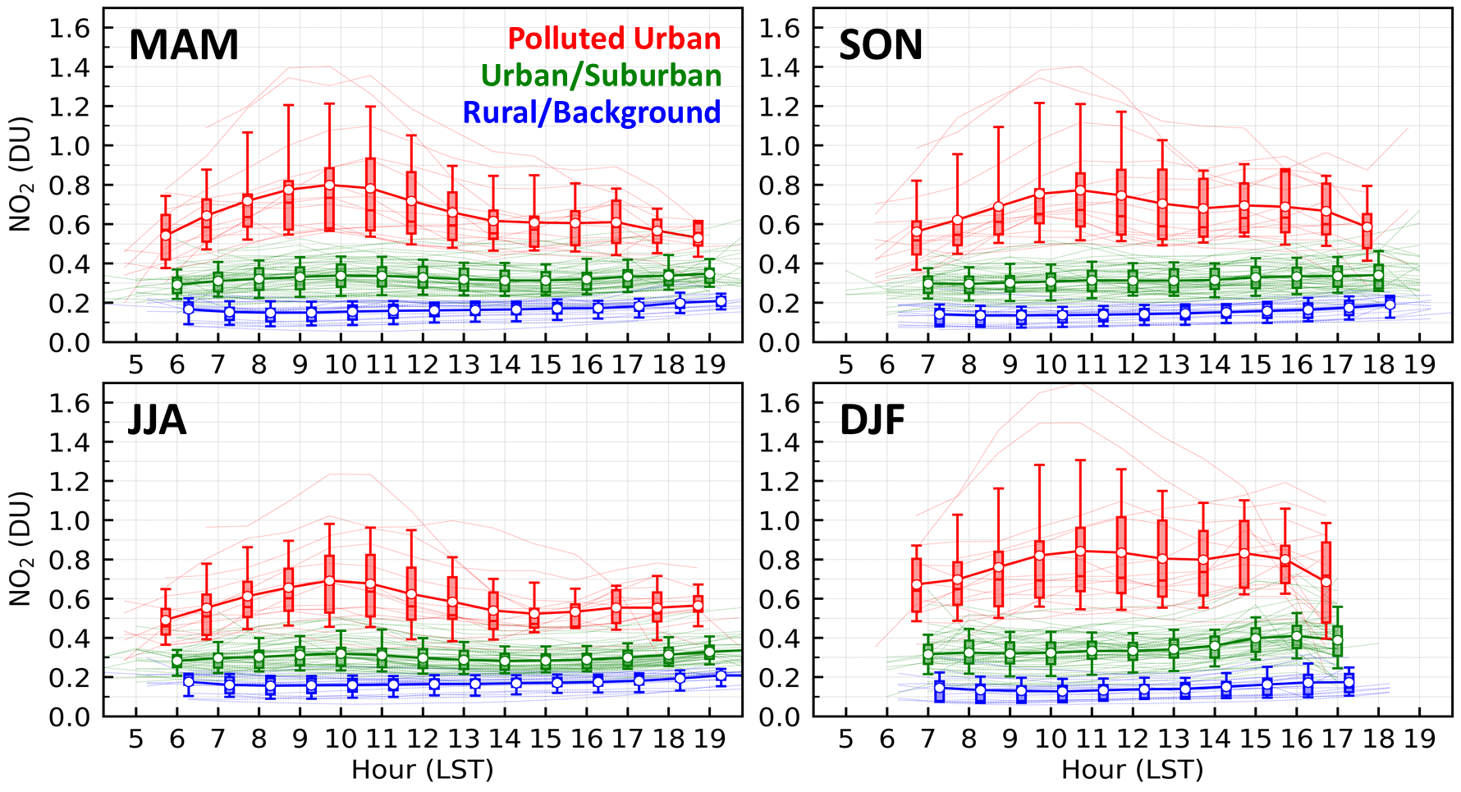
Diurnal Variation of NO₂ Vertical Column Density
N.H. only
Polluted Urban stations generally exhibit pronounced diurnal variations with larger amplitudes and show a clear seasonal dependency in their diurnal variation patterns.
Notes:
shows the diurnal variation patterns of NO₂ VCD across different environmental categories and seasons.
Polluted Urban stations generally exhibit pronounced diurnal variations with larger amplitudes and show a clear seasonal dependency in their diurnal variation patterns.
During the summer months, NO₂ VCD increases in the morning as daytime NOx emissions are generally higher than nighttime in urban areas, peaking around 10–11 Local Standard Time (LST).
Greater insolation near noon enhances the NOx loss rate to nitrogen reservoirs (e.g., primarily HNO₃ and peroxy nitrates), subsequently lowering NO₂ VCD until it reaches an afternoon minimum of around 15 LST.

Slide 9

Diurnal Variation of NO₂ Vertical Column Density
Column
Surface
Seoul
Polluted Urban
[Crawford et al., 2021]
Diurnal variation of NO₂ VCD can largely differ from that of surface concentrations. As additional factors, such as the boundary Layer height, can significantly influence the ground-level mixing ratios.

Slide 10
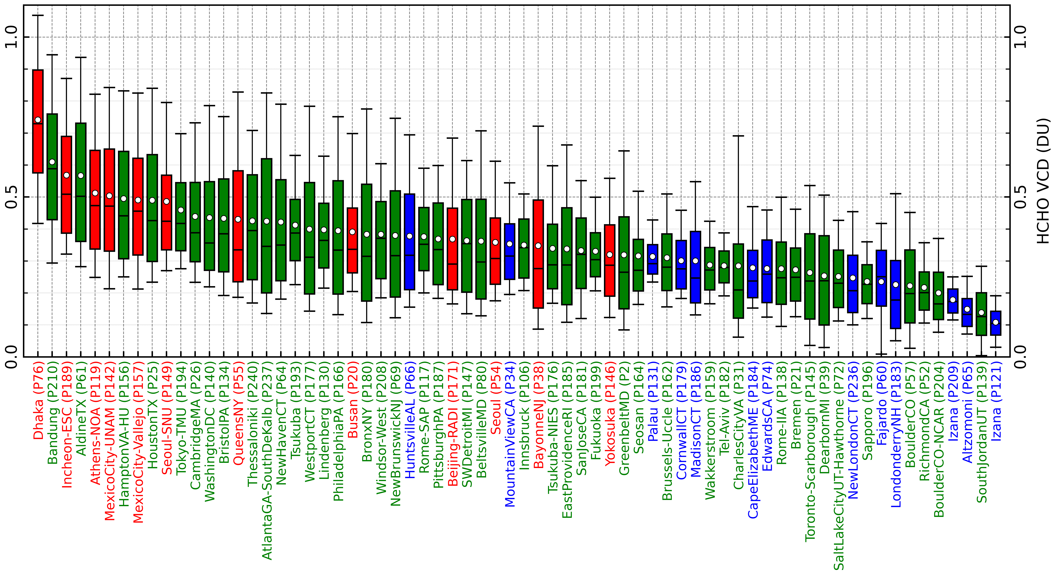
HCHO Vertical Column Density
Polluted Urban (12 sites)
Urban/Suburban (41 sites)
Rural/Background (13 sites)
**Note**
Urban/Suburban stations with substantial biogenic precursor emissions often show higher HCHO concentrations.
Notes:
stations sorted in descending order of average hourly HCHO VCD.
HCHO concentrations in the atmosphere can be substantially influenced by both anthropogenic (e.g., mobile, oil and gas industries, residential heating) and natural (e.g., biogenic, wildfires) emissions of its precursors (i.e., reactive organic carbons or VOCs).
Urban/Suburban stations with substantial biogenic precursor emissions often show higher HCHO concentrations.
Station latitude significantly influences HCHO concentrations, as both biogenic VOC emissions and photochemical HCHO formation rates increase at lower latitudes due to higher insolation and temperatures.

Slide 11
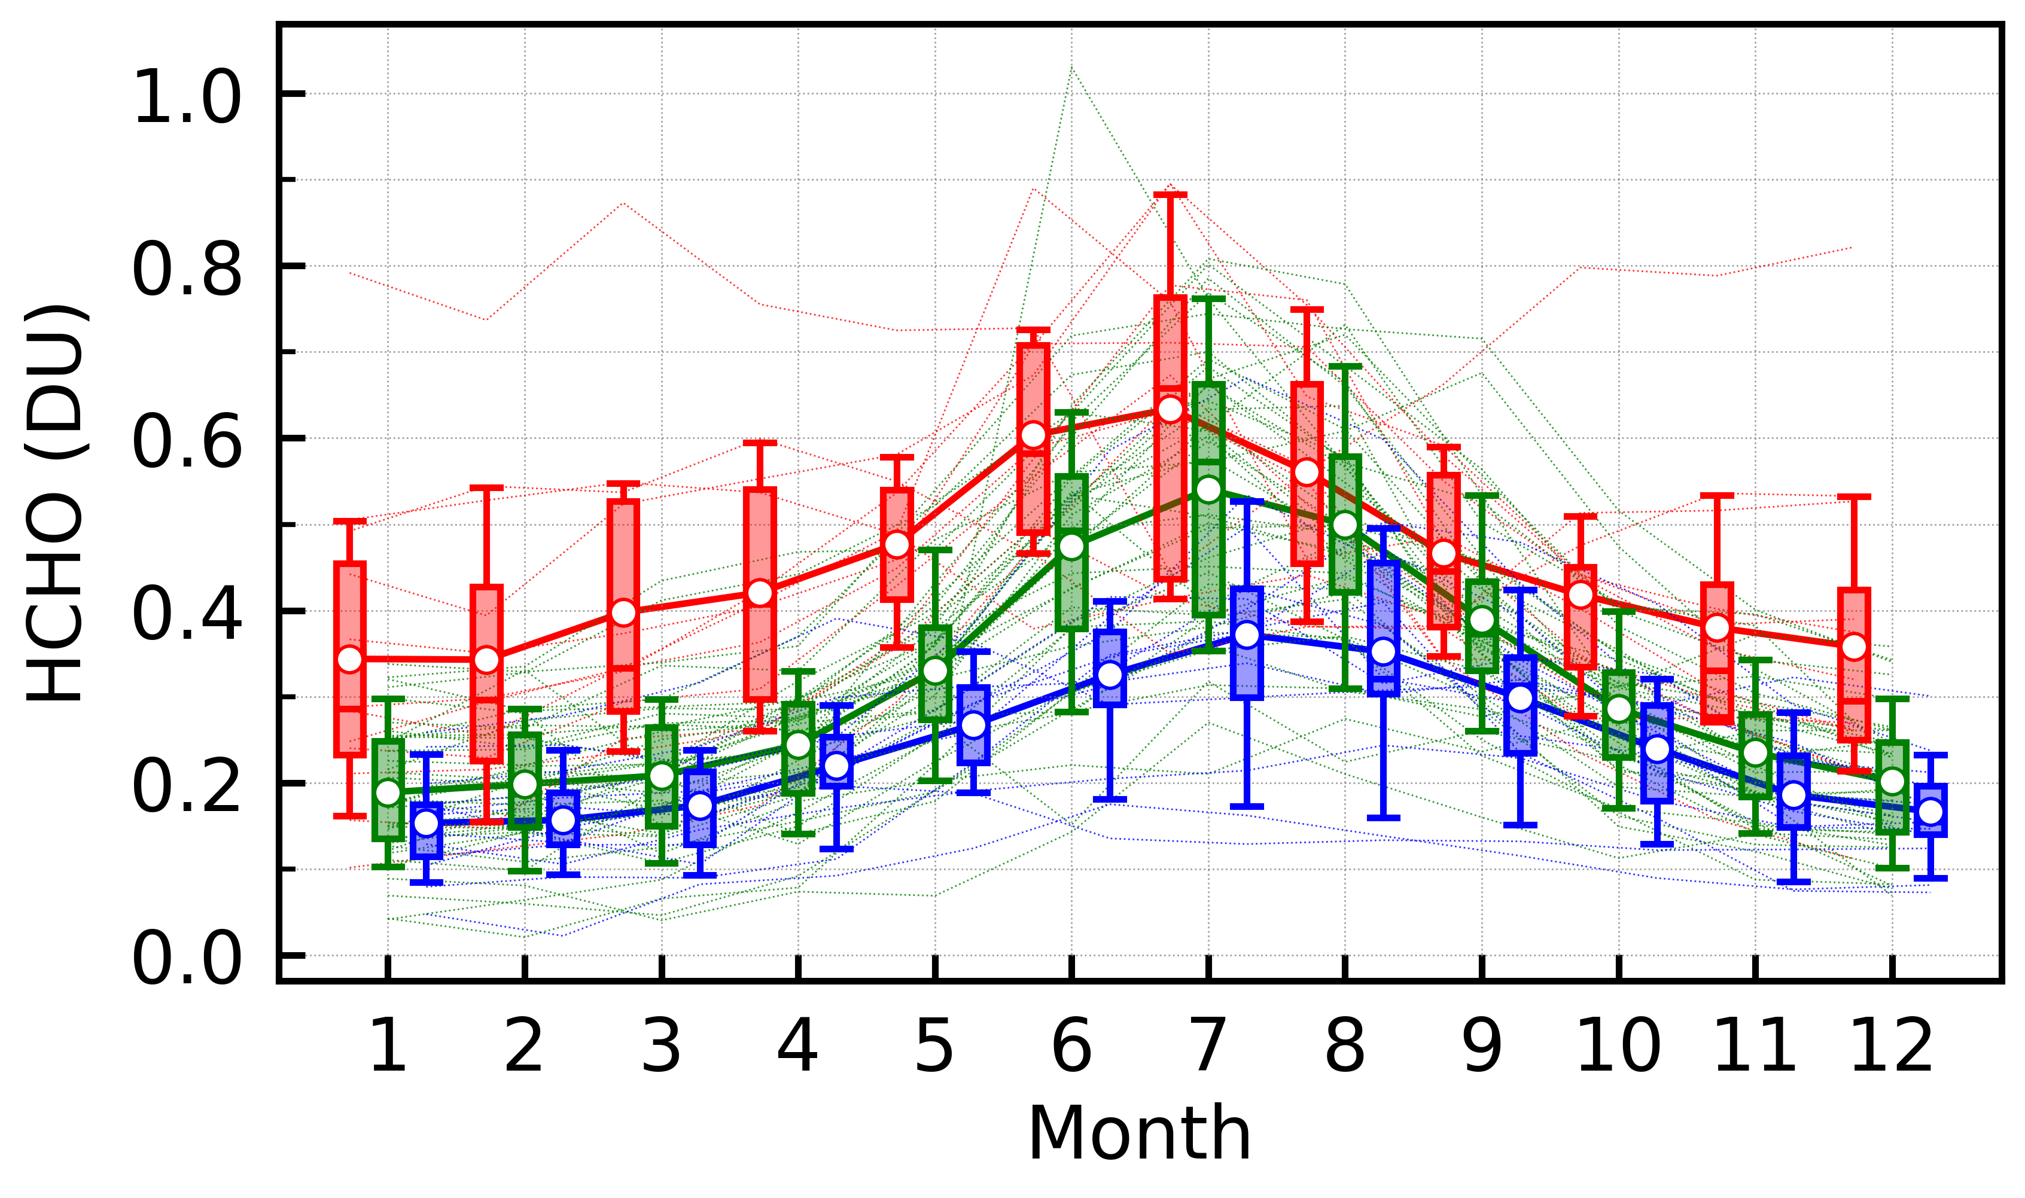
Monthly Variation of HCHO Vertical Column Density
Polluted Urban (12 sites)
Urban/Suburban (41 sites)
Rural/Background (13 sites)
N.H. only
A clear seasonal variation in HCHO VCDs across all environmental categories in the Northern Hemisphere, characterized by a distinct increase during summer and a decrease in winter.
Notes:
shows a clear seasonal variation in HCHO VCDs across all environmental categories in the Northern Hemisphere, characterized by a distinct increase during summer and a decrease in winter. Regardless of anthropogenic VOC contributions, stronger biogenic VOC emissions and enhanced photochemical reactions under higher temperatures and insolation drive the summertime maxima.

Slide 12
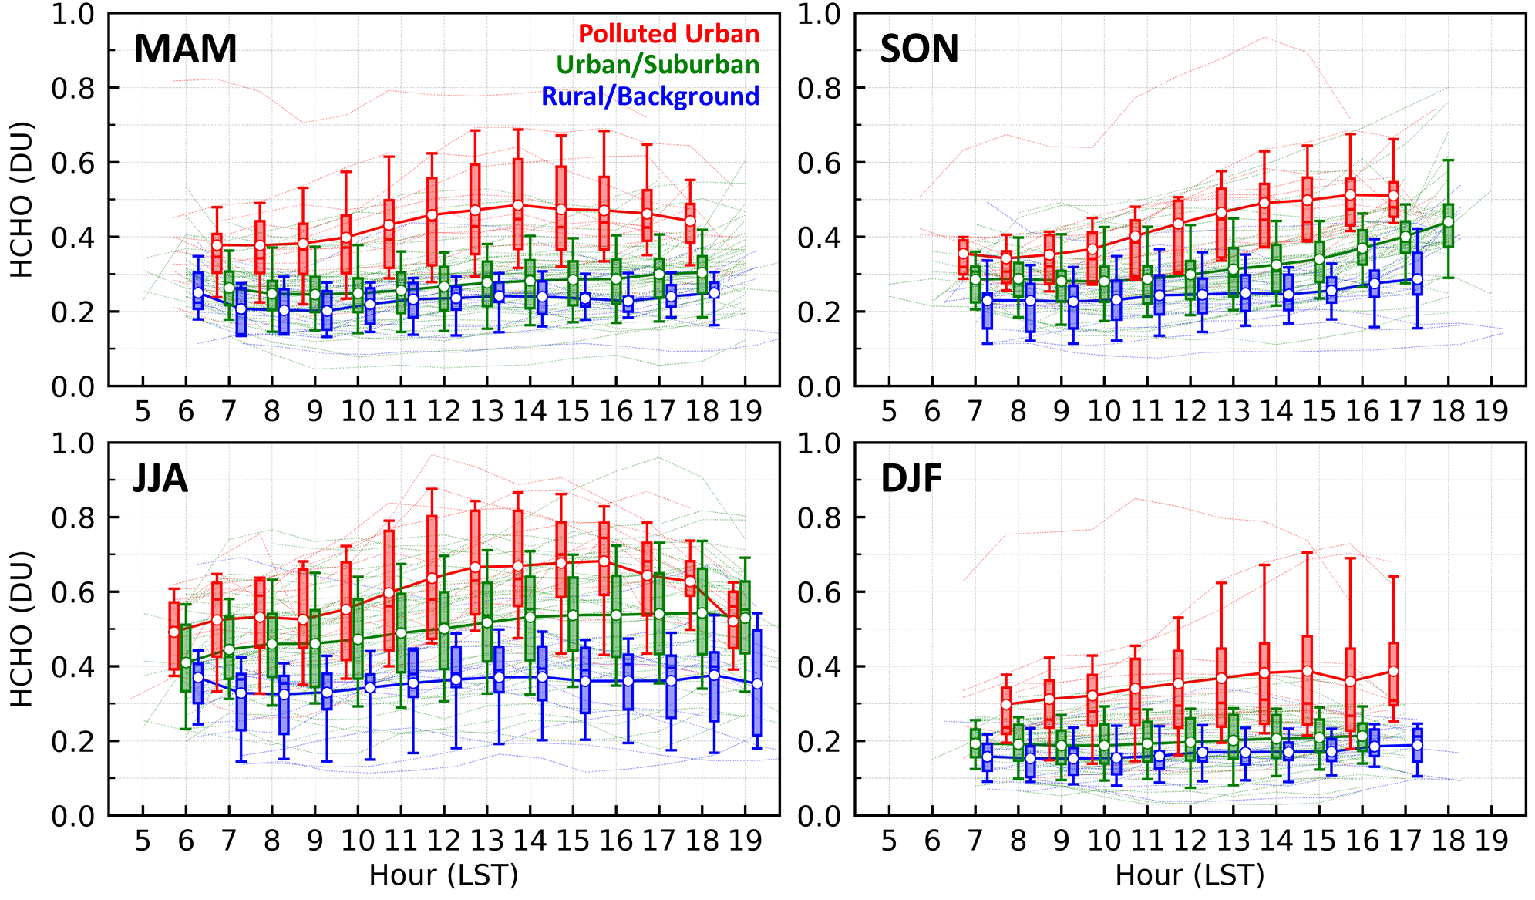
Diurnal Variation of HCHO Vertical Column Density
N.H. only
The diurnal variation of HCHO VCD can be characterized by a general increase in the morning, followed by elevated levels persisting in the afternoon due to HCHO photochemical production from VOC oxidation after sunrise, but with exceptions during winter and at Rural/Background stations.
Notes:
The diurnal variation of HCHO VCD can be characterized by a general increase in the morning, followed by elevated levels persisting in the afternoon, due to HCHO photochemical production from VOC oxidation after sunrise,
but with exceptions during winter and at Rural/Background stations, where photochemical reactivity and/or emissions are insignificant

Slide 13
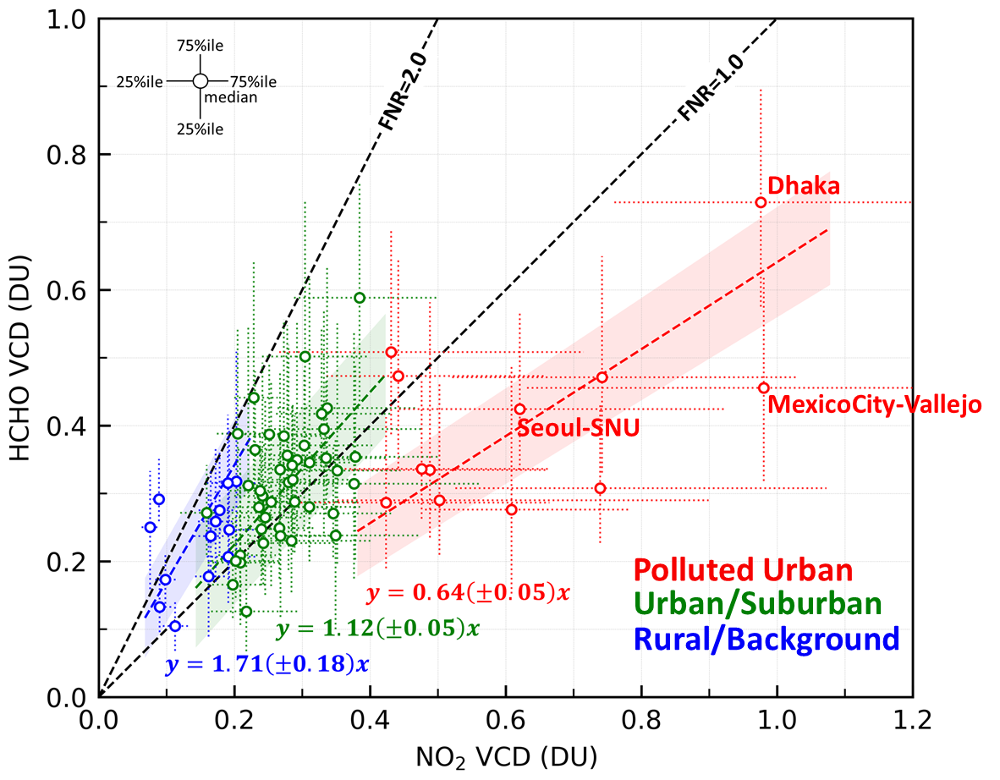
Relationship bet. NO₂ and HCHO Vertical Column Densities
HCHO-to-NO₂ ratio (FNR)
Most Polluted Urban stations exhibit FNR values less than 1, with an average of 0.64 (±0.05); a VOC-sensitive regime.
The average FNRs over Urban/Suburban stations and Rural/Background stations are 1.12 (±0.05) and 1.71 (±0.18), respectively, which are higher than those at Polluted Urban stations due to limited anthropogenic NOx emissions: transitional regime (e.g., 1 < FNR < 3), where these stations can shift between NOx-sensitive and VOC-sensitive regimes depending on the time of day and season.
Notes:
The relative abundance of satellite NO₂ and HCHO VCDs has been widely investigated, as it serves as a practical indicator of the O₃ production regime. satellite-derived FNRs are susceptible to significant uncertainties, primarily due to satellite VCD retrievals and limited spatial resolution.
displays the typical FNRs calculated from NO₂ and HCHO VCDs measured at PGN Pandora stations.
Generally, lower FNR values indicate VOC sensitivity, while higher values indicate NO_{x} sensitivity.
Most Polluted Urban stations exhibit FNR values less than 1, with an average of 0.64 (±0.05). hence, Polluted Urban stations can generally be regarded as falling within the VOC-sensitive regime.
The average FNRs over Urban/Suburban stations and Rural/Background stations are 1.12 and 1.71, respectively, which are higher than those at Polluted Urban stations due to limited anthropogenic NOx emissions. These values may fall within the transitional regime (e.g., 1 < FNR < 3), where these stations can shift between NOx-sensitive and VOC-sensitive regimes depending on the time of day and season.

Slide 14
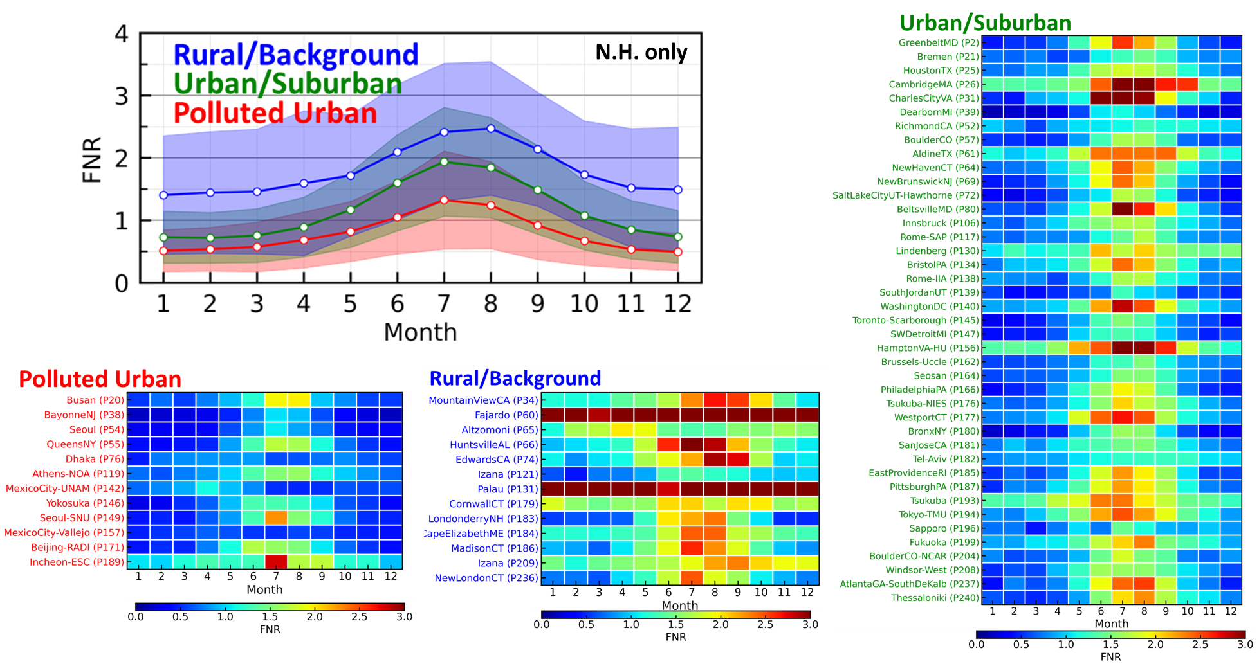
Monthly variations of HCHO-to-NO₂ ratio (FNR)
Since NO₂ and HCHO VCDs generally exhibit antiphase seasonal variation (i.e., NO₂ VCDs increase in winter, while HCHO VCDs increase in summer), FNRs show a prominent increase during summer across all environmental categories.
Notes:
FNRs show a prominent increase during summer across all environmental categories.
FNR values falling within intermediate range (e.g., 1 < FNR < 3) during summer, which may infer the possible subtle shift in the O₃ production regime toward a VOC-limited regime.

Slide 15
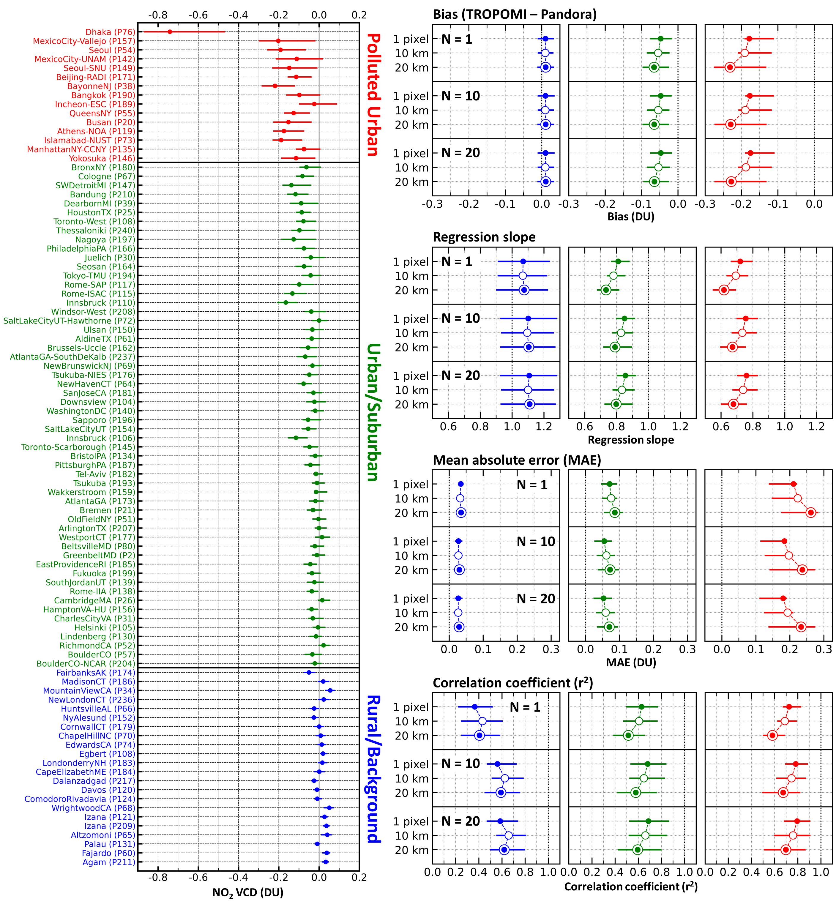
NO₂ and HCHO VCDs: Pandora vs. TROPOMI
NO₂
TROPOMI generally underestimates NO₂ VCDs in polluted environments, with more pronounced negative biases at stations with higher year-round NO₂ levels.
NO₂ and HCHO VCDs from TROPOMI and Pandora are intercompared across different environmental conditions with various collocation strategies, including
(1) enlarging the spatial collocation range (e.g., 1 pixel, 10 km, and 20 km), and
(2) increasing the number of collocated data points (N) averaged before intercomparison (e.g., N=1, 10, and 20).
TROPOMI underestimates NO₂ VCDs at Polluted Urban (27.9±10.8 %) and Urban/Suburban (19.0±10.6 %) stations, whereas a slight overestimation is found for Rural/Background stations (6.9±19.4 %).
TROPOMI – Pandora (DU)
Notes:
One of the greatest advantages of the global Pandora observation network provides is its pertinence as a reference for evaluating satellite retrievals.
NO₂ VCD biases between TROPOMI and Pandora (i.e., TROPOMI minus Pandora) are presented; calculated from the base-state collocation criteria (i.e., “1 pixel” – single satellite pixel containing Pandora location; “N=1” – single collocated data points intercompared without taking the respective average in prior) and sorted in descending order of average NO₂ VCD at each station.
TROPOMI generally underestimates NO₂ VCDs in polluted environments, with more pronounced negative biases at stations with higher year-round NO₂ levels. .
The underestimation of TROPOMI in urban areas has been a well-documented issue, and several previous studies have explained this phenomenon as a combination of different causes.
NO2 TROPOMI bias compared to collocated Pandora, CF < 0.3, 1pix, pm 15 min, 25-75 percentile, mean circle
NMB (Normalized Mean Bias) 보다는 0-intercept regression이 더 좋은 지표 (of relative bias)로 판단됨. → NMB can become extreme value under low VCD condition, and subsequent outliers significantly affect the average value.

Slide 16
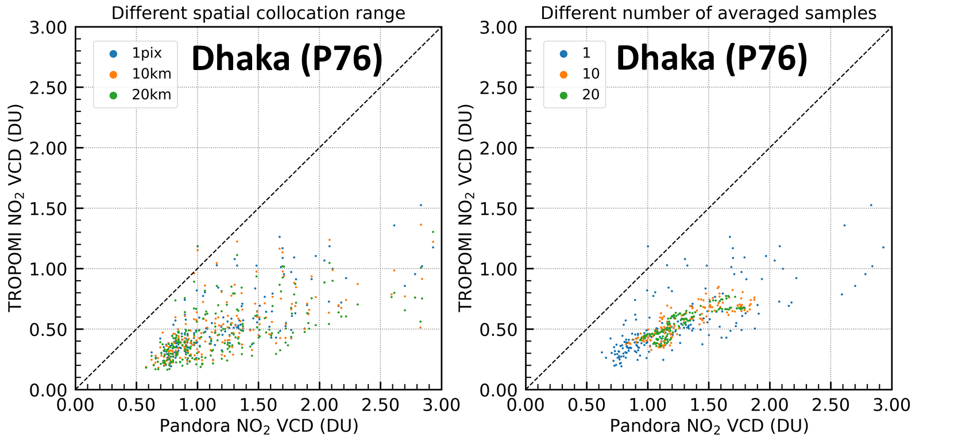
NO₂ and HCHO VCDs: Pandora vs. TROPOMI
NO₂
TROPOMI – Pandora (DU)
Notes:
One possible cause for such excessive negative bias of TROPOMI is the underestimation of NOx emissions in the CTM (i.e., TM5-MP) over the Dhaka area. When anthropogenic emissions near the surface are underestimated, the resulting NO₂ profile tends to place more weight at higher altitudes, where scattering weights are generally larger. This leads to an overestimation of the AMF, which can cause satellite retrievals to underestimate VCD. Inaccurate

Slide 17
NO₂ and HCHO VCDs: Pandora vs. TROPOMI
NO₂
TROPOMI generally underestimates NO₂ VCDs in polluted environments, with more pronounced negative biases at stations with higher year-round NO₂ levels.
NO₂ and HCHO VCDs from TROPOMI and Pandora are intercompared across different environmental conditions with various collocation strategies, including
(1) enlarging the spatial collocation range (e.g., 1 pixel, 10 km, and 20 km), and
(2) increasing the number of collocated data points (N) averaged before intercomparison (e.g., N=1, 10, and 20).
TROPOMI underestimates NO₂ VCDs at Polluted Urban (27.9±10.8 %) and Urban/Suburban (19.0±10.6 %) stations, whereas a slight overestimation is found for Rural/Background stations (6.9±19.4 %).
Increasing the number of collocated data points (N) in the satellite–Pandora intercomparison effectively reduces the influence of random biases regardless of their origin—not only in polluted environments but also at Rural/Background stations.
TROPOMI – Pandora (DU)

Slide 18
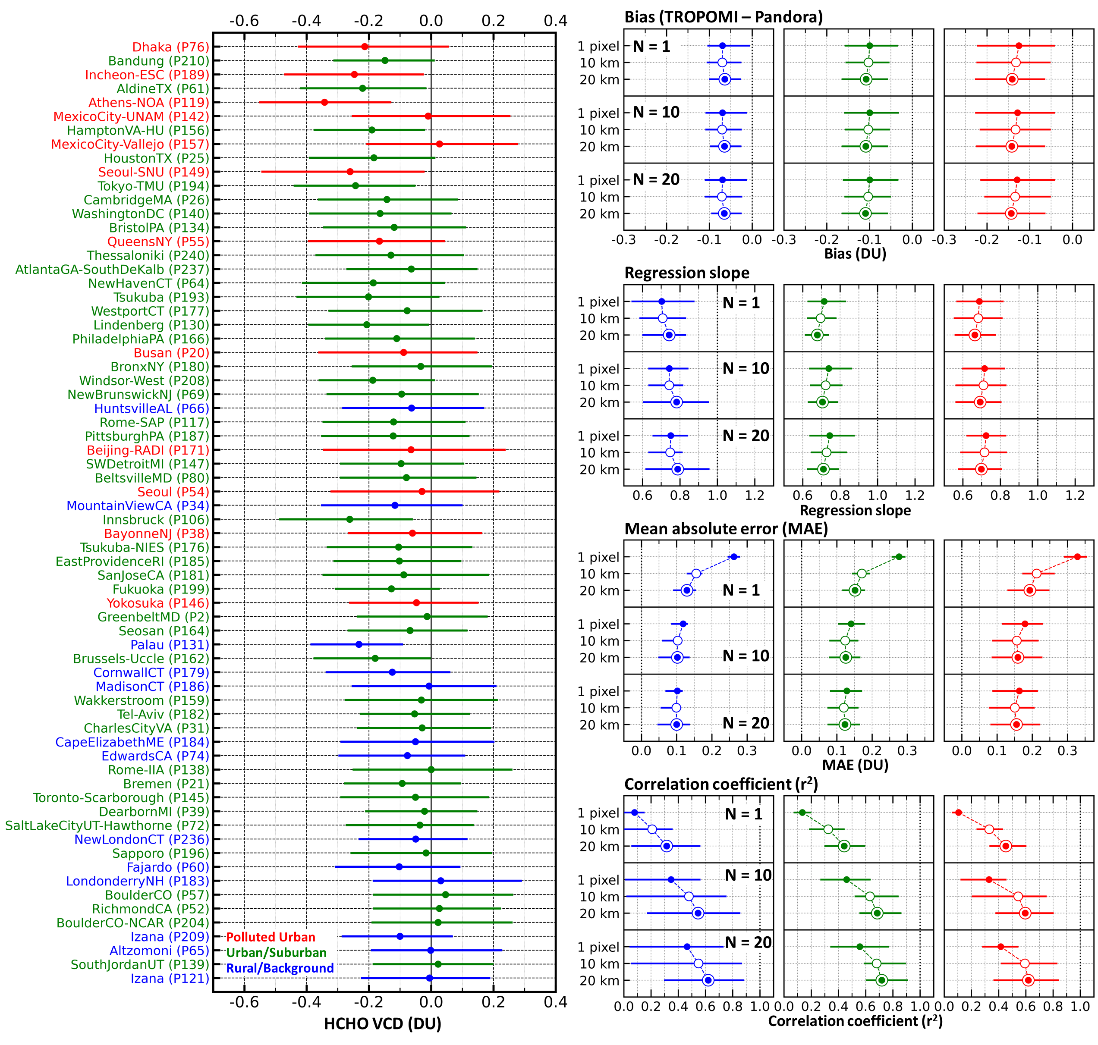
NO₂ and HCHO VCDs: Pandora vs. TROPOMI
HCHO
Pronounced negative mean biases in TROPOMI HCHO are observed at stations with higher HCHO VCDs, while no apparent positive biases are found at Rural/Background stations.
Enlarging the spatial collocation range of TROPOMI generally improves the intercomparison results of HCHO VCDs, except for the slight increase in the negative mean bias of TROPOMI in Polluted Urban and Urban/Suburban environments.
The improving intercomparison scores, especially the evident decrease in MAE and increase in r², further epitomize that random uncertainties in satellite HCHO VCD retrievals are the main cause of the generally low r² and large MAE in HCHO VCD intercomparisons
TROPOMI – Pandora (DU)
Notes:
shows the intercomparison results between TROPOMI and Pandora HCHO VCDs.
negative biases become more pronounced at higher HCHO concentrations, with the mean biases of TROPOMI reaching below -0.2 DU at stations with high HCHO VCDs (e.g., annual mean HCHO VCD > 0.5 DU).
no apparent positive biases are observed even at Rural/Background stations.
Another prominent feature is that the biases between TROPOMI and Pandora are much more variable, with a larger interquartile range of approximately 0.4 DU, regardless of the environmental categories .
As the number of collocated samples (N) averaged prior to the intercomparison increases, MAE decreases and r² increases simultaneously at all stations to a similar degree.

Slide 19
Short Summary
We conducted a global-scale analysis of 5-year NO₂ and HCHO VCDs from PGN sites.
NO₂ in the polluted urban sites exhibited noticeable seasonal patterns, with a decrease during the summer months, and diurnal patterns, showing an increase in the morning hours.
On the other hand, HCHO VCDs displayed a consistent increase during the summer across all sites, with no clear diurnal variation, albeit a slight increase during daytime hours.
The HCHO-to-NO₂ ratio (FNR) in the polluted urban sites was found to be less than approximately 1.0, while in urban/suburban areas, it ranged between 1.0 and 2.0.
Collocation strategy from Pandora-TROPOMI comparison
- NO₂: closest data point from satellite footprint
- HCHO: increase both data points and spatial coverage (i.e., ~ 20 points, ~ 20 km)

