Slide 1







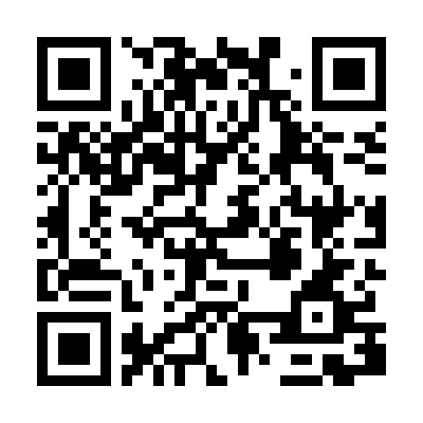
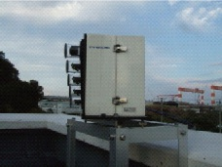
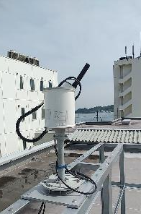
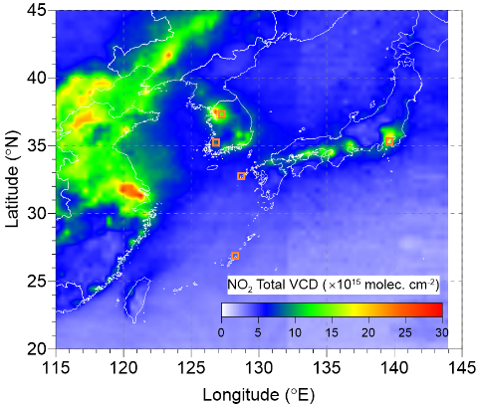
Progress with MAX-DOAS observations to validate TROPOMI Collection 3 and GEMSv3 NO₂ (TropVCD)
Yugo Kanaya, Phuc T. M. Ha (JAMSTEC), Yongjoo Choi (HUFS), and colleagues
https://www.jamstec.go.jp/egcr/e/atmos/observation/maxdoashp/
7 x MAX-DOAS
2 x Pandora
CEOS AC-VC#21, Takamatsu, 11 Jun 2025
Kanaya et al. ACP 2014, Choi et al. (RS, 2021), Ha et al. (submitted to PEPS, 2025)
June, 2021
Seoul (Korea U.)
Incheon
(POSCO tower)
Yongin w. Pandora
(since 2021/09)
Gwangju
Yokosuka
w. Pandora
(since 2018/11)
Fukue
Cape Hedo
GEMS (grid size 0.5°×0.5°; SZA<85°; CF<30%)

Slide 2
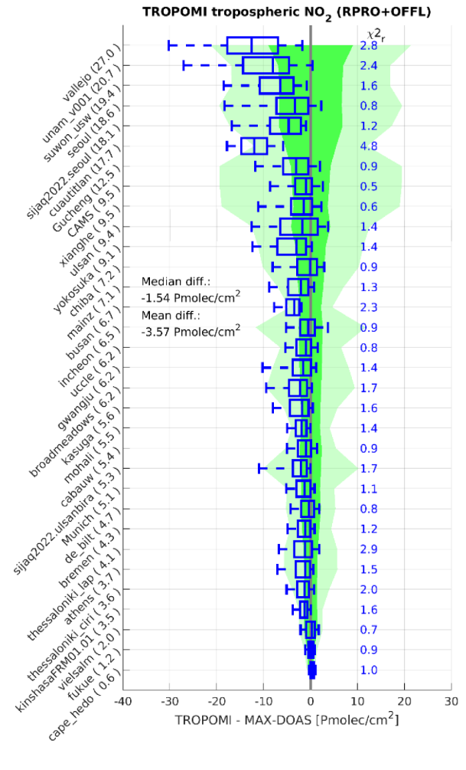

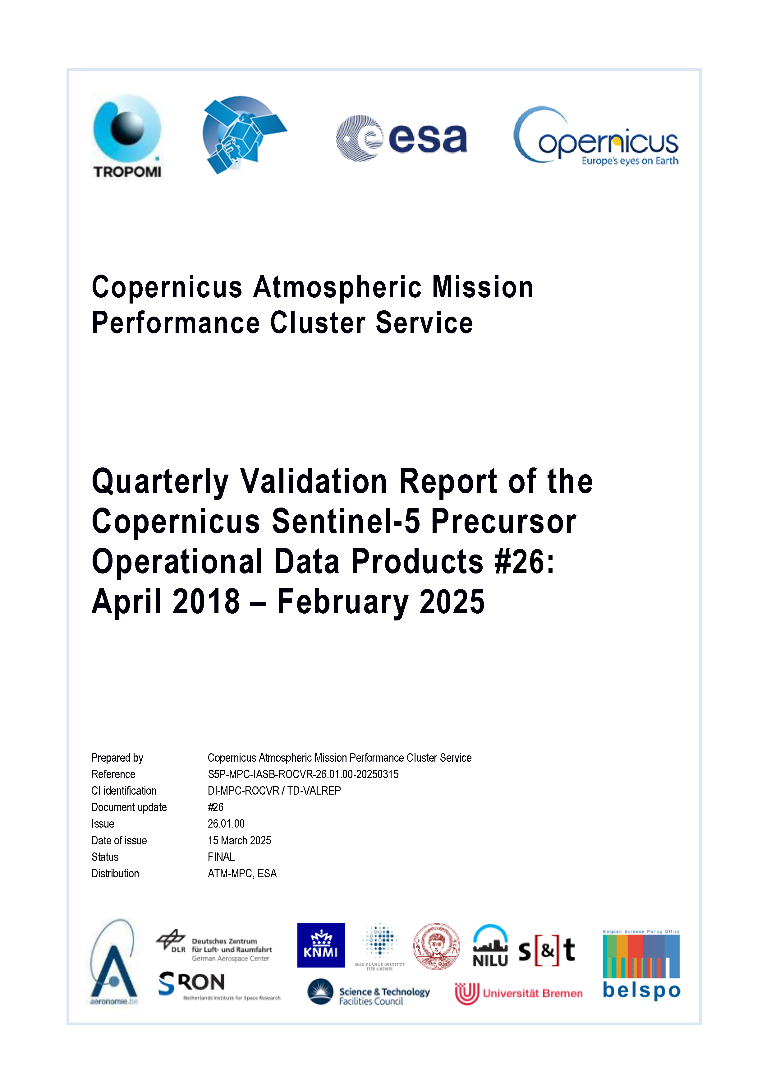
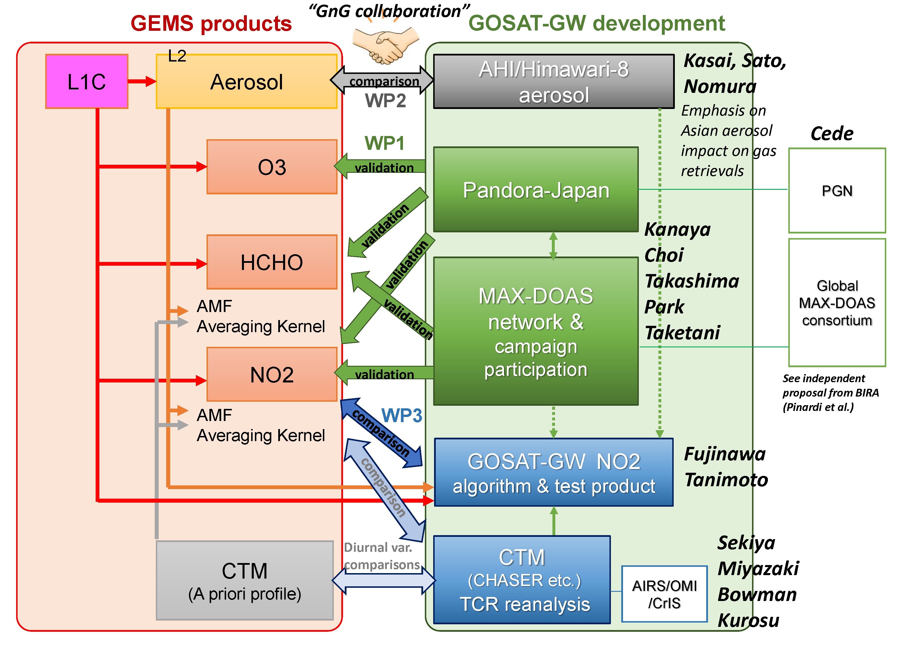
Validation of TROPOMI Collection 03 and GEMSv3 NO2
https://mpc-vdaf.tropomi.eu/
Notes:
https://mpc-vdaf.tropomi.eu/

Slide 3
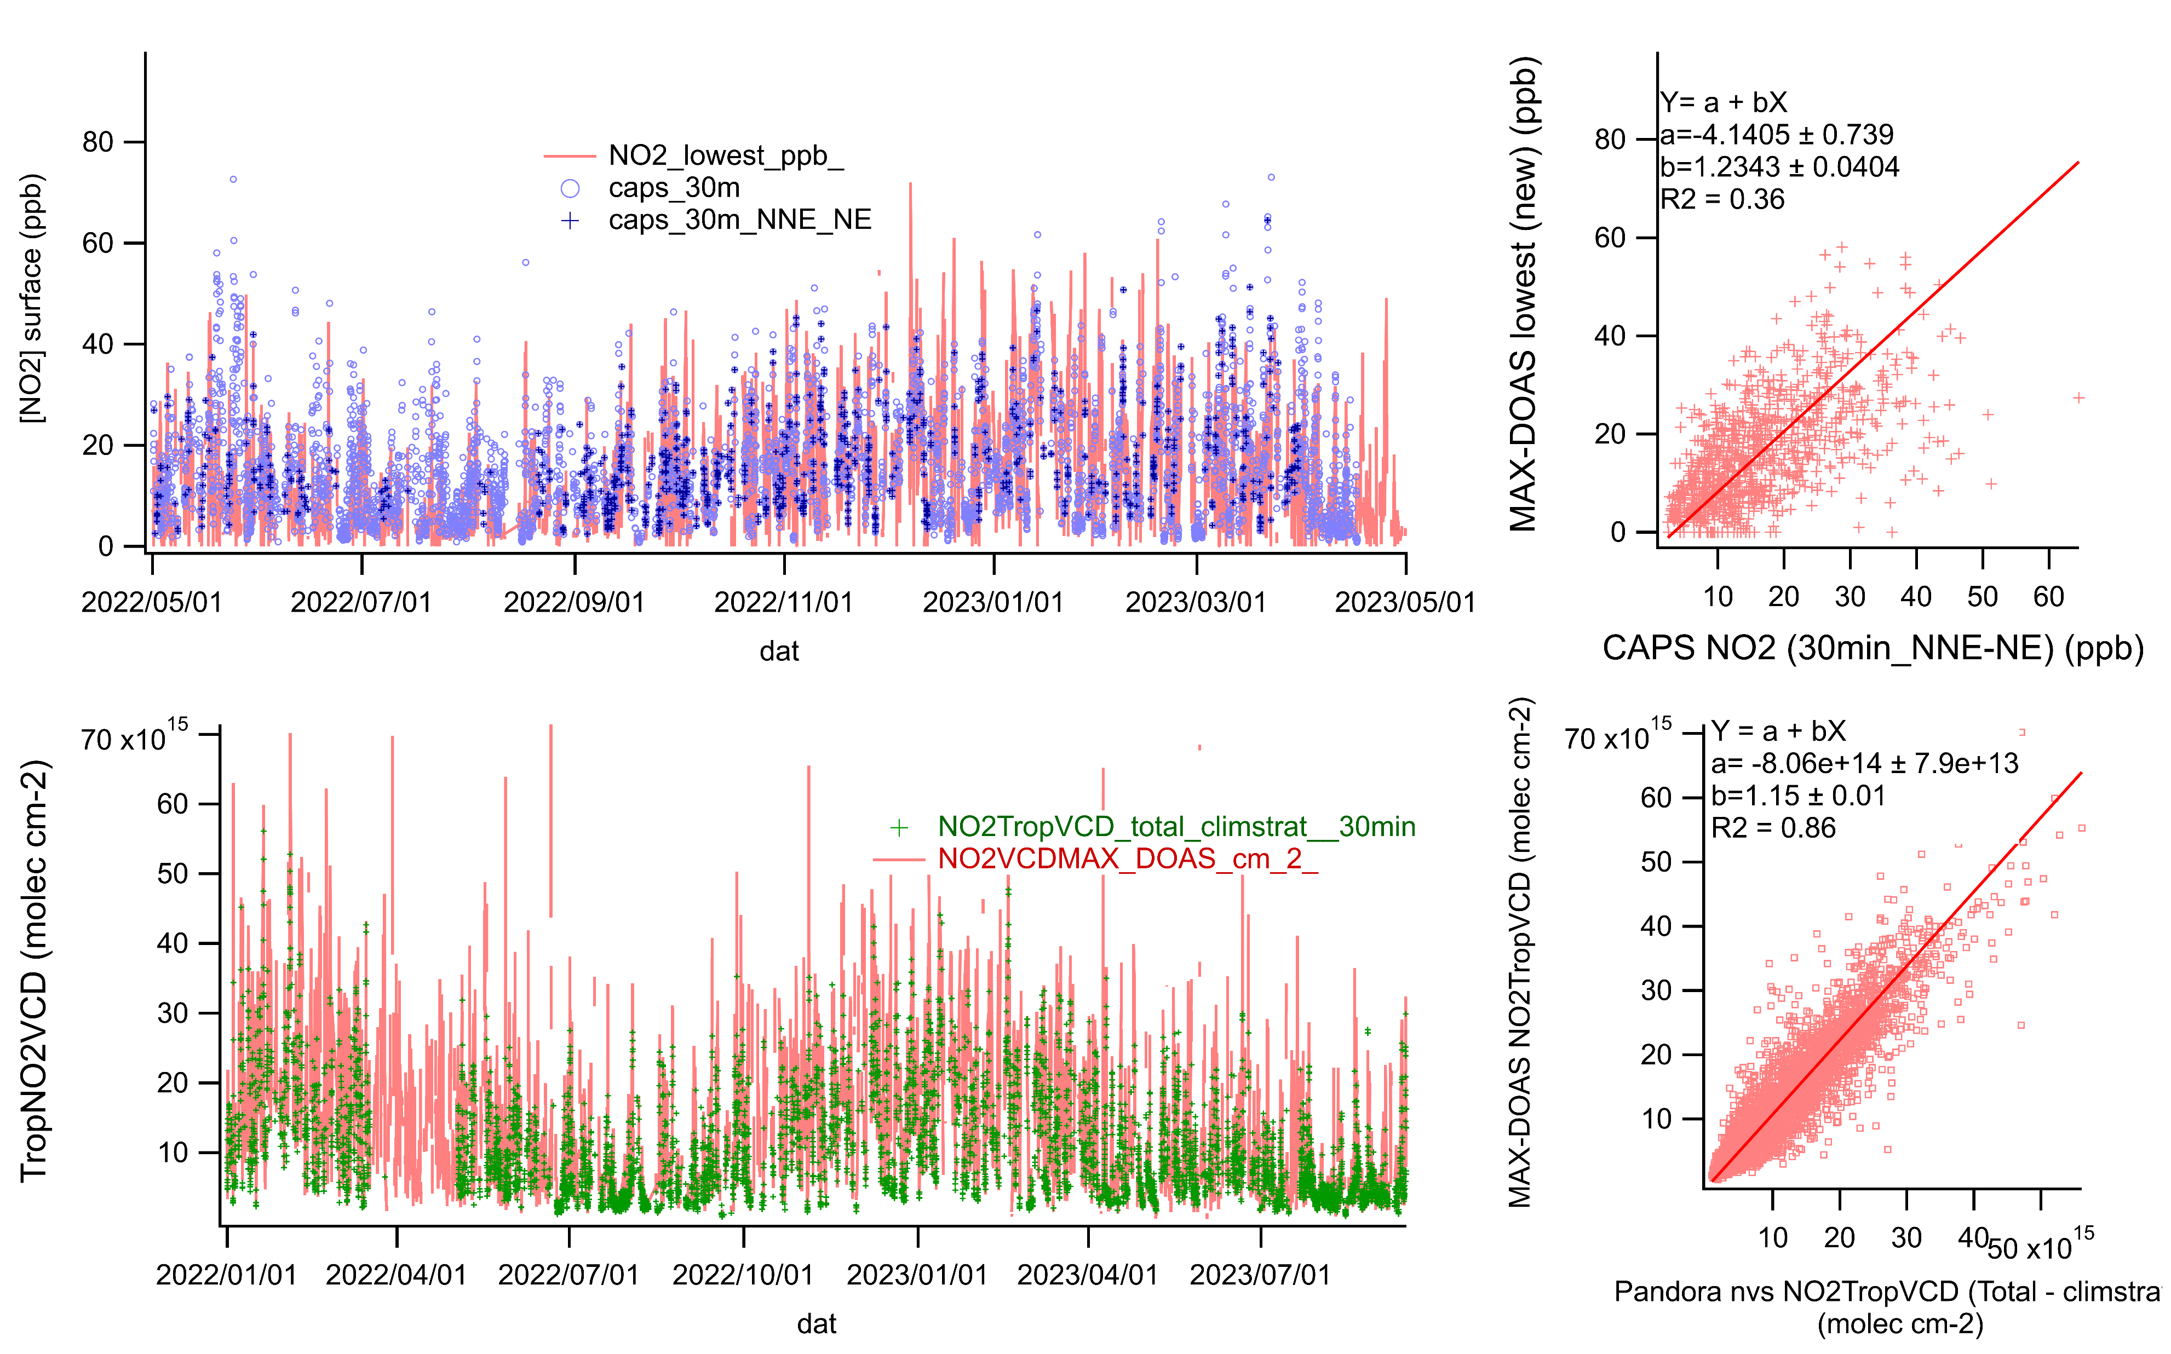
Improved MAX-DOAS retrieval: agreed better with co-located CAPS and Pandora
Updated optimal estimation parameters :
State vector (TNO2VCD, v_{0-1km}, v_{1-2km}, v_{2-3km}); Uncertainty range (Sa(2,2), (3,3), (4,4)=(0.05, 0.03, 0.03)
v_{0-0.5km}, v_{0.5-1km}, v_{1-2km} (ini = 0.6, 0.5, 0.8)
0.4, 0.4, 0.2
Yokosuka
Surface in-situ NO₂
MAX-DOAS retrieval
MAX-DOAS
CAPS(in situ)-NO₂
MAX-DOAS increased by a factor of 2
Slope ~1.2
CAPS(insitu)-NO2
TropNO2VCD
MAX-DOAS retrieval
MAX-DOAS
MAX-DOAS decreased by ~10%, Slope ~1.15
Pandora #146 (nvs) Total - strato
Pandora #146 (nvs)
Total - strato
Notes:
F:\maxdoas\results\was_yok1_22_2405.xlsm
F:\maxdoas\results\was_yok1_22_2405_maxdoas_vs_pandoracaps.png

Slide 4
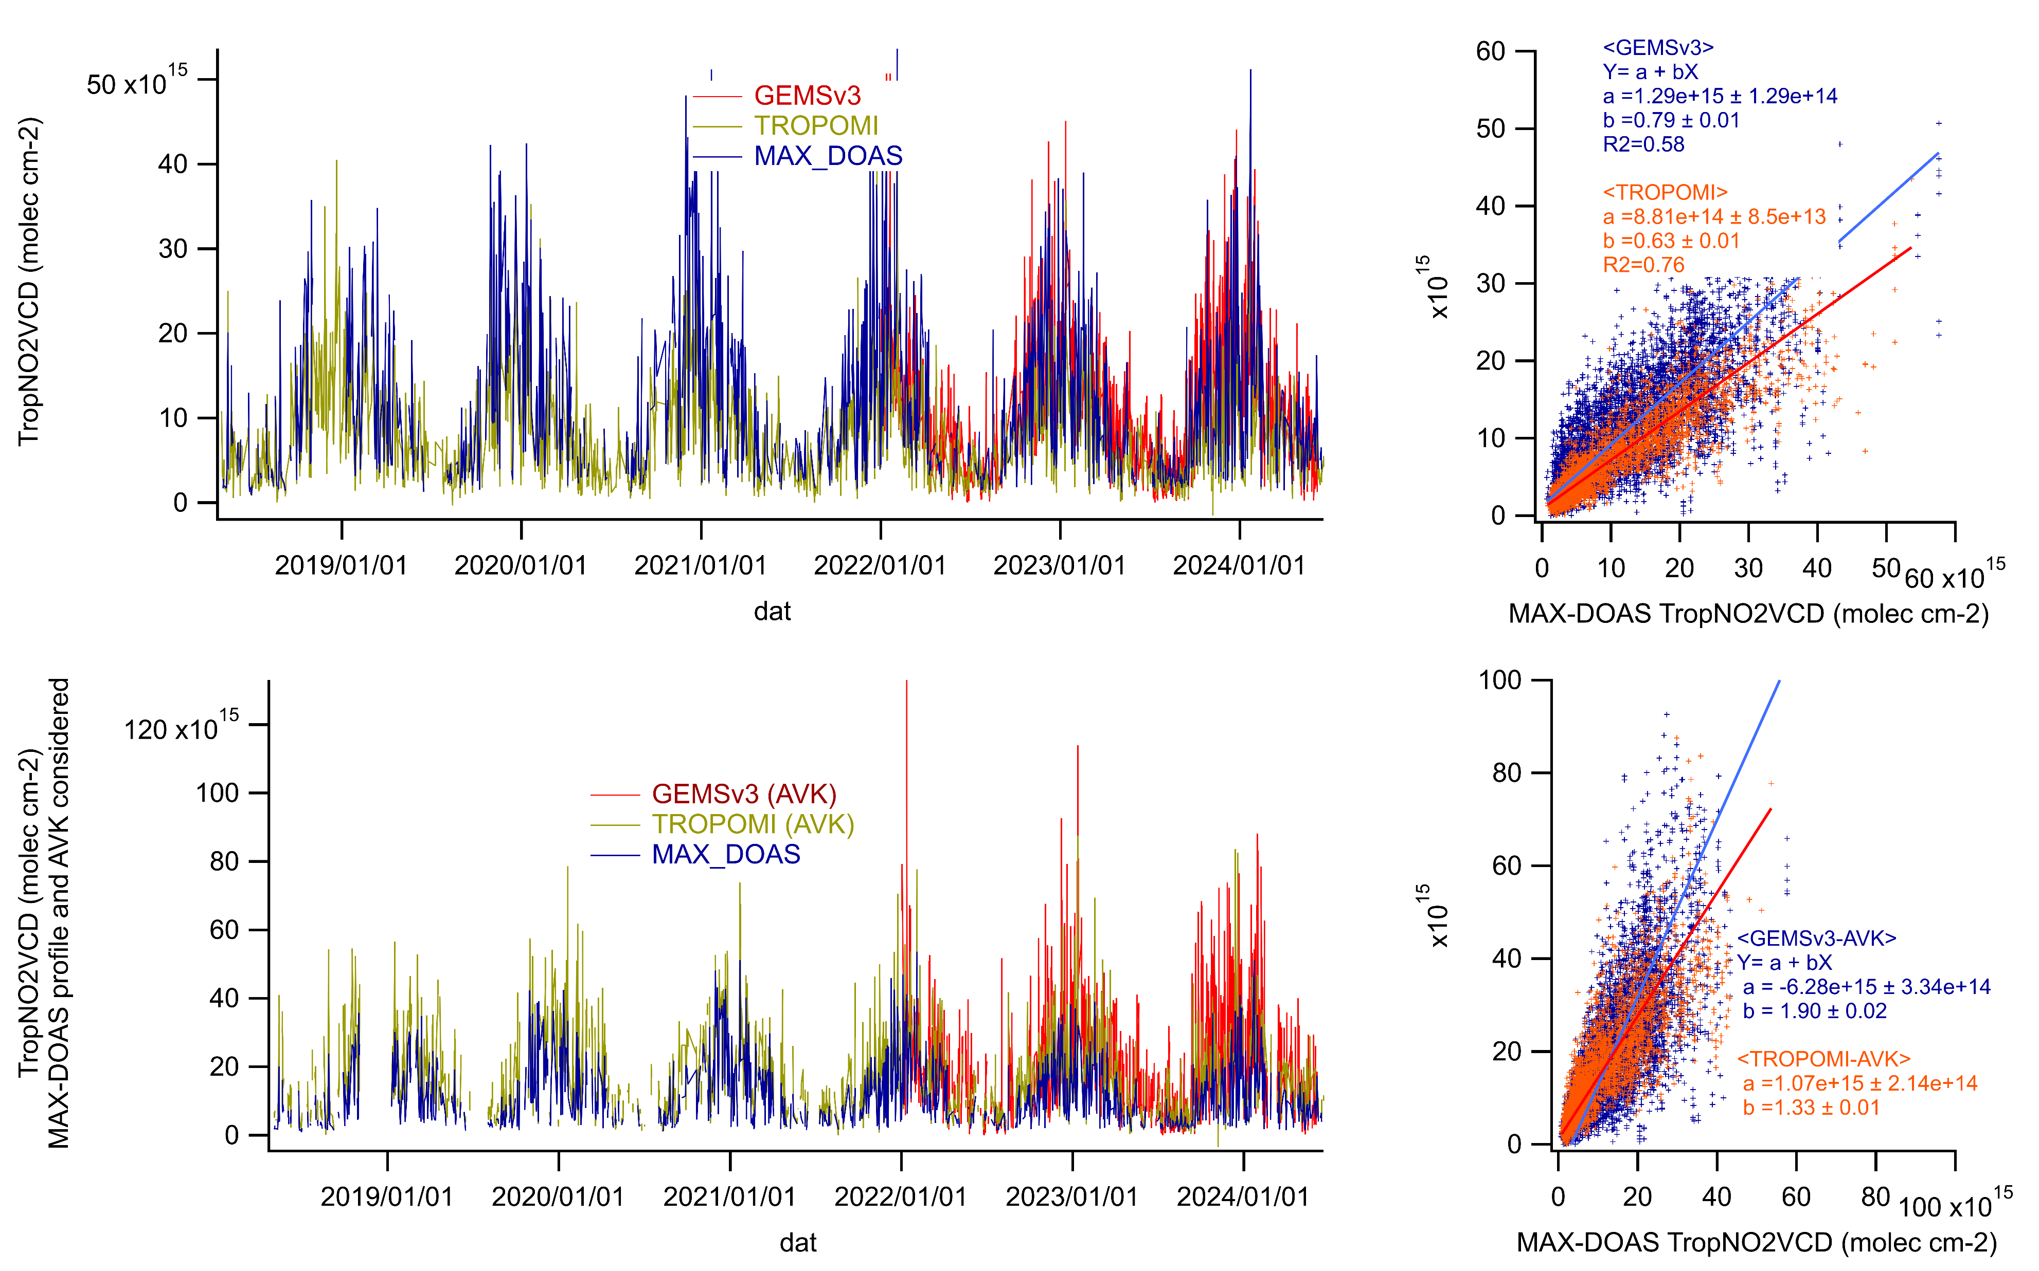

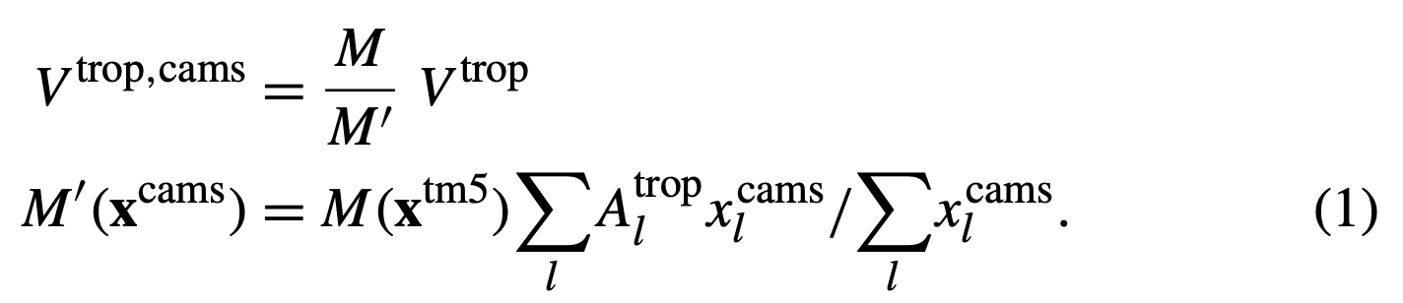
GEMSv3 & TROPOMI TropNO2VCD vs. iMAX-DOAS: Yokosuka
Δlat, lon<0.05, Δt<30min,
GEMS v3: Final Algorithm Flag=0, CF<0.3
TROPOMI: Collection 3 (≥v2.4), qa value>0.75, CRF<0.5
GEMS v3
slope = 0.79
R² = 0.58
GEMSv3 performed well, as TROPOMI, when validated against iMAX-DOAS, in terms of slope and correlation.
Comparisons considering “vertical profile shapes and AVK” are still difficult, as the NO₂ profile shapes are not certain enough (Though GEMSv3(GEOSChem) profiles and AVKs look OK)
TROPOMI
slope = 0.63
R² = 0.76
When AVK & MAX-DOAS profile are used for smoothing..
slope=1.90
MAXDOAS
Douros et al., 2023
MAXDOAS
GEOSChem
MAXDOAS
MAXDOAS
slope=1.33
Notes:
F:\gemsv3no2_Yokosuka\gemsv3_yokosuka_2201-2406avk_r.xlsm
F:\tropomi_yokosuka_out240730reduced_avk240805.xlsm
F:\gemsv3no2_Yokosuka\gemsv3_tropomi_yokosuka_fukue_hedo_2201-2406_avk.pxp, png

Slide 5
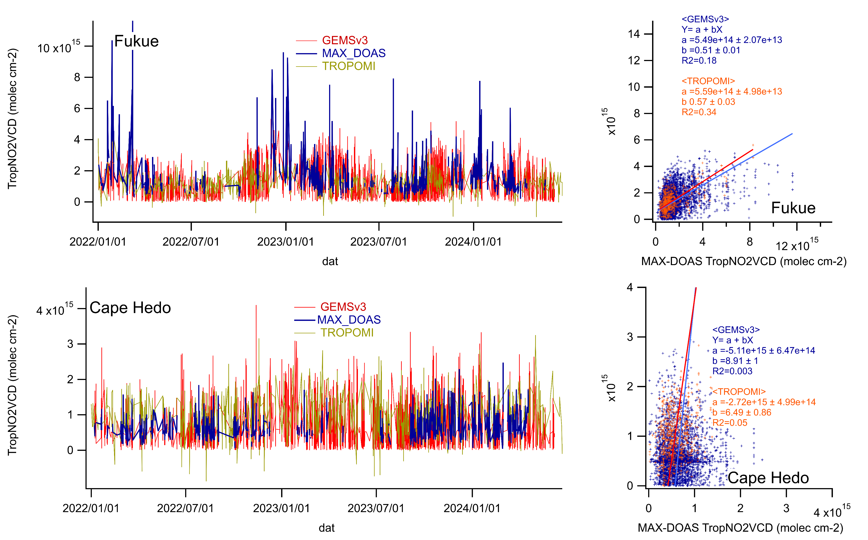
GEMSv3 & TROPOMI TropNO2VCD vs. iMAX-DOAS: Fukue & Cape Hedo
Δlat, lon<0.05, Δt<30min,
GEMS v3: Final Algorithm Flag=0, CF<0.3
TROPOMI: Collection 3 (≥v2.4), qa value>0.75, CRF<0.5
GEMSv2.0
At cleaner sites, GEMSv3 TropNO2VCD also agrees well with iMAX-DOAS as well as TROPOMI.
Y-axis intercepts diminished to (0.5-2) from GEMSv2 (3-10)x10¹⁵ cm⁻².
(Bi-variate regressions are difficult to evaluate for Cape Hedo)
TROPOMI
slope = 0.57
R² = 0.34
GEMS v3
slope = 0.51
R² = 0.18
Notes:
gemsv3_tropomi_yokosuka_fukue_hedo_2201-2406_avk.pxp
gemsv3_tropomi_fukue_hedo_2201-2406_nonavk.png

Slide 6
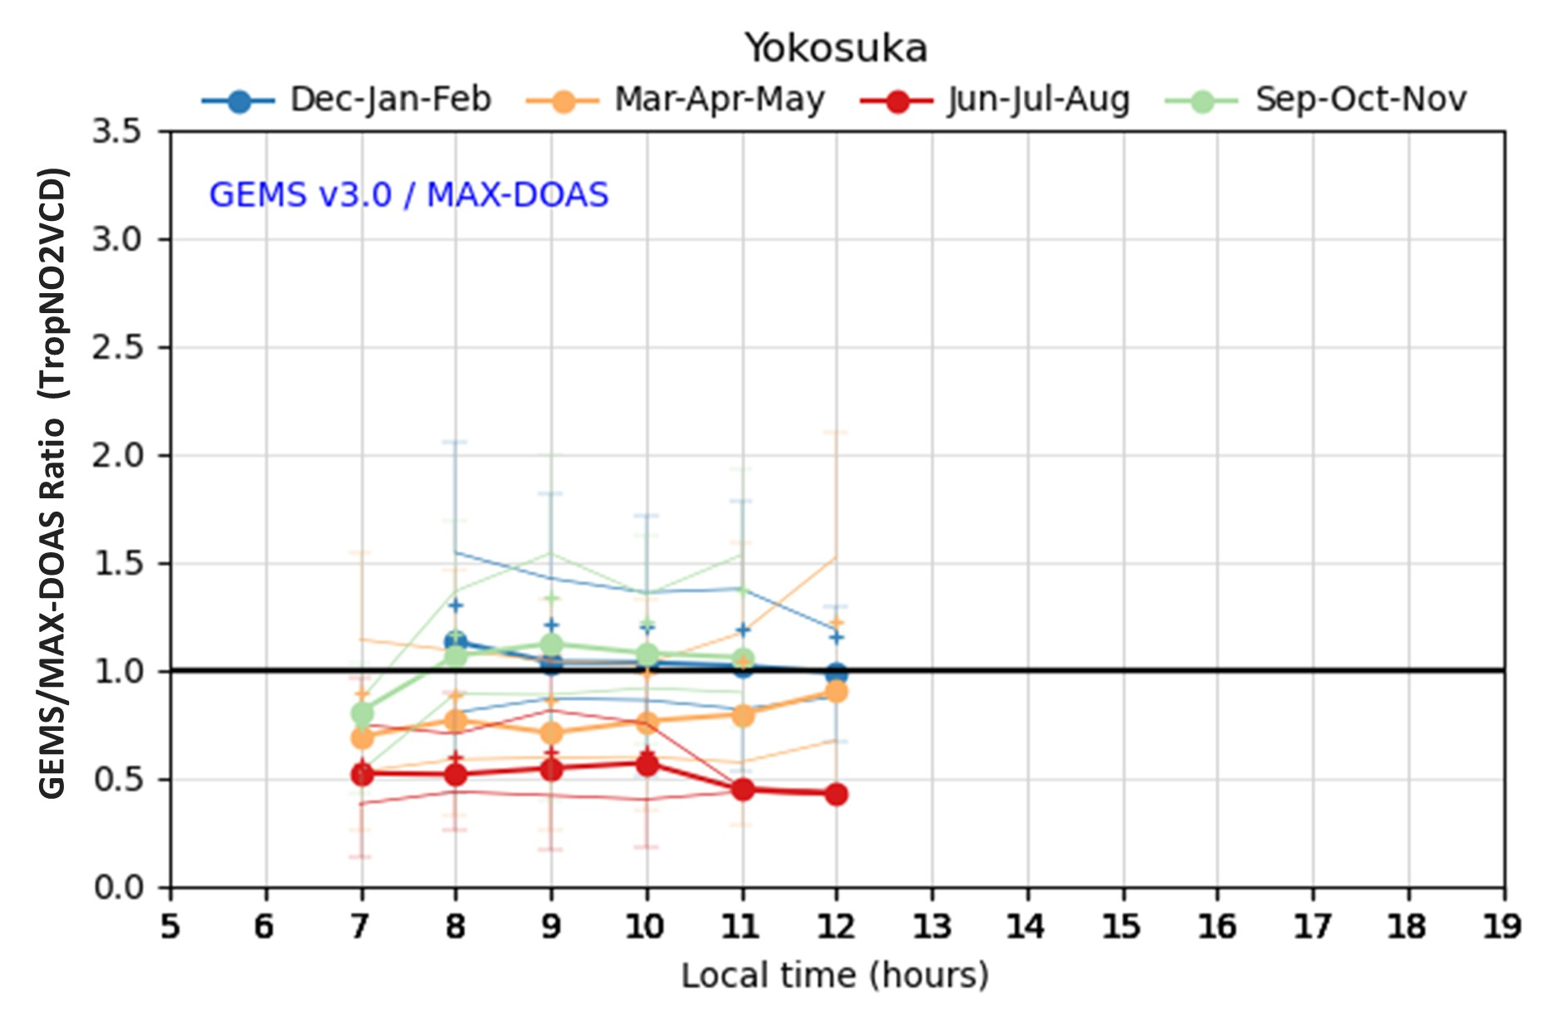
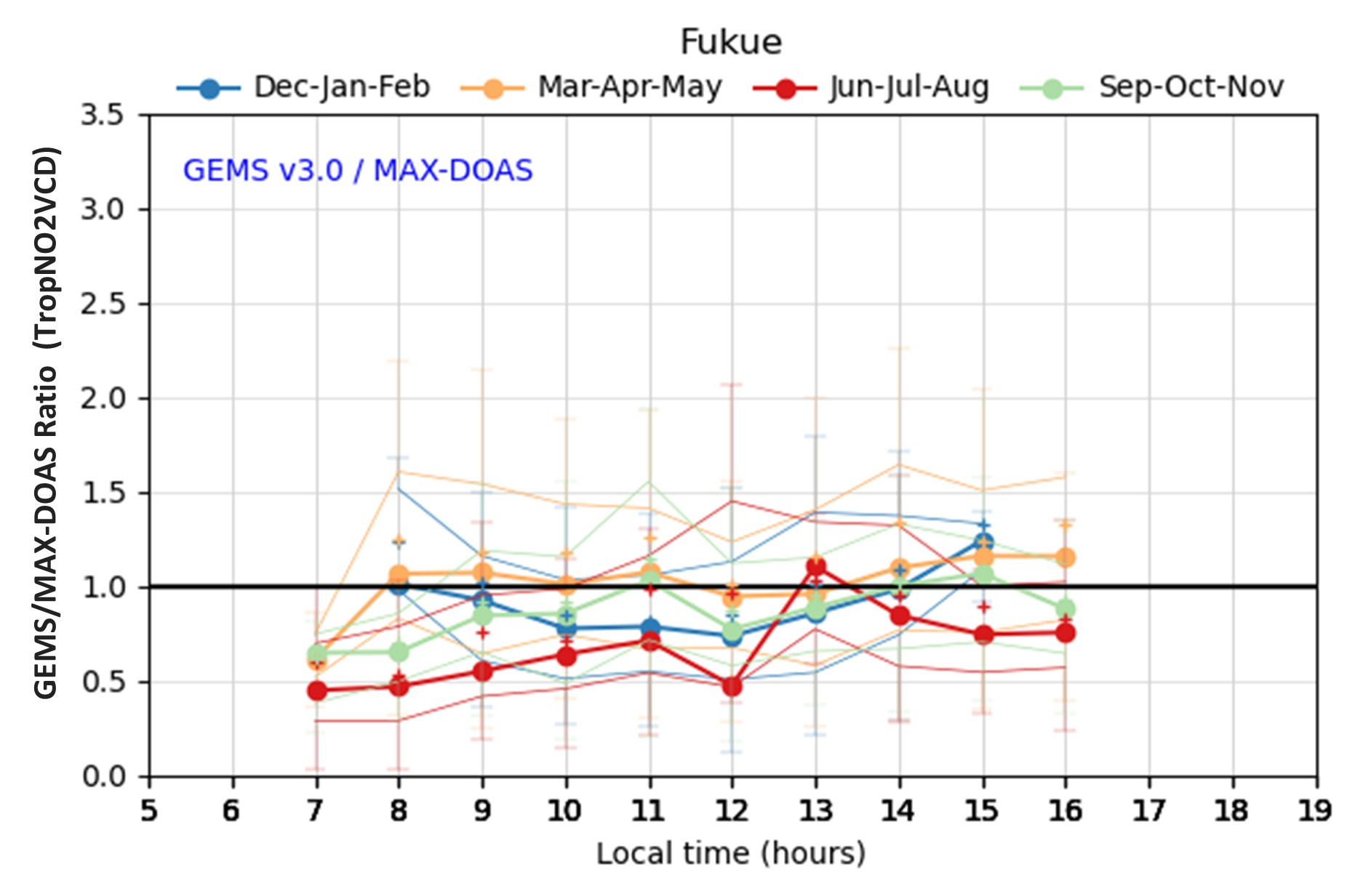
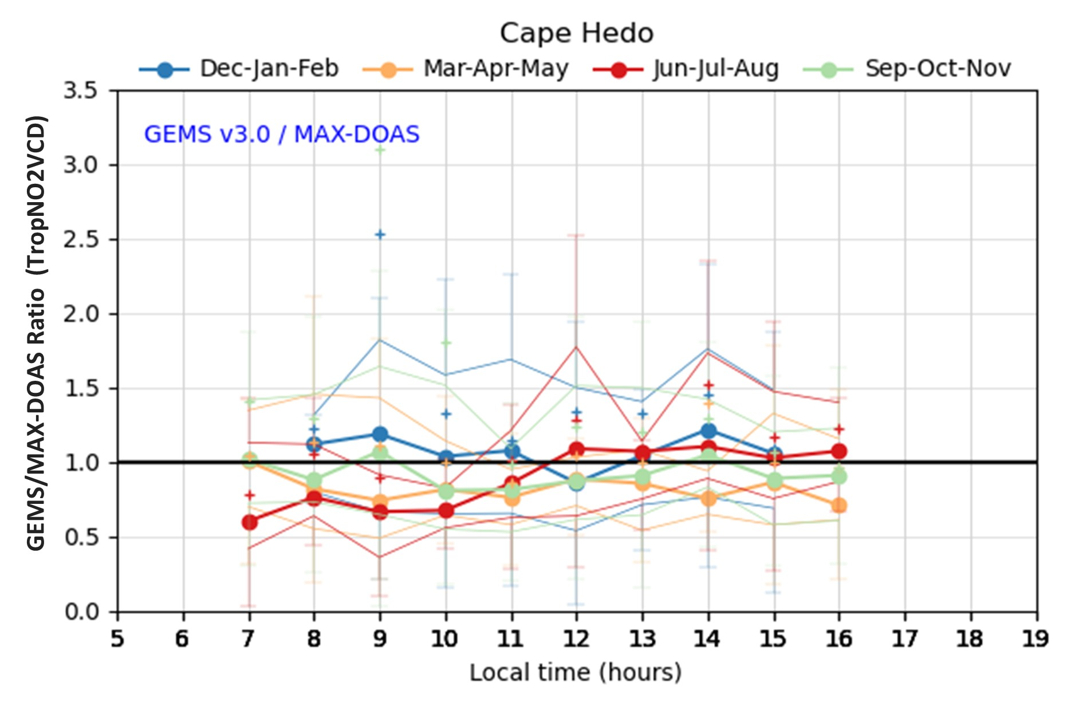
Diurnal variation of GEMSv3 TropNO2VCD
Yokosuka
DJF
MAM
JJA
SON
Ha et al., submitted 2025
GEMSv3/MAX-DOAS ratio
(TropNO2VCD)
Almost flat and close to unity over time of day
DJF
MAM
JJA
SON
DJF
MAM
JJA
SON
Fukue
Cape Hedo

Slide 7
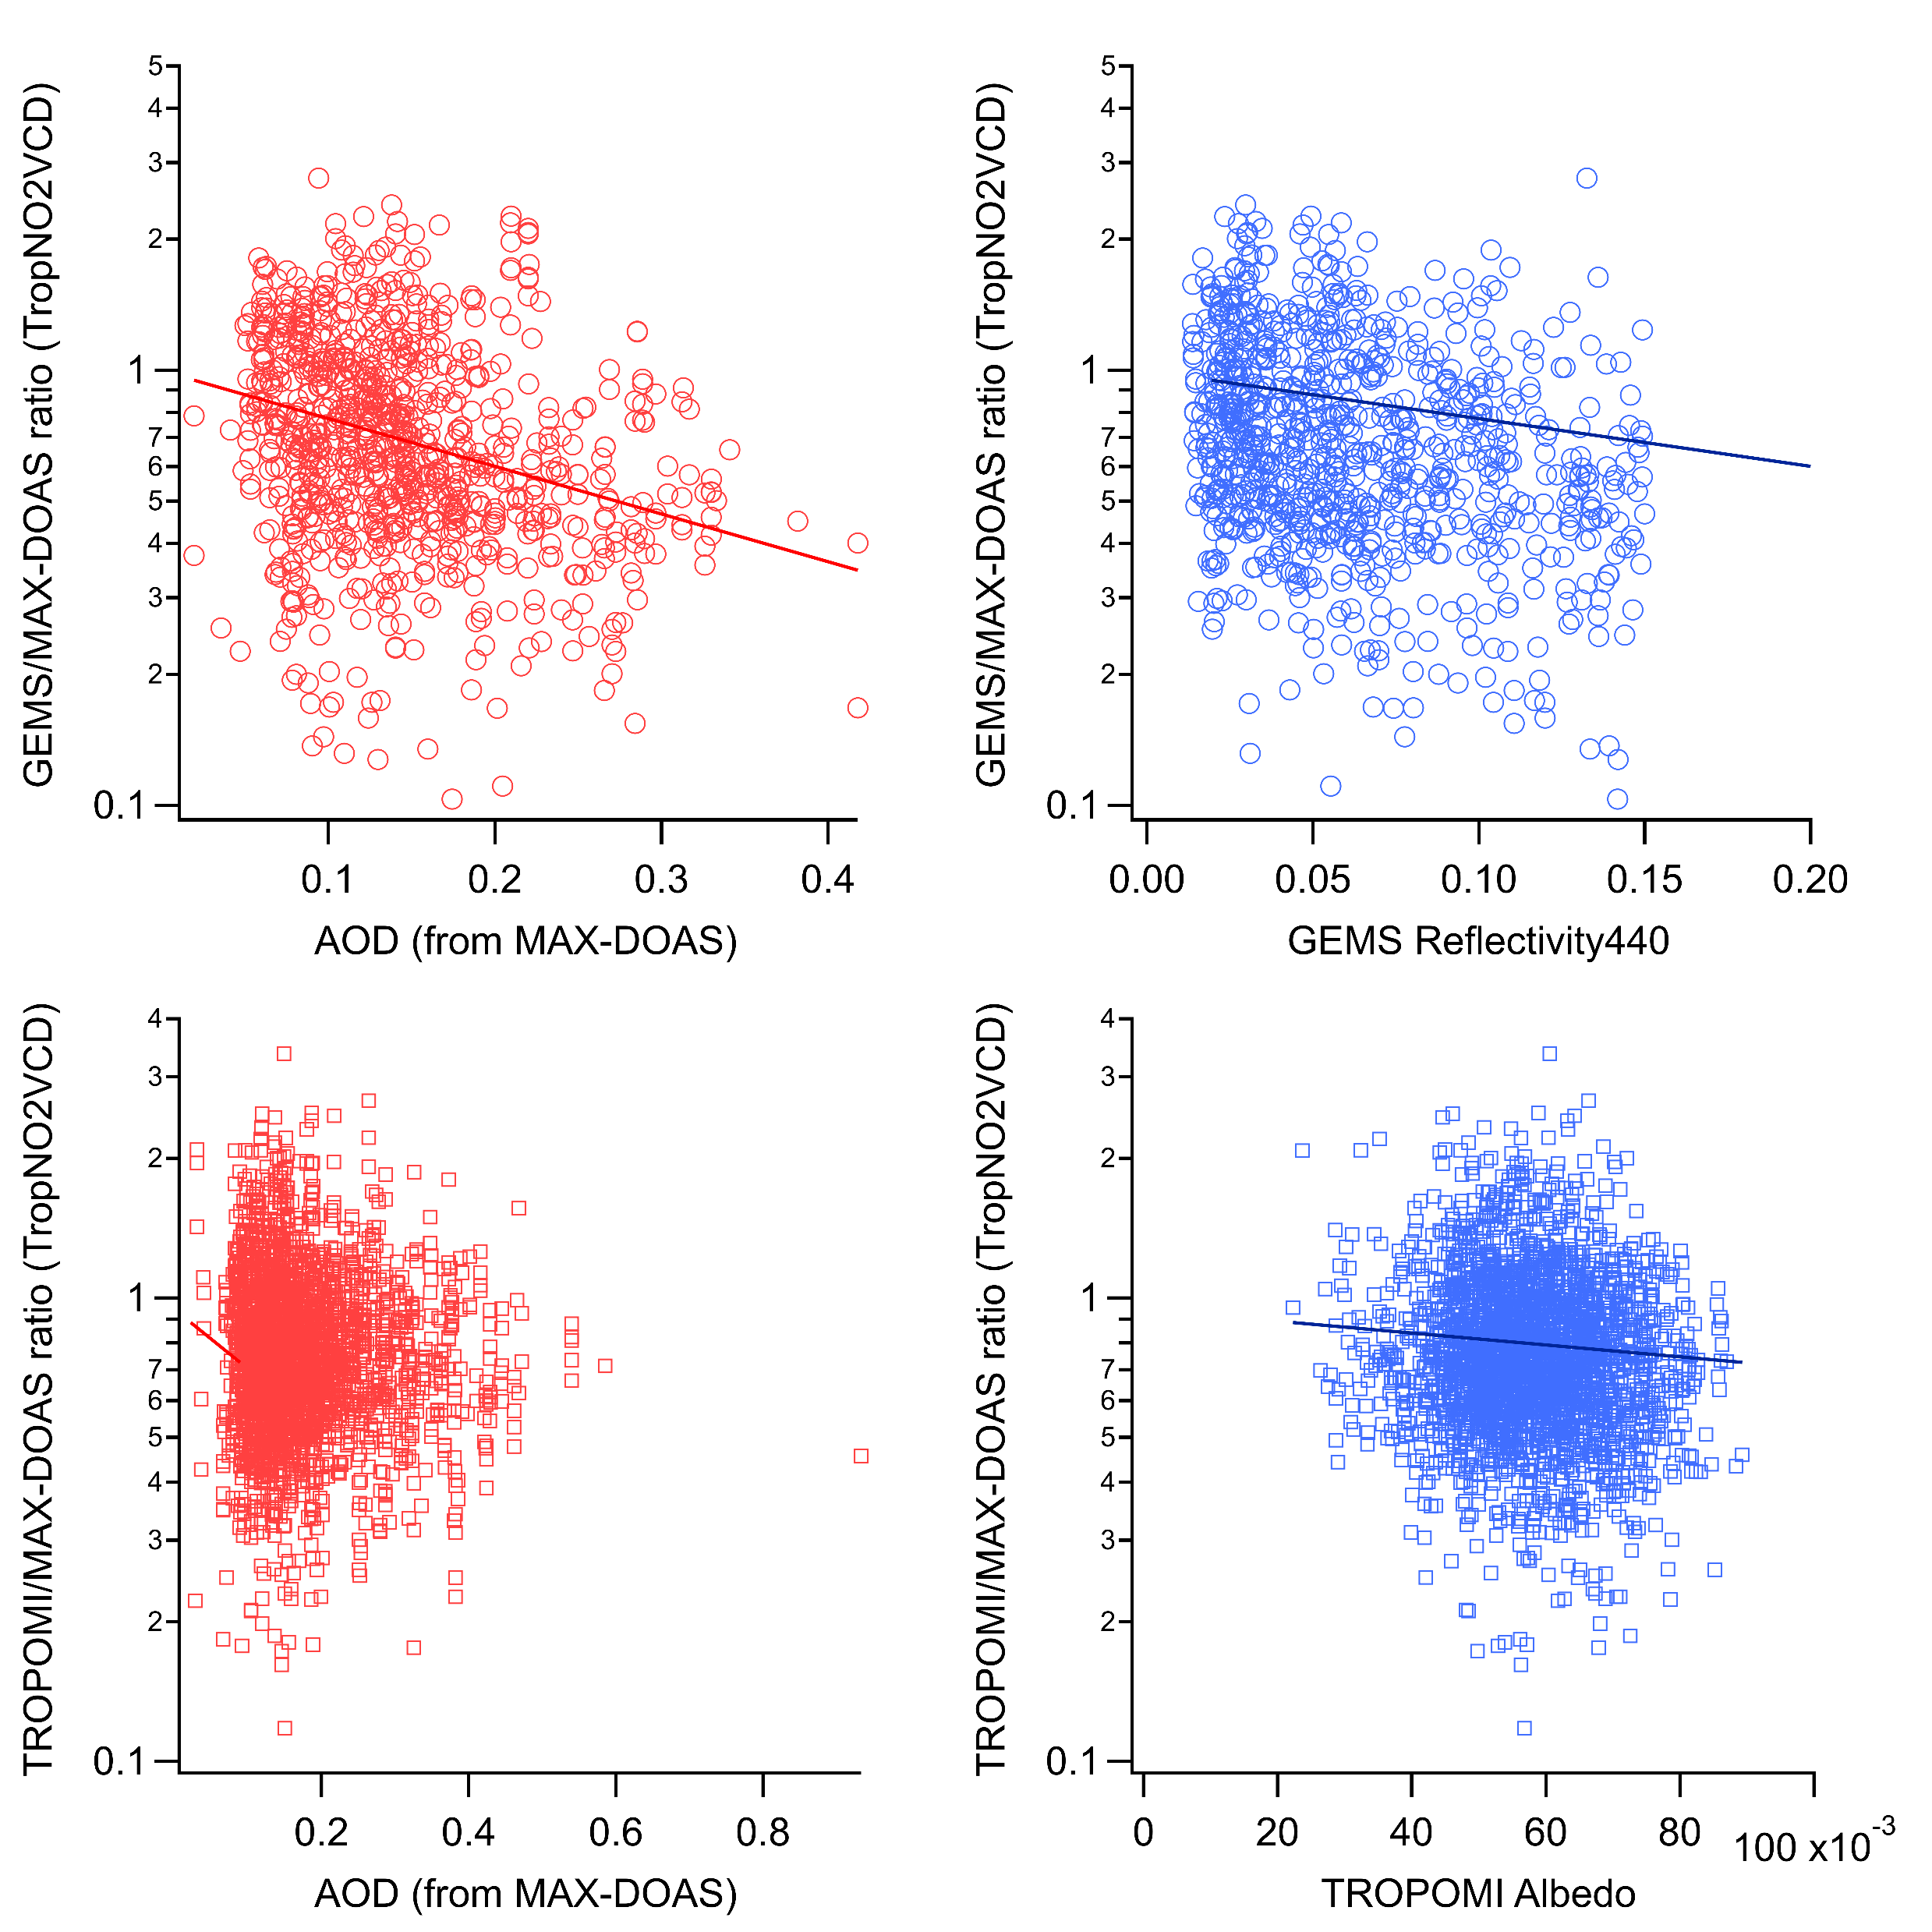
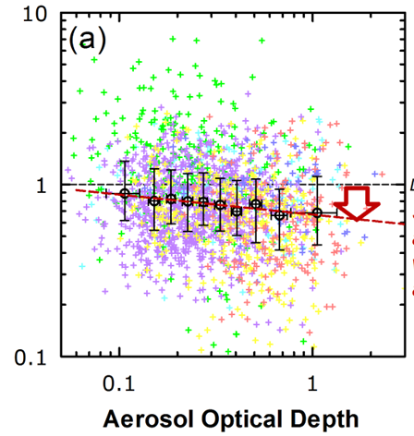
Aerosol shielding effect?
CF<0.05, Yokosuka
GEMS/MAX-DOAS ratio
(TropNO2VCD)
OMI/MAX-DOAS ratio
(TropNO2VCD)
TROPOMI/MAX-DOAS ratio
(TropNO2VCD)
Kanaya et al., ACP 2014 (OMI validation)
AOD
Surface Albedo/Reflectance440
Notes:
F:\gemsv3no2_Yokosuka\gemsv3_tropomi_maxdoasratio_aod_alb.png

Slide 8
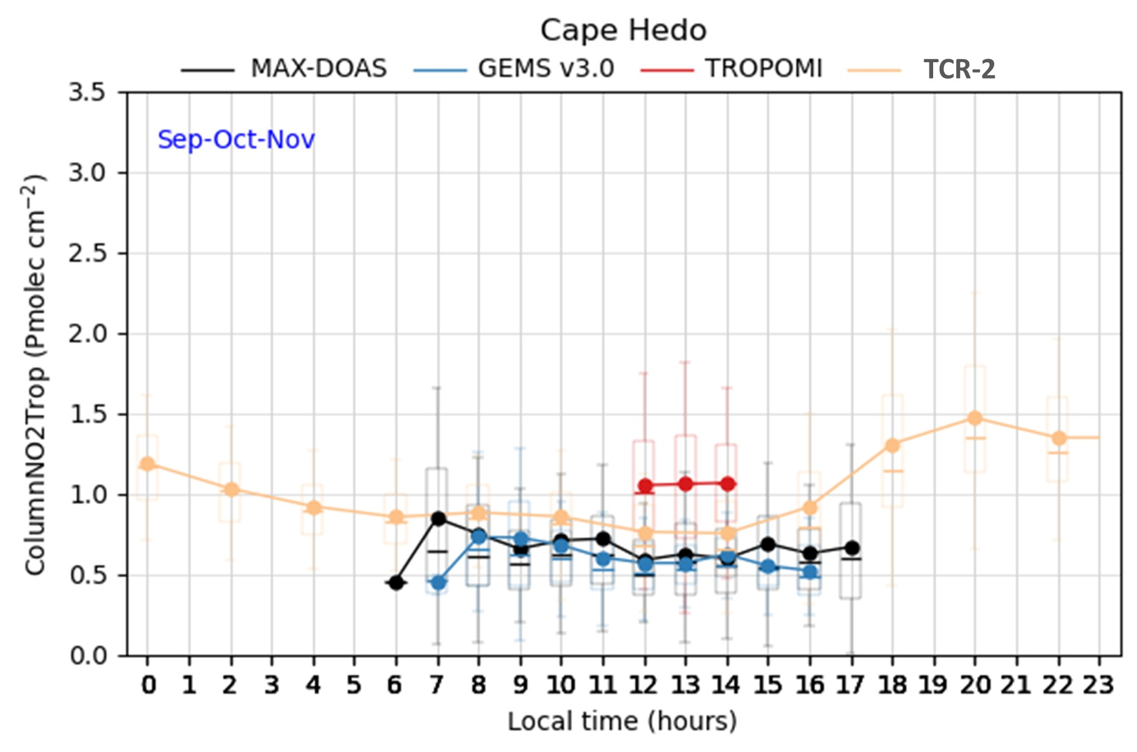
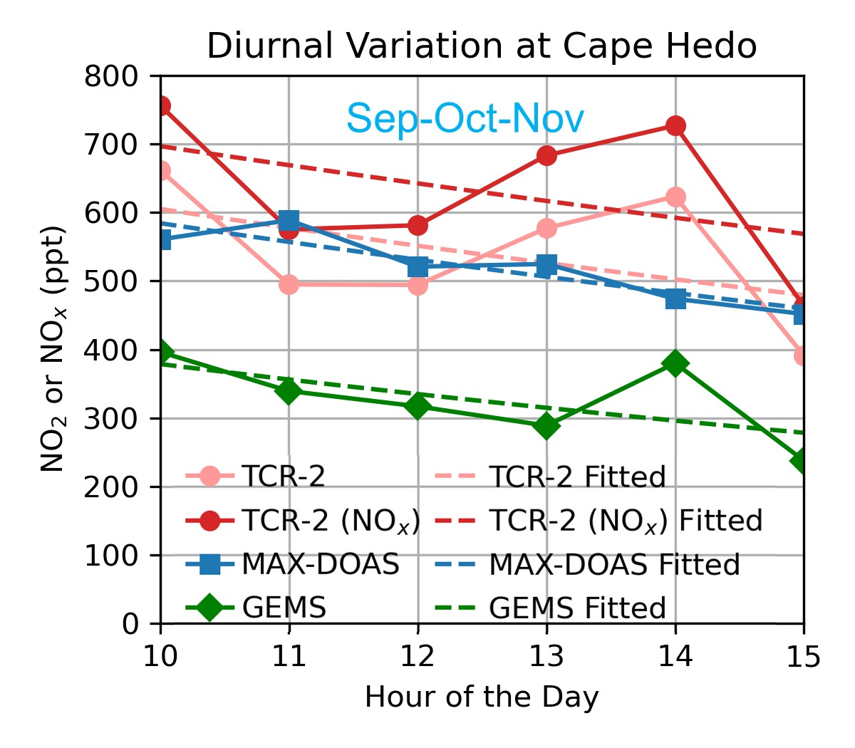
TropNO2VCD midday decay rates in clean region (Cape Hedo, Autumn)
Ha et al., submitted 2025
Sep-Oct-Nov
TCR-2
22±20 h
MAX-DOAS
21±5 h
GEMSv3
16±10 h
MAX-DOAS
GEMSv3
TROPOMI
TCR-2

Slide 9
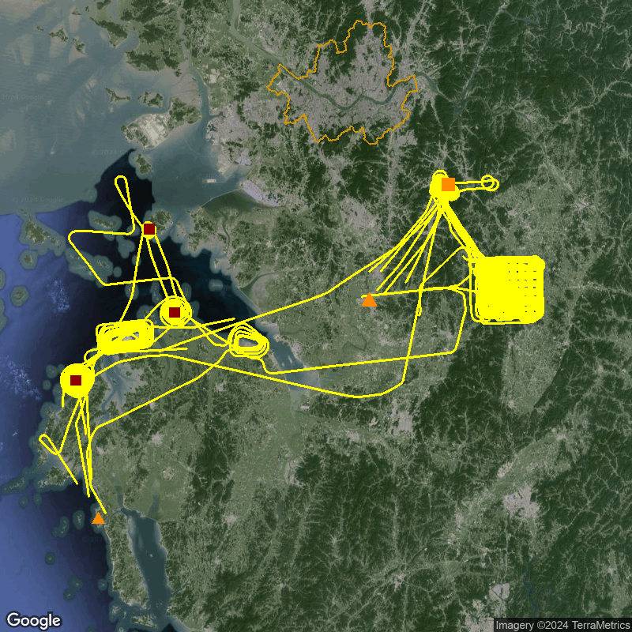
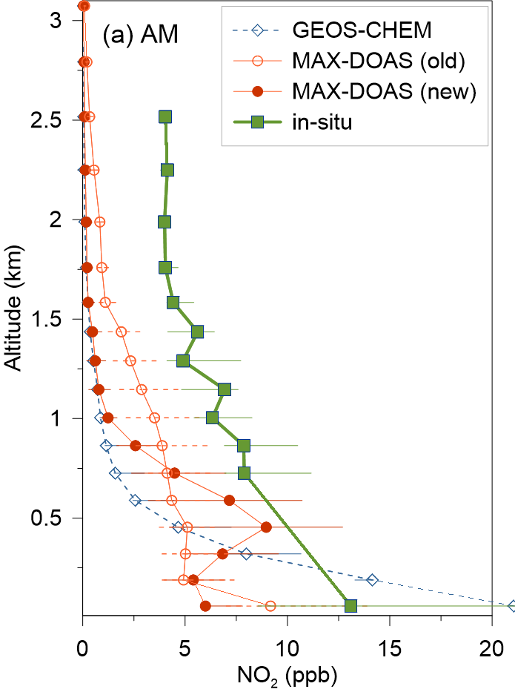
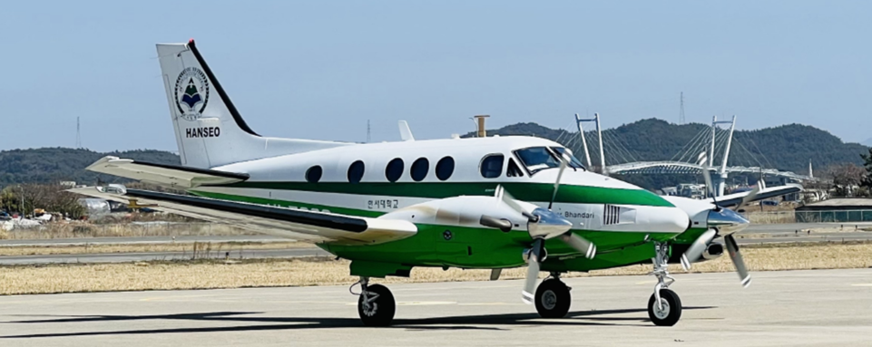
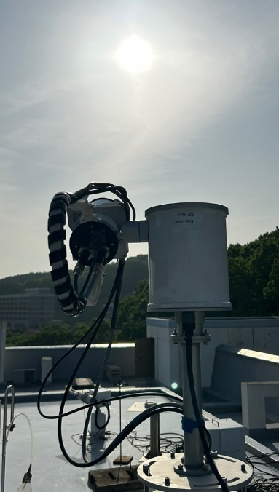
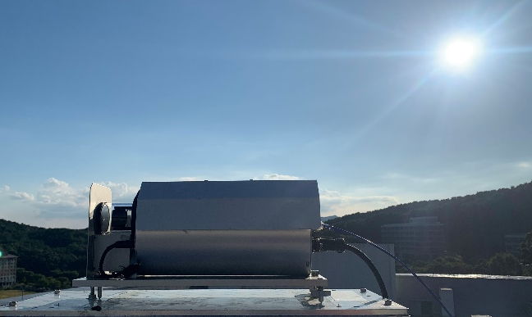
Challenges: True NO₂ profile shapes? MAX-DOAS vs. aircraft during ASIA-AQ
Choi et al. in preparation, 2025
Seoul
Target 1. Power plants
Target 2. HUFS
(Pandora/MAX-DOAS)
Yeonghueng PP
Dangjin PP
Deasan
Hyundai
Osan Airbase
Livestock
Teaan PP
Target 3. Livestock
KingAir C90GT
Pandora
(2023.09~)
No in-situ data under ~ 1 km
MAX-DOAS
(2021.10~)
Teaan

Slide 10
Summary
Validation tools improved: With algorithm update (optimal estimation), MAX-DOAS agreed better with Pandora (TropNO2VCD) and CAPS (surface NO₂) at Yokosuka.
GEMSv3.0 performance (TropNO2VCD) improved: Against iMAX-DOAS, GEMSv3.0 performed as well as TROPOMI. Diurnal variations are almost reasonable. Same for Fukue, Cape Hedo, and Korean sites.
Challenges: NO₂ vertical profiles are yet difficult to determine from MAX-DOAS, hindering comparisons with AVK-smoothing. Benchmarking with aircraft observations etc. is underway.

